Slide 1
Frost Number Model
An Indicator of Permafrost Occurrence
Lecture 1
Permafrost Modeling Short Course

Slide 2
What is Permafrost?
35% of the terrestrial surface experiences mean annual temperature < 0 °C
Permafrost = ground that remains at or below 0 °C for two or more consecutive years.

Slide 3
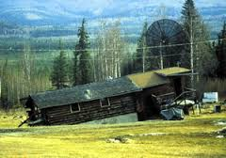
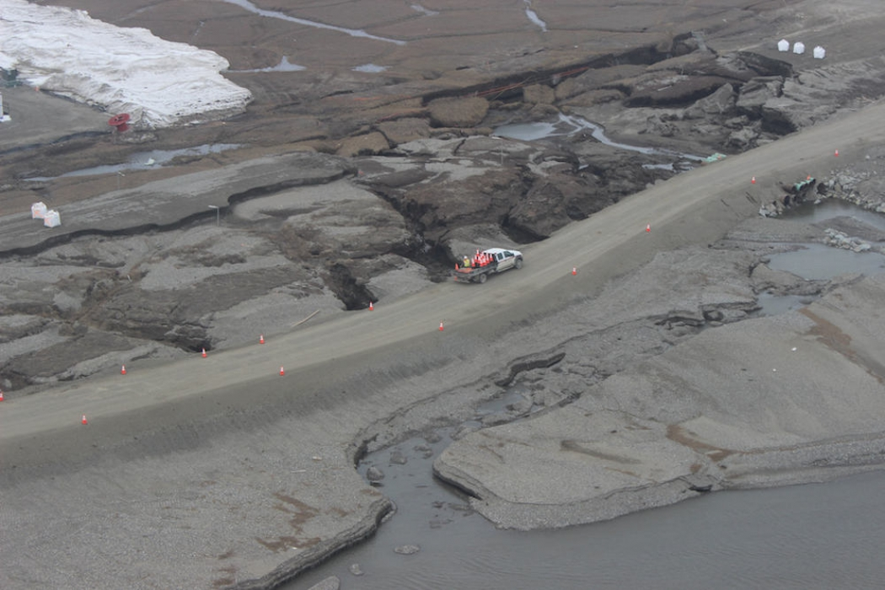
Permafrost and infrastructure
Building foundation dislodged
Image credit: kml.gina.alaska.edu
Dalton Highway damaged every summer
Image credit: A-DOT

Slide 4
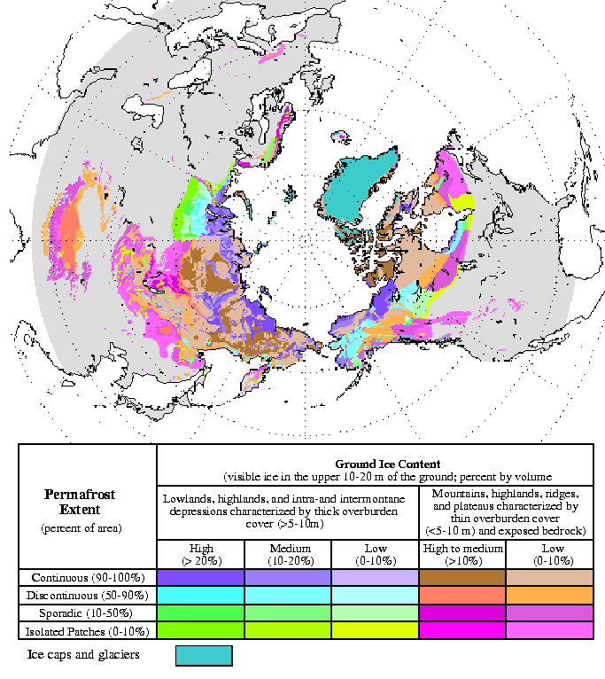
Where does Permafrost Occur?
24 % of the Northern Hemisphere
In mountainous areas permafrost occurs at high elevation and in isolated patches. e.g. RMNP
In High-Arctic permafrost is ‘continuous’ and deep. E.g. North Slope of Alaska

Slide 5
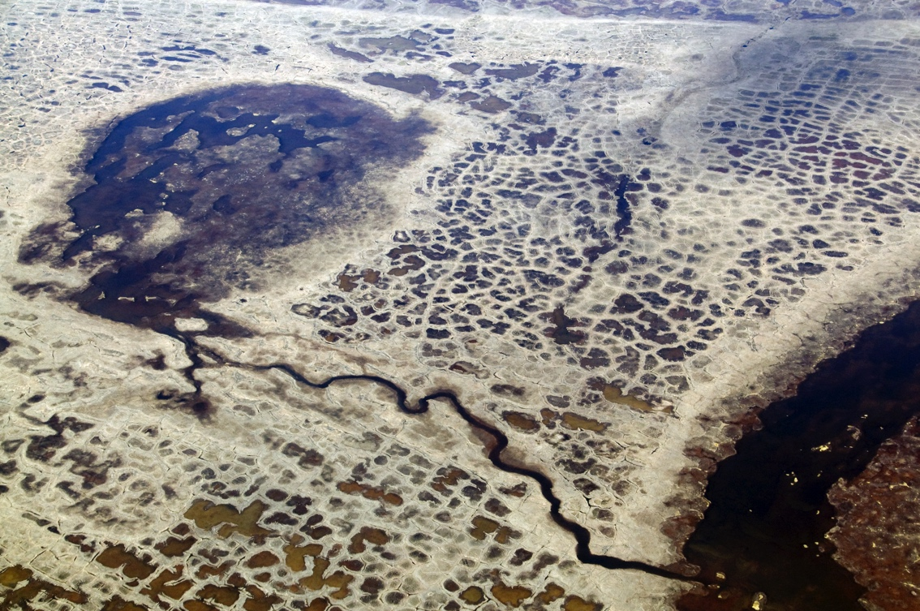
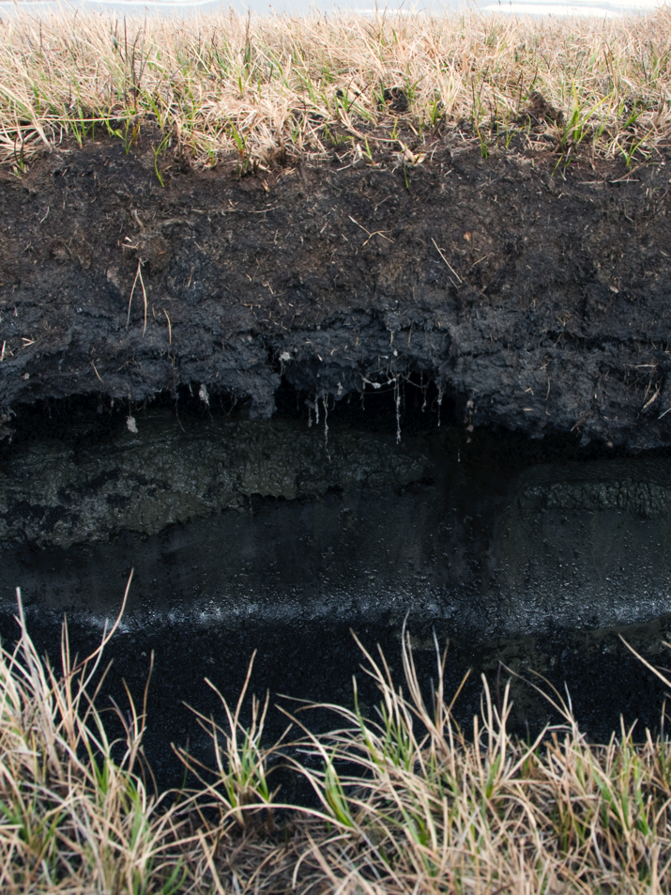
Continuous permafrost
Patterned Ground, North Slope Alaska, June 2008.
(Photo courtesy, Irina Overeem)
Active Layer and permafrost,
North Slope Alaska, June 2008.
(Photo courtesy, Irina Overeem)

Slide 6
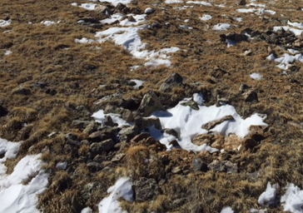
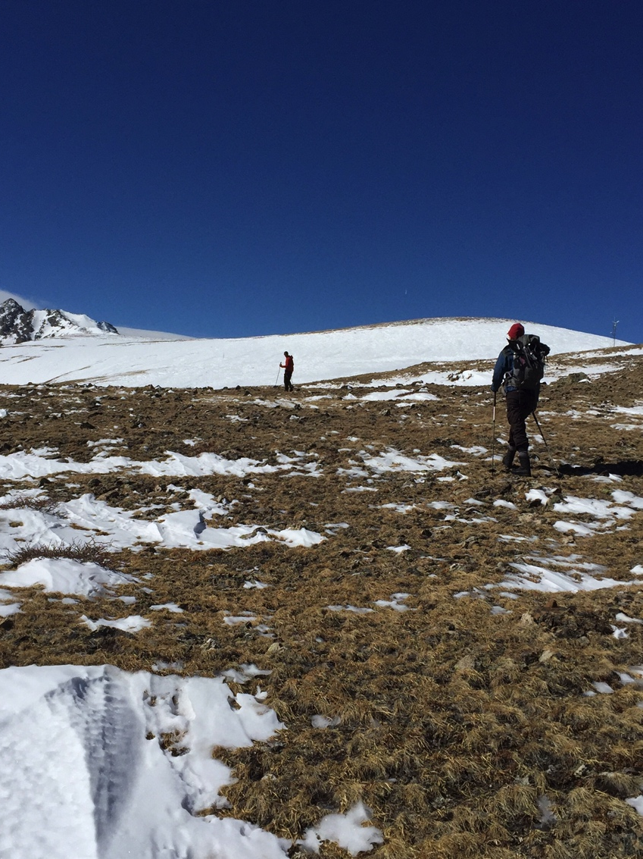
Discontinuous permafrost?
Sorted Circle at Niwot Ridge, Rocky Mountains,
Colorado, March 2017. (Photo courtesy, Irina Overeem)
Niwot Ridge, Rocky Mountains, Colorado
March 2017 (Photo courtesy, Irina Overeem).

Slide 7
‘Air’ Frost Number
F = Frost Number (-)
DDF = freezing day index (°C days)
DDT = thawing day index (°C days)
(From: Nelson and Outcalt, 1987, AAAR.)

Slide 8
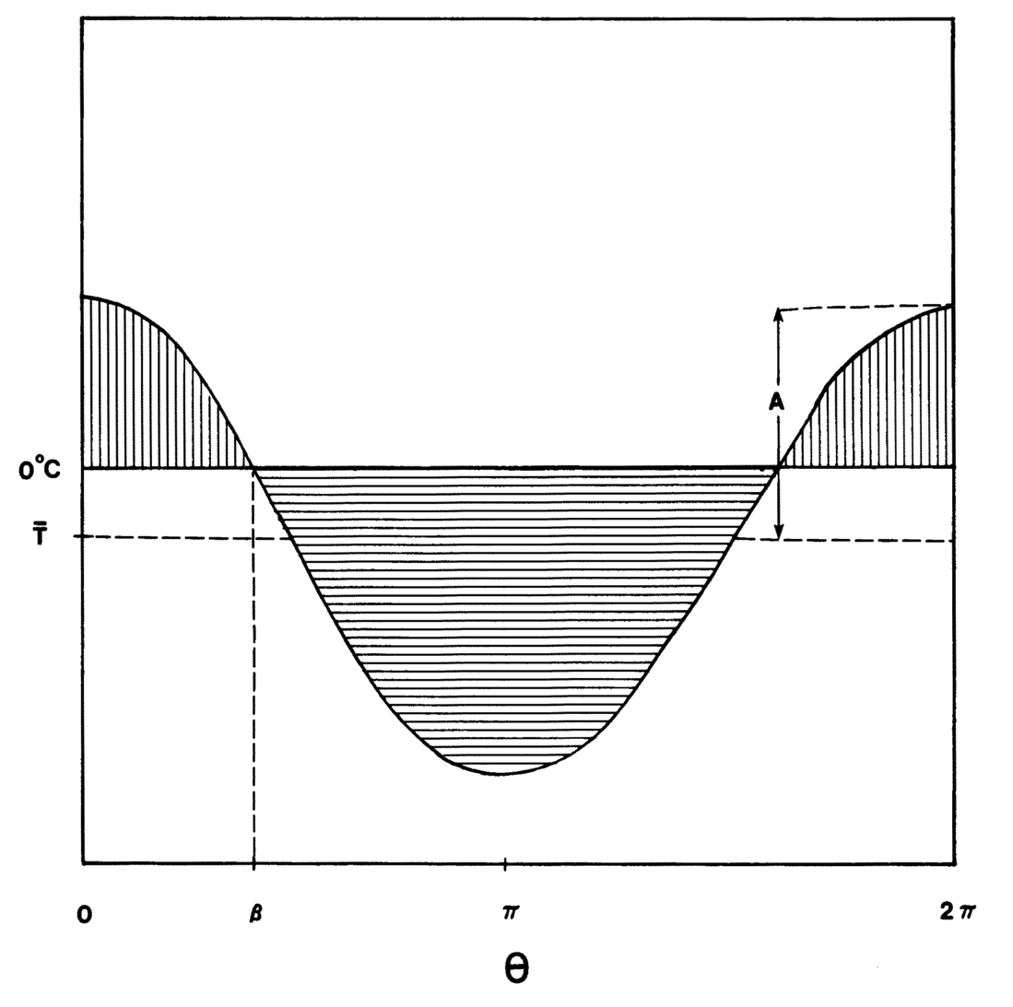
Cosine Approximation of Annual Temperature Distribution
A= amplitude in °C
Temperature
β
Time in days
(From: Nelson and Outcalt, 1987, AAAR)

Slide 9
Calculate DDT and DDF
Symbol | Parameter | unit
MAAT | Mean annual temperature | °C
A | Yearly temperature amplitude | °C
beta | Frost angle | -
Ts | Mean summer temperature | °C
Tw | Mean winter temperature | °C
Ls | Length of summer | days
Lw | Length of winter | days

Slide 10
Defining the Permafrost Limit
Permafrost is theoretically possible:
When the mean annual temperature is < 0°C
When the freezing and thawing indices are equal; thus when F > 0.5

Slide 11
References
Nelson, F.E., Outcalt, S.I., 1987. A computational method for prediction and prediction and regionalization of permafrost. Arct. Alp. Res. 19, 279–288.
Janke, J., Williams, M., Evans, A., 2012. A comparison of permafrost prediction models along a section of Trail Ridge Road, RMNP, CO. Geomorphology 138, 111-120.

Slide 12
Notes with Lab 1 Exercises
Location | Temperature Coldest Month °C | Temperature Warmest Month °C | Frost Number
Vladivostok, Russia | -13 | +19.5 | 0.42
Yakutsk, Russia | -40.9 | +19.5 | 0.63
Murmansk, Russia | -11.3 | +12.6 | 0.479
>> Murmansk being at latitude 68.9 N, had you expected this result?

Slide 13
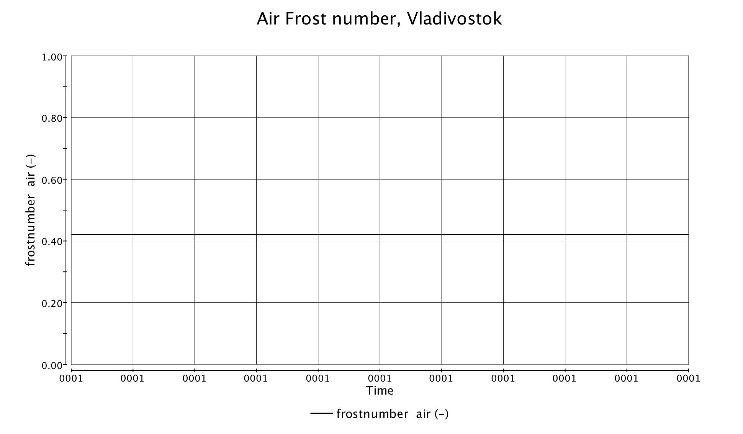
Notes with Lab 1 Exercises
Frost Number = 0.42
Timeseries of 10 years, Frost number = 0.42. Meaning permafrost is unlikely.
All years had the same user-defined warmest and coldest month. Thus a straight line!

Slide 14
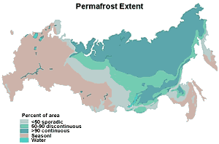
Permafrost Occurrence
Permafrost Extent
Murmansk
Yakutsk
Percent of Area
< 50% sporadic
50-90 discontinuous
>90% continuous
seasonal
Vladivostok

Slide 15
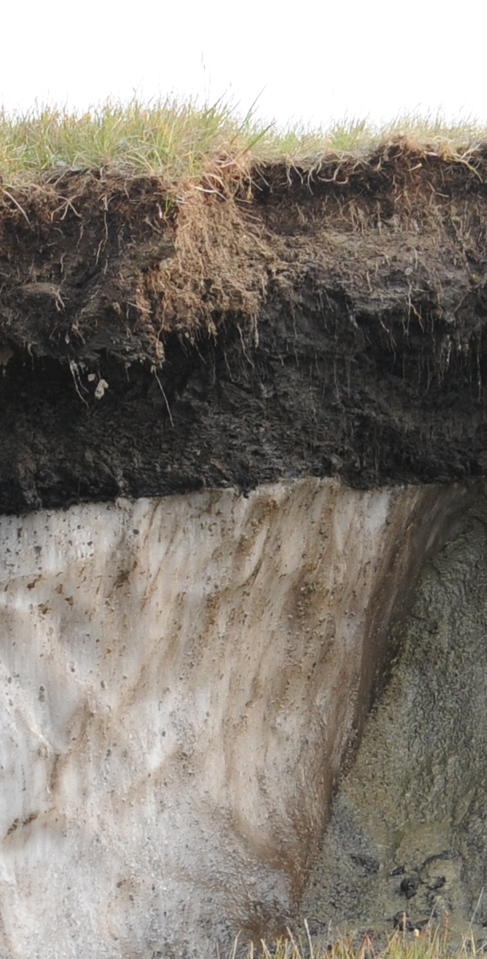
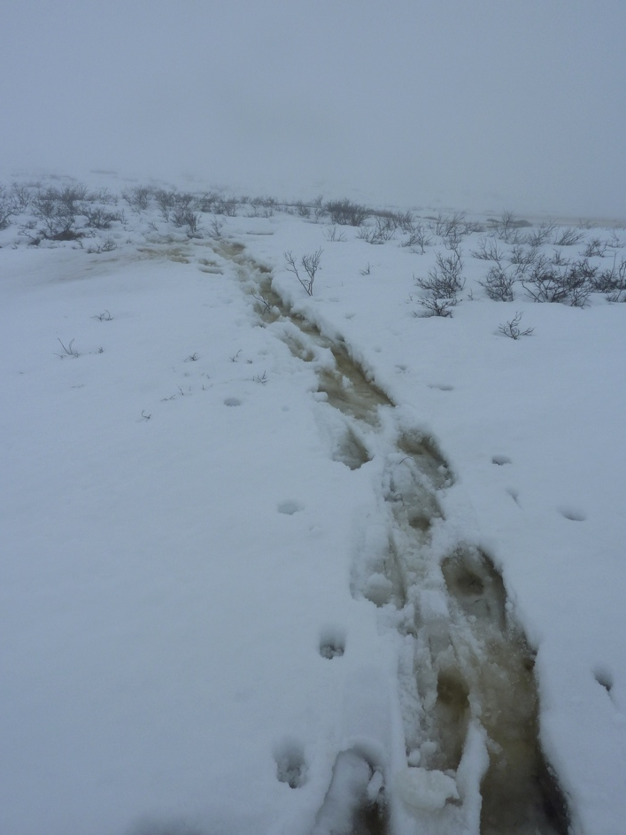
Air temperature and what more?
Images Irina Overeem

