Slide 1
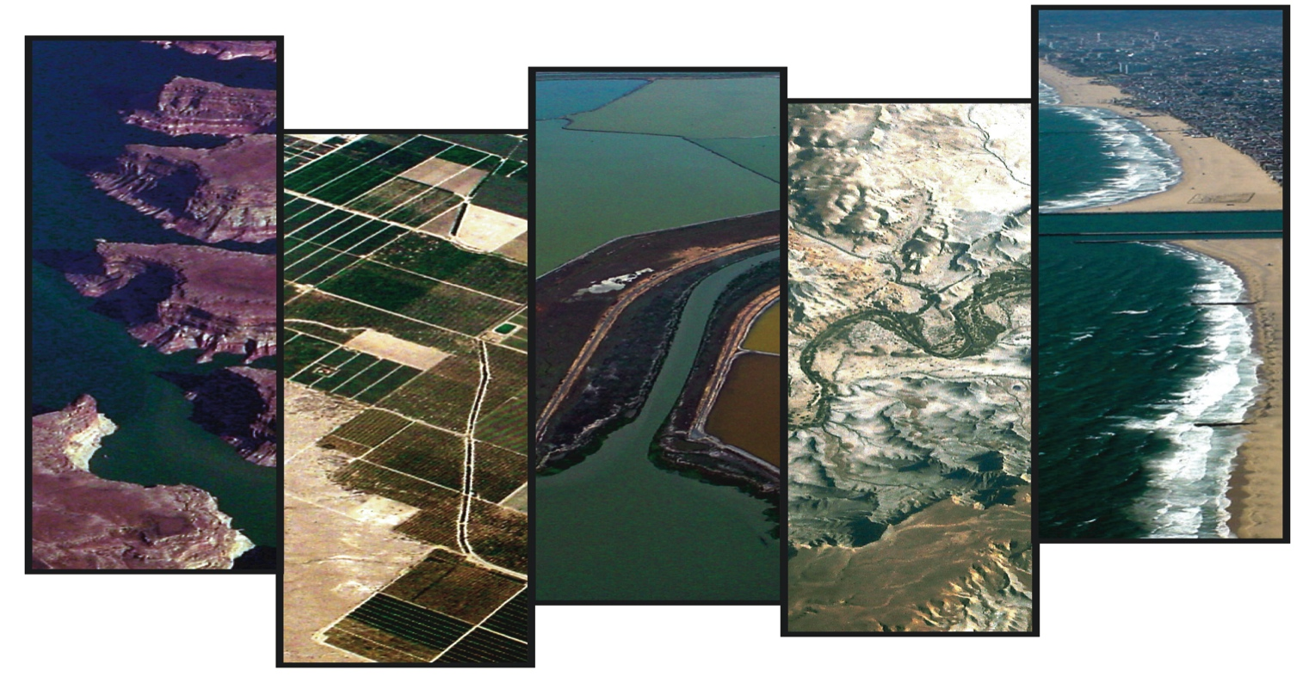

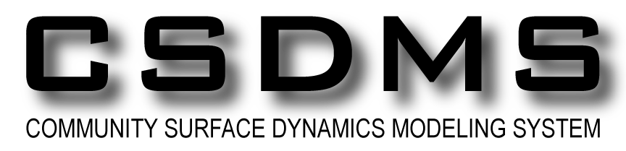
CSDMS: the Community Surface Dynamics Modeling System
Develops, integrates & disseminates software to define the earth’s surface dynamics by simulating the movement of fluids, sediment & solutes through landscapes, seascapes, and their sedimentary basins.
Irina Overeem
CSDMS Integration Facility, University of Colorado

Slide 2
What does CSDMS do?
Builds a community of model developers and users (through meetings and website)
Archieves model codes and metadata in a model repository
Maintains a supercomputer for members allowing experimentation
Defines model coupling protocols & builds model coupling interfaces
Educates and offers educational resources on surface process modeling

Slide 3
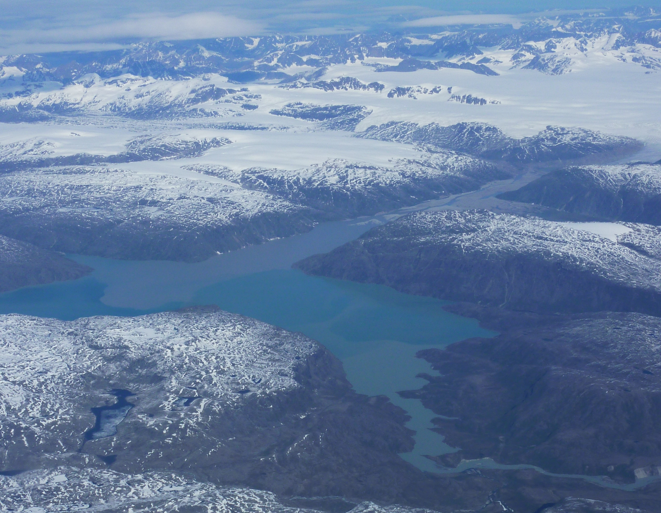
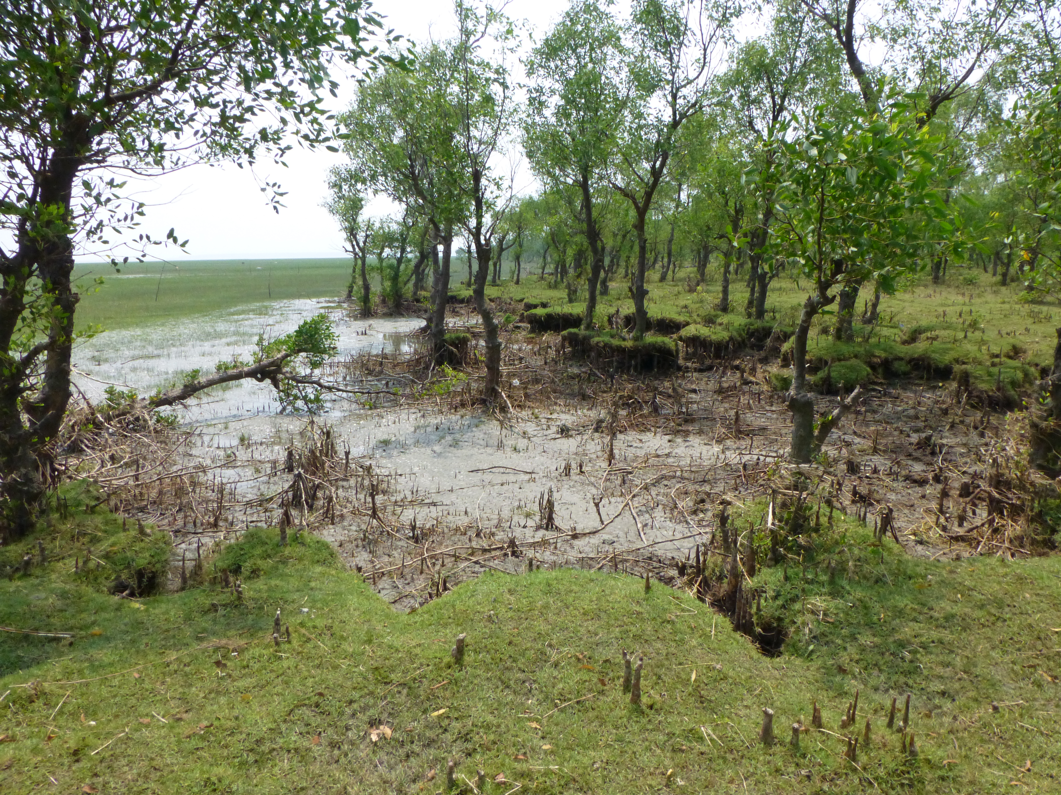
CSDMS Model Domains & Scales
Cryosphere: glaciers, permafrost, icebergs
Hydrology: watershed, reach to global, discharge and sediment transport
Terrestrial: hillslope processes, landslides, river processes, coupling to tectonics
Coastal: wetlands, estuarine processes, beach and barriers, storm erosion
Marine: circulation, surges, tides, waves, gravity flows, turbidity currents
River discharge and Delta Plume Dynamics,
Greenland
Floodplain and coastal aggradation and degradation,
Ganges delta, Bangladesh

Slide 4
1) CSDMS capacity building and community networking
~830 members contribute to
8 Working or Focus Research Groups
As of July 2012.
340 institutions from 52 countries (75% academic, 17% private, rest government)
Terrestrial | 379
Coastal | 298
Hydrology | 291
Marine | 213
Cyber | 131
EKT | 119
Carbonate | 58
Chesapeake | 42
month
Notes:
.

Slide 5
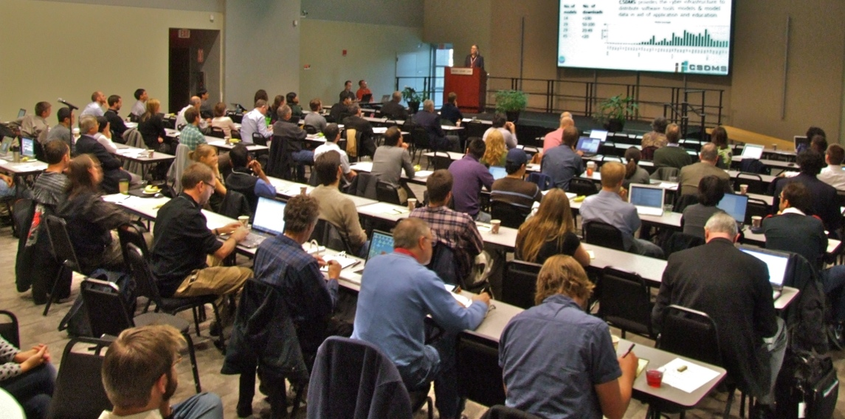
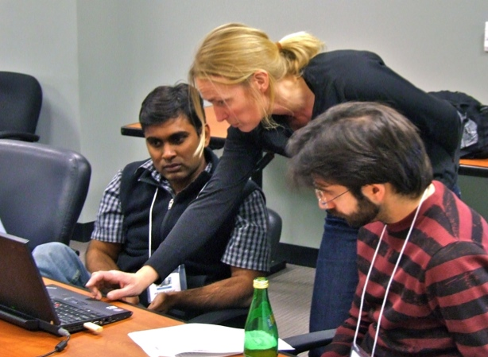
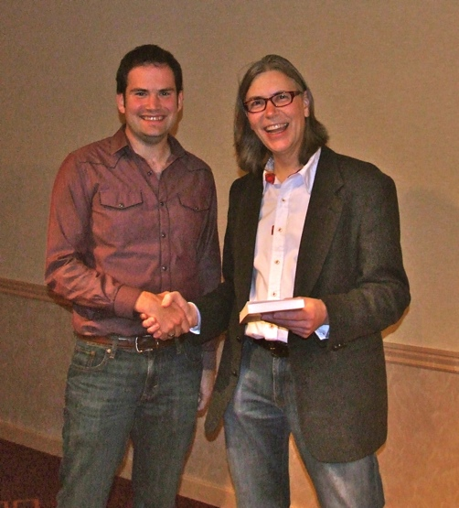
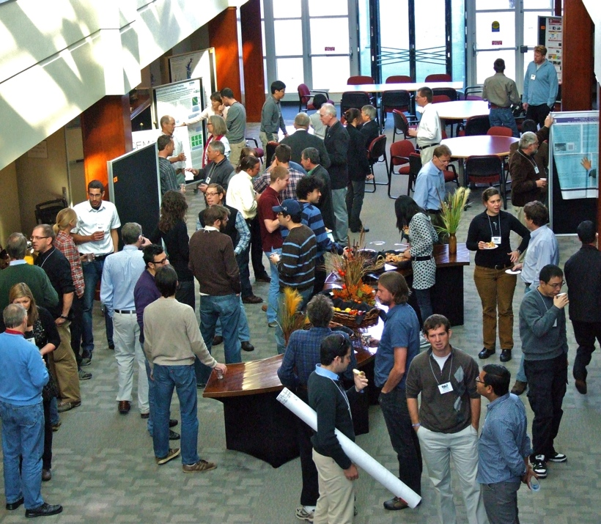
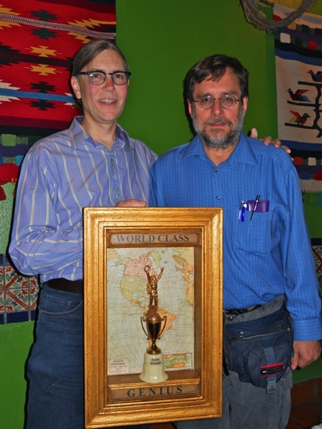
CSDMS capacity building and community networking
Advertize your research in workshops, symposia & meetings
Learn in CSDMS Short Courses
Annual Student award
Annual Lifetime Achievement award
Networking with other modelers

Slide 6
2) Open-source Model Repository
CSDMS requires metadata and source code, developer can submit through a web-based database. http://csdms.colorado.edu/wiki/Contribute_model
Metadata becomes accessible for everyone, code is archived in Subversion and downloadable.
As of July 2012, 102 model developers (or teams) contributed their source code.
A total of 217 models & tools are now available (>5 million lines of code).

Slide 7
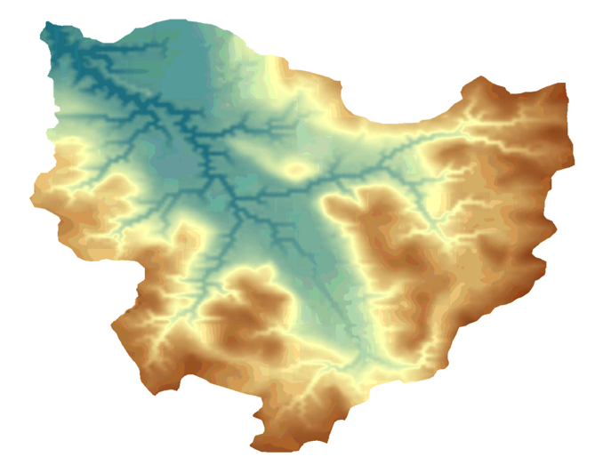
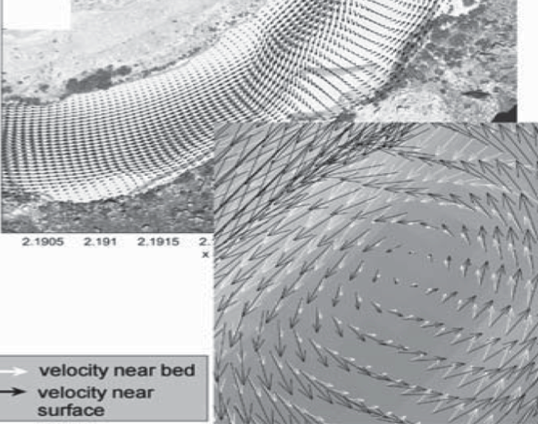
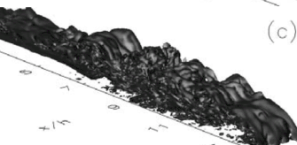
2) Open-source Model Repository
CHILD
Landscape Evolution & Stratigraphic Models
Simulations across geological time and space by incorporating geophysical & geochemical feedbacks including tectonics, climate change, sea level, post-depositional processes and biology.
Morphodynamic Models
Simulations of an evolving transport pathway and mobile bed with dynamical feedback — may include ecodynamics.
Often originate from engineering domain.
Transport / Circulation Models
Simulations of the material flux along pathways at the event scale (e.g. river floods, ocean storms) using advanced computational fluid dynamics
Delft3D/ROMS
TURBINS

Slide 8
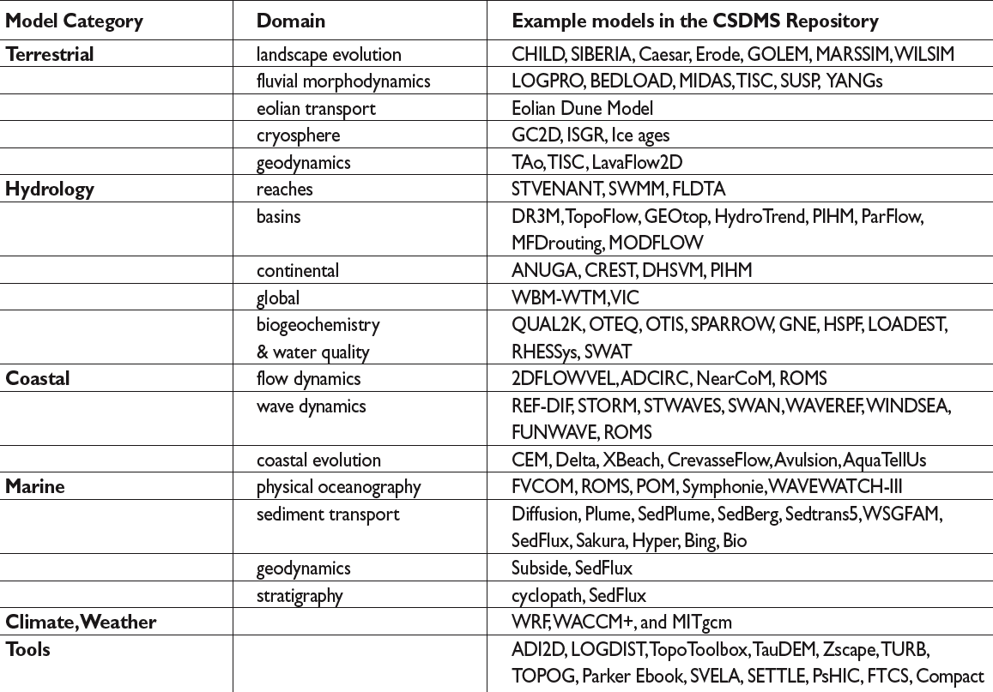
2) Open-source Model Repository
Often different models for similar processes have been submitted
Recorded 9060 downloads from 2008 onwards, ~20 models have >100 downloads

Slide 9
>160 CSDMS members running simulations on the CU/USGS experimental HPCC Beach who have met a use criteria
  Running CSDMS models to advance science
  Developing a model for the CSDMS model repository.
  Developing a data or visualizations systems in support of CSDMS models.
Beach 8Tflop/s HPCC
88 compute nodes
704 3-GHz cores
2-4 GB/core mem
non-blocking infiniband
~100TB RAID storage.
~3PB offsite disk storage.

Slide 10
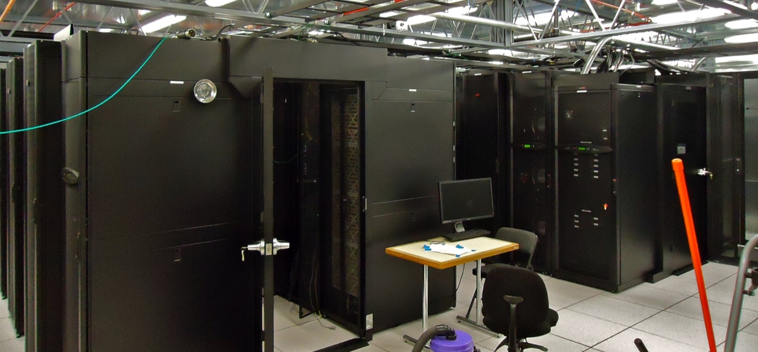
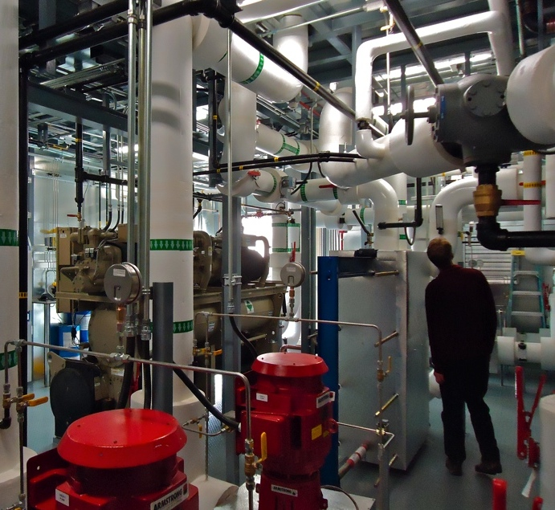
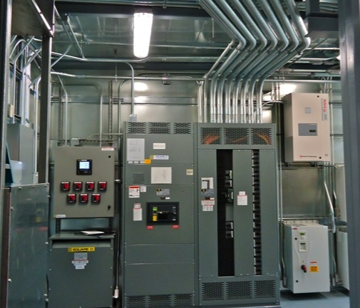
3) HPCC test bed & support for running models
Beach is linked (10 Gb) to NSF/CU Janus offering 16,416-cores, 150 Tflop/s
1368 nodes
6 cores/processor x 2
2.8 GHz cores
2 GB/core memory
non‐blocking Infiniband;
1PB of RAID storage
3PB offsite disk storage
Notes:
Some companies consider HPCC a potential game changer,
we are offering researchers this resource to test their models and bring our community into the HPCC world.

Slide 11
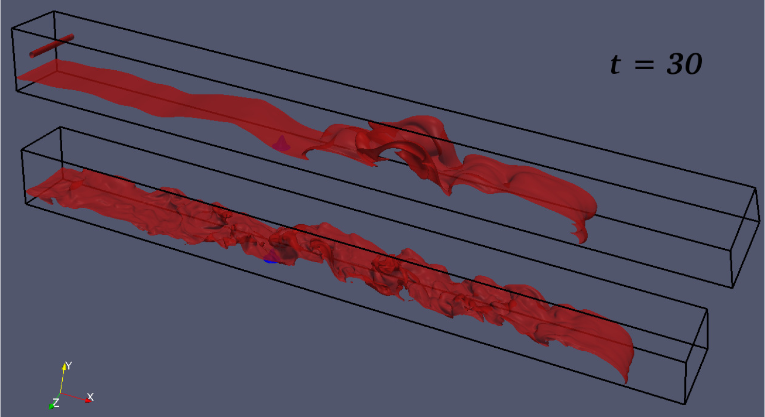
3) HPCC test bed & support for running models
Gravity currents (Meiberg & Radhakrishnan)
Re=1,000 (DNS)
Re=200,000 (LES)
High-Re LES shows much more fine-scale structure than low-Re DNS
Computational fluid dynamic modeling with high number of grid cells and time steps on HPCC Beach (& Janus).
Experiments with such high Reynold’s numbers had not been done before, HP computing power was essential.

Slide 12
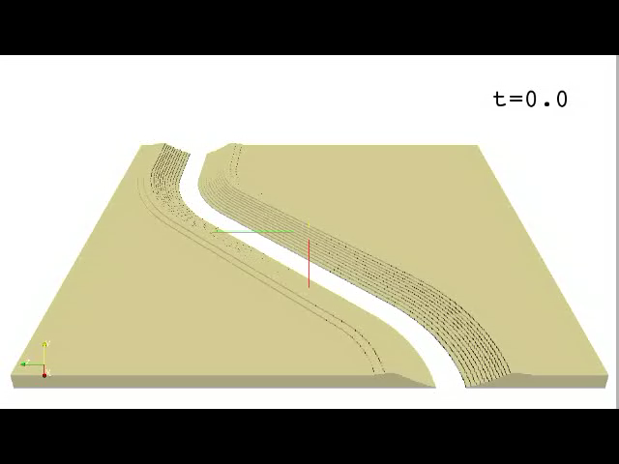

Slide 13
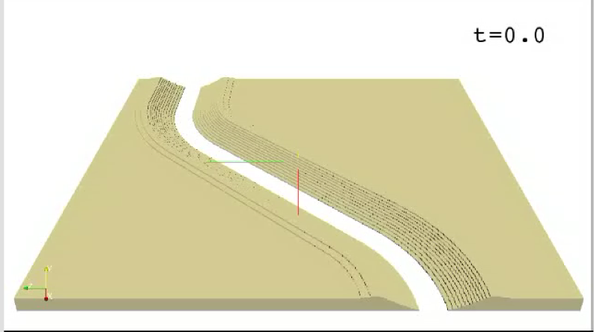

Slide 14
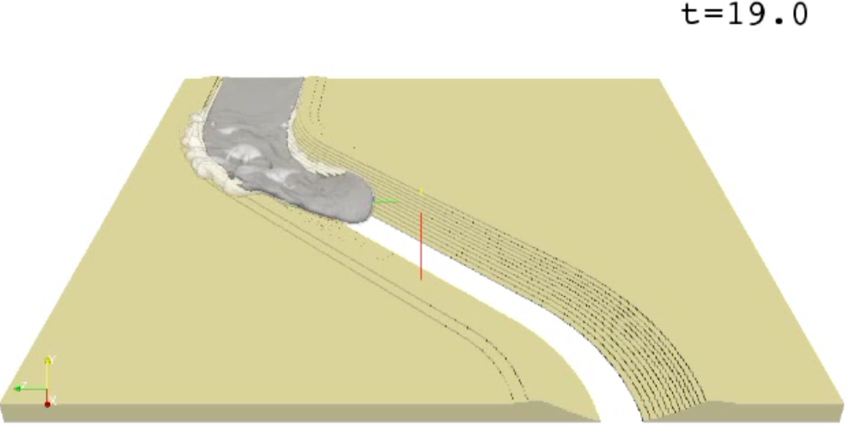

Slide 15
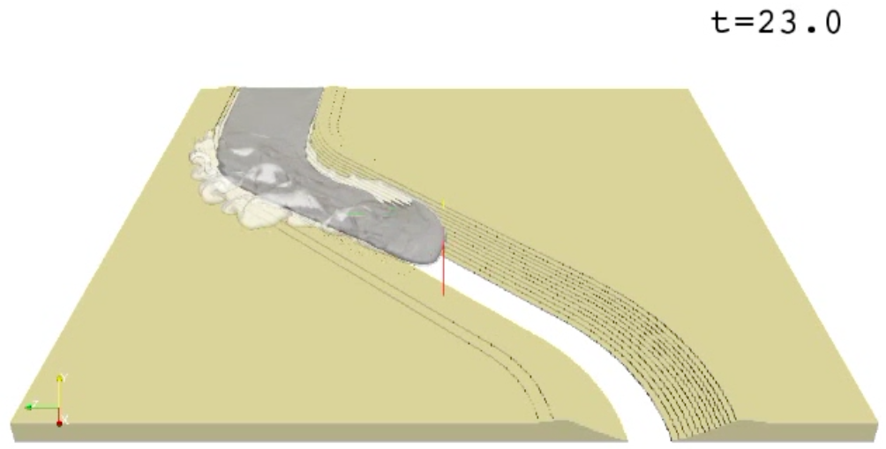

Slide 16
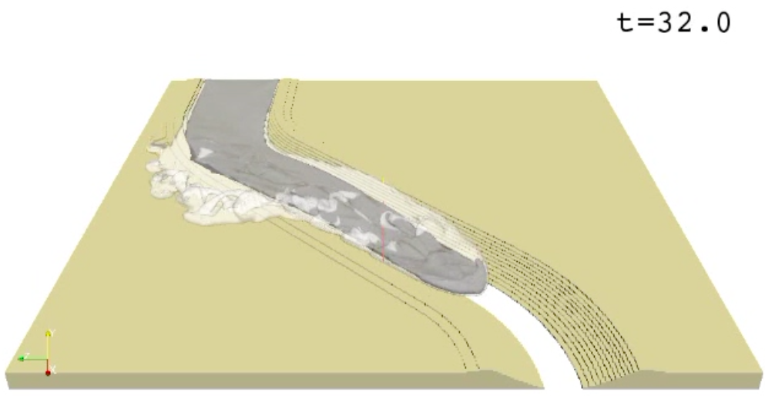

Slide 17
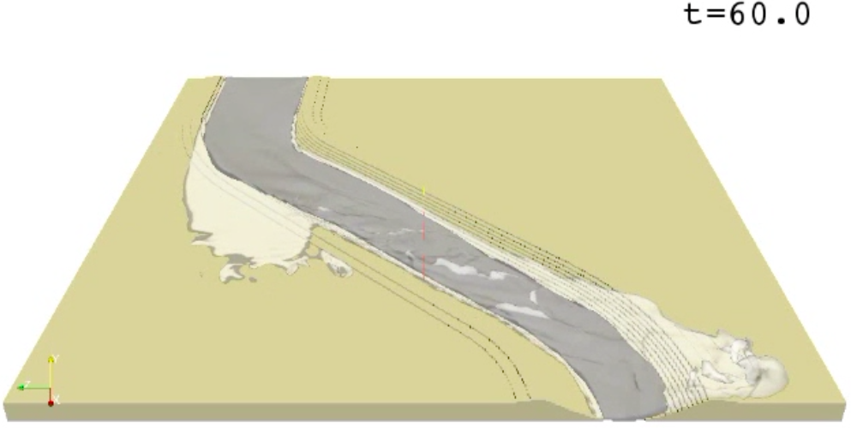

Slide 18
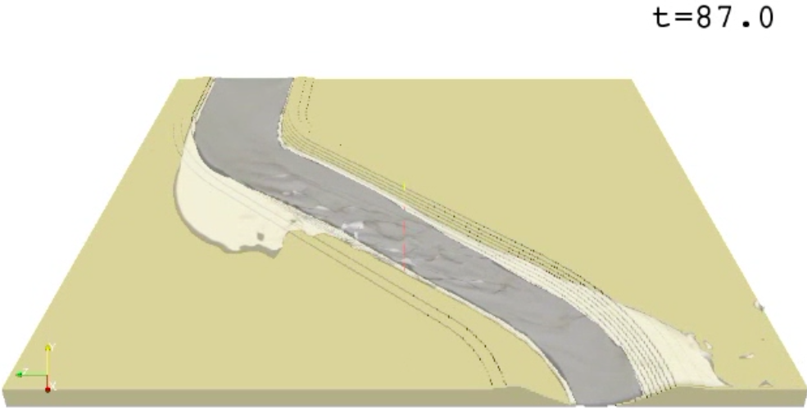

Slide 19
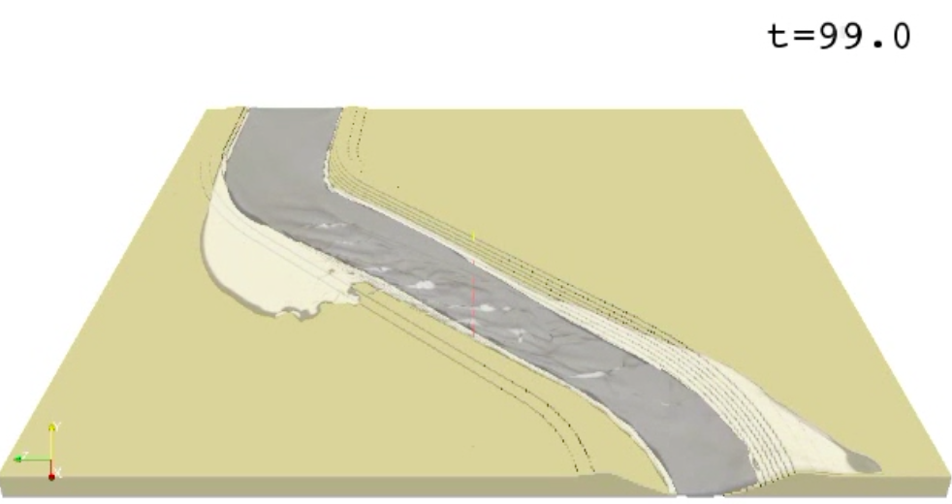

Slide 20
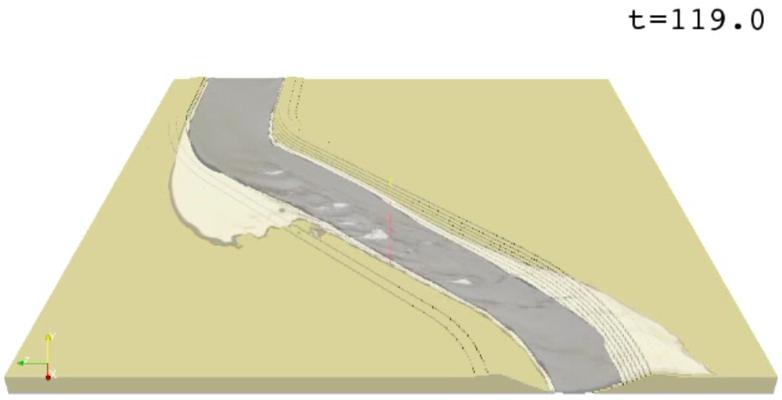

Slide 21
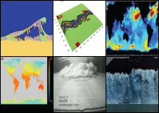
4) CSDMS Education & Knowledge Transfer
CSDMS is facilitating a quantitative revolution in Earth Surface Processes, as new technologies for data collection, increased computing power and innovative numerical approaches drive a more predictive discipline.
CSDMS shares all information through their wiki website, and invests significant effort in informing its research community on protocols, models & data, builds help systems and documentation.
CSDMS-EKT aims to transfer modeling science, engineering practices and quantitative skills to a larger user audience: K9-16 students and practicioners.
EKT Repository
student labs (12)
modeling short courses (7)
lectures (85)
textbooks (4)
Meeting presentations (290)
Real event movies (32)
Laboratory movies (14)
Model animation (56)
Imagery (139)

Slide 22
4) CSDMS Education & Knowledge Products
CSDMS instructional videos offer step by step instruction on how to use the various tools and facilities of CSDMS.
These will be expanded in 2012!
Courses like this one engage students in modeling and HPC-simulations

Slide 23
5) Developed Protocols for CSDMS-component models
Under an open-source license & widely available.
Written in a Babel-supported open-source language (C, C++, any Fortran, Java, Python)
Refactored with a Basic Model Interface (BMI)
With metadata & test I/O files.
Clean, documented and preferably vetted by the community — the software should do what it says it does.
All state variables described and defined

Slide 24
5) Developed GUI for running CSDMS-component models
CMT ‘help system’ avoids black-box syndrome
Notes:
We will get to see this during these two days.

Slide 25
5) CSDMS CMT - component modeling tool
CSDMS CMT Framework & Services:
Platform-independent GUI CMT (Linux, Mac OS X, Windows)
Language interoperability (C, C++, Java, Python, Fortran) with Babel;
Component preparation & project management using Bocca;
Low-level model coupling within a HPC environment using Ccaffeine;
Single-processor spatial regridding (OpenMI Regrid) or multi-processor spatial regridding (ESMF Regrid) – all grid types;
Component interface standards BMI & CMI;
Open-source standards (e.g. CCA, SIDL, OGC, MPI, NetCDF, OpenDAP) to avoid proprietary dependencies (e.g. Windows C#, Matlab).
Visualization of large datasets in a multiple processor environment (VisIt)
Message passing within the HPC environment using MPI (MPICH) & OpenMP with PETSc - Portable Extensible Toolkit for Scientific Computation

Slide 26
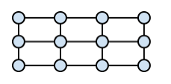

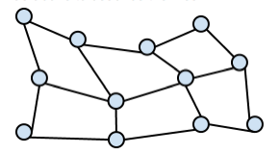
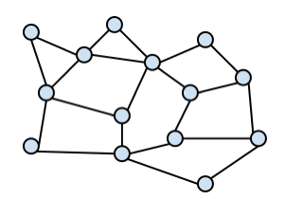
5) Protocols & GUI for running CSDMS-component models
CCA Framework
Service
Components
CMI
CMI
BMI
BMI
Model 1
Model 2
BMI CSDMS "Basic Model Interface" is a set of public functions for developers
CMI CSDMS “Component Model Interface” provides BMI components with CMT services for coupling models written in different: 1) programming languages, 2) computational grids, 3) time-stepping, 4) variable names, 5) units; or 6) to run models on HPCC, or to 6) write output to NetCDF files (and future service functionality….)

Slide 27
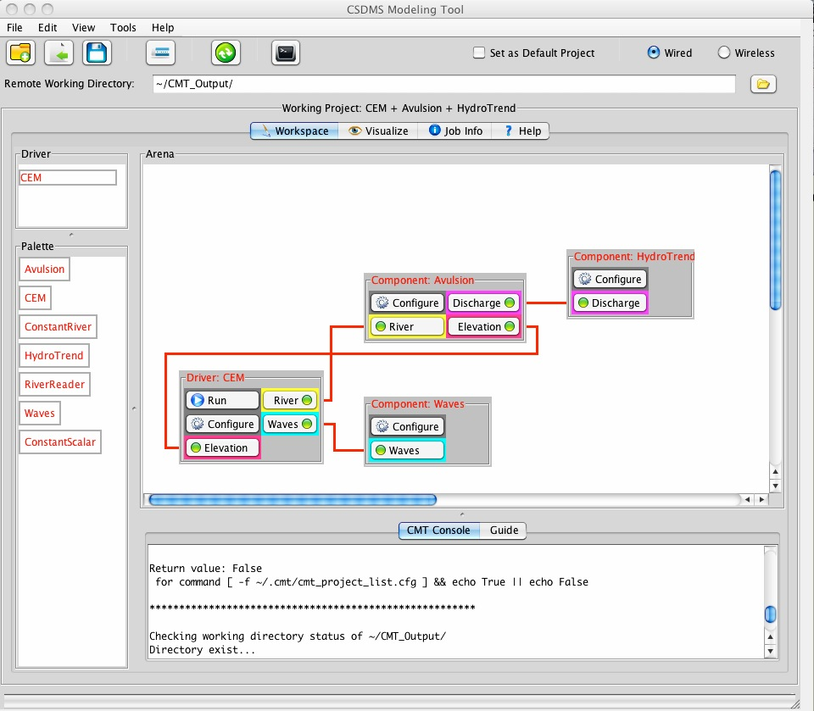
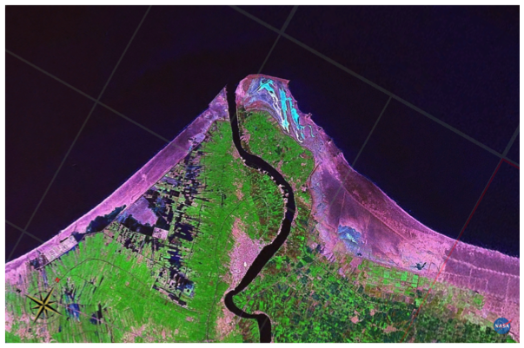
6) Model Coupling Example
Running CMT allows a user’s computer to become a client that connects remotely to a server on the CSDMS HPC cluster, where the model computation takes place
Delta Avulsion
HydroTrend
Coastal Evolution Model
Waves
Coupled code has 3 legacy models and 1 new model of > 7 developers linked.

Slide 28
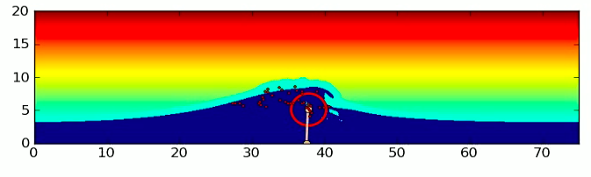
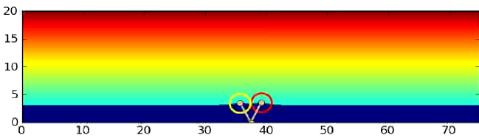
6) Model Coupling & Model Reuse
Coupling a coastal evolution model (CEM) with a delta avulsion model (Avulse), a hydrological model (HydroTrend) and a wave generator (WAVE).
These codes were all in C, but originally had different dimensions (1D and 2D).
(Ashton et al., Computers & Geoscience, 2012)

Slide 29
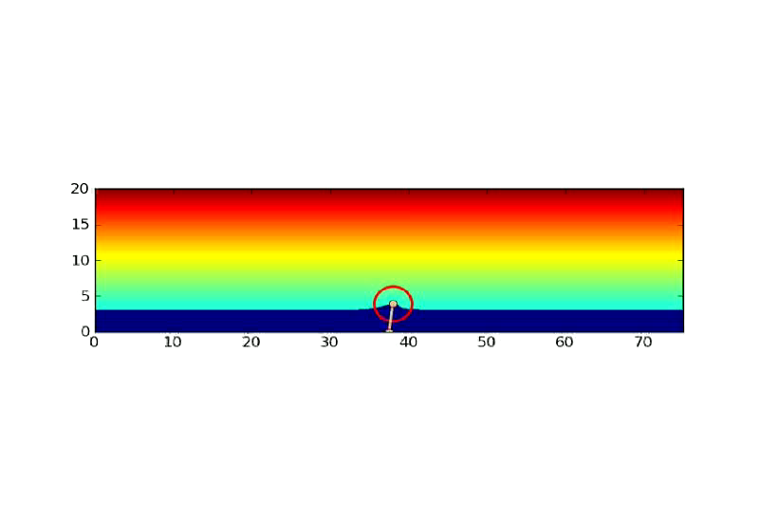
Single River, High Sediment Supply
Wave-dominated Delta Evolution
(Ashton et al., Computers & Geosciences, 2011 in press)

Slide 30

Multiple Rivers, High Sediment Supply
Wave-dominated Delta Evolution
(Ashton et al., Computers & Geosciences, 2011 in press)

Slide 31
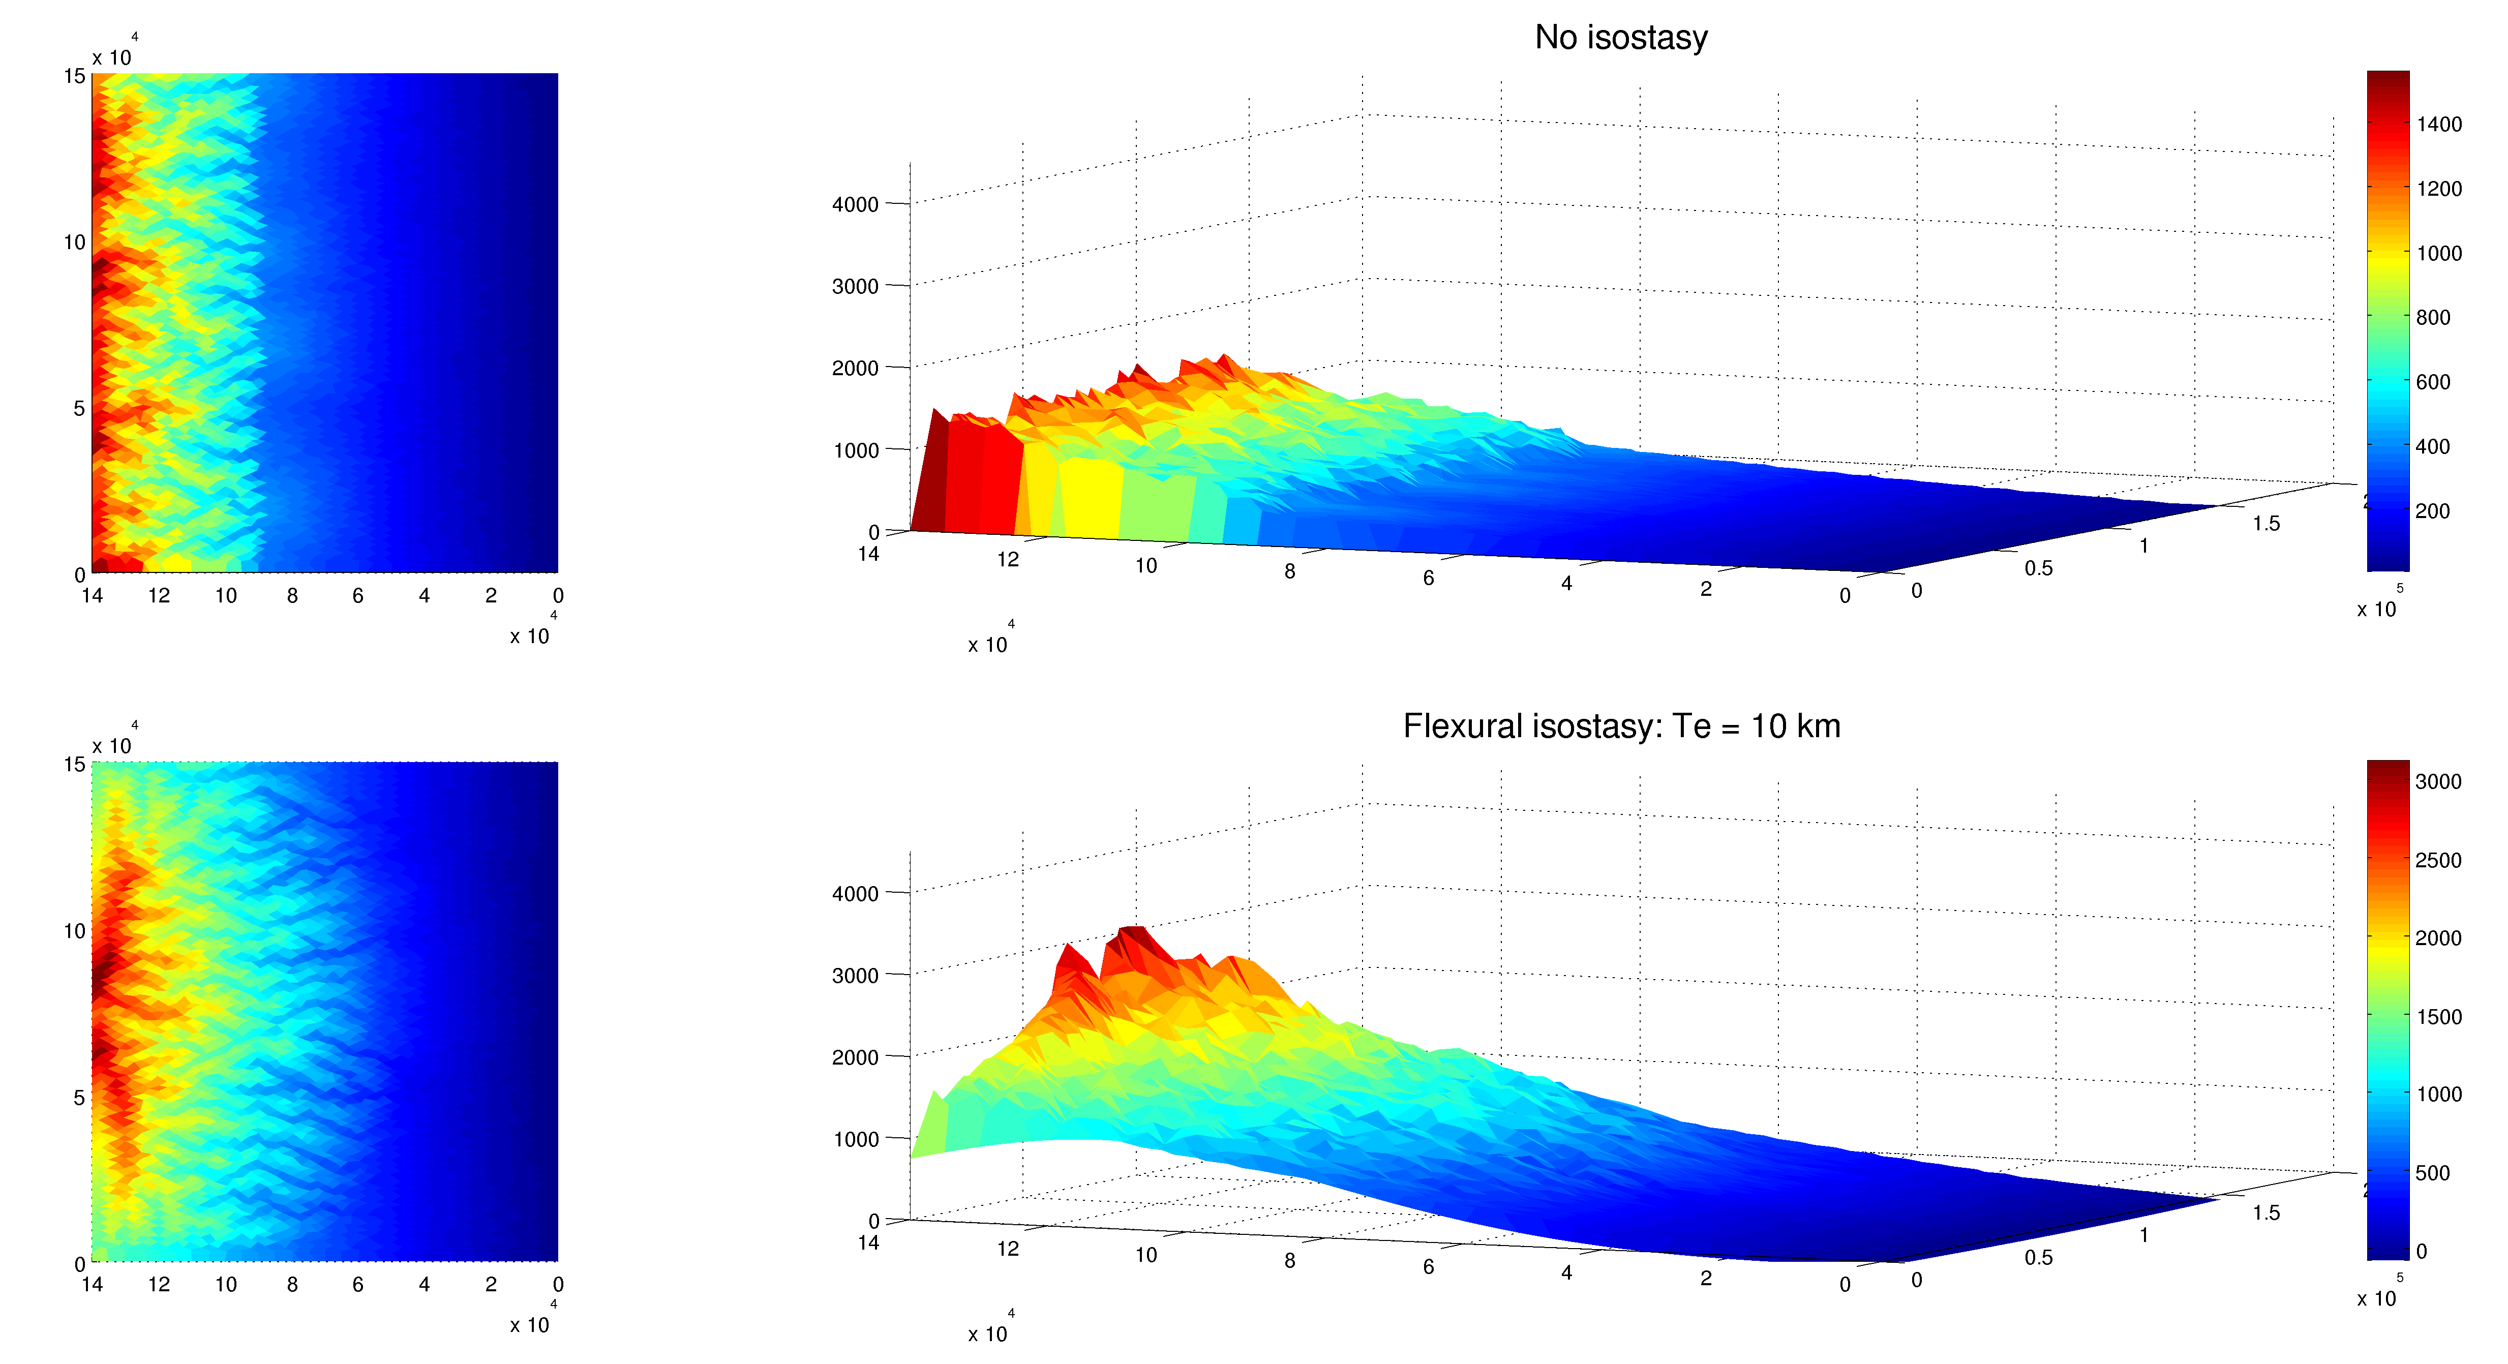
6) Model Coupling & Model Reuse
Coupling a LEM (CHILD) with a geophysical model (FLEX)
Codes are in different languages (C and Python).
Wickert et al., 2011, JGR in prep

Slide 32
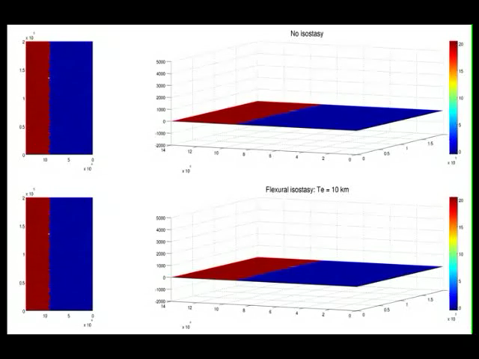
6) Model Coupling & Model Reuse
Andy Wickert, University of Colorado, in prep 2011
Notes:
Formation of piggy bag basin…CHILD has never shown this before!

Slide 33
Future CSDMS Technology Development (2012-2017)
A web-based Component Modeling Tool (CMTweb) that allows users to run CMT directly through a web browser
Pre-built executables of models and tools able to run on a wide range of platforms
Automate ‘wrapping’ processes to allow legacy code in the repository to become plug-and-play components faster
Incorporate benchmark data into the CSDMS modeling framework, for both benchmarking and model inter-comparison experiments
Develop a robust mechanism for ingesting and utilizing semantic mediation databases within its modeling framework
Development of an Educational Toolkit

Slide 34
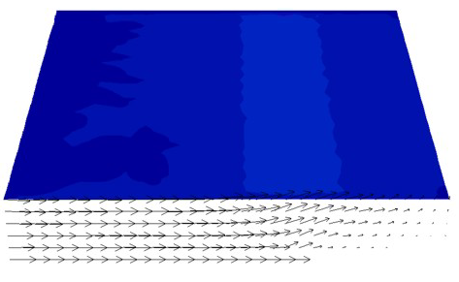
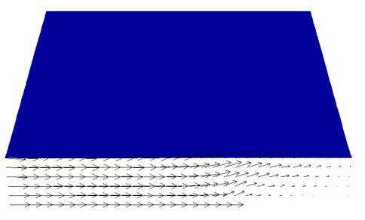
Future CSDMS Initiatives (2012-2017)
ii) a geodynamics initiative to investigate the interplay among climate, geomorphology, and tectonic processes in governing surface processes and landscape evolution
Lithospheric Model Coupling with Surface Processes
< Highly Erodible Material >
< Less Erodible Material >
Eunseo Choi, LDEO

Slide 35
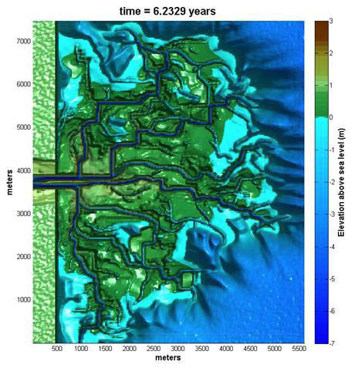
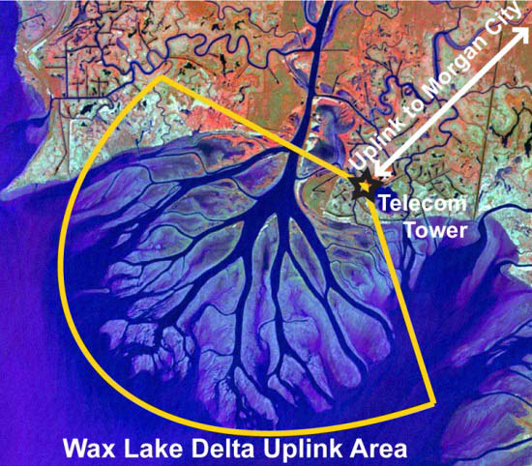
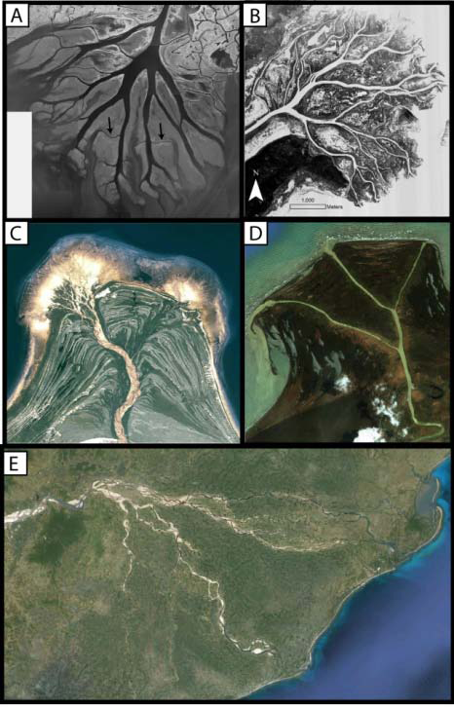
Future CSDMS Initiatives (2012-2017)
iv) a coastal vulnerability modeling initiative, with emphasis on deltas and their multiple threats and stresses,
The Delta Dynamics Collaboratory (DDC) will develop & test, high-resolution, quantitative models incorporating morphodynamics, ecology, and stratigraphy to predict river delta dynamics over engineering to geologic time-scales, to address questions of system dynamics, resiliency, and sustainability.

Slide 36
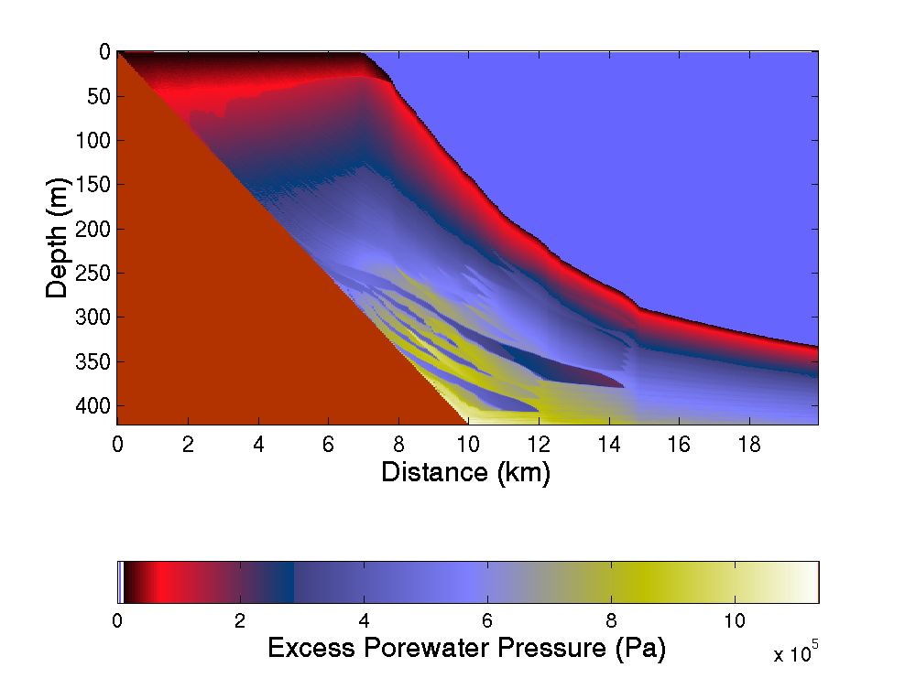
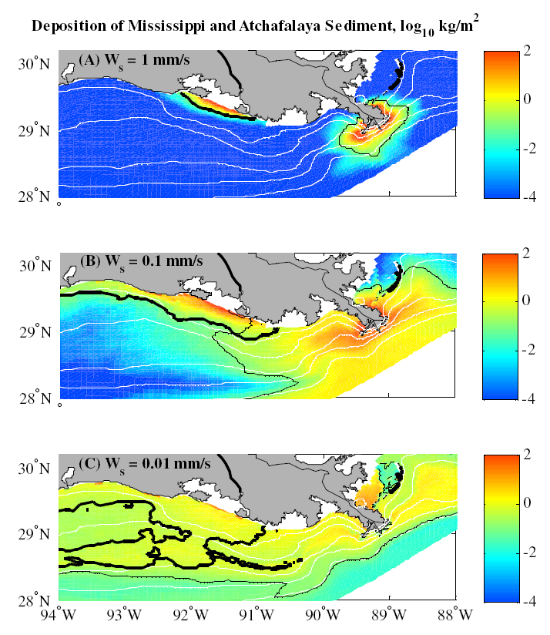
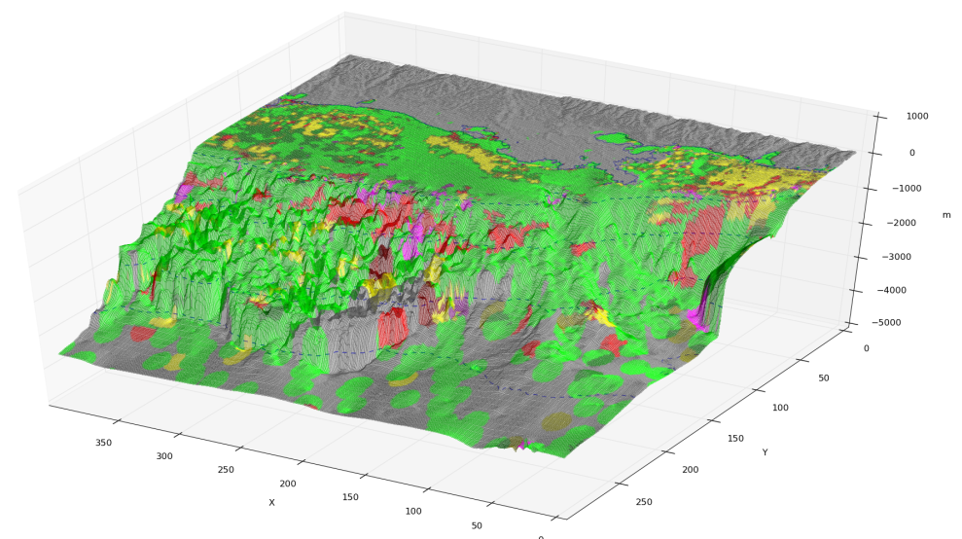
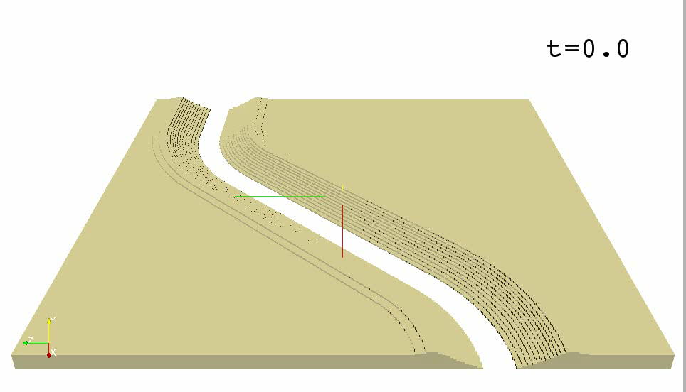
Future CSDMS Initiatives (2012-2017)
v) a continental margin modeling initiative, to capture extreme oceanic and atmospheric events on generating turbidity currents (case-study in the Gulf of Mexico)
Hydrodynamic & sediment transport model for inner – middle shelf (ROMS)
SedFlux Sediment Failure Model
LES Turbidity Current Model
DbSEABED: C. Jenkins

Slide 37
More Updates: http://csdms.colorado.edu
Annual Meeting 2013, March 8-11 (?)

