Slide 1
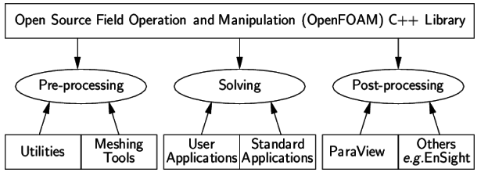
OpenFOAM
Open source CFD toolbox, which supplies preconfigured solvers, utilities and libraries.
Flexible set of efficient C++ modules---object-oriented.
Use Finite-Volume Method (FVM) to solve systems of PDEs ascribed on any 3D unstructured mesh of polyhedral cells.
Good parallelization.
Overview of OpenFOAM structures
Resourceful community (CFD forum, http://www.cfd-online.com/Forums/openfoam/) contribution (user-defined libraries).
interFoam, which is a solver for 2 incompressible fluids with interface tracking, is used in the present study.
Tutorials: http://cfd.direct/openfoam/user-guide/dambreak/
Notes:
OpenFOAM is an open source code that provides preconfigured solvers, utilities….

Slide 2
0 where boundary conditions are defined for
alpha.water, B, k, nuSgs, p_rgh, U
Mesh building -- blockMeshDict
constant
Turbulence closure – turbulenceProperties, LESProperties
Initial condition -- setFieldslDict
Computational time control -- controlDict
system
Numerical schemes -- fvSchemes
Numerical solvers -- fvSolution
Domain decomposition -- decomposeParDict

Slide 3
Build the domain and set the grids
Choose the turbulence closure
Set the initial condition
Set the boundary condition
Choose the numerical schemes
Choose the numerical solvers
Set the time control
Decompose the domain
Run the case

Slide 4
Build the domain and set the grids
Choose the turbulence closure
Set the initial condition
Set the boundary condition
Choose the numerical schemes
Choose the numerical solvers
Set the time control
Decompose the domain
Run the case

Slide 5
Domain Layout
z
3 (0 0 0.3)
7 (0 0.6 0.3)
How to choose an appropriate domain height?
- Big enough to make sure the breaking wave will not touch the top boundary;
- Not to big, to save computational cost.
y
x
0 (0 0 -0.3)
4 (0 0.6 -0.3)
6 (18.2 0.6
0.3)
2 (18.2 0 0.3)
How to choose an appropriate domain width?
- Big enough to cover several largest eddies in the experiment;
- Not to big, to save computational cost.
1 (18.2 0 0.064)
5 (18.2 0.6 0.064)
In this case, the domain length is set to be smaller than that in the experiment [Ting 2006, 2008] but long enough to cover the initial shoreline and swash zone

Slide 6
Build the grids
z
x
Nz = 80.
How to determine the number of grids in the vertical direction?
-- Determined by the number of grids needed to solve the wave.
E.g., in this case, H₀=0.22 m. Using 30 grids to solve the wave
$∆z$ = 7.5 mm at the left boundary
Nz = Domain height / $∆z$ = 80
Nx = 2427.
How to determine the number of grids in the streamwise direction?
-- Make sure the ratio of $∆x/∆z$ is not too big (<5).
E.g., in this case, Δz_{max}=7.5 mm at the left boundary; Δz_{min}=3 mm at the right boundary.
To make $∆x/∆z$ < 5, choose Δx_{max}=11.5 mm ($∆x/∆z$ = 3.8) at the left boundary
and
Δx_{min}=4.6 mm ($∆x/∆z$ = 1.5) at the right boundary.
$∆x$ is shrinking from the left to the right. (So is $∆z$ )
Ny = 80.
How to determine the number of grids in the spanwise direction?
Make sure the ratios of $∆y/∆z$ and $∆x/∆y$ are not too big. E.g., in this case, $∆y$ = 7.5 mm

Slide 7
Build the domain and set the grids
Choose the turbulence closure
Set the initial condition
Set the boundary condition
Choose the numerical schemes
Choose the numerical solvers
Set the time control
Decompose the domain
Run the case

Slide 8
Choose the turbulence closure
Large-eddy simulation in this simulation
Filter is defined as
Dynamic Smagorinsky closure is used, and an improved version of dynamic Smagorinsky closure developed by Alberto Passalacqua is adopted.
How to install the improved dynamic Smagorinsky closure in OpenFOAM?
Download the source code using git:
git clone git://github.com/AlbertoPa/dynamicSmagorinsky.git
2. Enter the directory where the source code has been extracted, and compile it by typing:
wmake libso
3. Add the following line to the controlDict of your case: libs ( "libOpenFOAM.so" "libdynamicSmagorinskyModel.so" ) ;
4. Specify LESModel dynamicSmagorinsky; delta cubeRootVol; in LESModel. 5. Add the subdictionary
dynamicSmagorinskyCoeffs
{ filter simple;
ce 1.048;
}
to LESModels.
https://github.com/AlbertoPa/dynamicSmagorinsky

Slide 9
Build the domain and set the grids
Choose the turbulence closure
Set the initial condition
Set the boundary condition
Choose the numerical schemes
Choose the numerical solvers
Set the time control
Decompose the domain
Run the case

Slide 10
Set the initial condition
Offshore
(0 0 0)
(0 0.6 0)
(0 0 -0.3)
Onshore
(0 0.6 -0.3)
(15 0 0)
(15 0.6 0)

Slide 11
Build the domain and set the grids
Choose the turbulence closure
Set the initial condition
Set the boundary condition
Choose the numerical schemes
Choose the numerical solvers
Set the time control
Decompose the domain
Run the case

Slide 12
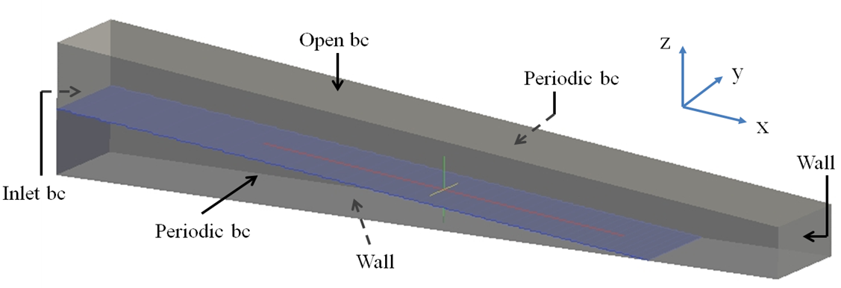
Define the boundaries
(Wall function is used)
Sends in the target solitary wave through groovyBC
What is groovyBC?
-- A library that can be used to generate arbitrary boundary conditions based on expressions. It is included in the swak4Foam library package.
Link: https://openfoamwiki.net/index.php/Contrib/swak4Foam

Slide 13
Install groovyBC
1. Download swak4Foam library package from
svn checkout svn://svn.code.sf.net/p/openfoam-extend/svn/trunk/Breeder_2.0/libraries/swak4Foam/ swak4Foam_2.x
2. In the directory of the sources, type
wmake all

Slide 14
Use groovyBC to send in solitary wave
Expression of the theoretical surface elevation in Lee et al. [1982]
Expression of the theoretical velocity in Lee et al. [1982]

Slide 15
Specify the boundary conditions
alpha.water: (percentage of water in each cell) in the VOF equation
B: subgrid-scale tensor in LES. is the unit tensor; is the deviatoric part of the subgrid-scale tensor and is parameterized by subgrid closure
k: subgrid-scale kinetic energy in LES. , , is the rate of strain
nuSgs: , sub-grid scale viscosity in LES
p_rgh: dynamic pressure
U: velocity

Slide 16
Specify the boundary conditions
zeroGradient: normal gradient is zero
cyclic: periodic boundary condition
inletOutlet: $≈$ zeroGradient. But switch to fixedValue (using “inletValue”) if the velocity just outside the boundary is flowing into the domain
totalPressure: Total pressure is fixed; when changes, p will be adjusted accordingly
pressureInletOutletVelocity: = pressureInletVelocity + inletOut
pressureInletVelocity: When $p$ is known at the inlet, $U$ is evaluated from the flux normal to the path.

Slide 17
Build the domain and set the grids
Choose the turbulence closure
Set the initial condition
Set the boundary condition
Choose the numerical schemes
Choose the numerical solvers
Set the time control
Decompose the domain
Run the case

Slide 18
Numerical schemes
ddtSchemes: first time derivative $\left(∂/∂t\right)$. “CrankNicholson 1” is the pure 2nd-order Crank-Nicolson scheme
gradSchemes: Gradient $∇$. “Gauss linear” means Gauss’ theorem is used when transforming integral over volume into integral over surface; “linear” means central difference scheme (CDS)
divSchemes: Divergent $∇∙$. “Gauss limitedLinearV 1” and “Gauss vanLeer” are both TVD schemes with different limiters. “Gauss interfaceCompression” is used for the interface compression term
laplacianSchemes: Laplacian . “Gauss linear corrected” is CDS with some correction terms
interpolationSchemes: numerical scheme for the evaluation of face values from the cell center values
snGradSchemes: component of gradient normal to a cell face
fluxRequired: fields which require the generation of a flux

Slide 19
Build the domain and set the grids
Choose the turbulence closure
Set the initial condition
Set the boundary condition
Choose the numerical schemes
Choose the numerical solvers
Set the time control
Decompose the domain
Run the case

Slide 20
Numerical solvers
Solves the Pressure Poisson Equation
Set the solvers for p_rgh and U
PIMPLE = SIMPLE + PISO

Slide 21
Build the domain and set the grids
Choose the turbulence closure
Set the initial condition
Set the boundary condition
Choose the numerical schemes
Choose the numerical solvers
Set the time control
Decompose the domain
Run the case

Slide 22
Set the time control
startFrom
stopAt
deltaT
writeControl
adjustTimeStep
maxCo
maxAlphaCo
maxDeltaT

Slide 23
Build the domain and set the grids
Choose the turbulence closure
Set the initial condition
Set the boundary condition
Choose the numerical schemes
Choose the numerical solvers
Set the time control
Decompose the domain
Run the case

Slide 24
Decompose the domain
“decomposeParDict”
numberOfSubdomains 8;
simpleCoeffs
{
n (4 1 2);
…
}
Type
decomposePar
z
y
x

Slide 25
Build the domain and set the grids
Choose the turbulence closure
Set the initial condition
Set the boundary condition
Choose the numerical schemes
Choose the numerical solvers
Set the time control
Decompose the domain
Run the case

Slide 26
Run the case
Type
interFoam

