Slide 1






CSDMS Annual Meeting 2016: Capturing Climate Change (May 17-19, 2016)
A turbulence-resolving Eulerian two-phase model for coastal sediment transport applications
Zhen Cheng¹ (Charlie), Tian-Jian Hsu¹ (Tom), Julien Chauchat², Thibaud Revil-Baudard³
¹University of Delaware, Newark, DE, 19716, USA
²LEGI, Grenoble-INP, France
³LEGI, now at Karlsruher Institut für Technologie
Notes:
Today, I’m going to introduce a turbulence-resolving Eulerian two-phase model for coastal sediment transport applications.
My name is Charlie, and this work is done with my advisor Tom Hsu, and we’re collaborating with Dr. Julien Chauchat, and Thibaud from LEGI in France on the model development and validation.
This research is supported by NSF and ONR fundings, and the numerical simulations are carried out on UD hpc computing center and Xsede.

Slide 2
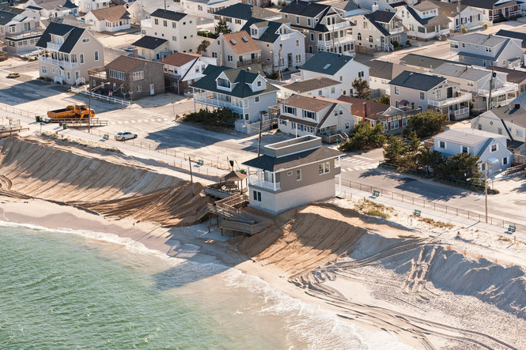
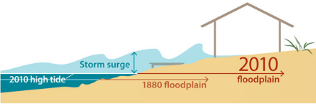
Motivation
The coastal zone is a very important human habitat of high ecological diversity and critical economic importance. Over 38% of the world's population lives within 100 km of the coast or estuaries (1995, from World Resource Institute).
Accelerated sea-level-rise, due to the global climate change during the past century, makes coastal zone more vulnerable to natural hazards such as storm surges.
Figure adopted from https://storm-surge.org/the-science/
Ortley Beach, Toms River, NJ after Hurricane Sandy. Adopted from Star Ledger.
Studying Sediment transport is essential for beach erosion and recovery, however, field evidences suggest that the mechanisms critical in major storm condition were not parameterized properly by state-of-the-art sediment transport models (Foster et al., 2006; Cheng et al., 2016).
Notes:
So, why do we care about the coastal sediment transport?
for the past century, sea-level- has been rasing rapidly… accelerated sealevel rise has …..
Well, we know that the coastal zone is a very important place for living and tourism, according to the survey in 1995, over %38 of the world’s populations are living within 100 km of the coast, so It’s both ecologically and economically significant.
However, due to the global climate change, as illustrated in this cartoon, the sea-level-rise becomes more and more severe, and it makes the castal zone more vulnerable to natural hazards, such as storm surge. Here is a picture of Ortley beach in New Jersey after Hurricane Sandy, we can see that the beach erosion is very serious, and the hurricane and left many homes at risk.
Study sediment transport is essential for the beach erosion and recovery, however, there are many field evidences suggest that the mechanisms critical in major storm conditions were not parameterized properly by conventional sediment transport models.

Slide 3
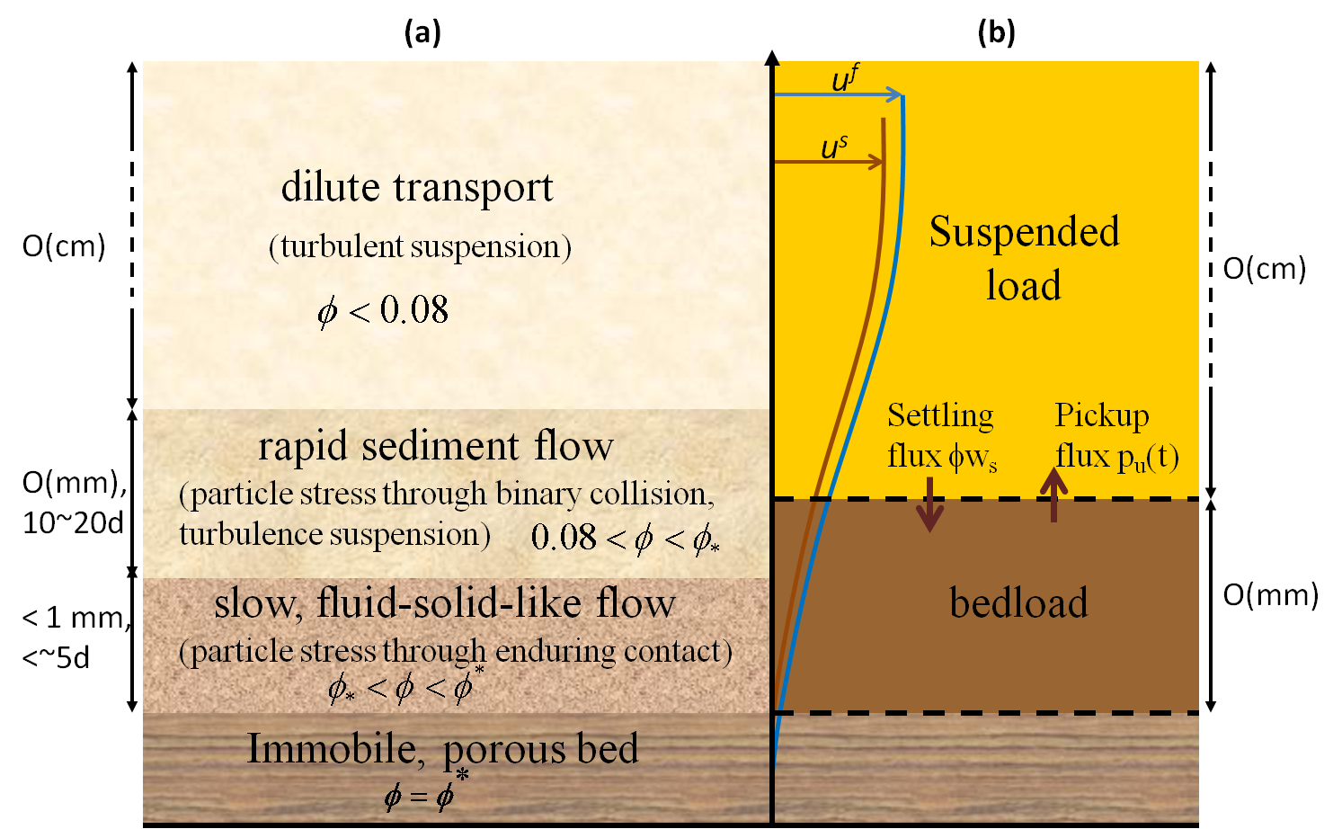
Eulerian Two-phase Model for Sediment Transport
(a) single-phase
(b) two-phase
Why two-phase model?
Using two-phase flow equations with closures on interphase momentum transfer (e.g. drag), particle stresses and turbulence-sediment interaction, full profiles of transport can be obtained.
Conventional bedload/suspended load assumptions are not necessary.
SedFOAM (Cheng et al., 2016, Coastal Engineering, under revision), an Eulerian two-phase model based on a k-ɛ turbulence model, is publically available via Community Surface Dynamics and Modeling System (CSDMS) model repository maintained by GitHub.
A CSDMS clinic was hosted on SedFOAM in 2015: https://csdms.colorado.edu/wiki/CSDMS_2015_annual_meeting_Tom_Hsu
Adopted from Yu et al. (2012), Adv. Water Res.
Notes:
(too rush) In the state-of-the-art sediment transport model, the sediment transport are divided into bedload and suspended load, the bedload is modeled using empirical formulation, while the suspended load also requires an empirical pick-up flux from the bottom.
sate is based on the single-phase approach.
(continuum description!!! continously from water surface to the immobile bed…)
To get rid of these empirical formulations, we propose to use a two-phase model for the sediment transport, which describe continuous picture of sediment transport from the water surface to the immobile bed. Using two-phase flow equations with momentum coupling term by the drag, and closures of particle stress and turbulence-sediment interactions, full transport profile can be obtained without bedload/suspended load assumptions are needed.
We’ve already developed a turbulence-averaged two-phase model for sediment transport, and it’s called sedFOAM, and has been dissemblred to the CSDMS model repository, last year, we’ve hosted a clinic to introduce the sedFOAM, you can find the youtube link for this clinic from this website.

Slide 4
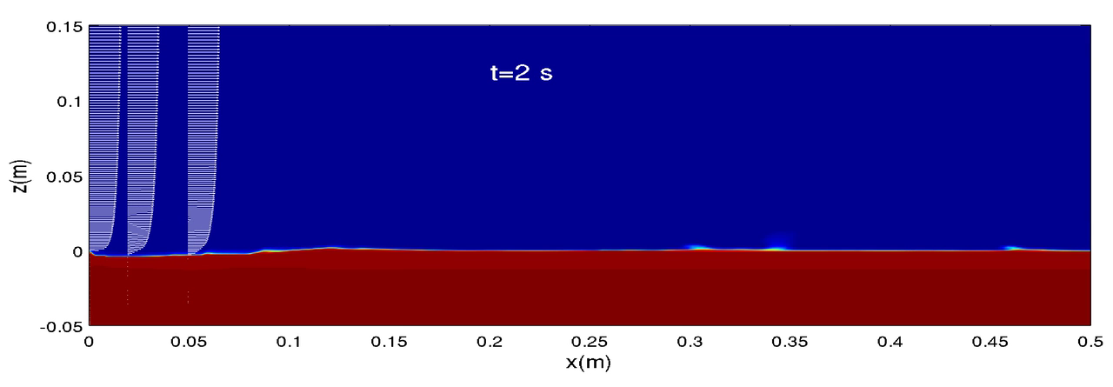
SedFOAM (Cheng et al., Coastal Eng., in revision)
SedFOAM has been validated with oscillatory sheet flow experiment (O’Donoghue and Wright, 2004)
It has been used by many researchers for different applications such as scour problems.
Figure. Modeled (solid curve) and measured (symbols) concentration profiles at four instants in M5010 experiment of O’Donoghue and Wright (2004)
Movie. Scour downstream an apron, u_{f}=3.69 cm/s, d=0.25 mm
Notes:
turbulence-averaged model has been validated with experiment data (OD data) and as been used by the find sand , reference to paper Ceng
validated
applied
With this turbulence-averaged two-phase model, we already have many applications. So

Slide 5
Why turbulence-resolving:
In turbulence-averaged models, closure of turbulence-sediment interactions is highly empirical.
For oscillatory sheet flow:
Turbulence-averaged two-phase model works reasonably well for medium to coarse sand.
Most existing models including turbulence-averaged two-phase model fail to predict enhanced transport thickness for fine sand (i.e., sand with d₅₀< 0.15 mm)
How can we do a better job for fine sand?
Dohmen-Janssen et al. (2001), JGR.
Hypothesis:
Turbulence-sediment interactions are critical for fine sand.
Typical wave conditions in coastal environment are transitionally turbulent (especially during flow reversal).
A turbulence-resolving simulation approach is needed
Notes:
(add one figure of RANS applicatins, validated by experiment data, and used by many researchers) Now that we have a turbulence-averaged model, why do we still need to develop a turbulence-resolving model??
Well, in the turbulence-resolving model, the turbulence-sediemnt interactions need empirical closures, and these closures works well for medium and coarse sand, however, according the Dohmen-Janssen’s experiment data, (as shown in this figure), the scaling of transport thickness for fine sand is much larger than the medium sand, however, this feature cannot be captured by the existing models, including the turbulence-averaged models.
So, can we do a better job for find sand?
We hypothesize that for fine sand, the turbulence-sediment interactions are more important, so turbulence should be well-reslved.
Meanwhile, for typical wave conditions in coastal environment, the flow is transitionally turbulence, especially during the flow reversal, at this condition, the turbulence-averaged model will fail.
So we are motivated to develop a turbulence-resolving model.

Slide 6
Filtered Eulerian two-phase flow equations:
  Mass Conservation Equations
fluid and sediment density
filtered sediment concentration
filtered fluid and sediment velocities
  Momentum Equations
Fluid and sediment momentum coupling are dominated by drag force: M_{i}^{fs}, M_{i}^{sf}.
Fluid stresses are modeled with sub-grid turbulence model (Germano, 1991).
Particle stresses due to collisions and frictions are modeled with kinetic theory for granular flow and frictional stress models (Ding and Gidaspow, 1990; Srivastava and Sundaresan, 2003).
Notes:
Notations!!! Citation!
Let’s first recall the governing equations for two-phase Eulerian models,
we treat the both fluid phase and sediment phase as continuum, and they are solved with separate mass conservation and momentum equations, The fluid and sediment momentum are coupled with a drag force, and fluid stress are modeled with turbulence model, the particle stresses due to particle collisions and frictionsa re modeled with kinetic theory and frictional stress models.

Slide 7
Sub-grid model:
Turbulence-resolving: Eulerian two-phase equations are solved in 3D with a domain size sufficiently larger than the largest eddies and high numerical resolution (on the order of grain size).
Large eddies/structures are directly resolved, and effect of small eddies/structures on large scale motions are modeled with sub-grid closures:
For fluid and particle sub-grid stress:
where,
The coefficient C_{s} is determined using a dynamic procedure (Germano, 1991), and similar closures are used for sediment sub-grid stress.
For sub-grid contribution of drag:
Ozel et al. (2013): mesoscale structures of sediment particles such as streamer and clusters, may not be resolved by the mesh size, and they can have a dramatic effect on the overall sediment dynamics.
The effect of unresolved mesoscale structure can be accounted by a sub-grid drag correction:
The coefficient K depends on grid size and sediment concentration, and it’s determined by using a dynamic procedure (Ozel et al., 2013).
Notes:
First sentence slow!!! large eddy simulation approach (louder)
In our turbulence-resolving model, the two-phase equations are solved in 3D domain, which is large enough to capture the largest eddies, and high numerical resolutions are used to resolve enough turbulence motions. So, large-scale

Slide 8
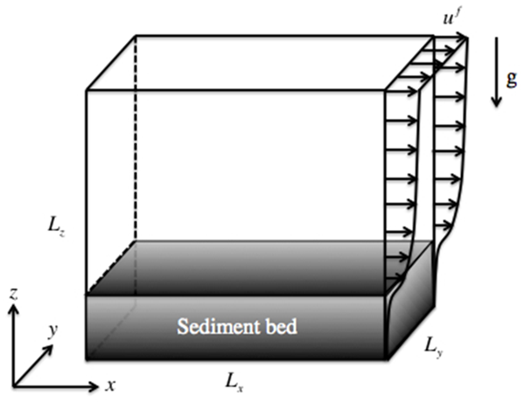
Model Validation - Sheet flow in steady channel flow
LEGI experiment (Revil-Baudard et al., 2015, JFM):
Colocated two-component velocities (u, w) and sediment concentration (ϕ) are measured.
Revil-Baudard et al. (2015)
Flow condition: u* = 5 cm/s, h = 0.13 m
Sediment properties: s =1.192, d = 3 mm, W_{s} = 5.59 cm/s
Shields parameter:
Numerical simulation:
Domain size and grid resolution are verified by velocity fluctuation correlation and energy spectrum.
Notes:
our domain size is large, and grid resolution is on the order of grain size…
snapshot (3D turbulence, instantaneous feature) Beause turbu… 3D

Slide 9
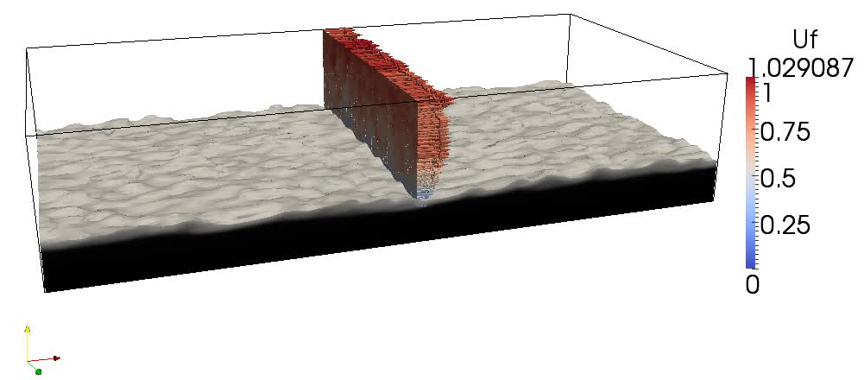
3D view- Sheet flow in steady channel flow
ϕ >= 0.08
Notes:
our domain size is large, and grid resolution is on the order of grain size…
snapshot (3D turbulence, instantaneous feature) Beause turbu… 3D

Slide 10
Ensemble-averaged flow statistics
Symbols: measure data (Revil-Baudard et al., 2015, JFM)
Curves: simulation results
Notes:
overall mag is reasonable, anisotropic fluc… however, underpredict/over..

Slide 11
Ensemble-averaged flow statistics
Symbols: measure data (Revil-Baudard et al., 2015, JFM)
Curves: simulation results

Slide 12
Ensemble-averaged flow statistics
Symbols: measure data (Revil-Baudard et al., 2015, JFM)
Curves: simulation results
ο
✕

Slide 13
Evidence of attenuated fluid turbulence by sediments
Rough-wall log law velocity profile:
Reduction of von Karman constant:
×××××
measured
Measured: κ = 0.23
Modeled: κ = 0.2
< Clear fluid: κ = 0.41
Sediment-induced density stratification can damp fluid turbulence
Notes:
It’s well know …damping density stratifiacation…
raise the scientific question! damping the turbulence, by semilog velocity, usually density, using our model we found another damping mechanism…drag
quantify by velocity profile , get the von Karman constant

Slide 14
Evidence of attenuated fluid turbulence by sediments
Rough-wall log law velocity profile:
Reduction of von Karman constant:
×××××
measured
Measured: κ = 0.23
Modeled: κ = 0.2
< Clear fluid: κ = 0.41
Sediment-induced density stratification can damp fluid turbulence, however, it’s playing a minor role comparing to drag induced turbulence damping effect for this flow condition and sediment (W_{s}/u*=1.1).

Slide 15
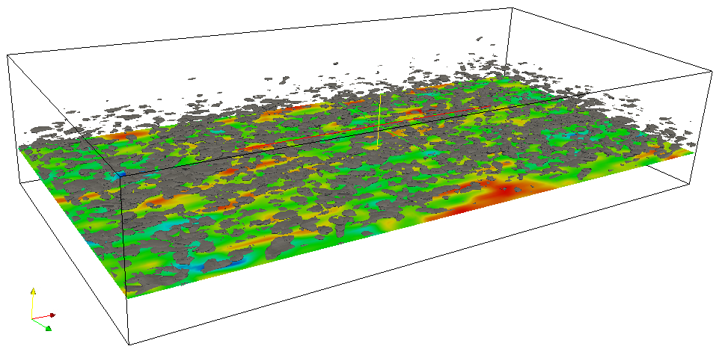
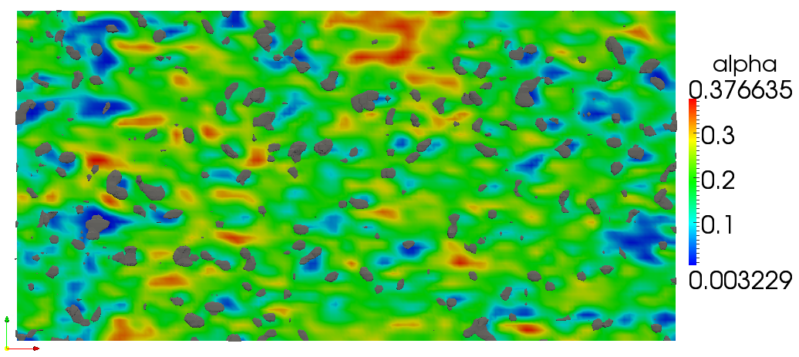
Preferential concentration
Heavy particles are preferentially biased to regions of high strain rate and low vorticity (Wang and Maxey, 1993), and second invariant Q is used to identify these regions (Chakraborty et al., 2005):
sediment clusters
Iso-surface of Q = 250 along with a plane cut of sediment concentration at (z-z_{d})/d=4, <ϕ>=0.2
ϕ
Q>0
low ϕ
Similar phenomenon are also reported by Cheng et al. (2015, Computers & Geosciences).
Plane-view of Q = 250 (gray color) and concentration fields.

Slide 16
Intermittency
Turbulent motions:
w’
u’<0, w>0
ejection
u’>0, w’>0
outward interact
u’<0,w’<0
inward interact
u’>0, w’<0
sweep
u’
Measurement
bed level
Measurement
Wallace (2016), Ann. Rev. Fluid Mech.
(Revil-Baudard et al., 2015, JFM)
Ejection
⇒ Increase of bed level
Sweep
⇒ Drop of bed level
Simulation
Notes:
Cite Revil--- JFM

Slide 17
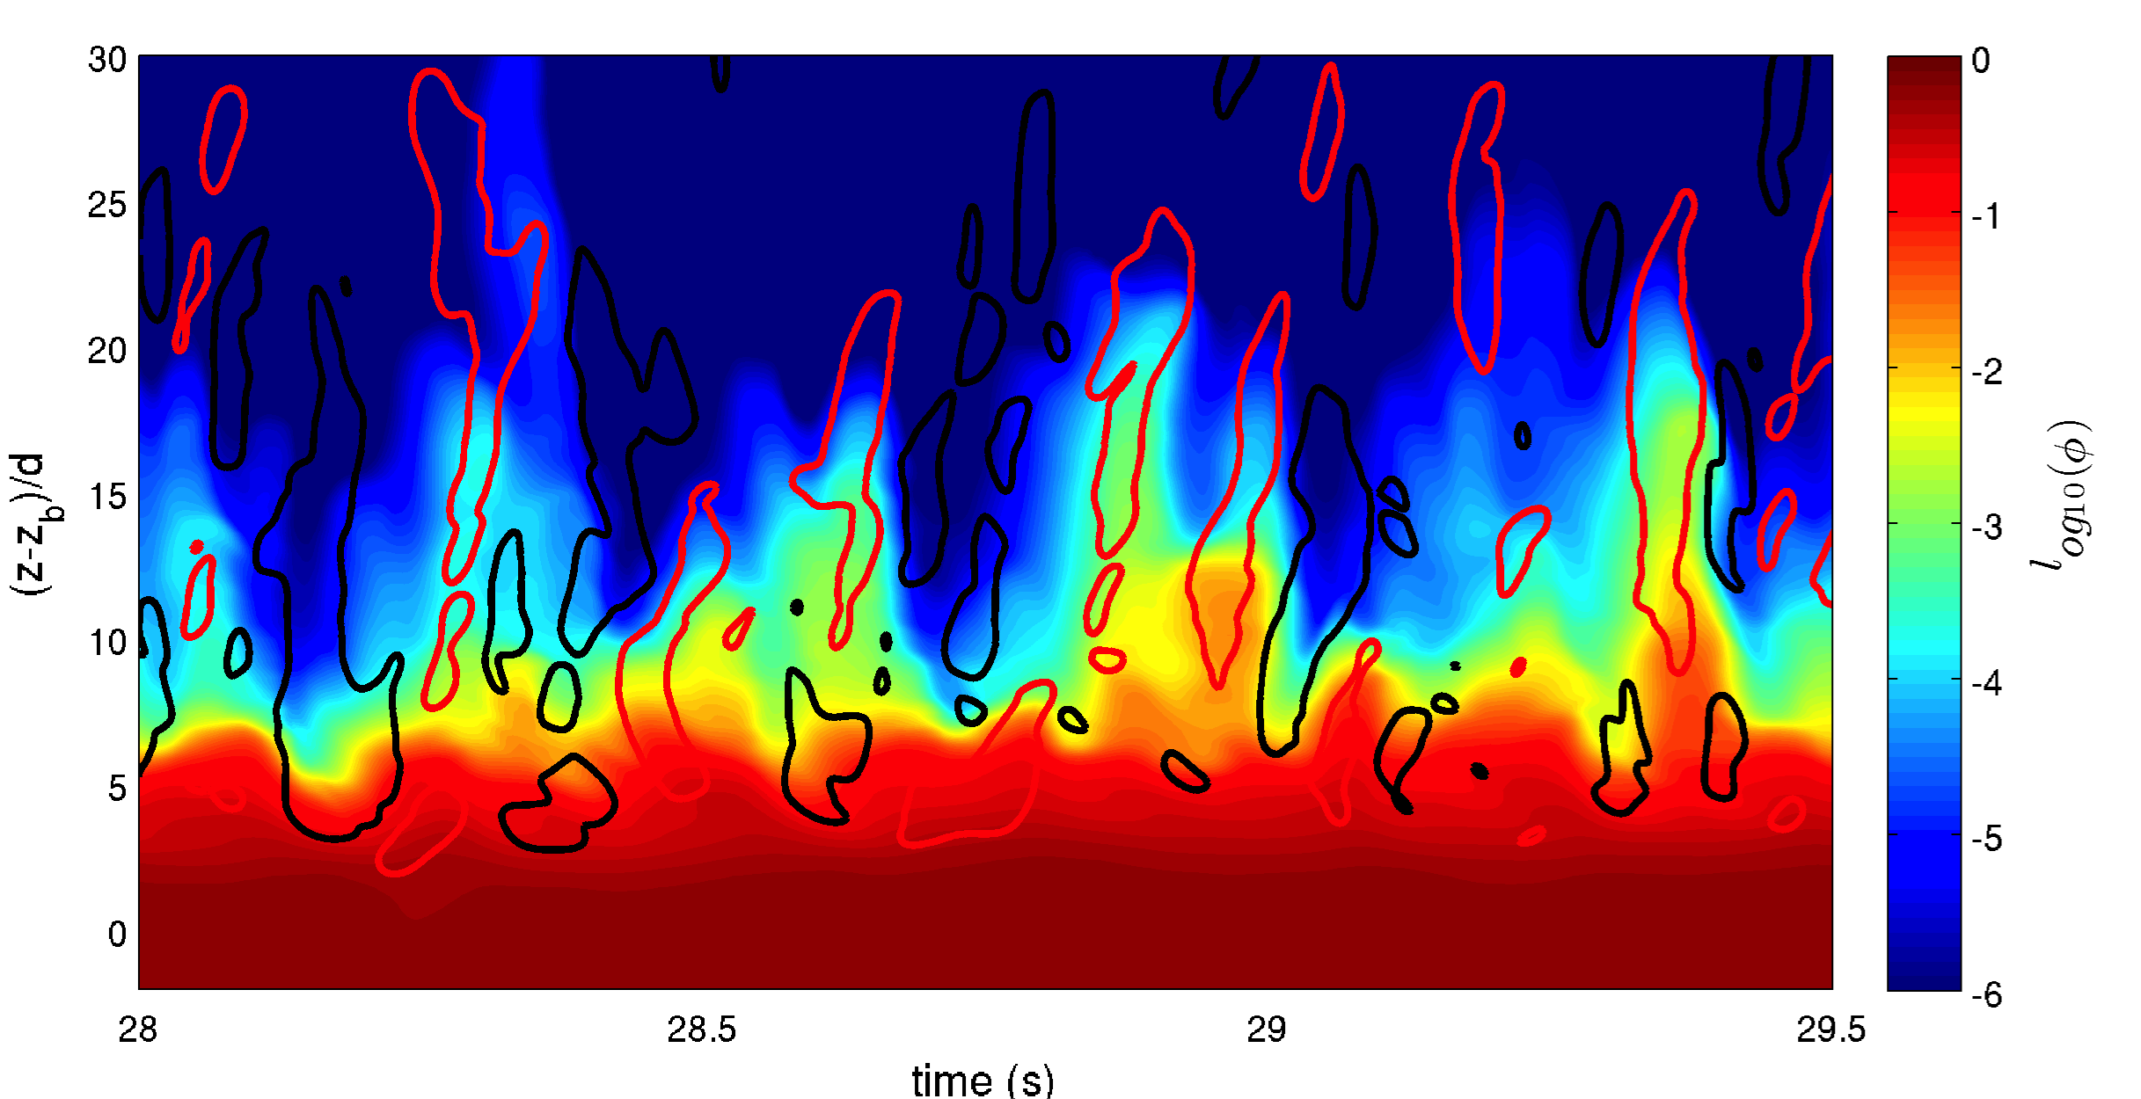
Intermittency
Turbulent motions:
w’
u’<0, w>0
ejection
u’>0, w’<0
sweep
u’
bed level
Measurement
Wallace (2016), Ann. Rev. Fluid Mech.
Ejection
⇒ Increase of bed level
Sweep
⇒ Drop of bed level
Simulation
Notes:
experiment found that bed intermittency associated with turbulent ejections/sweep, resolving is necessary, results are qualitatively similar to the experiment, however, more quantitaties analysis needs to be done.

Slide 18
Concluding Remarks
Findings:
Turbulence-resolving two-phase Eulerian model is developed and validated with LEGI steady sheet flow experiment.
Drag-induced turbulence attenuation becomes more important than the density stratification in LEGI experiment.
Model is able to capture sediment preferential concentration.
Further investigations:
Streamwise velocities and sediment suspension is under-predicted in the dilute region.
The inward/outward interaction events are under-predicted by our model (not reported).
More quantitative analysis of bed intermittency are needed.

Slide 19
Thank you!
A turbulence-resolving Eulerian two-phase model for coastal sediment transport applications
Zhen Cheng¹ (Charlie), Tian-Jian Hsu¹ (Tom), Julien Chauchat², Thibaud Revil-Baudard³
¹University of Delaware, Newark, DE, 19716, USA
²LEGI, Grenoble-INP, France
³LEGI, now at Karlsruher Institut für Technologie
Notes:
Today, I’m going to introduce a turbulence-resolving Eulerian two-phase model for coastal sediment transport applications.
My name is Charlie, and this work is done with my advisor Tom Hsu, and we’re collaborating with Dr. Julien Chauchat, and Thibaud from LEGI in France on the model development and validation.
This research is supported by NSF and ONR fundings, and the numerical simulations are carried out on UD hpc computing center and Xsede.

