Slide 1




EF5: A hydrologic model for prediction, reanalysis and capacity building
Zachary Flamig
Postdoctoral Scholar

Slide 2

Ensemble Framework for Flash Flood Forecasting
Inputs
Model
Outputs
Flamig, Z. L., H. Vergara, R. Clark III, Y. Hong, and J. J. Gourley, 2016: EF5: Version 1.0. doi: 10.5281/zenodo.59123
Snowmelt
Simulation options:
1. SNOW-17
Routing
Simulation options:
1. Linear reservoir
2. Kinematic wave
Precipitation
Native data options:
1. MRMS
2. GPM/TMPA RT
3. Any GeoTIFF
  QPE
  QPF
Surface Runoff
Simulation options:
1. CREST
2. SAC-SMA
3. Hydrophobic
Inundation
Simulation options:
1. Mass conservation
Evapotranspiration
Native data options:
1. GeoTIFF PET
2. GeoTIFF temperatures
Outputs
Type options:
1. Streamflow
2. Recurrence interval
3. Water depth
4. Soil moisture
Parameter Optimization
Type options:
1. DREAM

Slide 3
Ensemble Framework for Flash Flood Forecasting
C++
19,815 Lines of code
1,189 Total water balance (6%)
919 Total routing (5%)
89% “Glue” code!
  Configuration
  I/O

Slide 4

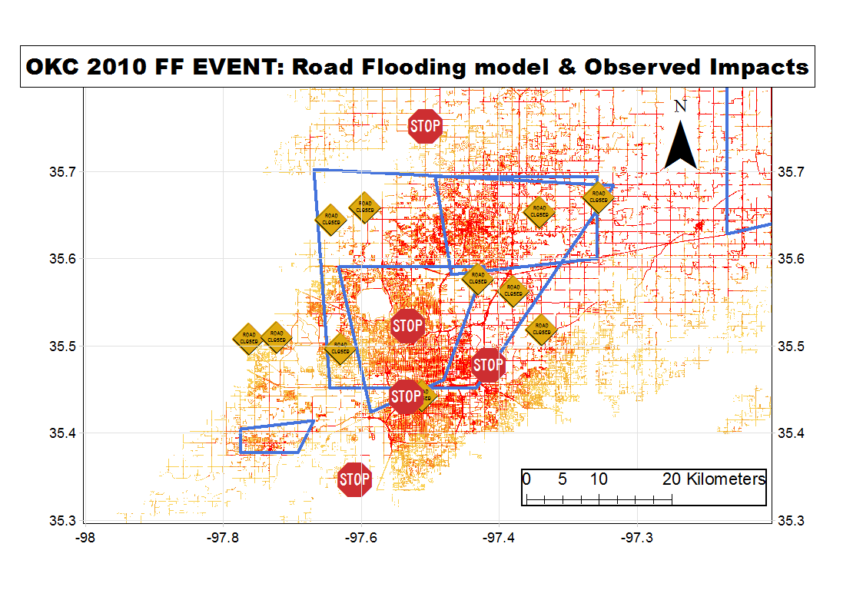
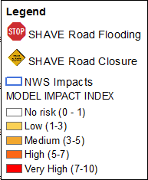
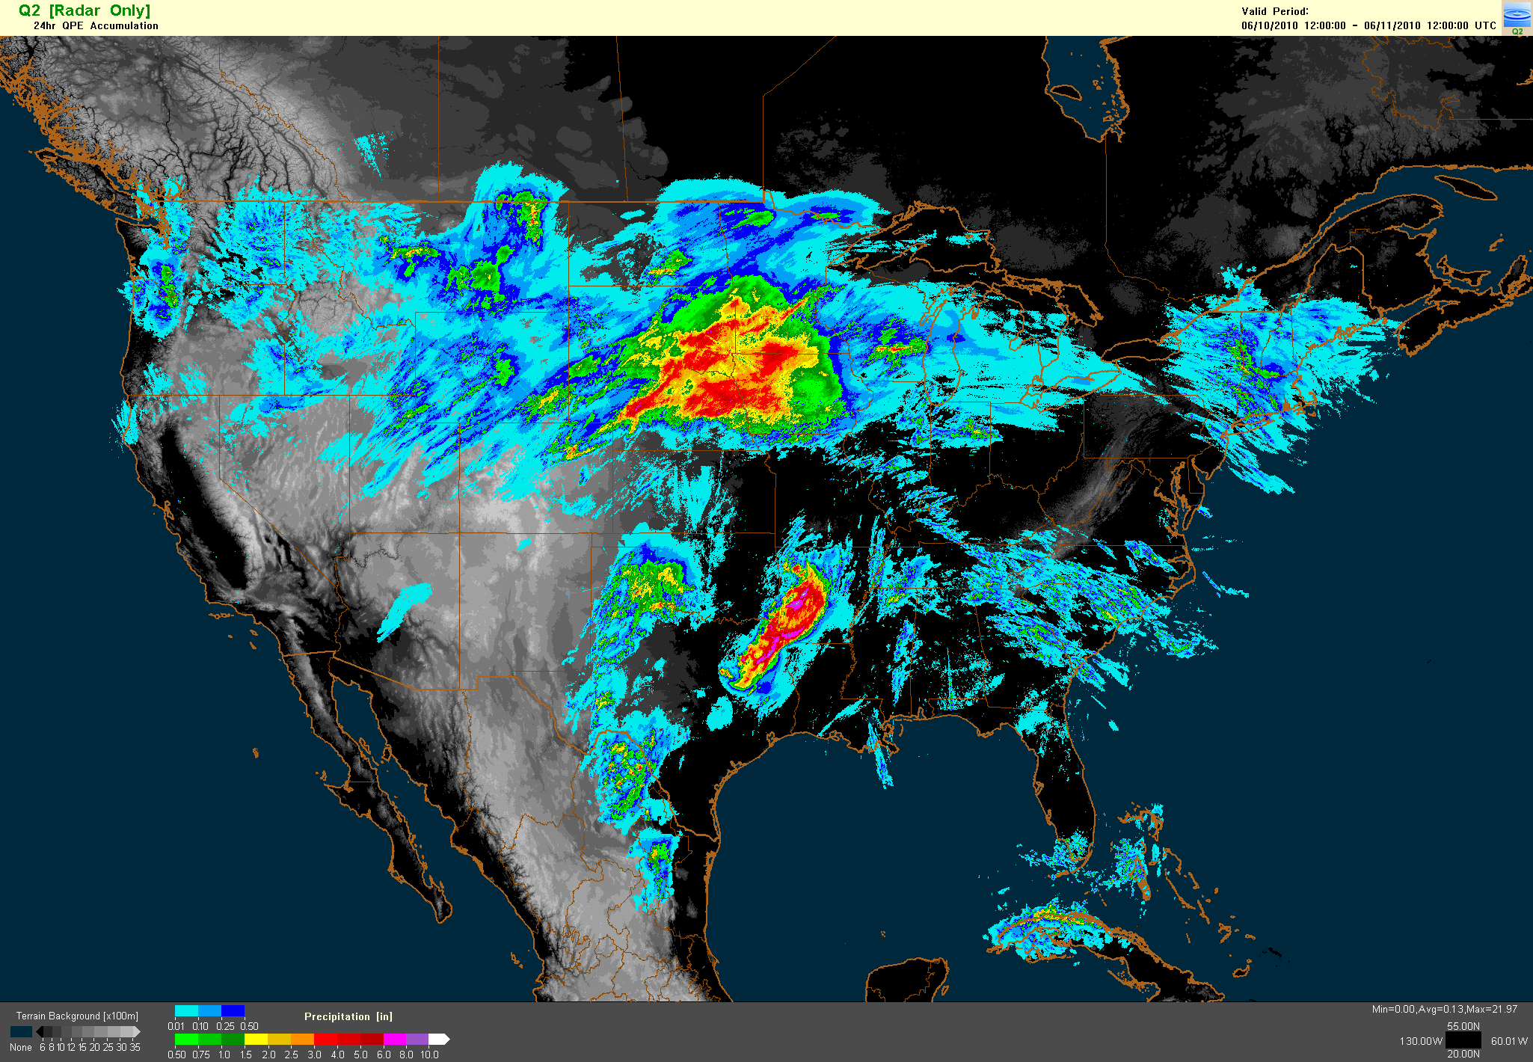
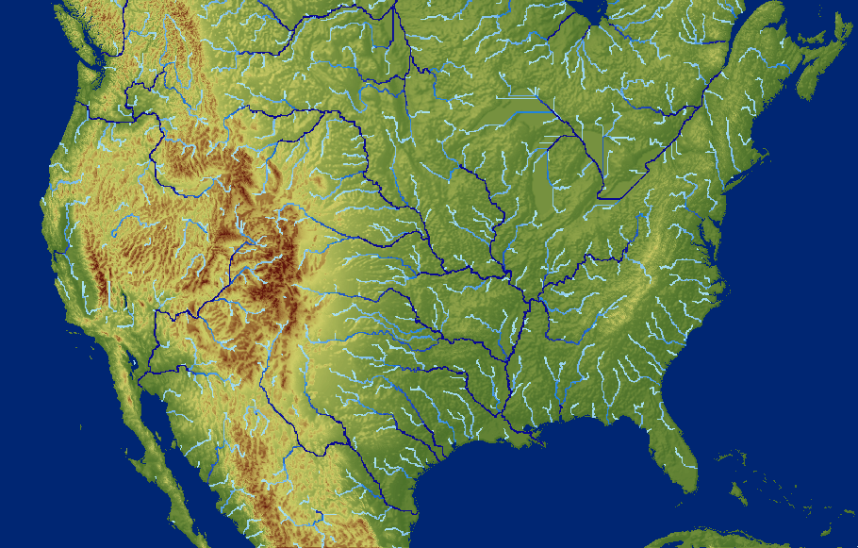
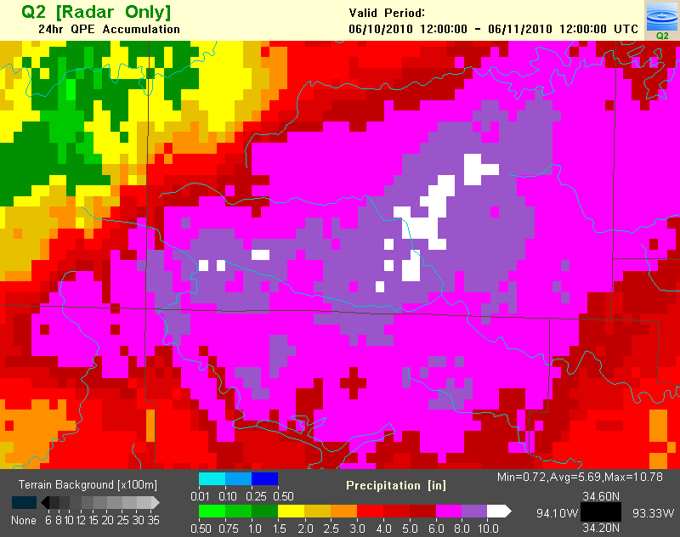
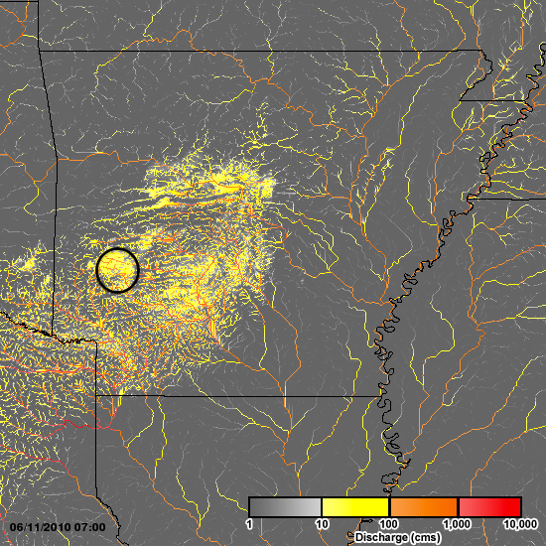
Multi-Radar Multi-Sensor QPE (MRMS)
Flooded Locations And Simulated Hydrographs (FLASH)
MRMS/Q3 Rainfall Observations
1km²/2 min
Stormscale Distributed Hydrologic Model Framework
-1km²/10 min
Flooding Impacts
Probabilistic Forecast Products on the Flash Flood Impacts and Magnitudes (70% chance of hazardous road flooding)
Simulated surface water flows and return period
150
200
First distributed hydrologic modeling framework to operate at the flash flood scale in real-time across the conterminous USA
250 mm/10”
20 fatalities
10-11 June 2010, Albert Pike Rec Area, Arkansas

Slide 5
Comparison with National Water Model
NWM
  2.6 million forecast points
  Single physics solution
  Calibrated
FLASH
  10.2 million forecast points
  Multiple water balance physics
  A priori parameters

Slide 6
Comparison with National Water Model
01:00
00:50
00:40
00:30
Initialization Time
00:20
FLASH
NWM
00:10
00:00
00:00
01:00
12:00
18:00
Forecast time (Valid Time)

Slide 7
Hydrologic Reanalysis
EF5 with CREST/SAC-SMA/HP & Kinematic Wave Routing
  Apriori parameters
  0.01x0.01˚ spatial resolution over CONUS
  5-minute time steps
  MRMS precipitation rate as forcing
Kept daily values
  Maximum Q
  Time of maximum Q
  Maximum unit Q
  Minimum soil moisture
Kept complete basin outlet time series for gauged basins
<1000 km²
2002-2011 period of record for MRMS forcing
  2001 used as warmup period

Slide 8
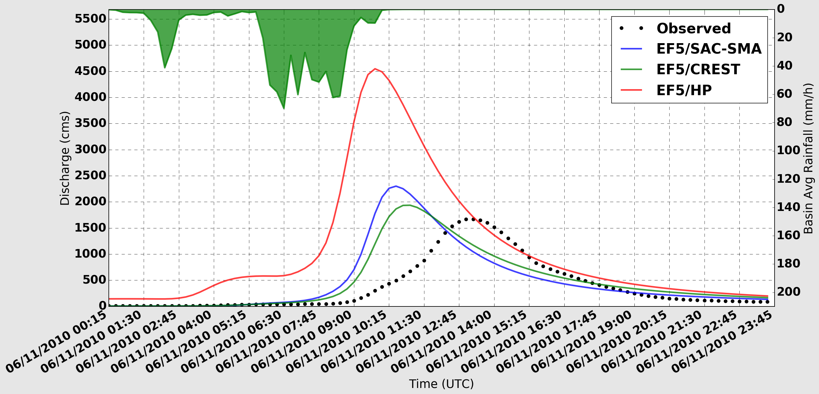
Observed and simulated hydrographs from Caddo River near Caddo Gap, AR. The contributing basin area at this point is 352 km².

Slide 9
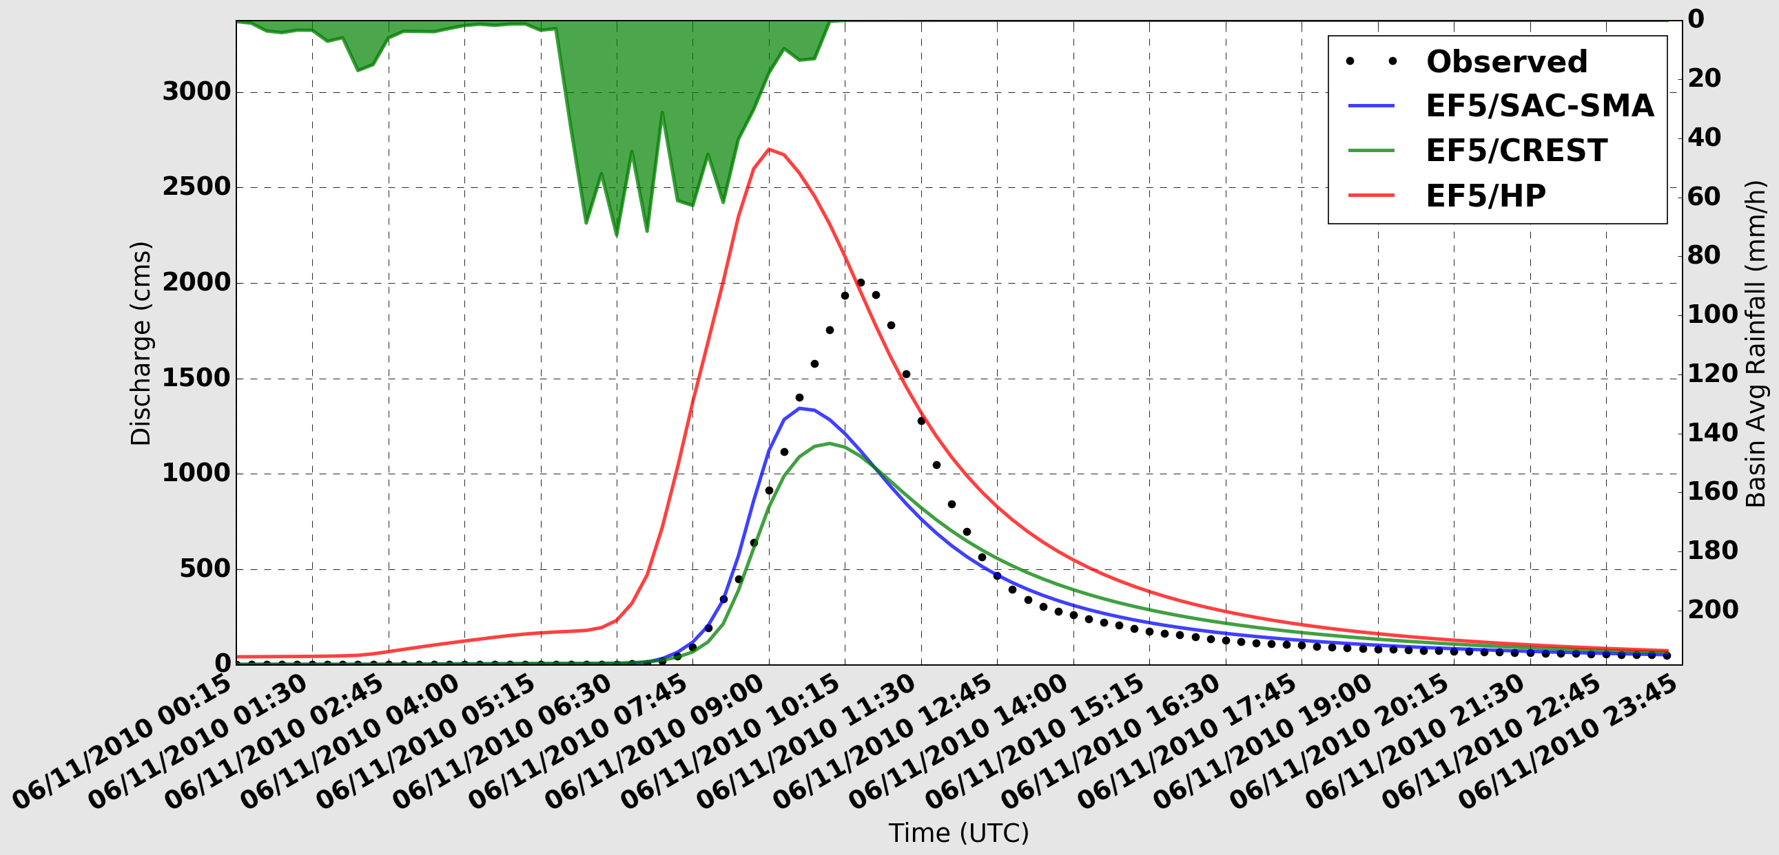
Observed and simulated hydrographs from Little Missouri River near Langley, AR. The contributing basin area at this point is 177 km².

Slide 10
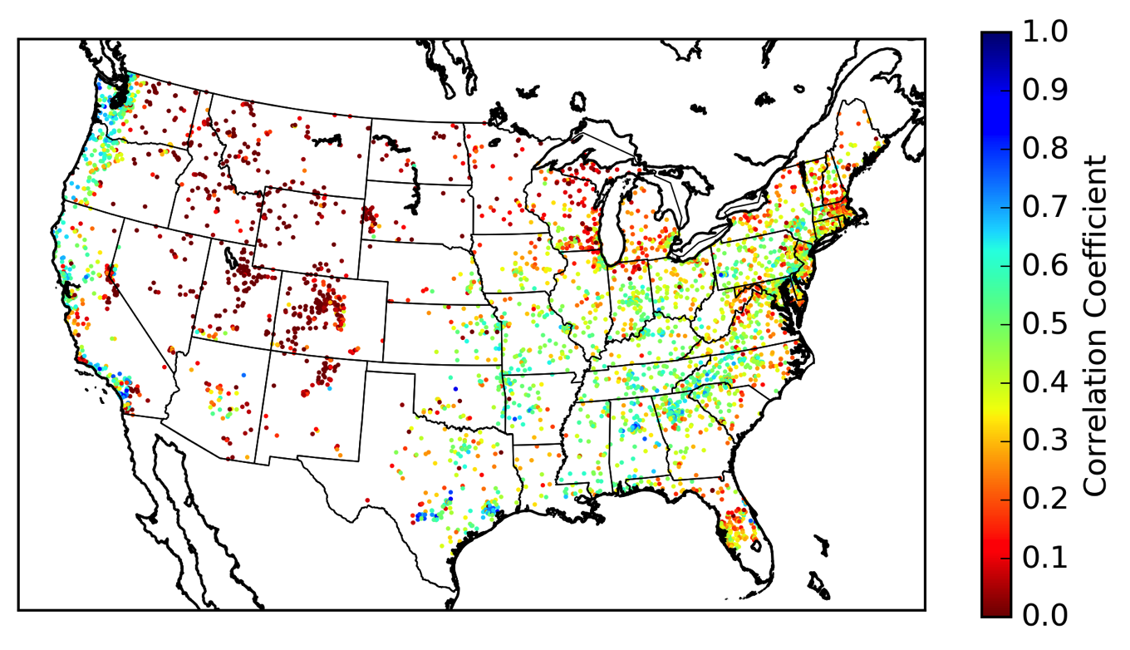
Simulation Validation
CREST water balance
4,366 USGS gauges

Slide 11
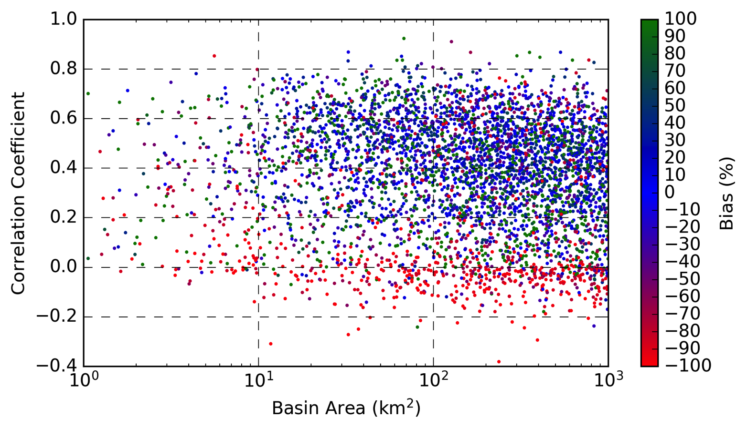
Simulation Validation
CREST water balance
4,366 USGS gauges

Slide 12
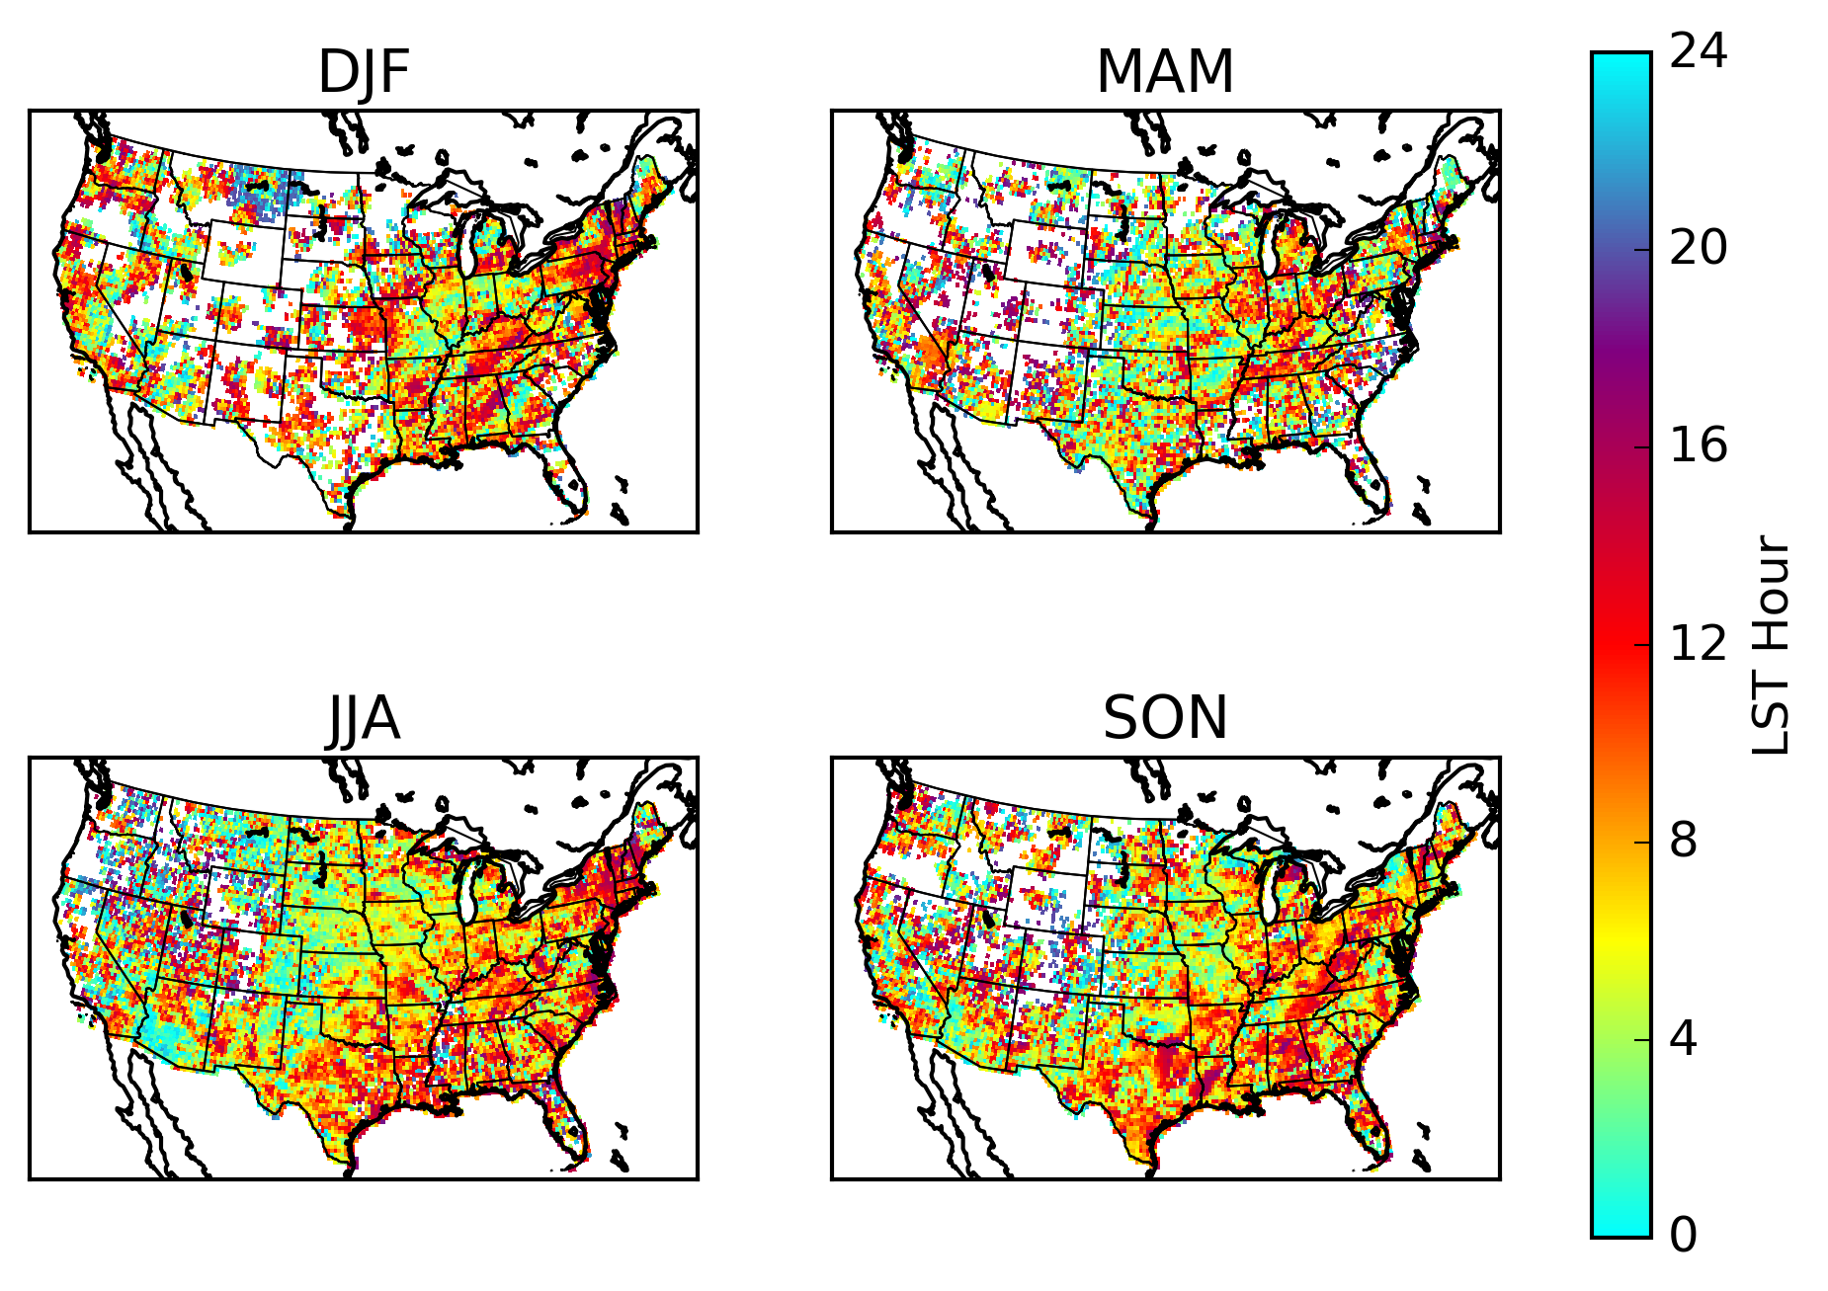
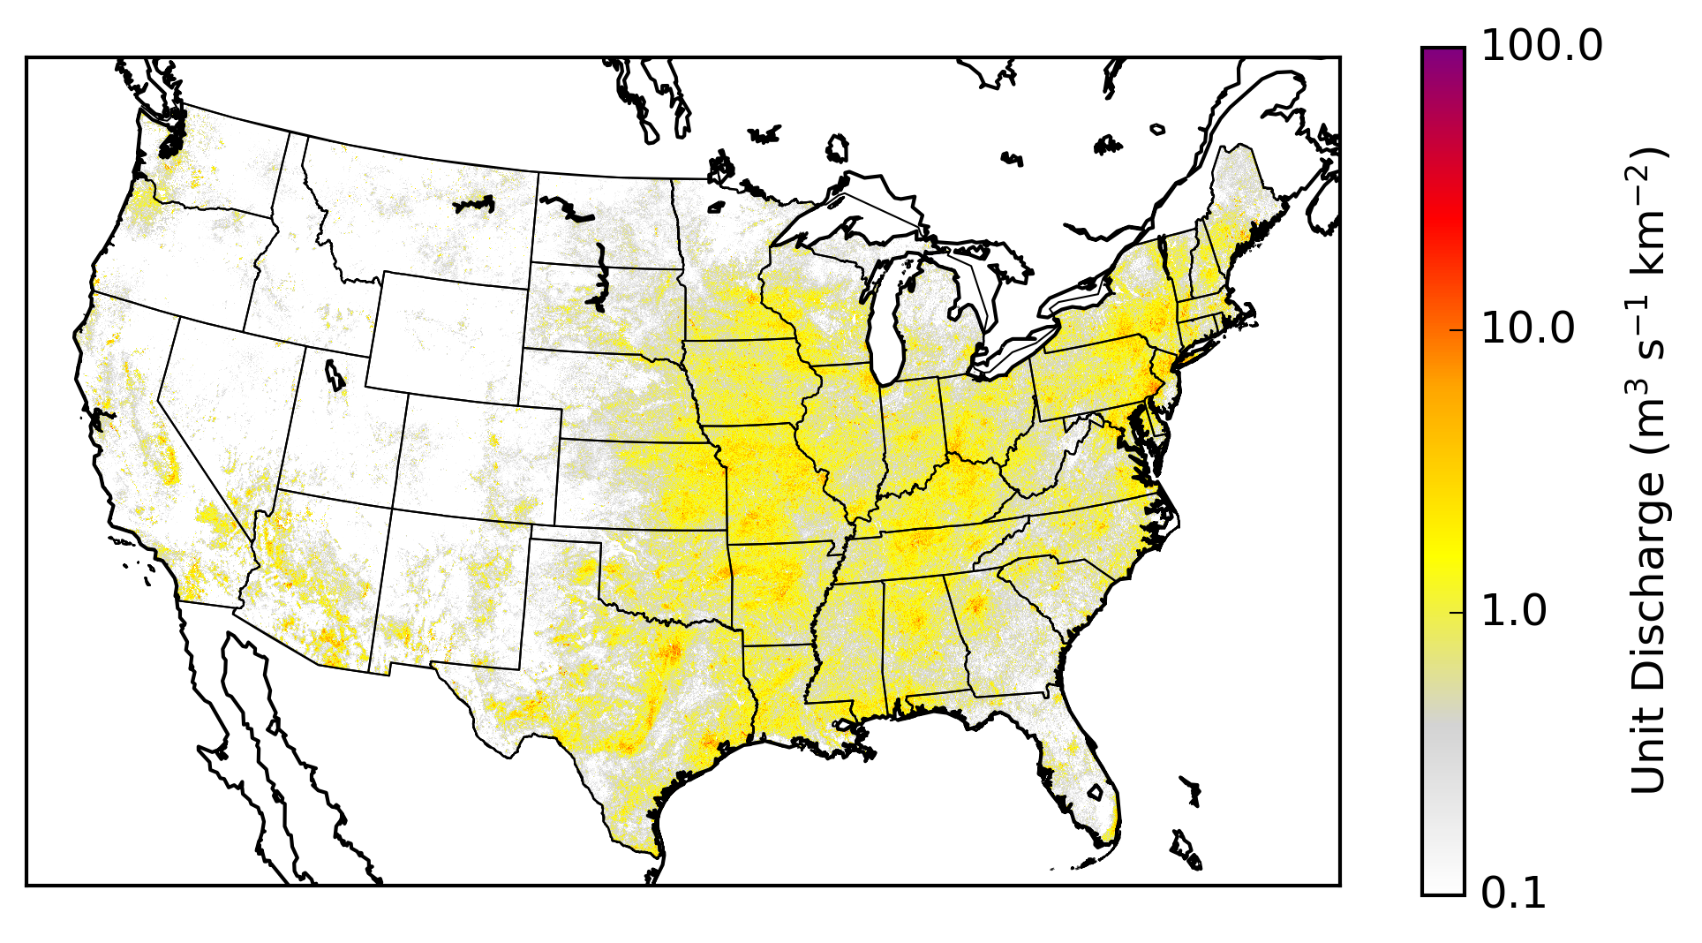
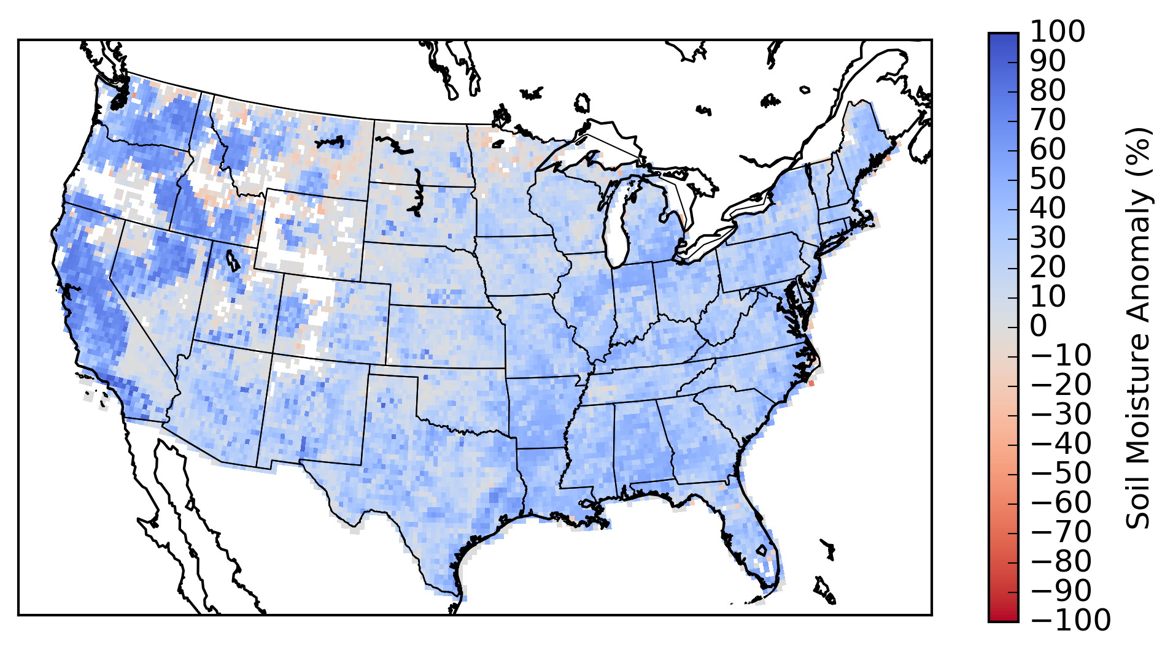
Reanalysis
http://flash.ou.edu/reanalysis
Produced daily from 2002-2011:
Maximum Streamflow
Maximum Unit Streamflow
Time of day of Maximum Streamflow
Minimum Soil Moisture

Slide 13

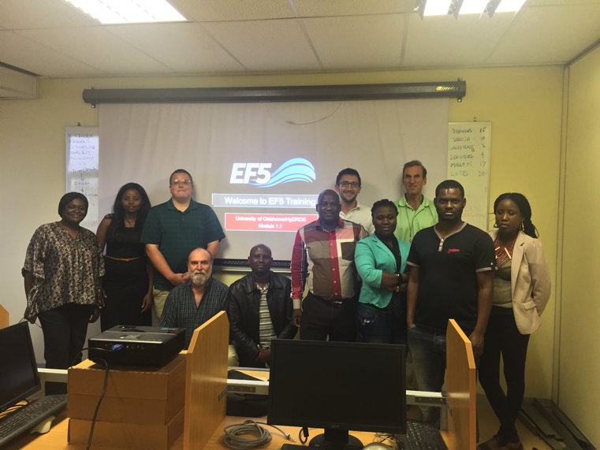
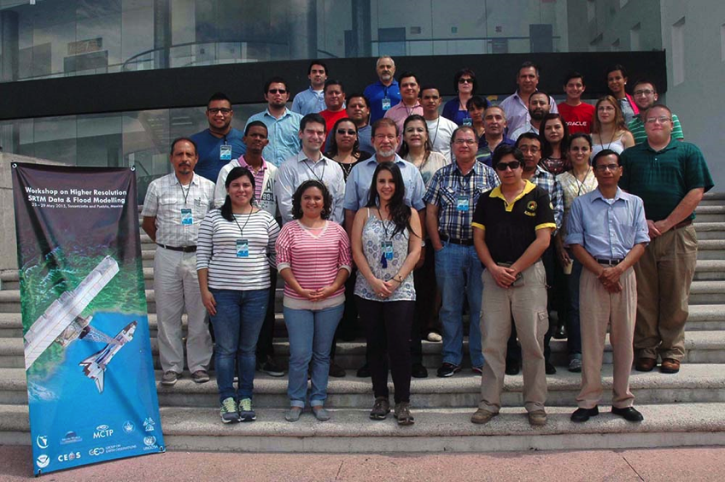


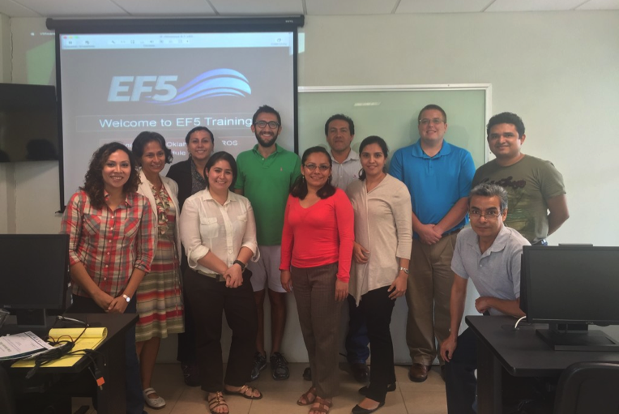
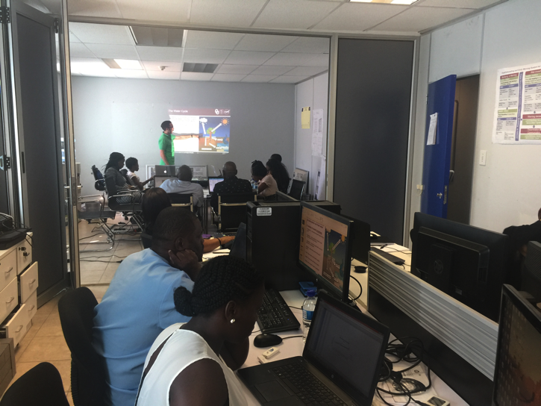


EF5 Capacity Building
Windhoek, Namibia 2015
Puebla, Mexico 2015
Nairobi, Kenya 2017
Villahermosa, Mexico 2015
Windhoek, Namibia 2016

Slide 14

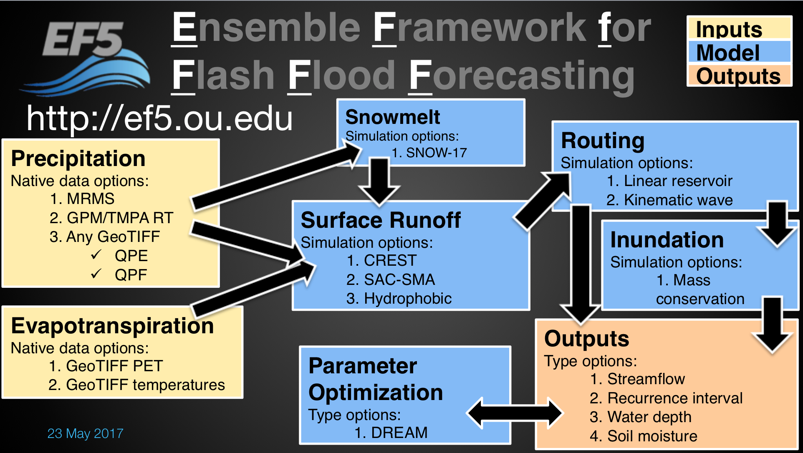
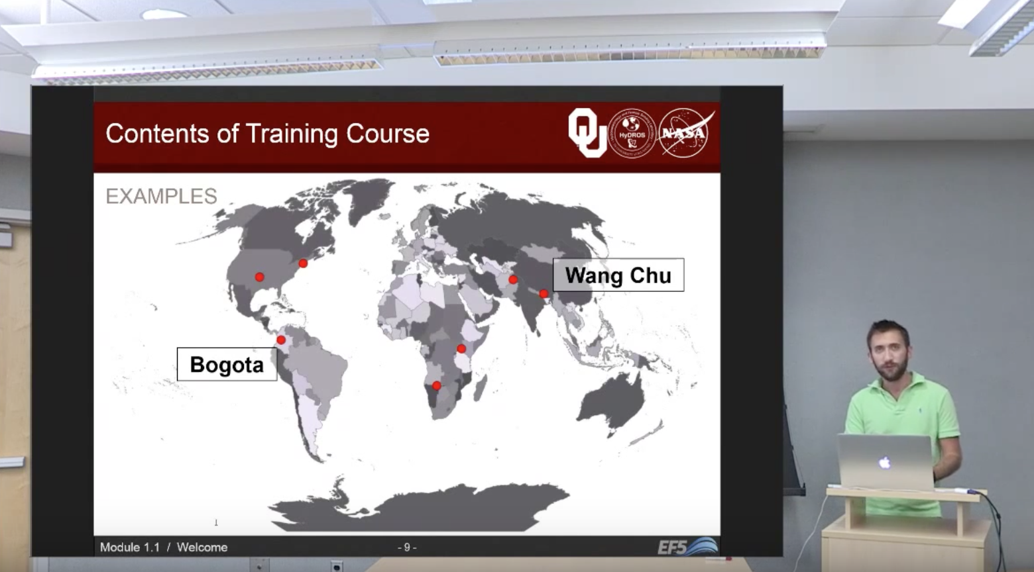
http://ef5.ou.edu
Reanalysis
http://flash.ou.edu/reanalysis
Produced daily from 2002-2011:
Maximum Streamflow
Maximum Unit Streamflow
Time of day of Maximum Streamflow
Minimum Soil Moisture
http://ef5.ou.edu/videos

