Slide 1
From Relative Sea Level Rise to Coastal Risk: Estimating Contemporary and Future Flood Risk in Deltas
CSDMS 2016 Annual Meeting
May 19, 2016
Zachary Tessler¹, Charles Vörösmarty^{1,2}, Michael Grossberg², Irina Gladkova², Hannah Aizenman², James Syvitski³, Efi Foufoula-Georgiou⁴
2
3
4
1

Slide 2
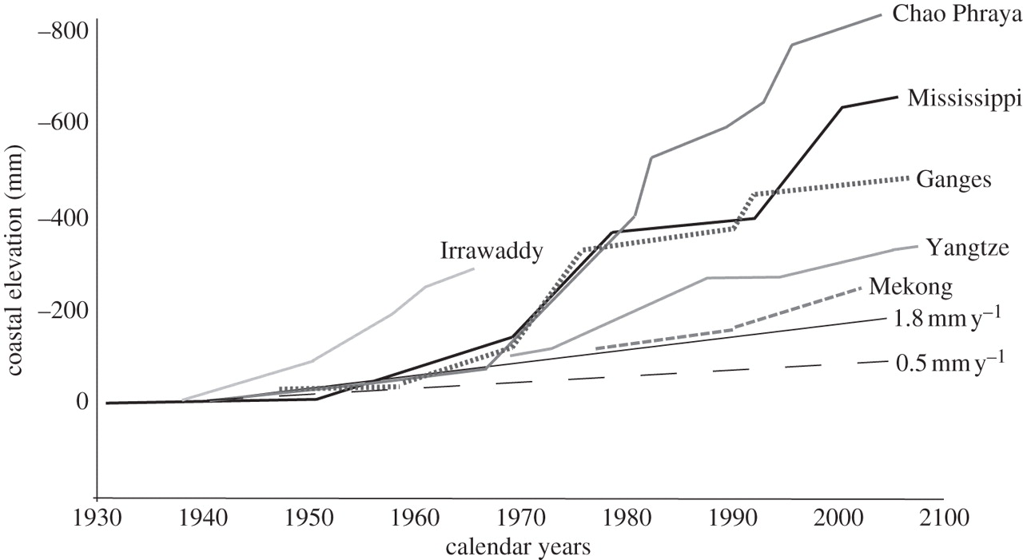
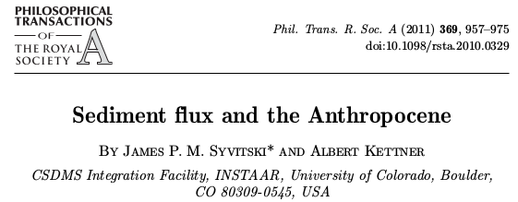
Relative Sea Level Rise is a major challenge in deltas
Mississippi
Approx. Global Mean
Nile
Newer estimates put rate of global mean SLR at 2.6-2.9+-0.4 mm/yr over satellite altimetry era (Watson et al. 2015)
Syvitski et al., 2009, Nature Geoscience

Slide 3
Drivers of RSLR

Slide 4
But, consequences of RSLR are not equal across deltas
Coastal development:
vs.

Slide 5
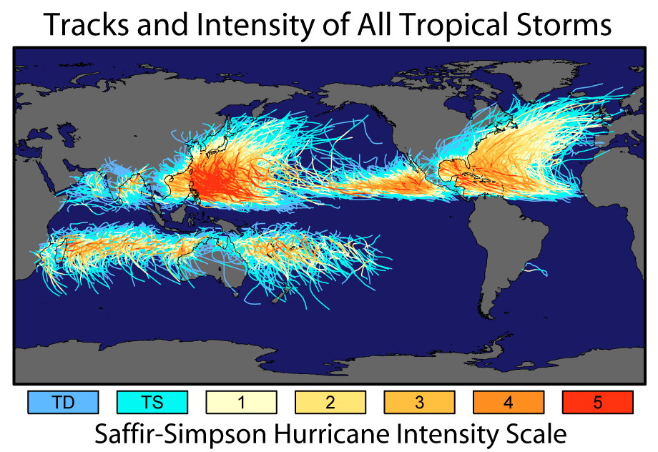
But, consequences of RSLR are not equal across deltas
Coastal development:
vs.
Different climo-meterologic conditions:

Slide 6
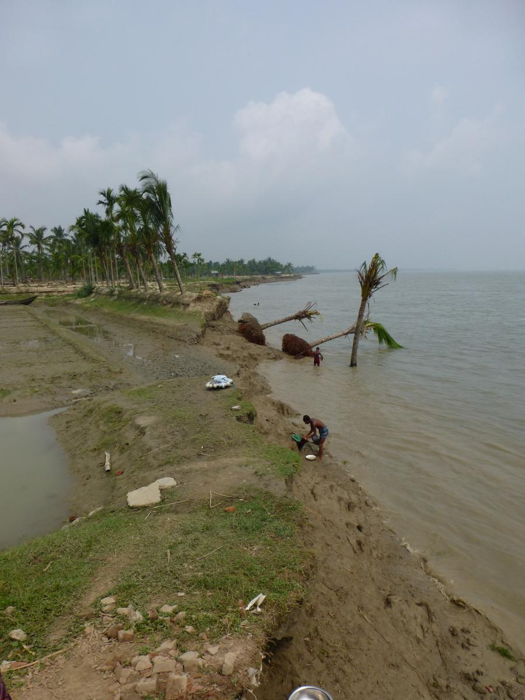
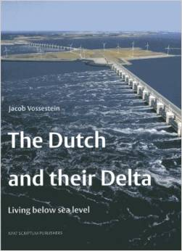
But, consequences of RSLR are not equal across deltas
Coastal development
vs.
Coastal defense
Different climo-meterologic conditions
vs.
Ganges Delta (photo: Irina Overeem)

Slide 7
But, consequences of RSLR are not equal across deltas
Coastal development
vs.
RSLR will impact the communities living on these deltas very differently
Coastal defense
Different climo-meterologic conditions
vs.
Ganges Delta (photo: Irina Overeem)

Slide 8
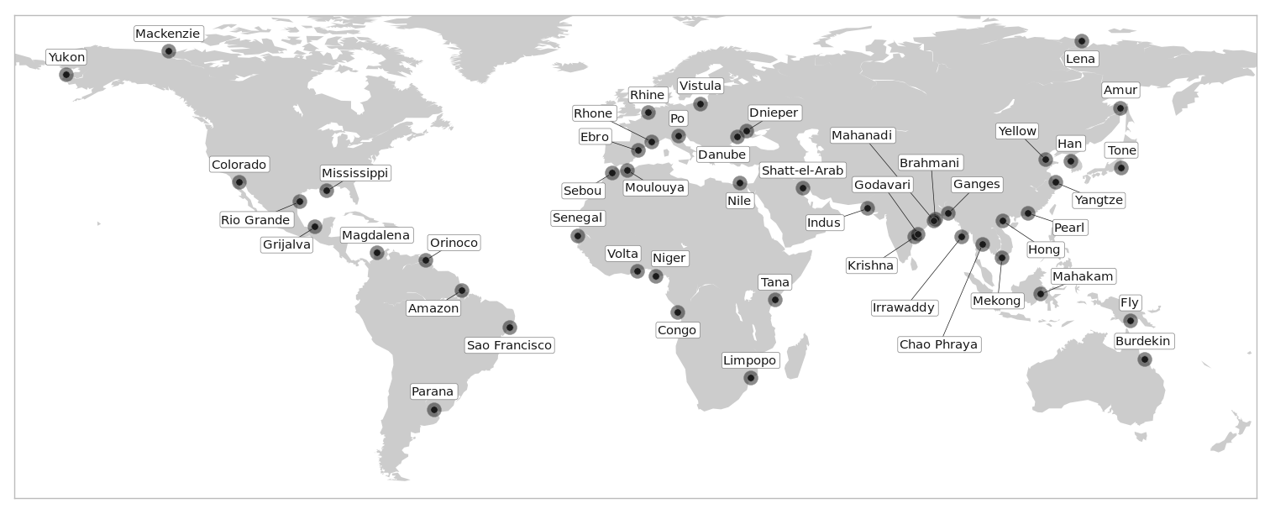
Goal: Estimate sensitivity of flood risk to RSLR across 48 major global deltas

Slide 9
Risk and vulnerability modeling

Slide 10


Delta Flood Risk Model
Model risk as an expected loss
Loss from a single hazardous event, h_{0:}
E is exposure, the number of people exposed to hazardous conditions by h₀
V is vulnerability, is the average harm or loss endured by those exposed

Slide 11
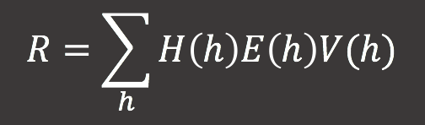
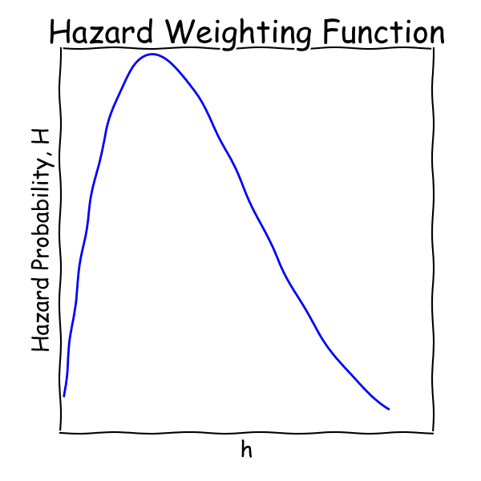
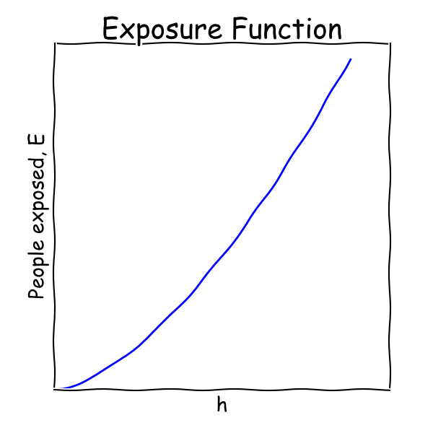
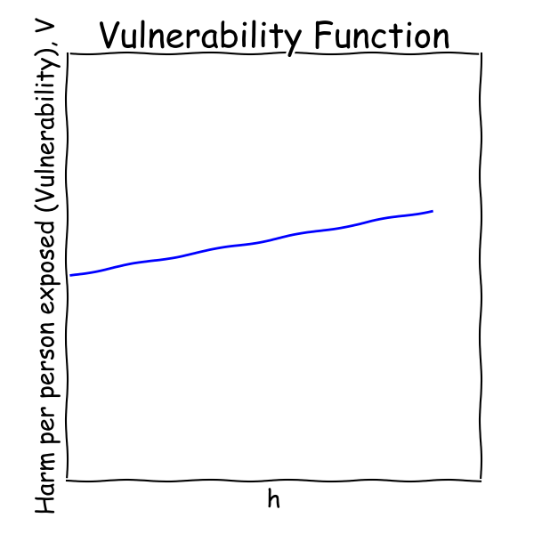
Delta Flood Risk Model
Total risk or expected loss, R, is the sum of expected losses over all possible hazardous events, weighted by each event’s probability H(h):
V
H
E

Slide 12
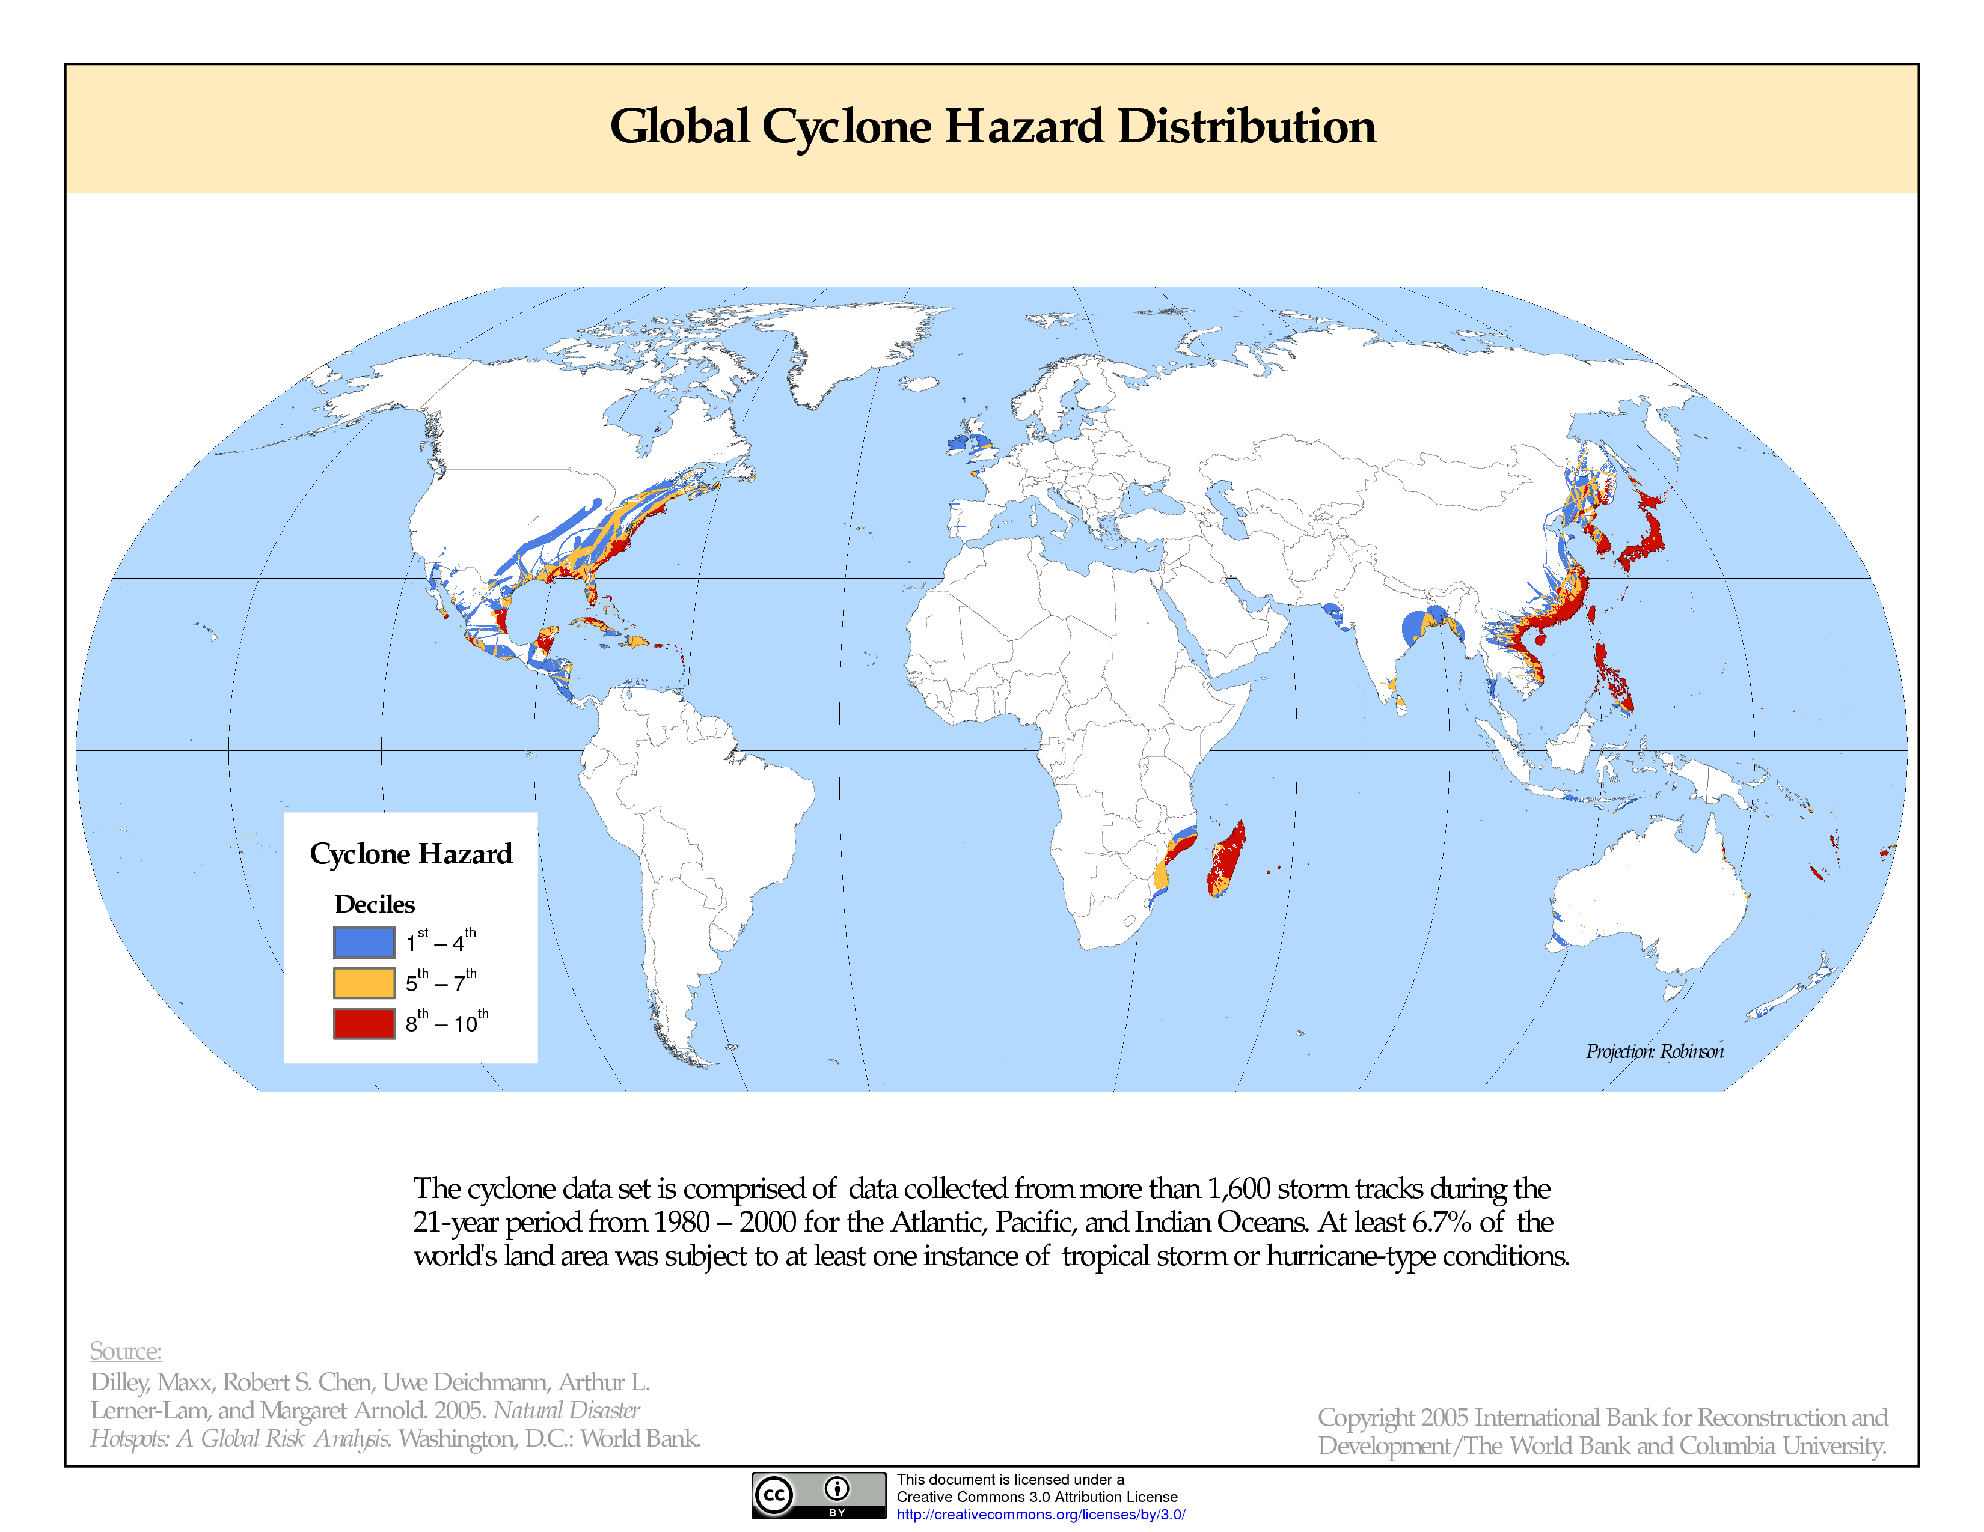
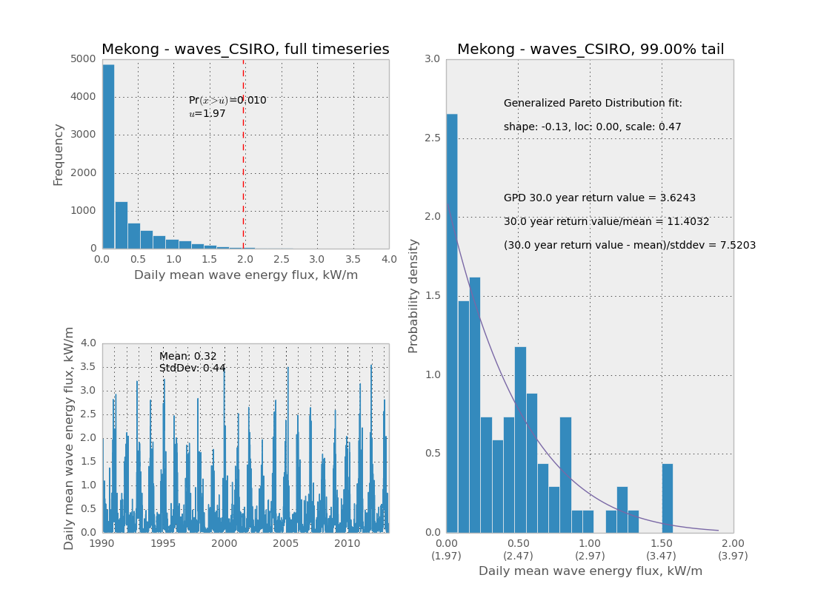
Hazard Frequency and Intensity (H)
Indicators:
Tropical cyclone intensity and frequency
M2 tidal amplitude
River discharge 30yr return value (standardized)
Wave energy 30yr return value (standardized)

Slide 13
Vulnerability (V)
vs.
Many variables have been used in local/regional studies to estimate social vulnerability
Here, restricting ourselves to datasets available at the global scale
Vulnerability of a delta varies at the household scale (strength/quality of housing) and the delta scale (coastal infrastructure)
Indicators:
Per capita GDP (household vulnerability)
Aggregate GDP (Capacity for infrastructure investment)
Government effectiveness index (Capacity/will for preparedness, response)

Slide 14
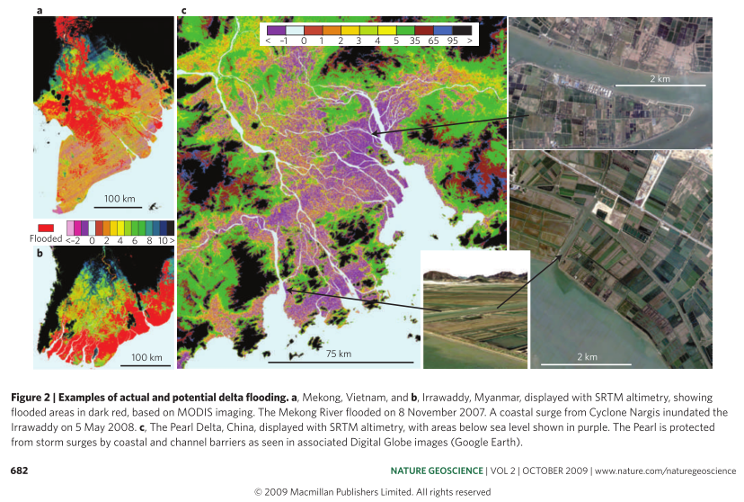
Exposure (E)
vs.
RSLR results in lower elevation, increased population exposed (for a given hazard)
Estimate RSLR from available indicators
Obtain estimate for changing flood risk due to RSLR
RSLR ~ E’
While low-lying areas in the Mekong and Irrawaddy are flooded, <0m elevation land in the Pearl is protected by coastal and channel barriers (From Syvitski 2009)

Slide 15
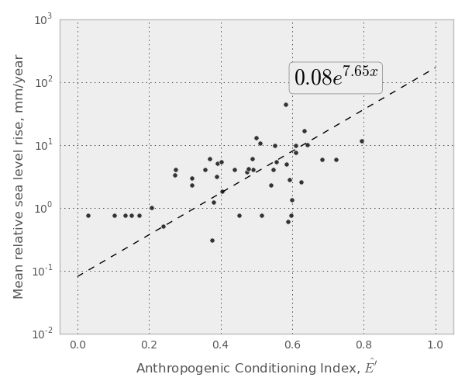
RSLR Indicators
Delta:
Population Density
Wetland Disconnectivity
Impervious Surface Area
Groundwater Depletion
Hydrocarbon Extraction
Upstream Basin:
Population Density
Wetland Disconnectivity
Impervious Surface Area
Offshore:
Local sea level rise trend
Estimates from Ericson (2006) and Syvitski (2009)

Slide 16
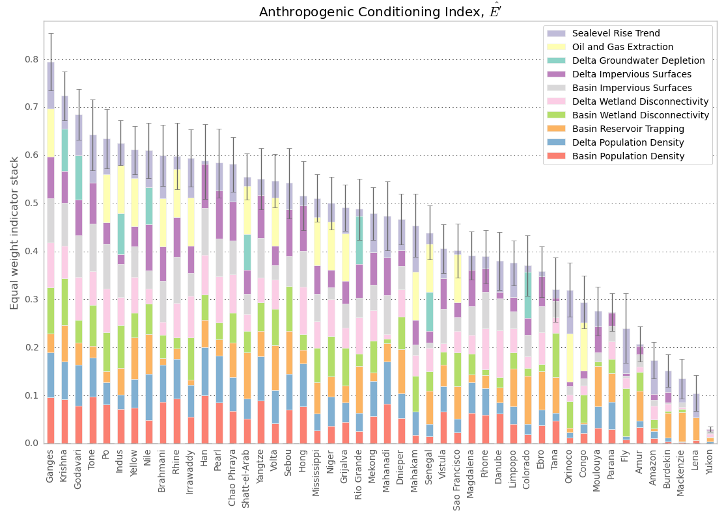
Rate of Change of Exposure (E’)
Ganges
Mekong
Amazon

Slide 17
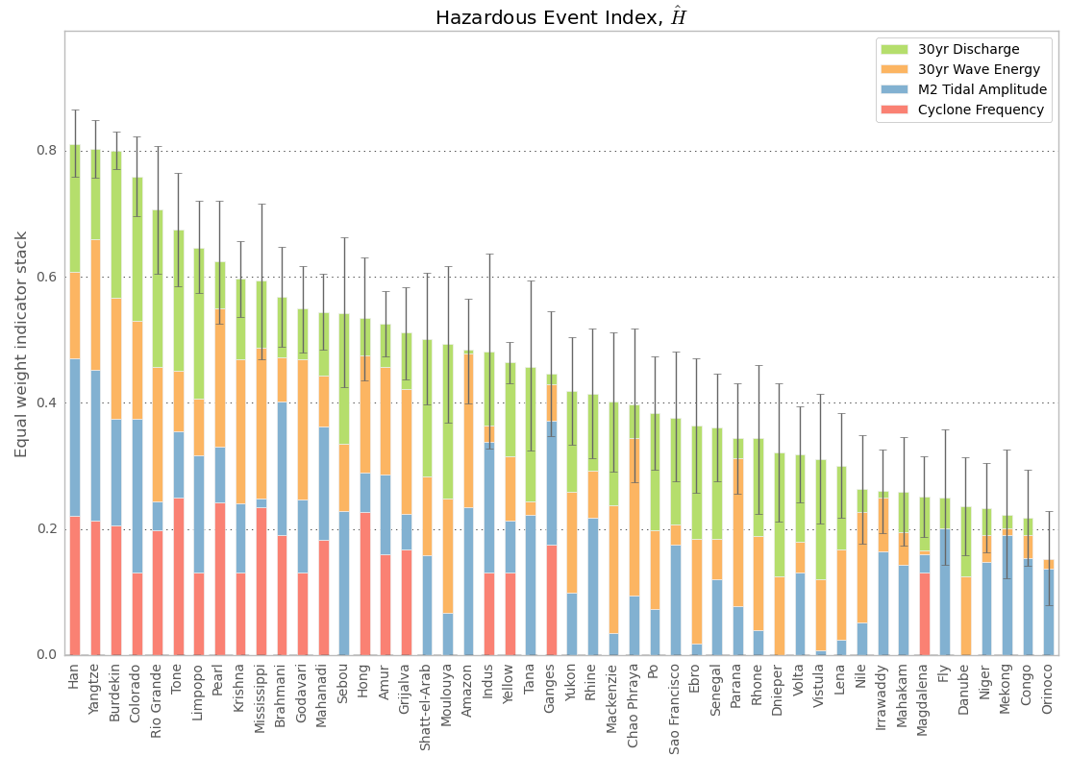
Hazard Frequency and Intensity (H)
Amazon
Ganges
Mekong

Slide 18
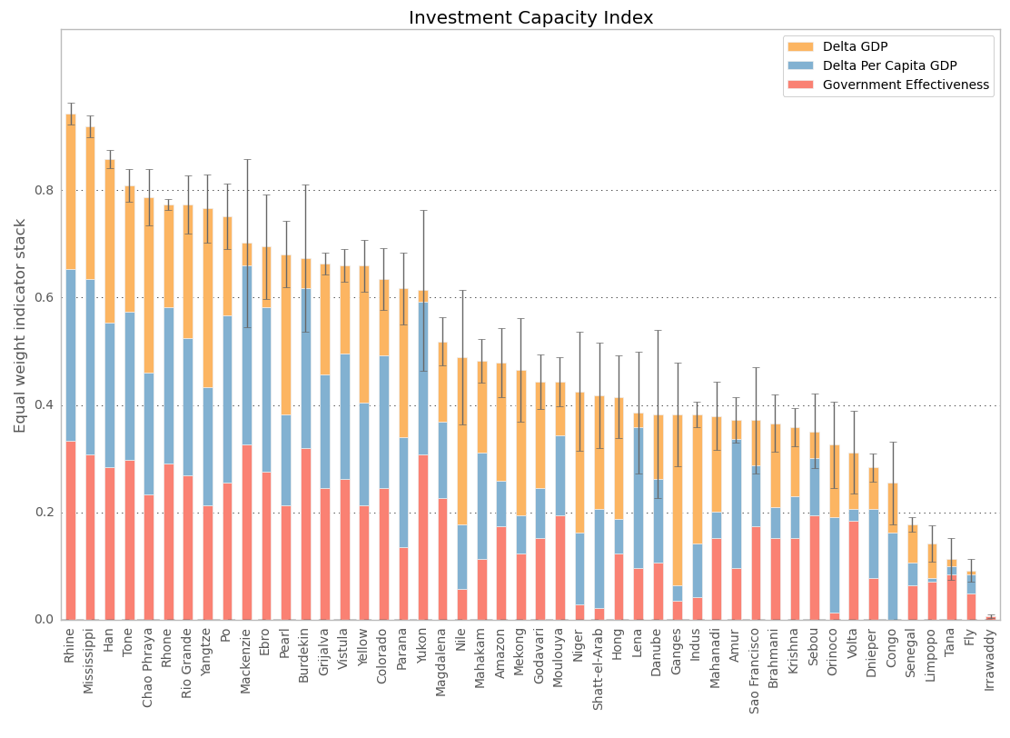
Investment Capacity - inverse of Vulnerability (V)
Low Vulnerability
High Vulnerability
Mekong
Ganges
Amazon

Slide 19
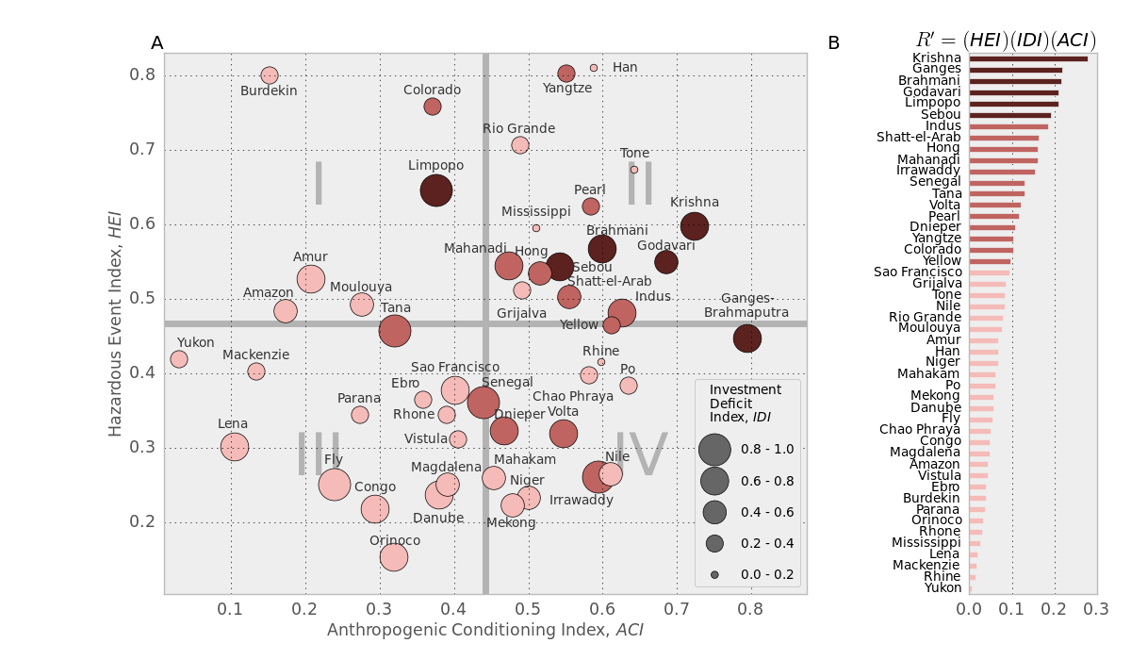
Delta R’ Space

Slide 20
A thought experiment...
How might vulnerability change in an energy-constrained future?
Energy prices are expected to rise faster than GDP (US Energy Information Administration models)
Require stronger infrastructure to maintain constant level of protection due to future SLR
Overall, more expensive to reduce vulnerability
Re-weight Vulnerability Index to reduce the relative importance of GDP
(more difficult to “buy your way out of trouble”)

Slide 21
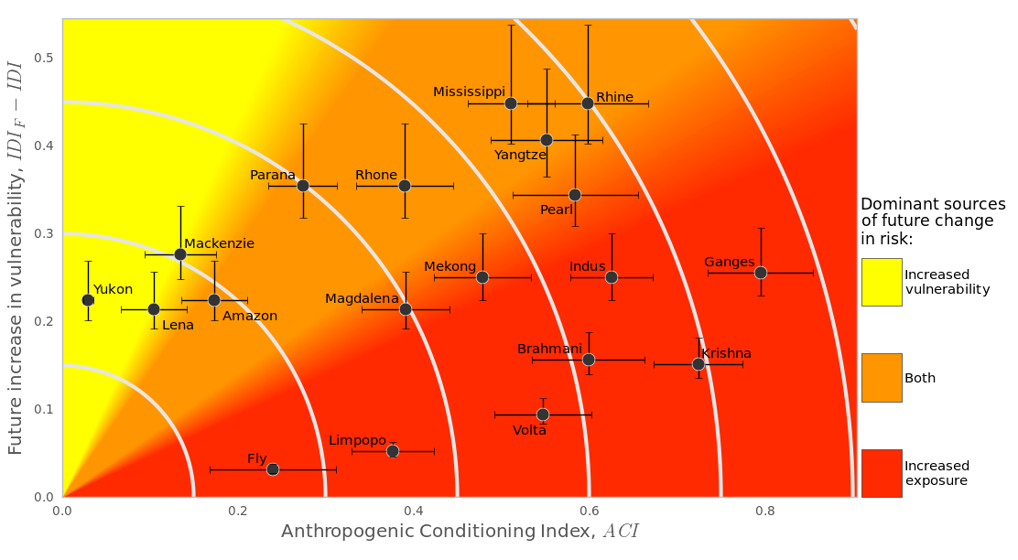
Future Changes in Vulnerability, and Exposure
Both future vulnerability and exposure increases

Slide 22
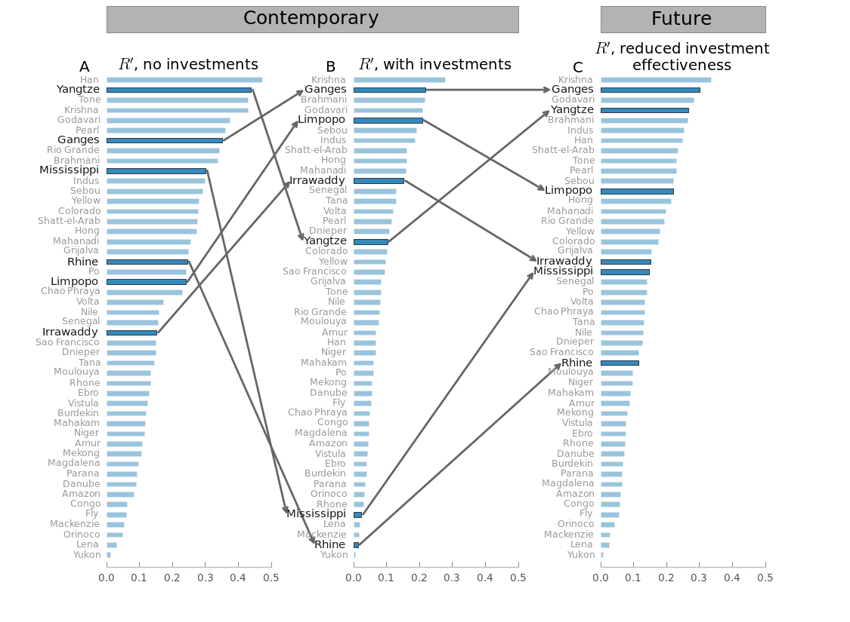
How do we expect R’ to change in this future scenario?
If this is not an option in the future, risk “rebounds” and approaches the risk state with no investment.
Seen most dramatically in wealthy deltas in hazardous locations – Mississippi, Rhine, Han, Yangzte...
Wealthy deltas currently invest in protective infrastructure, reducing risk from increasing RSLR despite geophysical setting

Slide 23
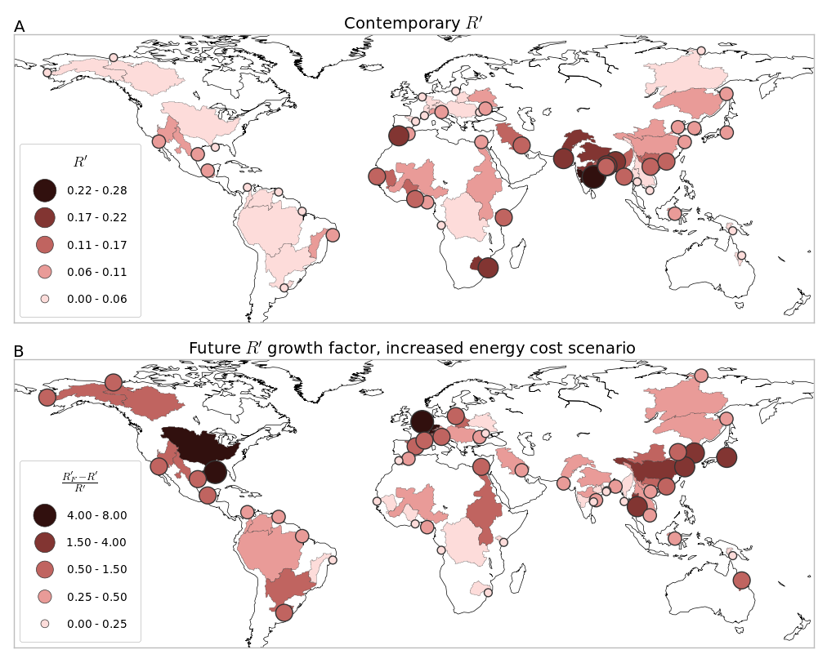
Risk’, now and future scenario change

Slide 24
Future Scenarios
Current methodology utilizes coarse scale indicators to build a heuristic model of coastal risk
Lack of physical process modeling makes incorporating future change difficult.
We considered future global macroeconomic trends – can we extend this to include other processes:
Accelerating SLR
Increased dam construction
Population growth, migration
Can we quantify the effect of mitigation strategies on coastal risk?

Slide 25
Environmental change -> RSLR
Following Ericson 2006 model of RSLR, with Syvitski and Milliman 2007 BQART model of mean fluvial sediment flux:
Estimate long-term mean RSLR across global deltas based on global available remote sensing, modeling, and other data
Ericson, 2006

Slide 26
Delta risk framework
Geophysical data – temperature, rainfall, basin relief, lithology…
GPWv4 population distribution
Global river network, basins, and delta maps
BQART sediment flux model
SRTM Delta Relief
Contemporary and future populations-at-risk
Artificial reservoir locations, size
Coastal risk model
Natural subsidence
Contemporary, future sediment flux
UN Population forecasts
Contemporary, future RSLR
Groundwater, hydrocarbon mining
Ericson RSLR model
Historical storm surge return periods
Vulnerability index

Slide 27
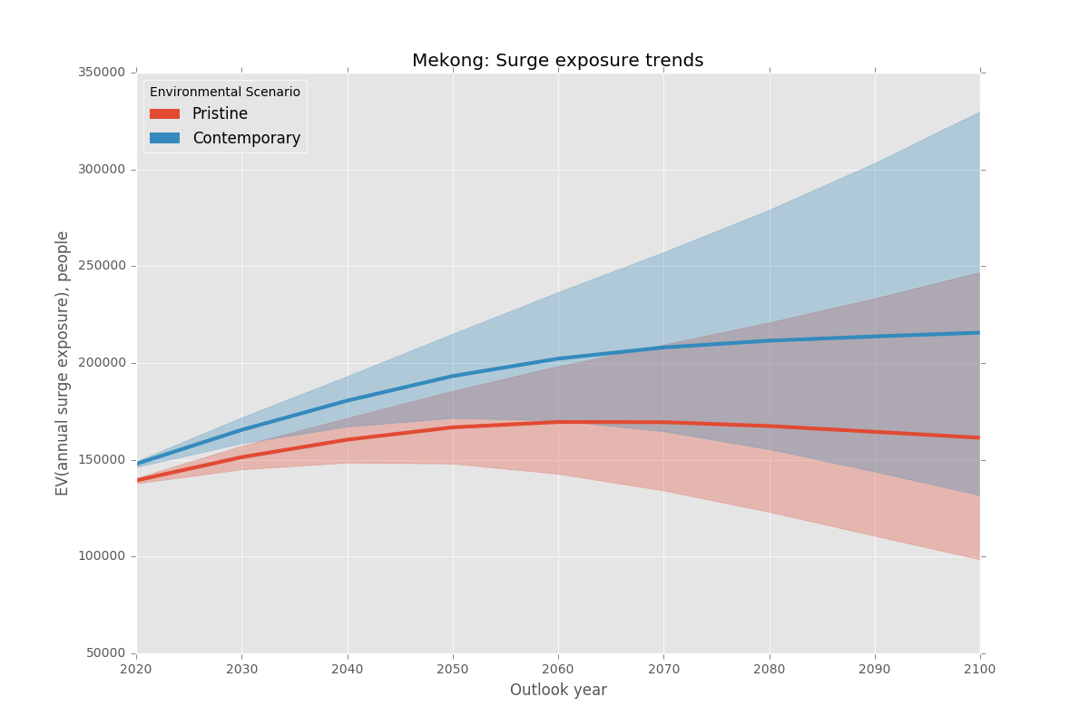
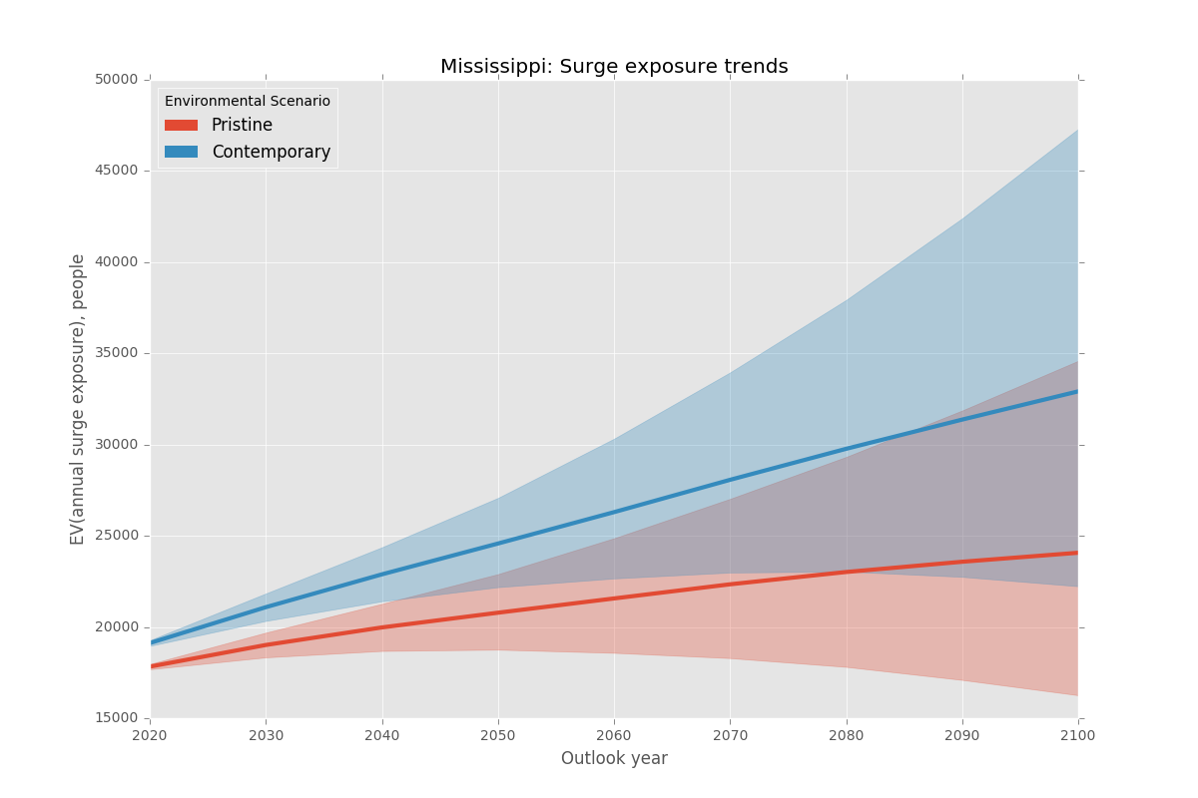
“Pristine” vs “Contemporary” conditions
No humans, no reservoirs, no groundwater/hydrocarbon mining, 1.5mm/yr SLR
Modern conditions based on globally-available datasets, 3mm/yr SLR

Slide 28
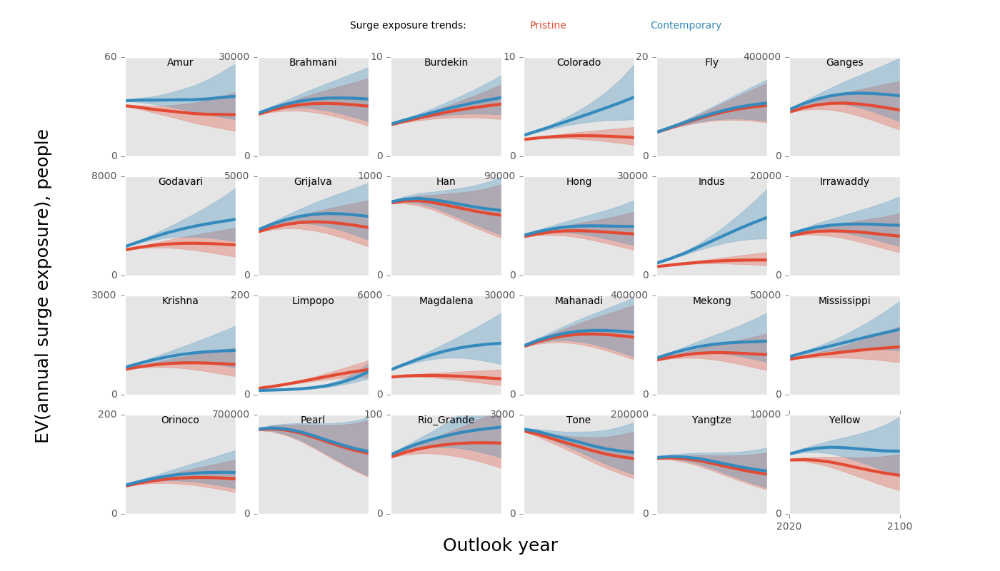
“Pristine” vs “Contemporary”

Slide 29
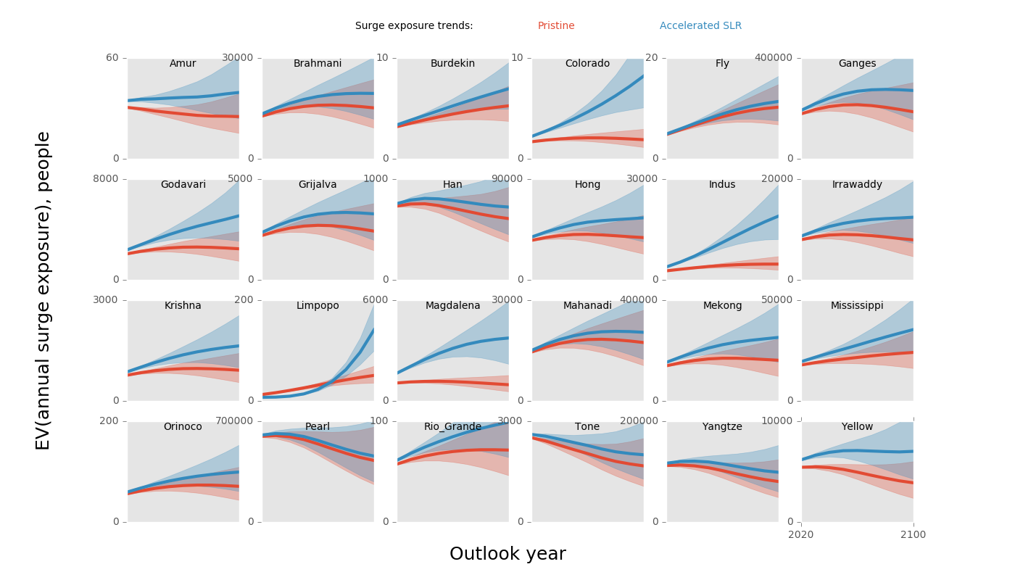
“Pristine” vs “Accelerated SLR (5mm/yr)”
Potential for a wide range of “What if” questions.
Compare relative scale of impact from different drivers?
Which deltas are more sensitive to specific environmental changes?

Slide 30
Delta Risk Profiling Conclusions
Krishna, Ganges, Brahmani, Godavari deltas are most sensitive to increased RSLR (per capita risk basis)
Several wealthy deltas (Mississippi, Rhine) have low R’ despite high hazard and high RSLR estimates due to low vulnerability
Future changes to vulnerability due to changing economics of coastal protection will have outsized effects on these systems. These particular systems are highly sensitive to changing vulnerability.
Starting to investigate how anthropogenic changes to the upstream and coastal environments propagate through to affect long-term coastal risk.
Population growth/contraction is a critical factor in future risk–collaborations with social scientists are very important!

Slide 31
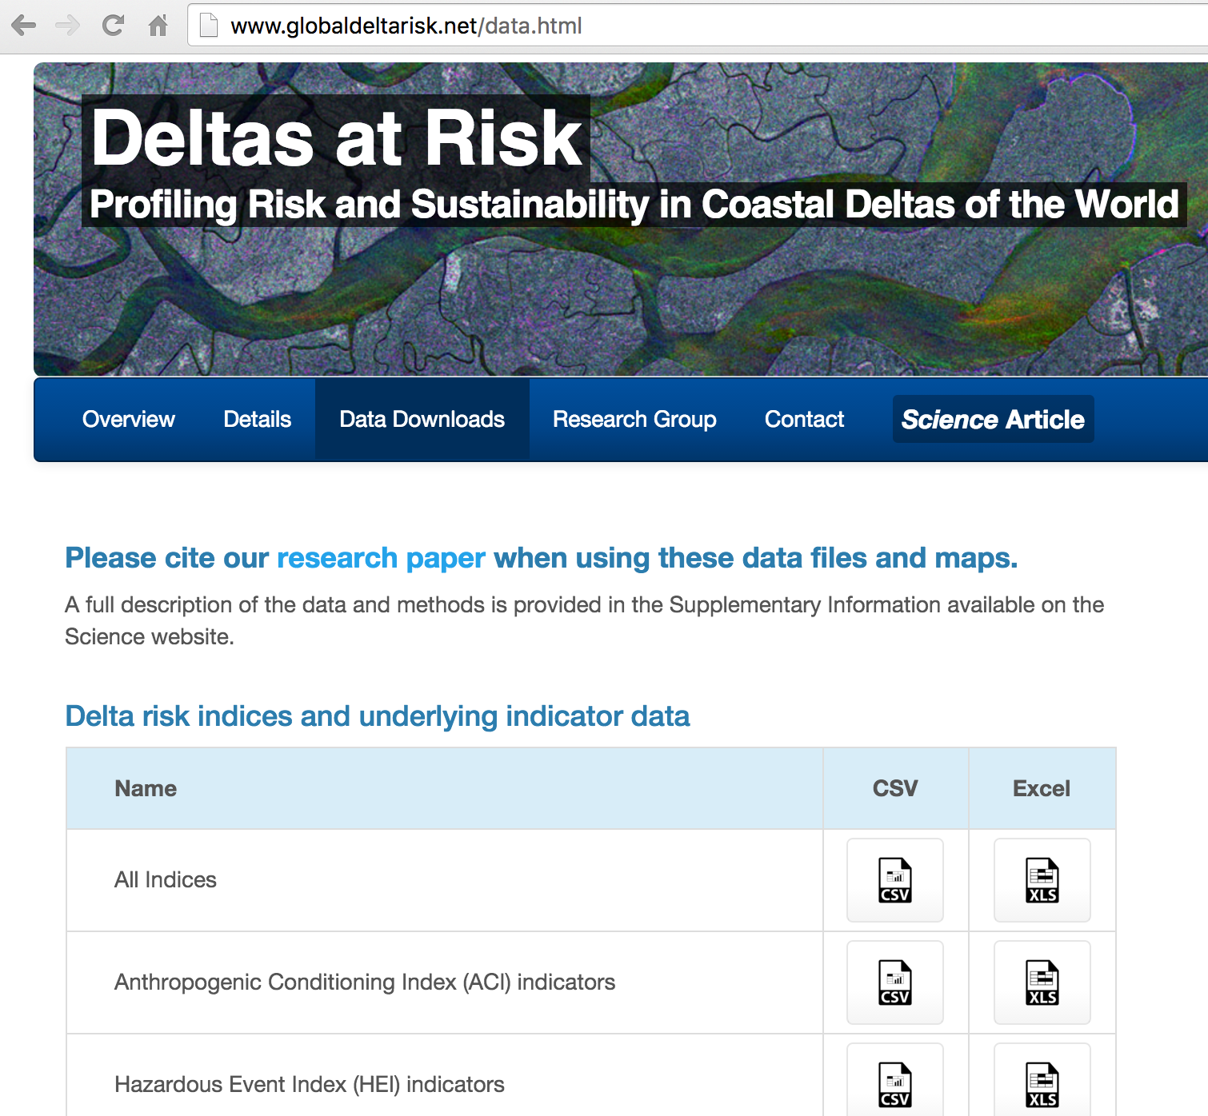
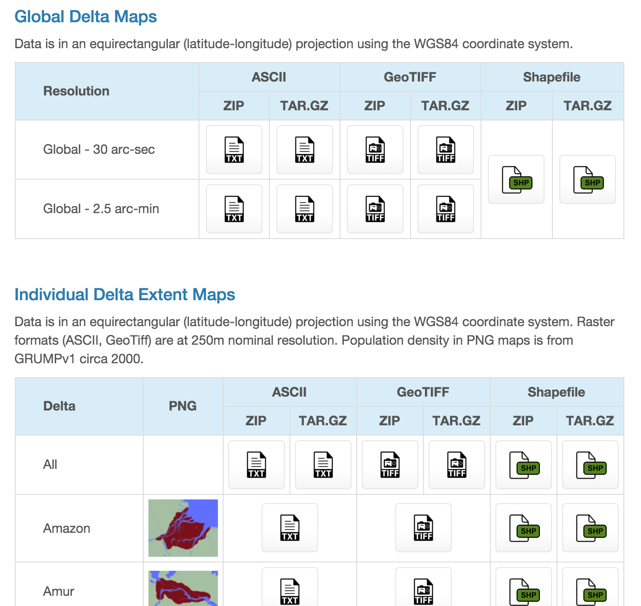
www.globaldeltarisk.net
Overview of research, plus all data indices, and all delta maps are available for download
More details in Tessler et al., 2015, Science 349

