Slide 1






Overcoming Grand Challenges by Collaboration between Experimentalists and Modelers
Wonsuck Kim, Brandon McElroy,
Kimberly Miller, Raleigh Martin, Leslie Hsu
Notes:
Good morning I am Wonsuck Kim at the University of Texas at Austin.
I am pleased to be here to represent the SEN team, sediment experimentalist network led by B, K, R, L.
Thanks to CSDMS to allow SEN to jointly hold the meeting.
I expect this will bring a great synergy between two communities.
I am pretty sure this event will enhance our network between two communities and light shed on the future directions for strong collaborations between modelers and experimentalists.

Slide 2
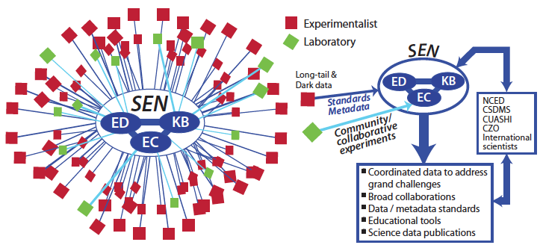
What is SEN?
CSDMS-SEN 2016
Sediment Experimentalist Network
NSF EarthCube Research Coordination Network (RCN)
  To support a data-enabled community for experimental Earth-surface process research
EC: Experimental Collaboratories;
ED: Education & Data Standards;
KB: Knowledge Base;
Notes:
“SEN” is STRONG in Korean and YOU in Turkish. For us, it is Sediment Experimentalist Network.
SEN is an NSF, EarthCube, Research Coordinate Network, -sponsored project whose goal it is to support a data-enabled community for experimental Earth-surface process research.
SEN projects include three focus groups: (1) the Experimental Collaboratories (SEN-EC) to facilitate collaborative multi-institution experiments, the (2) Education and Data Standards (SEN-ED) initiative to develop and spread best practices for performing and documenting our research work and (3) the Knowledge Base (SEN-KB) to share experimental methods and datasets.

Slide 3
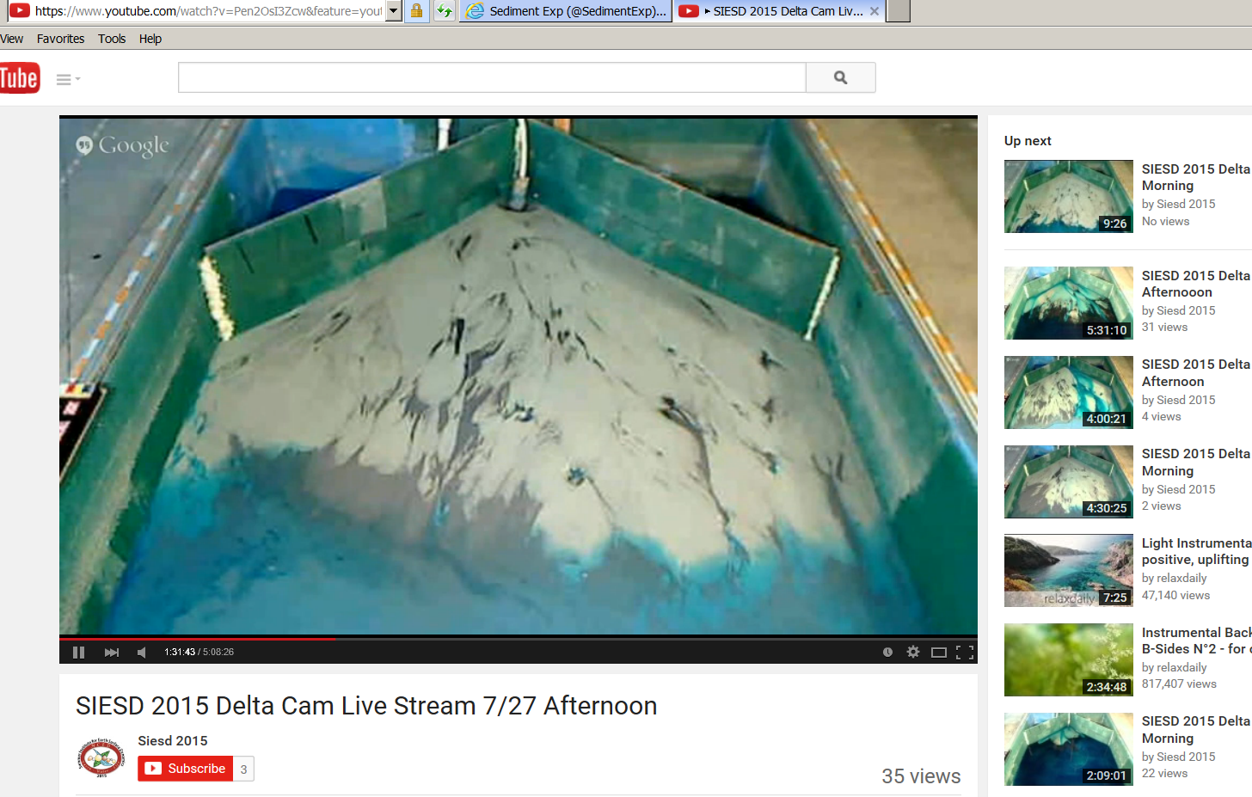
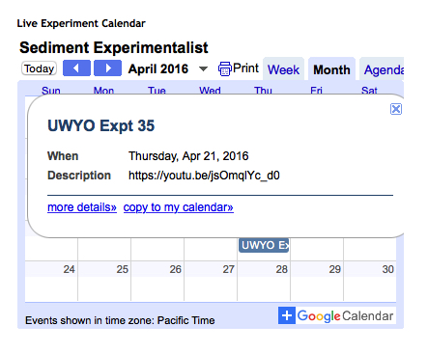
SEN-EC (Experimental Collaboratories)
CSDMS-SEN 2016
Experimental Collaboratories
  Facilitate collaboration between experimental labs
    Develop collaborative infrastructure
    Broadcast experiments
    Distribute experimental data
    Address community grand challenges
Broadcasting Experiments
Live Experiment Calendar

Slide 4
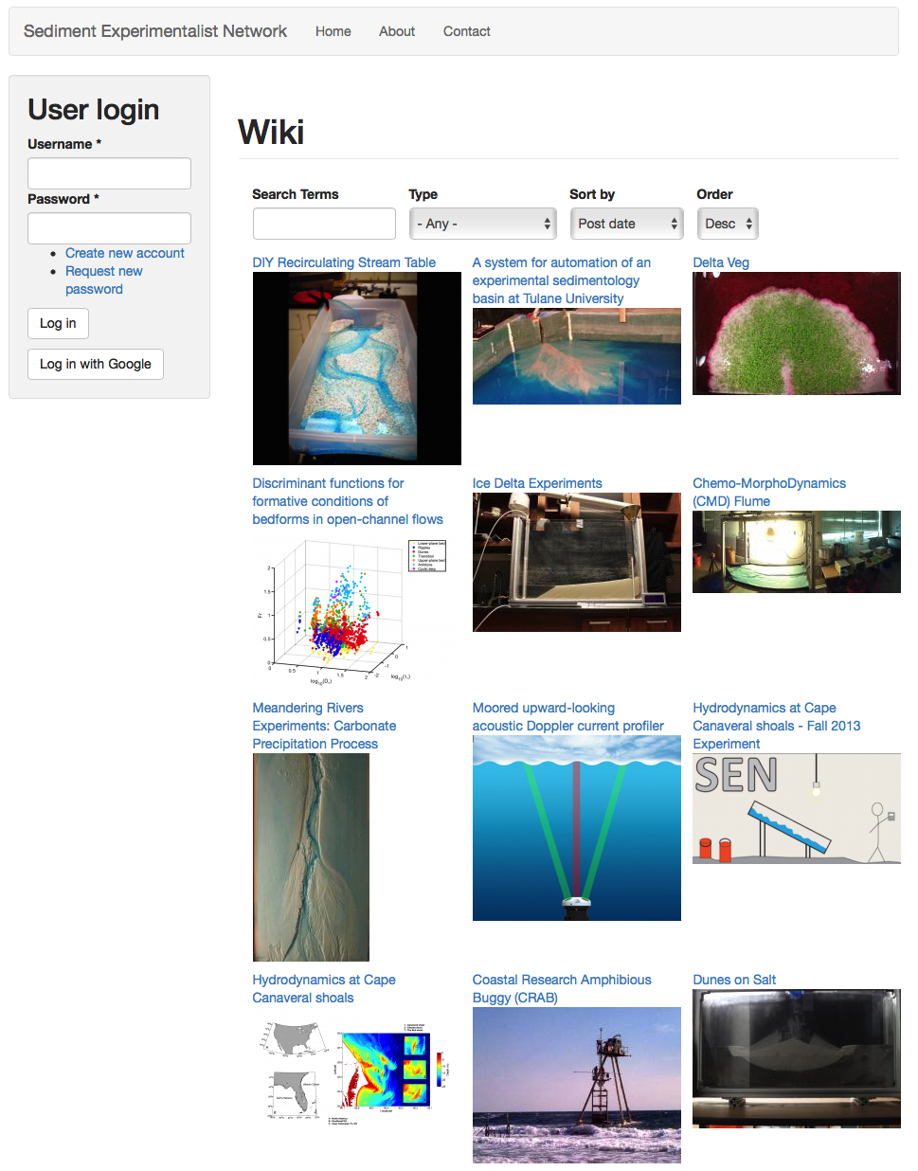
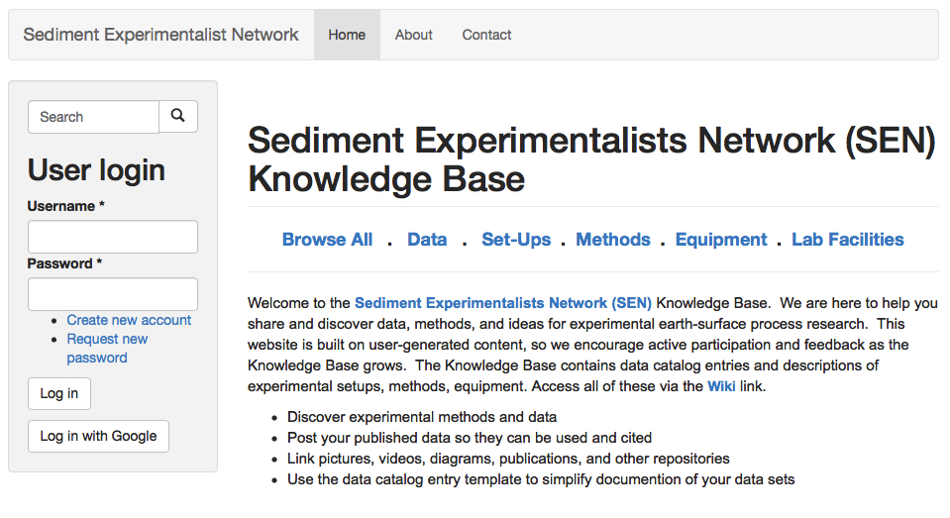
SEN-KB (Knowledge Base)
CSDMS-SEN 2016
Knowledge Base
  Develop online resources for experimental data management
    SEN-Wiki (sedexp.net)
      45 Data; 26 Setups; 18 Methods; 21 Equipment; 6 Labs
    Forum for user-based information exchange
    Metadata, methods and facilities library

Slide 5
SEN-ED (Education & Data Standards)
CSDMS-SEN 2016
Develop & disseminate recommendations for data practices and standards
Geomorphology paper in Binghamton Symposium
  Data management, sharing, and reuse in experimental geomorphology: Challenge, strategies, and scientific opportunities
Workshop
  2014 SEN Workshop at Utrecht University
  2013 SEN Workshop at Nagasaki University
  2012 SEN Workshop at UT-Austin
AGU Town Hall
  2012-2014: Publishing and sharing Earth Surface Process Data
Summer Institute on Earth-surface Dynamics
Two most significant challenges
  Data discoverability
  Data accessibility
Notes:
A major achievement among many for the last 3 years is a paper published in a special Binghamton symposium volume in Geomorphology. “Data management, sharing…”
You can find more about our community challenges, strategies, and scientific opportunities.
We built a network through annual workshops and town-hall meetings to hear the needs in the community, data management and sharing, metadata practice. Based on what we learned from the community inputs, we shared best practice through many short courses such as the Summer institute on Earth-surface Dynamics.
Mostly we aimed to over come the two challenges in this focus group: Data discoverability and data accessibility.

Slide 6
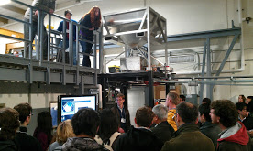
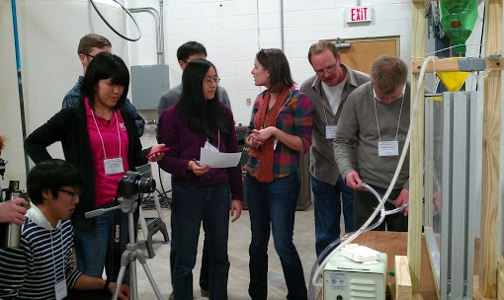
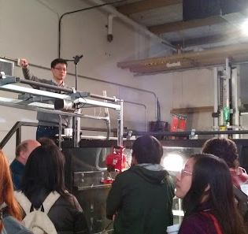
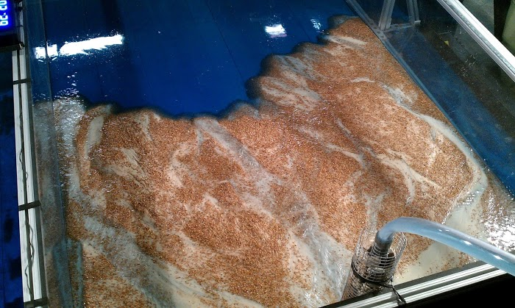
Calling All Experimentalists
CSDMS-SEN 2016
2012 SEN Workshop at the University of Texas

Slide 7
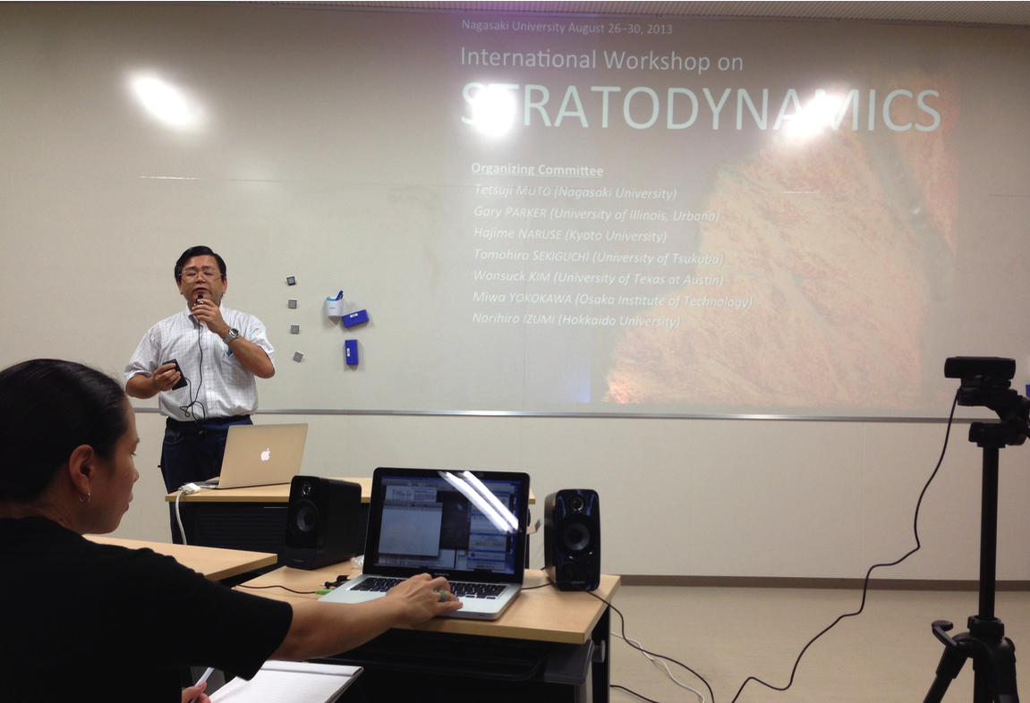

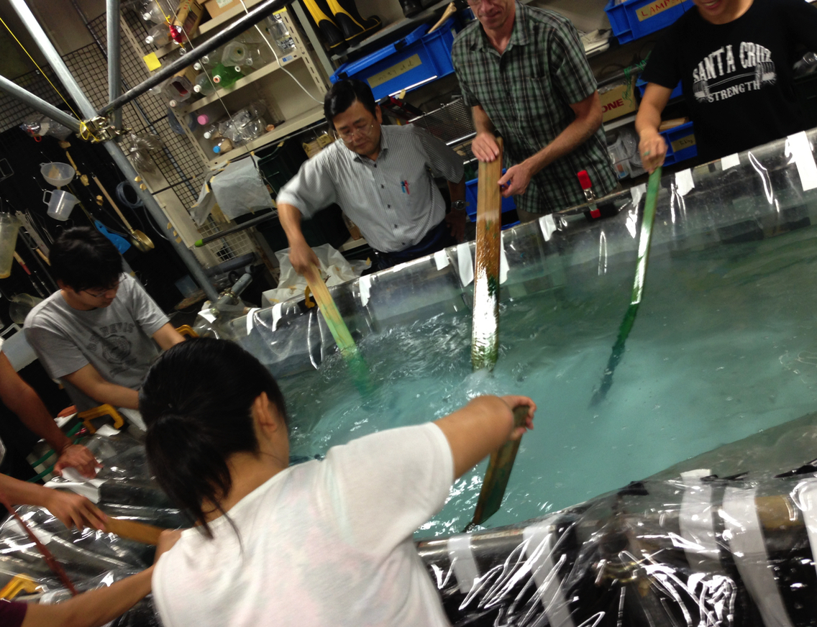
CSDMS-SEN 2016
2013 SEN Workshop at Nagasaki University, Japan
Stratodynamics
Tetsuji Muto
Hajime Naruse

Slide 8
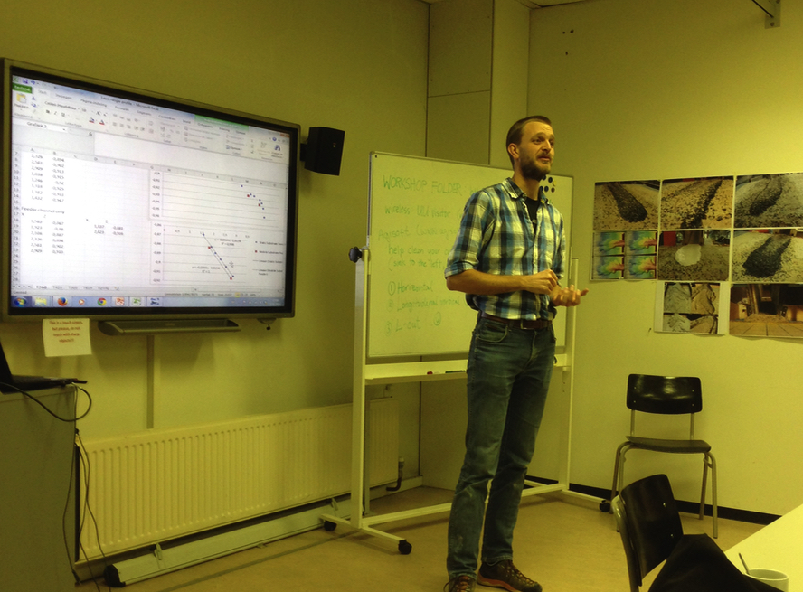
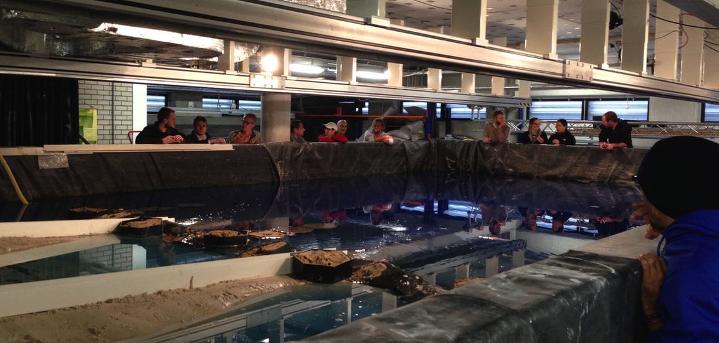
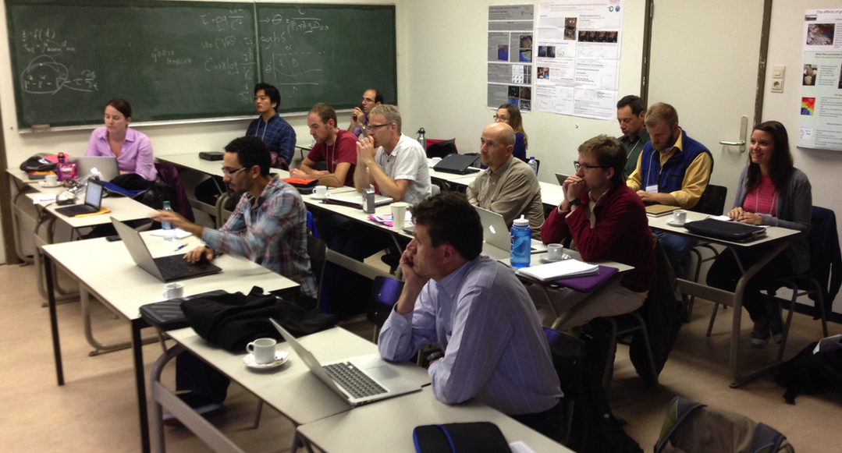
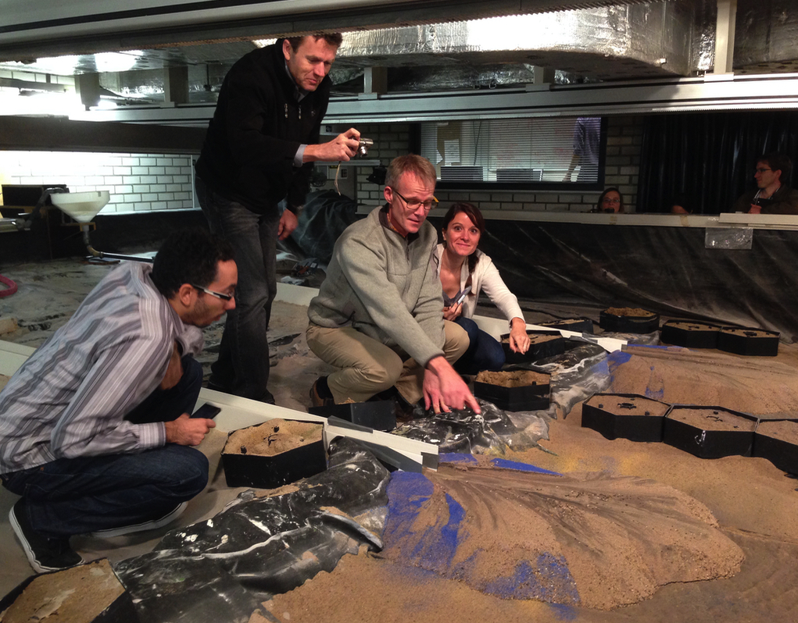
CSDMS-SEN 2016
2014 SEN Workshop at Utrecht University, Netherlands
SEN Going Dutch: Exploring the Life Cycle of Sedimentary Experiments.
Joris
Eggenhuisen

Slide 9
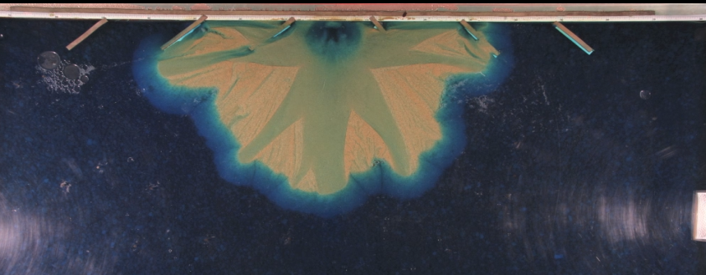
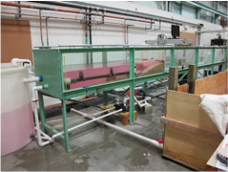
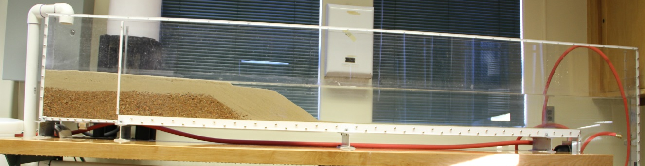
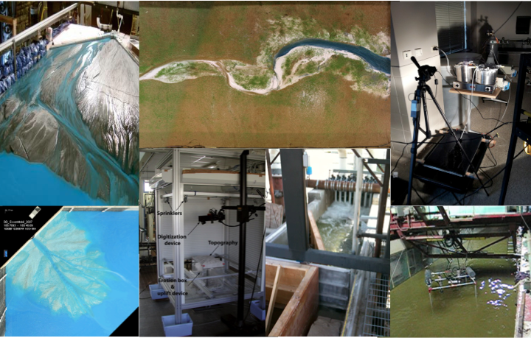
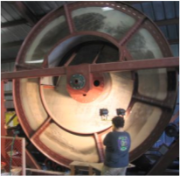
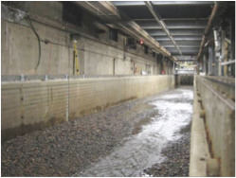
Why do we need a Sediment Experimentalist Network?
CSDMS-SEN 2016
Notes:
I would like to briefly talk about data challenge in our community and discuss further whether we need SEN.

Slide 10
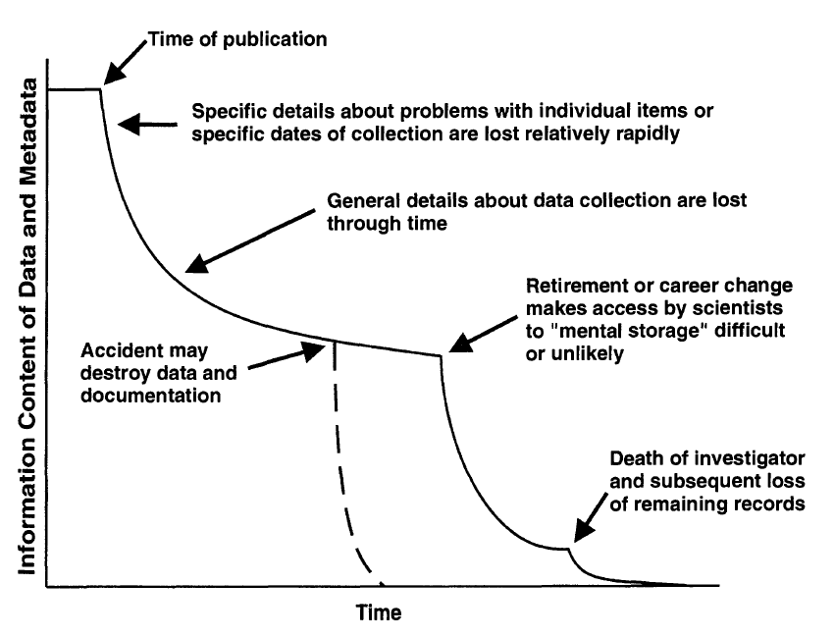
Data Challenges for Earth Surface Science
CSDMS-SEN 2016
Dark Data
Michener et al., 1997
Notes:
There are a few new terms that I learned through the SEN project. First one is “Dark Data”.
Experimentalists also have a lot of “dark data” that are difficult or impossible to access through the Internet.
Do you still have terabytes of data in your external hard drive? Does not know what to do to share the data with others?

Slide 11
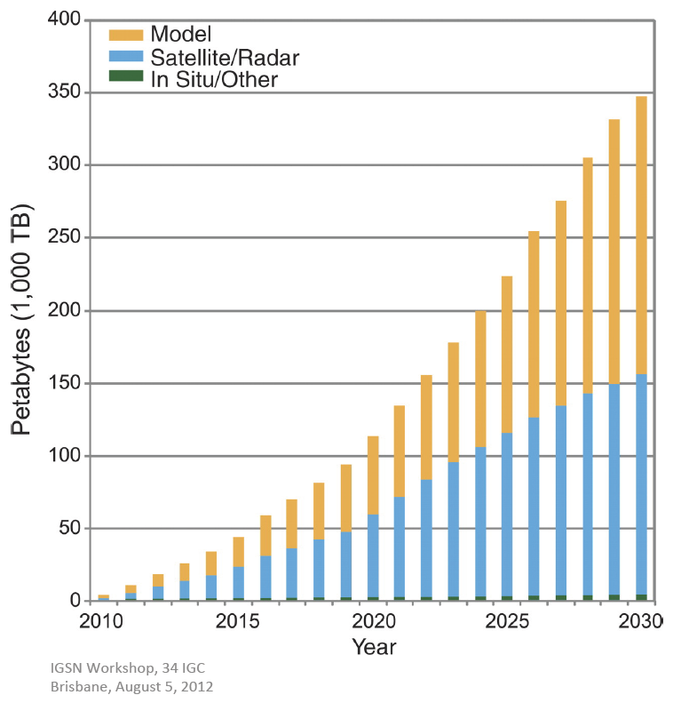

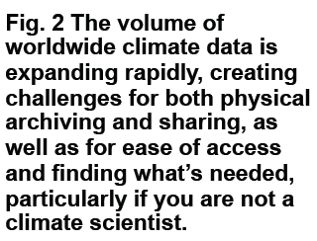


Data Challenges for Earth Surface Science
CSDMS-SEN 2016
Dark Data
Big Data
Notes:
My students and I can generate a Terabyte data with a set of experiment easily. We have typically lots of image data that hold a lot of space. To mange this large volume of data is challenging but searching what’s needed in the large volume is also a big challenge.

Slide 12
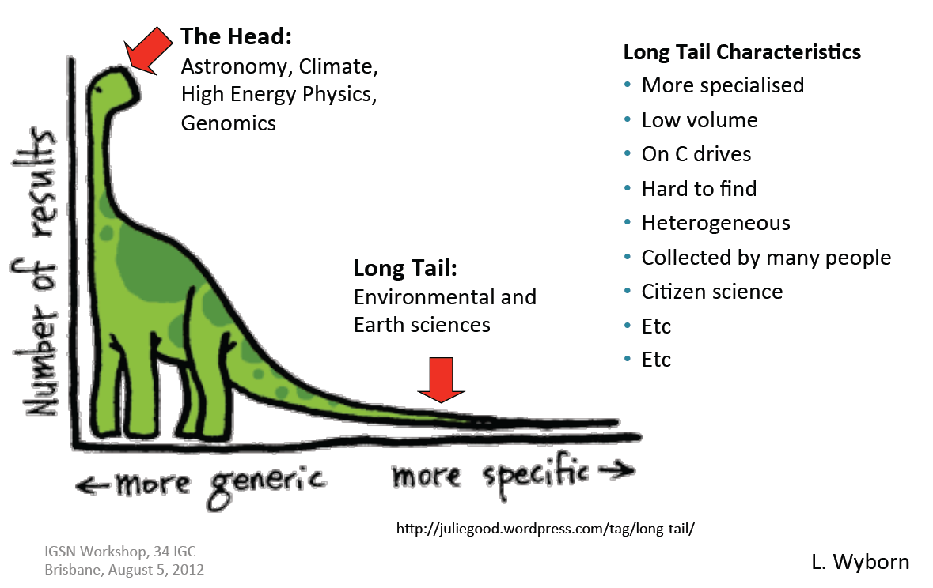
Data Challenges for Earth Surface Science
CSDMS-SEN 2016
Dark Data
Big Data
Diverse Data
Notes:
Sediment experimentalists are an example community in the “long tail”, meaning that their data are often collected in one-of-a-kind experimental set-ups and isolated from other experiments. Reproducing someone else’s experiment in a difference place is not trivial.

Slide 13
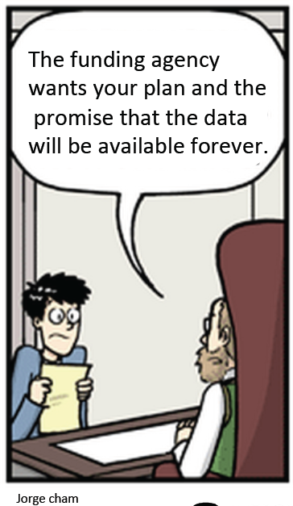
Data Challenges for Earth Surface Science
CSDMS-SEN 2016
Dark Data
Big Data
Diverse Data
Separable Data
  Funding agencies are asking for data management plans
  Journals are asking for links to archived full datasets
Notes:
Do we have tools and/or channels to resolve these data challenges?

Slide 14
Data Challenges for Earth Surface Science
CSDMS-SEN 2016
Clinic2.1: SEN: Take only measurements. Leave only data
Wednesday at 1:30 PM C120A/B
Best practices for data collection and management
  Lifecycle of data
  Metadata
  Data preservation, discovery, and reuse
  Workflow
  Cyberinfrastructure, web-based data repositories
  The SEN Knowledge Base, and more

Slide 15
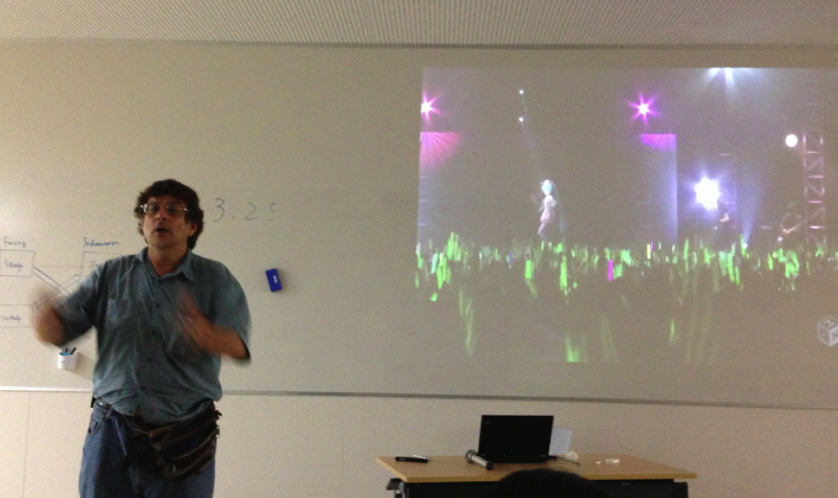
Challenges in Experimental Surface Science
CSDMS-SEN 2016
Earthscape 2100 (Gary Parker at the 2013 Nagasaki SEN Workshop)
2016 CSDMS: Advances in simulating the imprint of climate change on the land and seascapes, including the processes that influence them
Challenges in experimental surface science require data synthesis and experimentalist-modeler collaborations:
  Repeatability
  Scalability
  Autogenic vs. Allogenic Processes
Notes:
We are not aiming to provide just a tool for data management. We would like to plant a culture to share and reuse experimental data. The best way to carry on is we support people to do best science through SEN. This is year 3 in the SEN project. Now we want to focus more on science using the SEN-CSDMS collaborations.
One of the great outcomes from the workshops was … Parker story
(2) How to ensure comparability of experimental results from disparate facilities, (1) How best to relate experiments to natural systems and theory, and (3) How to distinguish external versus intrinsic processes observed in experiments. Experimentalist-modeler collaborations are essential for achieving solutions to all of these grand challenges.

Slide 16
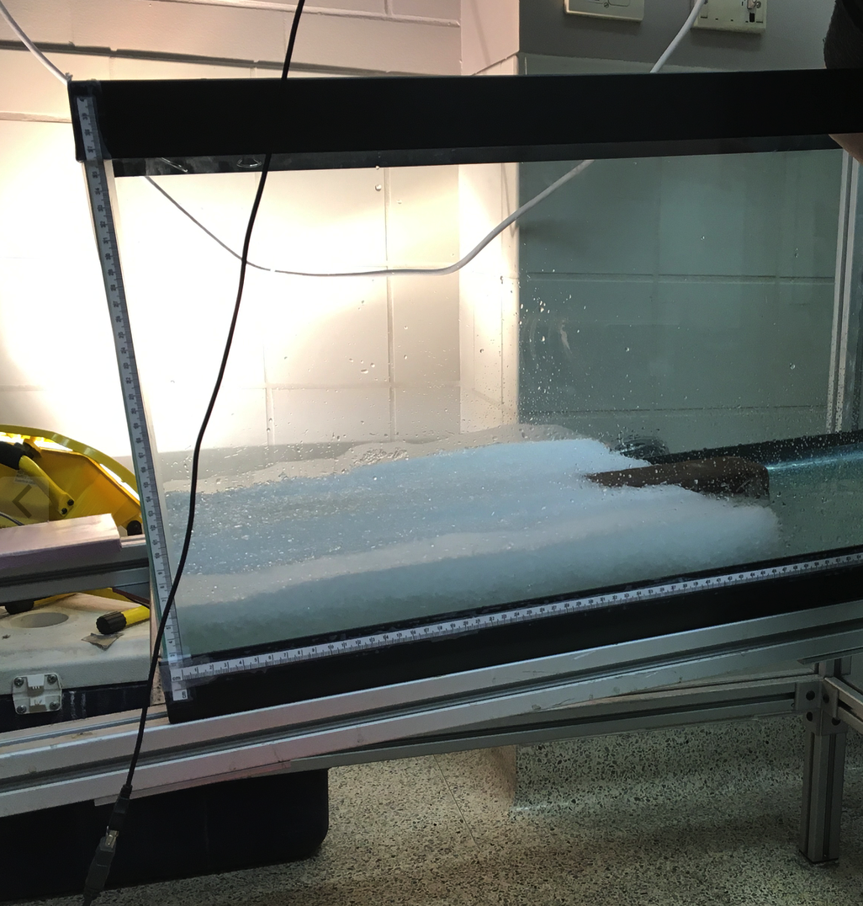
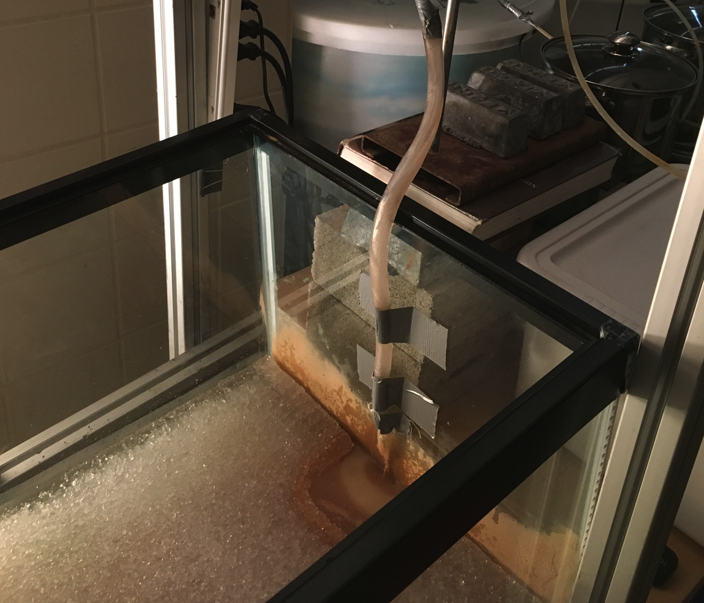
Arctic: A delta prograding an ice-cover lake
CSDMS-SEN 2016
Earthscape Imprint of Climate Change
Jan 2016, No name basin (0.9 m x 0.5 m)
Ye Jin Lim (MS student in UT)

Slide 17
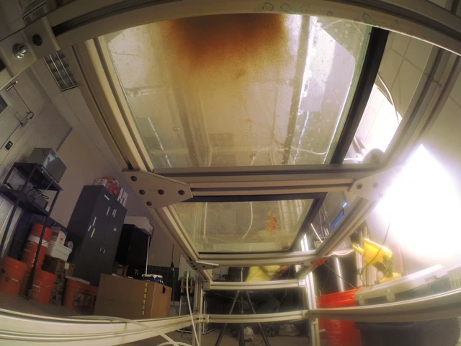
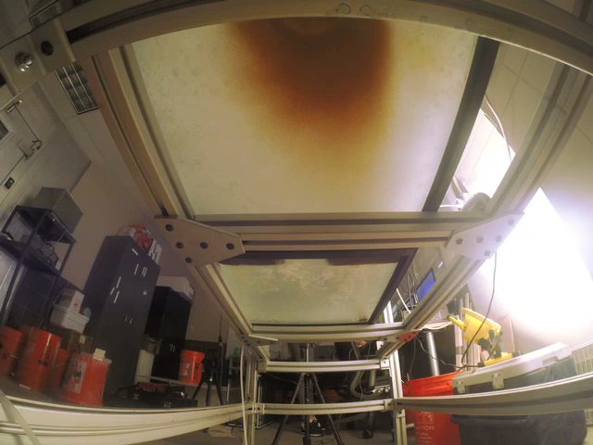
Arctic: A delta prograding an ice-cover lake
CSDMS-SEN 2016
Earthscape Imprint of Climate Change
Jan 2016, No name basin (0.9 m x 0.5 m)
No ice-cover
Ice-cover

Slide 18
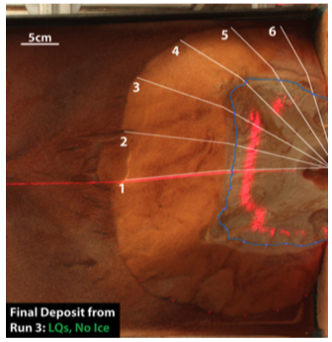
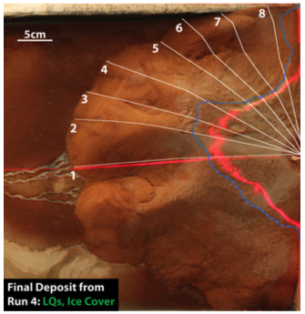
Arctic: A delta prograding an ice-cover lake
CSDMS-SEN 2016
Earthscape Imprint of Climate Change
Jan 2016, No name basin (0.9 m x 0.5 m)
No ice-cover
Ice-cover
Observation of core processes through Experiment
High-resolution data to support ideas

Slide 19
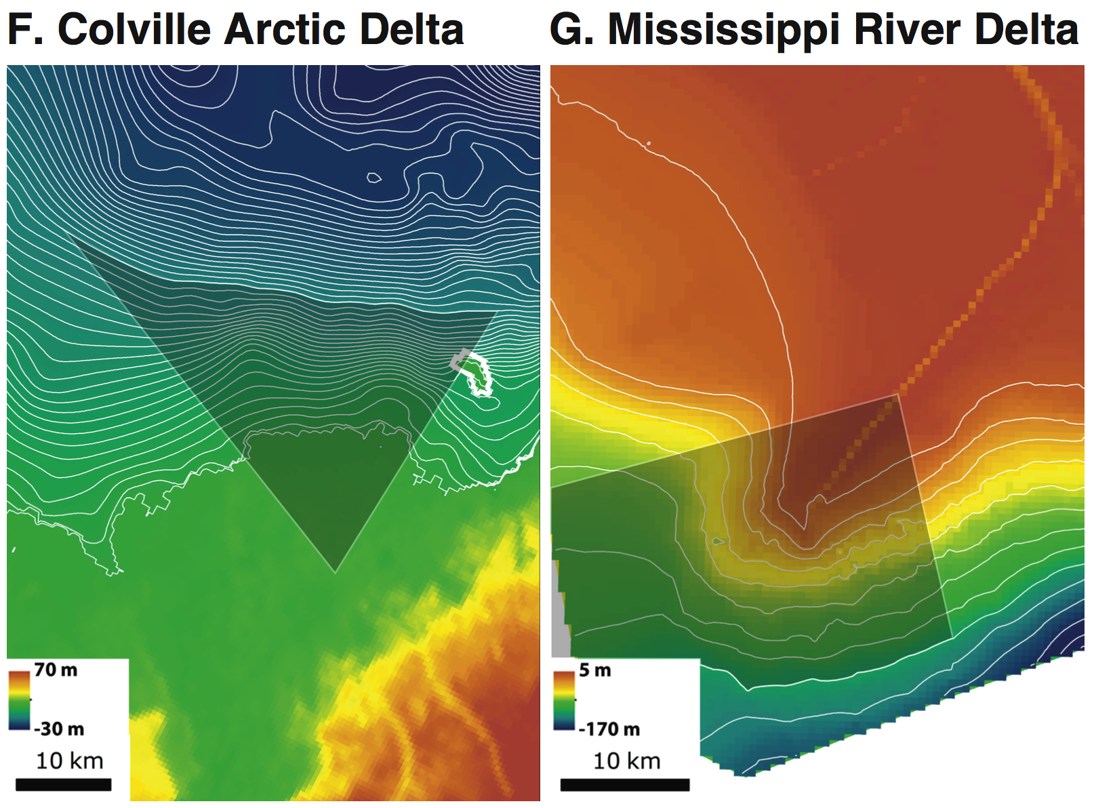
Arctic: A delta prograding an ice-cover lake
CSDMS-SEN 2016
The processes that created under-ice subaqueous channels and associated rough topography are demonstrated.
Ice-delta interaction produces the climate imprint on sea-scape!
Simple
Space and time scales
inaccessible in the field
HOWEVER,
  Scale?
  Natural example?

Slide 20
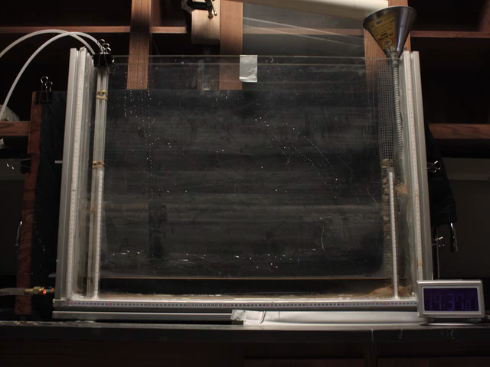
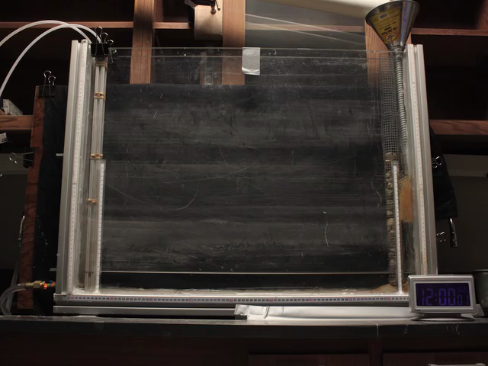
Experimental Results
CSDMS-SEN 2016
Autogenic vs. Allogenic Processes
R4: 0.052 mm/s RSLR
R5: 0.116 mm/s RSLR
Migration Reversal!
Carolina Baumanis (Undergrad student in UT)

Slide 21
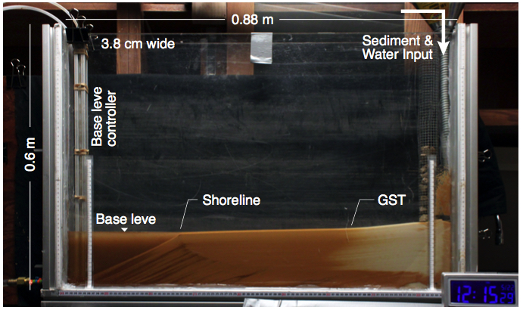
Physical Flume Experiment
CSDMS-SEN 2016
Verifying the mathematical model with sediment experiments
Flume dimensions: 0.88 x 0.6 x 0.04 m
Six Runs with RSLRs = 0, 0.072, 0.013, 0.052, 0.116, and 0.325 mm/s
Sediment mixture:
  Quartz sand (33%; D = 0.1 mm; 2650 kg/m³)
  Walnut sediment (66%; D = 0.1 mm; 1300 kg/m³)
Q_{s} = 3.34 g/s; Q_{w} = 11.39 ml/s
Initial base level: 5 cm

Slide 22
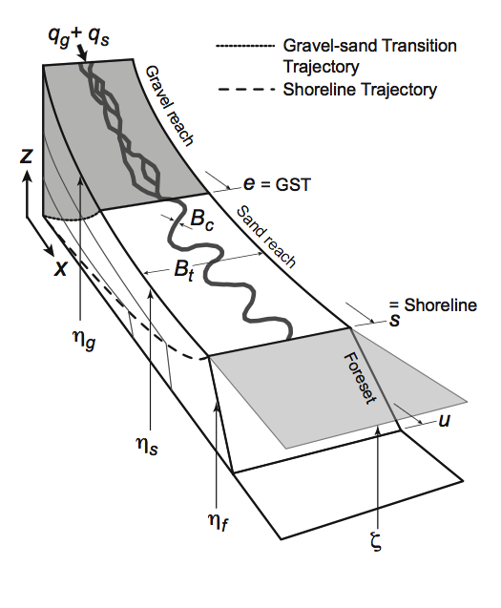
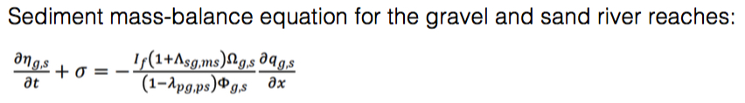
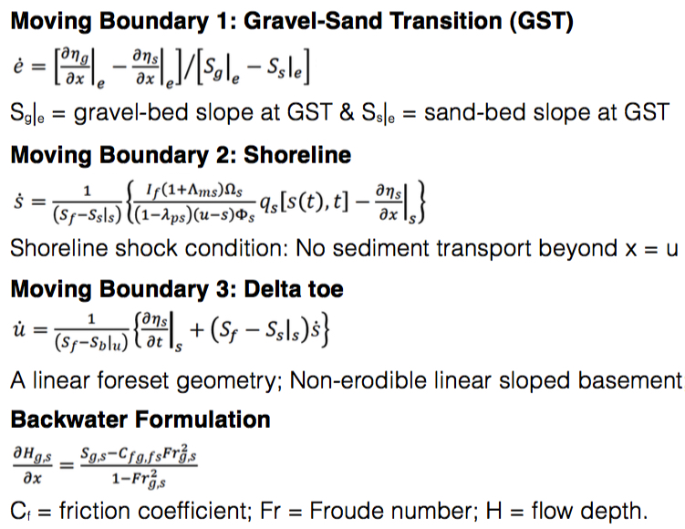

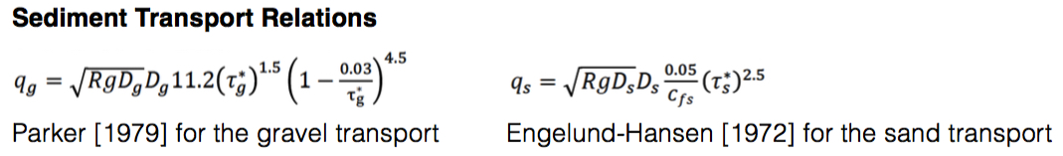
Mathematical Model
CSDMS-SEN 2016

Slide 23
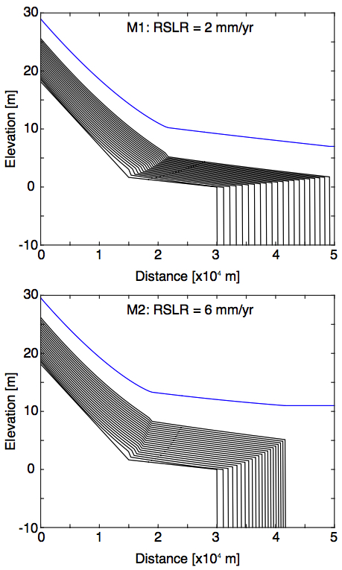
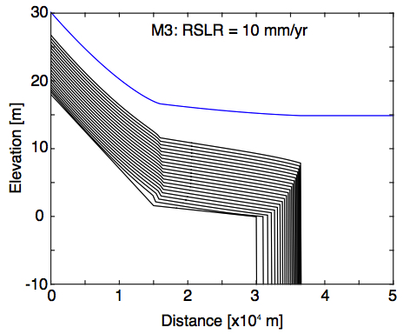
Modeling Results: Three RSLR Rates
CSDMS-SEN 2016
Q_{bf} [m³/s] Bankfull water discharge = 1000
Q_{g} [m³/s] Feed rate of gravel = 0.1
Q_{s} [m³/s] Feed rate of sand = 0.2
Initial s = 30 km; Initial GST = 15 km
RSLR (Relative Sea Level Rise)
= 2, 6, and 10 mm/yr
GST
Shoreline progradation
GST Retreat! Fining Upward
GST

Slide 24
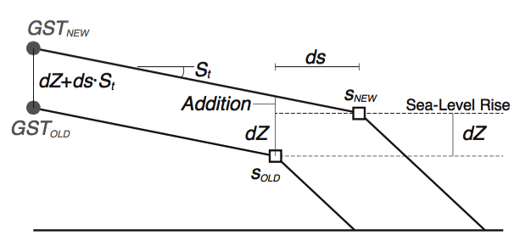
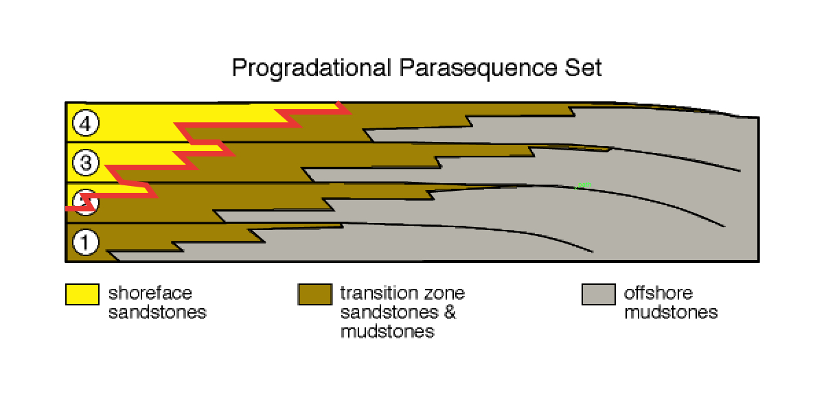
Migration Reversal in M3
CSDMS-SEN 2016
The GST and shoreline migrated opposing directions
The GST experienced faster RSLR rates
Additional rate ~ ds.S_{t} = (shoreline progradation rate x topset slope)
GST migrates in an opposing direction with respect to the shoreline

Slide 25
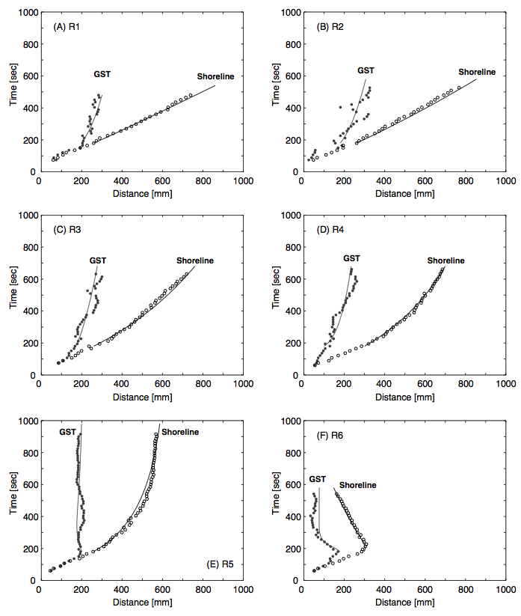
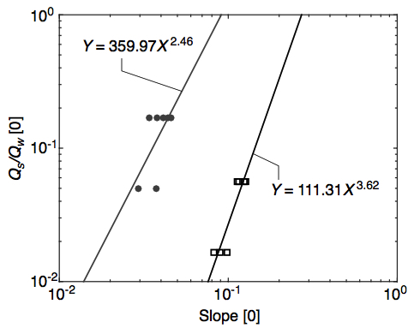
Comparison with Model
CSDMS-SEN 2016
Change the sediment transport relations to empirical relations from the current runs

Slide 26
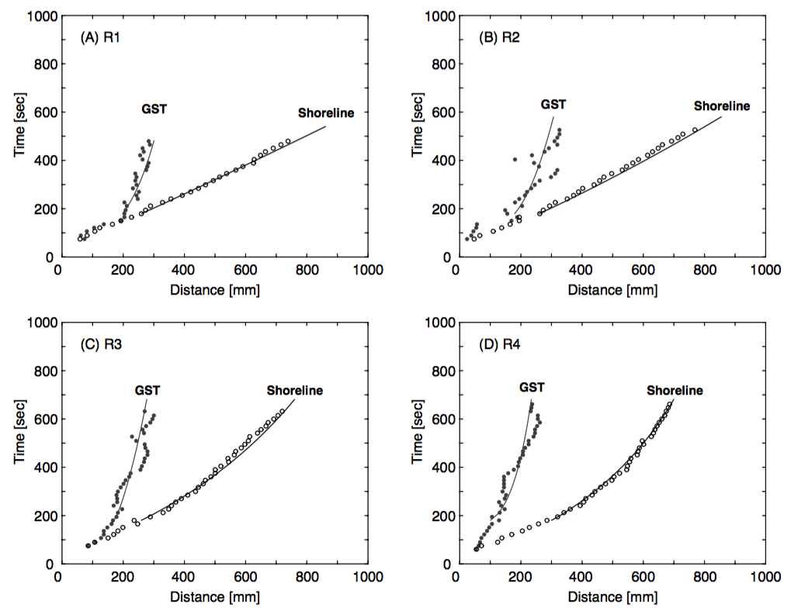
Autogenic vs. Allogenic
CSDMS-SEN 2016
Shazam?
Autogenic fluctuations of the GST migration

Slide 27
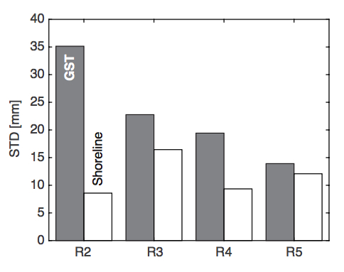
Autogenic Product as a Signal
CSDMS-SEN 2016
Standard Deviation for GST decreases with RSLR rate
Fluctuations of the topset slope (Kim and Jerolmack, 2008)
The zigzag shazam trajectories are from the cycles of autogenic processes
Higher RSLR rate
What caused the changes in the magnitude of variation?
Changes in slopes and depositional rates

Slide 28
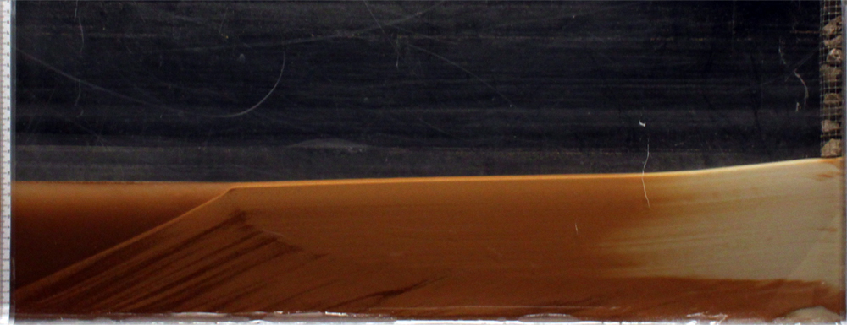
Stratigraphic Evolution: S2S
CSDMS-SEN 2016
Sand reach
Walnut reach
Darker
layers
Shazam
Storage in the sand reach → increasing slope
Less deposition of the sand reach at GST causes a retreat of GST
More deposition of the walnut reach at GST = less transport to the foreset
Only most fine sediment reaches the foreset, developing a darker layer
Storage in the walnut reach → increasing slope (some sand can transport through) and initiating release, developing a lighter-colored layer
Release in the walnut reach → decreasing slope, decreasing deposition at the GST
Release in the sand reach → decreasing slope and advancing GST

Slide 29


Modeling Autogenic Processes
CSDMS-SEN 2016
Modeling internal dynamics and stratigraphic signatures
Noise? Autogenic stratal product can be a useful signal to understand environmental controls (sea-level, tectonics, and sediment supply) to the sedimentary basin.
Example modeling results using the discontinuous
('sticky') sediment transport (Wolinsky, M.,
unpublished work).
Extreme Weather by Climate Change

Slide 30
Overcoming Grand Challenges by Collaboration between Experimentalists and Modelers
CSDMS-SEN 2016
Theoretical and numerical modeling based on first principles can help
  to extrapolate insight from experiments to field scales,
  to compare results from different lab facilities, and
  to decouple autogenic processes and allogenic forcings in geomorphology and stratigraphy.
The experimentalist-modeler collaborative effort will result in tremendous opportunities for overcoming grand challenges in our communities.

Slide 31

Thank You!
CSDMS-SEN 2016

