Slide 1
CSDMS and the Terrestrial World: Looking Back, Looking Forward
CSDMS annual meeting, March 2013

Slide 2
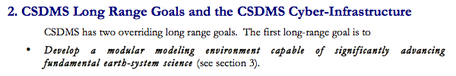

Original goals of CSDMS
From the 2008 Strategic Plan:

Slide 3
Model and Educational Repositories
Model repository: 166 models, 54 tools
  http://csdms.colorado.edu/wiki/Models_all
Education repository: movies, labs, lectures, images:
  http://csdms.colorado.edu/wiki/Movies_portal
Data repository:
  http://csdms.colorado.edu/wiki/Data_download

Slide 4
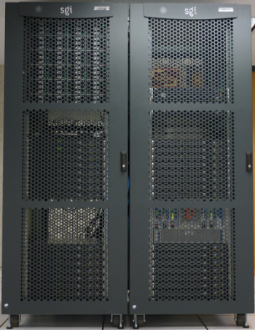
Supercomputer: Beach

Slide 5
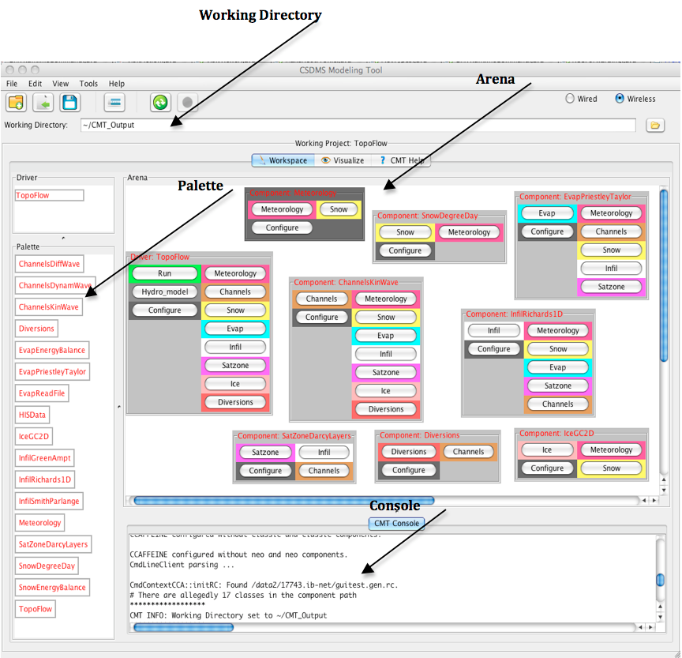
CSDMS Modeling Framework
Design, architecture, and cyber-infrastructure for plug-and-play coupling of models
  Different languages
  HPC support
GUI interface: CMT
Rapid idea generation, exploration, and hypothesis testing

Slide 6
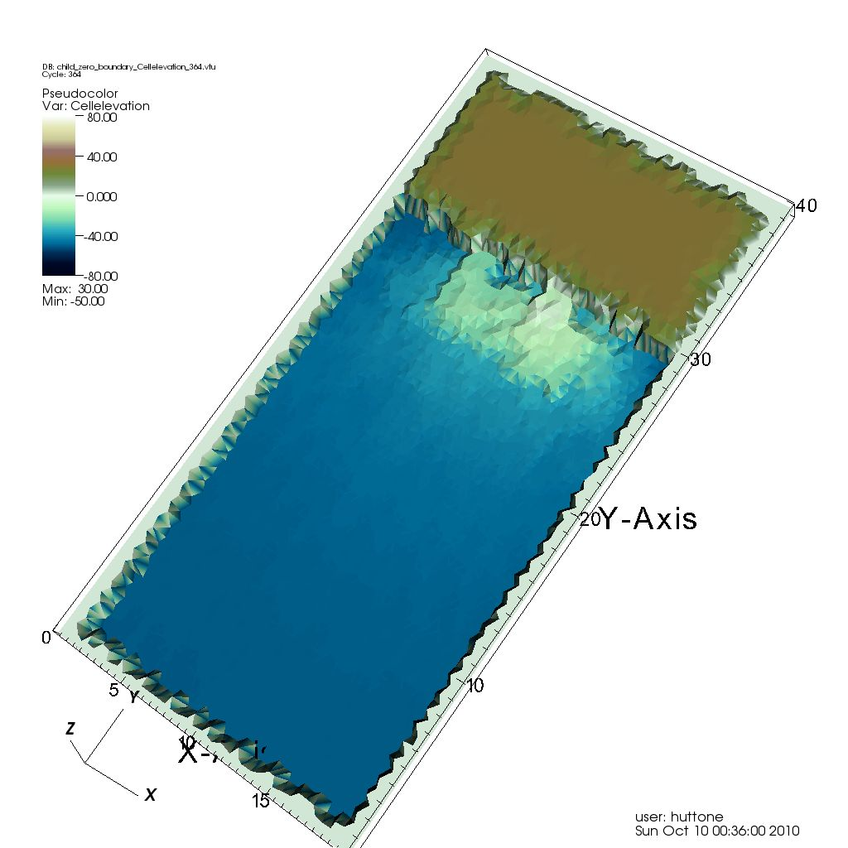
Example of CSDMS modeling framework: coupling CHILD (landscape evolution) and SedFlux (deltaic deposition)
Source-to-sink model combining CHILD and SedFlux components (courtesy of Eric Hutton)

Slide 7
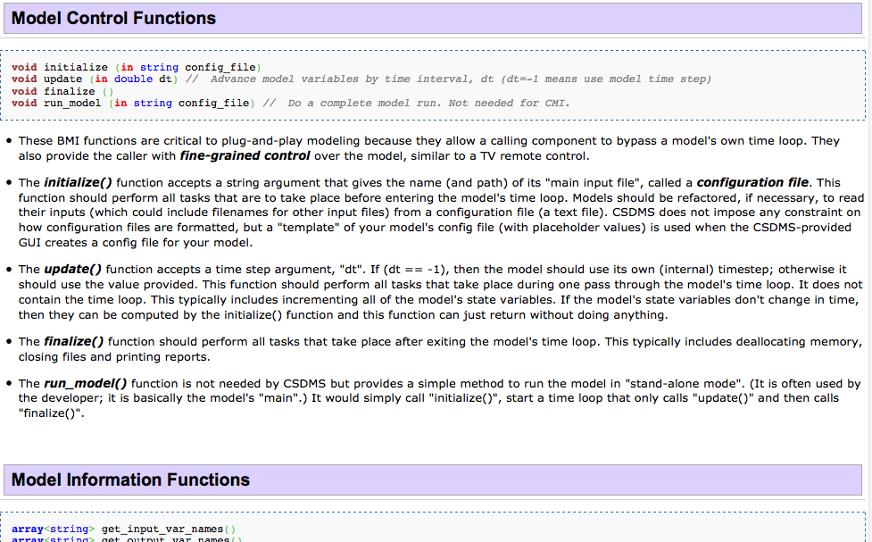
Making “plug and play” a reality: the Basic Model Interface (BMI)

Slide 8
Building a Culture of Practice: Community Moving Toward “Best Practices” such as:
Making open source code
Sharing
Using version control
Using model identification (DOI’s)
Writing good documentation
Implementing standard interfaces (BMI)
Using unit tests and regression tests

Slide 9
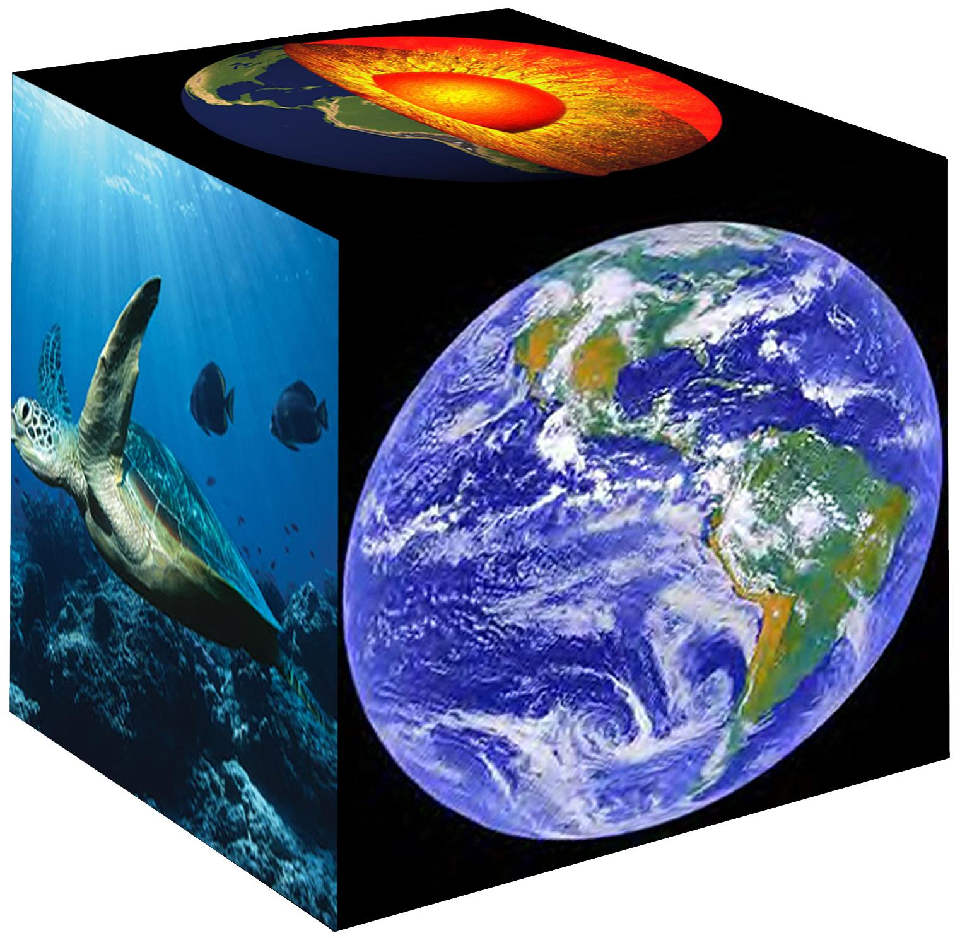
Funding agencies supporting computational science; examples:
NSF EarthCube
NSF Software Infrastructure for Sustained Innovation (SI2)

Slide 10
Some needs and next steps
Building and contributing fully-compatible components: “growing the library”
Benchmarking, testing, calibrating, and comparing models
Using CSDMS technology to do cutting-edge science

Slide 11
Role of Terrestrial Working Group
GUIDE CSDMS
CONTRIBUTE to CSDMS
USE CSDMS

Slide 12
Tasks for this meeting
Formulate long-term, short-term, and medium-term goals for strategic plan
Nominate model(s) for full inclusion in CSDMS modeling framework
Discuss “theme teams”

Slide 13
Agenda and google document for our breakout
https://docs.google.com/document/d/15xy2mkn-Yu7g0wRDtTHYMQDGOHpfKZNqG_A355dywxw/edit?pli=1

