Slide 1
Bringing CSDMS Models into the Classroom
Irina Overeem
irina.overeem@colorado.edu
Mark Piper
mark.piper@colorado.edu

Slide 2
Agenda
Using models in classroom? 45 minutes
Overview and demo of Web Modeling Tool
Available Model-Labs in EKT Repository
Hands-on Lab with ROMS-Lite 45 minutes
Visualization with Panoply
New developments in Educational Resources 30 minutes
Discussion on community use of these resources

Slide 3
Vision
CSDMS motto: “Explore Earth’s Surface with Community Software”
Develop a modular modeling environment capable of significantly advancing fundamental earth-system science; and
Develop functional and useful repositories for models, supporting data and tools, and other products for education in quantitative modeling.

Slide 4



Why teach modeling? To Future Citizens.
Essential basic elements of the science and engineering curriculum relate to modeling:
Asking questions and defining problems
Developing and using ‘models’
Analyzing and interpreting data
Using mathematics, information and computer technology and computational thinking
Constructing explanations and designing solutions
2017: emphasis on targeted lesson material, flexibility and online resources.

Slide 5
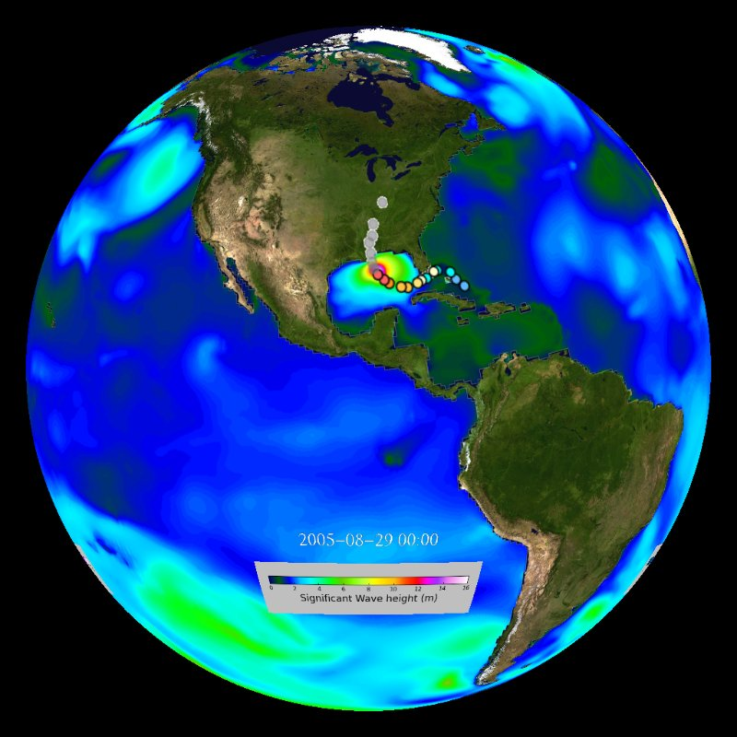
Teach modeling to Future Earth Scientists
Modeling is imperative to forecasting the behavior of a complex and evolving Earth System
Geoscience research nowadays heavily uses models:
Asking questions and defining problems
Developing and using codes
Planning and carrying out investigations
Analyzing and interpreting data
Using mathematics, information and computer technology and computational thinking
Constructing explanations and designing solutions

Slide 6
Learning outcomes of modeling labs
Awareness of models versus instrumental data
Awareness of simplification, assumptions and uncertainty in models
Explore possible outcomes of a system under different parameters
Describe feedbacks in coupled systems
Computing skills – basic familiarity with HPCC procedures
Efficacy with NetCDF File format and visualization

Slide 7
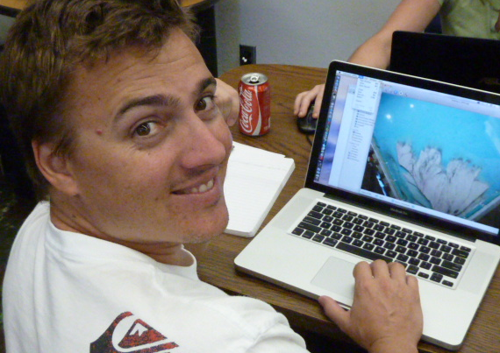
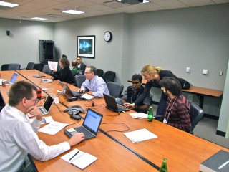
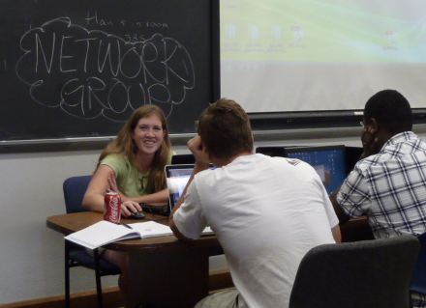
Using WMT for teaching
CSDMS members and > 150 graduate students have been exposed to CSDMS Modeling Tool
CSDMS clinics from 2010 to now.
CU graduate course on Earth Surface Process modeling
NCED SIESD 1 or 2-day clinics from 2011-now
We now use the WMT, the web-based tool

Slide 8
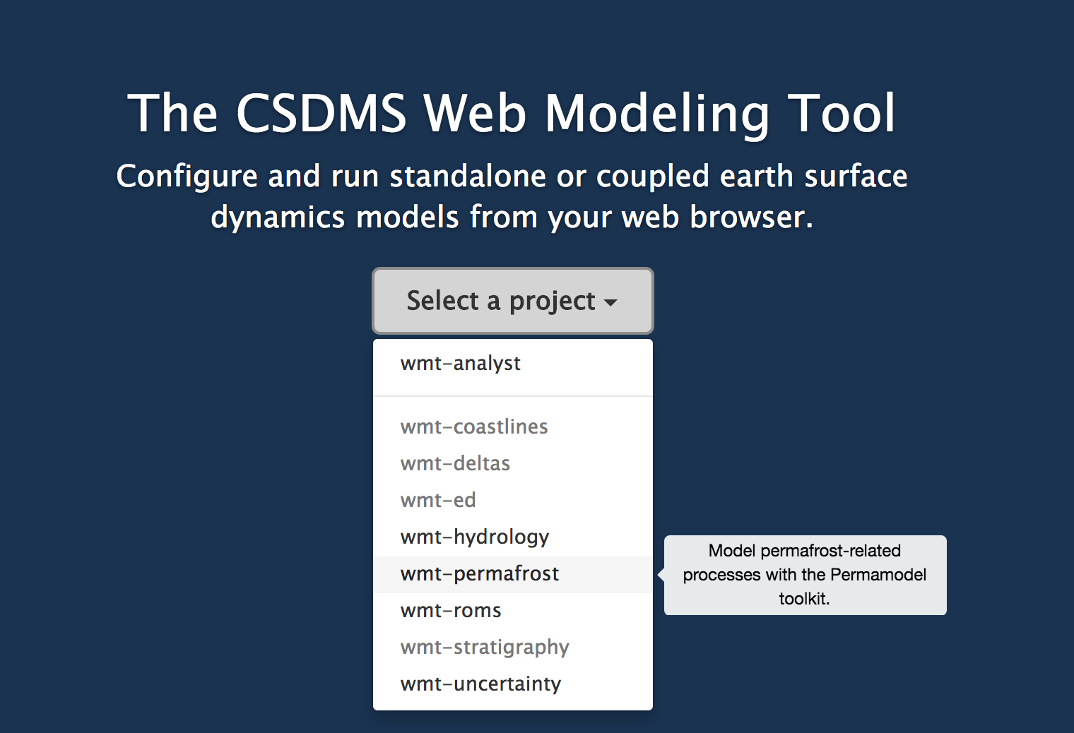
Web Modeling Tool
https://csdms.colorado.edu/wmt/

Slide 9
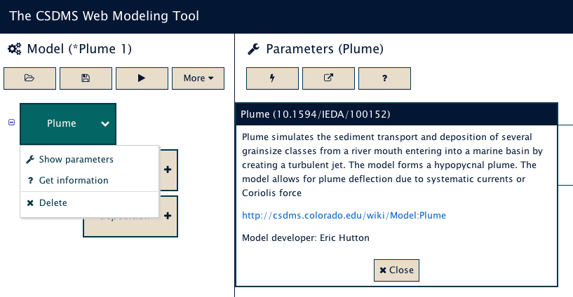
Integration between WMT and wiki
Click here

Slide 10
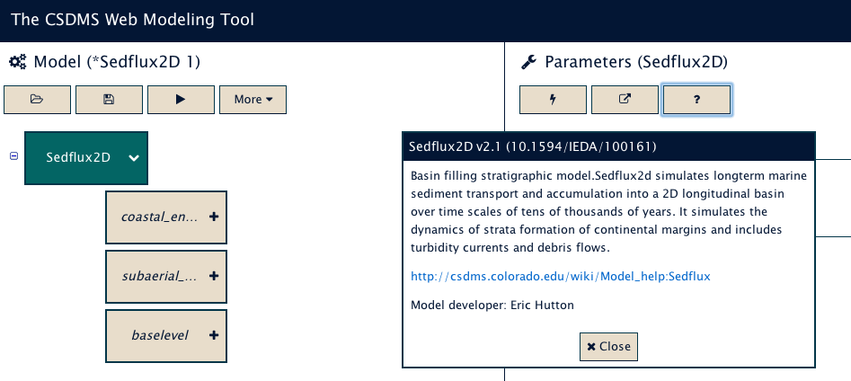
Model Help?
or Click Here

Slide 11
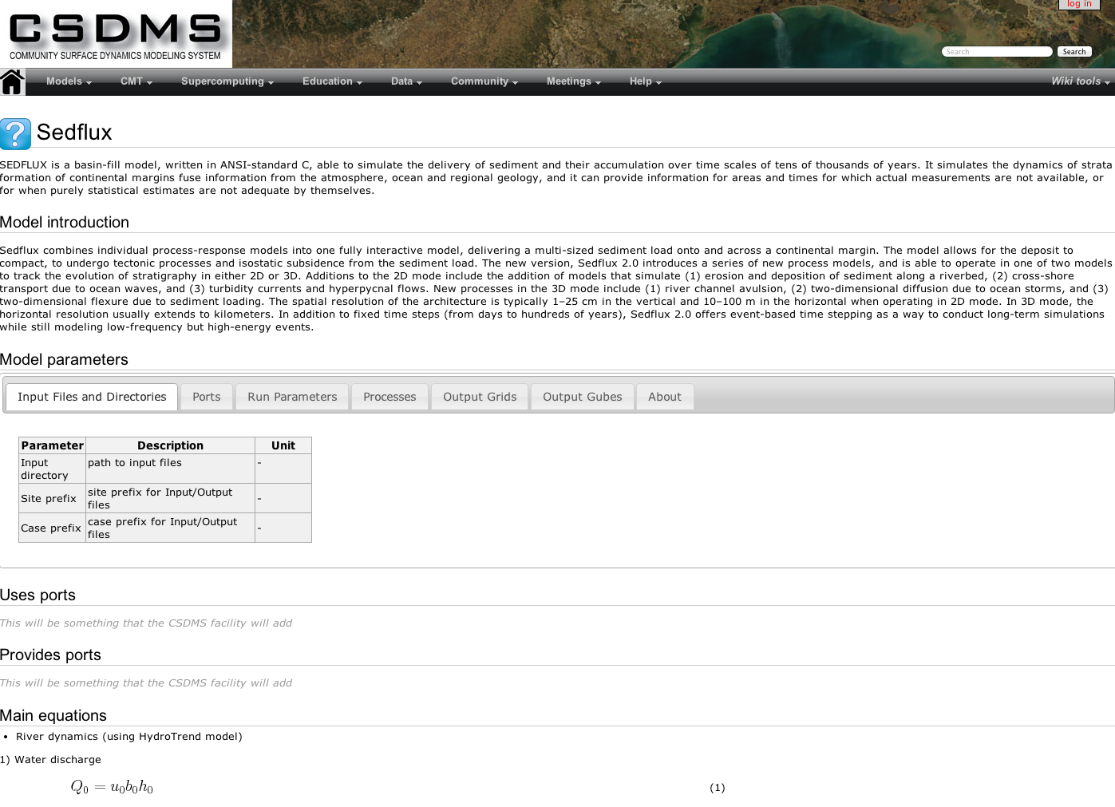
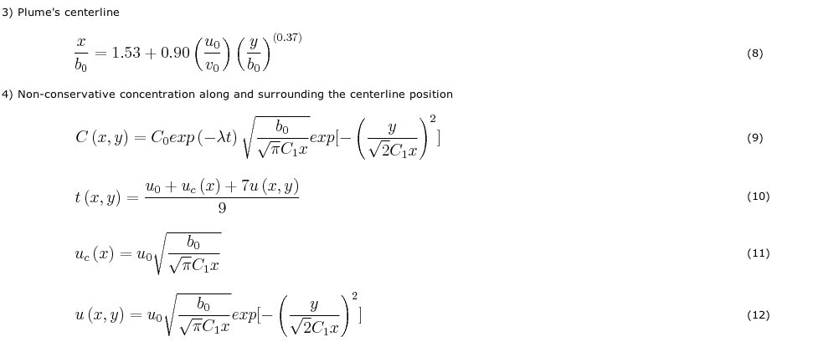
Model Help?
Notes:
These pages are designed to prevent a ‘black-box’ experience.
This is on the CSDMS wiki!! It can be edited by yourselves!!!

Slide 12
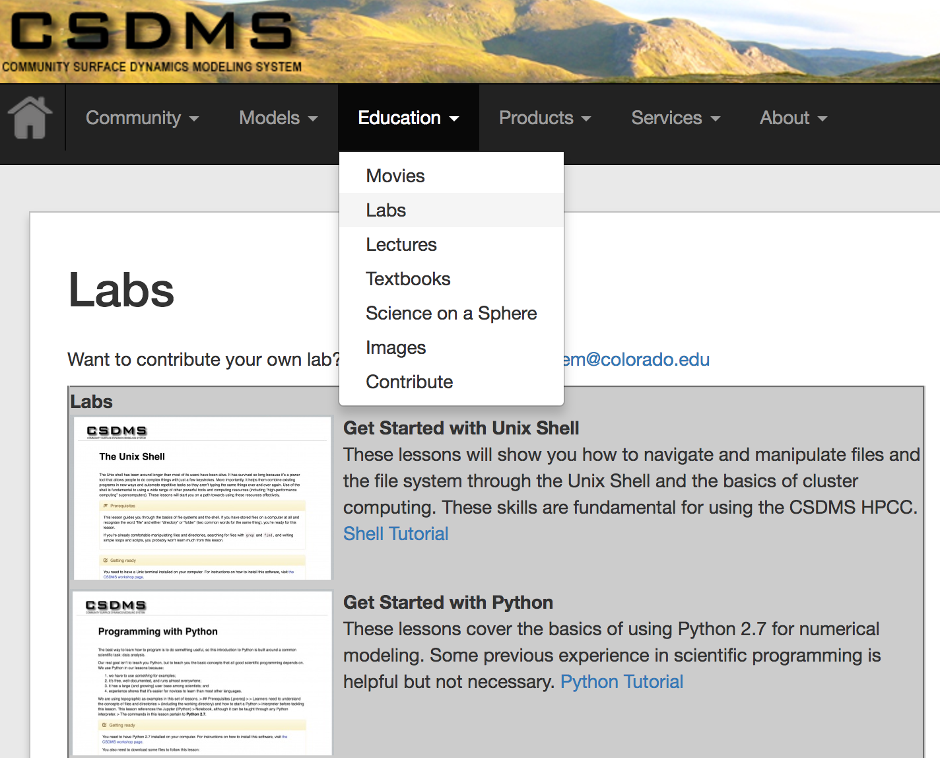
Existing Model Labs
Go to Education tab to find the “Labs” section
Overview of Labs for Teaching:
http://csdms.colorado.edu/wiki/Labs_portal

Slide 13
Model Labs
Labs are intended for advanced undergraduate and graduate classes (2-3 hrs, with homework). Labs include:
Tutorial on use of WMT
Tutorial on simple visualizations of NetCDF output
Presentations on the specific model and processes.
Instructions to run simulations. These runs have been tested.
Questions to meet topical learning objectives.
Key references to learn more on relevant processes and models.

Slide 14
Logistics/classroom management
Students need accounts on the CSDMS super-computer. This takes time; count on 4-5 work days.
Student need to familiarize with WMT
Students learn to visualize NetCDF time-series and grids. All CSDMS compliant models output NetCDF files. NetCDF can be visualized in Panoply, VisIT or ParaView (all open-source visualization tools) or Matlab. Some models have their own ASCII files. We provide a few examples with Panoply.

Slide 15
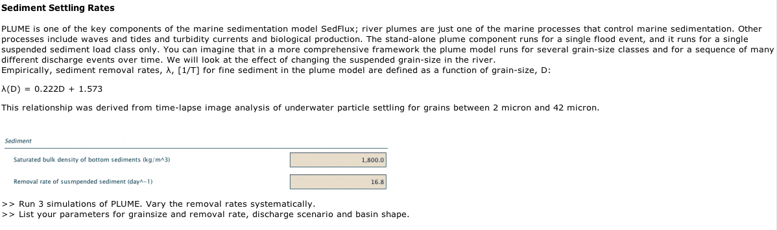

Example of a Model Lab
http://csdms.colorado.edu/wiki/Labs_WMT_PLUME
Instructions on Parameter Settings
Questions to guide more in-depth analysis of parameters

Slide 16
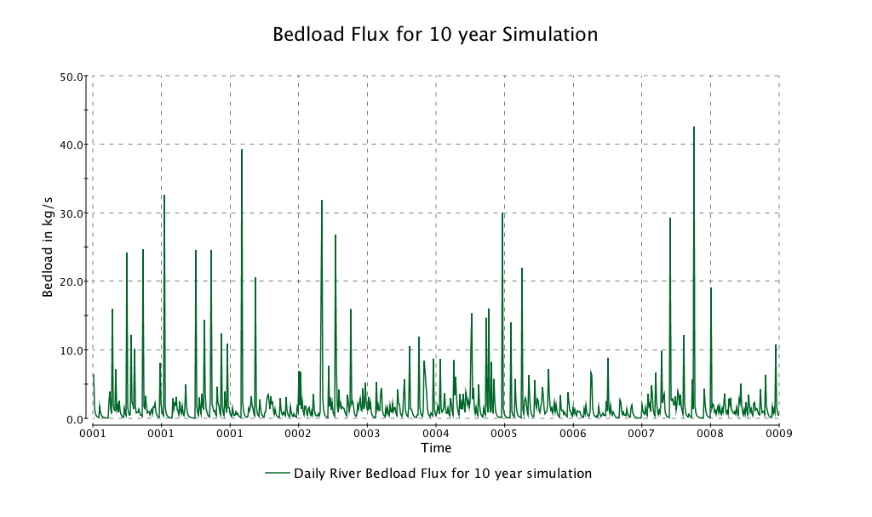
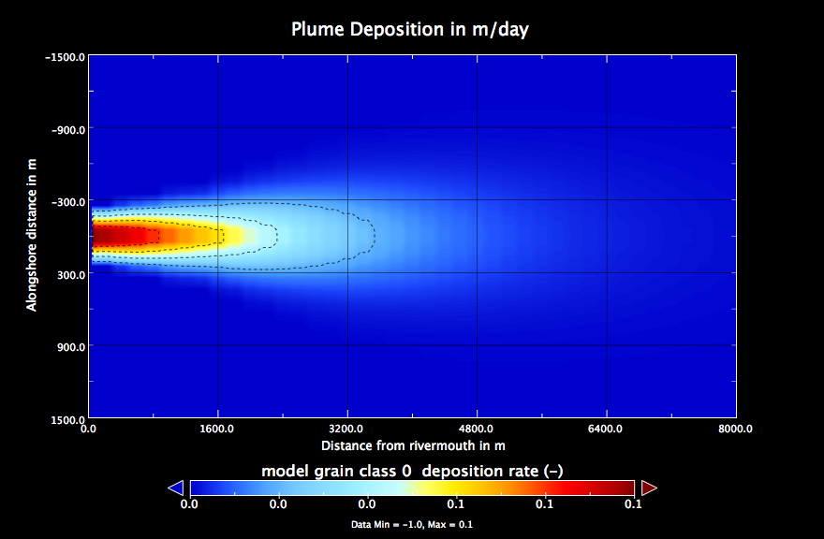
Visualize Output Files
Time Series Data
For straightforward visualization of
netCDF files, Panoply software is handy.
http://www.giss.nasa.gov/tools/panoply/

Slide 17
Demonstration of WMT features
Mark Piper
mark.piper@colorado.edu

Slide 18
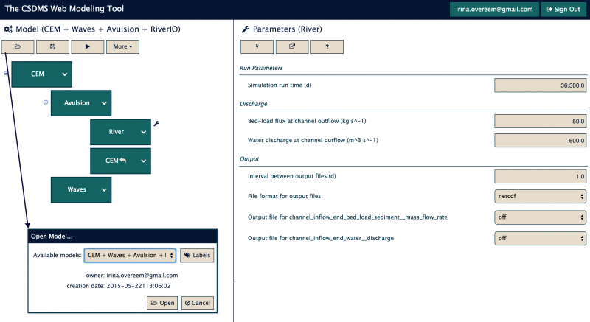
Open Example CEM+Waves+Avulsion
Option: use the pre-wired example; and start changing parameters from there.

Slide 19
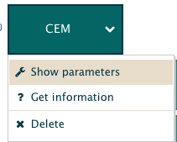
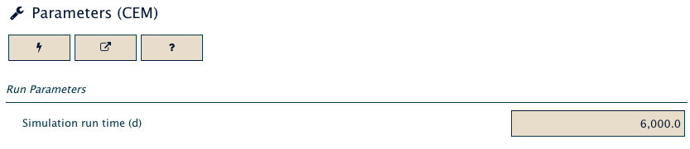
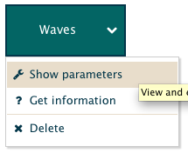
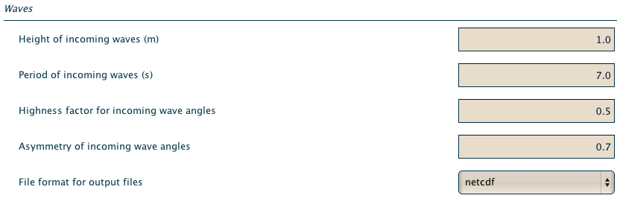
Parameter Setup

Slide 20
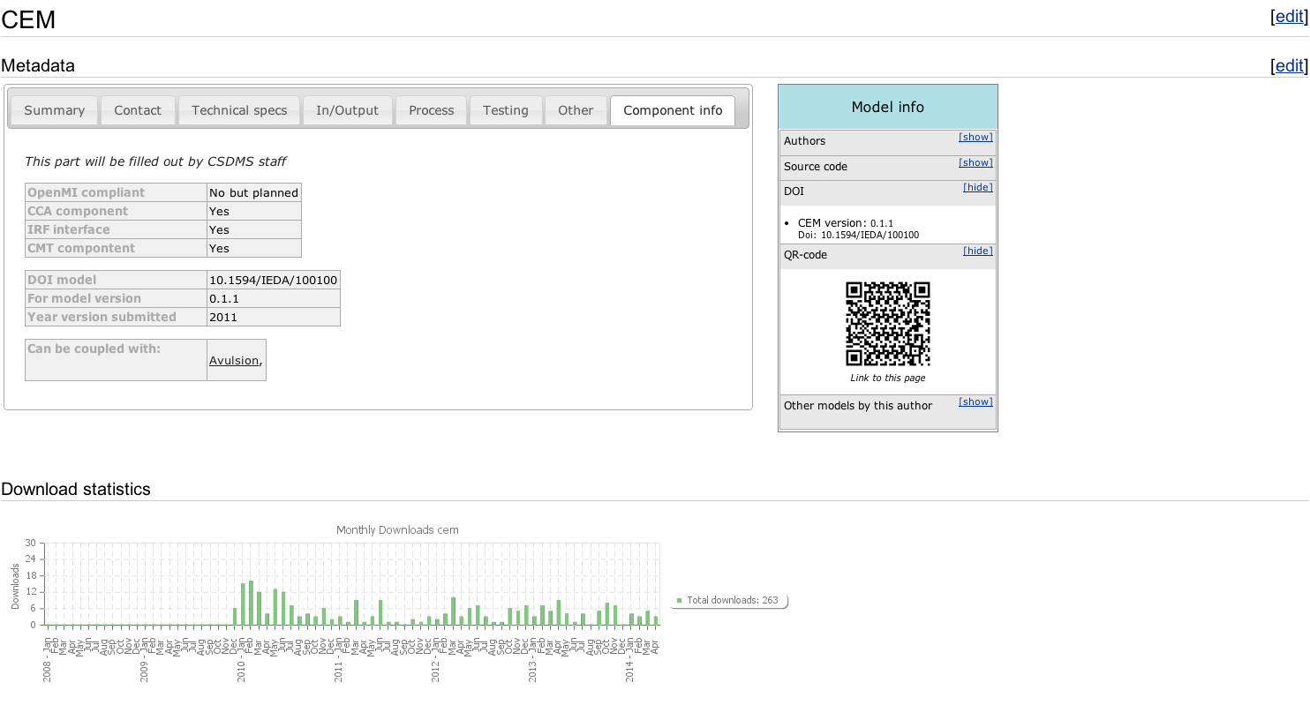
More information on Model

Slide 21
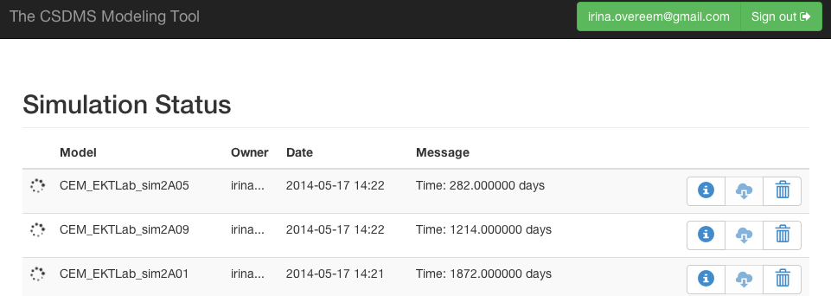
Simulation Status
Simulation takes about 5 minutes to complete, it reports progress in the ‘Simulation Status’ window
https://csdms.colorado.edu/wmt/api-dev/run/show

Slide 22
Hands-on Model Lab
Explore a model lab on coastal plume modeling (45 minutes)
ROMS-Lite, configured for teaching.
Team up with people who have their Beach account information available: you will need your user name and password.
Directions are on CSDMS wiki:
https://csdms.colorado.edu/wiki/Labs_WMT_ROMSLIte_RiverPlume

Slide 23
What is ROMS-Lite?
A basic configuration of the Regional Ocean Modeling System (ROMS) for inexperienced modelers to learn about ROMS, basic concepts in ocean modeling and look at a river plume affecting the coastal ocean and sediment transport.

Slide 24
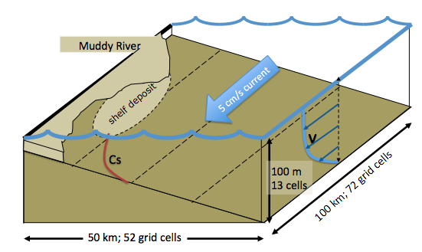
ROMS-Lite is based on RiverPlume 2
We set up a basic numerical experiment with inputs considered representative for a medium-sized river draining freshwater and sediment into the coastal ocean. The river discharge is kept constant at 1500 m³/sec.
Domain is 72 by 52 gridcells. ROMS has 20 vertical layers in the water column, and stores 10 layers in the ocean bed.

Slide 25
Visualize NetCDF files with Panoply
Download Panoply software
http://www.giss.nasa.gov/tools/panoply/
This is a crossplatform application. Downloads are available for Windows XP/Vista, Mac OS X, Linux.
Panoply is designed for NetCDF files (and also handles HDF and GRIB).
If model output includes geospatial information, this software is especially powerful.

Slide 26
Hands-on Model Lab
Explore a model lab on coastal plume modeling (45 minutes)
ROMS-Lite, configured for teaching.
Team up with people who have their Beach account information available: you will need your user name and password.
Directions are on CSDMS wiki:
https://csdms.colorado.edu/wiki/Labs_WMT_ROMSLIte_RiverPlume

Slide 27
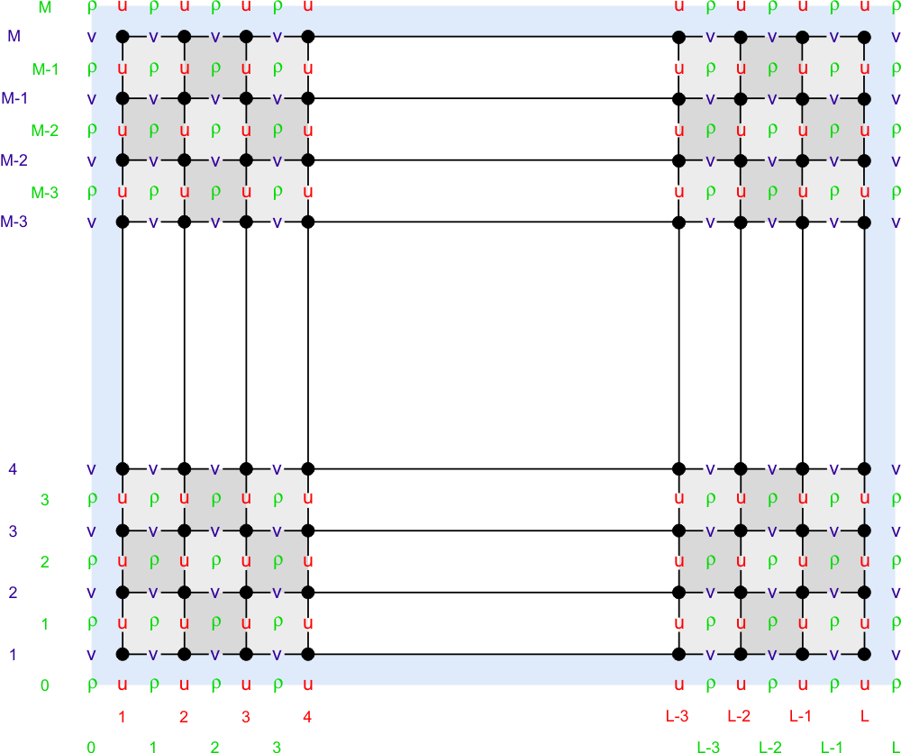
ROMS’
Horizontal Grid
Orthogonal curvilinear grid.
Arakawa-C grids often used in coastal models..
U, v, w, and ρ are represented at different locations within the model grid.
The u-, v-, and ρ-grids are different.
The u-, v-, and ρ-grids are different *sizes*
Figures from ROMS wiki.
Fringer, McWilliams, and Street, 2006.

Slide 28
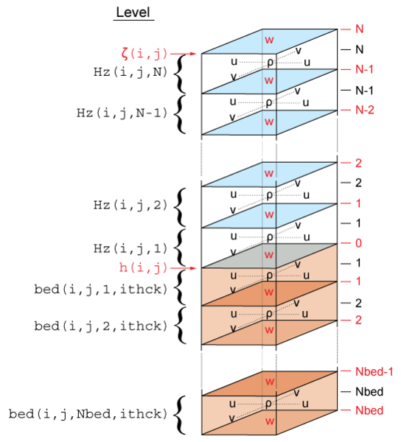
ROMS Vertical Grid
Figure from Warner et al. 2008
The vertical grid has two parts:
Water column shown in blue. “N” layers.
Sediment bed shown in brown. “Nbed” layers.

Slide 29
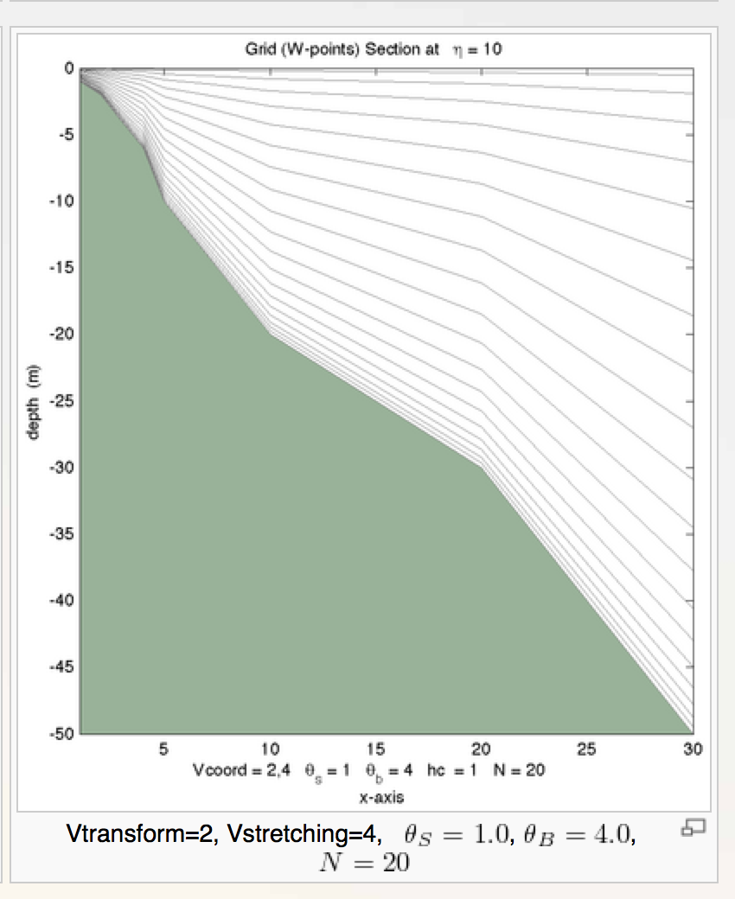
ROMS’
Vertical Grid
Terrain following.
Number of vertical grids is constant.
Stretched.
Implications:
Can maintain thin layers at surface and bed.
Need post-processing to calculate vertical water depths.
Example figure from ROMS wiki

Slide 30
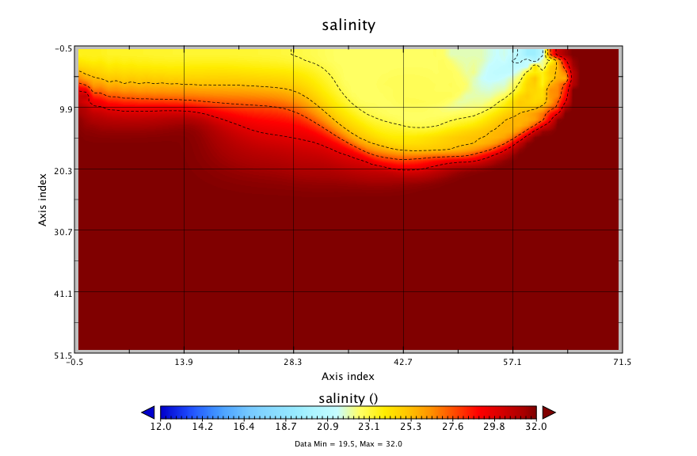
Hands-on Model Lab (1)

Slide 31
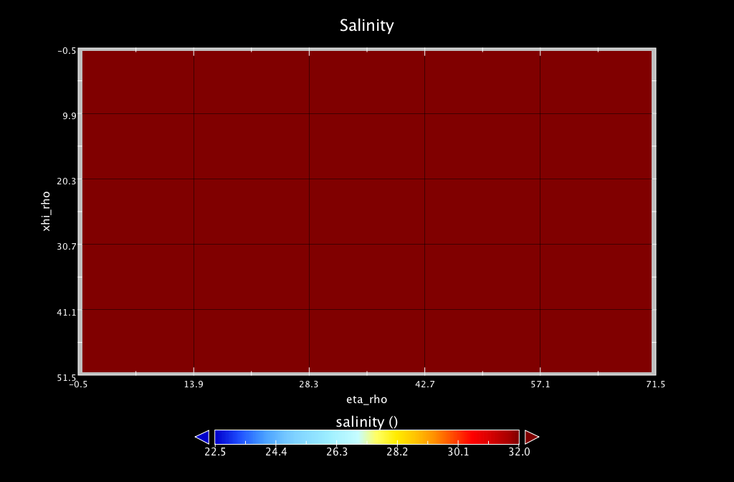
Salinity at the River Mouth
X-section, 96 hours simulation

Slide 32
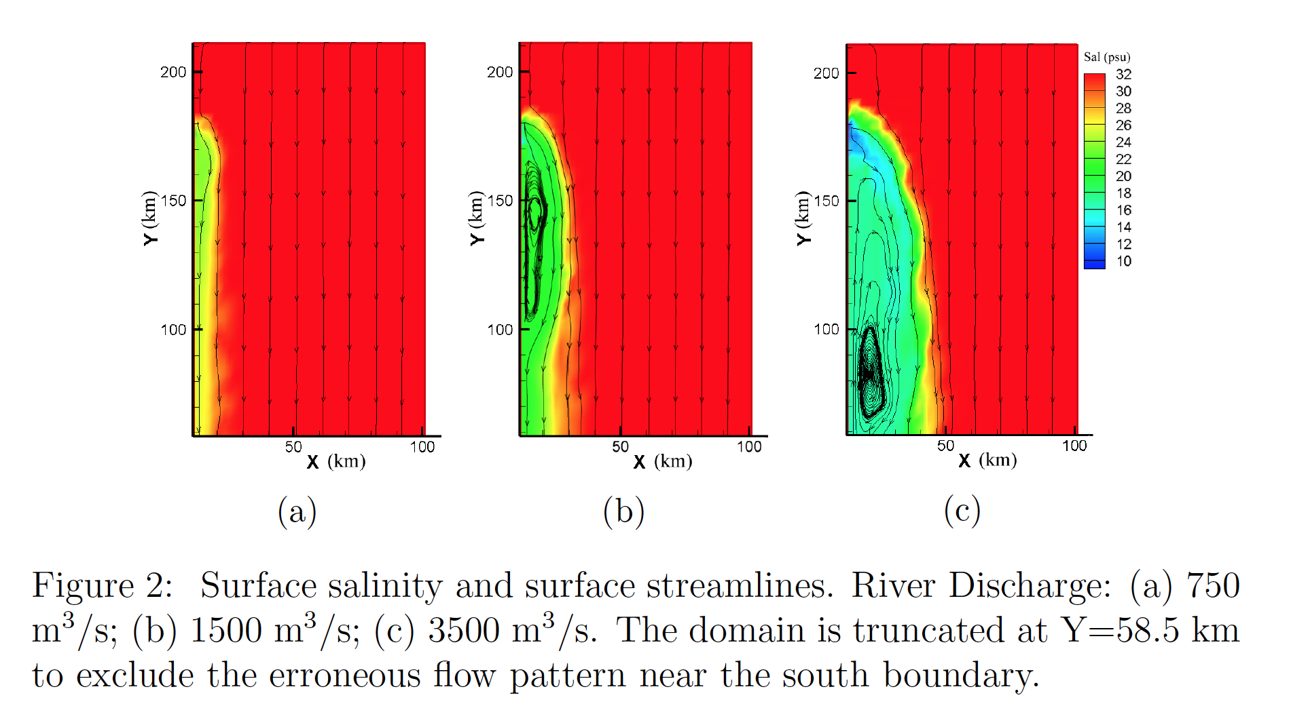
Model estimates for different river discharges
Salinity and velocity
Figure by Fei Ye, VIMS

Slide 33
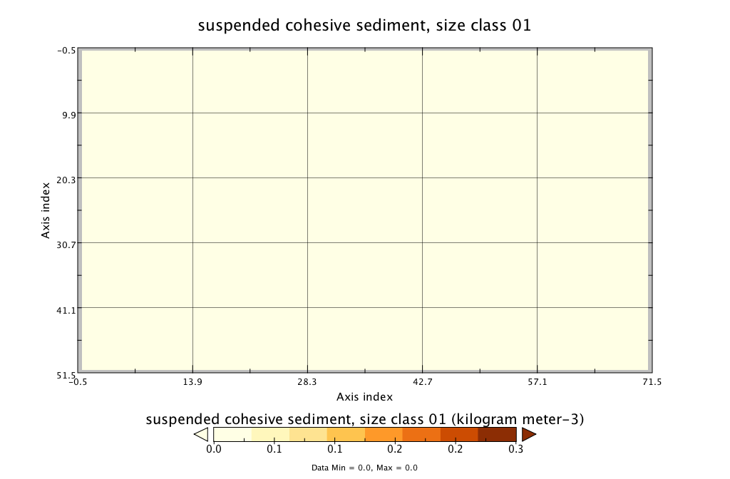
Suspended Sediment Concentration
Planview, 96 hours simulation

Slide 34
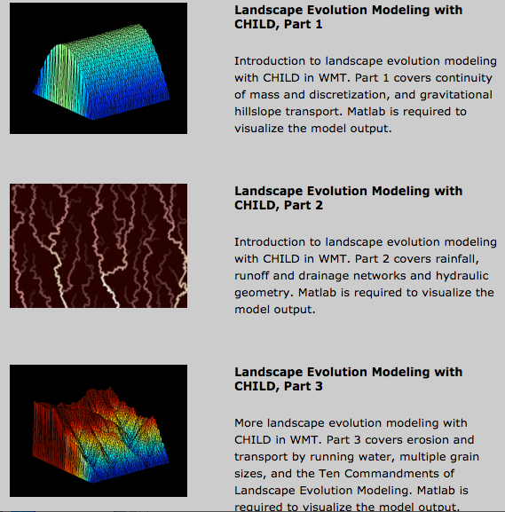
Available Model Labs
Introduction to WMT and Panoply
HydroTrend
HydroTrend and CESM input for future predictions
River Plumes
Coastal Evolution – Avulsion - Waves
Stratigraphic modeling Sedflux2D and 3D
Landscape Evolution Modeling with CHILD (Hillslopes, Drainage Networks, Erosion and Deposition, series of 3 labs modified from teaching material by Greg Tucker )
TOPOFLOW hydrological modeling (3 labs)
ROMS-Lite coastal processes (3 labs designed by Courtney Harris and Julia Moriarity
Permafrost Labs (3 labs from permafrost modeling project)

Slide 35
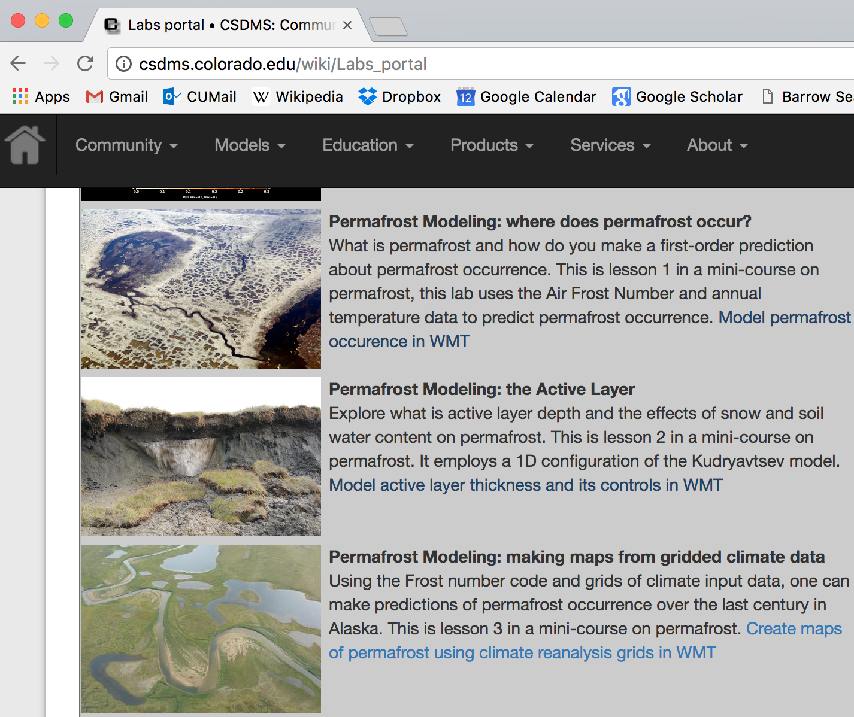
Available Model Labs

Slide 36
Questions and Discussion
Community input through EKT WG
What models are next?
Which topics are next?
What about documenting output?
Community volunteering
- We are recruiting TA’s and faculty to adopt and evaluate these teaching resources

Slide 37
A couple of Future Developments
WMT and Dakota, develop associated teaching material
RC-Delta, reduced complexity model of deltaic processes
Pre- and post lab assessments
Pathways to programming; IPython Notebooks

