Slide 1

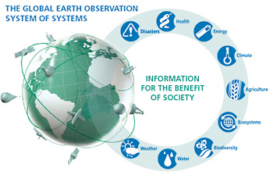

GEOSS and its Architecture
CSDMS 2015 Annual Meeting
Models meet Data, Data meet Models
May 26 -28th 2015, Boulder Colorado, USA
Stefano Nativi
National Research Council of Italy (CNR-IIA)

Slide 2

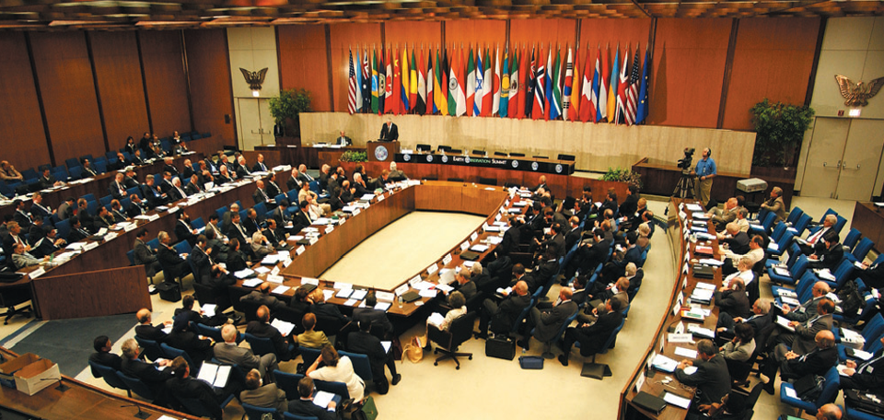
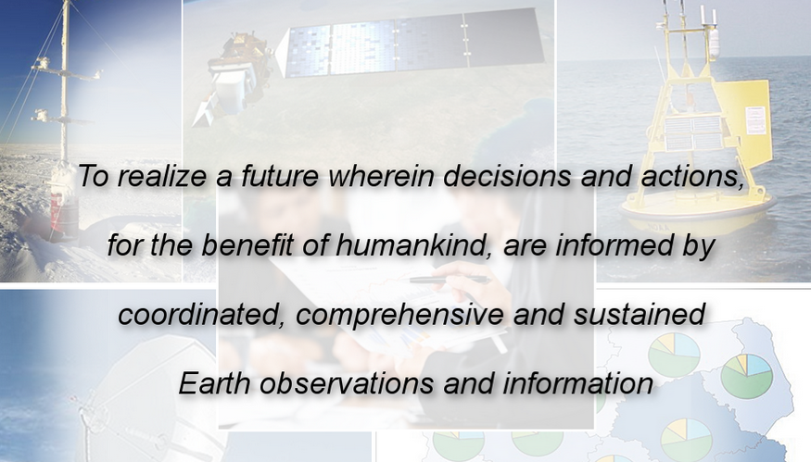
launched in response to calls for action by the 2002 World Summit on Sustainable Development, Earth Observation Summits, and by the G8 (Group of Eight) leading industrialized countries
voluntary partnership of 97 governments and 87 international organizations
provides a framework within which these partners can develop new projects and coordinate their strategies and investments
charged with developing GEOSS
Notes:
The 10-year Implementation Plan is the implicit convention that glues together all Members and POs.

Slide 3
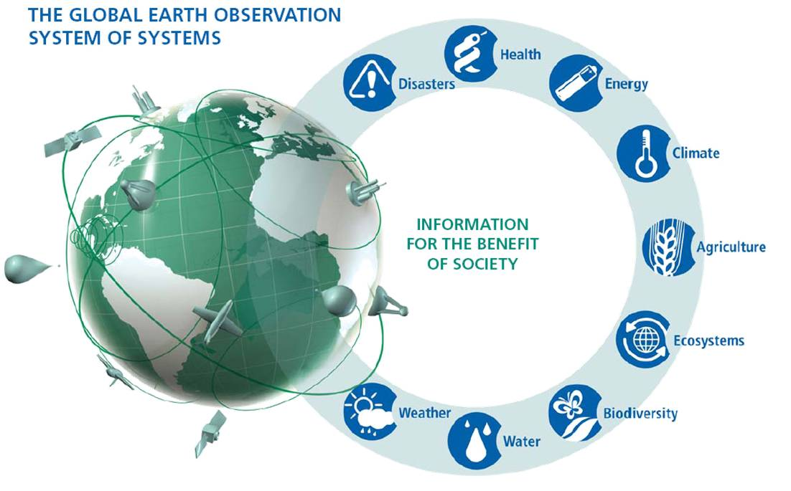
Global Earth Observation System of Systems (GEOSS)
GEOSS
Users
Infrastructure
Institutions
Notes:
Microsoft (Tony Hey)
Goggle (Ed Parsons)

Slide 4
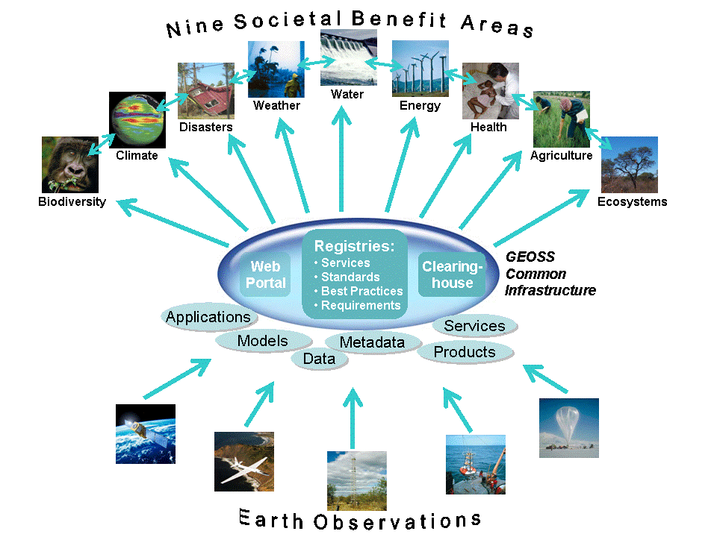
Rationale
Science & Society
GEOSS Portal
GEOSS
Common
Infrastructure
Discovery and Access Broker
Resource Registration
Data & Information Providers
Notes:
4
4
This Figure depicts the enhanced capabilities in an operational view diagram. The contribution of resources related to earth observing systems are primarily data and services, and their descriptions (metadata). The central portion of the diagram shows the GEOSS Common Infrastructure that coordinates access to the systems, applications, models, and products. Users are shown in the context of the nine official GEO SBAs.

Slide 5
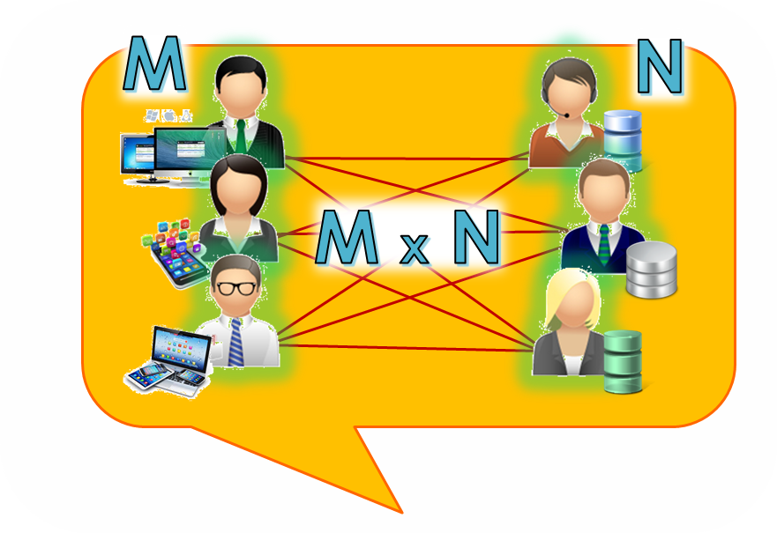
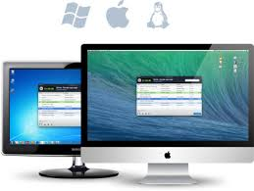

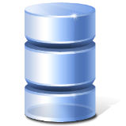
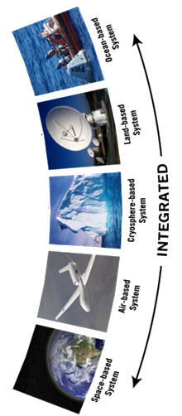
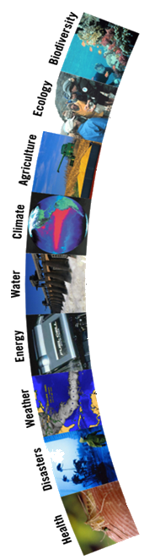
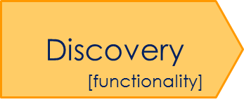

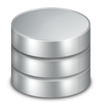


Service-Oriented Collaborative Architecture
Service Providers
Service Users
Data Applications
Data Infrastructures
Virtual-Collaborative
Management approach
Registry
[Governance]

Slide 6
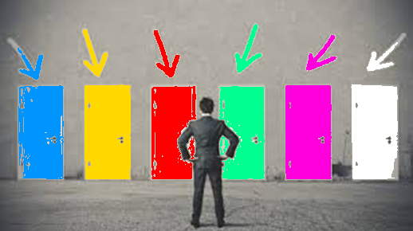

Recognized Barriers
(especially for GEOSS)
WIS
GBIF
DIAS
IODE
CEOS
OneGeology
So many different sources
So little time !
Brokering pattern
How to manage heterogeneity ?

Slide 7
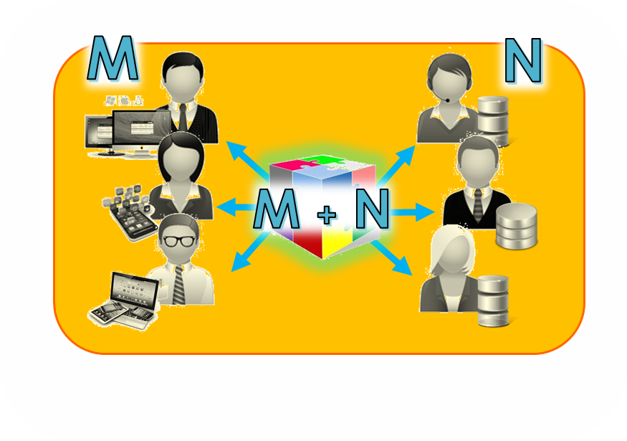
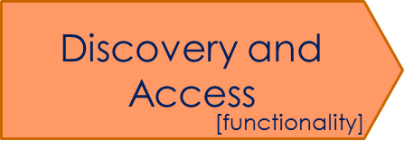

A Brokered Service-Oriented Collaborative Architecture
Service Providers
Service Users
Mediation
Mediation
Data Applications
Data Infrastructures
Mediation
Mediation
Collaborative-Acknowledged
Management approach
Mediation
Mediation
[Governance]

Slide 8
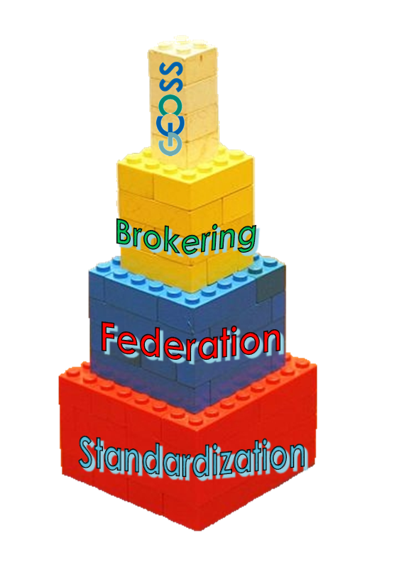



Interoperability
Standards
Multi-domain SoS / NoN
CoP Infrastructures
Domain-related Open Systems

Slide 9

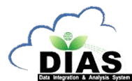
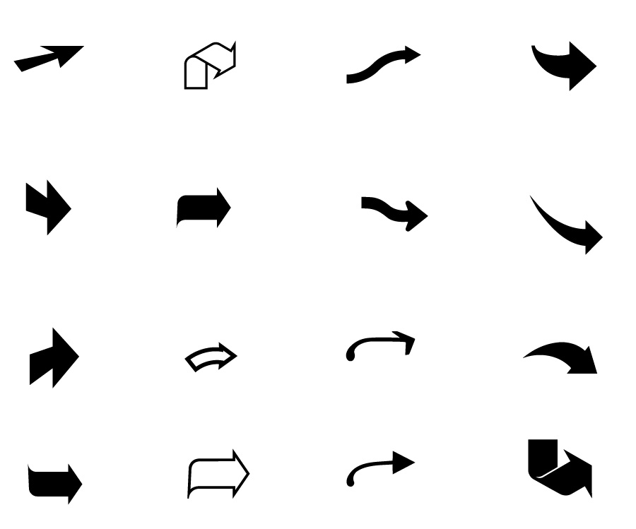



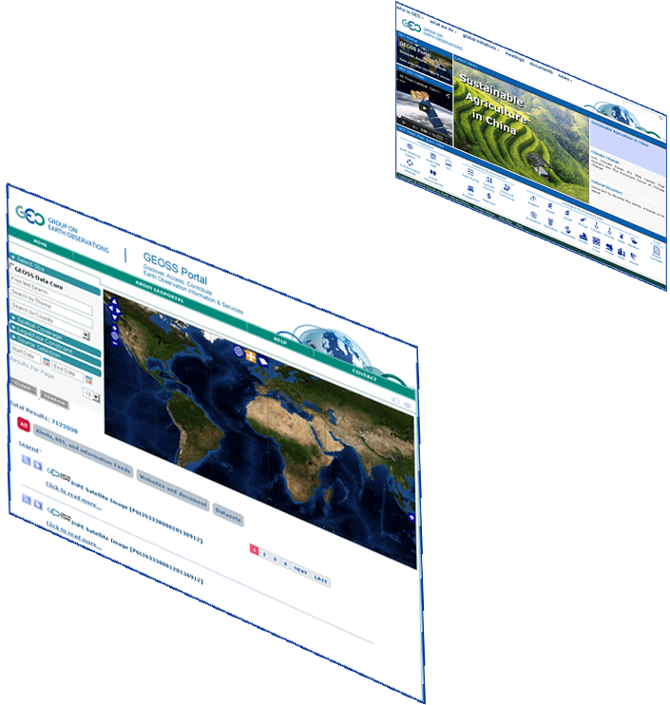









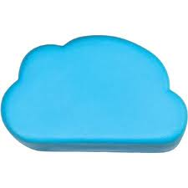




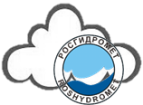
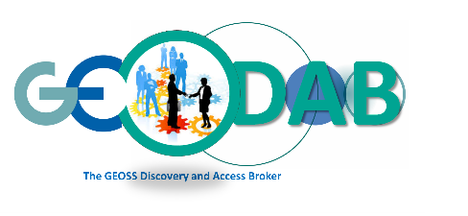





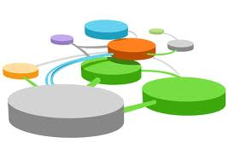














GEOSS Information System
GEO Home Page
GEOSS Portal
More than 40
brokered systems
Systems
Registry
Semantic engines
.. .
.. .
Data Providers Brokered (capacities, systems, networks, etc.)
Private sector(tested interoperability)
Notes:
Added GEOSS Clearinghouse, IDN, and CWIC, moved NOAA, added JAXA

Slide 10

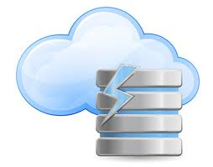







GEOSS Assets (Apr 2015)
More than 40 brokered Data Providers – capacities, systems, Communities
About 40 Million (about 2 Million GEOSS Data Core) Discoverable and potentially Accessible first level resources
(mix of data collections, datasets and individual images)
More than 170 Million (more than 51 Million
GEOSS Data Core) Discoverable and potentially Accessible individual resources
(e.g. satellite scenes, rain gauge records)
.. .
Publish
.. .
Contain [source: data providers]
Resources

Slide 11
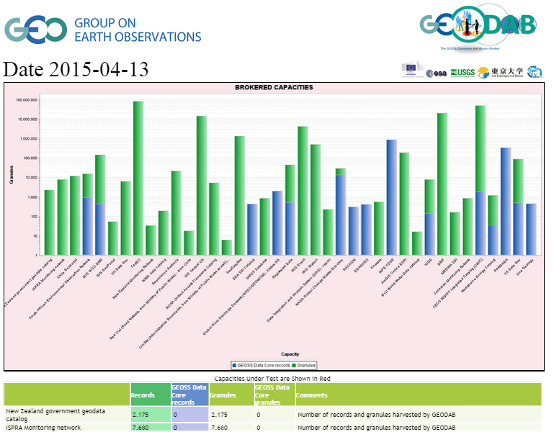

Ongoing Brokering tests:
IGN
DigitalGlobe
GBIF
Geoscience Australia
FP7 GeoCarbon DBs
UK.gov
FAO
RapidEye
EO MAP
…. ..





Slide 12
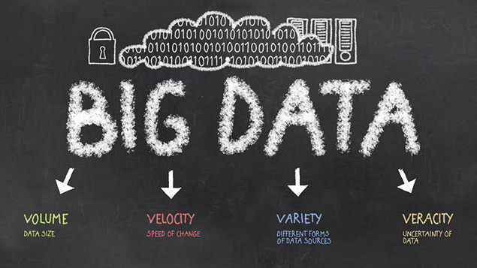
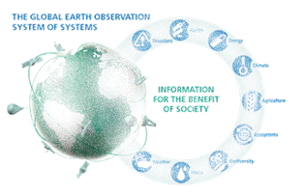


Big Data challenges for GEOSS
  Volume: Millions of discoverable (small & medium) products; Long EO time/space series, … .
Variety: Different product types (data, services, models, documents); Data models; Protocols; Semantics; Granularity levels; Organizations; Maturity level, … .
Veracity/Validity/Value: Evaluation support, Essential Variables, Discovery Ranking, User Feedbacks, … .
Velocity: serve Countries with limited Internet access, Fast Discovery & Access, Data Transformation and Analytics
Visualization: Preview, Tiling services, visual exploration, … .

Slide 13

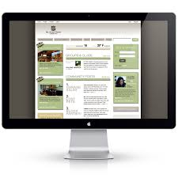
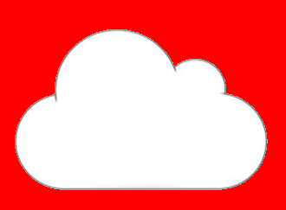




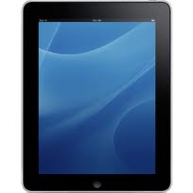

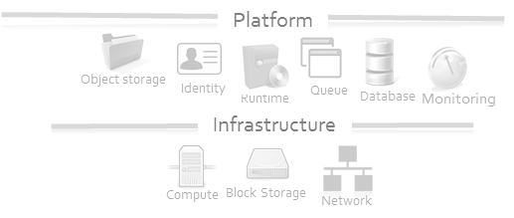





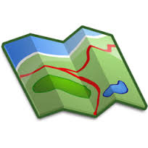
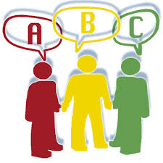





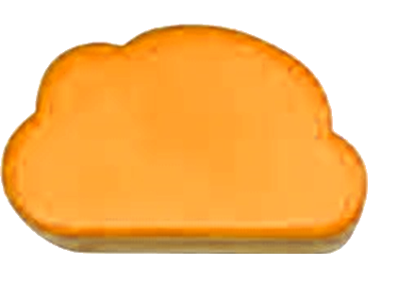

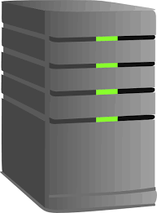


Web Browser
Mobile App
Mobile App
GEO Home Page
GEOSS Community Portals
Hybrid Cloud services
(integrating public and private clouds)
GEOSS Portal
DAB APIs
(Cloud-based)
Software Ecosystem
GWP
Discovery
Evaluation
Processing
(simple)
Visualization
Access
Collaborative-Acknowledged
Management approach
Brokering
Tagging
Workflow mangmt
QoS control
Tiling
Monitoring
Data Server
Platform
GEO DAB
GCI 2.0
Data Server
Infrastructure
[Governance]
GEOSS Providers
… .
GEOSS Providers

Slide 14
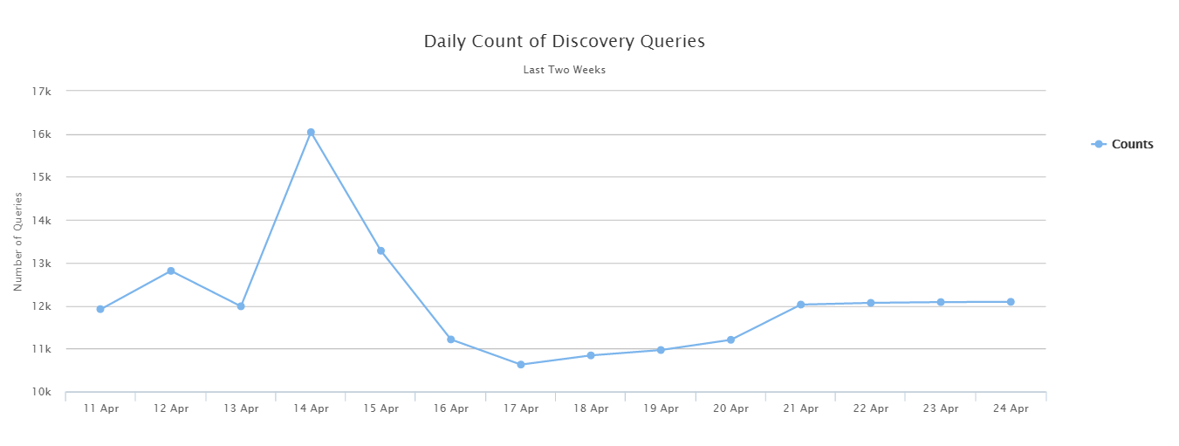
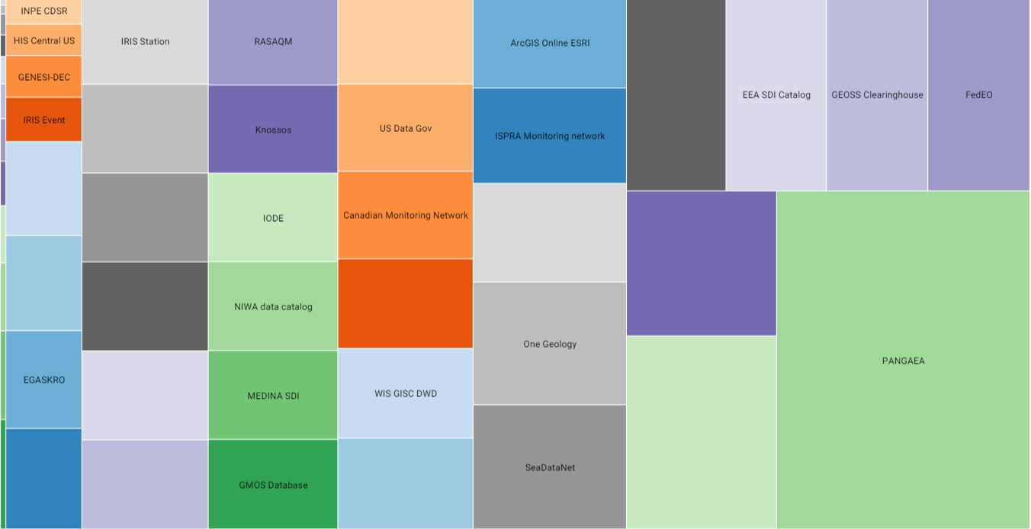
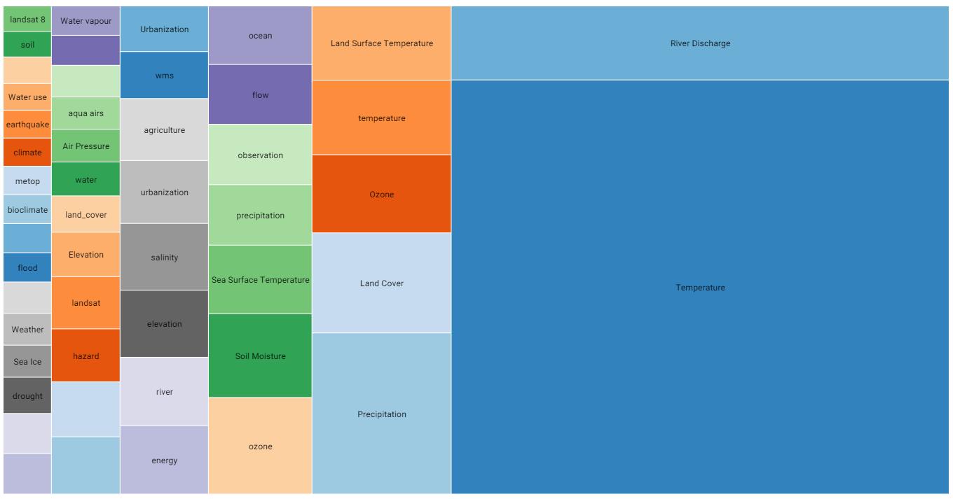
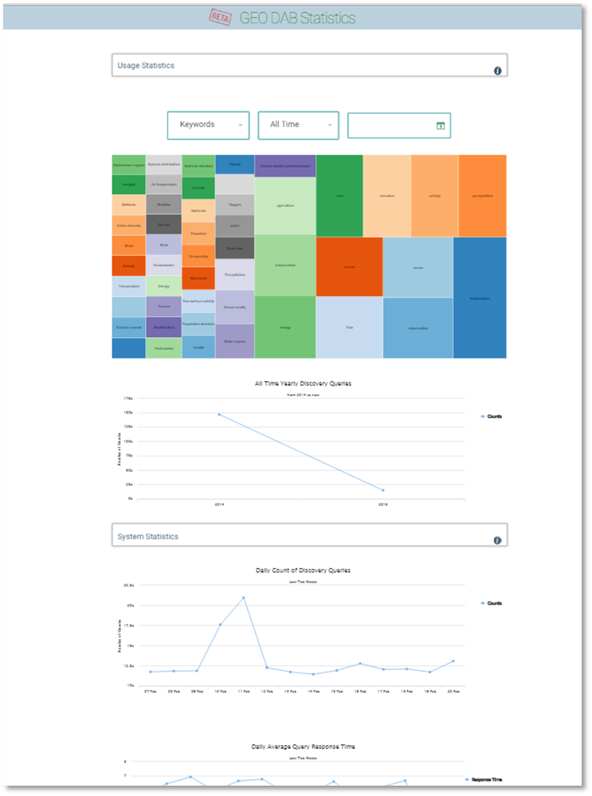
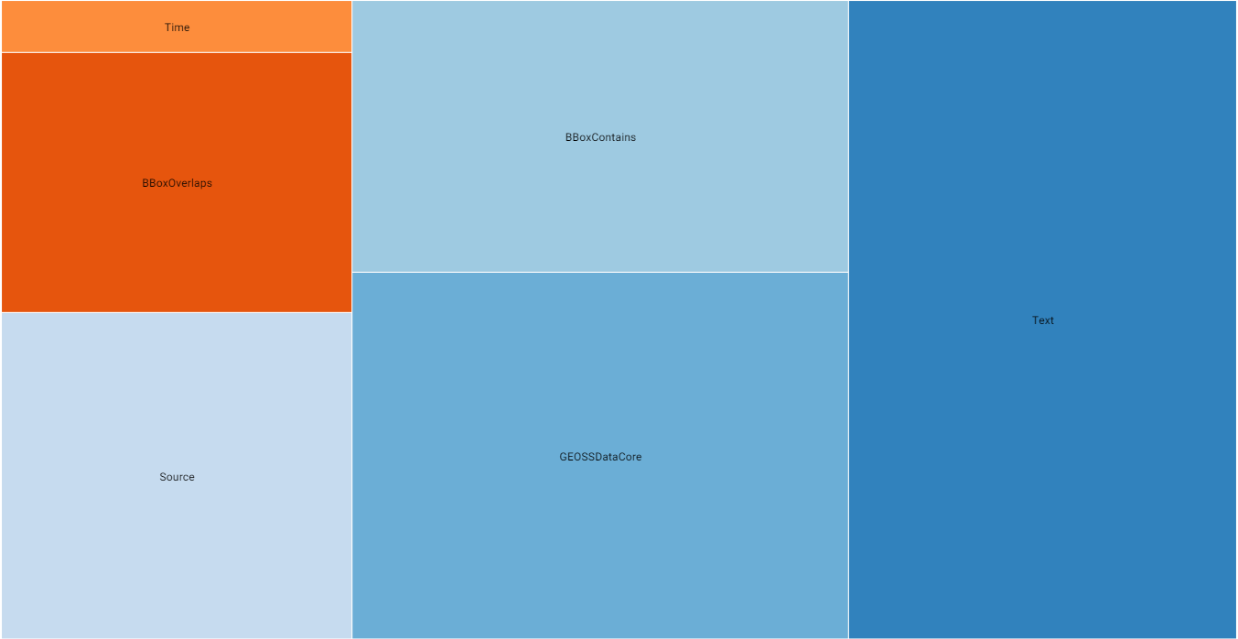
GCI (GEO DAB) Usage Statistics
2014: more than 410 thousands
First 4 months 2015: more than 150 thousands
Last two weeks: around 12 thousand per day
Monitor and assess the GCI/GEO DAB Usage*
All Time
Yearly
Monthly
Daily
Temperature
River Discharge
Precipitation
Lan Cover
…. .
PANGAEA
GRDC GEOWOW
CEOS WGISS
FedEO
EEA SDI
…. .
Number of Discovery Queries finalized
Most Searched Keywords
Most Searched Data Sources
Most Used Query Constraints:
Single constraint
Complex constraint
Keyword
GEOSS Data-CORE
BBOX
… .
* Only User’s requests contribute to the statistics

Slide 15
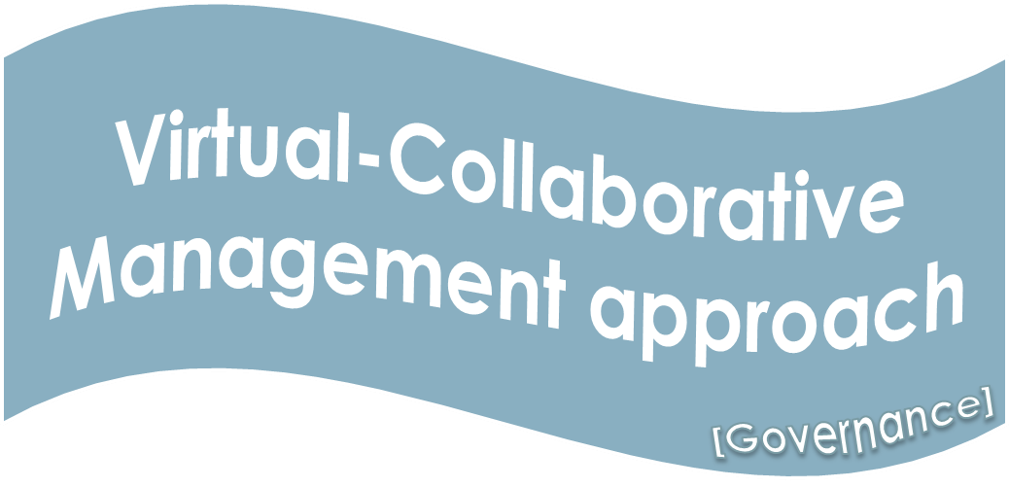
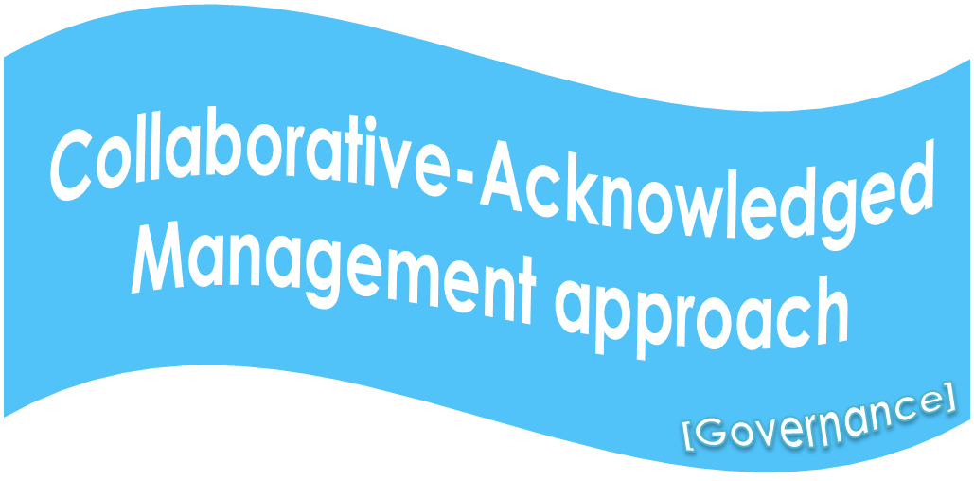
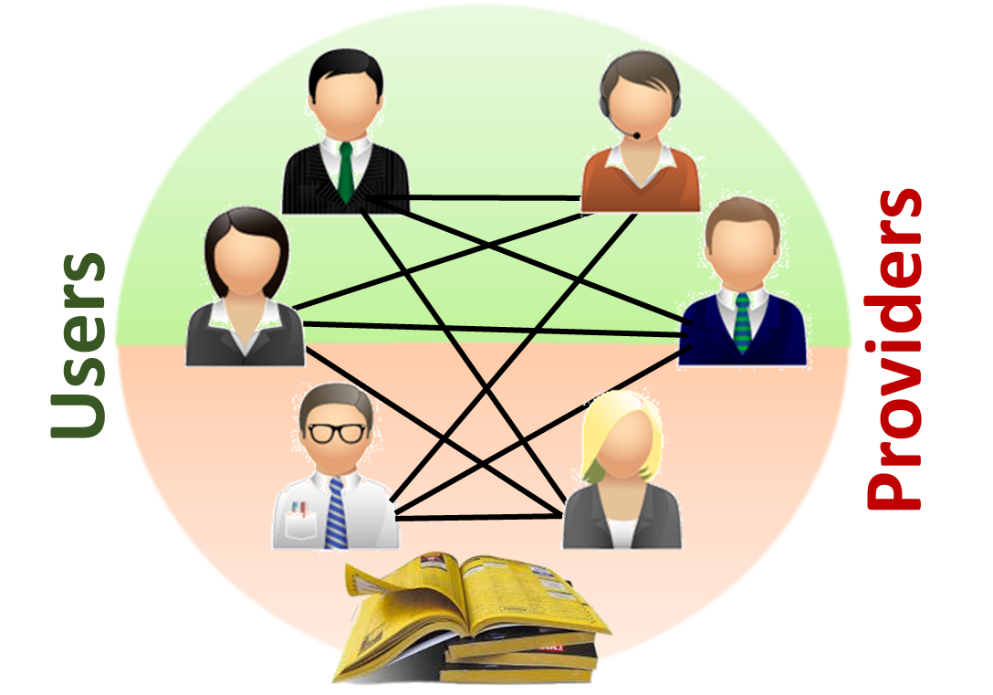
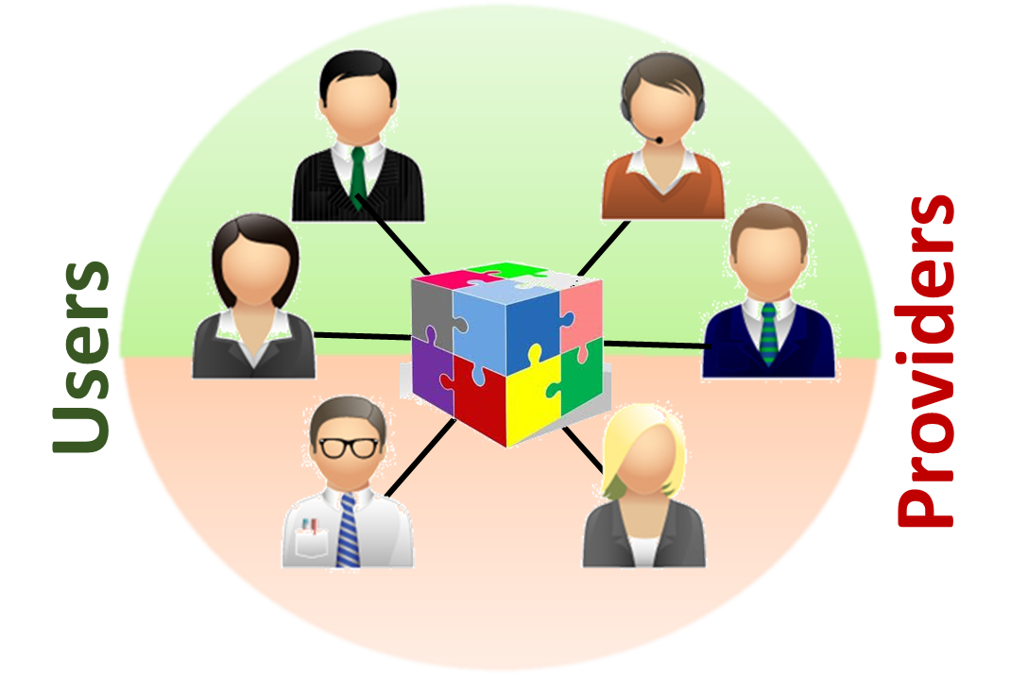
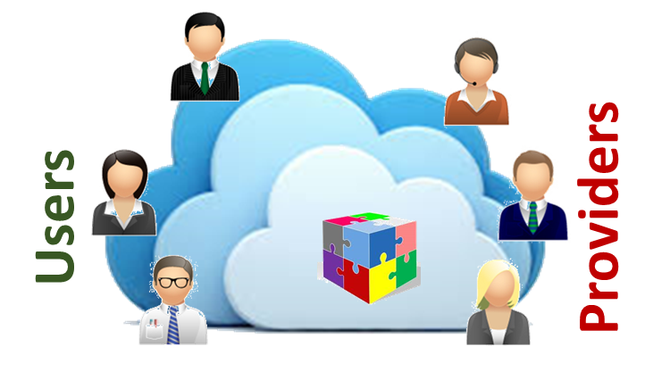
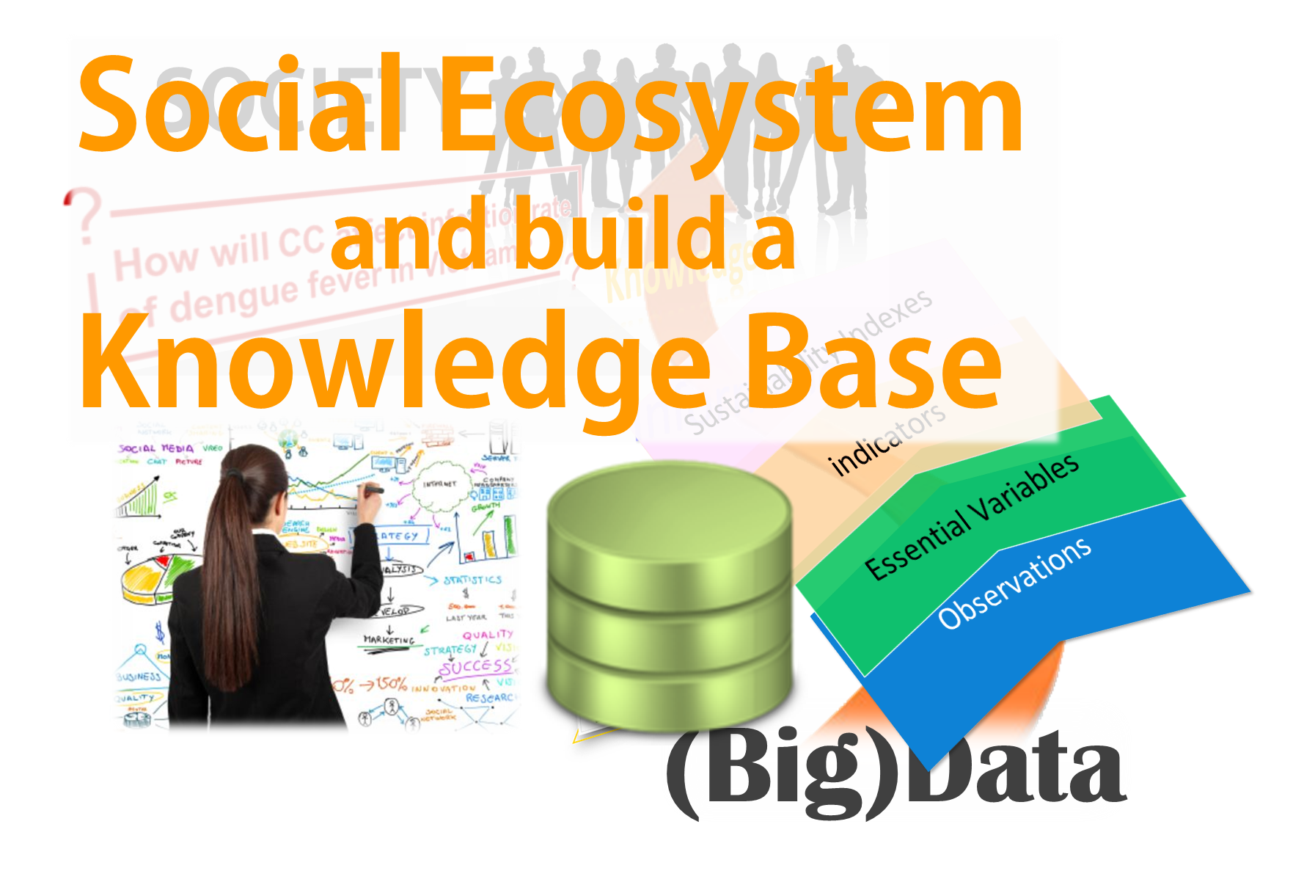
The Architectural Evolutions
2005
2011
2013
2016
1st Evolution
2nd Evolution
[Service driven]
Catalog of catalogs
3rd Evolution
[Brokering pattern]
Brokering framework
4th Evolution
[Big Data]
Cloud-based EcoSystem
[VRE]
… .
Discovery
Access
(re-)Use

Slide 16

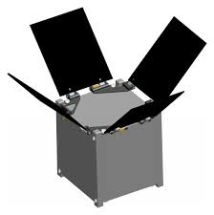



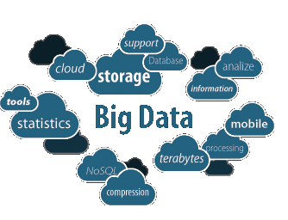
CROWDSOURCING
PICO SATELLITES
SMART CITIES
CLOUD COMP.
ANALYTICS
CONSUMERIZATION
CITIZEN OBSERVATORIES

Slide 17
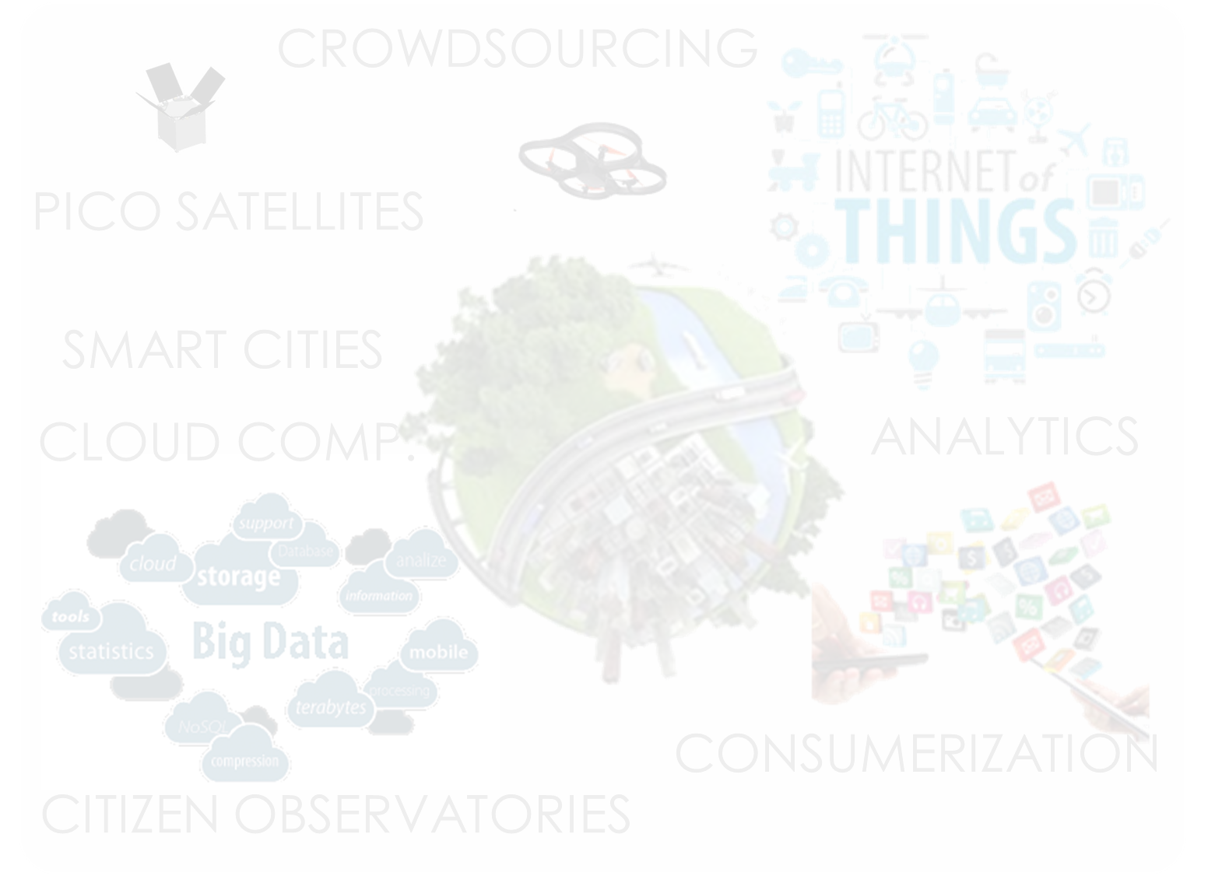
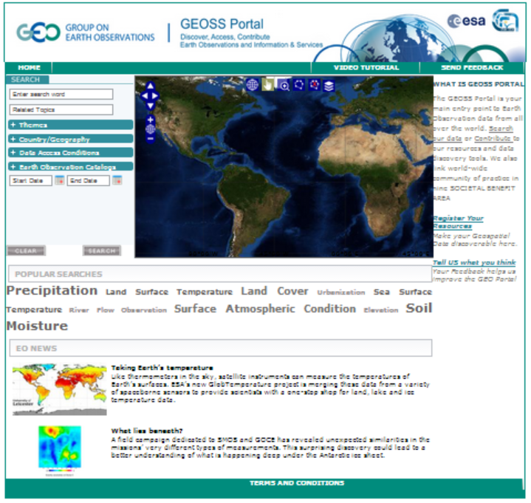















Private Company Systems
Community
Portals
GEOSS
Portal
… .
GEOSS Information
System
(GCI 3.0)
SoS
Brokering Framework
Software Ecosystem
(Cloud based)
GEOSS Knowledge Base
… .
Simplified GEOSS Registration
Public Systems
GEOSS interdisciplinary
Collaboration & Social
services
NGO systems

Slide 18


2005 GEOSS Implementation Plan Reference Document
Expert Knowledge
Models
Socio-economic Data
EO Data
Models
KNOWLEDGE
Socio-Economic Data
Earth Observation Data

Slide 19








What if…
Social Science
Socioeconomic
Fossil Fuel Use Model
[Source: Gary Geller, GEO Sec]
Data
Climatology
Global Climate
Model
Regional
Climate Model
Observational Data
(environment &
vector distribution)
Data
Data
Data
Health
Deforestation/
Disturbance Model
Vector Niche
Model
Infection
Rate Model
Biodiversity
Data
Human Population Density
and Distribution Model
Infection Rates
Social Science

Slide 20

Resources…
Data

Slide 21

Resources…
Data
Model

Slide 22






Resources…
Data
Model
Link (Integration)
Knowledge Bases (ontologies)
Semantic services
Brokers

Slide 23



Resources…
Business Process
Data
Model
Link (Integration)

Slide 24




GEO Model Web
A dynamic web of models, integrated with databases and websites, to form a consultative infrastructure where researchers, managers, policy makers, and the general public can go to gain insight into “what if” questions
[Coordinators: Stefano Nativi (CNR) and Gary Geller (GEO sec)]

Slide 25




From Data to
Knowledge
«algorithm»
2015
next decade
2020
BP
«algorithm»
BP
addressedBy
«Wisdom»
What if ...
1..*
0..*
«algorithm»
BP
«algorithm»
BP
Social Ecosystem
1..*
relatedTo
0..*
«Wisdom»
Scientific
Challenge

Slide 26









Data Volume
Users
EO Data Experts
(IT experts)
Environmental Experts
(Practitioners)
Global Change Experts
(Educators)
Policy Makers
(Citizens)
Tomorrow
Re-use
Today
Interoperability Level
Access
Discover
Observations
Essential Variables
Indicators
(Sustainability) Indexes
From Data to Knowledge

Slide 27
GCI 2.0 Achievements
(From a “Catalog of Catalogs” to) a multi-disciplinary Brokering Platform
(From discoverability to) accessibility and harmonization
(From an infrastructure to) cloud-based software ecosystem
(From a virtual governance to) collaborative-acknowledged governance

Slide 28
Future Work
From Observation to Knowledge management
Add socio-economic data
Add scientific models
Establish a Social ecosystem (a VRE) to capture expert knowledge
From accessibility to re-usability and re-producibility

Slide 29
Thank you !
Questions?

Slide 30
Generally Recognized Barriers (especially for GEOSS)
Problem: service users need to know the nature and location of service providers,
  making it difficult to bind and dynamically change the bindings between users and providers
Solution: The broker pattern separates users of services (clients) from providers of services (servers) by inserting an intermediary, called a broker.
  When a client needs a service, it queries a broker via a service interface. The broker then forwards the client’s service request to a server, which processes the request

