Slide 1
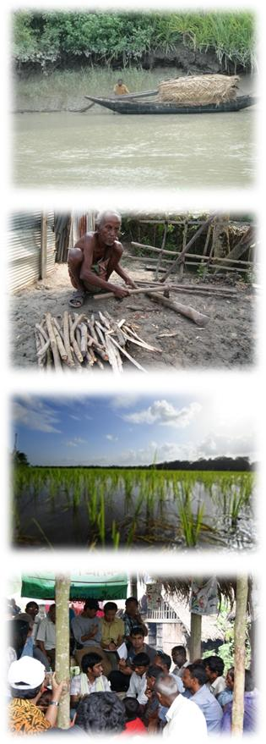





Deltas as Coupled Socio-Ecological Systems
Robert J. Nicholls
University of Southampton
CSDMS Meeting
23-25 May 2017
Boulder, CO

Slide 2

Plan
Introduction
Bio-physical and socio-economic components for coastal Bangladesh
Integration: Delta Dynamic Integrated Emulator Model (ΔDIEM)
Illustrative results
Concluding remarks

Slide 3
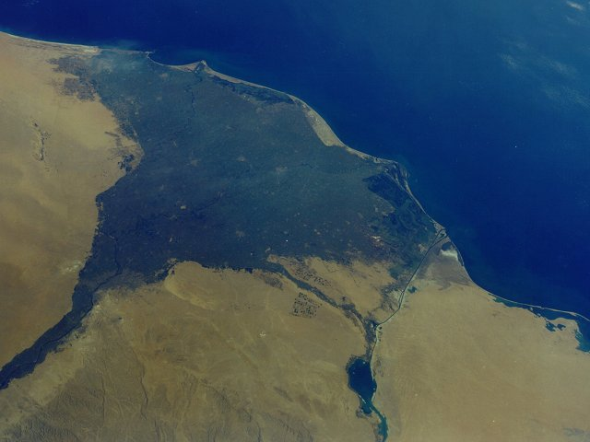
Nile delta

Slide 4
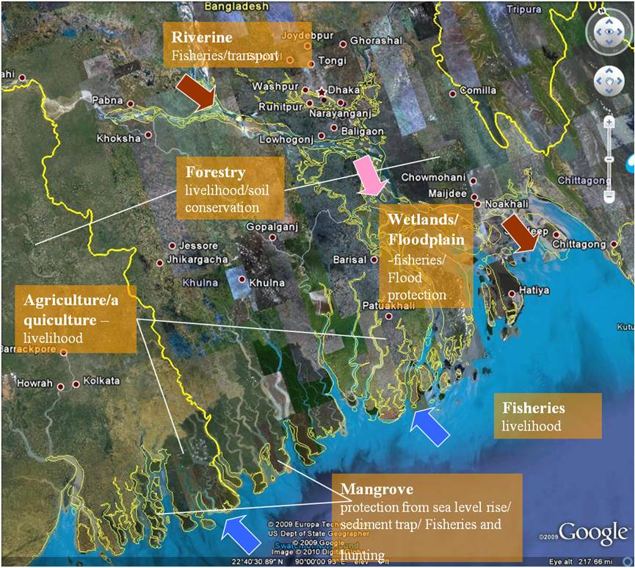
Ecosystem Services/Activities in GBM delta
Key Ecosystem Services:
Provisioning/Supporting:
Riverine
(Fisheries/Navigation)
Forestry
(livelihood/soil conservation)
Agriculture/Aquaculture
(livelihood)
Wetlands/Floodplains
(Fisheries/flood protection)
Marine Fisheries
(Livelihood)
Mangrove
(protection from sea level
rise/sediment trap/fisheries)
Key Ecosystem Services

Slide 5
Ecosystem Services for Poverty Alleviation (ESPA)
ESPA is a £40 million international research programme on this issue in developing countries.
ESPA is explicitly interdisciplinary, linking the social, natural and political sciences and promotes systems thinking of social and ecological systems.
ESPA Deltas (“Assessing Health, Livelihoods, Ecosystem Services And Poverty Alleviation In Populous Deltas”) was the largest ESPA Consortium Grant
(Duration: 2012 to 2016)
Active ESPA Deltas Continuation working with Planning Commission, Government of Bangladesh
(1 April 2017 to 31 March 2018)

Slide 6
ESPA Deltas Project Assessing Health, Livelihoods, Ecosystem Services And Poverty Alleviation In Populous Deltas – Ganges-Brahmaputra-Meghna (GBM) Delta
Source: http://dx.doi.org/10.1016/j.ecss.2016.08.017

Slide 7
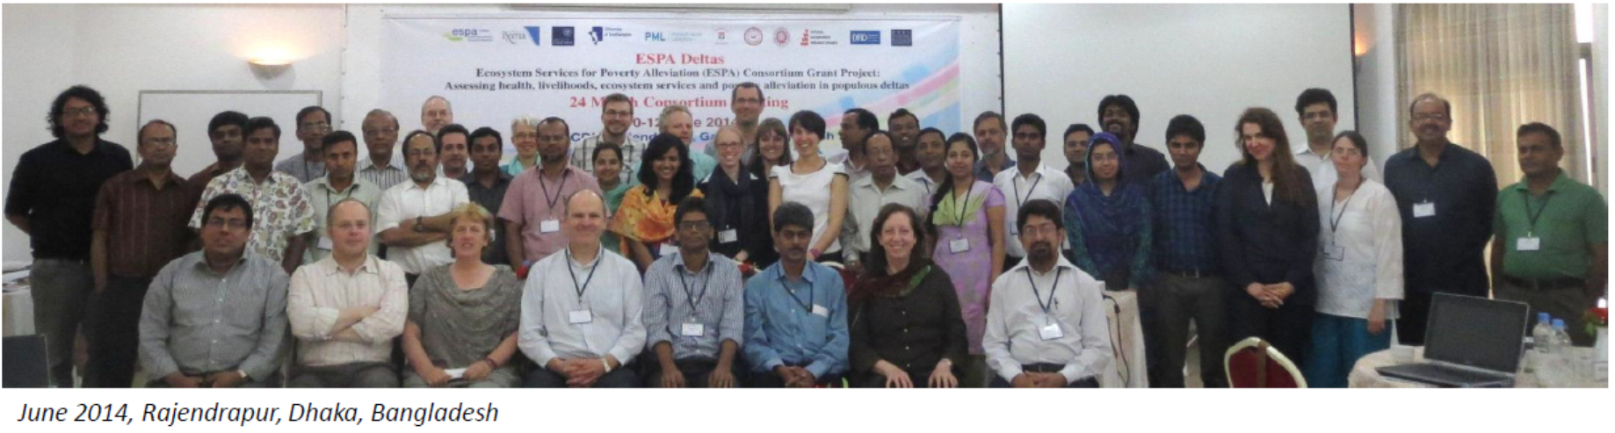
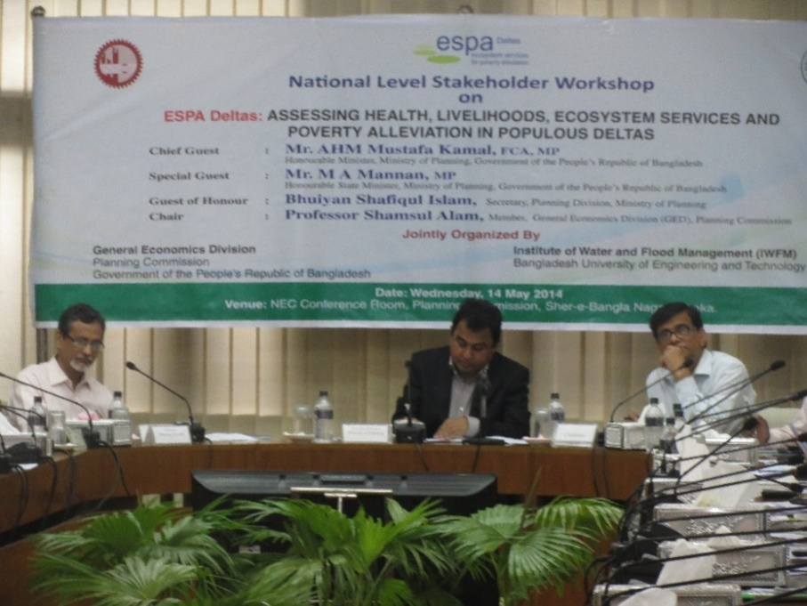
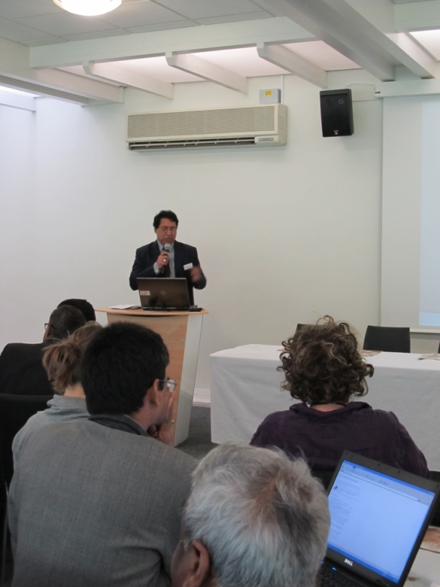

The ESPA Delta Consortium 21 partners and about 100 members from a range of disciplines
UK (7 partners)
University of Southampton- Lead Robert Nicholls PI
University of Oxford
Exeter University
Dundee University
Hadley Centre MET office
Plymouth Marine Laboratories
National Oceanography Centre Liverpool
Bangladesh (12 partners)
Institute of Water and Flood Management, Bangladesh University of Engineering and Technology (BUET) – Prof Rahman Lead PI
Bangladesh Institute of Development Studies (BIDS)
Institute of Livelihood Studies (ILS)
Ashroy Foundation
Institute of International Centre for Diarrhoeal Disease Research, Bangladesh (ICDDR,B)
Center for Environmental and Geographic Information Services (CEGIS)
Bangladesh Agricultural University
Bangladesh Agricultural Research Institute (BARI)
Technological Assistance for Rural Advancement (TARA)
International Union for Conservation of Nature (IUCN)
University of Dhaka
Water Resources Planning Organization (WARPO)
India (2 partners)
Jadavpur University: Indian Lead
IIT Kanpur
Strategic Partner: General Economic Division, Planning Commission

Slide 8
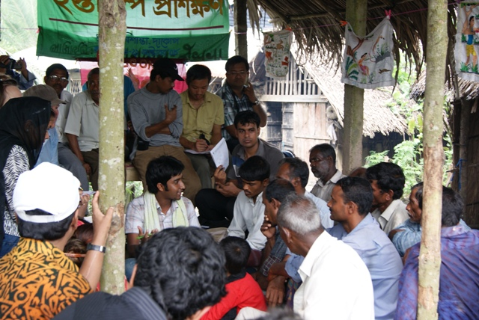
ESPA Deltas: Overarching aim
To provide policy makers with the knowledge and tools to enable them to evaluate the effects of policy decisions on ecosystem services and people's livelihoods
Vision: Link science to policy at the landscape scale
Engagement: With national level policy processes that impact at a community level

Slide 9
Key biophysical factors and links to governance and socio-economic factors
Source: http://dx.doi.org/10.1016/j.ecss.2016.08.017

Slide 10
The Approach
Analysis of present and future ecosystem services and human livelihoods in coastal Bangladesh requires:
integration of the social, physical and ecological dynamics of deltas
identification and quantification of the mechanisms by which the system components interact to produce human well-being
Hence, the Project:
applied participatory techniques to engage stakeholders to identify issues, develop scenarios and discuss results
determined which physical and biological processes affect life, livelihoods, health and mobility
analysed and quantified these relationships
developed a predictive model to analyse scenarios and explore possible futures

Slide 11
The Approach
Source: http://dx.doi.org/10.1016/j.ecss.2016.08.017

Slide 12
ESPA Deltas: Components
Climate
HadRM3/PRECIS
Laws, policies:
Gaps, conflicts, implementation efficiencies
Sea level, Sea Surface Temperature, Winds, etc.
Temperature, Rainfall, Potential Evaporation, etc.
Stakeholder engagement:
Key issues, scenario development, iterative learning
Bay Bengal:
GCOMS
Upstream Basin:
INCA,
MODFLOW,
HydroTrend
Governance Analysis & Stakeholder Engagement
Surge level
Water, Sediment, Nutrients, Salinity
Knowledge integration (ΔDIEM)
Scenario development & quantification
Delta Plain
FVCOM,
Delft3D,
MODFLOW
Soil
salinity
Agriculture CROPWAT
Qualitative household survey:
Ecosystem services versus livelihoods
Flooding
Aquaculture
Quantitative household survey: Consumption, assets, employment, migration, health, poverty, etc.
Water, Salinity,
Sediment
Mangrove
Morphology Land Cover Land Use
Coastal Fisheries
Size- & species-based models
Statistical Associative model:
Land use, environment, socio-economy, census
Population projections
Primary productivity, Temperature, Salinity, Oxygen, Currents
Economic analysis
Quantitative Biophysical Models
Socio-Economic Data Collection & Analysis
Source: http://dx.doi.org/10.1016/j.ecss.2016.08.017

Slide 13
Delta Dynamic Integrated Emulator Model (ΔDIEM)
Interdisciplinary tool
- environment
- socio-economy
- demography
- governance
Builds on
- high fidelity models,
- secondary data
- ESPA Deltas household survey (1486 households, three times over a year)
- expert knowledge (ESPA Deltas team, stakeholders)
Meta-model
- harmonises scales & methods
- fully coupled
- ‘quick’ running time

Slide 14
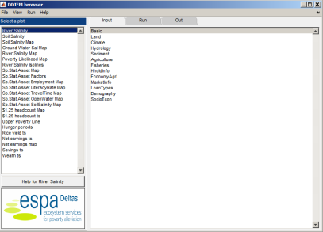

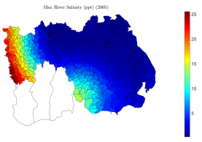
The participants in ΔDIEM development
Five main groups of participants
Stakeholders
Households
ESPA Deltas team
Integrators
Users
50+ agencies
1486 surveyed households
~100 specialists
Climate
Demography
Agriculture
Oceanography
Fisheries
Mangroves
Social science
Economics
Water resource management

Slide 15



Delta Dynamic Integrated Emulator Model (ΔDIEM)
Iterative learning
Long iteration route that involves seeking advice from a broader team
Shorter iteration, running ΔDIEM with different inputs, SSPs,…
v
Users

Slide 16
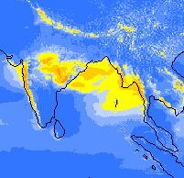
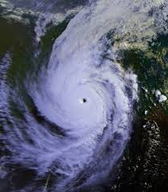
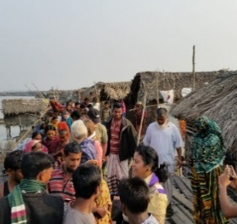
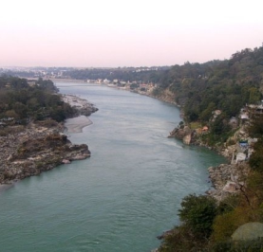
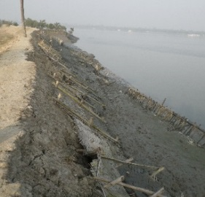
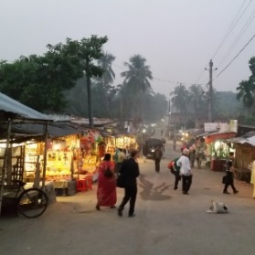
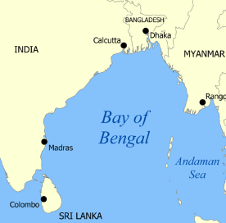
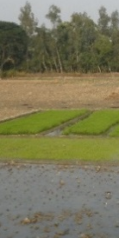
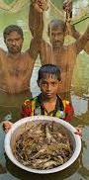

ΔDIEM – Main Inputs
Climate
Hazards
Demography
-precipitation
-temperature
-evaporation
-cyclone
-storm surge
-life expectancy
-fertility rate
-migration rate
Hydrology
Levees/Polders
Economy
-discharge
-sediment
-location
-height
-drainage rate
-market price
-cost of farm inputs
-wages
Ecosystem
Services
Bay of Bengal
Governance
-mean sea level
-(subsidence)
-agriculture
-aquaculture
-fisheries
-mangroves
-subsidies
-land use planning
-infrastructure
planning

Slide 17
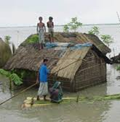
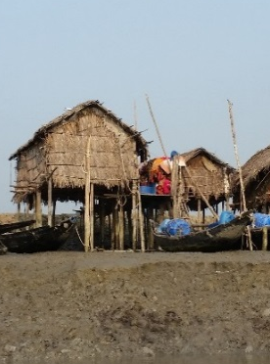
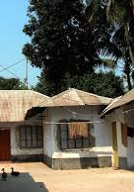
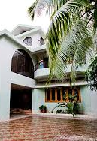
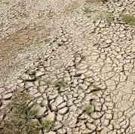
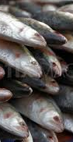
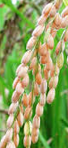
ΔDIEM – Main Outputs
Coastal hydrology
Wellbeing, Poverty & Health
water elevation
inundated area
inundation depth
Salinisation
I. Household outputs:
a) Bayesian statistical module:
asset-based relative poverty indicator
b) Process-based module:
economics (income, costs/expenses, savings/assets)
relative wealth-level
calories / protein intake / BMI
monetary poverty indicators
river salinity
groundwater salinity
union-wise soil salinity
crop productivity
Livelihoods
fish catches
net earnings from
- farming,
- aquaculture &
- fishing
II. Regional economic outputs
sectoral output (tons, BDT)
GINI
GDP/capita
income tax revenue
household debt level

Slide 18
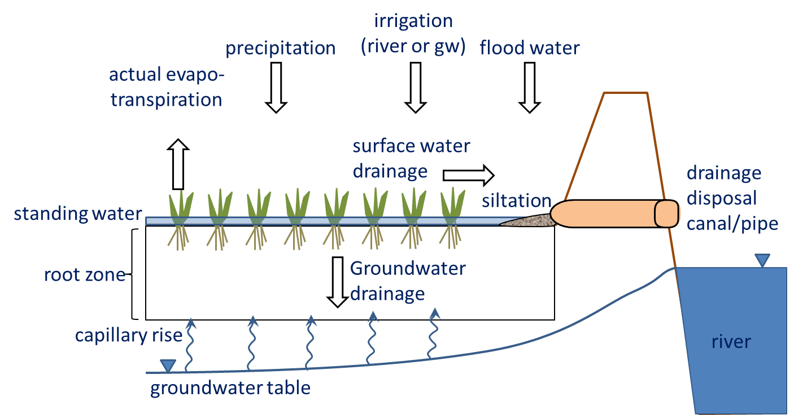
Delta Dynamic Integrated Emulator Model (ΔDIEM)
Bio-physical environment emulation is based on high fidelity models
Climate (Met Office Hadley Centre)
Hydrology (INCA, Delft-3D, FVCOM, MODFLOW-SEAWAT)
Bay of Bengal (POLCOMS-GCOMS, fisheries species model)
Mangrove (SLAMM, Markov chain & cellular automata model)
Own development
Statistical emulation method of
complex numerical models
Regional soil salinity model
Extended FAO CROPWAT model
Soil salinity conceptual model

Slide 19
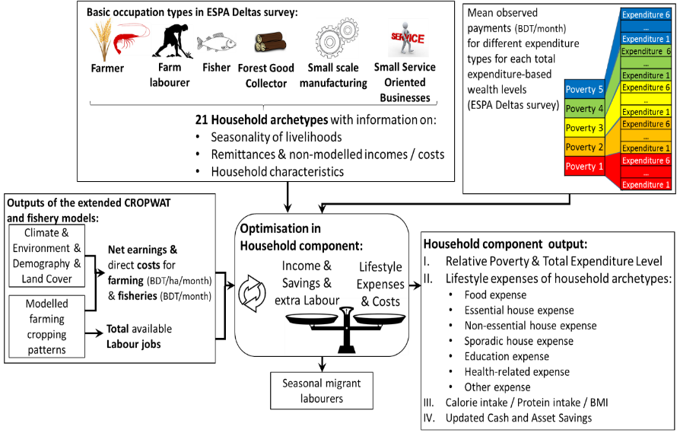
Delta Dynamic Integrated Emulator Model (ΔDIEM)
The novel household component is built on
primary data (ESPA Deltas household survey)
secondary data (BBS, HIES)
expert knowledge
Key features:
30+ household archetypes based on seasonality of livelihoods
economic decisions (i.e. coping strategies including loans)
poverty/health indicator outputs

Slide 20
Delta Dynamic Integrated Emulator Model (ΔDIEM)
Verification:
programming bugs
ΔDIEM outputs vs. high fidelity simulator outputs
coupled ΔDIEM outputs: make sense?
Validation:
ΔDIEM outputs vs. other datasets (spatially / temporally)

Slide 21
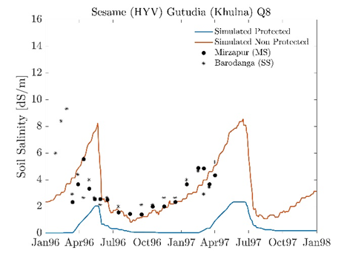
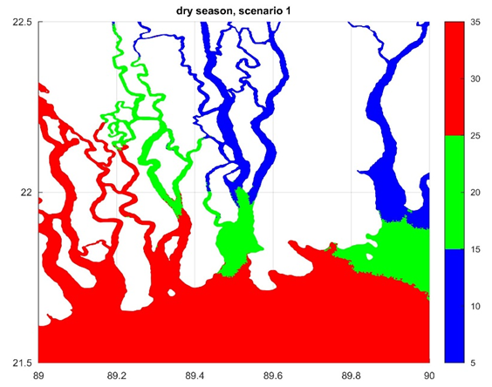
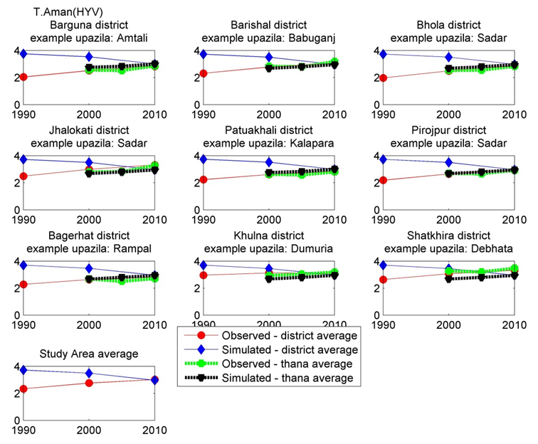
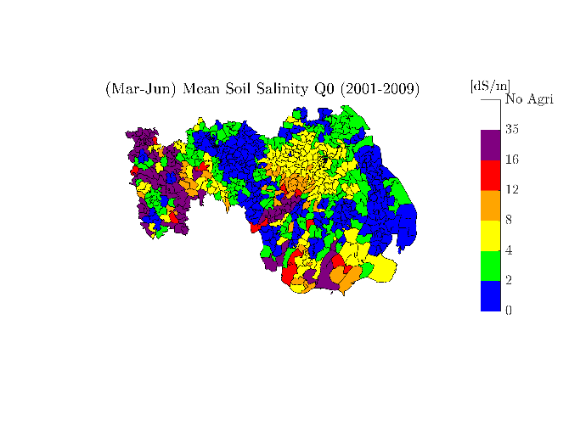
Delta Dynamic Integrated Emulator Model (ΔDIEM)
Verification / Validation (some examples)
soil salinity under Sesame
Observed: Mondal et al. (2001)
FVCOM results
(Q0 BaU, year 2000)
Observed soil salinity (SRDI, 2012; average monthly for 2001-2009)
ΔDIEM simulated
Union level
(BaU, Q0, year 2005)
Observed vs. simulated
T. Aman (HYV) yield (tons ha¹)
ΔDIEM emulated Union level
(BaU, Q0, year 2005)

Slide 22
Delta Dynamic Integrated Emulator Model
Verification / Validation
Black lines: simulated mean study area values,
Shaded area: min-max simulated range within the study area,
grey dots and diamonds: observations.
Observations:
BBS (2011) HIES, Table 4.4
BBS (2011) HIES, Table 5.3
BBS (2011) HIES, Table 5.4
dots: rural inequality: Ferdousi and Dehai (2014), Diamonds: national inequality - UNDP (http://hdr.undp.org/en/content/income-gini-coefficient)
World Bank: People living on less than $1.90 a day (http://povertydata.worldbank.org/poverty/country/BGD)

Slide 23
Scenario Framework and Participatory Methods (Iterative Learning Loop)
Development Scenarios
 | Less Sustainable (LS) | Business As Usual (BAU) | More Sustainable (MS)
Q₀
Q₈
Q₁₆
X
Q0MS
SRES A1B (RCP 6.0 - 8.5)
By 2050
X
Q8BAU
X
Q16LS
Key observations on stakeholder engagement
A workshop can be no more than a day
Narratives are a key communication device
Source: http://dx.doi.org/10.1016/j.ecss.2016.08.017

Slide 24
Scenario Examples
Climate, sea level and subsidence
Cropping patterns
Land cover
River flow and nutrient inputs (from INCA model)
Fisheries (from PML models)
Economic growth
Demography
Etc.

Slide 25
Bay of Bengal total catches and values
(i) Fisheries Scenarios – from PML models
Current catches are not sustainable, but significant fisheries can be sustained with appropriate management
Notes:
Smoothed curves: 5-year moving average

Slide 26
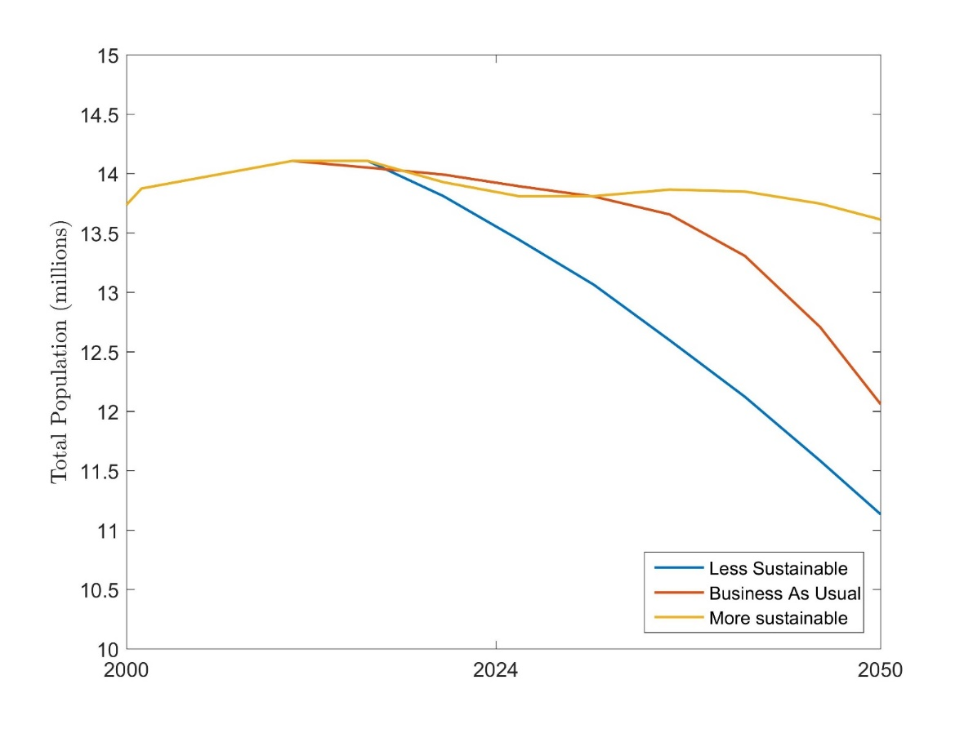
(ii) Demographic scenarios of study site
Population of study area is expected to decline under all scenarios
Notes:
Plot one figure with 3 lines

Slide 27
(iii) Economic scenarios
Economic input variable | Less Sustainable | Business As Usual | More Sustainable
Cost of agriculture (seed, pesticide, fertiliser types) | 0 | 10 | 20
Cost of aquaculture (feed, post larvae, fishling) | 20 | 10 | 0
Cost to keep livestock/poultry, fishing, Forest collection | 0 | 10 | 20
Land rent cost (farming) | 0 | 10 | 20
Cost to do Services & Manufacturing business | 20 | 0 | -20
Market (selling) price of agriculture crops | 0 | 10 | 20
Market (selling) price of fish | 30 | 10 | 20
Market (selling) price of aquaculture crops (shrimp) | 0 | 10 | 20
Income from forest goods (honey, fruits, timber, etc.) | -20 | -10 | 0
Income from Manufacturing, Services and Livestock/Poultry | 65 | 110 | 165
Remittances (BDT/month) | 20 | 30 | 40
Household expenses | 0 | 10 | 20
Daily wage (without food) (BDT/day) | 0 | 10 | 30
Cost of diesel (BDT/gallon) | 0 | 10 | 20
Employment rate (% population) | 0 | 10 | 30
Literacy rate (% population) | 2 | 4 | 8
Children in school (% population)* | 2 | 5 | 10
Travel time to major cities * | -10 | -30 | -50
USD/BDT exchange rate & PPP exchange rate* | 0 | 0 | 0
Percentage change in ΔDIEM Economic Input Variables by 2030
No further change after 2030

Slide 28
Illustrative Results

Slide 29
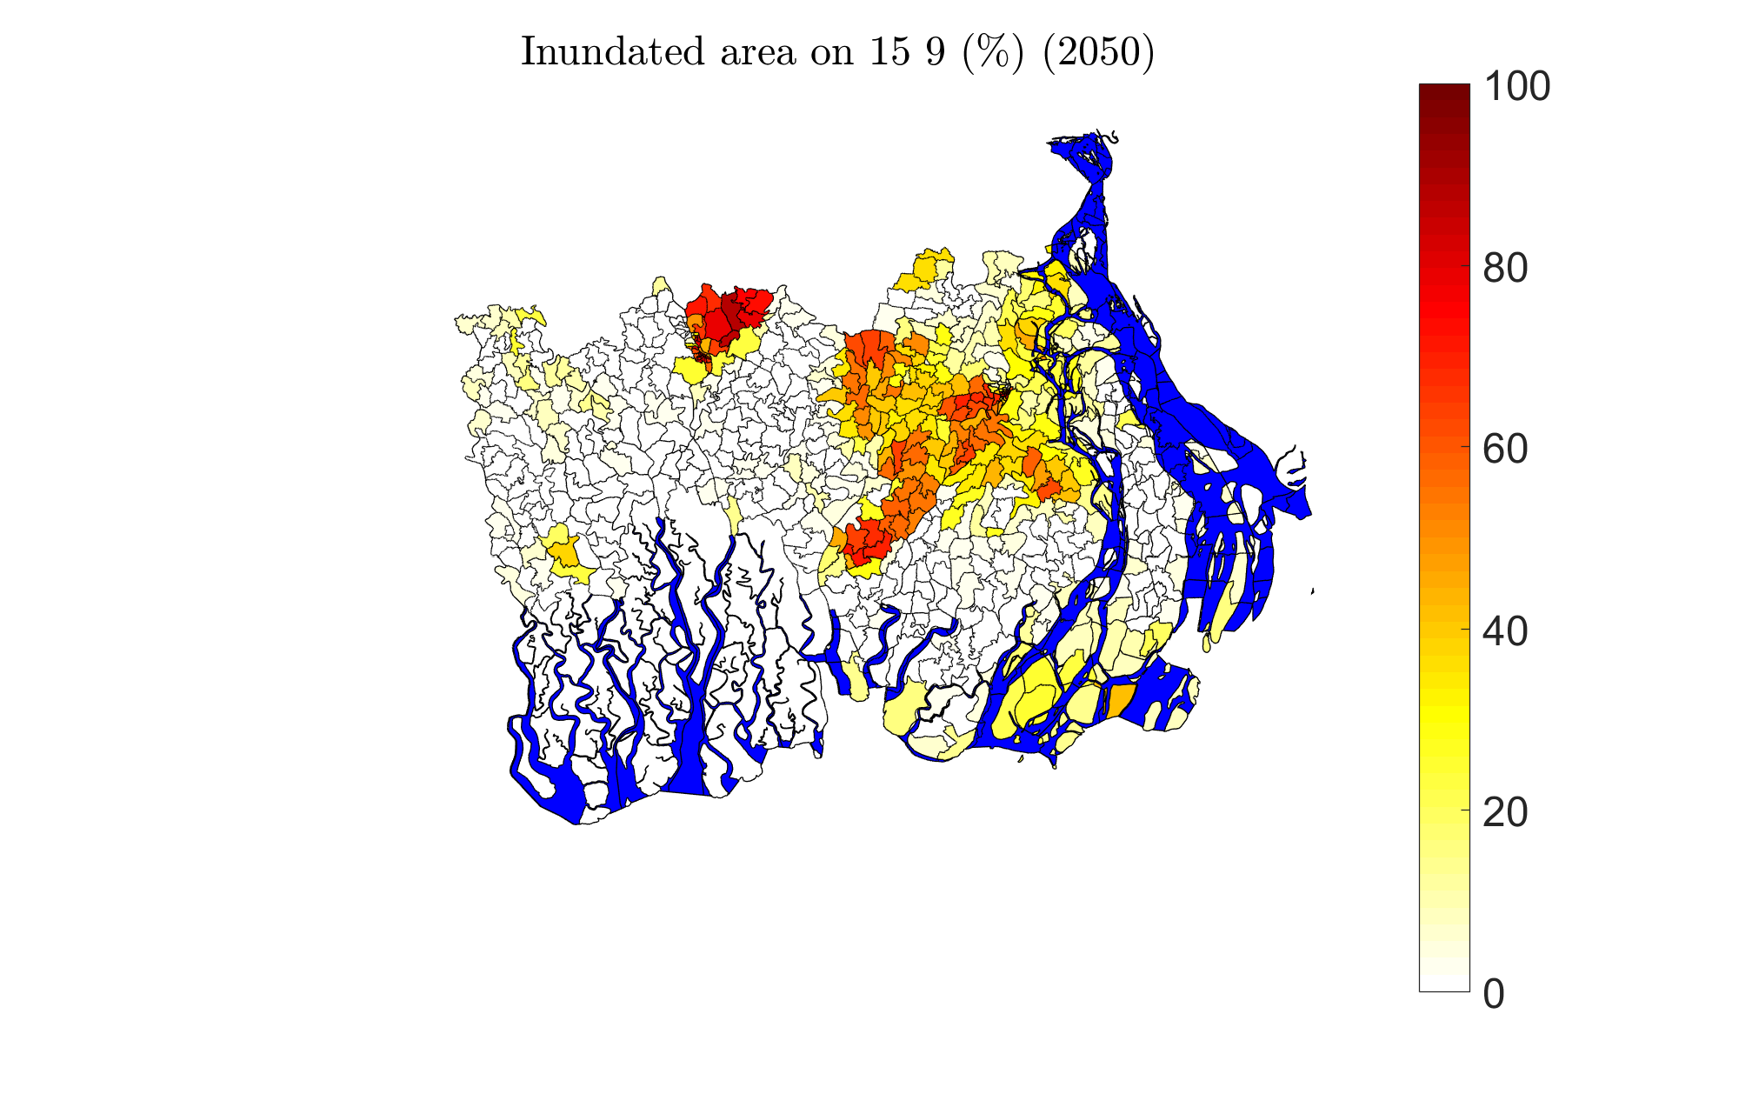
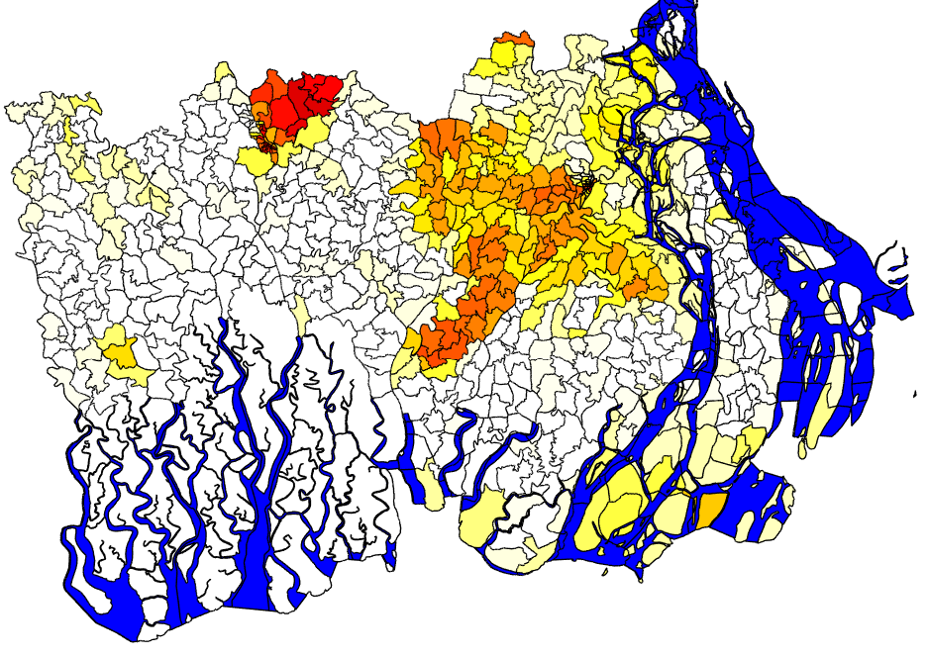
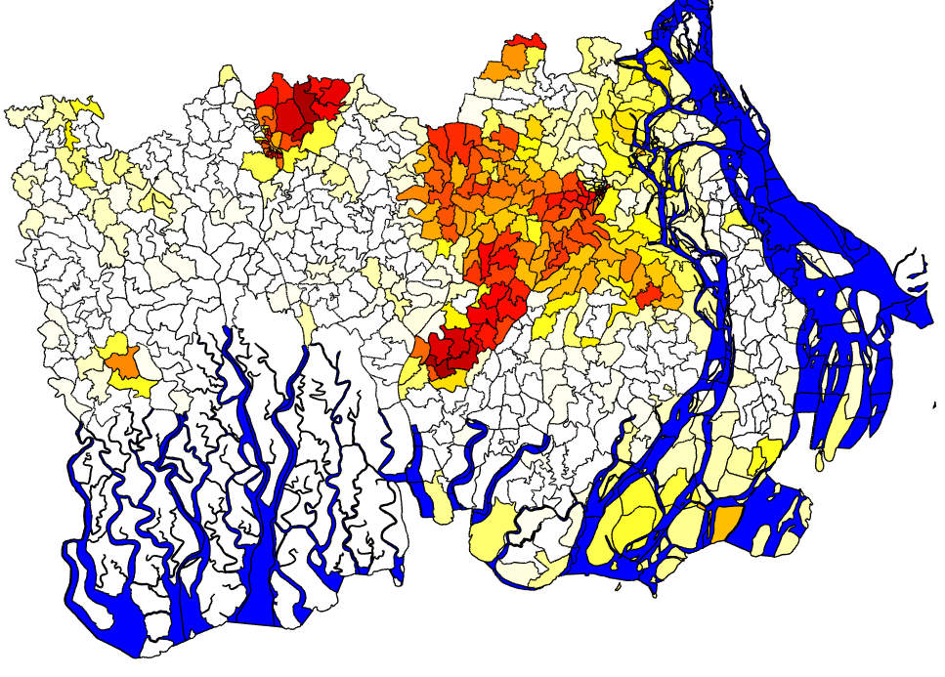
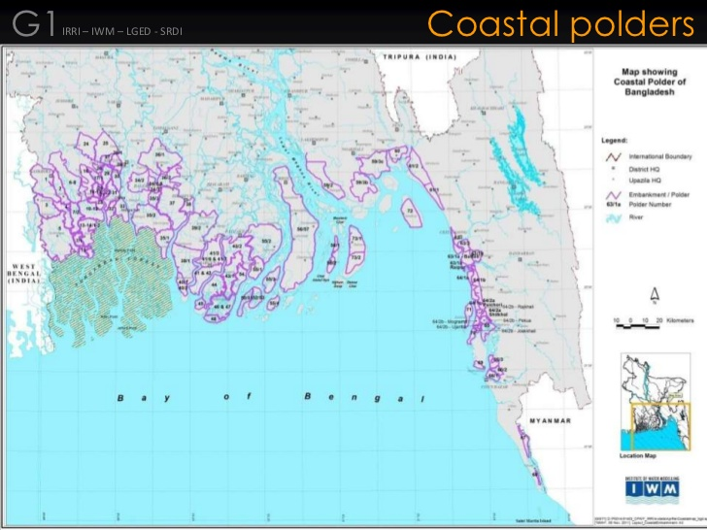
Inundated area at end of monsoon 15 September 2050, Across scenarios, (% of union area)
Q0MS
Q8BAU
Q16 LS

Slide 30
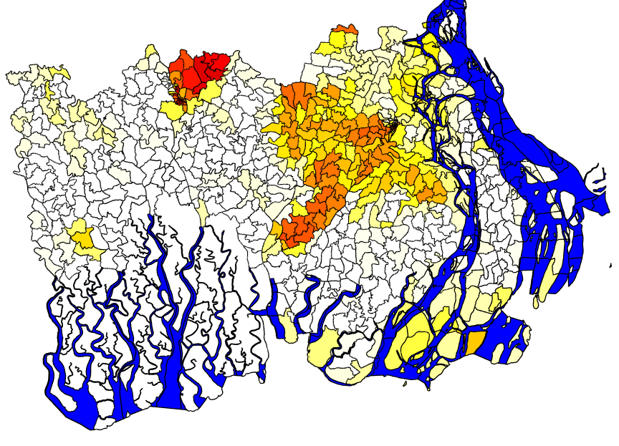
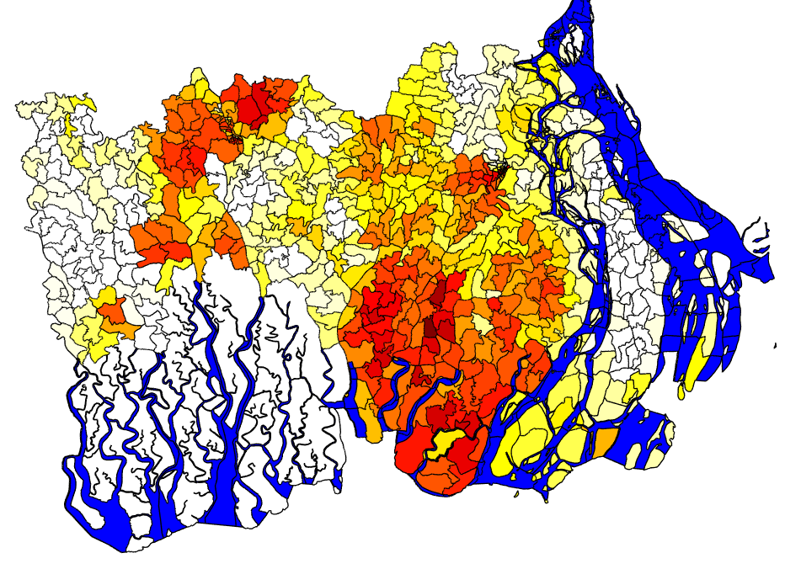
Inundated area at end of monsoon 15 September 2050, Q8BAU changing dike height, (% of union area)
+3 meters
Design height
-3 meters

Slide 31
Crop yield in 2050 (fraction) mean across all crops and seasons
Higher yield and more salt tolerant crops perform better
Crop variety depends on the development scenario.
Notes:
Mean for all crops

Slide 32
Provisioning Ecosystem Services Socio-economic situation
Less Sustainable (LS)
Business As Usual (BAU)
More Sustainable (MS)
Inter-annual variability
Greatest for environmental hazards; Moderate for provisioning ecosystem services; Minimal for socio-economic indicators

Slide 33
Dominance of livelihoods (Q₀BAU) Six examples from the 37 archetypes
Ecosystem Service-based livelihoods decline in importance over time for all household types.
Small farm owners and fishers rely less on Ecosystem Services.
Importance of business and manufacturing incomes increases.
Selected archetypes
Business-Business-Business (Land Owner Businessman). Fairly balanced income distribution; ends up relying heavily on off-farm business activities
Farming-Farming-Farming (Landless farmer). Pond-based aquaculture and farm labour provide the bulk of their income
Farming-Farming (Large Land Owner farmer). Large land to sustain wellbeing; extra income from occasional farm labour & business activities
Fishing-Fishing-Fishing (Landless traditional fisher). Fishing and livestock provides livelihood with increasing limited fishing income
Business-Manufacturing-Business (Landless Off-farm labourer). Only do off-farm activities,
Forest Dependent. Does both ES-based and off-farm activities with no significant change in income dominance.

Slide 34
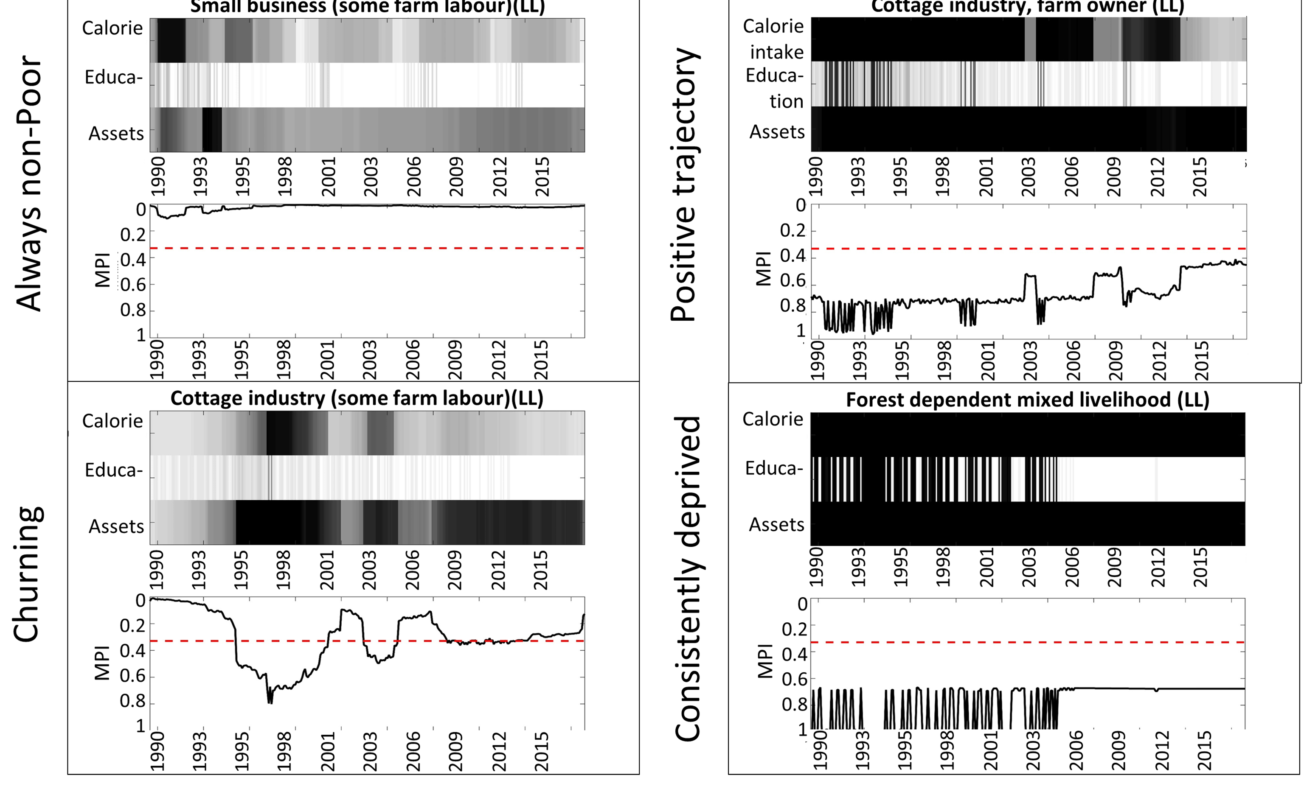
Multidimensional Poverty Index (MPI) Trajectories
Source: Lazar and Adams, in review

Slide 35
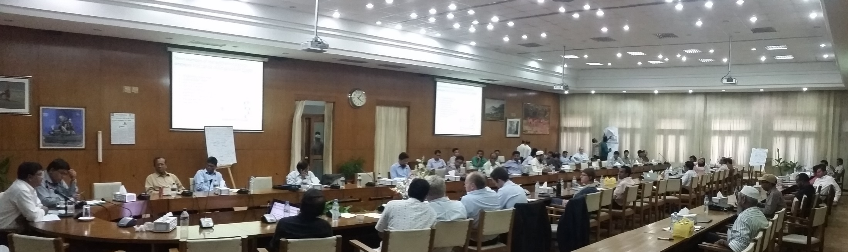
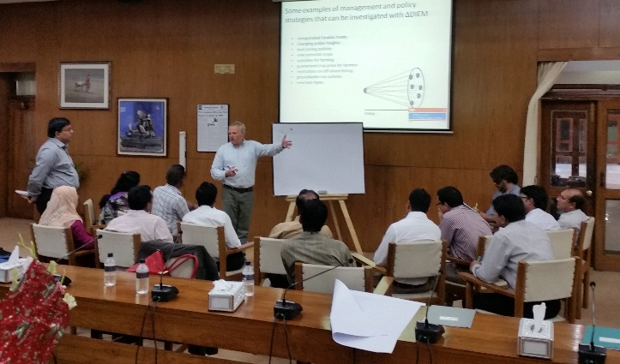
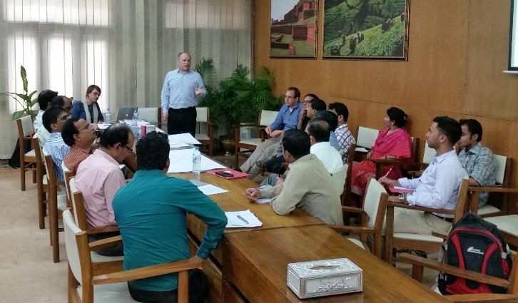
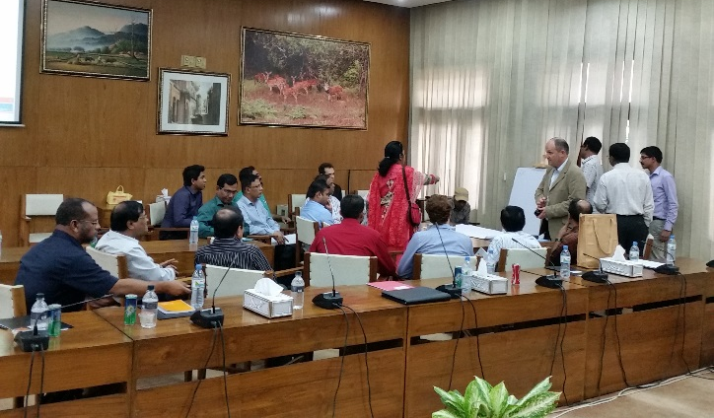
Stakeholder Engagement General Economic Division, Dhaka 16 September 2015 An ongoing process from the beginning of the project: (1) Issue Identification; (2) Scenario development; (3) Policy exploration

Slide 36
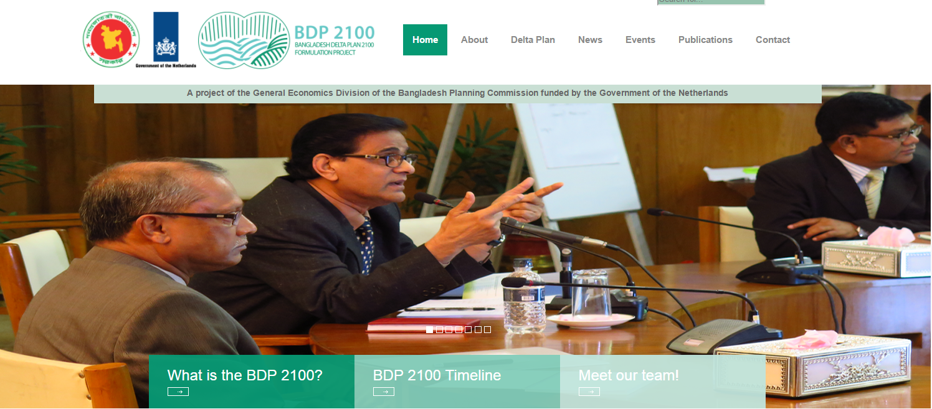
Bangladesh Delta Plan 2100

Slide 37
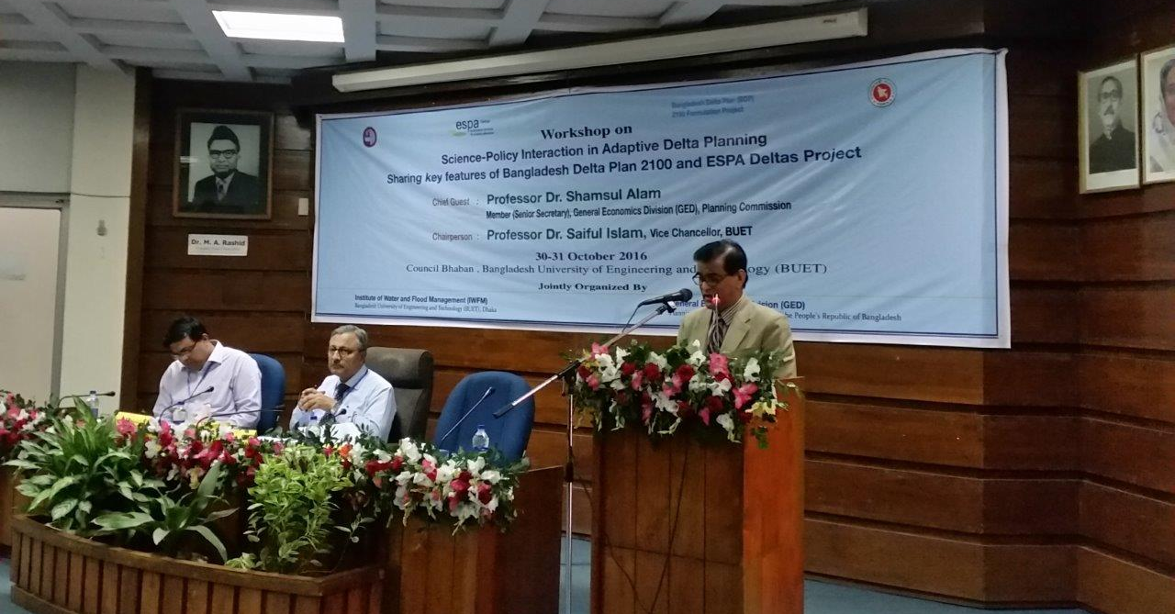
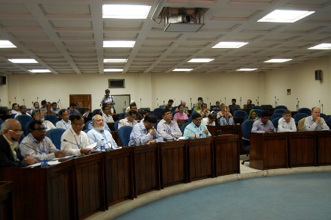
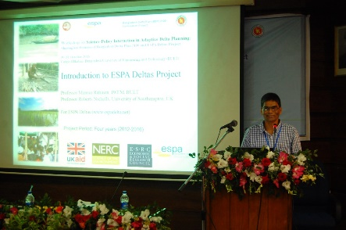
ESPA Deltas Final Event Bangladesh 30/31 October 2016
Science-Policy interaction in adaptive delta planning
Sharing key features of Bangladesh Delta Plan 2100 and ESPA Deltas Project
Goals:
Research into Use,
Linkage with BDP 2100,
Potential use of ESPA deltas results in BDP 2100
Summary Outcomes:
Policy intervention can be assessed using the developed tool (ΔDIEM)
ΔDIEM can be adjusted to judge investment decision both in the short and long term basis

Slide 38
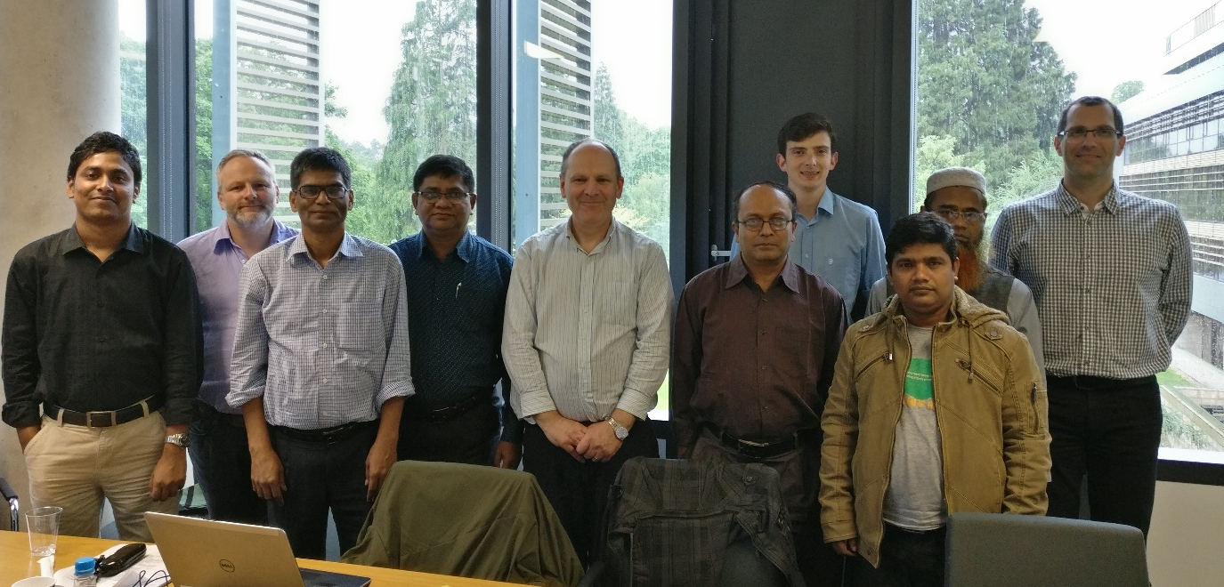
ESPA Deltas Continuation 2017-2018 Southampton, UK, 17 May 2017

Slide 39
Delta Dynamic Integrated Emulator Model (ΔDIEM)
Examples of management and policy strategies that can be analysed with ΔDIEM
renegotiated Farakka treaty
Ganges Barrage
changing polder heights
land zoning policies
new potential crops
subsidies for farming
guaranteed crop price for farmers
restrictions on off-shore fishing
new loan types
Different national policies (REACH Project)
Raise polders
Managed retreat
Unplanned retreat
Build elevation (tidal river management)
today
future

Slide 40
Concluding Thoughts
This work provides a new linked model and data framework for thinking about the future of coastal Bangladesh
The modular approach allows incremental improvement
The participatory approach adopted was a key element to engagement with stakeholders – giving local ownership
Understanding uncertainty/sensitivity is an ongoing process
Three key results for coastal Bangladesh (to 2050)
Future is more influenced by human choices/policy interventions than climate change
Ecosystem services diminish as a proportion of the economy with time, continuing historic trends
Significant poverty persists in some locations under all scenarios
Engaging with policy questions forces consideration of human dimensions

Slide 41
Deltas as Coupled Socio-Ecological Systems
Robert J. Nicholls
University of Southampton
CSDMS Meeting
23-25 May 2017
Boulder, CO

