Slide 1
The Power of Water: Rivers in the Arid Western US
Teacher Workshop
August 2015
Irina Overeem

Slide 2
Outline
What is the ‘Arid Western US’?
Flow characteristics of Arid Rivers
Dams and reservoirs to store water resources
Sedimentation into reservoirs
Sediment from contributing arroyo systems
Vegetation and reduced sediment flux?

Slide 3
Definition of the US West?
1878 report of John Wesley Powell
West of the 100th meridian
Rainfall less than 20 inches/year

Slide 4
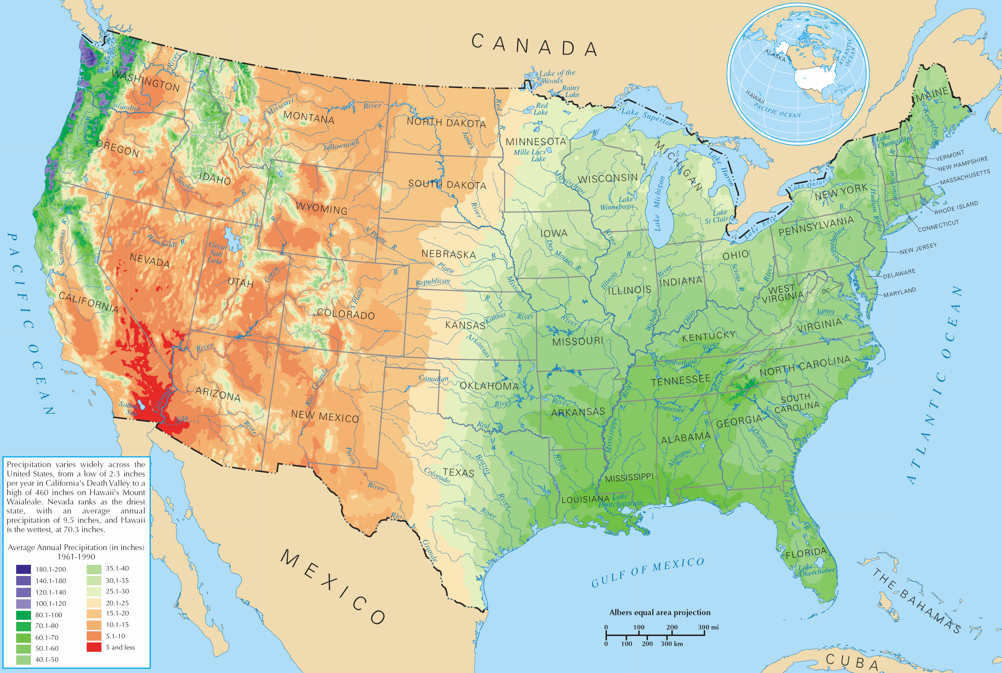
100th
meridian
Columbia
Colorado
River
Rio Grande
River
Source: wikipedia
Notes:
Arkansas River, Platte River
Two major Western Rivers originate in the Rocky Mnt: The Colorado River, CO, UT, NV, AZ to Sea of Cortez
Rio Grande River Basin: CO, NM and Mexico
P-average= 9 inches/year

Slide 5
Student Activity on ‘Aridity’
Calculate the annual rainfall for your own city
Resource for Boulder:
http://www.esrl.noaa.gov/psd/boulder/Boulder.mm.precip.html
Notes:
Boulder 18 inches
CO springs 16.5 inches, 37 inches snow.

Slide 6
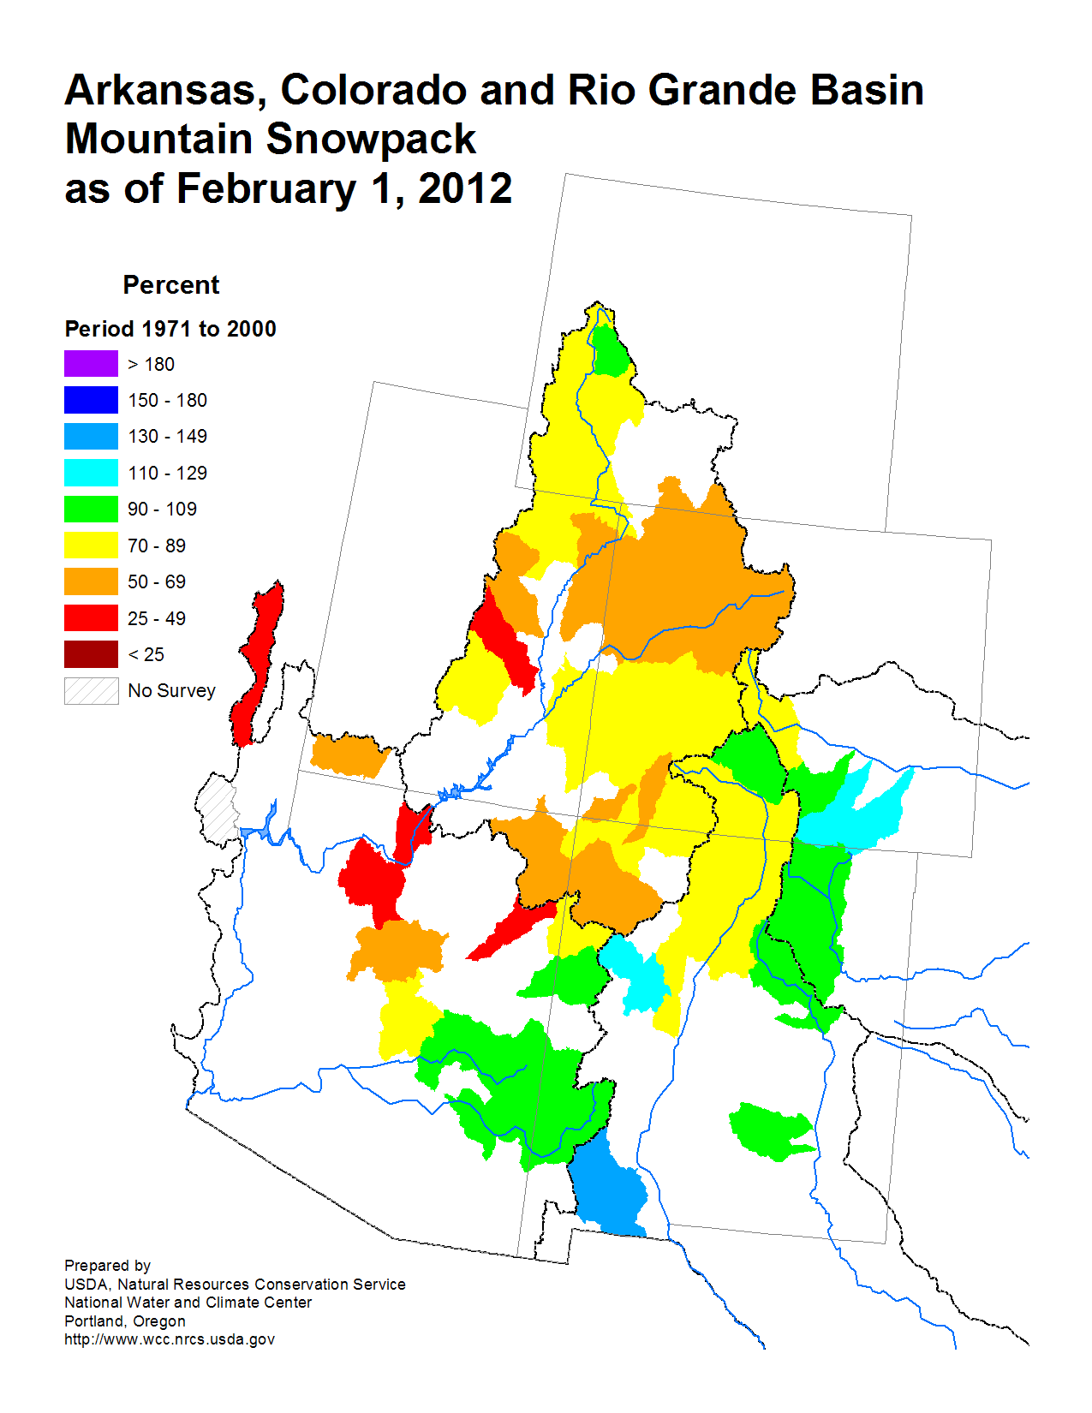
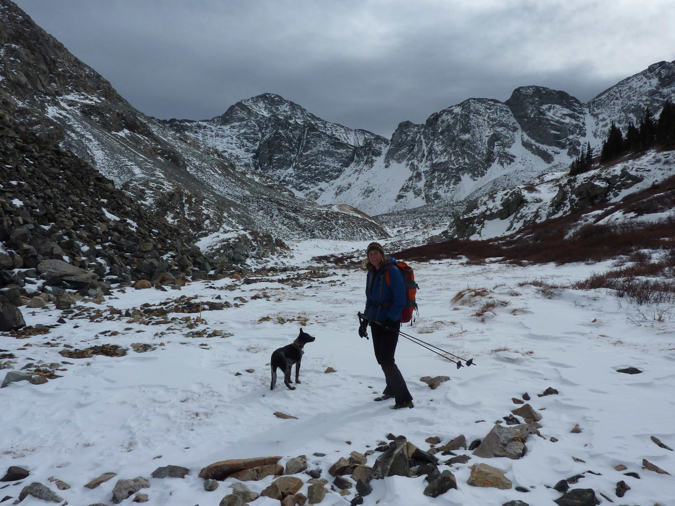
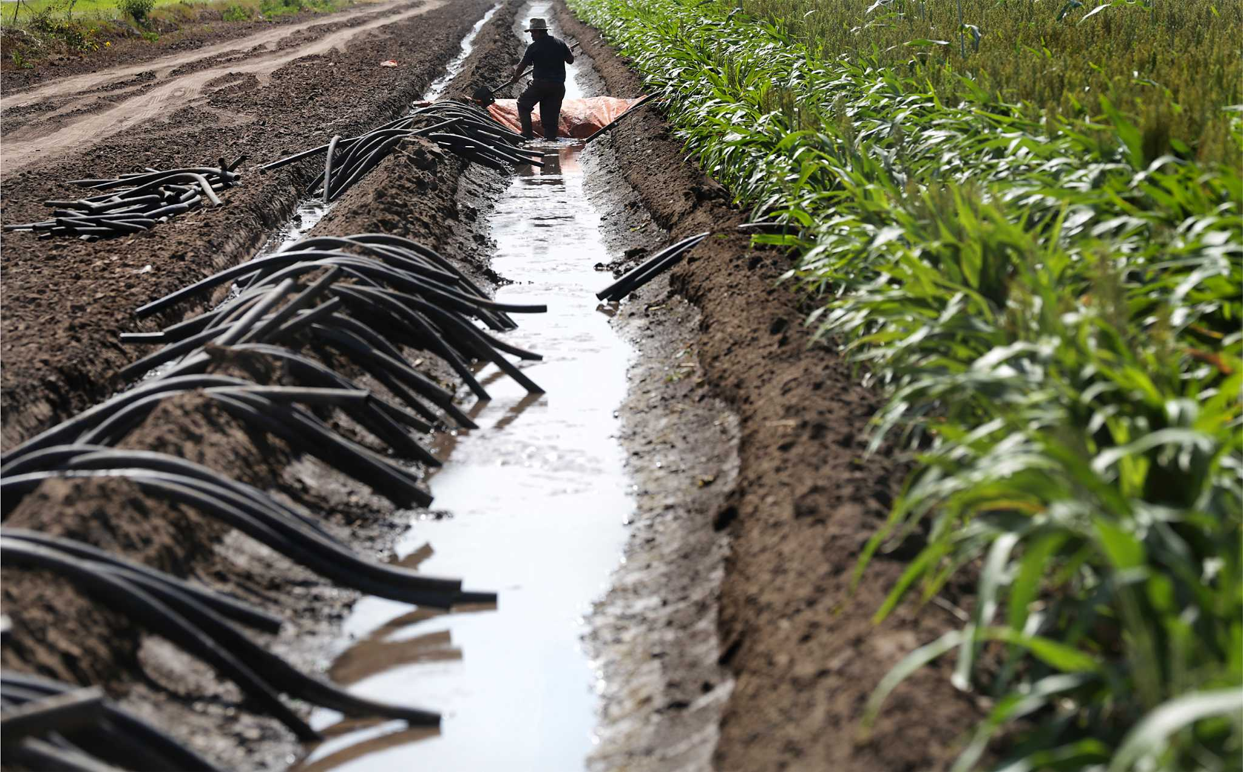
Water resources originate from Rocky Mountain Snowpack
Snow in November, San Juan, Mnts
From: NWCC
Irrigation near El Paso, Image Courtesy Bob Owen

Slide 7
Snow Water Equivalent
Snow Water Equivalent (SWE) is a common snowpack measurement.
SWE is the amount of water contained within the snowpack. It can be thought of as the depth of water that would theoretically result if you melted the entire snowpack instantaneously.
SWE=snow depth*snow density
Typical cold weather powder snow density is 5%
Typical late spring winter storm snow density is 20%
Both types of snow settle with gravity over time and become denser

Slide 8
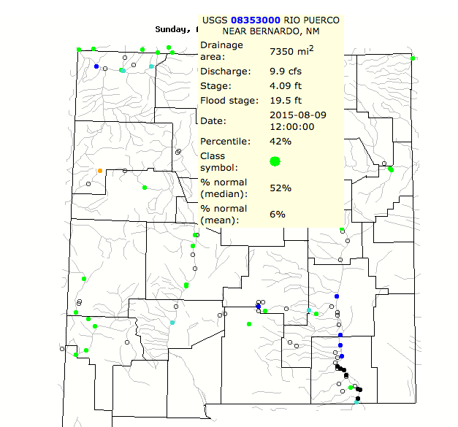
Student Activity on Streamflow
http://waterdata.usgs.gov/co/nwis/rt
Find gaging stations in the state map
Click on the station for more information
Click on Discharge as an available parameter, ask for the number of days you want to look at….(last week? a full year?)

Slide 9
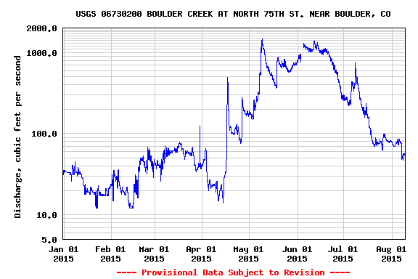
Student Activity on Streamflow
Investigate streamflow in Boulder Creek, over a season
Notes:
Take-away point; system gets a lot of snow melt, some of the superimposed peaks in the spring time were rainfall as well.
Note that the scale is a log scale….

Slide 10
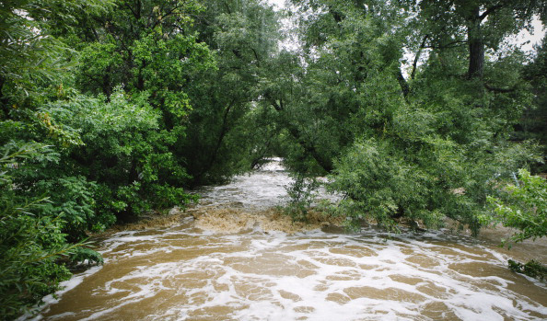
Snow melt Impacted Stream: Example Boulder creek
Boulder Creek, snow melt episode in March 2014

Slide 11
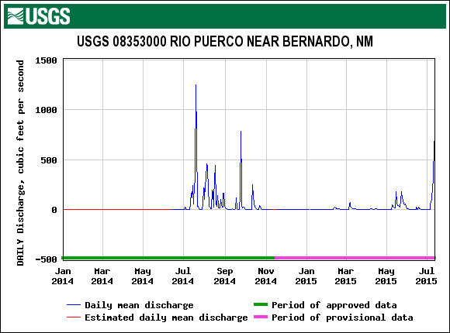
Student Activity on Streamflow in Dryland River System
Notes:
Take-away point:
This stream is dry parts of the year, and there is only significant water during periods of rain in tis contributing catchement. This type of stream is common in the Arid US West is called an ephemeral stream.

Slide 12
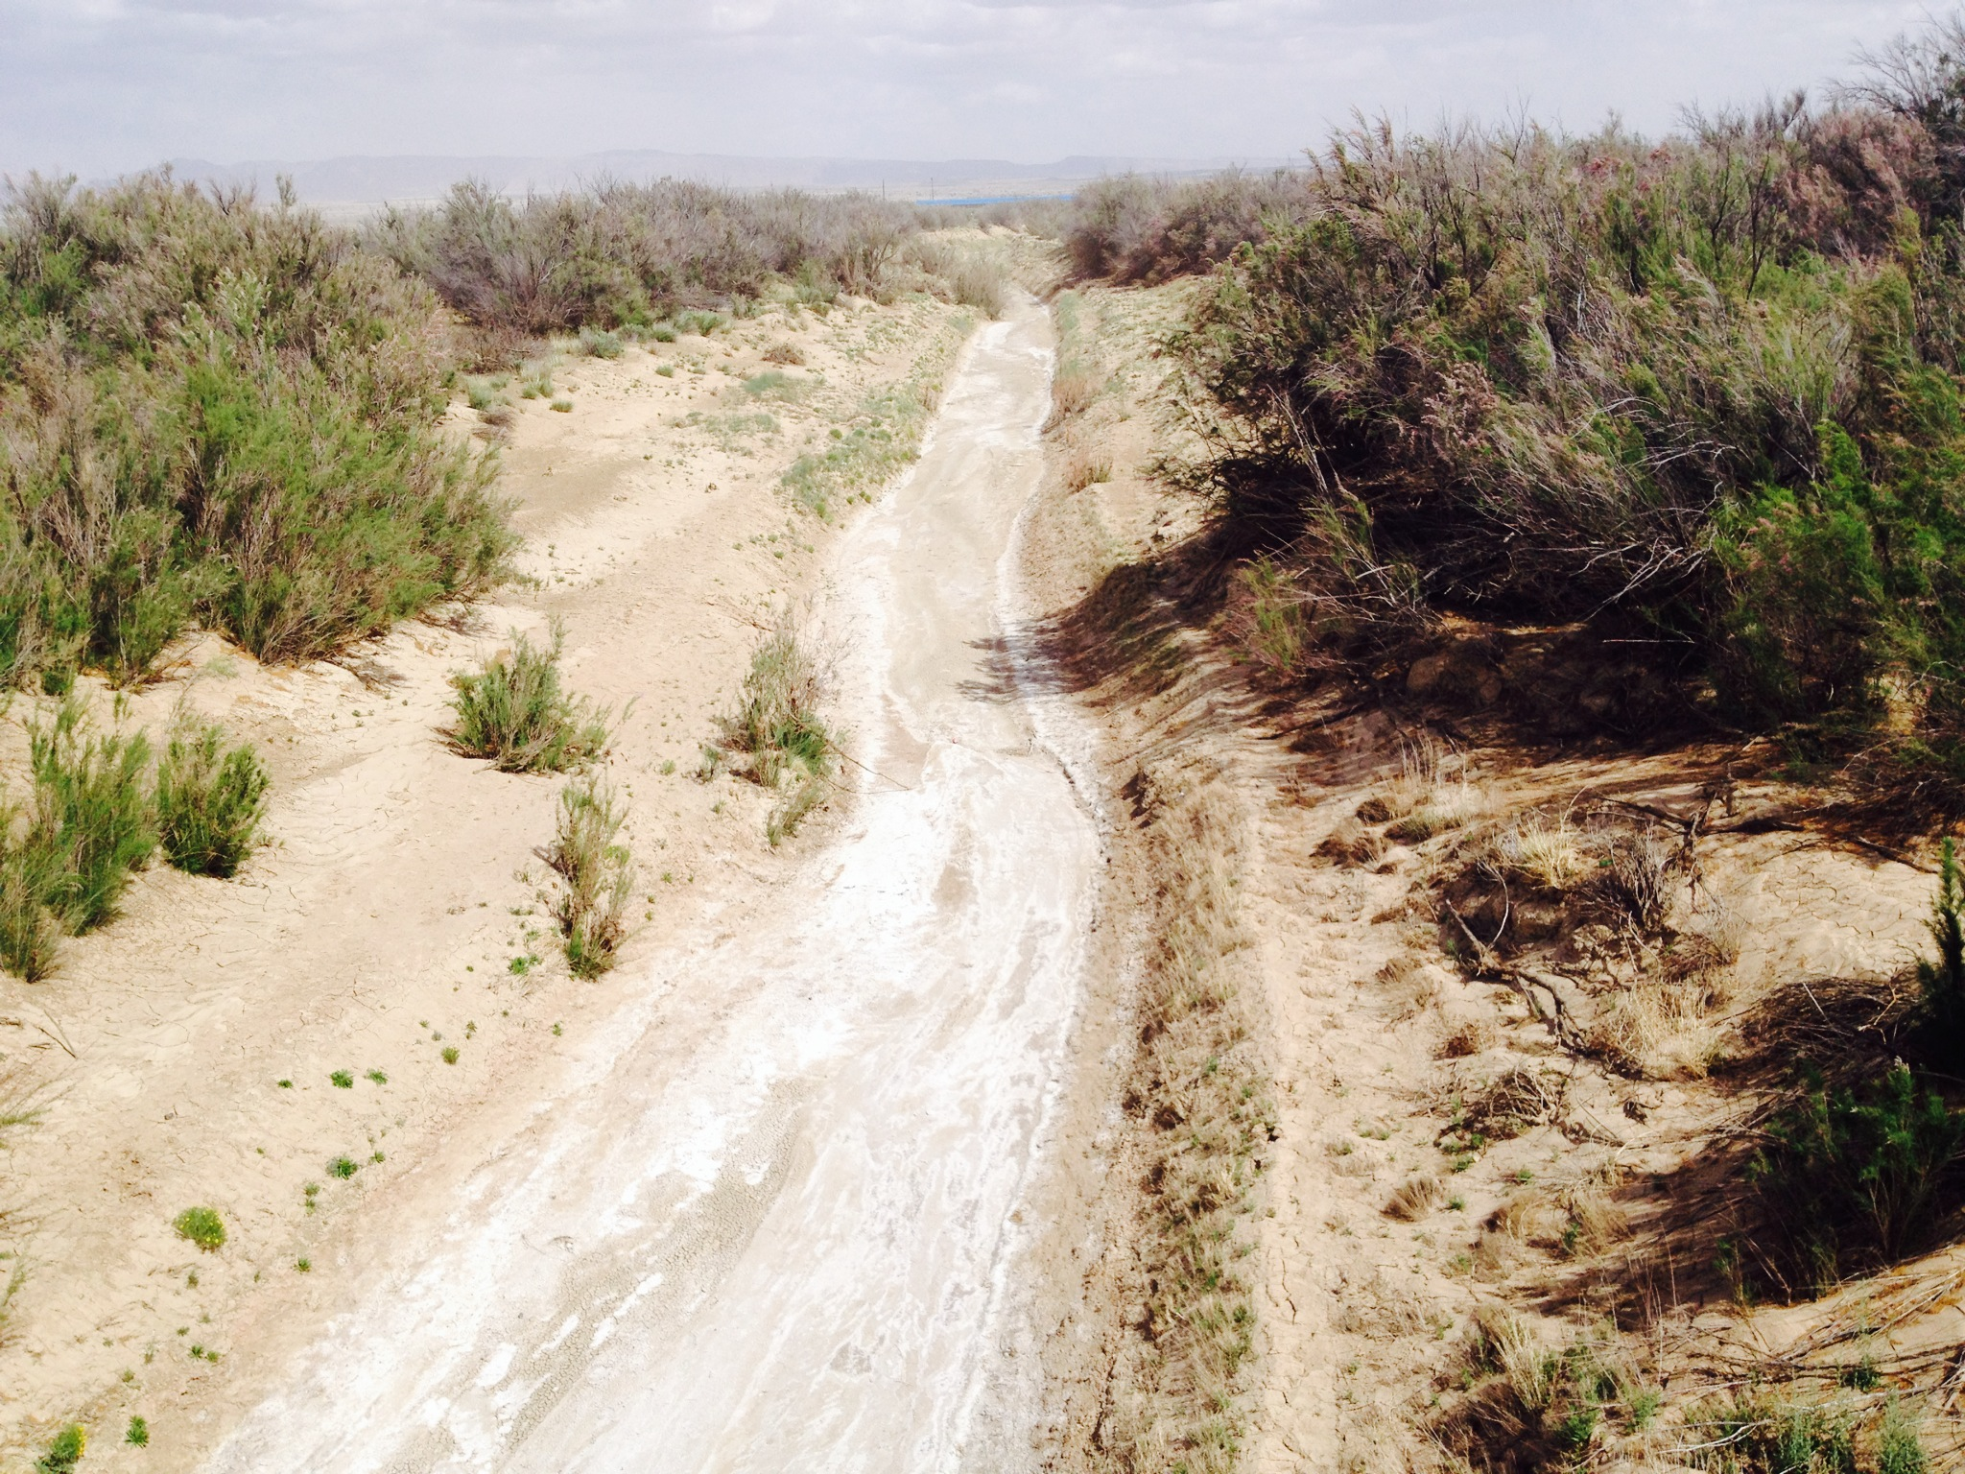
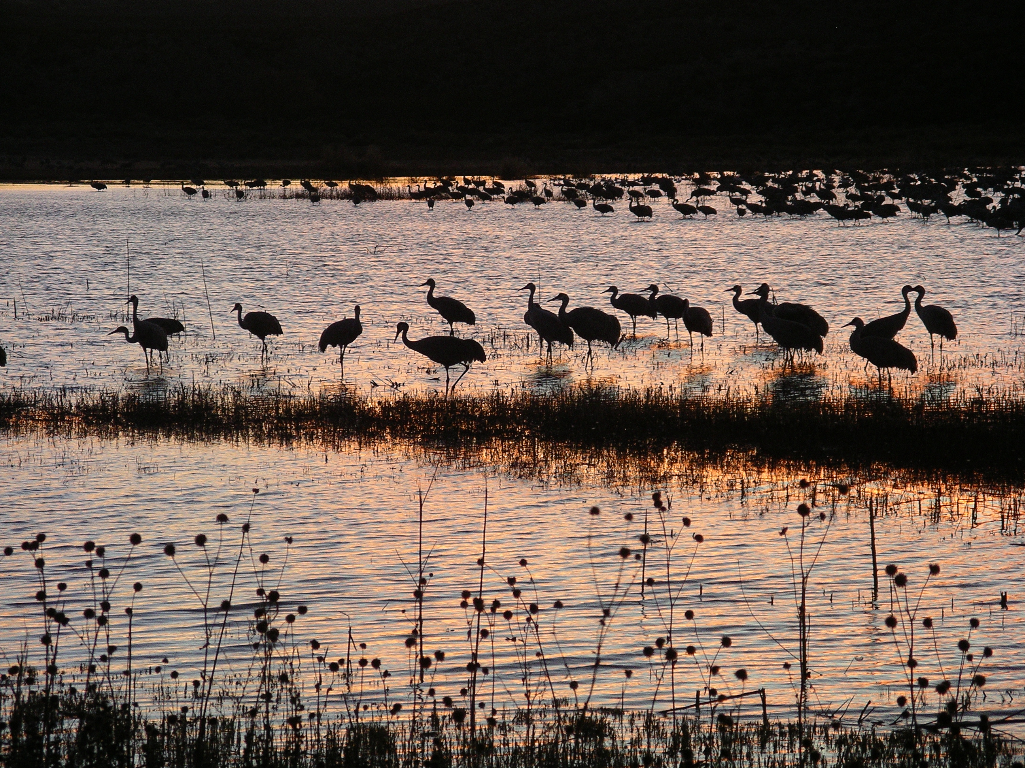
Rio Grande River
Rio Puerco in April 2014
Photo: Irina Overeem
One of 10 major world rivers ‘under threat’ (WWF).
Bosque del Apache wetlands along
the Rio Grande
Photo: Irina Overeem

Slide 13
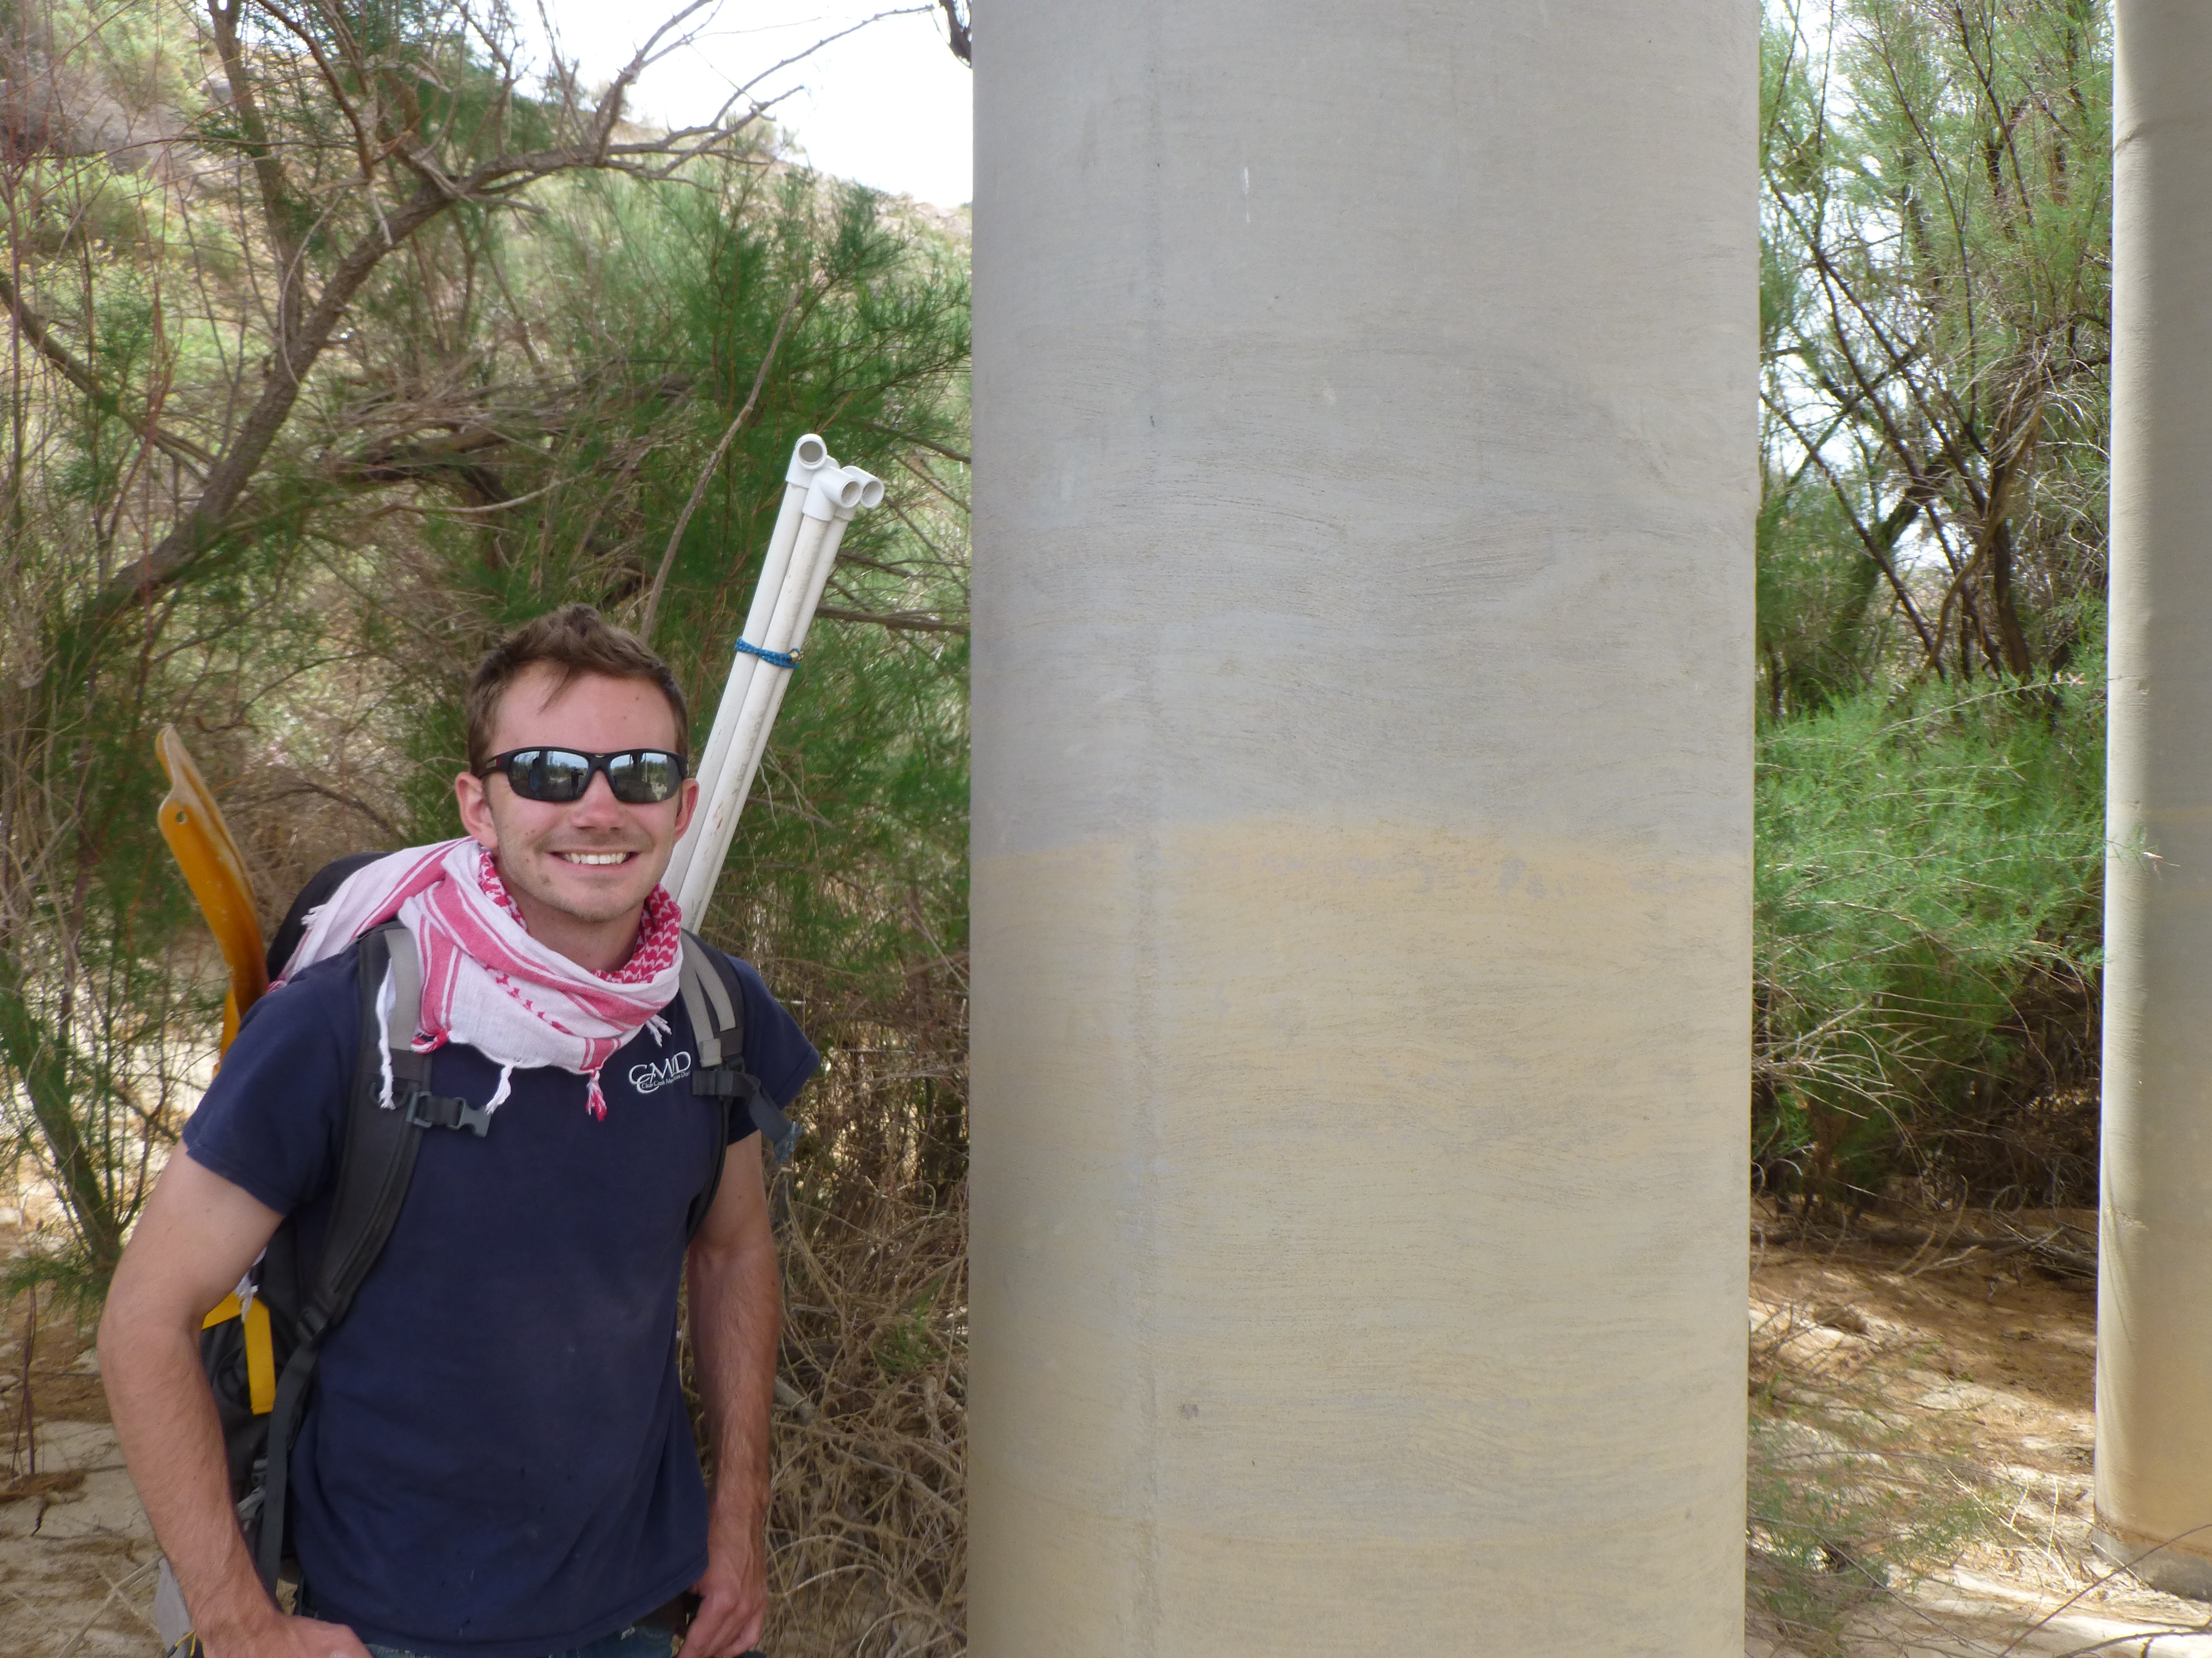
Evidence for high discharge shown as a ’silt line’ in Rio Puerco remaining evidence in April 2014
Photo: Irina Overeem

Slide 14
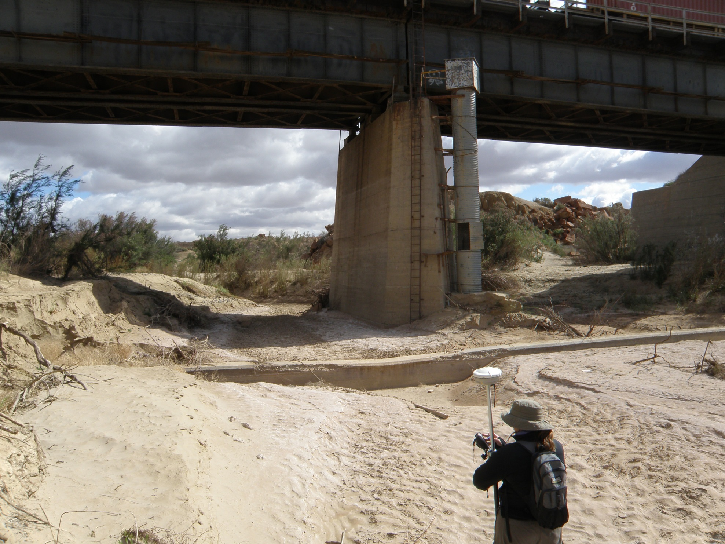
High-water line at AT&SF RR bridge near Hwy 6 crossing
Rio Puerco in April 2014
Photo: Ellie Griffin, USGS

Slide 15
John Wesley Powell Map (1890)
Notes:
Map of the Arid Regions of the United States, showing Drainage district.
John Wesley Powell advocated for small scale irrigation, and state borders based on watershed boundaries.
Presumably rail road companies interest lobbied for large-scale settlement instead

Slide 16
Dams and Reservoirs to store water
Find this movie here: http://csdms.colorado.edu/wiki/Movie:US_dams
Notes:
Answer to scarcity in water resources: building dams.

Slide 17
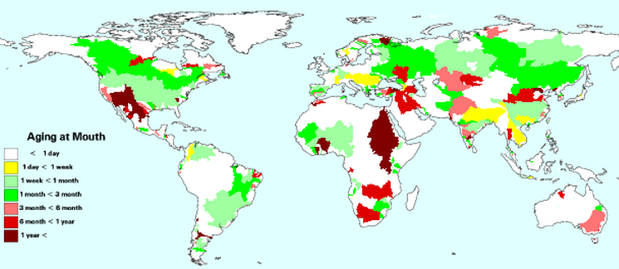
Dams Distort Natural Hydrographs
• 700% increase in water held by river systems
• Several years of residence time change in many basins
Tripling of river runoff travel times globally (from 20 up to 60 days)
Stored Runoff
< 2% annual flow
2
10
25
50
100
>100
From: Charles J Vörösmarty et al., Anthropogenic sediment retention: major global impact from registered river impoundments, Global and Planetary Change, 39, 1–2, 2003, 169-190, http://dx.doi.org/10.1016/S0921-8181(03)00023-7.

Slide 18
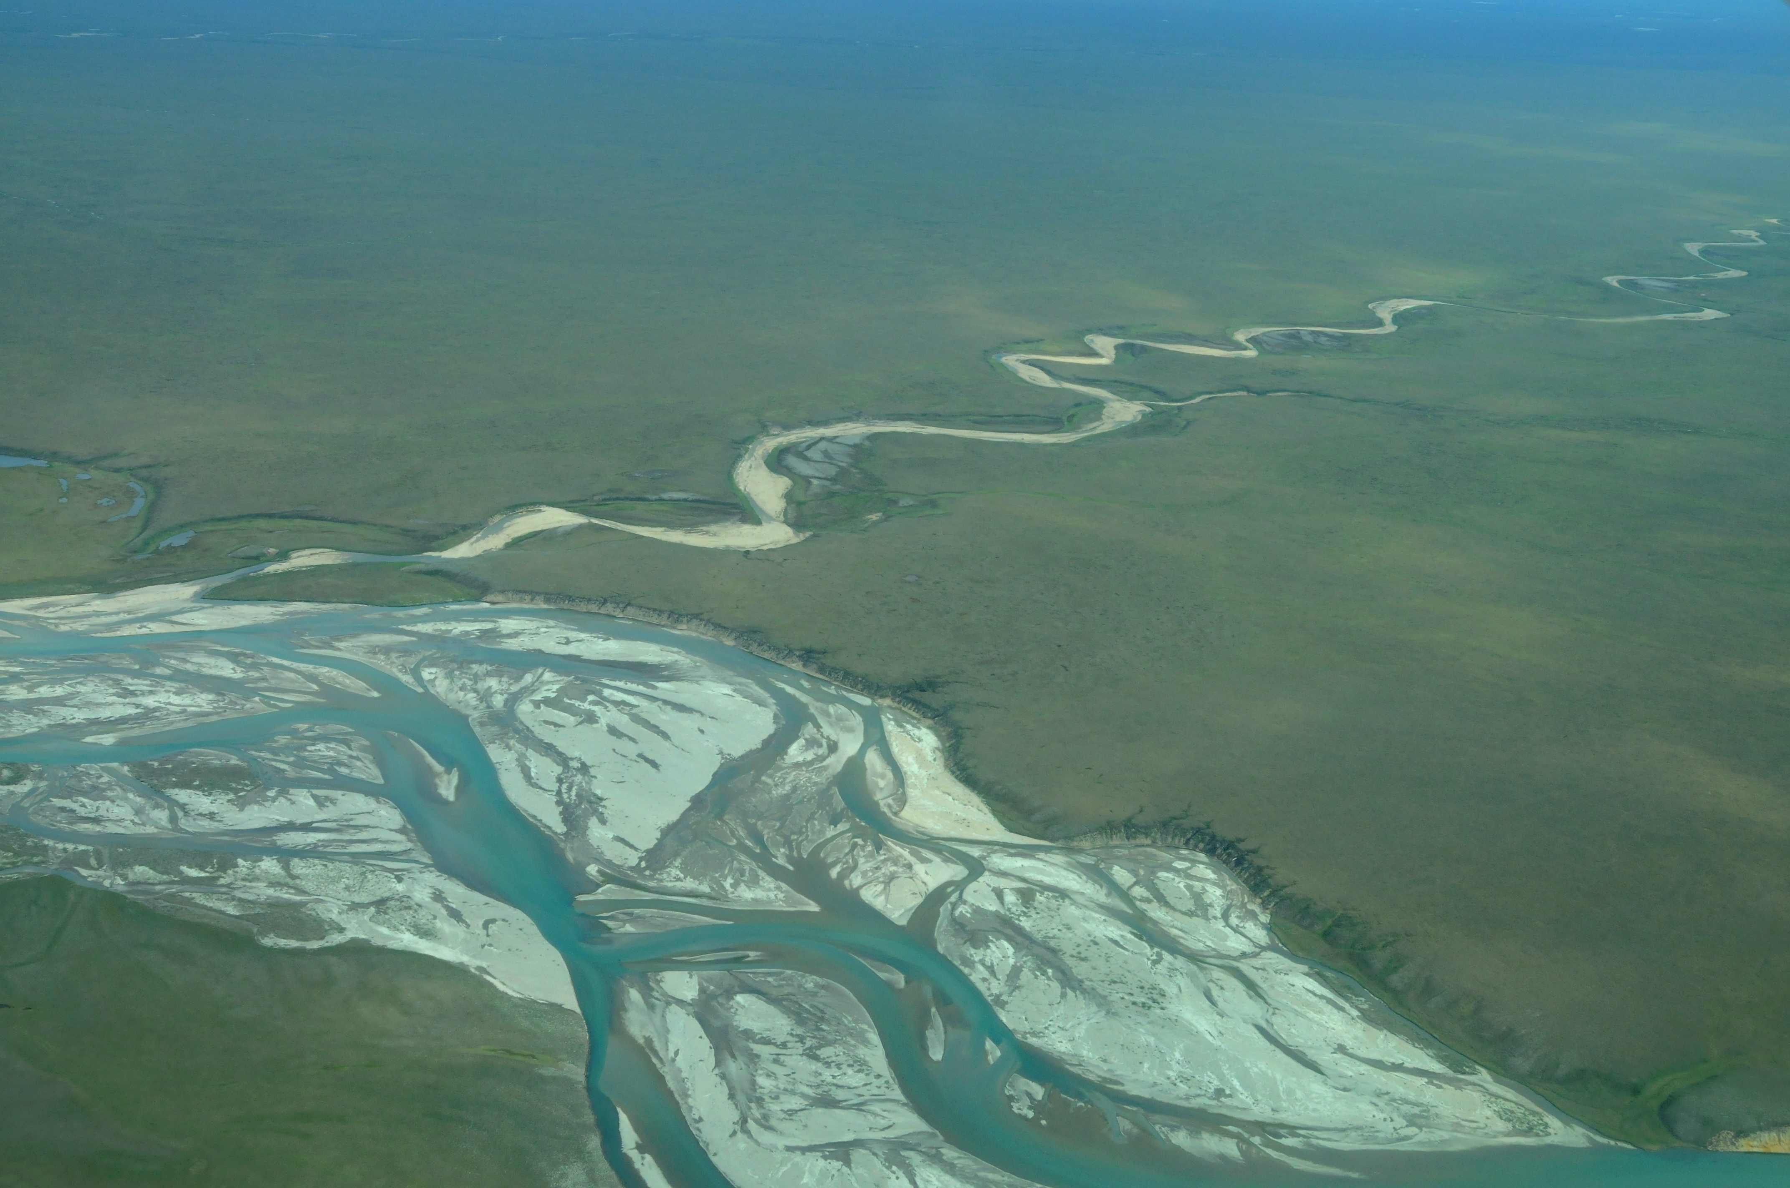
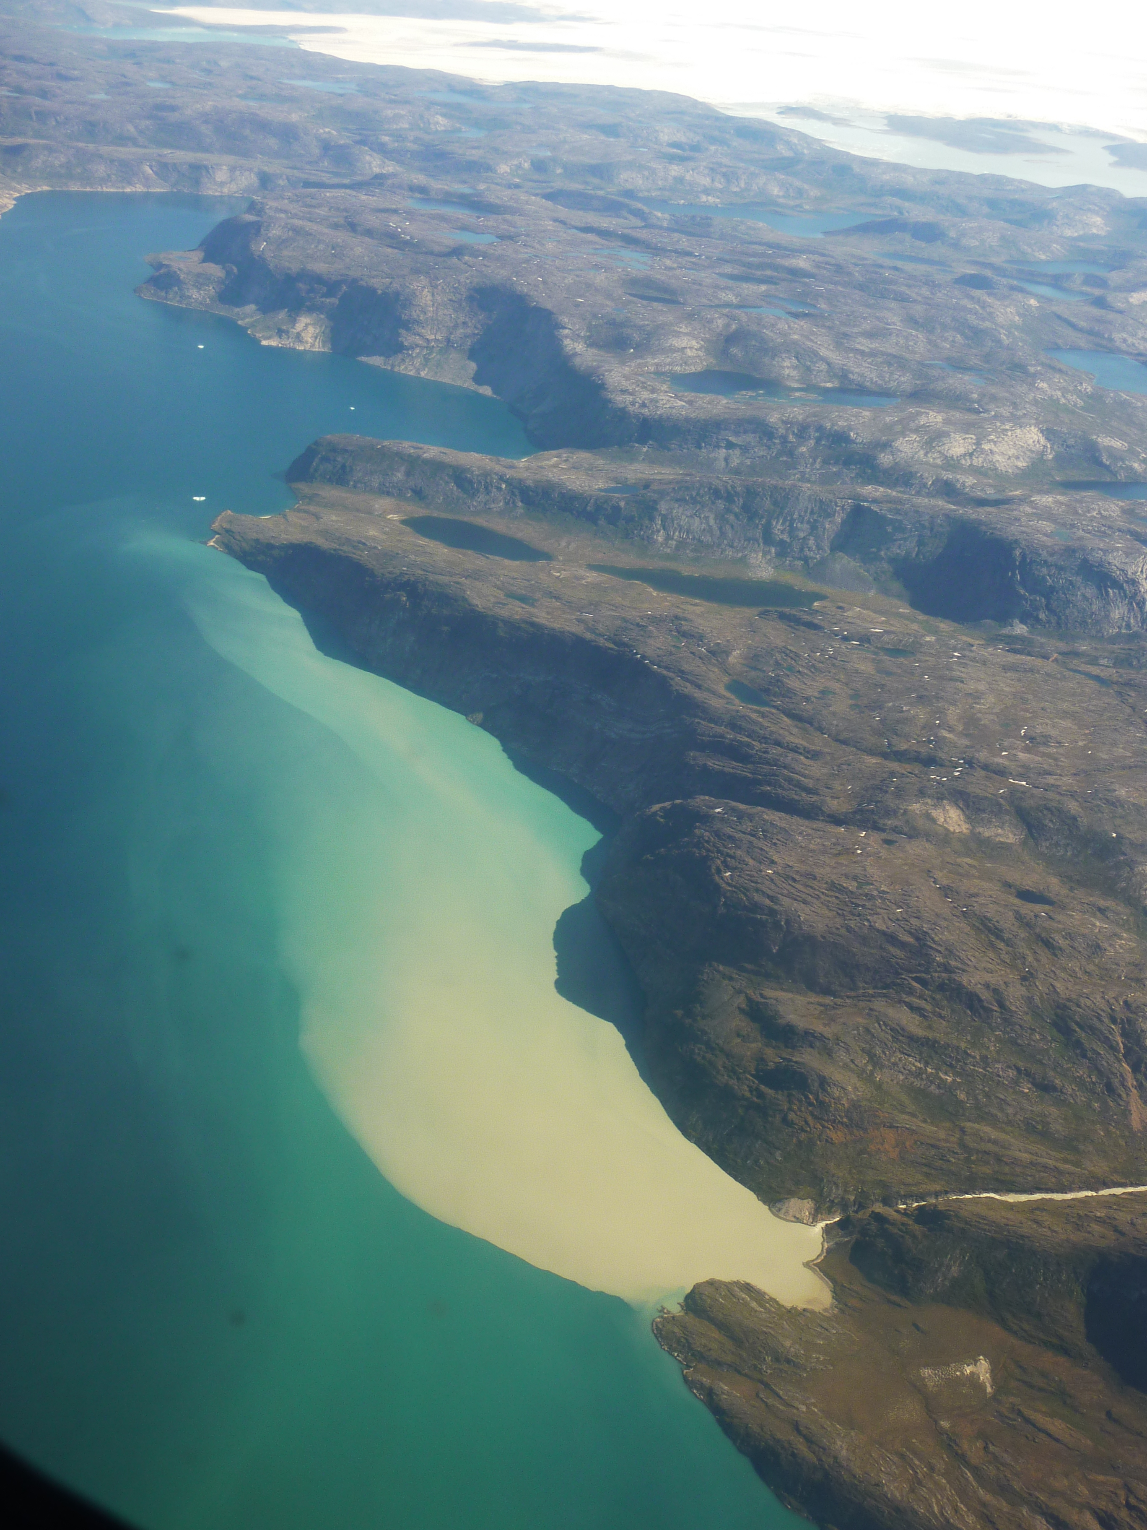
Two types of sediment load
Bedload = Sediment or other material that slides, rolls, or bounces along a stream or channel bed of flowing water. Most incoming bedload is stored in reservoirs
Suspended load = the body of fine, particles, typically of very fine sand, clay, and silt, that travels with stream water without coming in contact with the stream bed. Suspended sediment settles over time, the larger the reservoir the more sediment trapping.

Slide 19
Sediment Trapping efficiencies of large dams
Western US Rivers
From: Charles J Vörösmarty et al., Anthropogenic sediment retention: major global impact from registered river impoundments, Global and Planetary Change, 39, 1–2, 2003, 169-190, http://dx.doi.org/10.1016/S0921-8181(03)00023-7.

Slide 20
Trapping of Sediment in Reservoir
TE = 1-(0.05/ΔTR^{1/2})
ΔTR = V_{res}/Q_{annual}
TE = trapping efficiency of a single large reservoir (-)
ΔTR = mean residence time change for river water over unimpounded conditions (s)
Vres = effective reservoir volume (m³ or cuft or acre-feet)
Qannual = mean annual discharge (m³/s or cuft/s)
Empirical model formulated for US reservoirs in 1953 (Brune 1953)

Slide 21
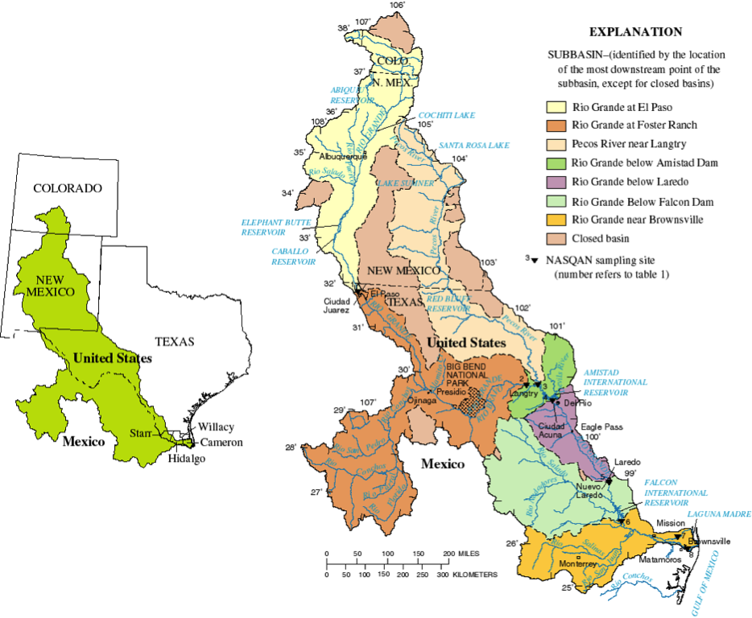
Rio Grande River Basin
Originates in San Juan Mnts, CO
Flows through Albuquerque, NM and El Paso, TX , then it is the border between US and Mexico
Rio Grande river ~3,000 km long
10 million people (WRI 2003) and growing
80% of river water is extracted for irrigation
Elephant Butte is most important reservoir
Image Courtesy: NASQAN, USGS

Slide 22
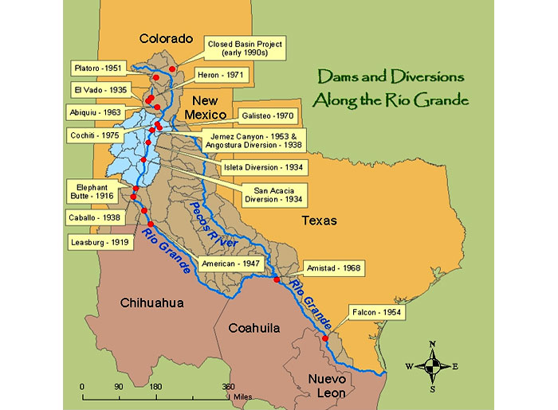
Dams in Rio Grande Basin
Cochiti Lake
built 1975
provides sediment
control
Elephant Butte
Reservoir (1916)
Is most important
For water storage
Notes:
Cochiti Lake has maintained a permanent recreation pool of approximately 62,000,000 m3 (50,000 acre·ft) since the dam was completed.
The permanent pool, which includes an intermittent pond in the arm of the Santa Fe River, provides sediment control benefits, trapping about 1,200,000 m3 (970 acre·ft) of sediment per year

Slide 23
Rio Puerco Flood, September 2013
http://csdms.colorado.edu/wiki/Movie:Rio_Puerco_Flood_2013

Slide 24
Arroyo flashflood moves large amounts of sediment
http://csdms.colorado.edu/wiki/Movie:FlashFloodUT

Slide 25
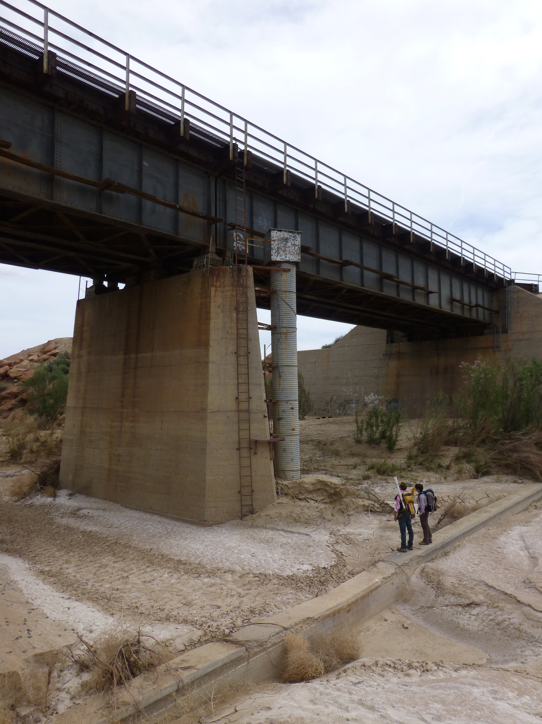
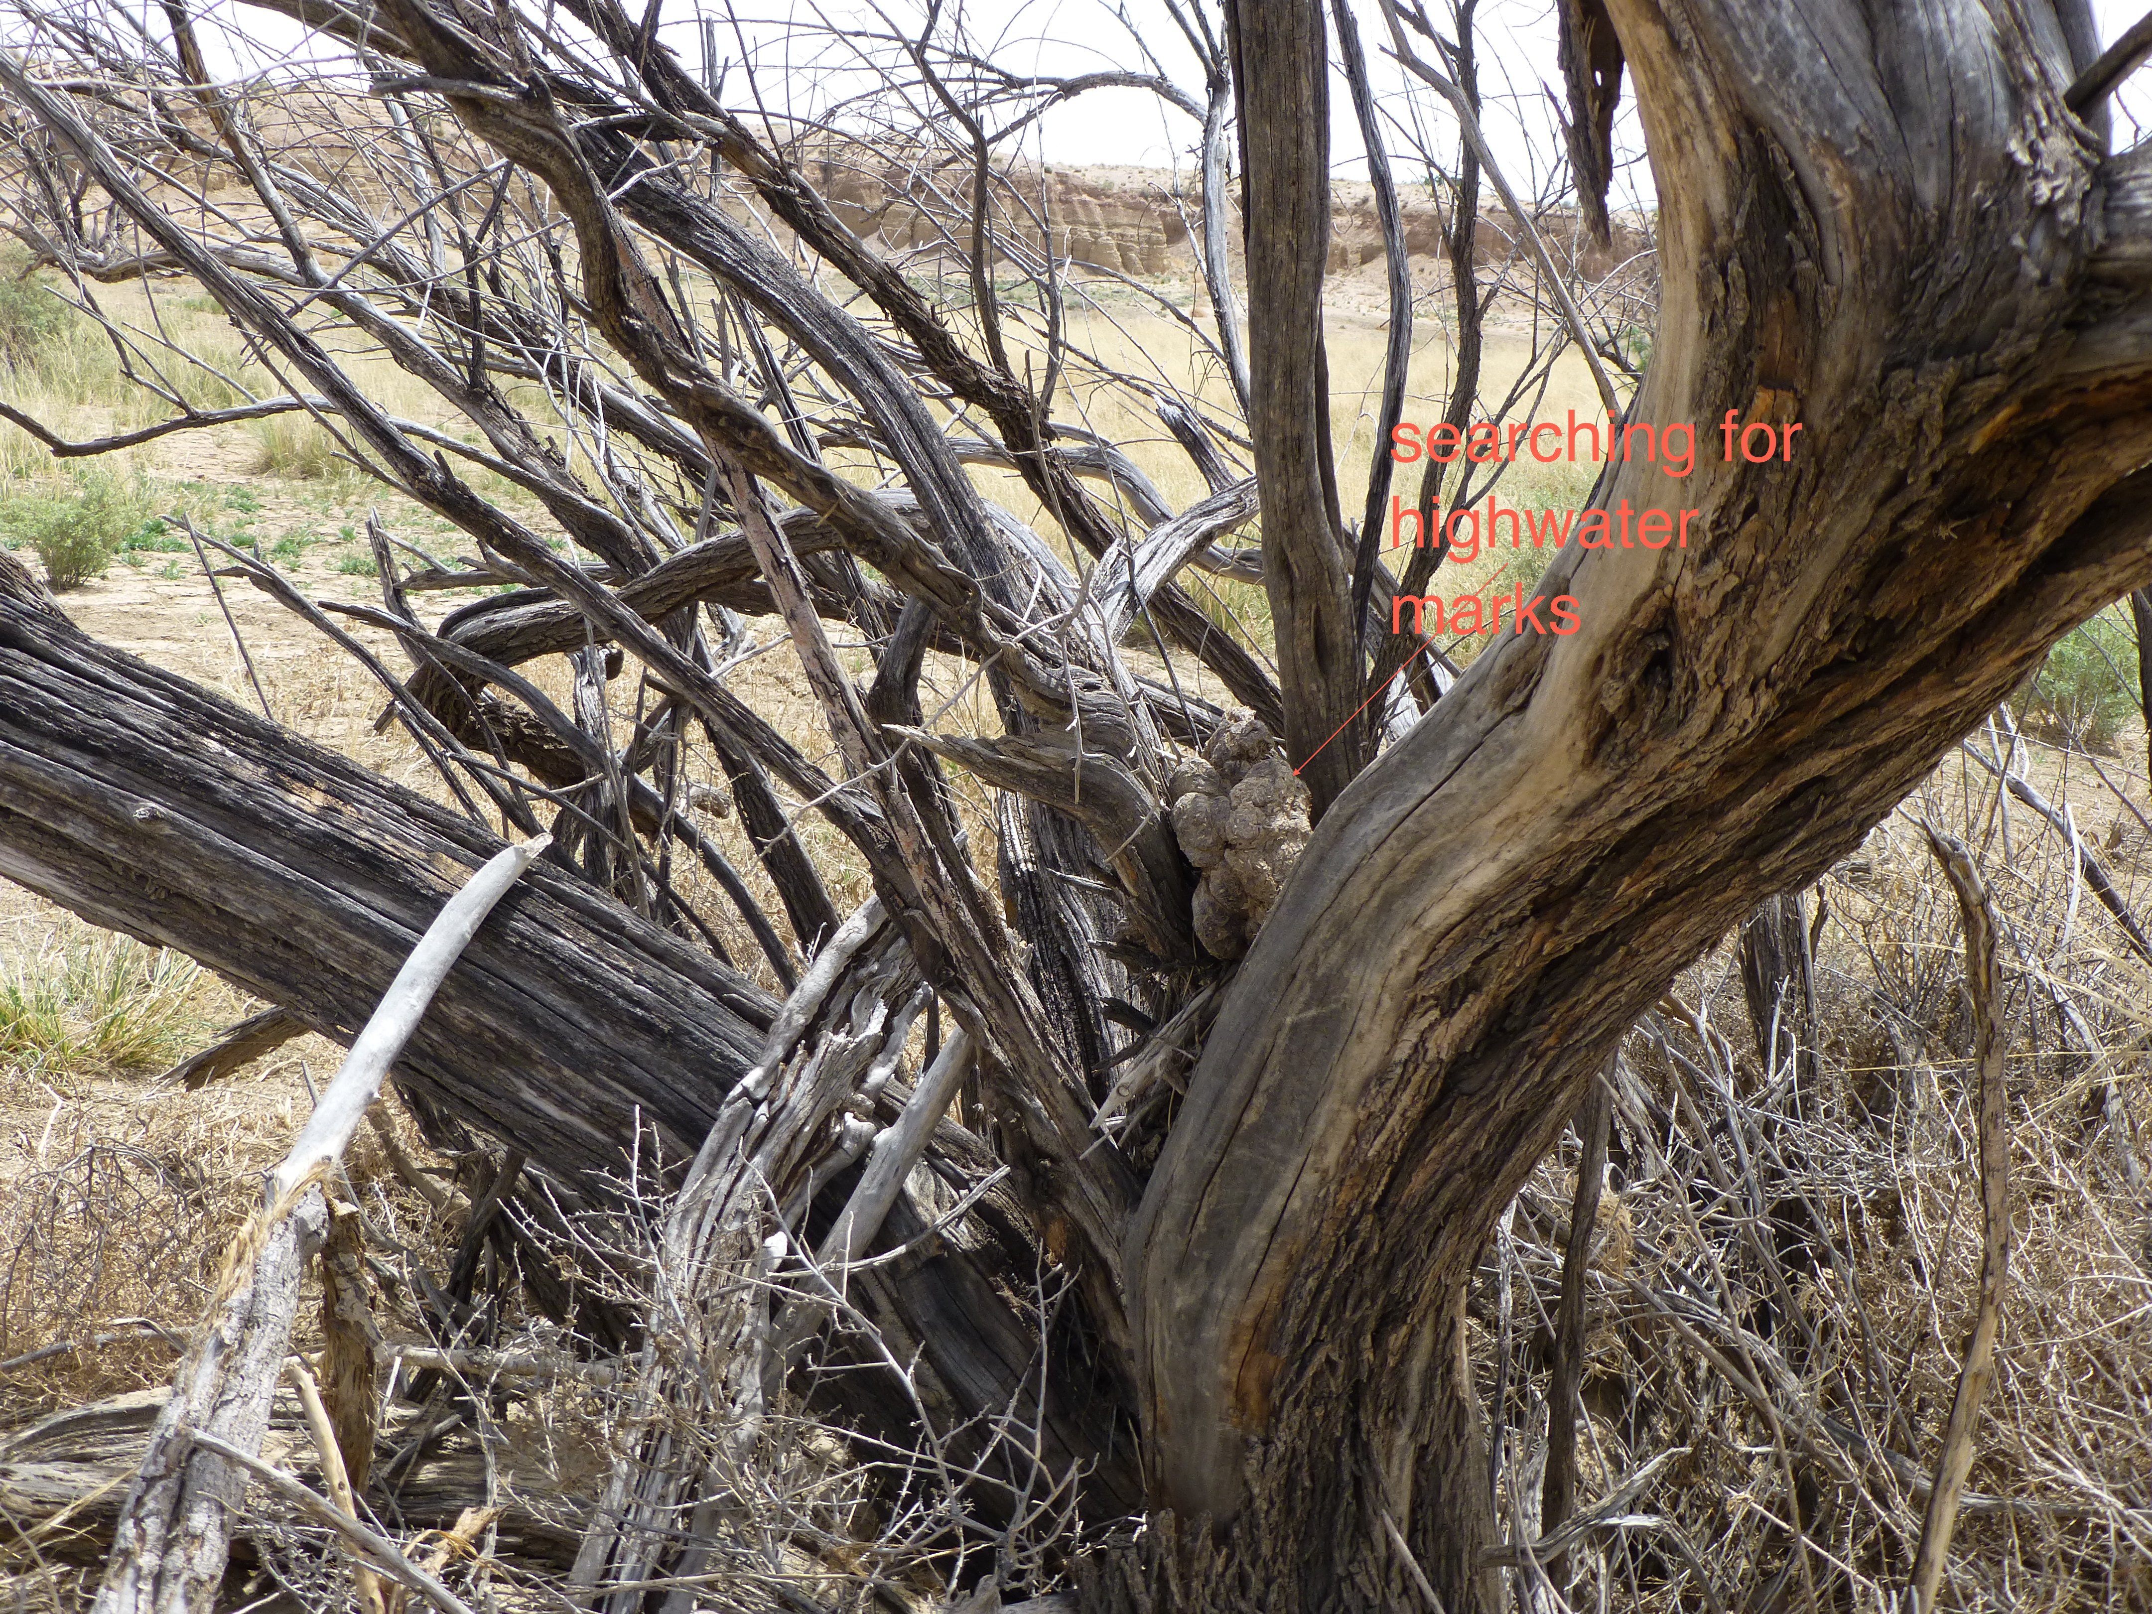
Flood line
Rio Puerco in April 2014
Photo: Irina Overeem
Silt lines
Cow dung floats and marks high water level
Photo: Irina Overeem
Notes:
How high did the flood waters reach? 5.5 m!

Slide 26
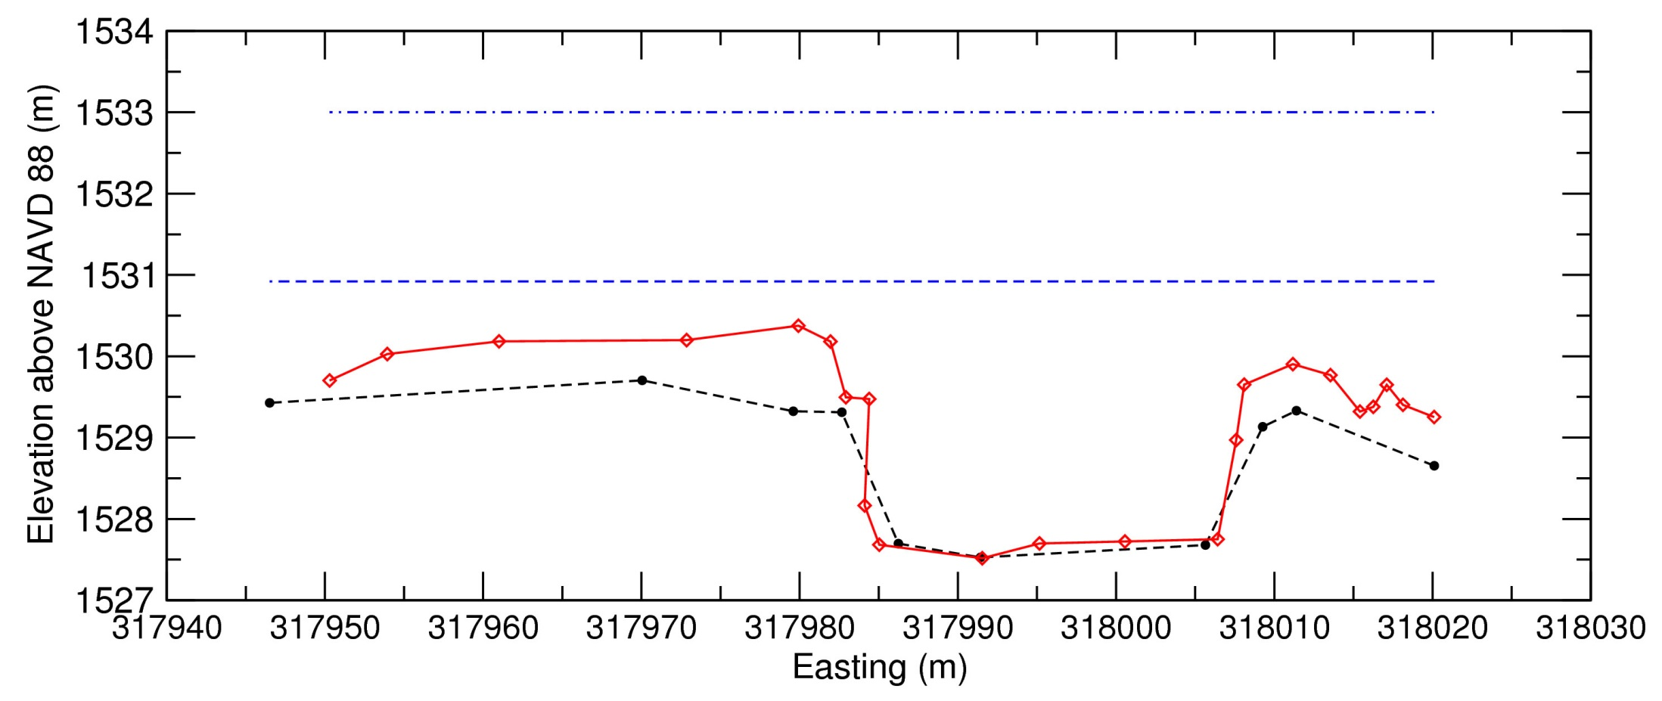
Repeat Measured Cross-section 1
along the concrete sill at the Railroad bridge
Sep 2013 w-s elev = 1533.0 m
2.1 m
5.48 m
Aug 2006 w-s elev = 1530.9 m
GPS survey Apr 2014
GPS survey Jan 2007
Estimated August 2006 flood peak Q at this site was 625 m³/s (Griffin et al., 2014). Discharge has not yet been estimated for the 2013 flood.
Notes:
(View looking upstream)

Slide 27
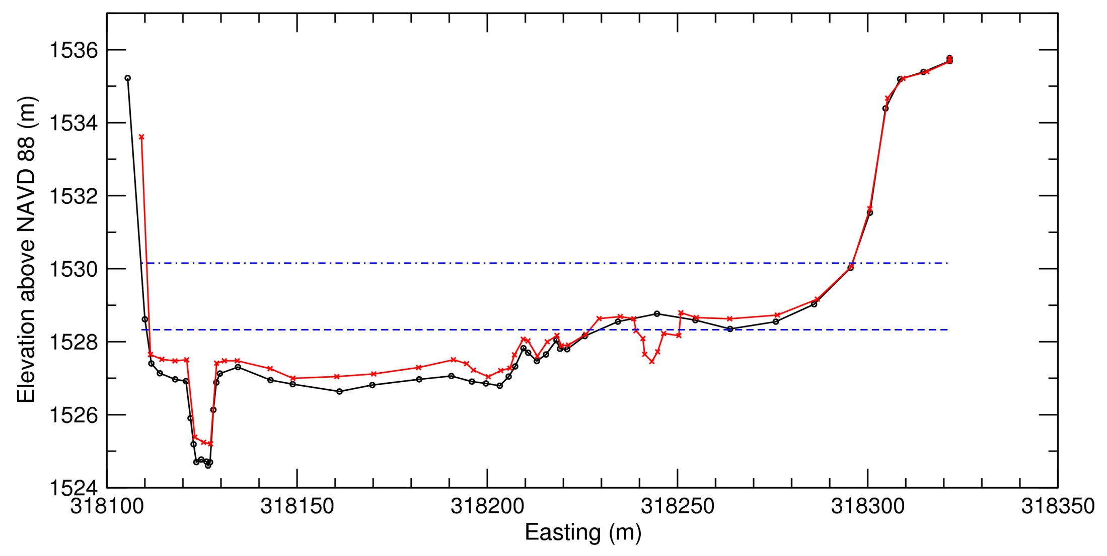
Repeat Measurements of Cross-section 2
at Highway 6 trench site
Sep 2013 w-s elev = 1530.15 m
3.0 m
1.8 m
Aug 2006 w-s
elev = 1528.33 m
GPS survey Apr 2014
GPS survey Apr 2010
From Apr 2002 to Apr 2010 (post 2006 flood), the channel bed aggraded 0.71 m. From Apr 2010 to Apr 2014, the bed aggraded 0.59 m. Deposition across the floodplain surface was less in Sep 2013 than in Aug 2006, in part because much of the former large floodplain depression at this site was filled by deposition during the 2006 flood (Data courtesy Ellie Griffin, USGS, 2015).
Notes:
(View looking upstream)

Slide 28
Drought in the Rio Grande Basin
http://www.nytimes.com/2015/04/13/us/mighty-rio-grande-now-a-trickle-under-siege.html?ref=science&_r=0

Slide 29
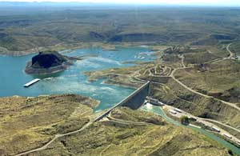
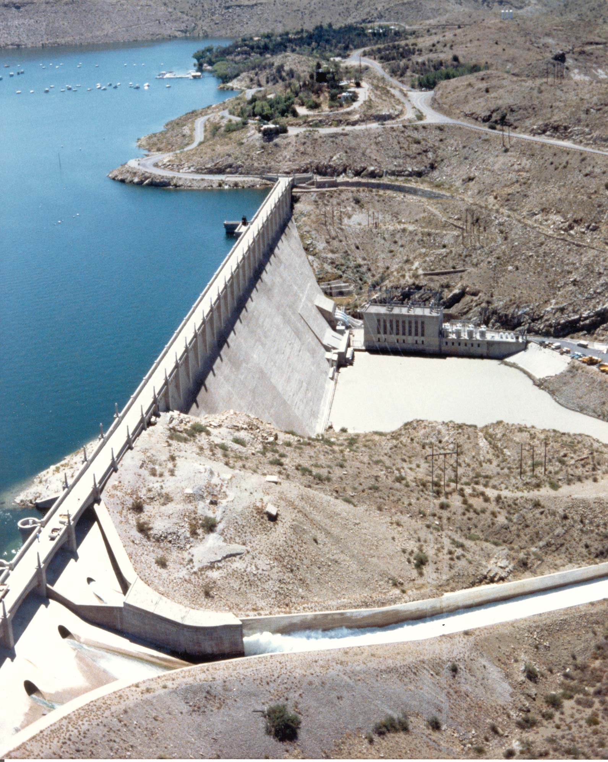
Elephant Butte Reservoir
One of the first major dams in US (1916)
Storage for irrigation water and drinking water
Even in the early 20th century variability in annual water discharge of the Rio Grande was recognized. It was the main reason why Elephant Butte Reservoir was designed to be so large. In his 1916 dedication speech Arthur Davis, then Chief Engineer of the Reclamation Service, said:
“Sometimes a series of dry years occurred together, and at other times more than one of wet years occurred in a series; and ……. full utilization of this water supply could not be obtained without a reservoir of immense dimensions-one large enough, first, to hold the waters of those great years when 2,000,000 acre-feet were discharged, and to provide for evaporation and hold that water here until a dry year should come. Then, in addition to the great capacity necessary for that purpose, it would be necessary to provide for the entire time storage of the large amount of sediment that passes down this river.”
Notes:
Elephant Butte Reservoir is designed to store a vast amount of river water to supply both Texas as well as Mexican farmers with necessary irrigation water. This reservoir is contained by one of the earliest large irrigation dams built in the Western US. Mexico, and the states of Colorado, New Mexico and Texas already clashed on water use since the 1890’s. Negotiations on the Rio Grande water allocations finally resulted in the authorization of the Rio Grande Reclamation Project in 1905 by the US Congress. An enormous concrete dam was completed, and reservoir flooded in 1916 (Kelly et al., 2007).
Quote from:Address of Arthur P. Davis Director and Chief Engineer of the Reclamation Service, at the Dedication of the Elephant Butte Dam, N. Mex., October 19, 1919,7 RECLAMATION REC. 554 (1916).

Slide 30
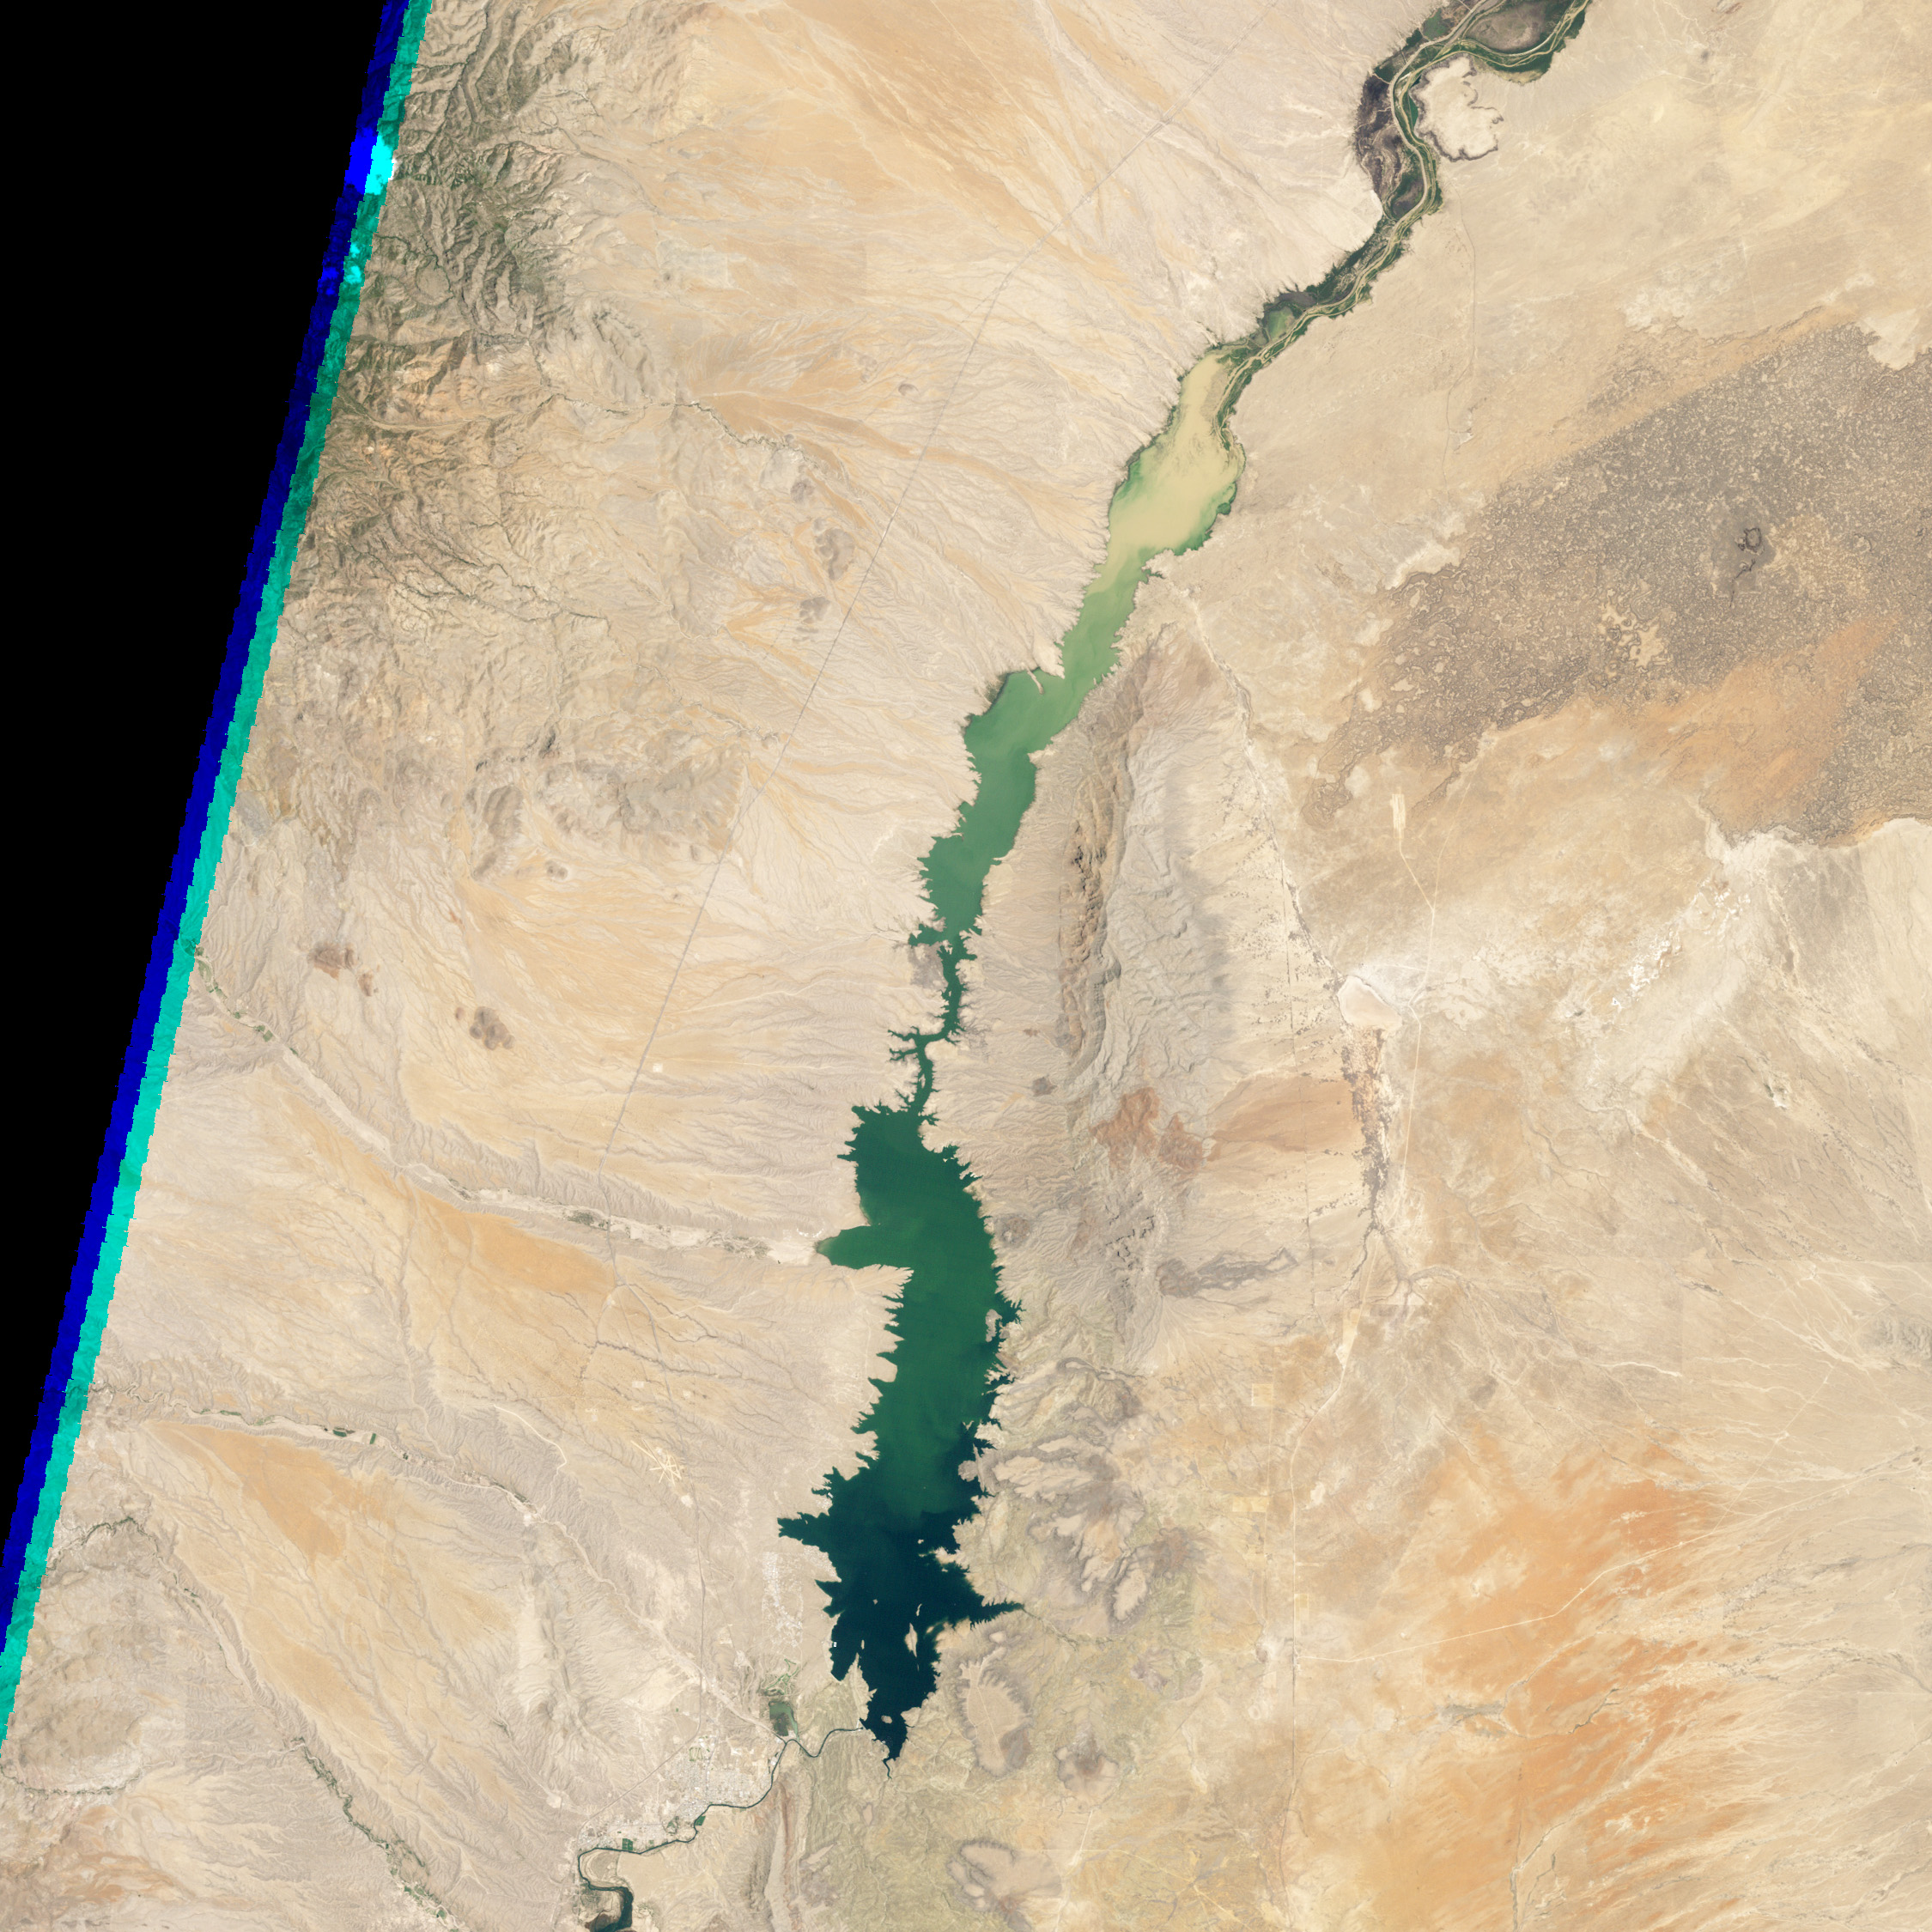
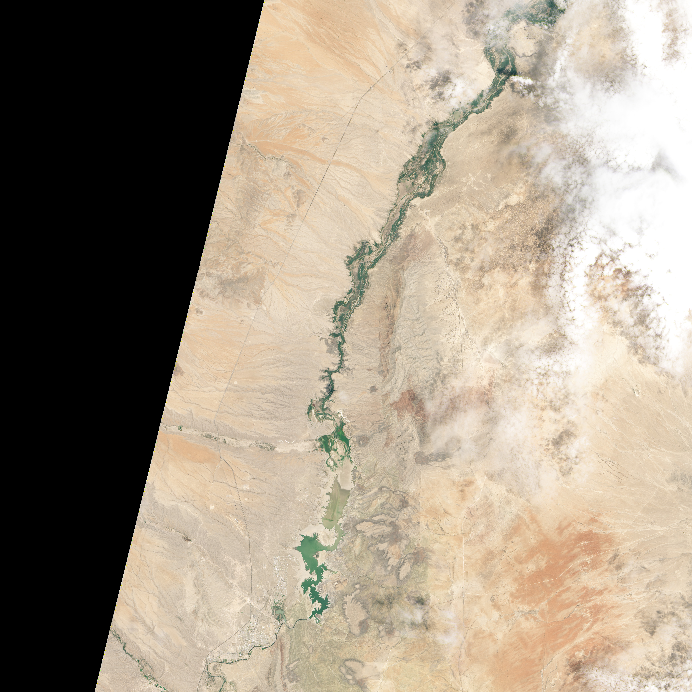
Some sediment flux
into reservoir
Landsat TM5
June 2, 1994
NASA Landsat 8
July 8, 2013
Reservoir at 80% of capacity
Reservoir at 3% of capacity
Snowfall in San Juan Mnts in 2013 exceptionally low
Farmers received only 1/10 of normal allocated water

Slide 31
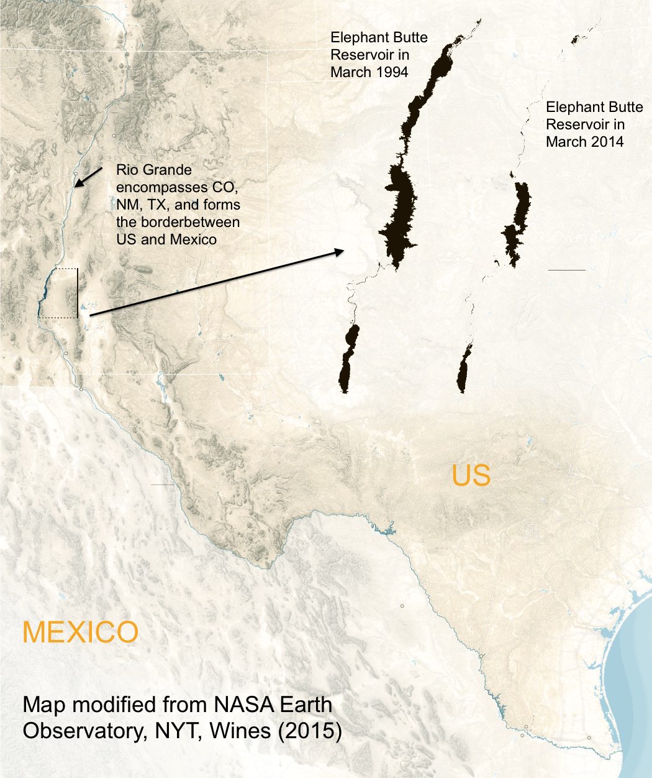
Elephant Butte Reservoir
Rio Grande drainage basin and the location of Elephant Butte Reservoir in NM (about 100 miles North of El Paso, TX).
The black outlines show the areal extent of the reservoir for March 1994, and March 2014, respectively (Modified after Wines, 2015).
Notes:
the reservoir is a speck with small tentacles on the map now in March 2014, and so much more expanded in March 1994

Slide 32
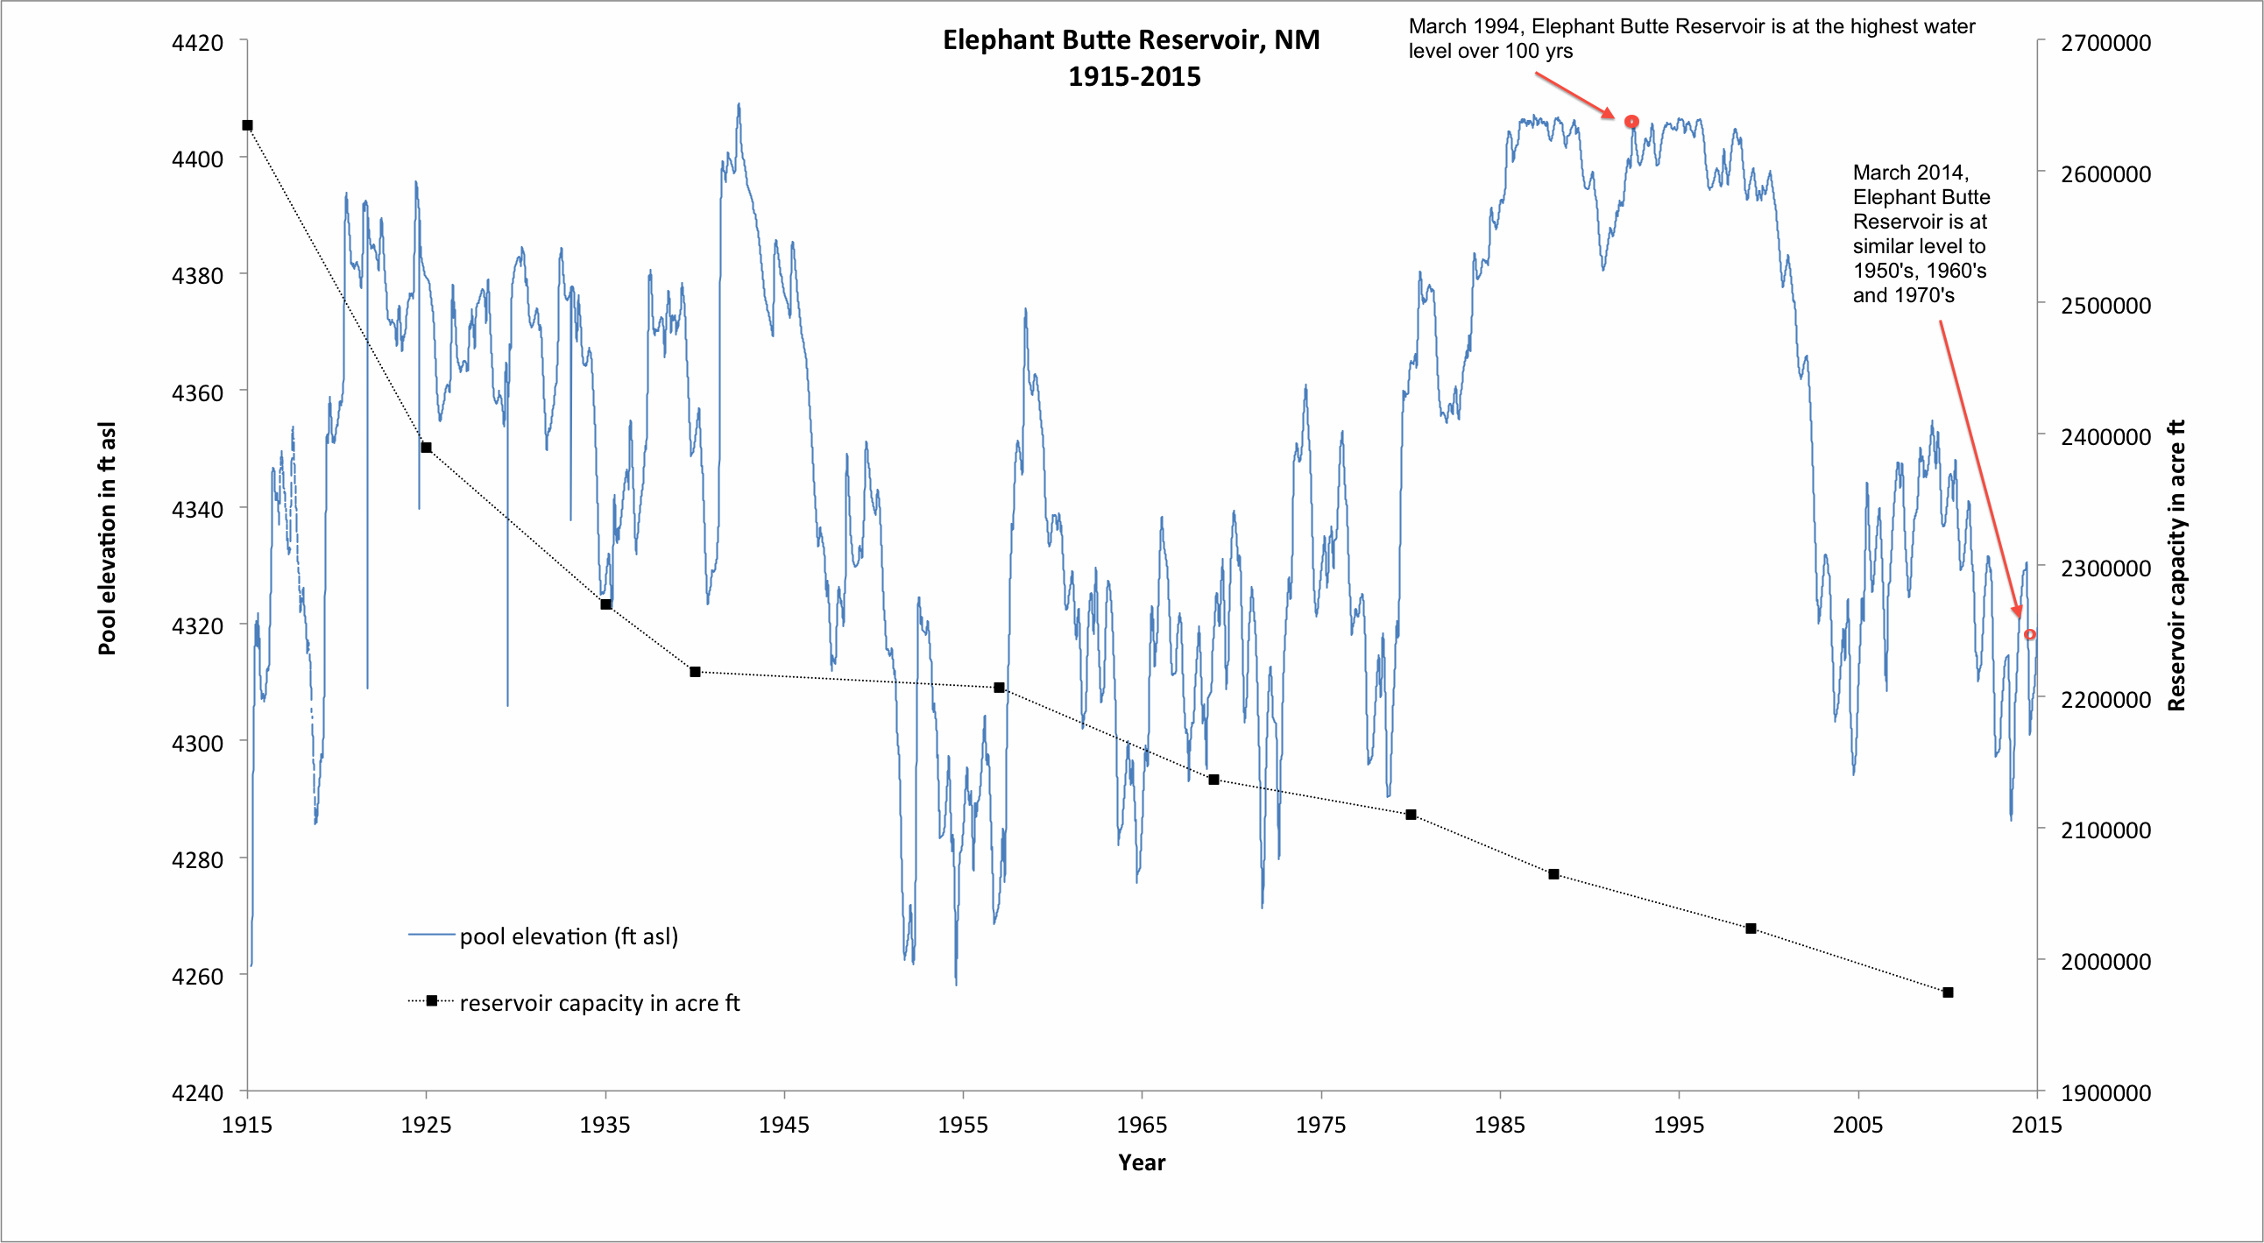
Water Level in Elephant Butte Reservoir (100 year record)
Data record: Bureau of Reclamation, retrieved from website April 27th 2015.
Notes:
Records maintained by the Bureau of Reclamation at Elephant Butte Reservoir now provide us with almost 100 years of water level variability.
The records show indeed periods of multiple years to decades of relative dry conditions and alternating wetter conditions, a wiggly blue line.
If one sorts the water level measurements, it turns out that only for a total of ~4 years of the century of existence of the reservoir has it reached the exceptionally high level of March 1994.
The conditions of March 2014 are low, but much more typical; there are about 26 years recorded with water levels as low or even lower over the last 100 years.
So no, the map comparison is not really fair. It contrasts the exceptionally high water level of 1994 with the present-day low water situation that has re-occurred for many years, most notably from 1951-1978.
Bureau of Reclamation, 2015. Data on Elephant Butte Reservoir downloaded from database maintained by El Paso Field Office of US Bureau of Reclamation, downloaded on April 25, 2015: http://www.usbr.gov/uc/elpaso/water/rgreports/faces/Reservoirs.jsp

Slide 33
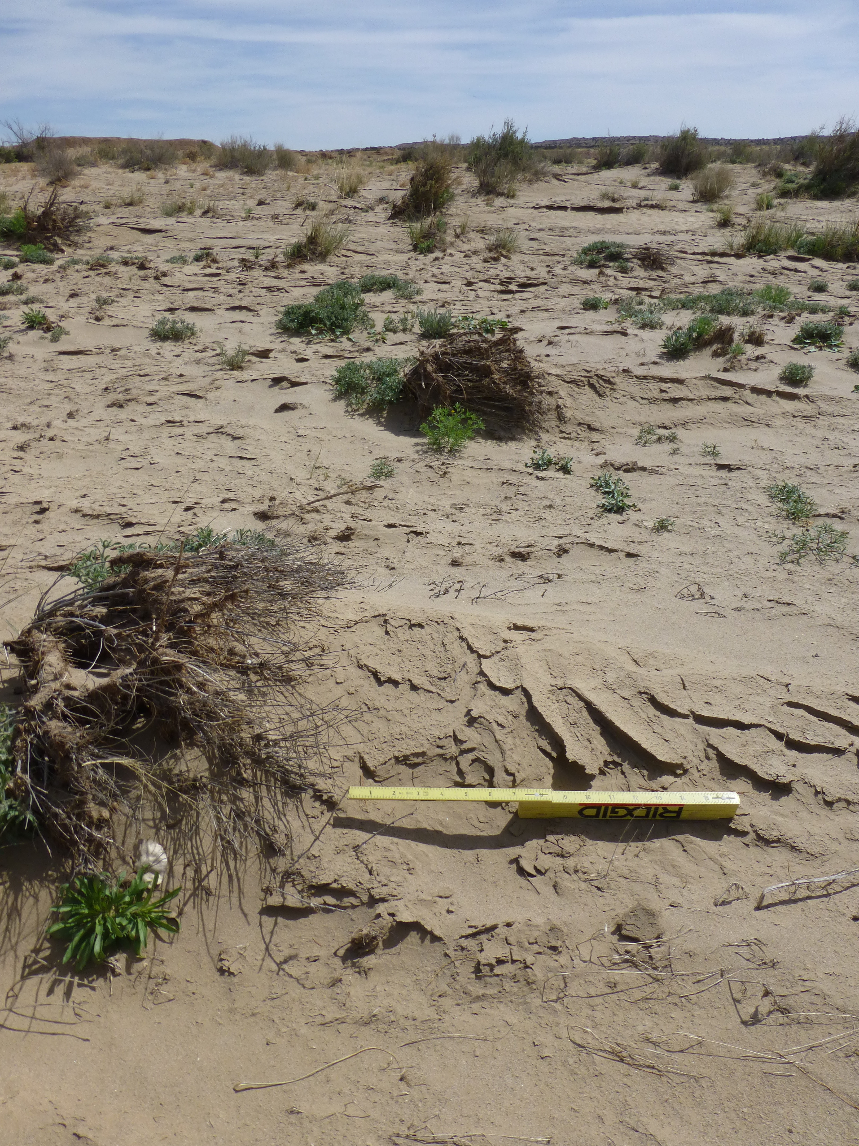
Sediment trapping due to grassy vegetation in floodplain

Slide 34
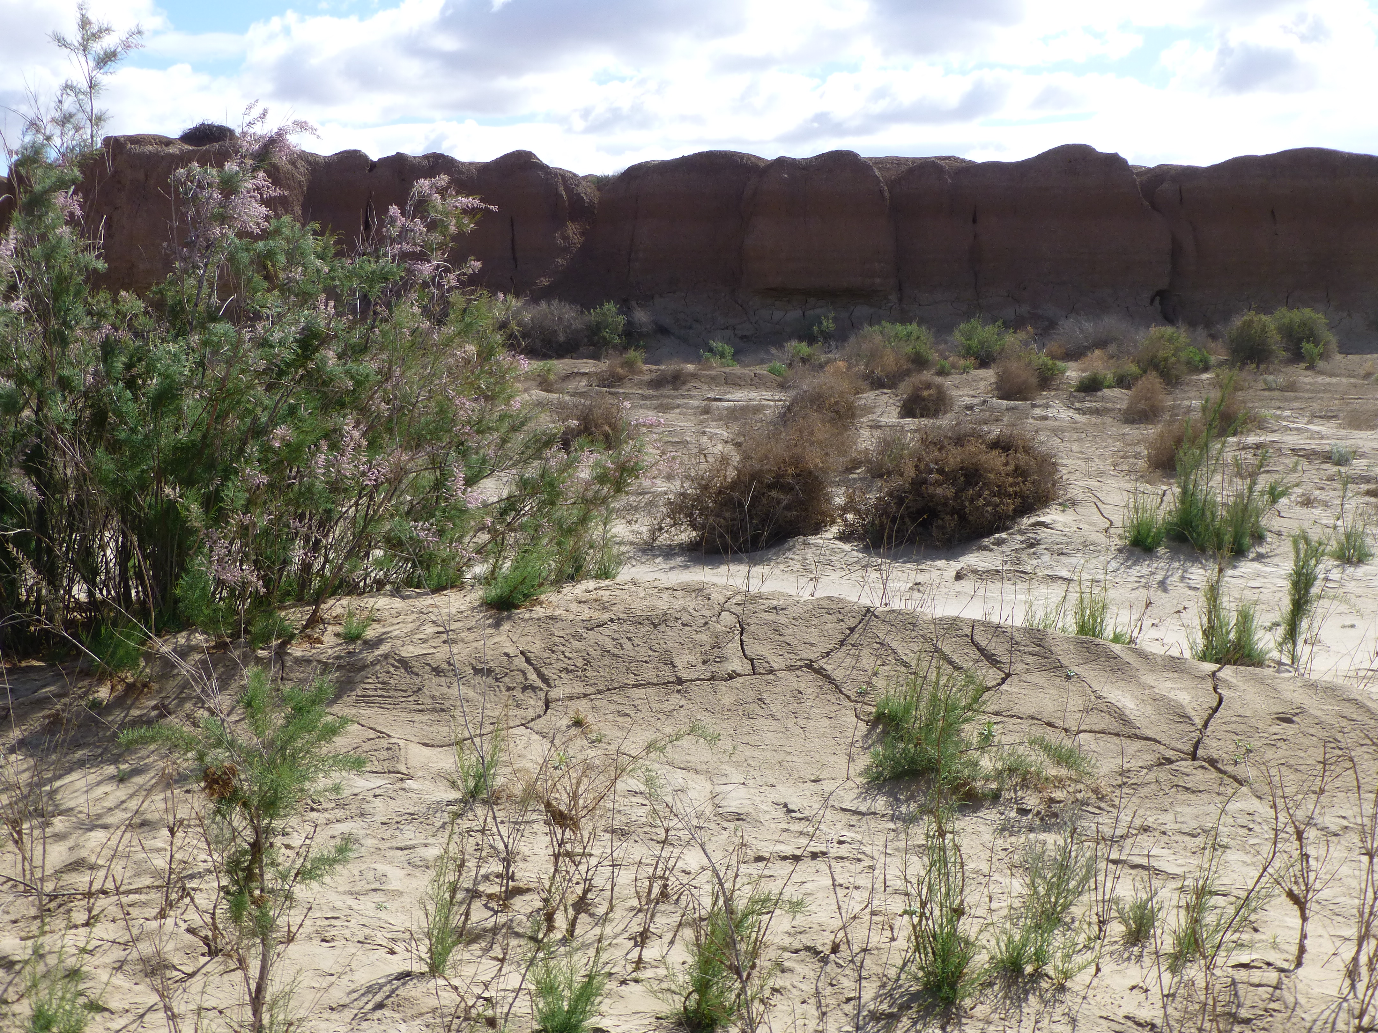
Sedimentation behind Tamarisk bush

Slide 35
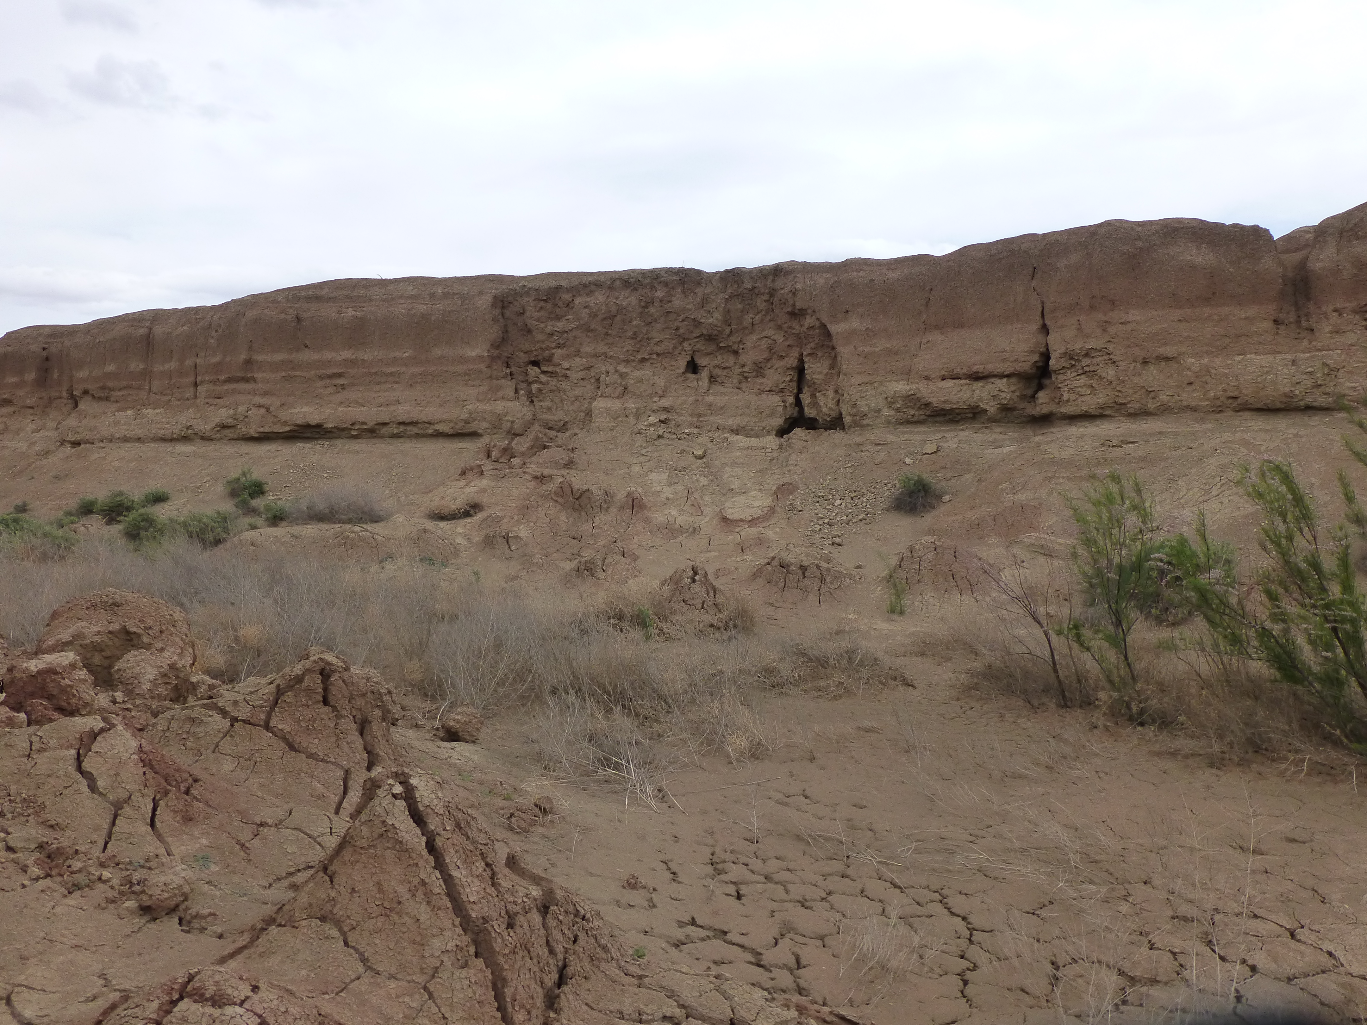
Sidewall Slumps

Slide 36
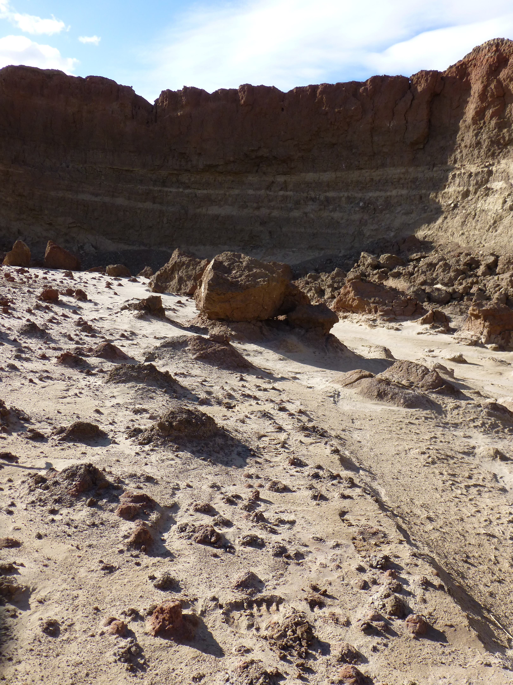
Sidewall Slumped Material
Sidewall collapses provide large amounts of sediment.
Even in really large flood event it was not evacuated very far.

Slide 37
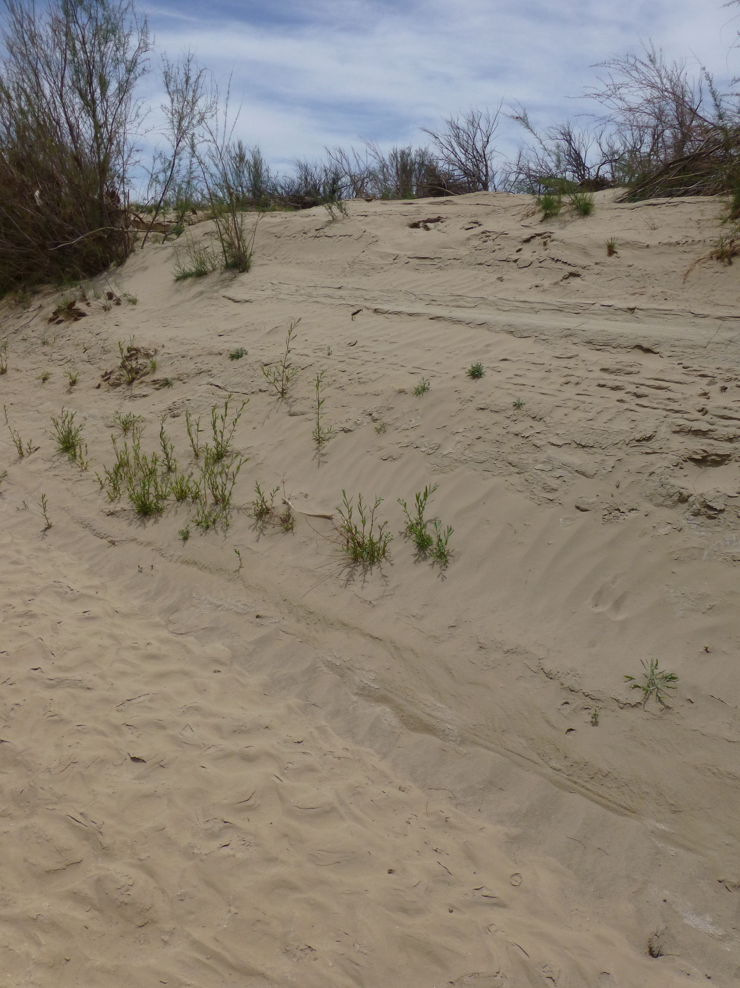
Sandbar Willow
Pointbar sedimentation in Rio Puerco
Sandbar Willow regenerates through the new sediment cover

Slide 38
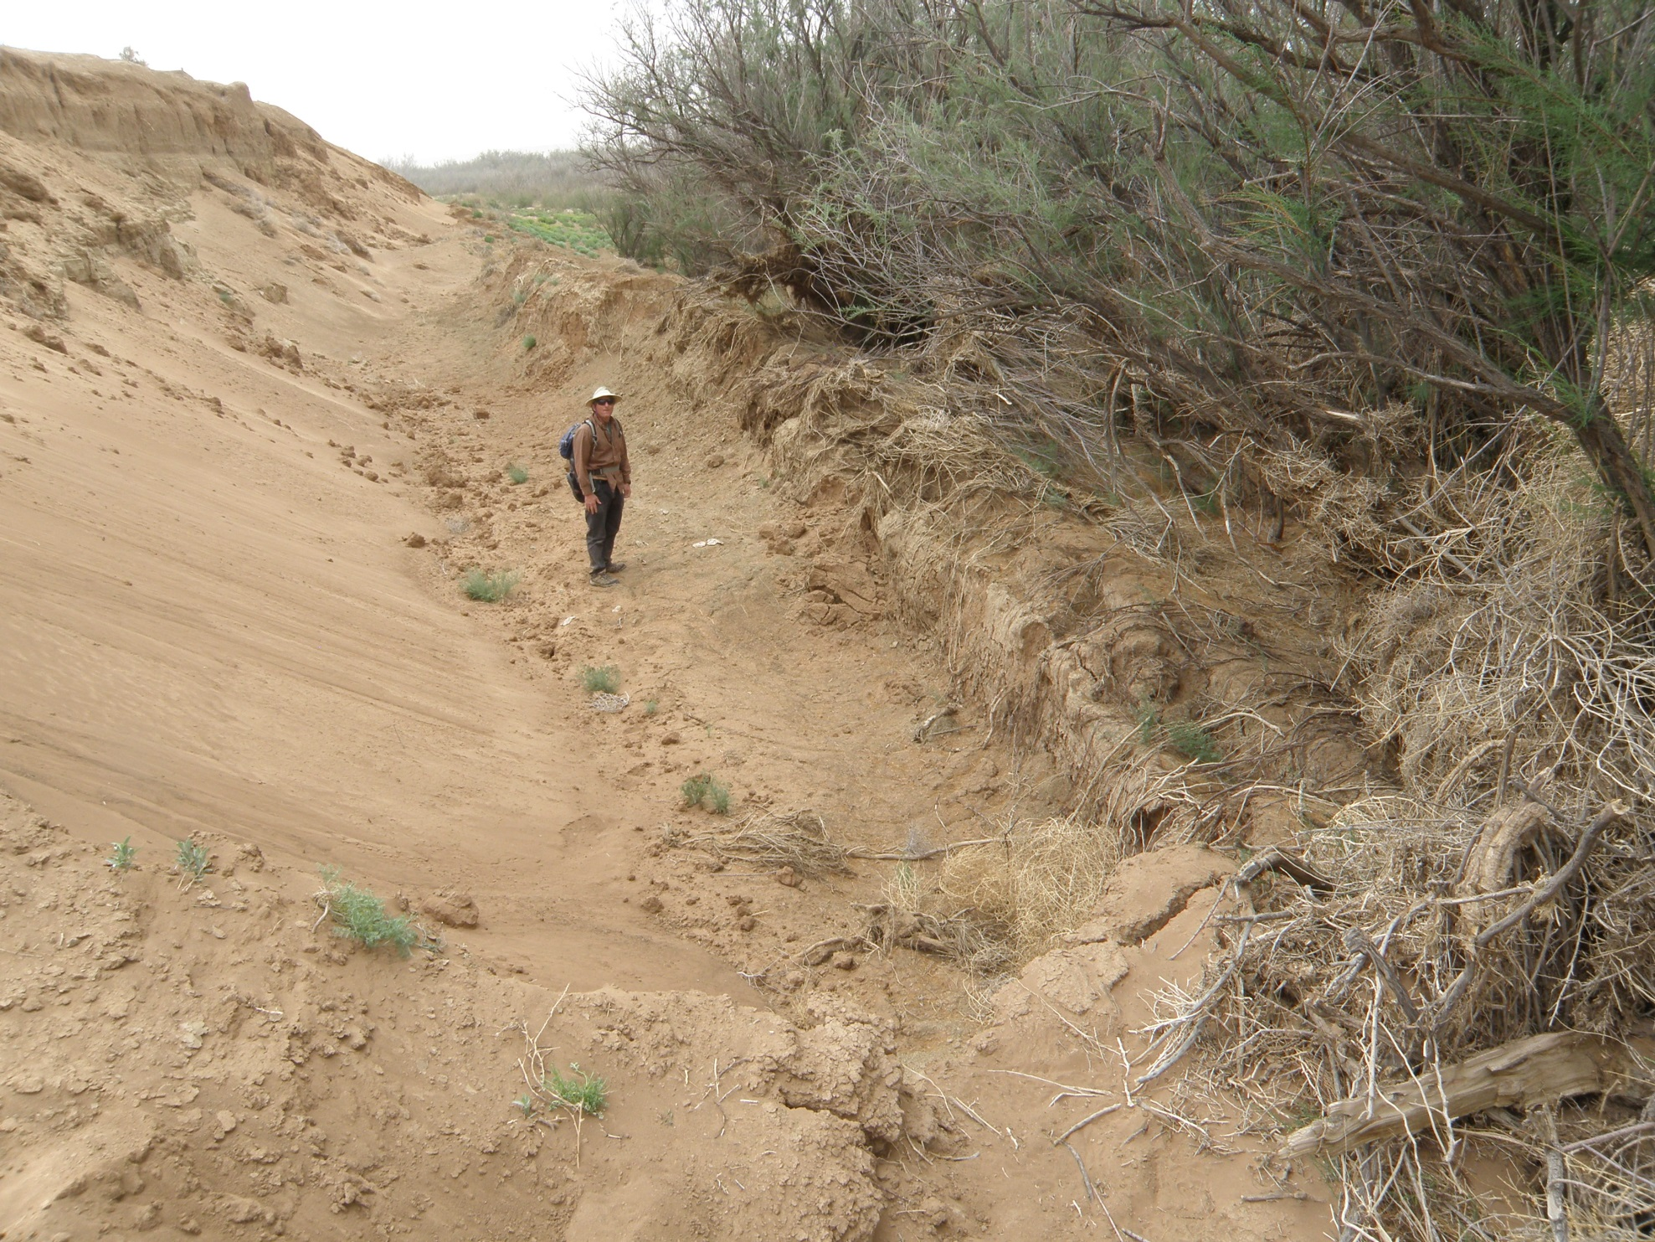
Localized Erosion
Erosion along base of arroyo wall near the Belen trench site resulting from Sep 2013 down-valley flood flow
Photo courtesy: Ellie Griffin

Slide 39
Capacity of Elephant Butte Reservoir (100 year record)
Data record: Bureau of Reclamation, retrieved from website April 27th 2015.
Notes:
Black line shows the reservoir capacity, the total volume of water the reservoir can potentially store before overtopping its dam.
Reservoir capacity has decreased by 25% over the existence period of the dam, with most of the infill occurring in the 25 years upto 1940.
Farmers downstream do not care about the reservoir area extent, they care about the volume of water they can use to irrigate their crops. Over the lifetime of the reservoir, sediment has filled in part of the reservoir. Over 100 years, Elephant Butte Reservoir has lost about 24% of its original 1916 capacity (Fig. 2). Most of this infill occurred in the 25 years upto 1940, and nowadays sedimentation only reduces the reservoir capacity by less than 1% per decade. But still, the slow infill of the reservoir with muddy desert sediments means that water levels of the past do not quite represent the same volume of irrigation water delivered.

Slide 40
Conclusions
People & agriculture in the Arid Western US depend on rivers for water.
Disproportionate amount of annual precipitation falls in the Rocky Mountains as snow, reservoir storage is needed to regulate the water availability over the year.
Small dryland river systems can have extreme sediment loads.
Downstream reservoir capacity is reduced by trapping of sediment.
Vegetation attenuates sediment flux through small dryland river systems.
Modern Rio Puerco with vegetation is less effective source of sediment

