Slide 1
The Power of Water: Basics of River Flow and Sediment Transport
Greg Tucker
Teacher Workshop
August 2015

Slide 2
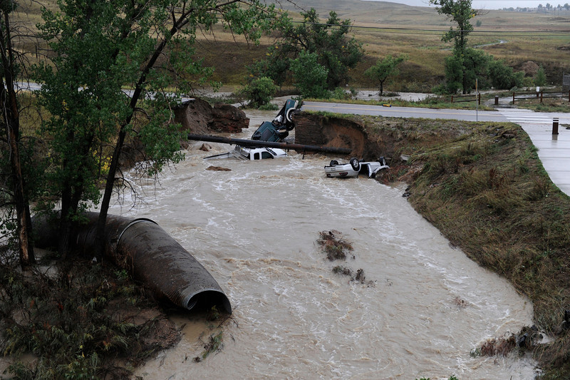
Boulder County flooding, September 2013
Three vehicles crashed into a creek after the road washed out from beneath them near Dillon Rd. and 287 in Broomfield Colorado, September 12, 2013 in heavy flooding. Three people were rescued. (Photo By Andy Cross/The Denver Post)
Notes:
Three vehicles crashed into a creek after the road washed out from beneath them near Dillon Rd. and 287 in Broomfield Colorado, September 12, 2013 in heavy flooding. Three people were rescued. (Photo By Andy Cross/The Denver Post)

Slide 3
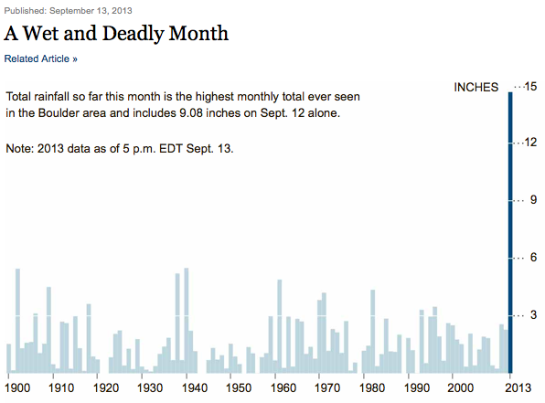

Slide 4
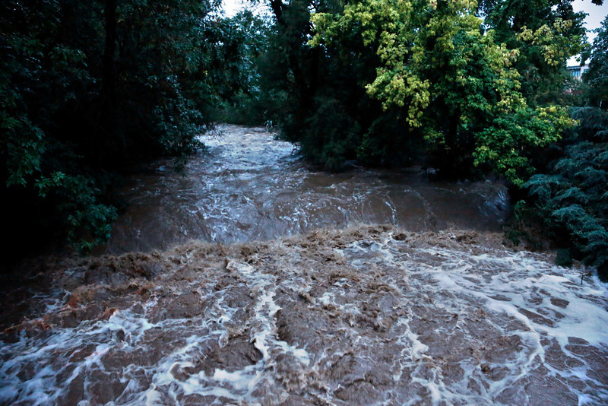
High water levels flow down Boulder Creek following overnight flash flooding in downtown Boulder, Colo., Thursday, Sept 12, 2013. The widespread high waters are keeping search and rescue teams from reaching stranded residents and motorists in Boulder and nearby mountain communities as heavy rains hammered northern Colorado. (AP Photo/Brennan Linsley)
Notes:
High water levels flow down Boulder Creek following overnight flash flooding in downtown Boulder, Colo., Thursday, Sept 12, 2013. The widespread high waters are keeping search and rescue teams from reaching stranded residents and motorists in Boulder and nearby mountain communities as heavy rains hammered northern Colorado. (AP Photo/Brennan Linsley)

Slide 5
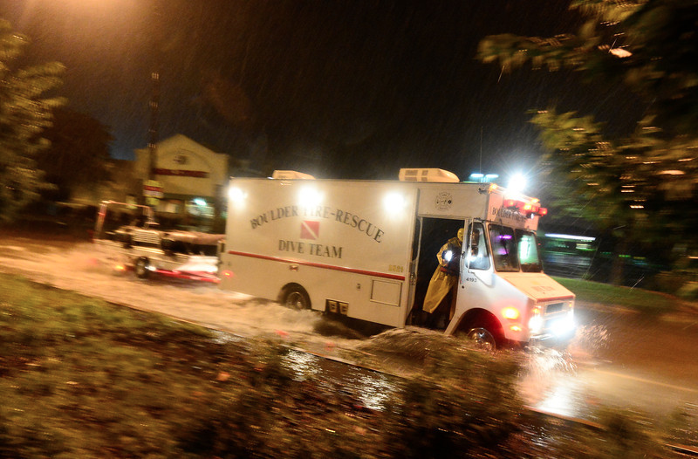
Notes:
A Boulder Fire-Rescue Dive team truck passes through a flooded section of 28th near Pearl, Thursday, Sept. 12, 2013, in Boulder. (Matthew Jonas/Times-Call)

Slide 6
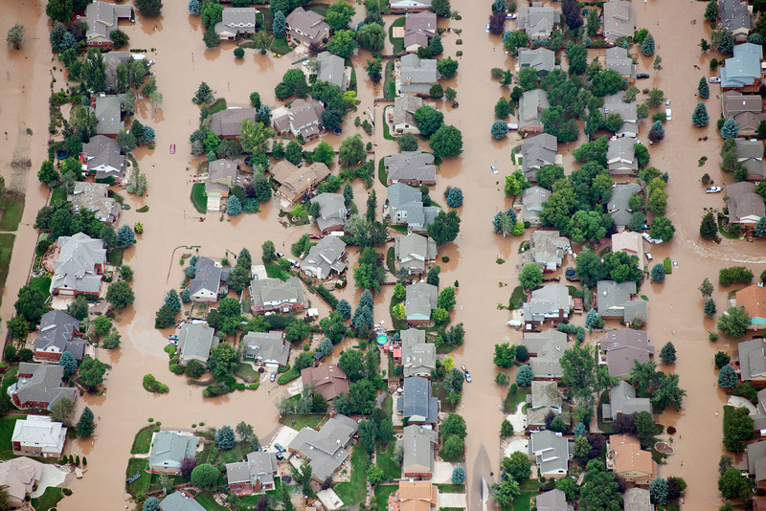
Longmont Colorado flooding. (Photo by John Wark, Special to The Denver Post)
Notes:
Longmont Colorado flooding. (Photo by John Wark, Special to The Denver Post)

Slide 7
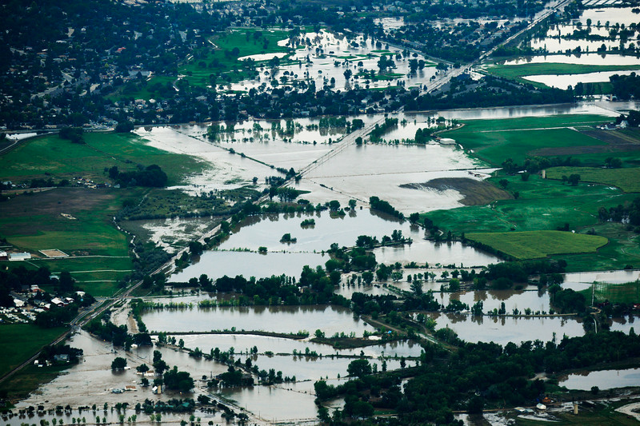
An aerial photograph looking east form Lyons shows the damage from the flood, September 13, 2013. Massive flooding continues to hit Colorado. (Photo By RJ Sangosti/The Denver Post)
Notes:
An aerial photograph looking east form Lyons shows the damage from the flood, September 13, 2013. Massive flooding continues to hit Colorado. (Photo By RJ Sangosti/The Denver Post)

Slide 8
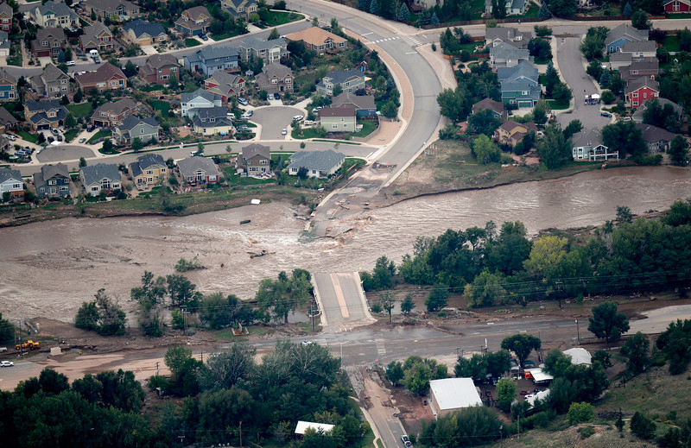
An aerial photograph shows the damage in Lyons from the flood, September 13, 2013. Massive flooding continues to hit Colorado. (Photo By RJ Sangosti/The Denver Post)
Notes:
An aerial photograph shows the damage in Lyons from the flood, September 13, 2013. Massive flooding continues to hit Colorado. (Photo By RJ Sangosti/The Denver Post)

Slide 9
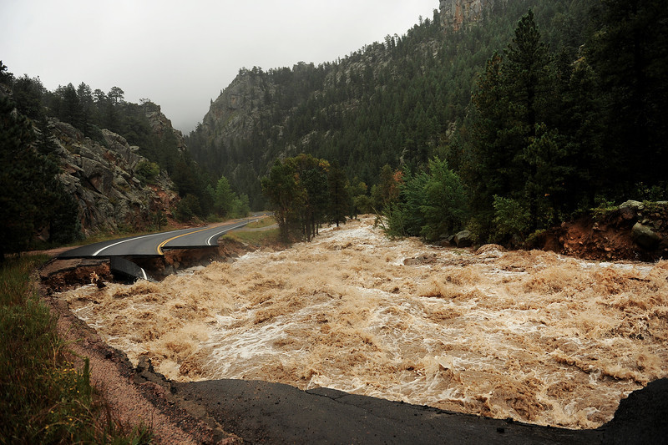
Hwy 7 is completely blown out from the South St. Vrain river as a torrent of raging water rips through it about 12 miles west of Lyons, CO. along Highway 7 on September 12, 2013. (Photo By Helen H. Richardson/ The Denver Post)
Notes:
Hwy 7 is completely blown out from the South St. Vrain river as a torrent of raging water rips through it about 12 miles west of Lyons, CO. along Highway 7 on September 12, 2013. (Photo By Helen H. Richardson/ The Denver Post)

Slide 10
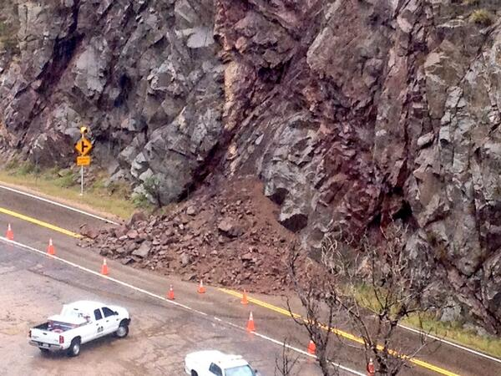
Landslide in Boulder Canyon between Magnolia and Sugarloaf. #boulderflood pic.twitter.com/xWBHfdYqry
Notes:
Landslide in Boulder Canyon between Magnolia and Sugarloaf. #boulderflood pic.twitter.com/xWBHfdYqry

Slide 11
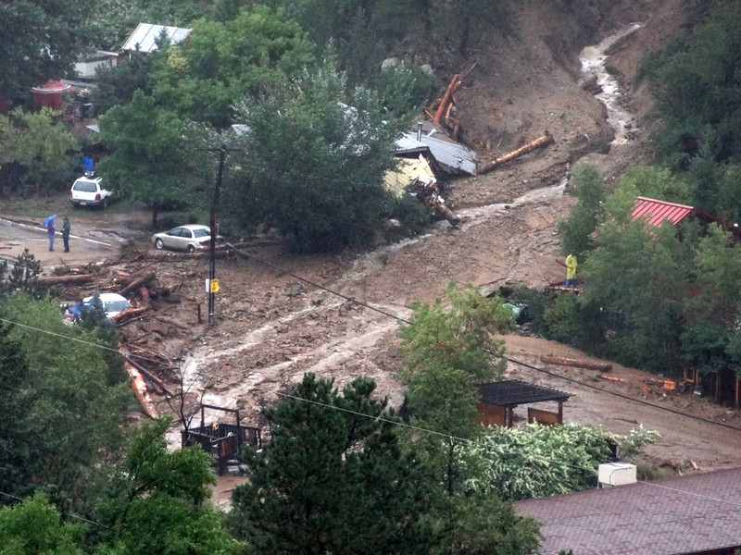
Photo from Jamestown showing a home wiped out by the flooding. Photo provided by Matthew Gurnsey
Notes:
Photo from Jamestown showing a home wiped out by the flooding. Photo provided by Matthew Gurnsey

Slide 12
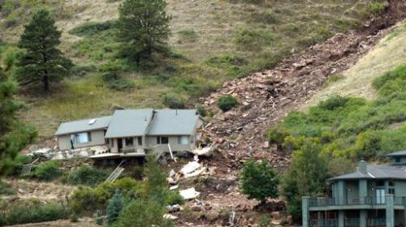
After about 72 hours and 12 inches of rain, the home of Dan and Pam Frisby in the Linden neighborhood was devastated by a massive slide above their home, from which it took four hours to free Dan Frisby. (PHOTO COURTESY: DARRIN HARRIS FRISBY) (from dailycamera.com)
Notes:
After about 72 hours and 12 inches of rain, the home of Dan and Pam Frisby in the Linden neighborhood was devastated by a massive slide above their home, from which it took four hours to free Dan Frisby. (PHOTO COURTESY: DARRIN HARRIS FRISBY) (from dailycamera.com)

Slide 13
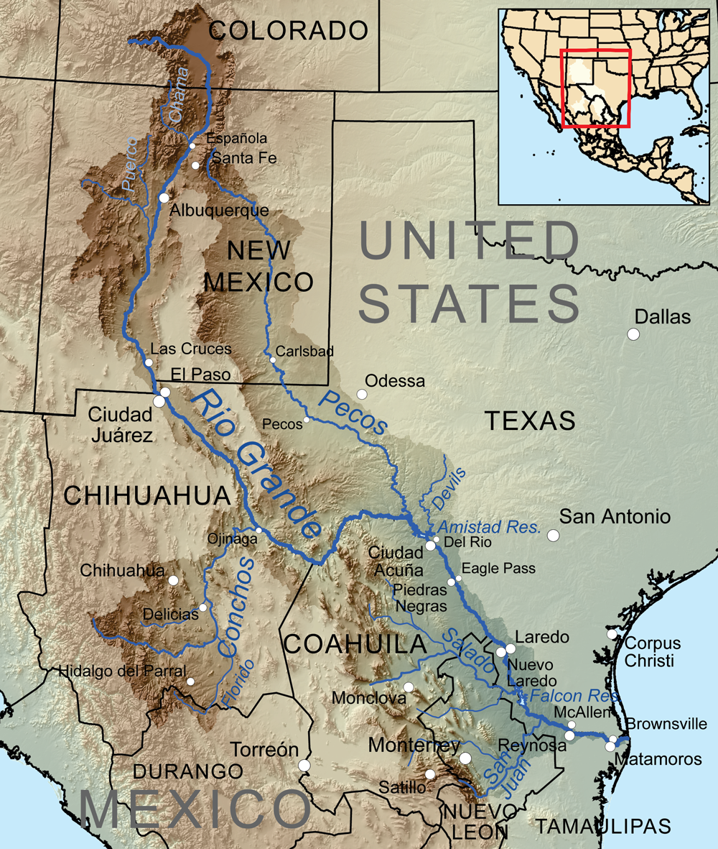
Meanwhile, 800 miles south: Rio Puerco, NM

Slide 14
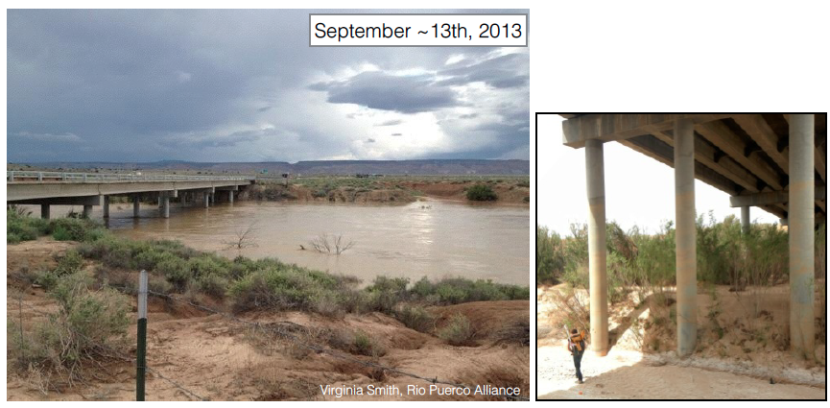
Rio Puerco flooding, Sep 2013
http://csdms.colorado.edu/wiki/Movie:Rio_Puerco_Flood_2013

Slide 15
Rivers and floods
How much water does it take to produce a flood?
What determines how fast water moves in a river?
What sets the biggest size of sediment particles that can be moved?

Slide 16
Discharge
Discharge is defined as the volume of water flowing through a stream cross-section over a given amount of time (such as 1 second).
Usually measured in cubic meters per second (cms) or cubic feet per second (cfs).
Often represented with the symbol Q.

Slide 17
Gaging stations and hydrographs
Discharge is measured (often continuously) at a gaging station
In the US, the US Geological Survey (USGS), state agencies, and other organizations maintain gaging stations
Some examples:
http://waterdata.usgs.gov/co/nwis/rt
http://www.dwr.state.co.us/Surfacewater/data/detail_graph.aspx?ID=BOCOROCO&MTYPE=DISCHRG

Slide 18
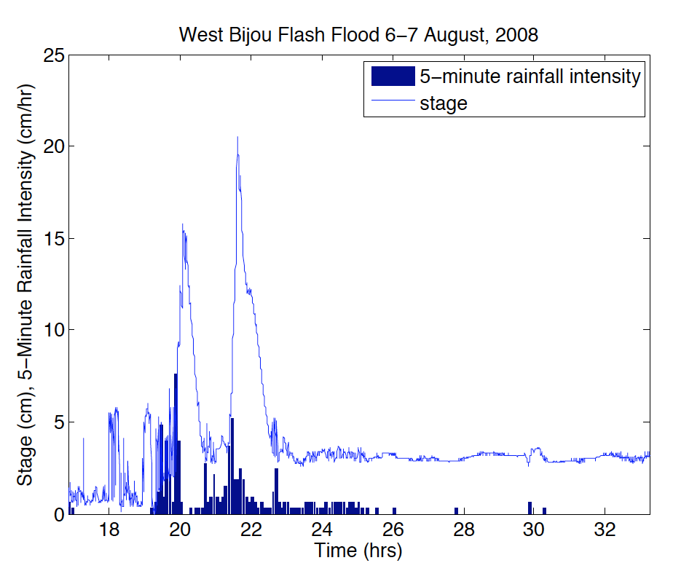
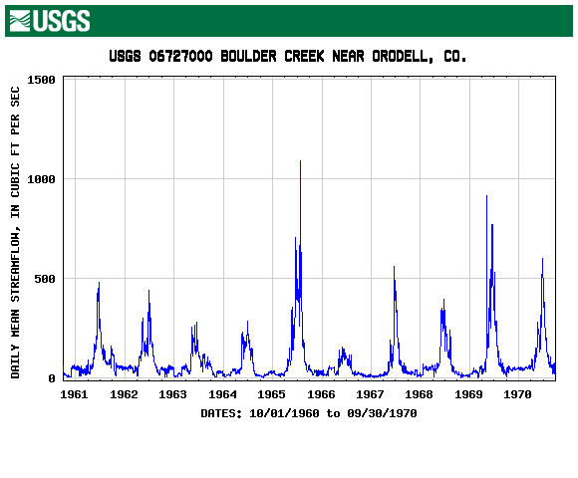
Gaging stations and hydrographs
A plot of discharge versus time is known as a hydrograph

Slide 19
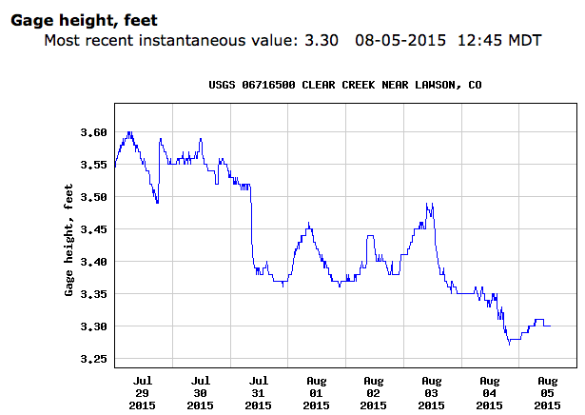
Stage
Stage, or gage height, is the height of the water relative to some fixed level
Used to calculate discharge

Slide 20
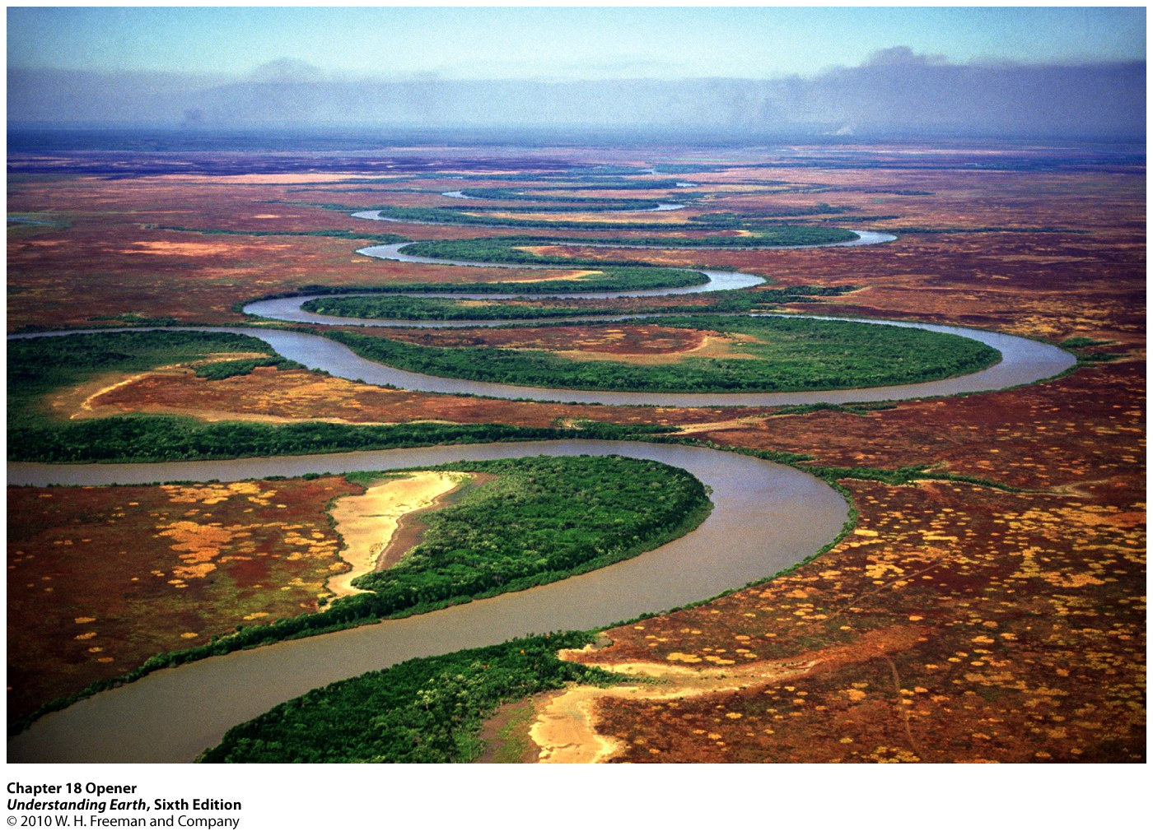
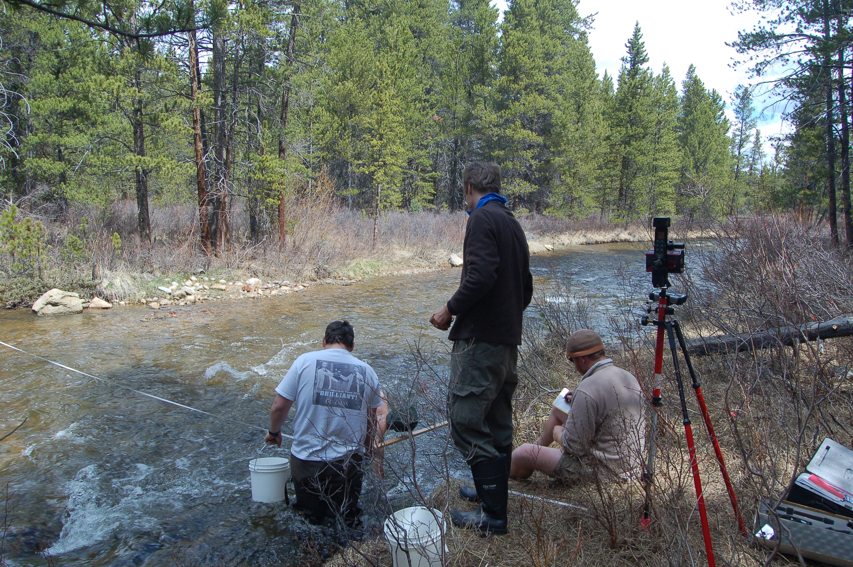
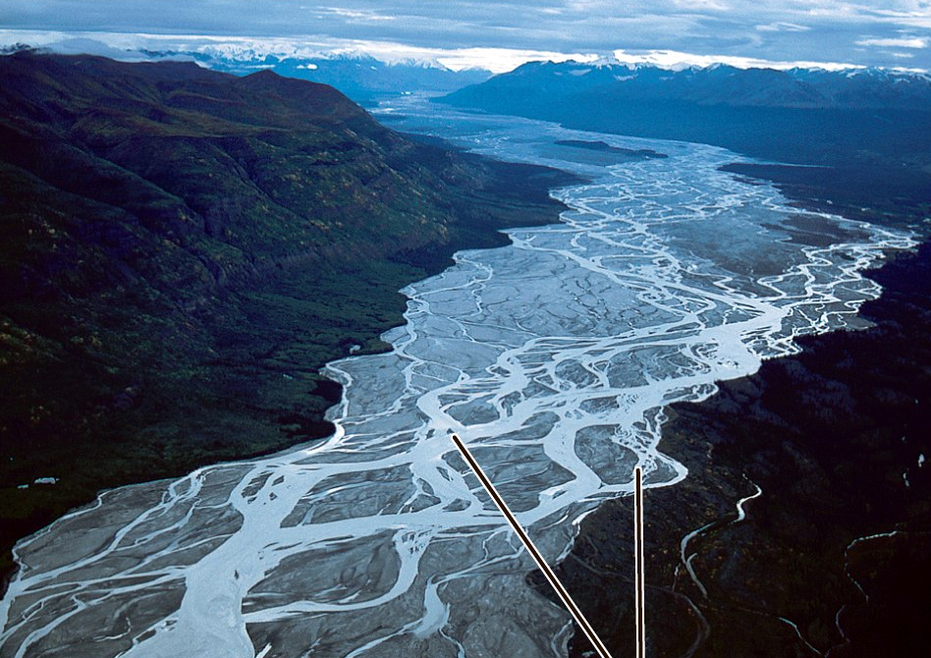
Channels
Streams normally flow in an identifiable channel
Channels come in all shapes and sizes

Slide 21
River Channel Geometry Definitions
Hydraulic radius R = A/P
Notes:
Hydraulic Radius quantifies how much of the flow feels the channel edge

Slide 22
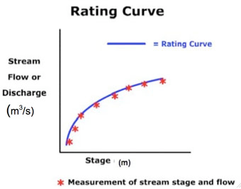
Stage-discharge relationship
This method is operational around the world, was first used in the 1800’s.

Slide 23
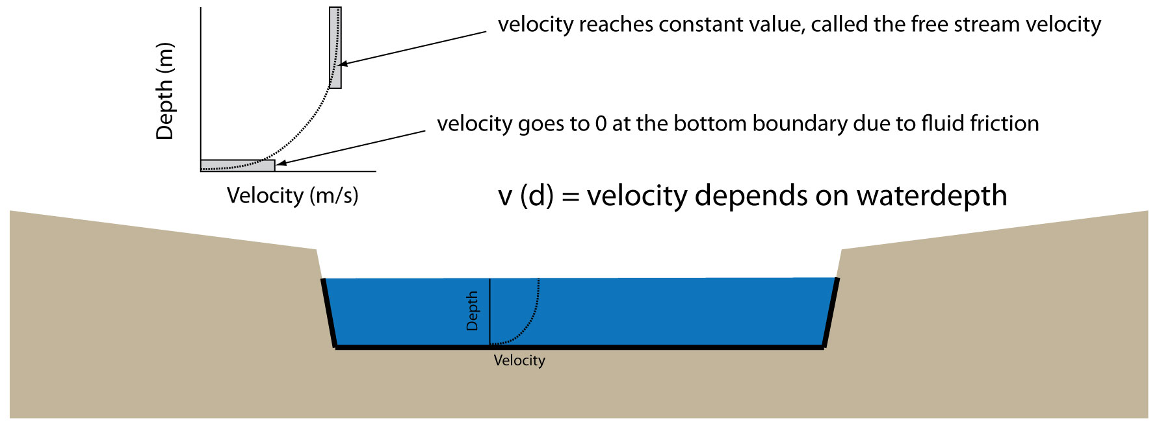
Velocity-depth profile

Slide 24
Discharge in a channel
Discharge is defined as the volume of water flowing through a stream cross-section
Q= V w d = v A
Q = discharge (in m³/s)
V = average velocity (in m/s)
A = channel cross-sectional area (in m²)

Slide 25
When the channel is full
“Rain added to a river that is rank
Perforce will force it overflow the bank”
-- William Shakespeare, Venus and Adonis
When the channel is full to the brim, we have bankfull width, depth, and discharge.
If you knew bankfull width, depth, and velocity, you could calculate the bankfull (maximum) discharge. You can measure w and d, but what about V?

Slide 26
River Flow velocity: Manning’s Equation
V= flow velocity (in ft/s or m/s)
n = Manning roughness coefficient (in s/ft^{1/3} or s/m^{1/3})
R = hydraulic radius (in ft or m)
S= channel slope (in ft/ft of m/m)
k = conversion constant (k=1.49 for US units, 1 for SI units)
Notes:
From theory on ‘open channel hydraulics’.
Manning’s equation is empirical, it is one of several of these empirical relationships. Mention Chezy?
Manning’s n characterizes the channel’s resistance.
Emphasize that Manning’s equation gives average flow, but in reality there is a velocity-depth profile

Slide 27
Floodplain Definition
High water events that exceed the capacity of the channel, water overtops the banks and flood into nearby plains.
This is the so-called floodplain. It is an intrinsic part of the river system. Floods typically re-occur every 2-3 years under natural conditions.
Floodplain width is commonly >20x channel width

Slide 28
Vegetation slows down flow on floodplains

Slide 29
Vegetation: friction from tree stems
Physics of flow around a cylinder
Force of drag on an object depends on:
Density of the fluid
Cross-sectional area of the object
Velocity (squared!)
Drag coefficient (“Cd”)
Formula:
F = (1/2) x Cd x density x area x velocity^2

Slide 30
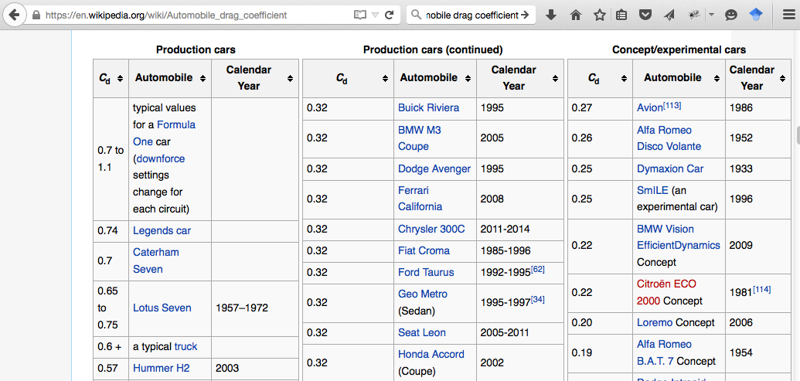
You can do this calculation for your car…

Slide 31
What about sediment?
Why do some streams carry only sand while others routinely toss around softball-sized rocks?
How much water do you need to move sediment the size of…
A raisin?
A grape?
A watermelon? …etc.

Slide 32
Gravity versus friction
Force of gravity (weight of water)
Force of friction

Slide 33
River friction
It’s easy to calculate the weight of a “block” of water: density x volume x “g” x channel slope
Divide friction force by surface area of the river bed and you have bed shear stress:
Shear stress = density x g x depth x slope
Example: in a 1 m deep stream with 1% slope, shear stress is 1000 x 10 x 1 x 0.01 = 100 Pa

Slide 34
Moving sand and rocks
Sediment won’t move until shear stress is above a threshold
The threshold depends on grain diameter and density
http://geofaculty.uwyo.edu/heller/sed_video_downloads.htm

Slide 35
Closing thoughts
Floods happen when discharge is greater than what the channel can carry…
…which depends on channel size, slope (speed), and roughness
Students can easily get data on stream stage and discharge: practice reading graphs and relating river flow to weather
Plants slow flow, making it drop sediment, and also making the water a bit deeper
River studies combine science, math, physics, and even a bit of biology

