Slide 1
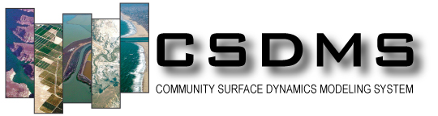

Regional Ocean Modeling System (ROMS)
For the Non-Specialist
(ROMS – LITE)
Courtney Harris
Virginia Institute of Marine Science
Thanks to Julia Moriarty and Tara Kniskern
Posted by Irina Overeem, May 2016

Slide 2
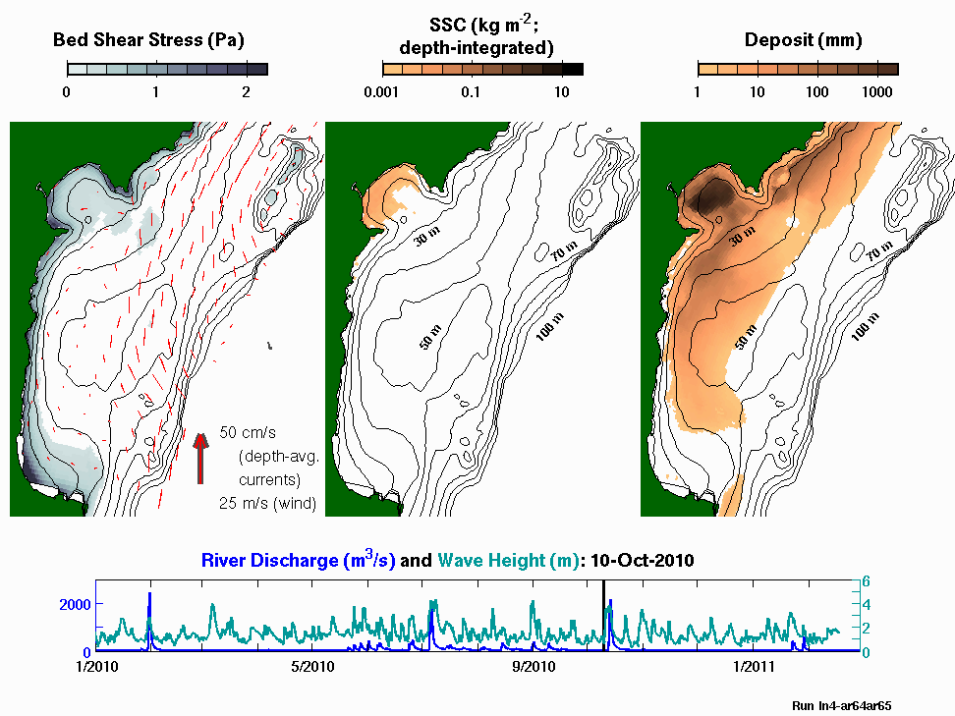

Waipaoa Shelf, New Zealand
Moriarty et al. 2014

Slide 3
ROMS within CSDMS
Three-dimensional hydrodynamic ocean model.
Variety of modules can be loaded: sediment, biology, etc.
  CSDMS Marine working group asked for a hydrodynamic ocean model capable of representing suspended transport for idealized coastal environments.
ROMS available on CSDMS repository because it was requested.

Slide 4
Outline
Overview the ROMS model framework and input / output.
Demonstrate an idealized continental shelf model.
Learn to browse model results.
Learn to modify the test case and re-run it.

Slide 5
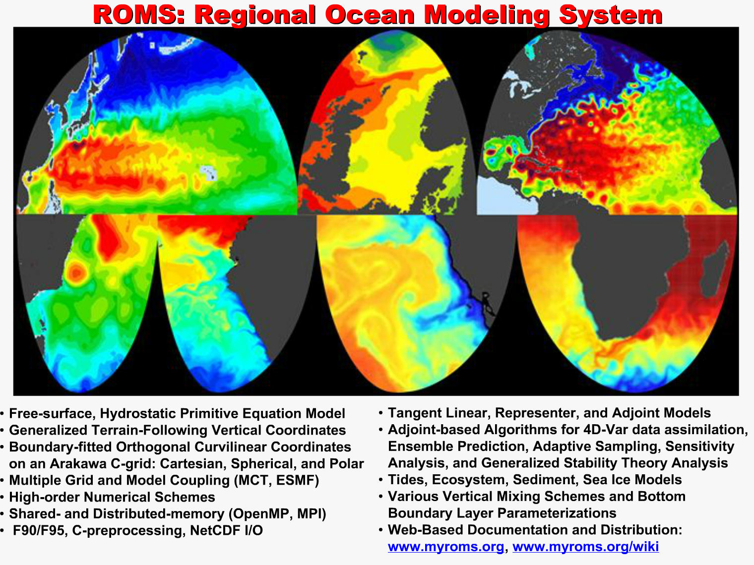
SLIDE from Hernan Arango, Rutgers

Slide 6
Overview of ROMS
Three-dimensional, time-dependent hydrodynamic model.
  Solves the conservation of mass and momentum equations.
  Includes transport equations for temperature and salinity.
Community model
  Open source.
  Wide user community, > 4000 registered users.
In addition to hydrodynamics:
  Modules for sediment transport (Warner et al. 2008; bedload and suspended load), biogeochemistry (NPZD), ice.
  Can be run as nested model, and wetting-drying; large data assimilation community.
  Two-way coupled to wave model (SWAN), wind model (WRF).

Slide 7
Overview of ROMS, cont.
Features of the code:
  Written in Fortran-90
  Parallelized (MPI).
  Includes sets of options: advection schemes, turbulence closures, bottom boundary layer treatments.
  Output: NetCDF “history” file, ocean_his_*.nc.
  Input: format is a somewhat flexible (confusing?) mix of NetCDF, text files, and some hard-wiring.

Slide 8
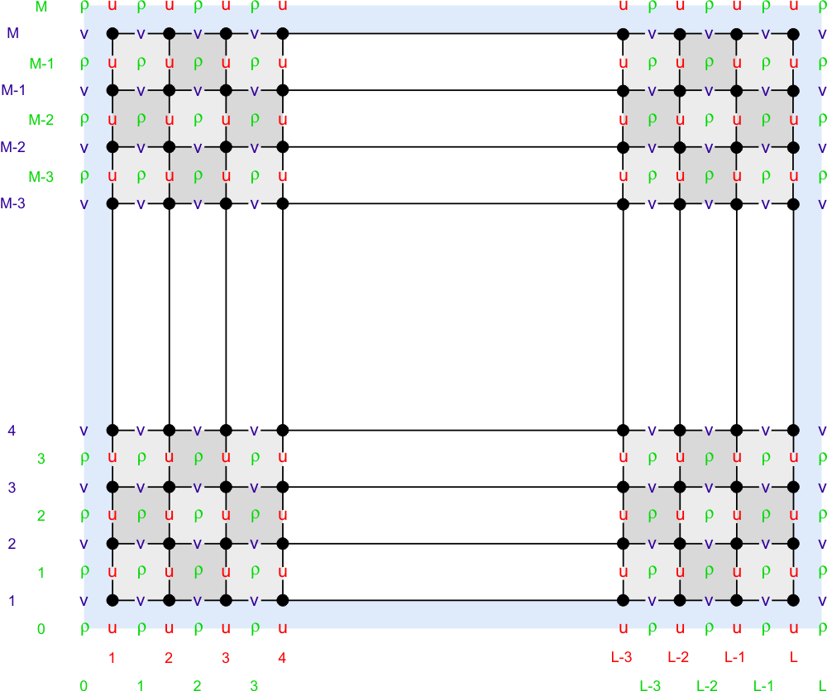
ROMS’
Horizontal Grid
Orthogonal curvilinear grid.
Arakawa-C grids often used in coastal models..
U, v, w, and ρ are represented at different locations within the model grid.
The u-, v-, and ρ-grids are different.
The u-, v-, and ρ-grids are different *sizes*
Figures from ROMS wiki.
Fringer, McWilliams, and Street, 2006.

Slide 9
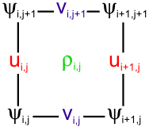
One Arakawa-C Grid Cell
“rho points”: density
salinity
sediment concentration
bed stress.
“u” and “v” points: velocities.
Sample Arakawa-C grid cell, seen from above. From https://www.myroms.org/wiki/index.php/File:grid_cell.png

Slide 10
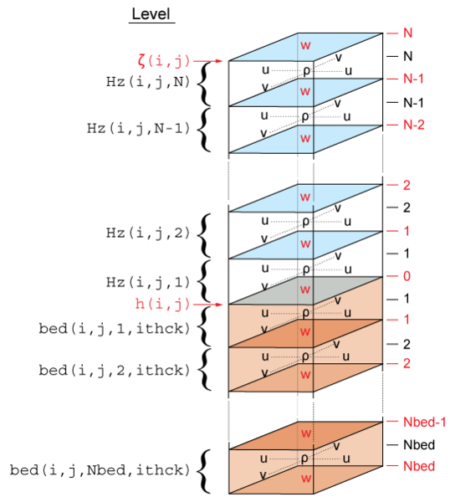
ROMS Vertical Grid
Figure from Warner et al. 2008
The vertical grid has two parts:
Water column shown in blue. “N” layers.
Sediment bed shown in brown. “Nbed” layers.

Slide 11
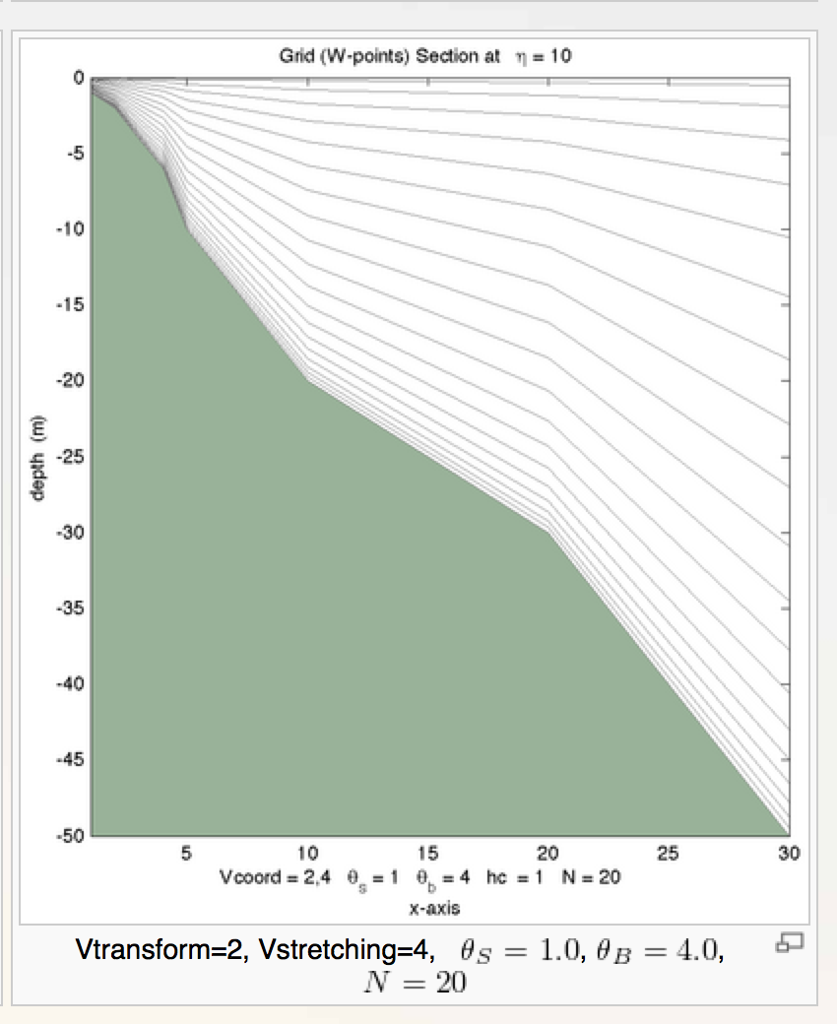
ROMS’
Vertical Grid
Terrain following.
Number of vertical grids is constant.
Stretched.
Implications:
Can maintain thin layers at surface and bed.
Need post-processing to calculate vertical water depths.
Example figure from ROMS wiki

Slide 12
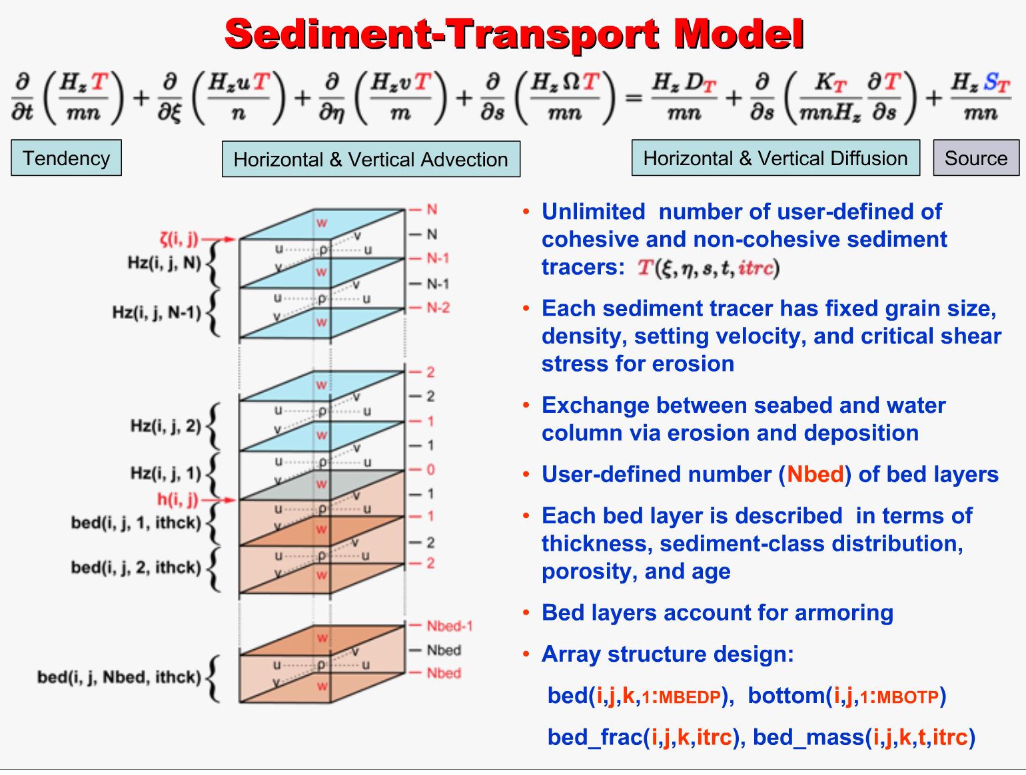
SLIDE from Hernan Arango, Rutgers

Slide 13
ROMS RIVERPLUME2
idealized continental shelf with a river plume.
Muddy River
5 cm/s current
shelf deposit
v
Cs
100 m
13 cells
100 km; 72 grid cells
50 km; 52 grid cells
Currents (~0.05 m/s) forced at open boundary.
Waves (Hsig = 2m, T = 10 sec)
Steady river discharge (1500 m³/s) with suspended sediment (2 g/L).

Slide 14
More about “RIVERPLUME2”
Model Input
Three sediment types | Nominally 0.01, 0.1, and 1 mm diameter
Settling velocities | 0.05, 0.1, and 1 mm/s
Critical shear stress | 0.04, 0.14, and 0.48 Pa
River concentration | 1 g/L, 1 g/L, and 0
River discharge | 1500 m³/s
Alongshelf current | 5 cm/s
Waves | 2 m height, 10 second
Vertical grid | 20 water column layers; 10 sediment bed layers
Numerical Setup
Boundary conditions | Mostly radiation, except depth-averaged velocities are “reduced physics”. Clamped free surface offshore. Both the alongshelf current and the river flow are specified as open boundary point sources.
Advection schemes | MPData for tracers; 3rd and 4th order advection for horizontal and vertical advection.
Bottom boundary layer | “SSW” Sherwood / Signell / Warner implementation of Madsen 94.
Turbulence | “LMD” Large / McWilliams / Doney.

Slide 15
Clinic Activity
Look at model output: Browse the output file (riverplume2.nc).
Modify the model: Make a change to the model and re-run it.
Analyze the revised model.

Slide 16
NetCDF Files
Download an easy netCDF viewer:
http://www.giss.nasa.gov/tools/panoply/
Some basic instructions to visualize time-series and grids, and make movies of grids over time in Panoply:
https://csdms.colorado.edu/wiki/Labs_WMT_VisualizeOutput

Slide 17
What participants might find useful for using the ROMS Ideal Shelf model:
Here today:
  Panoply methods for browsing and viewing ROMS output.
  Other NetCDF browsers: ncdump, nco.
  Need access to CSDMS HPCC beach if you want to run the code today.
Later:
  Access to beach if you want to run the code; or the source code if you want to recompile and run on your own computer.
  Matlab toolboxes snctools and nc_toolbox.
  Other ways to browse and visualize NetCDF (Python, “pyroms”, Panoply).
  The ROMS wiki and forum at myroms.org.

Slide 18
What is in riverplume2.nc?
Grid Information
Horizontal grid (x and y points) | (x_rho, y_rho); (x_u, y_u); (x_v, y_v); (x_w, y_w). | meters
Vertical grid (z’s) | Vertical location (z) is not stored in the history file. Need to do post-processing to get z. | meters
Water depth (i.e. bathymetry) | h | meters
Sediment bed grid | bed_thickness (vertical thickness of each of 10 bed layers) | meters
Time | ocean_time (in seconds relative to 1968-05-23 00:00:00 GMT) | seconds
Two-dimensional time-series variables (i.e. depth averaged)
Depth-avgd’ velocity | ubar, vbar (at the u- and v- grid points) | m/s
Total bed stress | bustrcwmax, bvstrcwmax (at the rho-points) | Pa
Sea surface elevation | zeta | meters
Wave orbital velocity | Ubot, Vbot | m/s

Slide 19
What is in riverplume2.nc? (Part 2)
Three-dimensional time-series variables
Velocities | u, v, w (at the u-, v-, and w-points) | m/s
Tracer concentrations | salt, temp (at the rho-points) | ppt, oC
Sediment concentrations | mud_01, mud_02, mud_03 (at the rho-points; concentrations in mass/volume within each grid cell, for each sediment class). | kg/m³
Bed sediment | mudmass_01, mudmass_02, mudmass_03 (amount of each sediment class in each sediment bed layer) | kg/m²
Thickness of sediment bed layers | bed_thickness (thickness of each of the 10 sediment bed layers. To get total thickness, sum the layers). | m

Slide 20
Key References
The ROMS manual and model background
https://www.myroms.org/wiki/Regional_Ocean_Modeling_System_(ROMS)
Shchepetkin, A. F., and J. C. McWilliams, 2005: The Regional Ocean Modeling System: A split-explicit, free-surface, topography following coordinates ocean model, Ocean Modelling, 9, 347-404.
Modeling Surface Trapped Sediment Plumes: a Sensitivity Study. Hyatt,J., Signell, R., Estuarine and Coastal Modeling (1999), New Orleans, LA, November 3-5.

