Slide 1
WMT-Hydrology Clinic
Irina Overeem and Mark Piper
Scott Peckham
CSDMS Annual Meeting, May 2016

Slide 2
Clinic Outline
Intro on WMT Hydrology and TOPOFLOW
Recent Advances in WMT (Mark Piper)
WMT Hydrology for Teaching (Irina Overeem)
Hands-on Example of Lab
Discussion on further developments

Slide 3
What is WMT-Hydrology?
A set of 18 hydrological processes components presented in the CSDMS Web Modeling Tool that allow inexperienced users to look at basic hydrological processes such as precipitation, evapotranspiration, infiltration, flow routing, channel runoff dynamics a.o..

Slide 4
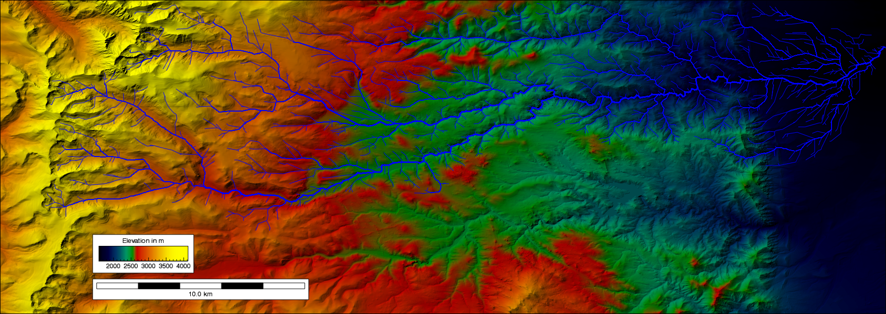
Spatially-Distributed Hydrological Model Components
Meteorology
Precipitation
Flow routing (D8)
Snow Melt
Channel Dynamics
Degree-Day
Energy balance
Kinematic Wave
Dynamic Wave
Diffusive Wave
Evapotranspiration
Energy-Balance
Priestley-Taylor
Infiltration
Green-Ampt
Richards
Smith-Parlange

Slide 5
WMT-Hydrology Philosophy
Tool for Teaching!
Level: advanced undergraduates
Goals: familiarize with running numerical models, familiarize with exploring scenarios, with fiddling with input data, get basic insight in model coupling techniques
Topical goals: quantitative hydrology, mass balance, energy balance, flow routing, channel dynamics etc….

Slide 6
TopoFlow is big and complex.
We trimmed it a bit to fit into WMT

Slide 7
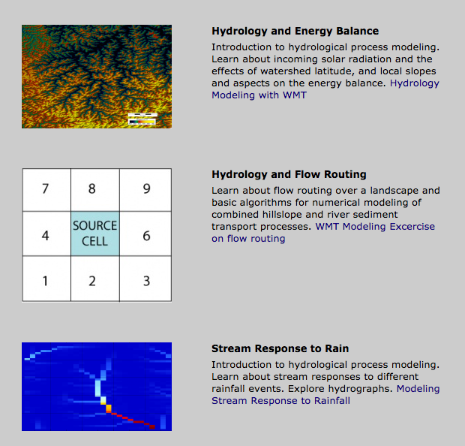
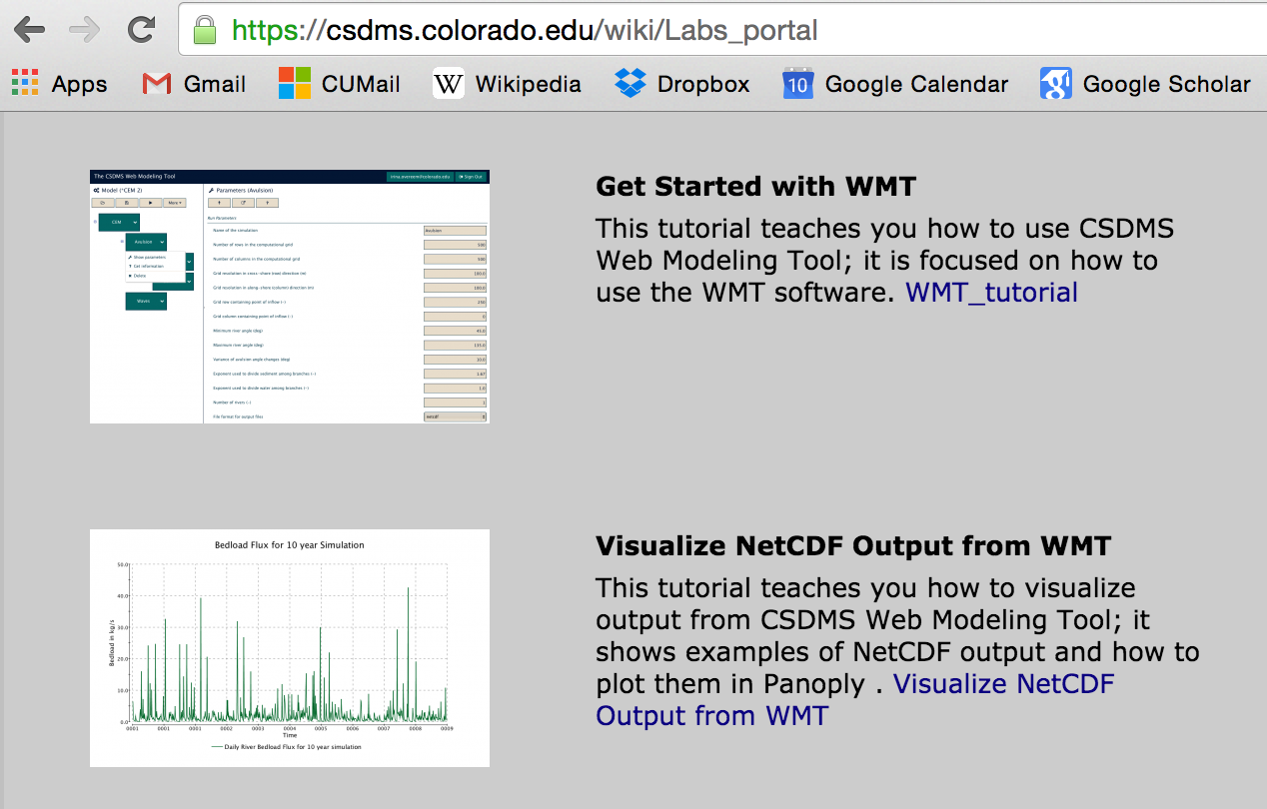
Using WMT Hydrology
As of May 2016, 3 hydrology labs are available
https://csdms.colorado.edu/wiki/Labs_portal
To get students started with WMT & Panoply
(2 Labs)

Slide 8
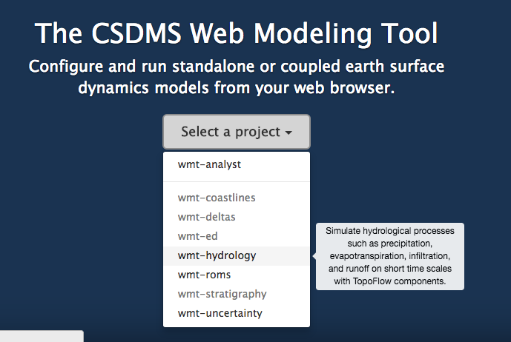
Web Modeling Tool
https://csdms.colorado.edu/wmt/

Slide 9
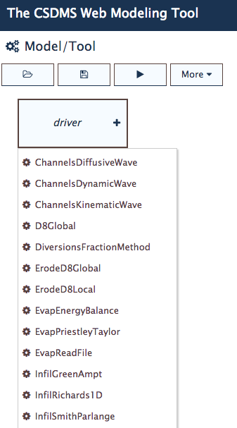
Components originate from TOPOFLOW
List of components with Basic Model Interface, most of these originate from TOPOFLOW (Peckham 2008). These set of components can now all be run as independent models; and are presented with tested default configuration.
Several components can be coupled programmatically through their BMI.
User can manipulate set of parameters in WMT GUI and run simulations

Slide 10
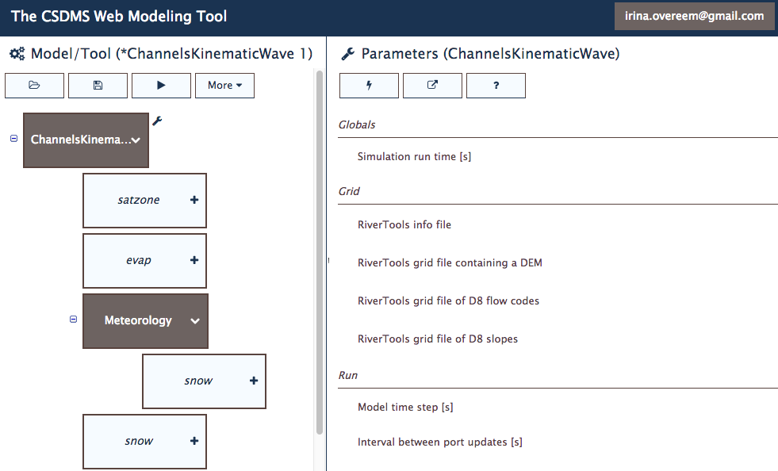
Run and Download Data
CLICK RUN and SUBMIT TO CSDMS HPCC
Notes:
Note that we identified a known bug; firefox….

Slide 11
Panoply for Data Visualization
Open source package Panoply for NetCDF files
Plots times-series, X-sections, gridded datasets.
Download it here:
http://www.giss.nasa.gov/tools/panoply/
To get started CSDMS has a basic lab on using Panoply.

Slide 12
Lab 1 Hydrology Modeling: Energy Balance
Lab based on Meteorology component
Learning objectives
relation between temperature incoming solar radiation
importance of watershed slope, aspect
Key concepts
Stefan-Boltzmann Law
Geometric relationship between Earth's tilt, day of year and local slope, aspect

Slide 13
Example Concept: Planetary Energy Balance
S= Solar energy Input
S= 1.74 * 10¹⁷ W
Planetary albedo ~0.3
a_{p} = 0.3
Stefan-Boltzmann Constant
σ = 5.67 *10⁻⁸ W m⁻² K⁻⁴
Earth’s surface area
5.1 * 10¹⁴ m²
Planetary Temperature without Atmosphere
254 K (or -19C or -2F)
Notes:
How would the mean temperature of the Earth change if its average albedo were changed to 0.1 or 0.5? (Courtesy Bob Anderson’s textbook, p 118).

Slide 14
Example Watershed Application: Radiation Incident on a Plane
η
equator
φ
S₀
Radiative Flux by latitude
Sij=cos(η+φ)
η = tilt of the Earth, varies -23.5° at summer soltice, to 23.5° at winter soltice.
φ = latitude

Slide 15
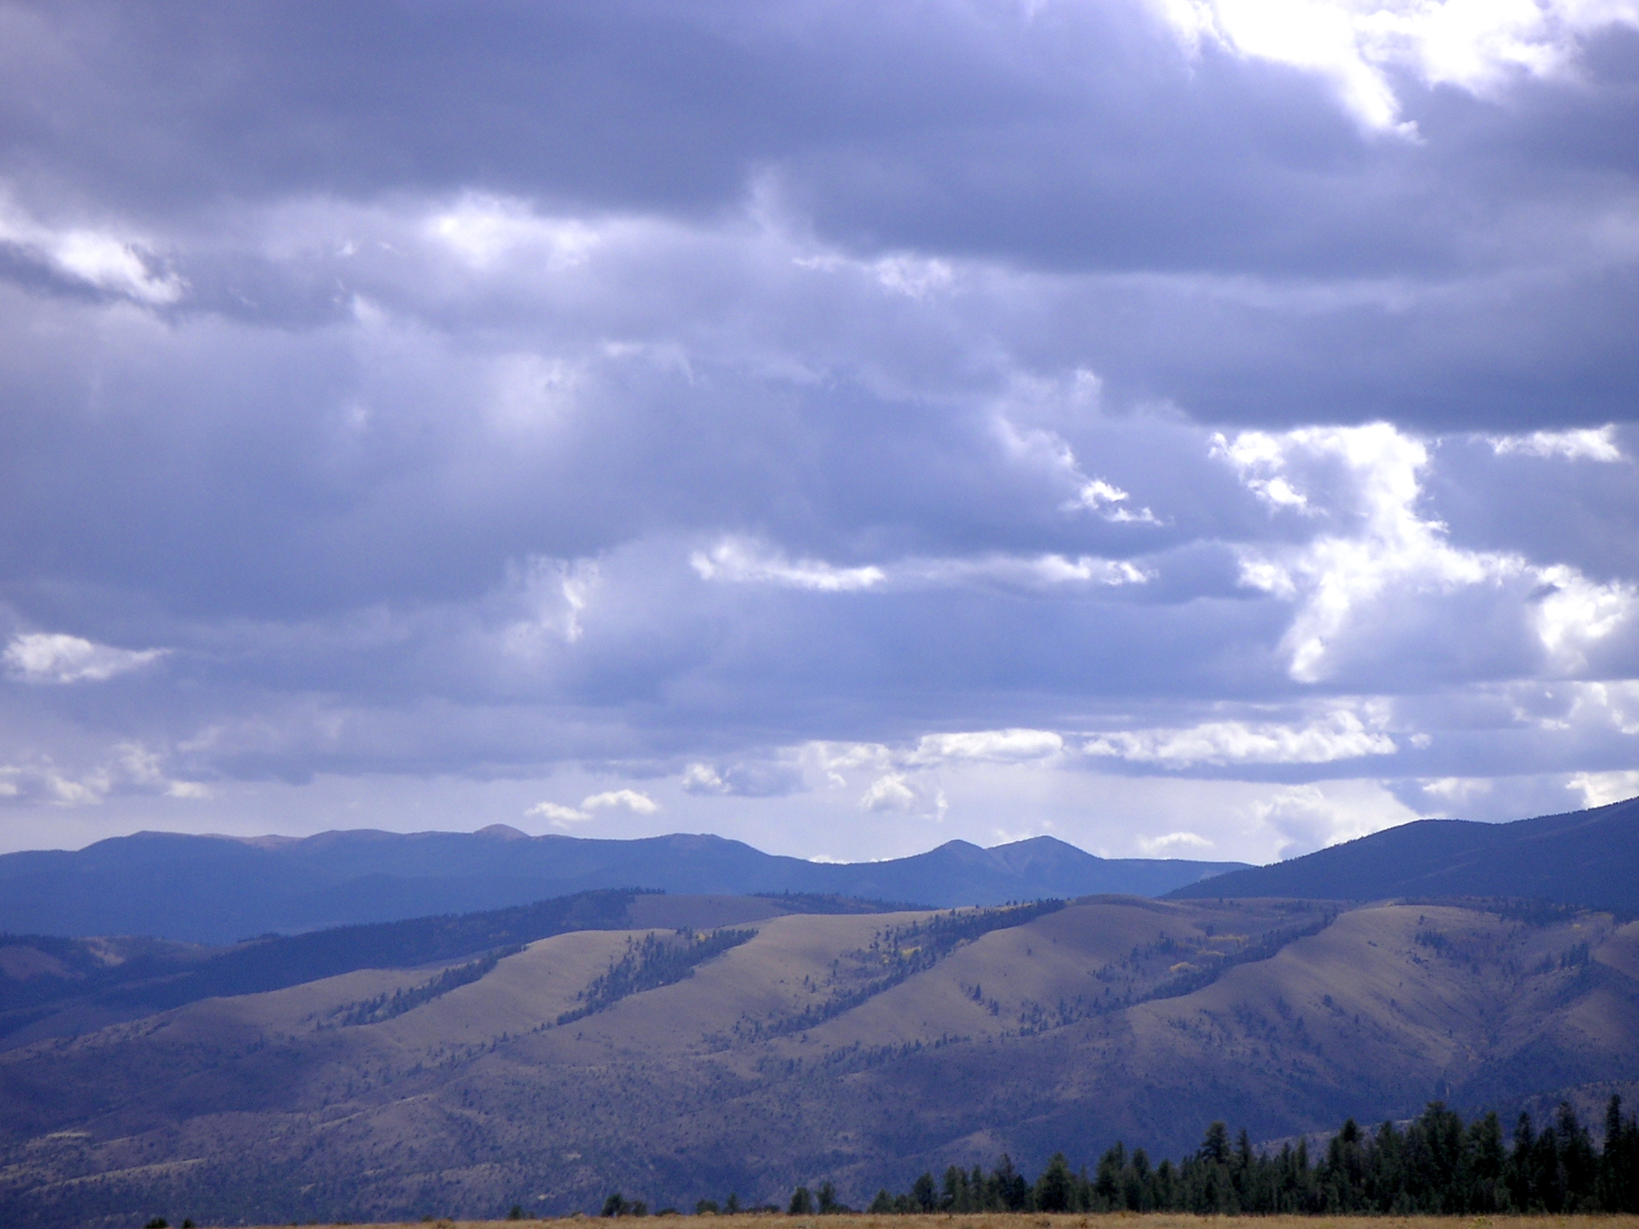
Morphometry of a Watershed
North-facing slopes
Aspect = direction that a topographical slope faces
Example in Rocky Mountain region, near Salida, Colorado.
North-facing slopes hold moisture and promote woody vegetation, whereas south-facing slopes are more dry and only grasses and small shrubs can sustain.
Image Courtesy; Irina Overeem
South-facing slopes

Slide 16
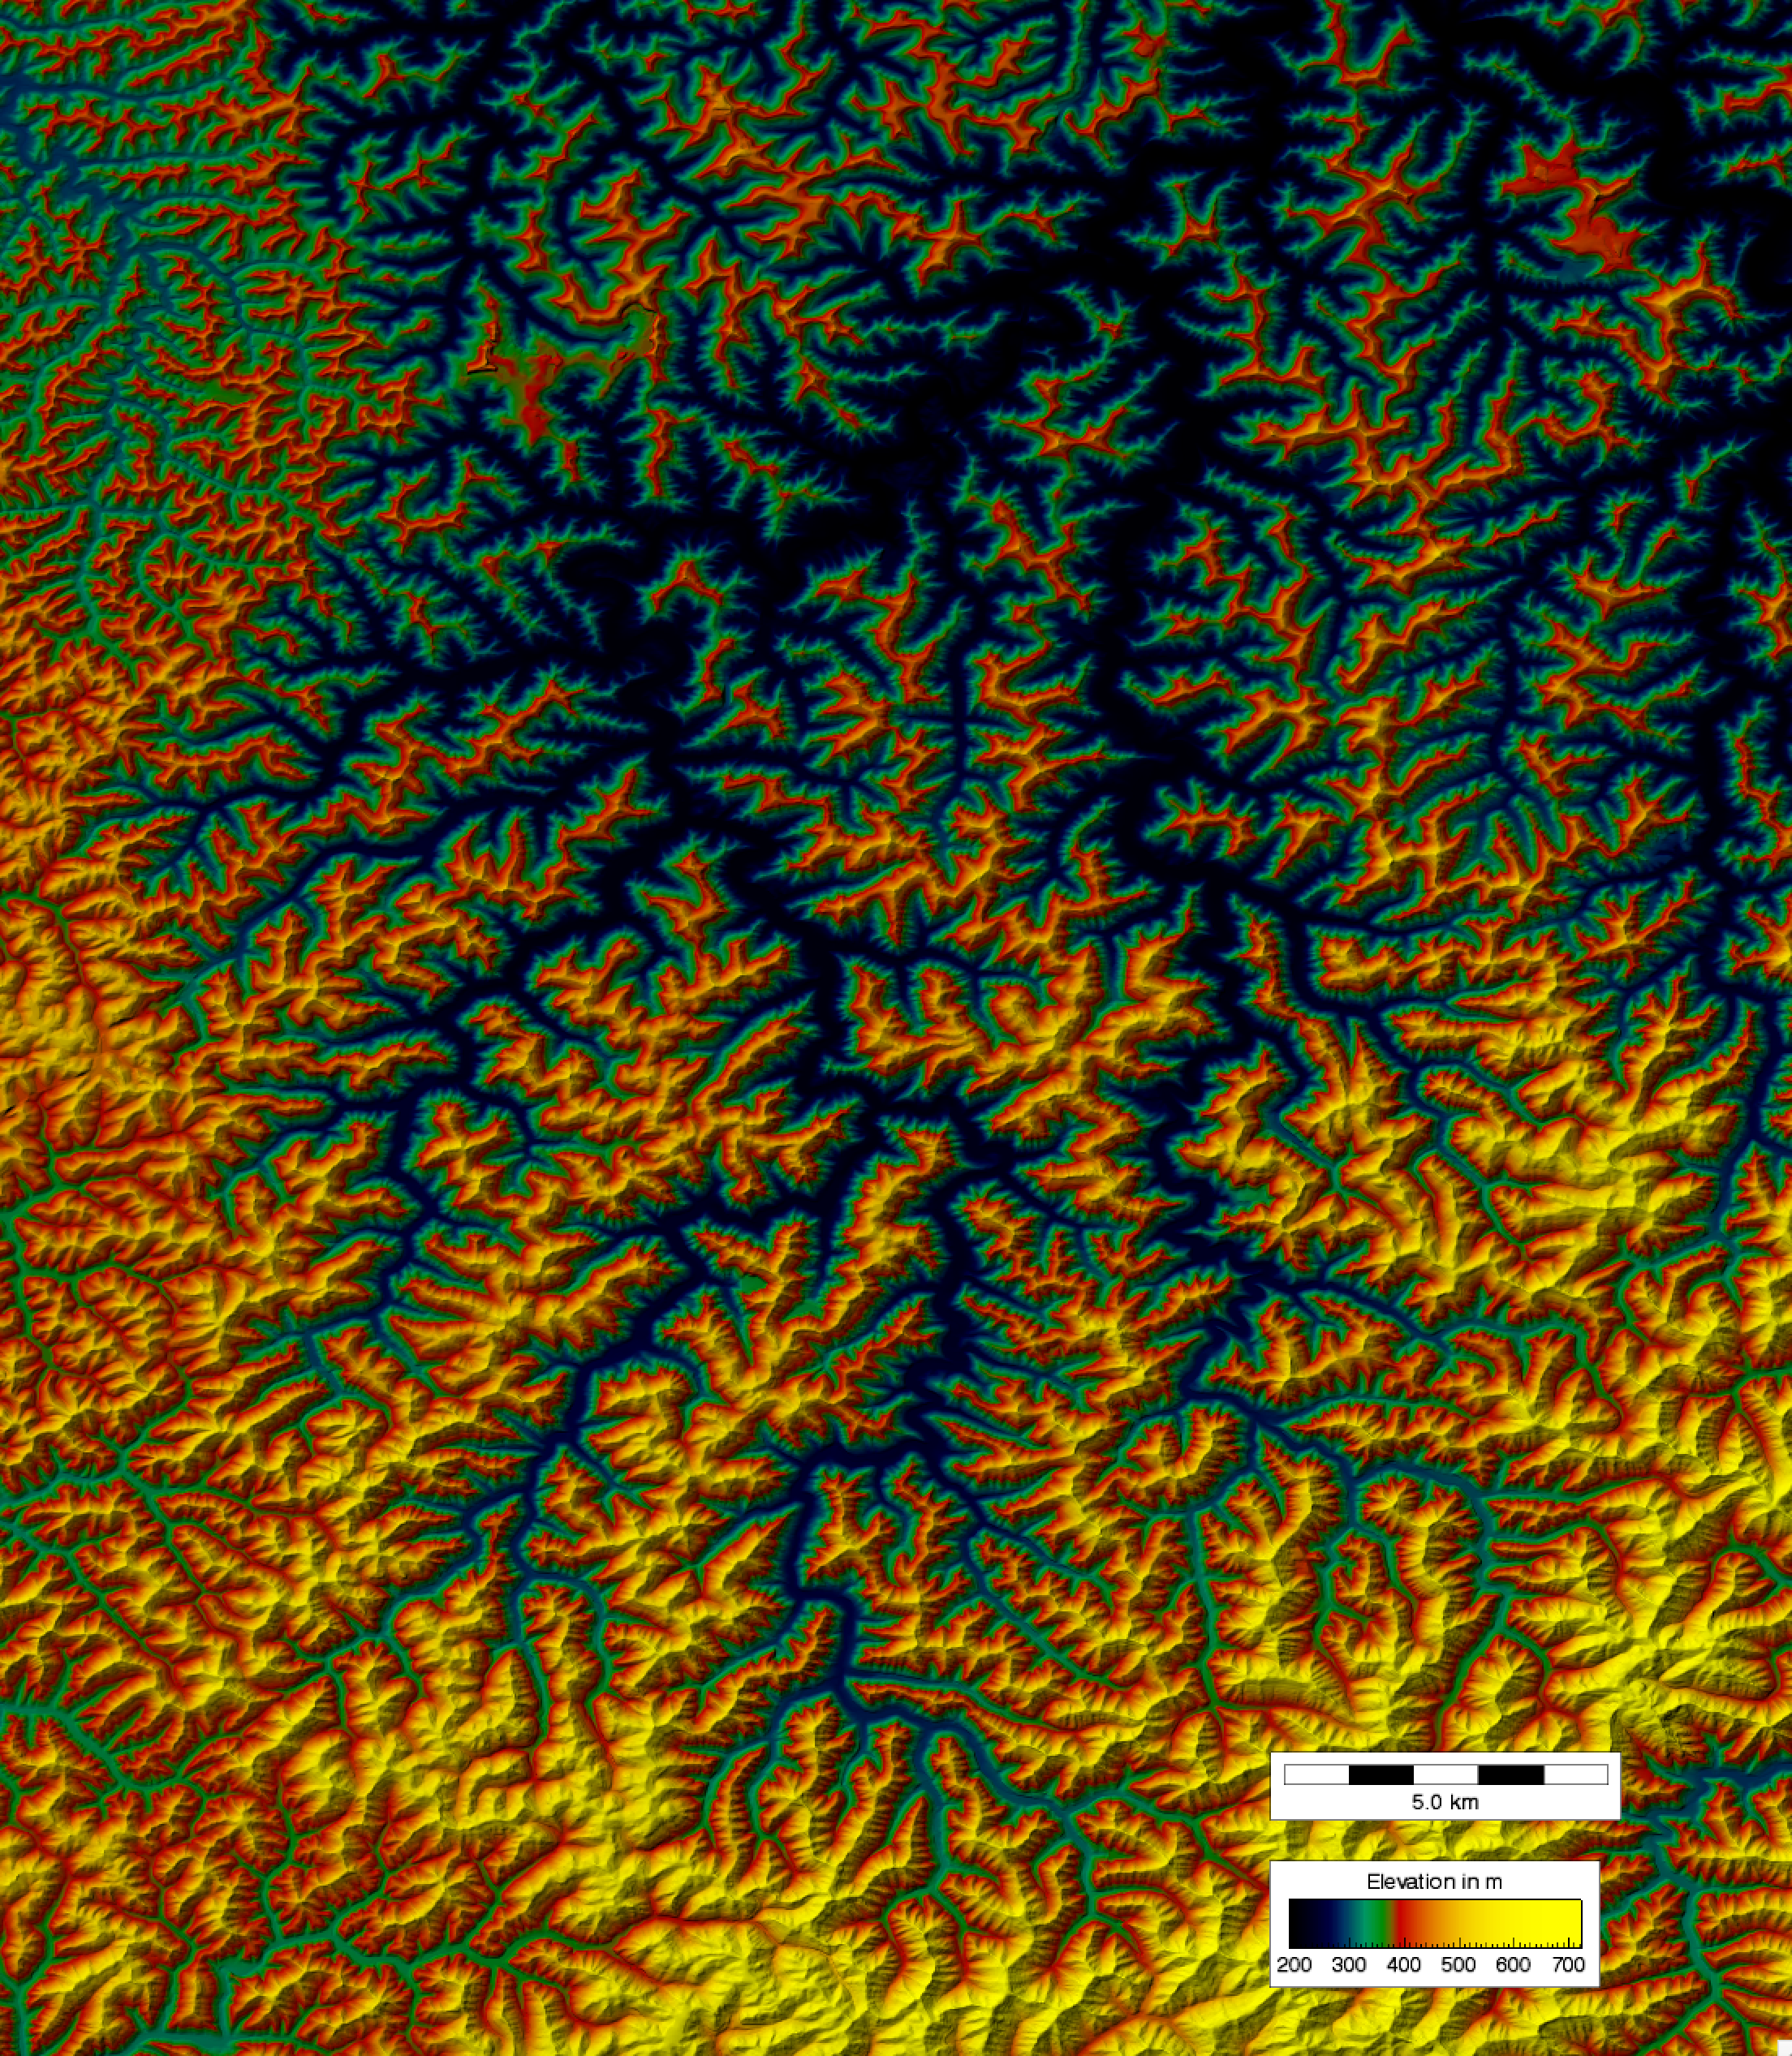
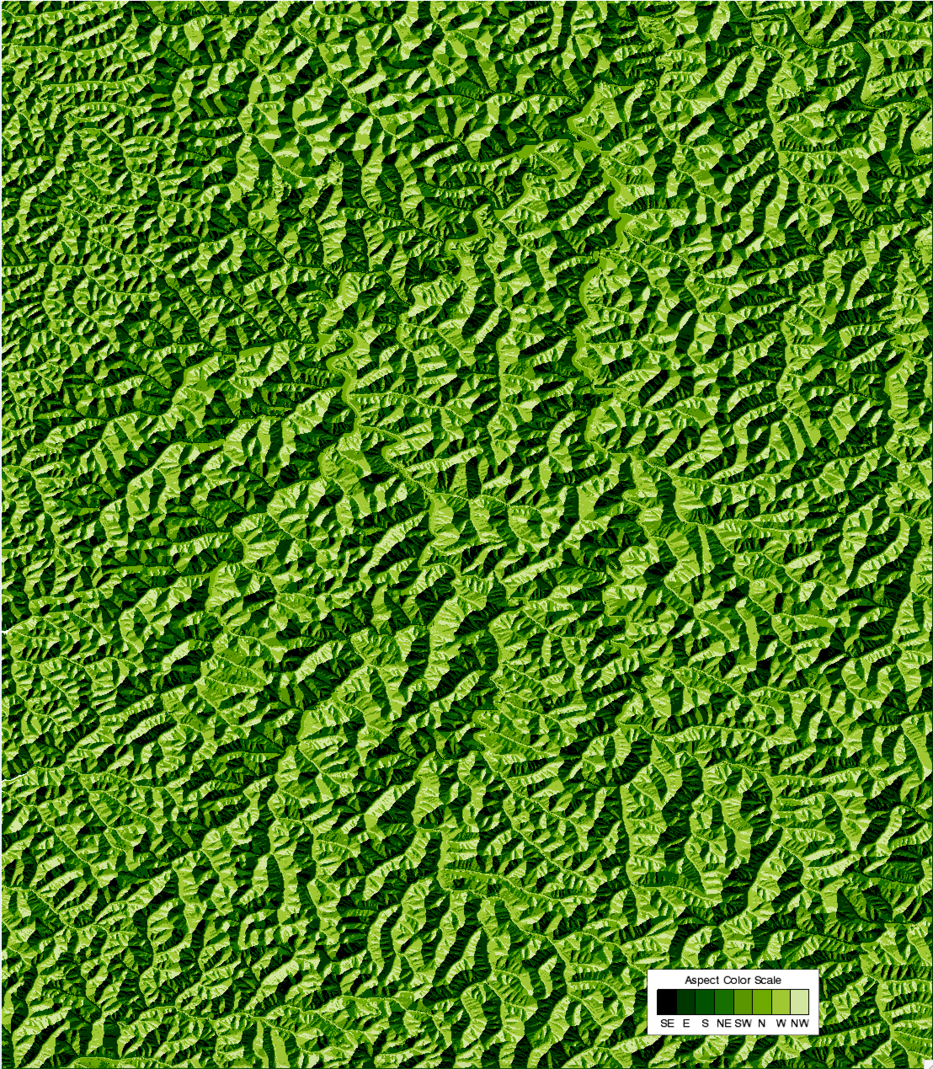
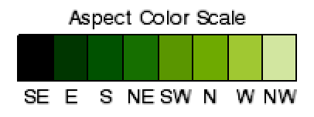
Beaver Creek Watershed, KY
Relief
Aspect
Beaver Creek is at 37° N
Classified into
45 degree bins

Slide 17
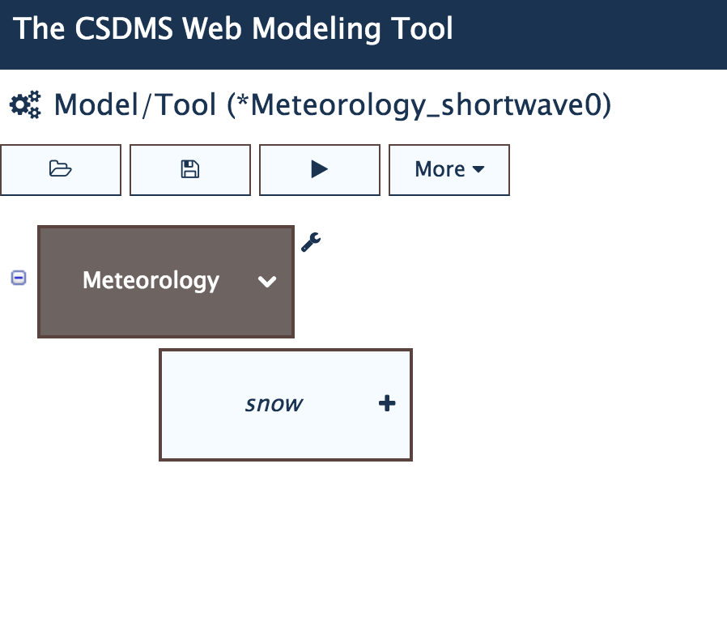
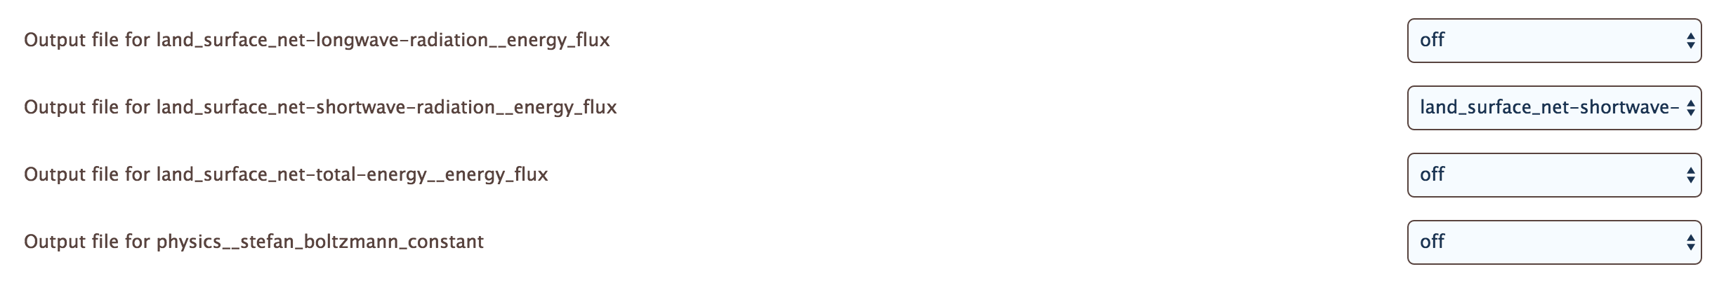
WMT-Hydrology
Energy Balance in Meteorology Component
Select Meteorology Component
Save output for:
‘land-surface-net-shortwave-radiation__energy flux

Slide 18
Setup in Meteorology
Use the example “Meteo_Shortwave_BeaverCreek”
Set up a run for a 6-hr simulation time (e.g. sunrise – noon) at an arbitrary date in the year.

Slide 19
WMT Energy Balance example

Slide 20
Possible Simulations/Exercises
Change the date settings to include the summer equinox, summer solstice
Can you discuss how short-wave radiation would change the Beaver Creek catchment would be at 70° N?
Show the implications of solar radiation differences with aspect.

Slide 21
Example Lab 3
Learning objectives
concepts of watershed and runoff
relation between rain and runoff in absence of evaporation and infiltration
Key concepts
Conservation of Mass
Modeling Concepts
Coupled models through BMI (time-step)
Standard names for parameters

Slide 22
https://csdms.colorado.edu/wiki/Labs_WMT_Hydrology_StreamResponsetoRain
Hands-on: Explore Lab 3

Slide 23
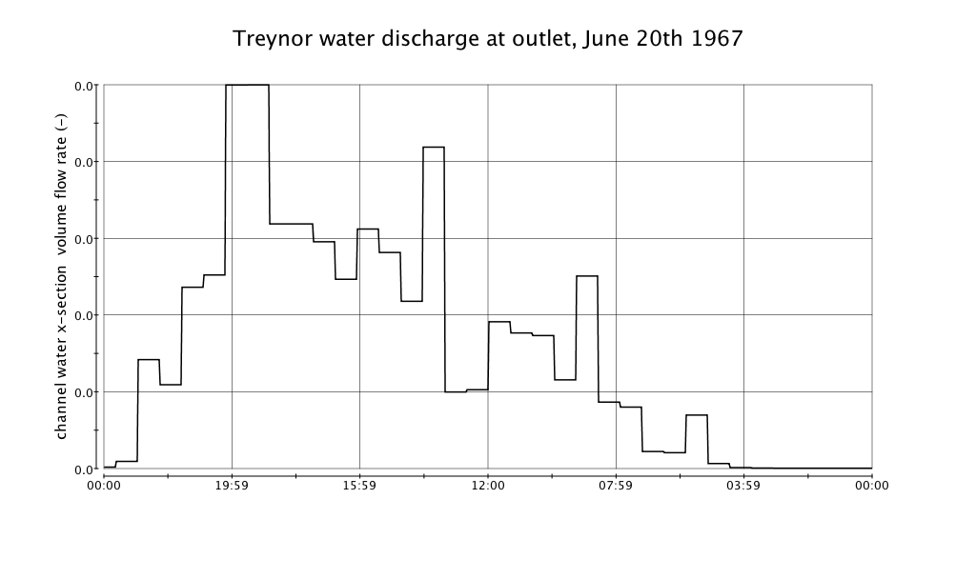
Simulation Output: Hydrographs
Freeform manipulation, or manipulate after reviewing theory?

Slide 24
Simulation Output: Planview Maps

Slide 25
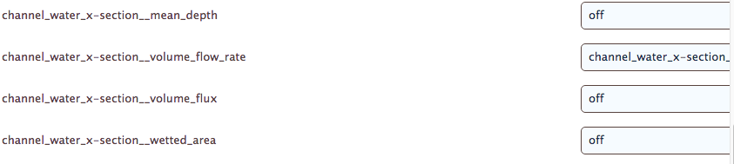
Modeling Concepts- Standard Names
https://csdms.colorado.edu/wiki/CSDMS_Standard_Names
Create awareness for code development: maintained the ‘long parameter names’. These are standard names through which the model BMI passes parameter information

Slide 26
Discussion on Future Development of WMT-Hydrology
EKT
Two more labs are in the works: snow melt and infiltration processes
Promote use by teaching faculty and TA’s? Who wants to test one or more labs in the classroom?
Software/CSDMS framework side
Expand capability to use other DEM data formats
What else would you wish for? What contributions can you make?
(More theory? Better learning assessments? Make it easier to publish new labs? Package this as stand-alone application?)

