Slide 1
ROMS-Lite Clinic
Courtney Harris, Julia Moriarty, Danielle Tarpley
Virginia Institute Marine Sciences
Irina Overeem, CSDMS

Slide 2
What is ROMS-Lite?
A basic configuration of the Regional Ocean Modeling System (ROMS) for inexperienced modelers to learn about ROMS, basic concepts in ocean modeling and look at a river plume affecting the coastal ocean and sediment transport.

Slide 3
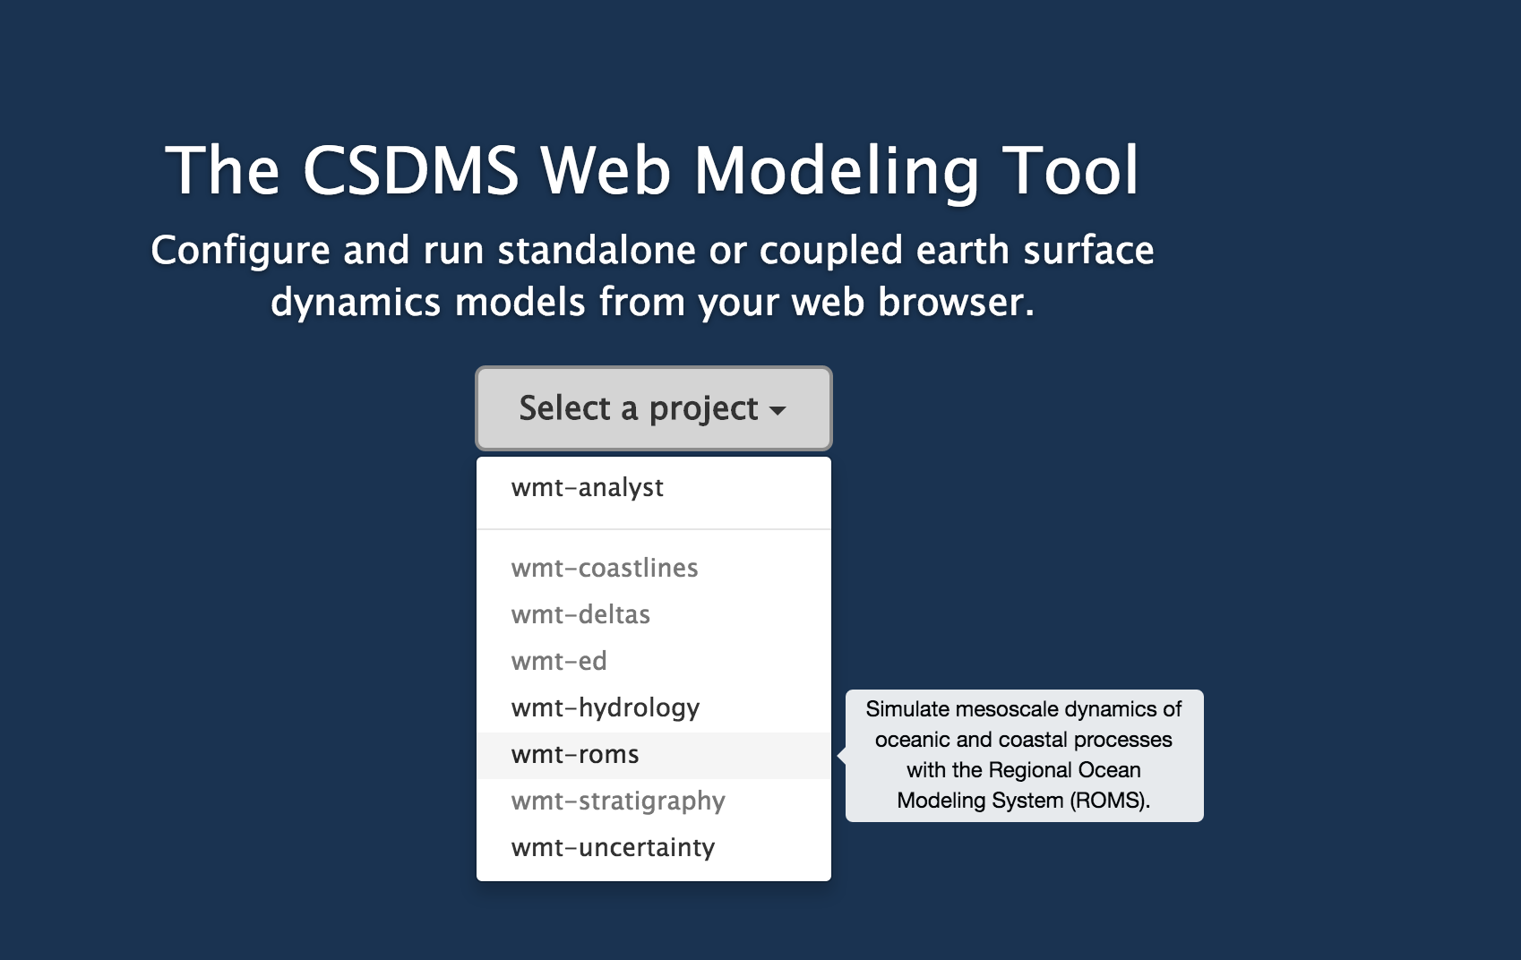
ROMS-Lite in Web Modeling Tool
https://csdms.colorado.edu/wmt/

Slide 4
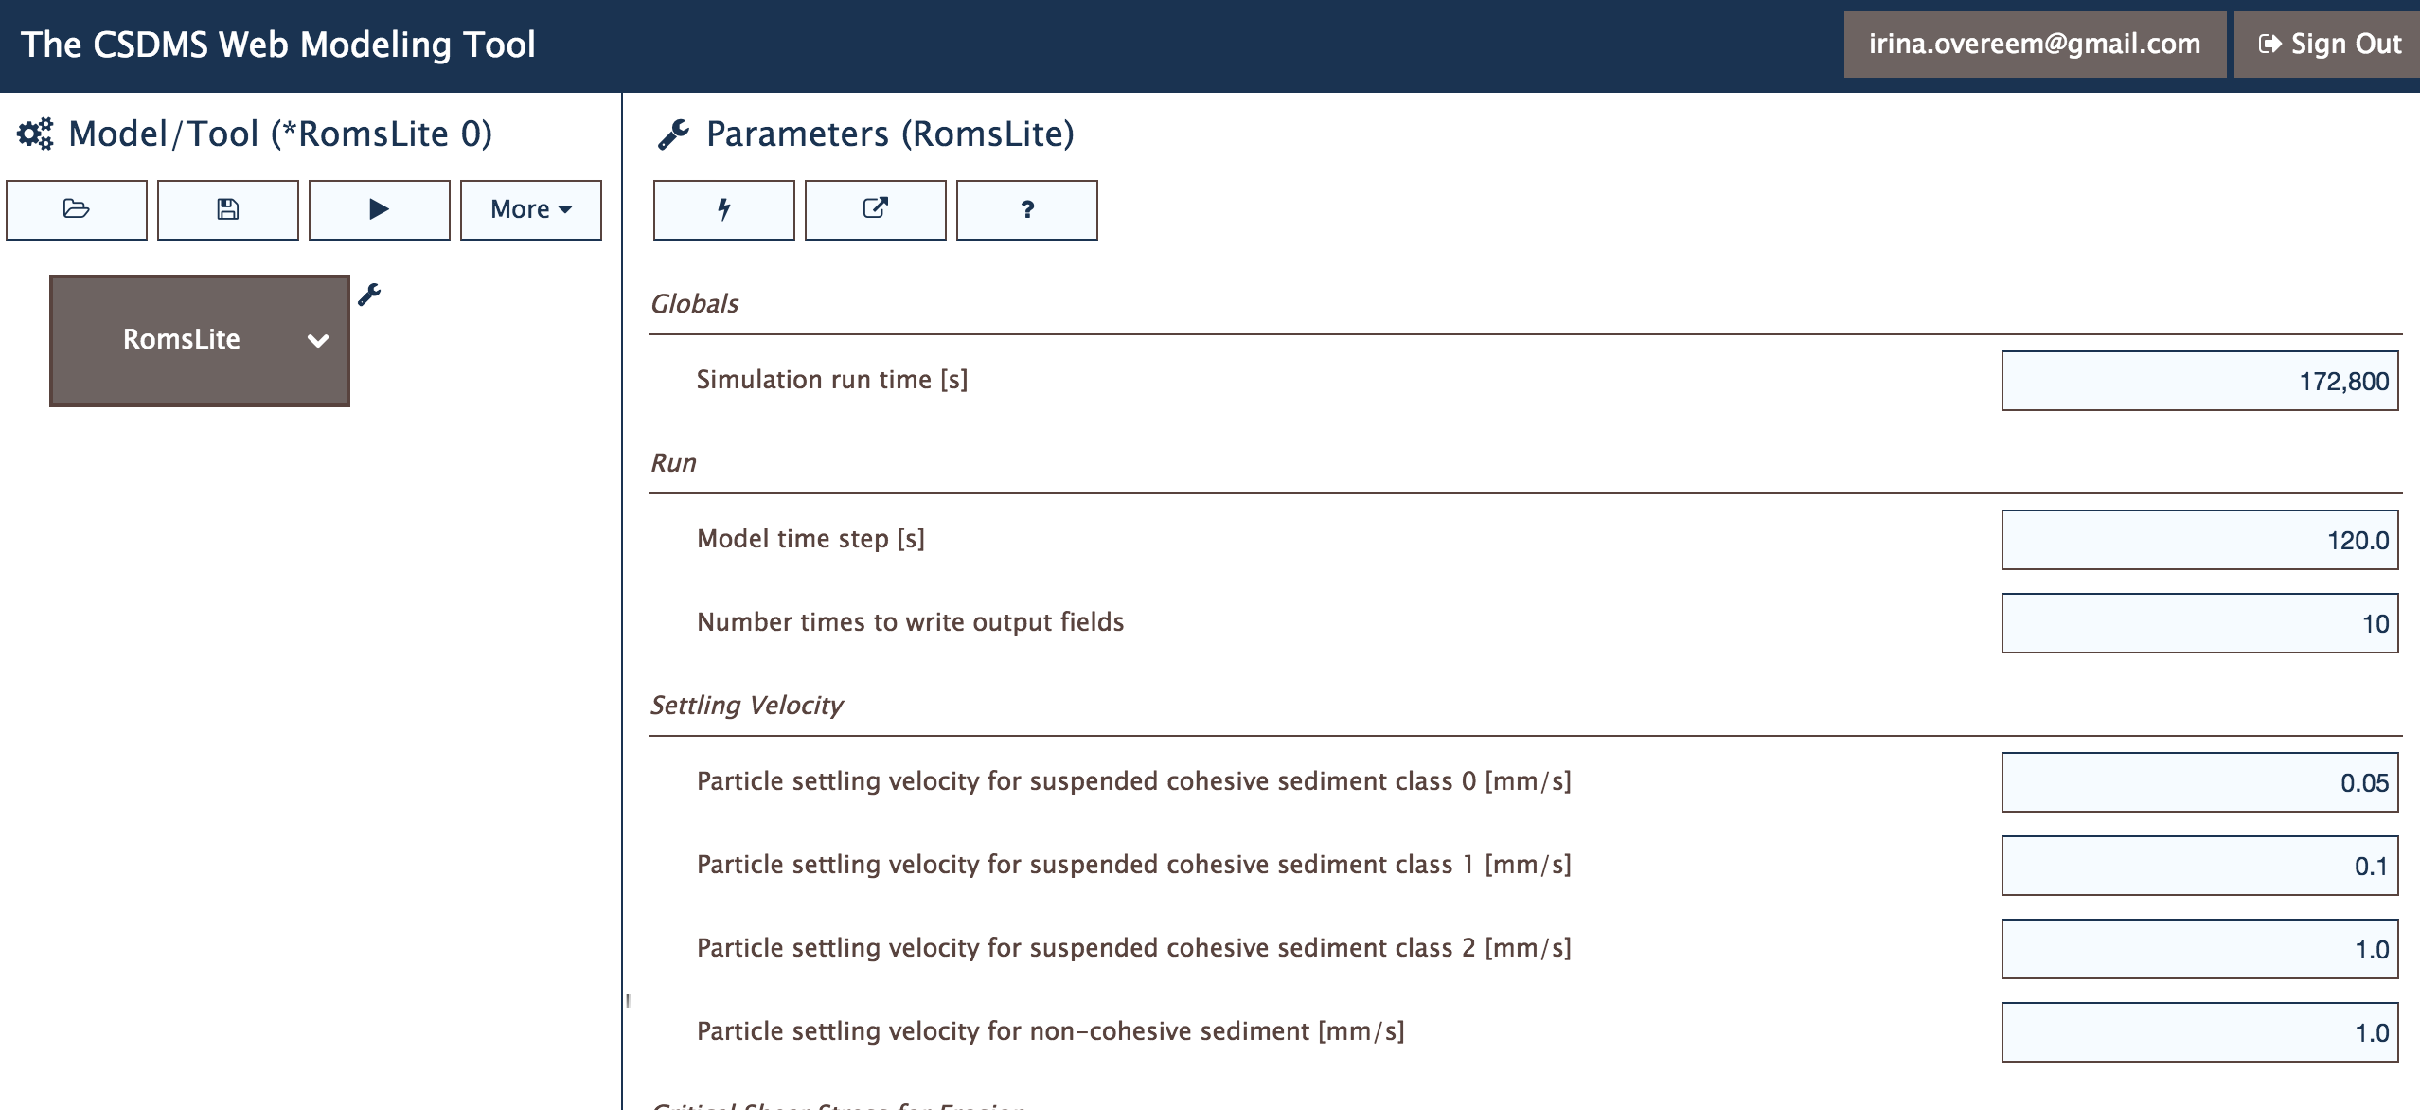
ROMS-Lite in Web Modeling Tool
Pre-compiled ROMS instance; with tested configuration.
User can manipulate a small set of parameters and run simulations

Slide 5
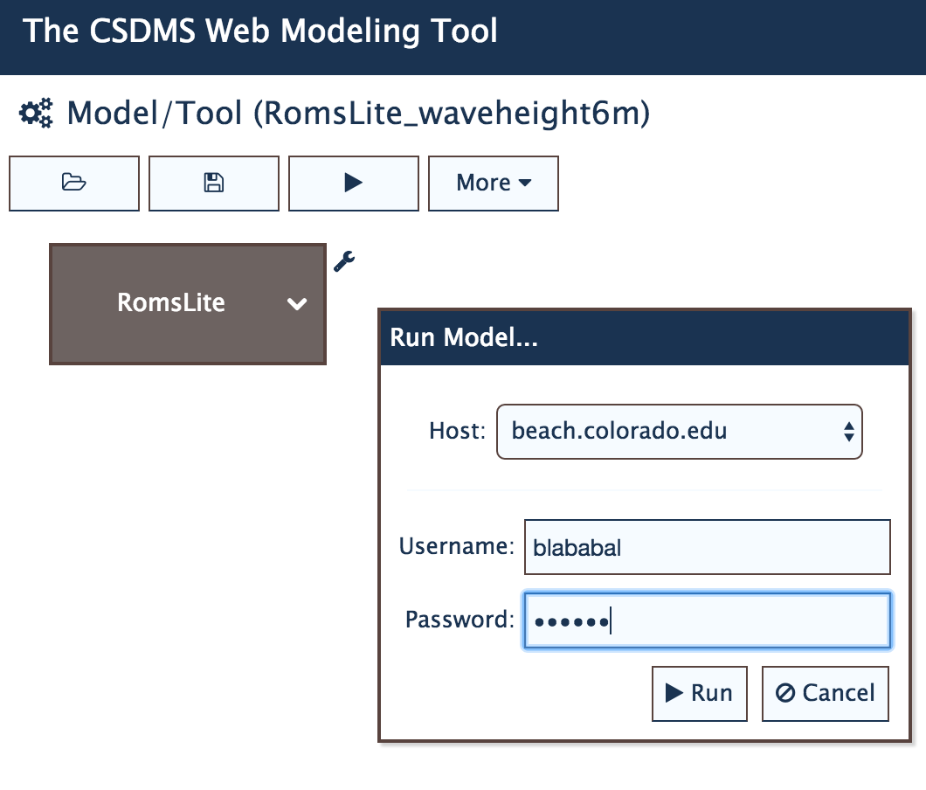
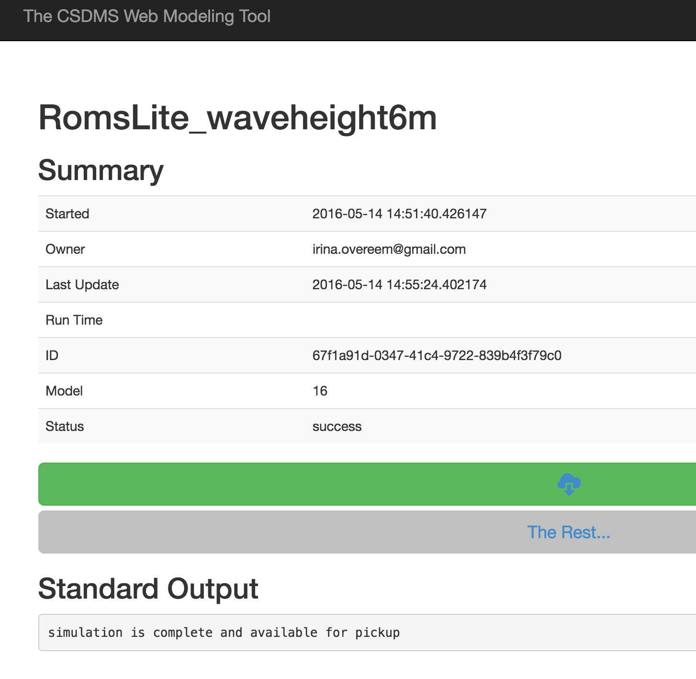
Run and Download Data
CLICK RUN and SUBMIT TO CSDMS HPCC
DOWNLOAD DATA
Notes:
Note that we identified a known bug; firefox….

Slide 6
Panoply for Data Visualization
Open source package Panoply for NetCDF files
Plots times-series, X-sections, gridded datasets.
Download it here:
http://www.giss.nasa.gov/tools/panoply/
To get started CSDMS has a basic lab on using Panoply.

Slide 7
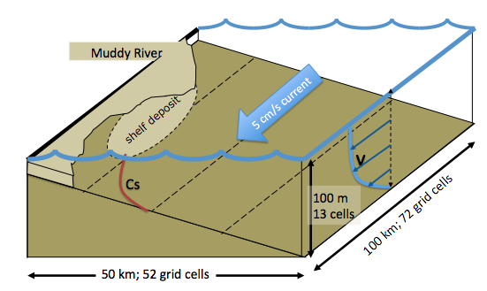
ROMS-Lite is based on RiverPlume 2
We set up a basic numerical experiment with inputs considered representative for a medium-sized river draining freshwater and sediment into the coastal ocean. The river discharge is kept constant at 1500 m³/sec.
Domain is 72 by 52 gridcells. ROMS has 20 vertical layers in the water column, and stores 10 layers in the ocean bed.

Slide 8
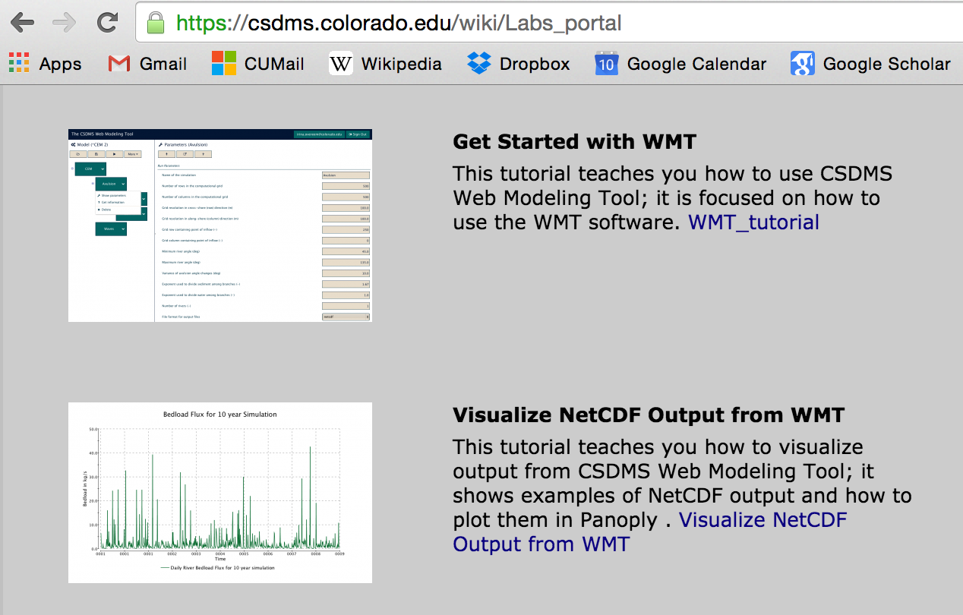
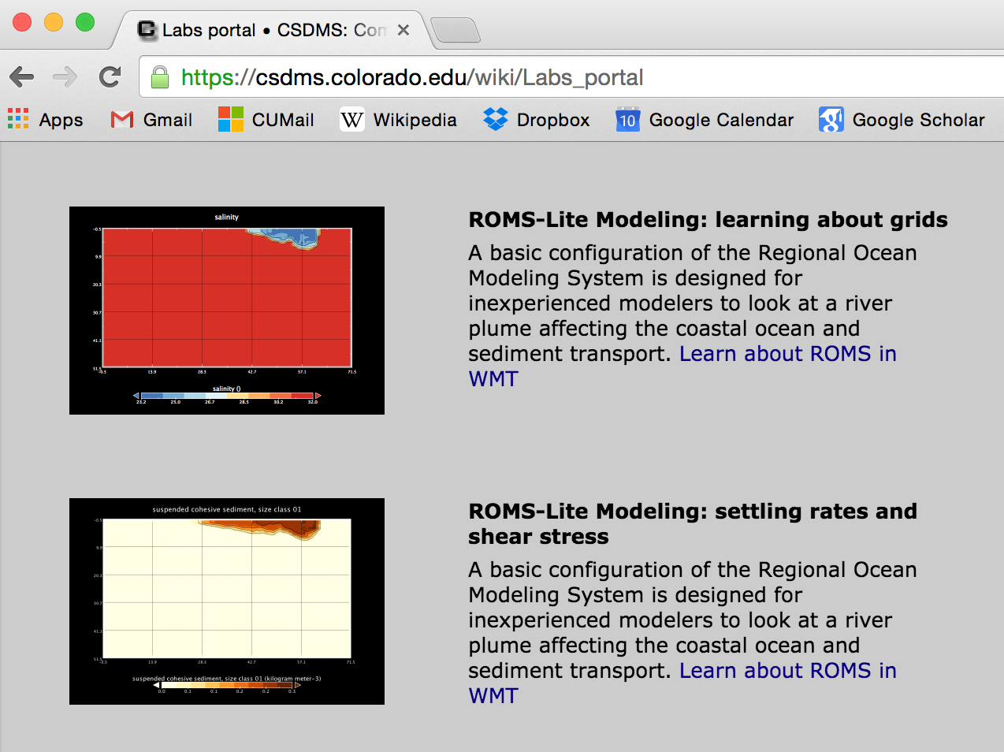
Teaching Using ROMS-Lite
As of May 2016, 3 ROMS labs are available
https://csdms.colorado.edu/wiki/Labs_portal
To get students started with WMT & Panoply
(2 Labs)
To get students started with ROMS-Lite
(3 Labs)

Slide 9
Lab 1 River Plume Exploration
Skills
Familiarize with a basic configuration of the Regional Ocean Modeling System
Hands-on experience with visualizing NetCDF output with Matlab or Panoply.
Topical learning objectives
Learn about grids in oceanographic modeling
Get a basic feel for integration of the conservation of momentum, continuity equation and conservation of tracers into a specific advection-diffusion scheme
Learn about a river freshwater plume evolving into a marine basin

Slide 10
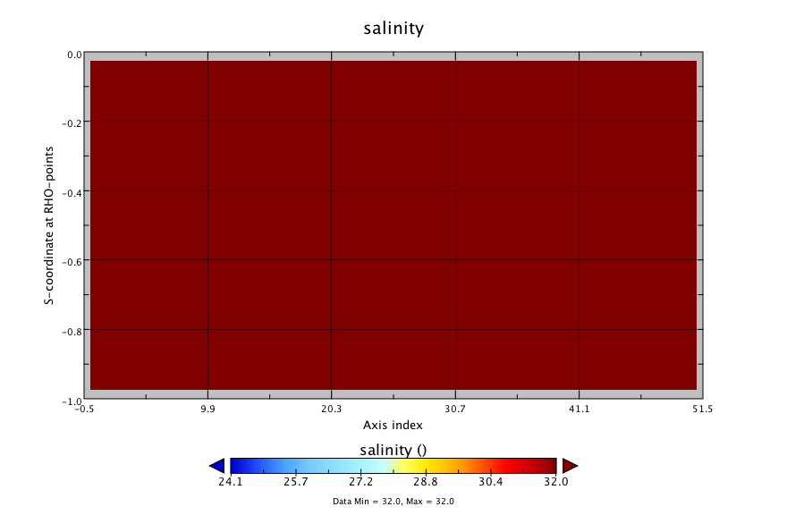
Salinity at the River Mouth
X-section, 96 hours simulation

Slide 11
Lab 2 Settling Rates and Shear Stress
Familiarize with sediment modeling approach of the Regional Ocean Modeling System
Learn how to manipulate parameters in ROMS-Lite and set up different experiments
Physics of settle rates
Fluid exerting stress and threshold to incipient motion
Shields and Yalin diagrams

Slide 12
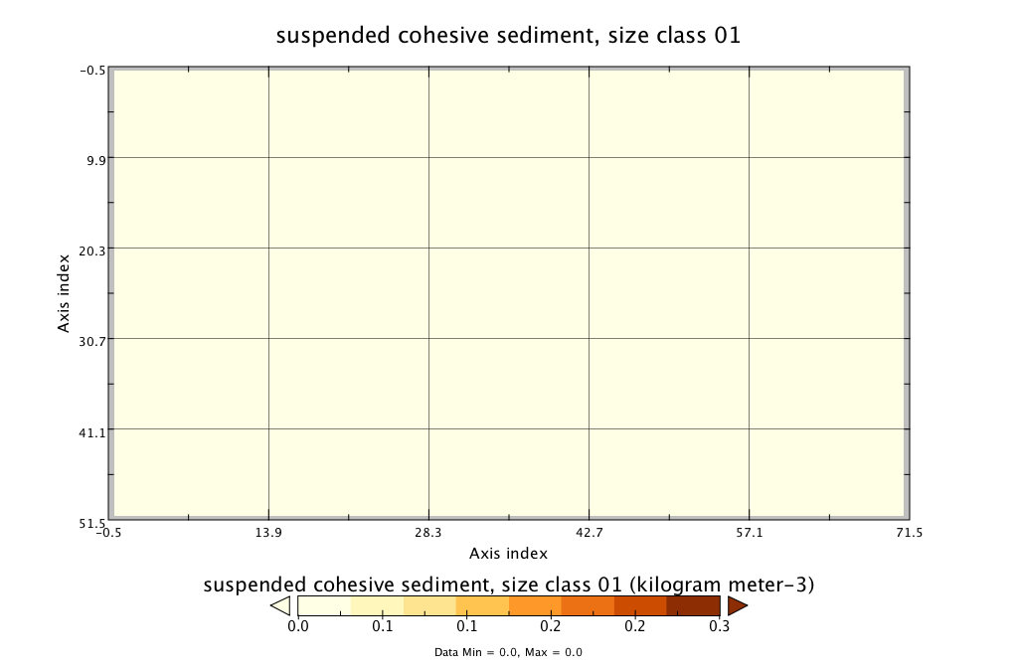
Suspended Sediment Concentration
Planview, 96 hours simulation

Slide 13
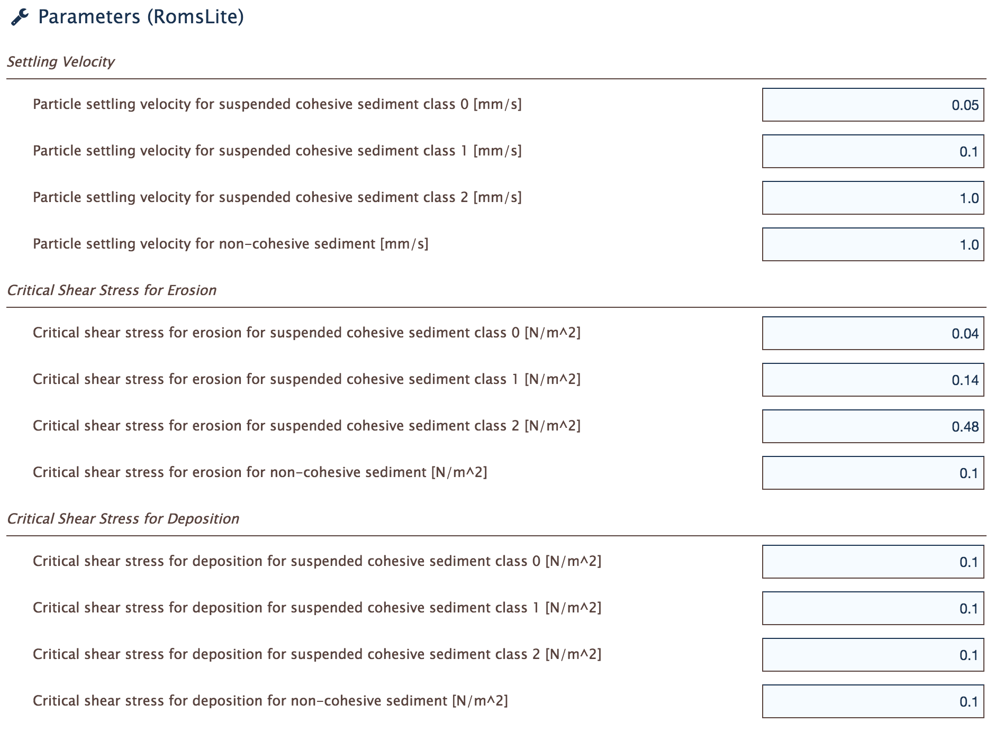
Settling Rates and Shear Stress
Manipulate
Settling velocities
Manipulate
Shear stress
Freeform manipulation, or manipulate after reviewing theory?

Slide 14
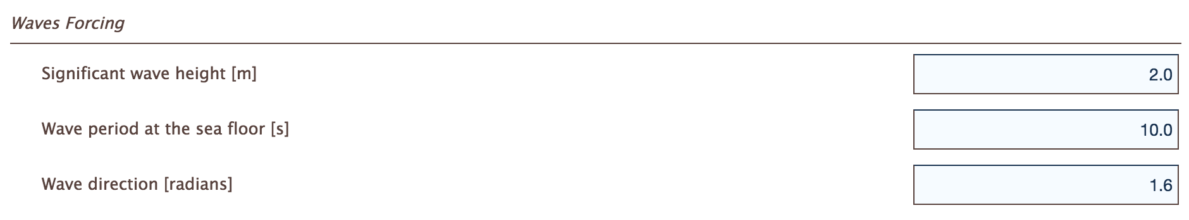
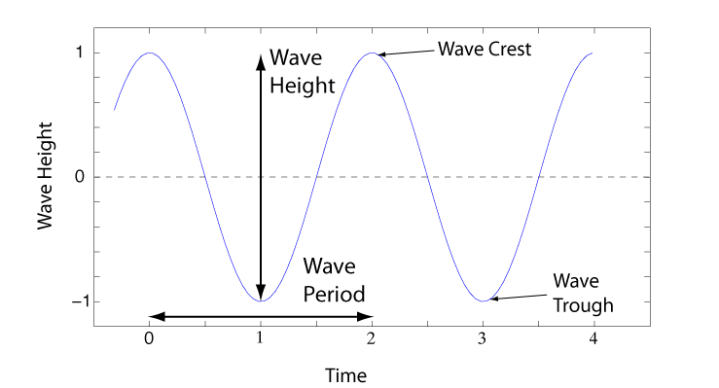
Wave Forcing

Slide 15
Discussion on Future of WMT and ROMS-Lite?
Promote use for teaching faculty? Test the labs?
Expand the number of labs?
(
Expand the precompiled ROMS instances?
(e.g. SED-TOY, ROMS-Lite for estuarine processes)

