Slide 1
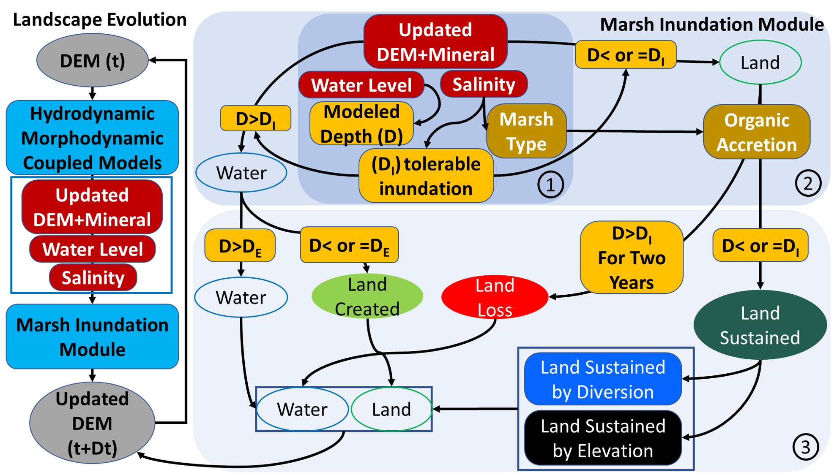
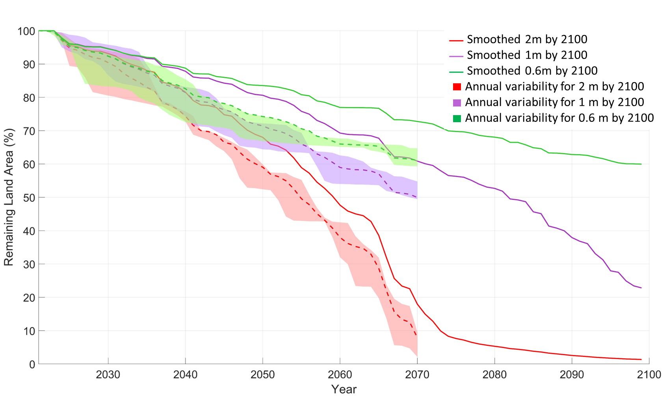
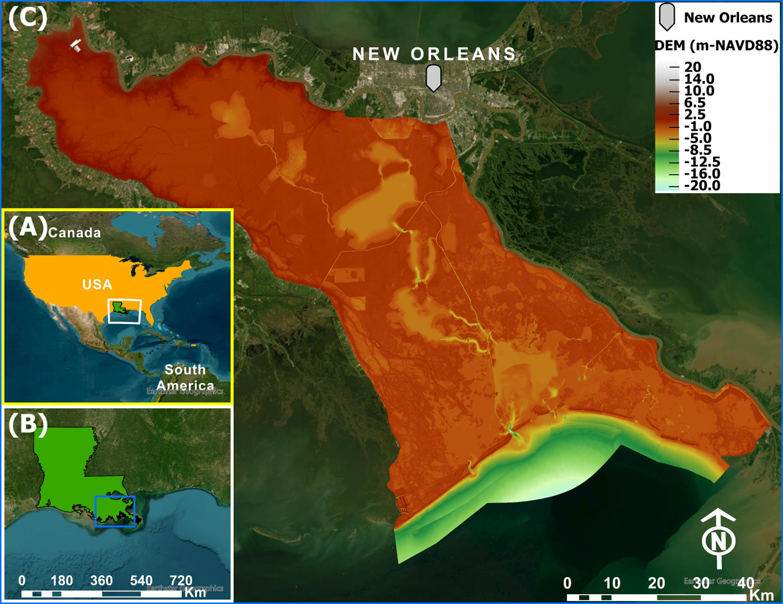
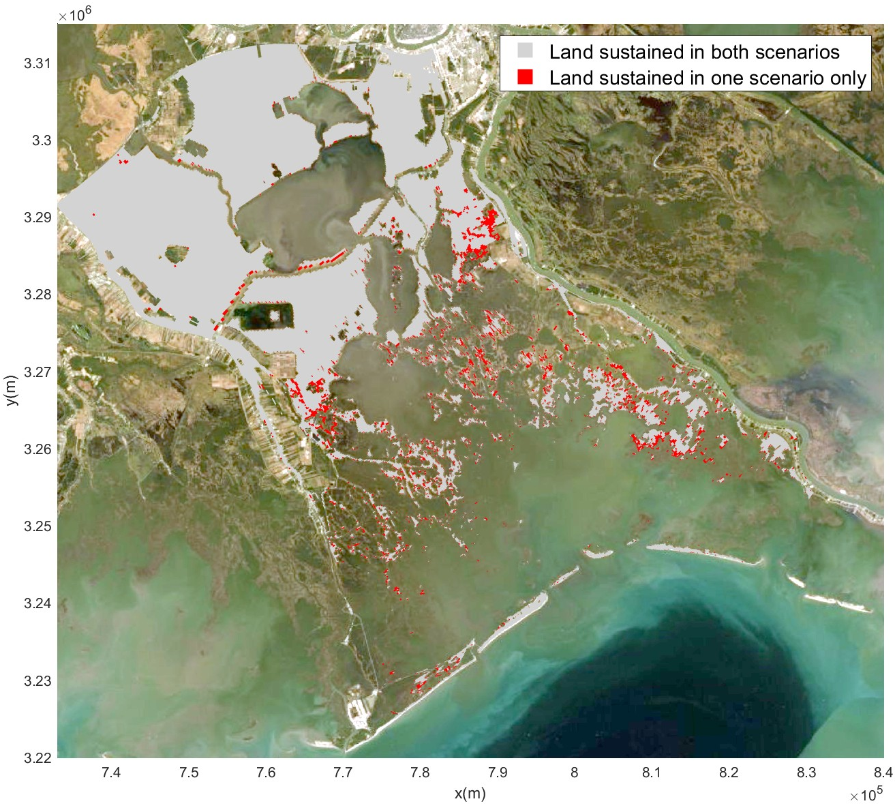
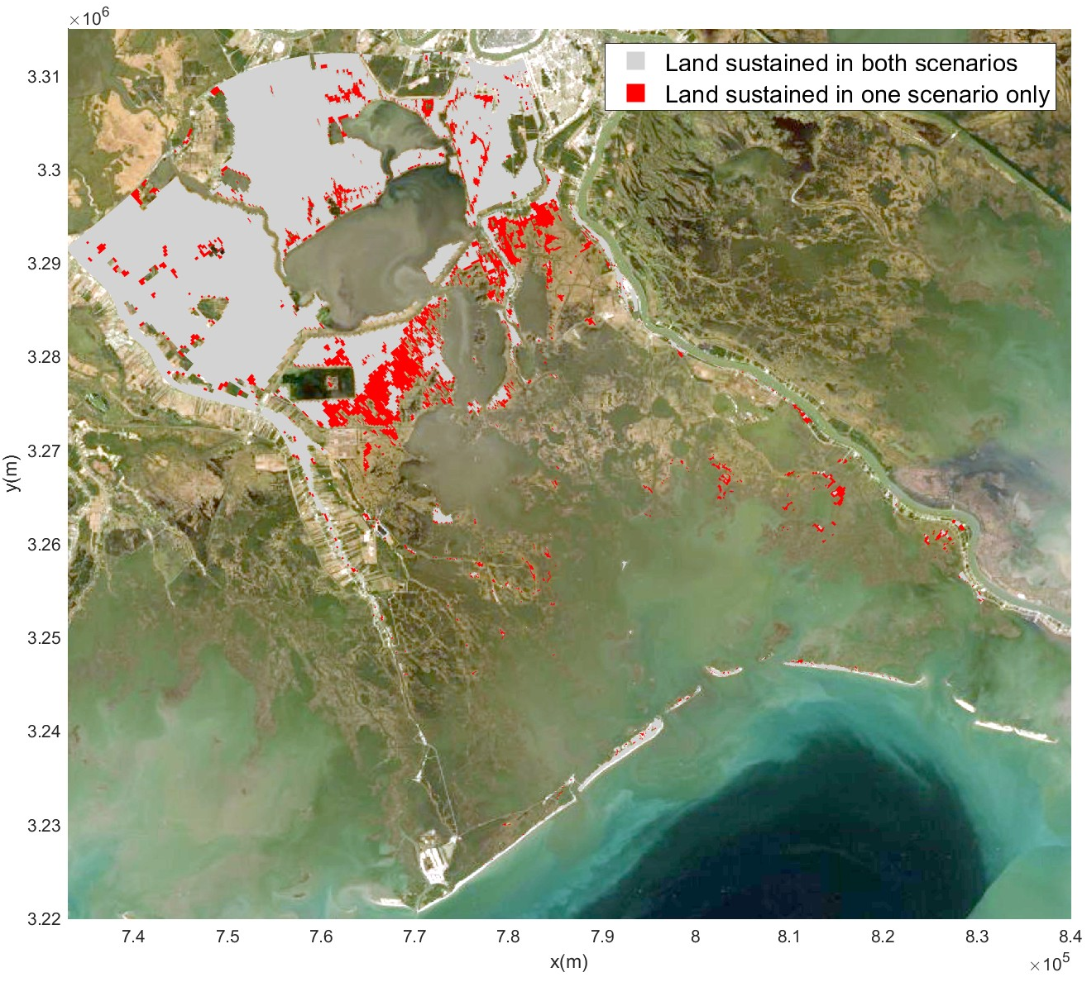
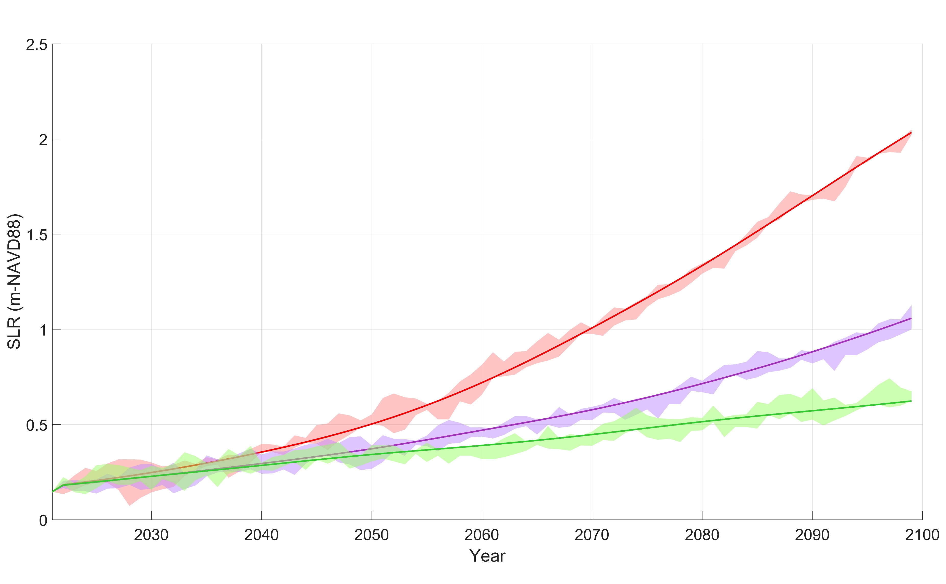
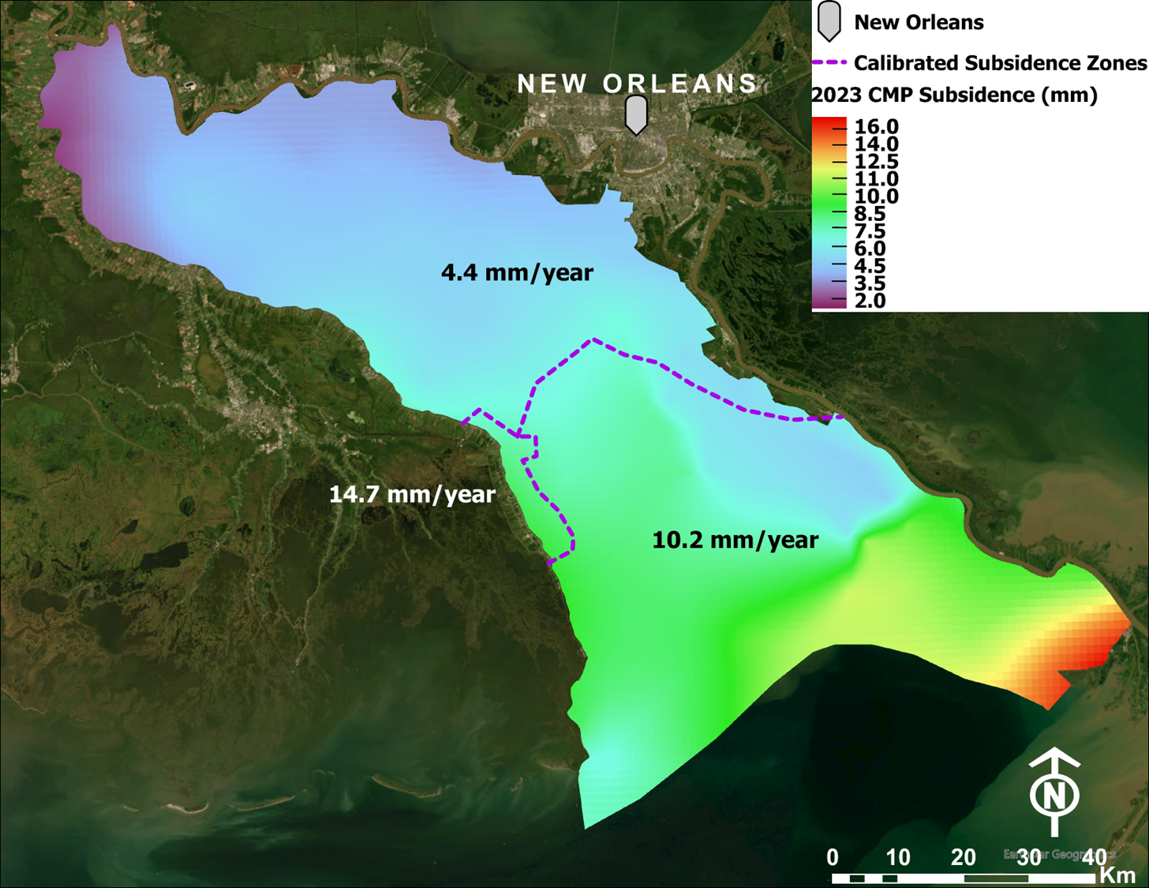
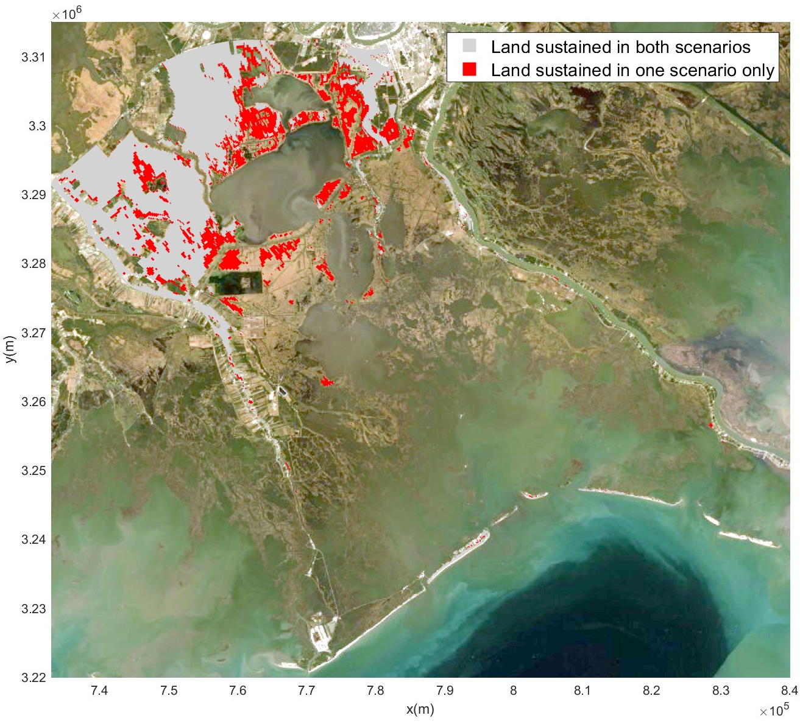
INVESTIGATION OF THE ENVIRONMENTAL IMPACT OF ANNUAL SEA LEVEL RISE VARIABILITY ON THE DELTAIC LANDSCAPE EVOLUTION IN ESTUARINE ENVIRONMENTS
Check Out Our Team Website
Ahmed Khalifa¹, Ehab Meselhe¹, Soenke Dangendorf¹, Mead Allison¹, Kelin Hu¹
akhalifa1@tulane.edu
River-Coastal Science and Engineering Department, Tulane University, LA, USA.
Introduction
Traditional deltaic landscape evolution models often simplify sea level rise (SLR) as a smooth curve to represent the impact of long-term increase in sea level. However, annual variability in SLR can significantly impact these dynamic ecosystems. This study employs a computationally efficient biophysical model to investigate the effects of varying SLR scenarios on Barataria Basin, a complex estuarine environment. Simulations were conducted using three smoothed SLR estimates (2m, 1.1m, and 0.6m by 2100) and three additional scenarios incorporating annual variability around each of the smoothed curves.
Barataria Basin
Barataria is a 6,600 km² estuarine basin bordered by the MR levees and Bayou Lafourche (Figure 1; Day et al., 2021). The upper part of the basin is dominated by wetlands and the lower part by open water. The upper Basin is fresh and dominated by bald cypress-water tupelo swamps and fresh marshes (Day et al., 2021). Until European colonization, Barataria Basin was isolated from other parts of the deltaic plain by the MR and Bayou Lafourche natural levees (Day et al., 2021). Under natural conditions, river water entered the Basin episodically, and rainfall runoff from elevated natural levees flowed mostly through wetlands to water bodies (Day et al., 2021). These connections were eliminated by engineering flood control levees along the MR built following the 1927 flood, cutting off MR flow into Bayou Lafourche.
The existing wetlands of the basin have been negatively affected by the lack of mineral deposition that used to nourish the Basin and the gradual rise in salinity due to RSLR, resulting in a change in the spatial distribution of marsh types (Snedden et al., 20115). These stressors, along with shoreline erosion due to tides and waves, resulted in substantial conversion of marsh to open water (Couvillion et al., 2017).
Figure 1: Barataria Basin, and DEM. (A) Location of Louisiana within the USA. (B) Location of Barataria Basin within Louisiana. (C) DEM data in (m-vertically referenced to North American Vertical Datum NAVD-88).
Figure 2: Subsidence spatial distribution. The background raster represents the 2023 CMP combined shallow and deep subsidence rates. The numbers represent calibrated subsidence values based on the 2017 CMP (Khalifa et al., 2024). The dashed lines represent the division between the different calibrated subsidence zones.
Simplified Biophysical Model (Khalifa et al., 2024)
Figure 3: Left, simplified landscape evolution coupling diagram. Cyan polygons represent the three different components utilized through the long-term simulations as: (1) hydrodynamic model, (2) morphodynamic model, and (3) marsh inundation module. Right, marsh inundation module. Maroon polygons represent data obtained from the coupled hydrodynamic and morphodynamic models. Orange boxes represent water depth comparisons. Different oval shapes’ colors represent different land categories where red is land loss, light green is land created, blue is land sustained due to a restoration strategy (if applicable), and black means land sustained due to the bed elevation. Brown polygons represent calculations based on the marsh type. (DI) is the maximum annual averaged inundation depth that vegetation can tolerate, (DE) is the annual averaged emergence depth, and (D) is the modeled annual averaged depth. Revised from Khalifa et al. (2024).
Sea Level Rise (SLR)
Figure 4: Three SLR smoothed projections (2 m, 1.1 m, and 0.6 m by 2100). Shaded bands represent the possible range of annual variability from three scenarios around each of the smoothed projections.
Landscape Evolution
Figure 5: Remaining land percentage [with marsh edge erosion based on Reed et. al., (2020) as the dashed colored lines]. Modeled land areas due to annual variabilities are plotted around scenarios with marsh edge erosion as shaded polygons.
Figure 6: Difference in modeled land estimates in various time snapshots. (1) 2036, (2) 2054, (3) 2059, and (4) 2062.
x
x
1
x
x
x
3
x
x
2
x
4
1
2
3
4
Conclusions
Our findings suggest that Barataria Basin could experience substantial land loss, potentially ranging from 50,000 to 70,000 acres between 2030 and 2070 due to annual variability in SLR.
These results underscore the critical need to consider SLR variability in coastal planning and management strategies to mitigate the impacts of rising sea levels.
References
Couvillion, B.,et al., 2017. Land Area Change in Coastal Louisiana (1932 to 2016). USGS. https://doi.org/10.3133/sim3381
- Day, J.W., et al., 2021. A review of 50 years of study of hydrology, wetland dynamics, aquatic metabolism, water quality and trophic status, and nutrient biogeochemistry in the barataria basin, mississippi delta-system functioning, human impacts and restoration approaches. Water (Switzerland). https://doi.org/10.3390/w13050642
- Khalifa, A.M., et al., 2024. Development and Application of A Simplified Biophysical Model to Study Deltaic and Coastal Ecosystems. Estuar. Coast. Shelf Sci. 306. https://doi.org/10.1016/j.ecss.2024.108899
- Reed, D., et al., (2020), Modeling wetland transitions and loss in coastal Louisiana under scenarios of future relative sea-level rise. Geomorphology,. https://doi.org/10.1016/j.geomorph.2019.106991
- Snedden, G.A., et al., 2015. Inundation and salinity impacts to above- and belowground productivity in Spartina patens and Spartina alterniflora in the Mississippi River deltaic plain: Implications for using river diversions as restoration tools. Ecol. Eng. 81, 133–139. https://doi.org/10.1016/j.ecoleng.2015.04.035

