Slide 1
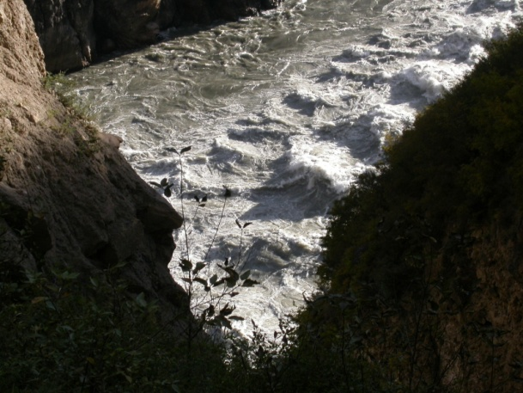
Unifying Tectonics & Surface Processes in Geodynamics
Peter O. Koons¹, Phaedra Upton^{1,2},
Samuel G. Roy¹, Gregory E. Tucker³
1 School of Earth and Climate Sciences,
University of Maine
2 GNS Science
3 CIRES, Department of Geological Sciences, University of Colorado, Boulder, CO
Funding through NSF Continental Dynamics, CDI, GeoPrism, Tectonics and GLD Programs

Slide 2
Motivation and Route Map
FERM = Failure Earth Response Model
I Material displacement, whether tectonic or geomorphic in origin, at or below Earth’s surface, is driven by local forces overcoming local resistance.
II Large displacements, whether tectonic or geomorphic in origin, irreversibly alter Earth material properties enhancing a long term strain memory mapped into the topography.
Motivation
To identify and use information of multiple temporal frequencies captured in topography
To generate an additional link of tectonics and topography at high spatial frequencies
To produce theory based on widely observed physical behavior and material parameters
To view tempo of earth evolution within a different paradigm
Route: Examine strength:strain relationship at increasing spatial frequencies
Examine strength:stress relationship for deforming Earth for elevated pore pressures
Examine strength:stress relationship for deforming Earth at increasing temporal frequencies (plate boundary strain rates to seismic strain rates)
Caveats: No transport today

Slide 3
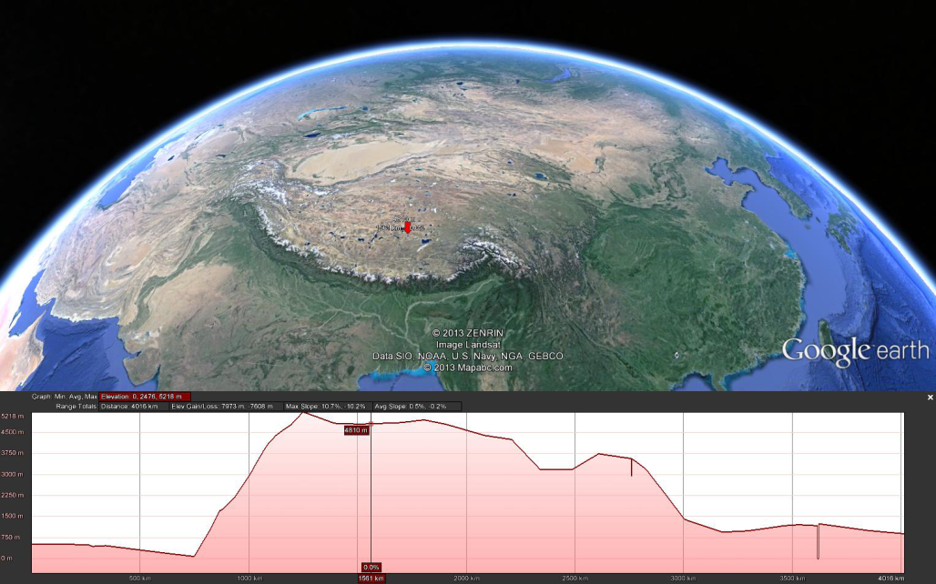
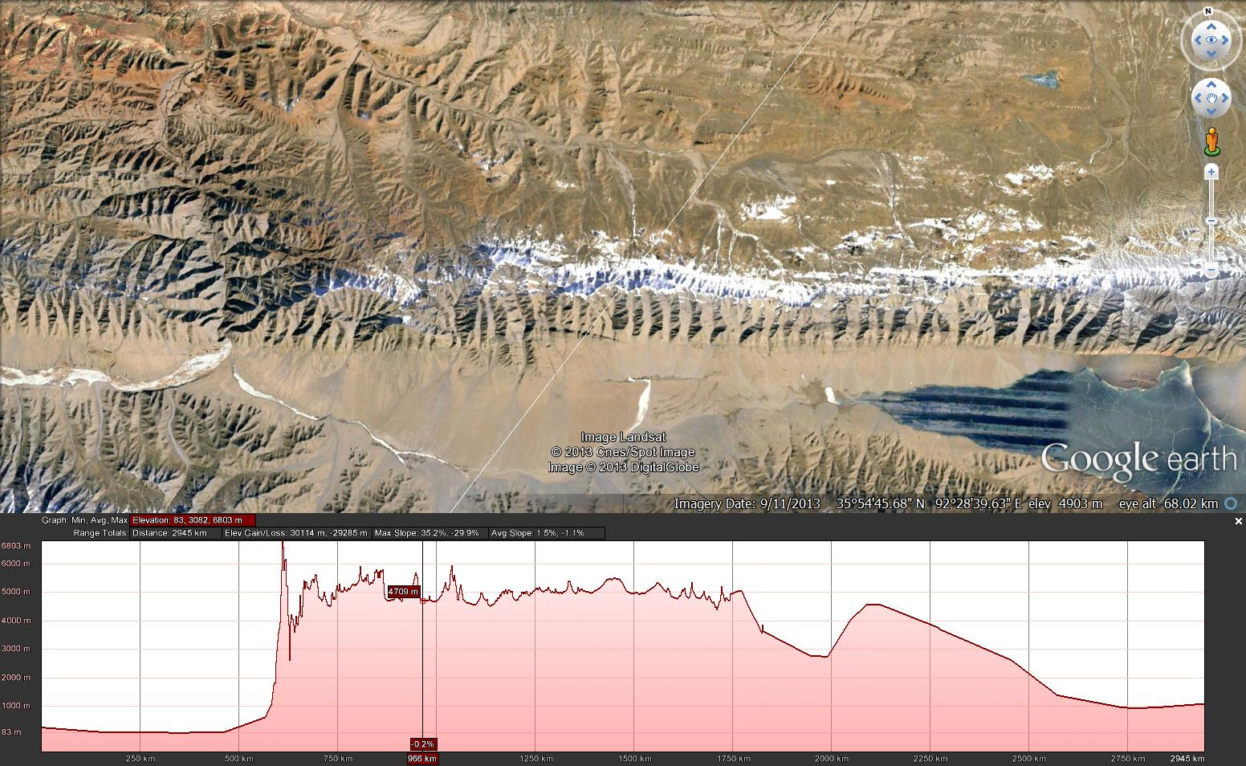
Broadband Earth; Space and Time
Topography at all frequencies contains critical information on cooperation among tectonic and geomorphic processes.
Low frequencies are well described in current theory of cooperative phenomena.
High frequency information is difficult or impossible to extract through conventional theory that does not explicitly permit cooperation.
Existing landscape theory struggles to incorporate multi-scale cooperation among tectonic and geomorphic processes.
8000
masl
0
Notes:
Temporal and spatial frequencies

Slide 4
Why Bother?
Modern conventional solutions produce realistic model landscapes with testable solutions (and great graphics).
Most obvious drawback in conventional solution is that any individual piece of Earth’s surface has different physical formulation for the same behavior depending on whether it is seen from above or below.
Material parameters in conventional theory are difficult or impossible to quantify leading to Rampant Parameterization
Computational advances are permitting resolution of rapidly varying dynamic 3D fields, Including dynamic stresses associated with varying stream velocities; i.e. the world of theory is changing

Slide 5
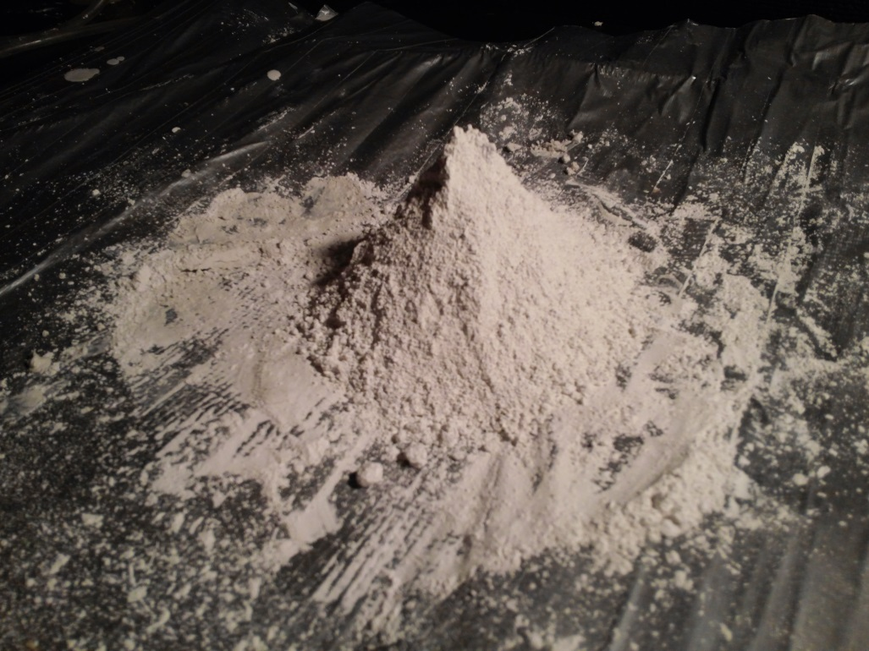
Why Bother? (cont): Recognized components of landscape evolution can not be incorporated within conventional theory; e.g. Seismically Generated Landslides
t_{characteristic} = f(Local Seismic Accelerations)

Slide 6
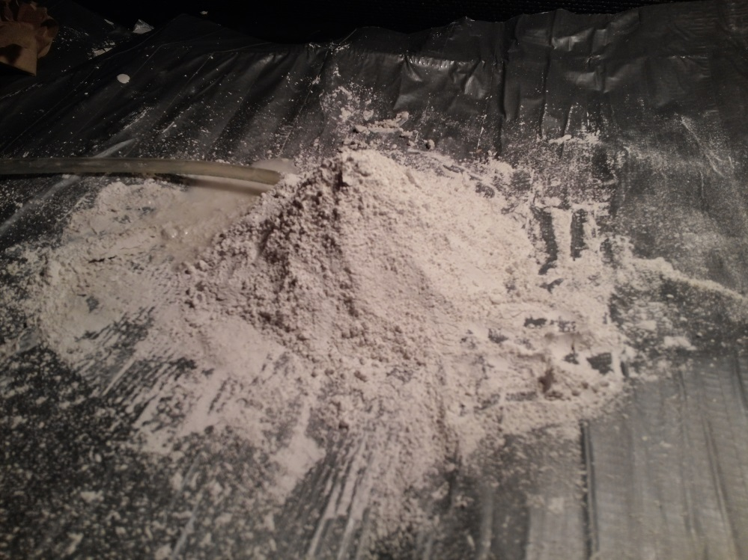
Why Bother? (cont): Recognized components of landscape evolution can not be incorporated within conventional theory; e.g. Pore pressure instabilities
t_{characteristic} = f(Effective Stress Transients) = f(Hydrological Regime)

Slide 7
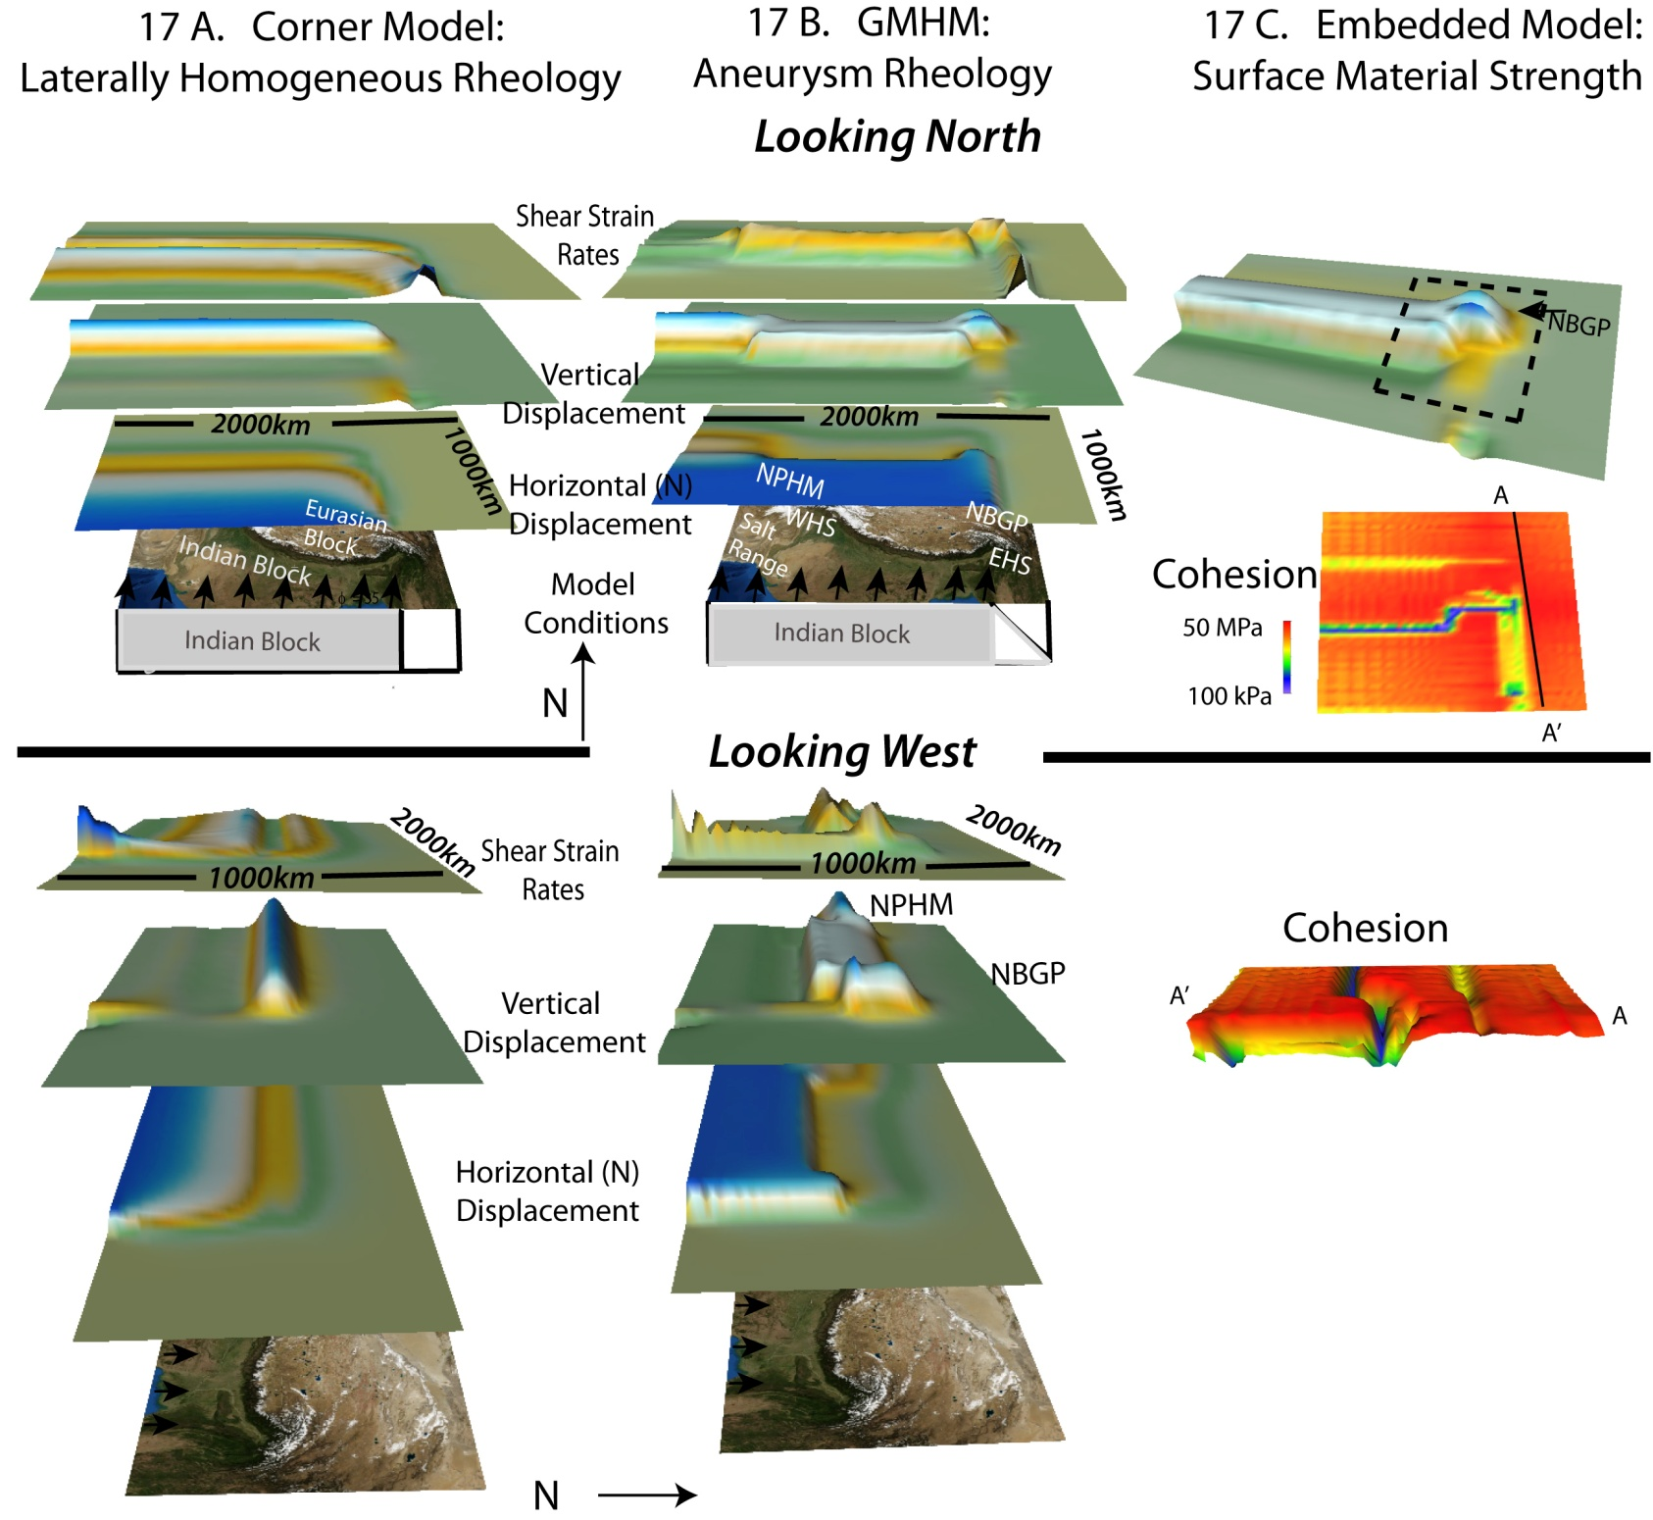
Low Frequency Tectonic Geomorphic Links ~ Advection
Model Class: Macroscale
Tectonic: Mantle-driven; Strain transmission through thermally-sensitive lithosphere,
Pressure-dependent upper crust
Atmospheric: Homogeneous or Orographic precipitation
Interaction = Advection and Mass distribution >~50km (lithospheric scale)
After Koons, Zeitler and Hallet, 2012

Slide 8
Intermediate Frequency Cooperation = Advection cooperates with Rheology
Model Class: Tectonic Aneurysm; Lithospheric strength= f(Advection); Advection = f(Lithospheric strength)
Tectonic: As above, + Exhumation-related thermal thinning of Pressure-dependent upper crust
Atmospheric: As above, + Vigorous and vicious spatially-concentrated fluvial and glacial erosion.
Interaction = As Above, + Thermal weakening and strain concentration in regions of concentrated erosion: Result: association of highest peaks with biggest rivers.
>~20km (crustal scale)
After Koons, Zeitler and Hallet, 2012

Slide 9
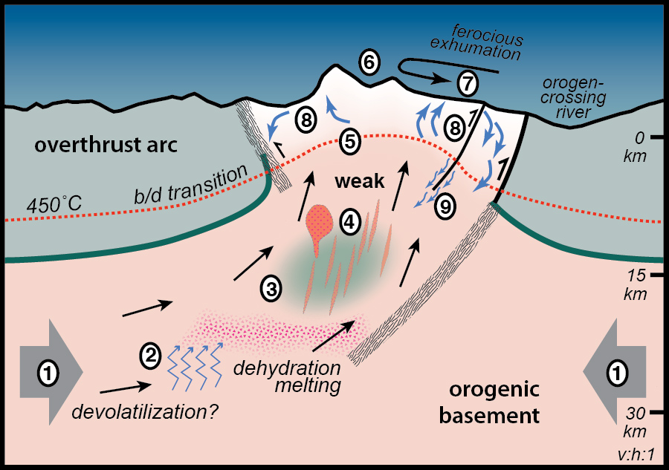
Intermediate Frequency Example of Tectonic Geomorphic Cooperation Make Strength a function of Kinematics and Kinematics a function of Strength and erode the beast (Velocity)= f(Erosion); Temperature =f(Velocity) Strength = f(Temperature ); ∴Strength = f(Velocity)
Resulting Tectonic Aneurysm
incorporates surface processes as a major driver of kinematics and metamorphism.
In: Koons, Zeitler and Hallet, 2012
Compiled from work of thousands plus Craw
Notes:
Simple slightly non-linear instability Figure PZ-Summary.

Slide 10
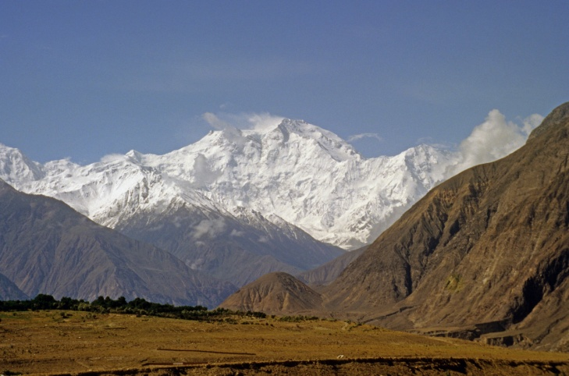
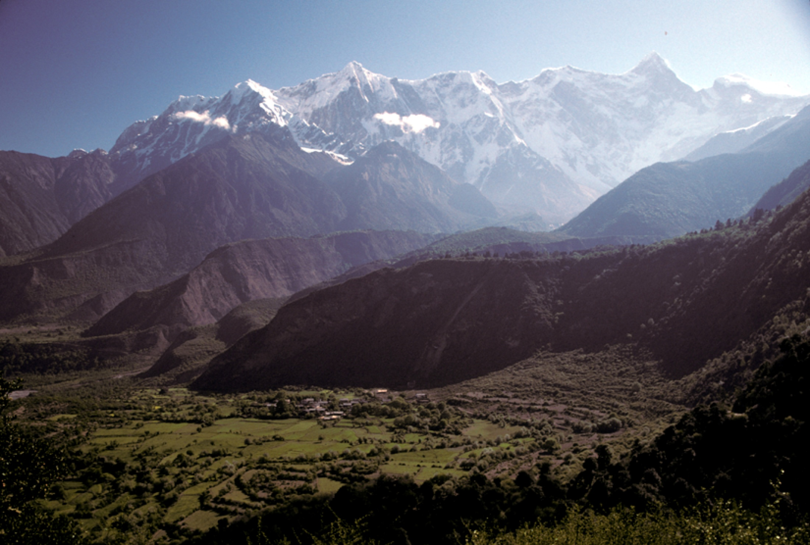
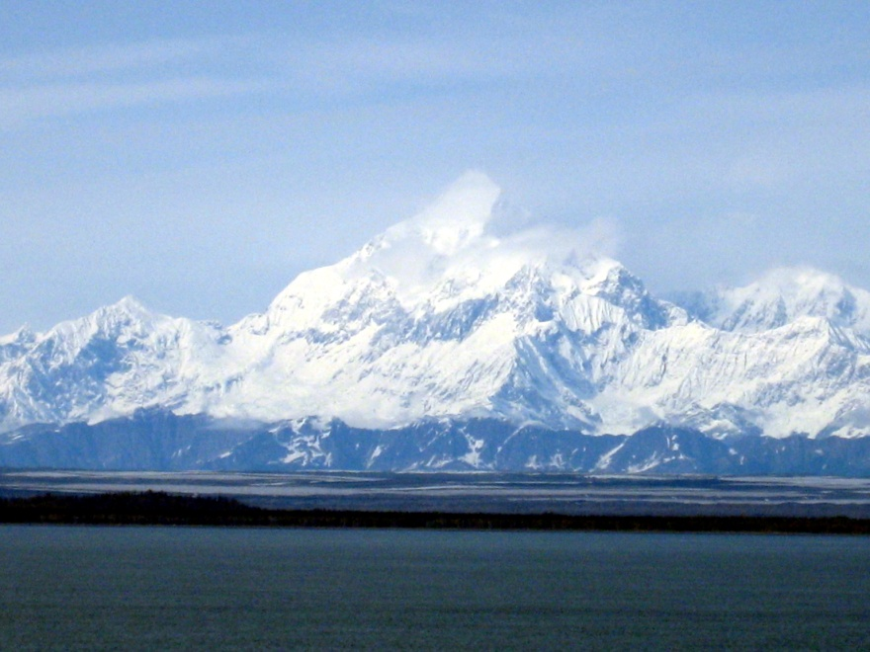
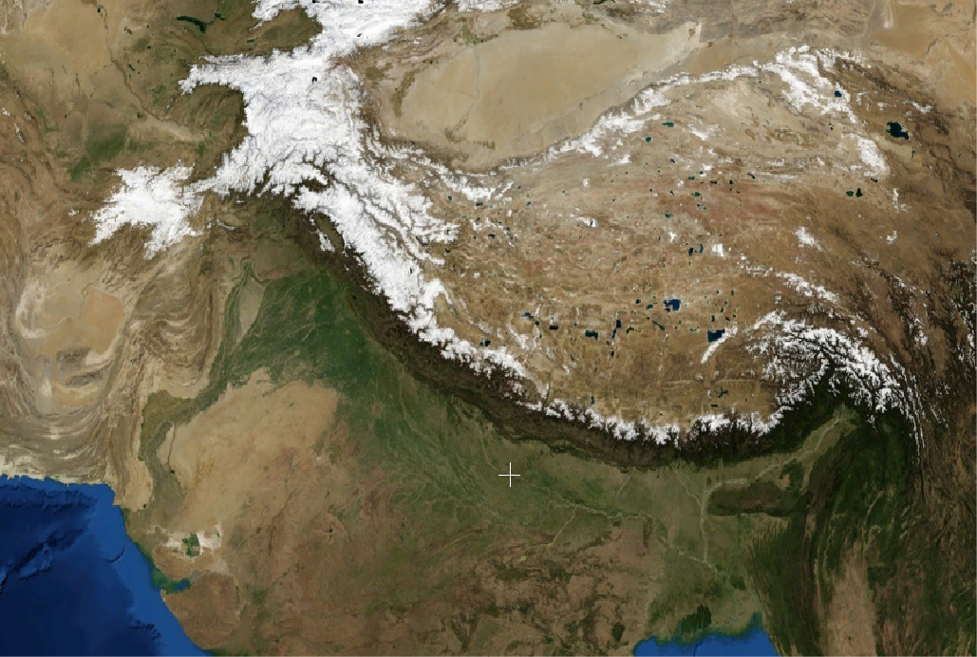
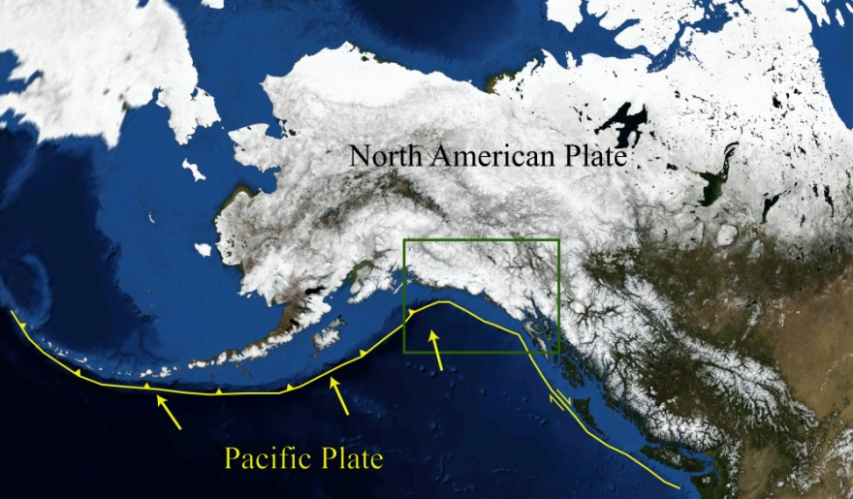
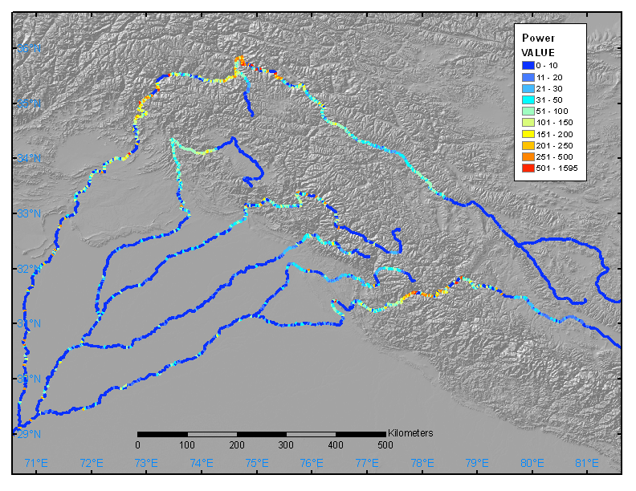
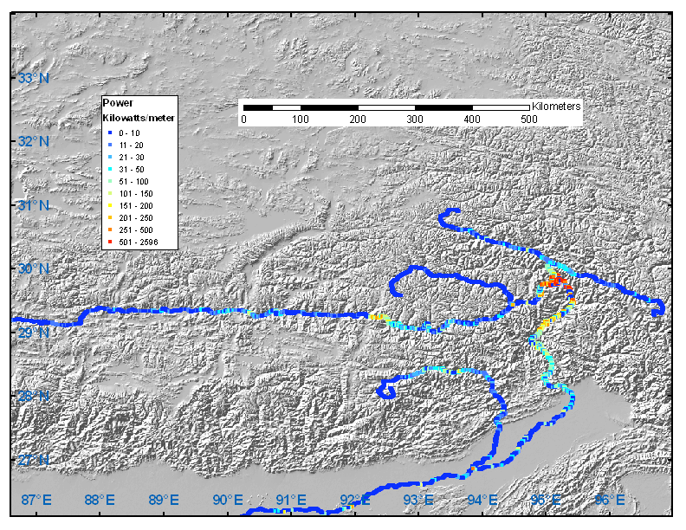
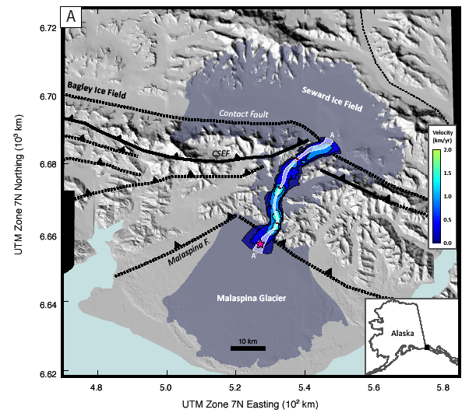
3 Tectonic Aneurysms: Erosion Influences Velocity - Influences Strength - Influences Velocity
A
B
C
Nanga Parbat : Indus
Namche Barwa : Tsangpo
St Elias : Malaspina
Eurasian Plate
Indian Plate
Focused River Power
Focused Glacier Power
Focused River Power
Thanks to H. Greenberg
From Headley et al. 2013
Notes:
Figure 6AB BH

Slide 11
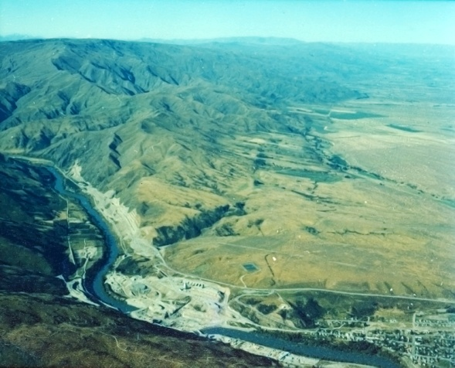
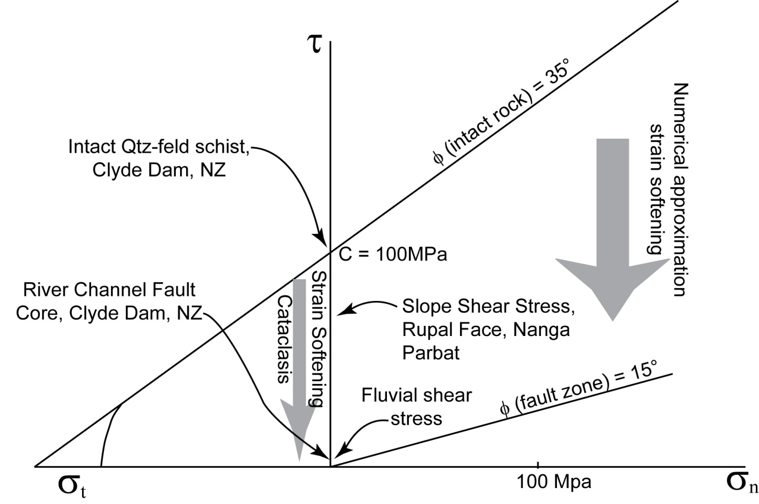
Higher Frequency: Strength = f(Strain)
Natural Example: River Channel Fault Zone, Clyde Dam, South Island, N.Z. from Geology, Drilling, Excavation
After Chester and Logan, 1986; Ben Zion and Sammis, 2003; Mooney et al 2007; Koons et al., 2010
Intact Schist
C ~ 100MPa
Recall that Erodibility = f(1/c² ); ~Sklar and Dietrich, 2004; Koons et al, 2011; and Roy et al, 2013)
Fault Gouge Core:
C < 10kPa
(after Thomson, 1992)

Slide 12
High-Frequency Cooperation: 1a Strength= f(Strain)
Model Class: Strain softening: Earth as Memory Material
Tectonic: As above, + Strain-weakening along fault damage zones in upper crust
Atmospheric: As above, + Material properties are spatially and temporally variable and a function of far field plate kinematics
Interaction = As Above, + Topographic fabric reflects tectonic fabric at all scales >~1m.
1000 km
2000 km
After Koons, Zeitler and Hallet, 2012

Slide 13
High-Frequency Cooperation: 1b Strength= f(Strain)
Model Class: Strain softening: Earth as Memory Material
Tectonic: As above, + Strain-weakening along fault damage zones in upper crust
Atmospheric: As above, + Material properties are spatially and temporally variable and a function of far field plate kinematics
Interaction = Fully coupled
After Koons, Zeitler and Hallet, 2012

Slide 14
Intermediate Implications of Strain:Strength Cooperation
Elevation
Both strain and erosion avoid the high strength blocks
Evolution toward a pattern of isolated high-strength massifs surrounded by shear zones is an inherent characteristic of the coupling of strain and strength
These patterns are very persistent
At moderate to high frequencies, Strength structure rules
Cohesion
Velocity field
Elevation and cohesion

Slide 15
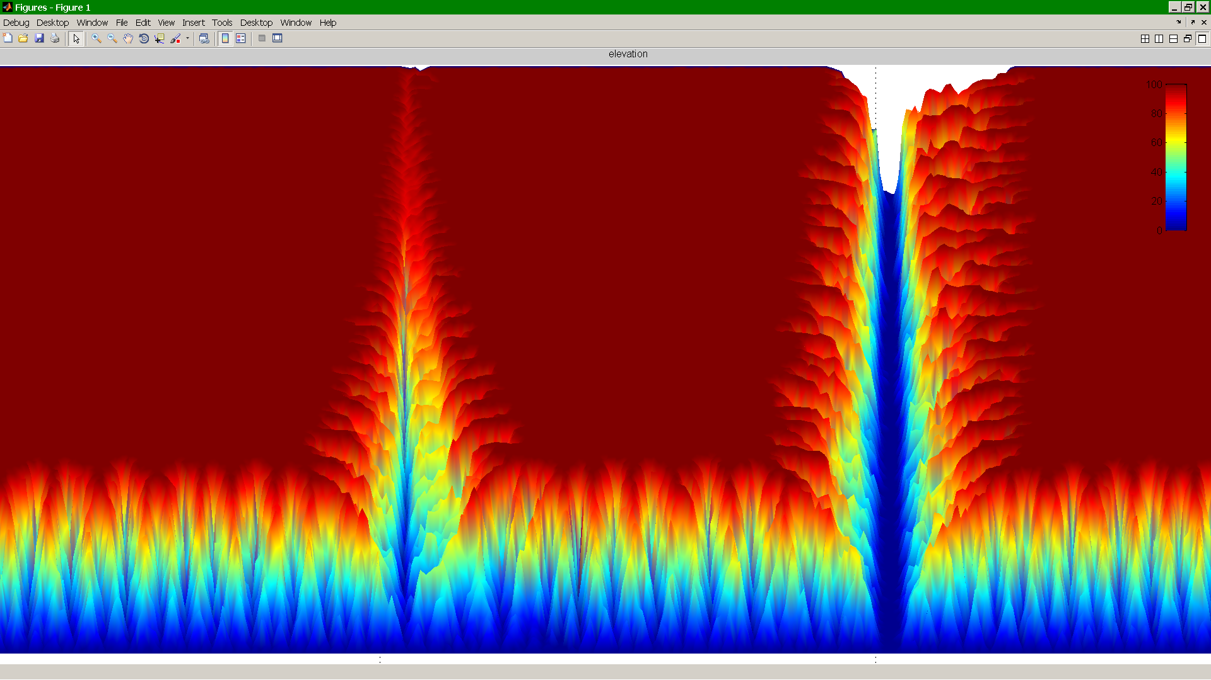
Example of Strength:Strain link from Sam Roy, UMaine
Hypothesis: Fault orientation Influences stream incision rates
(therefore influences all dependent features e.g. hillslope orientation etc…)
Test using CHILD (Tucker, 1999) Surface Process model modified by Roy (2013) to permit fault plane strain softening to material properties.
Simplifications for this specific model are: Detachment-limited, Constant precip…
Topographic Relief; Red=high
Cohesion gradient:
100 kPa
1 MPa
10 MPa
30 MPa
100 m
Topographic Relief; Red=high
Dipping fault lateral migration
(see SG Roy; Umaine Geodynamics

Slide 16
Intermediate Conclusions
Valleys are weak; Ridges are strong (Cols are weak- Buttresses are strong…….)
Heterogeneity from the beginning
Strength anisotropy is a fundamental landscape control in all Orogens and reduces complexity of surface
Topography and Rates are, consequently, anisotropic
3D strength structure contains a dominant record of Strain history
∴ Provides a long lived landscape memory of mantle kinematics

Slide 17
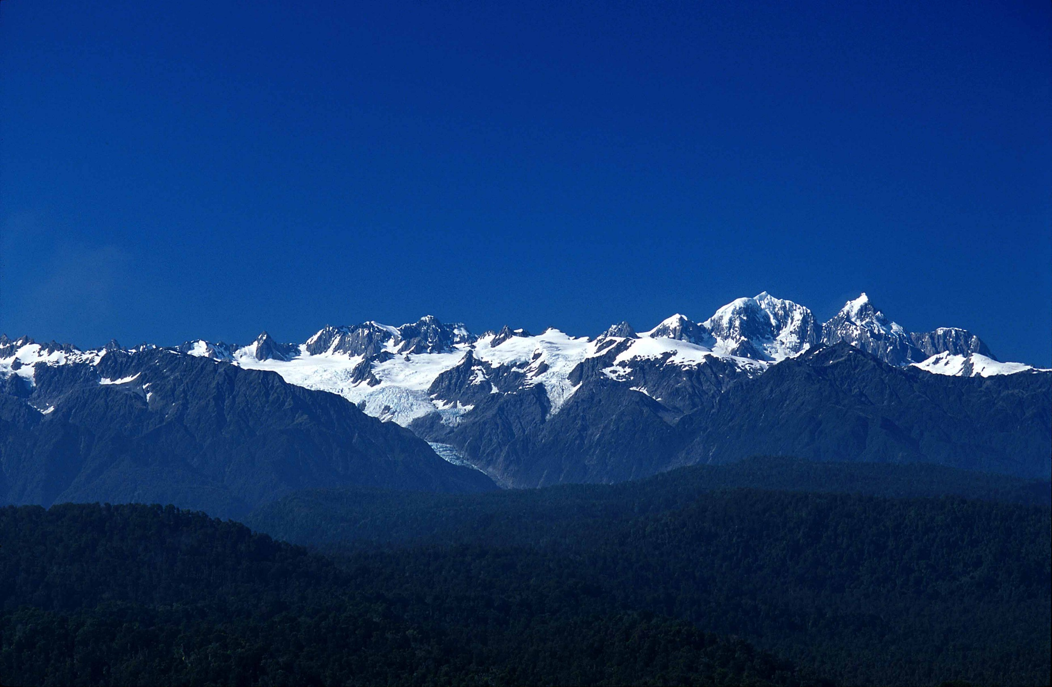
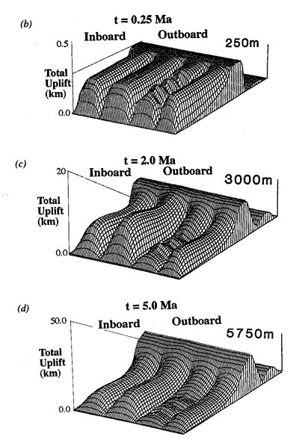
Still some problems and opportunities:
Physics of Earth dependent on whether viewed from below or above. i.e. Same Earth: Multiple formulations.
Onto Ferm I. Material displacement, whether tectonic or geomorphic in origin, at or below Earth’s surface, is driven by local forces overcoming local resistance.
3D Strength:Stress field and its time-evolution are the critical controlling parameters of unified model
New Zealand Southern Alps: From West to East
(Photo by E. Fordyce)
(After Koons, 1989)

Slide 18
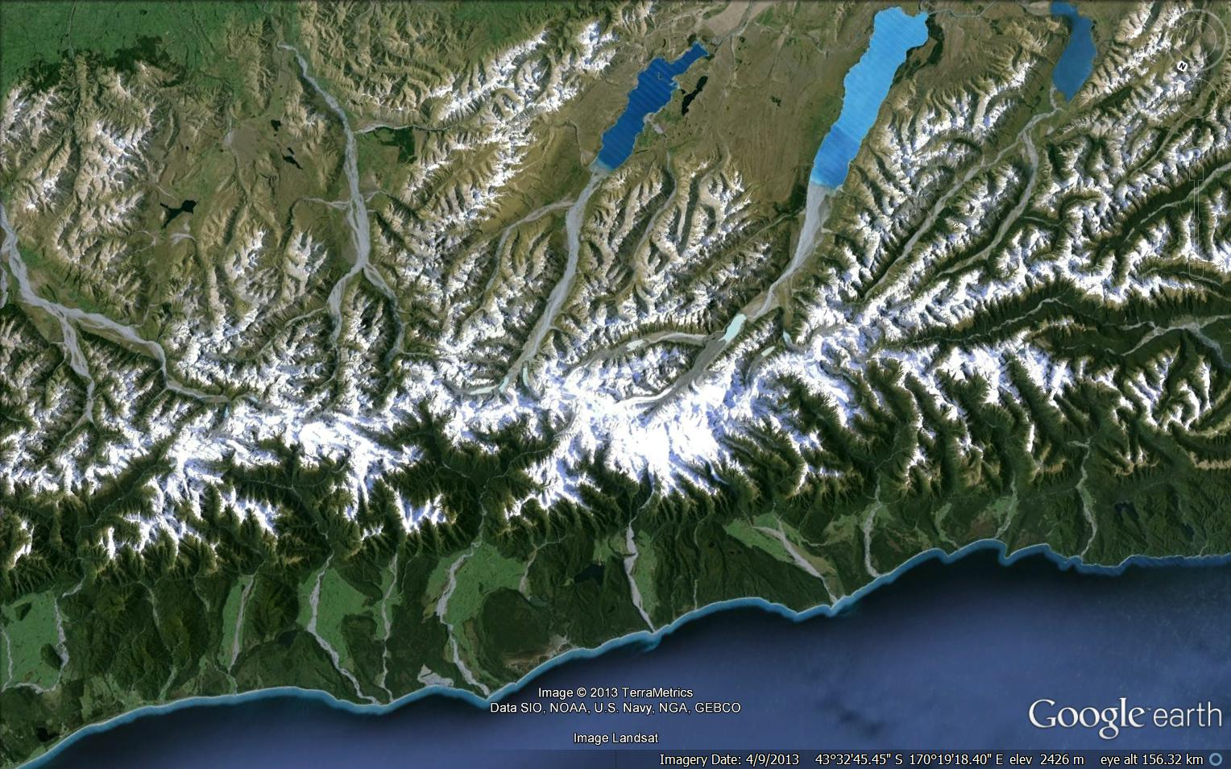
Determining the State of Stress at a Knickpoint i.e.; In conventional theory, geomorphic stress > threshold strength for detachment
σ₁
σ₃
σ₂
Notes:
$\frac{∂h}{∂t}=$ function of flux, 1/C²)
Sklar and Dietrich

Slide 19
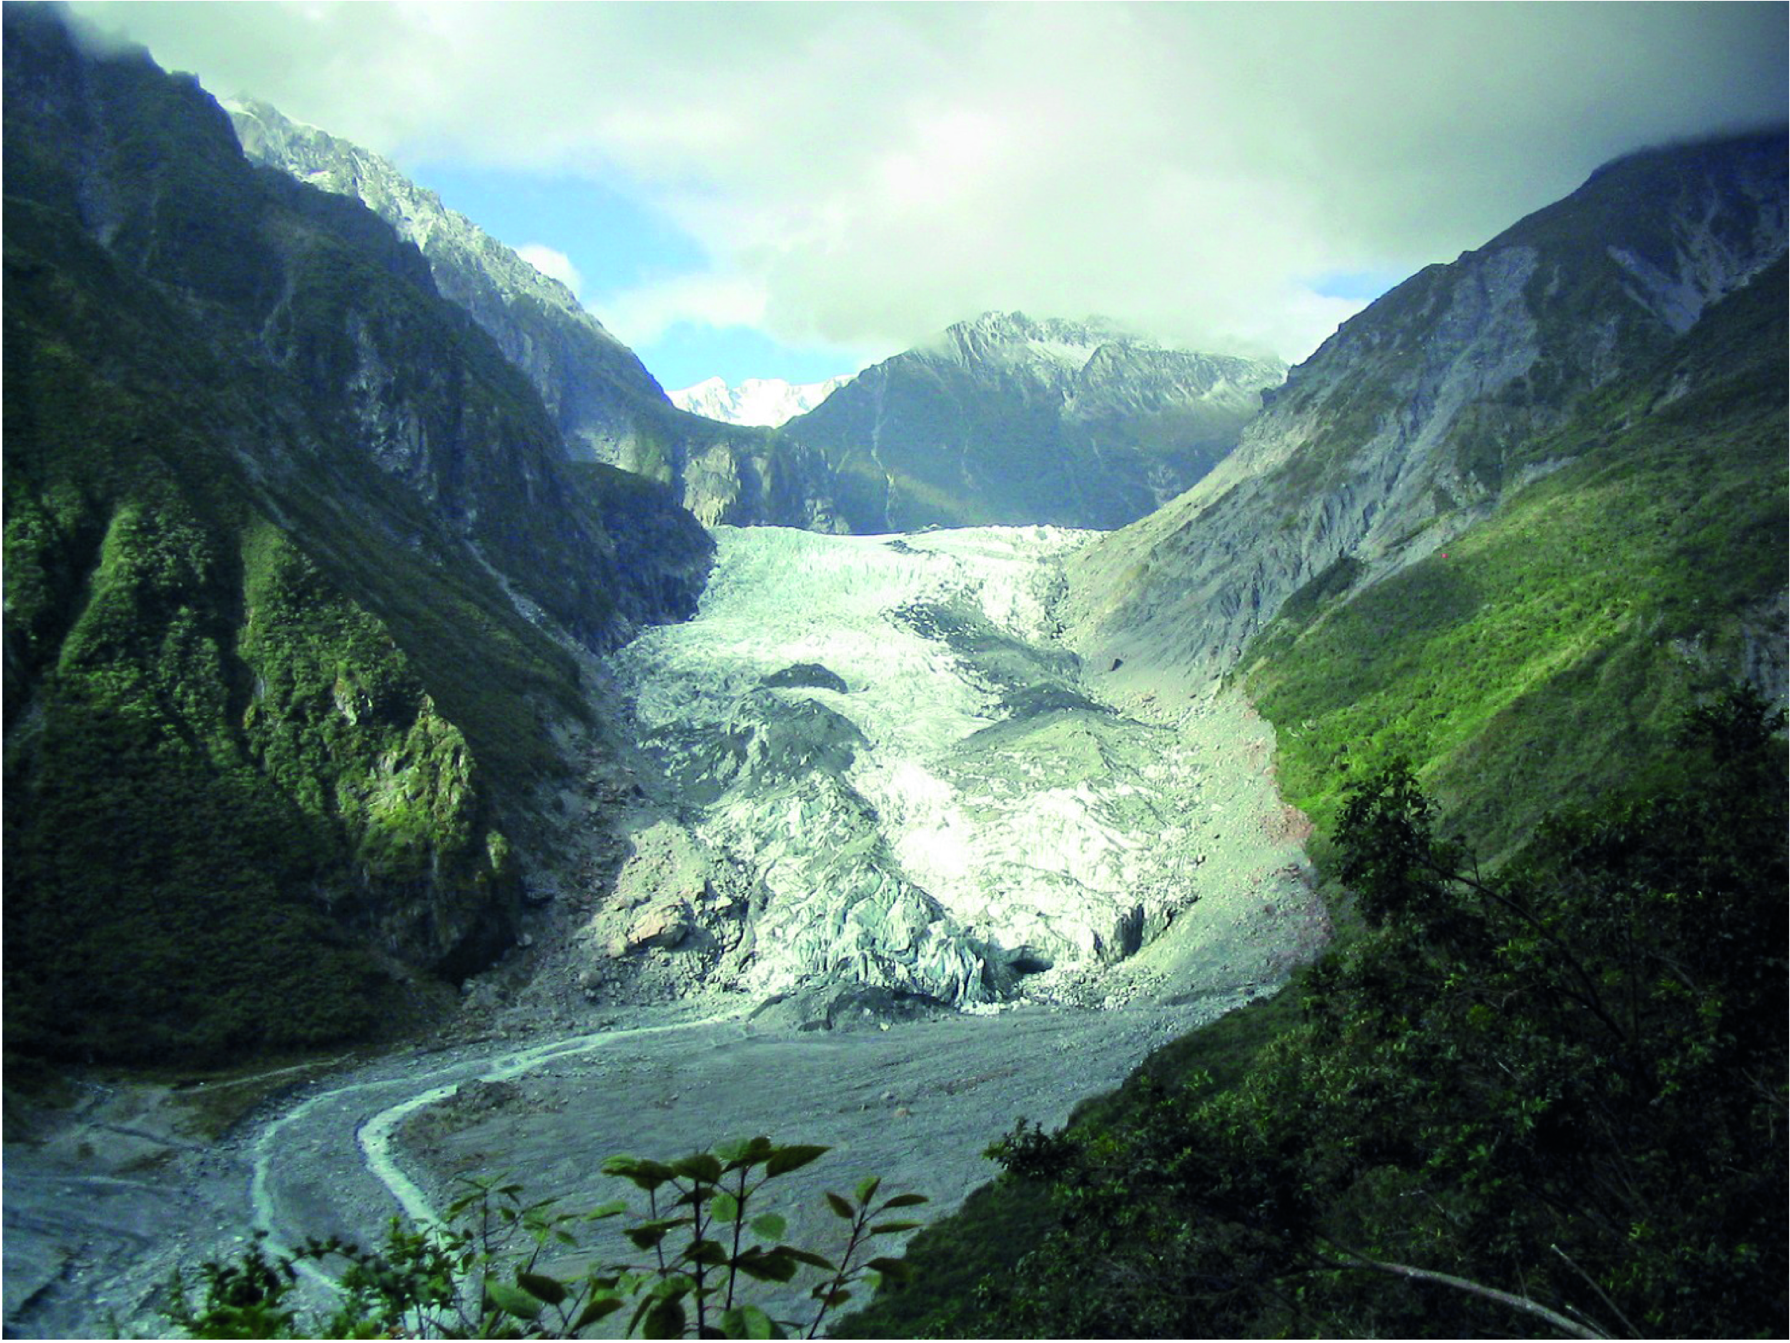
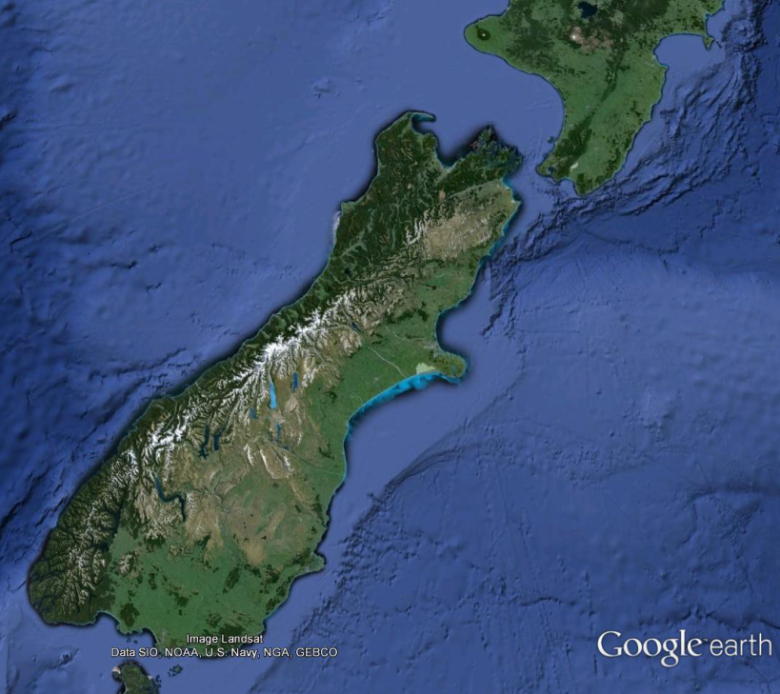
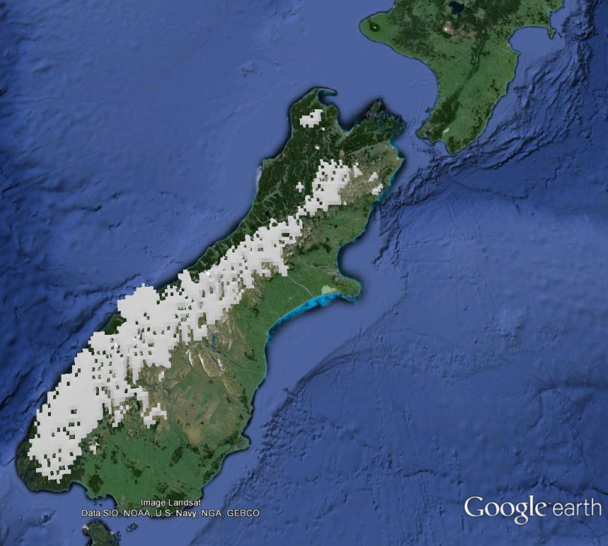
Determining the Total Stress at the Knickpoint
Σ = σ_{fluvial}
+ σ_{glacial}
( + σ_{coastal} )
+ σ_{slope}
+ σ_{tectonic}
+ σ_{dynamic}
σ₁
σ₂
σ₃
Photo : Graham Leonard, GNS

Slide 20
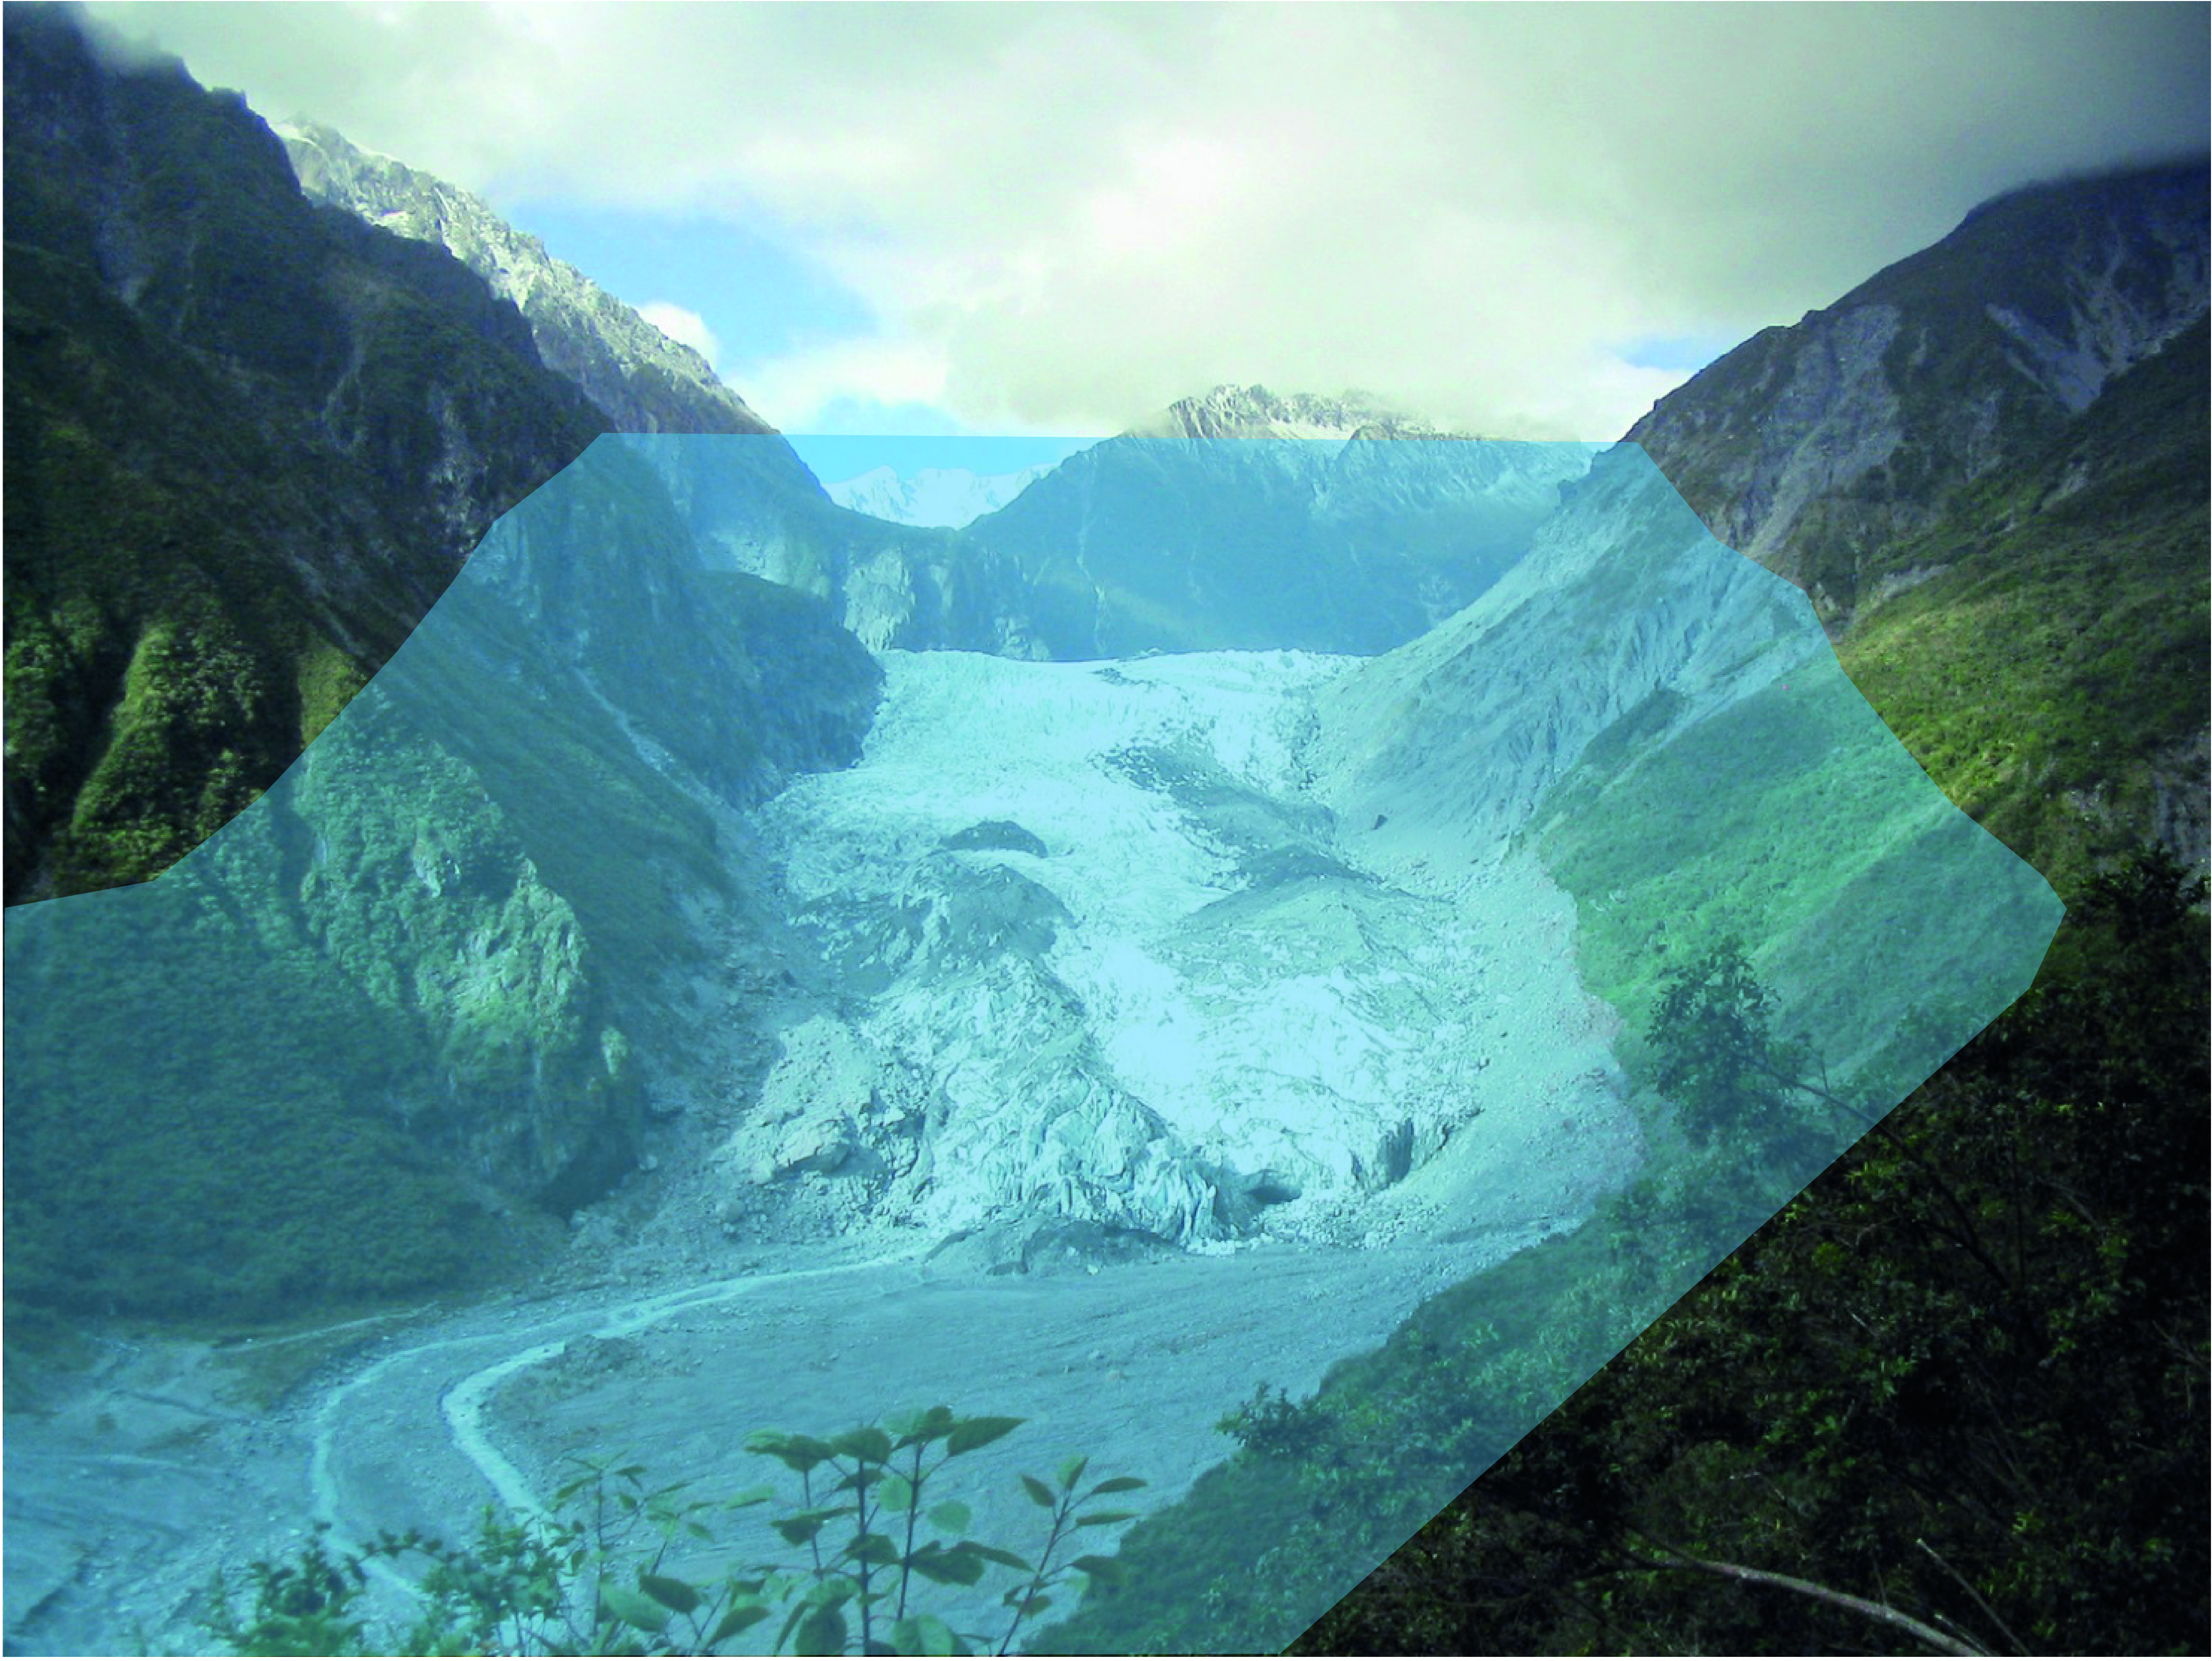
Determining the Total Stress at the Knickpoint
Σ = σ_{fluvial}
+ σ_{glacial}
( + σ_{coastal} )
+ σ_{slope}
+ σ_{tectonic}
+ σ_{dynamic}
Plus time-dependent glacial fluctuations
σ₁
σ₂
σ₃
Photo : Graham Leonard, GNS

Slide 21
Construction of FERM
For each point:
Re-formulate failure criteria in single, Geo-referenced (Cartesian) coordinate frame.
Sum all stresses: Geomorphic (slope and inertial), Tectonic (Static and Dynamic) into a single Total Stress tensor
Describe Earth failure using effective stress formulation, incorporating local fluid pressure
Allow time-dependent strength material behavior
Solve in 3D with a mesh/meshless method. (no transport in these models)

Slide 22
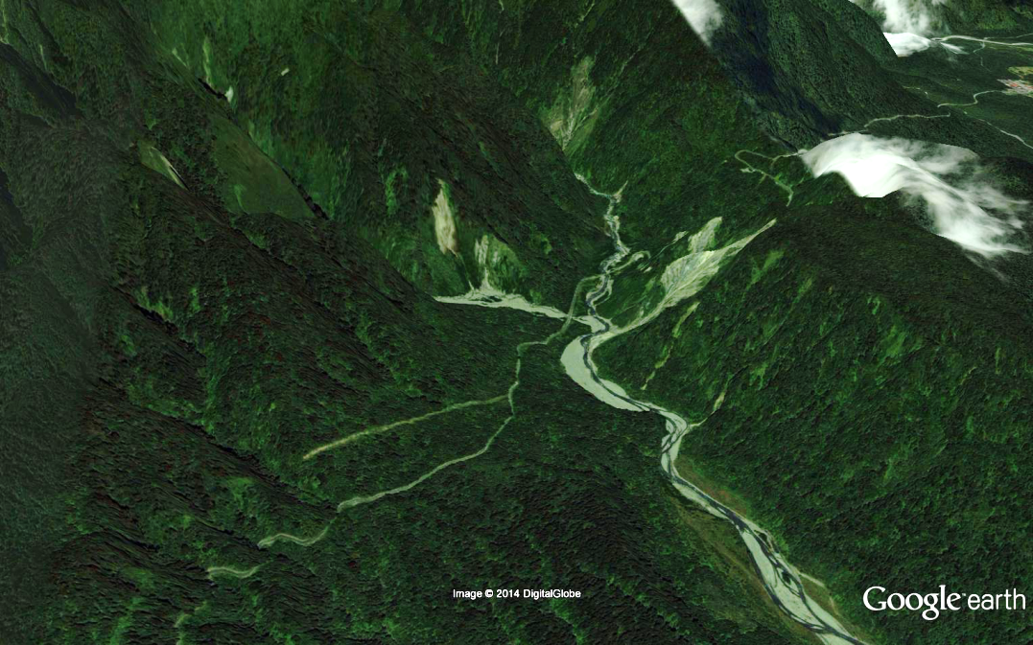
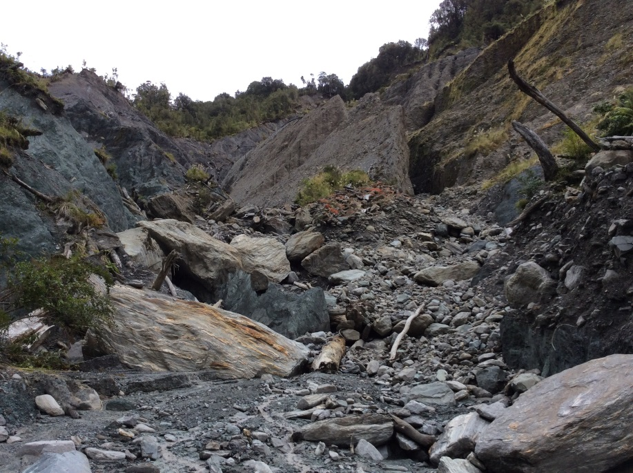
FERM Example: Waikakupa Landslide: Alpine Fault West Coast N.Z. From Phaedra Upton’s poster
Strength
Add Fluid Pressure
Add Tectonic Stress
Cohesion; Red=MPa; Blue= 100 kPa
Strength:Stress
Blue <1 = Failure
Strength:Stress
Blue <1 = Failure
~ 2 km cube
The shape of the Strength:Stress field in 3D and t reflects the source of perturbations

Slide 23
Strength: Stress Ratio : Blue ~1 = Failure; Red ~ 10
After Chester and Logan, 1986; Ben Zion and Sammis, 2003; Mooney et al 2007; Koons et al., 2010
20 km
Alter the Strength:Stress ratio by:
Pre-existing weaker material
Fault damage (strain weaken)
Elevate Pore Pressure (Effective Stress formulation)
Alter Tectonic Stresses
Introduce Dynamic Stress due to Seismic Acceleration
All of the above
And the results are predictable
Notes:
Empahsise heterogeneous strength structure therefore het stress structure.

Slide 24
Introduce Normal and Shear Stresses (Coordinate) along valley floor:
Tensile failure along ridge summits and steep faces
Stress State of incising valley/slope ensemble is continuous and physically reasonable
Introduce Oblique convergence
10km
10km
Strength: Stress Ratio : Blue ~1 = Failure; Red ~ 10
20km

Slide 25
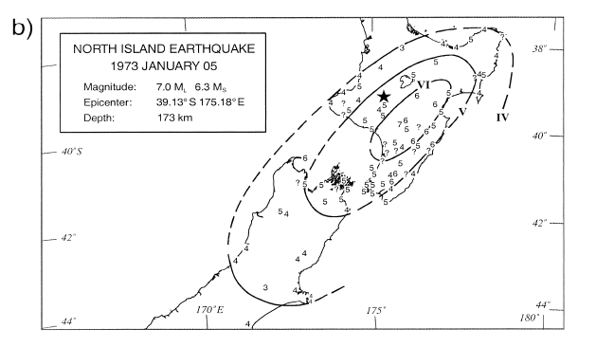
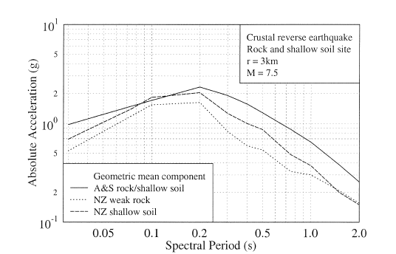
Dynamics: Earth Acceleration Response Spectra
Return to one historical motivation of all this
Landscape evolution and seismic hazard.
Scarp diffusion (here from Andrews and Hanks, 1985)
FERM view of Seismic Hazard
Stress:Strength relationship influenced by seismic acceleration
Earth response = f (local stress state, 3D acceleration as f(period)
Time and space pattern of acceleration field contains information on nature, proximity and timing of source
MM shaking (after McVerry et al)
NZ Spectral response after Abramson and Silva, 1997

Slide 26
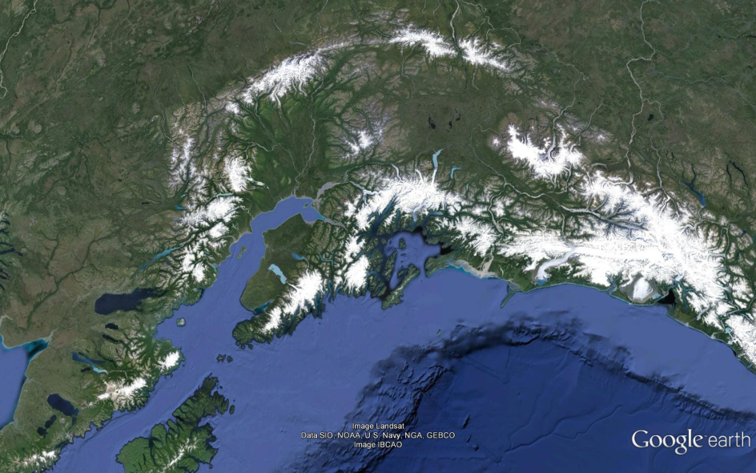
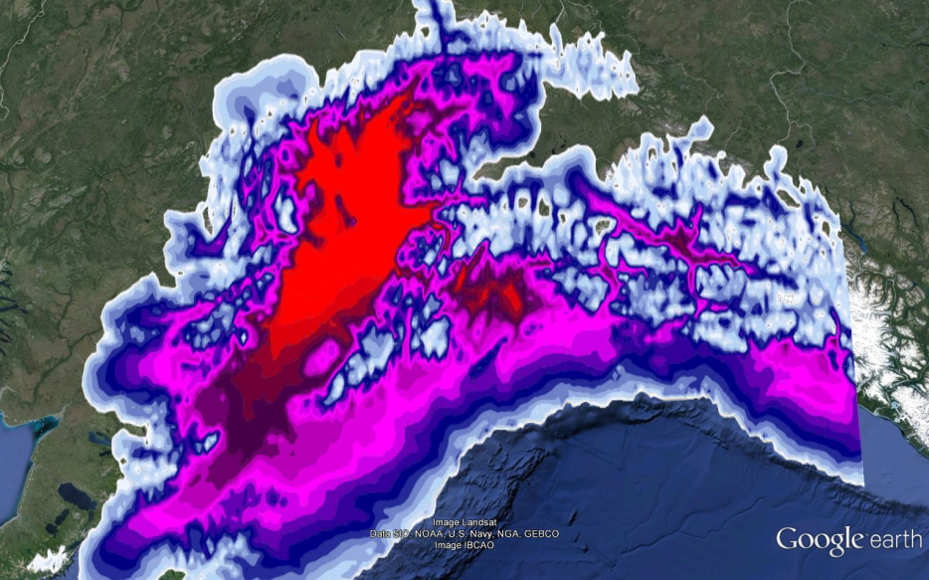
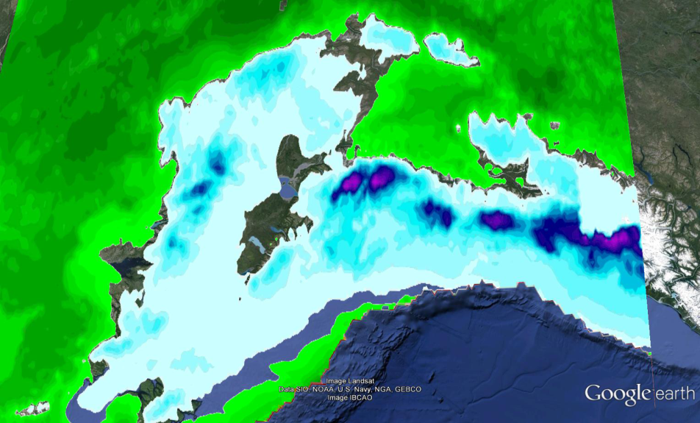
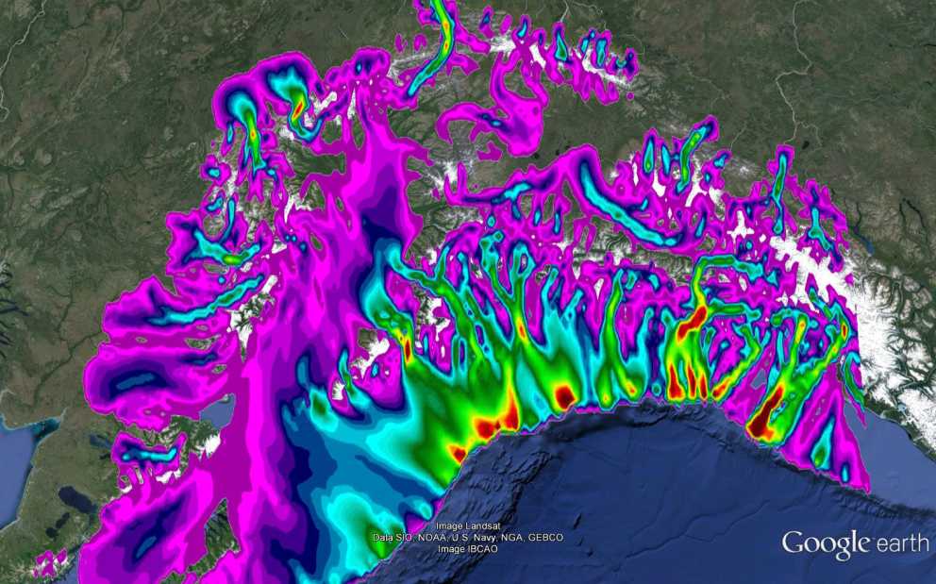
FERM Example: Last Glacial Maximum Load and Velocities, Southeast Alaska;
Climate and Glacier Models by Sean Birkel, Geodynamics by Lauren Wheeler, Upton, Koons, U Maine
In cooperation with B. Hallet, A. Barker, U.Washington
LGM Mass Balance; Blue=high
LGM Ice Thickness; Red=high
LGM Ice Velocity; Red=high
LGM Geodynamic Model; Vertical Stress

Slide 27
Some Implications
Critical parameters of FERM (Cohesion, Tensile Strength, Pore Pressure etc) can be measured (and have been for > 100years).
Valleys and Ridges consist of fundamentally different stress and strength states with very different response rates.
Non-linear sensitivity of incision rate on Strength means that strength differences (isolated massifs) are inescapable and persist for long times.
Landscape Tempo is not controlled by diffusion decay and is defined by evolution of Strength/Stress field (i.e. seismic accelerations, climatic fluctuations) that are recorded at high frequencies.
Geomorphic and Tectonic failure are the same; Broadband topography contains vast untapped information on surface, and .
Unification within the stress:strain framework of FERM offers the means to unwrap the broadband signal of Tectonic:Geomorphic cooperation contained in topography

Slide 28
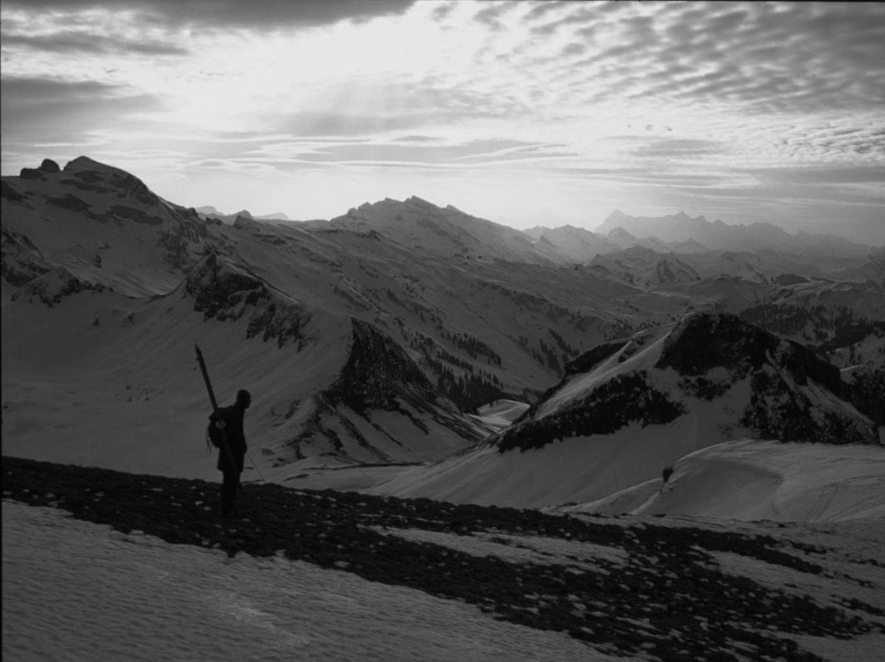
Challenges and Future Directions
Computational: Hardware GPU- assisted
Software: FERM, Meshless Methods, Particle in Cell …
Part of our contribution: Calculate and provide 3D Stress Tensor derived from global DEM and Topographic Stress Index for terrestrial Earth
Enough
Photo by J. Alean

Slide 29
