Slide 1

Permafrost Modeling Toolbox
Irina Overeem, Mark Piper, Kang Wang
with help of Elchin Jafarov, Scott Stewart, Kevin Schaefer

Slide 2
Objectives
Learn about the development goals and status of implementation of the Permafrost Toolbox.
Gain ability in running simulations in two models and visualize results of permafrost occurrence, soil temperature and active layer thickness for Alaska.
Contribute to the discussion of future development of the modeling system.

Slide 3
Outline of Clinic
Lecture (30 minutes)
Demonstration of permafrost models in WMT
Hands-on exercises with permafrost toolbox
(60 minutes)
Discussion on the future developments
and more advanced models (30 minutes)

Slide 4
Why
The state of Arctic permafrost is an essential climate indicator and carbon emissions from thawing permafrost will amplify anthropogenic warming.
Observations can quantify the current state of permafrost, but we need models to make predictions of future permafrost conditions

Slide 5
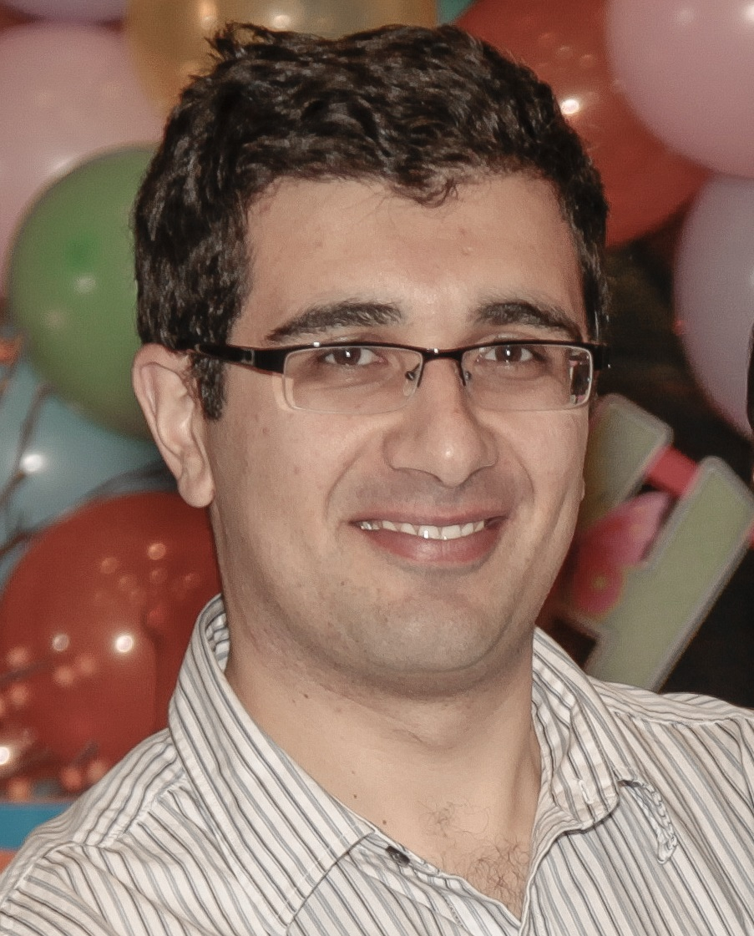
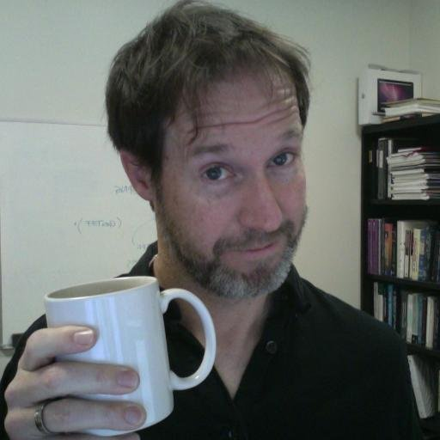
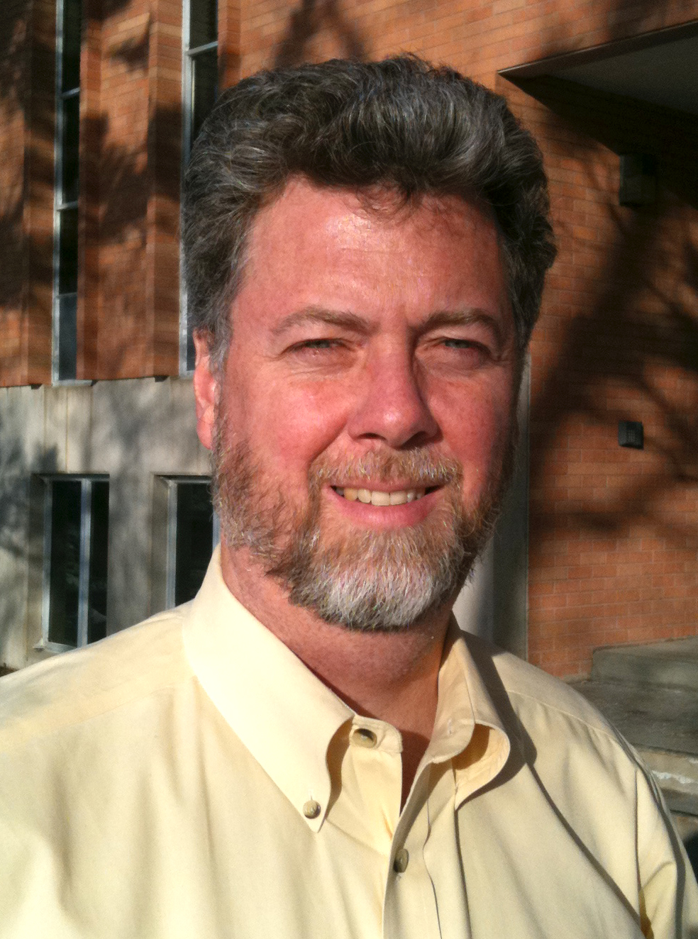
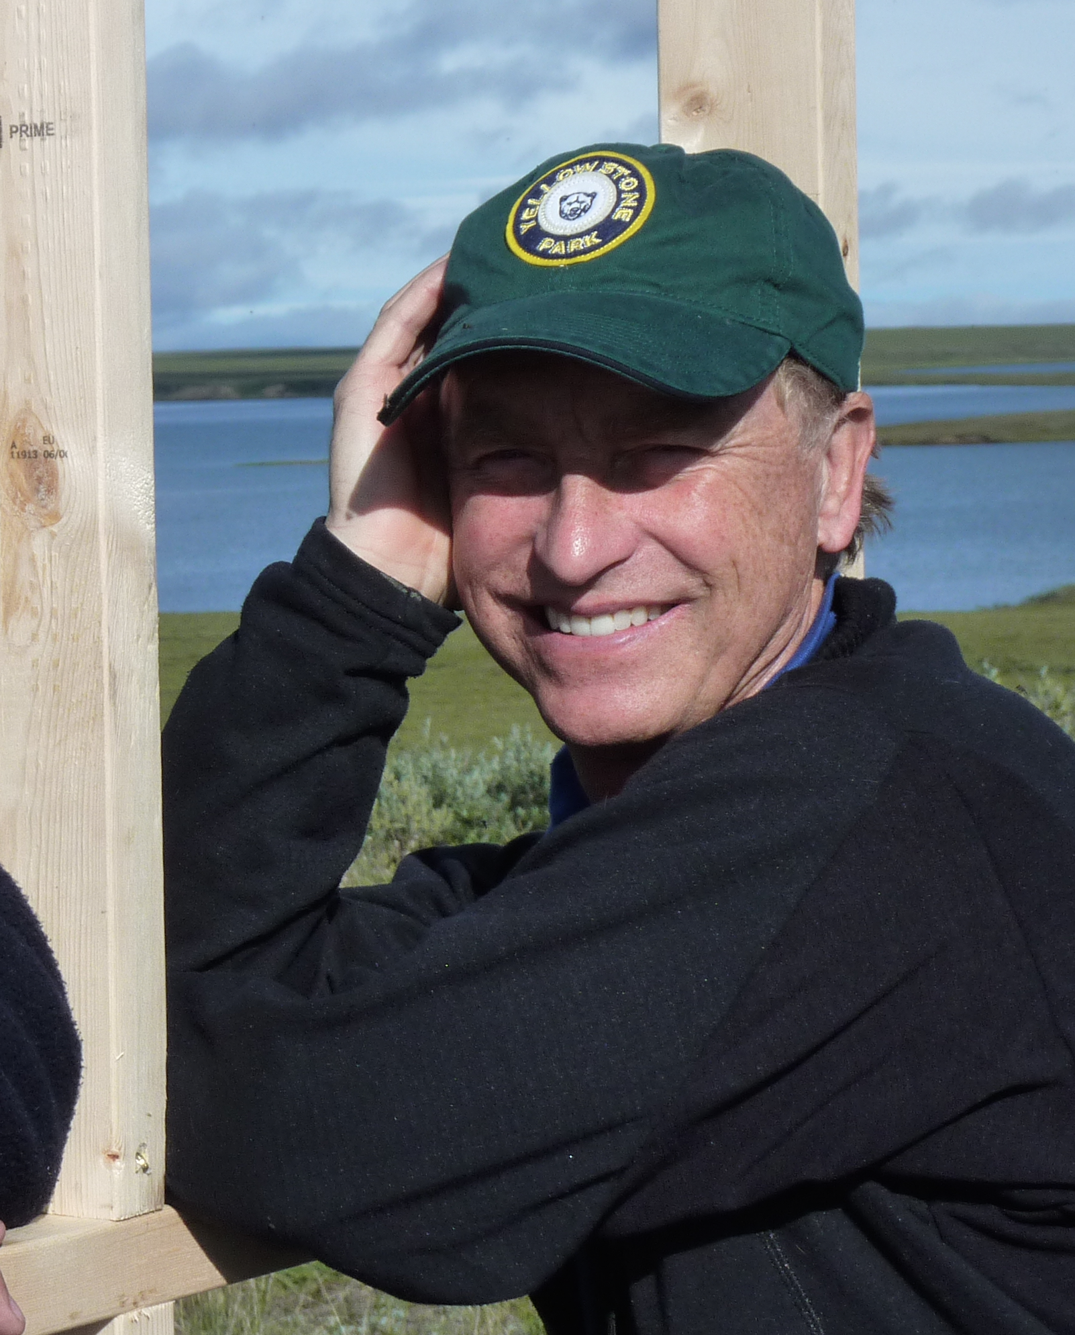
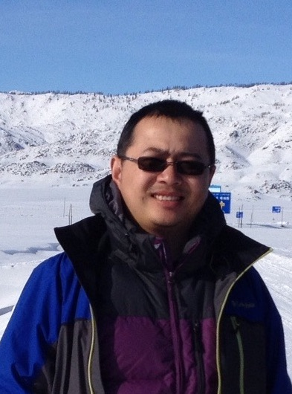
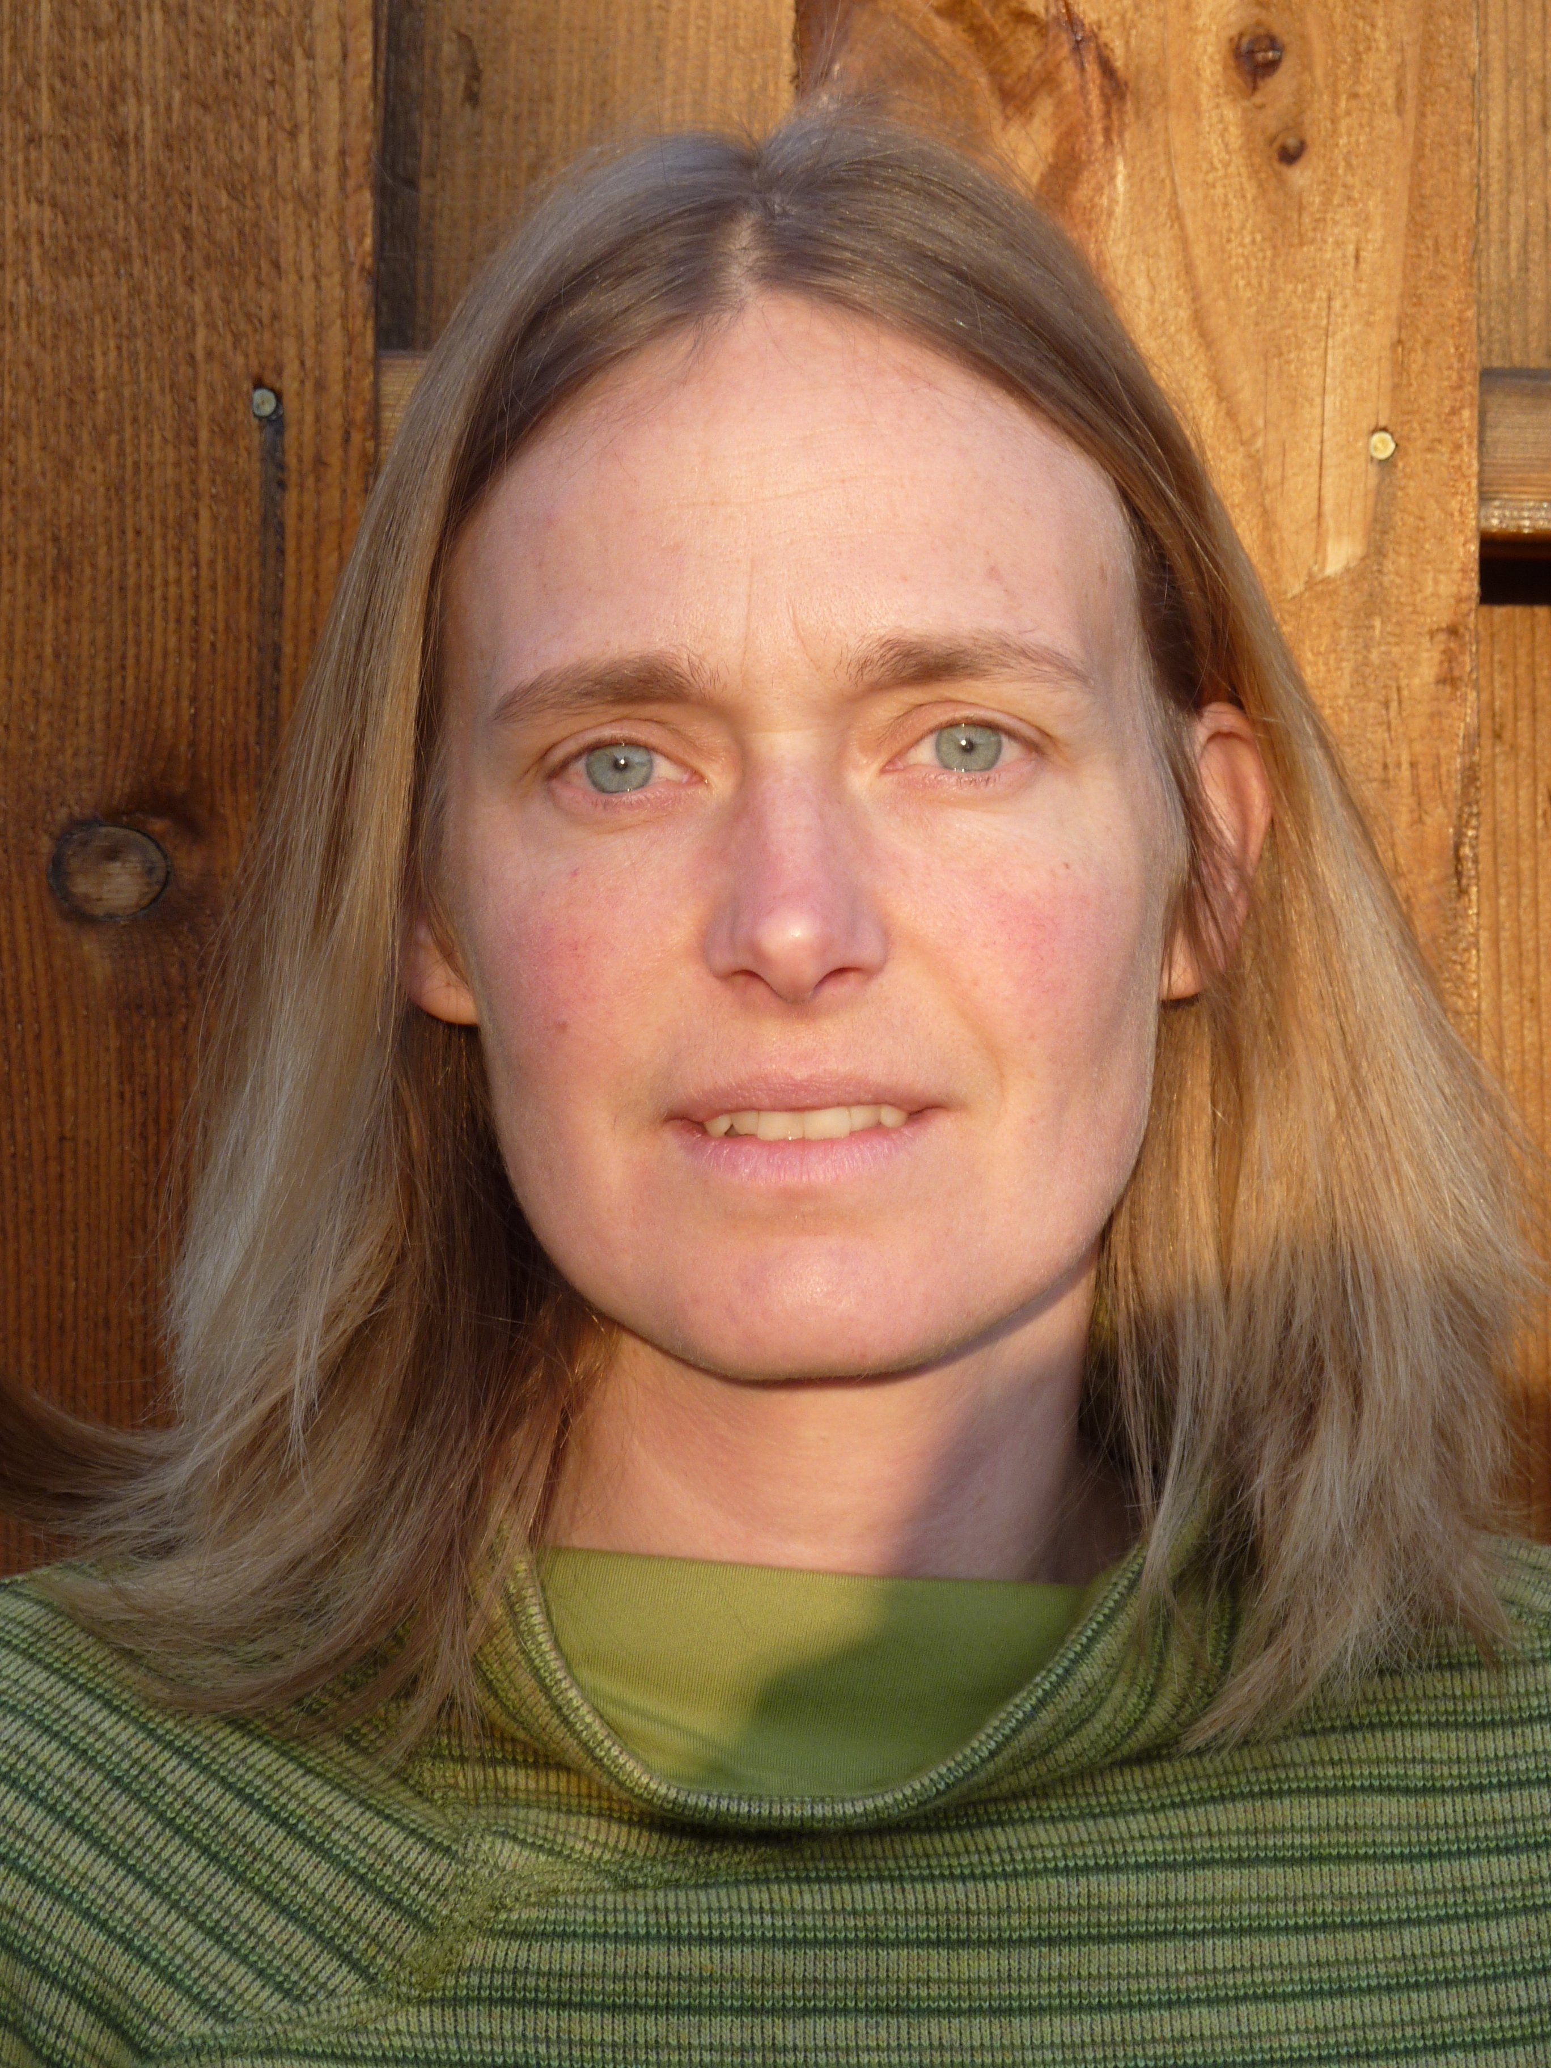
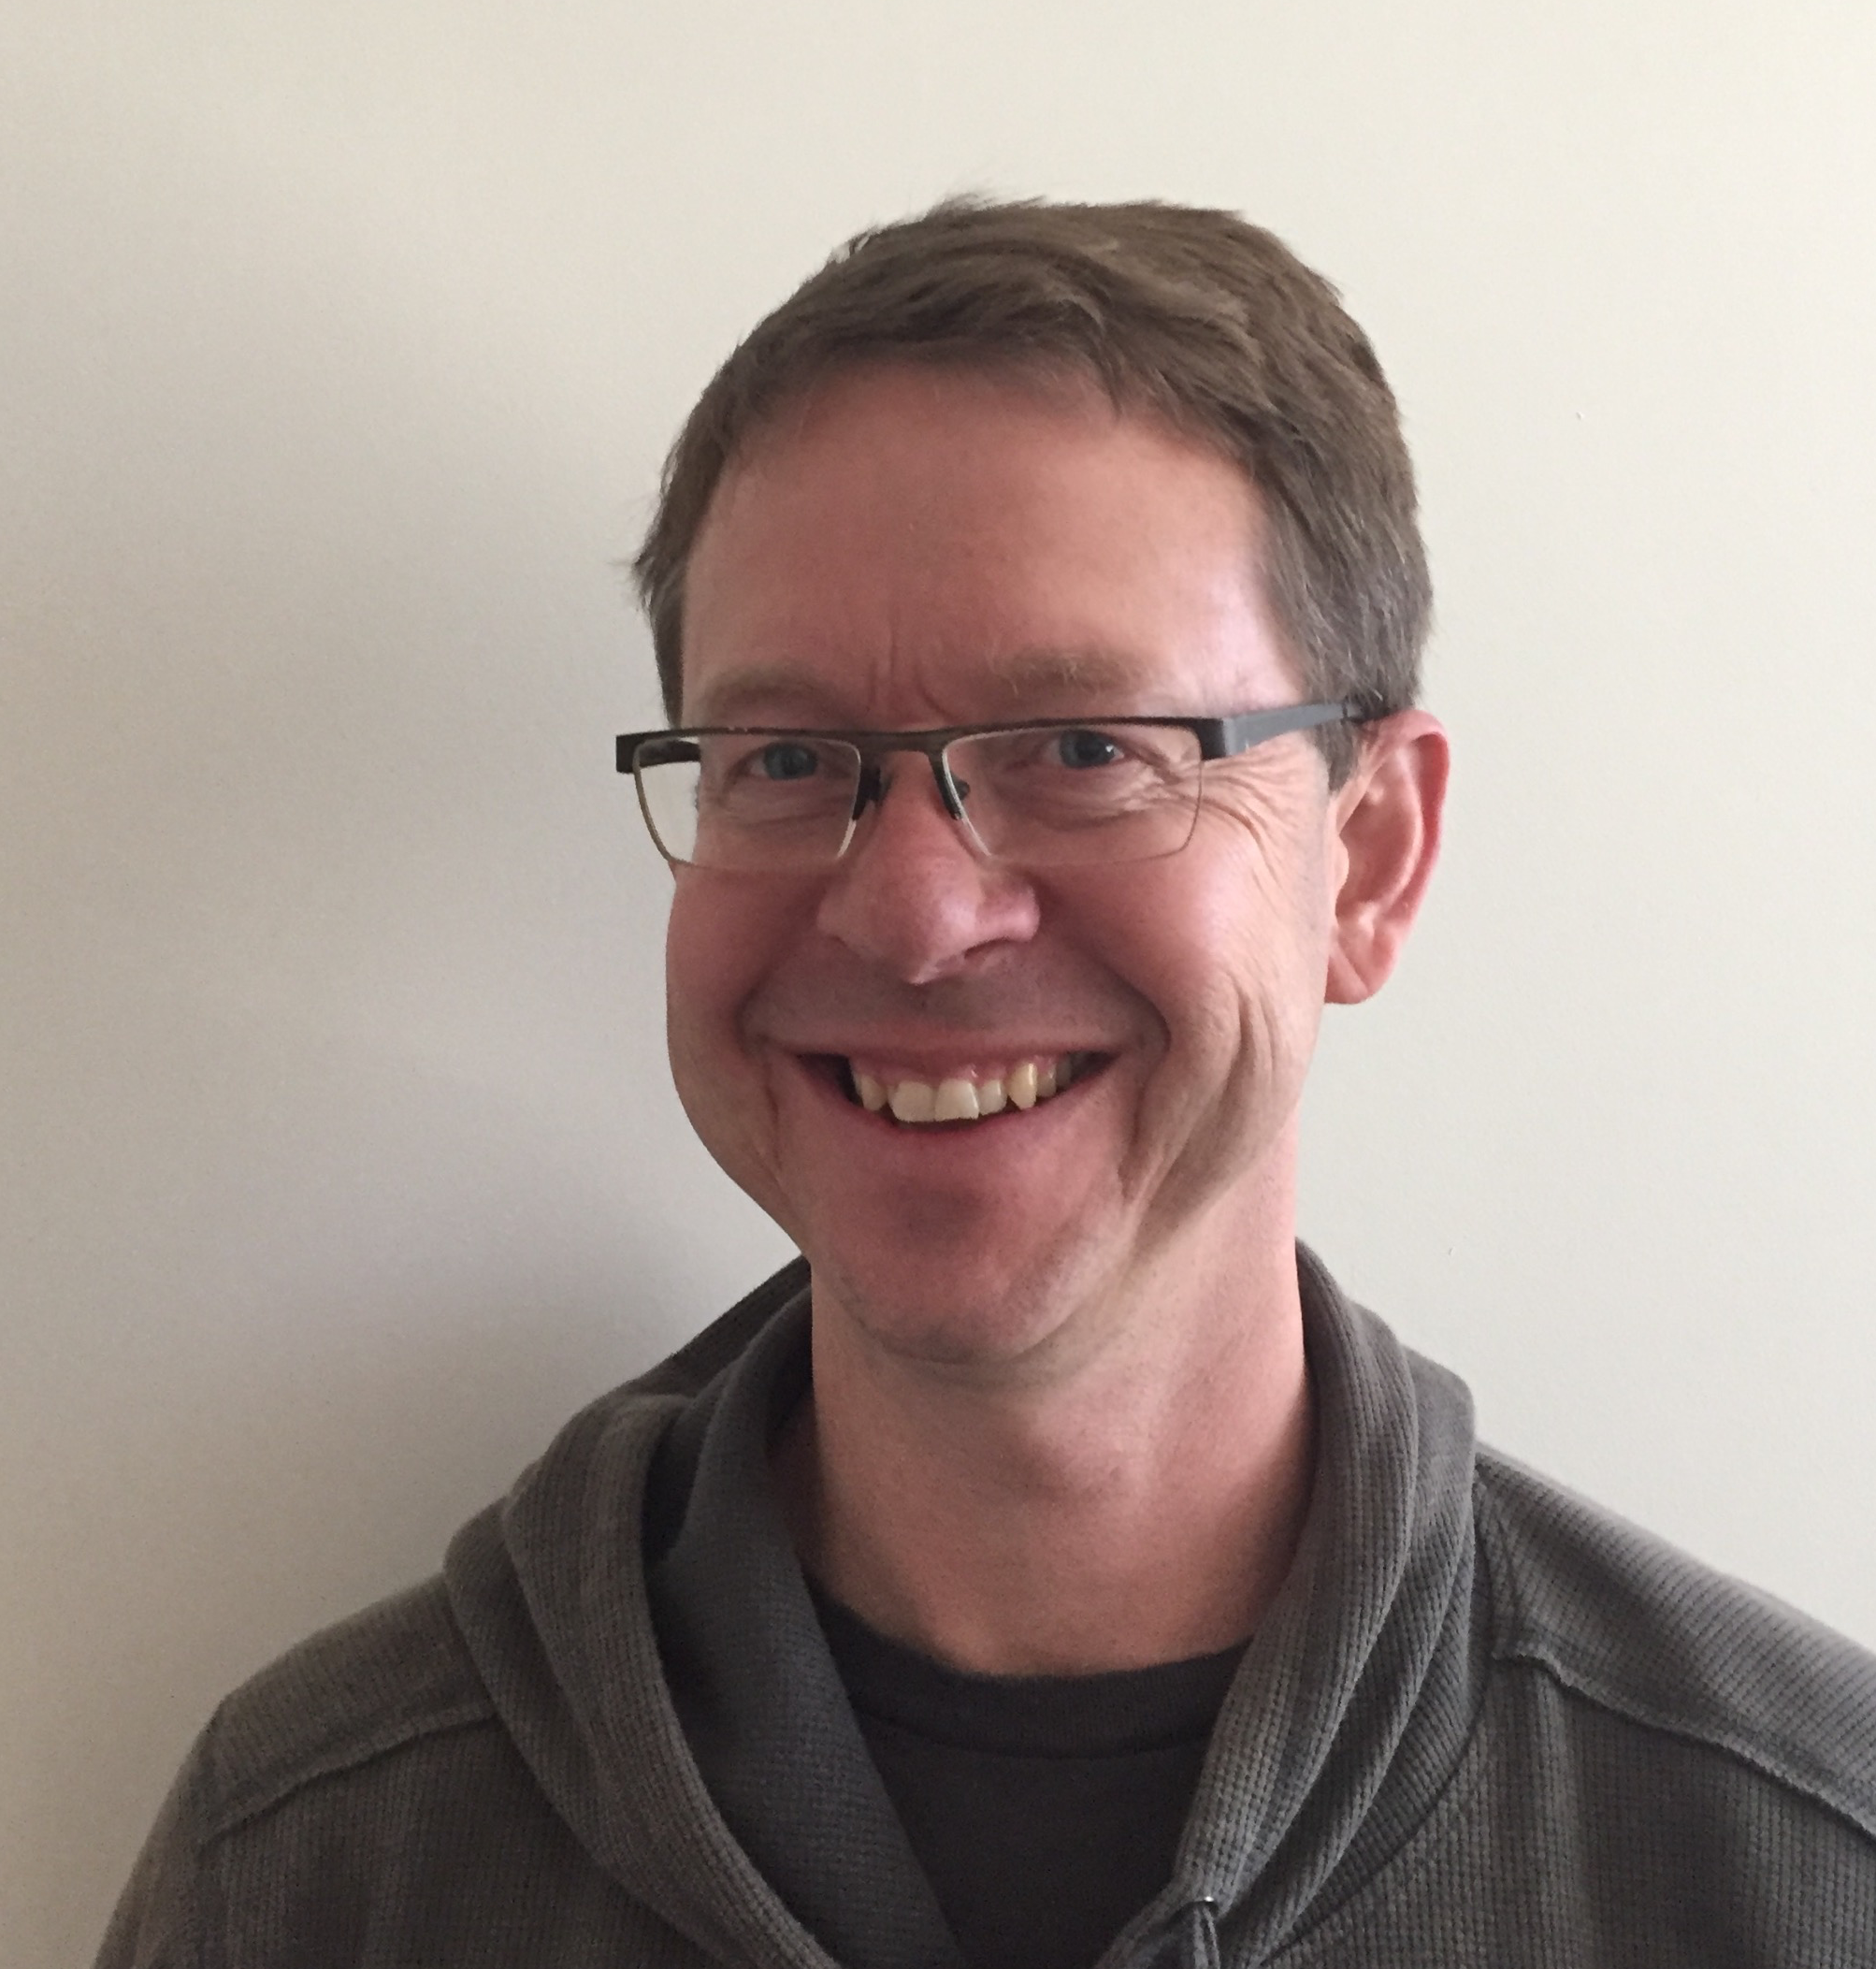
Our team
Irina Overeem, CU Boulder
Kevin Schaeffer, NSIDC
Elchin Jafarov, LANL
Kang Wang, CU Boulder
Mark Piper, CU Boulder
Scott Stewart, CU Boulder
Gary Clow, USGS

Slide 6
Goal
Permafrost Modeling toolbox develops easy-to-access and comprehensive cyberinfrastructure to promote permafrost modeling

Slide 7
Vision for Permafrost Modeling Toolbox
Models ranging in complexity
Allow input data to easily be ingested
Web interface for ease of use
Ultimate goal: coupled modeling across domains

Slide 8
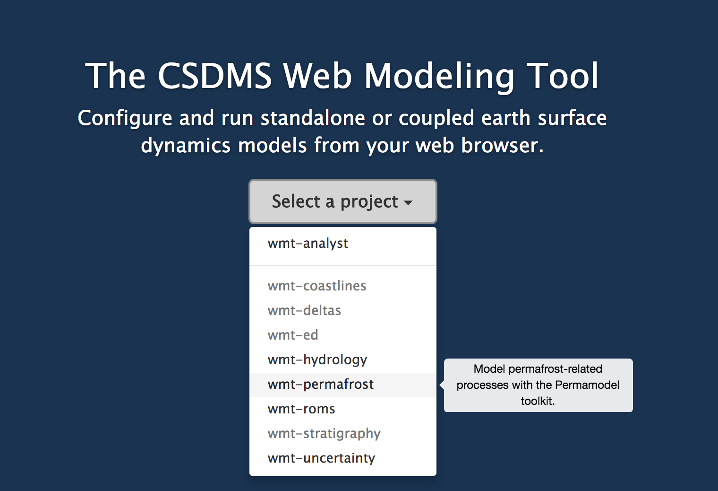
Web Modeling Tool
https://csdms.colorado.edu/wmt/

Slide 9
Develop Models as ‘Components’
Models receive a ‘Basic Model Interface’
Specify with precision which parameters components do need, which parameters do they generate (Standard Names).
Components generate netCDF output

Slide 10
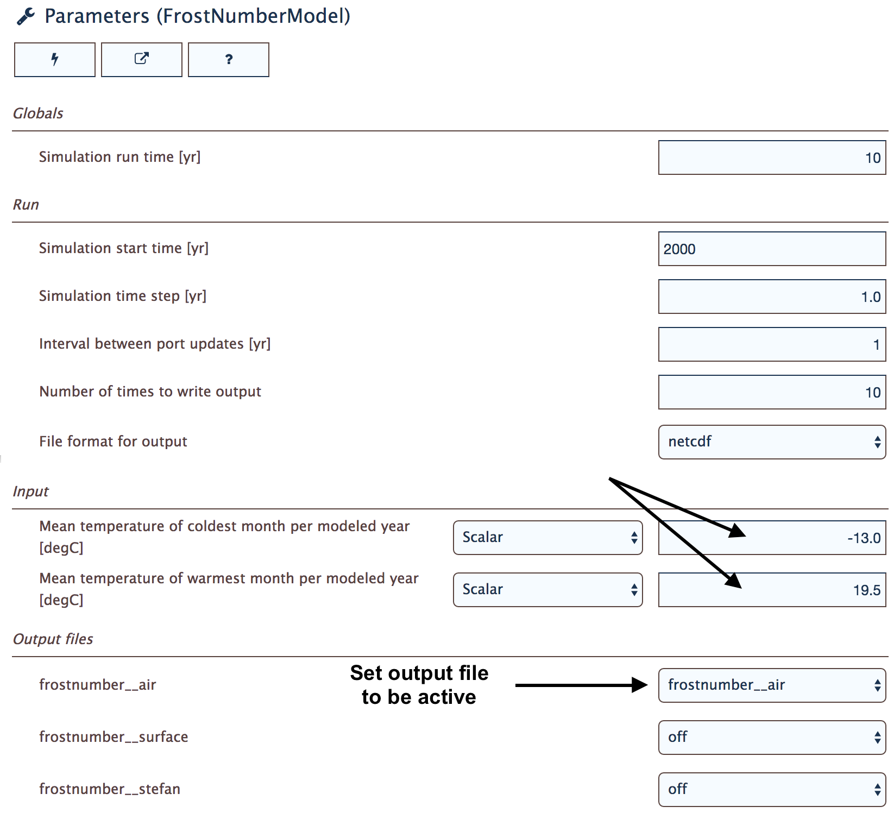
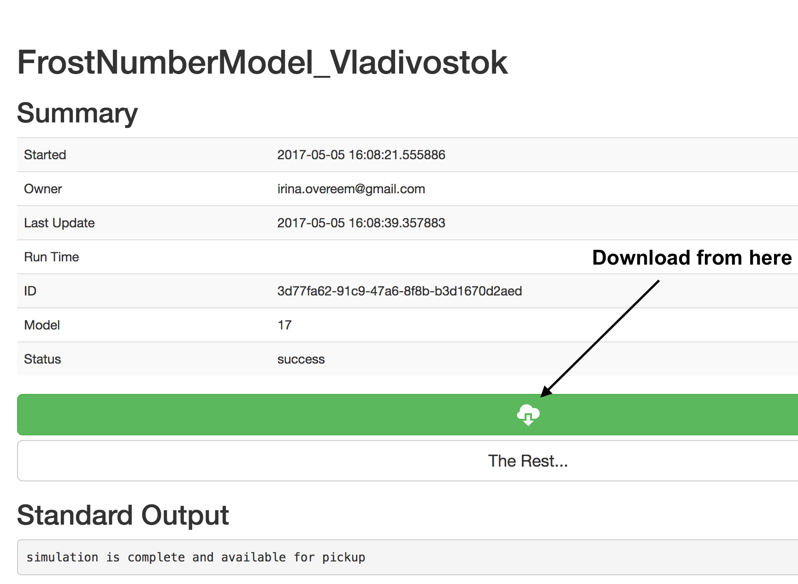
Web Modeling Tool
Web Modeling Tool allows new users to get familiar with main parameters of components
in permafrost modeling toolbox, run simple simulations, download output.

Slide 11
Physical Models
Air Frost Number model – 1D
Air Frost number model –GEO
Kudryavtsev model – 1D
Kudryavtsev model – GEO
GIPL model – daily time-series, continuous depth
(UAF Geophysical Institute Permafrost Lab model)
Continuum volume model (G. Clow, USGS)
Increasing complexity

Slide 12
‘Air’ Frost Number
F = Frost Number (-)
DDF = freezing day index (°C days)
DDT = thawing day index (°C days)
(From: Nelson and Outcalt, 1987, AAAR.)

Slide 13
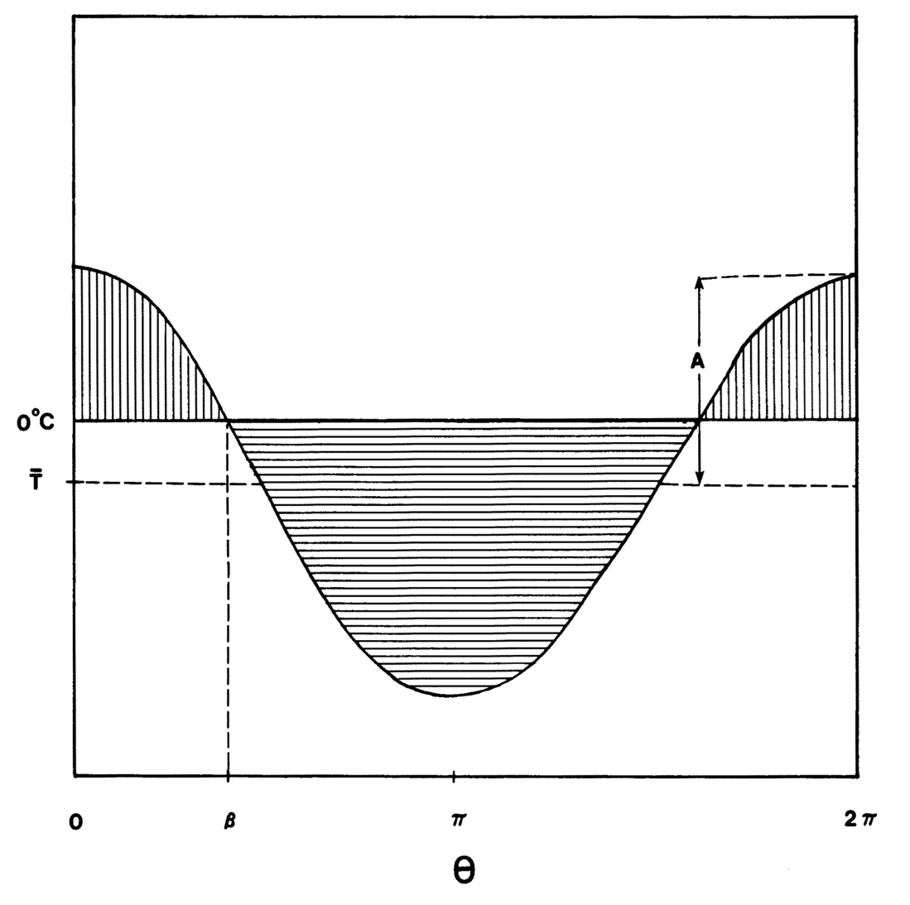
Cosine Approximation of Annual Temperature Distribution
A= amplitude in °C
Temperature
How much time in a year are temperatures above or below freezing?
β
Time in days
(From: Nelson and Outcalt, 1987, AAAR)

Slide 14
Calculate DDT and DDF
Symbol | Parameter | unit
MAAT | Mean annual temperature | °C
A | Yearly temperature amplitude | °C
beta | Frost angle | -
Ts | Mean summer temperature | °C
Tw | Mean winter temperature | °C
Ls | Length of summer | days
Lw | Length of winter | days

Slide 15
Defining the Permafrost Limit
‘Air Frost Number’ predicts that permafrost is theoretically possible:
When the mean annual temperature is < 0°C
When the freezing and thawing indices are equal; thus when Frost Number >= 0.5

Slide 16
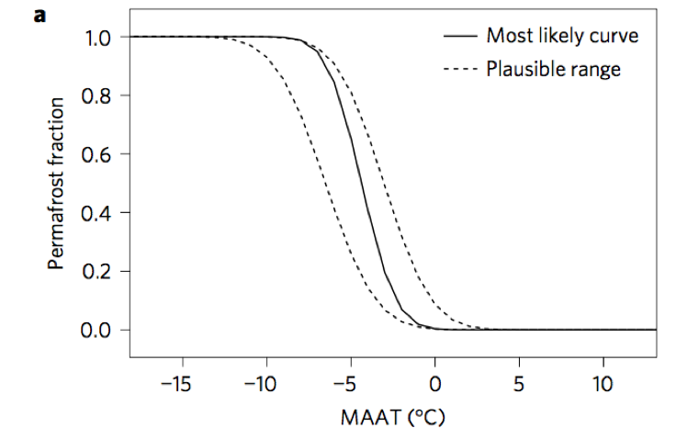
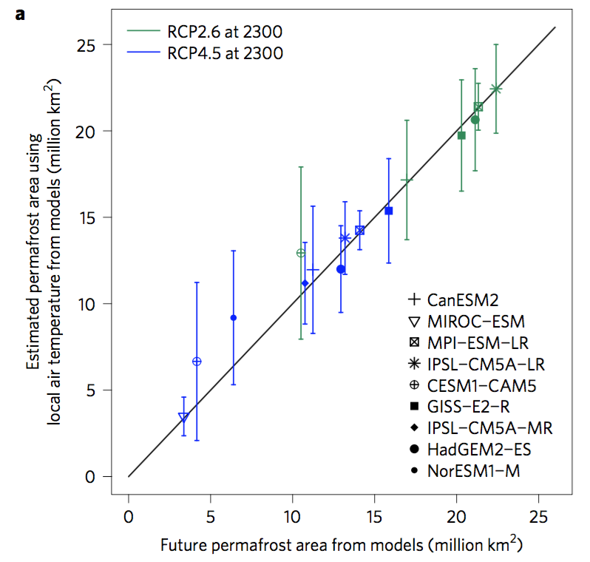
What is the use of such a simple model?
(From: Chadburn et al., 2017, Nature Climate Change)

Slide 17
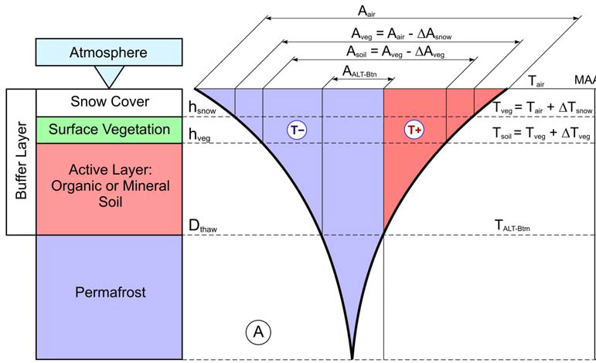
Kudryavstev Model
The Ku model is an semi-empirical model developed in 1970s.
It essentially is an thermal equilibrium model.
Calculates annual soil temperature, active layer thickness
Includes layers of snow and vegetation.
(Anisimov et al., 1997)

Slide 18
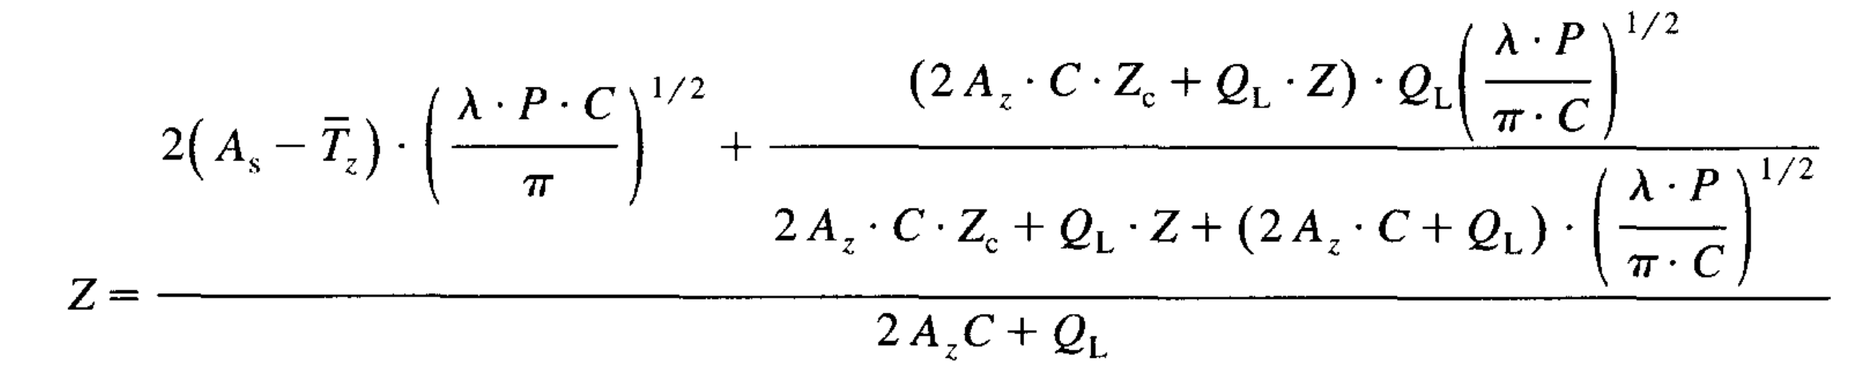
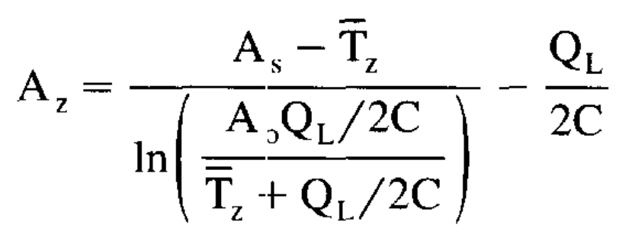
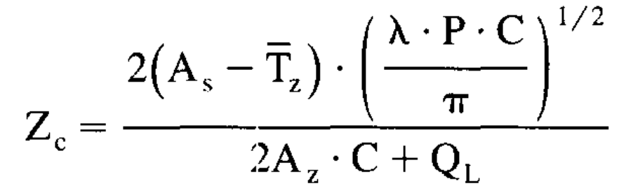
Depth to freezing or thawing (Z)
A_{s} = annual amplitude of surface temperature
T_{z} = mean annual temperature at depth of seasonal thawing
λ = thermal conductivity W m⁻¹ C⁻¹
C = volumetric heat capacity J m⁻³ C⁻¹
Ql = volumetric latent heat of fusion J m⁻³

Slide 19
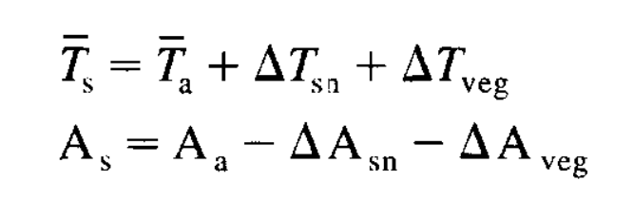
Consider temperature at each layer interface separately
Temperature and annual amplitude at the soil surface (s) depends on the thermal effects of snow and vegetation.
(Anisimov et al., 1997)

Slide 20
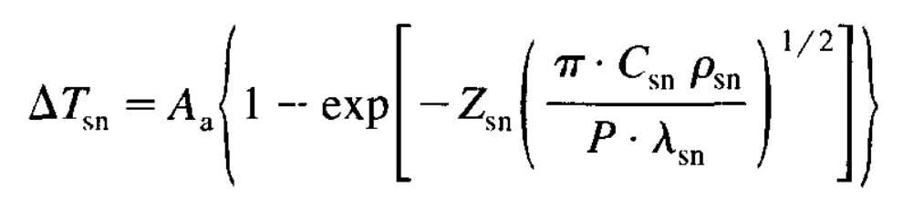
Snow thermal effect
Z_{sn} = snow cover thickness in m
λ_{sn} = snow thermal conductivity W m⁻¹ C⁻¹
C_{sn} = snow volumetric heat capacity J m⁻³ C⁻¹
ρ_{sn} = density of snow in kg m⁻³

Slide 21
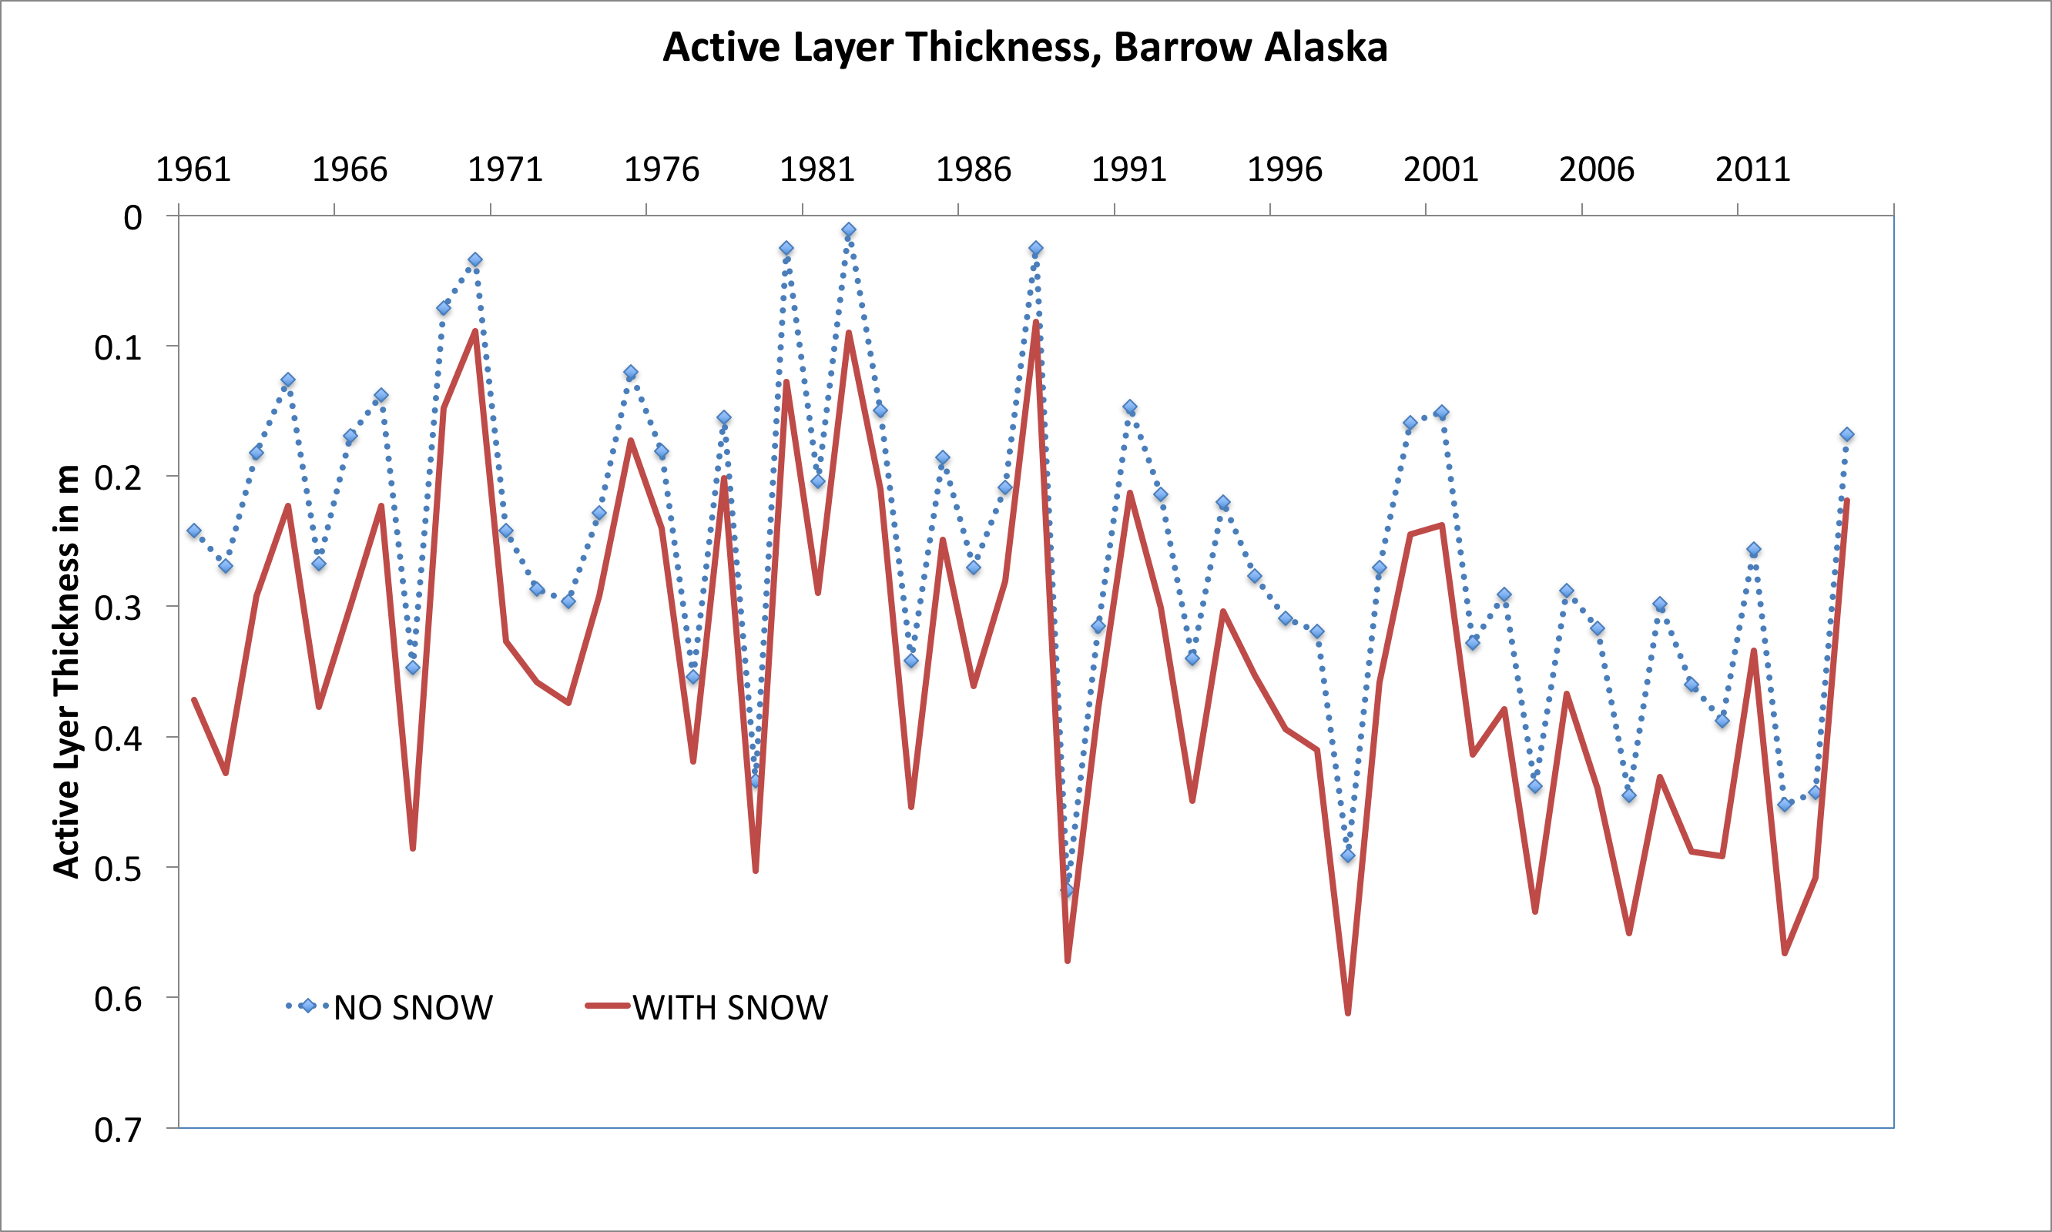
What is the use of such a medium complexity model?
Discussion within federal agency with request to support in-situ snow monitoring on the Alaskan North Slope…...
If we’d would not have data on seasonal snow thickness, our predictions of permafrost active layer thickness would be impacted. Ku model can quickly demonstrate this bias for a given location.

Slide 22
Datasets
User-specified at single location
Time-series (Barrow and Fairbanks)
Reanalysis grids (CRU-AKtemp)
Soil properties, snow depths
Other climate variables CRU-NCEP, e.g. prec
Other climate datasets (e.g. CALM stations)
ESM climate data, i.e. for future scenarios
Increasing complexity

Slide 23
Time series of climate data
Focus on Barrow and Fairbanks, Alaska
1961-2015 observed meteorological data
Associated data of CALM stations 1991-2015
CRU-NCEP SNAP reanalysis dataset with spatial coverage of climate characteristics over Alaska

Slide 24
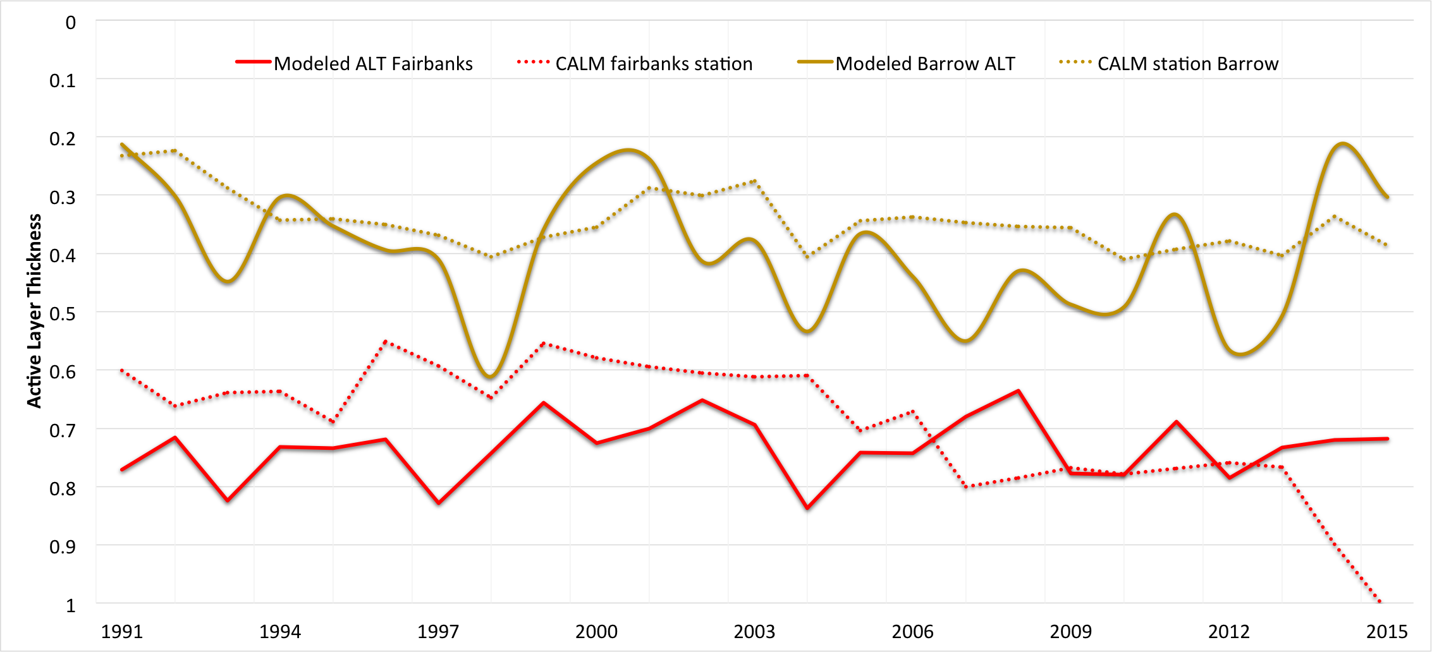
Data-Model Comparison

Slide 25
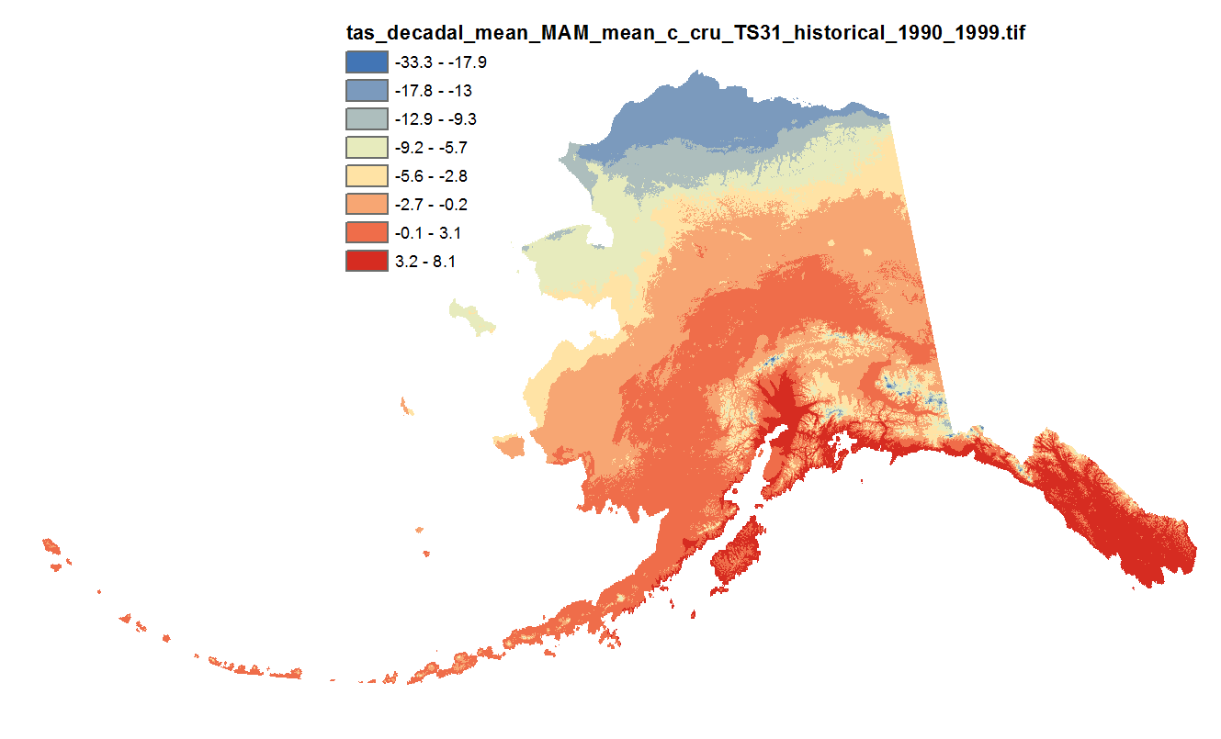
Climate Reanalysis Data
Original data source was CRU-TS3 monthly climate data at 771 * 771 m resolution.
It covers 1900-2009
http://ckan.snap.uaf.edu/dataset/historical-monthly-and-derived-temperature-products-771m-cru-ts

Slide 26
CRU_AKtemp
What is specific for this dataset within the permafrost modeling tool:
Data component, has an CSDM basic interface and can be coupled to models that need temperature data.
Python 2.7 package that provides access to NetCDF file constructed from the original GeoTiffs.
Geographical extent of this dataset reduced to Alaska.
Spatial resolution has been reduced by a factor of 13 in each direction, resulting in an effective pixel resolution of about 10km.
The data are monthly average temperatures for each month from January 1901 through December 2009.

Slide 27
Config File with CRU-AKtemp
#===============================================================================
# Config File for: cruAKtemp_method
#===============================================================================
# Input
filename | {filename} | string | name of this file
run_description | {run_description} | string | description of this configuration
run_region | {run_region} | string | general location of this domain
run_resolution | {run_resolution} | string | highres or lowres
# Dates are converted to datetime.date objects
reference_date | {reference_date} | string | model time is relative to this date
model_start_date | {model_start_date} | string | first day with valid model data
model_end_date | {model_start_date} | string | last day with valid model data
# Grid variables are processed separately after all config variables have been read in
# need to create np.float array of grids
grid_name | {grid_name} | string | name of the model grid
grid_type | {grid_type} | string | form of the model grid
grid_columns | {grid_columns} | int | number of columns in model grid
grid_rows | {grid_rows} | int | number of columns in model grid
# with temperature as np.zeros((grid_columns, grid_rows), dtype=np.float)
i_ul | {i_ul} | int | i-coord of upper left corner model domain
j_ul | {i_ul} | int | j-coord of upper left corner model domain
# timestep is converted to datetime.timedelta(days=timestep)
timestep | {timestep} | int | model timestep [days]
# Output
Note, input is specified in ‘grid rows’ and ‘grid columns’, for now we have no proper geo-referencing and remapping tools in CSDMS, so we just use the original projection and its grid.

Slide 28
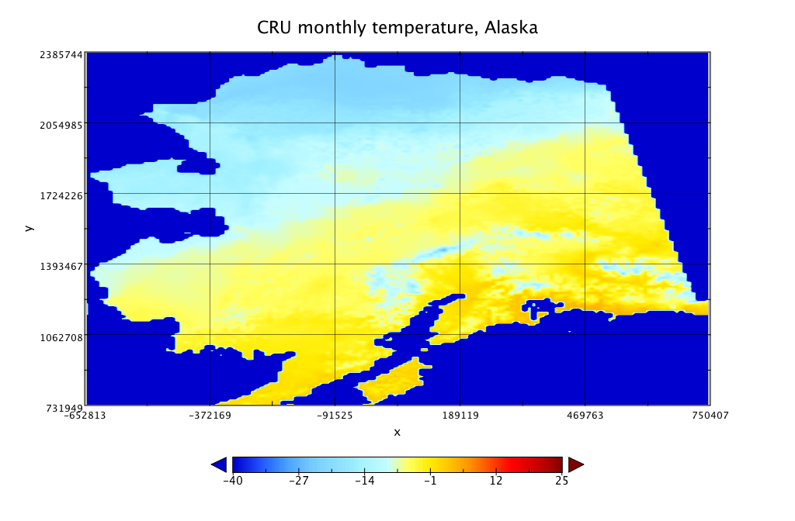
CRU_Aktemp example

Slide 29
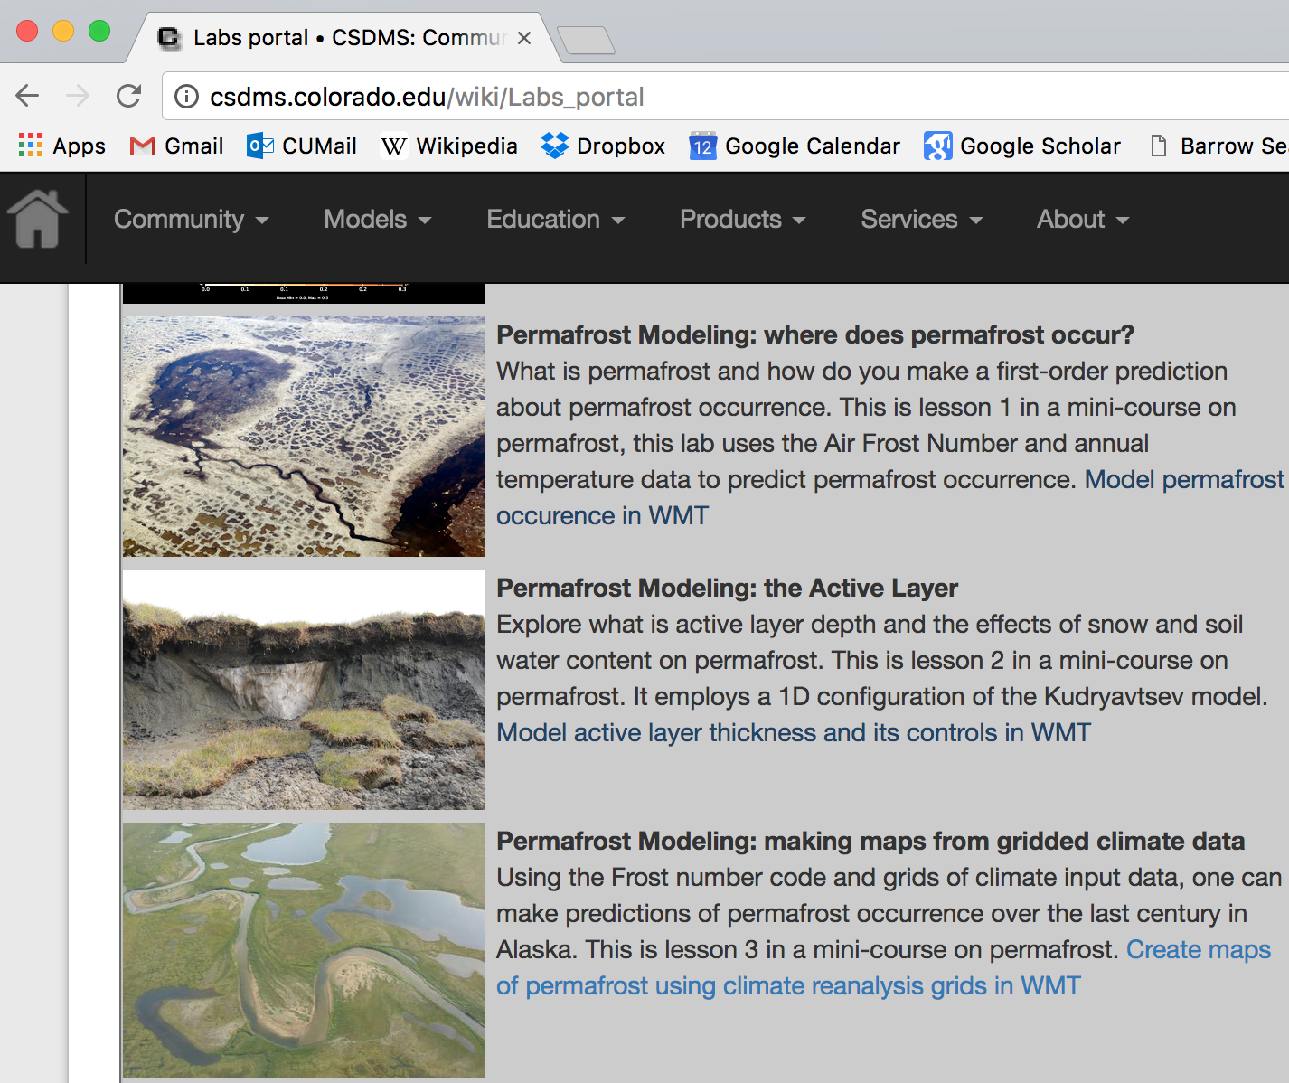
Demonstration
http://csdms.colorado.edu/wiki/Labs_portal

Slide 30
Demonstration
https://csdms.colorado.edu/wmt/

Slide 31
Demonstration
Retrieve Output
Set up parameters

Slide 32
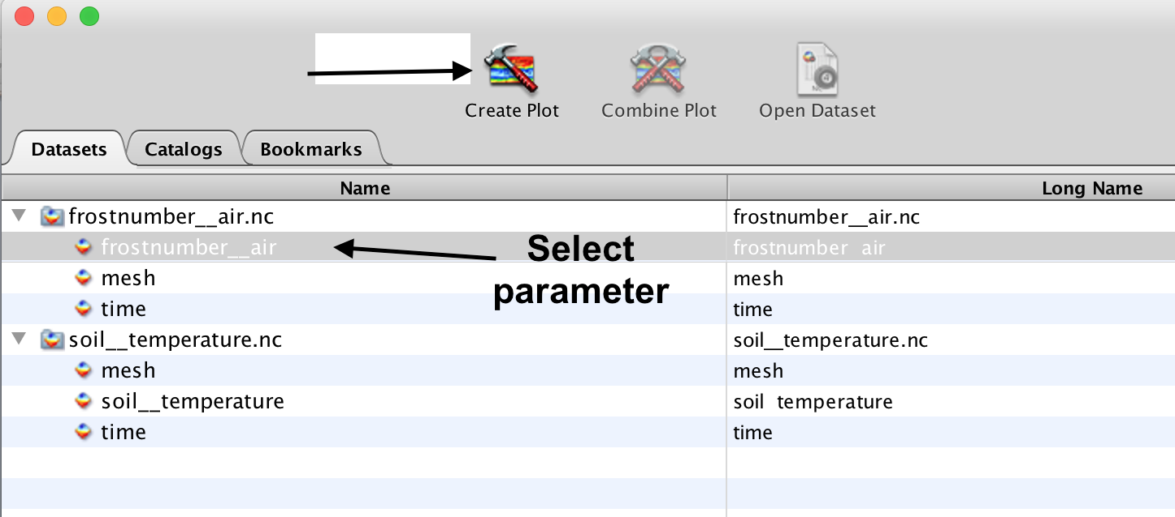
Visualize Output with Panoply
https://www.giss.nasa.gov/tools/panoply/

Slide 33
Hands-on
Ku-model 1D
Frost-model GEO
http://csdms.colorado.edu/wiki/Labs_portal

Slide 34
More advanced modeling
Elchin’s overview of GIPL and other LANL models

Slide 35
Ipython notebooks
https://github.com/permamodel/permamodel/blob/master/notebooks/Ku_2D.ipynb

Slide 36
What’s next: Collaborate
https://github.com/permamodel
You can download codes
You can use codes and report issues
You can become part of the team and contribute datasets or code
Coupled model challenge for summer 2017

Slide 37
What’s next: cyberinfrastructure development
What major questions could we tackle with this tool?
Who is interested in collaborating?
What models could be brought in and useful?
What data could be brought in and useful?
Other ideas?????

Slide 38
Acknowledgements
NSF Polar Programs Grant 1503559, ‘Towards a Tiered Permafrost Modeling Cyberinfrastructure’

Slide 39
References
Nelson, F.E., Outcalt, S.I., 1987. A computational method for prediction and prediction and regionalization of permafrost. Arct. Alp. Res. 19, 279–288.
Janke, J., Williams, M., Evans, A., 2012. A comparison of permafrost prediction models along a section of Trail Ridge Road, RMNP, CO. Geomorphology 138, 111-120.
Anisimov, O. A., Shiklomanov, N. I., & Nelson, F. E. (1997). Global warming and active-layer thickness: results from transient general circulation models. Global and Planetary Change, 15(3-4), 61-77. DOI:10.1016/S0921-8181(97)00009-X
Sazonova, T.S., Romanovsky, V.E., 2003. A model for regional-scale estimation of temporal and spatial variability of active layer thickness and mean nnaual ground emperatures. Permafrost and periglacial processes 14, 125-139. DOI: 10.1002/ppp.449

