Slide 1
Carbonate FRG in CSDMS 2.0
Strategy from 2013 onwards

Slide 2
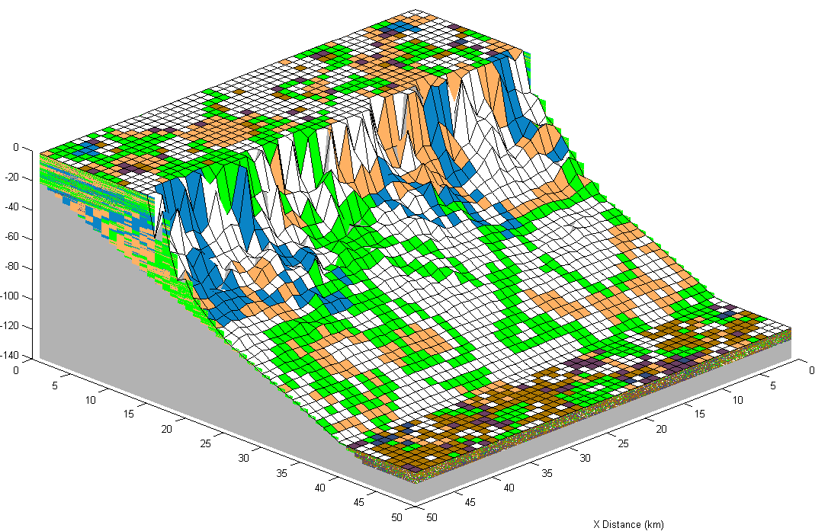
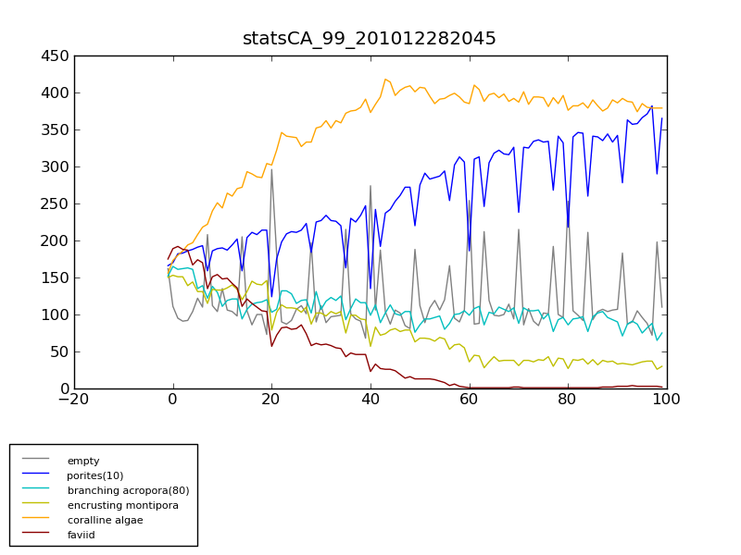
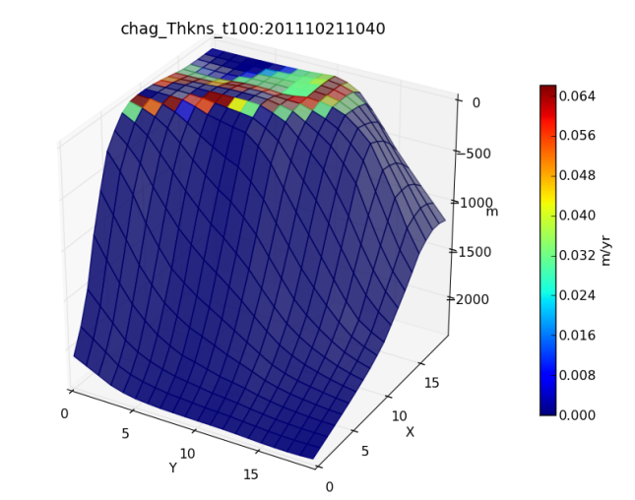
Carbonate FRG Progress To Date
Initial 60+ group currently represented by only a few members actively coding and compiling data with some NSF support
Multiple carbonate models developed since 2008
Database of rates for carbonate systems being populated, and able to be interrogated by developing models
Population ecology
Cover (Number of CA cells)
Years

Slide 3
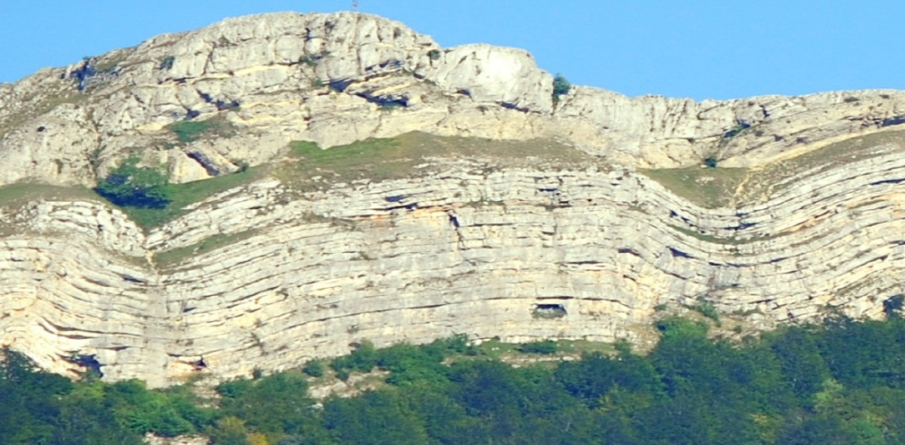
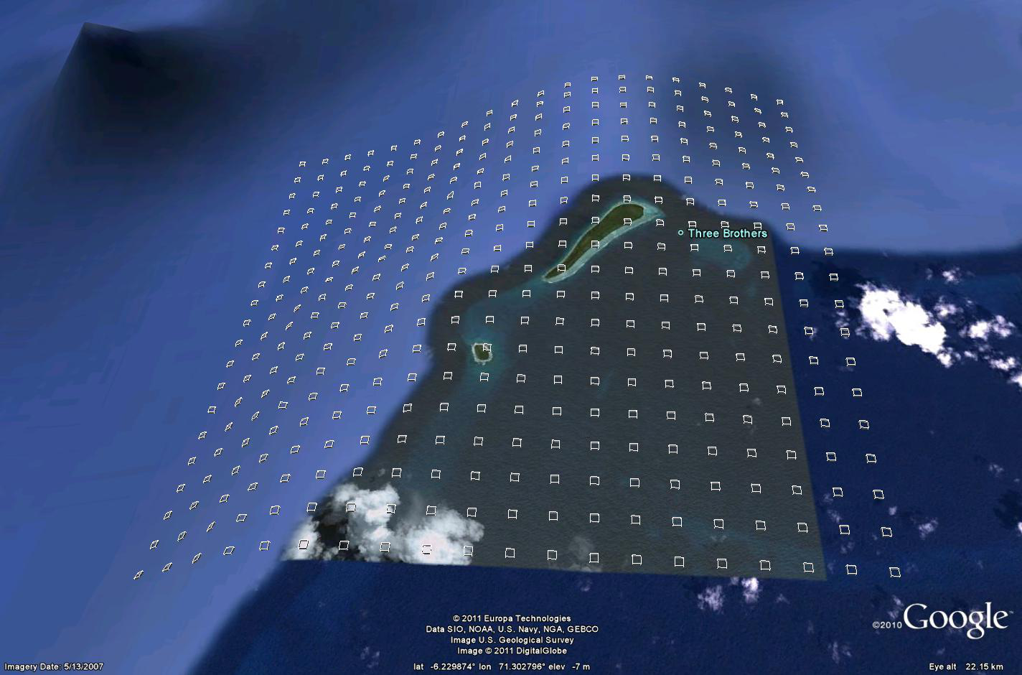
Carbonate FRG Long-Term Goals
Original group vision from 2008 remains valid – develop componentized “workbench” of carbonate models and encourage non-modellers to use them as default tools
Ultimate goals are understanding of carbonate rock heterogeneity and 100 year prediction of carbonate response to environmental change, both from a suite of new next-generation components that more properly represent complex carbonate biology and chemistry
What is unique in our style
  Population dynamics
  Spatial organization, mosaics, statistics
  To-do trophics, water chemistry
  Knowledge base
  Real world runs

Slide 4
Carbonate FRG Long-Term Strategy:
Specific Steps:
Develop BMI “wrapped” coupled carbonate model components that do all that the currently separately developed carbonate models (e.g. CarboCAT, CarboLOT, CarboCELL) do
  Represents an evolution of the original Carbonate Workbench concept from 2008-2009
  Components will represent both short time scale (decadal+) and long time scale processes (100Ky+) to satisfy the range of potential users
  Will make extensive use of existing elements of SedFlux for representation of deposition as accumulated strata and for sediment transport elements. Non-relevant parts of SedFlux will be turned off
Complete development and population of a carbonate knowledge base and integrate it with carbonate model components
  Currently lots of diverse rate data in an Excel spreadsheet, being developed by Chris and Don
  Attracting lots of community interest, but not yet shared more widely, nor able to be interrogated by any models
Re-engage the wider “fizzhead” FRG community (the other 60 members) and grow the community by offering the developed components as a focal point for testing, benchmarking, further development and use as educational tools

Slide 5
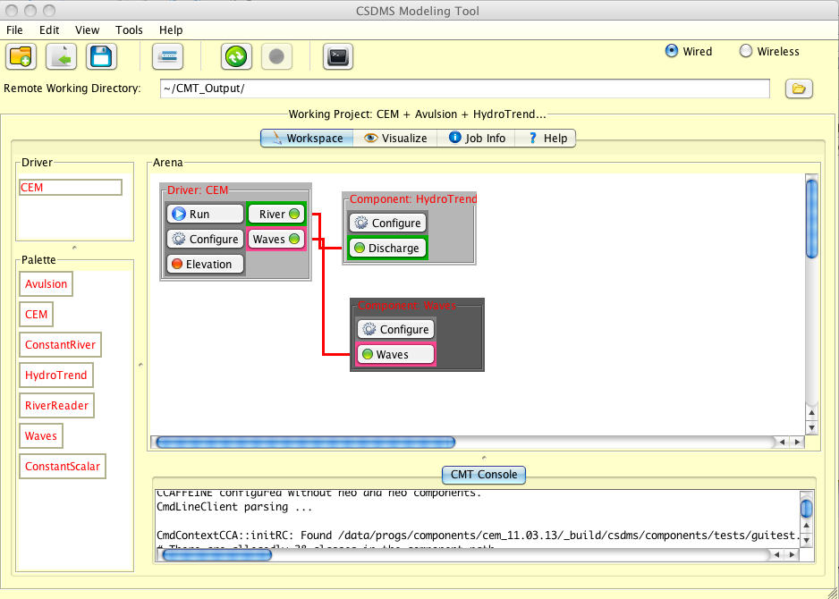
    Carbonate Components

Slide 6
    Carbonate Components
Accommodation: flexural isostasy
Sediment production rate: restriction model
SedFlux/Carbo*
Accommodation: Subsidence and eustasy
Sediment production rate: water chemistry
Sediment production rates: water depth model
Spatial distribution of production: LV population model
Spatial distribution of production: cellular automata
Sediment transport: off-platform plume
Sediment transport: generalized steepest descent
Sediment transport: bedload under unidirectional flow

Slide 7
Carbonate FRG Short to Medium-Term Strategy
Summary plan:
Detailed plans to engage with industry, NSF Steppe and NGOs
  Tasks defined for PhD students, possibly funded by NSF Steppe & direct industry funding
  Engage with NGOs for prediction for coastal defence reef growth
Document and share the carbonate knowledge base in its current form and open it up to contributions from and development by the wider carbonate community
  Document the existing parameters that are in the knowledge base
  Share the knowledge base on Google documents
  Publish via CSDMS web site as an online database product
Recruit more carbonate coders
  Coding group is gradually growing
  Actively seeking new people who can help us write component code e.g. PhD students and postdocs
Change of leadership if Euro-CSDMS progresses rapidly

