Slide 1
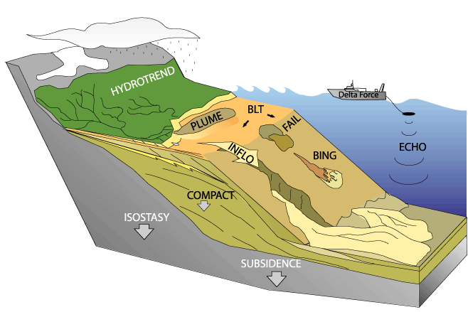


Modeling Stratigraphy
Irina Overeem
Notes:
Disclaimer about tectonics….

Slide 2
Fluvio-Marine Stratigraphic Models
Sloss – 1962
Harbaugh, Bonham-Carter - 1970
Leeder-1978 - fluvial cross-sectional architecture
SEDSIM- Harbaugh &Tetzlaff -1989, Martinez - 1992, Griffiths –now
FUZZSIM – Nordlund (1990)
DELTA2, PLUME– Syvitski, Morehead, Skene (1992 onwards)
SedFlux – Syvitski, Hutton (2008) and many others
Ritchie et al. (1999), fan-deltas
SEDPAK – Kendall, Csato
Dionysus – Granjeon – diffusion-based
Mackey and Bridge (1995)- 3D fluvial architecture
DeltaSIM (2D) and AquaTellUs (3D) – Overeem & Hoogendoorn (2002)
Notes:
Overview of Models and their uses – good reference: Paola 2000.

Slide 3
Sediment Supply vs. Accommodation
Q = sediment supply = quantity of sediment supplied per unit time Qs(x)
A = accommodation=rate of subsidence relative to base level
D = dispersal= total effect of sediment transport processes (qs(x,y))
M = measure of composition and texture of sediment, probability density D in sediment supply

Slide 4
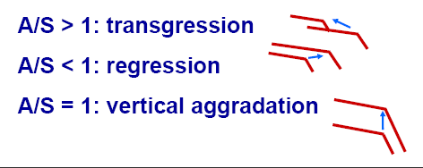
The interplay of sediment supply, sea level and subsidence
A/S ratio (Jervey, 1988). First numerical model.
A = accommodation = the space made available for potential sediment accumulation by tectonics and sea level change.
S = supply = amount of sediment being delivered to a basin.

Slide 5
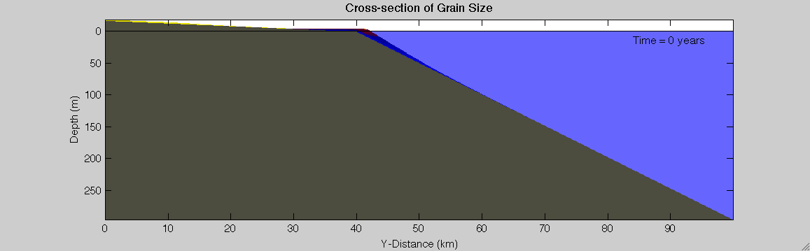
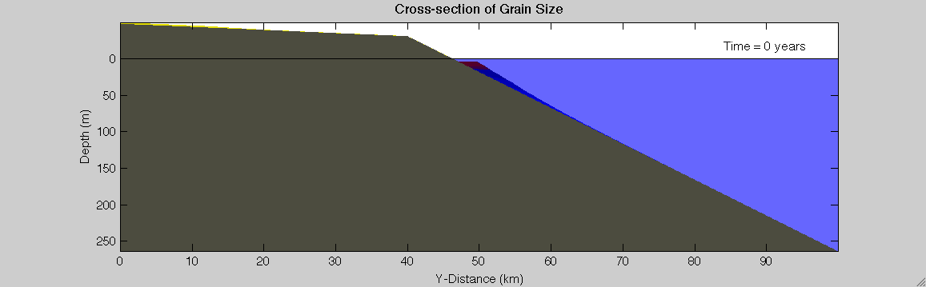
Sea level changes
Notes:
Upper case: lowering sea level, regression
Lower case: rising sea level, transgression

Slide 6
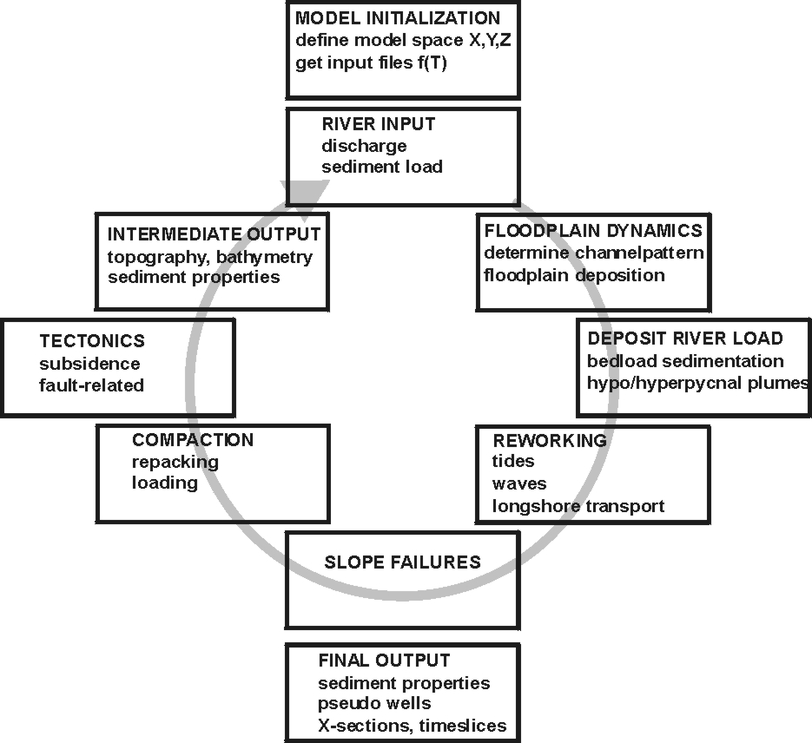
Process modules
Forcing Factors over time:
- river water & sediment flux
sea level changes
subsidence
ocean climate

Slide 7
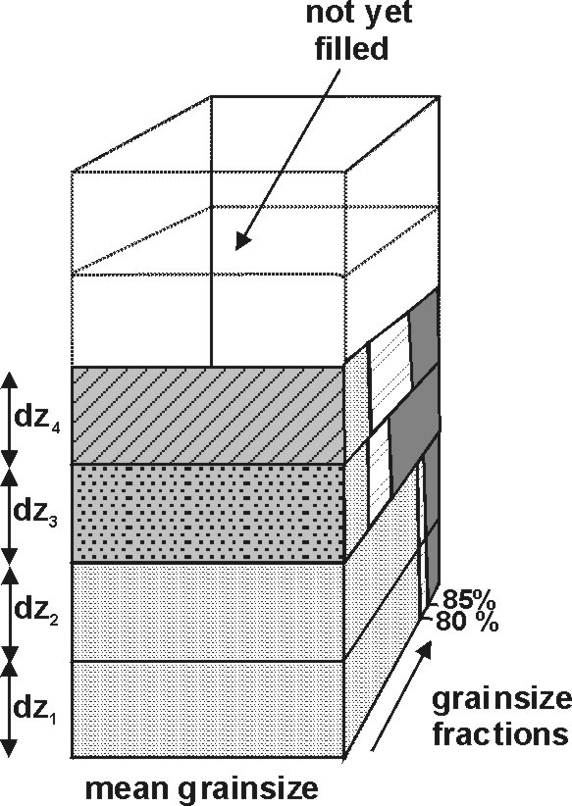
Model Sediment Grid
SedFlux keeps track of grain-size, age, porosity, facies, permeability, % mud.
Visualization including:
- X-sections
Time or Horizon slices
Pseudo-cores
Time-line plots
Typical bin size
dz = 0.05m, dx= 100m
Notes:
Emphasize multiple grain sizes, emphasize porosity, permeability etc
Talk about what this hypercube

Slide 8
How Much Memory?
Let’s say SedFlux stores 2 parameters: mean grain-size and age, both as 8 byte numbers.
Calculate for a 2D run:
100 km X-section
Cells of 100m by 0.1m
Domain goes from 5 m above.s.l to -200 m below sea level
What is the output file size, if we save every 1000 years for a 5000 year simulation?
Notes:
1000 cells lengthwise, 205*10 depthwise*2*5*8byte
The answer is >156 MB

Slide 9
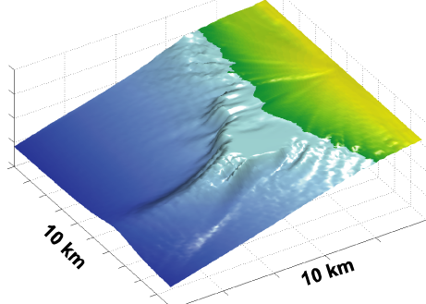
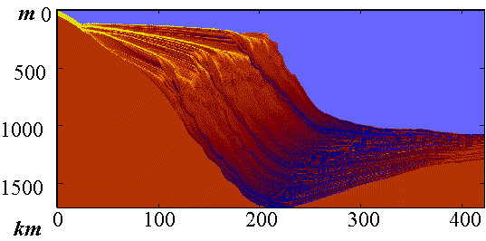
SedFlux 2D and 3D Capability
3D Sedflux Resolves Lateral Dimension
Floodplain erosion and sedimentation
Lobe Avulsions are explicit
Multiple Rivers possible
No Wave Erosion and Sorting
No 3D Slope Failure Processes
No 3D Debris Flows / Turbidity currents
This is the simpler model….
2D Sedflux is ‘Basin-Average’
Advanced option for river dynamics
Simplifications for Lobe Avulsions
Simplifications for Floodplains
Includes Wave Erosion and Sorting
Includes Slope Failure Processes
Includes Debris Flows
Includes Turbidity currents

Slide 10
3D Processes in SedFlux

Slide 11
3D Fluvial erosion and deposition
Paola et al. (1992), based on first principles of mass and momentum conservation
η is the height of the bed, t is time, x is the position along the long profile and ν is the diffusion coefficient. Transport-limited approach.
q is the discharge, cf is the drag coefficient, C0 is the sediment concentration of the bed, s is sediment-specific gravity and A is a river-type dependent constant. A differs for meandering rivers (A=1) and braided rivers (A = (ε / (1+ ε)) 3/2 ). The value of ε relates the shear stress, τ, in the center of the channel to the critical shear stress, τc, needed for bank erosion (τ = (1+ ε) τc ).

Slide 12
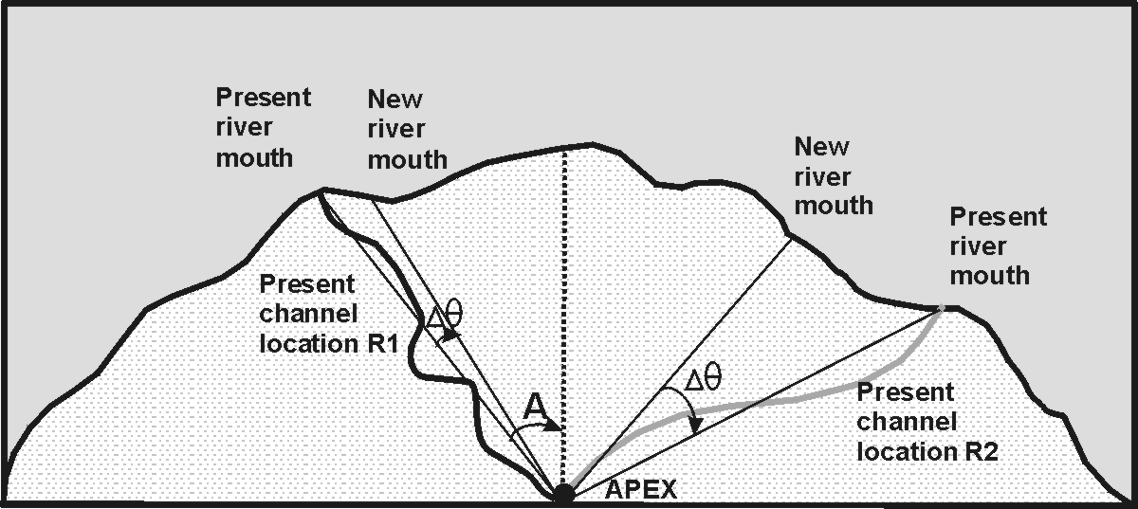
3D Avulsion mechanism
At specific time steps, t + Δt, the river mouth angle, A, changes by an amount drawn from a Gaussian distribution. The rate of switching is controlled by changing the scaling factor, μ of the Gaussian deviate, X.

Slide 13
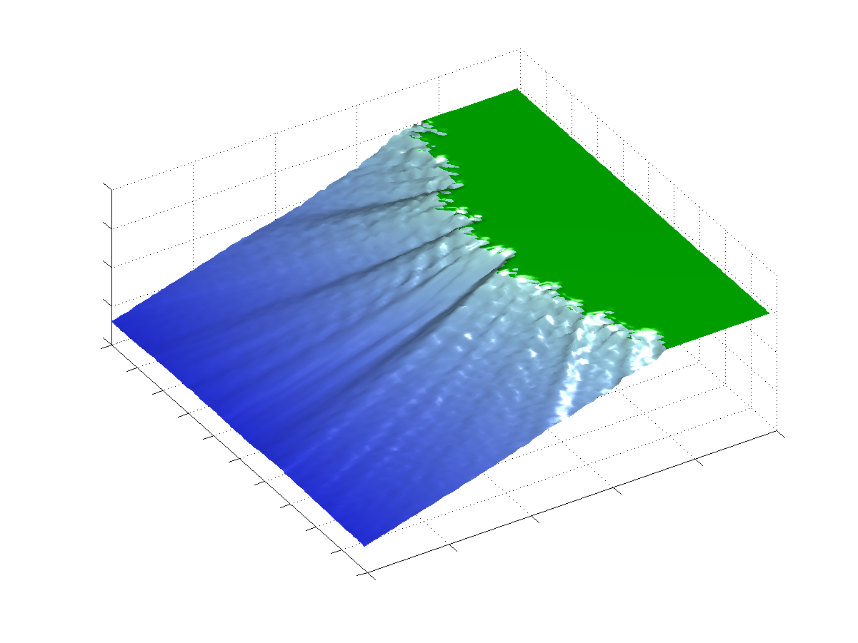
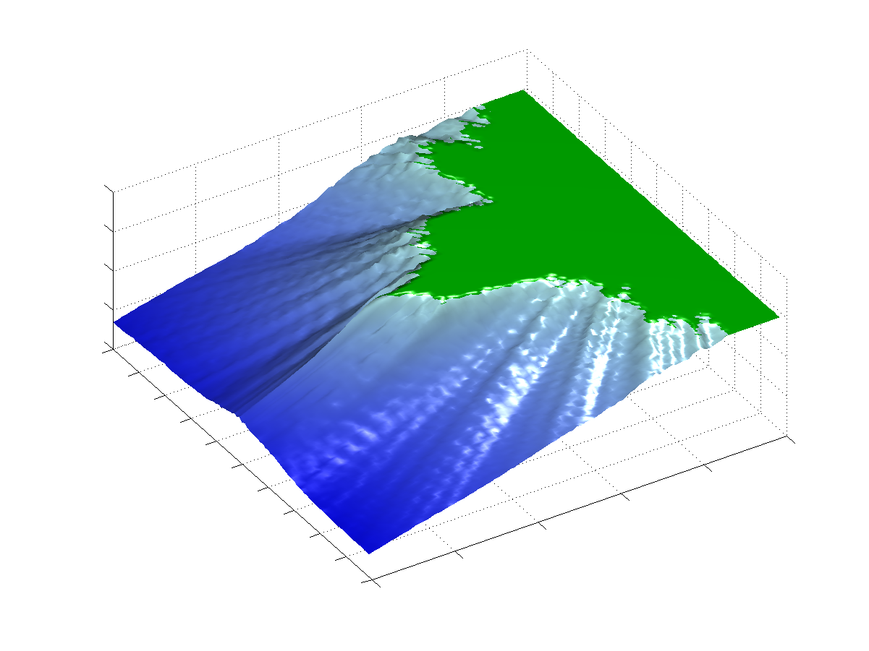
Avulsions of main delta lobe
The scaling factor μ = 0.3
The scaling factor μ = 0.03
Depth in m
100m
200m
300m
10 km
10 km
10 km
10 km
High avulsion frequency results in
uniform progradation
Low avulsion frequency results in
distinct lobe formation and locally
enhanced progradation

Slide 14
3D Fluvial Hypopycnal Plumes
Steady 2D advection-diffusion equation:
  where: x, y are coordinate directions
  u, v are velocities
  K is turbulent sediment diffusivity
  I is sediment inventory
  λ is the first-order removal rate constant

Slide 15
3D Fluvial Hypopycnal Plumes
Position of centerline:
Concentration along and around centerline:
where: b₀=river mouth width
C₁=0.109 (empirical)

Slide 16
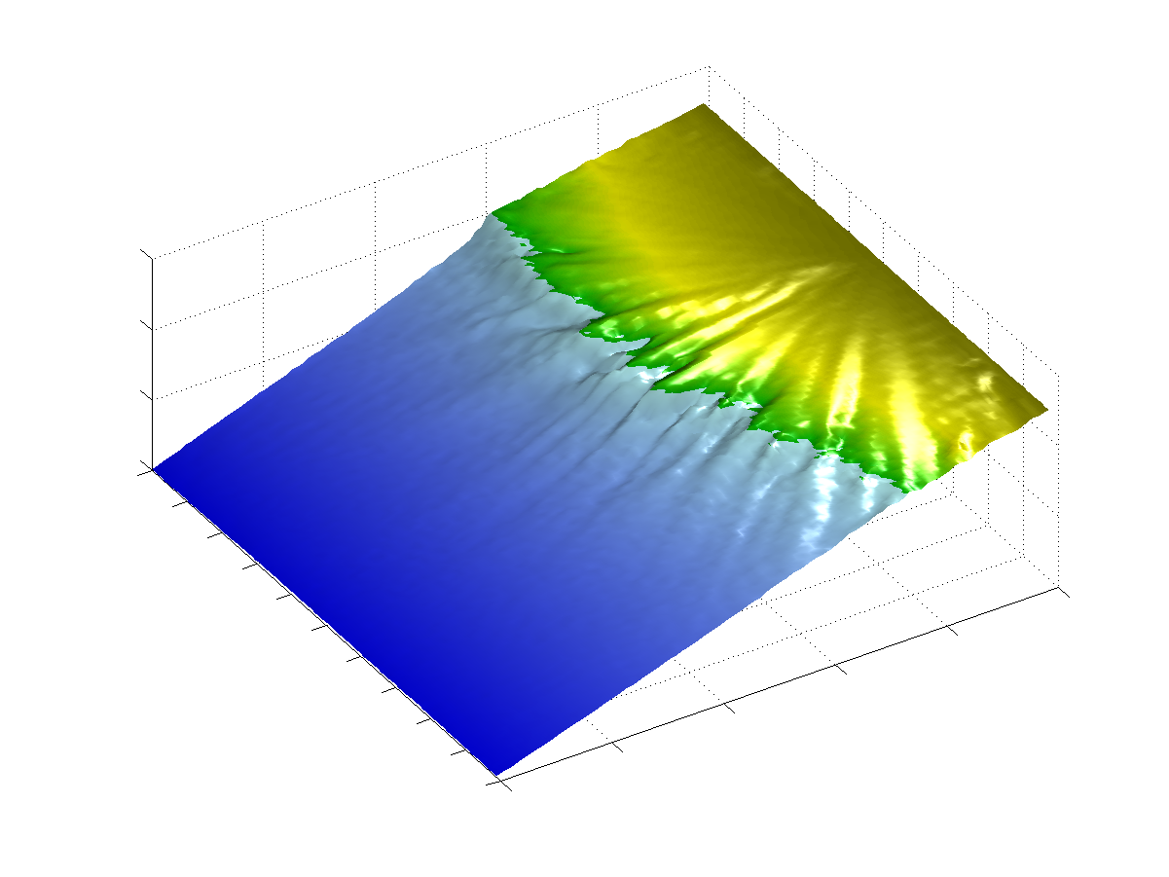
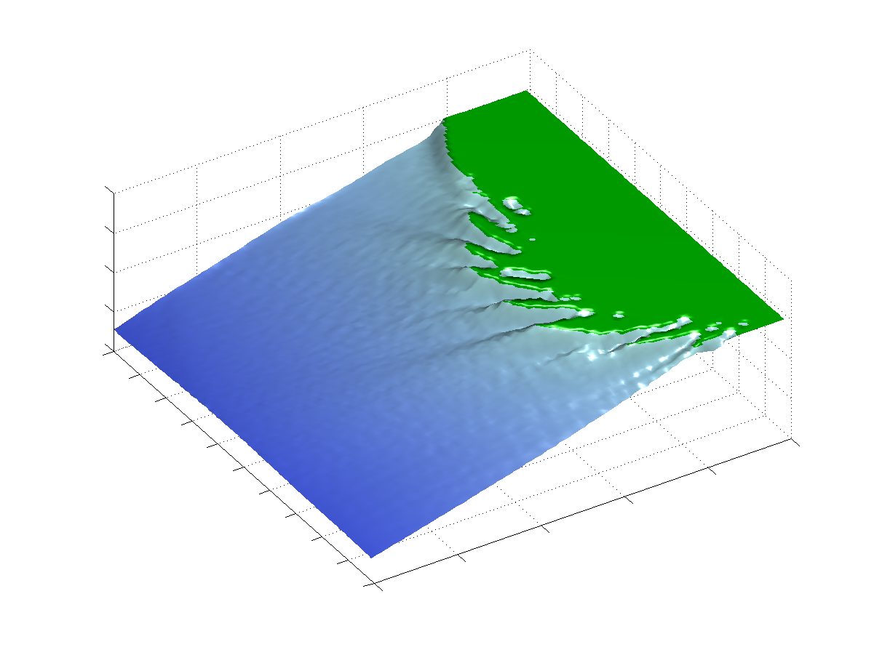
3D Plume forcing factors
Depth in m
100m
200m
300m
10 km
10 km
10 km
10 km
Asymmetric progradation due to
Coriolis Force
Curved plumes due to dominant
current (0.5 m/s)

Slide 17
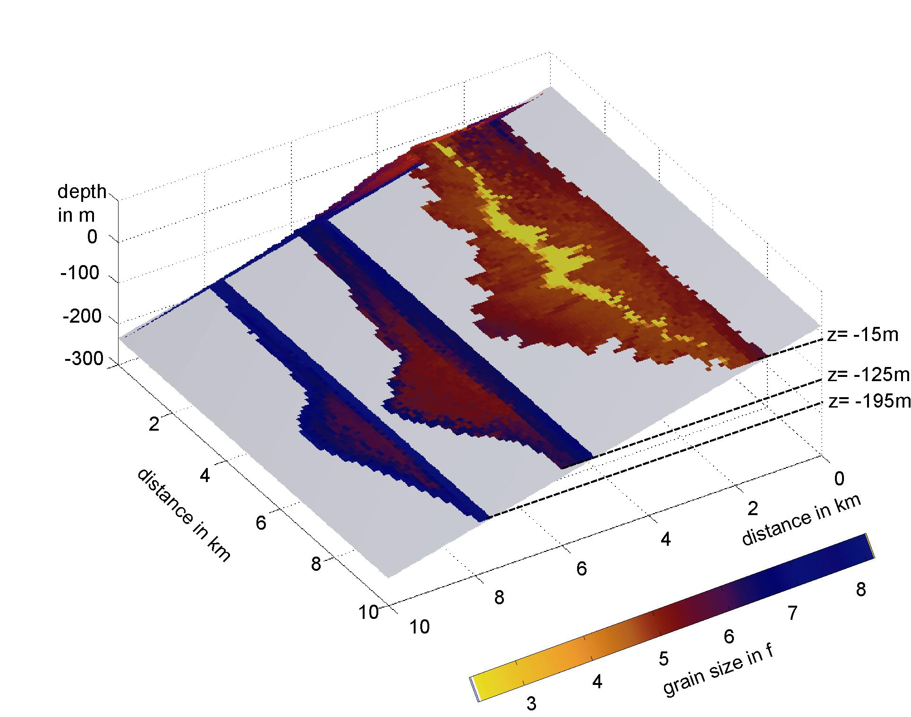
Depth slices of SedFlux3D run
backfill of incised valleys
zone of coarse
near-shore sands
Progressively
finer sediment
(pro-delta)

Slide 18
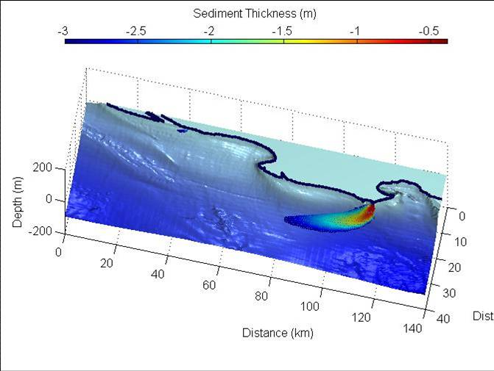
Short-term Simulation: 3D Plumes
Flood-Plume Deposits of the Rhone River, France, 90 days weather data.
Compared with oceanography studies of Drexler, Nittrouer, Ogston et al., 2008.

Slide 19
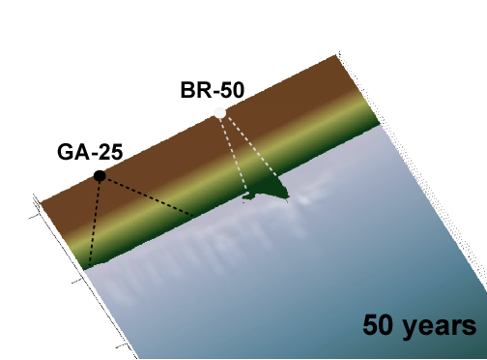
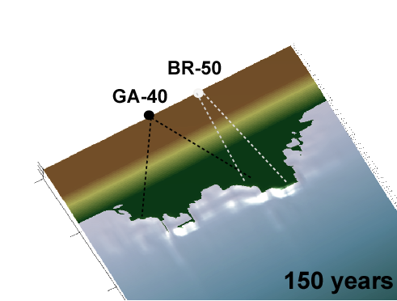
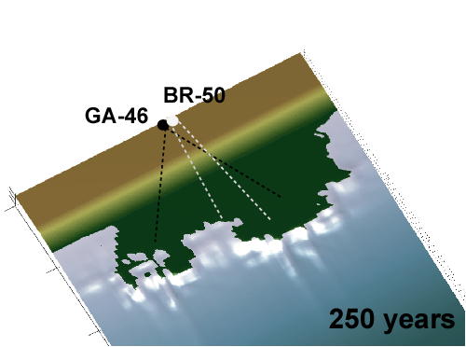
3D SedFlux: fluvio-deltaic systems undergoing sea-level rise
Holocene Deposits of the Ganges-Brahmaputra River.
Sedflux-HydroTrend Coupling
Compared with field studies of Kuehl, Goodbred,
Meade et al., 2008.
Sea-level rise 2 m/100 years
distance 80km
Notes:
The two river systems are simulated in one grid here. The Ganges migrates gradually eastward over the grid and merges over the last 100 years with the Brahmaputra that is more confined. The little dots indicate the approximate positions of the hinge point, the dotted lines show the zone wherein the respective rivermouths avulse over time. Even under present-day conditions the two river systems combined still show progadation in this coastal stretch of 80 km.

Slide 20
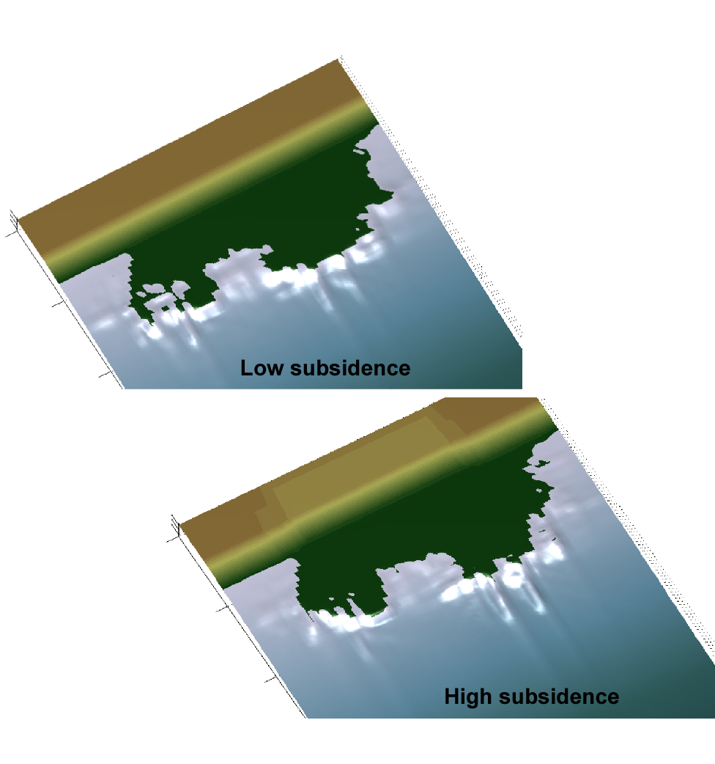
3D SedFlux: two fluvio-deltaic systems with rapid subsidence
Different Subsidence Rates
‘low subsidence’
4 mm/year uniformly over entire grid
‘high subsidence’
7.5 mm/year locally in ‘graben’
distance 80 km
Notes:
System is definitely still dominated by its large flux of incoming sediment…under the fast subsidence scenario we do see

Slide 21
2D Processes in SedFlux

Slide 22
Shelf diffusivity
Resuspension and Advection by Bottom Boundary Energy
k(t,z) varies over time t (pdf of storms), and water depth z. Following Airy wave theory, k falls off exponentially with water depth.
k_{i} is an index between 0 and 1 that reflects the ability of grain size i to be resuspended and advected.
k(t,z) ≥ k_{i} for sediment transport

Slide 23
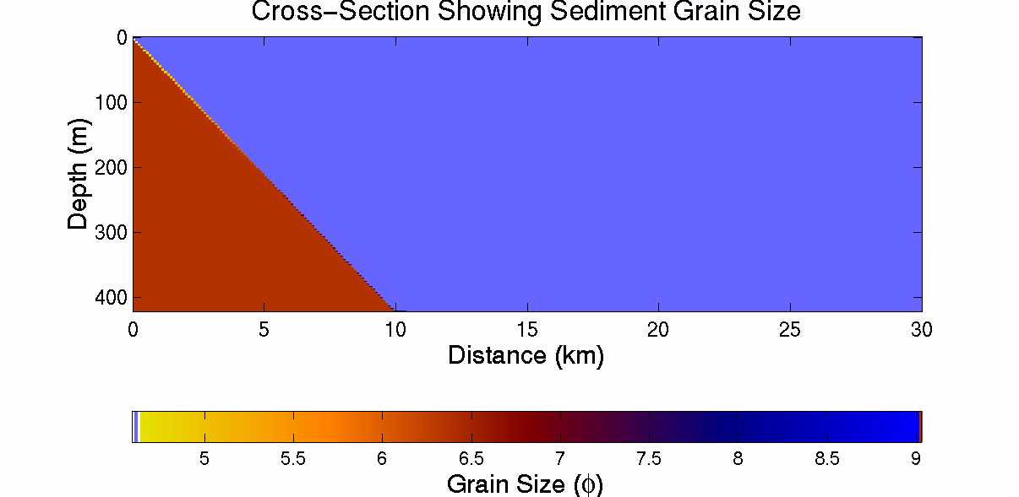

Plume Processes Only
Plume & Diffusion
Coarse Grain Size
Fine Grain Size

Slide 24

Plume & Diffusion
Plume & Diffusion
& Fluid Muds
Coarse Grain Size
Fine Grain Size

Slide 25
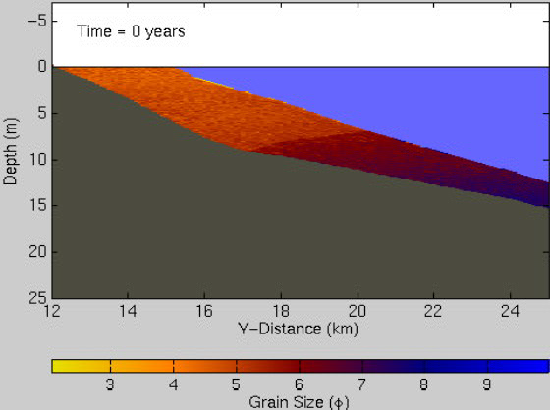
Plumes, Waves and Longshore Transport

Slide 26
Forced Regression: Fjord Stratigraphy
Deglacial Sediment Supply
Rapid uplift
Sea level rise

Slide 27
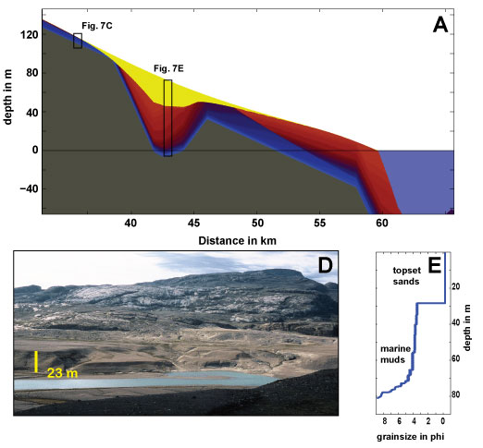
Fjord Stratigraphy vs Field Observations
Stratigraphy matches sedimentary packages in overdeepened sections of deglacial fjord,
Baffin Island. (Overeem et al., 2010)

Slide 28
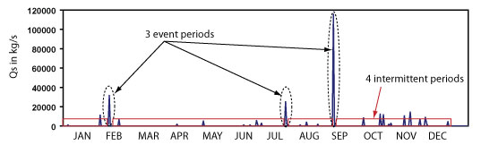
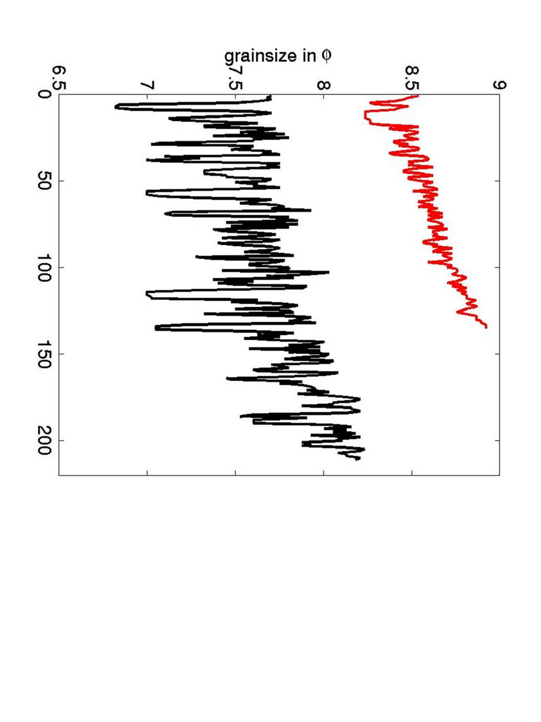
Sedflux- Event-based Time stepping
Further offshore well (65 km)
Event-based Time stepping
- Reduces computational time
- Stratigraphy changes, we ‘honor’ variability
yearly time step
event-based time step

Slide 29
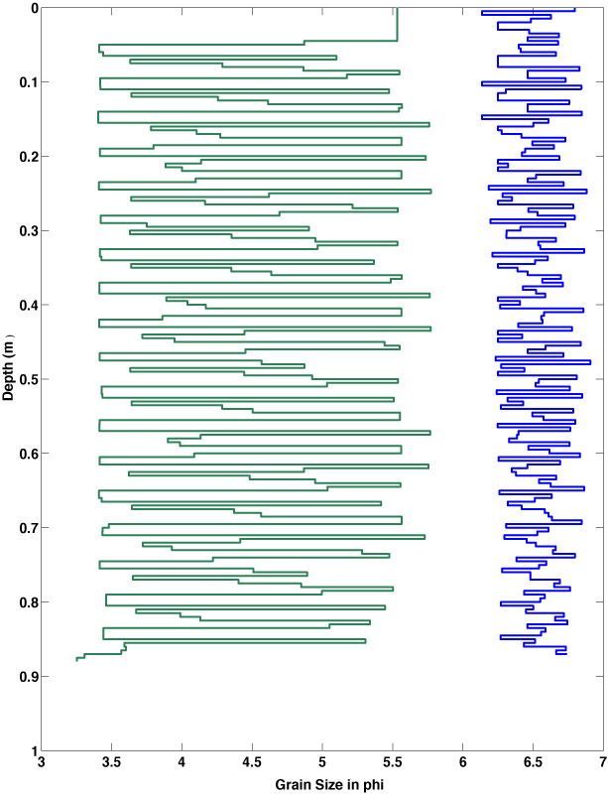
River Floods and Waves Events
Storm regime
Wave event-layers
Flashy river flood
event-layers
For these experiments, storm events are sampled from a PDF with a mean wave height set at 2m.
12 km

Slide 30
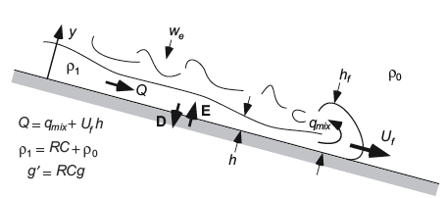
SAKURA models hyperpycnal flows
Dynamic model based on layer-averaged, 3-equations model of Parker et al. (1986)
Able to simulate time-dependent flows at river mouth
Data input: velocity, depth, width, sediment concentration.
Predicts grain-size variation within a turbidite bed
Applicable to complex bathymetry with upslopes

Slide 31
Minibasins filled by Turbidites
Gulf of Mexico Mini-Basins Deposits
Compared with experimental data (Parker, Paola; comparison in Kubo, 2004).

Slide 32
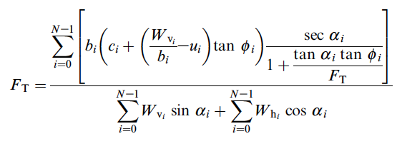

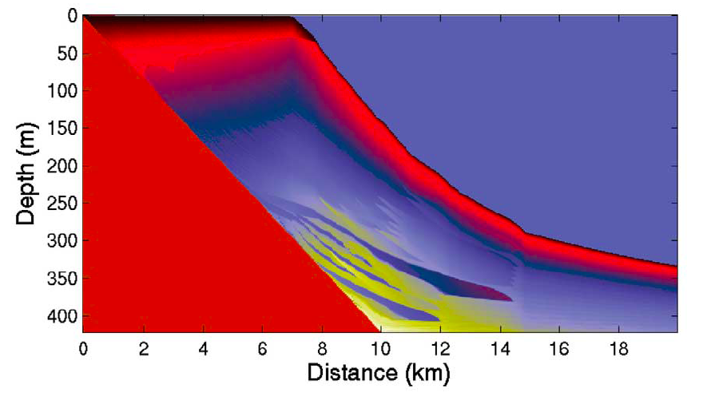

Failures and Turbidites and Debris Flows
Failure controlled by Janbu Criterion of Safety
Ft = factor of safety
b = width of slide
C= sediment cohesion
f = internal friction angle
W = weight of column
α= slope of failure
u= excess pore pressure
Excess pore pressure (Hutton et al, 2004).
Criterion for decision between debris flow
or turbidity currents
τ = remolded shear strength
σe = effective stress
Coarse Deposits
Lower excess pore pressure

Slide 33
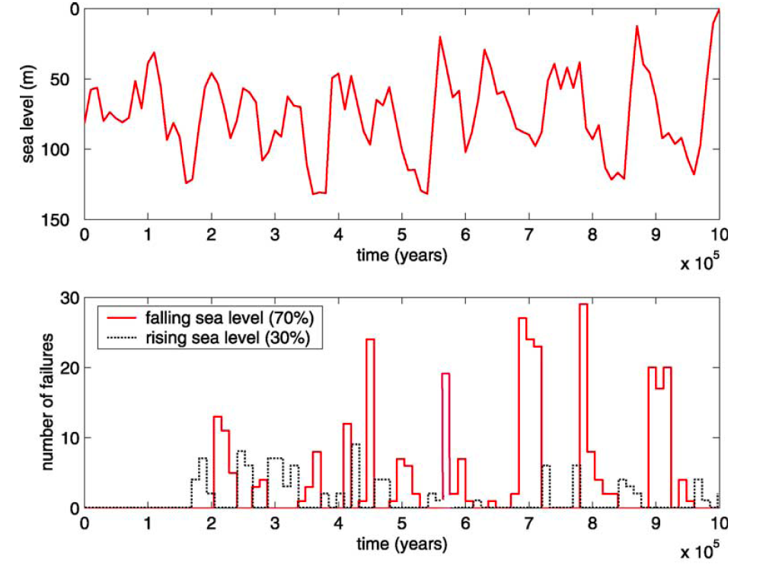
Forcing Factor vs Debris Flow Stratigraphy
Falling sea level conditions show comparatively more sediment failures.
Notes:
This is what Michael Pyrcz was talking about?
Global sea level curve of the last 1 Myr, based on the NO18 fractionation signal recovered from deep sea foraminifera
(time=present at 106 yr). Bottom panel: Number of failures generated by SedFlux (see Fig. 6) with the modulating in-
Åíuence of sea level Åíuctuations. The Åërst 200 kyr show few failures and reÅíect model spin up e.ects. Falling sea level conditions
show comparatively more sediment failures than rising sea level.

Slide 34
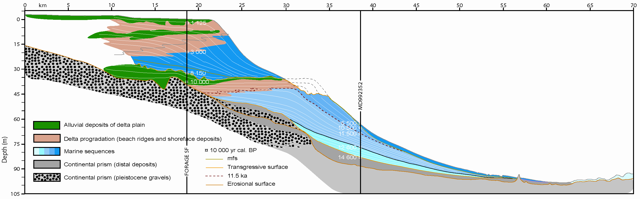
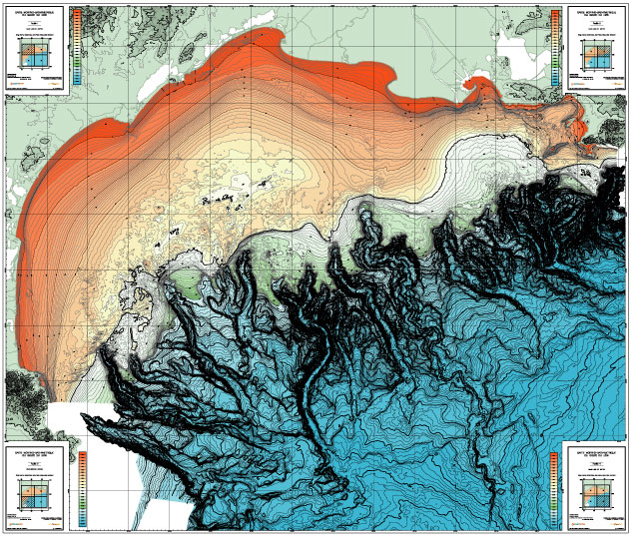
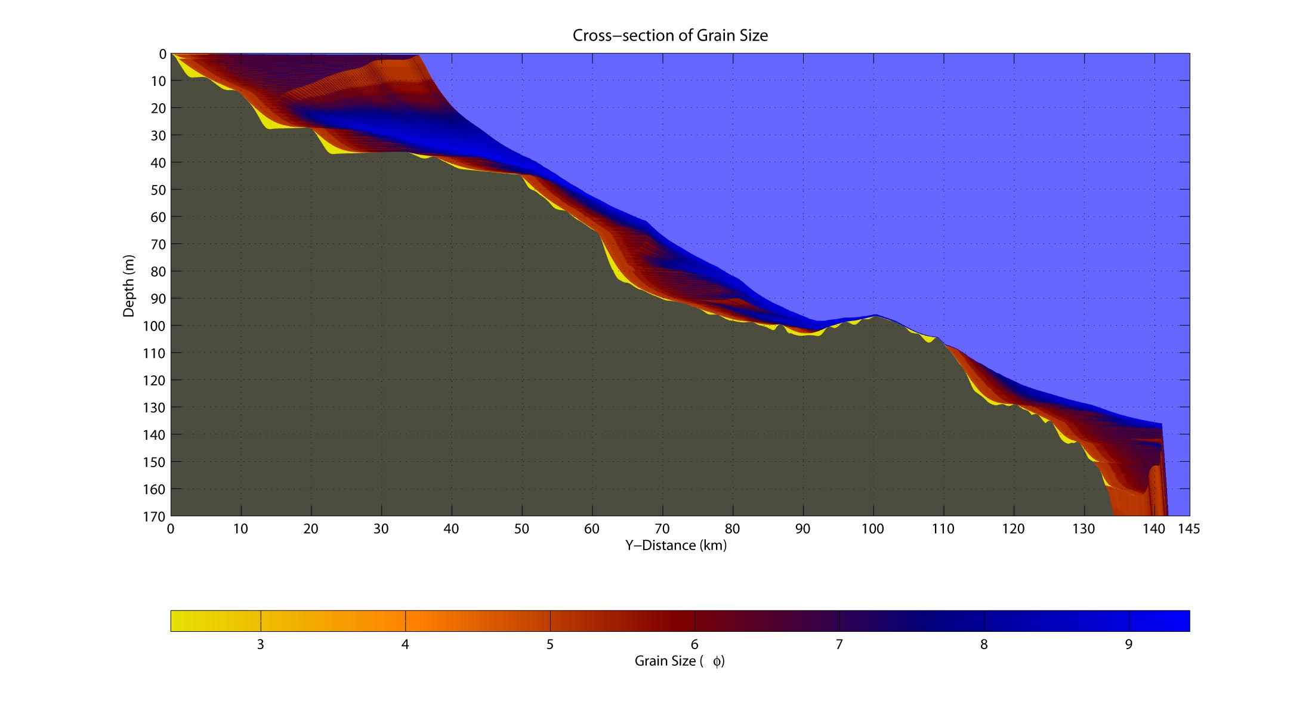
Deglacial Rhone Delta, 2D - SedFlux simulation last 21 Ky
… are used to alter the flux of sediment delivered to the 2D-SedFlux profile
Autocyclic details such as distances off profile of lobes …

Slide 35
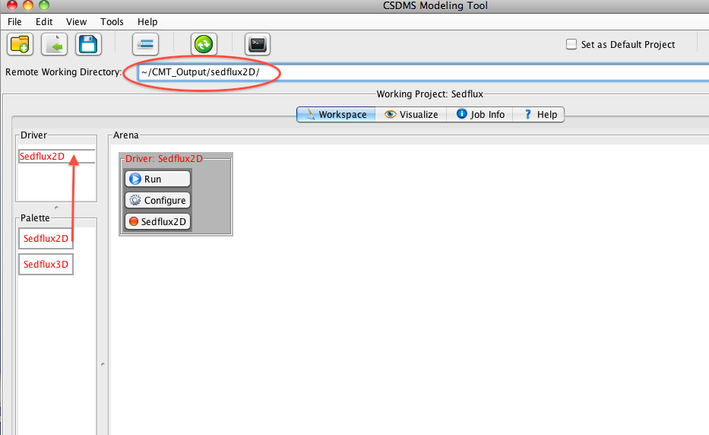
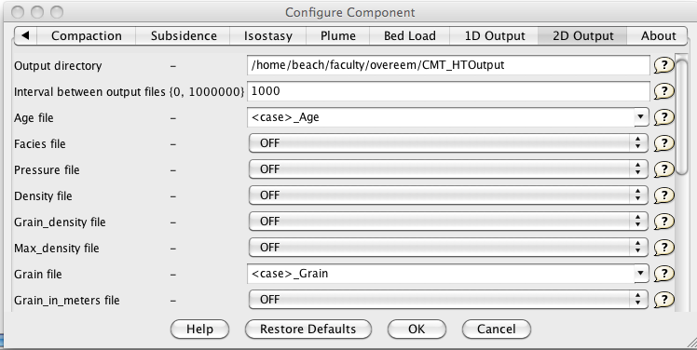
SedFlux in CSDMS Modeling Tool (CMT)

Slide 36
Discover Sedflux
Time for Hands-on……..

Slide 37
Future
Advance functionality of SedFlux Component
- failures and turbidity currents
variable number of grain size classes
coupling with CHILD is already realized
coupling with Hydrotrend
Decomponentize Sedflux Component into multiple components

