Slide 1

Testing modeling frameworks or… how can we improve predictive skill from our data?
Mary C. Hill, University of Kansas; Emeritus, U.S. Geological Survey
Laura Foglia, Technical University of Darmstadt (soon at UC Davis)
Ming Ye, Florida state University
Lu Dan, Oak Ridge National Laboratory

Slide 2
Frameworks for Model Analysis
Look for surprises
Surprises can indicate
  New understanding about reality
  or
  Model limitations or problems
Fast methods are convenient -- enable routine evaluation. Computationally frugal, parallelizable methods

Slide 3
What do I mean by a modeling framework?
Methods used to
  Parameterize system characteristics
  Compare to data
  Adjust for data (calibration, tuning)
  Sensitivity analysis
  Uncertainty quantification

Slide 4
What do I mean by a modeling framework?
Methods used to
  Parameterize system characteristics
Define zones or simple interpolations and estimate relatively few parameter values
Define many interpolation points. Estimate a parameter value at each point.

Slide 5
What do I mean by a modeling framework?
Methods used to
  Parameterize system characteristics
  Compare to data
    Graphical
    Statistics like sum of squared residuals

Slide 6
What do I mean by a modeling framework?
Methods used to
  Parameterize system characteristics
  Compare to data
  Adjust for data (calibration, tuning)

Slide 7
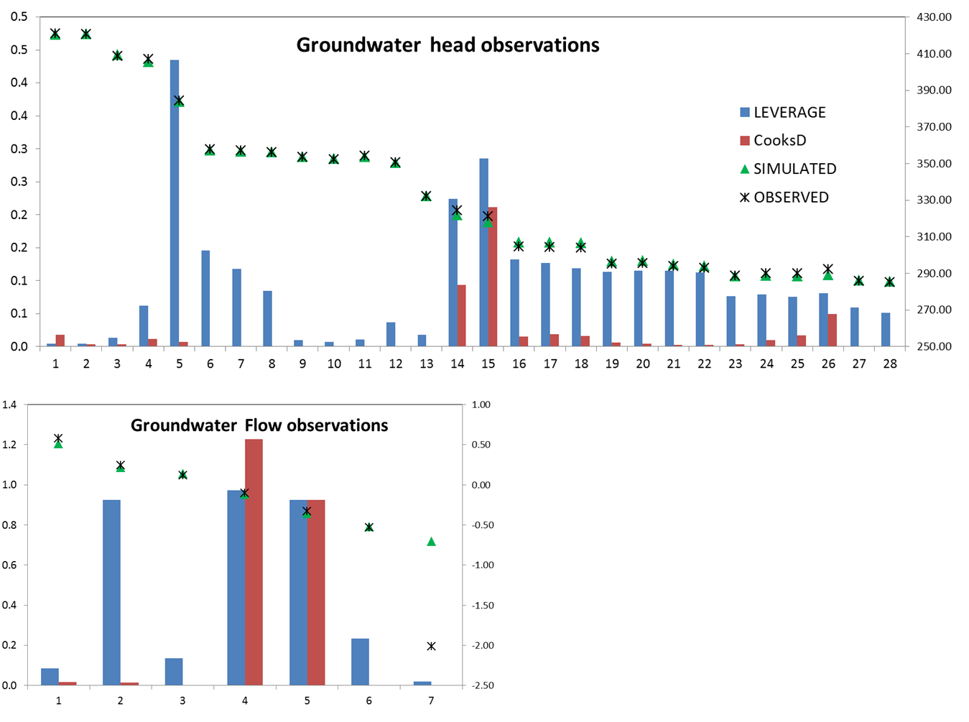
What do I mean by a modeling framework?
Methods used to
  Parameterize system characteristics
  Compare to data
  Adjust for data (calibration, tuning)
  Sensitivity analysis
Foglia et al, in preparation
0.5
0.4
0.3
0.2
0.1
0.0
425
390
355
320
285
250
Observation importance using leverage, Cook’s D
Head, in meters
Head identifier

Slide 8
What do I mean by a modeling framework?
Methods used to
  Parameterize system characteristics
  Compare to data
  Adjust for data (calibration, tuning)
  Sensitivity analysis
  Uncertainty quantification
Lu et al. 2012 WRR

Slide 9
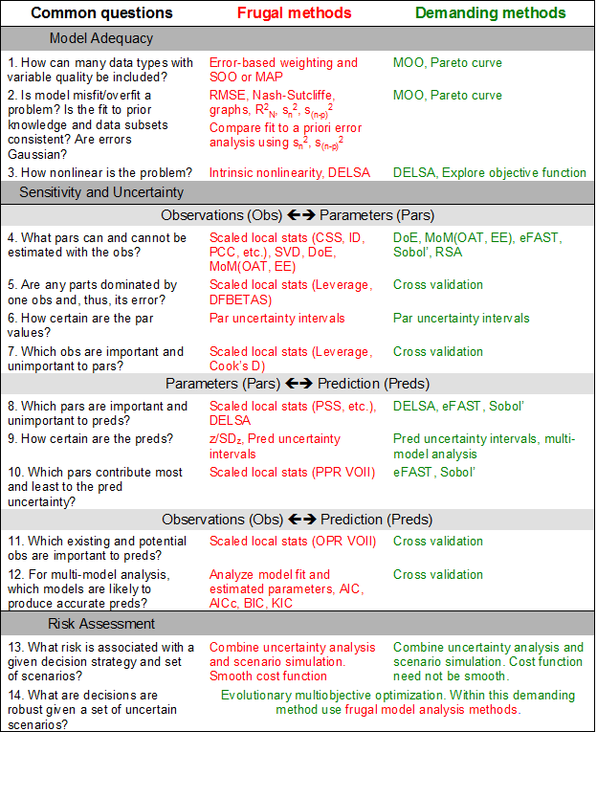
Overview of framework methods
Problems:
-Many method - Tower of Babel?
-Colossal computational demands – Necessary?
Hill + 2015, Groundwater

Slide 10
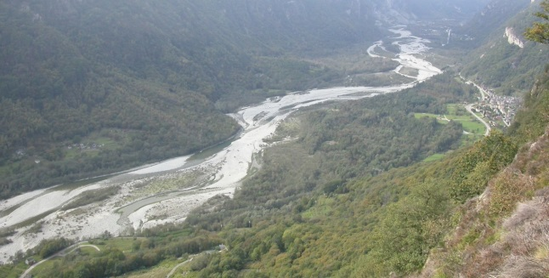
Testing modeling frameworks
  Test using cross-validation

Slide 11
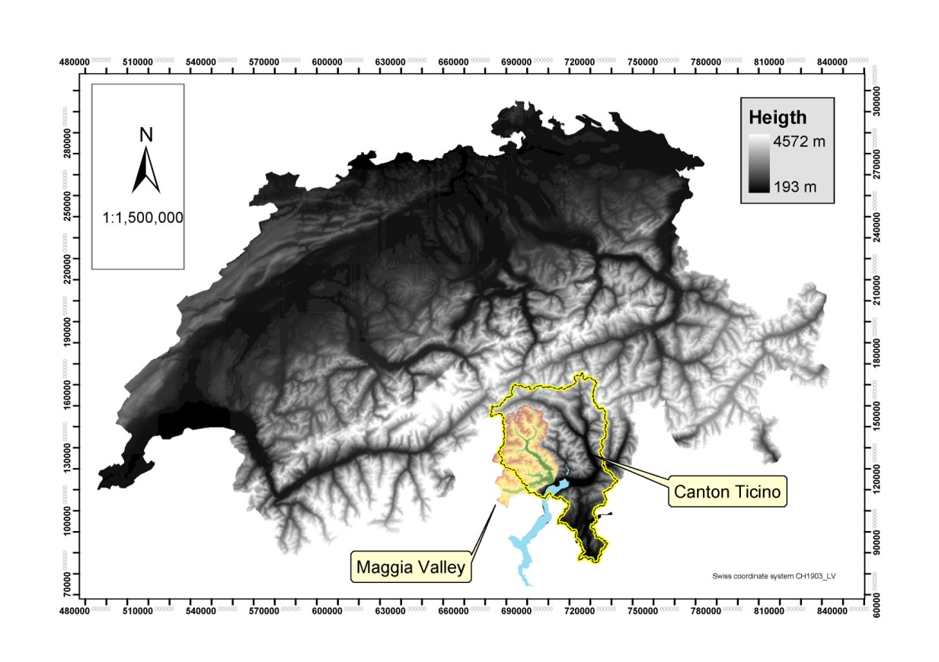
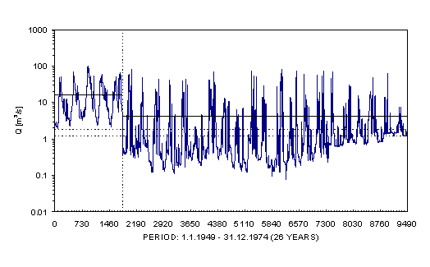

Maggia Valley, Switzerland
Goal: Integrated hydrologic model to help manage ecology of this altered hydrologic system.
Use component sw and gw models to test methods for the integrated model.
1954: Dams closed upstream

Slide 12
Maggia Valley, southern Switzerland
  Series of studies to identify and test a computationally frugal protocol for model development
  1. Test frugal sensitivity analysis (SA) with cross-validation
  MODFLOW Model w stream (dry) (Foglia+ 2007 GW)
  2. Demonstrate frugal optimal calibration method
  TOPKAPI Rainfall-Runoff model (Foglia + 2009 WRR)
3. Here - SA and calibration methods enable test of computationally frugal model selection criteria
MODFLOW GW model (wet) (Foglia + 2013 WRR)
4. Integrated hydrologic model – SW and GW
Software: UCODE (Poeter + 2005, 2014)
MMA (MultiModel Analysis) (Poeter and Hill 2007)

Slide 13
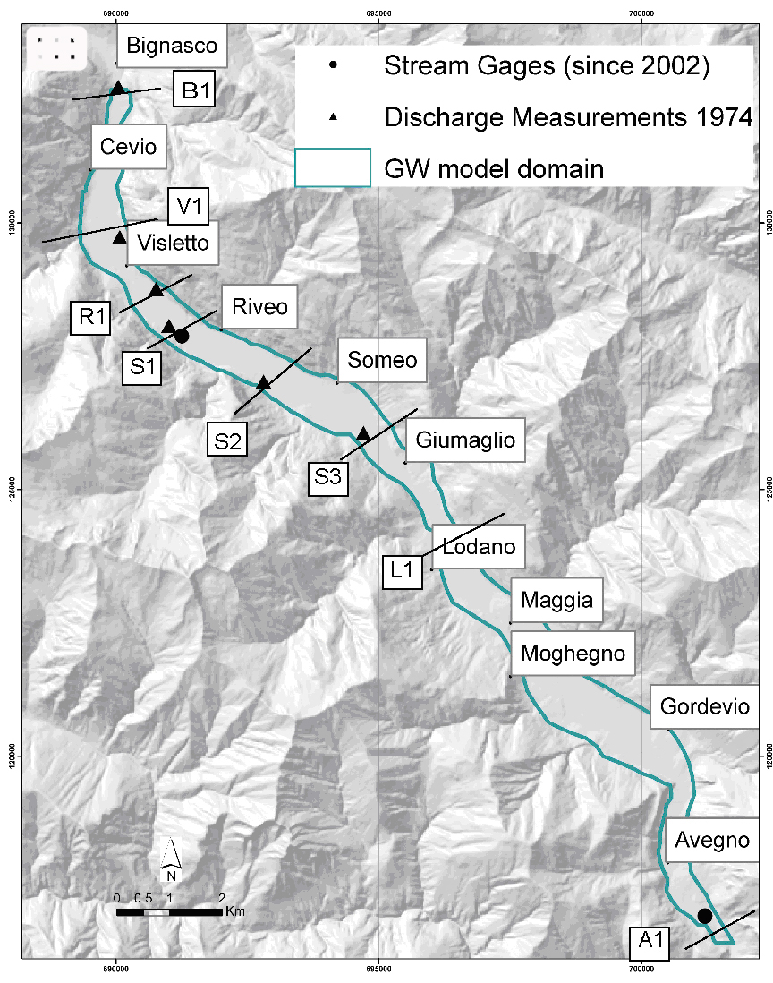
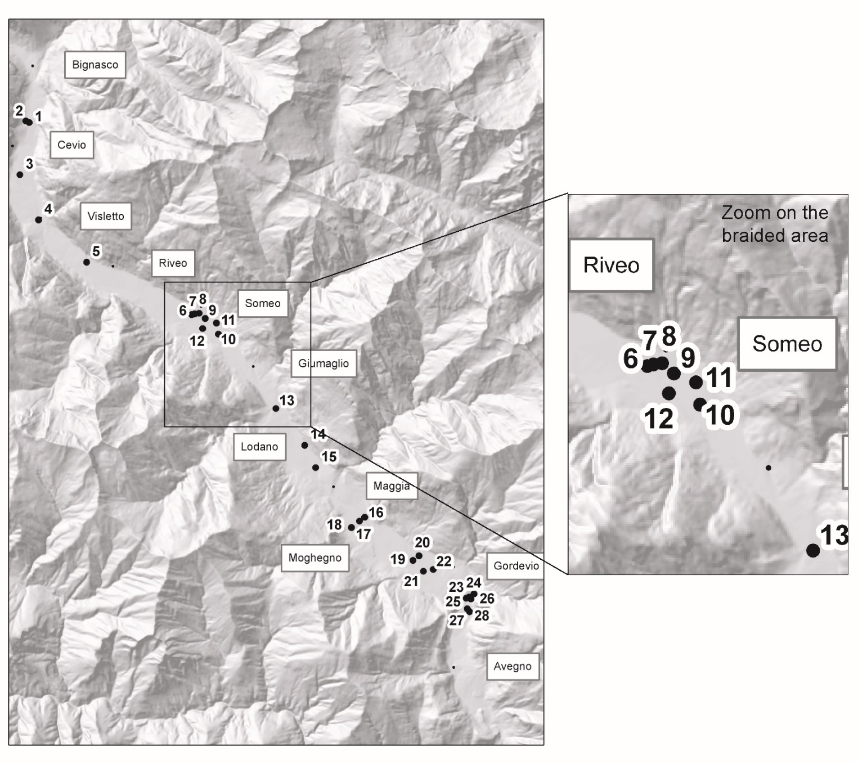
Model outline and 35 Obs Locations
Flow data (use gains/losses)
Head data
13

Slide 14
Model structures
SFR
RIV
Streamflow Routing (SFR2) vs. River (RIV)
Recharge
  Zero, constant, TOPKAPI
Bedrock boundary
  Old & New: Before and after gravimetric survey.
  Depth in south x 2.
K
  Based on map of surficial quaternary geology
  5 combinations, from 1 parameter to 6
K
Range:5e-4 to 1e-3
64 alternative models

Slide 15
Cross validation experiment
Flow data (use gains/losses)
Head data
3 gains/losses omitted for cross-validation experiment
8 heads omitted for cross-validation experiment
15

Slide 16
How important are the omitted observations in the alternative models?
Use SA measure leverage for models calibrated with all 35 obs.
High leverage = important obs.
Each symbol represents a different model
1
2
3
4
5
6
7
8
9
10
11
12
13
14
15
16
17
18
19
20
21
22
23
24
25
26
27
28
V1_diff
R1_diff
S1_diff
S2_diff
S3_diff
L1_diff
Leverage
Observation number or name

Slide 17
How important are the omitted observations in the alternative models?
Quickly evaluate using SA measure leverage. Identifies observations important and unimportant to parameters.
Omitted obs are very important to not important.
Omitting these obs should provide a good test of methods of analyzing alternative models
1
2
3
4
5
6
7
8
9
10
11
12
13
14
15
16
17
18
19
20
21
22
23
24
25
26
27
28
V1_diff
R1_diff
S1_diff
S2_diff
S3_diff
L1_diff
Leverage
Observation number or name

Slide 18
Tests conducted
Test model selection criteria AIC, BIC, and KIC
  Forund problems – especially for KIC
Compared results with a basic premise related to model complexity
  Led to some specific suggestions about model development
  Present this part of the analysis here

Slide 19
Our results vs basic premise?
Prediction error
Model Fit
Lines connect models that are the same except for K

Slide 20
Our results vs basic premise?
Prediction error
Model Fit
Solid: SFR
Hollow: RIV
Lack of improvement with added K parameters indicates the K parameterization has little relation to the processes affecting the data
Lines connect models that are the same except for K
Notes:
Solid: SFR Hollow: RIV
Red: top 5 by AIC when all obs used

Slide 21
Our results vs basic premise?
Prediction error
Model Fit
Solid: SFR
Hollow: RIV
Lines connect models that are the same except for K

Slide 22
Our results vs basic premise?
Prediction error
Model Fit
Solid: SFR
Hollow: RIV
Lines connect models that are the same except for K

Slide 23
Our results vs basic premise?
Prediction error
Model Fit
Solid: SFR
Hollow: RIV
Sensitivity analysis indicated the models with the most parameters were poorly posed. Suggests we can use these methods to detect poor models.
Lines connect models that are the same except for K

Slide 24
What do poor predictions look like?

Slide 25
Identify important parameters
Results from the integrated hydrologic model
Groundwater model + distributed hydrologic model + new observations for low flows

Slide 26
Identify important parameters
B_ETP1
Soil depth
Saturated K
Porosity
Overland
Rivers
KRiv
K
Rech
Mannings

Slide 27
Identify important parameters
GW observations are quite important to some of the SW parameters
SW obs are interpreted as GW flow (gain/loss) obs, which are important
B_ETP1
Soil depth
Saturated K
Porosity
Overland
Rivers
KRiv
K
Rech
Mannings

Slide 28
Conclusions from this test
The surficial geologic mapping did not provide a useful way to parameterize the K
Sensitivity analysis can be used to determine when the model detail exceeds what can be supported by data.
Models unsupported by data are likely to have poor predictive ability
5 suggestions for model development

Slide 29
Testing modeling frameworks
Enabled by computationally frugal methods, which are enabled by computationally robust models
This is where you, the model developers come in!

Slide 30
Do your models have numerical daemons???
Kavetski Kuczera 2007 WRR; Hill + 2015 GW; test with DELSA Rakovec 2014 WRR
Need important nonlinearities. Keep them!
Get rid of unrealistic, difficult numerics

Slide 31
Identify important parameters
GW observations are quite important to some of the SW parameters
SW obs are interpreted as GW flow (gain/loss) obs, which are important
B_ETP1
Soil depth
Saturated K
Porosity
Overland
Rivers
KRiv
K
Rech
Mannings

Slide 32
Perspective
In 100 years, we may very well be thought of as being in the Model T stage of model development
A prediction: In the future, simply getting a close model fit will not be enough. It will also be necessary to show what obs, pars, and processes are important to the good model fit.
This increased model transparency is like the safety equipment in automobile development.

Slide 33
I am looking for a test case
Test a way to detect and diagnose numerical daemons.
High profile model applications preferred.

Slide 34
AGU: New Technical Committee on Hydrologic Uncertainty
SIAM: New SIAM-UQ section and journal

Slide 36
Quantifying Uncertainty
Lu Ye Hill 2012 WRR
Investigate methods that take 10s to 100,000s of model runs (Linear to MCMC)
New UCODE_2014 with MCMC supports these ways of calculating uncertainty intervals

Slide 37
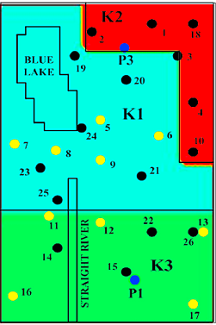
Test Case
MODFLOW
3.8 km x 6 km x 80m
Top: free-surface
No-flow sides, bottom
Obs: 54 heads, 2 flows, lake level, lake budget
  Parameters:
    5 for
    recharge
    KRB
    confining unit KV
    net lake recharge,
    vertical anisotropy
    K : 1 (HO), 3 (3Z), or 21 (INT)
    Data on K at yellow dots
True
3Z
Int

Slide 38

Calibrated model, Predictions, Confidence Intervals
Model runs
100
1,600
480,000
True
HO 3Z INT
Name of alternative model……..
Statistics to use when the truth is unknown
Lesson about uncertainty
 | HO | 3Z | Int
Standard error of regression | 1.49 (1.25-1.84) | 1.27 (1.06-1.57) | 1.00 (0.88-1.30)
¹Intrinsic nonlinearity | 0.54 | 0.02 | 0.26
R_{N}² | 0.99 | 0.99 | 0.99
May be more important to consider the uncertainty from many models than use a computationally demanding way to calculate uncertainty for one model
Notes:
Needs color code
Add comment about mcmc based on linear problem. Acceptance rate controls acceptance rate. State acceptance rate.

