Slide 1
TOWARD TRANSPARENT, REFUTABLE HYDROLOGIC MODELS IN KANSAS OR OZ
In class:
Mary C. Hill U.S. Geological Survey, Boulder
Olda Rakovec Wageningen University, Netherlands
Other co-authors:
Martyn Clark UCAR, Boulder
A. H. Weerts Deltares, Wageningin University
A. J. Teuling Wageningin University
R. Uijlenhoet Wageningin University

Slide 2
Problem
Transparency and refutability are championed in articles by Oreskes and others as necessary for meaningful environmental models
Transparency and refutability are supposed to be served by model analysis methods.
  Analyze model fit, sensitivity analysis, uncertainty
Many model analysis methods
  Nearly every field and even report use a different method.
Many analysis methods require heroic efforts
  10,000s to millions of model runs.
  Modelers forced to choose between processes and analysis.
How well are transparency and refutability served?
Can we do better?

Slide 3
Include computationally frugal methods and organize by purpose

Slide 4
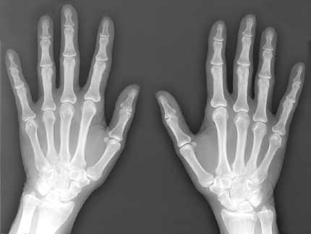
Sensitivity analysis
Exposes what is important to a given situation, test, etc.
Needed????
“Would you go to a orthopedist who didn’t
take x-rays and show them to you?”
SimLab web site: http://simlab.jrc.ec.europa.eu

Slide 5
Outline
Some basics about sensitivity analysis
Sensitivity analysis – Global and local methods
  Total-order statistics
Simple test case (analytical example relevant to FUSE) – run local sensitivity analysis in class
Sensitivity analysis results for the test case
Some results from FUSE

Slide 6
Some basics about sensitivity analysis
Decide on model
Decide on parameters
  Can include parameters on unusual aspects of the model, like additive or multiplicative parameters for precipitation
  Decide on ranges for each parameter
  The defined parameter space has the dimensions of the number of parameters, k. Easy to plot results for 1- and 2-D parameter space. Could easily be 10-D parameter space!
Decide on performance metric, ψ
Calculate performance metric variability over parameter space. Measure it with the variance V(ψ)

Slide 7
Some basics about sensitivity analysis
Total-order sensitivity for parameter j S_{T}^{j}
  1 minus Fraction of V(ψ) explained by variation in all other parameters.
  Includes of interdependence of parameter j with the other parameters.
Values of S_{T}^{j} range from 0.0 to 1.0.
  Small value ➔ unimportant parameter
  Large value ➔ important parameter

Slide 8
Sensitivity analysis – Global method
Define a ranges for each parameter
Sample the parameter space R times using Sobol’. For each, calculate performance metric, ψ
V(ψ) = Σ_{r=1,R} ψ_{r}² - [Σ_{r=1,R} ψ_{r}]²
S_{T}^{j} = 1 – [U - Σ_{r=1,R} ψ_{r}² ] / V(ψ)
U = (1/R)Σ_{r=1,R} [ψ_{r} ψ_{r}^{-j}]
Number of model runs = R(k+1)
R typically 10,000

Slide 9
Sensitivity analysis – Local methods
Sample the parameter space N times. For each, calculate ψ and ∂ψ/∂θ_{j} (θ_{j} is parameter j)
V_{L}(ψ) = (∂ψ/∂θ)^{T} V(θ) (∂ψ/∂θ)
S_{T(L)}^{j} = 1 - [(∂ψ/∂θ)^{T} V(θ)_{(j)} (∂ψ/∂θ)] / V_{L}(ψ) (New)
V(θ)
  Here, V(θ) diagonals equal parameter variances and V(θ)_{(j)} has a zero for parameter j.
  Make variances consistent with parameter ranges used for global method. Here, st dev = (max-min)/2.
Number of model runs = L(2k + 1)
N typically 1 for local results. We suggest the idea of multi-location local methods, and N>1.

Slide 10
Simple Test Case
(analytical example relevant to FUSE)
Nonlinear reservoir with 2 parameters
ODE: dS/dt = p(t) – q(t)
Here, p(t)=0, so: q(t)=K(S(t)/Ssc)^{c}
  where K[mm/day] and c[-] are analyzed parameters
  Ssc [mm] is a scaling parameter that is held constant
Goal: investigate sensitivity of K and c to ψ=mean(S)
Used R script that solves the problem using fixed-time step, implicit Euler.
Solution is in R script FUN_Nonlinear_Implicit_v02.r

Slide 11
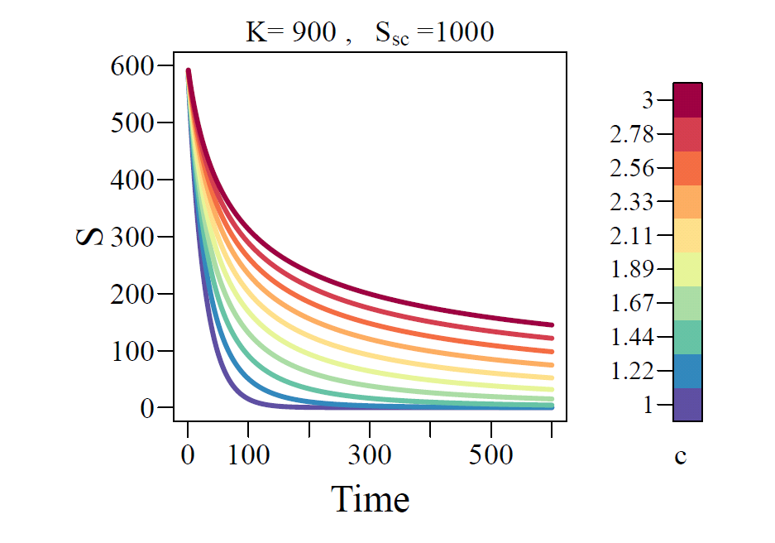
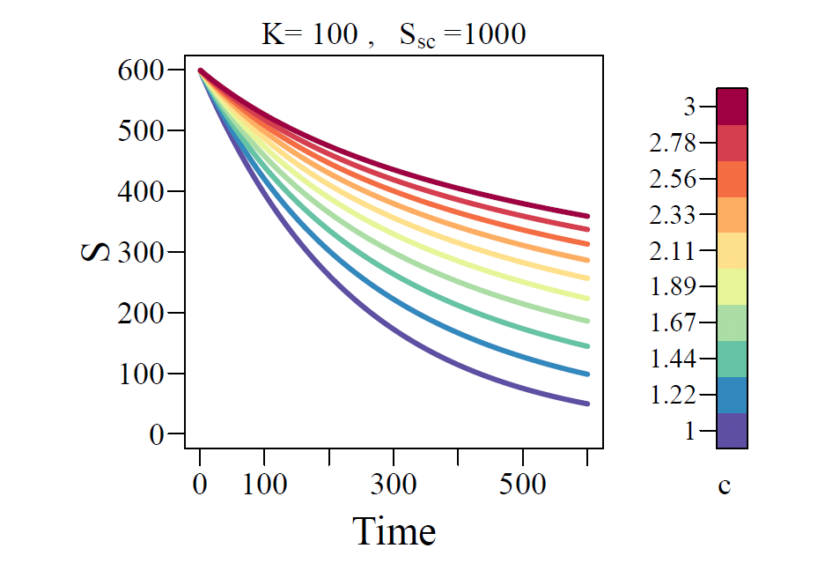
Simple Test Case
Run R script “Sensitivities_Global_Local_v02.r”
Time series plots of storage (Files: 1_Plot_S__K900_vs_c.pdf, 1_Plot_S__K100_vs_c.pdf)
ψ = mean storage over time, so average over each curve

Slide 12
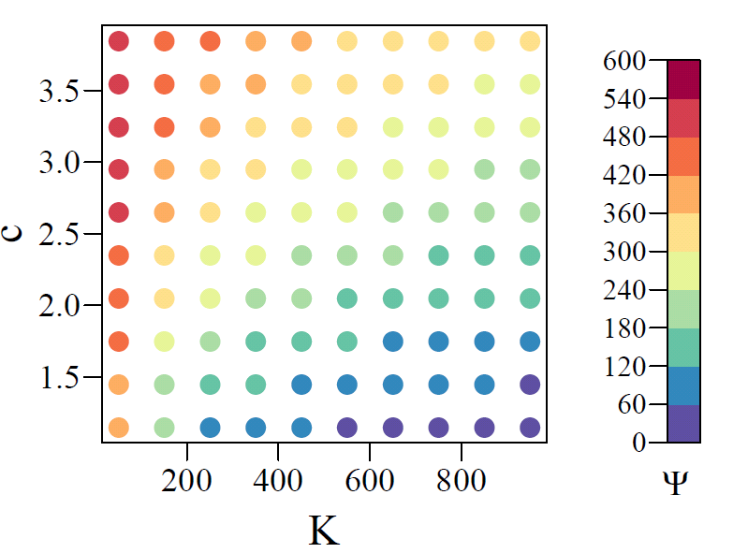
Simple Test Case
Performance metric ψ (mean storage)
File: 2_Image_OF_2D_K_vs_c.pdf

Slide 13
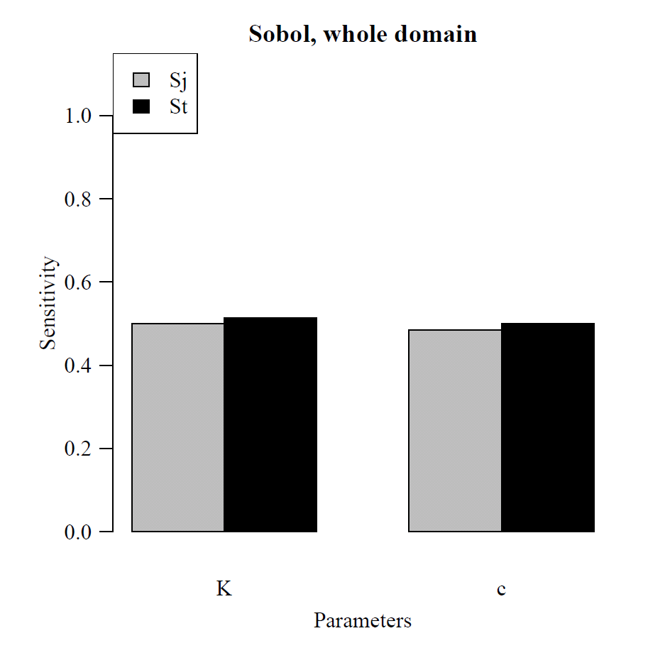
Typical Sobol’ Global Sensitivity Analysis
File: 7_Barchart_SobolSens_NONLIN888.pdf
First-order sensitivity
Total order sensitivity
Global Sobol’ suggests the two parameters have the same sensitivity.
10,000 model runs

Slide 14
Can we say more?
Consider evaluations at many locations within the parameter space. Like these 100 locations.
How does parameter importance change as the solution conditions change?
File: 2_Image_OF_2D_K_vs_c.pdf
Global and local statistics both need V(ψ).
What values of V(ψ) do we get at each point using Sobol’ and local methods?

Slide 15
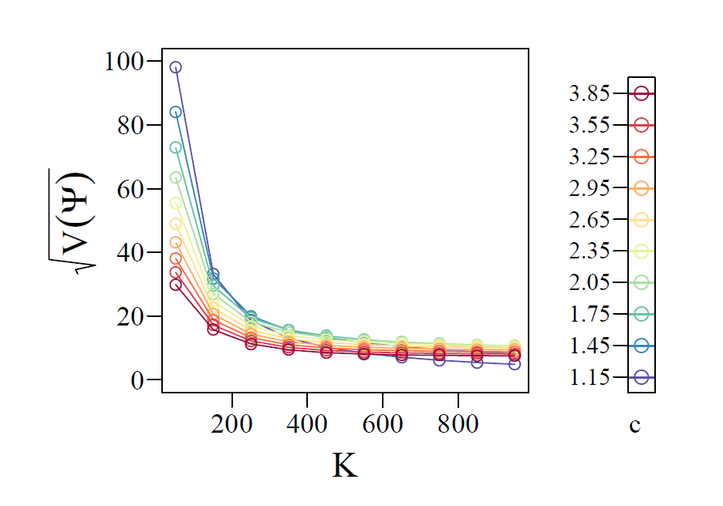
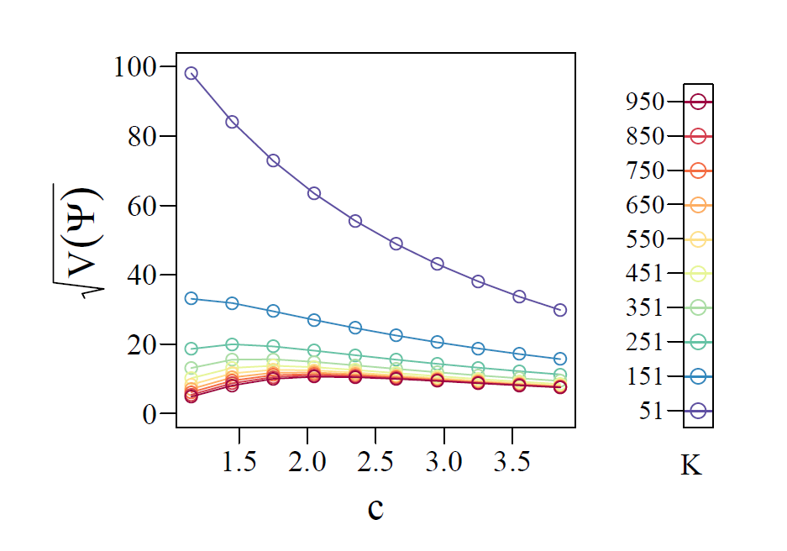
Sobol’ Global variance^{½}, V(ψ)^{1/2}
These are the 100 values -- V(ψ)^{1/2} calculated for each of the 100 points plotted two ways.
Both in file: 3_Variances_Sobol.pdf
Bootstrapping suggests 3,000,000 model runs are needed to obtain stable results

Slide 16
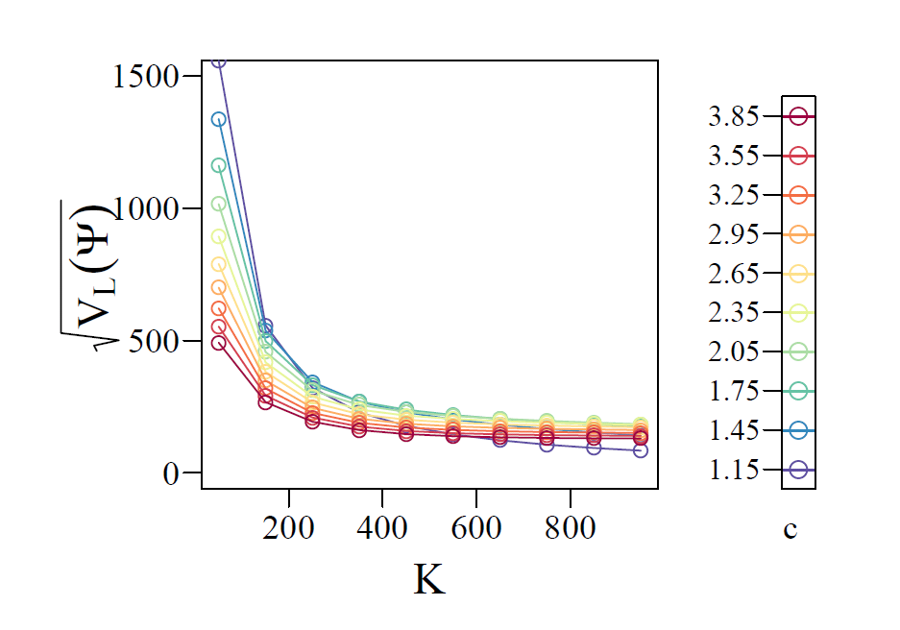
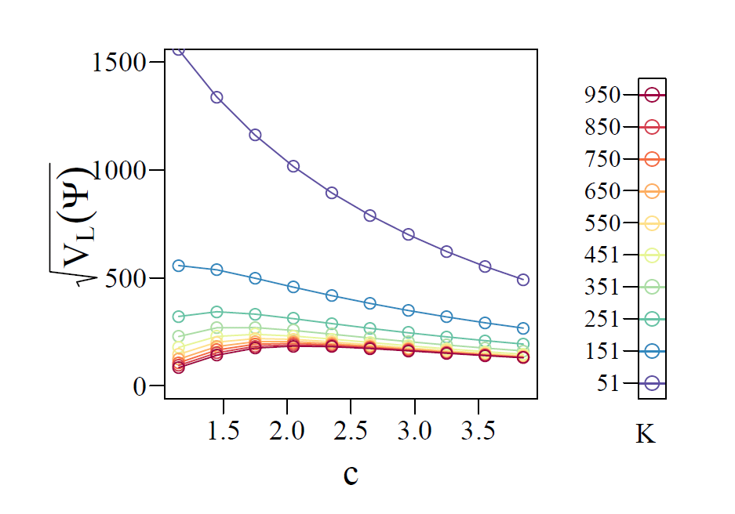
Sobol’ variance (3,000,000 model runs) file: 3_Variances_Sobol.pdf
Local variance (300 model runs) file: 4_Variances_psi_local.pdf

Slide 17
Sobol’ variance (3,000,000 model runs) file: 3_Variances_Sobol.pdf
Local variance (300 model runs) file: 4_Variances_psi_local.pdf
The way we calculate parameter variance from the range needs to be different. Total-order statistics divide variances, so this constant multiplicative difference divides out for the results here. We seem to be getting the relative values for different parameters right.

Slide 18
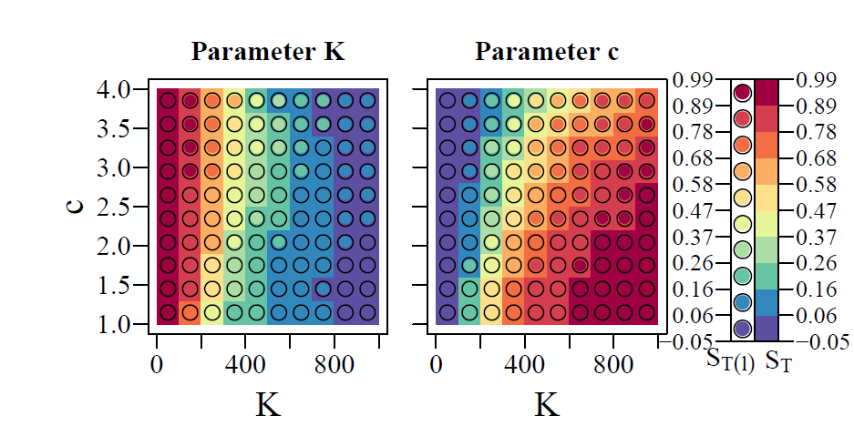
Total sensitivity indices (S_{T}) at many locations
Results obtained from local (300 model runs) and
global  (3,000,000 model runs)
Importance of
Importance of
Parameter is… important
not
important
File: 5_Image_sens_tot_2D_K_vs_cx.pdf

Slide 19
Exercise
The Sobol’ results are provided – the runs take too long for class (about 12 hours).
You can produce the local sensitivity results in class using an R script written by Olda.

Slide 20
Exercise instructions
How to run
  Start R using R-2.15.3/bin/i386/Rgui.exe or R.bat
  File/Open script/ Sensitivities_Global_Local_v02.r Change path on line 17 to where the R script is. Change any \ to /. Spaces ok.
  Run program: With R script window active, cntl-a, cntl-r.
PDF files are produced
  All the files in the ppt presentation. You did all the calculations for the local method right here.
Explore
  For the global method defined parameter ranges (max,min).
  For local method used st dev=(max-min)/2.
  R script Sensitivities_Global_Local_v02.r
    Defines st dev for K as WW1=499.5 and for c WW2=1.5. Use caps to search for variable names.
    Try changing these values by a constant such as multiplying by 10. Do the figures change?
    Try changing just one of the values by a factor of 10. Do the figures change?
Notes:
Some had to comment out install packages at top of script once.

Slide 21
FUSE (Clark et al, 2008)

Slide 22

FUSE accommodates different decisions regarding process selection and representation
Consider an example conceptual model of hydrological processes
uninfluenced
influenced
saturated
3
6
9
12
15
18

Slide 23
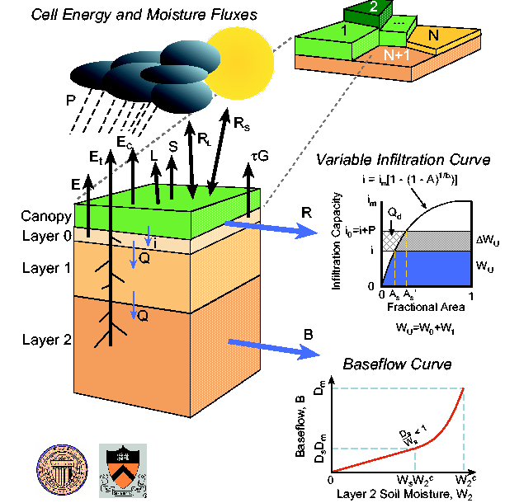
FUSE accommodates different options for model architecture
Consider the “mosaic” approach to representing heterogeneity in vegetation, as in the VIC model
… and contrast against other model architectures:
should different vegetation types compete for the same soil moisture?
should the architecture allow for sub-grid variability in soil moisture, to simulate the co-variability between vegetation type and water availability?

Slide 24
FUSE Separates the hypothesized model equations from their solutions
Many hydrologic models use ad-hoc approaches to add/subtract model fluxes from model stores in a pre-determined sequence
For example, the Sacramento model implementation
Critically: Lack of attention applied to numerical error control

Slide 25
FUSE supports quantifying uncertainty using multiple models…
PRMS
SACRAMENTO
PCTIM
IMPZR
ADIMC
RZONE
ADIMP
LZONE
IFLWR
UZTWC
UZFWC
GFLWR
LZTWC
LZFSC
LZFPC
TOPMODEL
ARNO/VIC
IZONE
SOILR
LAYR1
GWATR
GFLWR
LAYR2

Slide 26
Define model building decisions—1
PRMS
SACRAMENTO
PCTIM
IMPZR
ADIMC
RZONE
ADIMP
LZONE
IFLWR
UZTWC
UZFWC
GFLWR
LZTWC
LZFSC
LZFPC
UPPER LAYER ARCHITECTURE
TOPMODEL
ARNO/VIC
IZONE
SOILR
LAYR1
GWATR
GFLWR
LAYR2

Slide 27
Define model building decisions—2
PRMS
SACRAMENTO
PCTIM
IMPZR
ADIMC
RZONE
ADIMP
LZONE
IFLWR
UZTWC
UZFWC
GFLWR
LZTWC
LZFSC
LZFPC
LOWER LAYER ARCHITECTURE / BASEFLOW
TOPMODEL
ARNO/VIC
IZONE
SOILR
LAYR1
GWATR
GFLWR
LAYR2

Slide 28
Define model building decisions—3
PRMS
SACRAMENTO
PCTIM
IMPZR
ADIMC
RZONE
ADIMP
LZONE
IFLWR
UZTWC
UZFWC
GFLWR
LZTWC
LZFSC
LZFPC
PERCOLATION
TOPMODEL
ARNO/VIC
IZONE
SOILR
LAYR1
GWATR
GFLWR
LAYR2

Slide 29
Define model building decisions—4
PRMS
SACRAMENTO
PCTIM
IMPZR
ADIMC
RZONE
ADIMP
LZONE
IFLWR
UZTWC
UZFWC
GFLWR
LZTWC
LZFSC
LZFPC
SURFACE RUNOFF
TOPMODEL
ARNO/VIC
IZONE
SOILR
LAYR1
GWATR
GFLWR
LAYR2

Slide 30
and mix architecture + parameterizations…
PRMS
SACRAMENTO
PCTIM
IMPZR
ADIMC
RZONE
ADIMP
LZONE
IFLWR
UZTWC
UZFWC
GFLWR
LZTWC
LZFSC
LZFPC
TO CREATE HUNDREDS OF MODELS,
ALL WITH DIFFERENT STRUCTURE
+
+
TOPMODEL
ARNO/VIC
+
IZONE
+
SOILR
LAYR1
+
+
GWATR
GFLWR
LAYR2

Slide 31
FUSE-016
PRMS
SACRAMENTO
PCTIM
IMPZR
ADIMC
RZONE
ADIMP
LZONE
IFLWR
UZTWC
UZFWC
GFLWR
LZTWC
LZFSC
LZFPC
TOPMODEL
ARNO/VIC
IZONE
SOILR
LAYR1
GWATR
GFLWR
LAYR2

Slide 32
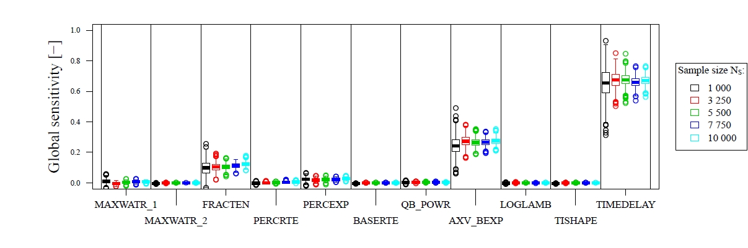
Total sensitivity results from FUSE-016
Global
Local

Slide 33
“Numerical Daemons”
(Clark, Kavetski, 2010; Kavetski and Clark, 2010, WRR) produced by thresholds can produce large local sensitivities
Kavetski, Kuczera 2007 WRR

Slide 34
Organizing computationally frugal and demanding methods by purpose

Slide 35
TOWARD TRANSPARENT, REFUTABLE HYDROLOGIC MODELS IN KANSAS OR OZ
In class:
Mary C. Hill U.S. Geological Survey, Boulder
Olda Rakovec Wageningen University, Netherlands
Other co-authors:
Martyn Clark UCAR, Boulder
A. H. Weerts Deltares, Wageningin University
A. J. Teuling Wageningin University
R. Uijlenhoet Wageningin University

