Slide 1




A Simple Model for Oxygen Dynamics in Chesapeake Bay
Malcolm Scully
Center for Coastal Physical Oceanography
Old Dominion University
Center for Coastal Physical Oceanography
Community Surface Dynamics Modeling System (CSDMS)
2011 Meeting; Boulder, CO
Outline:
Background and Motivation
Simplified Modeling Approach
Importance of Physical Forcing to Seasonal Variations in Hypoxic Volume
  River Discharge
  Heat Flux / Temperature
  Wind (Magnitude and Direction)
Inter-annual Variation in Hypoxic Volume
Conclusions

Slide 2


Testbed to Improve Models of Environmental Processes on the U.S. Atlantic and Gulf of Mexico Coasts
Estuarine Hypoxia Team
Federal partners
David Green (NOAA-NWS) – Transition to operations at NWS
Lyon Lanerole, Rich Patchen, Frank Aikman (NOAA-CSDL) – Transition to operations at CSDL; CBOFS2
Lewis Linker (EPA), Carl Cerco (USACE) – Transition to operations at EPA; CH3D, CE-ICM
Doug Wilson (NOAA-NCBO) – Integration w/observing systems at NCBO/IOOS
CSDMS partners
Carl Friedrichs (VIMS) – Project Coordinator
Marjorie Friedrichs, Aaron Bever (VIMS) – Metric development and model skill assessment
Ming Li, Yun Li (UMCES) – UMCES-ROMS hydrodynamic model
Wen Long, Raleigh Hood (UMCES) – ChesROMS with NPZD water quality model
Scott Peckham, Jisamma Kallumadikal (UC-Boulder) – Running multiple models on a single HPC cluster
Malcolm Scully (ODU) – ChesROMS with 1 term oxygen respiration model
Kevin Sellner (CRC) – Academic-agency liason; facilitator for model comparison
Jian Shen (VIMS) – SELFE, FVCOM, EFDC models

Slide 3
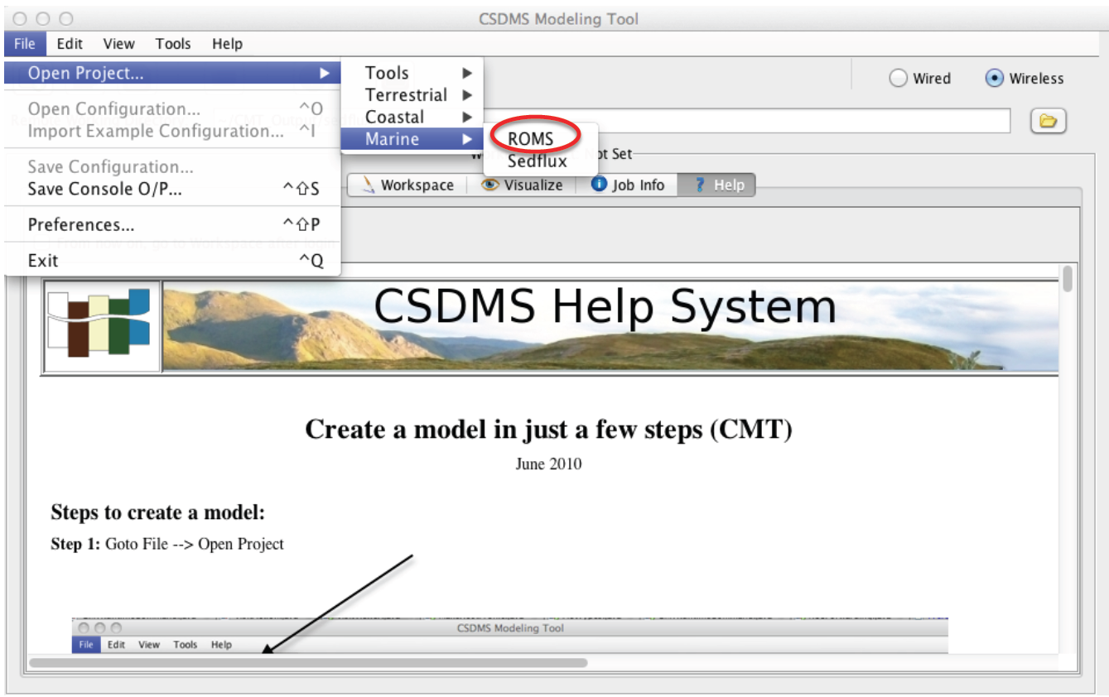
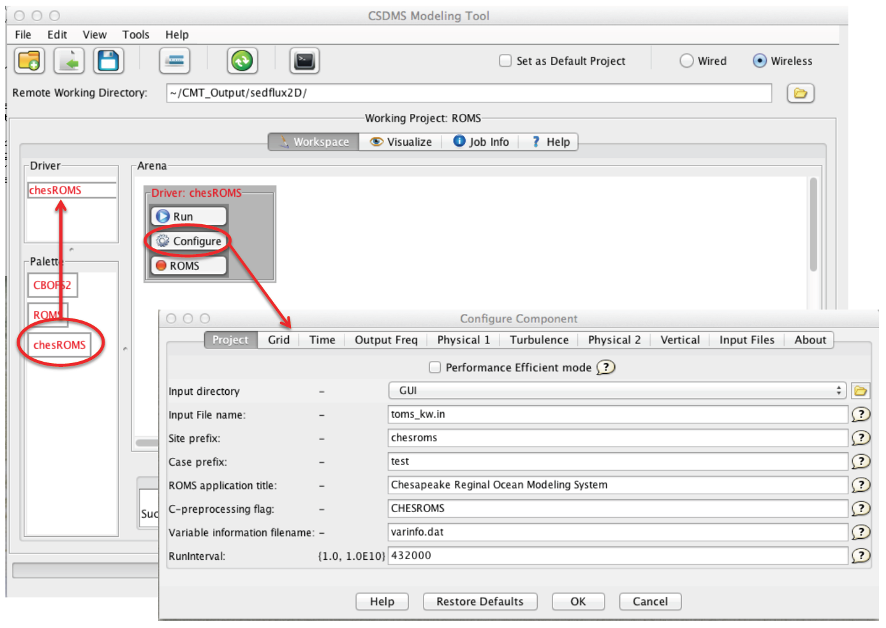
ChesROMS and two other flavors of ROMS are already incorporated into CSDMS.
1) Run CSDMS Modeling Tool
2) “File” → “Open Project”
→ “Marine” → “ROMS”
3) Drag selected “Palette”
(“chesROMS” in this case)
into Driver;
4) Choose “Configure”, adjust
settings as desired;
5) Run chesROMS

Slide 4
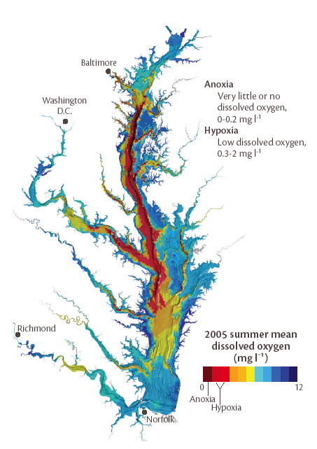
Map of Mean Bottom Dissolved Oxygen -- Summer 2005
Low DO has significant impact on a wide array of biological and ecological processes.
Large regions of Chesapeake Bay are impacted by hypoxia/anoxia.
Over $ 3.5 billion was spent on nutrient controls in Chesapeake Bay between 1985-1996 (Butt & Brown, 2000)
Assessing success/failure of reductions in nutrient loading requires understanding of the physical processes that contribute to the inter-annual variability.
From Chesapeake Bay Program newsletter: http://ian.umces.edu/pdfs/do_letter.pdf

Slide 5
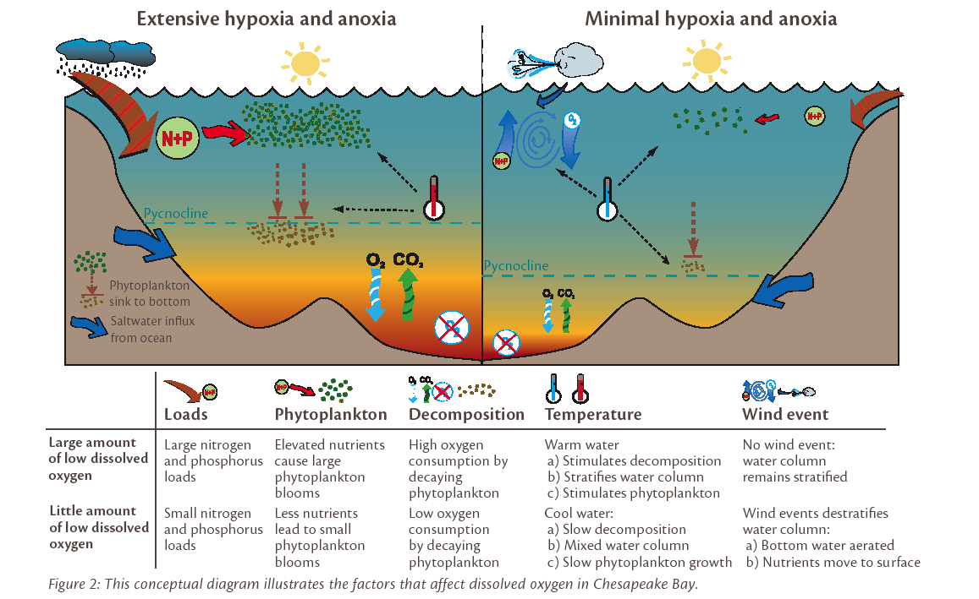

Slide 6
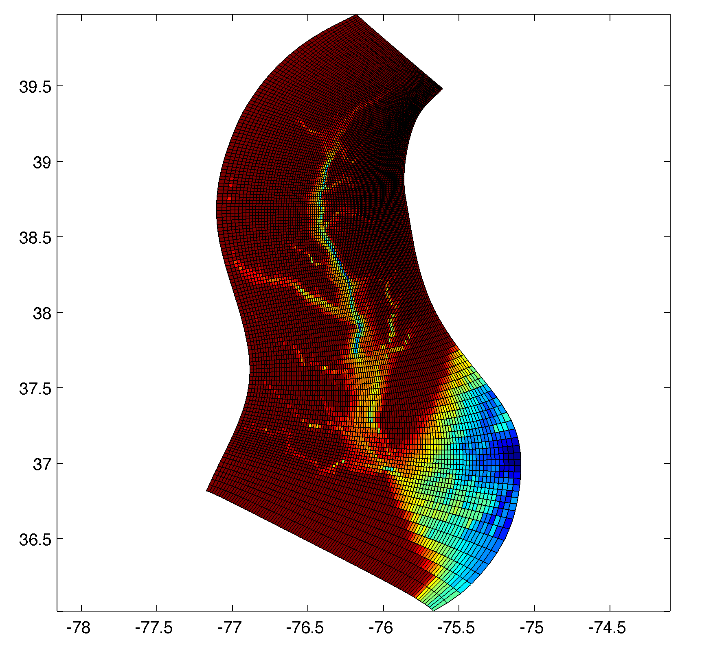
Regional Ocean Modeling System (ROMS)
Model forcing
Realistic tidal and sub-tidal elevation at ocean boundary
Realistic surface fluxes from NCEP (heating and winds)
Observed river discharge for all tributaries.
Temperature and salinity at ocean boundary from World Ocean Atlas.
ChesROMS Model Grid

Slide 7
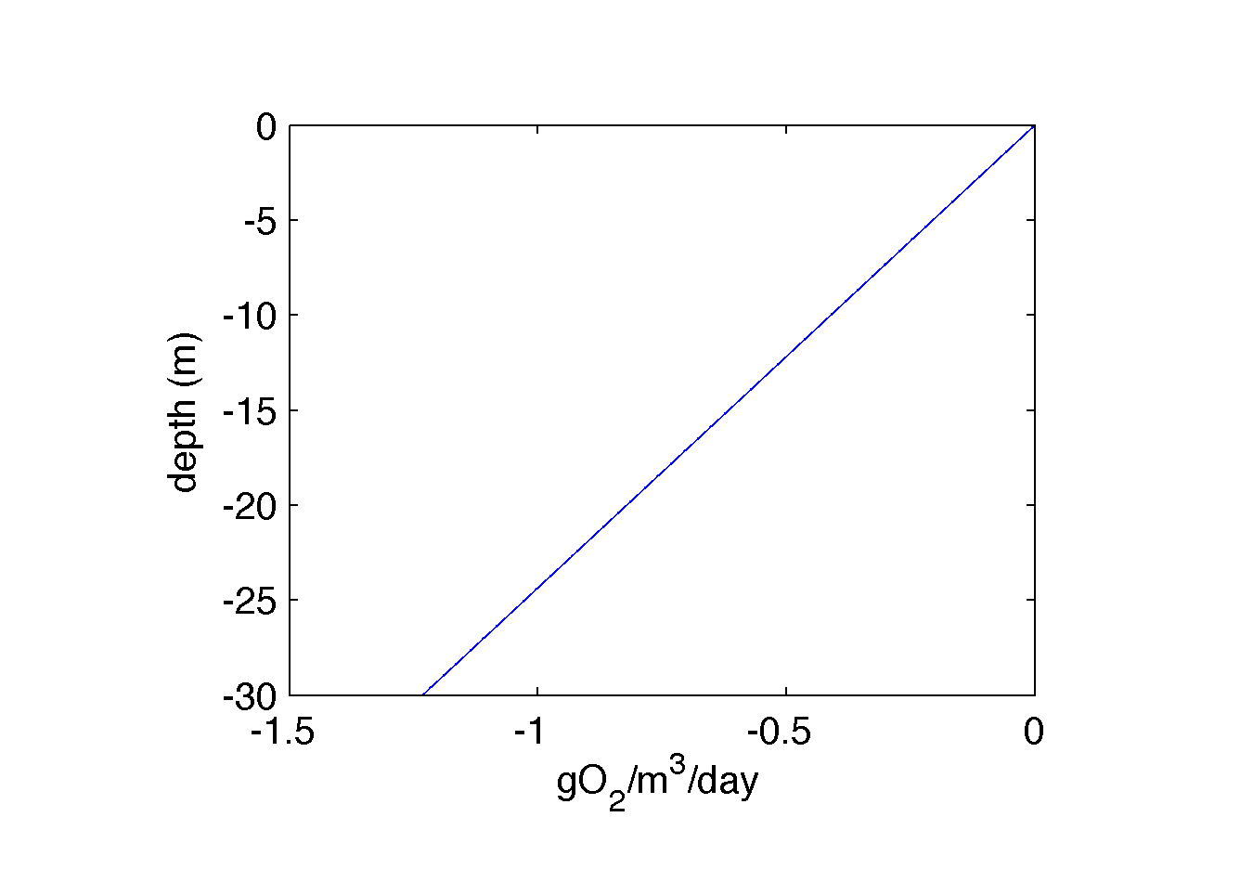
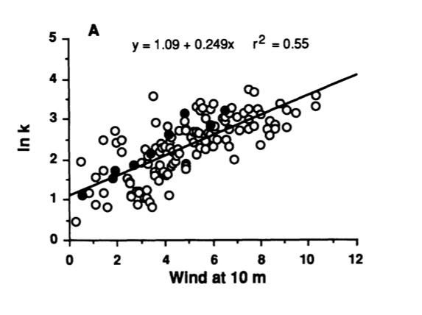
Depth-dependent Respiration Formulation
Oxygen Model
Oxygen is introduced as an additional model tracer.
Oxygen consumption (respiration) is constant in time, with depth-dependent vertical distribution.
No oxygen consumption outside of estuarine portion of model
No oxygen production.
Open boundaries = saturation
Surface flux using wind speed dependent piston velocity following Marino and Howarth, 1993.
No negative oxygen concentration and no super-saturation.
Surface Oxygen Flux using Piston Velocity:
Model assumes biology is constant so that the role of physical processes can be isolated!
From Marino and Howarth, Estuaries, 1993

Slide 8
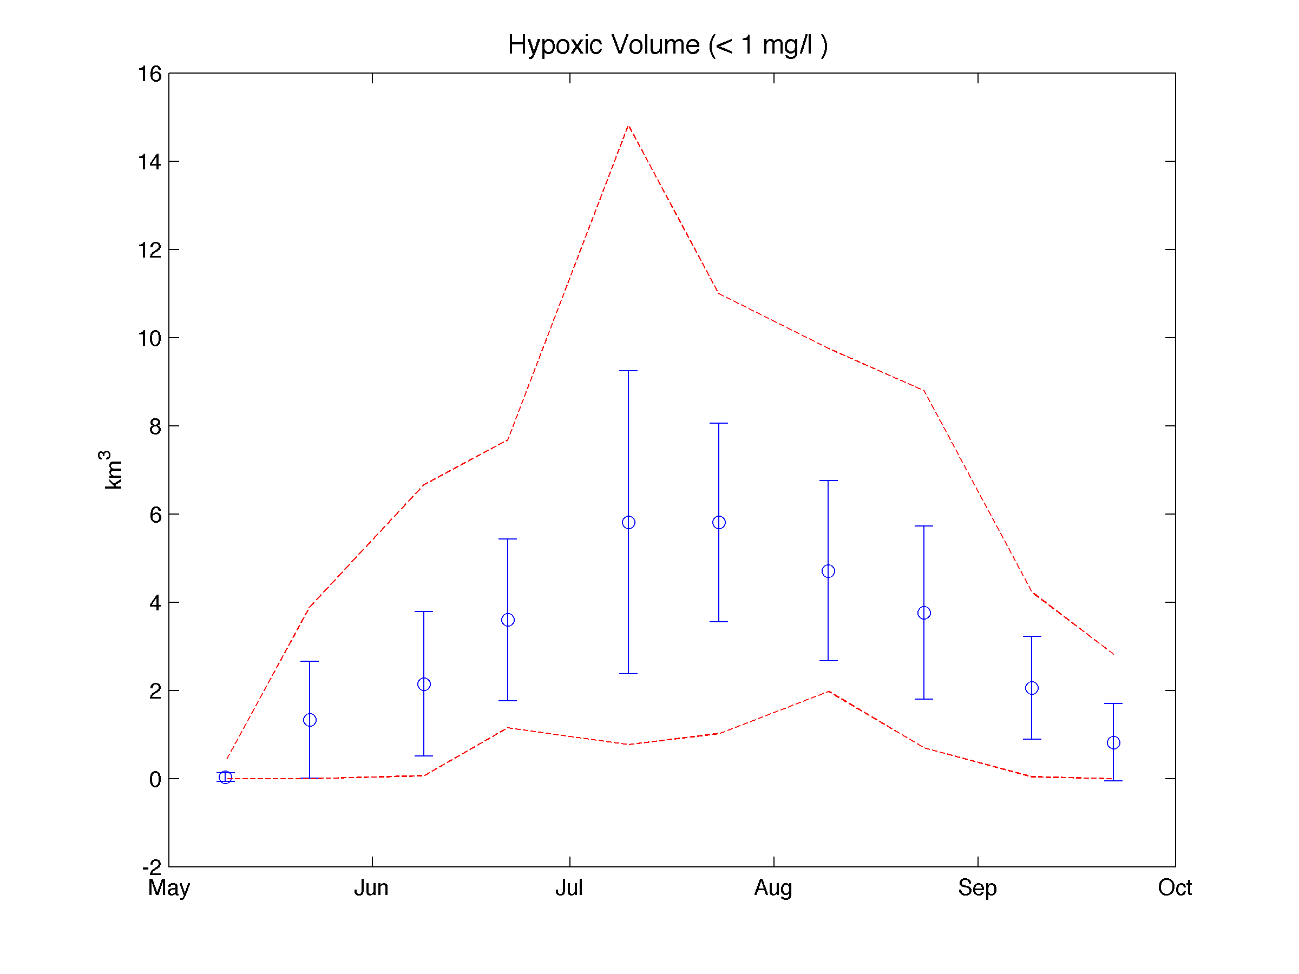
Seasonal and Inter-Annual Variability in Hypoxic Volume (from CBP data 1984-2009)
Maximum observed
Minimum observed
Data compiled from Murphy et al. (submitted)

Slide 9
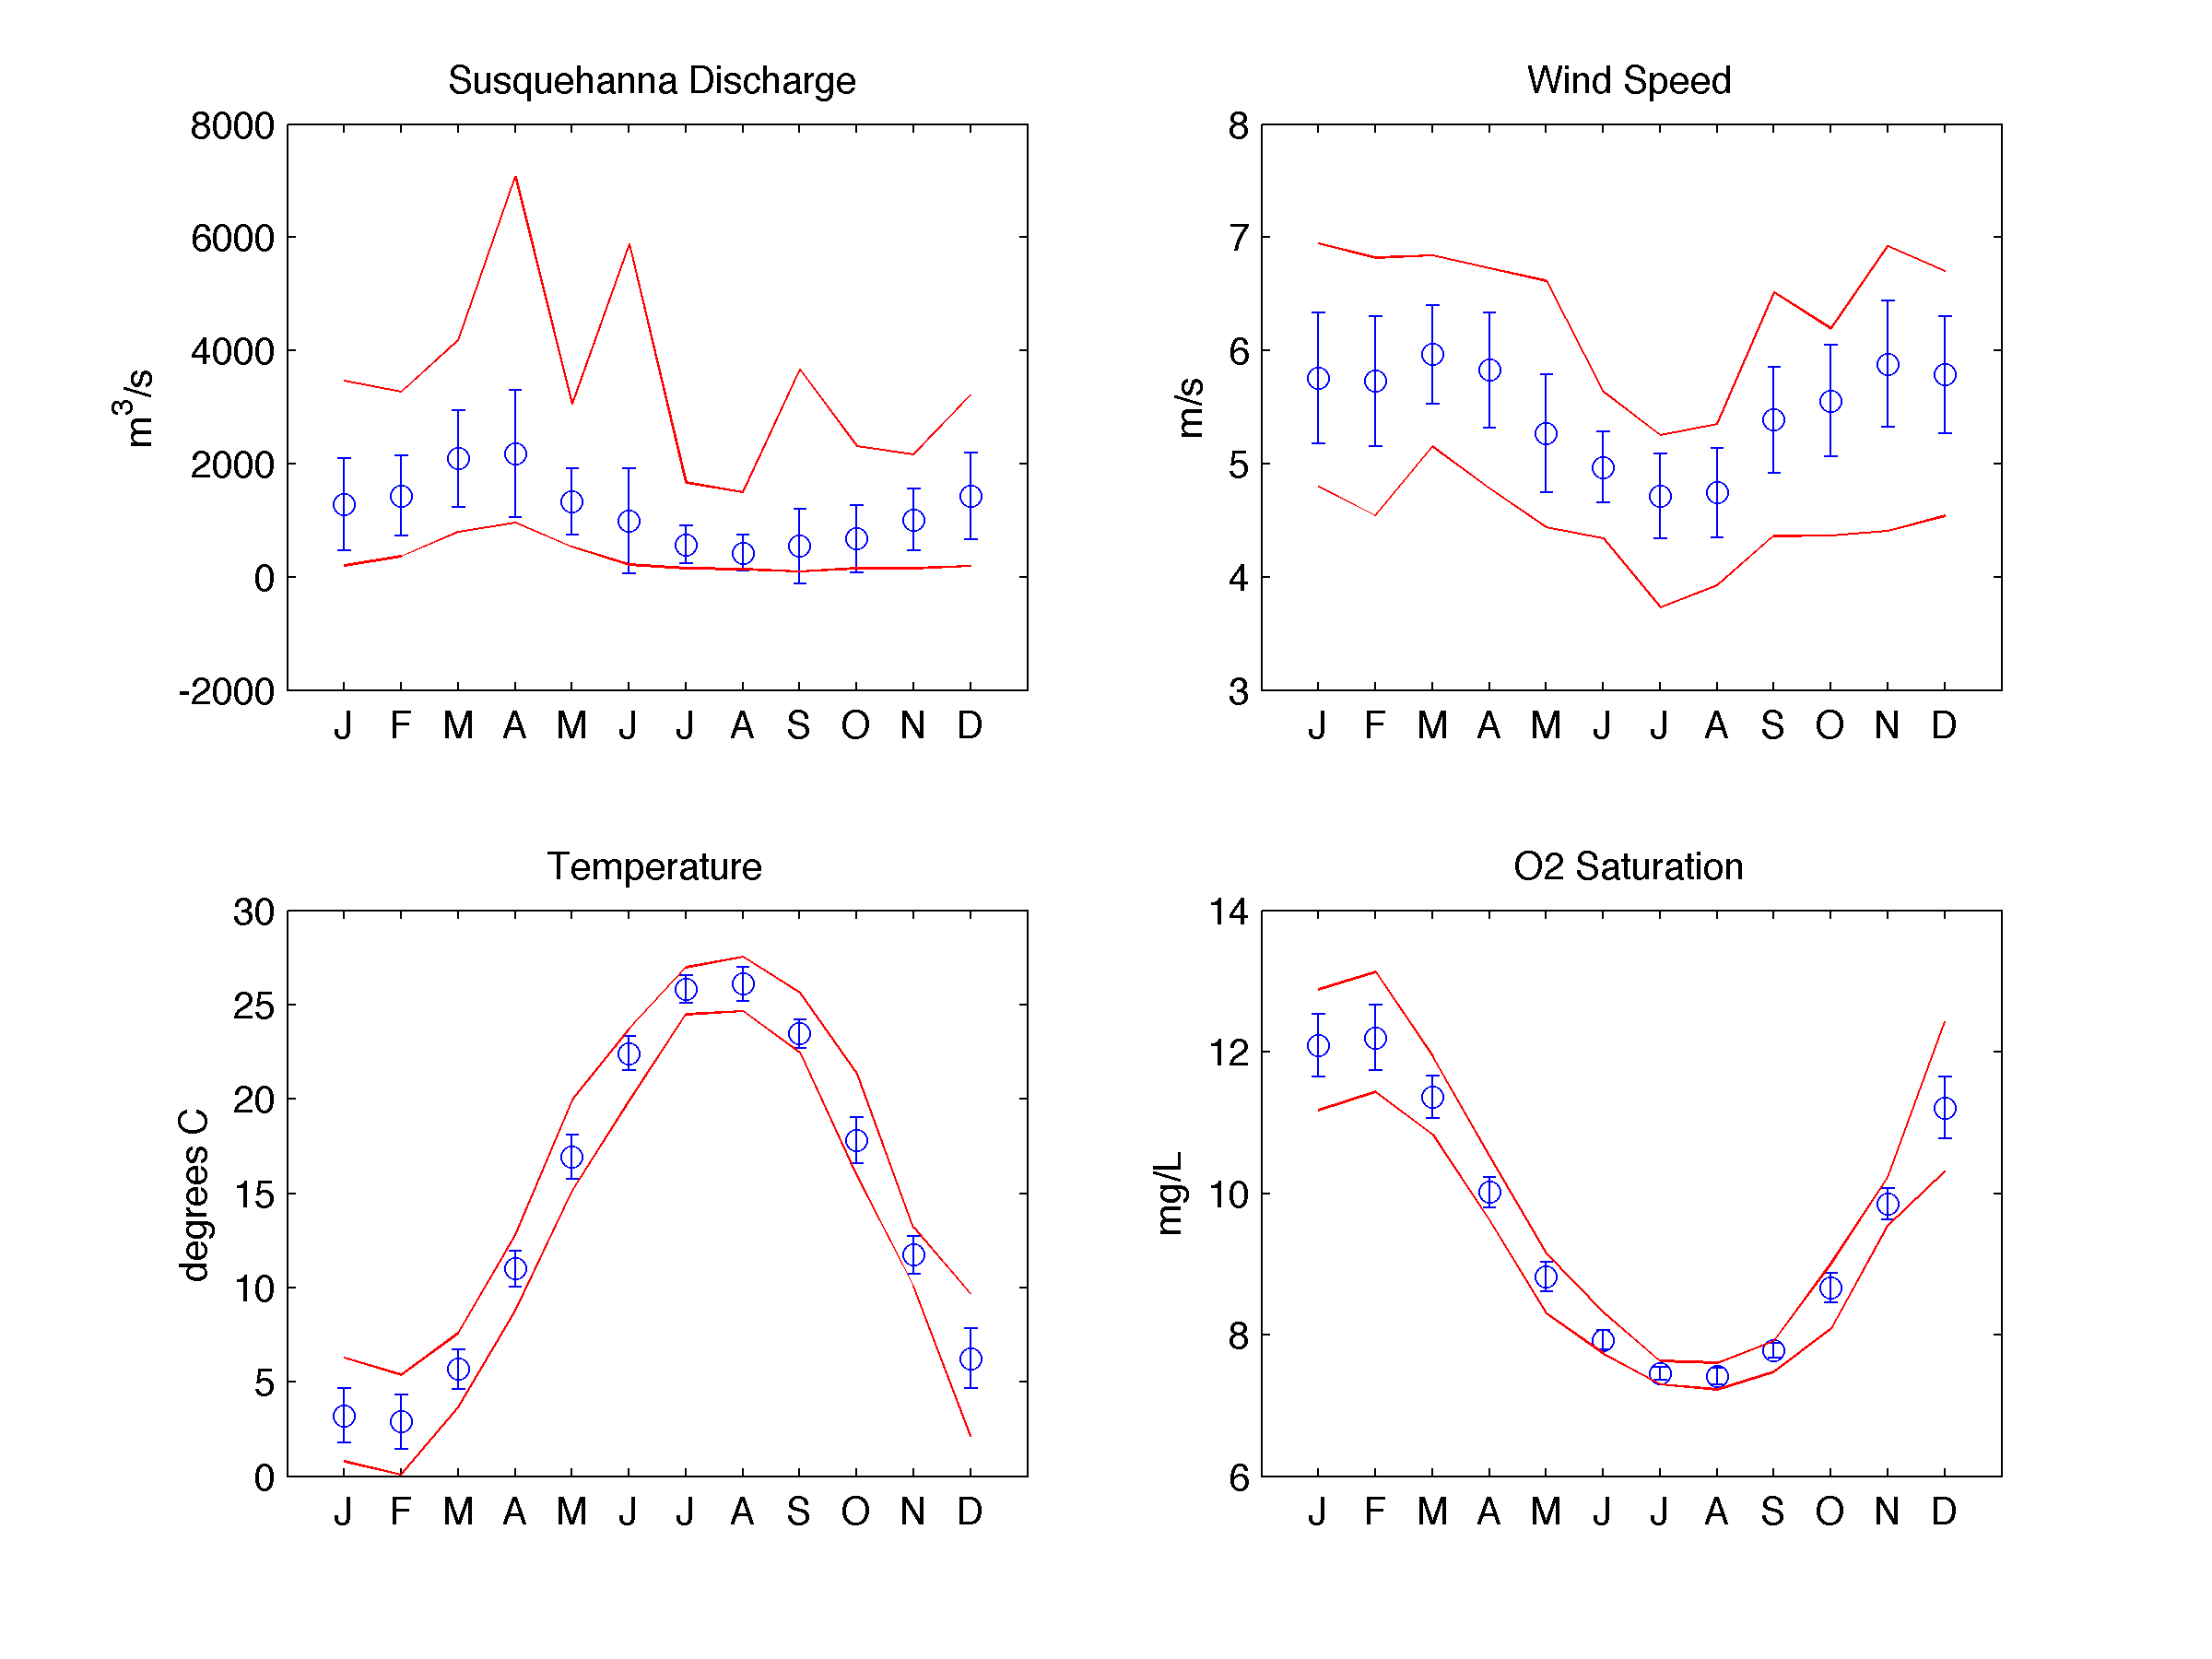
Variability of Physical Forcing
What is relative importance of different physical forcing in controlling seasonal and inter-annual variability of hypoxia in Chesapeake Bay?

Slide 10
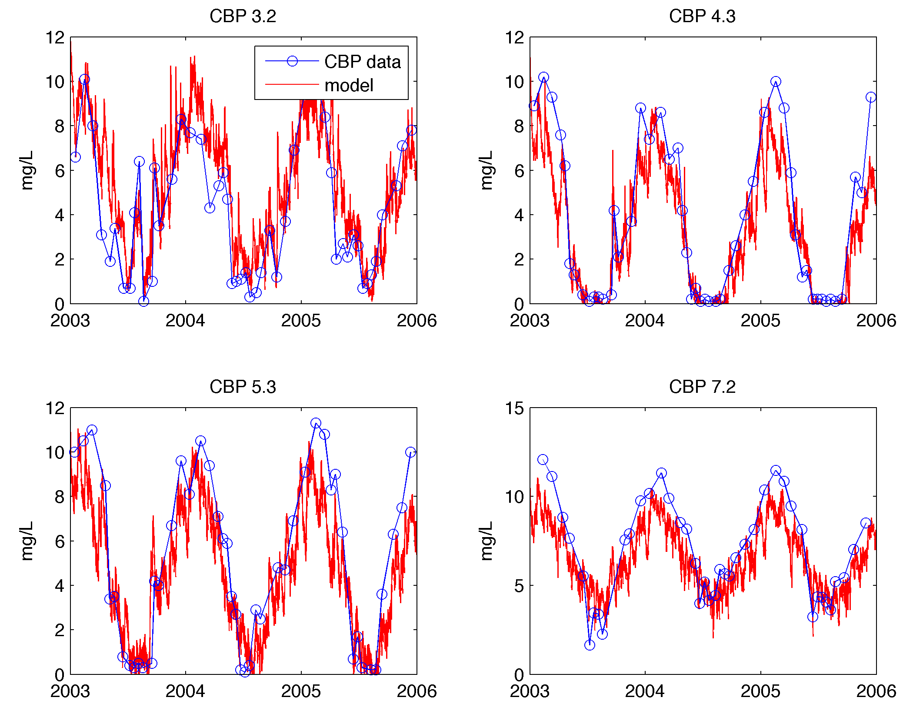
Comparison with Bottom DO at Chesapeake Bay Program Stations

Slide 11
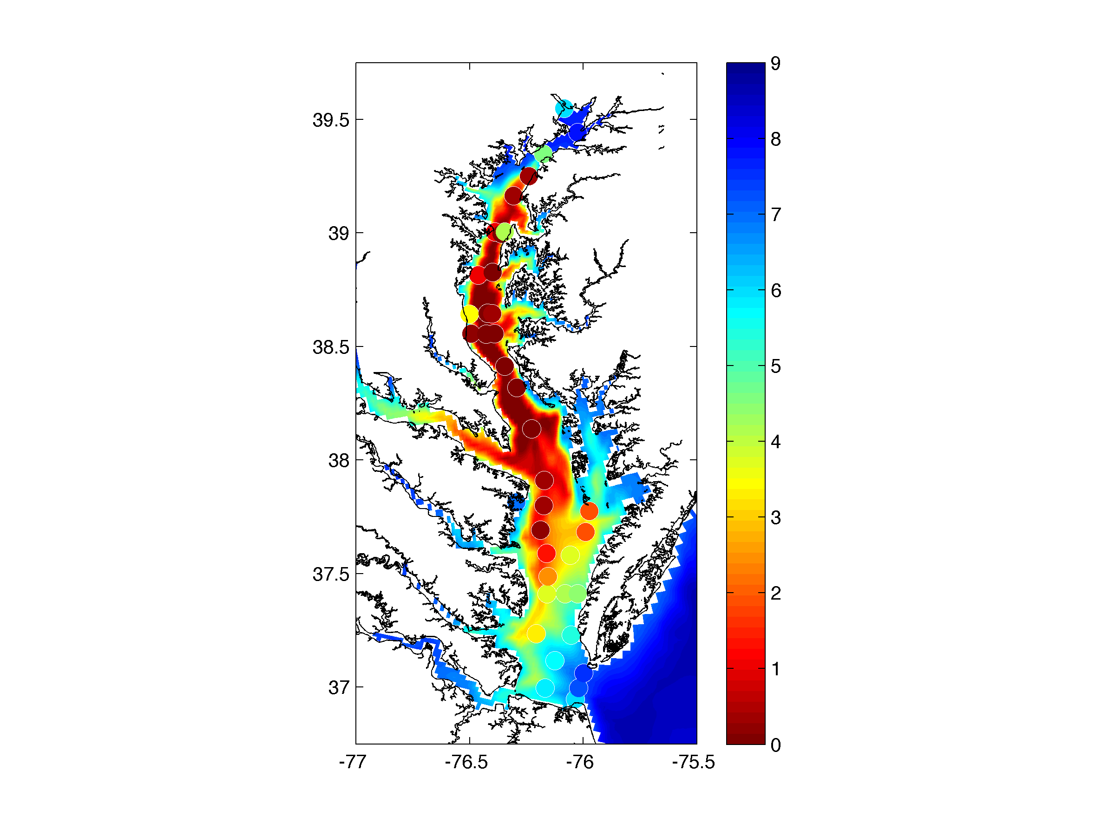
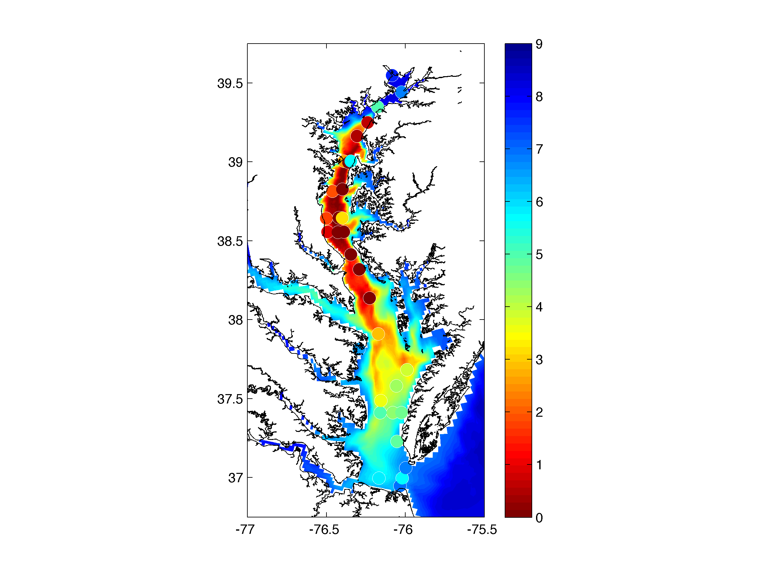
Comparison with Chesapeake Bay Program Data
Bottom Dissolved Oxygen Concentration (mg/L)
July 19-21, 2004
August 9-11, 2004

Slide 12
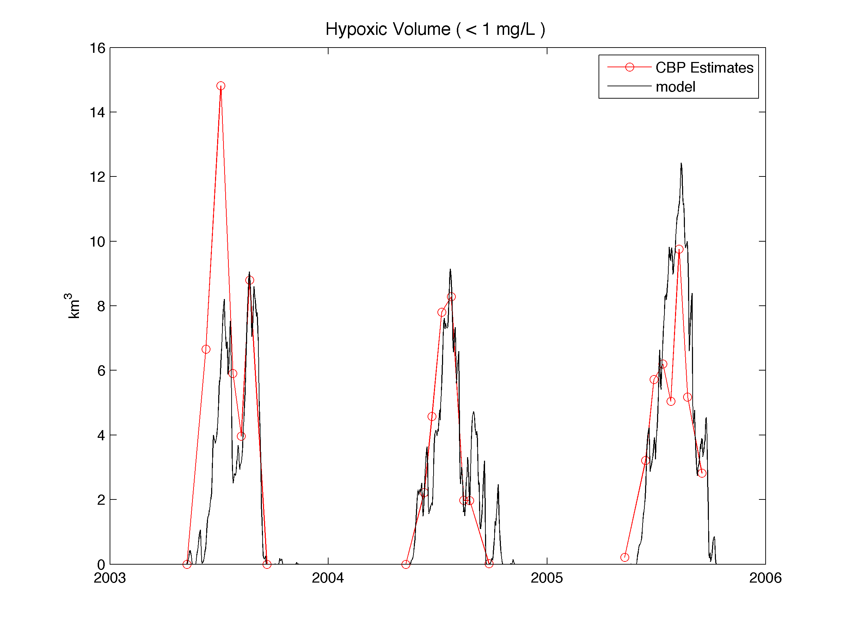
In addition to seasonal cycle, model captures some of the inter-annual variability
707 km³days
485 km³days
476 km³days
Model predicts roughly 50% more hypoxia in 2004 than in 2005, solely due to physical variability.

Slide 13
Physical Controls on Hypoxia in Chesapeake Bay
Malcolm Scully
Center for Coastal Physical Oceanography
Old Dominion University
Center for Coastal Physical Oceanography
Virginia Institute of Marine Sciences, Seminar
October 21, 2011
Outline:
Background and Motivation
Simplified Modeling Approach
Importance of Physical Forcing to Seasonal Variations in Hypoxic Volume
  River Discharge
  Heat Flux / Temperature
  Wind (Magnitude and Direction)
Inter-annual Variation in Hypoxic Volume
Conclusions

Slide 14
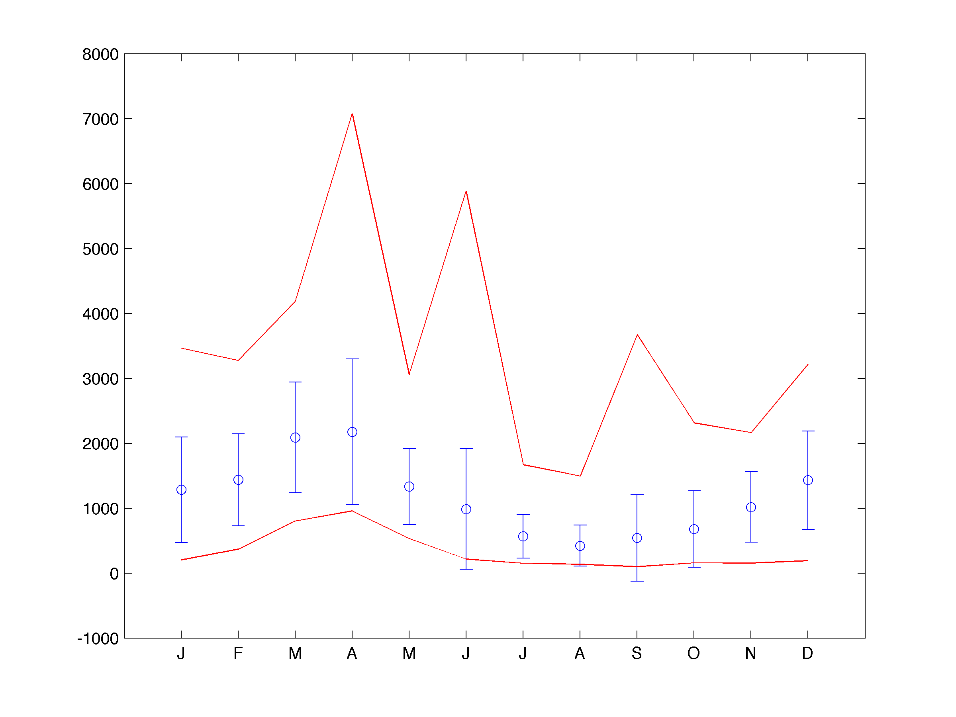
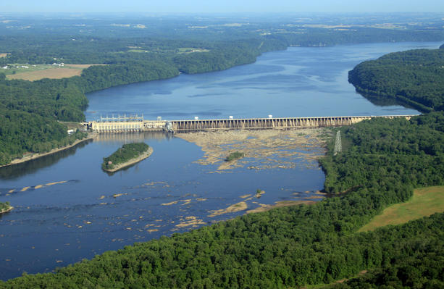
River Discharge Monthly Climatology
Susquehanna River at Conowingo Dam (1967-2010)
m³/s
Month

Slide 15
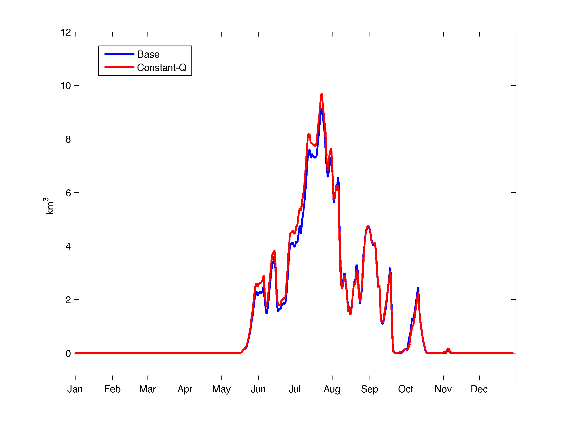
Importance of Seasonal Variations in River Flow
Hypoxic Volume (< 1 mg/L)
2004

Slide 16
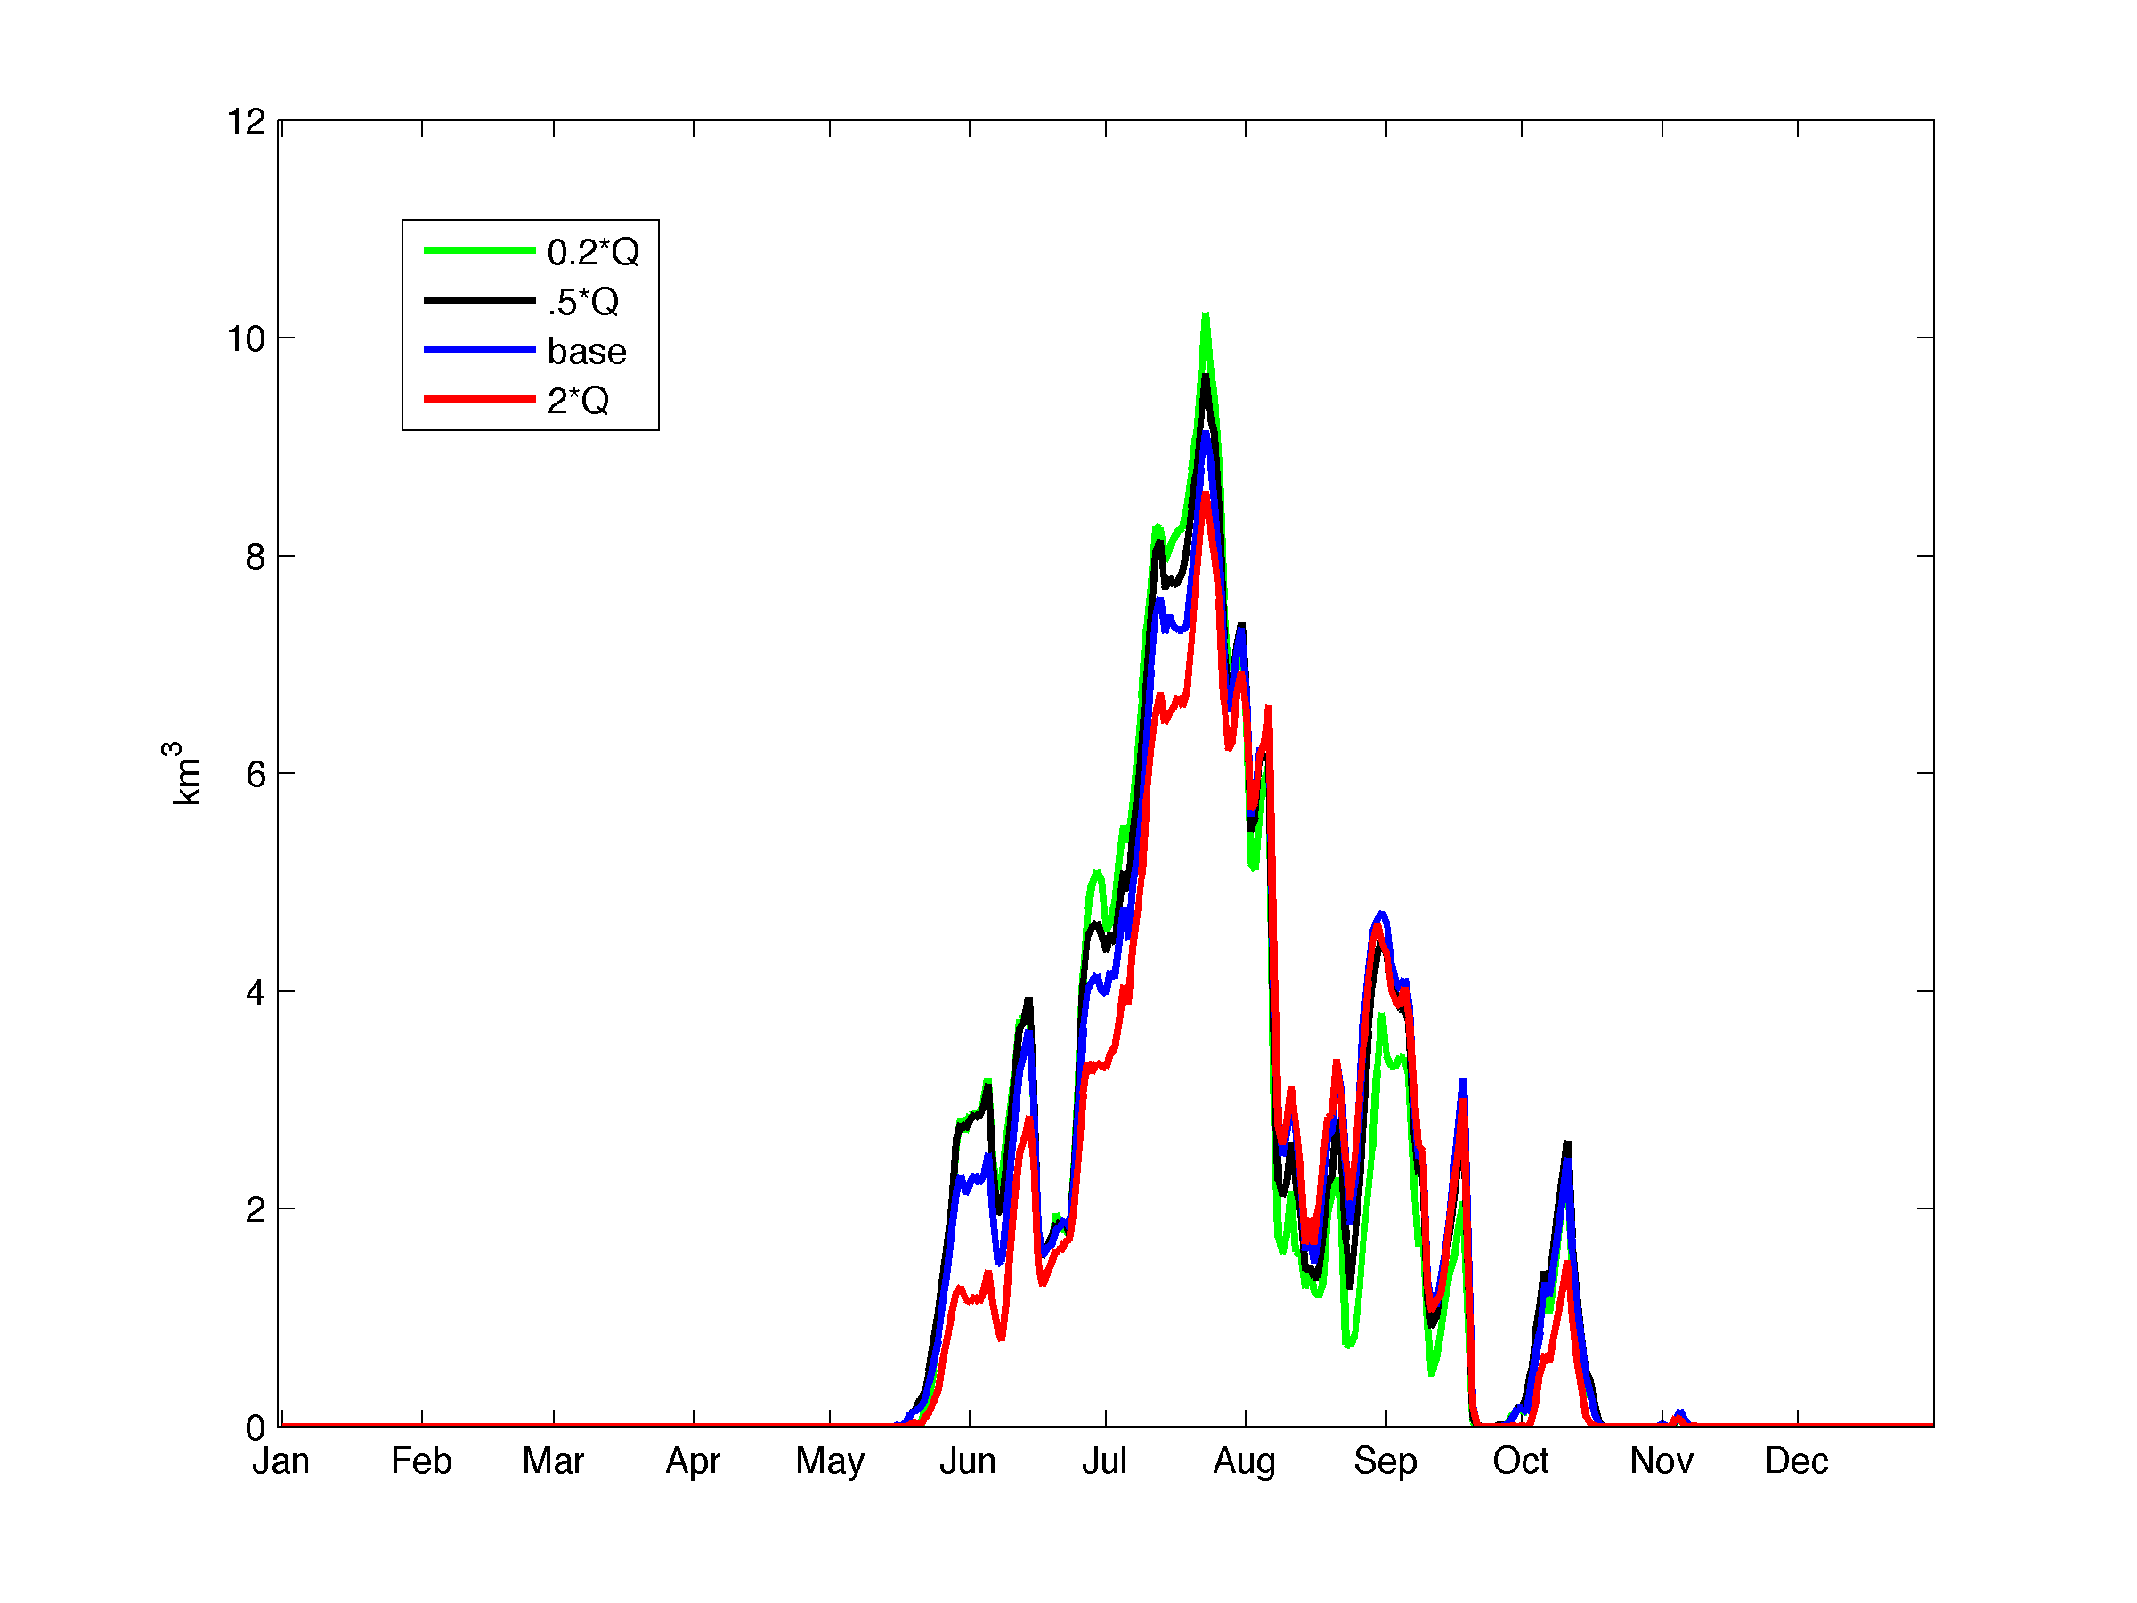
Sensitivity to River Discharge
Hypoxic Volume (< 1 mg/L)
Integrated volumes:
469 km³days
488 km³days
476 km³days
423 km³days
Order of magnitude change in river discharge leads to less than 10% change in integrated hypoxic volume.
2004

Slide 17
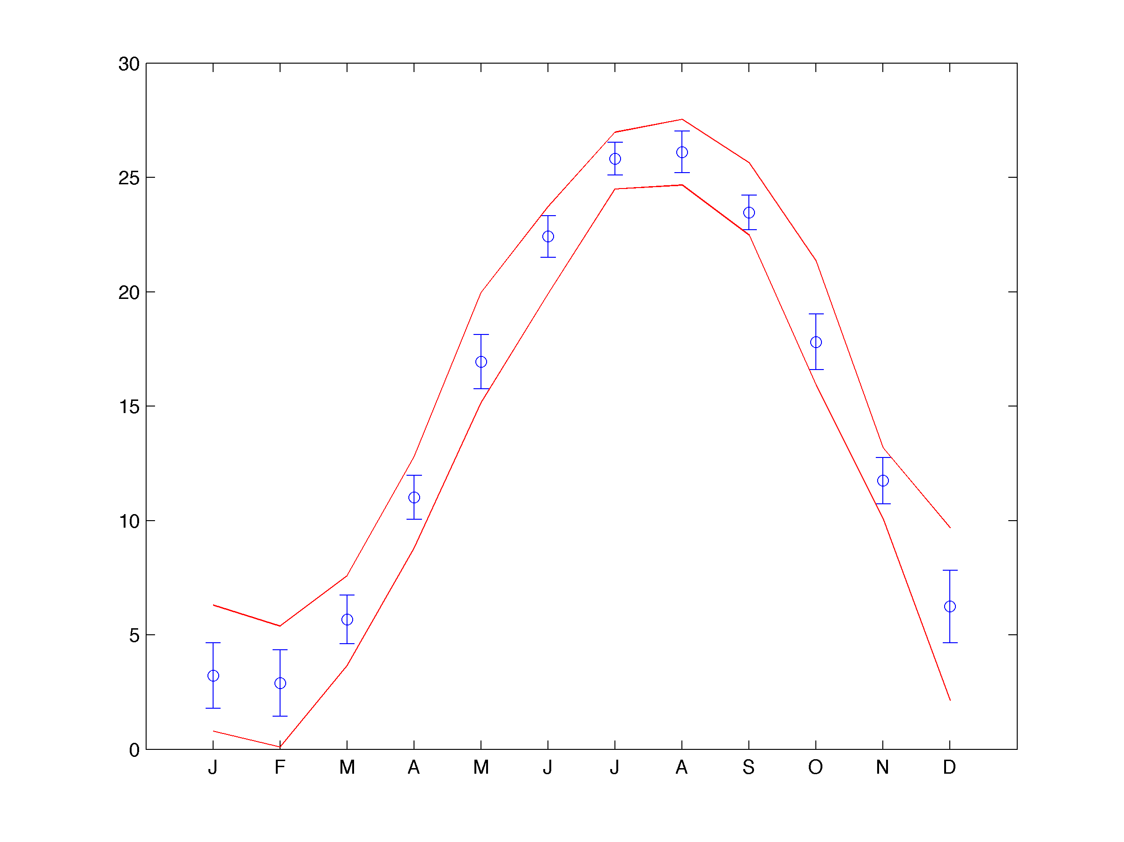
Water Temperature
Monthly climatology at Thomas Point Light (1986-2009)

Slide 18
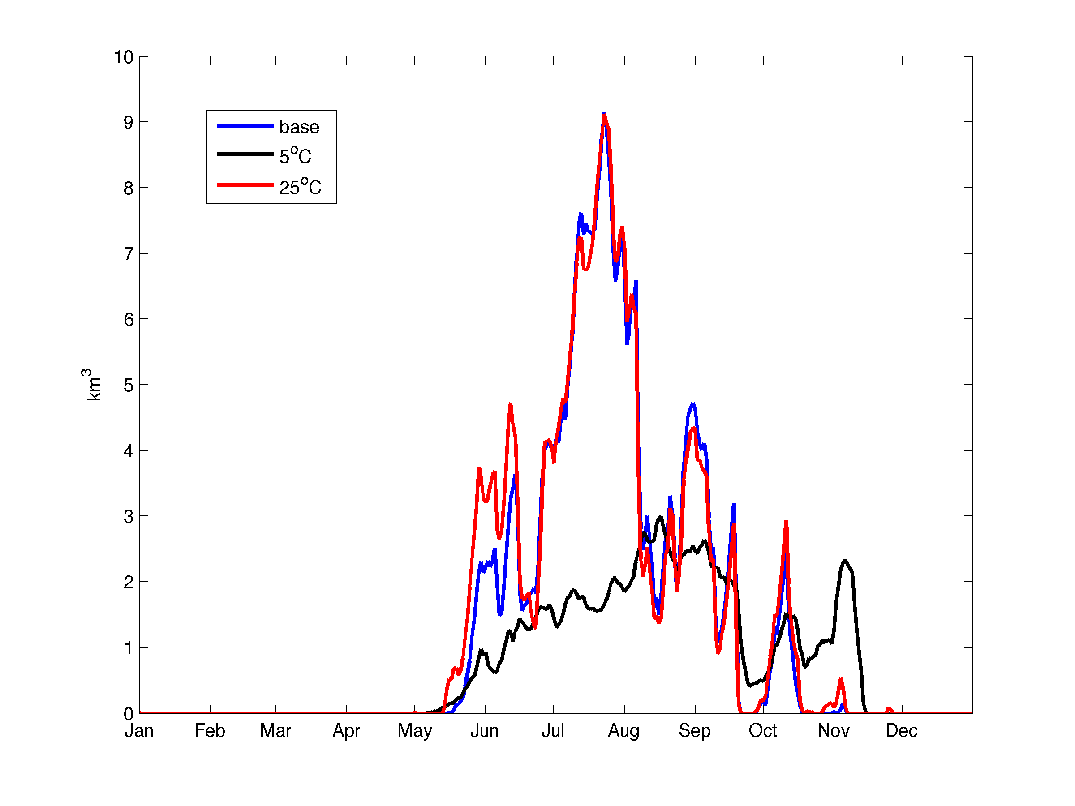
Importance of Seasonal Variations in Temperature

Slide 19
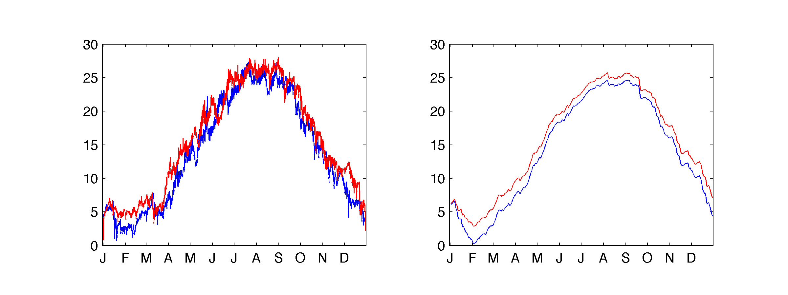
To simulate realistic variability in temperature forcing, model was run changing the air temperature by ± one standard deviation based on monthly climatology for air temperature.
Thomas Point Light Water Temp
Bay-averaged Water Temp (model)
1998
+ 1 std air temp
1992
- 1 std air temp

Slide 20
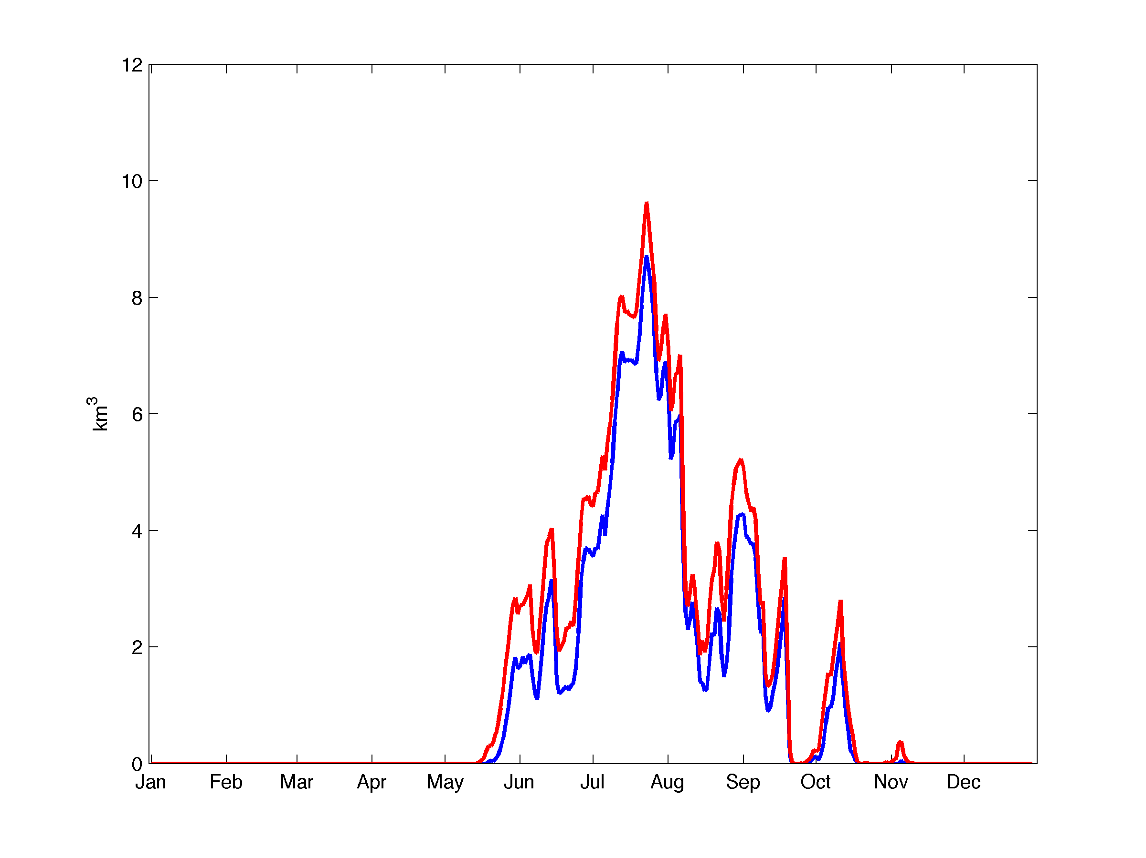
Sensitivity to Temperature
Hypoxic Volume (< 1 mg/L)
+ 1 std air temp
Integrated volumes:
- 1 std air temp
421km³days
534 km³days
Increase in surface heating results in greater than 20% change in integrated hypoxic volume.
2004

Slide 21
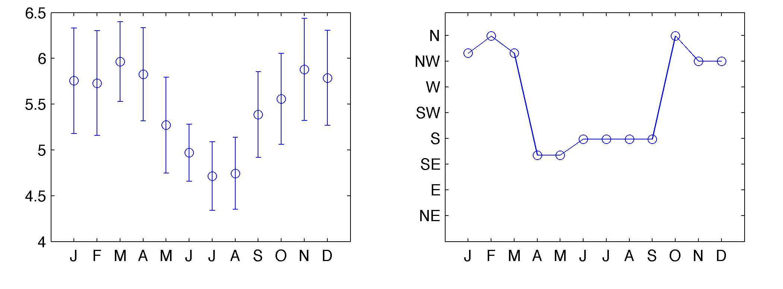
Wind Forcing
Wind Climatology from Thomas Point Light (1986-2010)
a) Wind Speed
b) Wind Direction
m/s

Slide 22
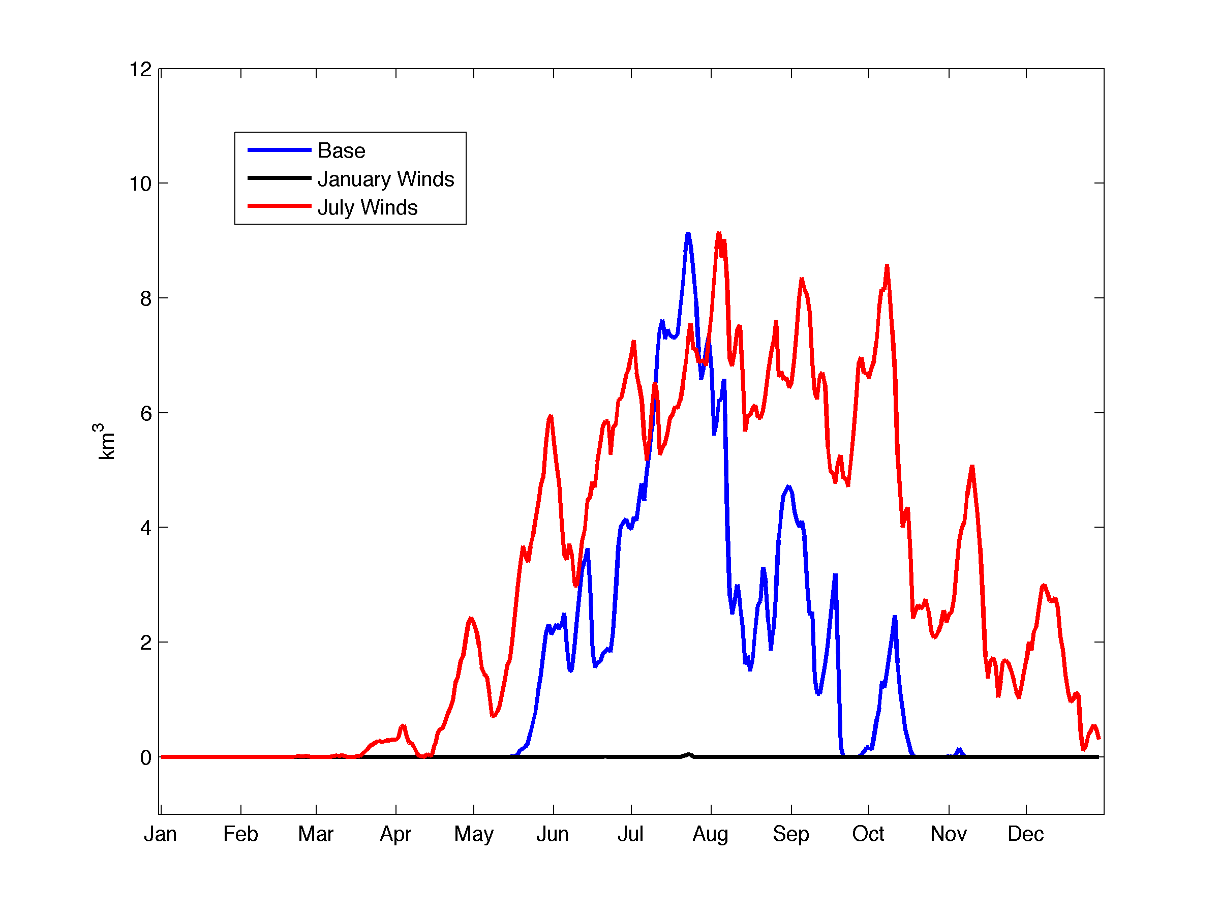
Importance of Seasonal Variations in Wind
Hypoxic Volume (< 1 mg/L)
2004

Slide 23
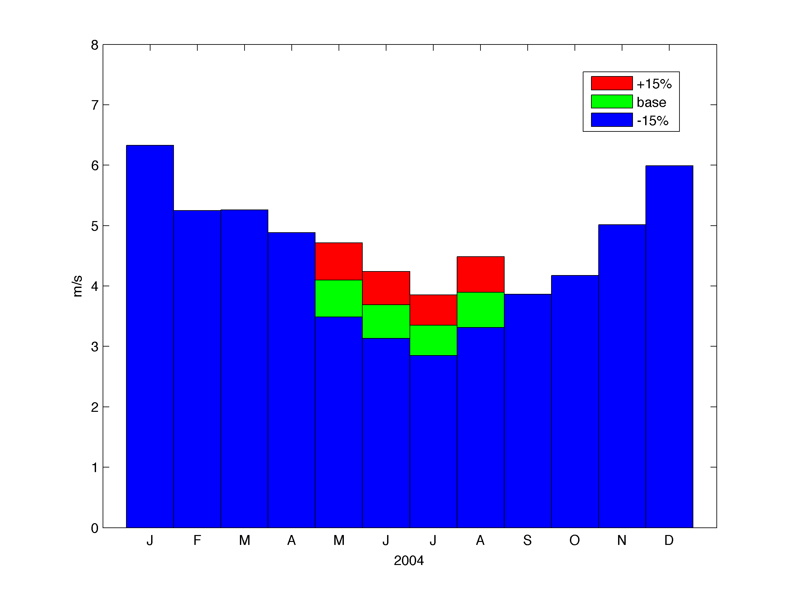
To simulate realistic variability in wind forcing, May-August wind magnitudes were increased/decreased by 15%.
Average Monthly Wind Speed from Model Mid-Bay location

Slide 24
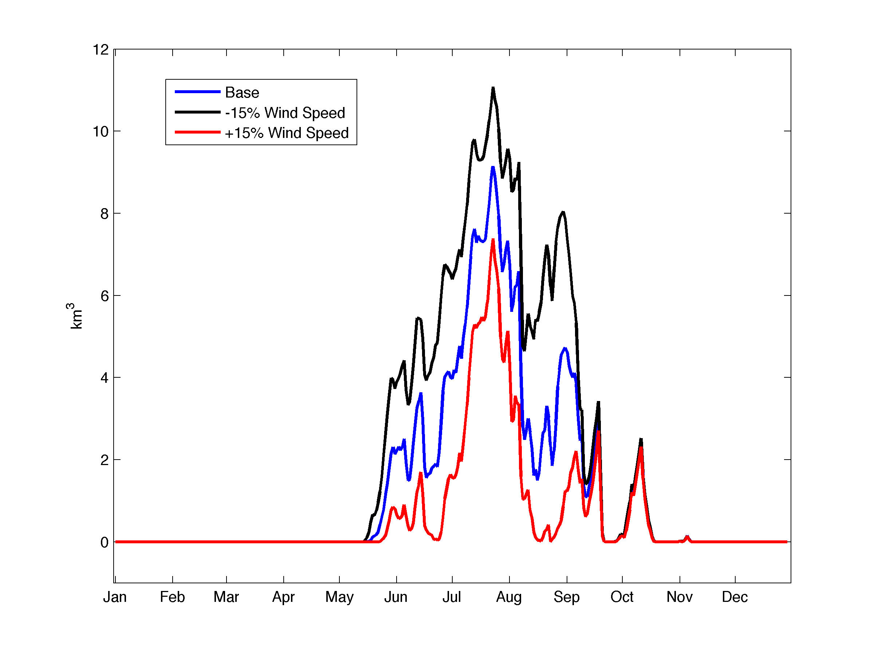
Sensitivity to Wind Speed
Hypoxic Volume (< 1 mg/L)
Integrated volumes:
751 km³days
476 km³days
242 km³days
Realistic changes in summer wind speed could change hypoxic volume by a factor of 3
2004

Slide 25
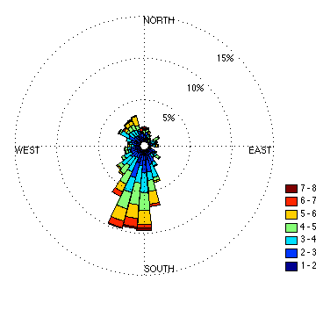
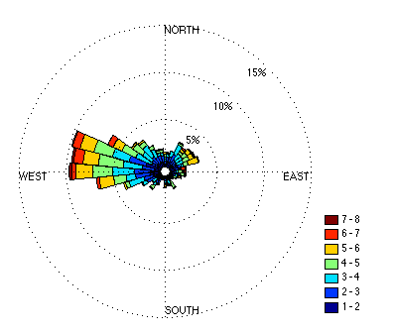
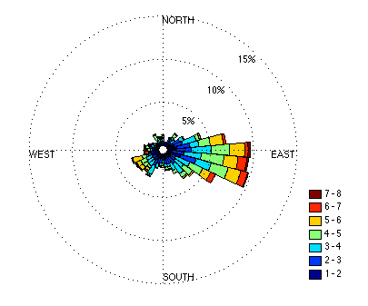
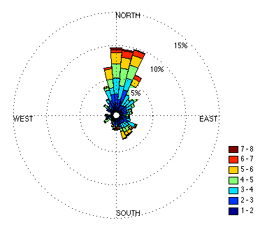
Sensitivity to Summer Wind Direction
Modeled summer wind direction
Base Summer Winds
Positive 90°
Negative 90°
180°

Slide 26
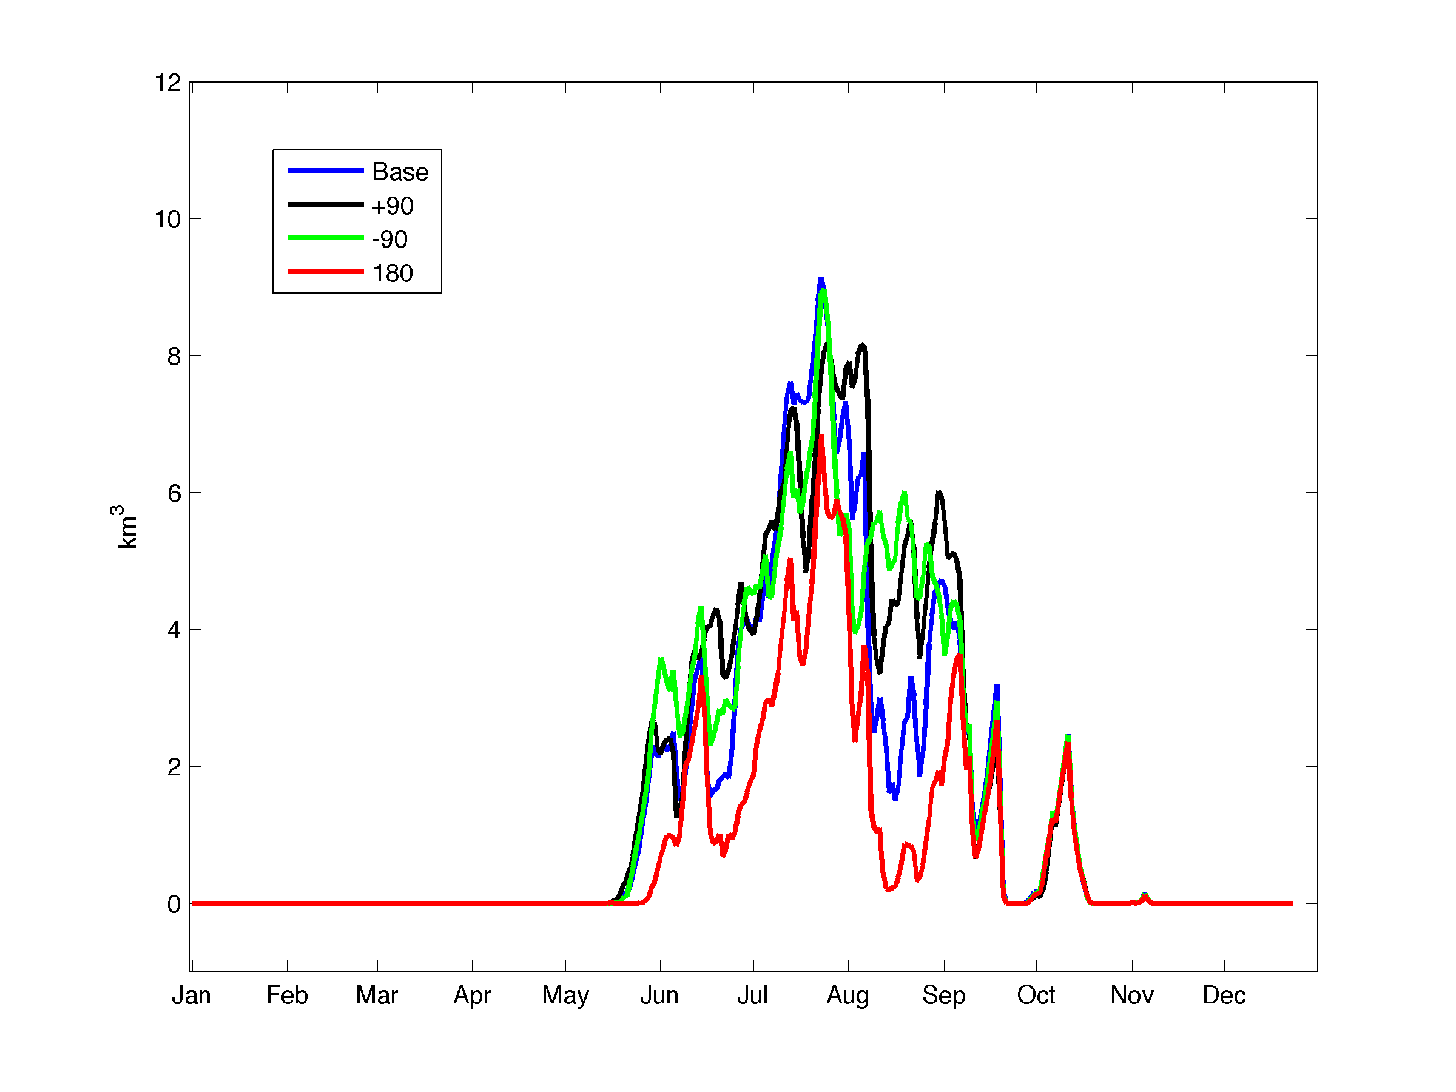
Sensitivity to Summer Wind Direction
Hypoxic Volume (< 1 mg/L)
Integrated volumes:
548 km³days
527 km³days
476 km³days
278 km³days
Changes in wind direction can change the hypoxic volume by a factor of 2
2004

Slide 27
Physical Controls on Hypoxia in Chesapeake Bay
Malcolm Scully
Center for Coastal Physical Oceanography
Old Dominion University
Center for Coastal Physical Oceanography
Virginia Institute of Marine Sciences, Seminar
October 21, 2011
Outline:
Background and Motivation
Simplified Modeling Approach
Importance of Physical Forcing to Seasonal Variations in Hypoxic Volume
  River Discharge
  Heat Flux / Temperature
  Wind (Magnitude and Direction)
Inter-annual Variation in Hypoxic Volume
Conclusions

Slide 28
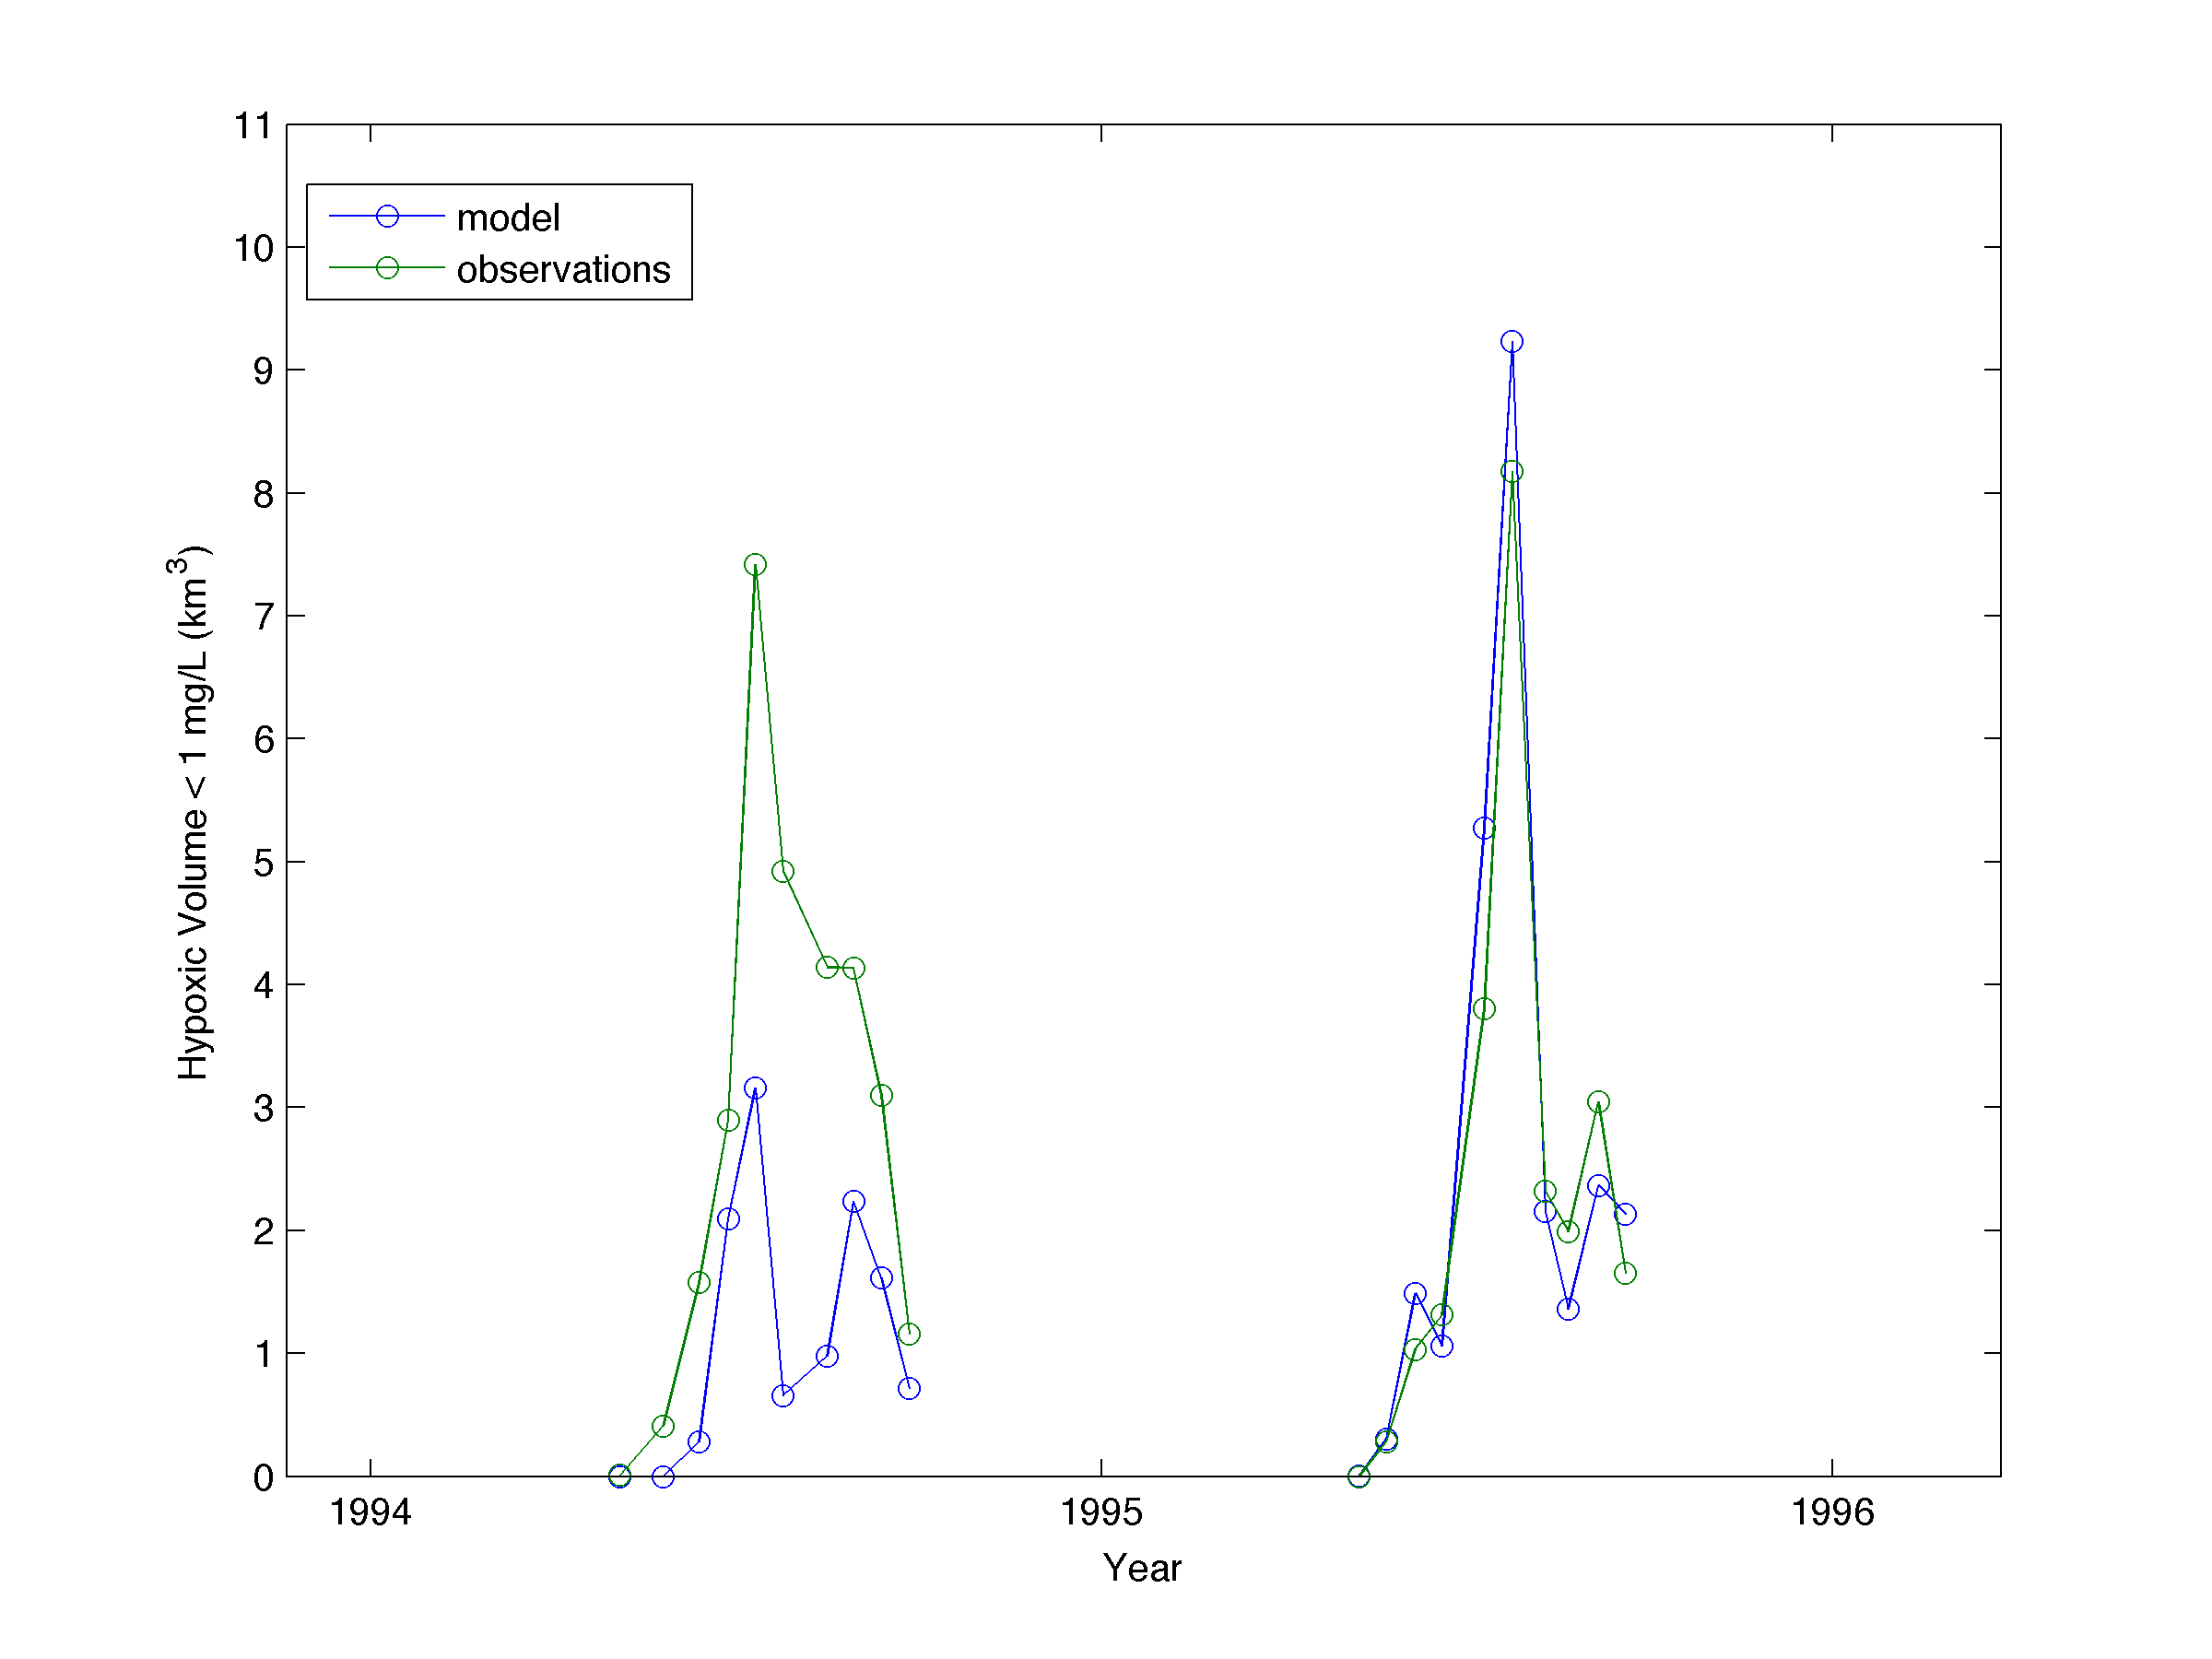
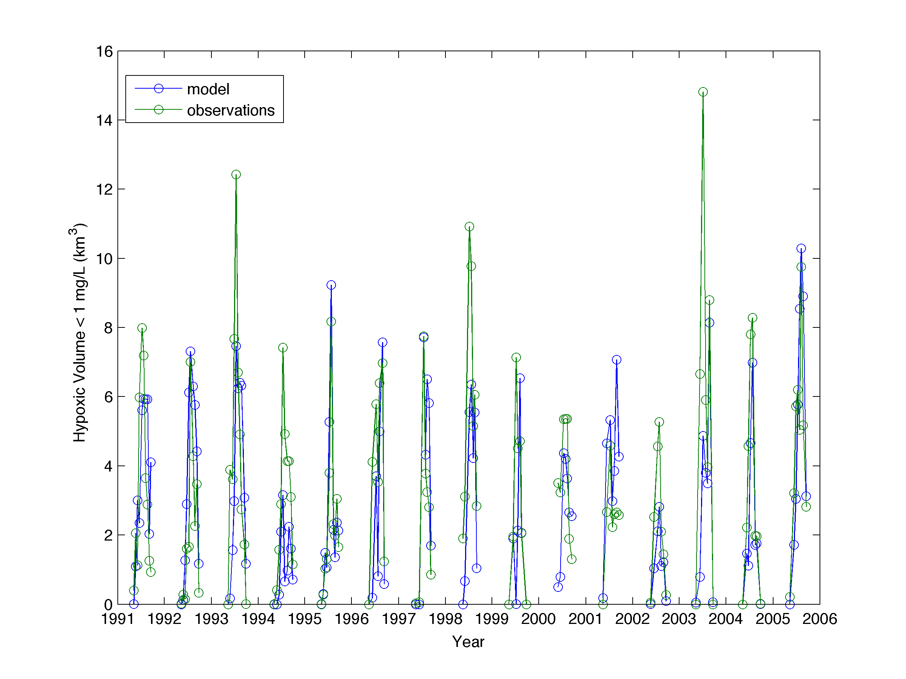
15-year Simulations (1991-2005)

Slide 29
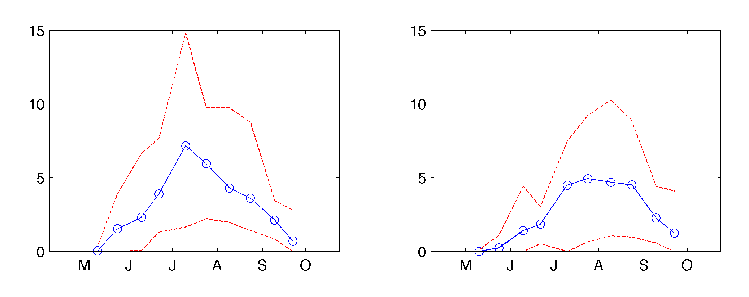
Analysis of 15-year Simulation of Hypoxic Volume (1991-2005)
Bi-monthly Averages
Observations
Model
max
Hypoxic Volume (<1mg/L)
Hypoxic Volume (<1mg/L)
mean
min
month
month
Model with no biologic variability shows significant inter-annual variability
Observations have greater variability than model
Model under predicts in early summer and slightly over predicts in late summer

Slide 30
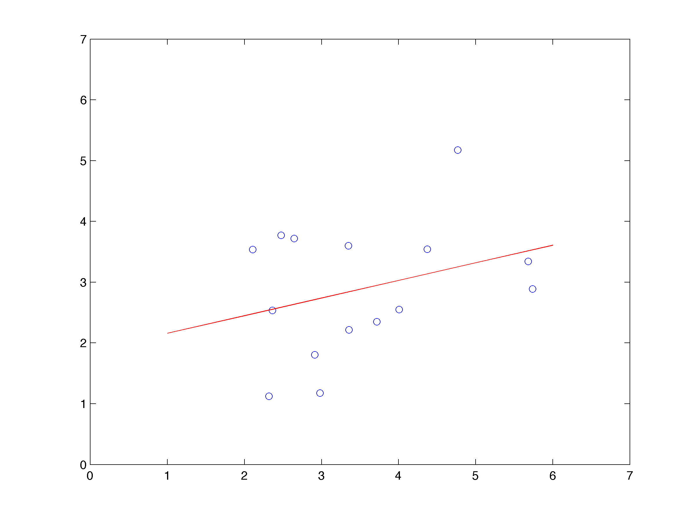
Does variation in physical forcing explain observed inter-annual variability in hypoxic volume?
r = 0.32
p = 0.25
Annual Mean Hypoxic Volume (Modeled)
Not in a statistically significant way!
Annual Mean Hypoxic Volume (Observed)

Slide 31
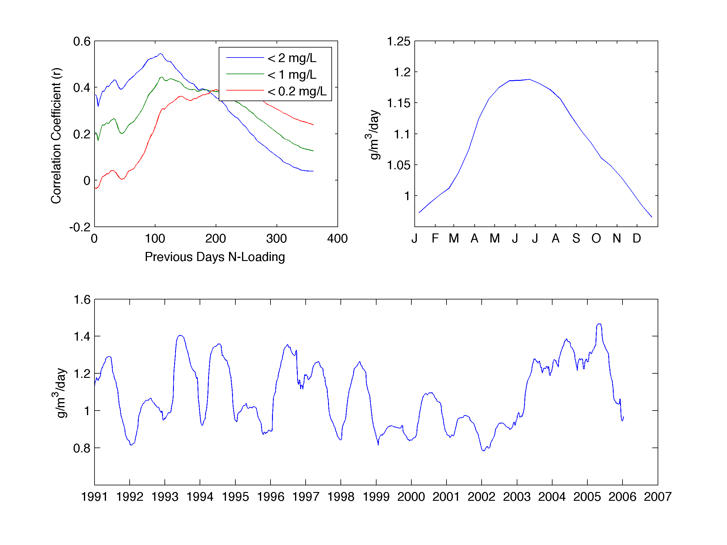
Next Steps: Simplified Load-Dependent Respiration Rate
Monthly-averaged Respiration Rate
Load-Dependent Respiration Rate (Scaled by Integrated Nitrogen Loading—Previous 250 days)

Slide 32
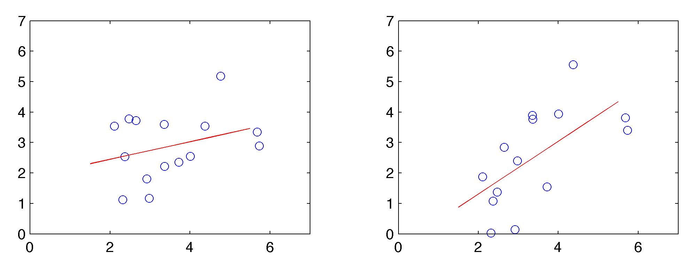
Preliminary Results with Load-Dependent Respiration Rate
Constant Resp. Rate
Load-dependent Resp. Rate
r = 0.315
p =0.252
r = 0.628
p =0.016
Hypoxic Volume (Modeled)
Hypoxic Volume (Modeled)
Hypoxic Volume (Observed)
Hypoxic Volume (Observed)

Slide 33
Conclusions
A relatively simple model with no biological variability can reasonably account for the seasonal cycle of hypoxia in Chesapeake Bay.
Wind speed and direction are the two most important physical variables controlling hypoxia in the Bay.
Model results are largely insensitive to variations in river discharge, when the role of nutrient delivery is not accounted for.
Changes in air temperature and the associated changes in water temperature via sensible heat flux can have a measurable influence on the overall hypoxic volume.
A 15-year model simulation with constant respiration rate produces significant inter-annual variability in hypoxic volume, by largely fails to reproduce the observed variability.
Model residuals are significantly correlated with the integrated Nitrogen loading demonstrating the importance of biological processes in controlling inter-annual variability
Preliminary attempts to include the effects of nutrient loading though a load-dependent respiration formulation show promise for capturing observed inter-annual variability.

