Slide 1
Landscape Evolution Modeling ERODE
Irina Overeem, February 2013

Slide 2
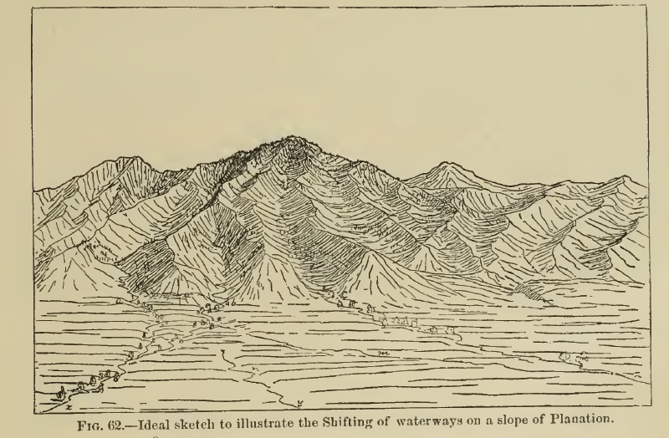
Early Landscape Evolution Model
Gilbert, 1877, ‘The Geology of the Henry Mountains’
Gilbert describes weathering, erosion processes and shifting of drainage divides
and waterways in Utah mechanistically.

Slide 3
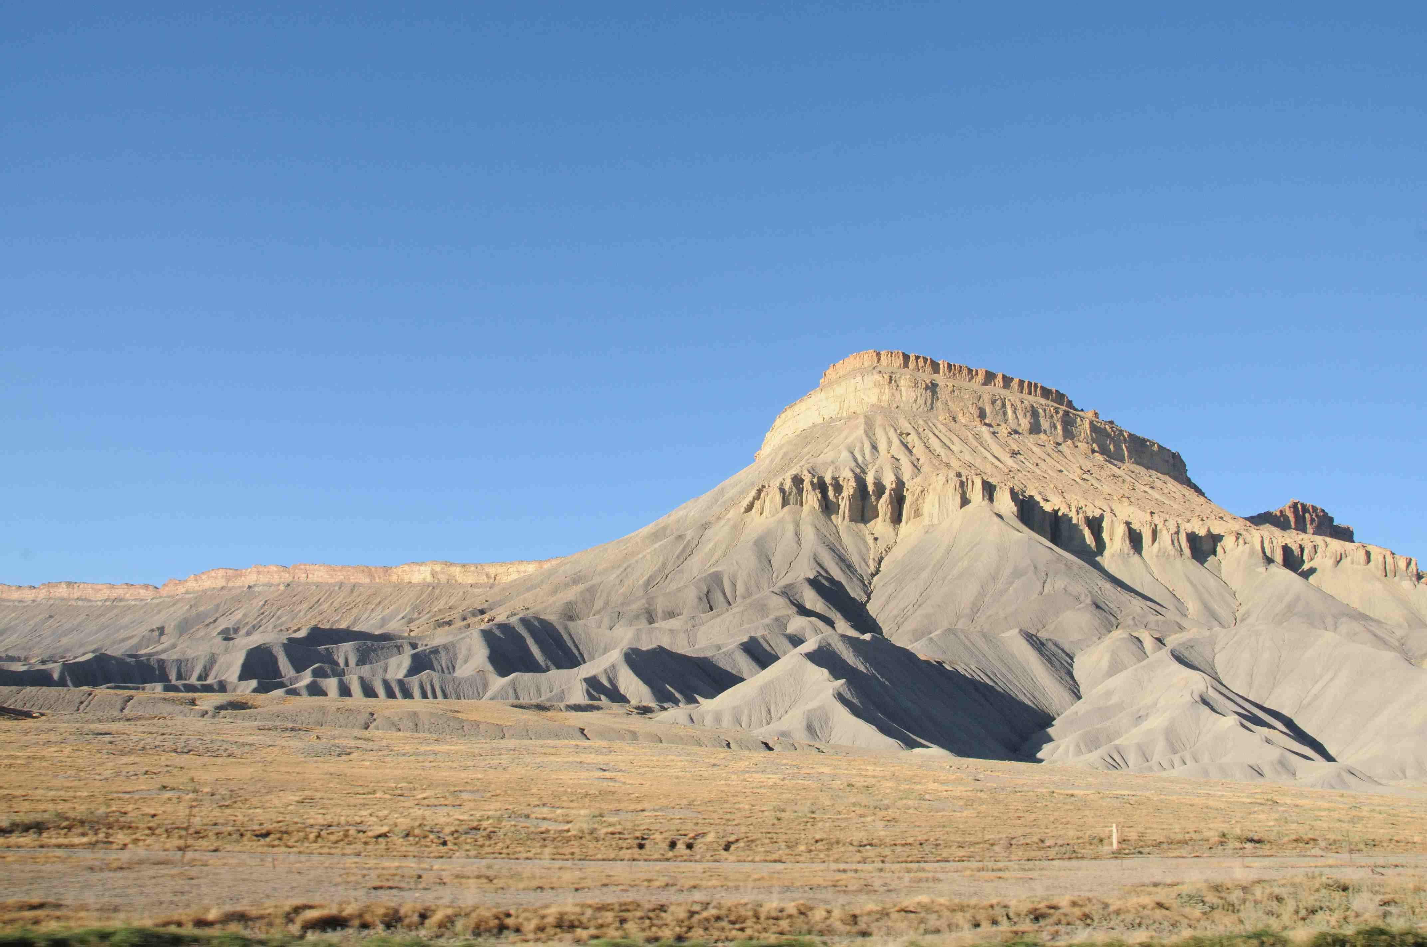
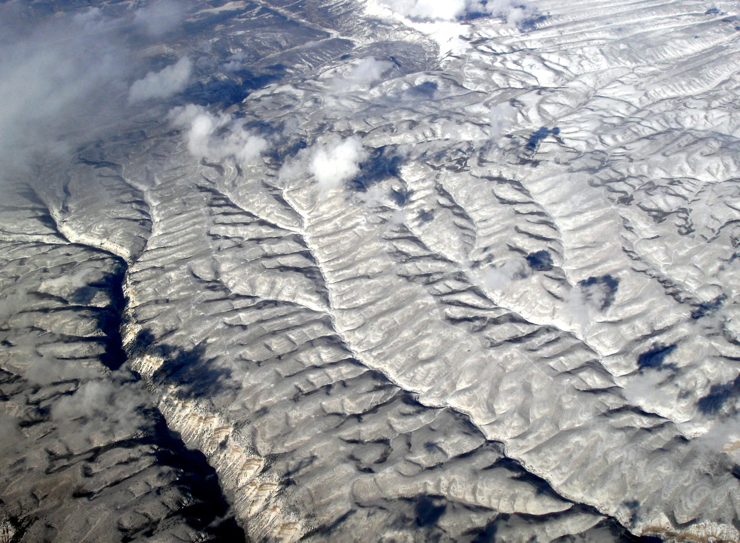
Landscape Evolution Model
Definition: mathematical theory describing how the actions of various geomorphic processes drive the evolution of topography over time.
Reference: Tucker & Hancock, 2010. Modelling landscape evolution. Earth Surface Processes and Landforms
Hillslopes
Stream and River Transport

Slide 4
Components to Landscape Evolution Model
Formulations for:
Continuity of mass
Runoff generation and Routing of water
Erosion-Transport laws for hillslope sediment
Erosion - Transport laws for river sediment

Slide 5
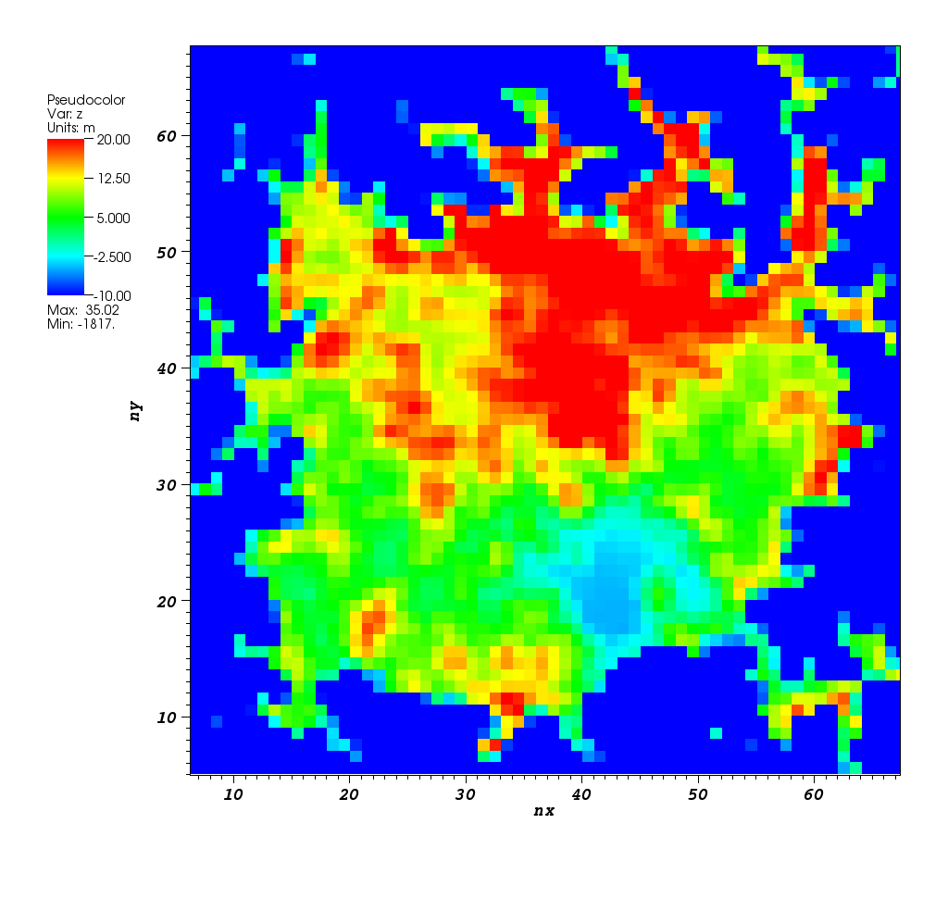
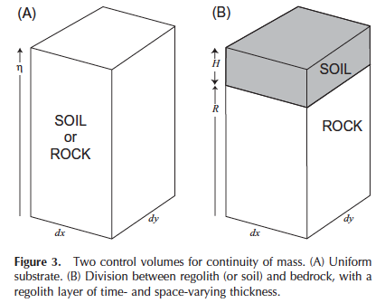
Raster Model
Any cell receive water and mass flux from
‘upstream’ cells, so we need to know drainage
pattern

Slide 6
‘D8 Algorithm’ for Drainage
We assume that water and mass flows into the
direction of the steepest slope:
COI
S = slope [-]
Δz= z_coi – z_neighbor [L]
d = distance [L]
What are the lengths, d, for the two potential drainage directions?

Slide 7
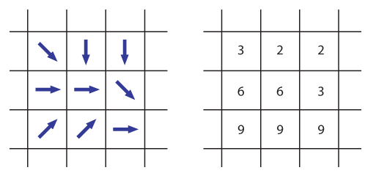
D8 Grid for Entire DEM
Assumption: The grid cell size is chosen to be smaller than the hillslope scale and larger than the width of the largest channel. Every grid cell then has ‘one channel’ associated with it that extends from the centre of the grid cell to the centre of the grid cell that it flows to according to the D8 method.
Notes:
The grid cell size is generally chosen to be smaller than the hillslope scale and larger than the width of the largest channel. Every grid cell then has
one channel associated with it that extends from the centre of the grid cell to the
Centre of the grid cell that it flows to according to the D8 method.

Slide 8
Continuity Equation in ERODE
TROC of mass = mass rate in – mass rate out
If the entire cell would be impacted by tectonic uplift (U):

Slide 9
Runoff Equation of ERODE
Q = water transport rate [L³/T]
R = rain rate [L/T]
A = contributing area[L²]
p = Q-A coefficient [-]

Slide 10
Sediment Transport Equation in ERODE
Qs = sediment transport rate [L³/T]
K = erodibility
Q = water discharge [L³/T]
S = slope [-]
m = discharge coefficient [-]
n = slope coefficient [-]

Slide 11
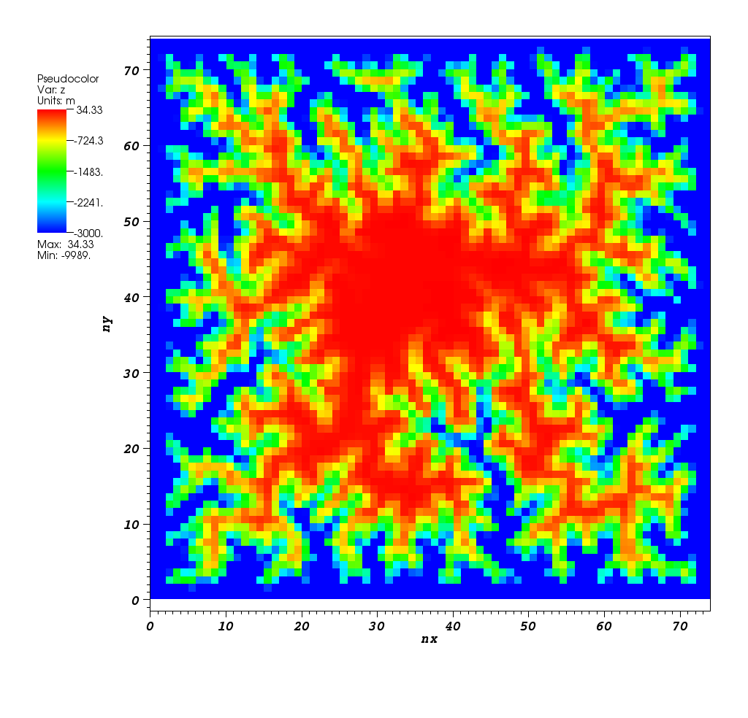
Output: Elevation Grids over Time
T ~ 200,000 years
T ~ 9,000,000 years

Slide 12
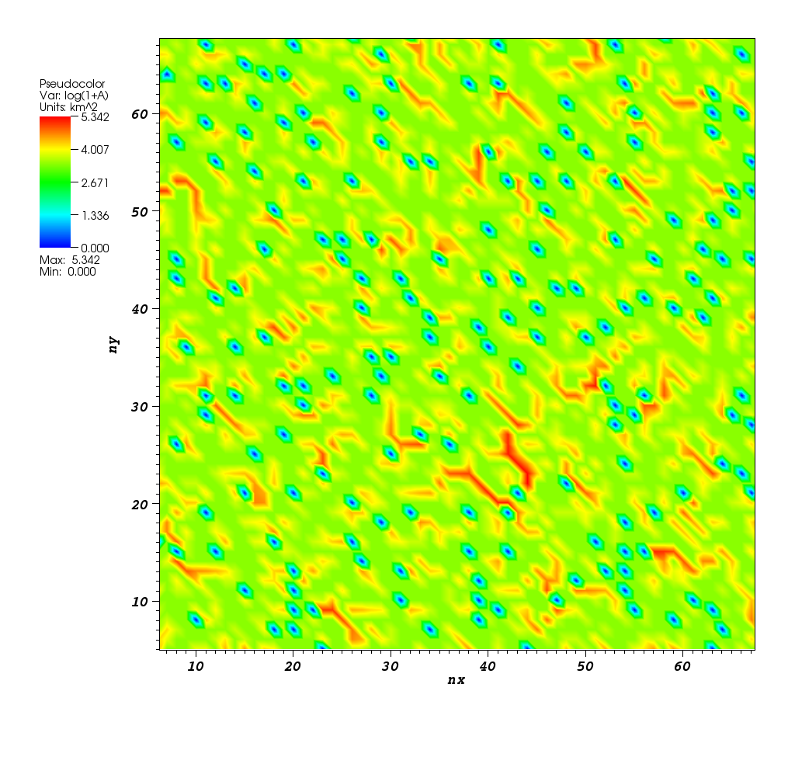
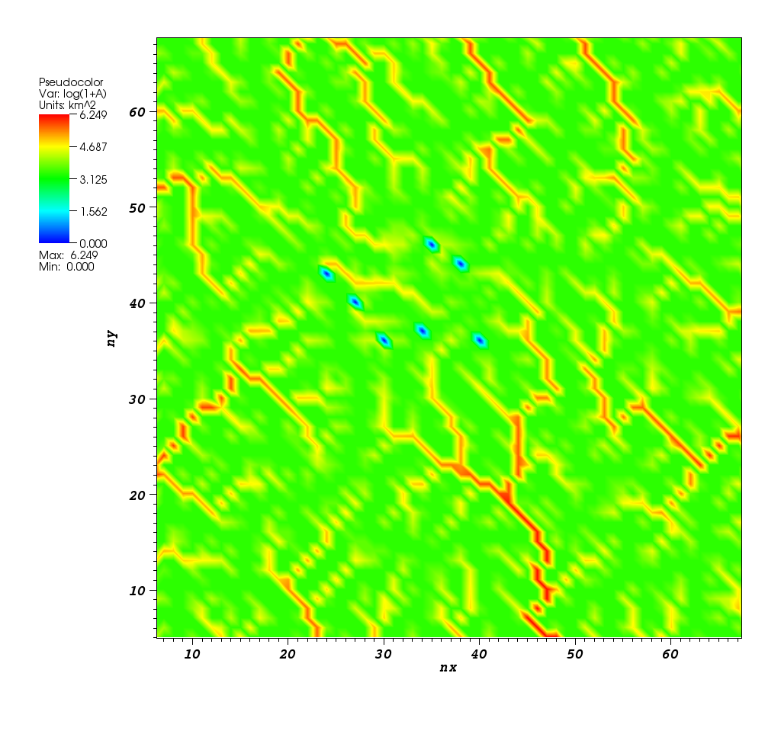
Output: Contributing Area Grids

Slide 13
Adaptive Time-Stepping CLF criterion
Courant-Friedrichs-Lewy Condition
A condition in numerical equation solving which states that, given a space discretization, a time step bigger than some computable quantity should not be taken.

