Slide 1
River Plumes
Irina Overeem, March 2013

Slide 2
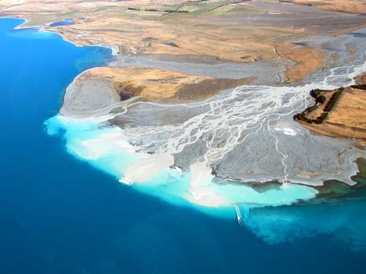
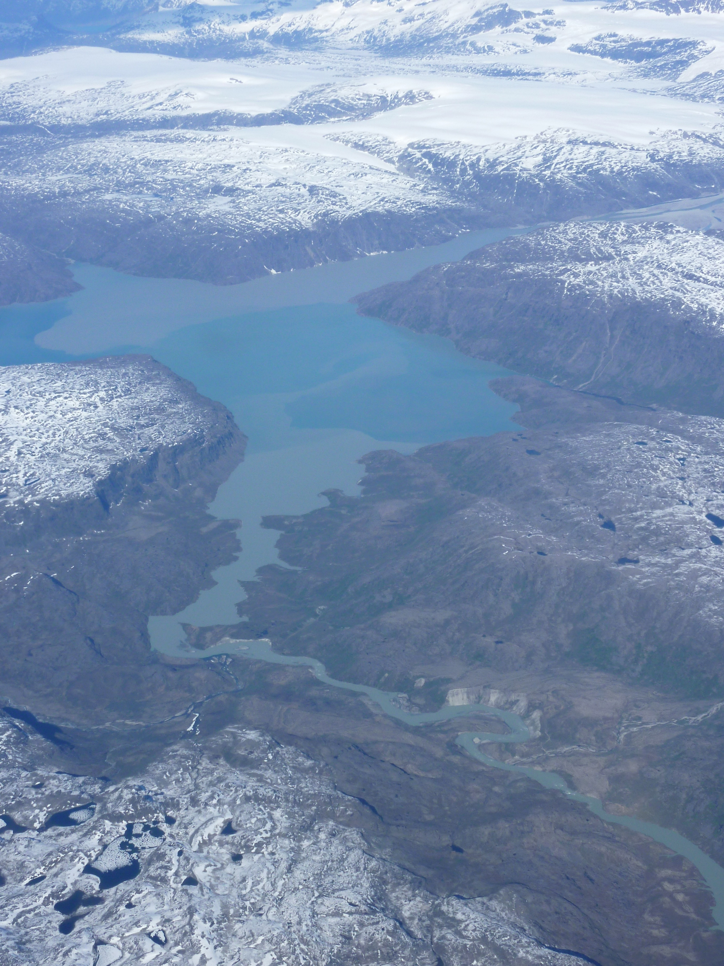
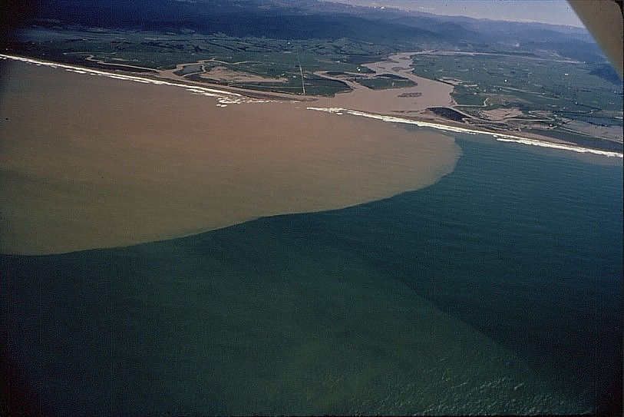
What is a River Plume?
Greenlandic River Plume, July 2010
Cass River Plume, NZ
Eel River Plume, CA 1974 flood

Slide 3
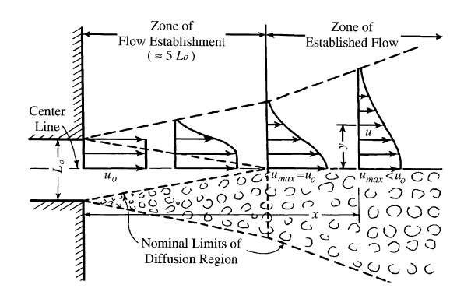
Concept of a Plume
After: Albertson, M.L., Dai, Y.B., Jensen, R.A., Hunter, R., 1950,
Diffusion of submerged jets. American Society Civil Engineers Trans, v. 115, p. 639-697.

Slide 4
Hypopycnal Plume
Steady 2D advection-diffusion equation:
  where: x, y are coordinate directions
  u, v are velocities
  K is turbulent sediment diffusivity / eddy diffusivity
  I is sediment inventory
  λ is the first-order removal rate constant
Albertson, M.L., Dai, Y.B., Jensen, R.A., Hunter, R., 1950,
Diffusion of submerged jets. American Society Civil Engineers Trans, v. 115, p. 639-697.
Notes:
Albertson et al, 1950

Slide 5
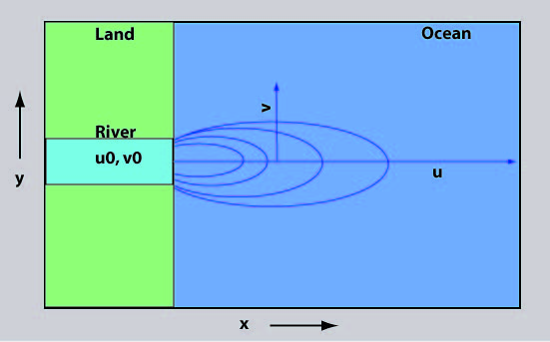
Steady 2D advection-diffusion equation:
  where: x, y are coordinate directions (m)
  u, v are velocities (m/s)
  K is turbulent sediment diffusivity (m²/s)
  I is sediment inventory (kg/m²)
  λ is defined per grainsize,
  it is the removal rate constant (1/s). This is also often called the settling rate.
Notes:
Albertson et al, 1950

Slide 6
Simple Plume Experiment

Slide 7
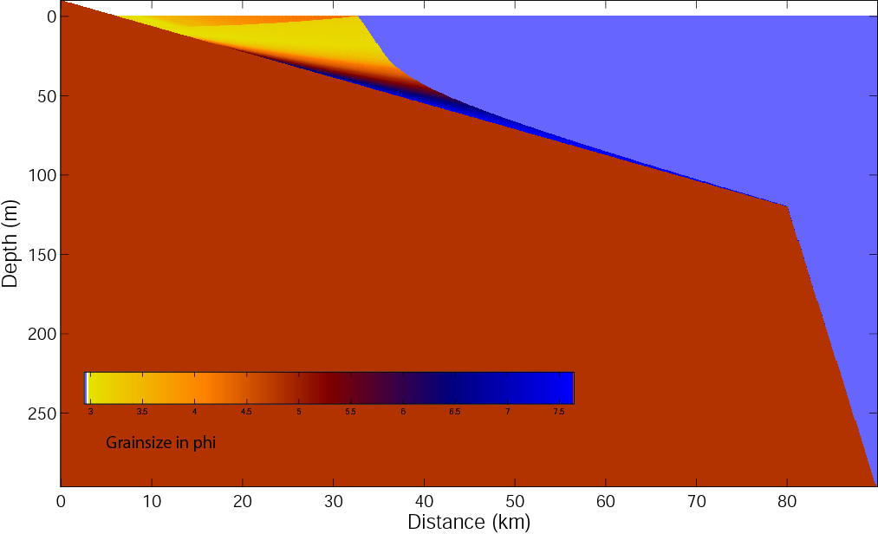
Simple Plume Experiment
Simple 1000 year 2D SedFlux experiment of 1000 year duration
- generic bathymetric profile (at 80 km, -120m waterdepth, dropping to 300m)
stable sediment input and water discharge
slow sea level rise

Slide 8
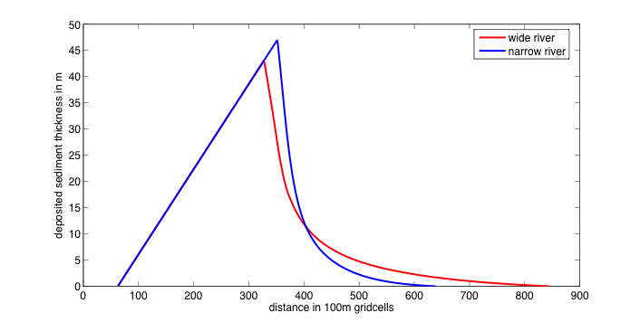
River mouth dependent deposition
Simple 1000 year Sedflux experiment with stable sediment input and slow sea level rise, stable total daily discharge:
Wide River scenario: width = 750m, depth=1.66m
Narrow River scenario: width = 125 m, depth =10m

Slide 9
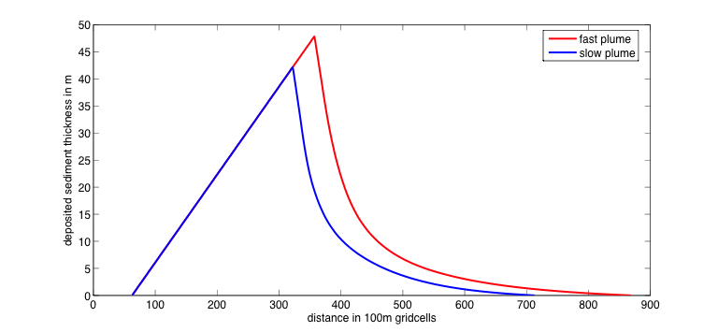
River velocity dependent deposition
Simple 1000 year 2D SedFlux experiment with stable sediment input and slow sea level rise, stable total daily discharge:
Fast Plume scenario: u0 = 1.2 m/sec
Slow Plume scenario: u0 = 0.8 m/sec

Slide 10
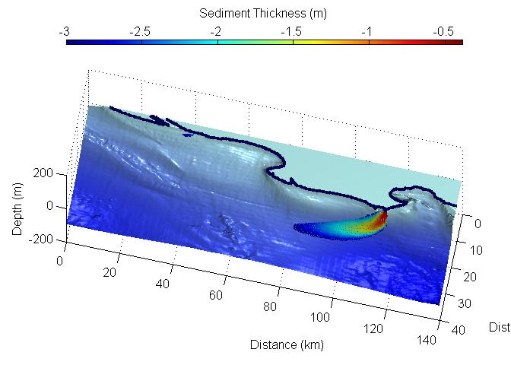
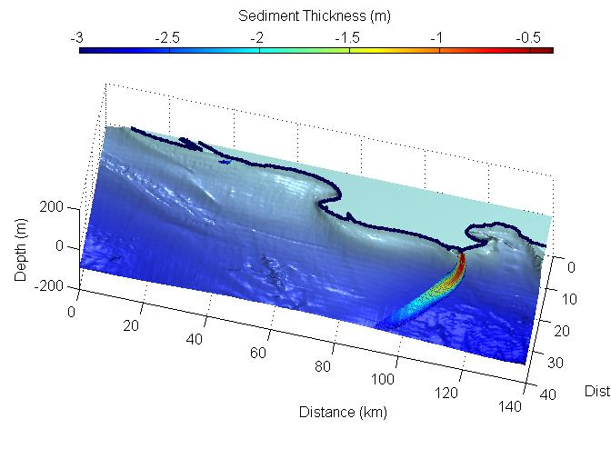
Plume examples
River Mouth Angle = 15 º
River Mouth Angle = 45 º

Slide 11
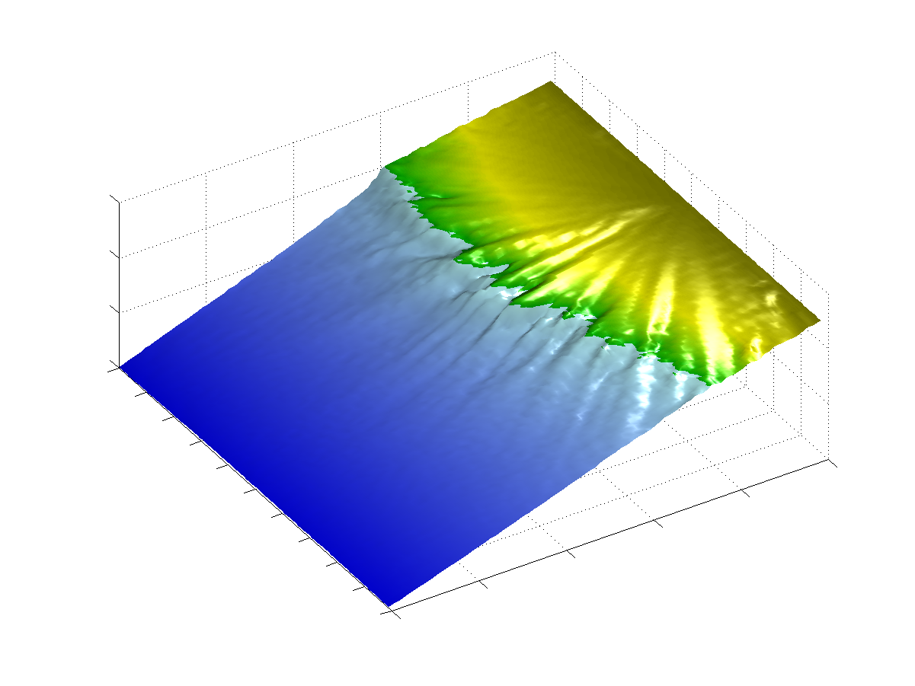
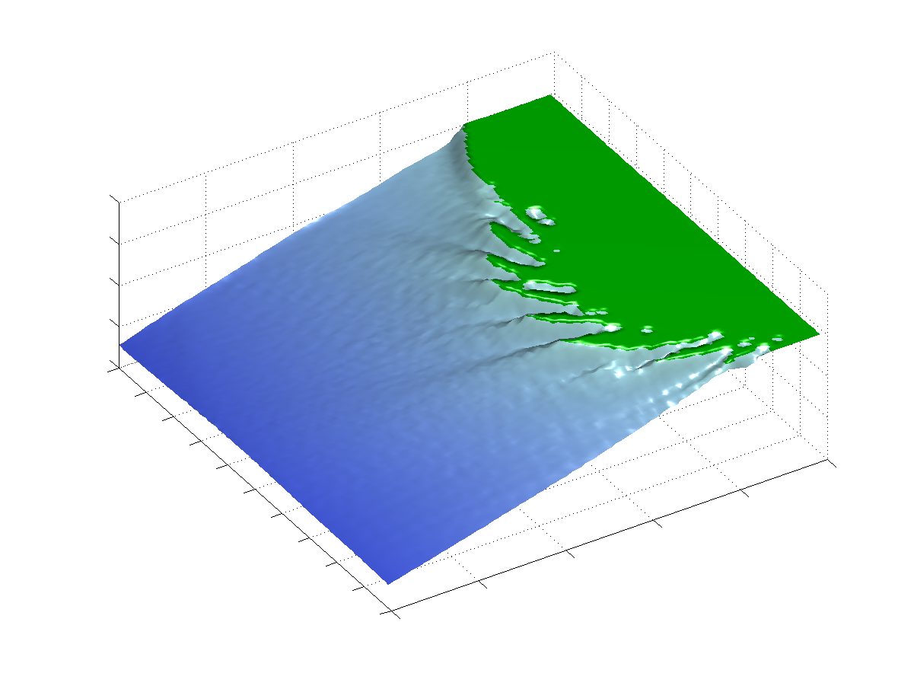
External factors influencing plumes
The shape that a hypopycnal plume will have, depends on a variety of factors:
Angle between the river course at the entry point and the coastline.
Strength and direction of the coastal current.
Wind direction and its influence on local upwelling or downwelling conditions.
Mixing (tidal or storm) energy near the river mouth.
Latitude of the river mouth and thus the strength of the Coriolis effect.
Coriolis effect
Curved plumes
Notes:
Overeem, I., Syvitski, J.P.M., Hutton, E.W.H., (2005). Three-dimensional numerical modeling of deltas. SEPM Spec. Issue, 83. ‘River Deltas: concepts, models and examples’. p.13-30.

Slide 12
References
Albertson, M.L., Dai, Y.B., Jensen, R.A., Hunter, R., 1950, Diffusion of submerged jets. American Society Civil Engineers Trans, v. 115, p. 639-697.
Bates, C.C., 1953, Rational theory of delta formation. AAPG Bulletin, v. 37, p. 2119-2162.
Syvitski, J.P.M., Skene, K.I., Nicholson-Murray, K., Morehead, M., 1998a, PLUME 1.1; deposition of sediment from a fluvial plume. Computers & Geosciences, v. 24, 2, p. 159-171.
Nemec, W., 1995, The dynamics of deltaic suspension plumes In: Oti, M.N., Postma, G.(eds.). Geology of deltas, Balkema, Rotterdam, The Netherlands. p. 31-93.
Overeem, I., Syvitski, J.P.M., Hutton, E.W.H., (2005). Three-dimensional numerical modeling of deltas. SEPM Spec. Issue, 83. ‘River Deltas: concepts, models and examples’. p.13-30.

