Slide 1
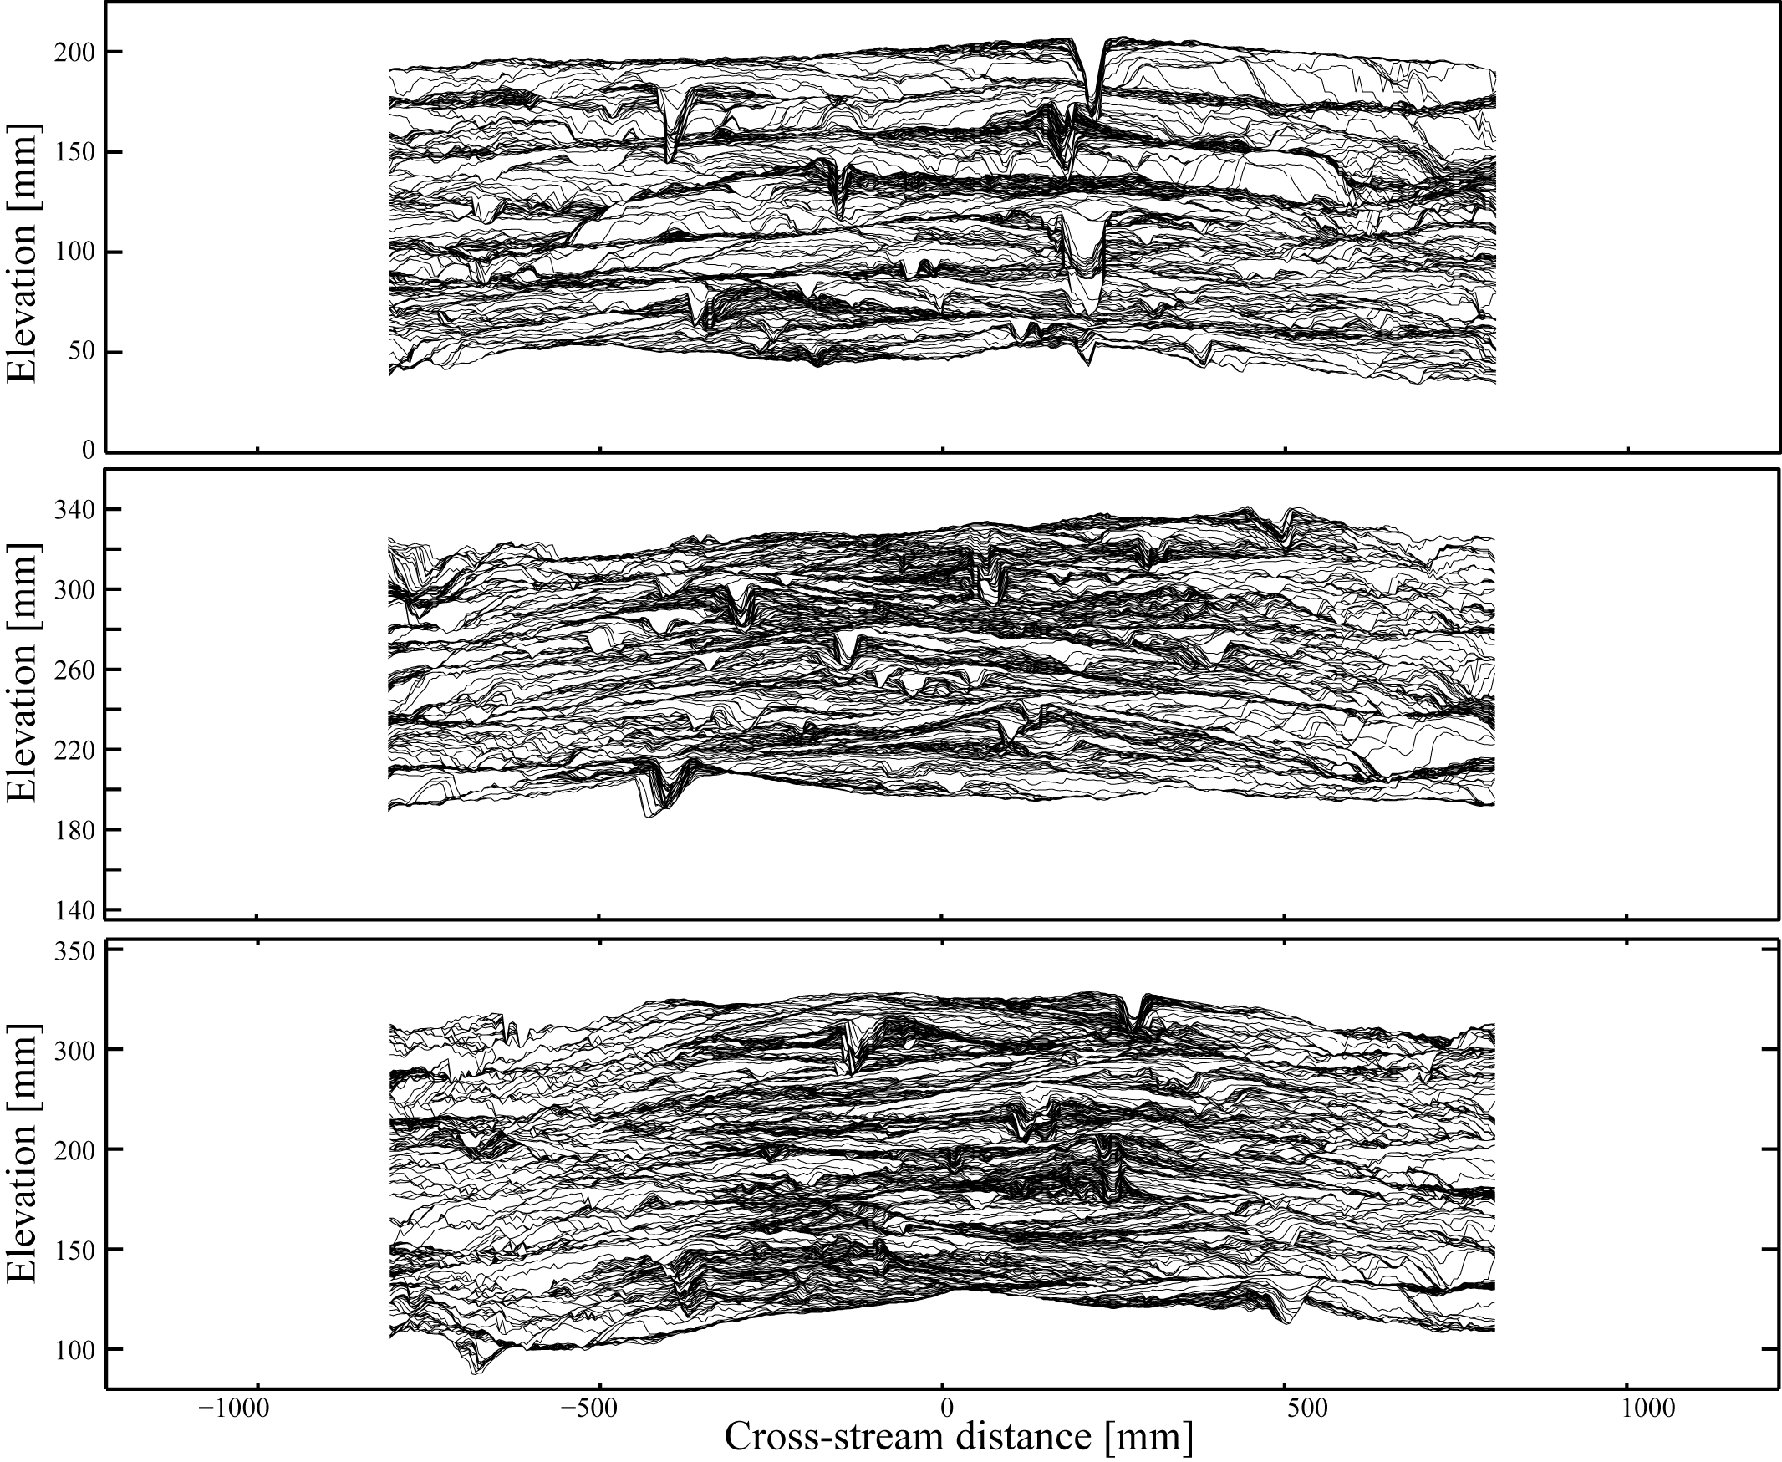
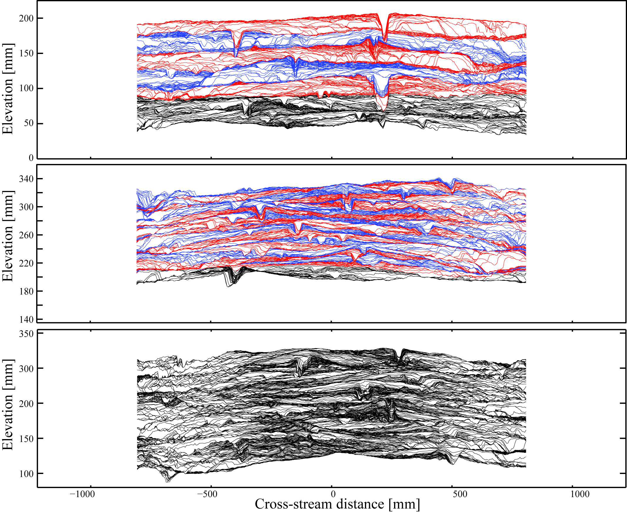
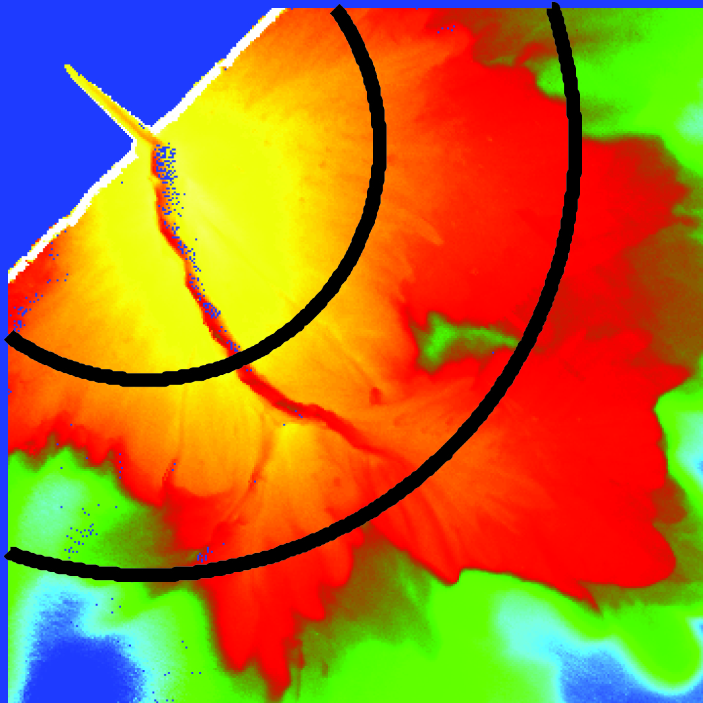
Proximal Synthetic Stratigraphy
4 H*, 2 T*
V.E. = 2.8
0.6 m
0.5H*, 0.5 T*
0 H*, 0 T*

Slide 2
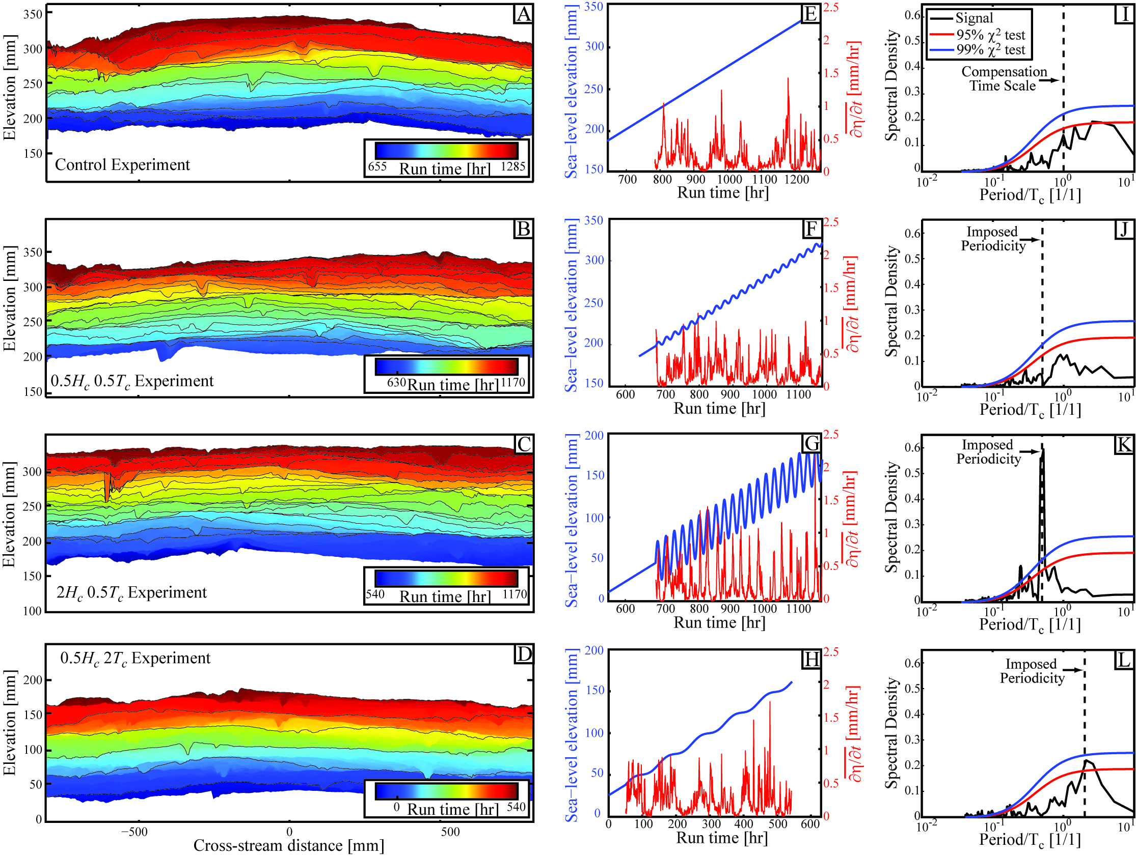
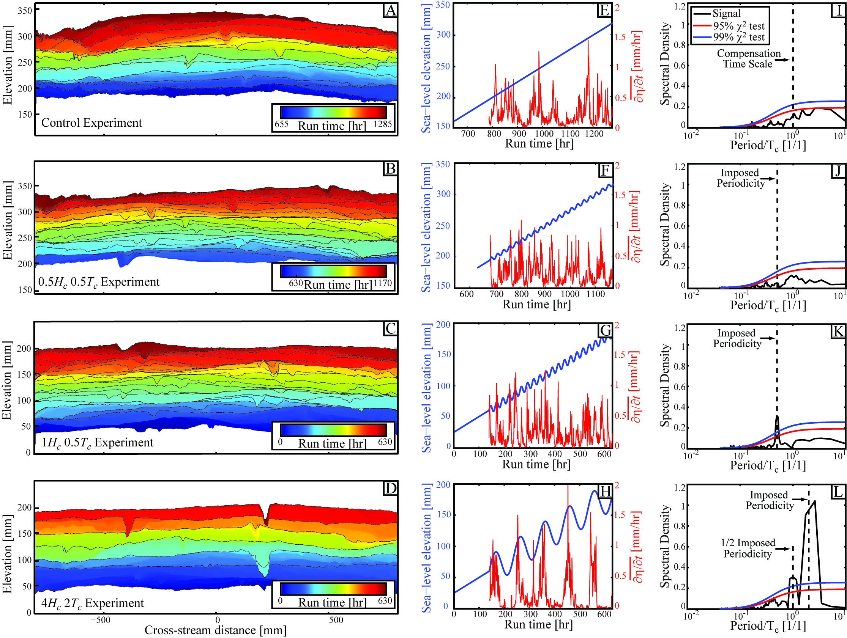
Shredding Results along X-section 600 mm from source
0 H*, 0 T*
0.6 m

Slide 3
Shredding Results along X-section 600 mm from source
0 H*, 0 T*
2 H*, 0.5 T*
0.6 m

Slide 4
Shredding Results along X-section 600 mm from source
0 H*, 0 T*
2 H*, 0.5 T*
0.5 H*, 2 T*

Slide 5
Shredding Results along X-section 600 mm from source
0 H*, 0 T*
0.5H*, 0.5 T*
Analogous to modulated turbulence [von der Heydt et al., 2003] and shredding of sediment flux signals [Jerolmack & Paola, 2010] there is no evidence of periodicity in stratigraphy when H* and T* < ~0.6.

Slide 6
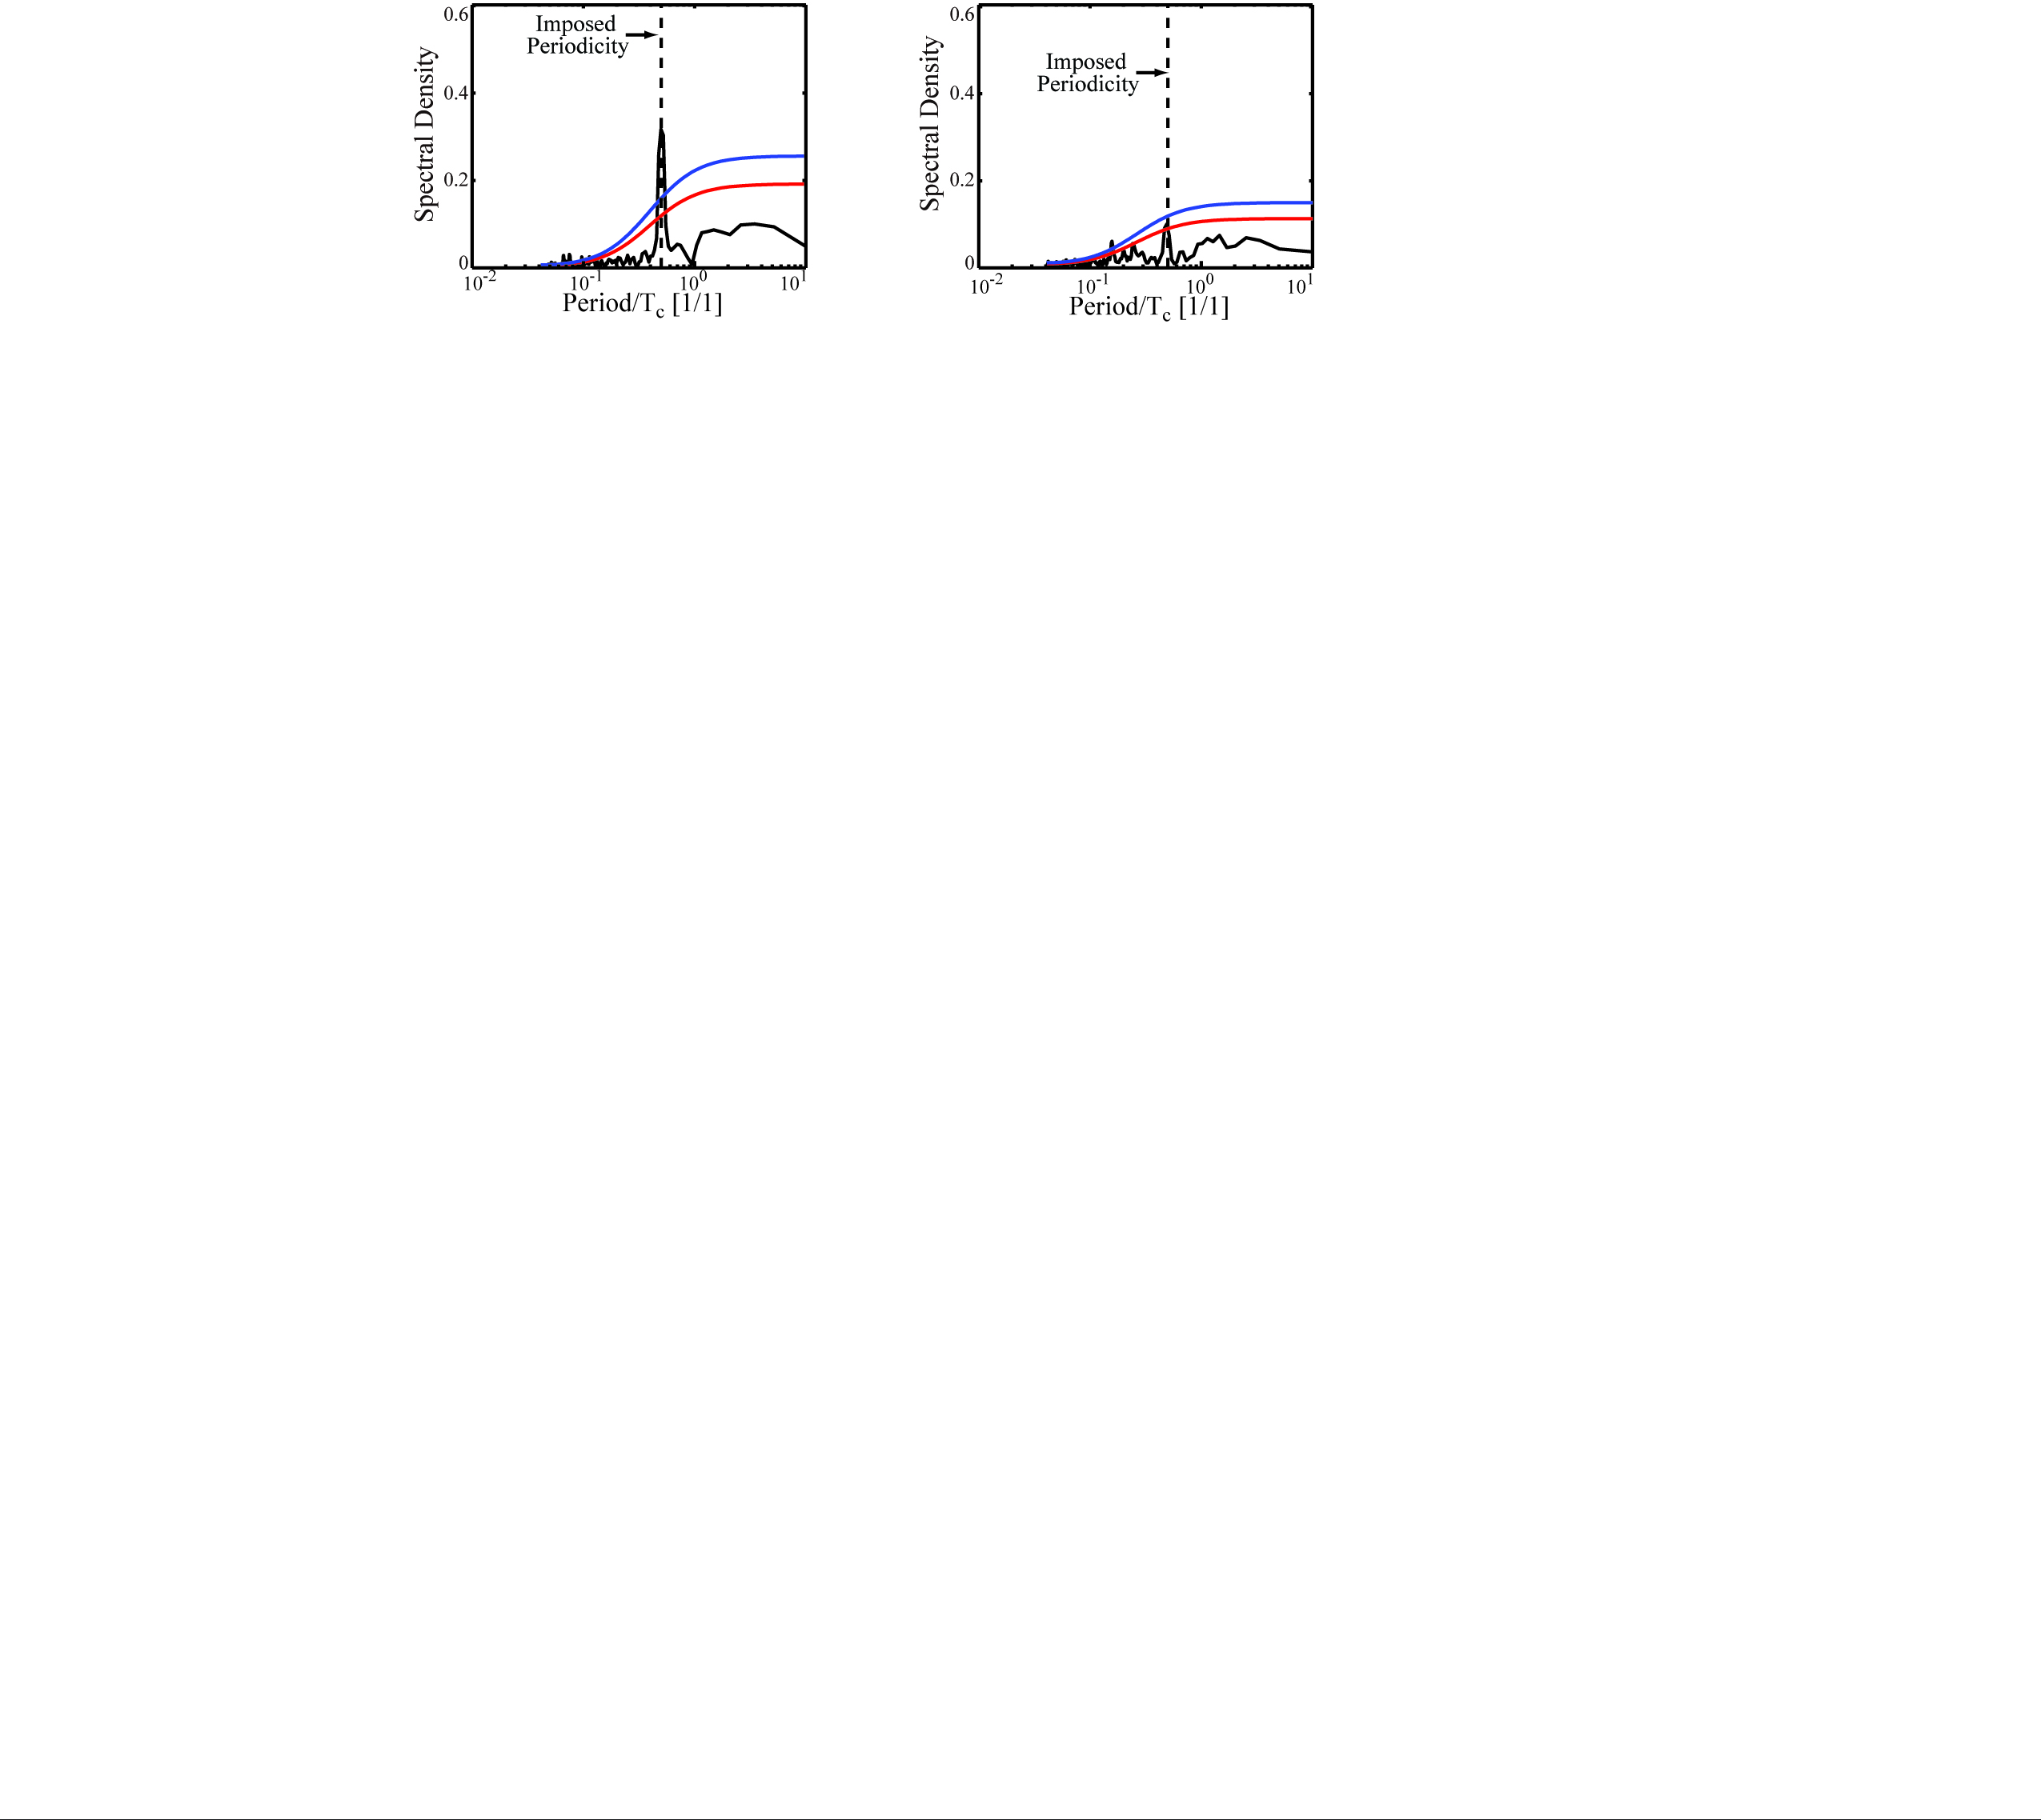
Additional Notes
600 mm from basin source
~ Average Backwater Transition
1100 mm from basin source
~ Average Shoreline Location
Optimal signal storage, in our experiments, does not occur at shoreline. It occurs at average backwater transition location.
Both from H* = 1 T* = 0.5 Experiment
H* = 2 T* = 0.5
H* = 0.5 T* = 2
Magnitude (Range) of RSL cycle appears to be more important than Period for signal storage (But both are important!)
600 mm from source for both

Slide 7

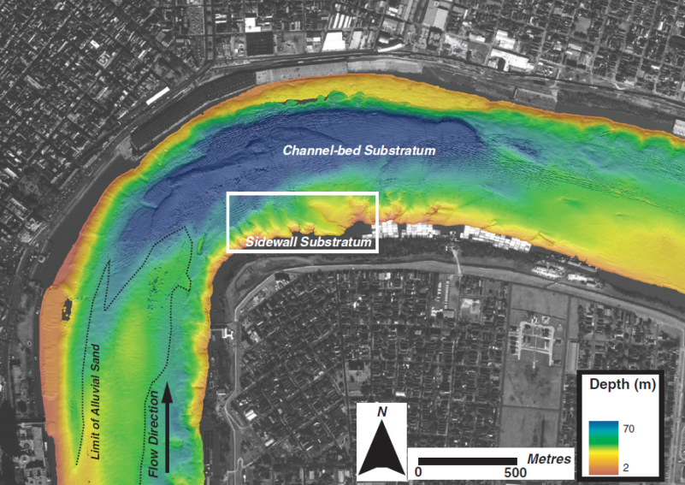
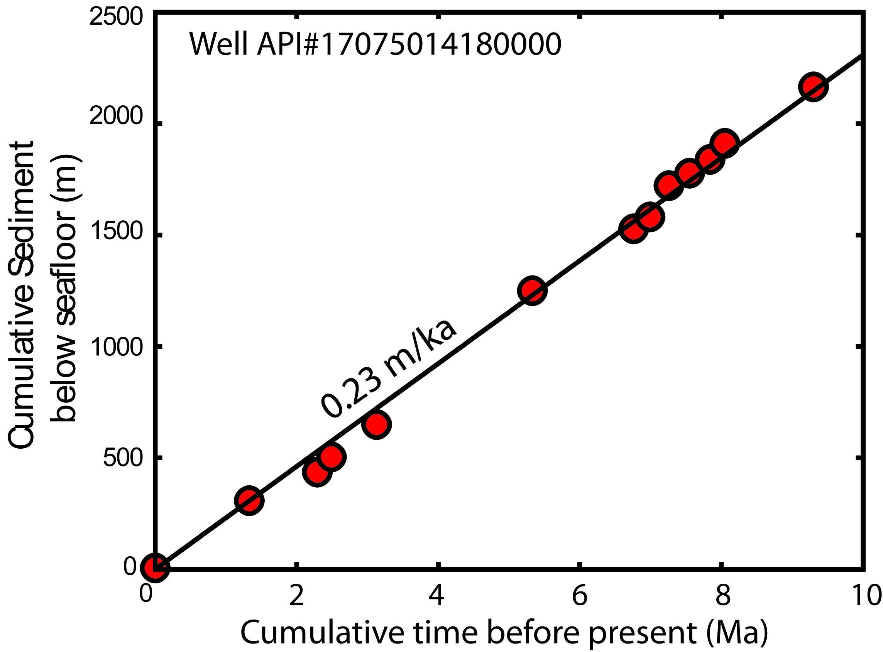
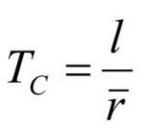
Autogenic time-scales for field scale systems
Channel depth of lower Mississippi river: 50 m
Nittrouer et al., 2013
Long-term sedimentation rate:
0.23 m/kyr
(Straub et al., 2009)
Photo Credit:
Cdr. Chris Hadfield
~217,000 yrs
Calculated autogenic time-scale (T_{c}) is long in comparison to many allogenic time-scales (e.g. Milankovitch Cycles)

