Slide 1
Kudryavtsev 1D Model
Lecture 2
Permafrost Modeling Short Course

Slide 2
What is the Active Layer?
35% of the terrestrial surface experiences mean annual temperature < 0 °C
Permafrost = ground that remains at or below 0 °C for two or more consecutive years.
Layer that seasonally thaws = ‘active layer’

Slide 3
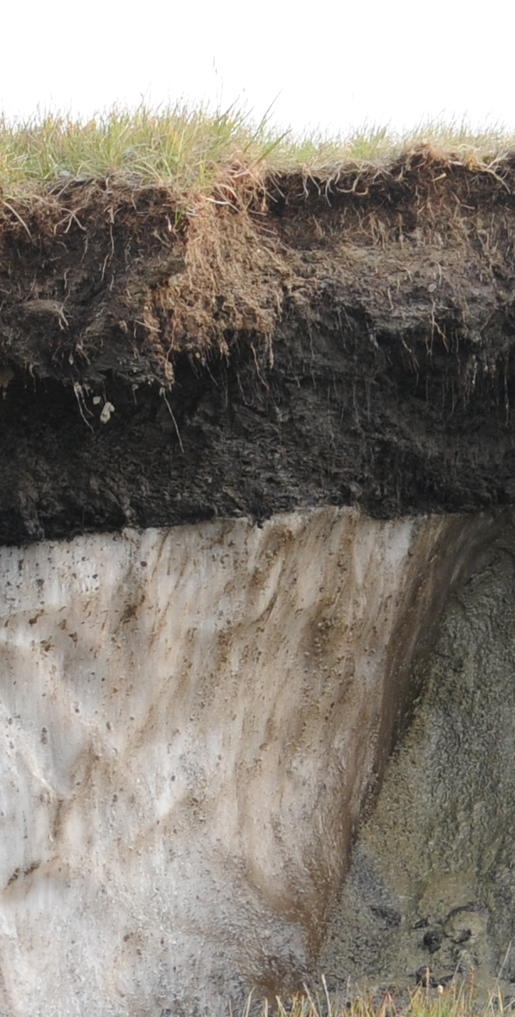
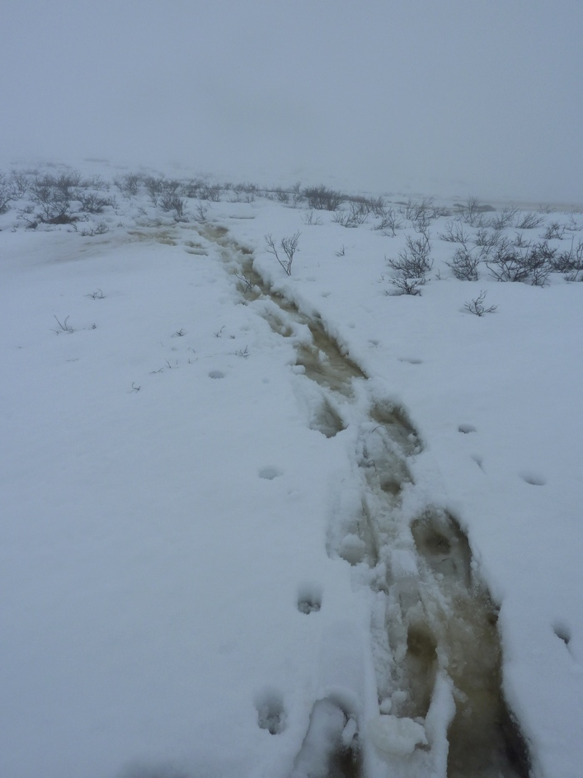
Air temperature and what more?
Organic layer and/or vegetation
Seasonal Snow cover
Images Irina Overeem

Slide 4
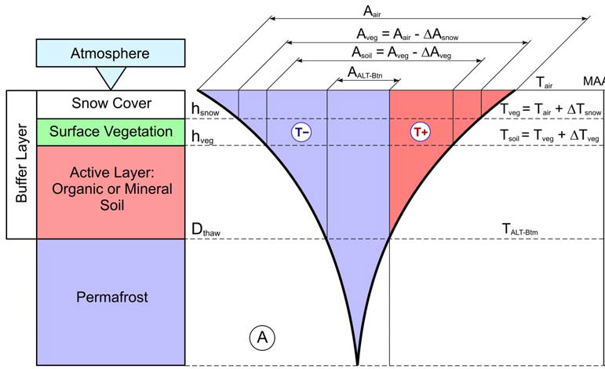
Kudryavstev Model
The Ku model is an semi-empirical model originally developed in 1970s.
It essentially is an thermal equilibrium model

Slide 5
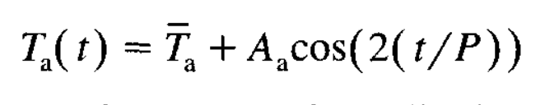
Cosine Approximation of Annual Temperature Distribution
A_{a} = annual amplitude of air temperature in °C
T_{a} = mean annual temperature in °C
P = period of temperature cycle (1 year in secs)
Note that the cosine is shifted to have the cosine start in January
(to fall on the low point in the curve)
Note: this is a similar approach as for the Frost number, see lesson 1.

Slide 6
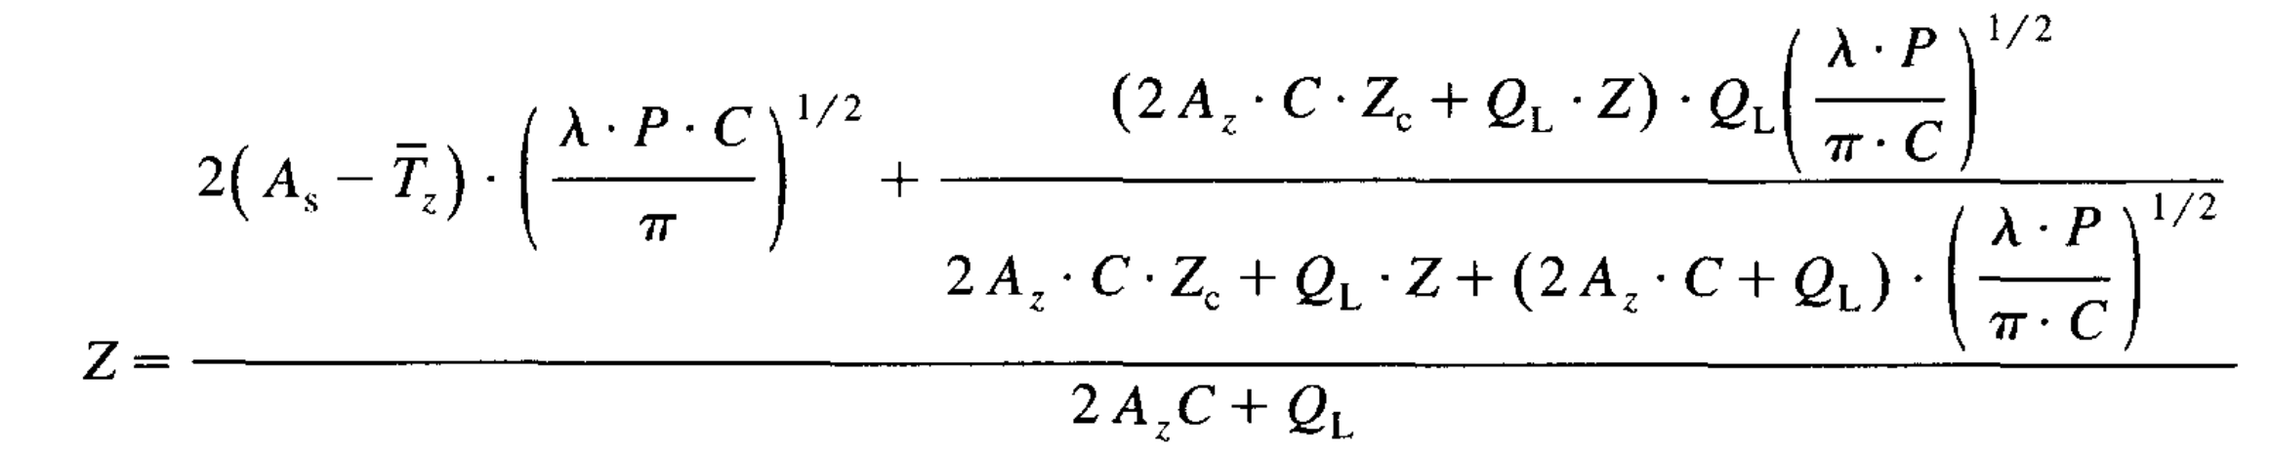
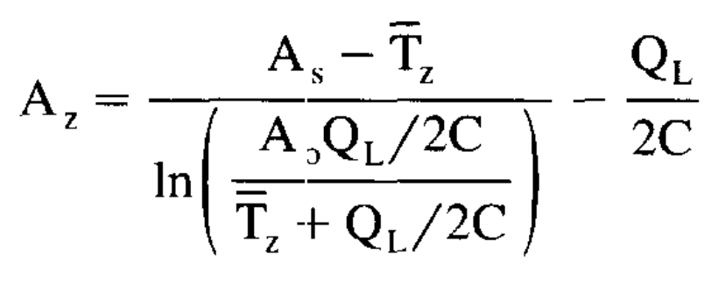
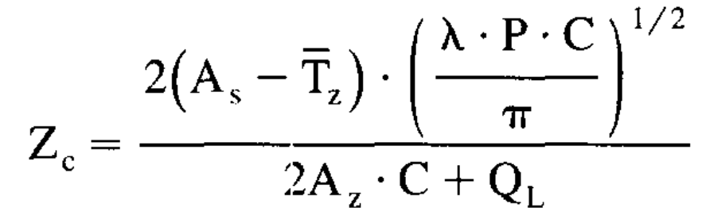
Depth to freezing or thawing (Z)
A_{s} = annual amplitude of surface temperature
T_{z} = mean annual temperature at depth of seasonal thawing
λ = thermal conductivity W m⁻¹ C⁻¹
C = volumetric heat capacity J m⁻³ C⁻¹
Ql = volumetric latent heat of fusion J m⁻³

Slide 7
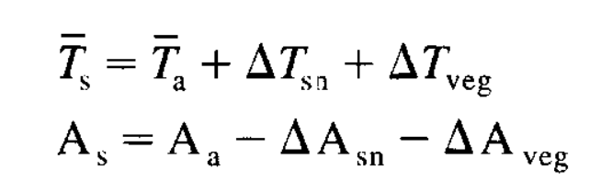
Consider temperature at each layer interface separately
Temperature and annual amplitude at the soil surface (s) depends on the thermal effects of snow and vegetation.
(Anisimov et al., 1997)

Slide 8
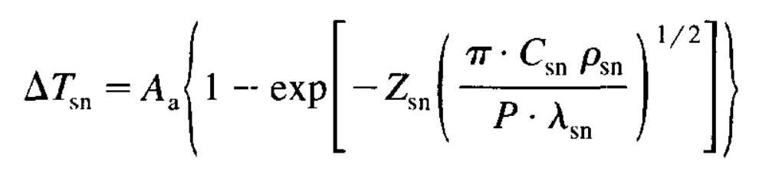
Snow thermal effect
Z_{sn} = snow cover thickness in m
λ_{sn} = snow thermal conductivity W m⁻¹ C⁻¹
C_{sn} = snow volumetric heat capacity J m⁻³ C⁻¹
ρ_{sn} = density of snow in kg m⁻³

Slide 9
References
Anisimov, O. A., Shiklomanov, N. I., & Nelson, F. E. (1997). Global warming and active-layer thickness: results from transient general circulation models. Global and Planetary Change, 15(3-4), 61-77. DOI:10.1016/S0921-8181(97)00009-X
Sazonova, T.S., Romanovsky, V.E., 2003. A model for regional-scale estimation of temporal and spatial variability of active layer thickness and mean nnaual ground emperatures. Permafrost and periglacial processes 14, 125-139. DOI: 10.1002/ppp.449

Slide 10

Notes with Lab Exercises
The next few slides contain notes & answers with the lab questions.
Do the lab first, then check back here.

Slide 11
Notes with Lab 2 Exercises
Notes:
Fairbanks mean annual temperature is approximately 1.6 degrees higher now that 50 years ago.
Barrow mean annual temperature is approximately 3.2 degrees higher now that 50 year ago

Slide 12
Notes with Lab 2
Barrow
Active Layer Thickness in m
Fairbanks
Notes:
ALT does not have an obvious deepening trend, despite warming.

Slide 13
Notes with Lab 2
Ku model predictions of ALT for Barrow 1961-2015
Notes:
Snow act as a thermal insolator, active layer reaches deeper when the soil is insolated in the coldest winter months

Slide 14
Notes with Lab 2
Notes:
Comparison with observed data from CALM permafrost station network, only available for 1991-2015

