Slide 1

Modeling a Coastal Environment with Human Elements
Kim de Mutsert, George Mason University
CSDMS Annual Meeting 2017
May 24, 2017

Slide 2
Ecological Modeling
Image: Texasaquaticscience.org

Slide 3
Application of Ecosystem Models
Ecosystem-Based Management of Fisheries
Ecosystem Restoration
www.lacoast.gov
Grüss et al. 2017

Slide 4
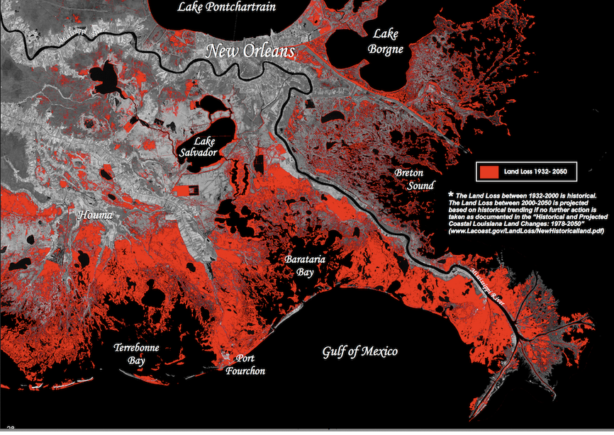

Slide 9
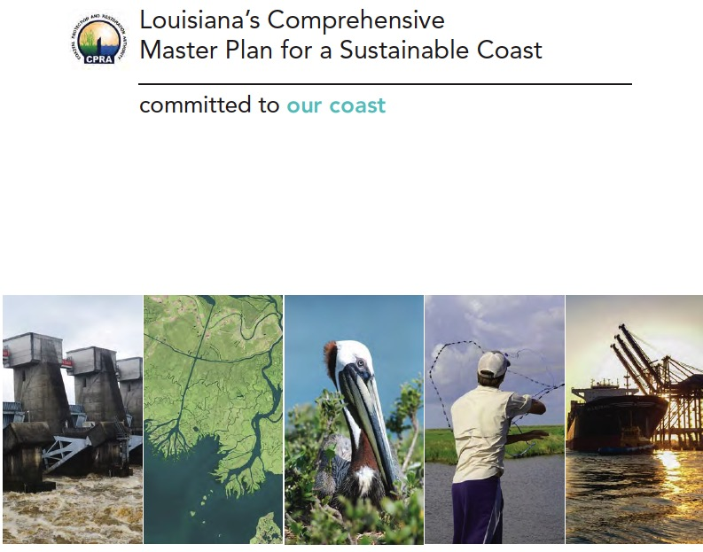

Slide 10
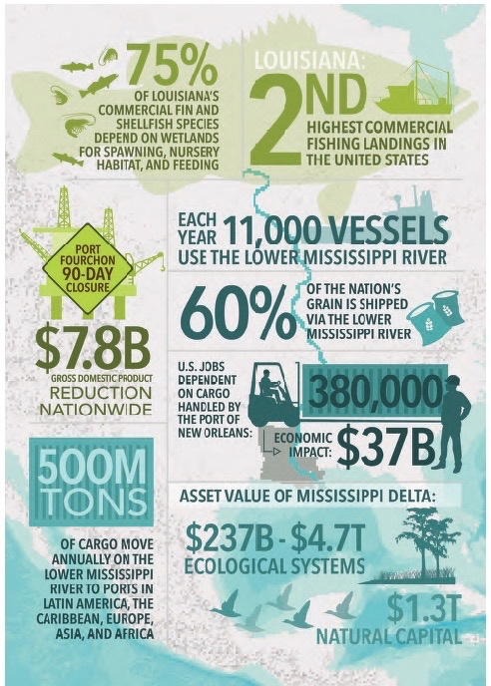
Image: 2017 Coastal Master Plan

Slide 11
ECOSYSTEM OUTCOMES
SEDIMENT DIVERSIONS
Image: 2017 Coastal Master Plan

Slide 12
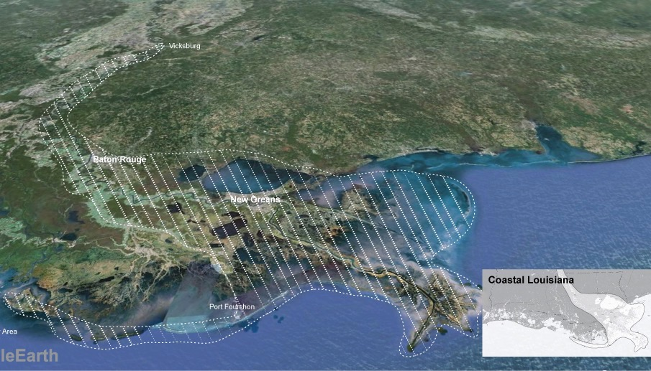


MISSISSIPPI RIVER DELTA MANAGEMENT

Slide 13
Image: Edmonds 2012

Slide 14
APPLIED ECOLOGICAL MODELING
Question: How do a select combination of sediment diversions affect fish and shellfish in the receiving basins?
Approach:
Develop ecosystem model that accounts for effects of environmental changes, fishing, and predator-prey interactions
Use output of a Delft3D hydrodynamic model as environmental drivers (Chlorophyll a, salinity, temperature, %wetland cover, and total suspended solids)

Slide 15
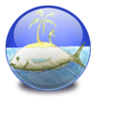
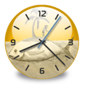

Ecopath with Ecosim
and Ecospace
Ecopath: Mass-balance “snapshot” of an ecosystem (initial conditions of the model)
Ecosim: Temporal dynamic simulations (used for model calibration)
Ecospace: Spatial-temporal modeling (framework of the model)

Slide 16
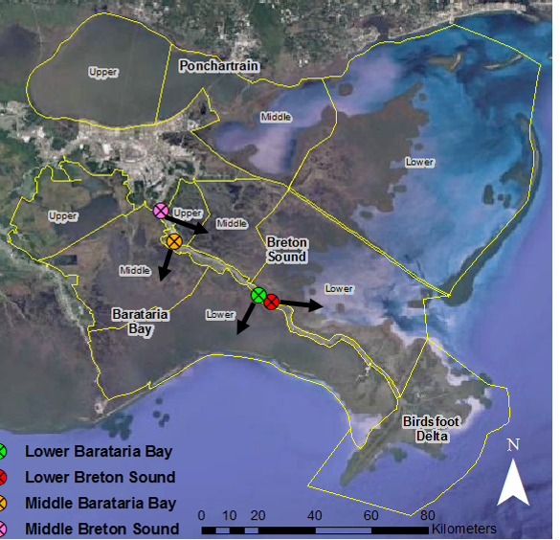

Slide 17
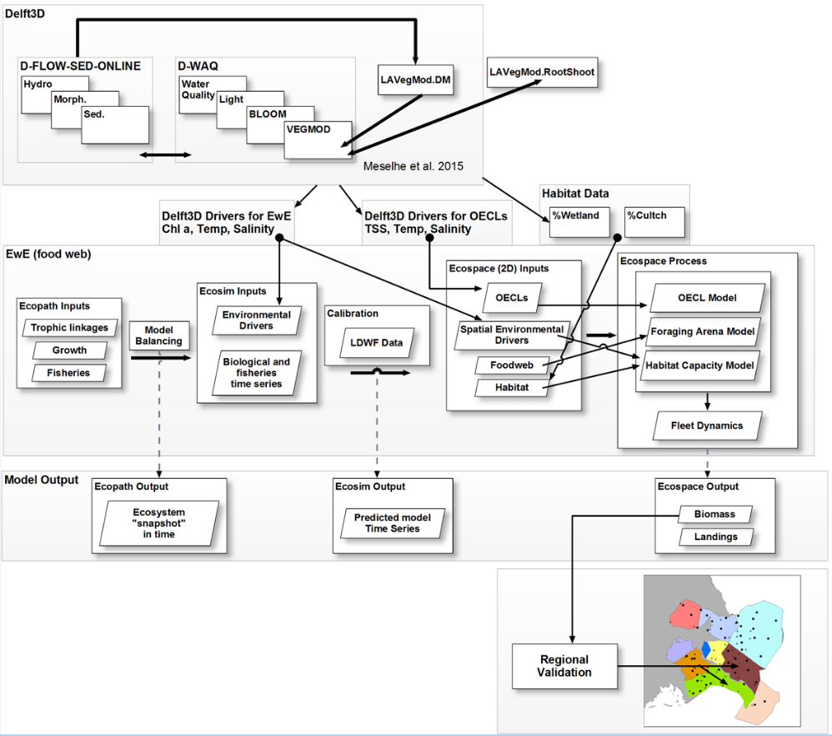
De Mutsert et al. in review

Slide 18
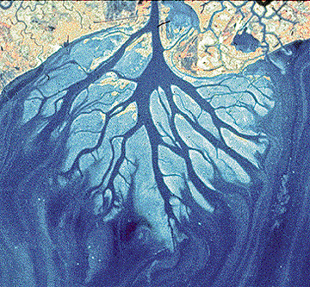
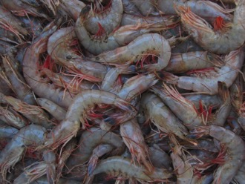
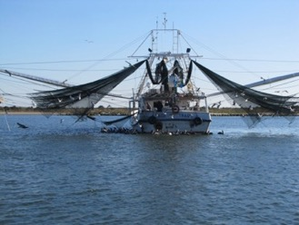
MRDM Delft 3D
Simulate sediment diversion operation plans
Output
Land gain per scenario
Daily
OECLs
Monthly env. drivers
MRDM Ecospace
cultch
Output
Fish biomass, distribution and landings
$?

Slide 19
Groups in the model
Fish | Fish | Invertebrates
Atlantic Croaker¹ | Silver Perch¹ | Mud crabs
Bay Anchovy¹ | silversides | Other shrimp
Black Drum¹ | Southern Flounder¹ | Oyster Drill
Blue Catfish¹ | Spot¹ | White Shrimp¹
Coastal sharks¹ | Spotted Seatrout¹ | Zoobenthos
Gizzard Shad¹ | Striped Mullet¹ | Zooplankton
Grey Snapper¹ | Sunfishes¹ | Primary producers
Gulf Menhaden¹ | Threadfin Shad¹ | Phytoplankton
Gulf Sturgeon¹ | Invertebrates | SAV³
Killifishes | Benthic crustaceans | Benthic algae
Largemouth Bass¹ | Blue Crab¹ | Other
Pinfish¹ | Brown Shrimp¹ | Kemp Ridley sea turtle
Red Drum¹ | Eastern Oyster² | Dolphins
Sand Seatrout¹ | Grass Shrimp | Detritus
sea catfishes¹ | Mollusks | Seabirds
Sheepshead¹
¹Juvenile and adult, ²spat, seed, and sack, ³submerged aquatic vegetation

Slide 20
Groups in the model
Fish | Fish | Invertebrates
Atlantic Croaker¹ | Silver Perch¹ | Mud crabs
Bay Anchovy¹ | silversides | Other shrimp
Black Drum¹ | Southern Flounder¹ | Oyster Drill
Blue Catfish¹ | Spot¹ | White Shrimp¹
Coastal sharks¹ | Spotted Seatrout¹ | Zoobenthos
Gizzard Shad¹ | Striped Mullet¹ | Zooplankton
Grey Snapper¹ | Sunfishes¹ | Primary producers
Gulf Menhaden¹ | Threadfin Shad¹ | Phytoplankton
Gulf Sturgeon¹ | Invertebrates | SAV³
Killifishes | Benthic crustaceans | Benthic algae
Largemouth Bass¹ | Blue Crab¹ | Other
Pinfish¹ | Brown Shrimp¹ | Kemp Ridley sea turtle
Red Drum¹ | Eastern Oyster² | Dolphins
Sand Seatrout¹ | Grass Shrimp | Detritus
sea catfishes¹ | Mollusks | Seabirds
Sheepshead¹
¹Juvenile and adult, ²spat, seed, and sack, ³submerged aquatic vegetation

Slide 21
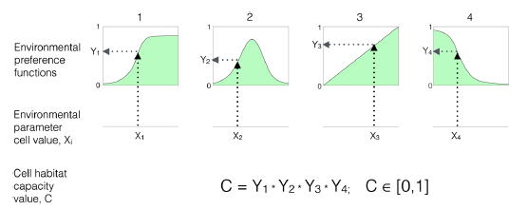
Habitat Capacity in Ecospace
Christensen et al. 2014

Slide 22
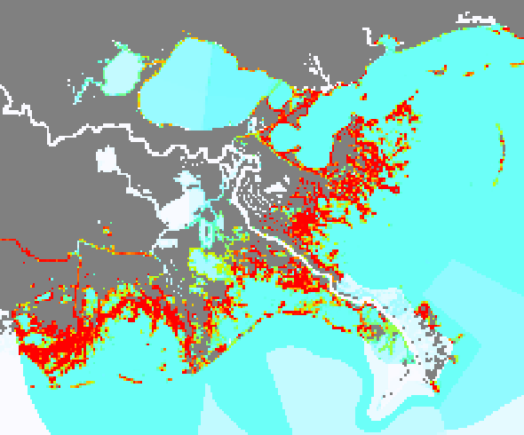
Example capacity map juvenile Brown Shrimp

Slide 23
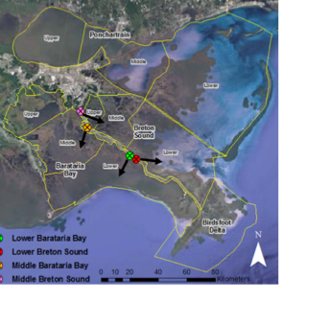
OPERATION PLAN:
open four sediment diversions for 50 year (opening triggered by 600,000 CFS in the river)
Compare with Future Without Action

Slide 24
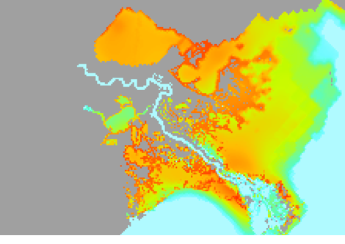
Juvenile Gulf Menhaden
June Year 50
FWOA

Slide 25
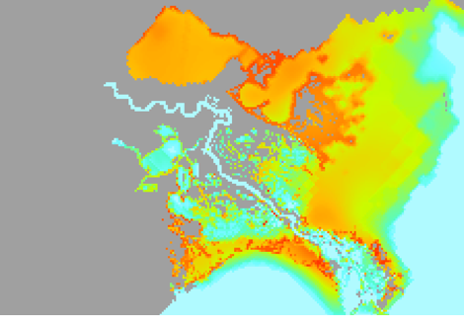
Juvenile Gulf Menhaden
June Year 50
Diversions

Slide 26
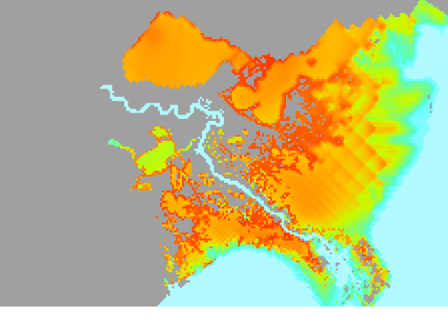
Juvenile Gulf Menhaden
October Year 50
FWOA

Slide 27
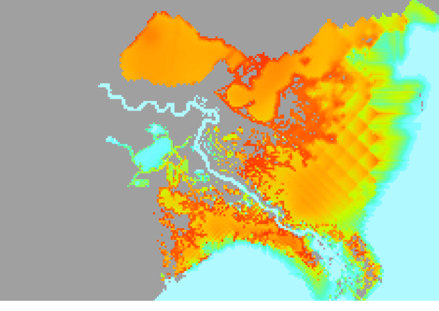
Juvenile Gulf Menhaden
October Year 50
Diversions

Slide 28
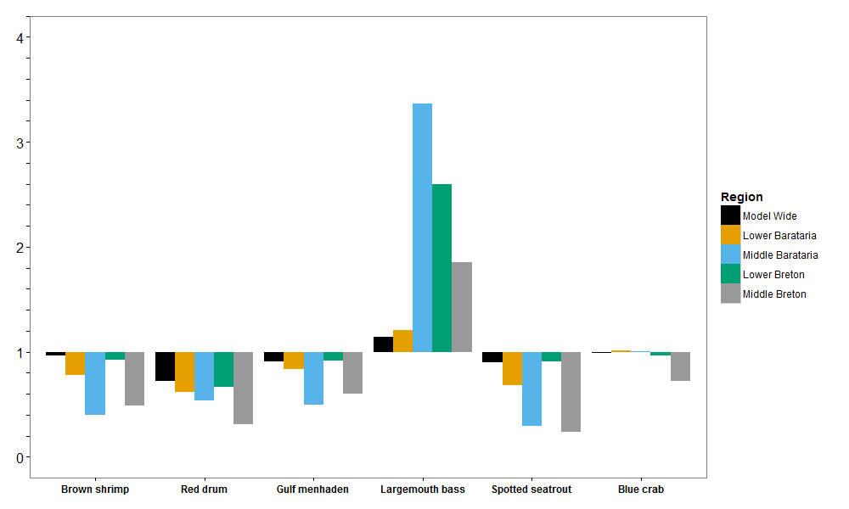
Year 50 Biomass Relative to FWOA

Slide 29
Operation Plan Summary
Decreases in species that prefer higher salinities on a sub-basin level, increases in (few) species that prefer lower salinities
Magnitude of change dampened on a larger spatial scale:
Redistribution of species
Large relative change in areas with low biomass doesn’t contribute much to total biomass change
Two lower diversions mostly responsible for total biomass change

Slide 30
Application
Focus on two upper diversions (Mid-Barataria and Mid-Breton), lower diversions put on hold
Land-building capacity benefits of upper diversions outweigh biomass losses
Spatial distribution allow for estimating change in habitat use

Slide 31
Permitting process will include conducting an Environmental Impact Statement
January 2017, Nola.com

Slide 32
Thank you!
Work presented made possible by funding from the Water Institute of the Gulf and Louisiana’s Coastal Protection and Restoration Authority under grant no. CPRA-2014-T32-SB01-EM.
Data used provided by FishBase and the Louisiana Department of Wildlife and Fisheries
Photographs taken and provided by Hunter Guidry: http://www.hunterguidry.com/
I would like to thank all collaborators, co-authors, and students that worked with me on the projects presented

