Slide 1

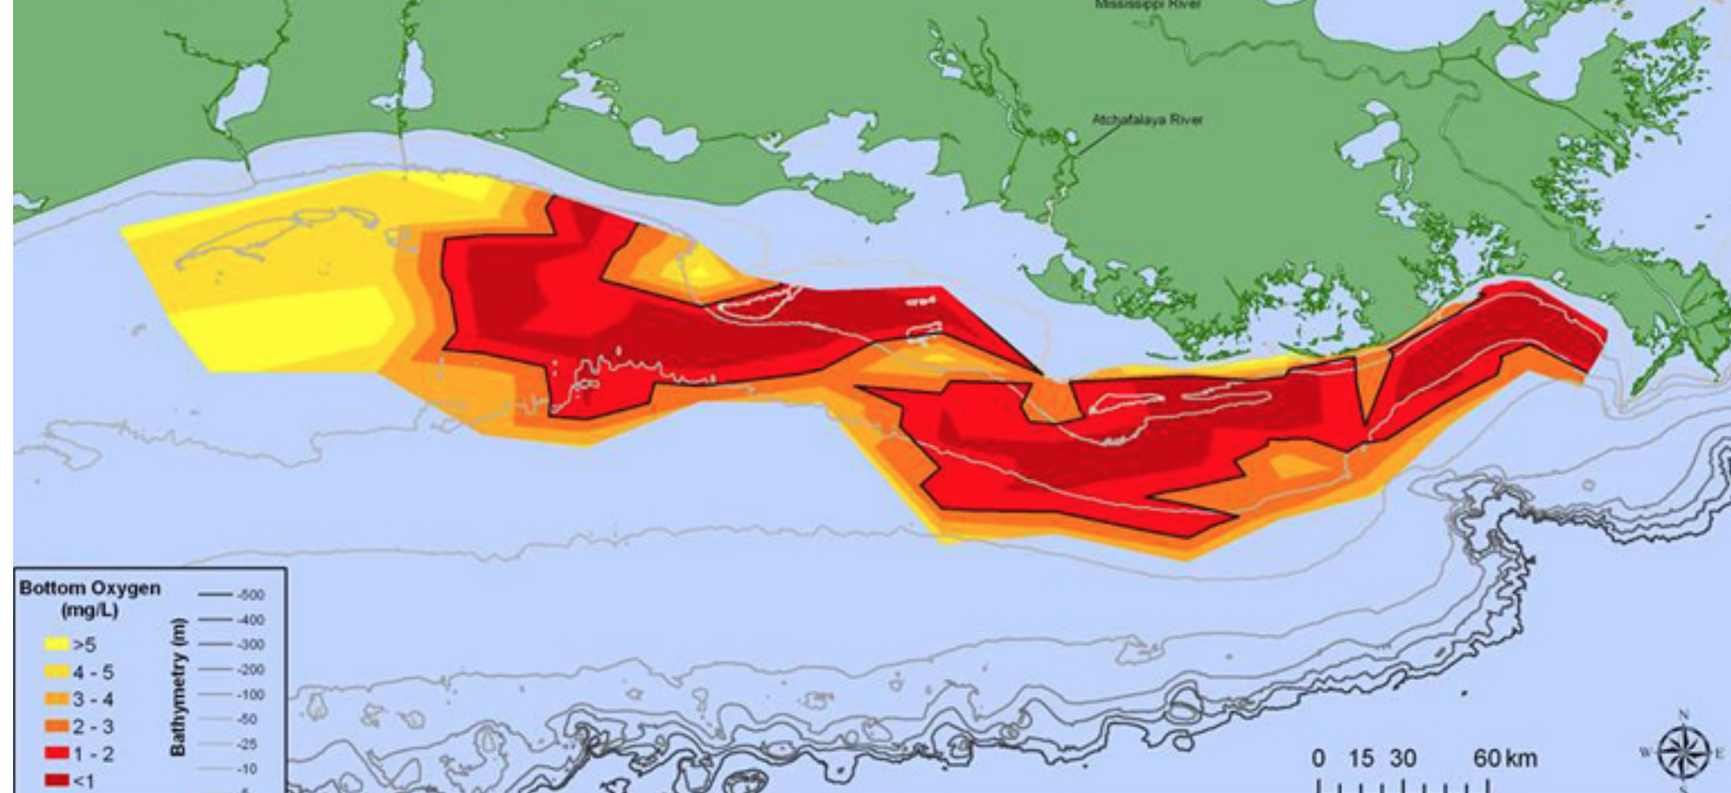



Coupling Sediment Transport and Biogeochemical Processes:
The Role of Sediment & Particulate Organic Matter Resuspension on Oxygen Dynamics
Julia Moriarty
CSDMS Annual Meeting; 23-25 May 2017
Collaborators:
Courtney Harris, Marjorie Friedrichs
Katja Fennel (Dalhousie), Kevin Xu (LSU), Christophe Rabouille (CNRS)
Notes:
News article from: http://www.gulfhypoxia.net/News/default.asp?XMLFilename=201508071251.xml

Slide 2
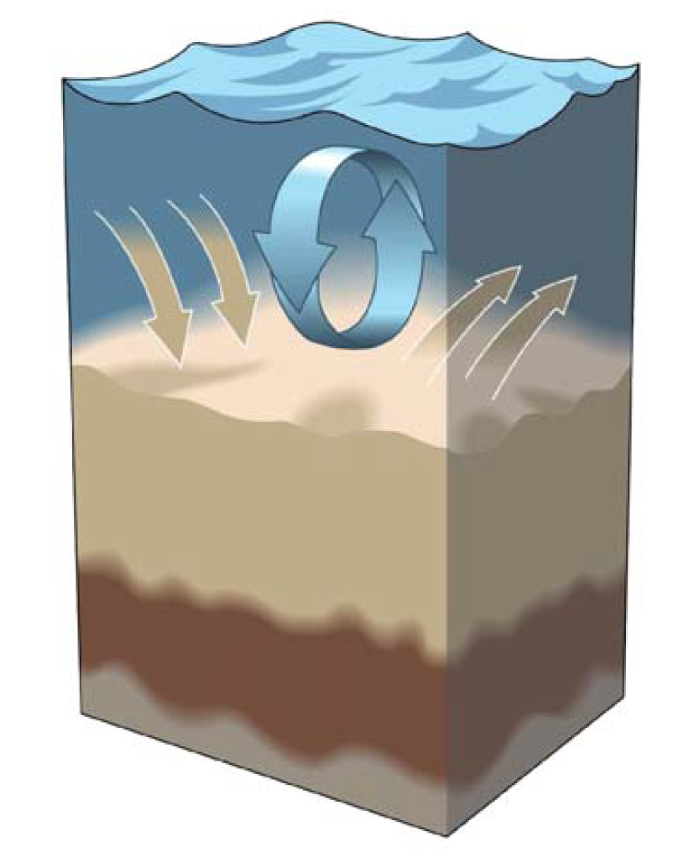
How Does Resuspension Affect
Oxygen Dynamics?
Flux of O₂ into the seabed
Decomposition of resuspended particulate organic matter consumes oxygen
Redistribution of organic matter
O₂
Toussaint et al. (2014), Abril et al. (1996), Sloth et al. (1996); Jorgensen et al., 1996; Aller (1998); Glud (2008); McKee et al. (2004); Lampitt et al. (1995); Moriarty et al. (2017)
After McKee et al. (2004);

Slide 3
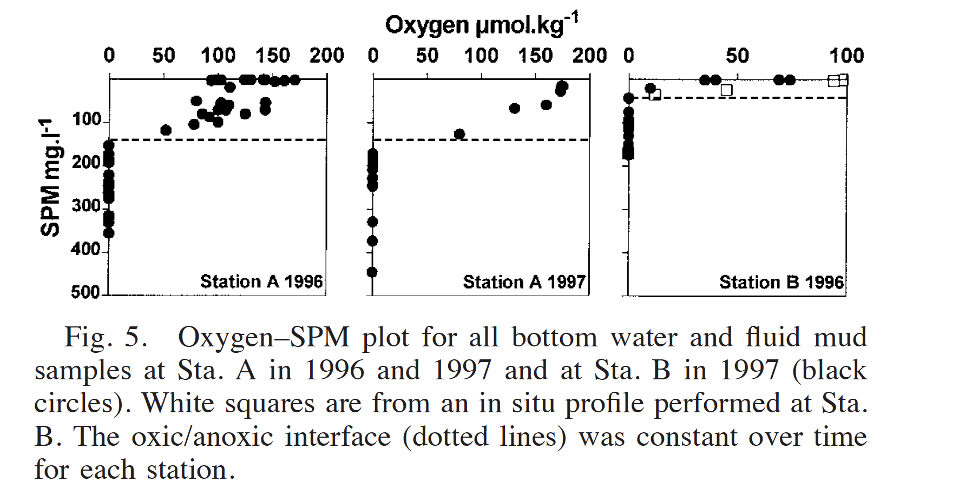
How Does Resuspension Affect
Oxygen Dynamics?
Flux of O₂ into the seabed
Decomposition of resuspended particulate organic matter consumes oxygen
Redistribution of organic matter
In-situ observations in the Gironde Estuary, France
200
Oxygen
(umol/kg)
0
0
500
Suspended Particulate Matter
(mg/L)
Abril et al. (1996)
Toussaint et al. (2014), Abril et al. (1996), Sloth et al. (1996); Jorgensen et al., 1996; Aller (1998); Glud (2008); McKee et al. (2004); Lampitt et al. (1995); Moriarty et al. (2017)

Slide 4
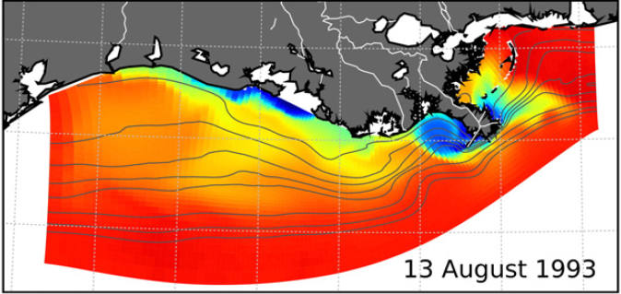
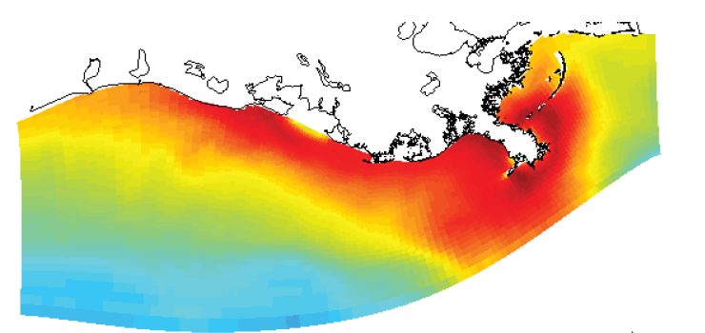
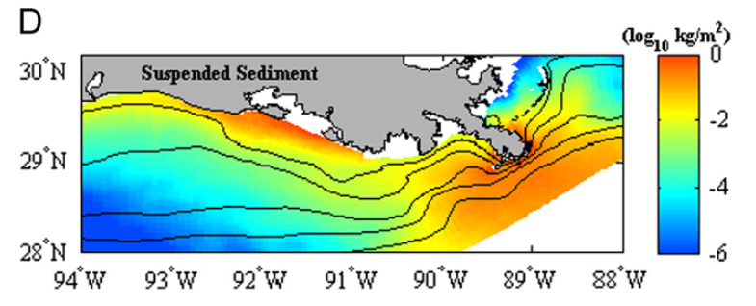
Previous Modeling Efforts
Hydrodynamics
Surface Salinity
Hetland and DiMarco, 2008
Water Column Biogeochemistry
Sediment Transport
Surface Chlorophyll
Surface Sediment
Fennel et al., 2011
Xu et al., 2011

Slide 5
Previous Modeling Efforts
Hydrodynamics
Surface Salinity
Hetland and DiMarco, 2008
Water Column Biogeochemistry
Sediment Transport
Surface Chlorophyll
Surface Sediment
???
Fennel et al., 2011
Xu et al., 2011

Slide 6
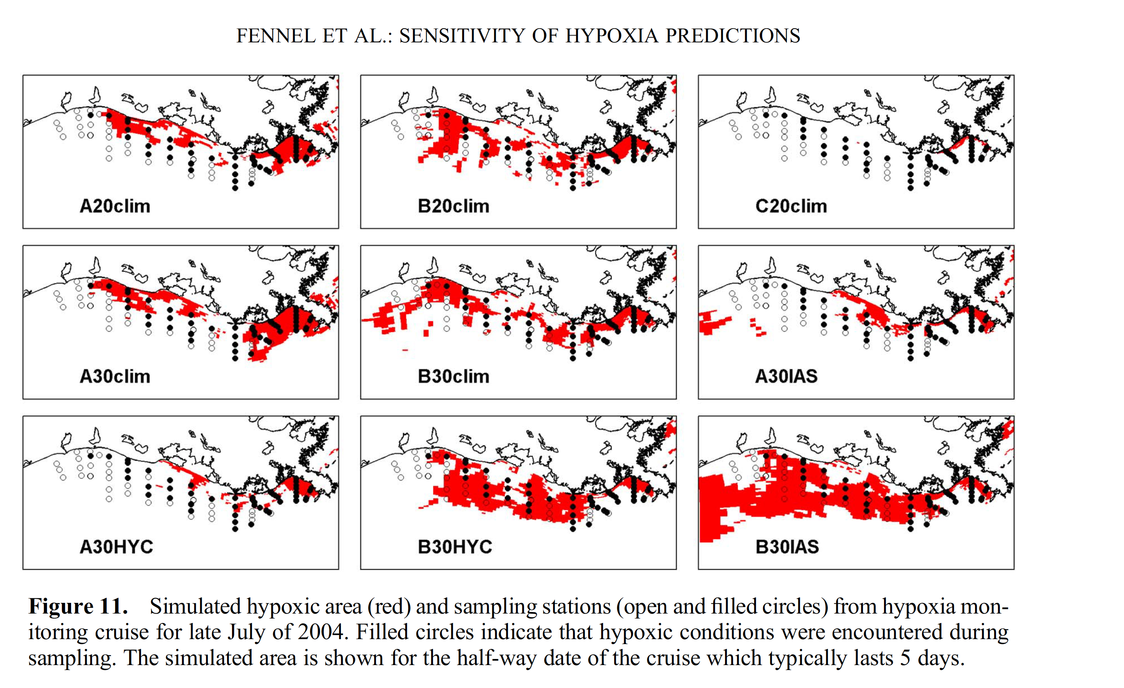
Previous Modeling Efforts
Hydrodynamics
Surface Salinity
Low-Oxygen Areas: Gulf of Mexico
Hetland and DiMarco, 2008
Parameterization:
#1
#2
#3
Water Column Biogeochemistry
Sediment Transport
    Modeled
    Observed
Surface Chlorophyll
Surface Sediment
???
Fennel et al., 2011
Xu et al., 2011
(Fennel et al., 2013)

Slide 7
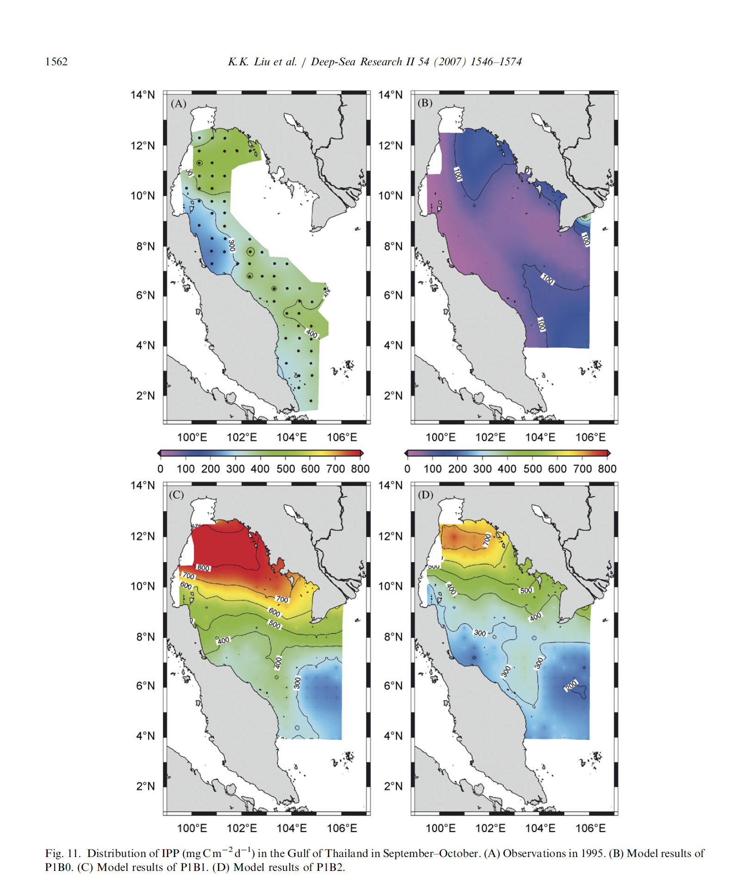
Motivation: Models are sensitive to
Parameterization of Seabed Biogeochemical Processes
Parameterization of Seabed Processes (i.e., Bottom Boundary Condition)
#1
#2
#3
Primary Production:
Gulf of Thailand
(Liu et al., 2007)
0
400
800
mg C m⁻² d⁻¹
Parameterization of Seabed Processes (i.e., Bottom Boundary Condition)
Low-Oxygen Areas: Gulf of Mexico
(Fennel et al., 2013)
#4
#5
#6
    Modeled
    Observed
Notes:
Oversimplification!

Slide 8
ROMS Framework
Hydrodynamics
(ROMS)
Water Column Biogeochemistry
(Fennel)
Sediment Transport
(CSTMS)
Haidvogel et al. 2000, 2008; Warner et al. 2008; Fennel et al. 2013;

Slide 9
HydroBioSed: A Coupled Model
Hydrodynamics (ROMS)
Water Column Biogeochemistry (Fennel)
Sediment Transport (CSTMS)
Seabed Biogeochemistry (Soeteart)
    Completed for Moriarty et al. (2017)
Haidvogel et al. 2000, 2008; Warner et al. 2008; Fennel et al. 2013; Soetaert et al. 1996

Slide 10
HydroBioSed
New model processes include:
Erosion of organic matter & storage in seabed
  Redistribution of resuspended organic matter
Fluxes of oxygen at seabed -water interface
Decomposition of organic matter and oxidation of reduced chemical species in seabed
Hydrodynamics (ROMS)
Water Column Biogeochemistry (Fennel)
Sediment Transport (CSTMS)
Seabed Biogeochemistry (Soeteart)
    Completed for Moriarty et al. (2017)

Slide 11
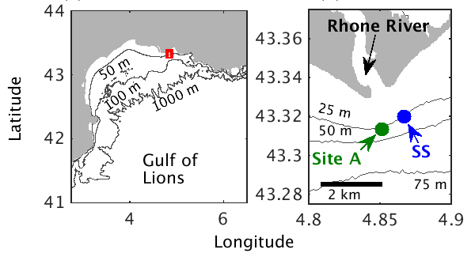

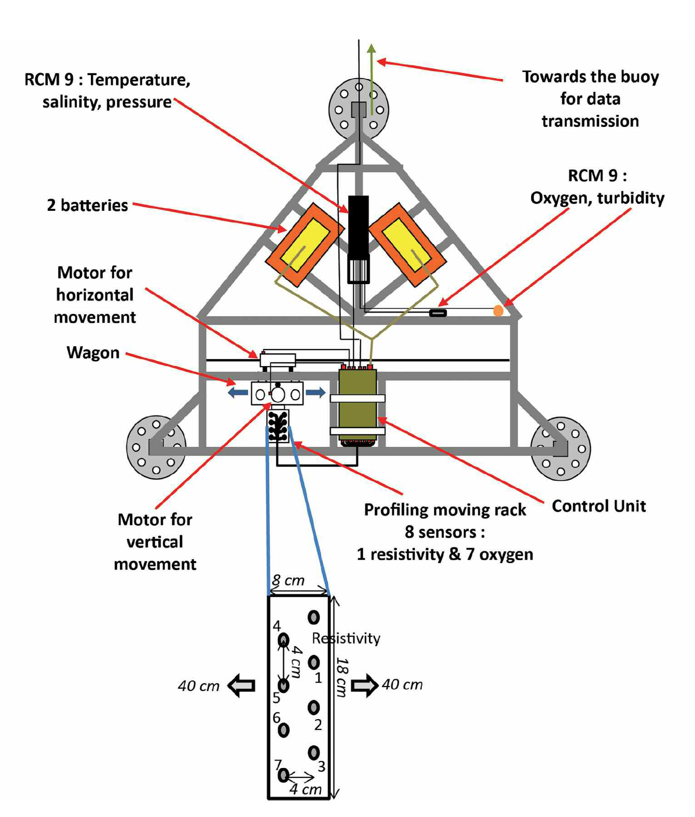
1-D Model Implementation:
Rhone Delta, France
France
Spain
Mediterranean Sea
Toussaint et al. (2014)
Notes:
Switch to motivation of rhone study, not showing an instrument

Slide 12
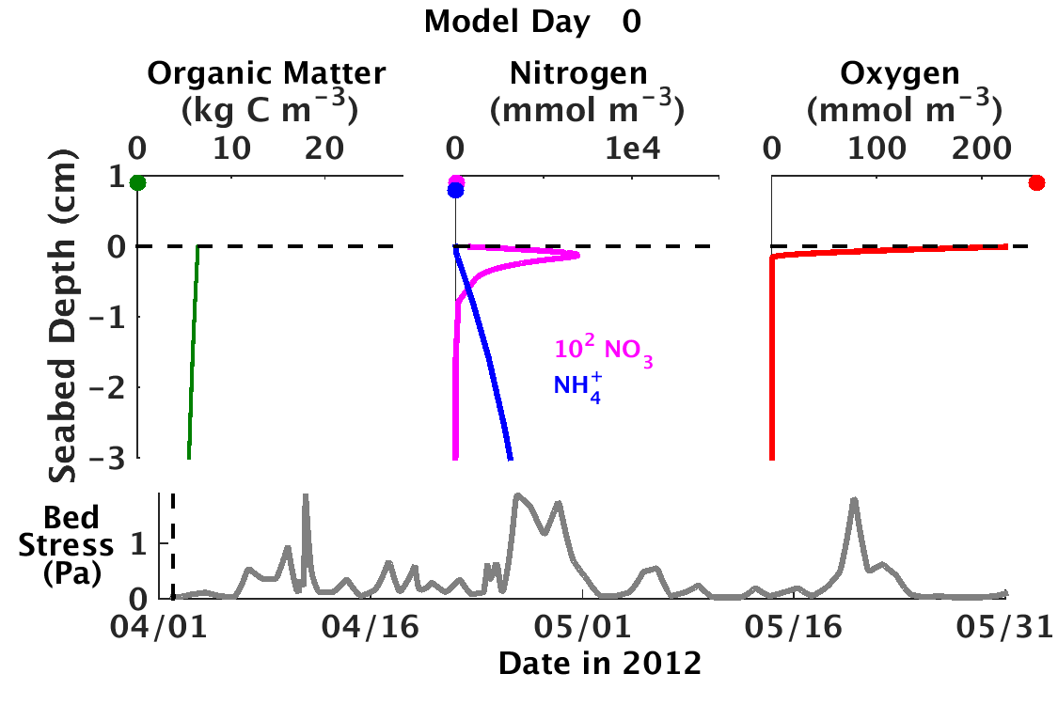

Slide 13


Slide 14
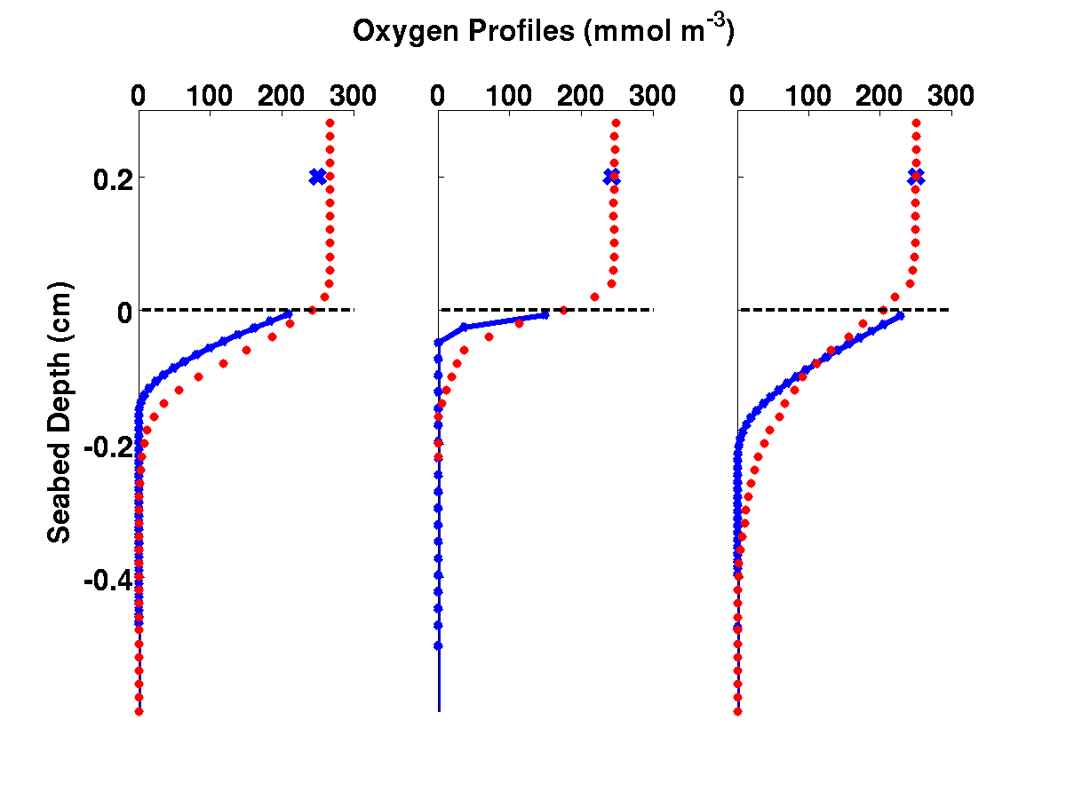
Result #1: Resuspension Increased Flux of Oxygen Into Seabed
Model (Moriarty et al., 2017)
Observations (Toussaint et al., 2014)
    Pre-Erosion
    Erosional
O₂ Profiles (mmol m⁻³)
0
300
0
300
Depth into Seabed (cm)
-0.2
0
0.2

Slide 15
Result #1: Resuspension Increased Flux of Oxygen Into Seabed
Model (Moriarty et al., 2017)
Observations (Toussaint et al., 2014)
    Pre-Erosion
    Erosional
O₂ Profiles (mmol m⁻³)
0
300
0
300
Depth into Seabed (cm)
-0.2
0
0.2

Slide 16
Result #1: Resuspension Increased Flux of Oxygen Into Seabed
Pre-Erosion
During Erosion
Model (Moriarty et al., 2017)
Observations (Toussaint et al., 2014)
Oxic Water Column
    Pre-Erosion
    Erosional
O₂ Profiles (mmol m⁻³)
0
300
0
300
Oxic Seabed
Depth into Seabed (cm)
-0.2
0
0.2
Anoxic Seabed

Slide 17
Result #1: Resuspension Increased Flux of Oxygen Into Seabed
Pre-Erosion
During Erosion
Model (Moriarty et al., 2017)
Observations (Toussaint et al., 2014)
    Pre-Erosion
    Erosional
Diffusive O₂ Flux
Diffusive O₂ Flux
O₂ Profiles (mmol m⁻³)
0
300
0
300
Depth into Seabed (cm)
-0.2
O₂
Consumption
0
O₂ Consump-tion
0.2

Slide 18
HydroBioSed Implementation for Northern Gulf of Mexico
Hydrodynamic Set-up:
Hetland and DiMarco (2008)
Surface Salinity
Water Column Biogeochemistry Set-up:
Fennel et al. (2011)
Seabed & Sediment Set-up:
Xu et al. (2011)
Surface Chlorophyll
Surface Sediment

Slide 19
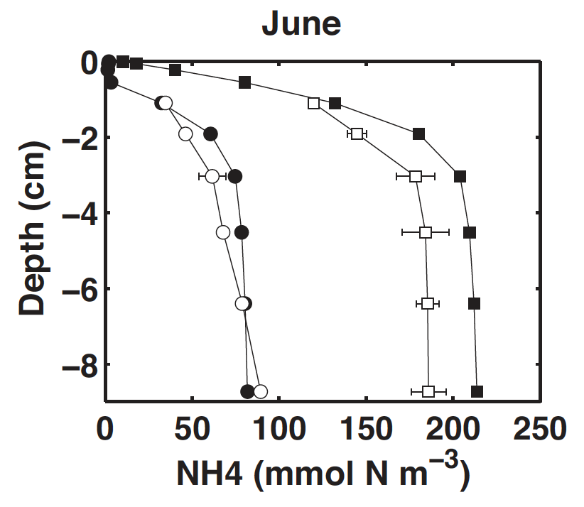
HydroBioSed Implementation for Northern Gulf of Mexico
Hydrodynamic Set-up:
Hetland and DiMarco (2008)
Surface Salinity
Water Column Biogeochemistry Set-up:
Fennel et al. (2011)
Seabed & Sediment Set-up:
Xu et al. (2011)
Surface Chlorophyll
Surface Sediment
NH4 Seabed Profiles
Seabed Biogeochemistry Set-up:
Laurent et al. (2016)

Slide 20
HydroBioSed Implementation for Northern Gulf of Mexico
Hydrodynamic Set-up:
Hetland and DiMarco (2008)
Surface Salinity
Water Column Biogeochemistry Set-up:
Fennel et al. (2011)
Seabed & Sediment Set-up:
Xu et al. (2011)
Surface Chlorophyll
Surface Sediment
NH4 Seabed Profiles
Seabed Biogeochemistry Set-up:
Laurent et al. (2016)

Slide 21
January – December 2006

Slide 22
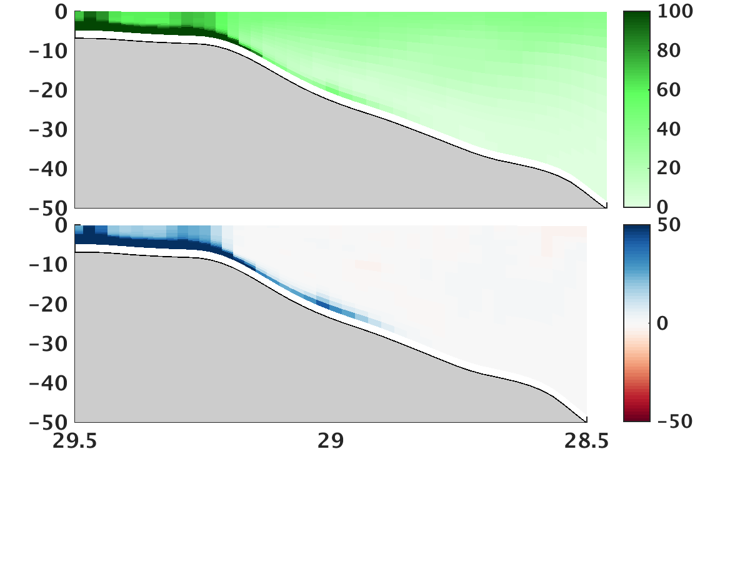
Result #2: Decomposition of resuspended organic matter increased bottom water oxygen consumption
Standard Model Run
(August 2006)
Change due to Resuspension
0 m
Organic Matter
(mmol C m⁻³)
50 m
0
50
100
-50
0
50

Slide 23
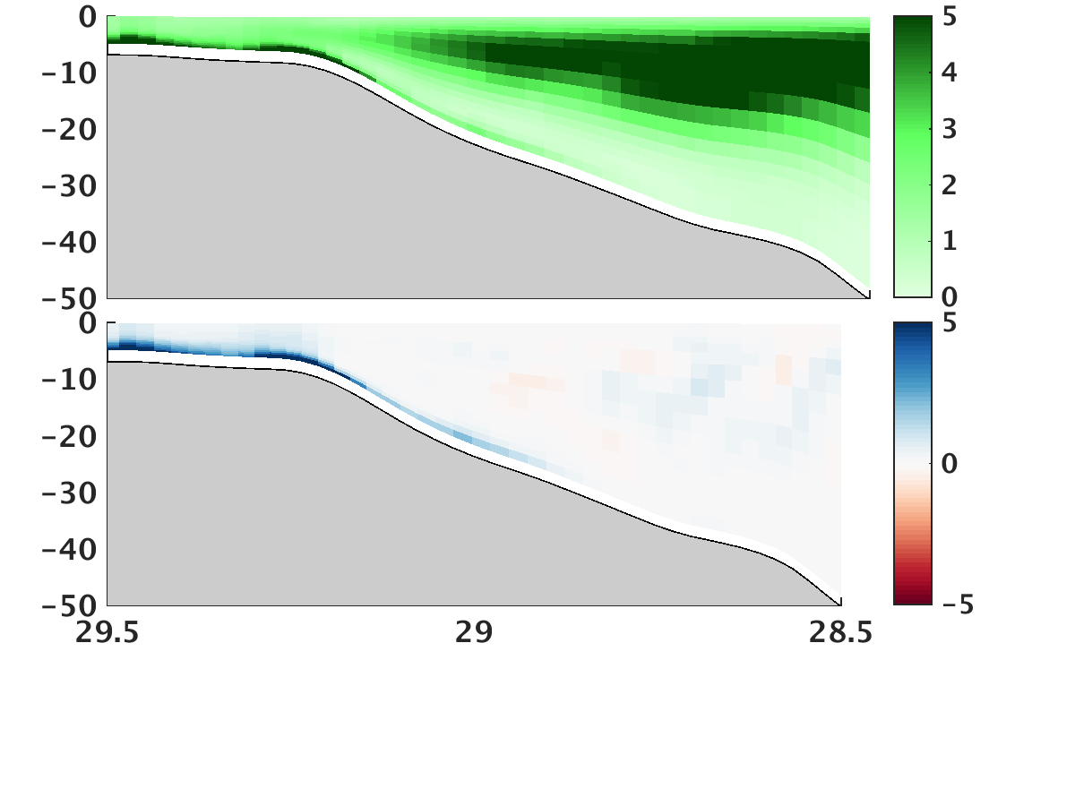
Result #2: Decomposition of resuspended organic matter increased bottom water oxygen consumption
Standard Model Run
(August 2006)
Change due to Resuspension
0 m
Organic Matter
(mmol C m⁻³)
50 m
0
50
100
-50
0
50
0 m
Decomposition Rate
(mmol C m⁻³ d⁻¹)
50 m
0
2.5
5
-5
0
5

Slide 24
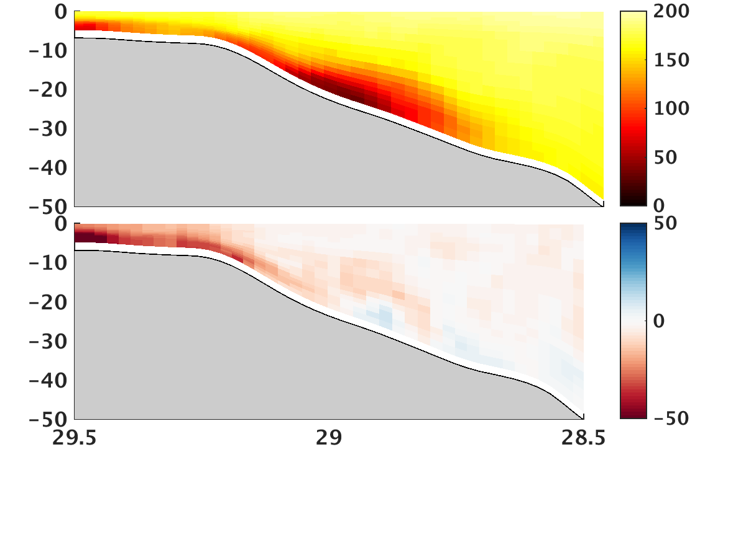
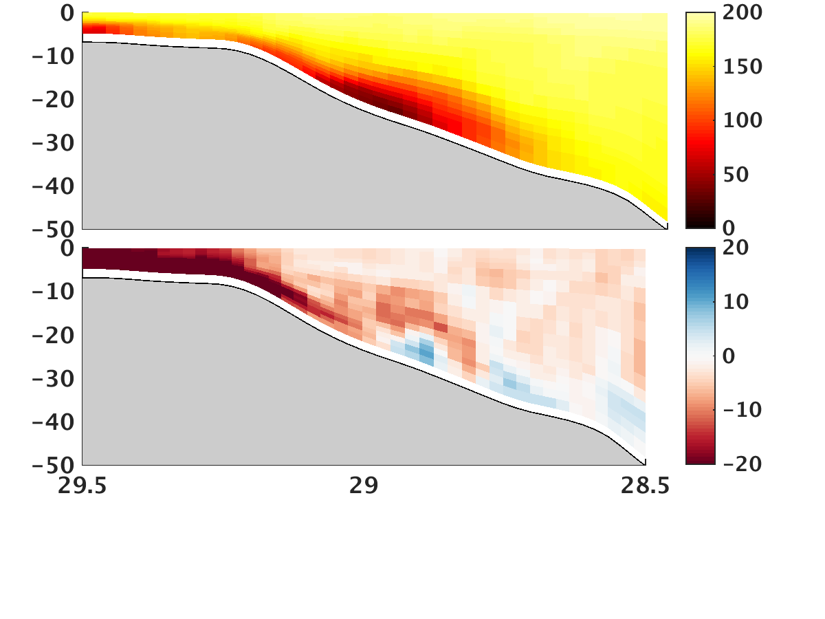
Result #2: Decomposition of resuspended organic matter increased bottom water oxygen consumption
Standard Model Run
(August 2006)
Change due to Resuspension
0 m
Organic Matter
(mmol C m⁻³)
50 m
0
50
100
-50
0
50
0 m
Decomposition Rate
(mmol C m⁻³ d⁻¹)
50 m
0
2.5
5
-5
0
5
0 m
Oxygen
(mmol O₂ m⁻³)
50 m
0
100
200
-50
0
50

Slide 25
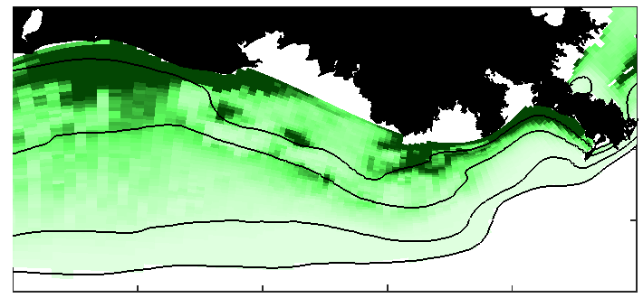
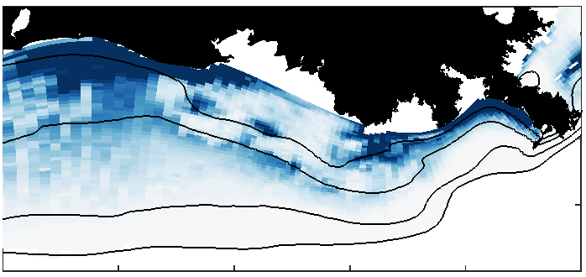
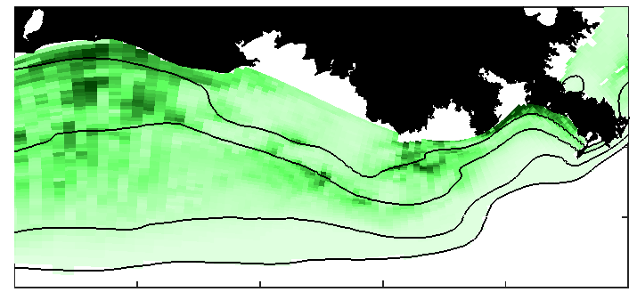
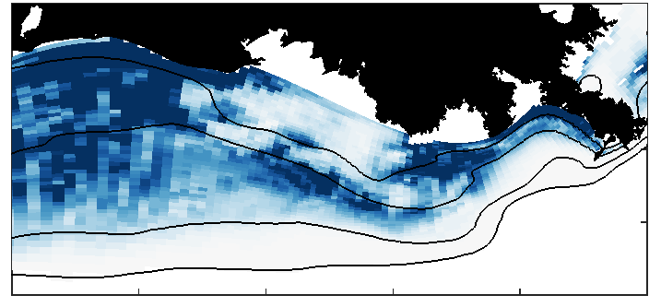
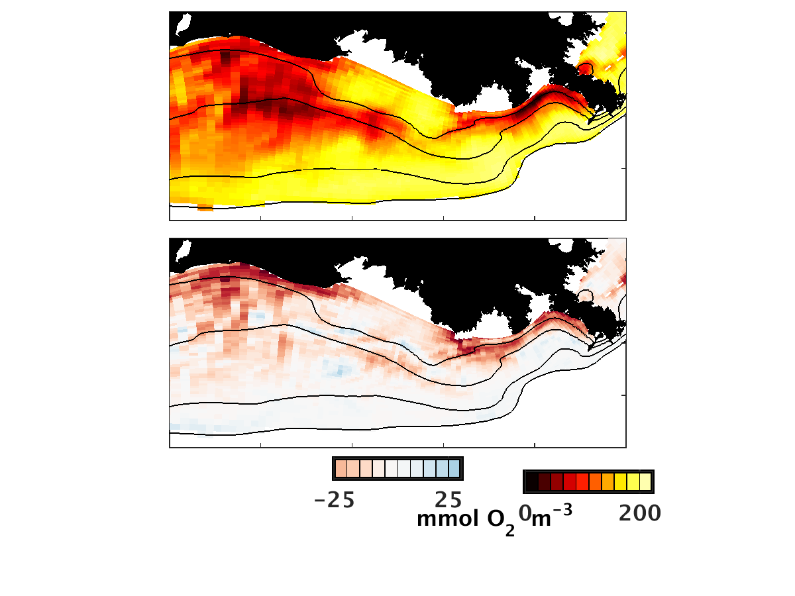
Result #3: Redistribution of organic matter affects patterns of oxygen depletion
Standard Model Run
(July 2006)
Change due to Resuspension
Organic Matter
(mmol C m⁻³)
-5
0
5
0
2.5
5
Decomposition Rate
(mmol C m⁻³ d⁻¹)
-10
0
10
0
10
20
Oxygen
(mmol O₂ m⁻³)
-25
0
25
0
100
200

Slide 26
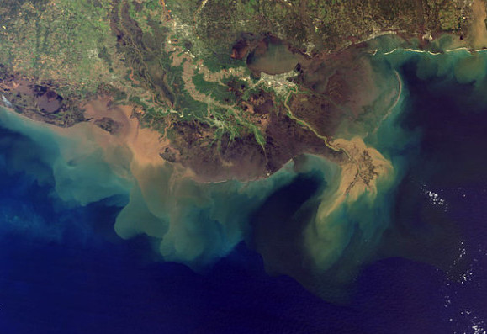
Conclusions
HydroBioSed, a coupled model that accounts for resuspension and deposition, as well as biogeochemical processes, was developed and implemented for the Rhone Delta (Moriarty et al., 2017) and Northern Gulf of Mexico.
Resuspension increased fluxes of oxygen into the seabed and increased bottom water oxygen consumption.
Ongoing work: implement model for Chesapeake Bay, and investigating the effect of resuspension on light attenuation.
Notes:
Satellite Image from: http://mediad.publicbroadcasting.net/p/wwno/files/201305/Mississippi_River_Delta_and_Sediment_Plume-e1367966139726.jpg

Slide 27
Acknowledgements
Collaborators
  Courtney Harris
  Marjorie Friedrichs
  Katja Fennel (Dalhousie)
  Kevin Xu (LSU)
  Rob Hetland and Steve DiMarco (TAMU)
  Liz Canuel
  Carl Friedrichs
  Harris & Friedrichs Labs
Support
  NOAA’s Mechanisms Controlling Hypoxia Project
  VIMS Graduate Program
  NASA

Slide 28
Extras

Slide 29
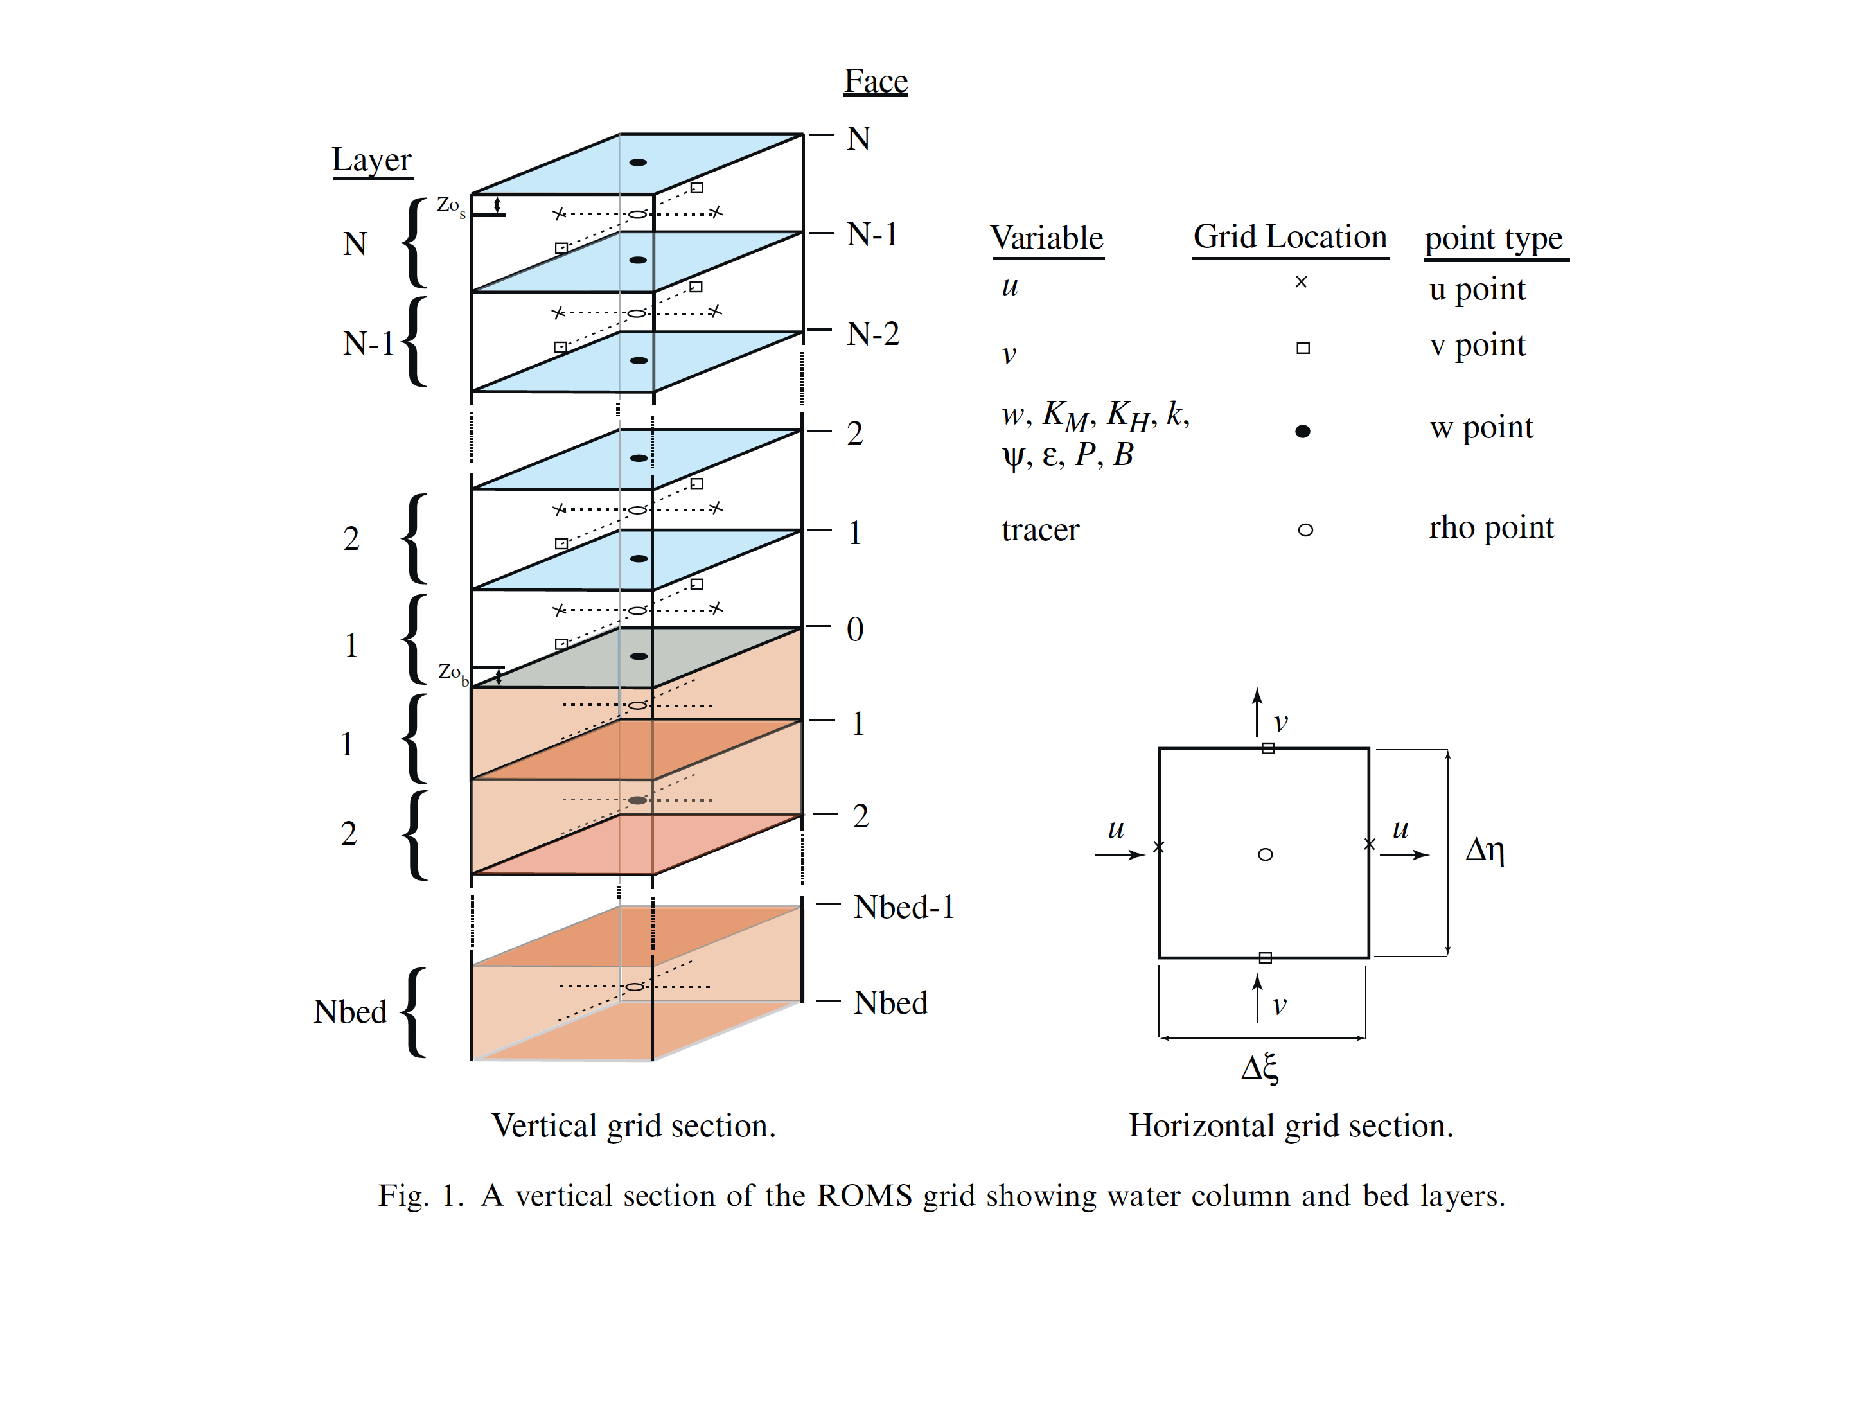


Water Biogeochemistry + Sediment + Seabed Biogeochemistry
Detritus
Suspended Sediment
Nutrients
O₂ NO₃ NH₄ ODU
Erosion and Deposition
Deposited Sediment
Diffusion

Slide 30
Water Biogeochemistry + Sediment + Seabed Biogeochemistry
Detritus
Suspended Sediment
Nutrients
O₂ NO₃ NH₄ ODU
Erosion and Deposition
Seabed Nutrients
O₂ NO₃ NH₄ ODU
Deposited Sediment
Diffusion
Seabed Organic Matter
    Completed Moriarty et al. (submitted)

Slide 31
Water Biogeochemistry + Sediment + Seabed Biogeochemistry
Detritus
Suspended Sediment
Nutrients
O₂ NO₃ NH₄ ODU
Diffusion
Erosion and Deposition
Seabed Nutrients
O₂ NO₃ NH₄ ODU
Deposited Sediment
Diffusion
Seabed Organic Matter
Soetaert’s Seabed Biogeochemical Model
    Completed Moriarty et al. (submitted)

Slide 32
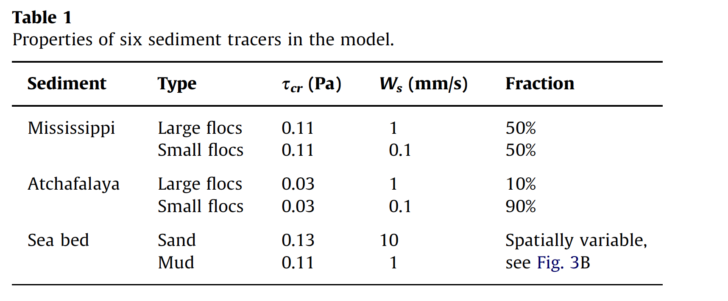
Model Implementations: Northern Gulf of Mexico
(Xu et al., 2011)

Slide 33
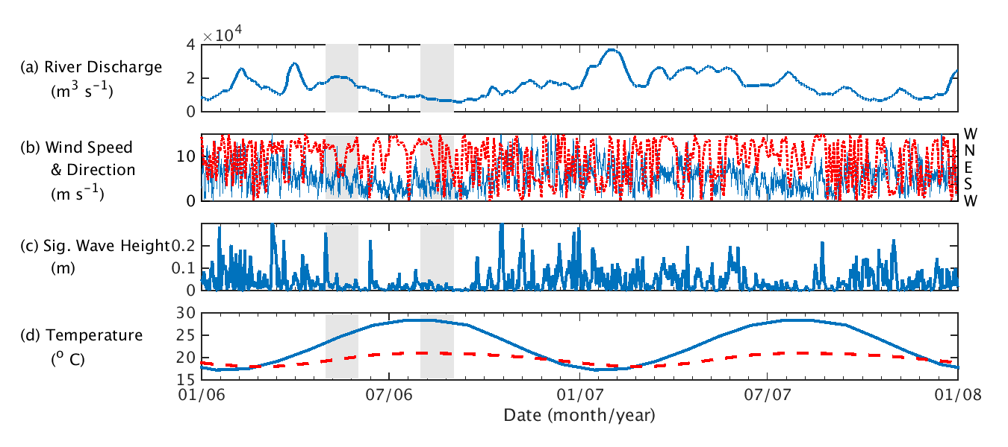
Model Implementation for the Northern Gulf of Mexico
Forcing for 2006-2007
River Discharge (m³ s⁻¹)
Wind Speed
(m s⁻¹)
Sig. Wave Height
(m)
Temperature in the Atmosphere and at the Open Boundary
(⁰C)
Model Runs
Standard Model Run
No-Resuspension Model Runs
  May – August 2006

Slide 34
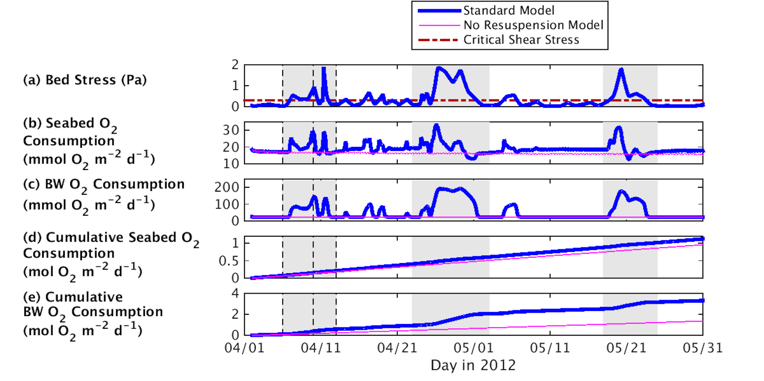
Rhone Delta: Resuspension increased seabed oxygen consumption
Standard Model (Time-Averaged)
No-resuspension model
Critical Shear Stress for Erosion
    Resuspension seabed O₂ consumption by:
    ~2 during events
    ~0.16 over two months
2
Seabed Shear Stress
(Pa)
0
Seabed O₂ Consumption (mmol O₂ m⁻² d⁻¹)
30
}
0
Cumulative Seabed Water O₂ Consumption (mmol O₂ m⁻²)
1
}
0
4/1
4/21
5/11
5/31
Day in 2012

Slide 35
Rhone Delta: Decomposition of Resuspended Organic Matter Increased Bottom Water Oxygen Consumption
Standard Model (Time-Averaged)
No-resuspension model
Critical Shear Stress for Erosion
2
Seabed Shear Stress
(Pa)
0
Bottom Water O₂ Consumption (mmol O₂ m⁻² d⁻¹)
200
0
4/1
4/21
5/11
5/31
Day in 2012

Slide 36
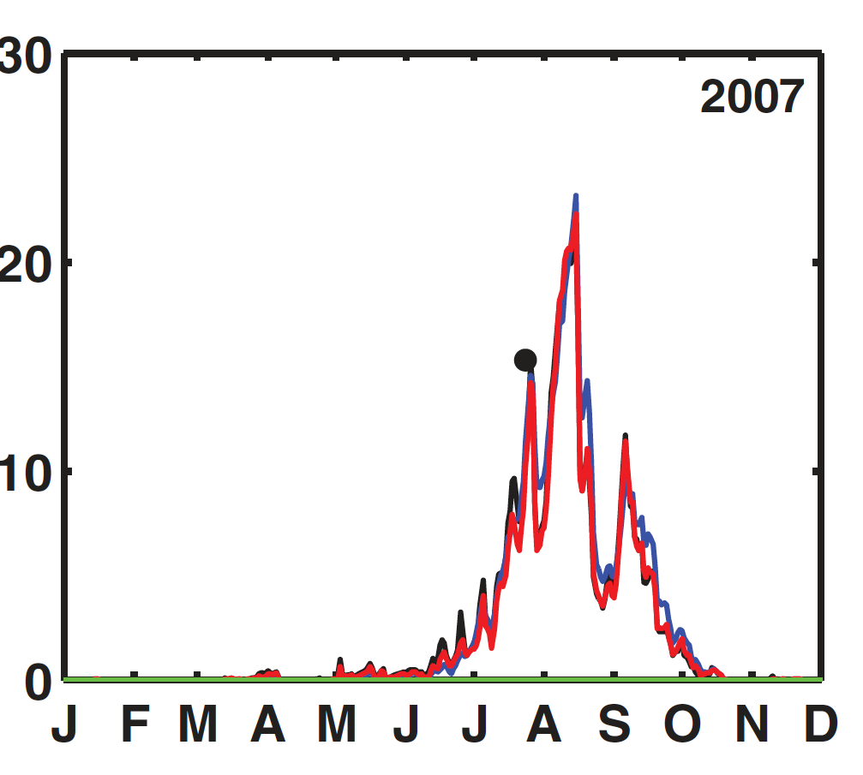
In Northern Gulf of Mexico, seabed oxygen consumption can account for almost all of hypoxic area
Observed Value
Full Biogeochemical Model
Parameterized Model
Seabed Oxygen Consumption only
(Parameterized model )
Water Column Oxygen Consumption only
(Parameterized model)
Hypoxic Area (10³ km²)
Water column oxygen consumption accounts for little of the hypoxic area
Month in 2007
Yu et al. (2015; JGR)

Slide 37

Figure from Fennel et al. (2013)
Observations from summer hypoxia cruises (e.g. see Rabalais et al., 2002)

