Slide 1
Integrating a 2-D hydrodynamic model into the Landlab modeling framework
Jordan Adams
May 18, 2016

Slide 2
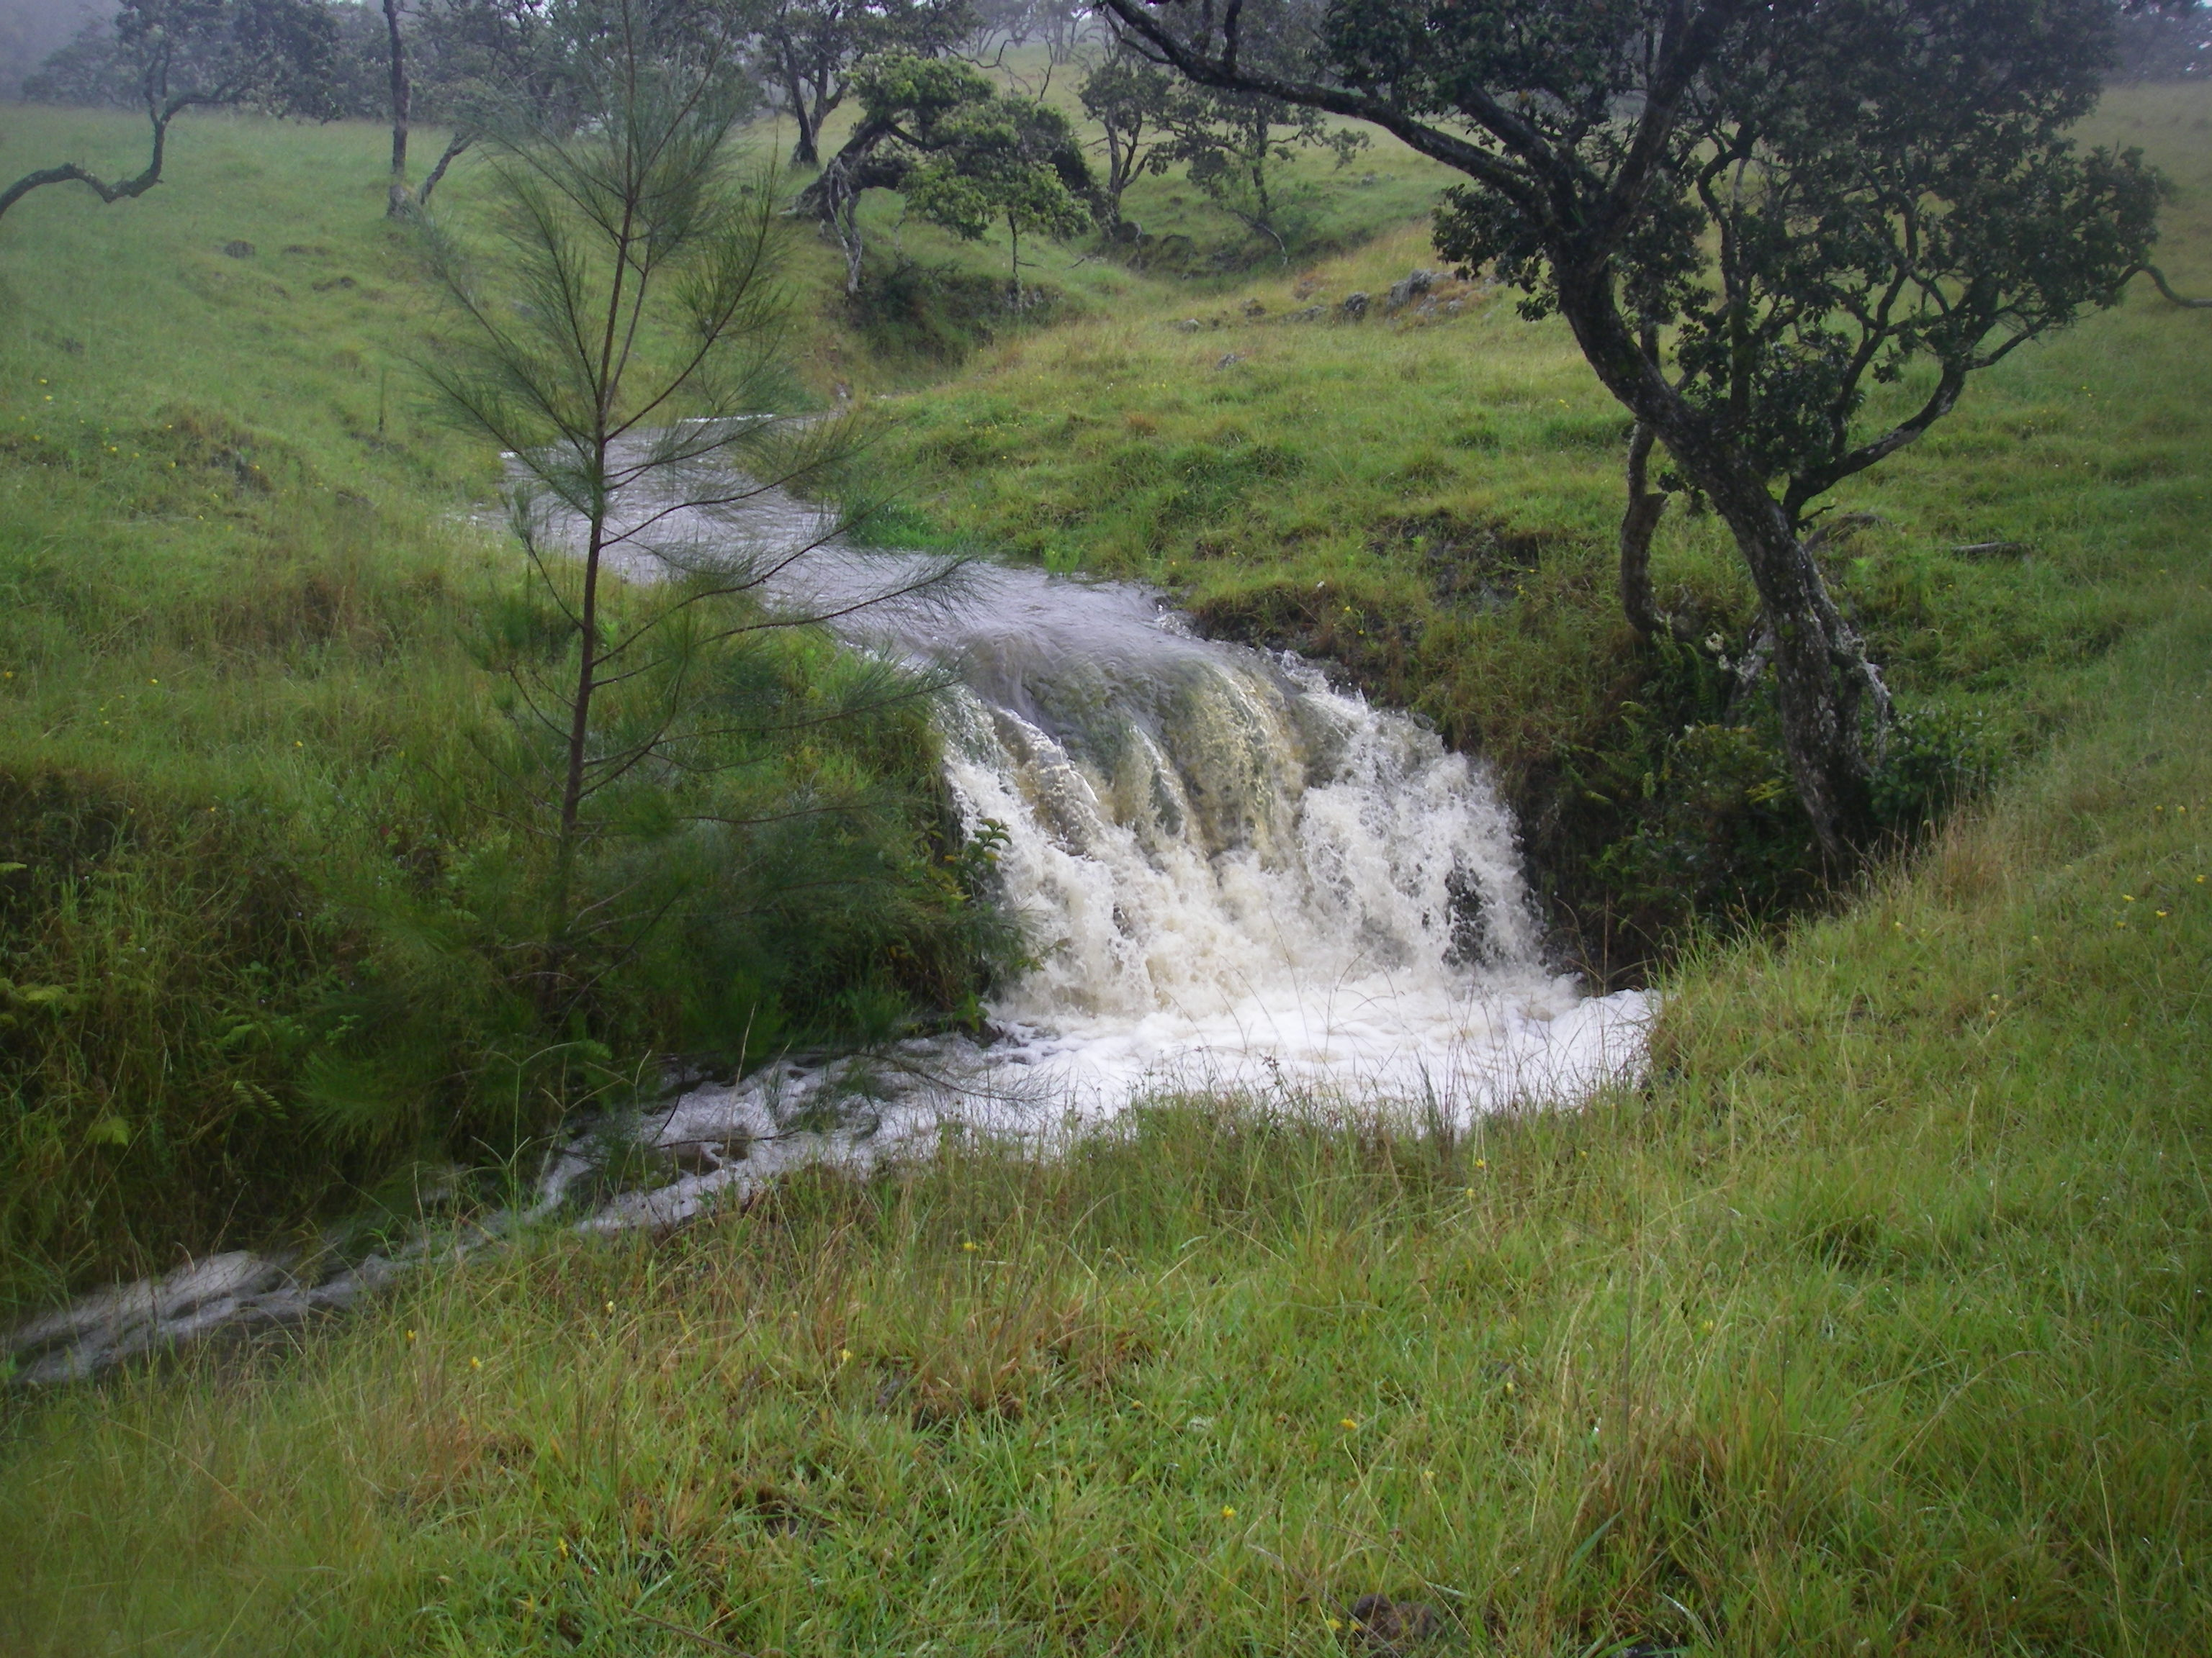
Landscape evolution models: numerical models of landform change through time, dynamic climate-topography-tectonic interactions
How do traditional landscape evolution models capture hydrology?
How does the hydrology method impact landscape evolution?

Slide 3
Steady-state hydrology
Nonsteady hydrology
Each event:
single rainfall rate
single discharge at all points in watershed
single incision rate
Each event:
single rainfall rate
wave propagates across watershed:
  nonsteady discharge at each point
  nonsteady incision at each point
Time
Low drainage area
Time
P
P
Rain Rate
Rain Rate
Q_{ss} = PA
Q_{h} = f(h, S, n …)
Discharge
Discharge
hydrograph
High
drainage
area
I_{ss} = KQ_{ss}^{m}S^{n}
I_{h} = KQ_{h}^{m}S^{n}
Incision Rate
Incision Rate

Slide 4
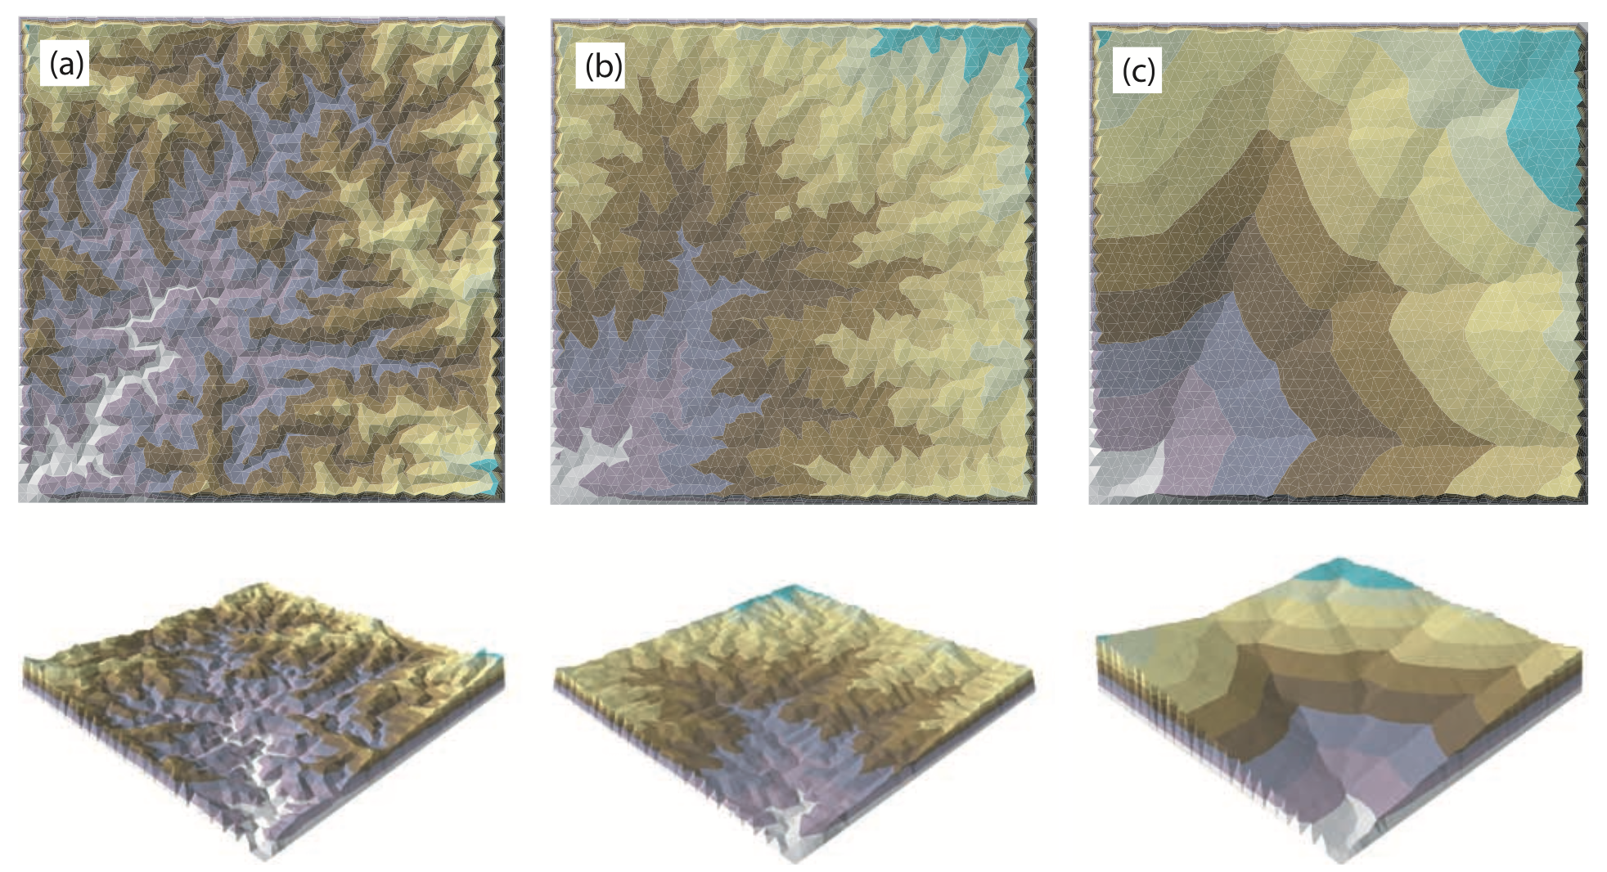
Steady-state assumption can be problematic:
large catchments and short-duration precipitation events
Steady-state nonsteady state
Note:
greater relief
increasing convexity
low valley density
Sólyom and Tucker, 2004, Journal of Geophysical Research

Slide 5
Landlab: A Python toolkit for modeling Earth surface processes
Open-source modeling library
  2-D gridding libraries
  Pre-built process components
  Coupling framework: multi-process models
  Input / output utilities
  Geared toward (but not limited to!) Earth-surface dynamics
Visit our website: http://landlab.github.io

Slide 6
de Almeida overland flow component
Urban flood inundation model (de Almeida et al., 2012)
Centered finite-difference, explicit
Routes hydrograph at all grid locations, flow in D4
n = 0.01 s/m^{1/3}
u = 0.4 m/s
Hunter et al., 2005,
Advances in Water Resources
de Almeida et al., 2012, WRR

Slide 7
Model domain
Simple stream power parameters
I = KQ^{m}S^{n}
Parameter | Value
K (erodibility) | 0.0007 m/yr
m | 0.5
n | 1.0
Geomorphic steady-state topography
(uplift == erosion rate)
36 km² drainage area
Grid resolution: 30 m x 30 m
Slopes: ~10⁻¹ to ~10⁻²

Slide 8
Steady-State Parameters
Time
Rainfall characteristics
P
0.5 m/yr total rainfall for 10 years
Low, constant rainfall rate
Q
I
Nonsteady Parameters
Time
P₁
P₂
P₃
500 hydrograph events
3 different storm types:
P
…
Hydrograph₁
Hydrograph₂
…
Intensity | Duration
2.5 mm/hr | 4 hr
5 mm/hr | 2 hr
10 mm/hr | 1 hr
Q
Intensity
I
Incisograph₁
Incisograph₂
…

Slide 9
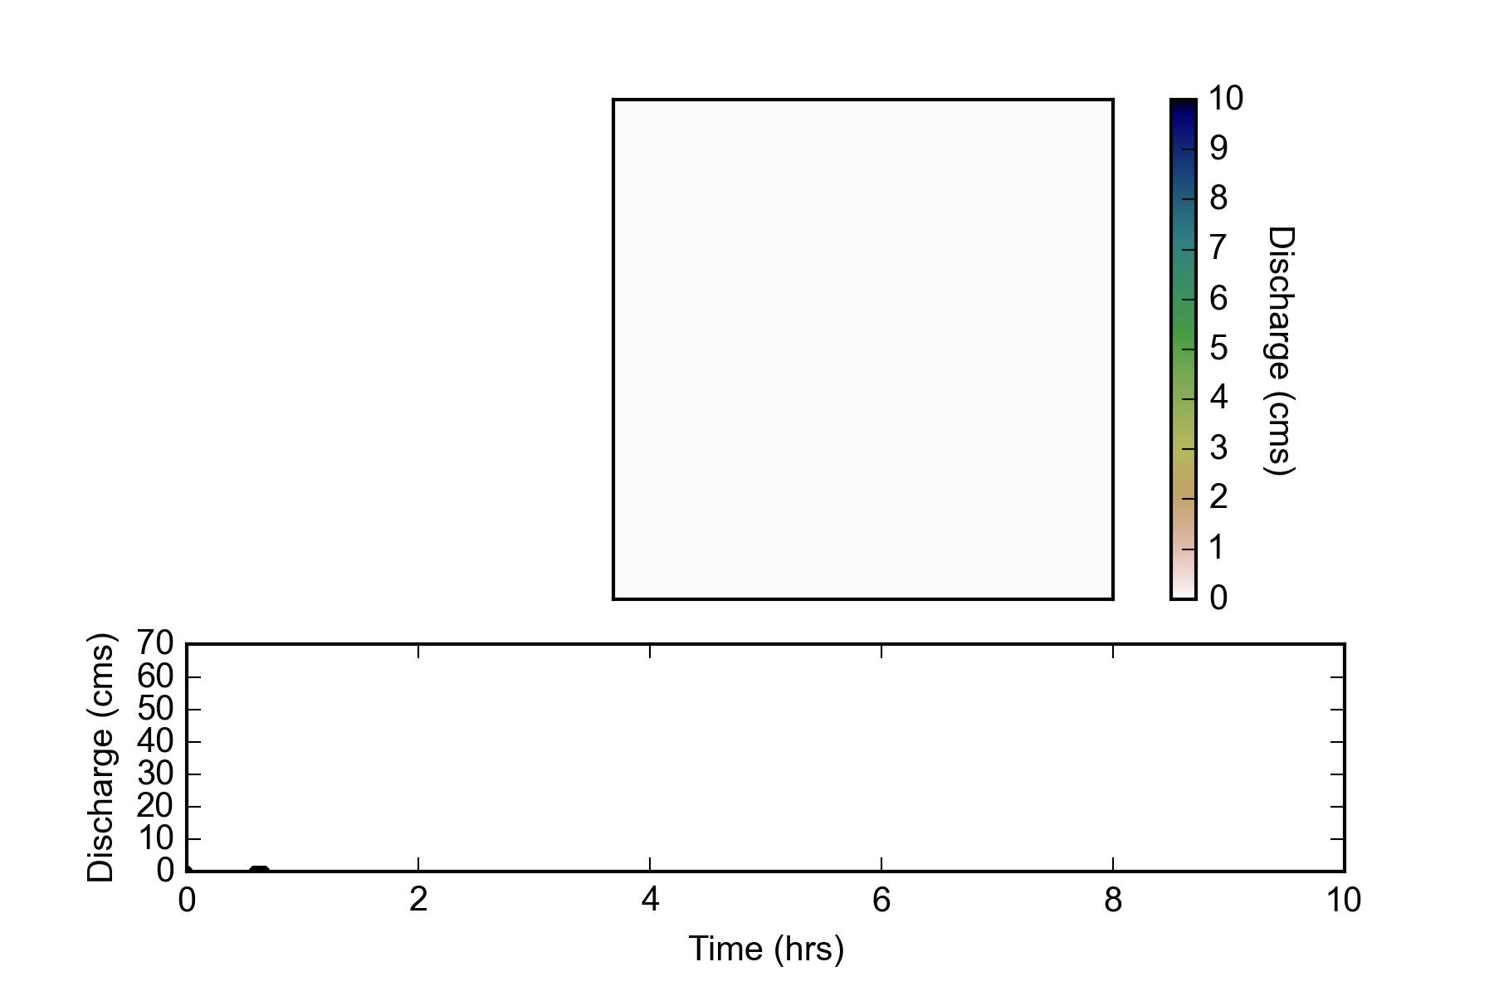
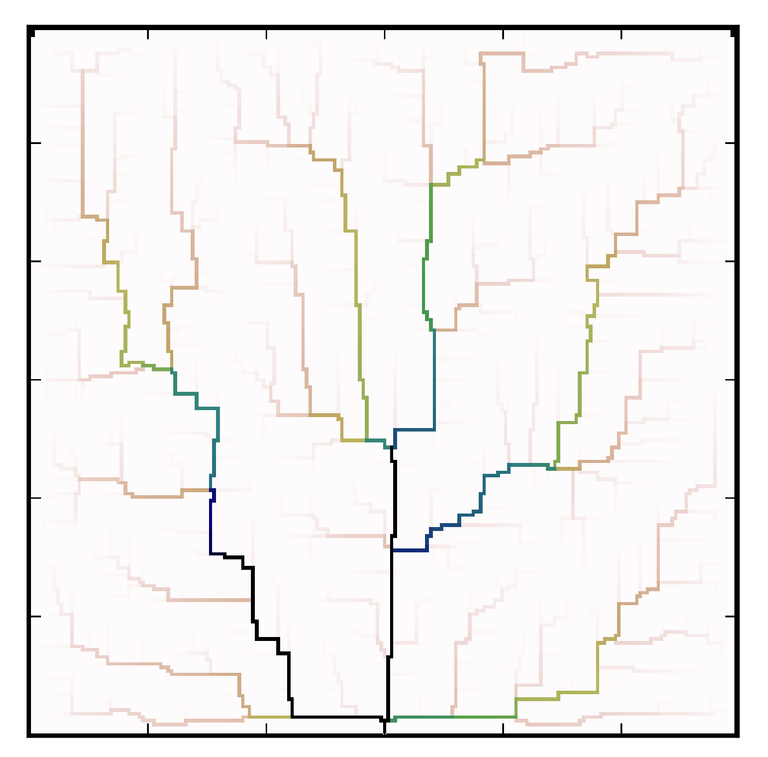
Steady-state
Nonsteady
Precipitation rate: 5 mm/hr for 2 hours
Peak discharge ~ 62 m³/s
(Q_{ss} = 49 m³/s)
Hydrograph at the watershed outlet
steady-state
nonsteady

Slide 10
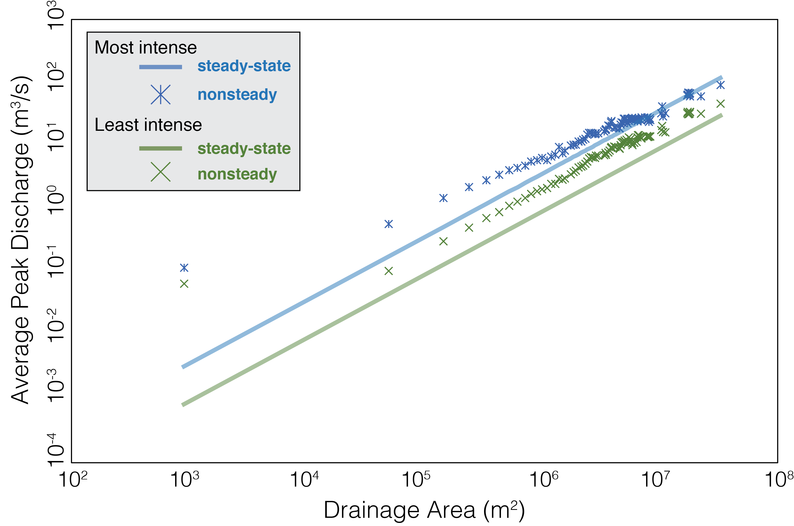
Average peak discharge is greater than predicted steady-state in upstream
upstream
downstream

Slide 11
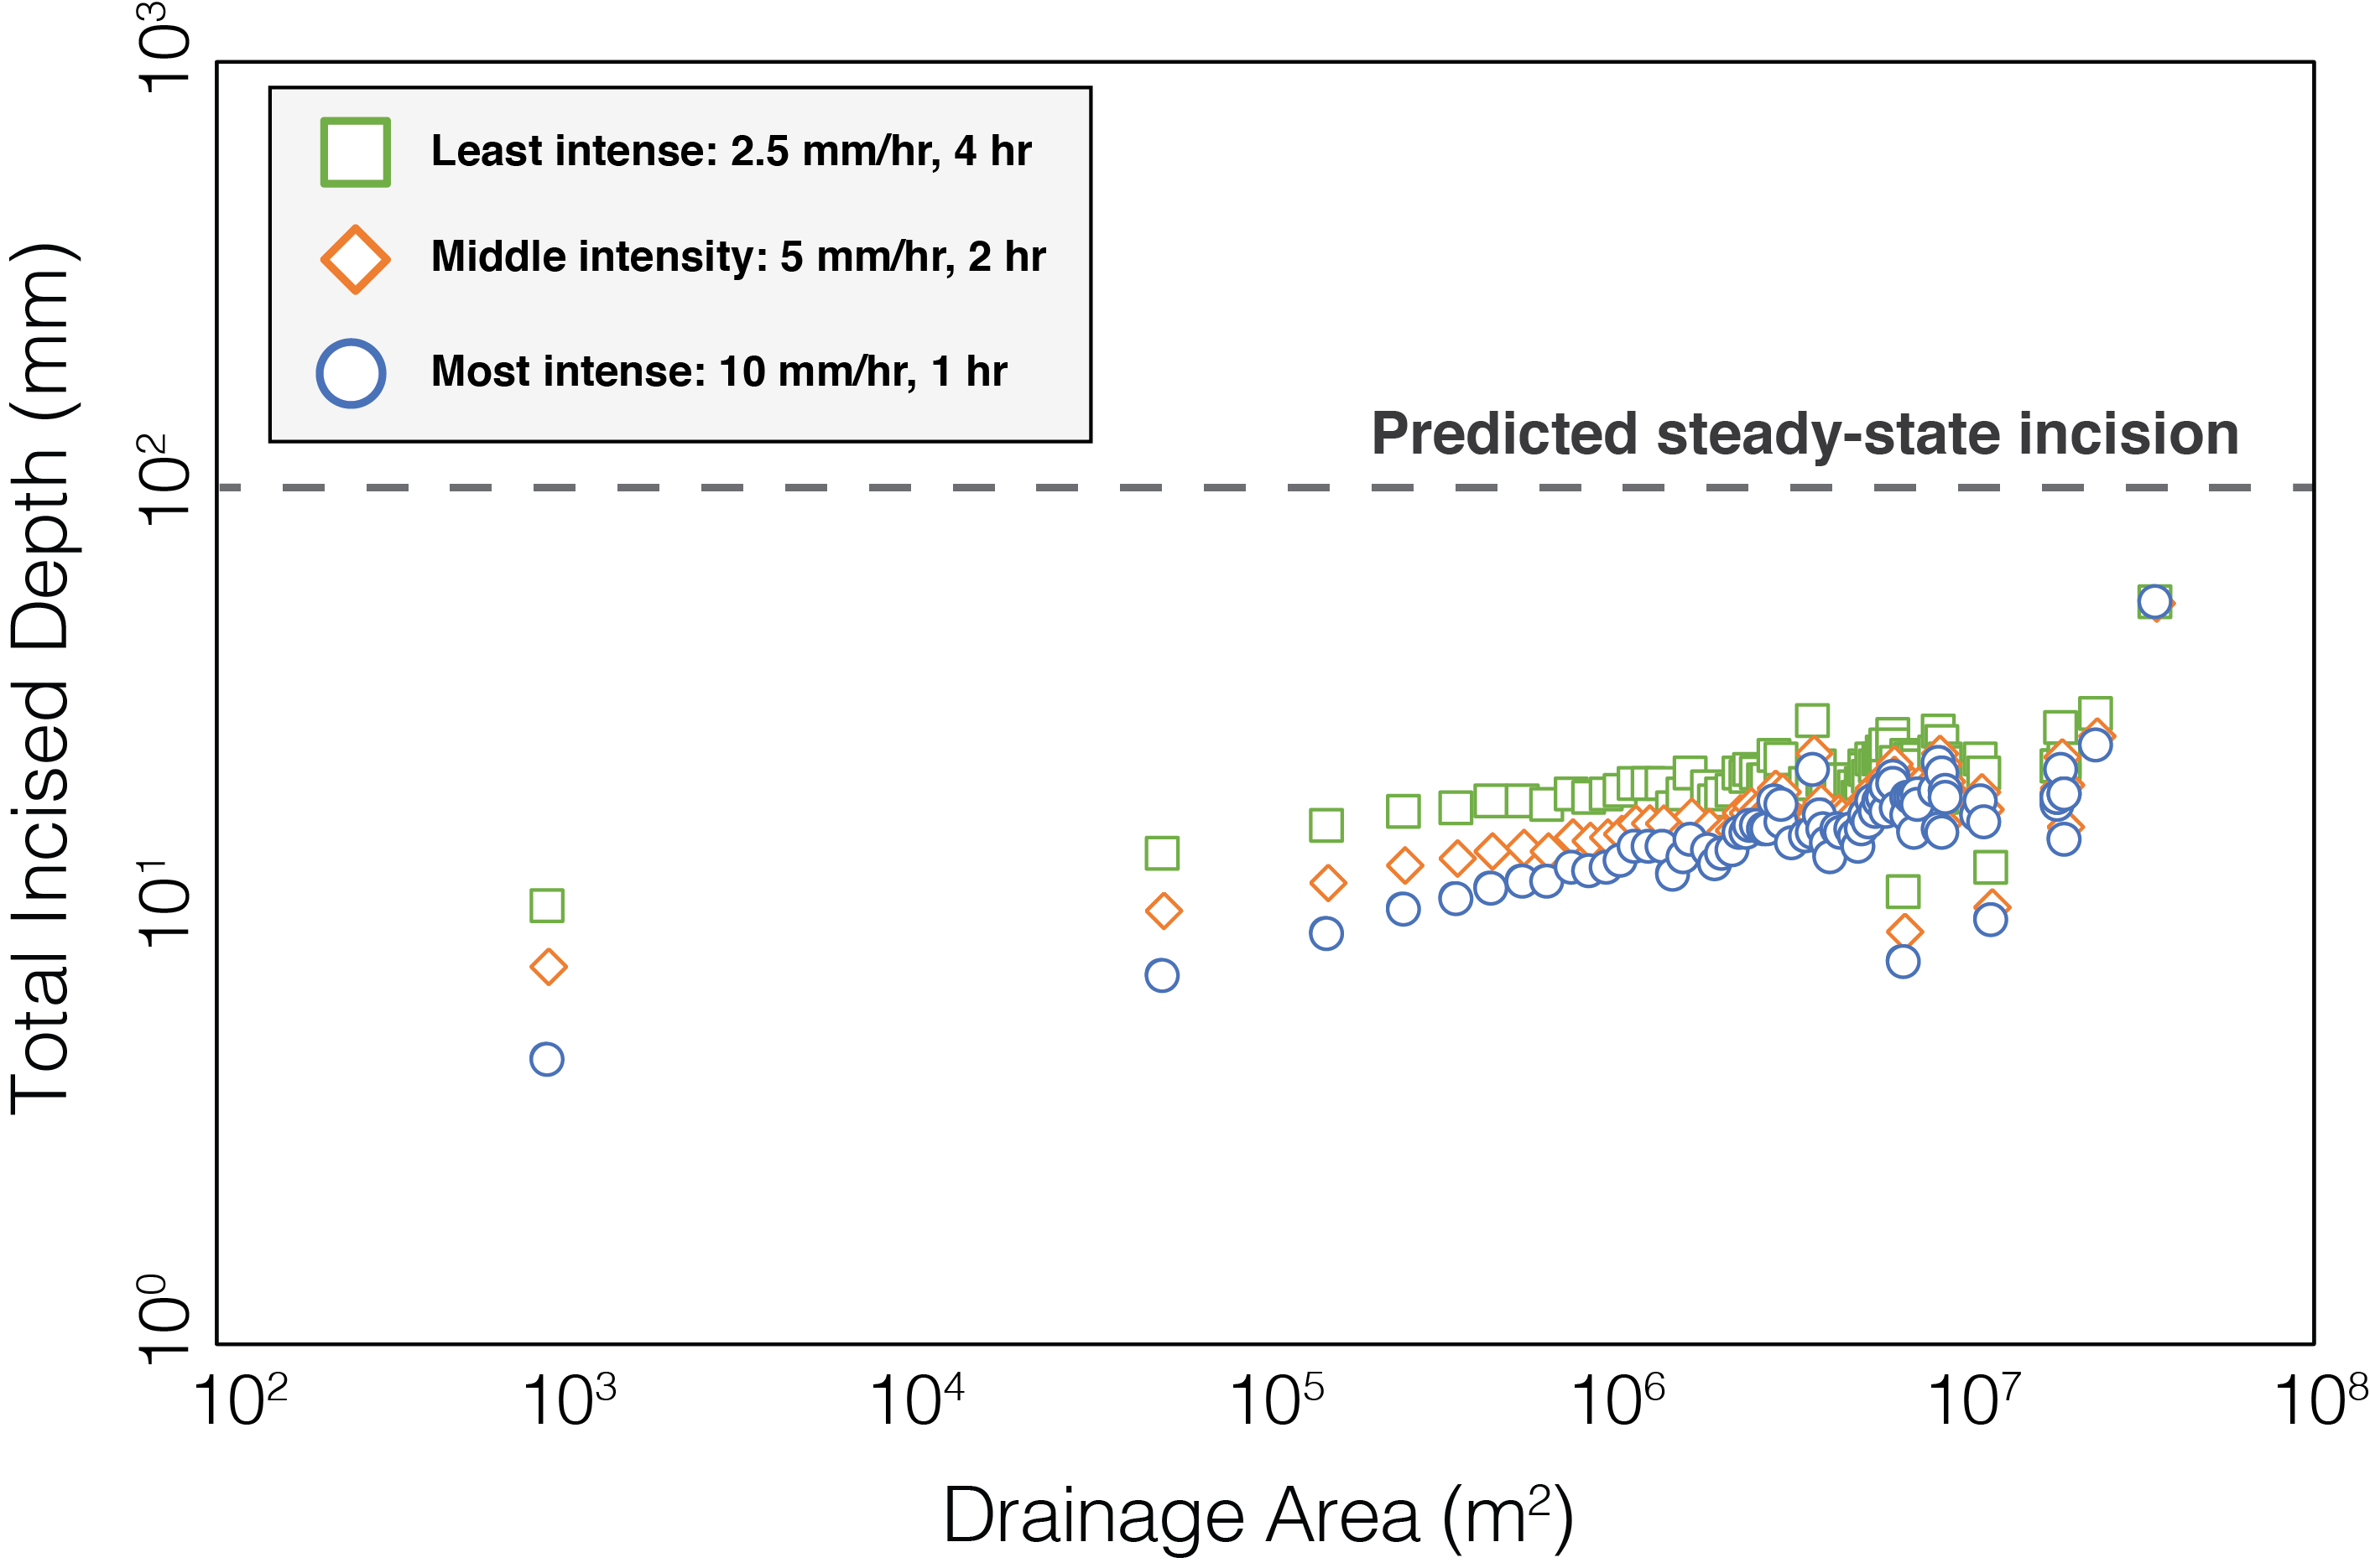
Cumulative incised depth by nonsteady method less than predicted by the steady-state hydrology model
In all intensities, higher drainage areas experience greater incision
Predicted geomorphic steady-state incision
uplift = incision rate
more incision
less incision
upstream
downstream

Slide 12
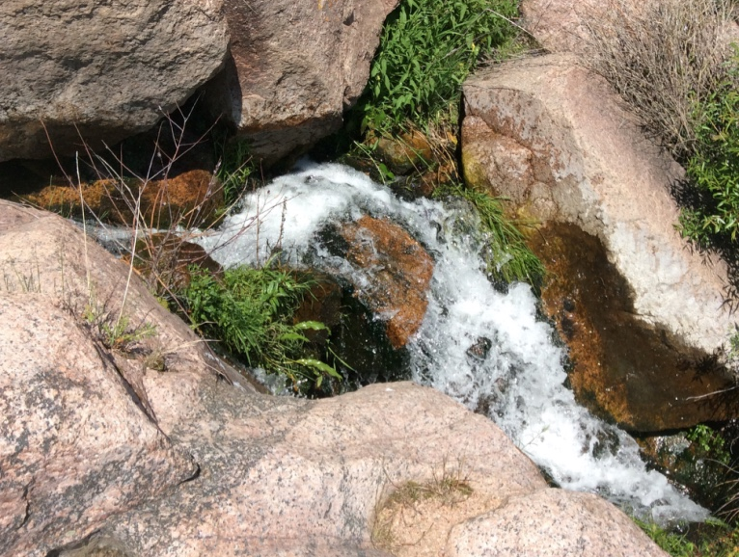
Peak discharge in nonsteady methods can exceed predicted steady-state: impact on incision?
Implications for landscape evolution modeling:
Incision in nonsteady cases less than steady-state:
    Higher incision downstream implies greater relief in modeled landscapes
    Potential for increases in channel concavities
    Are we capturing short-term events with steady-state?
        Predictive models: post-fire events

Slide 13
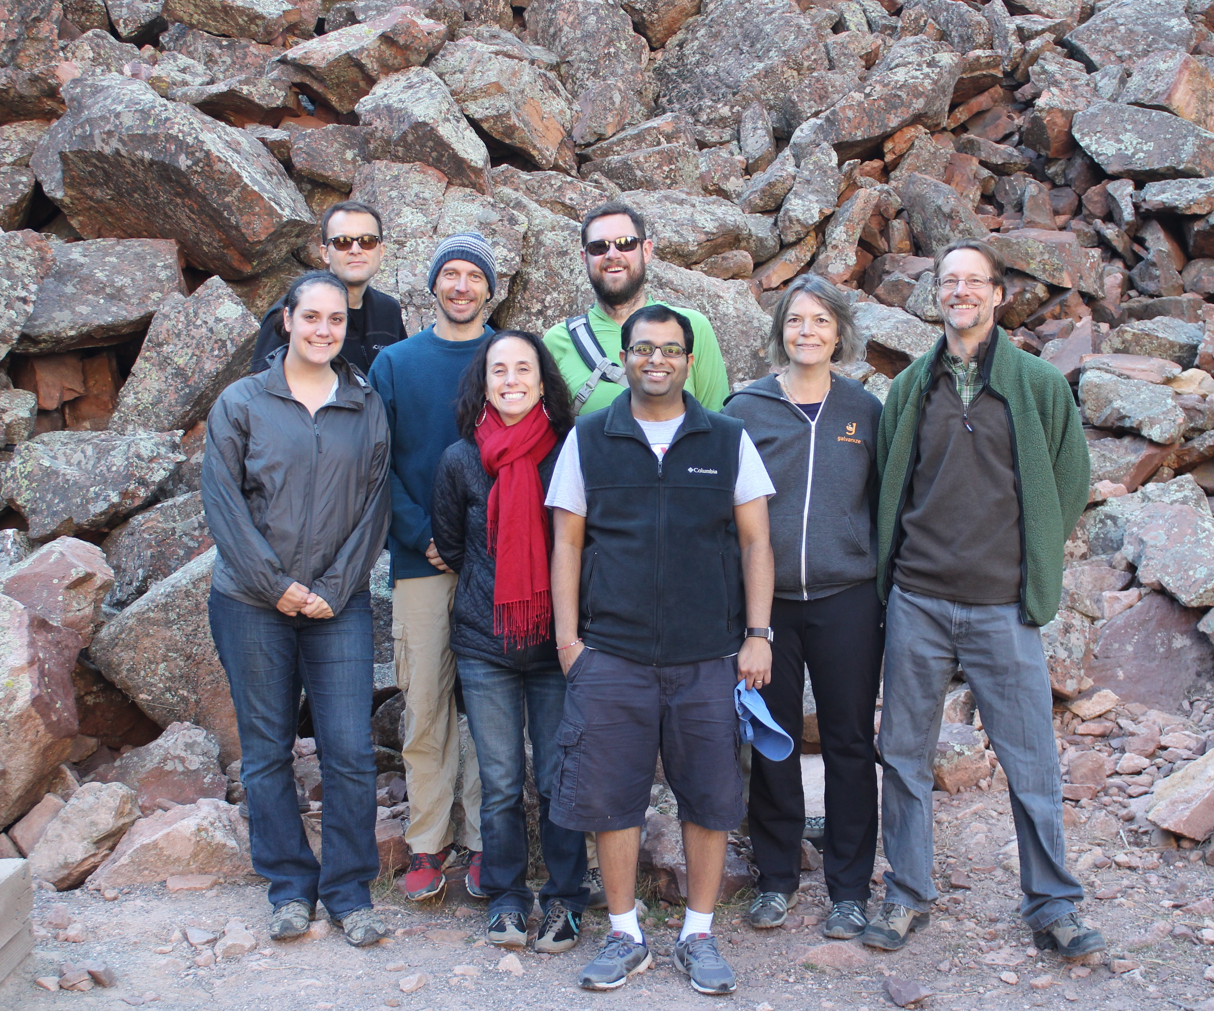




Visit our website: http://landlab.github.io
J. Adams supported by NSF grants ACI-1147519 and ACI-1450338, and a 2016 CSDMS Student Scholarship

