Slide 1
Integrated Modeling & Data Access — CUAHSI HIS HydroModeler
Jon Goodall, Assistant Professor
Department of Civil and Environmental Engineering
CUAHSI HIS Team Members:
David Maidment (PI), David Tarboton (co-PI), Ilya Zaslavsky (co-PI), Dan Ames (co-PI), Jon Goodall (co-PI), Michael Piasecki (co-PI), Rick Hooper (co-PI), Tim Whiteaker, James Seppi, Fernando Salas, David Valentine, Tom Whitenack, Matt Rodriguez, David Tarboton, Jeff Horsburgh, Kim Schreuders, Justin Berger, Tony Castronova, Robert Boykin, Ben Felton, Shirani Fuller, Ted Dunsford, Jiri Kadlec, Yoori Choi, Jennifer Arrigo
CUAHSI
HIS
Sharing hydrologic data
http://his.cuahsi.org
Support
EAR 0622374
CSDMS Meeting Boulder, CO - October 28-30, 2011

Slide 2
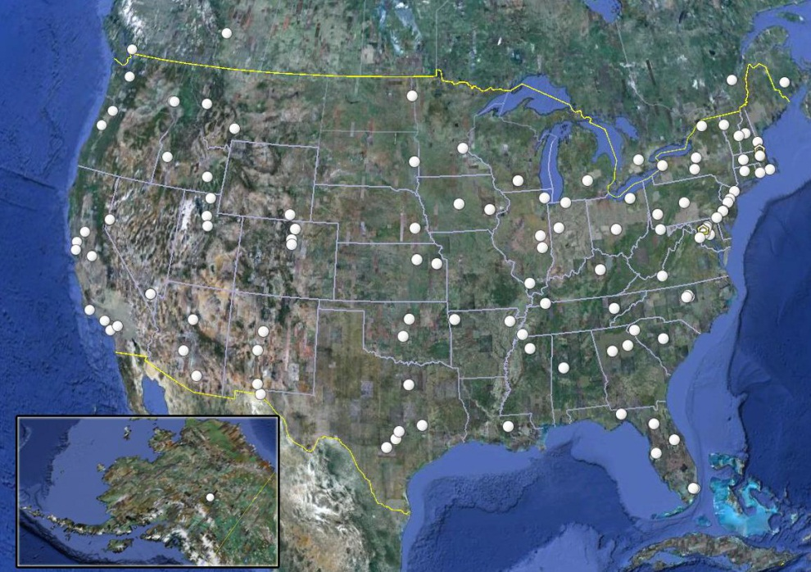
CUAHSI supports the water science community by (among other things):
developing, supporting, and operating research infrastructure;
improving and promoting access to data, information and models
www.cuahsi.org
125 University Members
Support from NSF

Slide 3
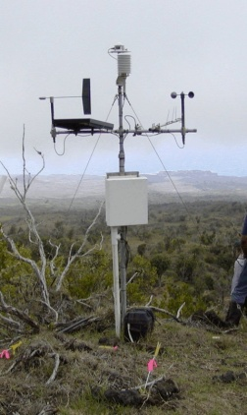
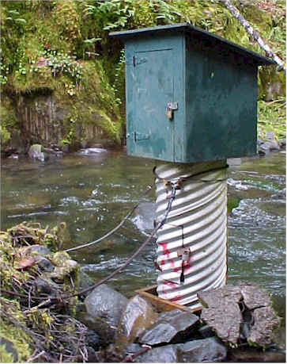
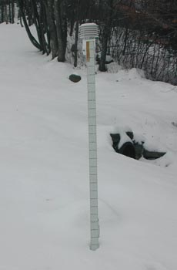
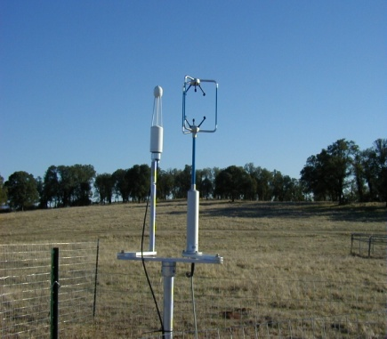
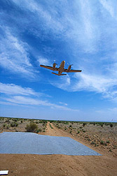
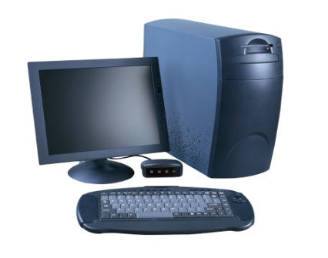
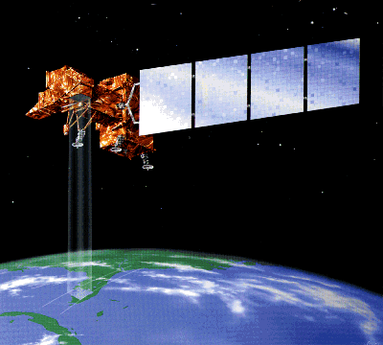
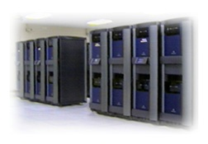
Problem Statement
We need new ways of handling the growing quantity of diverse data resources
Sensor Networks
Remote sensing
Model Output

Slide 4
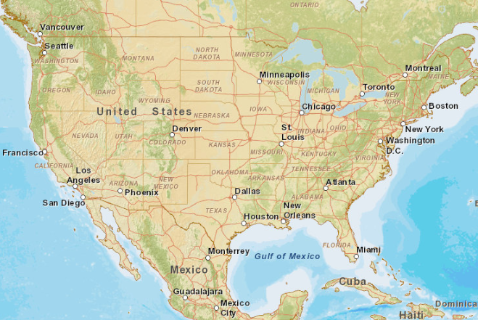
CUAHSI HIS Goal
To enhance hydrologic science by facilitating user access to more and better data for testing hypotheses and analyzing processes
CUAHSI
USU
NWIS
TWDB
Storet
UTexas
NCDC
Notes:
HIS helps you discover and access hydrologic data.

Slide 5
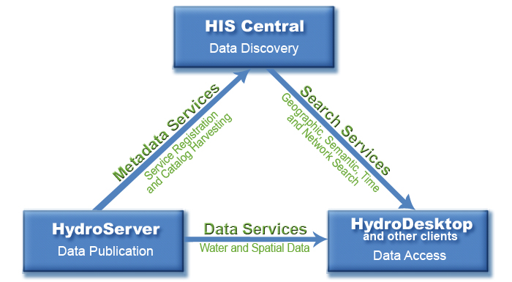
HIS Overview

Slide 6
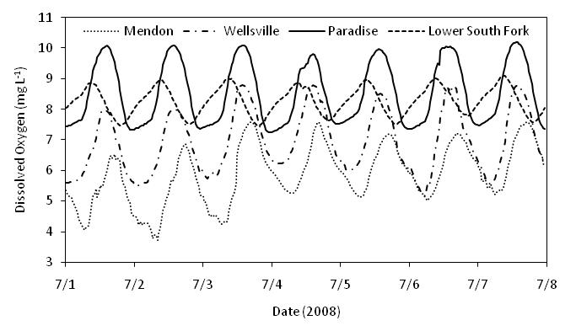
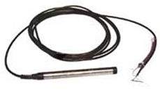
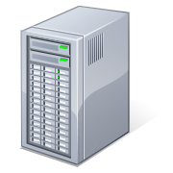
HydroServer
Point Observation Time Series
Ongoing Data Collection
Historical Data Files
GetSites
GetSiteInfo
GetVariableInfo
GetValues
ODM Database
WaterML
WaterOneFlow
Web Service
Horsburgh, J. S., D. G. Tarboton, D. R. Maidment and I. Zaslavsky, (2008), A Relational Model for Environmental and Water Resources Data, Water Resour. Res., 44: W05406, doi:10.1029/2007WR006392

Slide 7
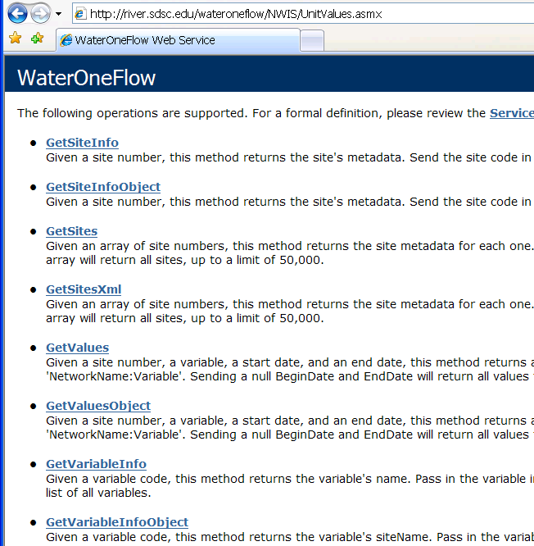
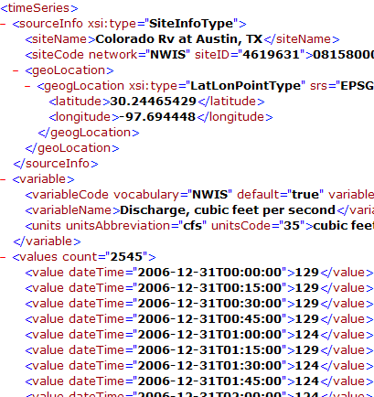
WaterML and WaterOneFlow
WaterOneFlow is a set of web services that return data in a WaterML format
Set of query functions (API)
Returns data in WaterML
Notes:
7

Slide 8
GetValues
GetVariables
qualifier
ISO Time
value
Notes:
8

Slide 9
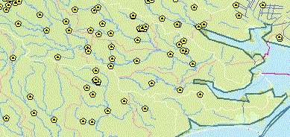
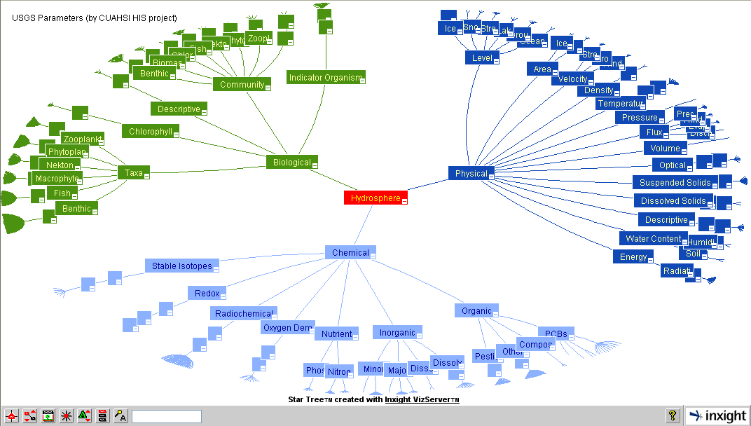
HIS Central
Centralized Observation Catalog with semantic mediation to enable search web services
Metadata catalog
66 services; 18,000 variables; 1.9 million sites; 29 million series; 5.1 billion data Values … and growing

Slide 10
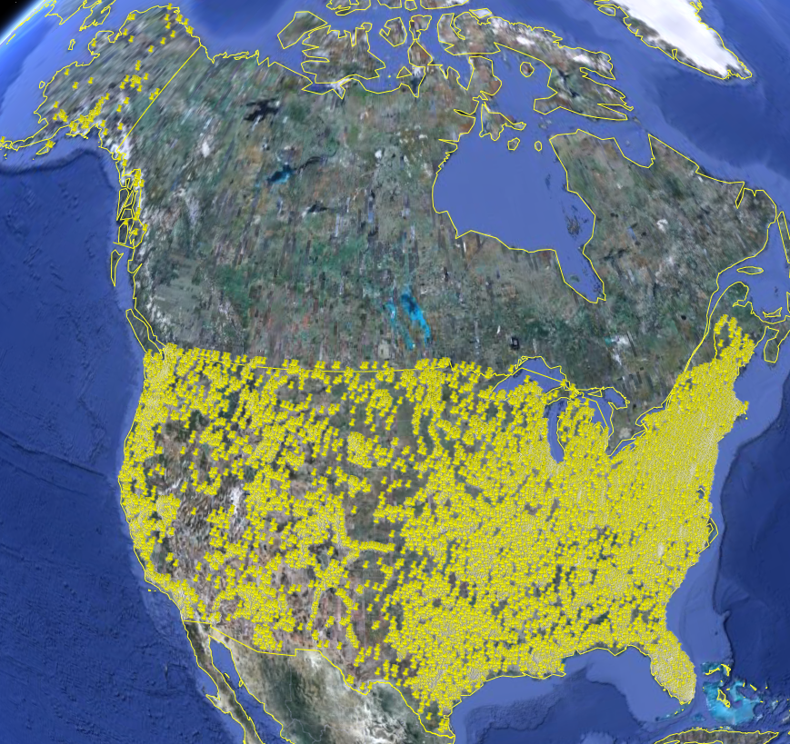
USGS Instantaneous Data
Real time, instantaneous data over the last 60 days
11188 sites, nationally for the US
80 variables
Published by USGS National Water Information System

Slide 11
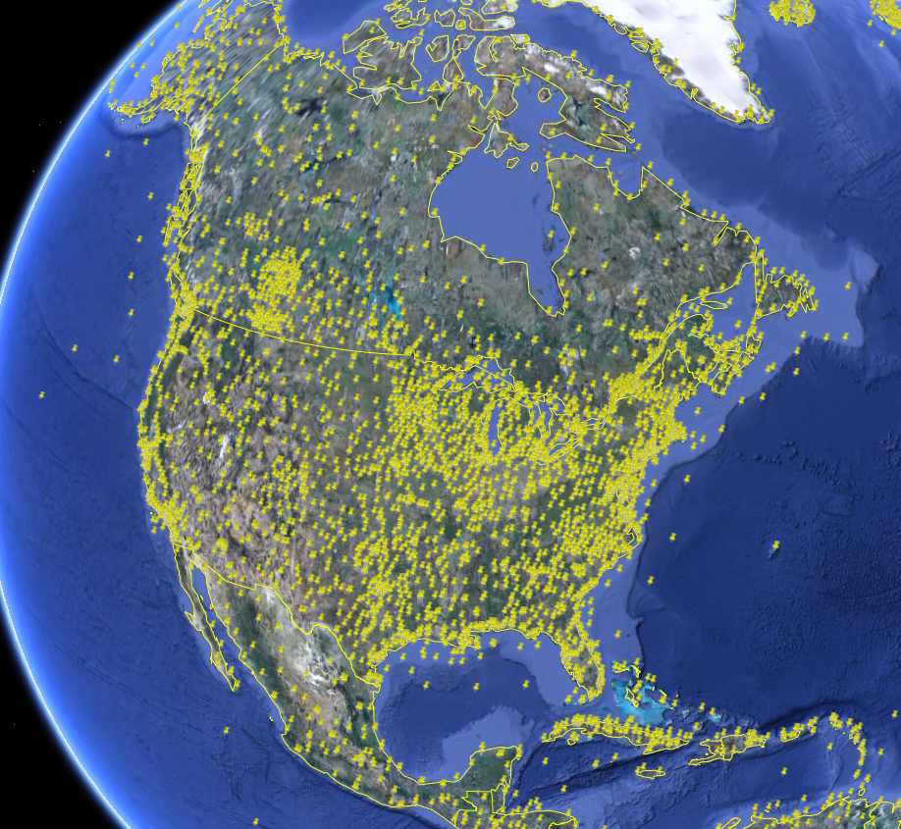
NCDC Integrated Station Hourly Data
Hourly weather data up to 36 hours ago
13,628 sites across globe
34 variables
Published by National Climate Data Center and populated with weather observations from national weather services
http://water.sdsc.edu/wateroneflow/NCDC/ISH_1_0.asmx?WSDL

Slide 12
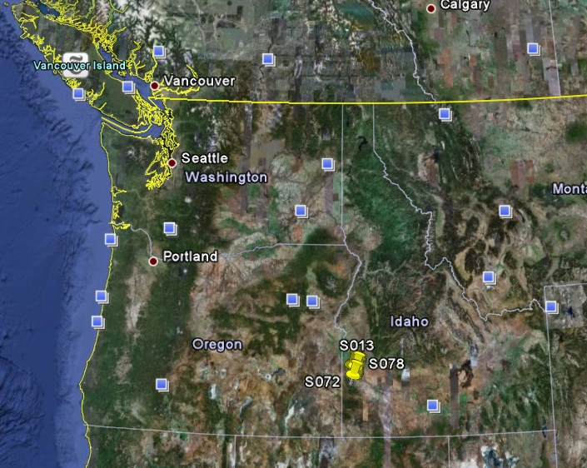
Reynolds Creek Experimental Watershed
1 data service
84 sites
65 variables
372 series
17.8 million data
Published by USDA-ARS as part of an Idaho Waters project
http://idahowaters.uidaho.edu/RCEW_ODWS/cuahsi_1_0.asmx?WSDL

Slide 13
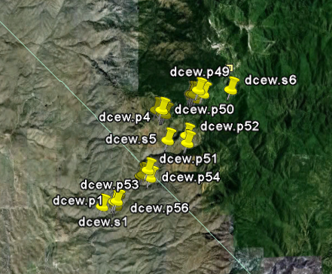
Dry Creek Experimental Watershed (DCEW) (28 km² semi-arid steep topography, Boise Front)
68 Sites
20 Variables
5924511 values
Published by Jim McNamara, Boise State University
http://icewater.boisestate.edu/dcew2dataservices/cuahsi_1_0.asmx?WSDL

Slide 14
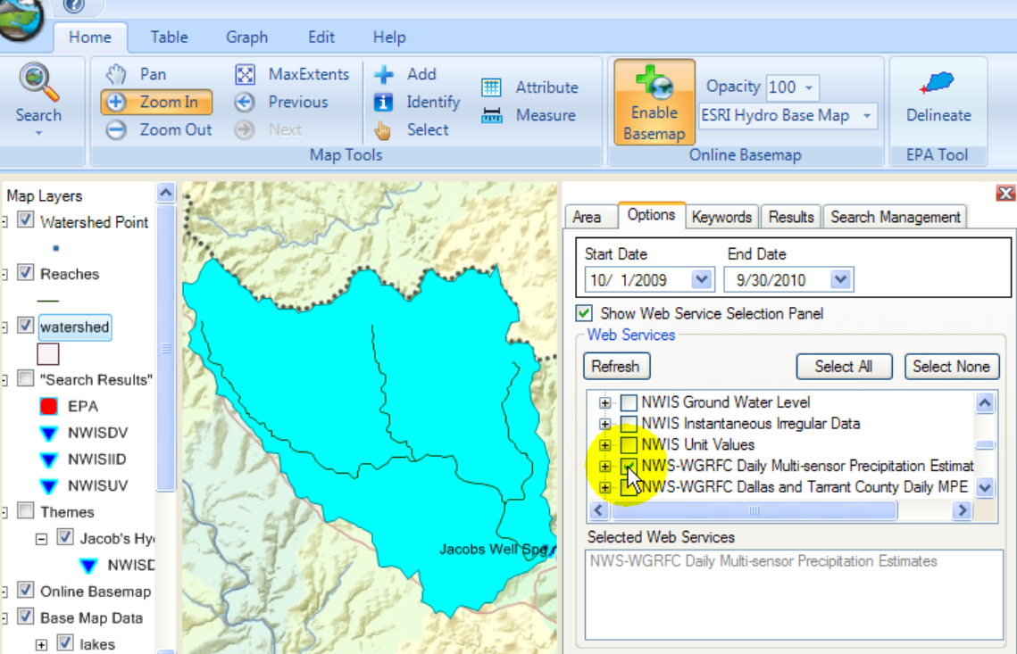
HydroDesktop
Metadata
Catalog
Data
www.hydrodesktop.org

Slide 15
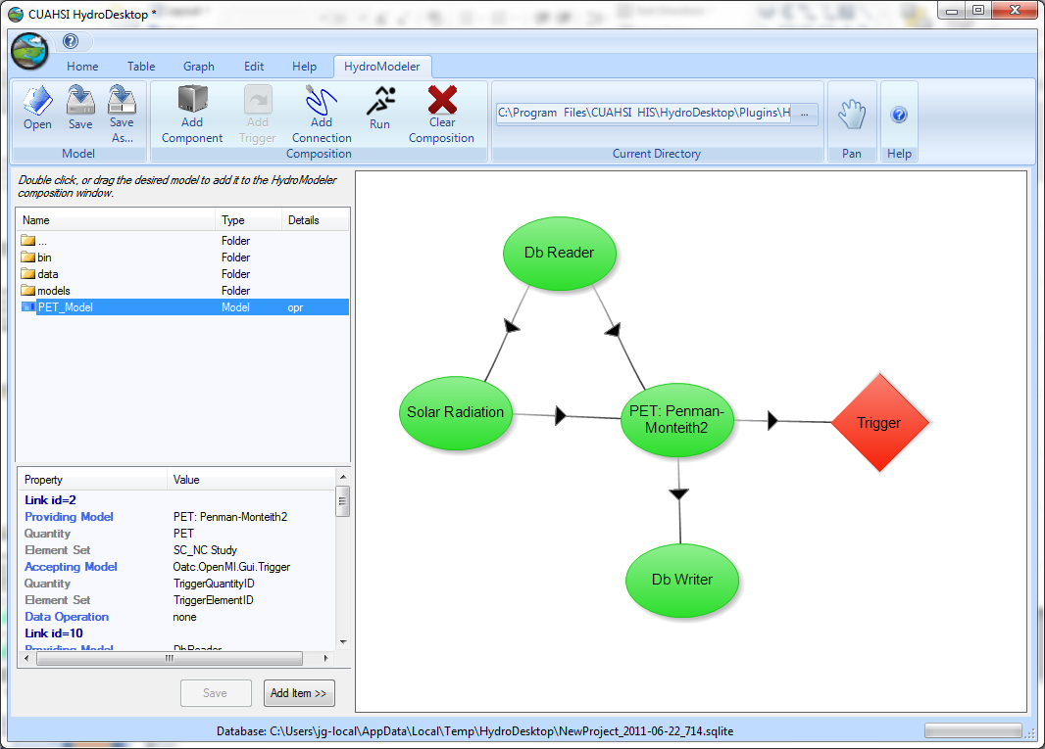
HydroModeler: A HydroDesktop Plug-in
Model Directory
Explorer
Model Configuration
Model Attributes

Slide 16
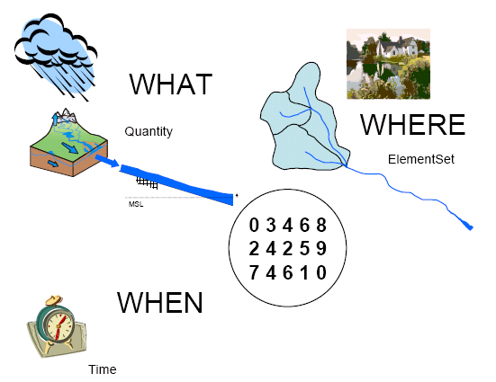
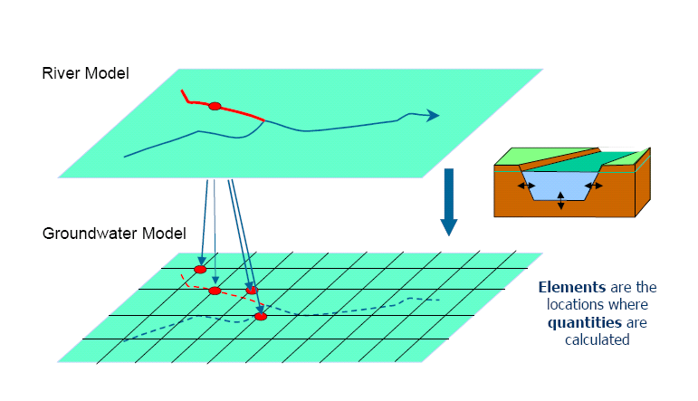
Open Modeling Interface
allows models to exchange on a time basis
- standard
- Software Development Kit (SDK)
Metadata
www.openmi.org

Slide 17
The Architecture of a Model Component
OpenMI
Interface
Initialize
PerformTimeStep
Finish
Procedural
Model
Data
config.xml
Input and Output Exchange Items, Time horizon and step, etc.
Supporting Libraries
Simple Model Wrapper
Castronova and Goodall, 2010, Environmental Modelling & Software

Slide 18
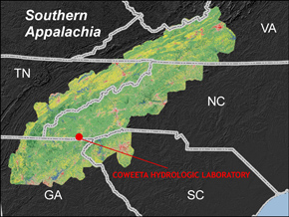
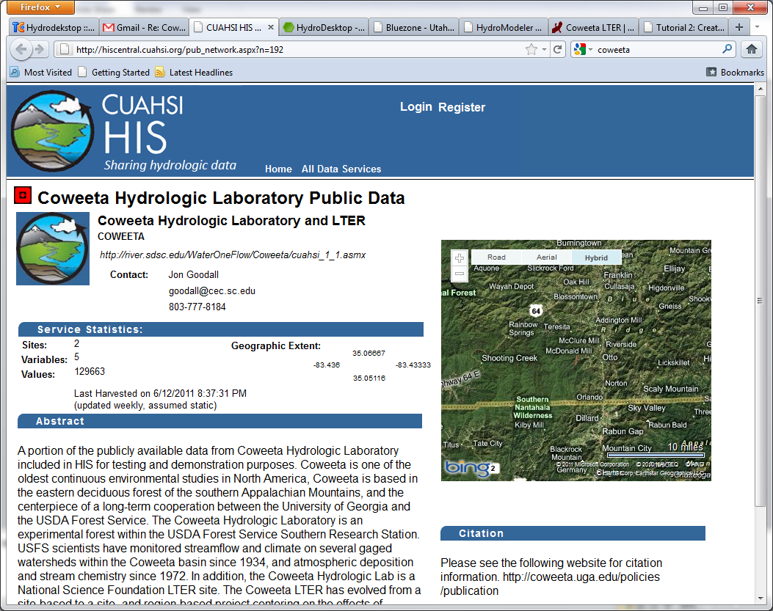
Example Application
Modeling rainfall/runoff for Coweeta Watershed #18
HIS Server includes publically available Coweeta data
Precipitation: daily accumulated
Air temp: daily min, max, and mean
Stream discharge: daily average
Coweeta HIS Server
Mostafa Elag and
Tony Castronova, USC
http://river.sdsc.edu/WaterOneFlow/Coweeta/cuahsi_1_1.asmx?WSDL

Slide 19
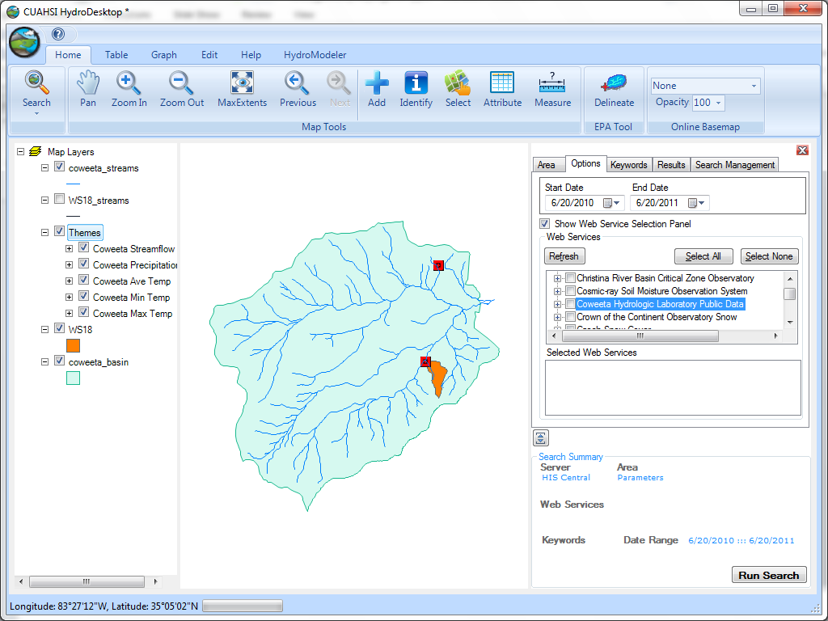
Coweeta Watershed #18
Watershed #18 Area: 12.48 ha (0.12 km²)
650m by 300 m

Slide 20
Steps in the Hydrologic Modeling Process
Revise perceptions
The Perceptual Model:
deciding on the processes
Revise equations
The Conceptual Model:
deciding on the equations
Debug code
The Procedural Model:
getting the code to run on a computer
Revise parameter
values
Model Calibration:
getting values of parameters
Model Validation:
good idea but difficult in practice
No
Declare
Success?
Rainfall-Runoff Modeling: The Primer, Beven, 2001
Yes

Slide 21
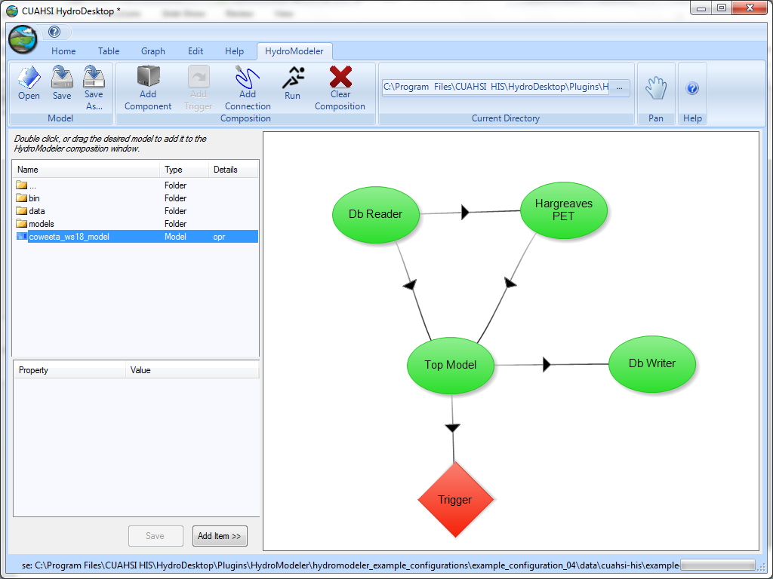
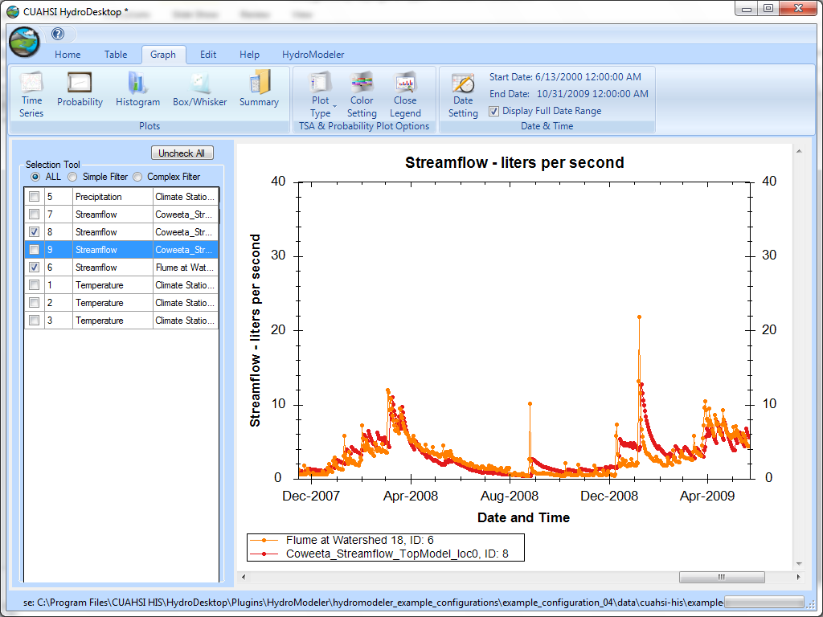
Model Development and Application
Do I have the important processes?
Is my mathematical representation of processes sufficient?
Are there bugs in my numerical solution?
Do I have an acceptable parameterization?

Slide 22
HIS Data can be used in other Modeling Systems
Object Modeling System v3.0

Slide 23
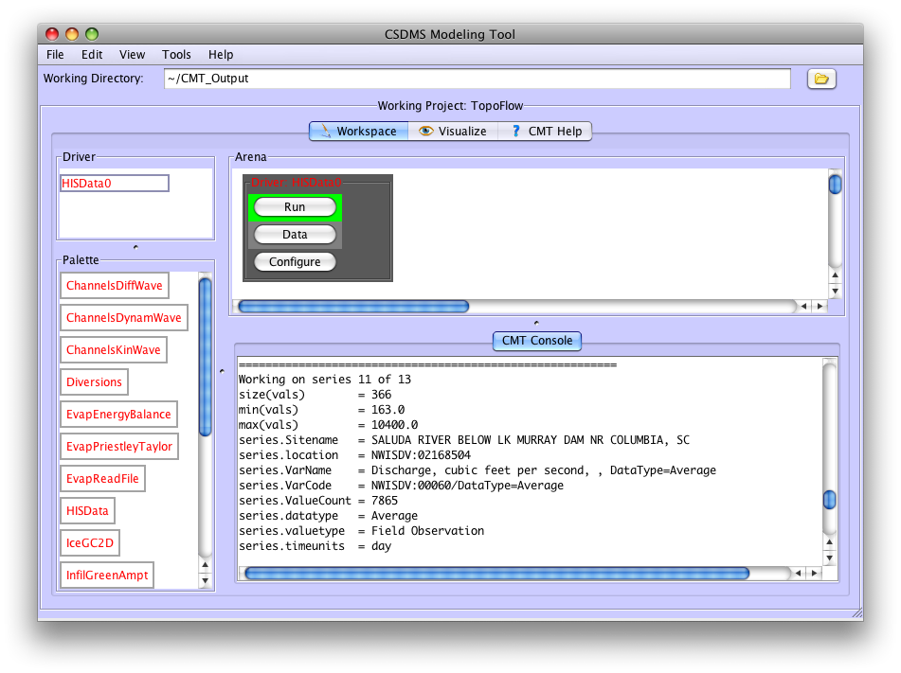
Example: Accessing HIS Data from within CMT
HISData is a CMT component that can search HIS Central and download data from WaterOneFlow web services
It allows HIS data to serve as input to CMT models
Peckham and Goodall, Computers & Geosciences, Submitted.

Slide 24
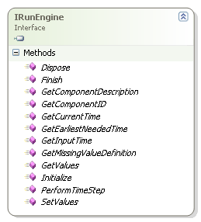
Path Forward
Cross-disciplinary science: Interoperability across modeling systems
OpenMI Model Interface
CSDMS Basic Modeling Interface (BMI)
Finalize
Getter
Initialize
Run
Setter

Slide 25
CSDMS/OpenMI Interoperability
Goal: Import CSMDS Components into an OpenMI modeling environment
CSDMS Component
Python element of Wrapper
OpenMI Model Linking Environment
CSDMS Component
XML Config File
OpenMI Wrapper using IronPython
Robert Boykin and
Tony Castronova, USC

Slide 26
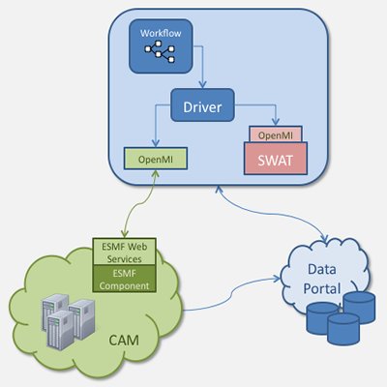
ESMF/OpenMI Interoperability
Goal:
Scientific Workflow that couples desktop hydrologic models (wrapped using OpenMI) with HPC climate models (wrapped using ESMF) through web services
Project Team:
Kathy Saint, Sylvia Murphy, and Cecelia DeLuca -- ESMF Core Team
Jon Goodall and Mehmet Ercan -- University of South Carolina
Ricky Rood and Laura Briley -- University of Michigan

Slide 27
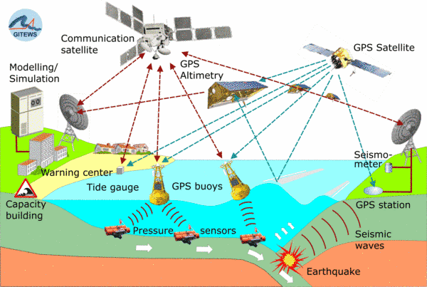
Common Standards across Earth Science Modeling and Information Systems
The Open Geospatial Consortium (OGC®) and the OpenMI Association announced that they recently signed a memorandum of understanding (MOU) to cooperate in standards development and promotion of open standards related to computer modelling.
http://www.opengeospatial.org/pressroom/pressreleases/1450
Open Geospatial Consortium (OGC)
WaterML 2.0 is a candidate Open Geospatial Consortium encoding standard for the representation of in-situ hydrological observations data.
http://www.opengeospatial.org/projects/groups/waterml2.0swg
Observations and Measurements Model
Sensor Web Enablement (SWE)
Sensor Observation Service (SOS)
The THREDDS Data Server (TDS) is a web server that provides metadata and data access for scientific datasets, using OPeNDAP, OGC WMS and WCS, HTTP, and other remote data access protocols.
www.unidata.ucar.edu/projects/THREDDS

Slide 28
Summary
HIS provides
standards for accessing hydrologic observational data
WaterML, WaterOneFlow API, ODM
software to simplify access and use of hydrologic observational data
HydroServer, HydroCatalog, HydroDesktop, HydroModeler
Agreed upon standards and protocols for component interfaces and data exchanges will facilitate interoperability across earth science modeling and information systems

