Slide 1
Connecting Human and Natural Systems: The Role of Agent-Based Models
Jonathan Gilligan
Vanderbilt University
Funding: ONR MURI, NSF WSC & Coastal SEES
CSDMS Annual Meeting
26 May 2017

Slide 2
The value of applying simple models to complex problems
Black-box versus glass-box modeling
Large, complex models are difficult for others to understand, even when source code is available.
Simple models may sacrifice fidelity to observations in favor of transparency:
Simple models to identify important dynamics
Identify what to study in greater detail
Case Studies:
Participatory agent-based simulations for public engagement on flood hazards
Coupled human natural systems:
Tidal river management in Bangladesh

Slide 3
Simple models to identify important questions
Crop-choice by farmers in Sri Lanka
Rice vs. green vegetables
Variation by reservoir condition and private irrigation wells
Different results for different decision models
Implication: Further research to understand farmers’ decision processes under risk & uncertainty

Slide 4
Participatory Agent-Based Simulations for Public Engagement with Flood Control
Floods are “acts of God,” but flood losses are largely acts of man.
— Gilbert F. White
Collaborators: C. Brady (VU), J. Camp (VU), J.J. Nay (VU), P. Sengupta (U. Calgary)

Slide 5
Participatory Agent-Based Simulations
Interactive simulations:
Trial and error with prompt feedback.
Learning from experience
Participatory simulations:
Multiple players interacting, explore social aspects of emergent phenomena.
Integrate participatory and agent-based approaches:
Players control high-level policy decisions.
Automated agents simulate low-level response by population

Slide 6
The Model
Cities along a stylized river
Choice not to use real geography
Particle hydrodynamics for channel & overland flow
Agent-based land markets for development, property value
Nonlinear time:
Slows down during flood events
Players:
Planners for neighboring cities
Receive tax revenue
Decide on flood wall construction
https://github.com/pratim/Floodpartsim

Slide 7
Master Interface
Map color indicates property value

Slide 8
Sequence
20-year run
Stochastic rain, river discharge
Automated land development
Slow time for floods (20+ year stage)
Every 20 years:
Discussion, levee building
After 100 years:
Generate 200-year flood

Slide 9
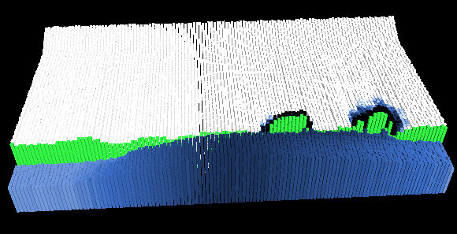
Flood Event and Damage Map

Slide 10
Experiments
Pre-service social studies teachers
Groups of 2-3
Sequence:
Pre-questionnaire and briefing
Participatory simulation exercise
Post-questionnaire and debriefing
Unexpected results:
Students became very emotionally engaged
“This is terrifying!” (covering mouth and gasping)
Emotional engagement may facilitate learning
Damasio, Slovic
Interactive simulations facilitate emotional engagement
Weizenbaum, “Eliza” (1966)

Slide 11
The research team
Faculty, Students,
Postdocs from
Vanderbilt University
Columbia University
Louisiana State U.
University of Colorado
Texas A&M
Karlsruhe Inst. Tech.
Dhaka University
Jahangirnagar U.
Khulna U.
Coupled Human-Natural Systems in Bangladesh
Sediment modeling by C. Tasich (VU)
Funding: ONR MURI, NSF Coastal SEES

Slide 12
Coastal Embankment Project: 1960s-70s
123 enclosed “polders”
“Beels”

Slide 13
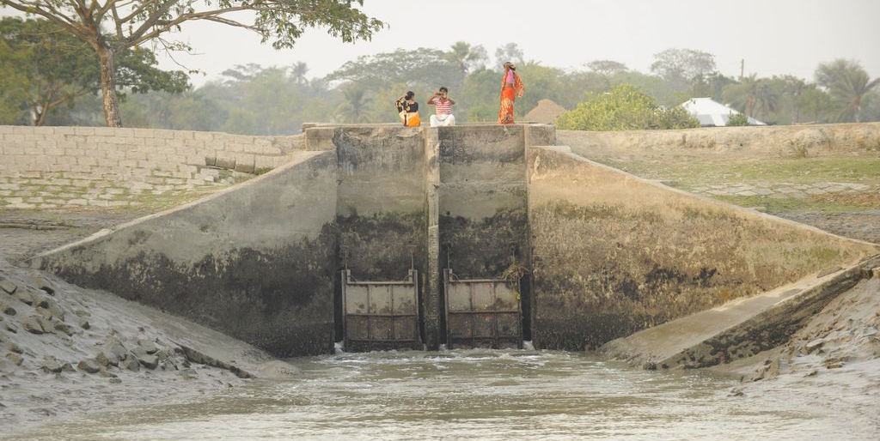
Embankments and Sluice Gates

Slide 14
Forgotten Wisdom of the Past
“Embankments … are likely to make the situation far worse in the long run”
—P.C. Mahalanobis (1927)
“If the river could flow properly, then
everything will be all right.”
— Farmer displaced by floods (Sept. 2011)

Slide 15
Beel Bhaina 2001

Slide 16
Beels Bhaina & Kukshia 2010

Slide 17
Beel Kukshia 2013

Slide 18
Public opposition to Tidal River Management
Photo Credit: BanglaNews24 2 June 2012
Notes:
Quotation from field interview Sept. 2011.

Slide 19
Failure of government drainage rehabilitation project
ADB Project evaluation:
No buy-in from local communities
Failure to compensate farmers for losses
“Lack of understanding of an indigenous knowledge base”
Local farmer:
“The [government] engineer … would not accept our suggestion because he thought it was given by the non-experts!”

Slide 20
Challenges
Representing local decision-making:
History: informal grass-roots activism vs. imposed government program
Explore role of voting and negotiation for building popular support
Inequality:
Unequal land holdings in size, quality
Higher elevation vs. lower elevation
Complex land tenure:
Tenant farmers, share-croppers, “dummy” owners, etc.

Slide 21
Modeling challenge
Limited data:
Qualitative social-science field-work (Key-informant interviews, focus-group discussions)
Review of qualitative social-science literature
Measurements of physical system elsewhere, but not near beels (Topographic surveys, tide gauges, suspended sediment, sedimentation rates)
For designing simple models, narratives can be more useful than quantitative survey data

Slide 22
Modeling Tidal River Management
Simple model of coupled human-natural system
Simple model of sediment deposition
Stylized representation of agricultural impact
Add human dimension: community decision-making
This work:
Stylized models: informed by empirical data, but not calibrated
No attempts so far at quantitative validation
Basic framework in place
Future work will explore social, economic, political dynamics

Slide 23
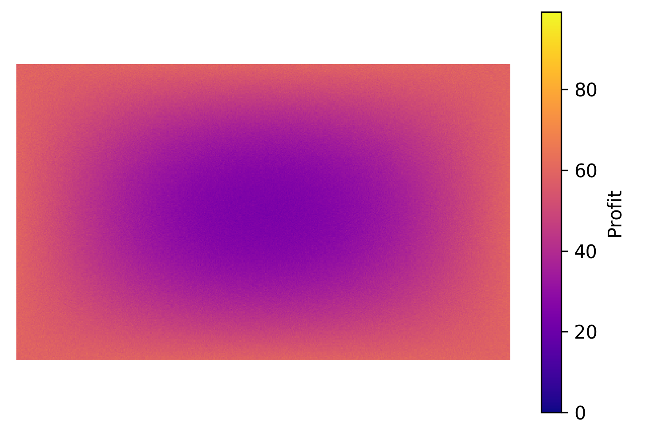
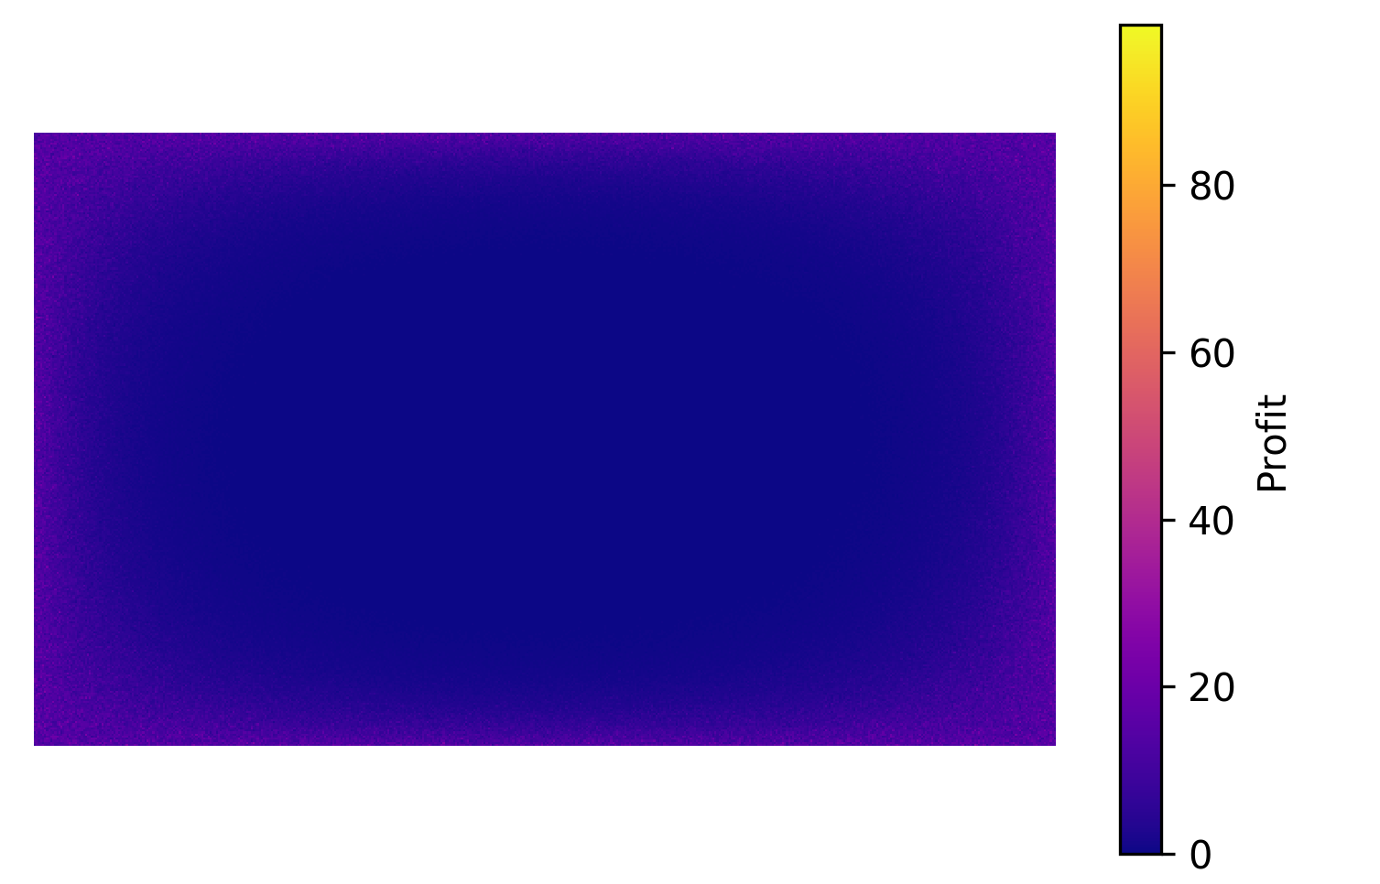
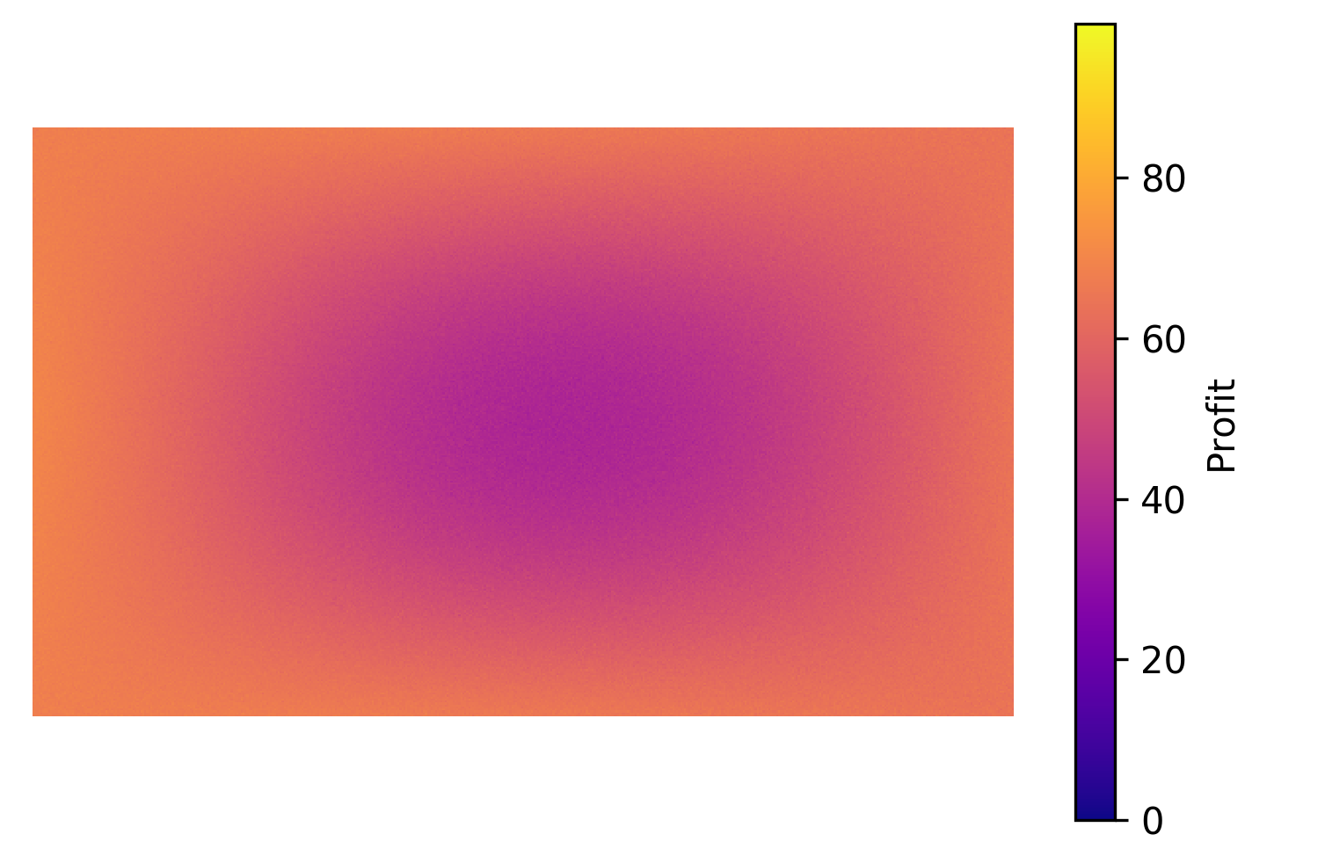
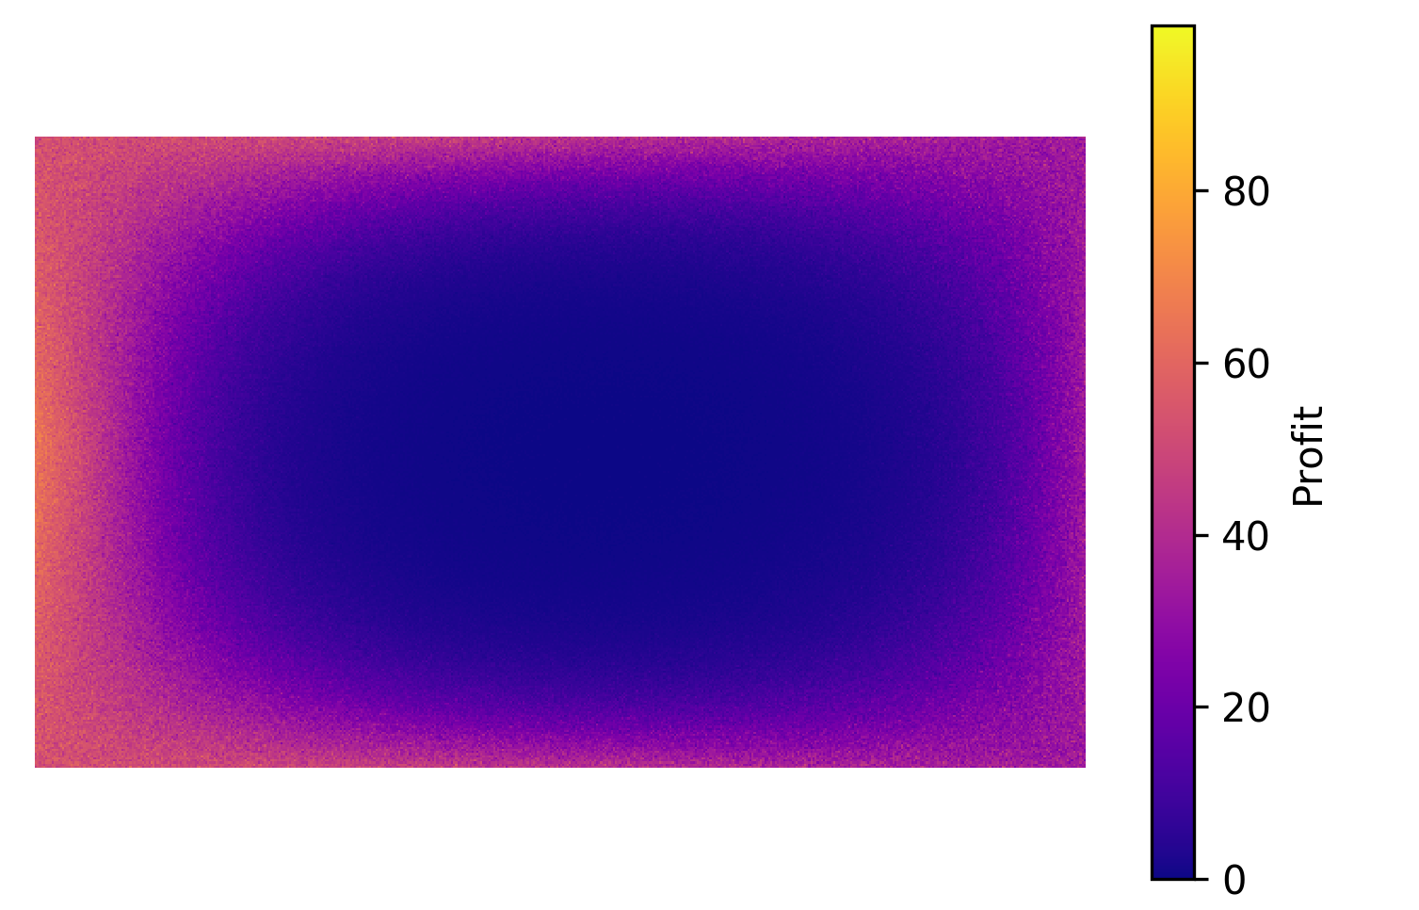
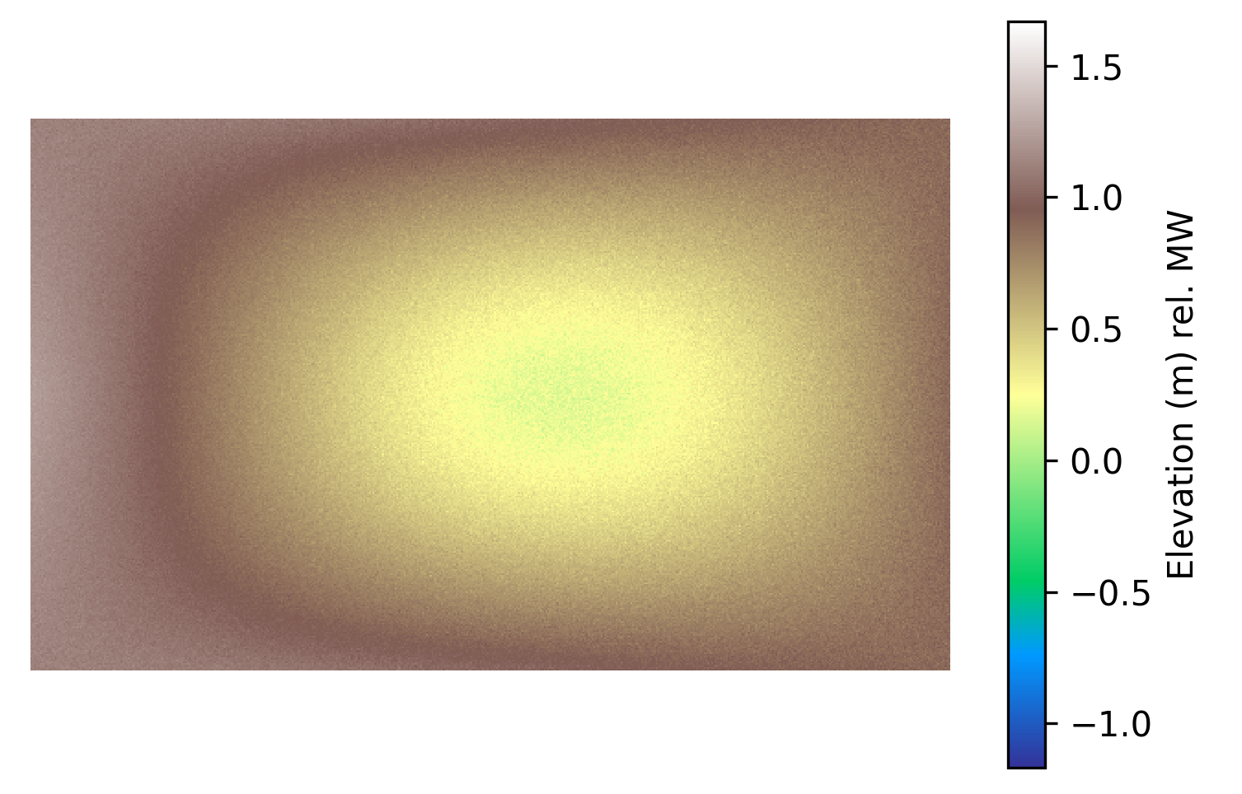
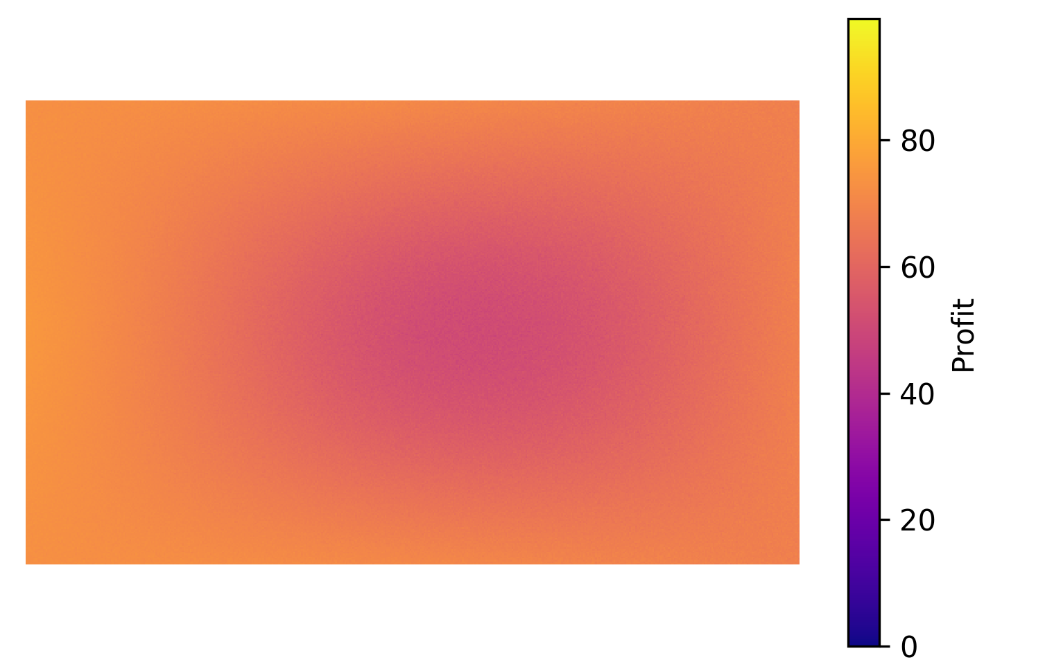
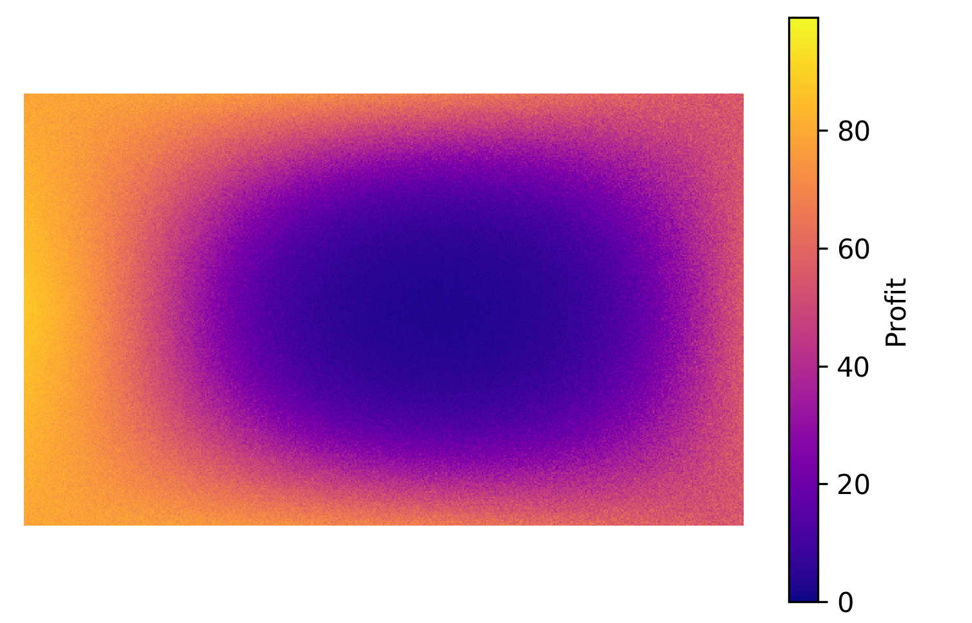
Elevation
Elevation
Rice yield (breach closed)
Rice yield (Breach open)
Breach
Initial conditions
After one year breach
After two year breach

Slide 24
Simulating community decisions
Simplified:
Not based on actual decision procedures
Informed by considerations expressed in key-informant interviews
Voting:
Instant-runoff in case of no majority in first round
Trading:
Farmers “trade votes”:
Winners offer compensation to losers to support choice
Continuous double-auction until a majority emerges

Slide 25
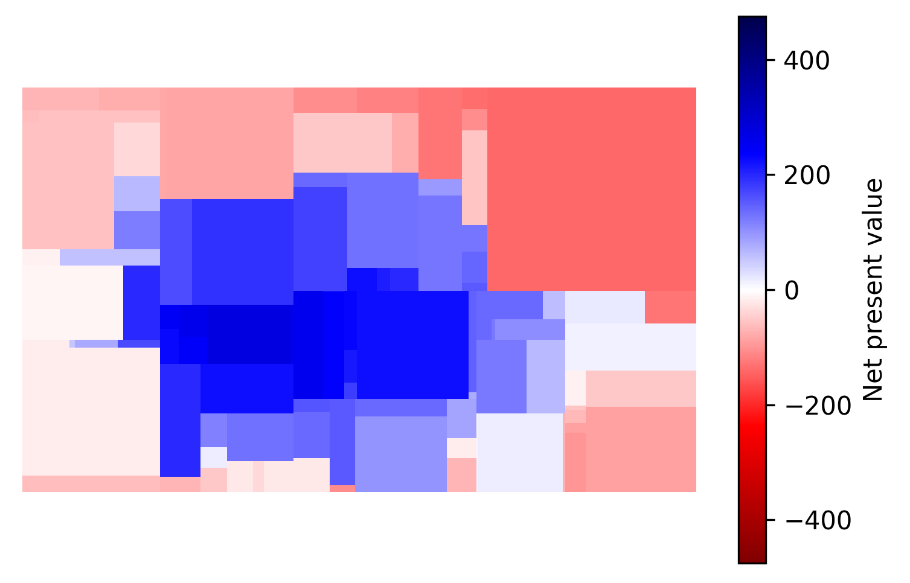
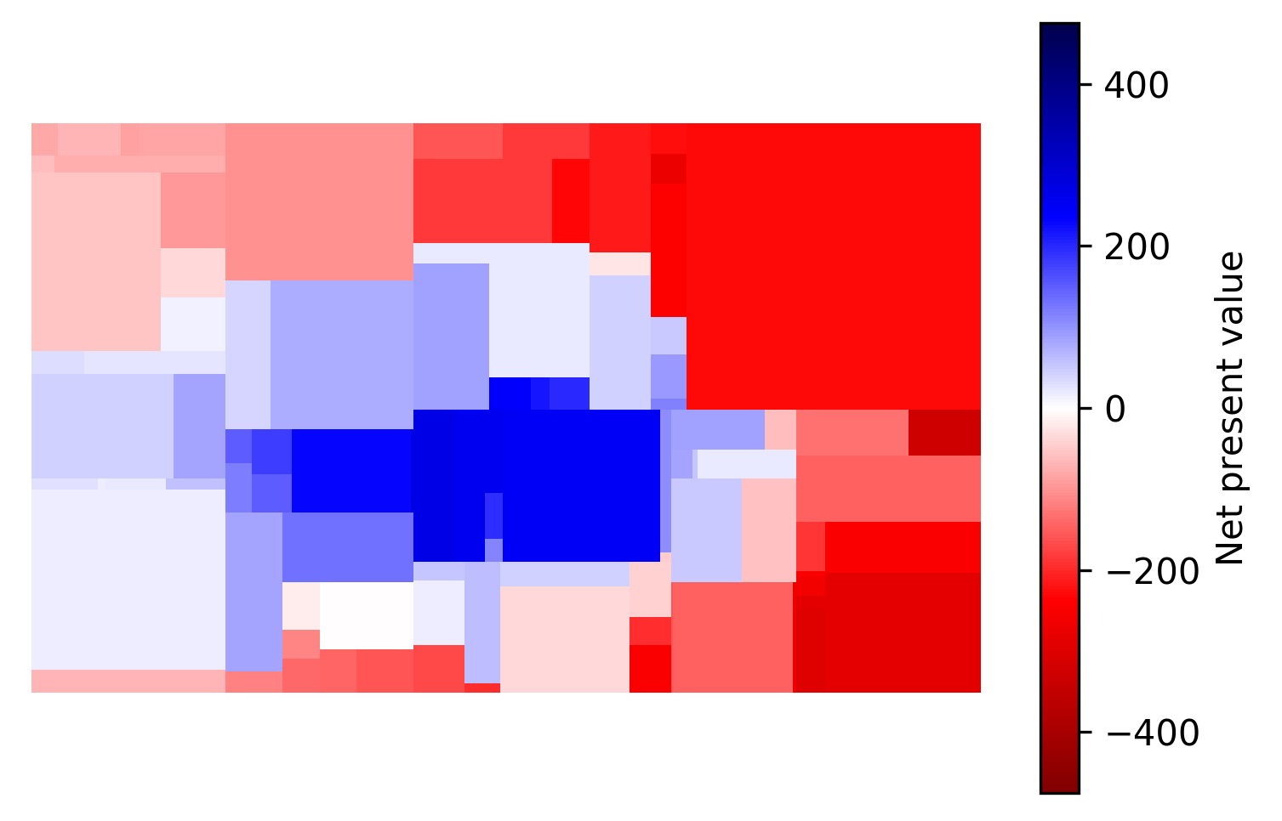
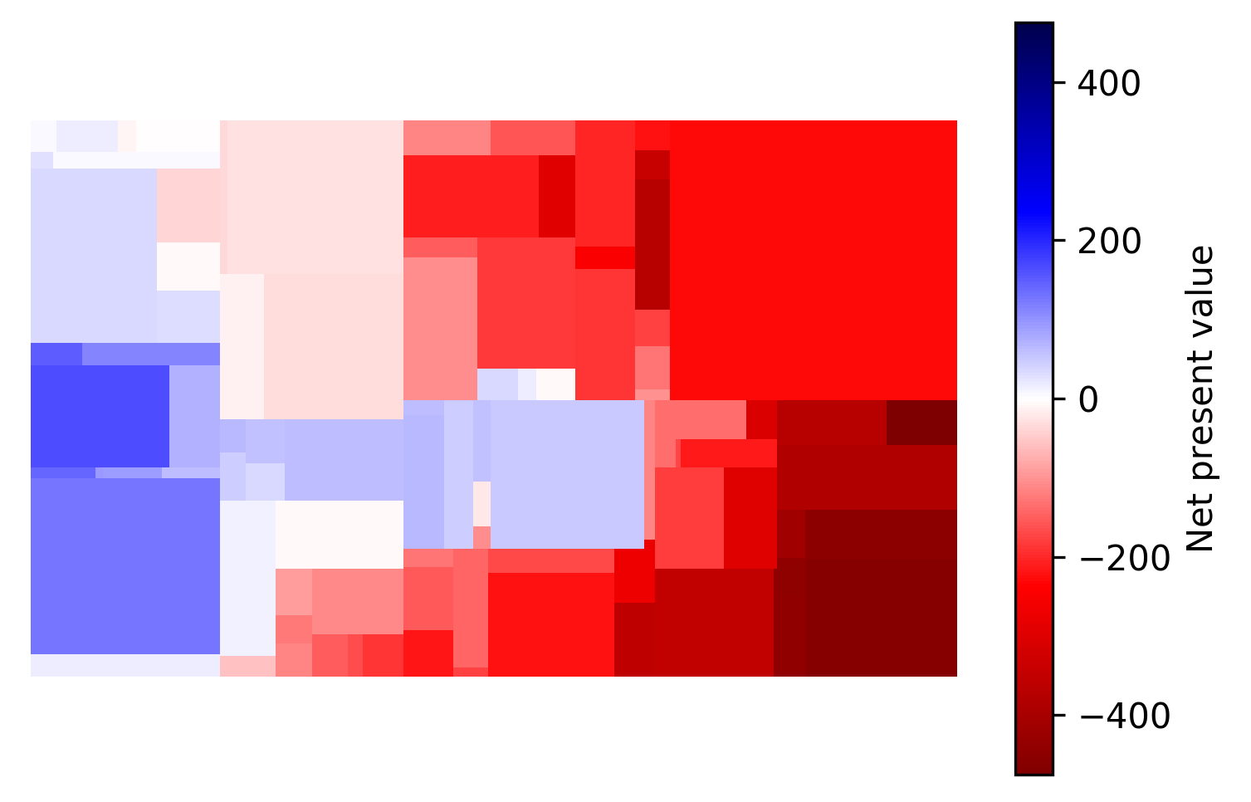
Discounted net-present value of n-years of breaches with 5-year horizon
1 year
2 years
3 years
No majority for any option
Most people are dissatisfied regardless of outcome
If winners can compensate losers, a majority emerges for 1 year breach, with fewer unhappy farmers

