Slide 1
Modeling the impact of vegetation changes on erosion rates and landscape evolution
Jon D. Pelletier, University of Arizona

Slide 2
Hillslope-fluvial geomorphologists have often taken climate change to be synonymous with changes in runoff/discharge/precipitation (i.e., driving shear stresses).
However, common vegetation cover changes lead to changes
in erosion rates and topography that are O(10) larger.
100
10
1
Drainage Density km/sq.km
after Dunne, 1979
0 50 Bare Area 100%
after Melton, 1957

Slide 3
NSF-sponsored workshop in Tucson
Geomorphic responses to veg cover is a key knowledge gap for all process zones
Generating reliable forecasts for the future requires that models be validated against the historical and geologic records over a range of time scales
Geomorphologists should collaborate more with ESMers

Slide 4
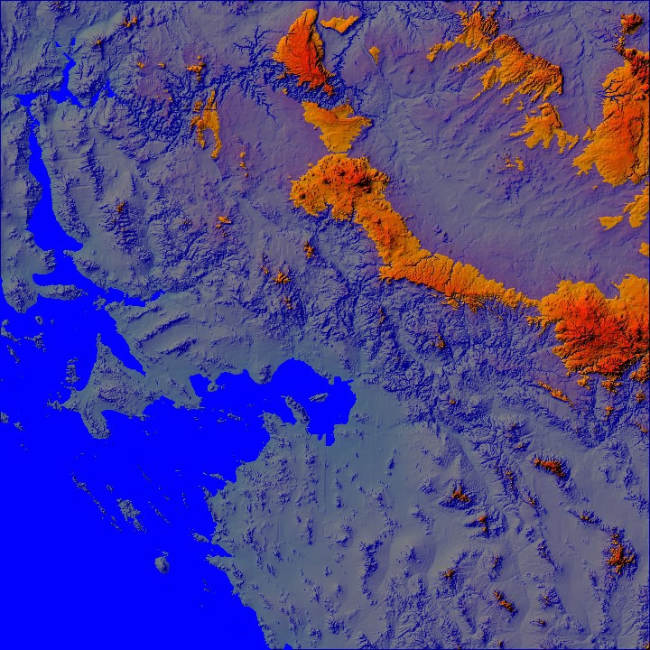
In SW US, forests were at 800 m a.s.l. at LGM and only occur above 1800 m a.s.l. today. So, large areas have fluctuated back and forth between shrubland/grassland and forest during G-I cycles.
above 1800 m
800-1800 m
80% of AZ has
fluctuated between
shrubland/grassland
and forest ~20 times
during the Q
below 800 m

Slide 5
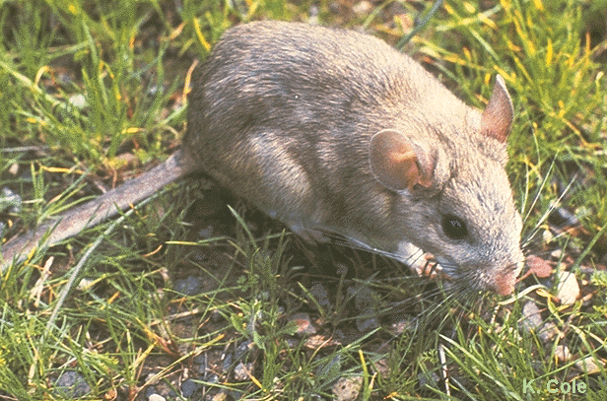
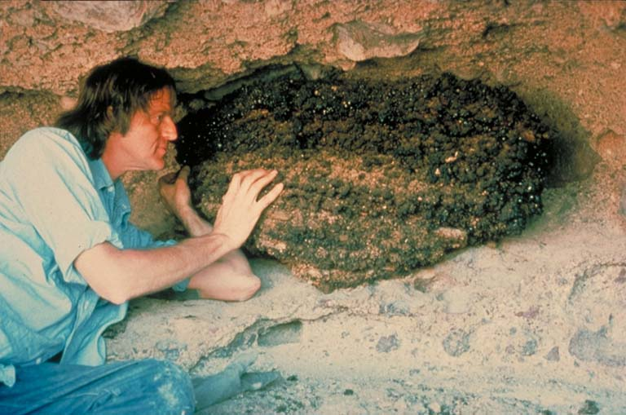
Packrat middens: an elevation-specific paleoveg constraint

Slide 6
Modeling framework (transport-limited case):
where
D as V
(more plants = faster bioturbation) O(1)
k as V
(fewer plants = more runoff, more bare area
acting as sediment sources) O(10)

Slide 7
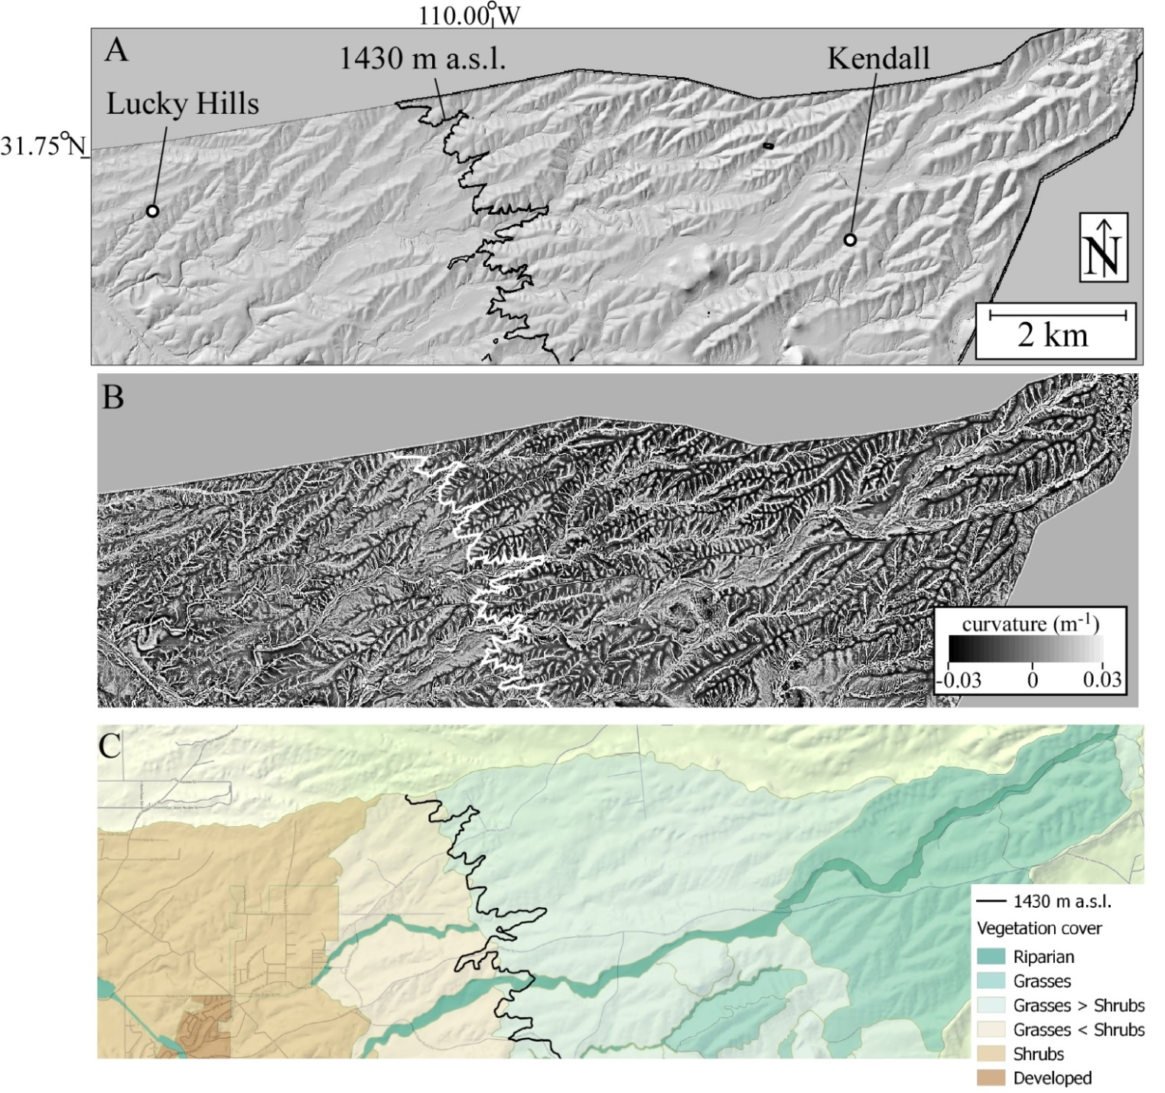
Example at ~10³ yr: Walnut Gulch Experimental Watershed
Shrubland vs.
Grassland:
Similar uplift/relief
Precip 10% lower
Sediment yield and
erosion rate are 30x
higher
D. density 4x higher
Concavity higher

Slide 8
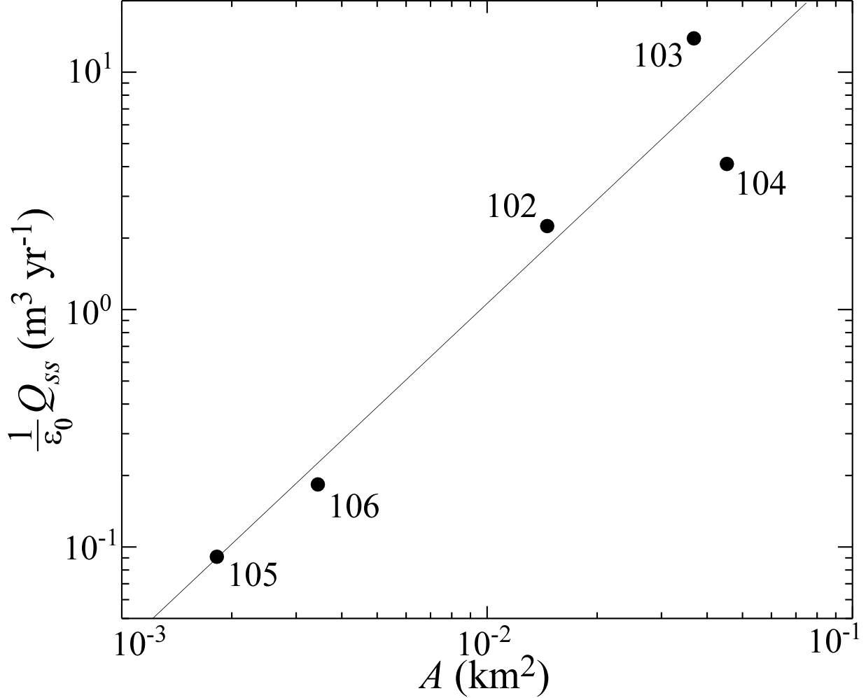
Long-term sediment fluxes well constrained: 30x higher in shrublands
shrubland sites
grassland
sites 30x lower

Slide 9
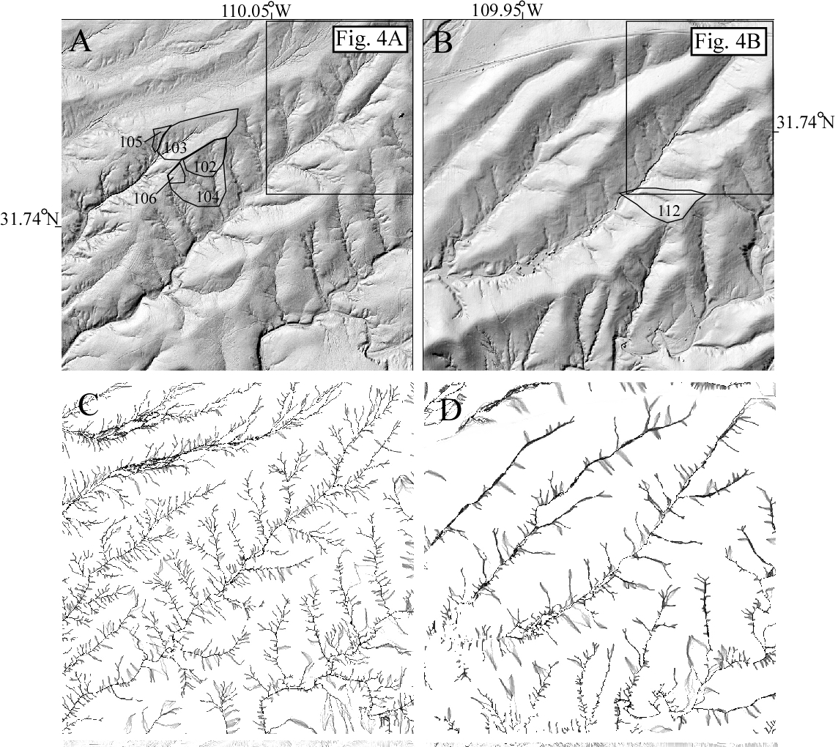
Drainage density is 4x higher in shrubland than grassland
Mean distance to valley = 15 m in shrublands, 60 m in grasslands

Slide 10
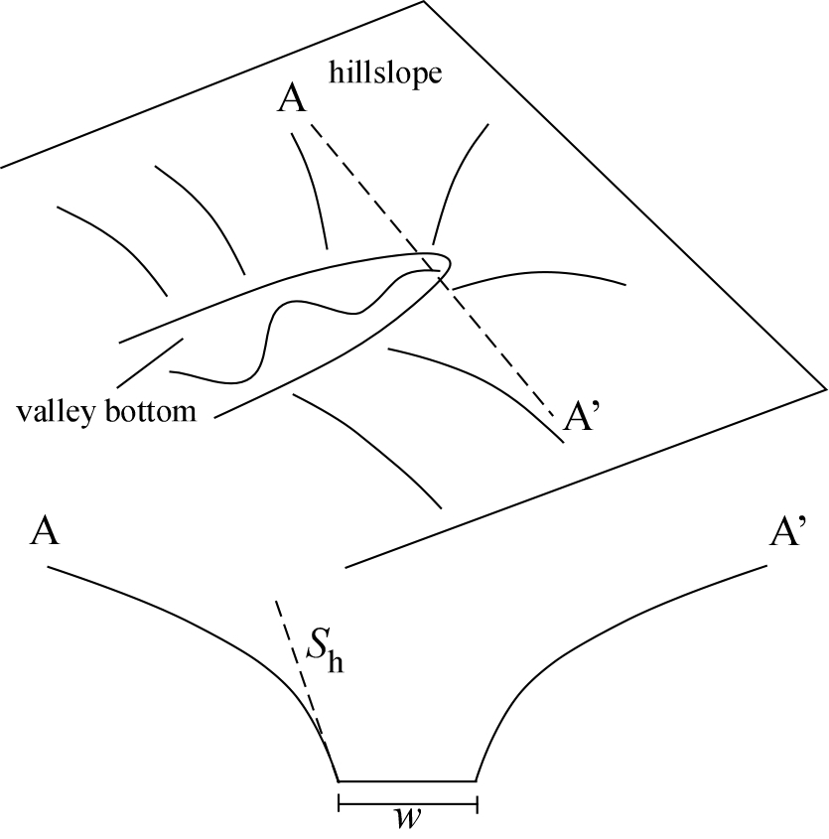
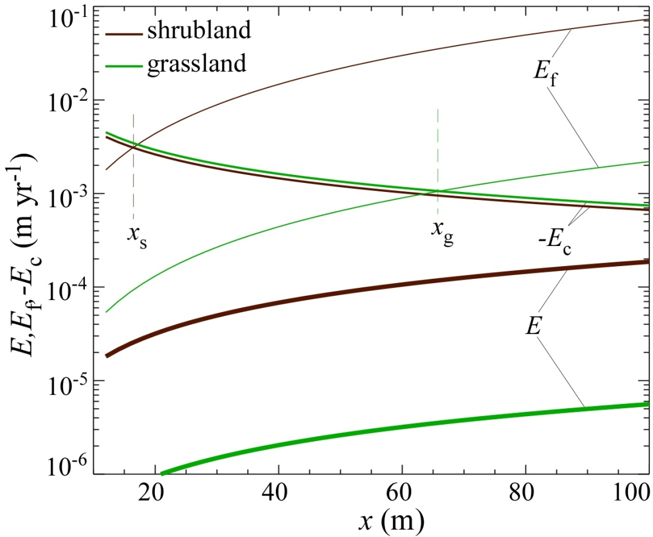
At valley heads, the fluvial erosion rate exceeds the colluvial deposition rate slightly (by an amount equal to the net erosion rate).
The model predicts drainage density as a function of veg cover and time since the veg transition.
Pelletier et al., Esurf, 2016

Slide 11
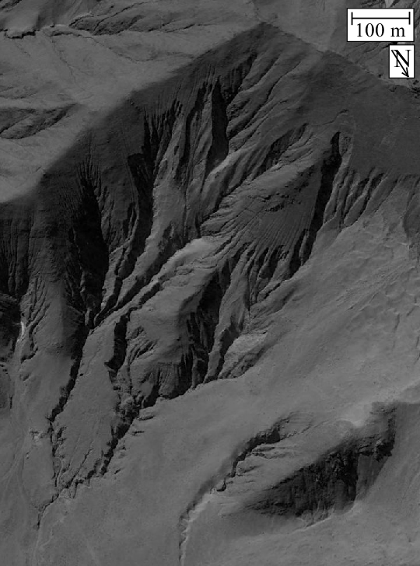
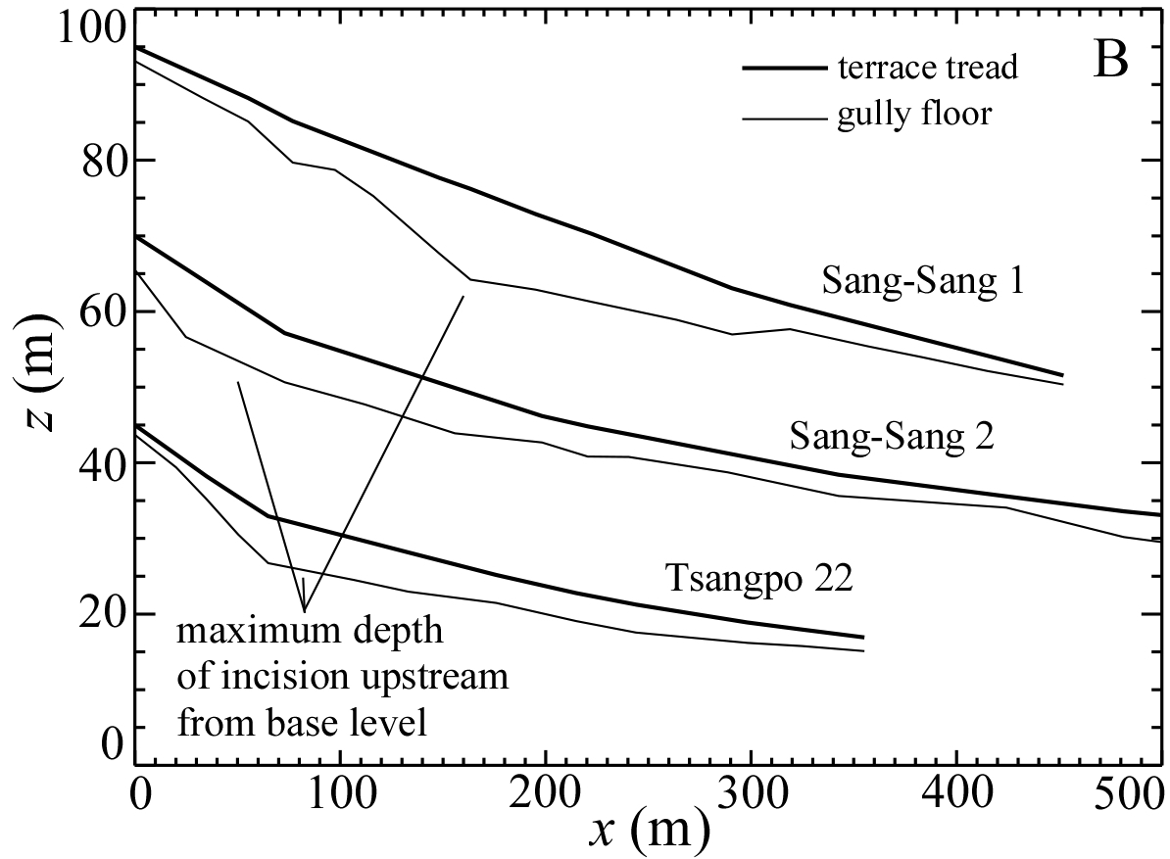
Another example over ~10³ yr
Fan deposits that grade to gullies in
Tsangpo V., Tibet, are late Holocene.
This constrains the cause to be
overgrazing.
Landscape responds with higher
drainage density and increased
channel concavity.
Numerical models with increase in
K reproduce this.
Pelletier et al.,, GSA Bull., 2011

Slide 12
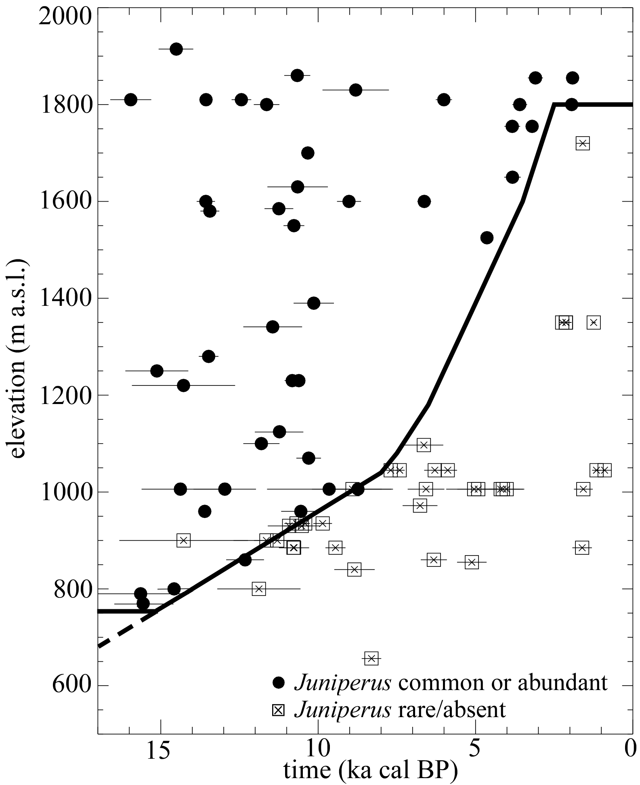
Example at ~10⁴ yr: timing of aggradation due to Pleistocene-
Holocene transition in SW US
Retreat of forests
from 800 to 1800m
a.s.l. was
time transgressive.
Can we predict
timing of
aggradation and
incision?

Slide 13
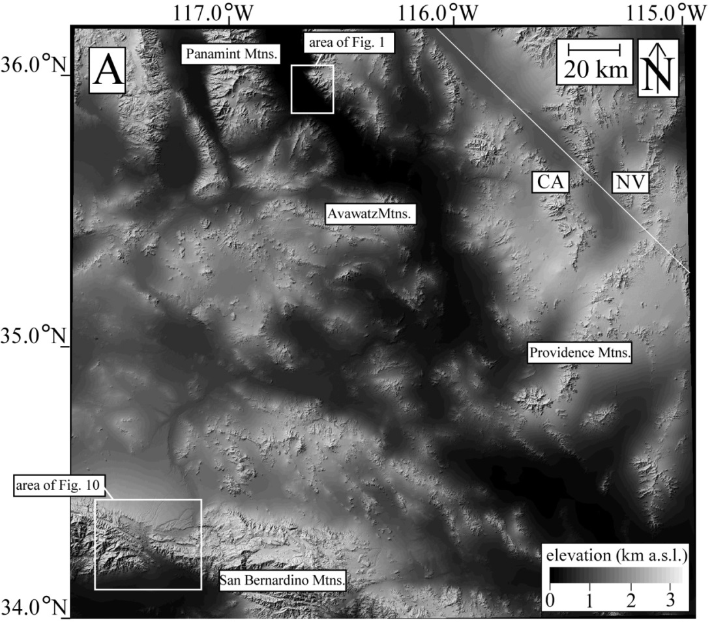
Model predicts timing of primary and secondary aggradation as a
function of upstream elevation, following the retreat of P-J. Primary
aggradation predicted to begin when 5% of source region undergoes
P-J-to-shrubland transition. Secondary aggradation begins when 50%
of source region has undergone P-J-to-shrubland transition.
Pelletier, Esurf, 2014

Slide 14
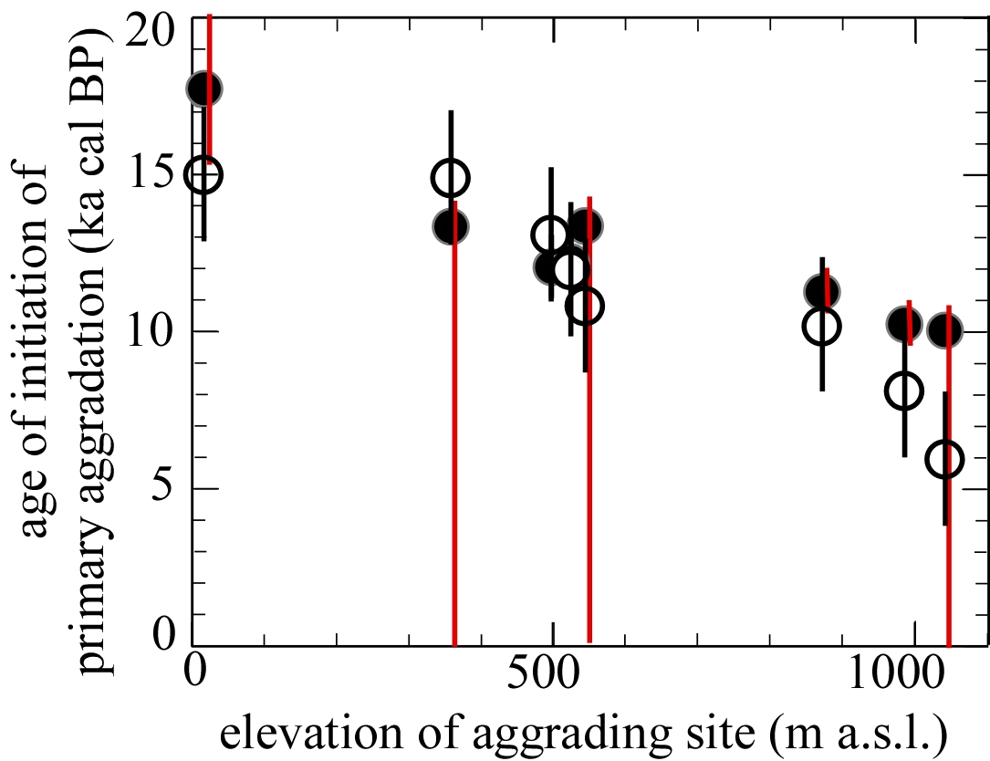
Model predictions vs. data (OSL ages low in Q3a stratigraphy)
Pelletier, Esurf, 2014

Slide 15
Conceptual model: Decrease in veg cover/Increase in % bare ground
triggers increase in drainage density, causing a pulse of sediment input
to fans and a complex response, i.e. multiple cycles of aggradation and
incision (Q3a and Q3b of Bull, 1991)
Bull (1991)

Slide 16
Unsolved problem:
Lower Colorado River has had
3 P-Q aggradation events of
>~ 1000 km³ (~100 m x 30 km
x 300 km).
House et al. (2005)

Slide 17
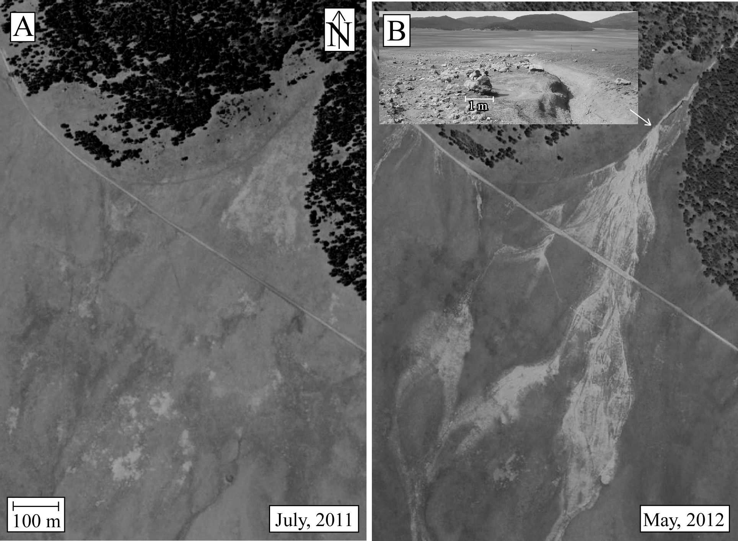
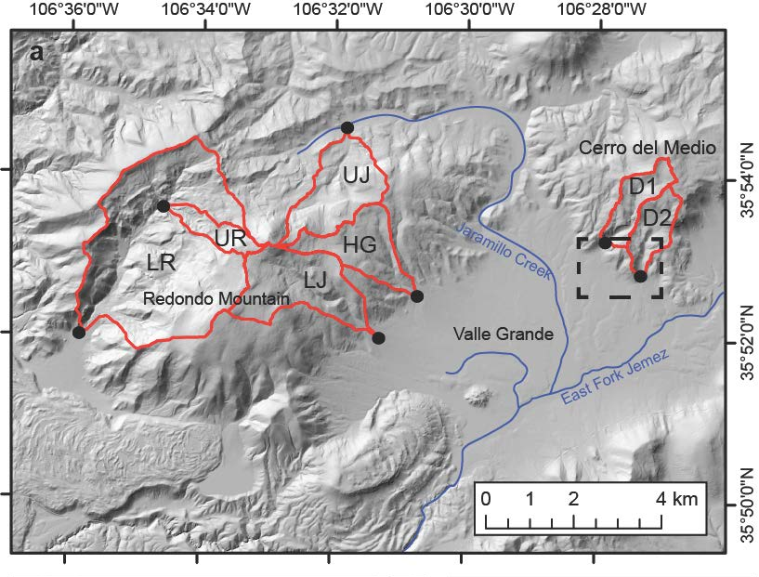
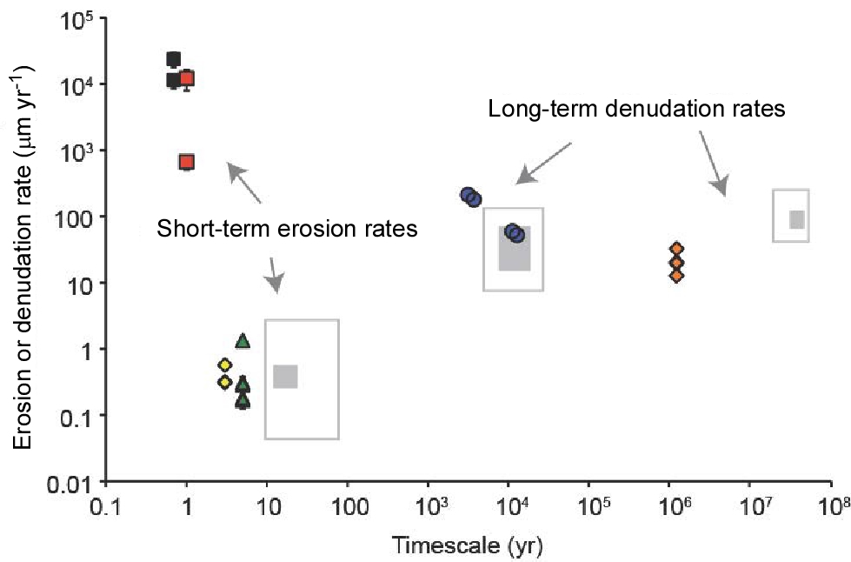
Wildfire is responsible for 99% of all long-term erosion in some
forested landscapes, e.g., Valles Caldera (Orem and Pelletier, JGR, 2016)

Slide 18
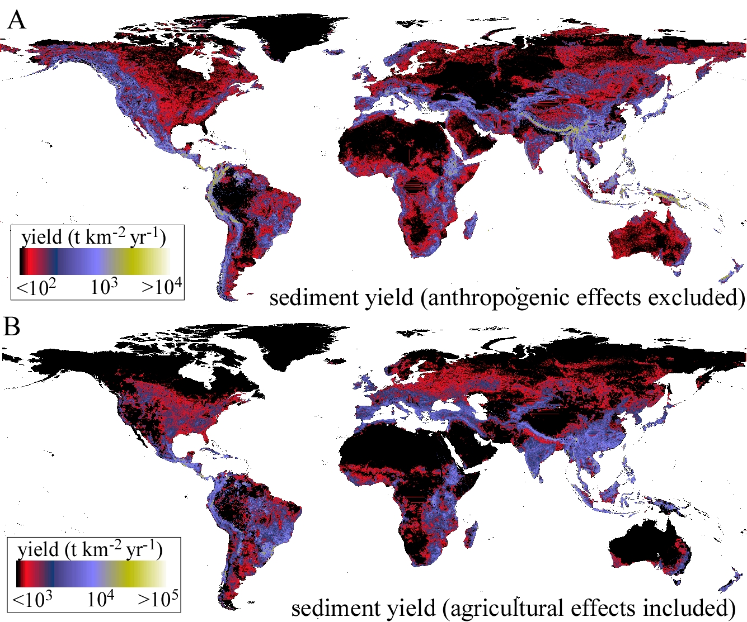
Example model over ~10² yr: Impact of ag on sediment yields

Slide 19
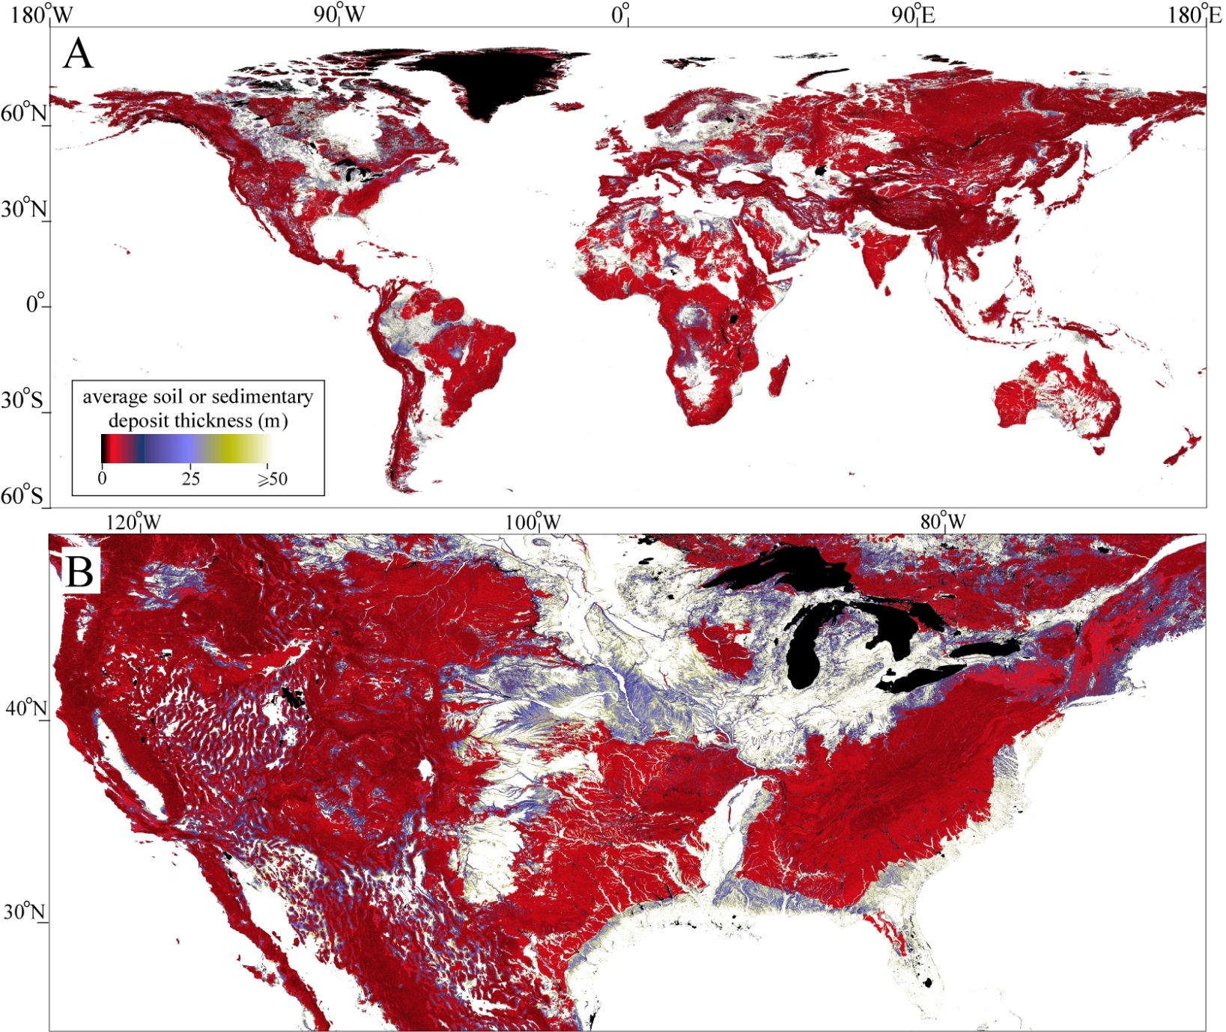
More collaboration with Earth System Modelers:
Soil/regolith thickness data (Pelletier et al., JAMES, 2016)

Slide 20
Example model over ~10³⁻⁶ yr: Evolution of cinder cones
More colluvial erosion has occurred on
S-facing slopes, yet there is more
vegetation on N-facing slopes. BUT, veg
cover was reversed in glacial times (most
of the Quaternary). Data can only be explained by increase in D with V.
McGuire et al. (2014)

Slide 21
Conclusions:
Common vegetation changes can trigger O(10) increases in
erosion rates and topographic metrics
In hillslope-fluvial systems, an increase in the fluvial
erodibility coefficient (K) reproduces the first-order behavior,
i.e. a transient increase in drainage density and channel
convexity, with a resulting pulse of aggradation on fans.
More vegetation cover can increase colluvial sediment
transport rates, but this effect is of smaller magnitude, (O(1)).
Global-scale ESM and dynamic vegetation models can be
used to determine future hotspots of geomorphic change.
Such models require better component models and input data
on geomorphology.

