Slide 1
Integrated Modeling Concepts
A clinic at the Community Surface Dynamics Modeling System (CSDMS) 2015 Annual Meeting
Boulder, Colorado
May 26-28, 2015
Jonathan Goodall
Associate Professor
Department of Civil and Environmental Engineering
University of Virginia
download slides: http://goo.gl/VRgzc9

Slide 2
Clinic Aims
This clinic is intended for early career researchers interested in gaining an understanding of basic integrated modeling concepts as they relate to modeling earth science systems.
The class will present
  key literature in the field,
  core concepts and terminology, and
  different integrated modeling systems.
Past, present, and future trends for designing integrating modeling systems will be discussed.
Participants will also gain experience applying integrated modeling concepts using CSDMS for simplified integrated modeling examples.

Slide 3
Outline
Introduction
  Motivation for integrated modeling/model coupling
  Terminology and key concepts
Example modeling frameworks
  CSDMS
  FRAMES
  ESMF
  OMS
  FluidEarth
Interface Standards
  OpenMI
  BMI
Current topics
  Semantics, ontologies, metadata controlled vocabularies
  Model web
Tutorials
  Getting Started with WMT (time permitting)
Summary

Slide 4
Integrated Modeling Definition
“Integrated Modeling includes a set of interdependent science-based components (models, data, and assessment methods) that together form the basis for constructing an appropriate modeling system (EPA, 2008b, 2009).”
Source: Laniak et al., 2013

Slide 5
Integrated Modeling Landscape
IM Applications: problem formations and solution approaches that are transparent and holistic; recognizing interdependent relationships
IM Science: transdisciplinary; human-environmental systems; stresses model uncertainties
IM Technology: provide a means to express, integrate, and share the science of IEM; standards and tools to facilitate the discovery, access, and integration of science components.
A Community of IEM stakeholders and associated organizations
The primary focus of this talk will be on the technology aspects of IM
Source: Laniak et al., 2013

Slide 6
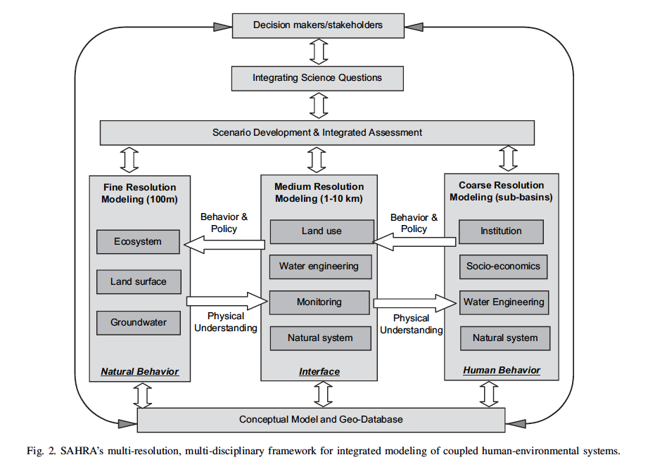
Example of Integrated Modeling
Source: Liu et al., 2008

Slide 7
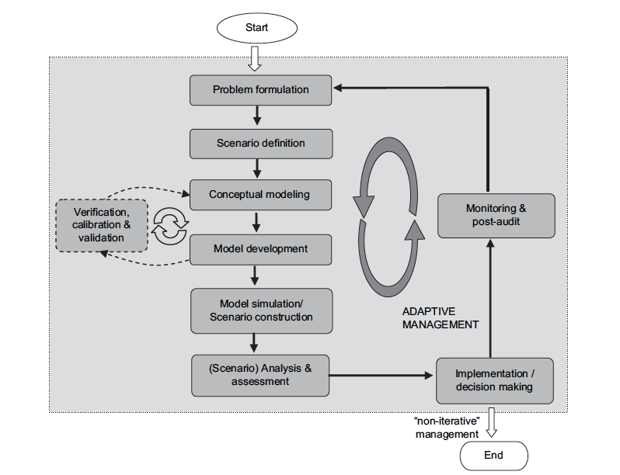
The big picture workflow
Source: Liu et al., 2008

Slide 8
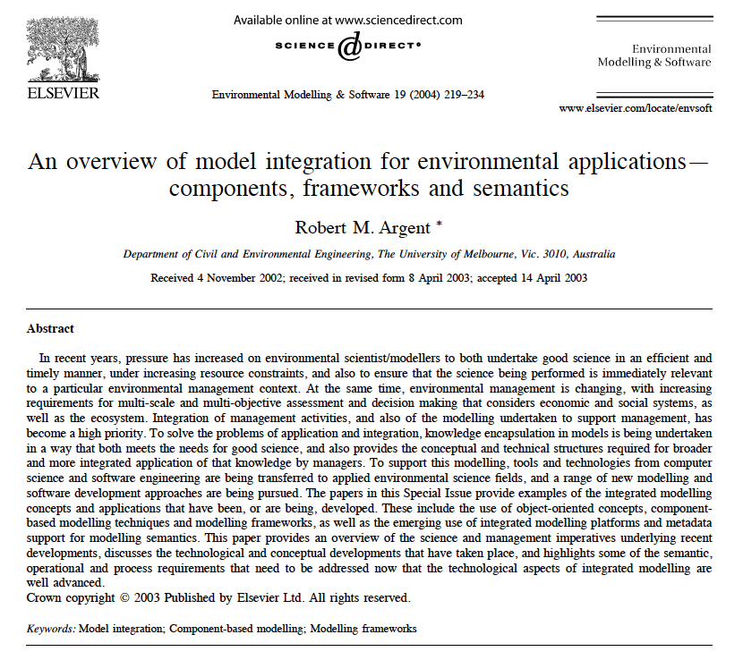

Slide 9
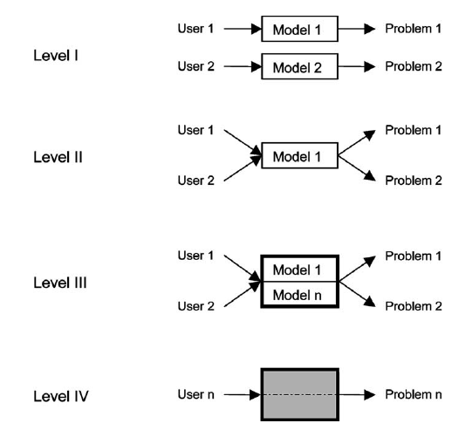
Argent (2004) Model Integration at development and application levels I-IV
Models developed by individuals for a specific research purpose
More general models that can be used for a range of research purposes
Flexible application to a range of situations; operations ready
Modelers not familiar with model workings; model operates as black box
Source: Argent, 2004

Slide 10
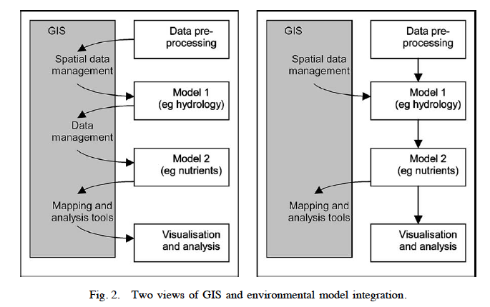
Two views of model integration
File-based
In-memory
Source: Argent, 2004

Slide 11
Terminology and Key Concepts
Development environment – a place where components can be built based upon existing components or component templates
Core components – a library of components that represent various pieces of knowledge
Support components – a library of components for common tasks (e.g., data collection, gap filling, basic analysis, output, and visualization).
Modeling framework – the place where modelers construct and manipulate multi-component models.
Integrated documentation system – for managing components and their metadata
Resource discovery system – for identification and access of components
Model execution system – supports model runs potentially in parallel from multiple users.
Source: Argent, 2004

Slide 12
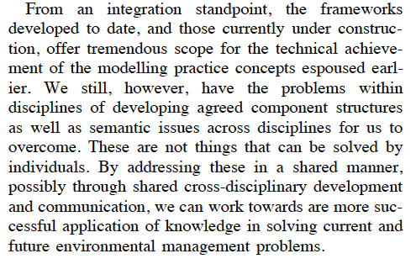
Argent’s final paragraph is still true today …
Source: Argent, 2004

Slide 13
What are these semantic issues?
“the meaning of data, variable and parameter names that are loaded into, used by, or exchanged between, components.”
“misunderstandings will arise unless there is a clear and established meaning for various state variables and concepts, and an agreed language for communicating these.”
Source: Argent, 2004

Slide 14
Argent’s prediction for progress in semantic issues
First, we need to acknowledge that these semantic difficulties exist and that the difficulties will be expanded as the scope of integrated modeling expands
Then, “as we gain experience in working with and explaining our terminology to members of other disciplines, we will develop a more semantically rich language”
Argent, 2004

Slide 15
Outline
Introduction
  Motivation for integrated modeling/model coupling
  Terminology and key concepts
Example modeling frameworks
  CSDMS
  FRAMES
  ESMF
  OMS
  FluidEarth
Interface Standards
  OpenMI
  BMI
Current topics
  Semantics, ontologies, metadata controlled vocabularies
  Model web
Tutorials (time permitting)
  Getting Started with WMT
Summary

Slide 16
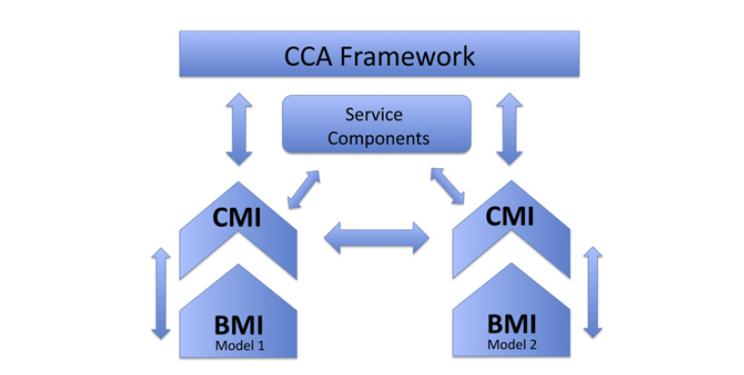
CSDMS Architecture
Source: Peckham et al., 2013

Slide 17
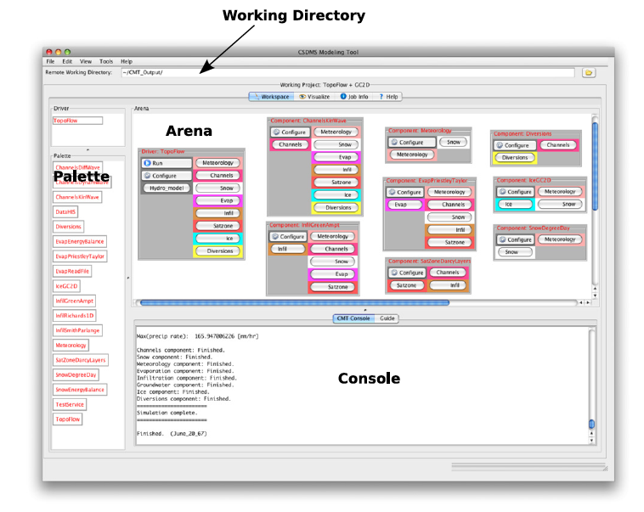
Original CSDSM Modeling Tool (replaced by by Web Modeling Tool: WMT)
Source: Peckham et al., 2013

Slide 18
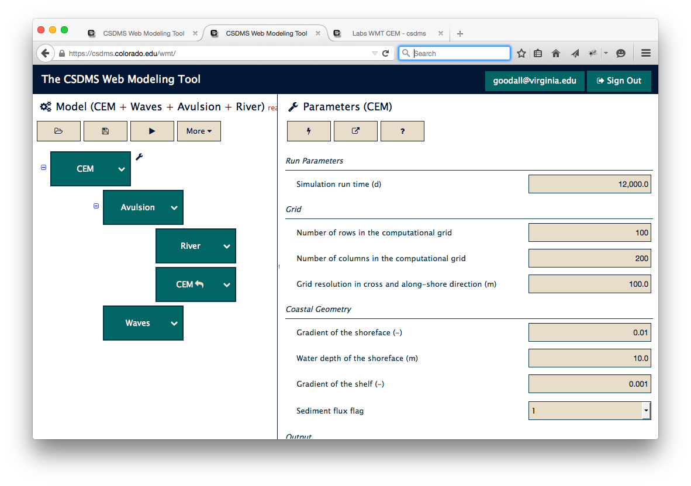
CSDMS Web Modeling Tool (WMT)

Slide 19
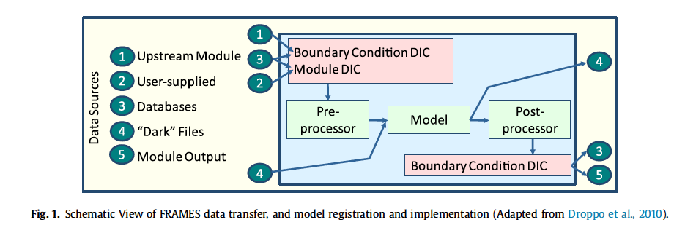
EPA FRAMES
Whelan et al., 2014

Slide 20
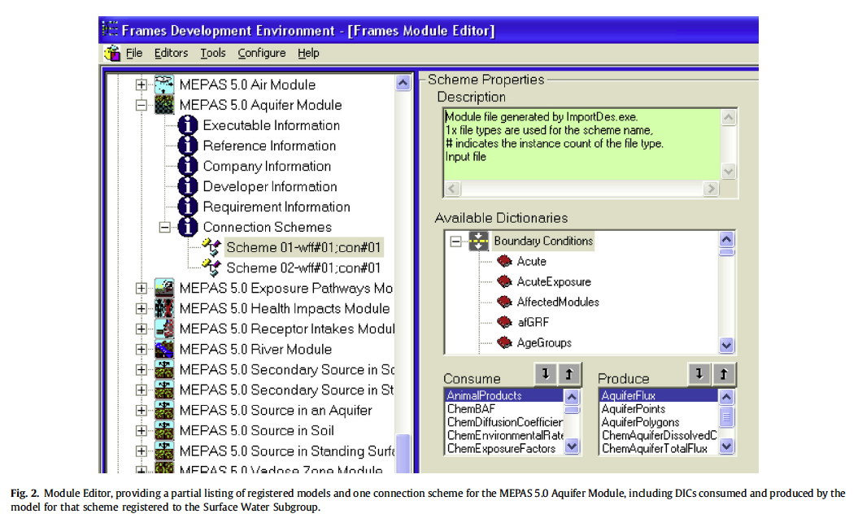
EPA FRAMES Module Editor
Whelan et al., 2014

Slide 21
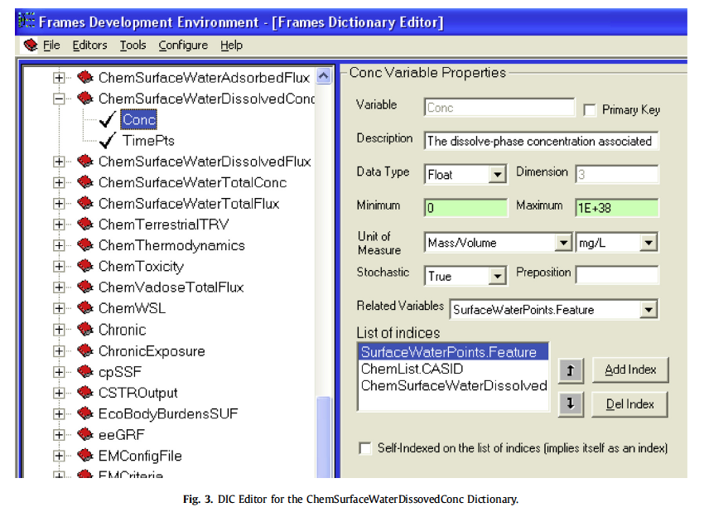
Frames Dictionary Editor
Whelan et al., 2014

Slide 22
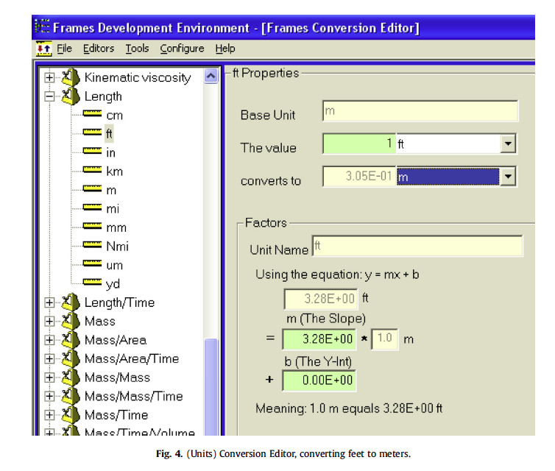
Frames Unit Conversation Editor
Whelan et al., 2014

Slide 23
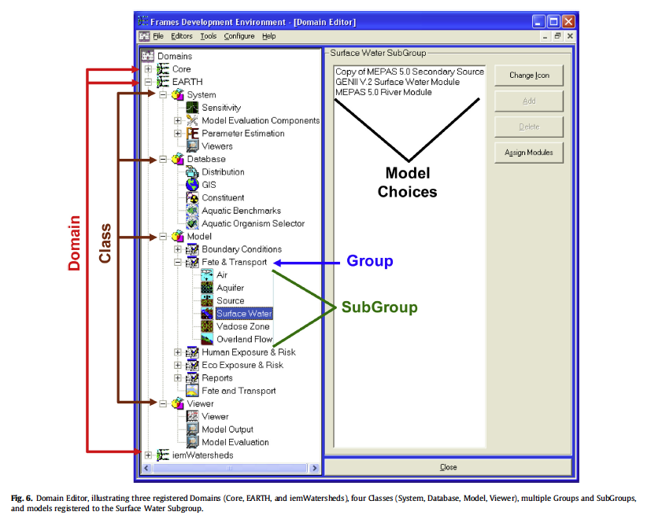
FRAMES Domain Editor
Whelan et al., 2014

Slide 24
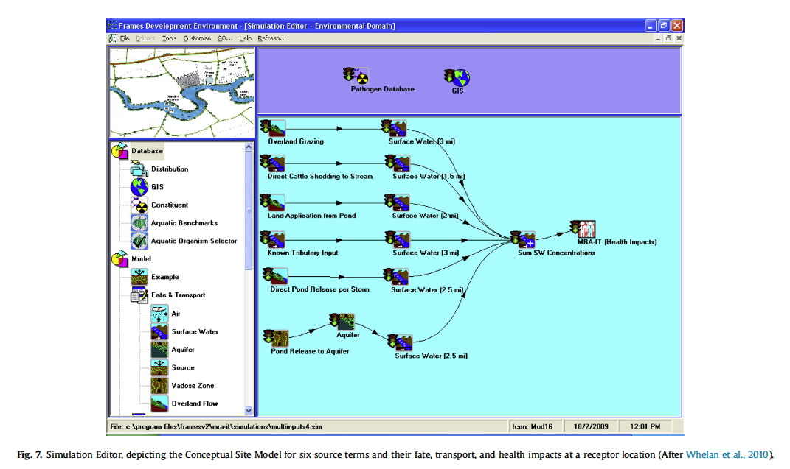
FRAMES Simulation Editor
Whelan et al., 2014

Slide 25
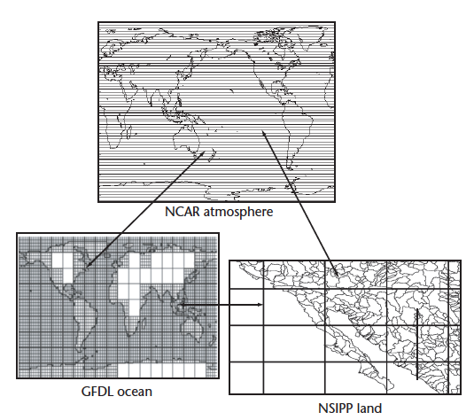
ESMF
Earth System Modeling Framework
Global models
HPC emphasis
Coupling models with gridded data structures
Source: Hill et al., 2004

Slide 26
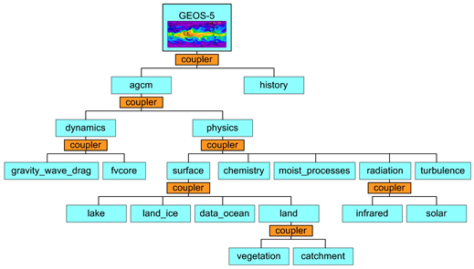
Components and Couplers in ESMF

Slide 27
Some of the ESMF Benefits
Well tested and used in operations
Optimized to reduce overhead due to coupling in high performance computing (HPC) environments
Parallel regridder with Python bindings that can be used apart from ESMF (e.g., it is used by CSDMS)

Slide 28
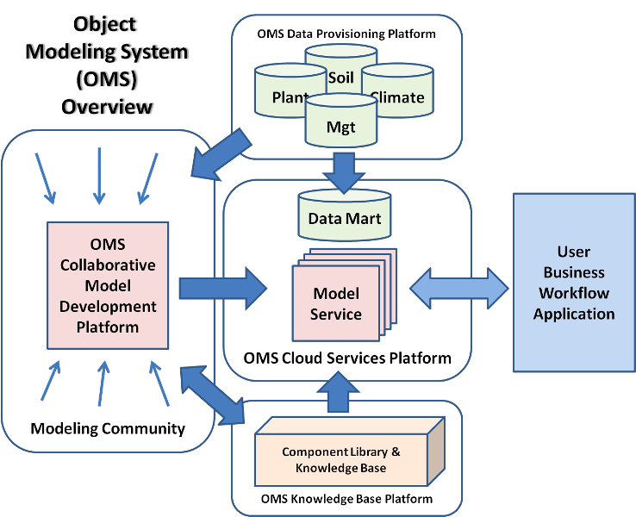
Object Modeling System 3 (OMS3)
http://www.javaforge.com/project/oms

Slide 29
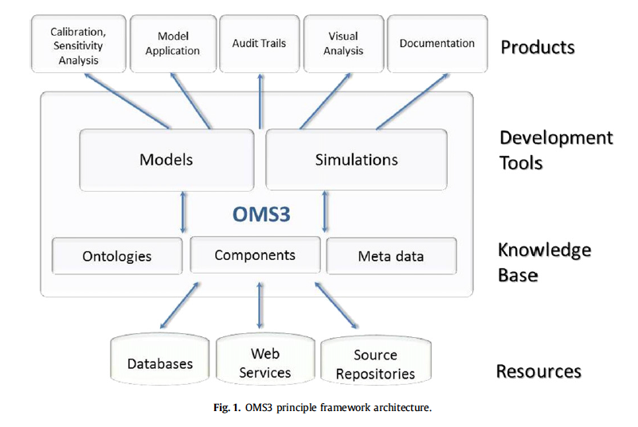
Object Modeling System 3 (OMS3): Principle Framework Architecture
Source: David et al., 2013

Slide 30
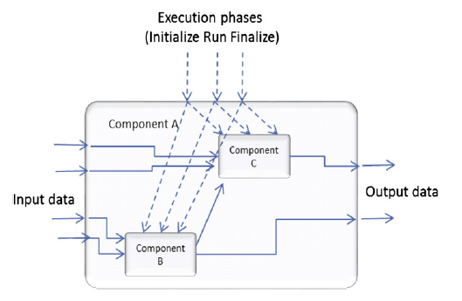
OMS3 Component Architecture
Source: David et al., 2013

Slide 31
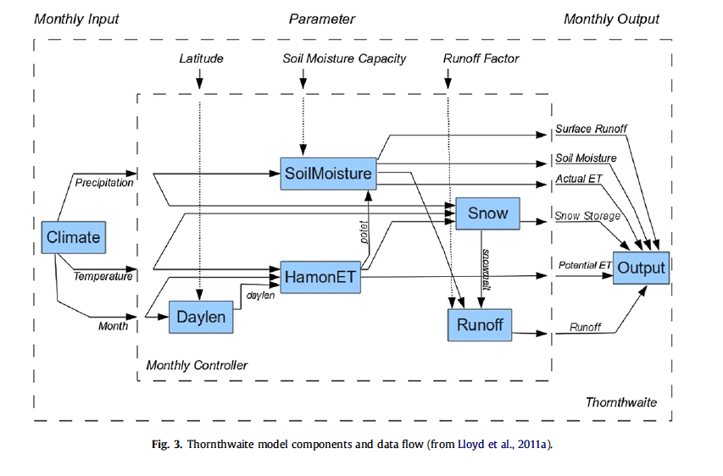
Example hydrologic model implemented as components in OMS3
Source: David et al., 2013

Slide 32
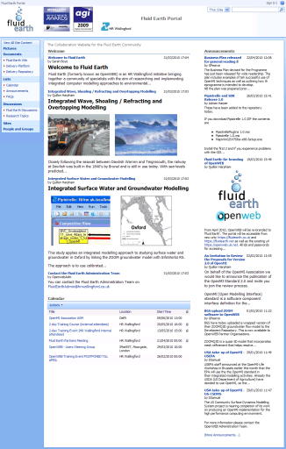
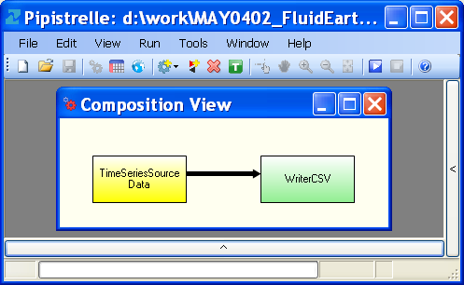
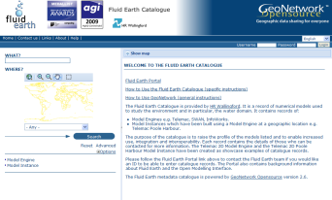

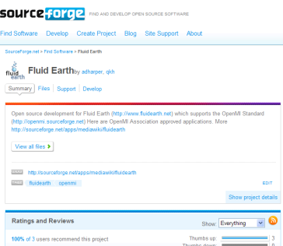
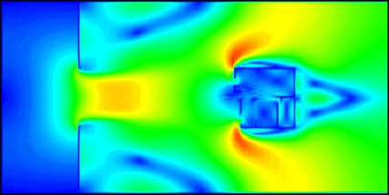
FluidEarth
FluidEarth is a functional and technical platform for using OpenMI.
Community
Model providers and users
Tools
Fluid Earth SDK
Pipistrelle GUI
(Reference Implementations for OpenMI 2.0)
Models
A library of models available for compositions
eInfrastructure
http://fluidearth.net
http://catalogue.fluidearth.net
http://sourceforge.net/projects/fluidearth/
Source: HR Wallingford, fluidearth.net

Slide 33
The FluidEarth Toolkit: Pipistrelle & SDK
The FluidEarth Software Development Kit is an OpenMI API:
- Creation of OpenMI 2.0 in C#, VB and FORTRAN;
- Windows or Linux (under Mono);
- Available on SourceForge in “Fluid Earth” project.
Pipistrelle is a tool for running OpenMI compositions:
- OpenMI 2.0;
- Windows (with GUI) or Linux (under Mono, with console only);
- Adaptor functionality;
- Component Builder Plug-in (initial version);
- Compatibility with and conversion of FE OpenMI 1.4 components into FE OpenMI 2.0 components to follow (if Data Operations not used);
- Spatial View Plug-in (to follow);
- Available on Source Forge in “Fluid Earth” project.
Source: HR Wallingford, fluidearth.net

Slide 34

2-way Connection
Configuration
Configuration
Model Engine 1
Model Engine 2
Initialize
Initialize
In
Out
Perform
Timestep
ADAPTOR
Perform
Timestep
In
Out
Complete
Complete
.xml
.xml
.omi
TRIGGER
.omi
Source: HR Wallingford, fluidearth.net

Slide 35
Outline
Introduction
  Motivation for integrated modeling/model coupling
  Terminology and key concepts
Example modeling frameworks
  CSDMS
  FRAMES
  ESMF
  OMS
  FluidEarth
Interface Standards
  OpenMI
  BMI
Current topics
  Semantics, ontologies, metadata controlled vocabularies
  Model web
Tutorials (time permitting)
  Getting Started with WMT
Summary

Slide 36
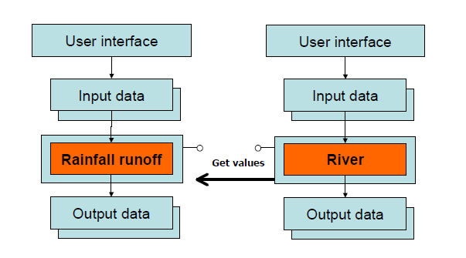
Run-time Coupling between Model Engines
Source: Moore and Tindall, 2005

Slide 37
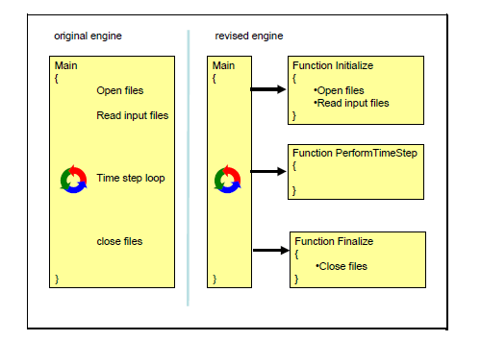
Refactoring Model to IRF Paradigm
Source: Moore and Tindall, 2005

Slide 38
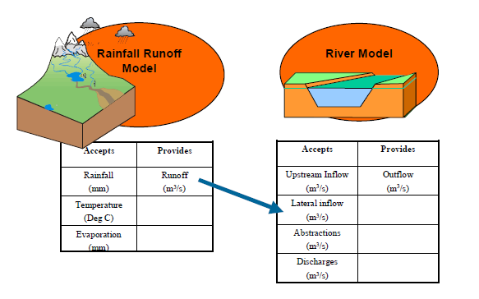
Manual Semantic Mediation
Source: Moore and Tindall, 2005

Slide 39
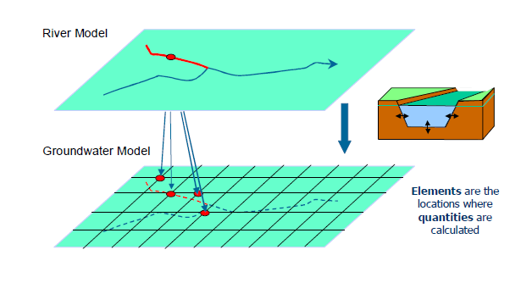
Spatial Referencing of Model Data Exchanges
Source: Moore and Tindall, 2005

Slide 40
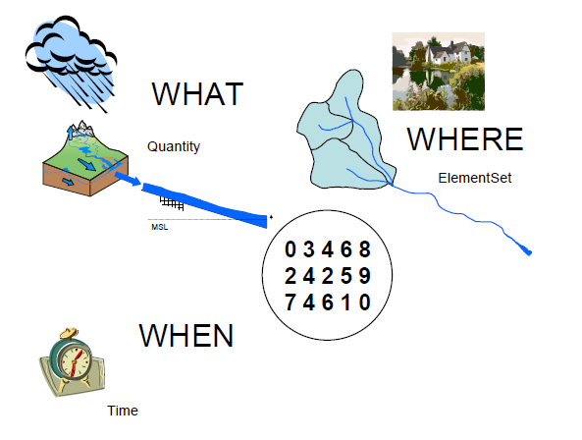
Data model for exchanges between models
Source: Moore and Tindall, 2005

Slide 41
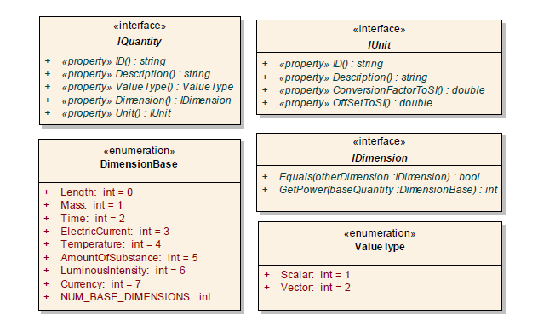
UML View of Quantities in OpenMI
Source: Moore and Tindall, 2005

Slide 42
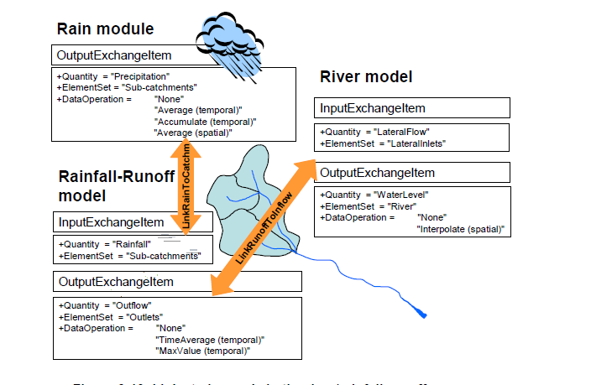
Links are used to define data exchanges between model components within a specific model configuration
Source: Moore and Tindall, 2005

Slide 43
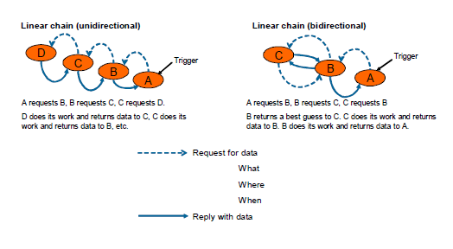
“request and reply” mechanism for data exchanges
Source: Moore and Tindall, 2005

Slide 44
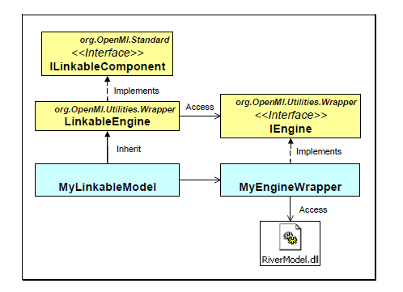
Components implement the ILinkableComponent Interface
Source: Moore and Tindall, 2005

Slide 45
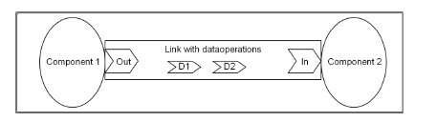
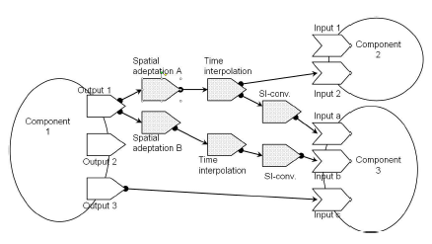
OpenMI 2.0 changes how models are linked
OpenMI version 1.4 uses data operations on links as discussed before
OpenMI version 2.0 uses the concept of data adaptors
Source: document #11-014r3 available here: http://www.opengeospatial.org/standards/openmi

Slide 46
Basic Modeling Interface (BMI)
BMI is defined using the Scientific Interface Description Lanaguage (SIDL) here: https://github.com/csdms/bmi/blob/master/bmi.sidl
BMI is meant to be a light-weight (basic) interface for exposing models as components
Frameworks would wrap BMI components using framework-specific model interface standards
<interface>
bmi
+ initialize()
+ update()
+ finalize()
+ get_start_time()
+ get_current_time()
+ get_end_time()
+ get_component_name()
+ get_input_var_names()
+ get_output_var_names()
+ get_value()
+ set_value()
+ get_var_units()
+ get_var_type()
+ get_var_grid()
+ get_grid_spacing()
+ get_grid_origin()
+ get_grid_shape()

Slide 47
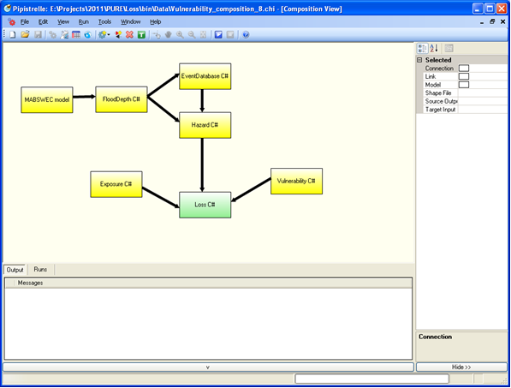


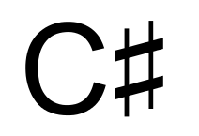



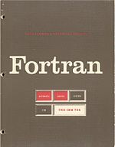
Proposed BMI to OpenMI Architecture
BMI components can be used in OpenMI v2.0 compliant frameworks such as FluidEarth
OpenMI Framework 1
OpenMI Framework 2
OpenMI Framework N
...
BMI to OpenMI Bridge Wrapper
Two layers of wrappers for (1) C# .NET interoperability and (2) BMI to OpenMI bridging
BMI .Net Wrapper
BMI Component 1
BMI Component 2
BMI Component N
...
BMI-compliant model components written in Python, C, or Fortran

Slide 48
Key Interfaces in BMI and OpenMI
<interface>
IBaseExchangeItem
bmi
OpenMI 2.0
<interface>
bmi
<interface>
IBaseLinkableComponent
<<attributes>>
+ Component : IBaseLinkableComponent
+ ValueDefinition : IValueDefinition
+ initialize()
+ update()
+ finalize()
+ get_start_time()
+ get_current_time()
+ get_end_time()
+ get_component_name()
+ get_input_var_names()
+ get_output_var_names()
+ get_value()
+ set_value()
+ get_var_units()
+ get_var_type()
+ get_var_grid()
+ get_grid_spacing()
+ get_grid_origin()
+ get_grid_shape()
+ Initialize()
+ Update()
+ Finish()
<<attributes>>
+ Arguments : IList<Argument>
+ Inputs : IList<ITimeSpaceInput>
+ Outputs :IList<ITimeSpaceOutput>
<interface>
ITimeSpaceExchangeItem
<<attributes>>
+ SpatialDefinition : ISpatialDefinition
+ TimeSet : ITimeSet
<interface>
ITimeSpaceComponent
<interface>
ITimeSpaceOutput
+ GetValues() : ITimeSpaceValueSet
<<attributes>>
+ Values : ITimeSpaceValueSet

Slide 49
Mapping between BMI and OpenMI 2.0
This will be presented for 5 categories using the following color coding convention:
Initialize, Run, Finalize (IRF) methods
General metadata properties
Getters and setters
Time information
Spatial representations

Slide 50
Overview of Mapping From BMI to OpenMI
<interface>
IBaseExchangeItem
bmi
OpenMI 2.0
<interface>
bmi
<interface>
IBaseLinkableComponent
<<attributes>>
+ Component : IBaseLinkableComponent
+ ValueDefinition : IValueDefinition
+ initialize()
+ update()
+ finalize()
+ get_start_time()
+ get_current_time()
+ get_end_time()
+ get_component_name()
+ get_input_var_names()
+ get_output_var_names()
+ get_value()
+ set_value()
+ get_var_units()
+ get_var_type()
+ get_var_grid()
+ get_grid_spacing()
+ get_grid_origin()
+ get_grid_shape()
+ Initialize()
+ Update()
+ Finish()
<<attributes>>
+ Arguments : IList<Argument>
+ Inputs : IList<ITimeSpaceInput>
+ Outputs :IList<ITimeSpaceOutput>
<interface>
ITimeSpaceExchangeItem
<<attributes>>
+ SpatialDefinition : ISpatialDefinition
+ TimeSet : ITimeSet
<interface>
ITimeSpaceOutput
<interface>
ITimeSpaceComponent
+ GetValues() : ITimeSpaceValueSet
<<attributes>>
+ Values : ITimeSpaceValueSet
Due to space restrictions, only selected information shown.

Slide 51
Outline
Introduction
  Motivation for integrated modeling/model coupling
  Terminology and key concepts
Example modeling frameworks
  CSDMS
  FRAMES
  ESMF
  OMS
  FluidEarth
Interface Standards
  OpenMI
  BMI
Current research topics
  Semantics, ontologies, metadata controlled vocabularies
  Model web
Tutorials
  Getting Started with WMT
Summary

Slide 52
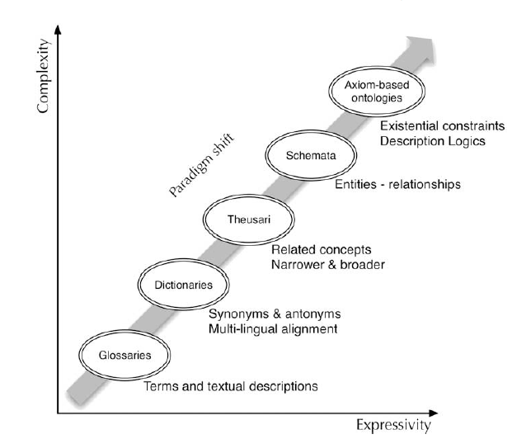
Semantics: From Glossaries to Ontologies
Villa et al., 2009

Slide 53
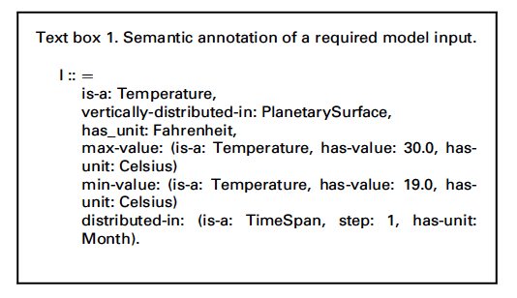
Example of Semantic Annotation for a Model Input
Villa et al., 2009

Slide 54
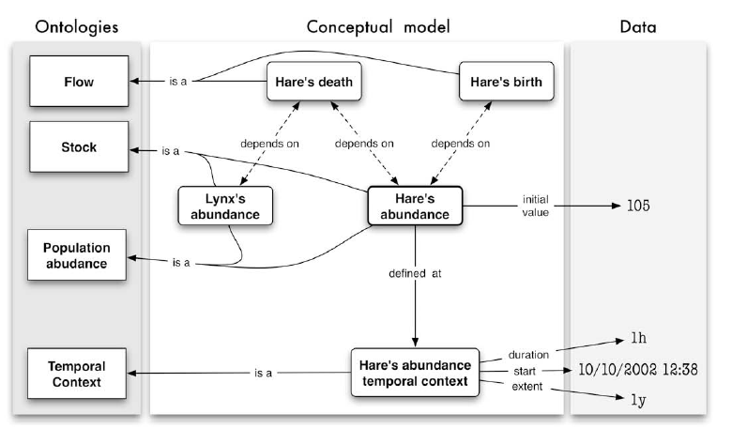
Sematic Relationships within Models
Villa et al., 2009

Slide 55
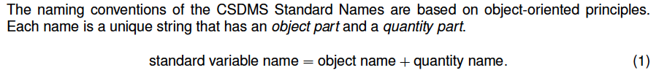
Semantic Matching for Model Variables
Hydro Model A
Output variables:
streamflow
rainrate
CSDMS Standard Names
channel_exit_water_x-section__
volume_flow_rate
atmosphere_water__rainfall_volume_flux
Hydro Model B
Input variables:
discharge
precip_rate
Goal: Remove ambiguity so that
the framework can automatically
match outputs to inputs.
Peckham, 2014

Slide 56
HydroShare
NSF supported collaborative project building from the CUAHSI Hydrologic Information System (HIS) project
Resource-based sharing of hydrologic data, models, analysis tools, etc.
Share resources with metadata with collaborators or public
Discover resources use hydrology-specific metadata
Social objects (comments, rating, etc.)
http://beta.hydroshare.org is live now and http://www.hydroshare.org is coming soon (the plan is for this summer)

Slide 57
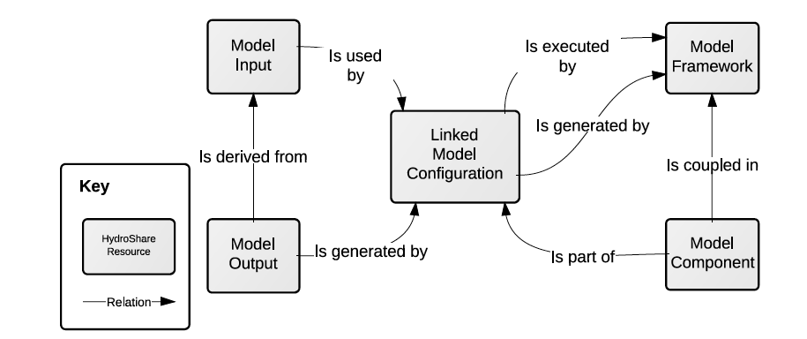
Conceptualization of Key Model Concepts and Relationships: Component-based Modeling
Morsy et al., 2014

Slide 58
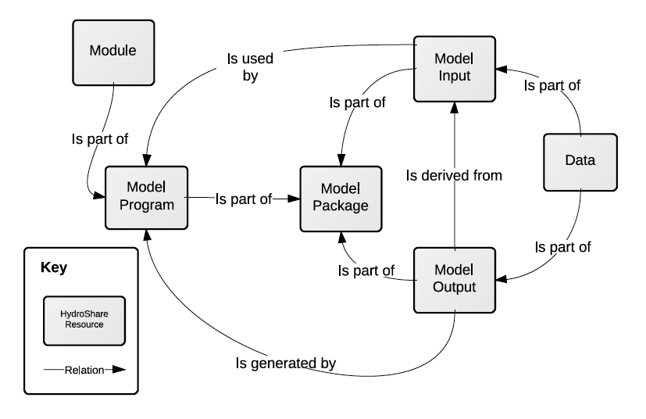
Conceptualization of Key Model Concepts and Relationships: Stand-alone Models
Morsy et al., 2014

Slide 59
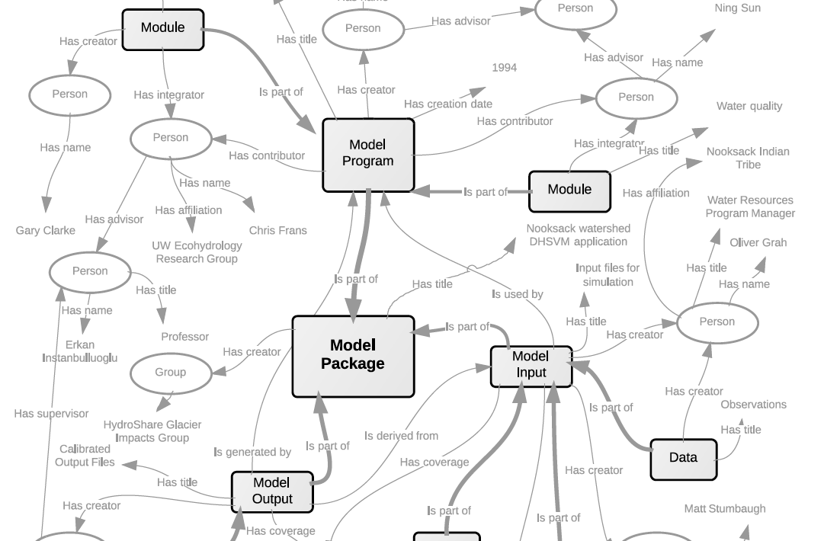
Model Metadata: Capturing Connections Between Models, Components, Raw Data, Derived Data, Model Inputs, Model Outputs, Developers, Users, Modeling Objectives, Etc.
Morsy et al., 2014

Slide 60
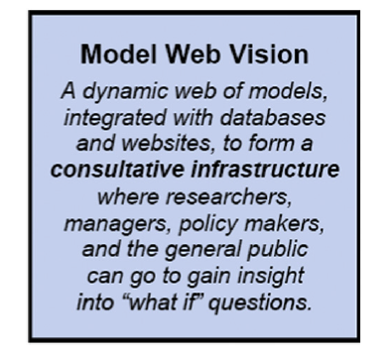
Nativi et al., 2013

Slide 61
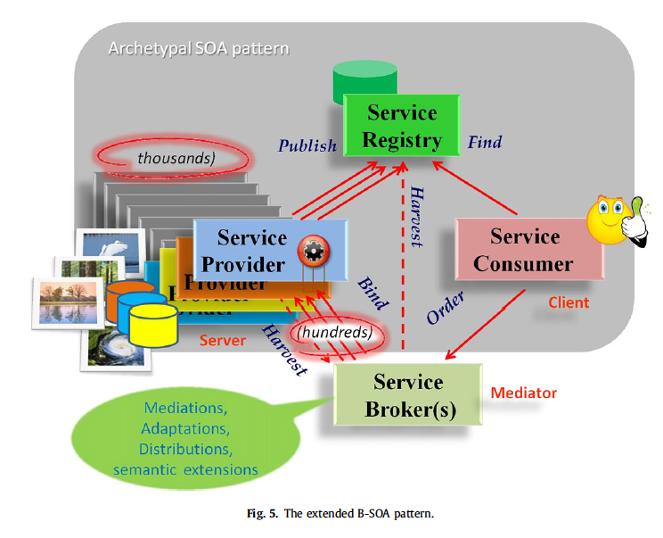
Nativi et al., 2013

Slide 62
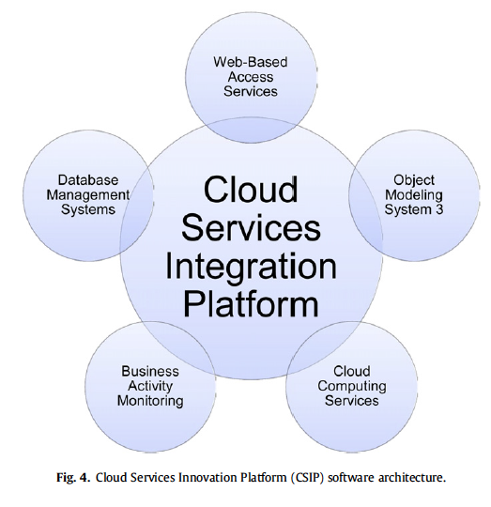
OMS 3 within the Cloud Services Innovation Platform architecture
David et al., 2013

Slide 63

The Model Resource Data Model proposed by Nativi et al. (2013)
Nativi et al., 2013

Slide 64

Example of using model web concept for coupling earth system models
Goodall et al., 2013

Slide 65

OpenMI/ESMF Interoperability via Web Services
Goodall et al., 2013

Slide 66

Data flow for OpenMI/ESMF Interoperability
Goodall et al., 2013

Slide 67


Scaling analysis: Data transmission time vs. model execution time
Goodall et al., 2013

Slide 68

Modeling Web using REST/ OGC Web Processing Service
Models exposed as services using the Open Geospatial Consortium (OGC) Web Processing Service (WPS) standard.
Get Capabilities gives metadata about models on server
Describe Process gives metadata about a specific model service
Execute is more complex that a typical WPS to support model time stepping (e.g., session state with users must be maintained)
Castonova et al., 2013

Slide 69
Outline
Introduction
  Motivation for integrated modeling/model coupling
  Terminology and key concepts
Example modeling frameworks
  CSDMS
  FRAMES
  ESMF
  OMS
  FluidEarth
Interface Standards
  OpenMI
  BMI
Current topics
  Semantics, ontologies, metadata controlled vocabularies
  Model web
Tutorials (time permitting)
  Getting Started with WMT
Summary

Slide 70
WMT Tutorial
Time permitting, I will briefly show how integrated modeling concepts are used by the CSDMS WMT.
I will use the integrated model described in the coastal evolution lab available here: https://csdms.colorado.edu/wiki/Labs_WMT_CEM

Slide 71
Outline
Introduction
  Motivation for integrated modeling/model coupling
  Terminology and key concepts
Example modeling frameworks
  CSDMS
  FRAMES
  ESMF
  OMS
  FluidEarth
Interface Standards
  OpenMI
  BMI
Current topics
  Semantics, ontologies, metadata controlled vocabularies
  Model web
Tutorials (time permitting)
  Getting Started with WMT
Summary

Slide 72
Take home points
What is integrated modeling? IM seeks to provide methods and tools that allow for the combination of data, models, assessment methods from multiple disciplines into a single simulation system.
How is this typically accomplished now? By defining modular components (or services) that encapsulate disciplinary knowledge and then coupling components using a modeling framework to simulate a system.
What are some key challenges that require attention by researchers? Creating general interface standards and semantic mediation across disciplines are two key challenges.
Where is this all heading? To a model web: Both web-based configuration of HPC models and Models as Services. Why? To overcome hardware and software dependencies; to advance reproducible, reusable, and extensible of models; to take advance of cloud infrastructures.

Slide 73
References (1 of 2)
Argent, R.M., 2004. An overview of model integration for environmental applications - Components, frameworks and semantics. Environ. Model. Softw. 19, 219–234. doi:10.1016/S1364-8152(03)00150-6
Boettiger, C., 2015. An introduction to Docker for reproducible research. ACM SIGOPS Oper. Syst. Rev. 49, 71–79. doi:10.1145/2723872.2723882
Castronova, A.M., Goodall, J.L., Ercan, M.B., 2013. Integrated modeling within a Hydrologic Information System: An OpenMI based approach. Environ. Model. Softw. 39, 263–273. doi:10.1016/j.envsoft.2012.02.011
David, O., Ascough, J.C., Lloyd, W., Green, T.R., Rojas, K.W., Leavesley, G.H., Ahuja, L.R., 2013. A software engineering perspective on environmental modeling framework design: The Object Modeling System. Environ. Model. Softw. 39, 201–213. doi:10.1016/j.envsoft.2012.03.006
Elag, M.M., Goodall, J.L., Castronova, A.M., 2011. Feedback loops and temporal misalignment in component-based hydrologic modeling. Water Resour. Res. 47, n/a–n/a. doi:10.1029/2011WR010792
Goodall, J.L., Saint, K.D., Ercan, M.B., Briley, L.J., Murphy, S., You, H., DeLuca, C., Rood, R.B., 2013. Coupling climate and hydrological models: Interoperability through Web Services. Environ. Model. Softw. 46, 250–259. doi:10.1016/j.envsoft.2013.03.019
Gregersen, J.B., Gijsbers, P.J.A., Westen, S.J.P., 2007. OpenMI: Open modelling interface. J. Hydroinformatics 9, 175. doi:10.2166/hydro.2007.023
Hill, C., DeLuca, C., Suarez, M., Da Silva, A., 2004. The architecture of the earth system modeling framework. Comput. Sci. Eng. 6, 18–28. doi:10.1109/MCISE.2004.1255817
Laniak, G.F., Olchin, G., Goodall, J.L., Voinov, A., Hill, M., Glynn, P., Whelan, G., Geller, G., Quinn, N., Blind, M., Peckham, S., Reaney, S., Gaber, N., Kennedy, R., Hughes, A., 2013. Integrated environmental modeling: A vision and roadmap for the future. Environ. Model. Softw. 39, 3–23. doi:10.1016/j.envsoft.2012.09.006

Slide 74
References (2 of 2)
Liu, Y., Gupta, H., Springer, E., Wagener, T., 2008. Linking science with environmental decision making: Experiences from an integrated modeling approach to supporting sustainable water resources management. Environ. Model. Softw. 23, 846–858. doi:10.1016/j.envsoft.2007.10.007
Moore, R. V., Tindall, C.I., 2005. An overview of the open modelling interface and environment (the OpenMI). Environ. Sci. Policy 8, 279–286. doi:10.1016/j.envsci.2005.03.009
Morsy, M.M., Goodall, J.L., Bandaragoda, C., Castronova, A.M., Greenberg, J., 2014. Metadata for Describing Water Models, in: International Environmental Modelling and Software Society (iEMSs) 7th International Congress on Environmental Modelling and Software. doi:10.13140/2.1.1314.6561
Nativi, S., Mazzetti, P., Geller, G.N., 2013. Environmental model access and interoperability: The GEO Model Web initiative. Environ. Model. Softw. 39, 214–228. doi:10.1016/j.envsoft.2012.03.007
Peckham, S.D., 2014. The CSDMS Standard Names: Cross-Domain Naming Conventions for Describing Process Models, Data Sets and Their Associated Variables. Int. Environ. Model. Softw. Soc. (iEMSs), San Diego, California, USA.
Peckham, S.D., Hutton, E.W.H., Norris, B., 2013. A component-based approach to integrated modeling in the geosciences: The design of CSDMS. Comput. Geosci. 53, 3–12. doi:10.1016/j.cageo.2012.04.002
Villa, F., Athanasiadis, I.N., Rizzoli, A.E., 2009. Modelling with knowledge: A review of emerging semantic approaches to environmental modelling. Environ. Model. Softw. 24, 577–587. doi:10.1016/j.envsoft.2008.09.009
Whelan, G., Kim, K., Pelton, M.A., Castleton, K.J., Laniak, G.F., Wolfe, K., Parmar, R., Babendreier, J., Galvin, M., 2014. Design of a component-based integrated environmental modeling framework. Environ. Model. Softw. 55, 1–24. doi:10.1016/j.envsoft.2014.01.016

Slide 75
Acknowledgements
Support for the development of this clinic material was provided by the National Science Foundation under award number CBET-0846244.

Slide 76
Questions?
Contact info:
Jon Goodall
University of Virginia
Dept. of Civil and Environmental Engineering
goodall@virginia.edu
download slides: http://goo.gl/VRgzc9

