Slide 1
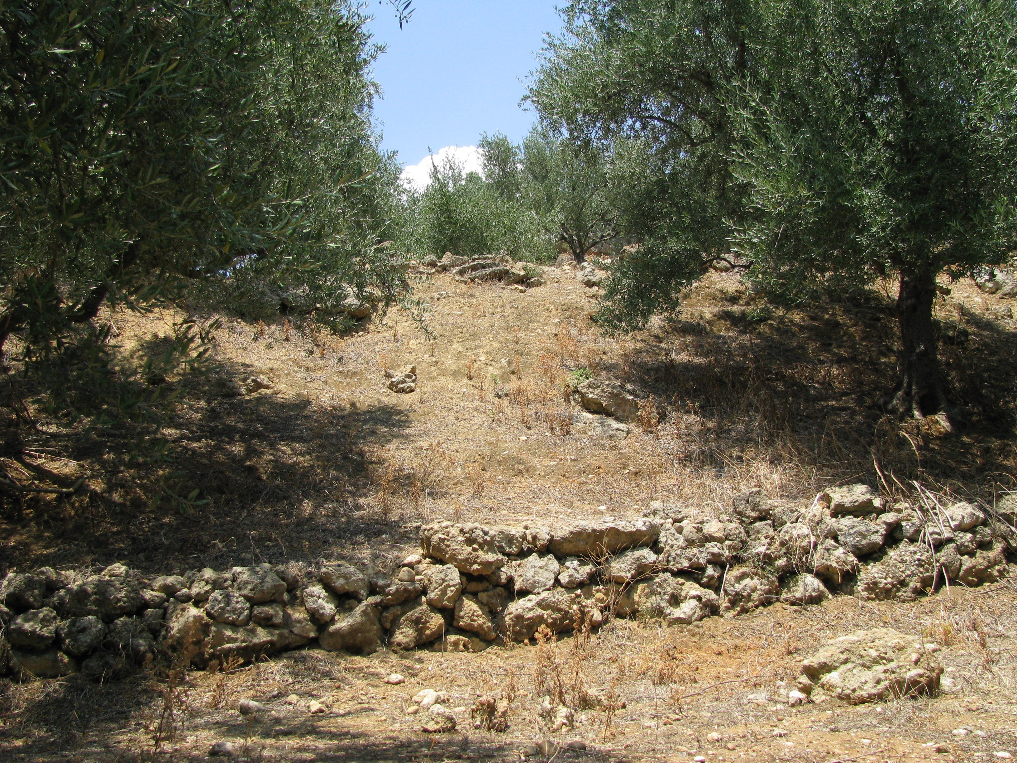
Coupled Human and Natural Systems: Testing the Impact of Agricultural Terraces on Landscape Evolution
Jennifer E. Glaubius and Xingong Li
Department of Geography, University of Kansas
CSDMS 2015 Annual Meeting
27 May 2015

Slide 2
Testing the Impact of Agricultural Terraces on Landscape Evolution
Research Motivation
Modeling Landscape Evolution of Terraced Terrain
Pilot Studies

Slide 3
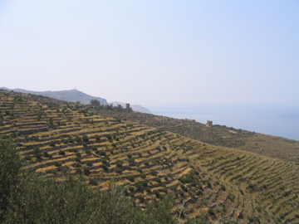

Research Motivation: Agricultural Terraces
Terraced Fields, The Mani, Greece
Longsheng Rice Terrace, China

Slide 4
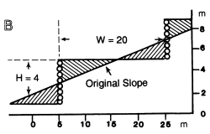
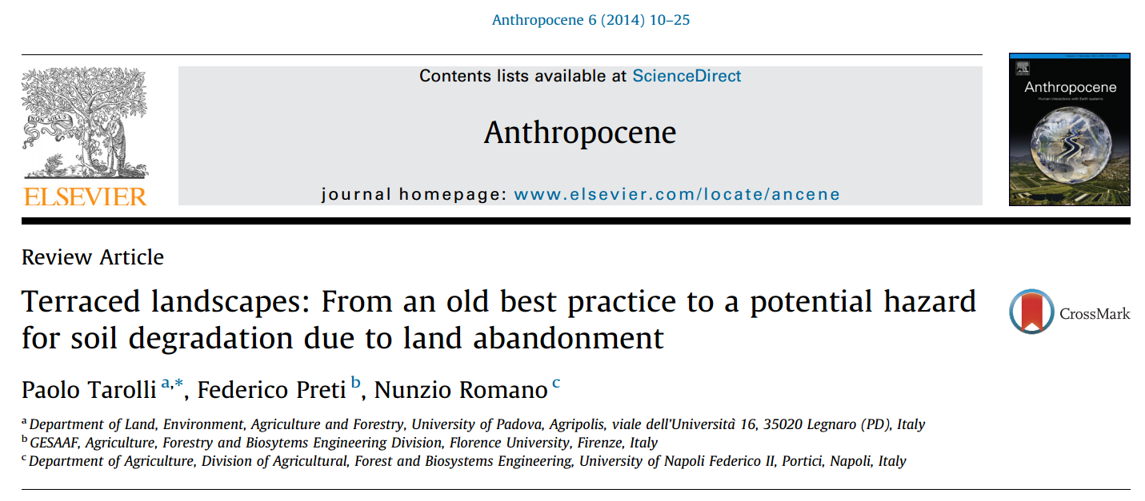
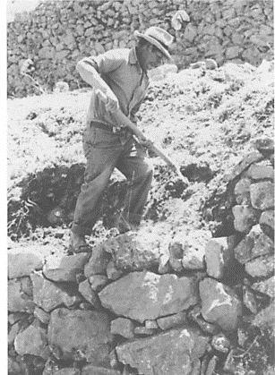
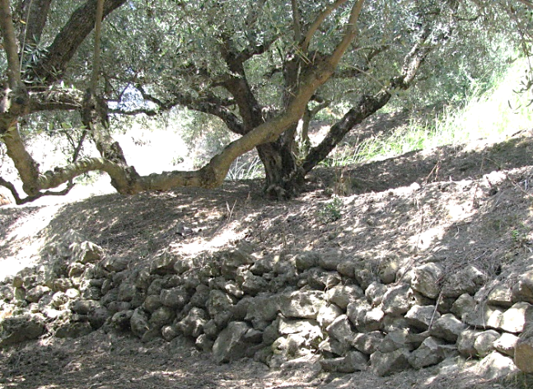
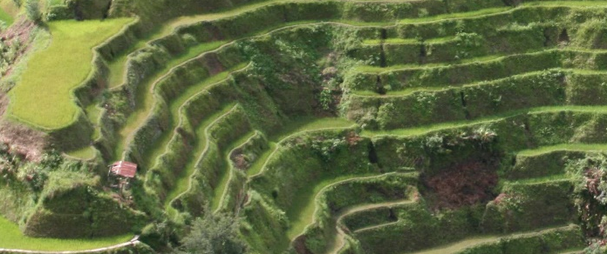
Research Motivation: Terrace Life Cycle Stages
Construction
Use
Reconstruction
Abandonment

Slide 5
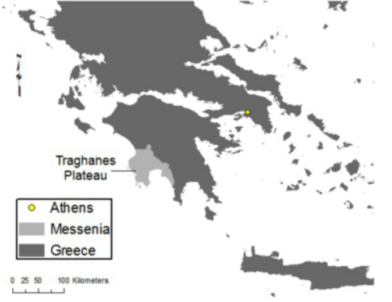
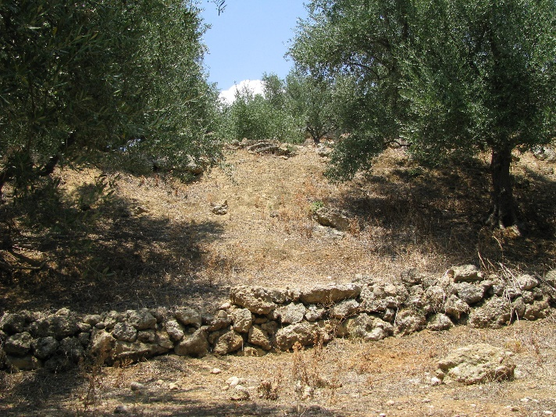
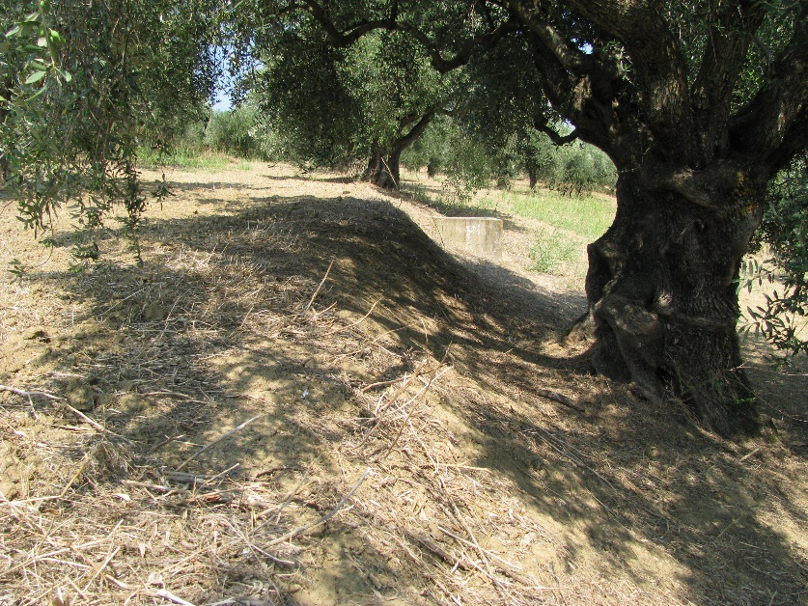
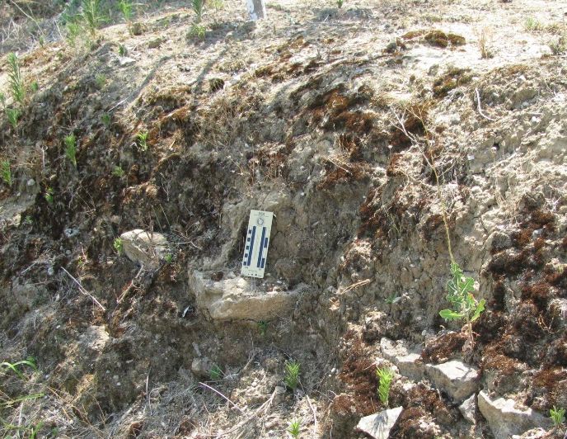
Research Motivation
How do human decisions regarding terrace maintenance impact landscape evolution?

Slide 6
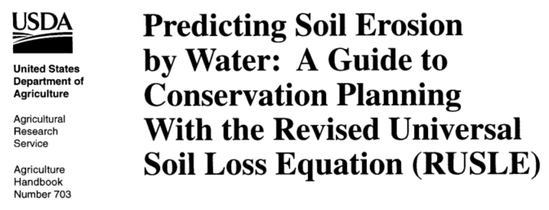
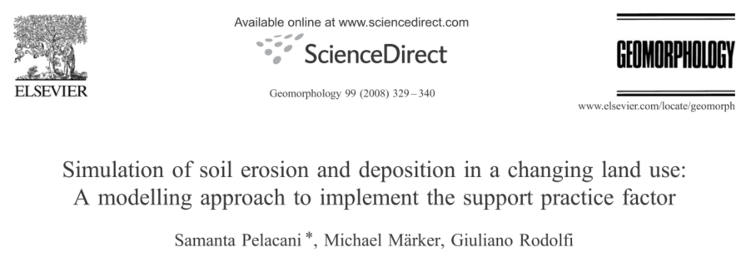
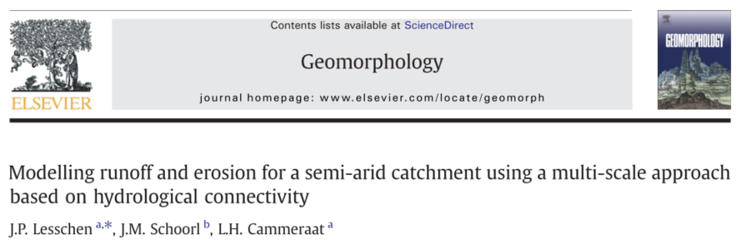
Modeling Landscape Evolution of Terraced Terrain
RUSLE
USPED
LAPSUS

Slide 7
Modeling Landscape Evolution of Terraced Terrain
Model Control
Landscape Evolution Model
Agricultural Terrace Model
Water transport and conservation
Landscape evolution
Conservation of sediment
(Chen et al. 2014)
Agent-Based Model (ABM)
Land use
Terrace maintenance
Riser collapse
Impact of biological factors

Slide 8
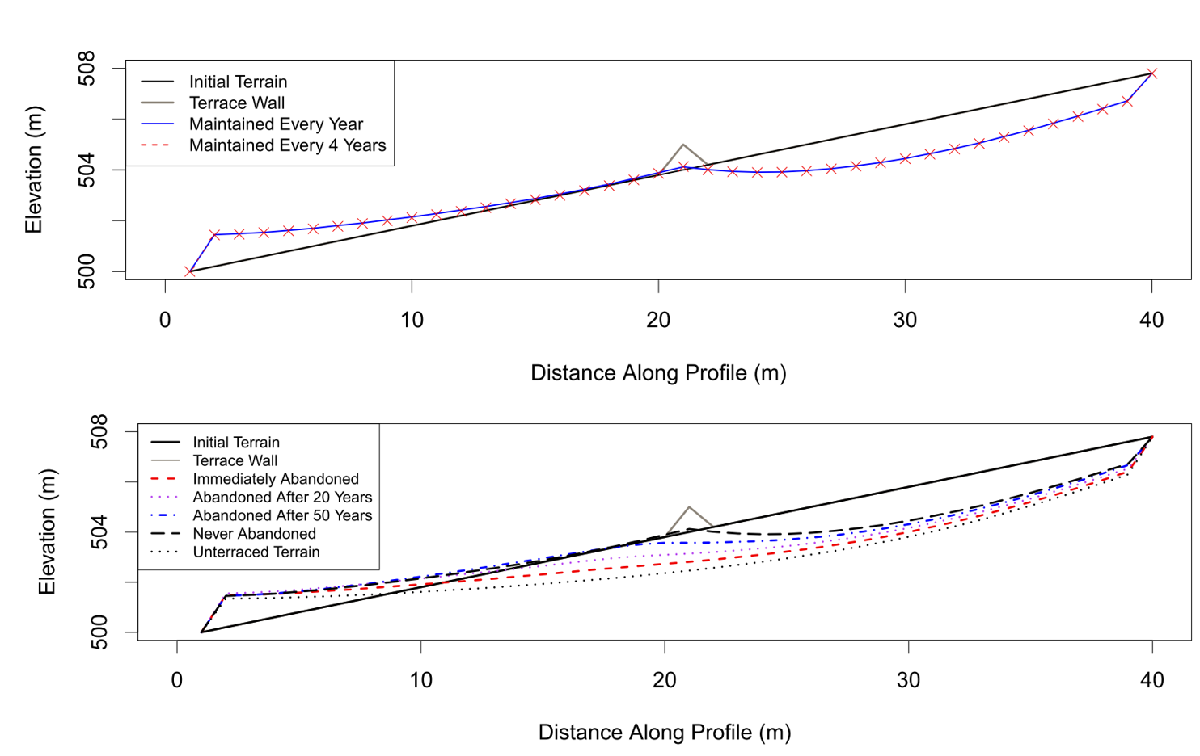
Pilot Studies: Maintenance and Abandonment
Maintenance
Abandonment

Slide 9

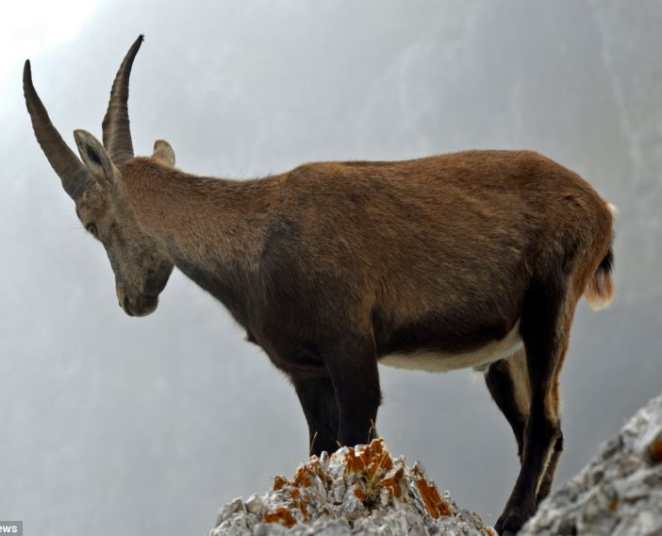
Pilot Studies: Goats ABM
Terrace Wall
Damaged Section of Wall
Goat

Slide 10
Questions? Comments?
Contact jen.glaubius@ku.edu

Slide 11

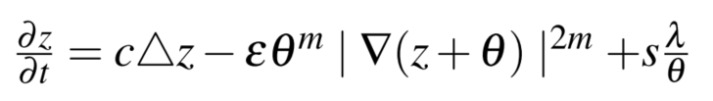

Modeling Landscape Evolution of Terraced Terrain
3-eqn Landscape evolution model from Chen et al. 2014

