Slide 1
Computers & Geosciences
Introduced by
Jef Caers
Energy Resources Engineering
Stanford University, USA

Slide 2
Aims & Scope
Computers & Geosciences publishes high impact, original research at the interface between Computer Sciences and Geosciences. Publications should apply modern computer science paradigms, whether computational or informatics-based, to address problems in the geosciences.

Slide 3
Editors look for
Considerable sophistication in Computer Science, in particular
  Software design
  Computational performance / Numerical modeling
  Artificial Intelligence and soft computing
  Database systems
  Graphics and visualization
  WWW (internet of things)
Clear and explicit application within a field of geosciences
We no longer consider standard applications

Slide 4

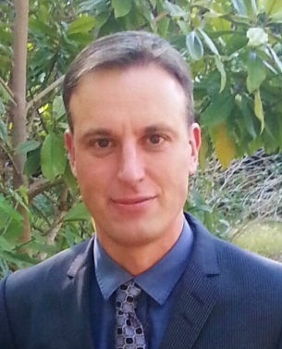
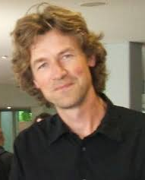
Editorial Team
Two Chief Editors
Eight Associate Editors:
  P. Atkinson, University of Southampton, Southampton, UK
  W. Buytaert, Imperial College London, London, UK
  B Chapman, NASA Jet Propulsion Laboratory, Pasadena, California, USA
  V. Demyanov, Heriot-Watt University, Edinburgh, Scotland, UK
  C. Gökçeoğlu, Hacettepe University, Ankara, Turkey
  T. Mukerji, Stanford University, Stanford, California, USA
  P.J.M. van Oosterom, Delft University of Technology, Delft, Netherlands
  S. Wechsler, California State University at Long Beach, Long Beach, California, USA
Close relationship with the IAMG
Edzer Pebesma

Slide 5
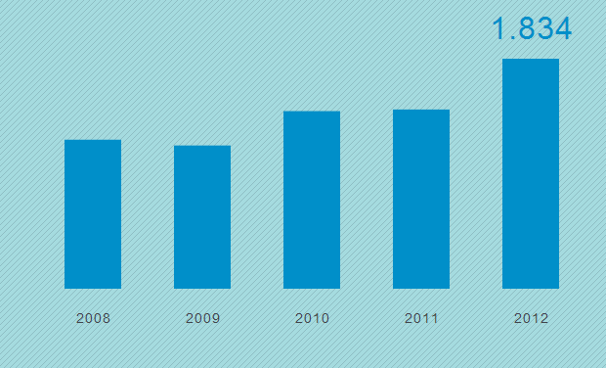
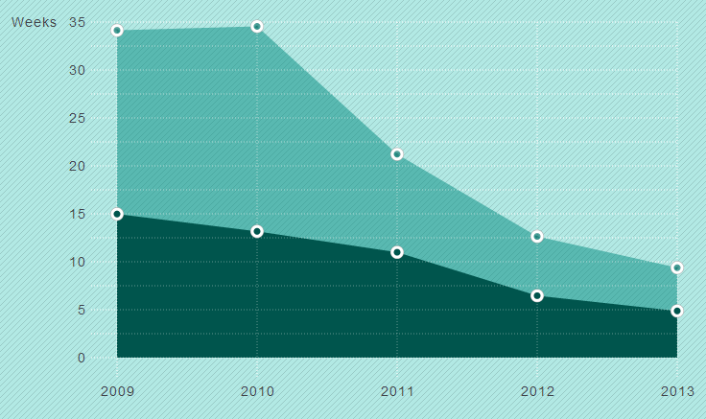
We are growing and improving
# submission in 2013: 800+
Impact factor rank: top 25%
Speed rank: top 5%

Slide 6
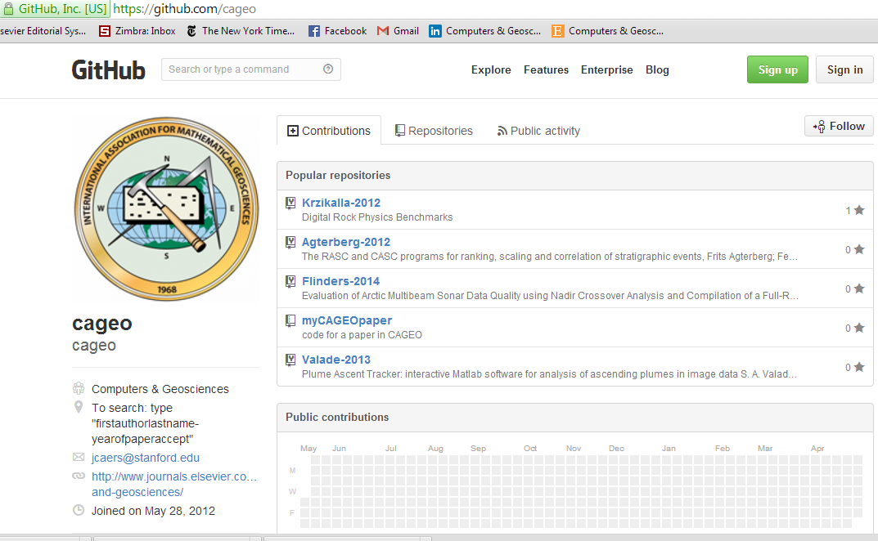
Data and software

Slide 7
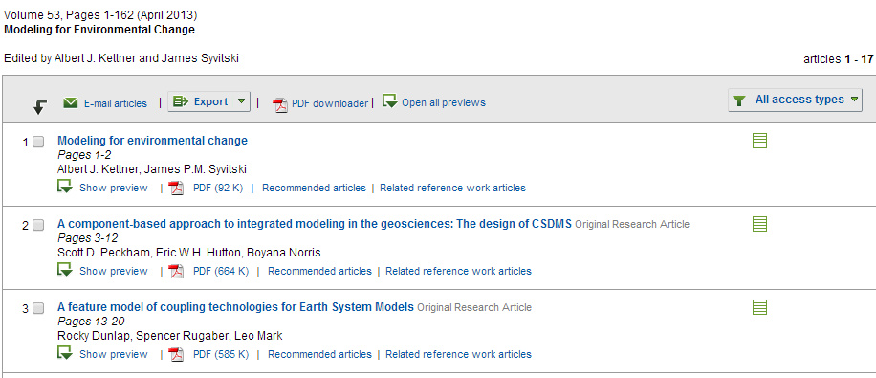
Special issues
Special issues have more impact and yield increased visibility for papers, example:

Slide 8
Selected keywords in those articles
Component software; CSDMS; Code generation; Climate model; Coupler; Feature analysis; Wave-influenced deltas; Sediment variability; Coupled modeling; Coupled human/natural systems; Coastline change; Alluvial-bedrock transition; Shoreline dynamics; Subsidence; Flexure; Numerical model; Continental shelf; LGM; Thermal model; Thaw lakes; Permafrost; MATLAB; RANS model; Education; Integrated modeling; Hydrologic data; Components; Web services; Geomorphology; Channel morphodynamics; Radionuclides

Slide 9
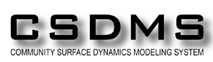
A call
I welcome a proposal for a special issue on
CSDMS 2014 Annual Meeting:
Uncertainty and Sensitivity
in Surface Dynamics Modeling

Slide 10

Please visit us for more information

