Slide 1
Modeling the Couplings Across the Earth Surface in CESM
Jean-François Lamarque
CESM Chief Scientist
National Center for Atmospheric Research

Slide 2
Components of CESM
(Community Earth System Model)
Coupler
Atm.
Land
Sea-ice
Ocean
Land-ice
Forcings:
Greenhouse gases
Manmade aerosols
Volcanic eruptions
Solar variability
Land-use change
Chemistry (CAM-Chem)
Whole atmosphere (WACCM)
Biogeochemistry
Biogeochemistry
Wave model

Slide 3


CESM Project
CESM Advisory Board
CESM Scientific Steering Committee
Based on 20+ Years of Model development and application
BioGeo-
Chemistry
Polar
Climate
Land
Ice
Chemistry-
Climate
Software
Engineering
Societal
Dimensions
Atmosphere
Model
Paleo-
Climate
Whole
Atmosphere
Land
Model
CESM is primarily sponsored by
the National Science Foundation
and the Department of Energy
Ocean
Model
CESM
Climate
Variability
and
Change
Most working groups have winter/spring meetings. Annual meeting in June
(≈400 participants).

Slide 4
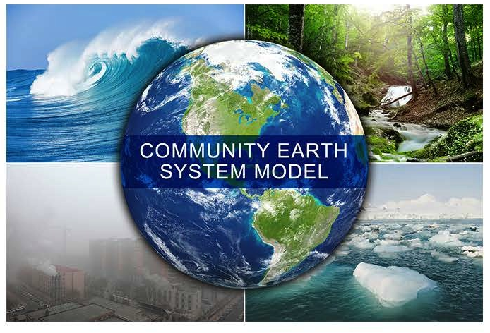
Science Highlights
Mechanisms of Climate Variations on Decadal to Century timescale
www2.cesm.ucar.edu
The Community Earth System Model: A Framework for Collaborative Research
J.W. Hurrell, M.M. Holland, P.R. Gent, S. Ghan, J.E. Kay, P.J. Kushner, J.-F. Lamarque, W.G. Large, D. Lawrence, K. Lindsay, W.H. Lipscomb, M.C. Long, N. Mahowald, D.R. Marsh, R.B. Neale, P. Rasch, S. Vavrus, M. Vertenstein, D. Bader, W. D. Collins, J.J. Hack, J. Kiehl, S. Marshall, Bulletin American Meteorological Society, 2013.
Graphic courtesy of Steve Ghan and DOE Graphics team

Slide 5
CMIP5 Model Intercomparison
CESM1-CAM5
CESM1-BGC
CCSM4
CESM1-FASTCHEM
CESM1-WACCM
Normalized distance from observations for surface temperature and precipitation
(Knutti, Masson, Gettelman, GRL, 2013)
Notes:
Normalized distance from observations. The distance metric is calculated as the root mean square of the surface temperature and precipitation distance as in Figure 1 but relative to
observations (NCEP, ERA40, and MERRA for temperature; GPCP and CMAP for precipitation, see MK11). Mean and
medians for the different ensembles are indicated by red solid and dashed lines, respectively.

Slide 6
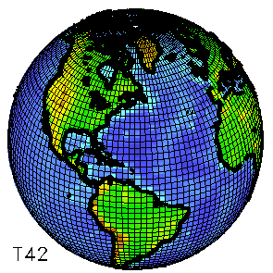
Community Earth System Model (CESM1)
0.25º, 1º , 2º resolutions, +regional-refinement
30 minute time step (for 1º and 2º)
32 atmosphere levels (72 for WACCM)
60 ocean levels (0.1º or 1º)
25 ground layers
~5 million grid boxes at 1º resolution
>1.5 million lines of computer code
Data archived (monthly, daily, hourly) for hundreds of geophysical fields
Utilized by hundreds of scientists all around the world
CESM2 will be released in December 2016

Slide 7
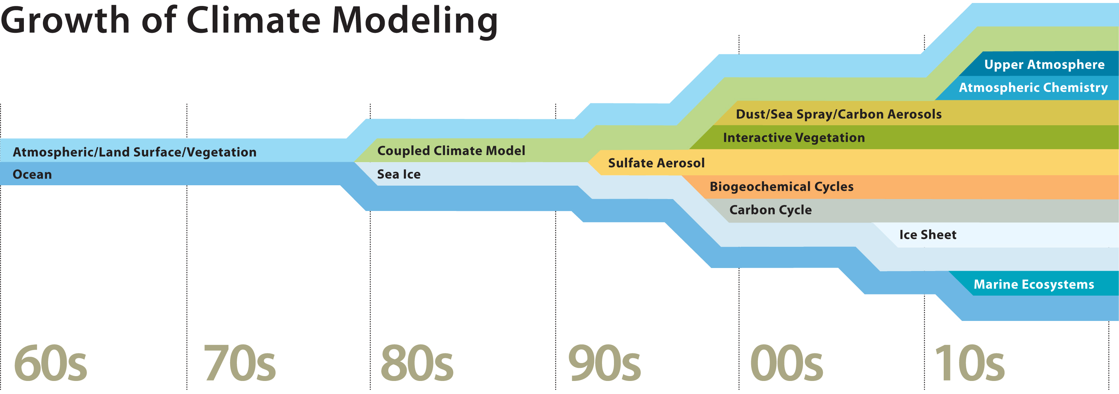
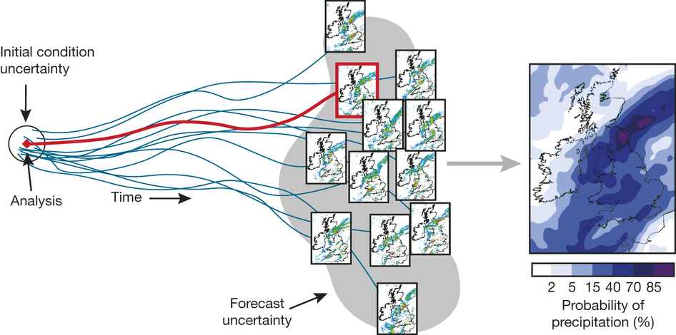
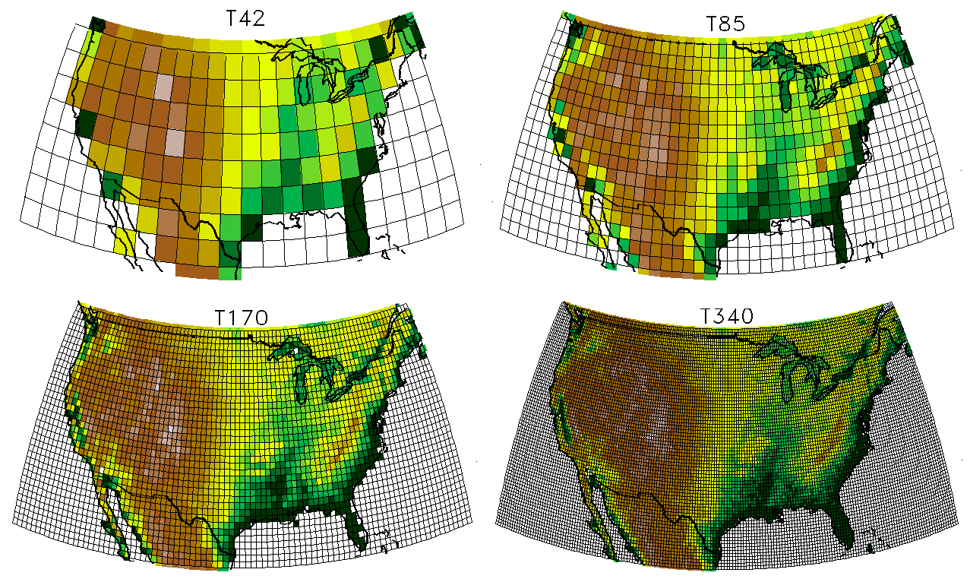
Complexity
Resolution
Resources
Ensemble size

Slide 8
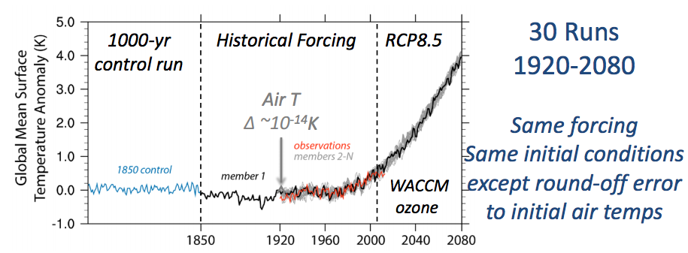
Internal variability and ensemble
Slide from C. Deser

Slide 9
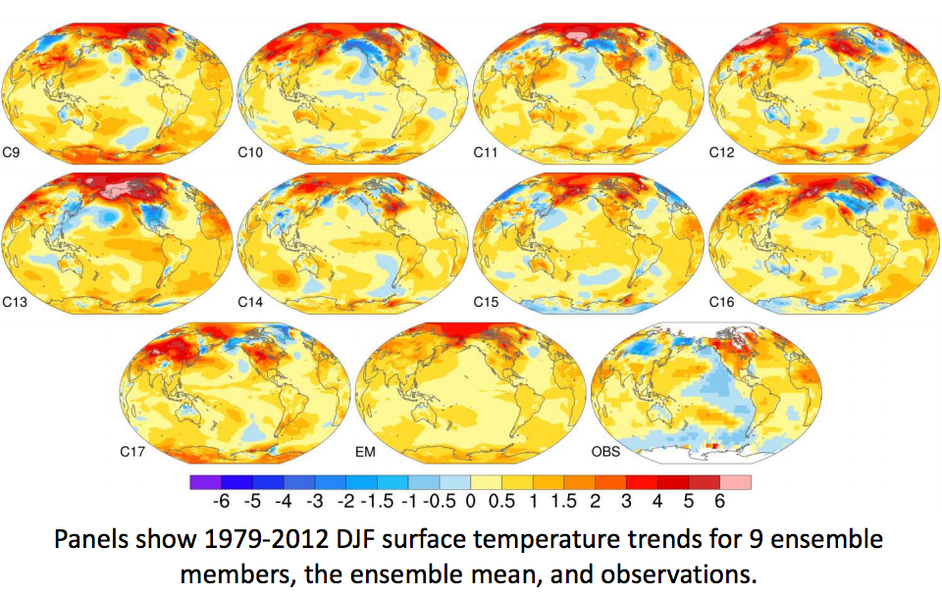
Internal variability and ensemble
Slide from C. Deser

Slide 10
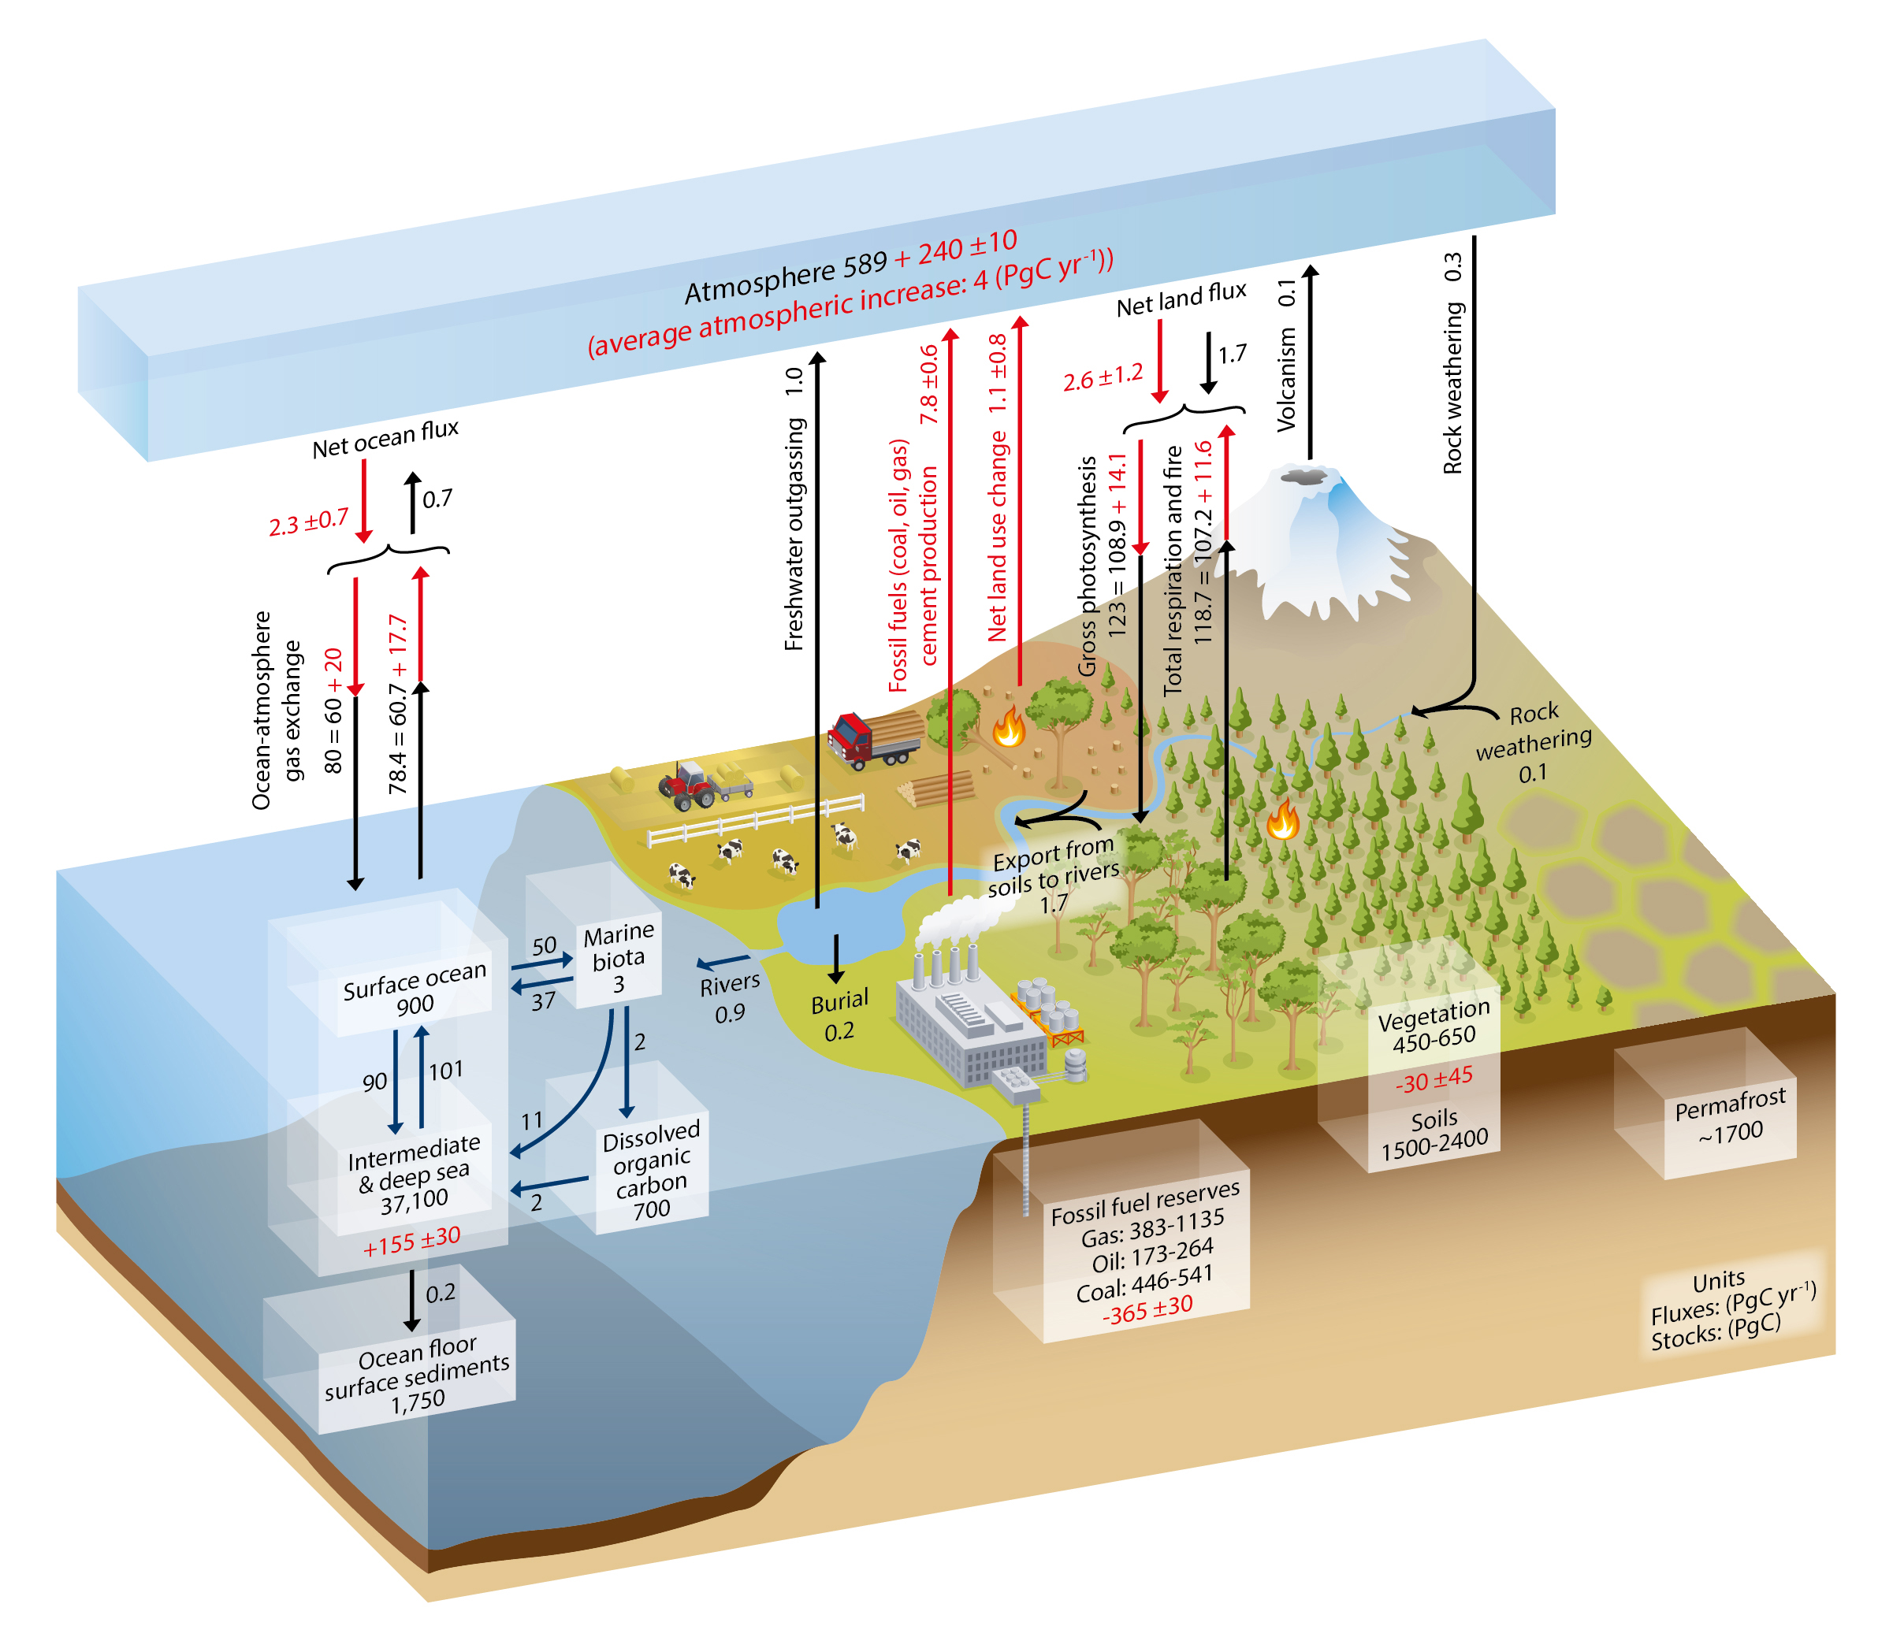
Carbon cycle in the Earth System
IPCC AR5 Ch.6

Slide 11
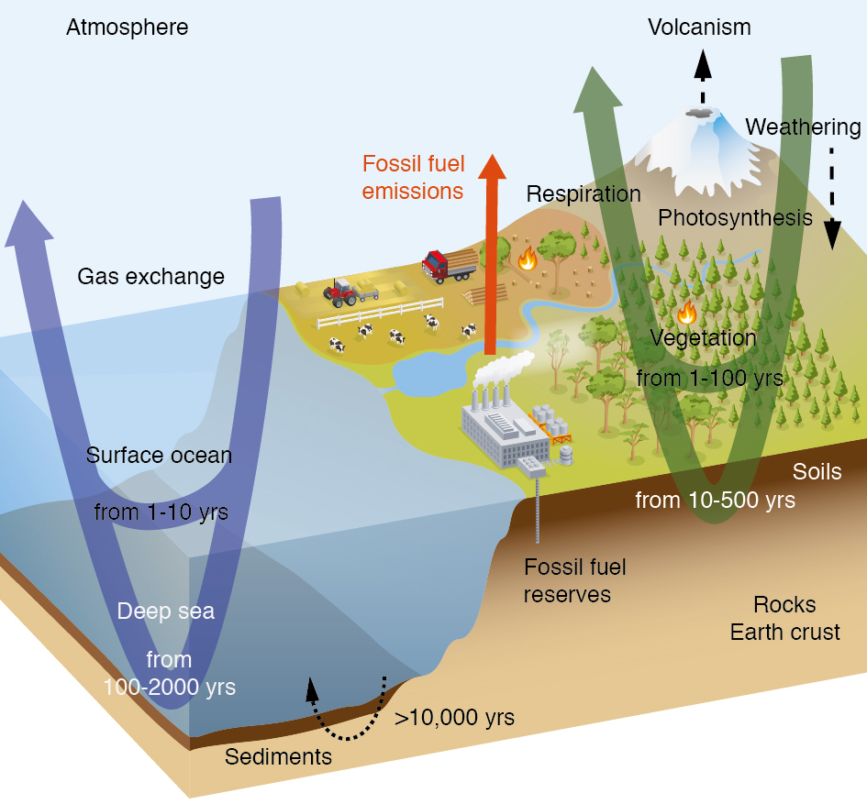
IPCC AR5 Ch.6

Slide 12



Processes in the CESM land model
Biogeochemical cycles
Glacier
CO2
BVOCs
Soil NOx
Water systems
Lake
CH4
Runoff
Competition
Disturbance
River
Routing
Wetland
Flooding
Irrigation
Vegetation Dynamics
River discharge
Land Use
Change
Urban
Wood harvest
Growth
Crops
Human systems
Ecosystem
Notes:
Snow on lake?

Slide 13
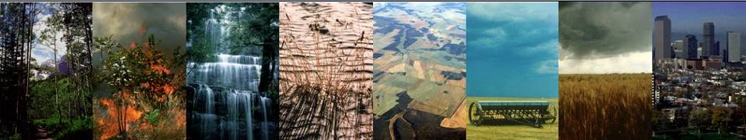
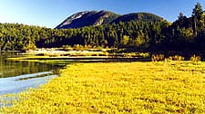

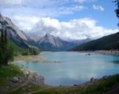

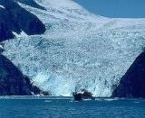
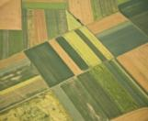






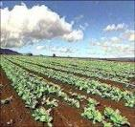
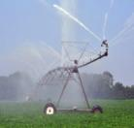



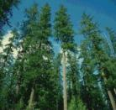
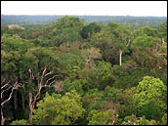

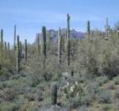


Land surface heterogeneity
CLM subgrid tiling structure
Gridcell
G
V
PFT1
V
PFT3
Landunit
V
PFT2
L
C1I
C1U
V
PFT4
TBD
HD
C2I
C2U
Vegetated
Lake
MD
Glacier
Crop
UT,H,M
Urban
Column
Roof
Shade
Wall
Impervious
Soil
Sun Wall
Pervious
Unirrig
Irrig
Unirrig
Irrig
PFT
PFT1
PFT2
PFT3
PFT4 …
Crop1
Crop1
Crop2
Crop2 …
Notes:
This is a schematic of the subgrid structure of the land model. There are four distinct heirarchies in the model. There is the gridcell level. A gridcell is divided up into landunits, columns, and plant functional types or pfts.
Landunits are glacier, wetland, vegetated, lake, and now urban. Beneath the vegetated landunit is at least one soil type. Plant functional types then share this soil type and the energy and water budgets associated with this.

Slide 14




Current processes in CLM
Surface energy fluxes
Hydrology
Biogeochemical cycles
Radiation
Diffuse solar
Heat
Momentum
Precipitation
Photosynthesis
BVOCs
Direct solar
Downwelling
longwave
Momentum flux
Wind speed
Fire
Autotrophic
respiration
0
u_{a}
Transpiration
Sensible heat flux
Evaporation
Latent heat flux
Reflected solar
Absorbed
solar
Emitted
longwave
Throughfall
Phenology
Vegetation C/N
Aerosol
deposition
Sublimation
Evaporation
Dust
N dep
N fix
CH₄
Infiltration
Heterotrop.
respiration
Melt
Surface
runoff
N₂O
SCF
Litterfall
Surface
water
Ground heat flux
Saturated
fraction
Soil (sand, clay, organic)
Soil
Root litter
Aquifer recharge
Soil
C/N
Denitrification
N leaching
Water table
N mineral-
ization
N
uptake
Sub-surface
runoff
Bedrock
Unconfined aquifer
Notes:
Snow on lake?

Slide 15
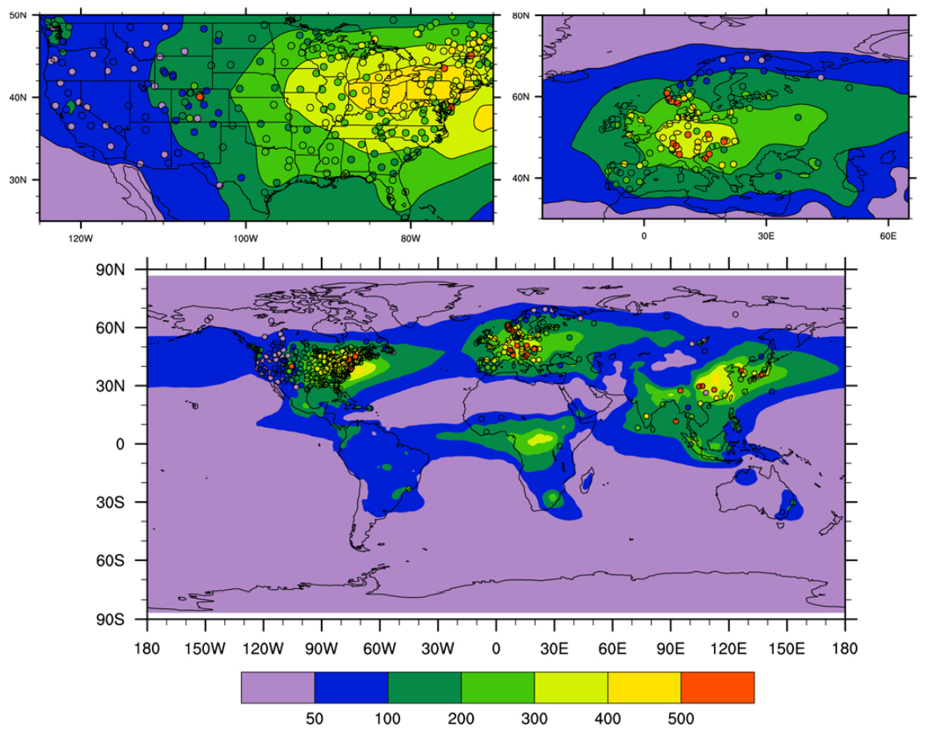
Current processes in CLM
Biogeochemical cycles
Photosynthesis
BVOCs
Fire
Autotrophic
respiration
Phenology
Vegetation C/N
N dep
N fix
CH₄
Heterotrop.
respiration
Litterfall
N₂O
Root litter
Soil
C/N
Denitrification
N leaching
N mineral-
ization
N
uptake
mg(N)/m²/yr
Lamarque et al., 2013
Notes:
Snow on lake?

Slide 16
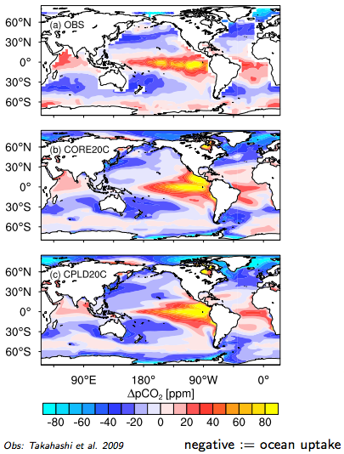
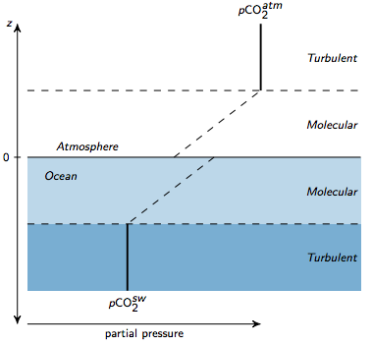
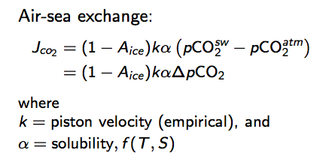
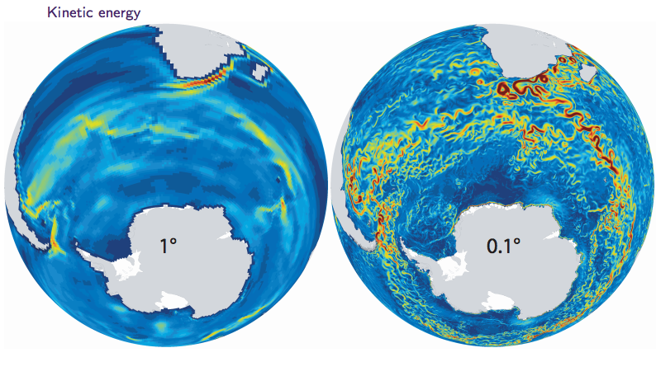
Air-sea exchange of CO₂
Slide courtesy of M. Long

Slide 17
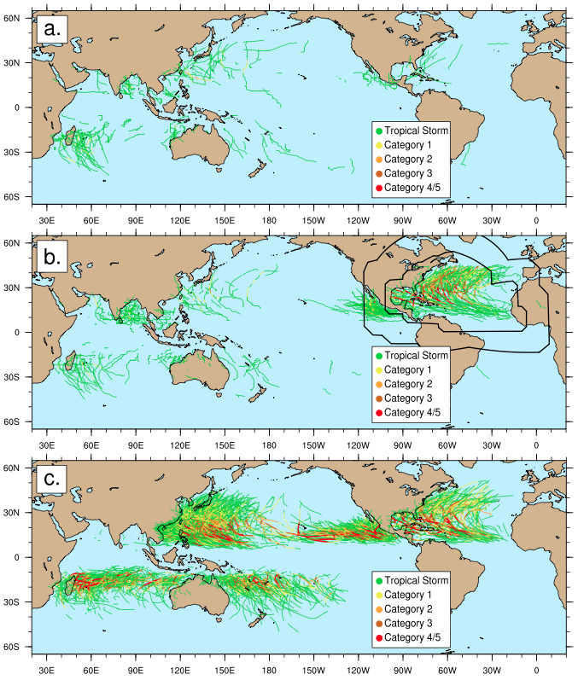
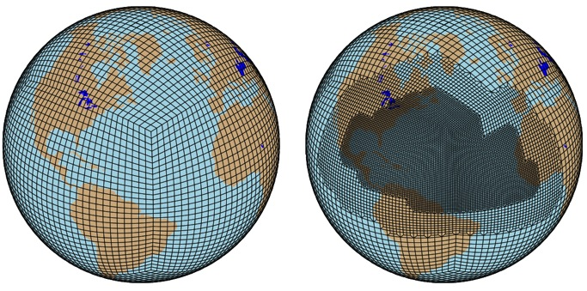
High res: Regionally refined grids
1° with 0.25° nest
Tropical cyclone tracks, 1980-2002
Uniform 1°
Uniform 1°
1° with 0.25° nest
Variable-resolution CAM-SE (CAM5) simulations -> dramatically improved tropical cyclone representation at regional scale
0.25° nest produces realistic storm counts/intensities in North Atlantic at 1/6th compute cost of globally-uniform 0.25° mesh
Challenges: Streamlining generation of new grids; Ensuring that physics parameterizations work across resolutions
Obs
Courtesy: Colin Zarzycki, U. Mich.
Notes:
Higher density of TC tracks in var-res simulation more closely matches observations (bottom). In addition to density being higher, warmer colors over Atlantic in var-res simulation mean stronger storm intensity resolved by high-resolution dynamics.

Slide 18
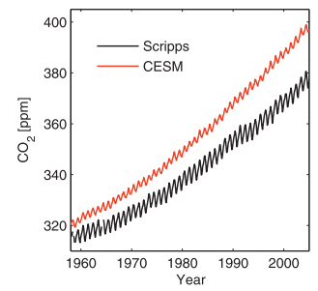
CO₂ over historical period in CESM1
Mauna Loa
Keppel-Aleks et al., 2013

Slide 19
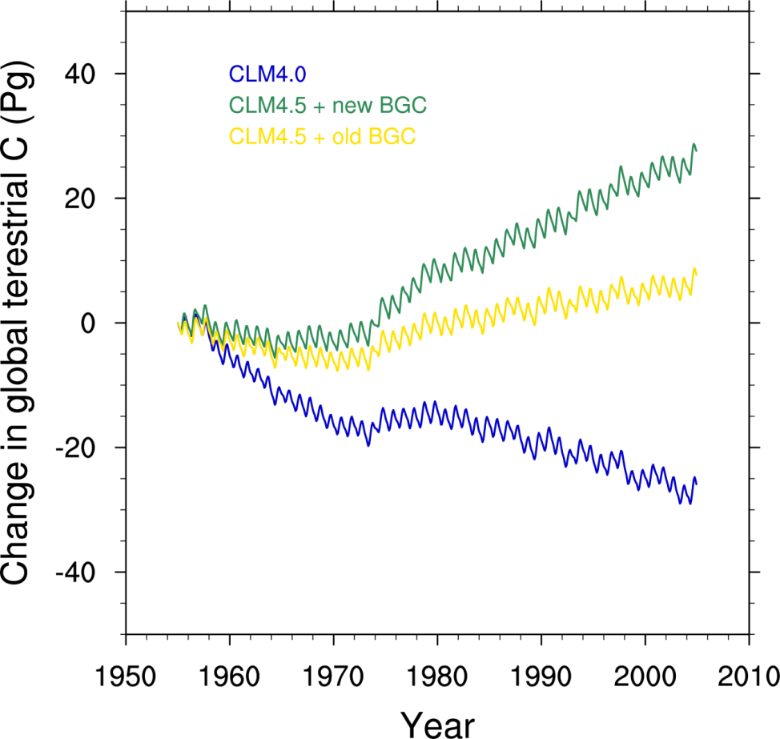
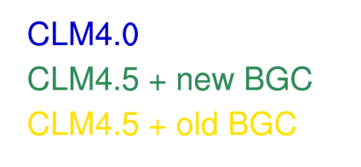
Impact of CLM4.5 model changes on historical global terrestrial carbon trajectory
GCP estimate for land C sink
In CLM4.5, land is a C sink over latter half of 20thC, as observed
Koven et al., 2013

Slide 20
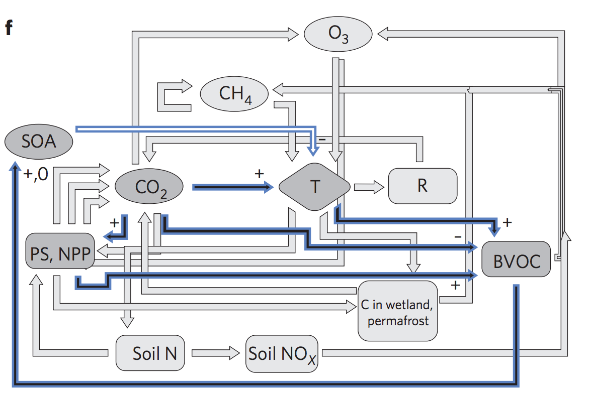
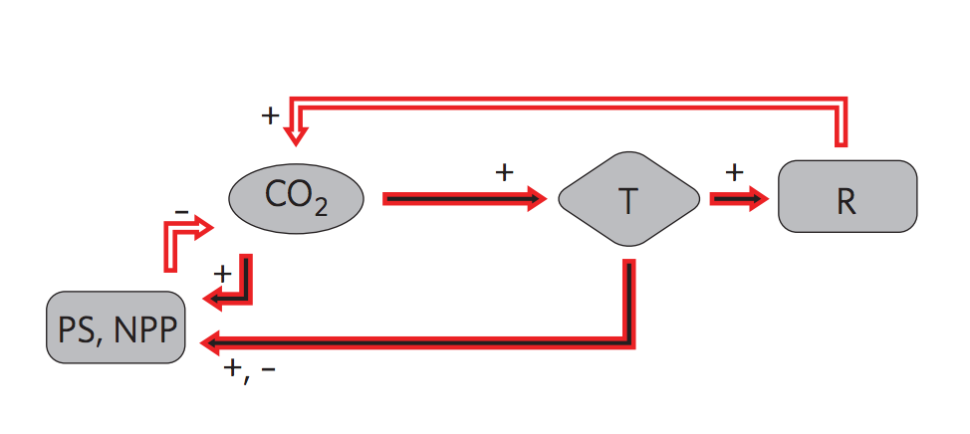
Land biogeochemistry feedbacks: CESM1 to CESM2
Arneth et al., 2010

Slide 21
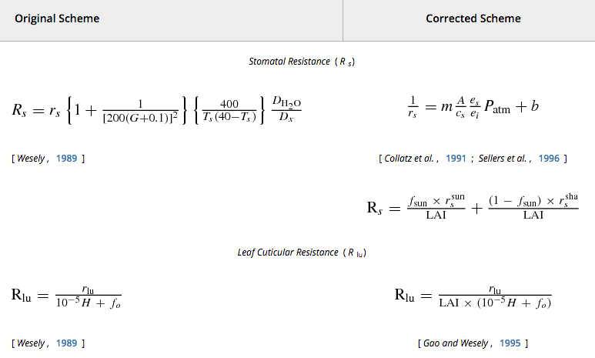
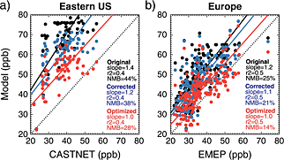
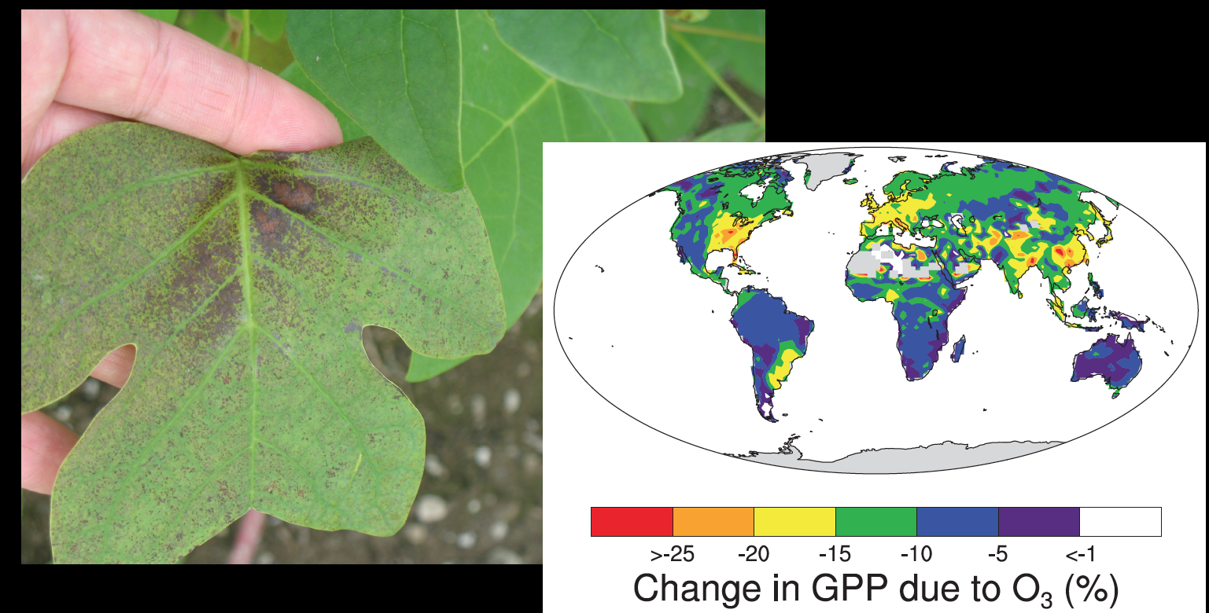
Improvement in ozone deposition and stomatal resistance
Val Martin et al., 2015
Lombardozzi et al., 2015

Slide 22
Summary
CESM is a versatile tool to explore complex interactions and feedbacks within and across elements of the Earth system
Strong emphasis is placed on continual improvement in process representation
This can only be achieved through numerous collaborations across disciplines and scales

