Slide 1
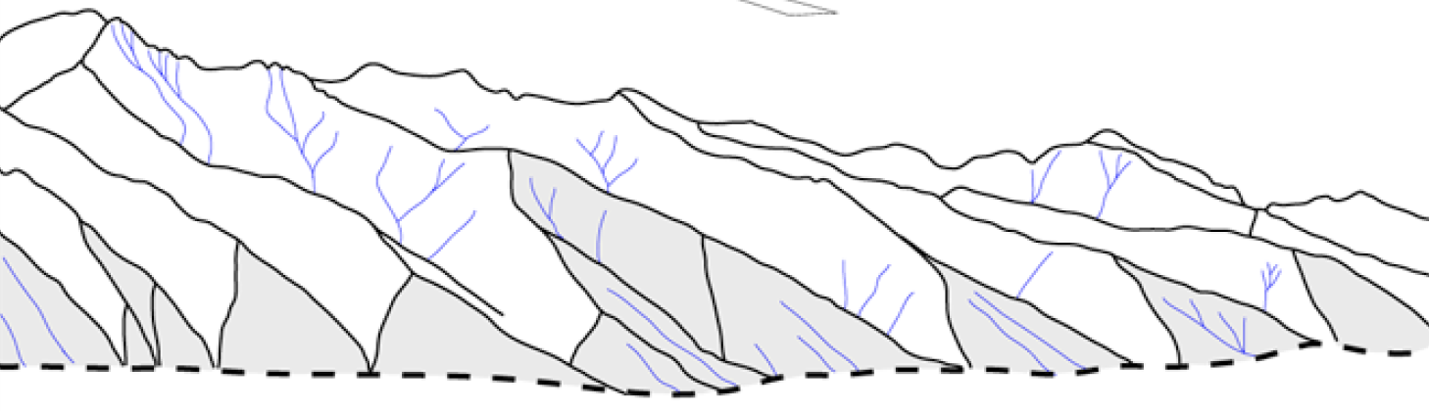
MODES OF EXTENSIONAL FAULTING
CONTROLLED BY SURFACE PROCESSES
Jean-Arthur Olive^{1,2}, Mark Behn², Luca Malatesta³
1 – MIT/WHOI, now LDEO, 2 – WHOI, 3 – Caltech

Slide 2
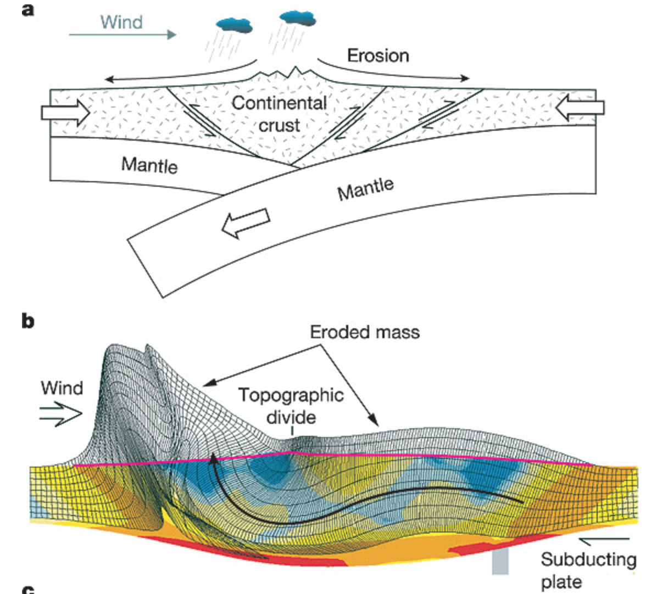
Feedbacks between tectonics and erosion
“Savor the irony
should mountains
owe their metamorphic muscles to the drumbeat
of tiny raindrops.”
Hoffman and Grotzinger [1993]
Willett [1999]

Slide 3
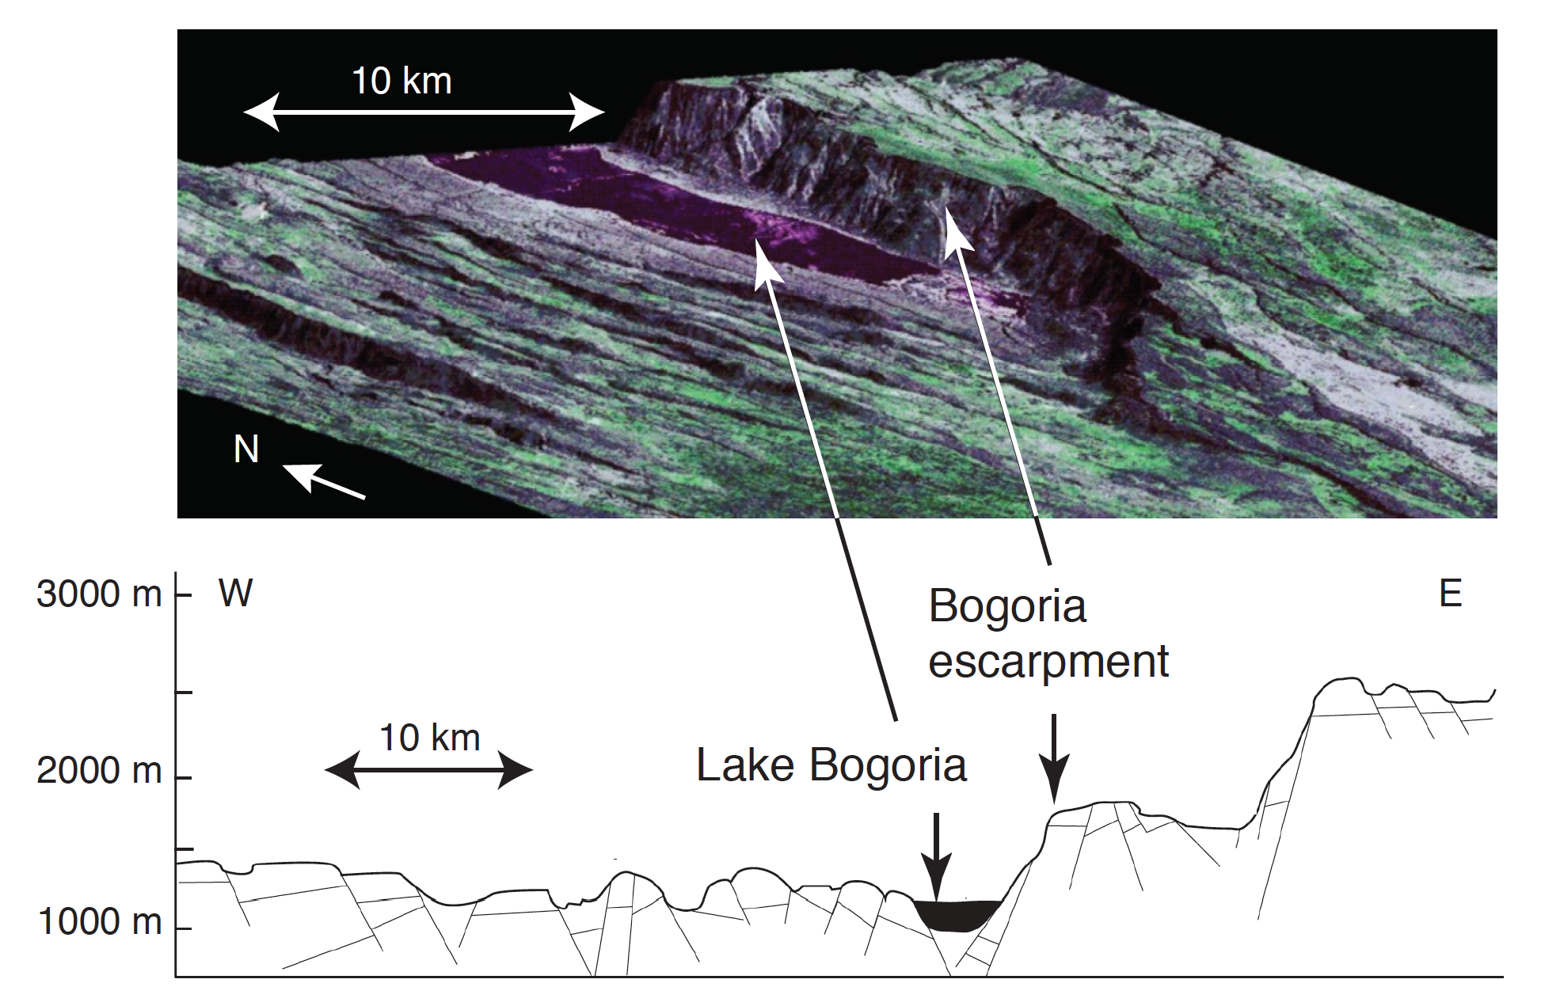
Diversity of (subaerial) normal fault styles
SHORT-LIVED FAULTS LONG-LIVED DETACHMENTS
Baringo-Bogoria half-graben (Kenya)
East African Rift - Eastern Branch
fault life span
SPOT / UCD
Renult & Tiercelin [1994]

Slide 4
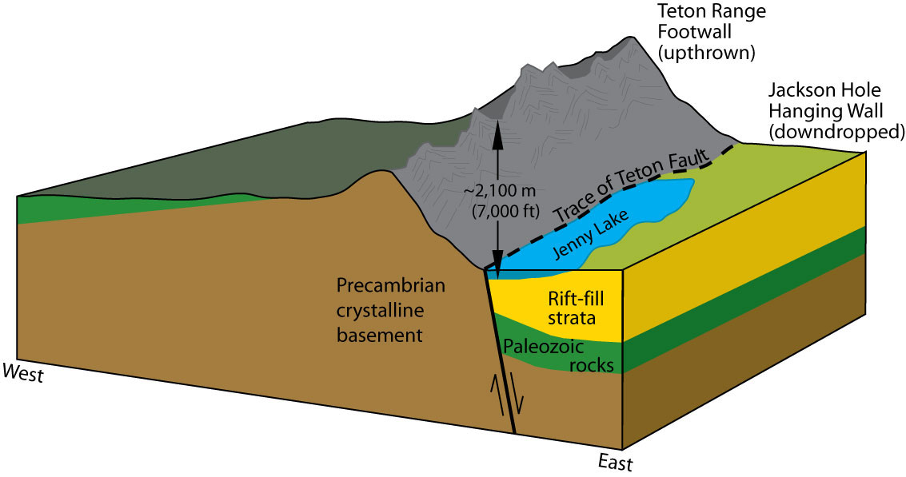
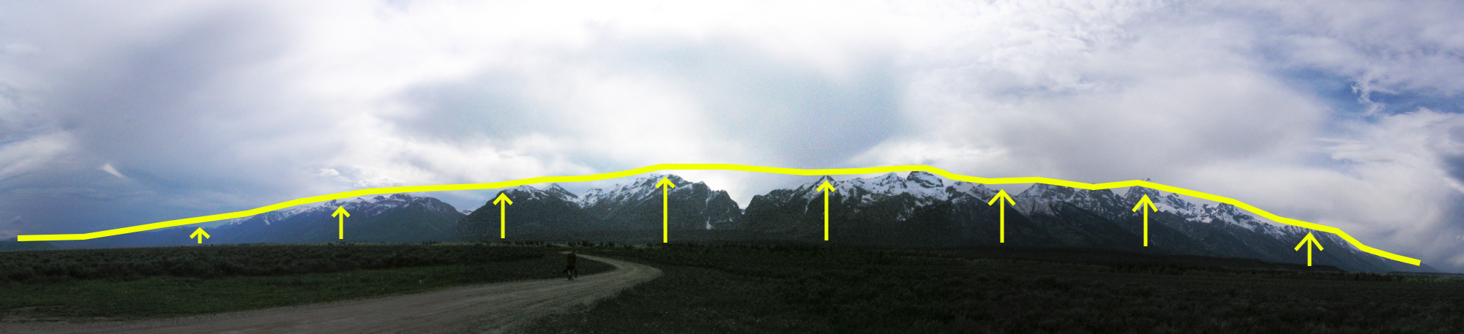
Diversity of (subaerial) normal fault styles
SHORT-LIVED FAULTS LONG-LIVED DETACHMENTS
Teton fault, Wyoming
Total slip ≈ 10 km
fault life span
NPS
C. Rowan

Slide 5
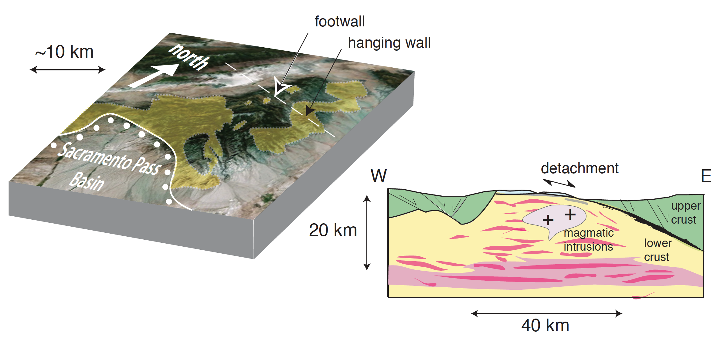
Diversity of (subaerial) normal fault styles
SHORT-LIVED FAULTS LONG-LIVED DETACHMENTS
fault life span
Northern Snake Range (Nevada)
Miller et al. [1983]; Whitney et al. [2012]

Slide 6
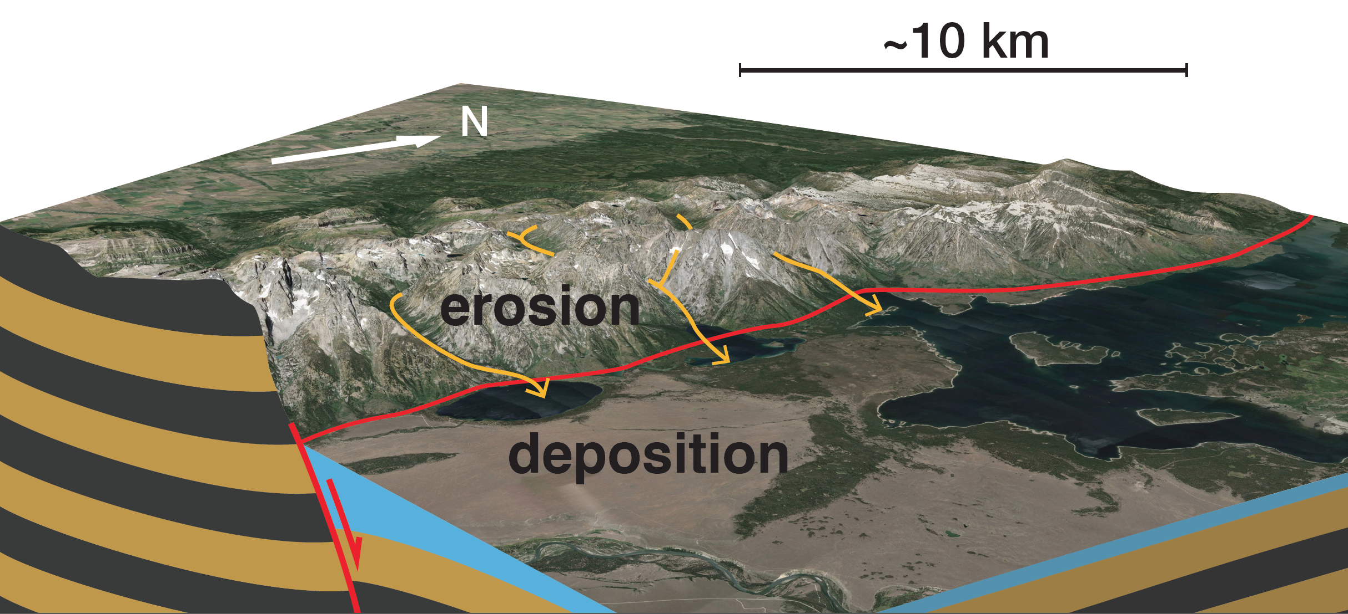
Normal faulting vs. surface processes
Surface processes redistribute mass and topographic loads
on a growing fault. Can they affect fault life span ?
Teton fault, WY
Landsat / Google Earth

Slide 7
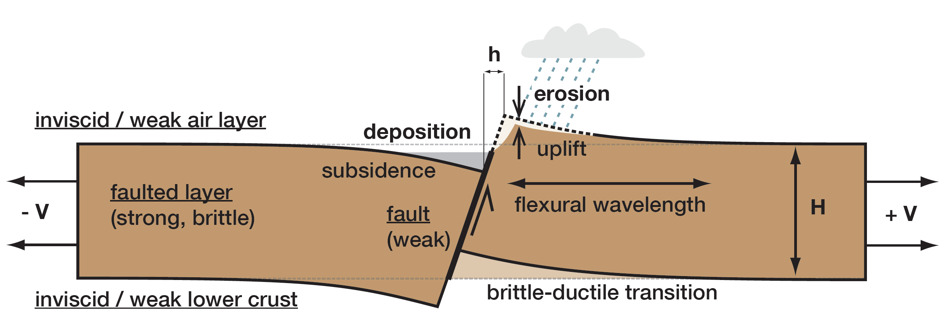
Coupled geodynamics – surface model
Geodynamic model (visco-elastic-plastic flow with FD/PIC):
Strong brittle layer (thickness H) with seeded fault subjected
to stretching at half-rate V. Fault evolution monitored as offset h increases.
Numerical simulations conducted with the SiStER code
(Simple Stokes with Exotic Rheologies).

Slide 8
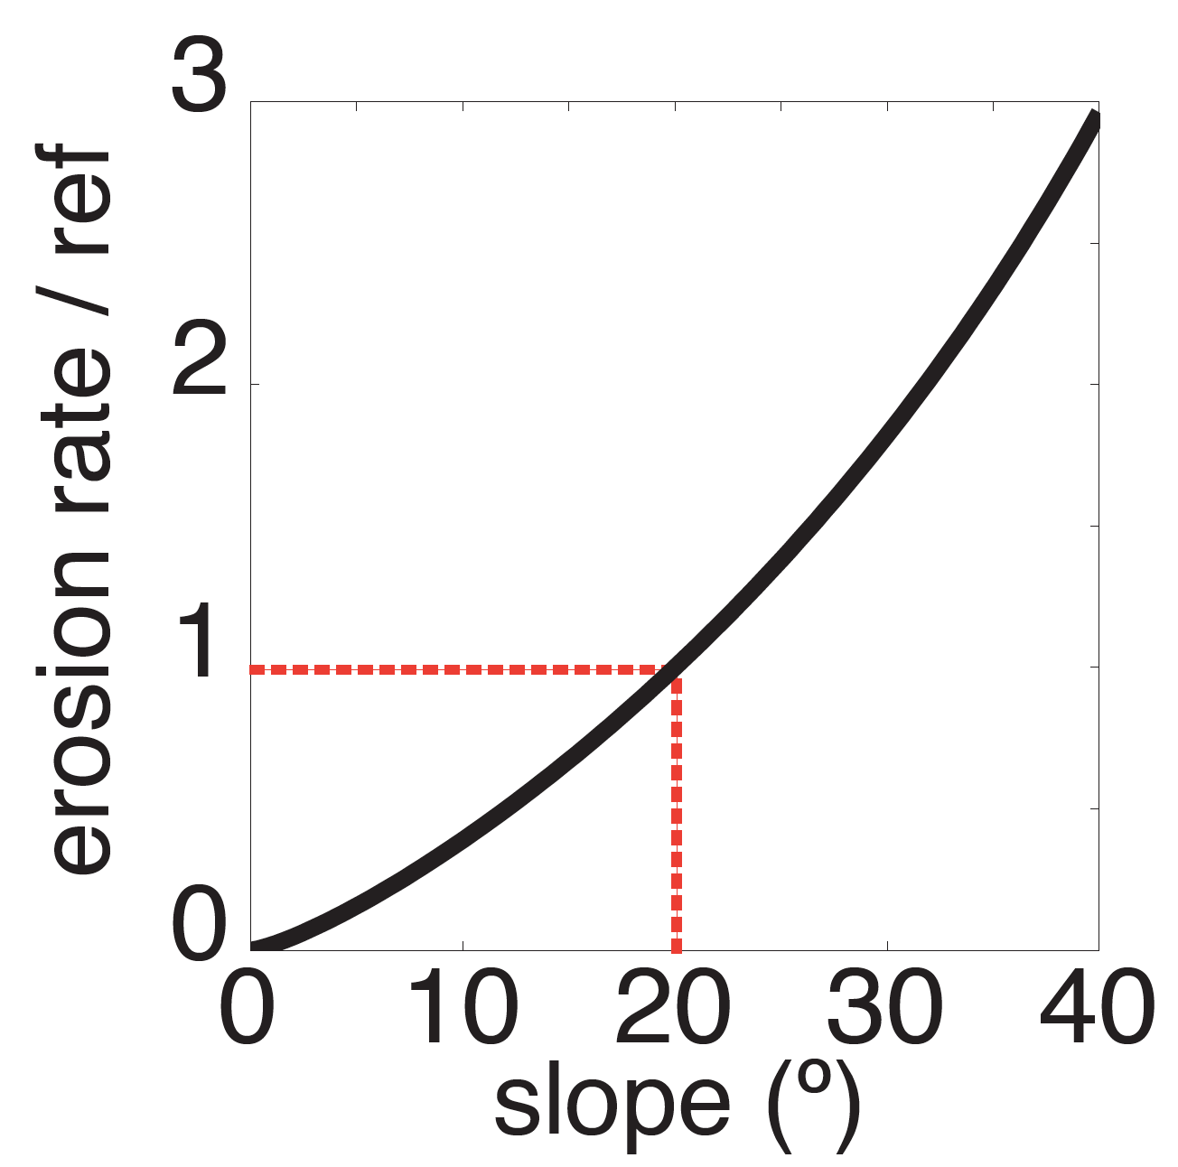
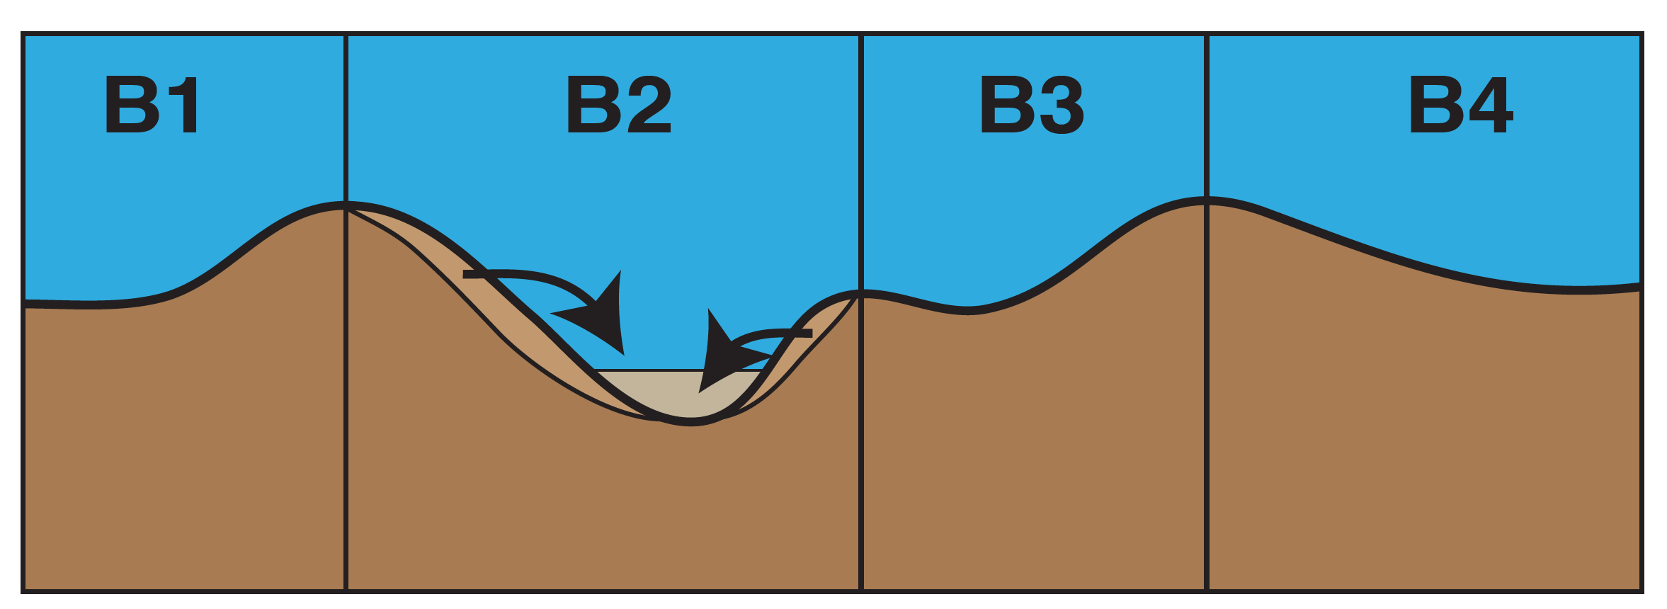
Coupled geodynamics – surface model
Surface evolution model (upper boundary condition):
Step 1: erode material
Step 2: deposit material flat
in corresponding watershed

Slide 9
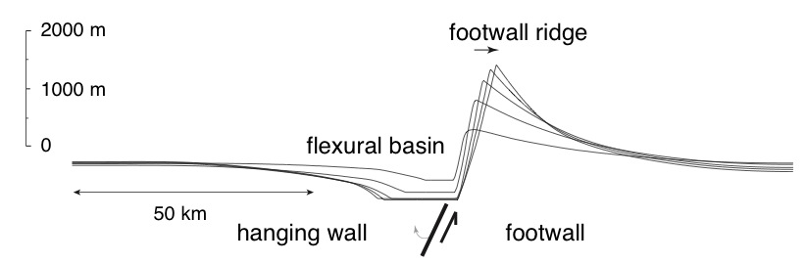
Fault growth with erosion and sedimentation
Fault growth is accompanied by
• Flexure of the footwall and hanging wall
• Rapid rotation of the fault plane down to 30-45º.
• Erosion of the footwall block, ridge migration,
deposition in flexural basin.
Notes:
END: now that is just one fault

Slide 10
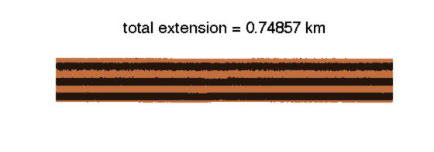
Sequence of faulting with slow erosion
Extending a 15 km thick layer at 2 mm/yr (full rate).
Ref. erosion rate = 0.05% of fault slip rate.
15 km
30 km

Slide 11

Sequence of faulting with fast erosion
Extending a 15 km thick layer at 2 mm/yr (full rate).
Ref. erosion rate = 35% of fault slip rate.
15 km
30 km

Slide 12
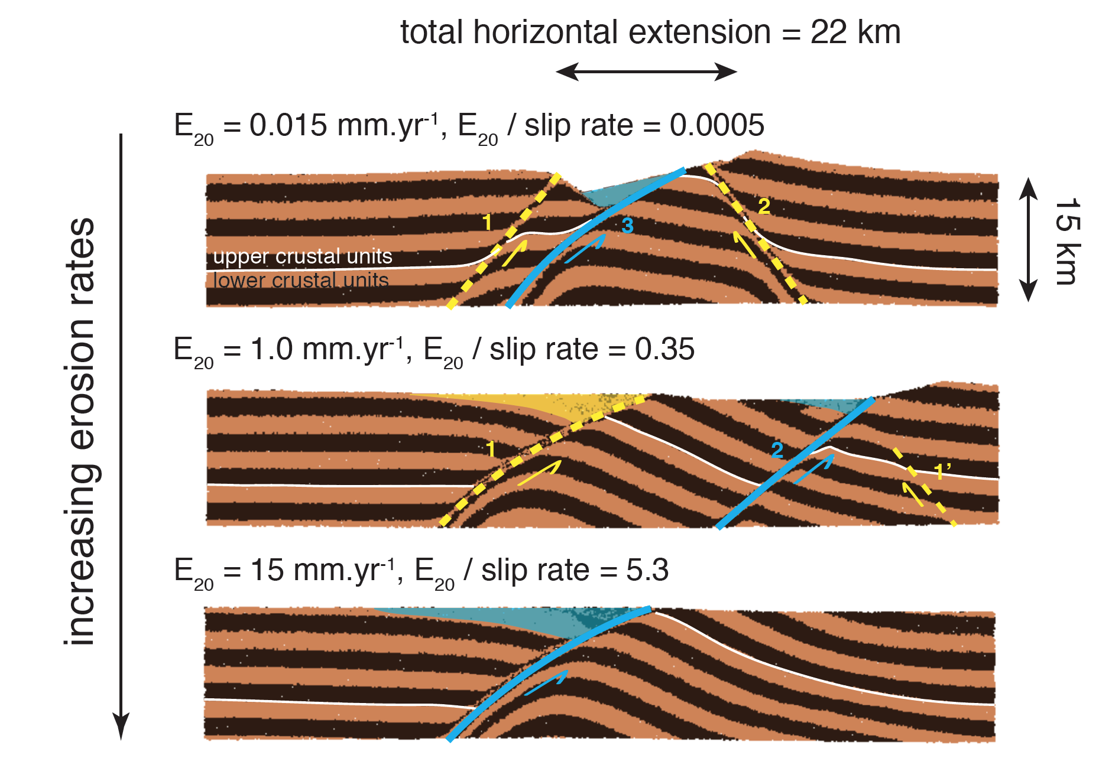
Faster surface processes = longer-lived faults

Slide 13
Faster surface processes = longer-lived faults
Surface processes further enhance fault life span
in thinner faulted layers for a given erosion / slip rate.
Layer
thickness
Extension
rate

Slide 14
Force balance on a growing normal fault
How to keep a normal fault active ? [Forsyth, 1992]

Slide 15
Force balance on a growing normal fault
How to keep a normal fault active ? [Forsyth, 1992]
Supply extensional work

Slide 16
Force balance on a growing normal fault
How to keep a normal fault active ? [Forsyth, 1992]
Supply extensional work
Overcome frictional resistance on the fault

Slide 17
Force balance on a growing normal fault
How to keep a normal fault active ? [Forsyth, 1992]
Supply extensional work
Bend the faulted layer
Overcome frictional resistance on the fault

Slide 18
Force balance on a growing normal fault
How to keep a normal fault active ? [Forsyth, 1992]
Supply extensional work
Sustain the growth
of topography
Bend the faulted layer
Overcome frictional resistance on the fault

Slide 19
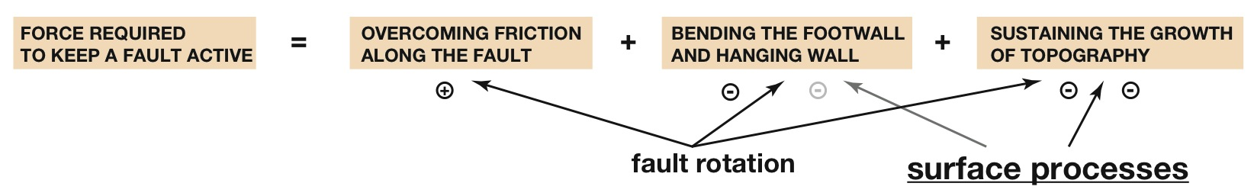
Topographic forcing on fault life span
Surface processes
enhance fault life span
by relieving the energy cost
of topography build-up.

Slide 20
Implications for the geometry of the 2nd fault
Topography build-up favors the formation of an antithetic second fault in the vicinity of the initial fault.
When surface processes suppress topography, internal bending controls the location and geometry of the 2nd fault.

Slide 21
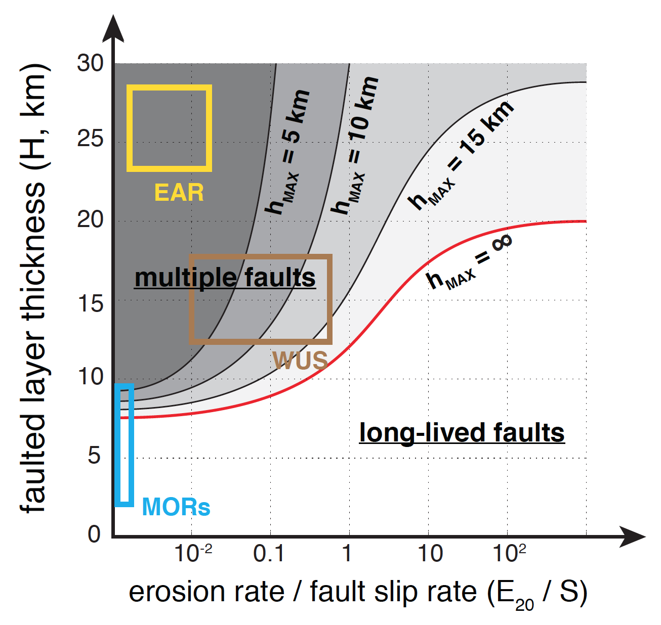
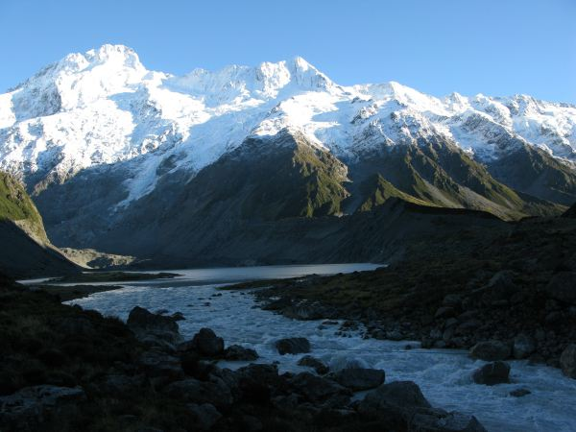
Implications for rift dynamics
Surface processes enable the large offsets (10+ km)
observed on major range-bounding normal faults.
(These would otherwise
be difficult to achieve
in 15 km-thick
brittle upper crust)
Rwenzori Mountains (Uganda)

Slide 22
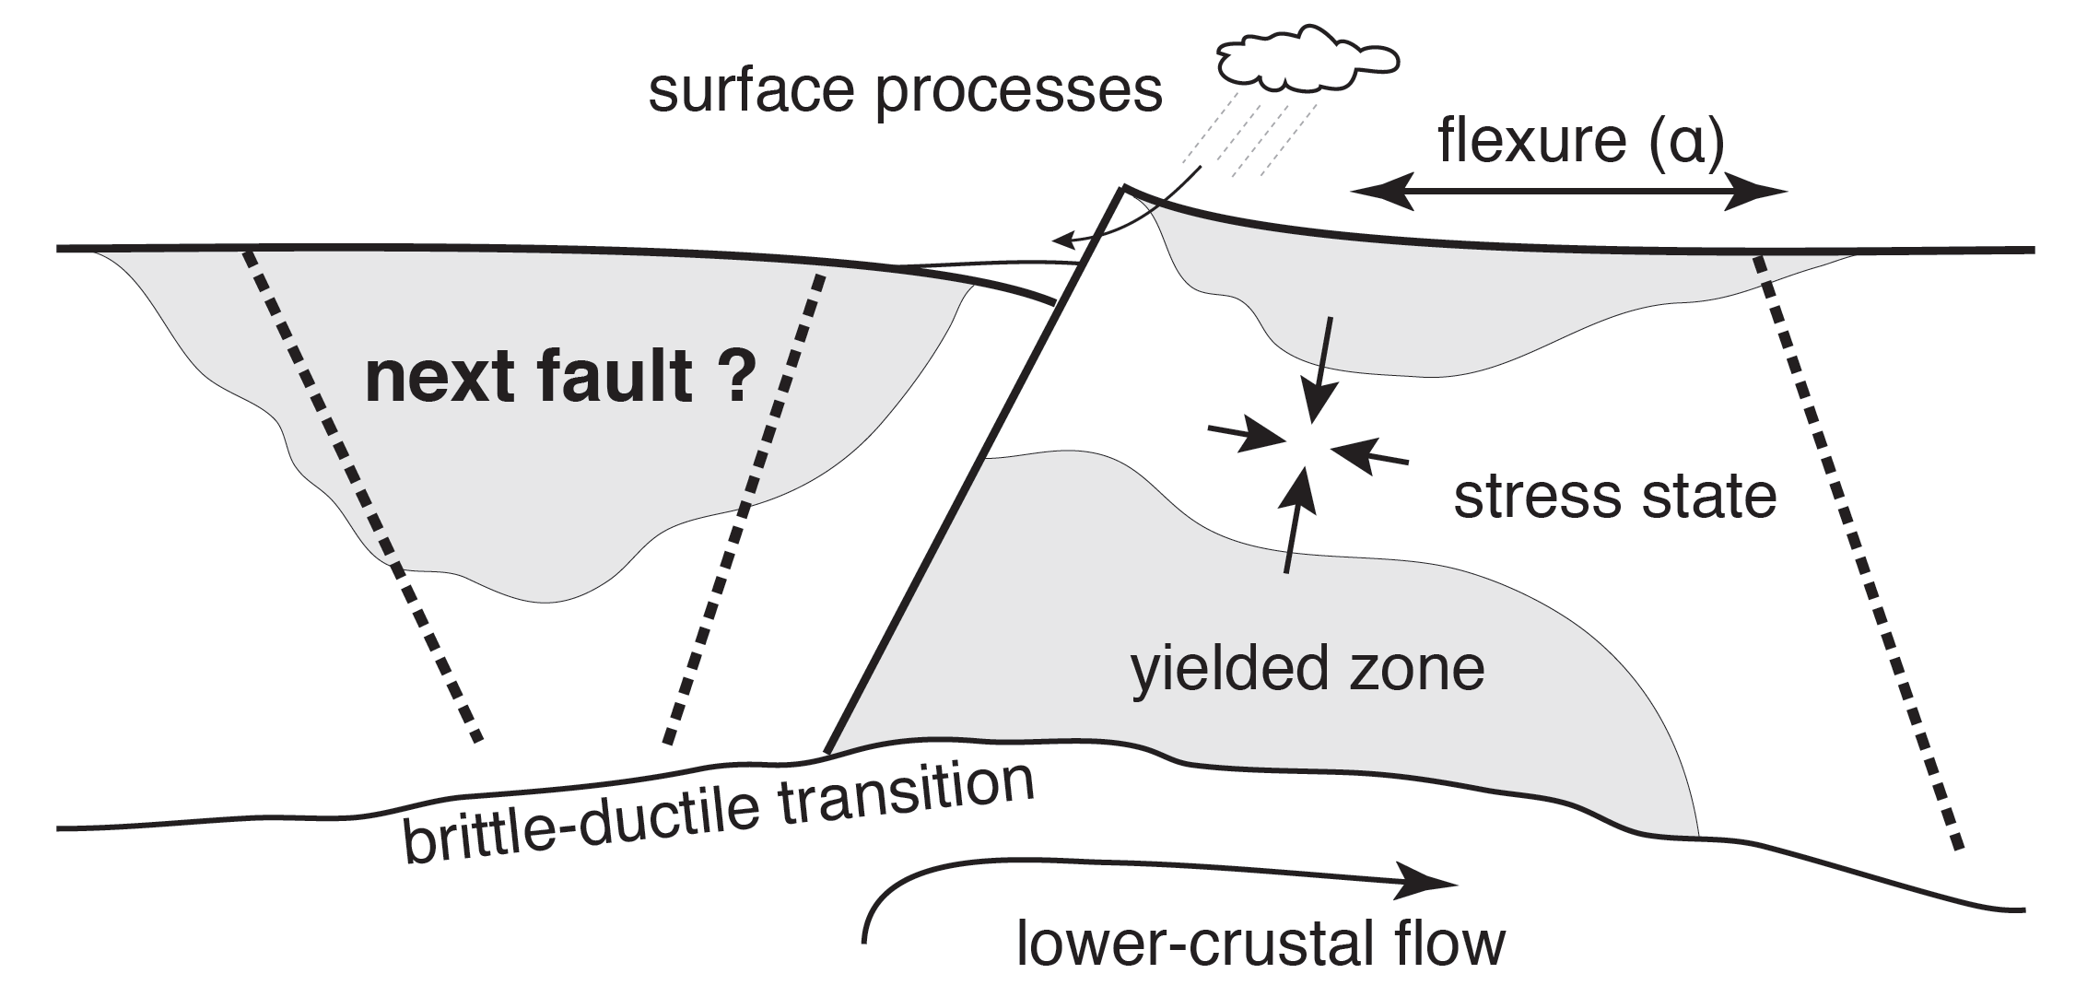
Future directions
• Top-down vs. bottom-up controls on rift dynamics ?
• Improved models of sediment deposition for load redistribution
• Model, meet data: mechanical vs. geomorphological observables

