Slide 1


The Community Surface Dynamics Modeling System
develops, integrates, archives & disseminates software to define the earth’s surface dynamics
James Syvitski, CSDMS Executive Director

Slide 2

Functions
Capacity building Community networking
Semantic
Mediation
& Ontologies
Open-source Repositories
Model
Benchmarking, Intercomparison & Uncertainty
HPCC
testbed & support
Model
Coupling & Reuse
Education & Knowledge Products
Protocols & GUI for component models
Syvitski, 2015
Notes:
Cryosphere: glaciers, permafrost, icebergs
Hydrology: watershed, reach to global, discharge and sediment transport
Terrestrial: hillslope processes, landslides, river processes, coupling to tectonics
Coastal: wetlands, estuarine processes, beach and barriers, storm erosion
Marine: circulation, surges, tides, waves, gravity flows, turbidity currents

Slide 3
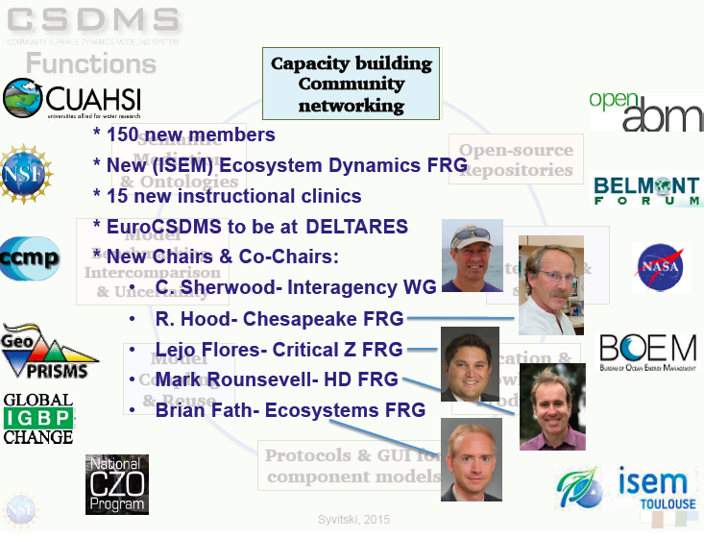

Slide 4

Capacity building, Community networking
Members from 500+ Institutions (academic, government, industry) from 68 countries
Working Groups
Focus Research Groups
Initiatives
Terrestrial | 610
Coastal | 480
Marine | 310
EKT | 190
Cyber | 185
Hydrology 470
Carbonate 80
Geodynamics 80
Chesapeake 60 Critical Zone 50 Anthropocene 40
Ecodynamics 20
Coastal Vulnerability 40
  Continental Margins 25

Slide 5

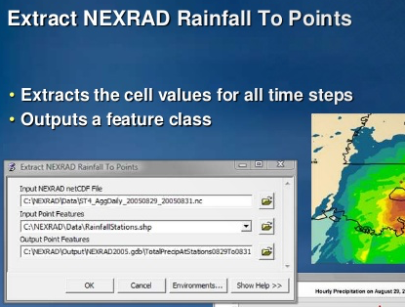

OceanWaves
Open-source Repositories
* 13 new terrestrial models & tools
* 5 new coastal models
* 7 new marine models
* 5 new hydrology models & tools
* 240 models & tools in total
* 15,000 downloads x2
* Downloads migrated to Github
Landlab
SLEPIAN delta
csdms-contrib
Models & tools by CSDMS members
csdmssupport@colorado.edu
wetland3p
Notes:
Cryosphere: glaciers, permafrost, icebergs
Hydrology: watershed, reach to global, discharge and sediment transport
Terrestrial: hillslope processes, landslides, river processes, coupling to tectonics
Coastal: wetlands, estuarine processes, beach and barriers, storm erosion
Marine: circulation, surges, tides, waves, gravity flows, turbidity currents

Slide 6
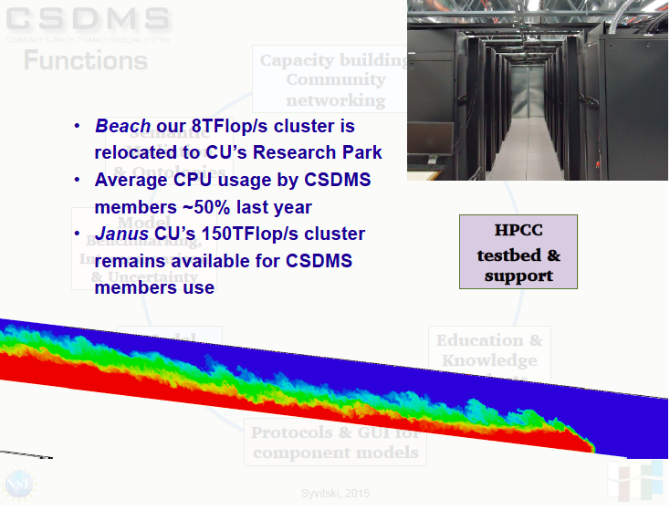

Slide 7
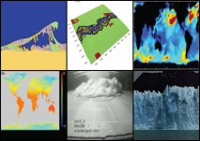
Student labs (16)
Modeling short courses (8)
Lectures (300)
Textbooks (5)
Global domain datasets (73)
Special Issue on model uncertainty in review at C&G (No. 4)
Instructional Clinics & Short Courses (72)
Science on a Sphere (8 datasets and labs)
Over 25,000,000 web page views
Education & Knowledge Products
Notes:
Cryosphere: glaciers, permafrost, icebergs
Hydrology: watershed, reach to global, discharge and sediment transport
Terrestrial: hillslope processes, landslides, river processes, coupling to tectonics
Coastal: wetlands, estuarine processes, beach and barriers, storm erosion
Marine: circulation, surges, tides, waves, gravity flows, turbidity currents

Slide 8
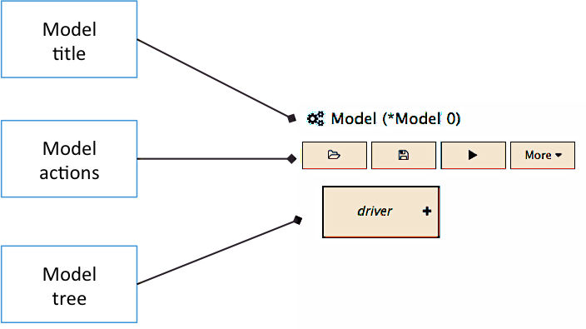
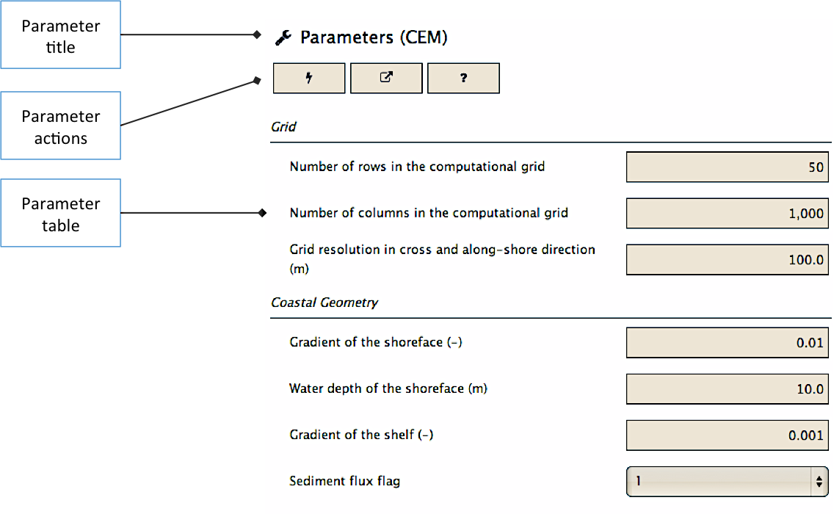
Simplified the use of CSDMS’s WMT
BMI Builder in the testing phase
BMI Importer for the CSDMS framework
Software Stack Installer for Mac OS & Linux
e.g. Yellowstone & Janus
Model
Coupling & Reuse
Protocols & GUI for component models
Notes:
Cryosphere: glaciers, permafrost, icebergs
Hydrology: watershed, reach to global, discharge and sediment transport
Terrestrial: hillslope processes, landslides, river processes, coupling to tectonics
Coastal: wetlands, estuarine processes, beach and barriers, storm erosion
Marine: circulation, surges, tides, waves, gravity flows, turbidity currents

Slide 9
Semantic
Mediation
& Ontologies
2600 CSDMS Standard Names (V. 0.8.1) with refined rules
Prototype interface for running DAKOTA in WMT
Python wrappers for DAKOTA
DAKOTA application completed: parameter studies and uncertainty quantification (e.g. Delft3D & HydroTrend)
Model
Benchmarking, Intercomparison & Uncertainty
Notes:
Cryosphere: glaciers, permafrost, icebergs
Hydrology: watershed, reach to global, discharge and sediment transport
Terrestrial: hillslope processes, landslides, river processes, coupling to tectonics
Coastal: wetlands, estuarine processes, beach and barriers, storm erosion
Marine: circulation, surges, tides, waves, gravity flows, turbidity currents

Slide 10

2015 Annual Meeting Agenda
Tuesday | Wednesday | Thursday | Friday
Welcome talks (3) | Keynotes (4) | Keynotes (2) | ExCom Meeting
Keynotes (2) | Group Business Meetings (5) | Clinics (3) | SC Meeting
Discussions (5) What do modelers want from the data community? | Lunch | Lunch | Lunch
Lunch | Clinics (3) | Keynotes (3)
Clinics (4) |  | Group Business Meetings (5)
Keynotes (2) | Posters | Reports & Wrap-Up (2)
Posters | Banquet | Departures

Slide 11
2015 Annual Meeting Theme:
Data meet Models, Models meet Data
1) Surface Dynamics Modeling — posters & presentations
2) Modeling Clinics: WMT & Dakota, Hydro Data, OpenFOAM, CHILD, CEM, BMI, Integrated Modeling, CSDMS EKT, Landlab, CUHASI WDC
3) Group Discussion: What do modelers want from the data community?
4) CSDMS Group Business Meetings: Goals and Activities
i) increasing the number of BMI components,
ii) advancing medium term and long term goals.
5) Fostering of a Community— Honors, Awards, and fun!

Slide 12
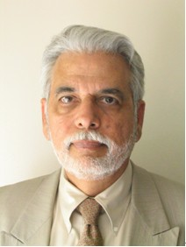
2015 CSDMS Program Director’s Award
Dr. Bilal Haq, former Director for Marine Geosciences, NSF
Ph.D. (Pakistan) and D.Sc. (U Stockholm)
Employment, U Vienna, U Stockholm, WHOI/MIT, Exxon, U Paris, White House, World Bank
Authored or co-authored 150 papers and books —several are citation classics, the most cited in geosciences
Francis Shepard Medal (SEPM), NSF’s Antarctic Medal
GSA Fellow; AAAS Fellow
AGU’s Ocean Science Award, Killam Chair
Honorary D.Sc. from the Sorbonne
A fossil Genus and a fossil species named after him
Merit — For Bilal’s sustained push to get the sedimentology and stratigraphy community to become more quantitative, better integrated and organized, and to collectively speak with a clearer voice in addressing the needs of the nation. This includes early recognition and support of CSDMS in addressing these needs.

Slide 13
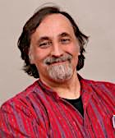
2015 CSDMS Life-time achievement Award
Prof Chris Paola, NCED Co-Director
B.Sc. Lehigh U, M.Sc. U Reading, D.Sc. MIT/WHOI
Geological Society of London’s Charles Lyell medal in 2011
SEPM’s Laurence L. Sloss Award in 2014
Awards for outstanding advising, instructing,
Authored or co-authored 150 papers and books —several outstanding journal papers
GSA Fellow, AGU Fellow
Citation — As a pioneer and world leader on the subject of quantitative dynamic stratigraphy, and for studies on basin filling and controls on physical stratigraphy, braided streams, particle fractionation in depositional systems, bedform dynamics and self-organization in landscape evolution.

