Slide 1





2017 CSDMS Annual Meeting:
Modeling Coupled Earth & Human Systems
- The Dynamic Duo
The Community Surface Dynamics Modeling System serves as a
Science Gateway
to support the
development, integration, archiving & dissemination of software to define Earth’s surface dynamics
Jai Syvitski, CSDMS Outgoing Director
Greg Tucker, CSDMS Incoming Director

Slide 2
Fundamental questions motivating
CSDMS scientists:
How do transport processes interact with properties of morphology, geology, ecology, climatology, oceanography and human activities?
What processes support self-organization and pattern formation in surface systems?
How do material fluxes and surface evolution vary across time and space scales? How are these fluxes recorded in sedimentary deposits?
How are physical, ecological & human processes coupled within surface systems and constrained by Earth’s interior and Earth’s atmospheric dynamics?

Slide 3

2.0 Functions
Capacity building Community networking
Semantic
Mediation
& Ontologies
Open-source Repositories
Model
Benchmarking, Intercomparison & Uncertainty
HPCC
support
Community of Communities
Model
Coupling & Reuse
Education & Knowledge Products
Protocols & GUI for component models
Notes:
Cryosphere: glaciers, permafrost, icebergs
Hydrology: watershed, reach to global, discharge and sediment transport
Terrestrial: hillslope processes, landslides, river processes, coupling to tectonics
Coastal: wetlands, estuarine processes, beach and barriers, storm erosion
Marine: circulation, surges, tides, waves, gravity flows, turbidity currents

Slide 4
CSDMS Governance
Steering
Committee
Executive Committee
Executive
Director
Working Groups (Land, Coast, Marine, EKT, Cyber & Numerics, Interagency)
CSDMS
Industrial Reps
CSDMS
Integration
Facility
Focus Research Groups
(Hydrology, Chesapeake, Human Dimensions, Critical Zone, Ecosystem Dynamics, Geodynamics, Carb-Biogenics)
Individual
Projects
Funders
(e.g. NSF,
Industry)
For every CSDMS IF $, NSF gives 13$ to CSDMS-affiliated projects ($64M/5 yr). Other agencies increase this 13:1 force multiplier.

Slide 5
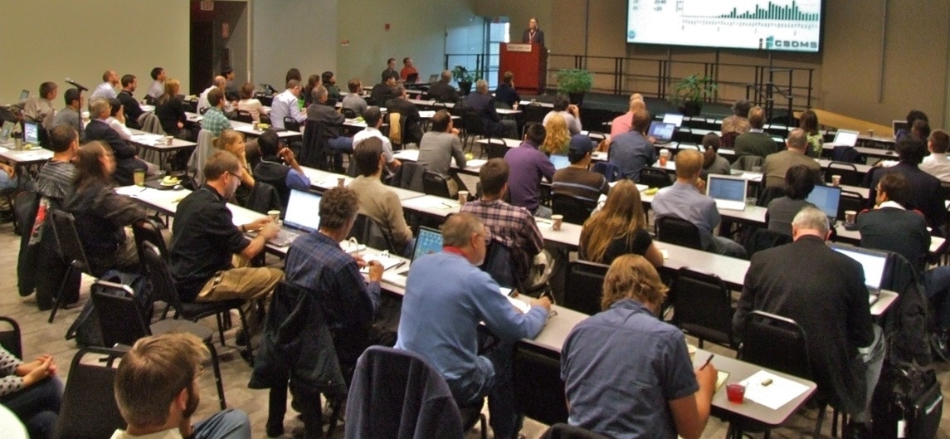
Capacity building, Community networking
150 members added per year
from 550+ Institutions (academic, government, industry) located in 69 countries
United States | 914
China | 80
United Kingdom | 77
Canada | 44
India | 43
France | 40
Netherlands | 38
Italy | 30
Germany | 29
Spain | 17
Australia | 14
Brazil | 12
Indonesia | 12
South Korea | 12
Bangladesh | 11
Norway | 9
Argentina | 8
Poland | 8
Portugal | 8
Belgium | 7
Chile | 7
Denmark | 6
Japan | 6
New Zealand | 6
Nigeria | 6
Pakistan | 6
Colombia | 5
Egypt | 5
Greece | 5
Ireland | 5
Sweden | 5
Switzerland | 5
Vietnam | 5
Iran | 4
Israel | 4
Malaysia | 4
Russia | 4
Taiwan | 4
Hungary | 3
Peru | 3
Romania | 3
Turkey | 3
Cuba | 2
El Salvador | 2
Ghana | 2
Mexico | 2
Philippines | 2
Saudi Arabia | 2
Singapore | 2
Thailand | 2
United Arab Em. | 2
Uruguay | 2
Venezuela | 2
Algeria | 1
Armenia | 1
Austria | 1
Bolivia | 1
Bulgaria | 1
Burma | 1
Cambodia | 1
Ecuador | 1
Iraq | 1
Jordan | 1
Kazakhstan | 1
Kenya | 1
Morocco | 1
Nepal | 1
Qatar | 1
South Africa | 1
Working Groups
Focus Research Groups
Initiatives
Hydrology 590
Geodynamics 150
Carbonate & Biogenics 110
Human Dimensions 100
Critical Zone 95
Chesapeake 80
Ecodynamics 80
Coastal Vulnerability 110
  Continental Margins 60
Terrestrial | 740
Coastal | 580
Marine | 370
EKT | 240
Cyber | 220

Slide 6
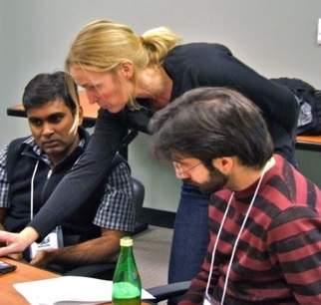
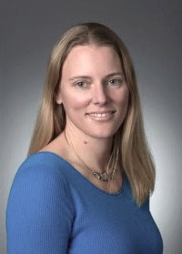
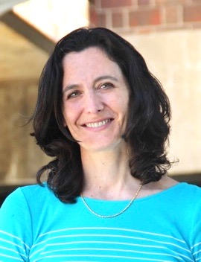
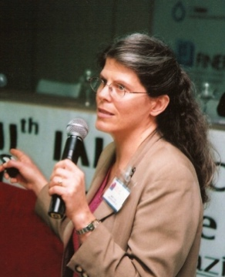
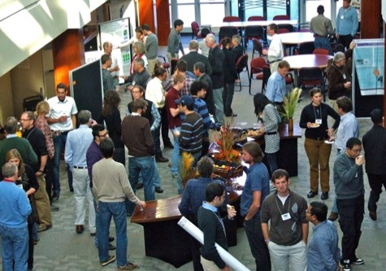
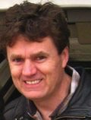
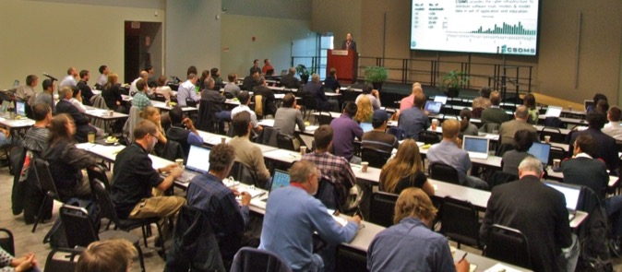
Functions
Capacity building Community networking
30+ CSDMS Short Courses
New Group Co-Chairs:
Kim de Mutsert- Ecosystems Dyn. FRG
Moira Zellner- Human Dimensions FRG
Mary Hill- Hydrology FRG
Scott Peckham-
Cyber & Numerics WG
50+ CSDMS Clinics
200+ CSDMS workshops, symposia
Notes:
Cryosphere: glaciers, permafrost, icebergs
Hydrology: watershed, reach to global, discharge and sediment transport
Terrestrial: hillslope processes, landslides, river processes, coupling to tectonics
Coastal: wetlands, estuarine processes, beach and barriers, storm erosion
Marine: circulation, surges, tides, waves, gravity flows, turbidity currents

Slide 7

Underworld2
SiStER
DynEarthSol3D
Kudryavtsev Model
CLUMondo
AnugaSed
Frost Model
LaMEM
RivMAP
PyDeltaRCM
Dakotathon
MCPM
Open-source Repositories
ILAMB
River Network Bed-Material Sed
SLAMM
Domain | Models | Tools | Compliant
Terrestrial | 80 | 75 | 7
Coastal | 61 | 7 | 7
Marine | 49 | 7 | 4
Hydrology | 62 | 45 | 20
Carbonate & Biogenics | 3 | 4 | 1
Climate | 12 | 4 | 2
Geodynamics | 13 | 1 | 1
csdms-contrib
Models & tools by CSDMS members
csdmssupport@colorado.edu
Notes:
Cryosphere: glaciers, permafrost, icebergs
Hydrology: watershed, reach to global, discharge and sediment transport
Terrestrial: hillslope processes, landslides, river processes, coupling to tectonics
Coastal: wetlands, estuarine processes, beach and barriers, storm erosion
Marine: circulation, surges, tides, waves, gravity flows, turbidity currents

Slide 8
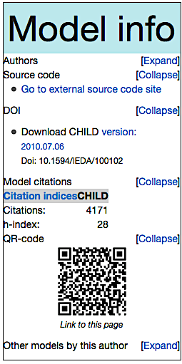
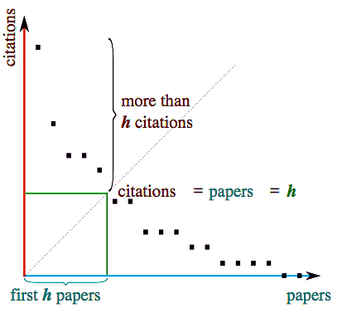
CSDMS provides:
Citation Indices for both model overview and model application pubs.
Model Metadata including a DOI (Digital Object Identifier) for each stable model version
Model Code
Version Control through Github.
Open-source Repositories

Slide 9
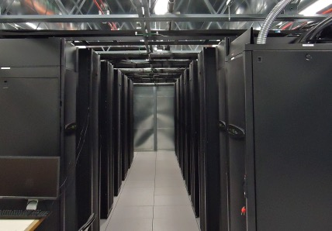
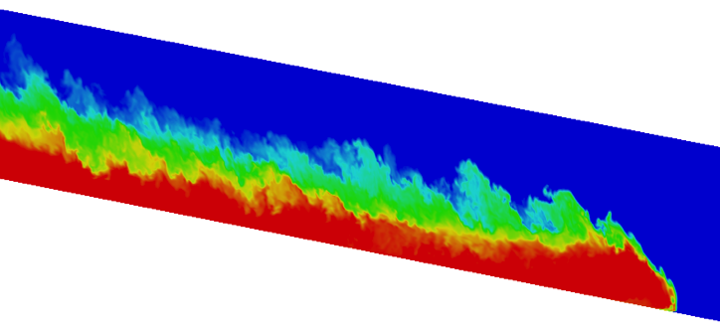
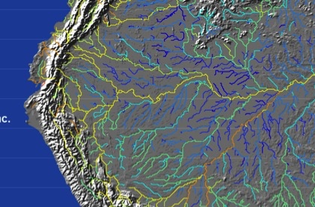
Functions
HPCC
support
Beach: RAM/core IC bandwidth Peak TFLOPS
704-3GHz cores, 2-4 GB/c, 21GB/s, 8TFlop/s
Janus:
16,416-3.2GHz cores, 2 GB/c, 40GB/s, 153TFlop/s
Summit:
9,960-3.3GHz cores, 5-42 GB/c, 100GB/s, >400TFlop/s
Notes:
Cryosphere: glaciers, permafrost, icebergs
Hydrology: watershed, reach to global, discharge and sediment transport
Terrestrial: hillslope processes, landslides, river processes, coupling to tectonics
Coastal: wetlands, estuarine processes, beach and barriers, storm erosion
Marine: circulation, surges, tides, waves, gravity flows, turbidity currents

Slide 10
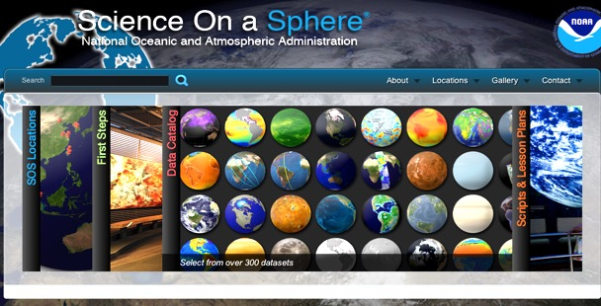
Functions
On Line Services
Student labs (31)
Modeling short courses (9)
Lectures (300+);
Textbooks (6)
Global domain datasets (84)
145 movies on the CSDMS YouTube channel
Science on a Sphere (9 datasets and labs)
600+ daily views of the CSDMS web portal on average
CSDMS Special Issues
1 Marine Transport Modeling
2 Stratigraphic Modeling
3 Modeling Environmental Change
4 Model Uncertainty & Sensitivity
Education & Knowledge Products
Notes:
Cryosphere: glaciers, permafrost, icebergs
Hydrology: watershed, reach to global, discharge and sediment transport
Terrestrial: hillslope processes, landslides, river processes, coupling to tectonics
Coastal: wetlands, estuarine processes, beach and barriers, storm erosion
Marine: circulation, surges, tides, waves, gravity flows, turbidity currents

Slide 11

EKT Repository: Quantitative toolbox
Tagged by concepts: heat flow, diffusion, flow routing, mass continuity, shallow water equations, settling rates, drag force, flocculation, fluid flow, Darcy’s flow, stability/torque balance, compaction, waves, uncertainty
Tagged by discipline: hydrology, sedimentology, geomorphology, oceanography, general climate/earth science/global change.
Tagged by domain: terrestrial, coastal, marine
Tagged by level: K6-12, undergraduate, graduate
Tagged by model difficulty progression: examine data or simulation movies → complete a simple calculation → carry out a 3-5 parameter model exercise→ model a realistic case study.
Education & Knowledge Products
Notes:
Cryosphere: glaciers, permafrost, icebergs
Hydrology: watershed, reach to global, discharge and sediment transport
Terrestrial: hillslope processes, landslides, river processes, coupling to tectonics
Coastal: wetlands, estuarine processes, beach and barriers, storm erosion
Marine: circulation, surges, tides, waves, gravity flows, turbidity currents

Slide 12
Functions
CSDMS Basic Model Interface or BMI standard is a distillation of key ingredients of major coupling systems.
Another BMI
component
BMI component
Initial Standalone Model
Initialize
Initialize
Run/Advance
Run/Advance
Finalize
Finalize
Get Value
Get Value
Set Value
Set Value
Model
Coupling & Reuse
Protocols & GUI for component models
Notes:
Cryosphere: glaciers, permafrost, icebergs
Hydrology: watershed, reach to global, discharge and sediment transport
Terrestrial: hillslope processes, landslides, river processes, coupling to tectonics
Coastal: wetlands, estuarine processes, beach and barriers, storm erosion
Marine: circulation, surges, tides, waves, gravity flows, turbidity currents

Slide 13
The CSDMS Process:
Model ➔ Component ➔ WMT - PyMT
Model
(C, C⁺⁺, Java, Fortran, Python)
BMI
BMI’d Model
BMI Tester
BMI Metadata
Babelizer
Python Component
Bakery
CCA/CSDMS Toolchain
WMT Executor
PyMT
WMT Metadata
WMT Server
Model
Coupling & Reuse
WMT Client
Protocols & GUI for component models

Slide 14
CSDMS Tools help developers add a BMI to their model.
Model
BMI Builder/Templates
BMI Tester
BMI’d Model
BMI Metadata
The CSDMS Babelizer makes a BMI’d model speak Python, and consists of Babel, Bocca, Ccaffeine, and CSDMS scripts.
WMT
Metadata
BMI’d Model
Babelizer
Python Component
WMT Server
CPU + WMT API
WMT Client
browser + GUI
BMI Metadata
PyMT
WMT Executor
eg beach
PyMT forms the basis of the executor portion of the model-coupling triad.

Slide 15

The Bakery is a repository of recipes and pre-built binaries for components and tools
Python Component
BMI’d Model
The
Bakery
Repository
Model
Tool
Model
Coupling & Reuse
Protocols & GUI for component models

Slide 16
Standard Names uses a variable naming template:
object name + [operation name] + quantity name
Developers provide a mapping dictionary of I/O variables using CSDMS Standard Names, and a Model Metadata File with units, grid type, etc
Semantic
Mediation
& Ontologies
Model
Benchmarking, Intercomparison & Uncertainty
DAKOTATHON uncertainty tool
ILAMB benchmarking tool
Notes:
Cryosphere: glaciers, permafrost, icebergs
Hydrology: watershed, reach to global, discharge and sediment transport
Terrestrial: hillslope processes, landslides, river processes, coupling to tectonics
Coastal: wetlands, estuarine processes, beach and barriers, storm erosion
Marine: circulation, surges, tides, waves, gravity flows, turbidity currents

Slide 17
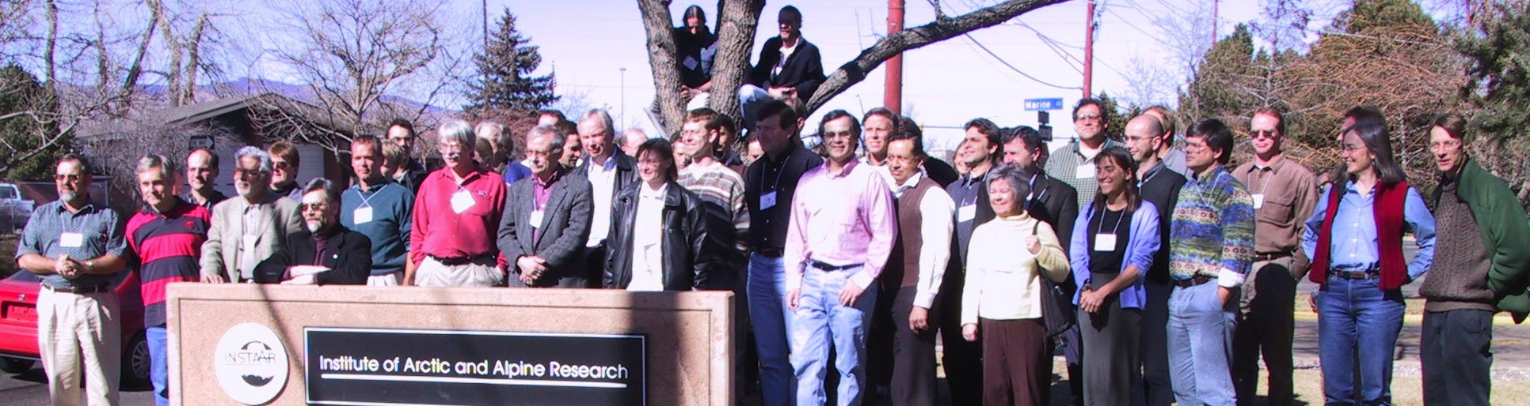
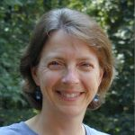
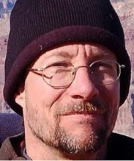
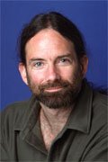
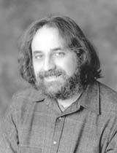
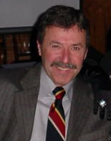
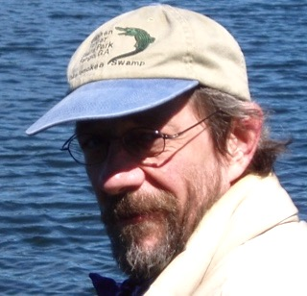
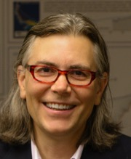
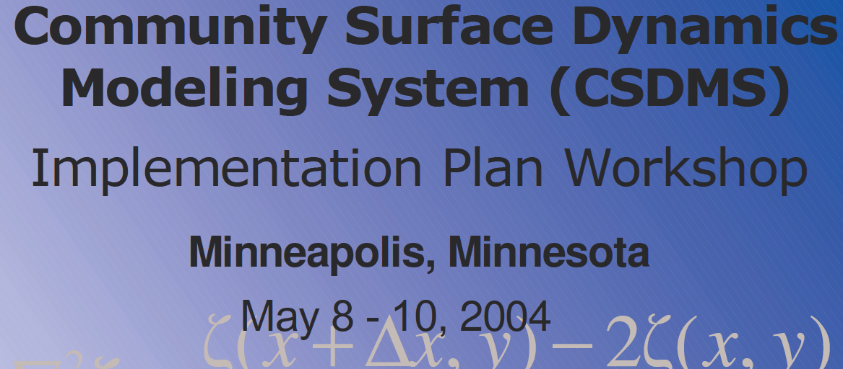
Initial CSDMS Initiators & heroes
1st CSDMS meeting 2002, Boulder
CSDMS DC-Agency meeting 2003
Pat Wiberg
Greg Tucker
Brad Murray
Chris Paola
Rudy Slingerland
Dave Furbish
Jai Syvitski
2nd CSDMS meeting 2004

Slide 18
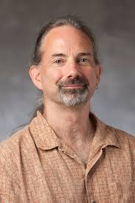
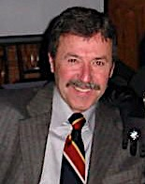
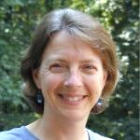
We herald in new CSDMS leadership with the recent and unanimous election of Professor Brad Murray as SC Chair and thank
Professor Pat Wiberg for her wisdom, insight and kindness
Pat Wiberg
SC Chair 2012-2017
Brad Murray
SC Chair 2017—
Rudy Slingerland
SC Chair 2007-2012

Slide 19
CSDMS History
2002
Initial planning begins
CSDMS2.0; Standard Names;
WG&FRG ‘13Strategic Plan
2013
NSF & Agency Meeting
2014
Web Modeling Tool 1.0;
CSDMS Portal; GitHub Repository
2004
Science Plan; Implementation Plan
2015
CSDMS Science on a Sphere;
CSDMS Portal; GitHub services
2016
DAKOTA-uncertainty; PyMT
Chesapeake MIP; Mod-H-index
2006
2007
CSDMS1.0; Integration Facility & Bylaws established
2017
Web Portal API; SedGrid;
Summit HPCC; Babelizer; Bakery
2008
CSDMS Beach HPCC;
WG ’08 Strategic Plan
2018
CSDMS3.0; Strategic Plan3.0
Model, Data, EKT Wiki Repositories
2010
CCA-CSDMS Tool Chain1.0; FRGs introduced
Janus HPCC; Component Modeling Tool Prototype;
ESMF & CSDMS Gridding mappers
2012
BMI release; CSDMS YouTube Channel;
DOI for CSDMS repository Models
Notes:
Cryosphere: glaciers, permafrost, icebergs
Hydrology: watershed, reach to global, discharge and sediment transport
Terrestrial: hillslope processes, landslides, river processes, coupling to tectonics
Coastal: wetlands, estuarine processes, beach and barriers, storm erosion
Marine: circulation, surges, tides, waves, gravity flows, turbidity currents

Slide 20
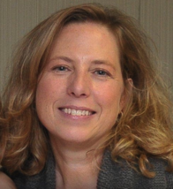


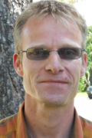
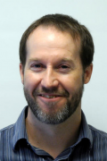

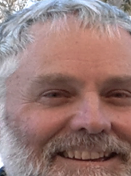

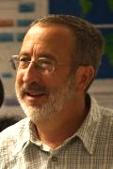


2017 CSDMS Integration Facility Staff & Associates
Greg Tucker
Incoming Director
Lynn McCready
Executive Assistant
Eric Hutton
Senior Software
Engineer
Irina Overeem
Education Officer
Albert Kettner
Cyber Com & Data
Mark Piper
Software Engineer
Mariela Perignon
Software Engineer
Chris Jenkins
Marine Data
Kimberly Rogers
Human Dimensions
Bob Brakenridge
Dir, Flood Observatory
Chrystal Pochay
Accountant
Chad Stoffel
IT

Slide 21
2017 CSDMS Annual Meeting:
Modeling Coupled Earth & Human Systems
- The Dynamic Duo
CSDMS 3.0:
Learning from the past,
Looking forward to the future

Slide 22
CSDMS: a growing community
+147 per year
“In a world of almost infinite data, it is code and software that turn data into information and knowledge.” – Teal (2017)

Slide 23
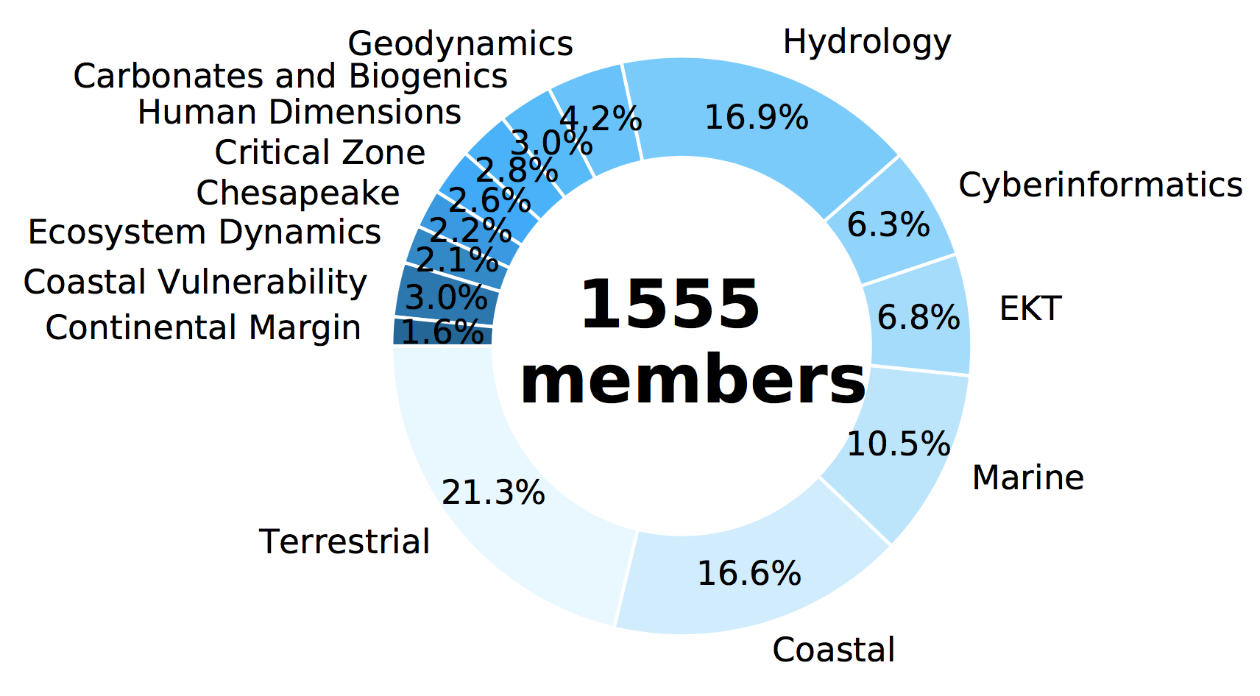
“The grand challenges of today … require convergence: the merging of ideas, approaches and technologies from widely diverse fields of knowledge to stimulate innovation and discovery..” – (NSF, 10 Big Ideas)

Slide 24
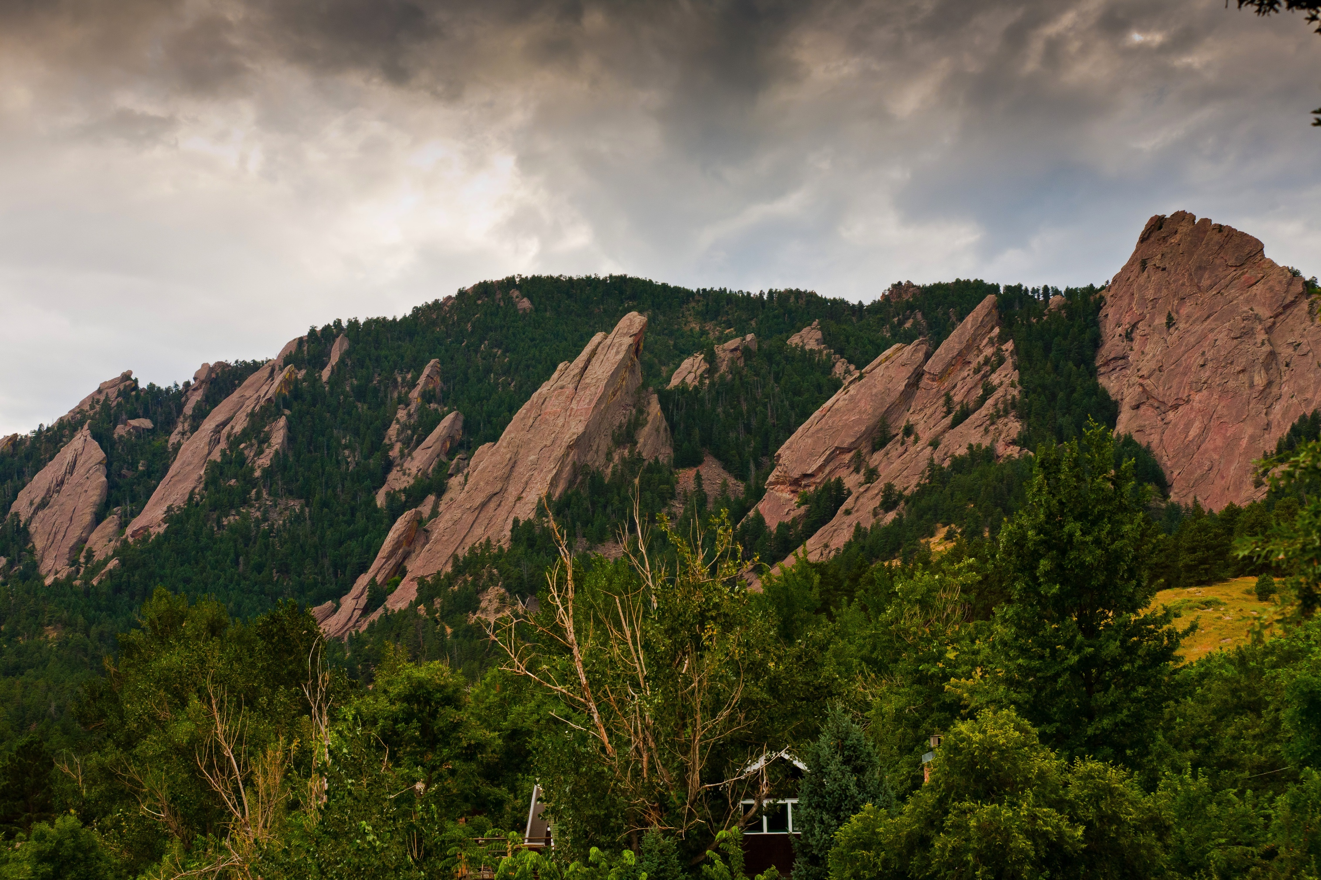
2016 Annual Meeting:
Capturing Climate Change
Results from breakout group discussions ➔ CSDMS 3.0
Model-Data Synthesis in Earth-Surface Science and Applications
Toward a more predictive science of the earth’s surface

Slide 25
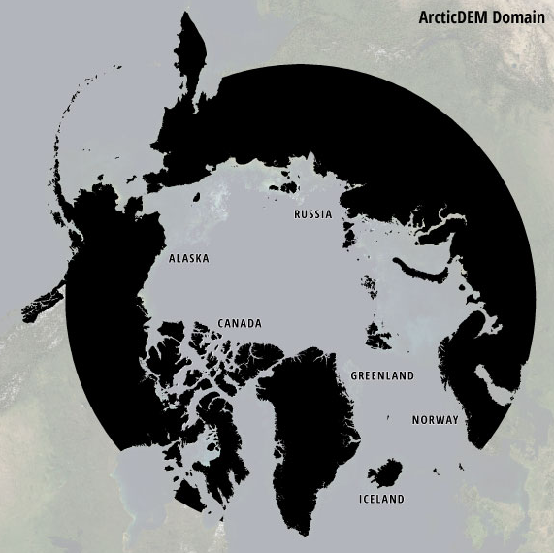
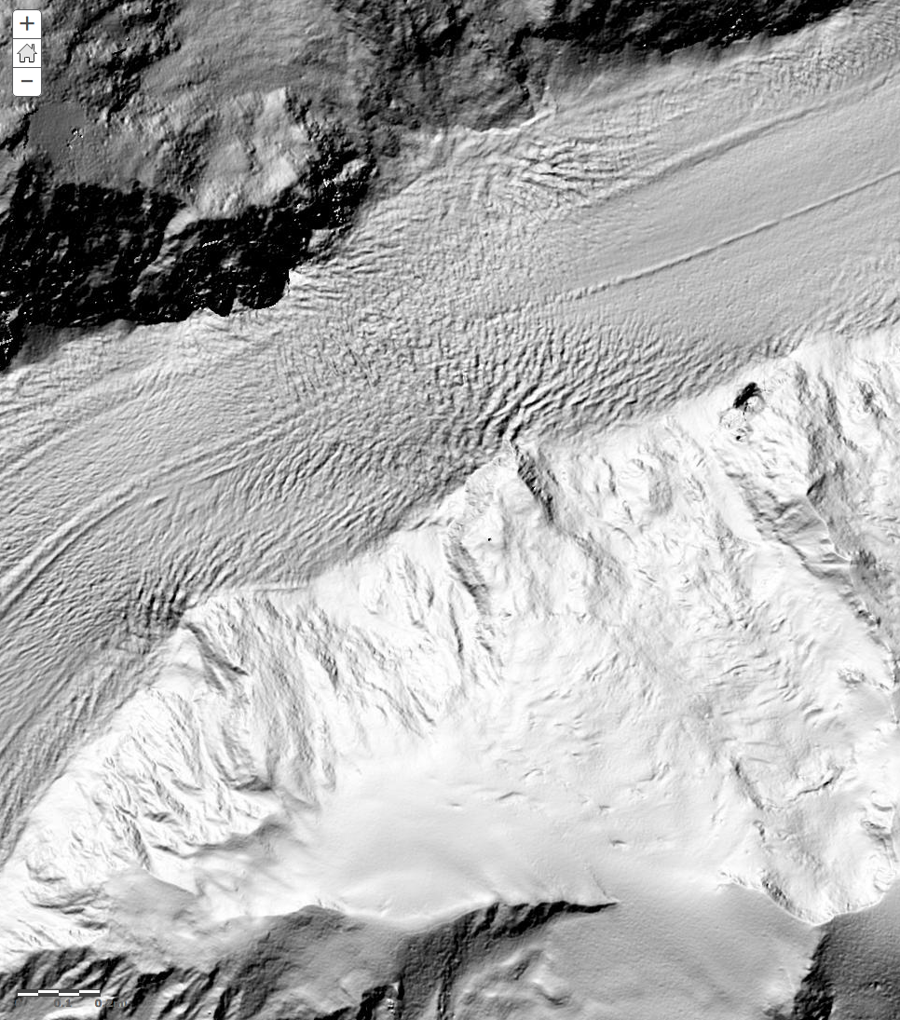
ArcticDEM: high-resolution (1-5 m), pan-Arctic,
repeatable satellite photogrammetry
https://www.pgc.umn.edu/data/arcticdem/

Slide 26
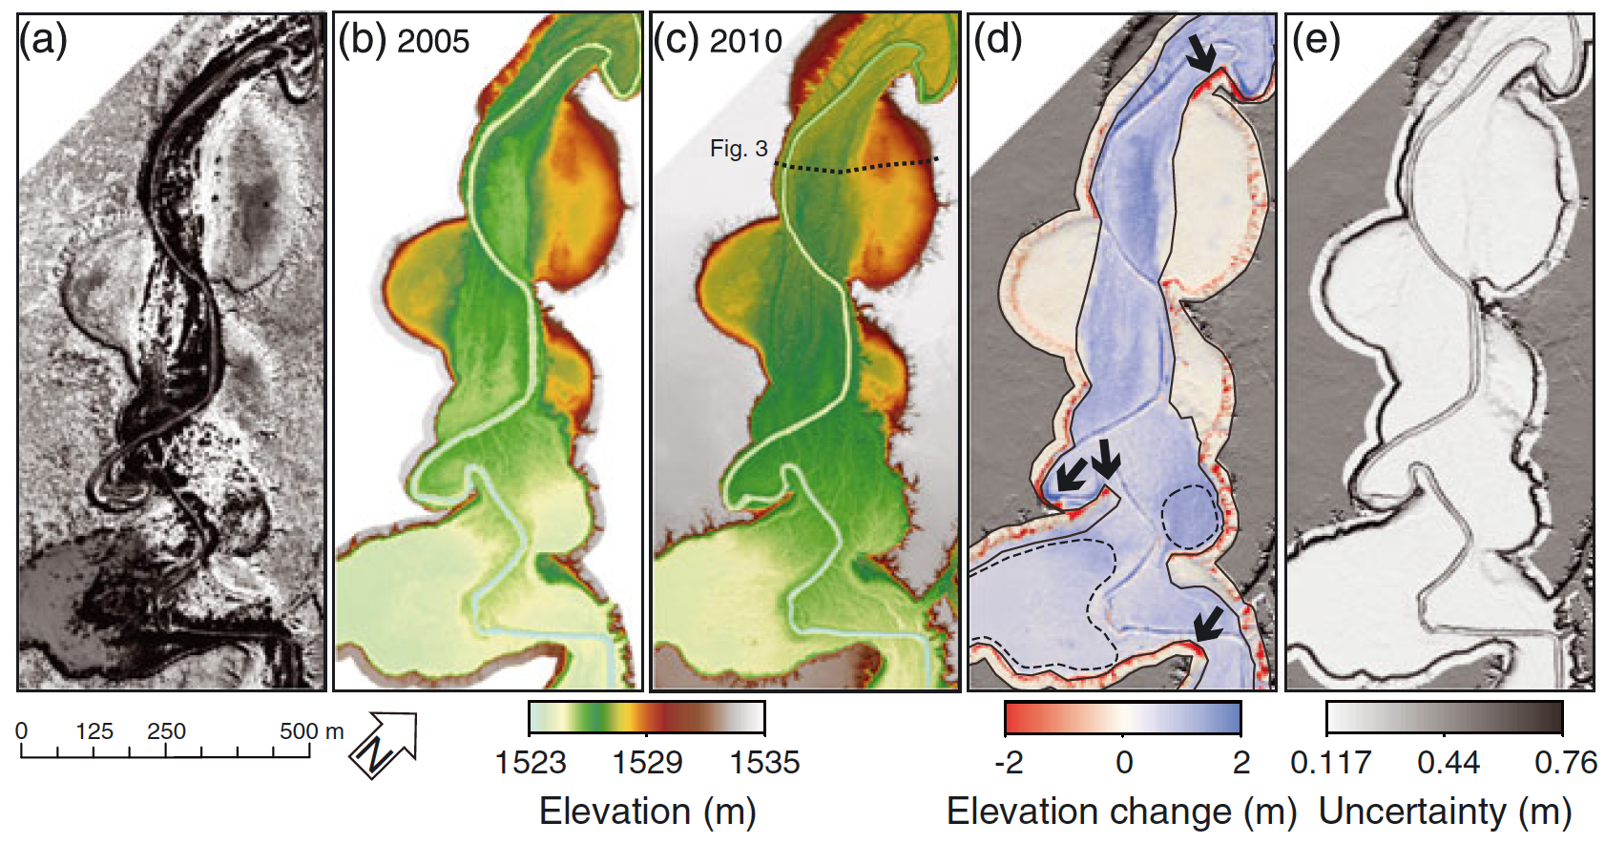
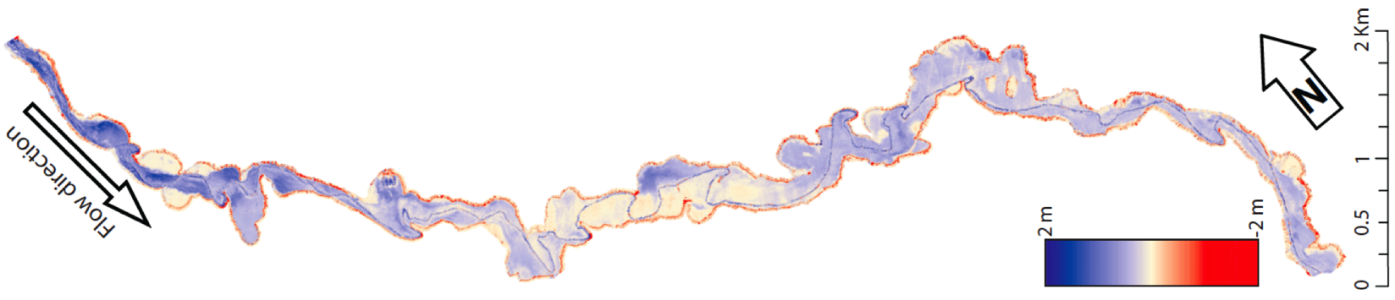
Example of LiDAR differencing for change detection
Rio Puerco, NM, LiDAR difference images
2010 minus 2005
(Perignon et al., 2013)

Slide 27

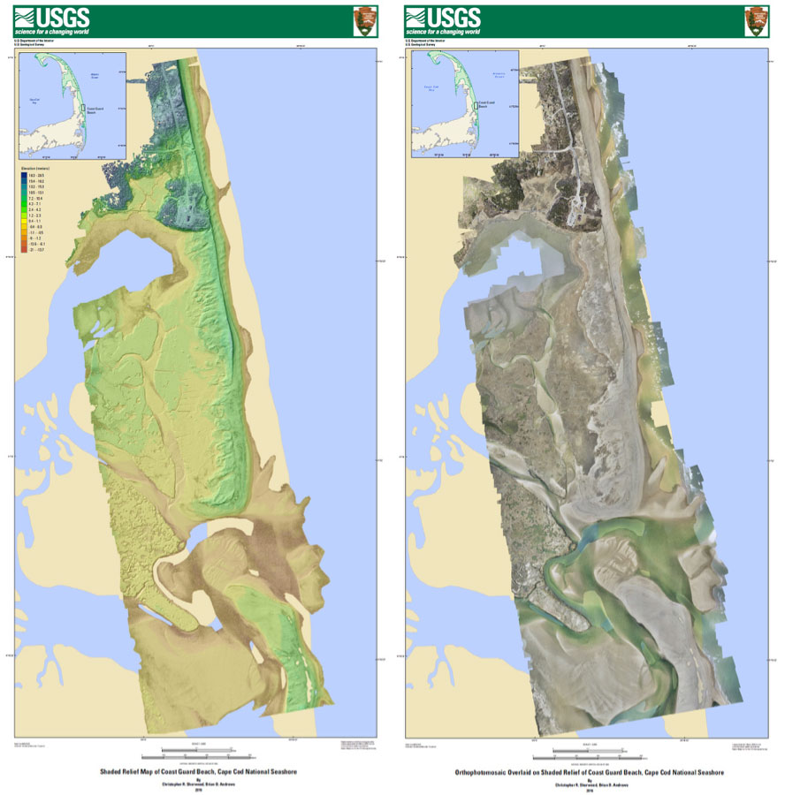

Slide 28
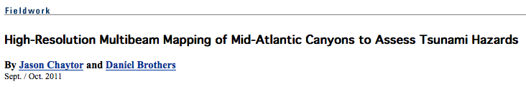
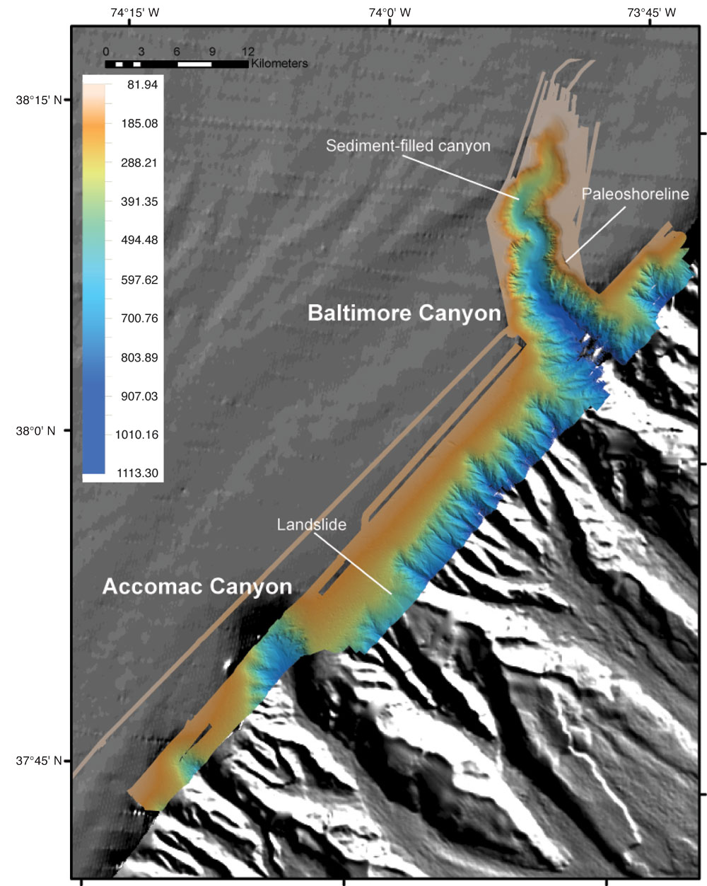
Multibeam bathymetry
5—10 m horizontal resolution

Slide 29
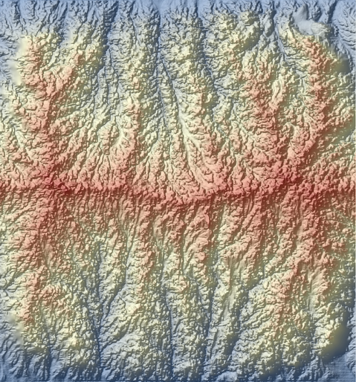
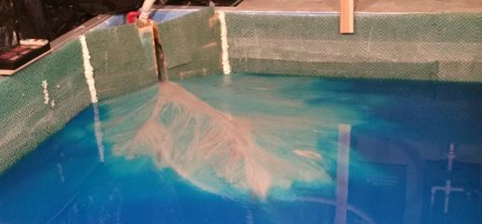
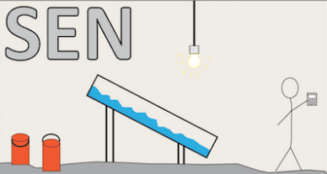
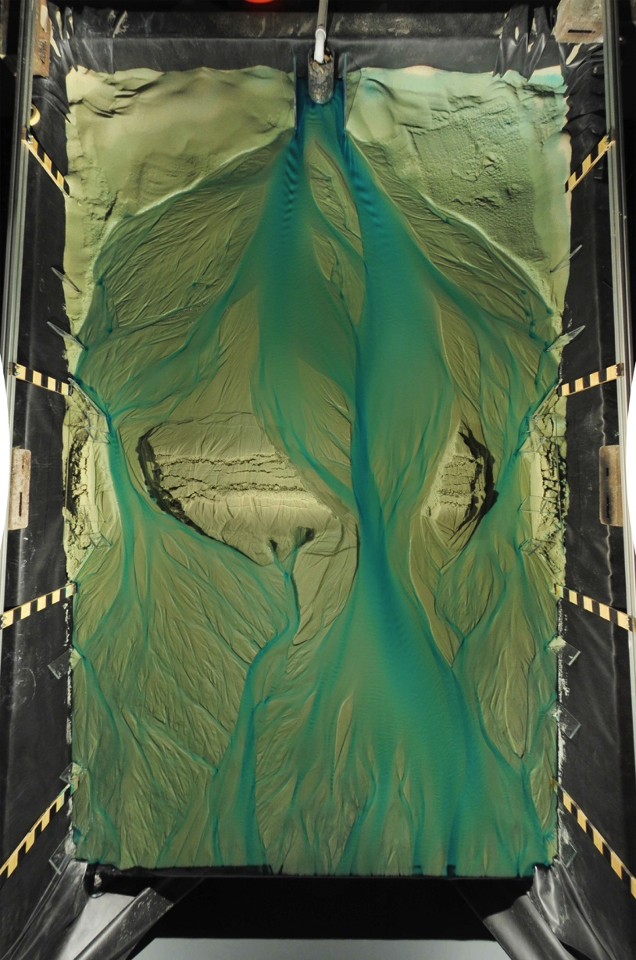
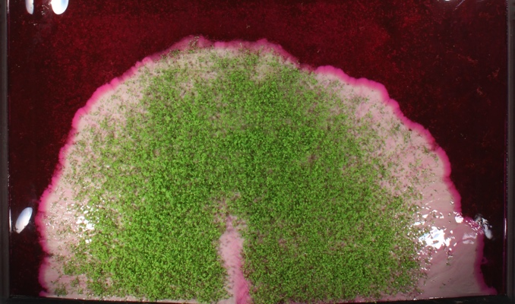
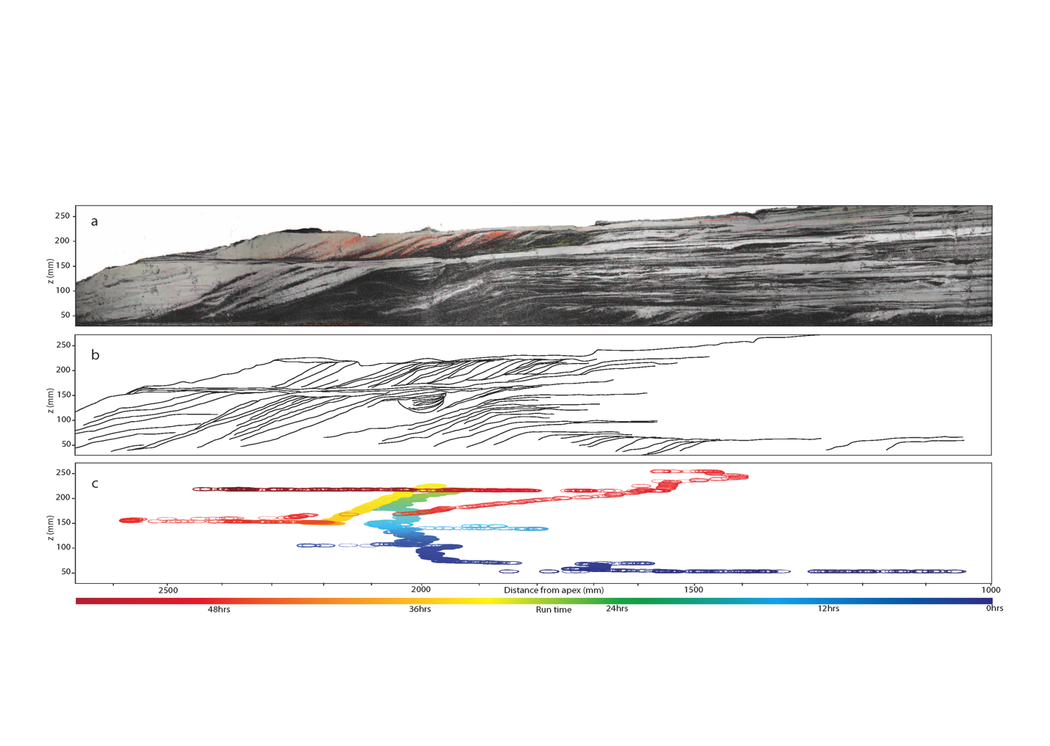
(K. Straub)
(A. Piliouras)
(K. Sweeney)
(Bufe et al., 2016)
(Mahon et al., 2015)

Slide 30





Meeting the challenge … in three pillars
share resources, collaborate
create, run, test, and apply models
learn and teach
COMMUNITY
SUPPORT
COMPUTING
RESOURCES
EDUCATION
OPPORTUNITIES

Slide 31
CSDMS 3.0: education & training
EKT Group and Repository
Clinics
Pre/post-meeting workshops
Webinars
Hackathons
CSDMS Summer Schools
EDUCATION
OPPORTUNITIES

Slide 32
CSDMS 3.0: computing resources
Basic Model Interface (BMI)
Web Modeling Tool ➔ Python …
Uncertainty tools
BMI for data & web API
GIS / geospatial capability
Landlab integration
Upgrade to BEACH
Python Modeling Tool (PyMT)
COMPUTING
RESOURCES

Slide 33
CSDMS 3.0: community support
Annual meetings
Hosted workshops
Enhanced model repository
Cryosphere Focus Group
Project and proposal support
Science Teams
  (a.k.a. Science Steering Committees)
COMMUNITY
SUPPORT

Slide 34
3.0
share resources, collaborate
create, run, test, and apply models
learn and teach
COMMUNITY
SUPPORT
COMPUTING
RESOURCES
EDUCATION
OPPORTUNITIES
csdms@colorado.edu

Slide 35
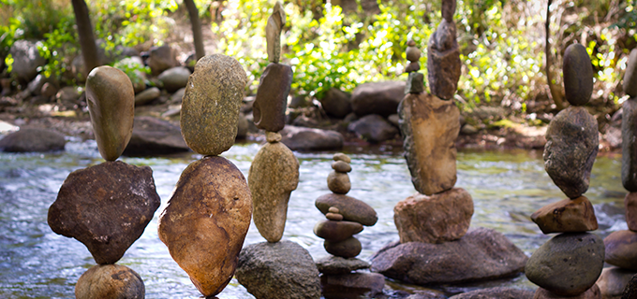
2017 CSDMS Annual Meeting:
Modeling Coupled Earth & Human Systems
- The Dynamic Duo
csdms@colorado.edu

Slide 36
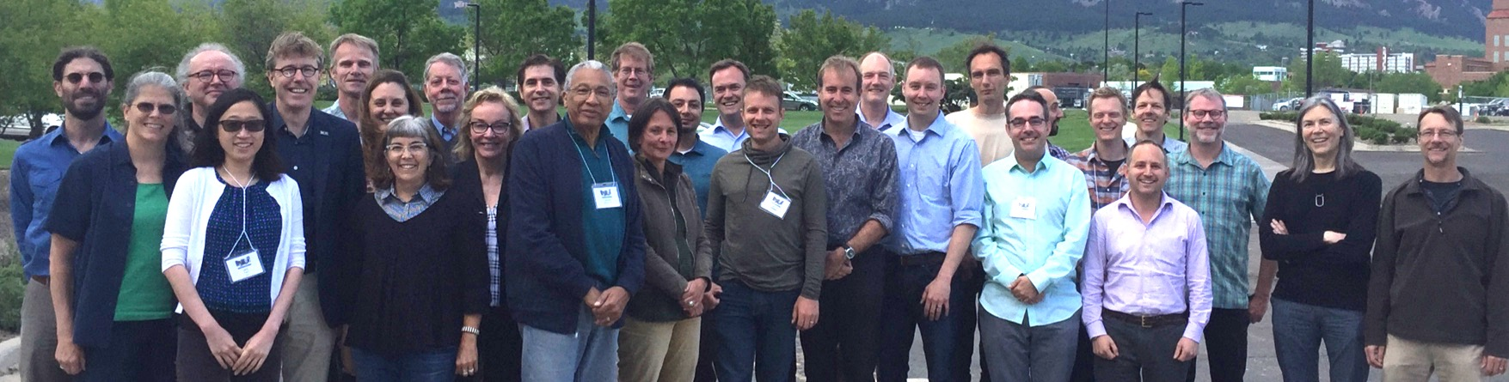
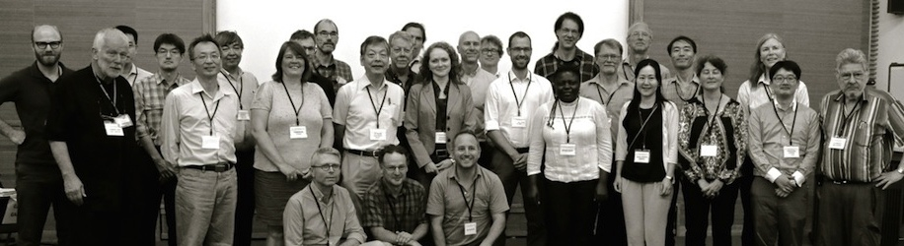
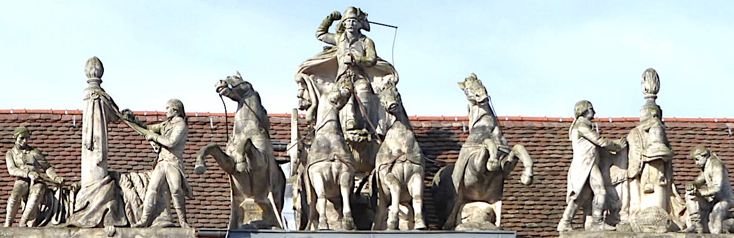


1) Linking Earth System Dynamics & Social System Modeling,
May 23-25 2016 Boulder CO USA
2) Modeling Challenges for Sustainability, Sept 27-30 2016, Kyoto, Japan
3) Integrated Modeling of Socio-Environmental Systems, Mar 13-15 2017, Potsdam, Germany
4) Modeling Coupled Earth & Human Systems - The Dynamic Duo, May 23-25 2017, Boulder CO USA

Slide 37


2017 Annual Meeting Theme The Dynamic Duo
Tuesday | Wednesday | Thursday | Friday
Welcome talks (3) | Plenary Keynotes (2) | Plenary Keynotes (3) | ExCom Meeting
Plenary Keynotes (2) | Plenary PyMT Demo
Discussion Breakout (6) Nat & Social Modeling | Group Business Meetings (5) | Clinics (4) | Steering Committee Meet
Lunch | Lunch | Lunch | Lunch
Clinics (4) | Clinics (4) | Plenary Keynotes (3)
Plenary Keynotes (2) | Posters | Group Business Meetings (5)
Posters | Banquet | Final Remarks Departures
2017 Best Poster Award
Modeling Clinics: Landlab & Dakota, ANUGA, SiSteR, ABM, PERMAFrost, BMI: Live!, LANDLAB1.0, CSDMS EKT, Landlab Toolkit, Best Practices, SEN, ParFlow, EcoPath & EcoSim
CSDMS Group Business Meetings: i) Goal updates, ii) CSDMS3.0

Slide 38



2017: Program Director’s Award
Student Modeler Award
Life-time achievement Award
Julia Moriarty
Michael Ellis
Bob Anderson
Oversaw CSDMS initiation at NSF.
First chair of Anthropocene FRG
(renamed Human Dimensions FRG).
“Coupling Sediment Transport & Biogeochemical Processes: Role of Resuspension on O² & Nutrient Dynamics”
Outstanding CSDMS model developer (aeolian transport, arctic coastal erosion, glacier dynamics, fjords, etc.)
BGS Director Land, Soil & Coast, and formerly —
BGS Director, Climate & Landscape Change
BGS Head, Climate Change Science
Founder & first AGU Chair, Earth & Planetary Surface Processes
NSF Director, Geomorphology & Land-use Dynamics
CU Distinguished Professor
CU Hazel Barnes Prize
NSF Presidential Young Investigator
GSA Gladys Cole Award
Fellow, AGU
Fellow, INSTAAR
AGU’s Gilbert award
157+ well-cited peer-reviewed papers & books
Ph.D candidate @ VIMS Physical & Geological Oceanography
NSF East Asia & Pacific Summer Institute Fellow, Academia Sinica, Taiwan
George R. Healy Fellowship Awardee, College of William & Mary

