Slide 1

Permafrost Modeling Toolbox
Irina Overeem, Mark Piper, Kang Wang
with help of Elchin Jafarov, Scott Stewart, Kevin Schaefer

Slide 2
Objectives
Learn about the development goals and status of implementation of the Permafrost Toolbox.
Gain ability in running simulations in data-model and visualize results of permafrost occurrence for Alaska.
Learn about possibilities for more advanced modeling
Contribute to the discussion of future development of the modeling system.

Slide 3
Outline of Clinic
Lecture (30 minutes)
Demonstration of permafrost models in WMT
(15 min)
Hands-on exercise with permafrost toolbox
(60 minutes) with wrap-up discussion
Discussion on advanced model development
and what developments are planned (15 minutes)

Slide 4
Why
The state of Arctic permafrost is an essential climate indicator and carbon emissions from thawing permafrost will amplify anthropogenic warming.
Observations can quantify the current state of permafrost, but we need models to make predictions of future permafrost conditions.

Slide 5
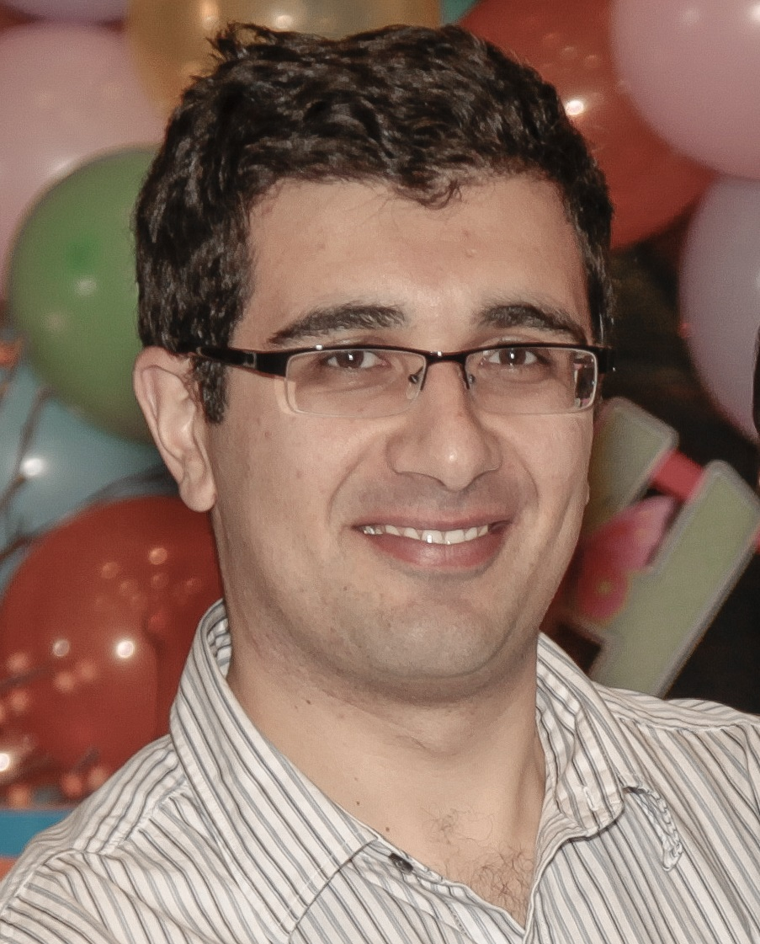
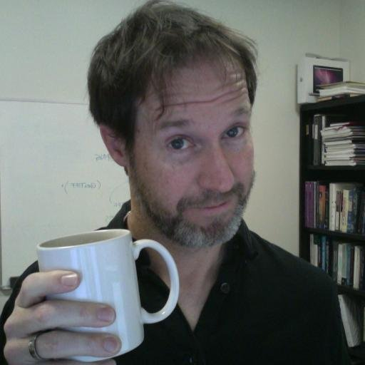
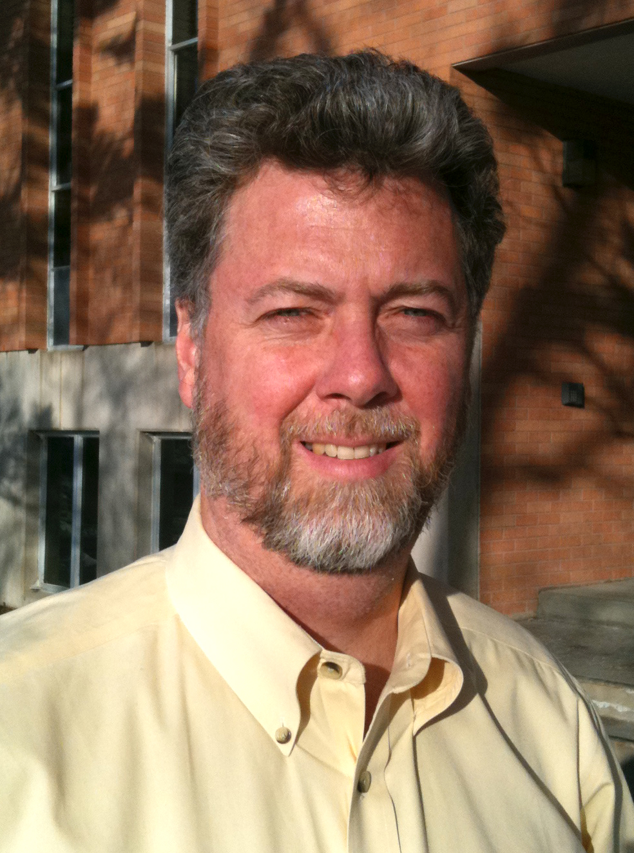
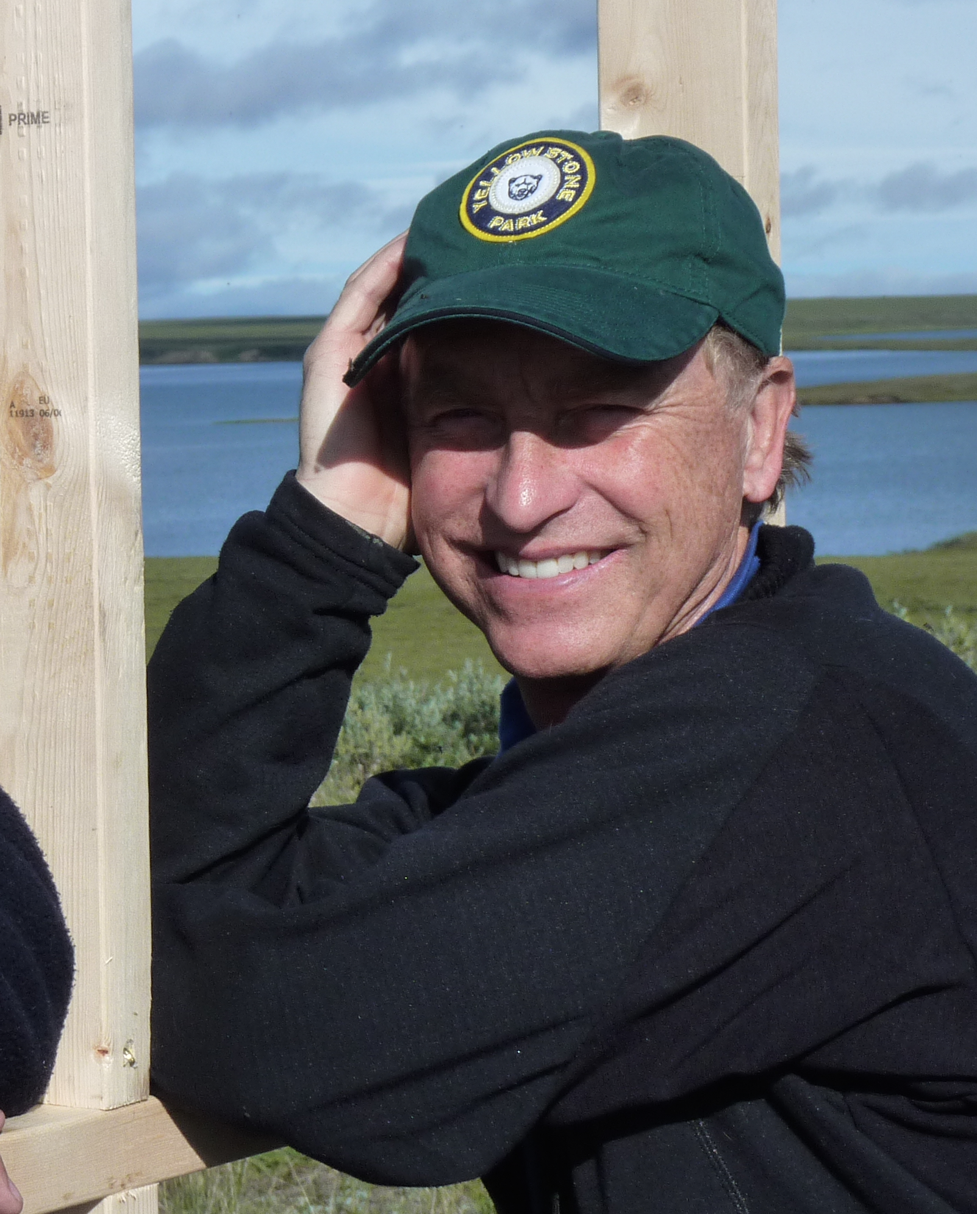
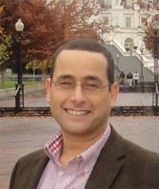
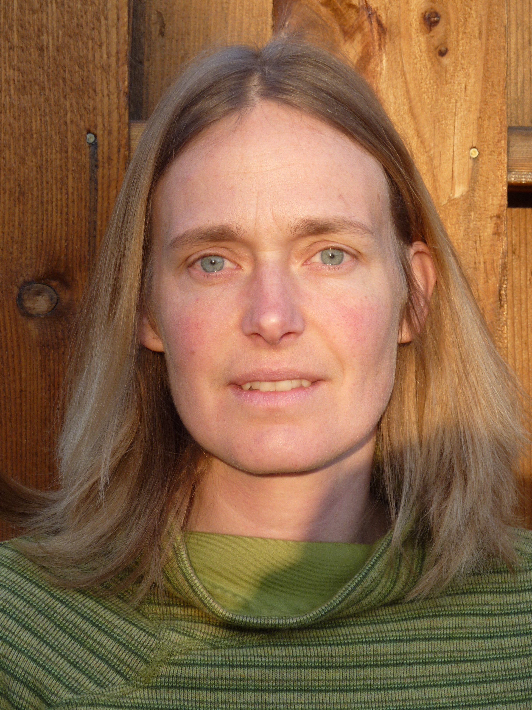
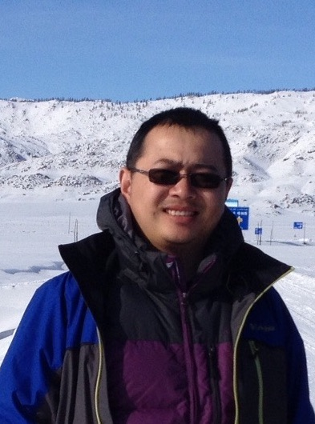
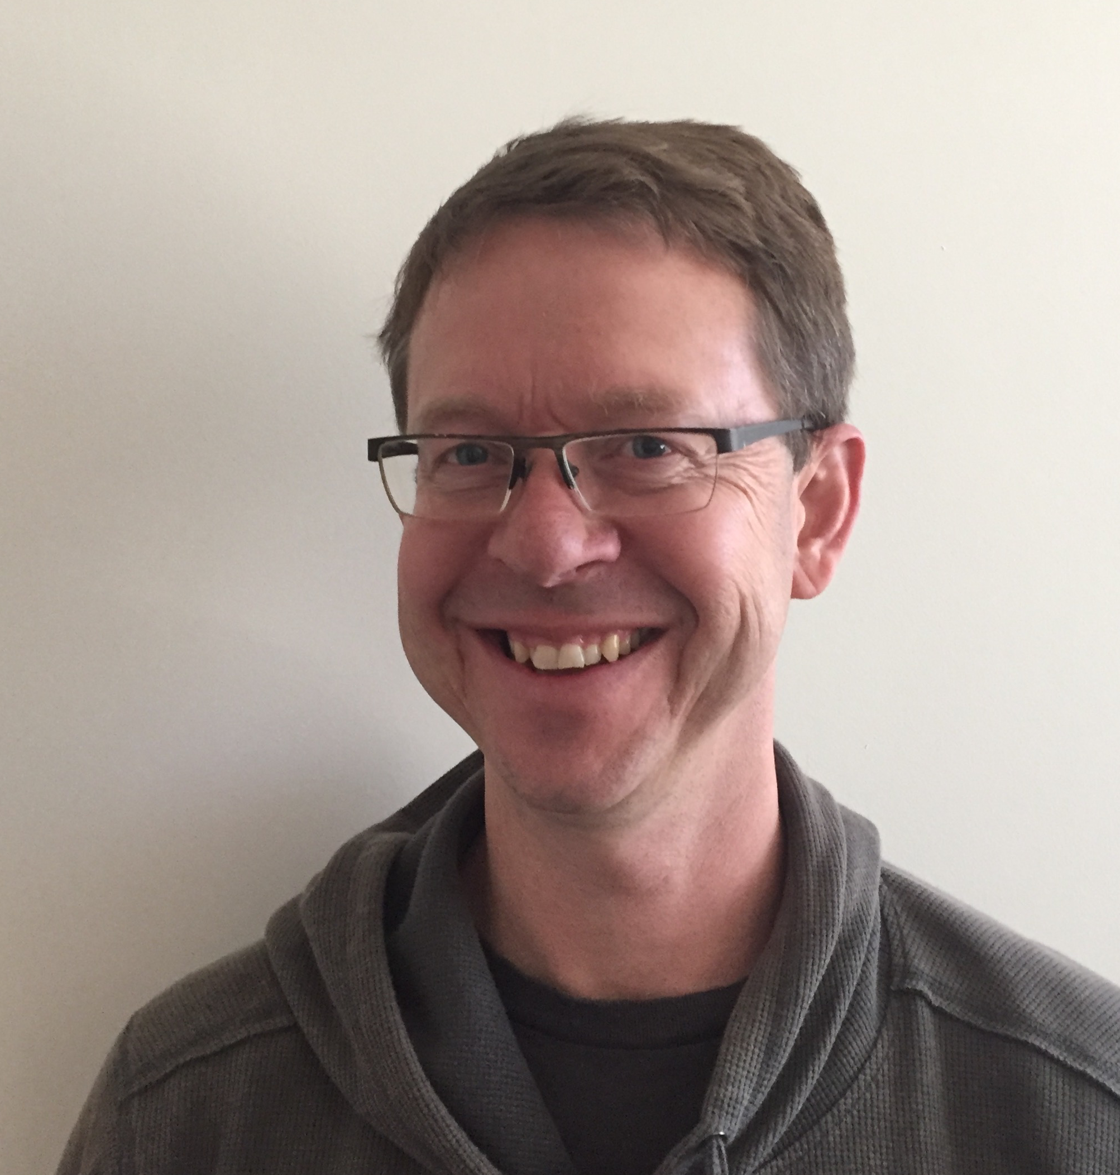
Our team
Irina Overeem, CU Boulder
Kevin Schaeffer, NSIDC
Elchin Jafarov, LANL
Kang Wang, CU Boulder
Mark Piper, CU Boulder
Scott Stewart, CU Boulder
Yasin Elshorbany, NSIDC
Gary Clow, USGS

Slide 6
Goal
Permafrost Modeling toolbox develops easy-to-access and comprehensive cyberinfrastructure to promote permafrost modeling

Slide 7
Vision for Permafrost Modeling Toolbox
Models ranging in complexity
Allow input data to easily be ingested
Web interface for ease of use
Ultimate goal: coupled modeling across domains

Slide 8
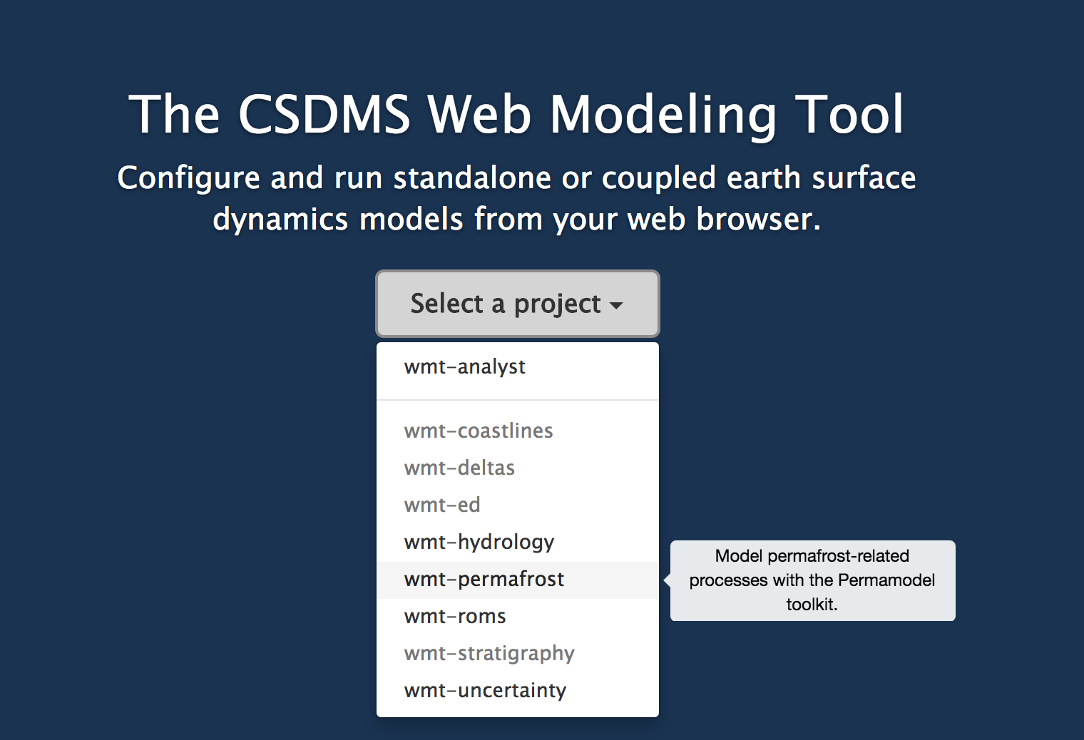
Web Modeling Tool
https://csdms.colorado.edu/wmt/

Slide 9
Develop Models as ‘Components’
Models receive a ‘Basic Model Interface’
Specify with precision which parameters components do need, which parameters do they generate (Standard Names).
Components generate netCDF output

Slide 10
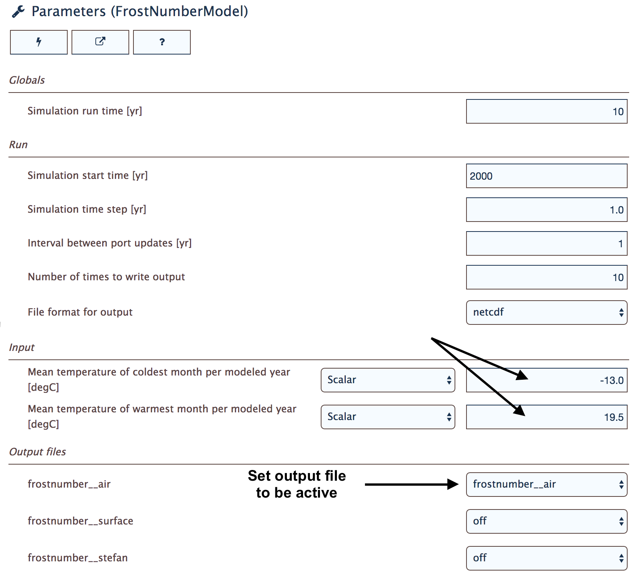
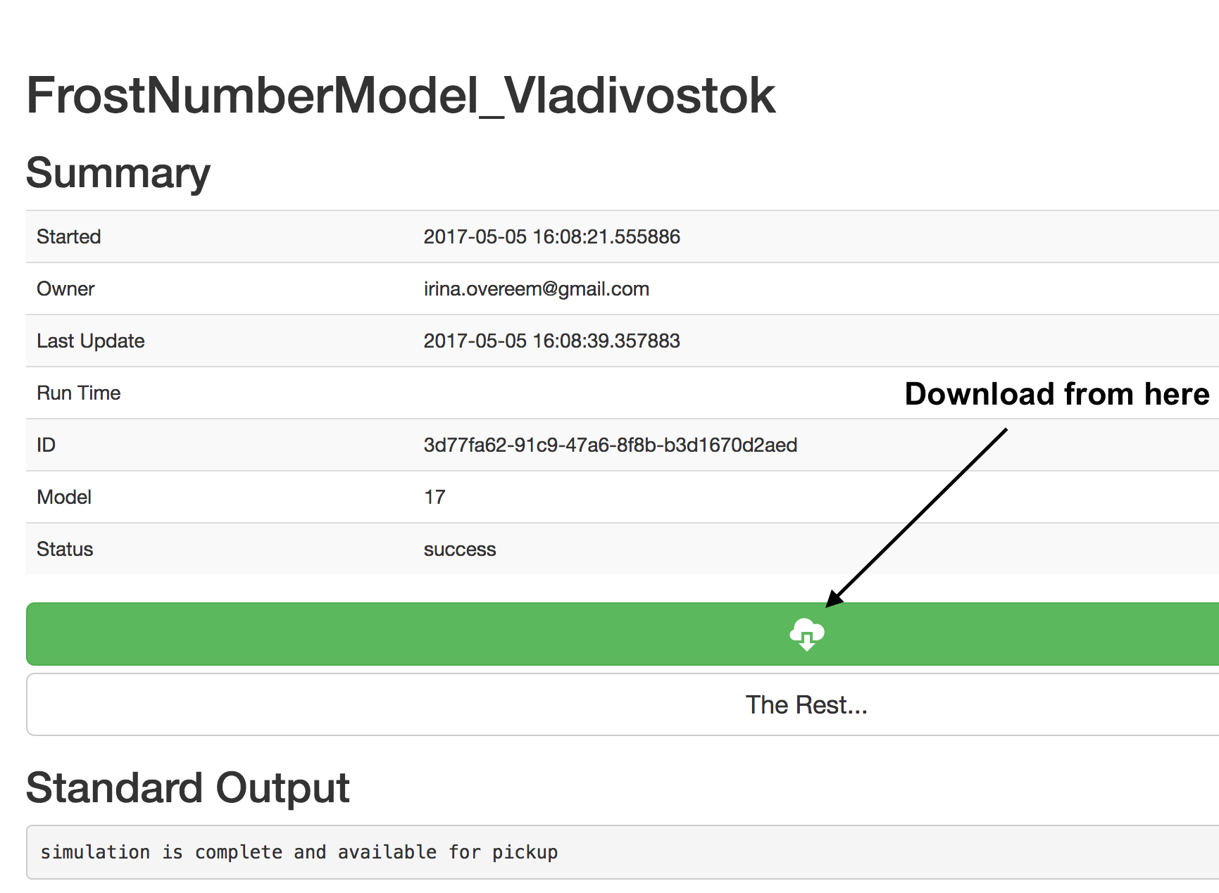
Web Modeling Tool
Web Modeling Tool allows new users to get familiar with main parameters of components
in permafrost modeling toolbox, run simple simulations, download output.

Slide 11
Physical Models
Air Frost Number model – 1D
Air Frost number model –GEO
Kudryavtsev model – 1D
Kudryavtsev model – GEO
GIPL model – daily time-series, continuous depth
(UAF Geophysical Institute Permafrost Lab model)
Continuum volume model (G. Clow, USGS)
Increasing complexity

Slide 12
‘Air’ Frost Number
F = Frost Number (-)
DDF = freezing day index (°C days)
DDT = thawing day index (°C days)
(From: Nelson and Outcalt, 1987, AAAR.)

Slide 13
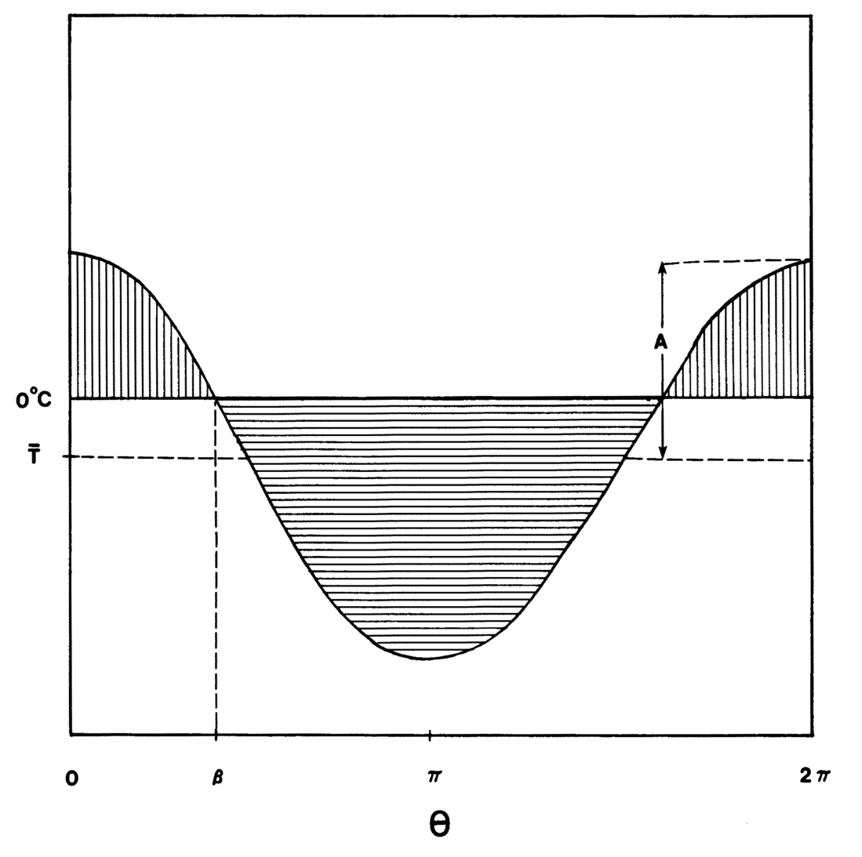
Cosine Approximation of Annual Temperature Distribution
A= amplitude in °C
Temperature
How much time in a year are temperatures above or below freezing?
β
Time in days
(From: Nelson and Outcalt, 1987, AAAR)

Slide 14
Calculate DDT and DDF
Symbol | Parameter | unit
MAAT | Mean annual temperature | °C
A | Yearly temperature amplitude | °C
beta | Frost angle | -
Ts | Mean summer temperature | °C
Tw | Mean winter temperature | °C
Ls | Length of summer | days
Lw | Length of winter | days

Slide 15
Defining the Permafrost Limit
‘Air Frost Number’ predicts that permafrost is theoretically possible:
When the mean annual temperature is < 0°C
When the freezing and thawing indices are equal; thus when Frost Number >= 0.5

Slide 16
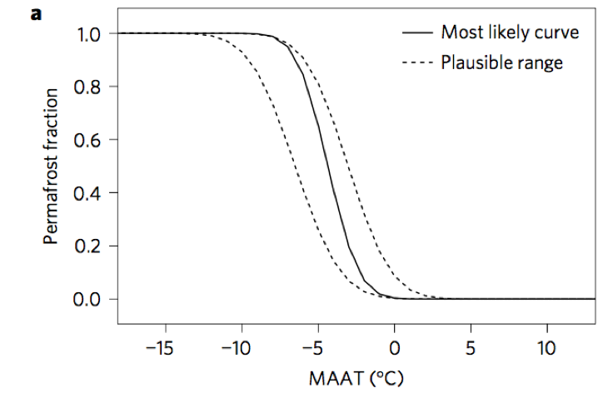
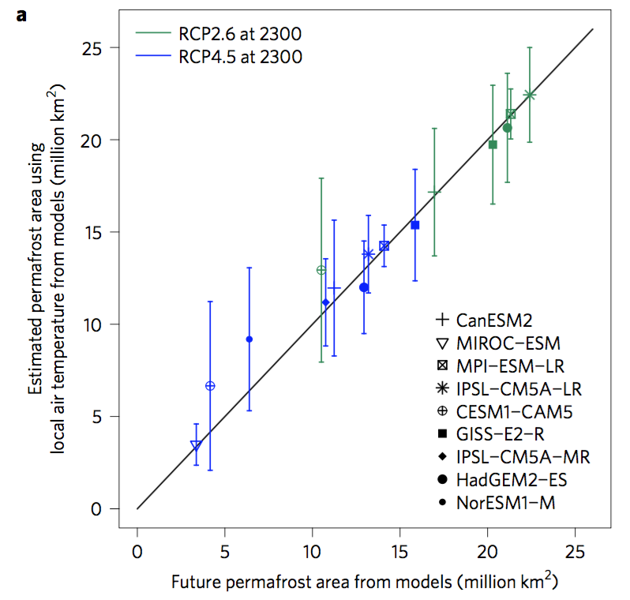
What is the use of such a simple model?
(From: Chadburn et al., 2017, Nature Climate Change)

Slide 17
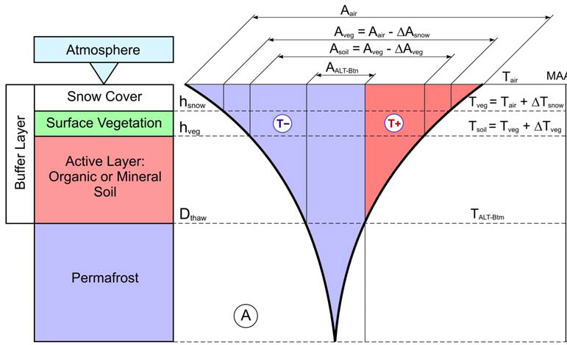
Kudryavstev Model
The Ku model is an semi-empirical model developed in 1970s.
It essentially is an thermal equilibrium model.
Calculates annual soil temperature, active layer thickness
Includes layers of snow and vegetation.
(Anisimov et al., 1997)

Slide 18
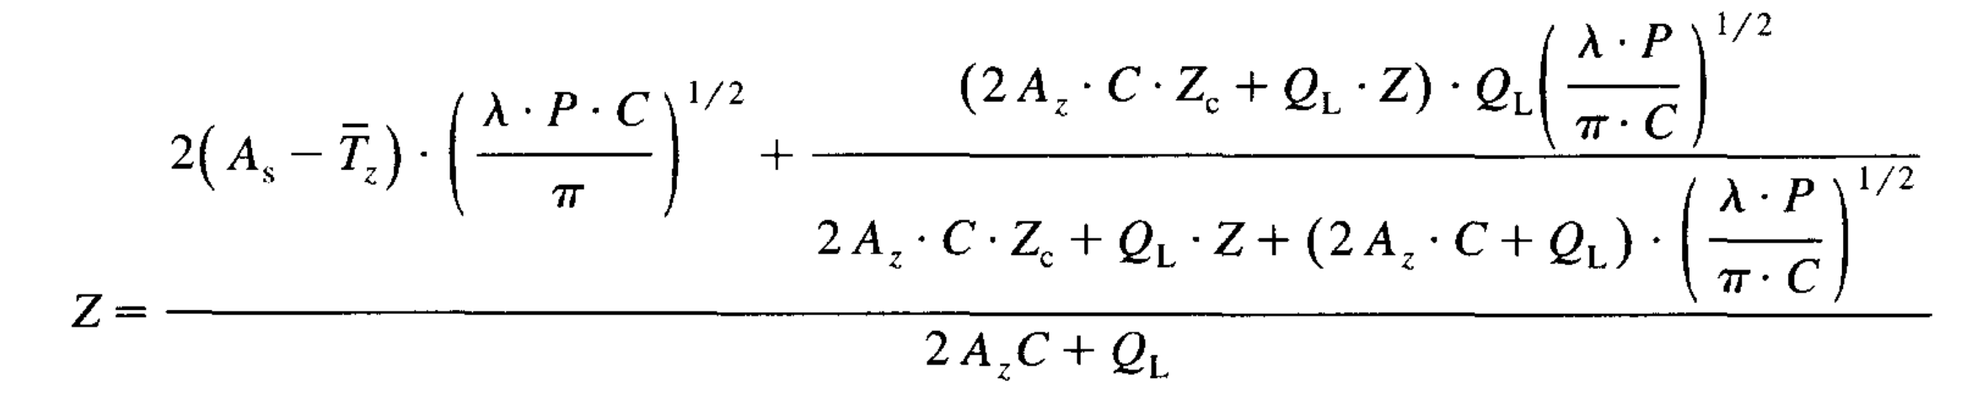
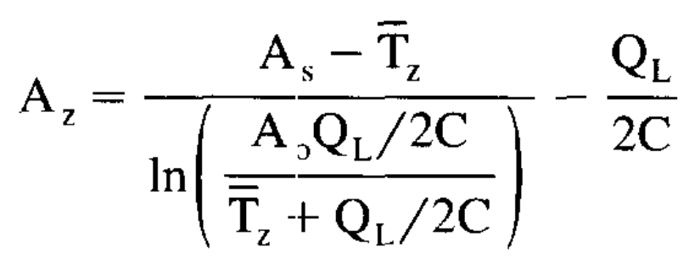
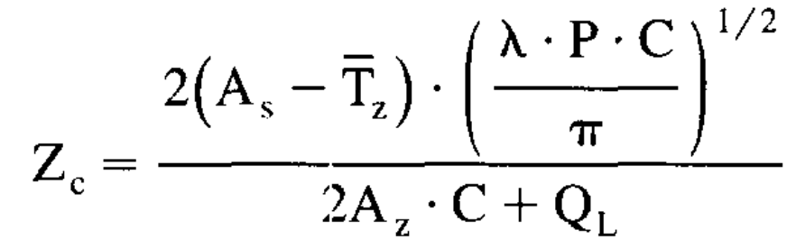
Depth to freezing or thawing (Z)
A_{s} = annual amplitude of surface temperature
T_{z} = mean annual temperature at depth of seasonal thawing
λ = thermal conductivity W m⁻¹ C⁻¹
C = volumetric heat capacity J m⁻³ C⁻¹
Ql = volumetric latent heat of fusion J m⁻³

Slide 19
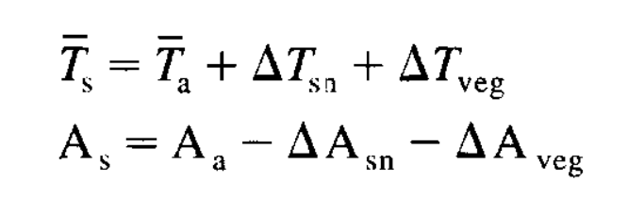
Consider temperature at each layer interface separately
Temperature and annual amplitude at the soil surface (s) depends on the thermal effects of snow and vegetation.
(Anisimov et al., 1997)

Slide 20
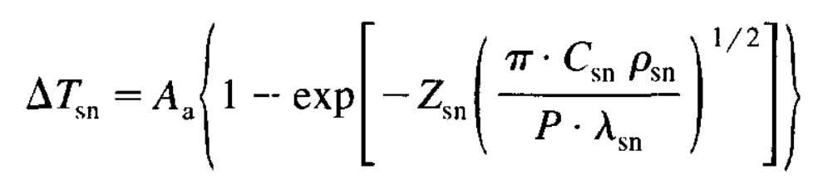
Snow thermal effect
Z_{sn} = snow cover thickness in m
λ_{sn} = snow thermal conductivity W m⁻¹ C⁻¹
C_{sn} = snow volumetric heat capacity J m⁻³ C⁻¹
ρ_{sn} = density of snow in kg m⁻³

Slide 21
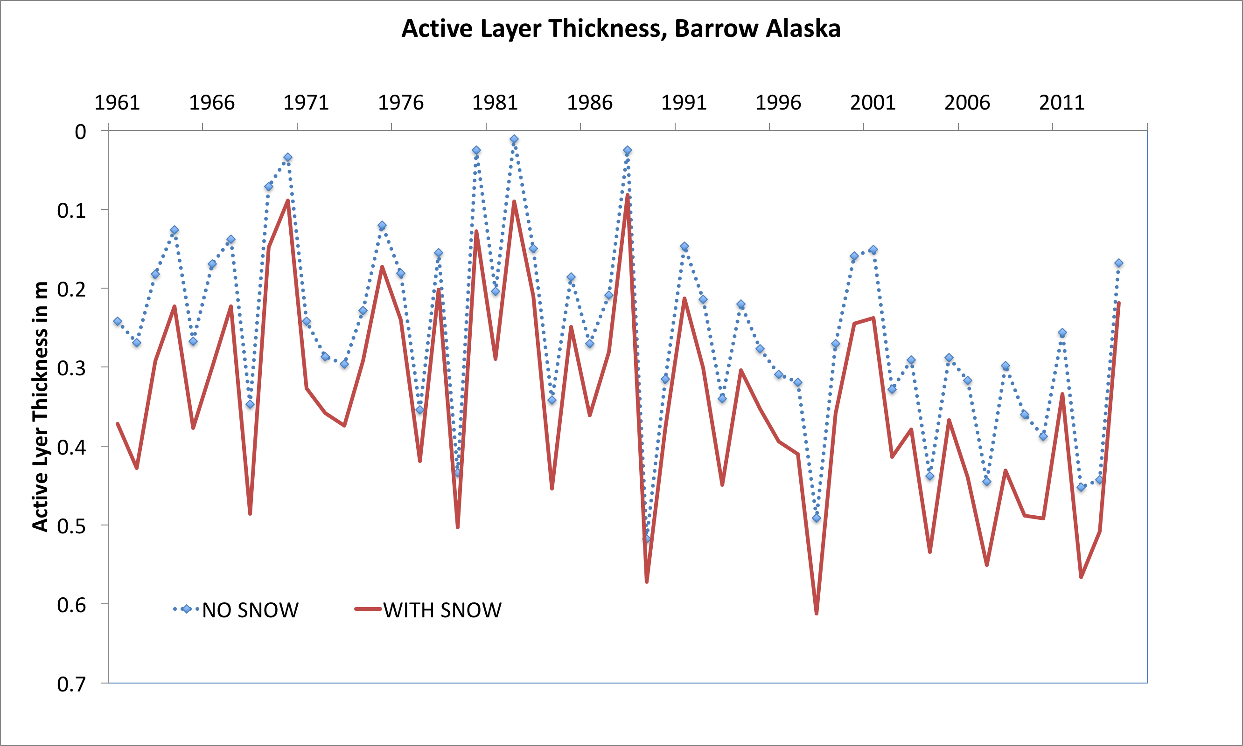
What is the use of such a medium complexity model?
Discussion within federal agency with request to support in-situ snow monitoring on the Alaskan North Slope?
If we’d would not have data on seasonal snow thickness, our predictions of permafrost active layer thickness would be impacted. Ku model can quickly demonstrate this bias for a given location.

Slide 22
Datasets
User-specified at single location
Time-series (Barrow and Fairbanks)
Reanalysis grids (CRU-AKtemp)
Climate model output for future (CMIP5)
Soil properties, snow depths
Other climate variables CRU-NCEP, e.g. prec
Other climate datasets (e.g. CALM stations)
Increasing complexity

Slide 23
Time series of climate data
Focus on Barrow and Fairbanks, Alaska
1961-2015 observed meteorological data
Alaska data of USGS, UAF and NPS permafrost stations 1991-2015
CRU-NCEP SNAP reanalysis dataset with spatial coverage of climate characteristics over Alaska

Slide 24
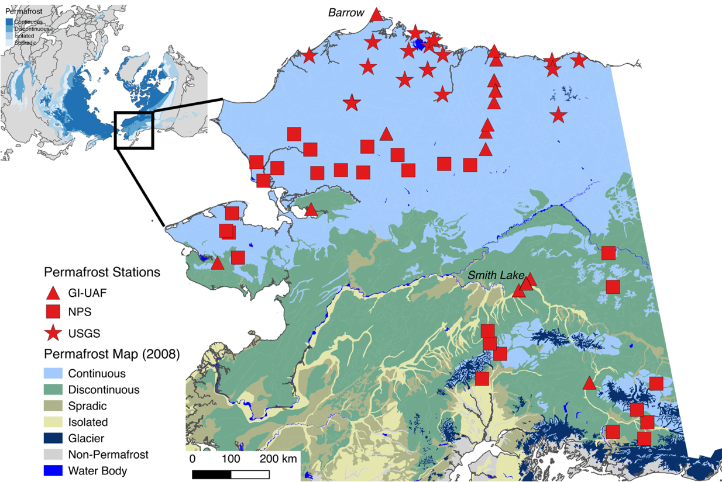
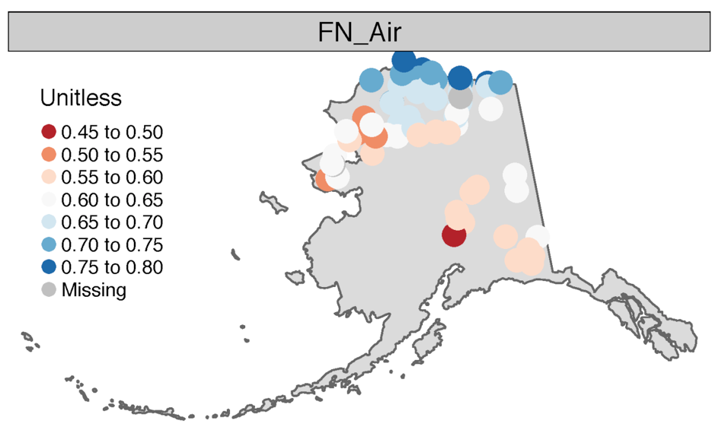
Benchmark against in-situ permafrost data
Wang et al., in review,
Earth System Science Data

Slide 25
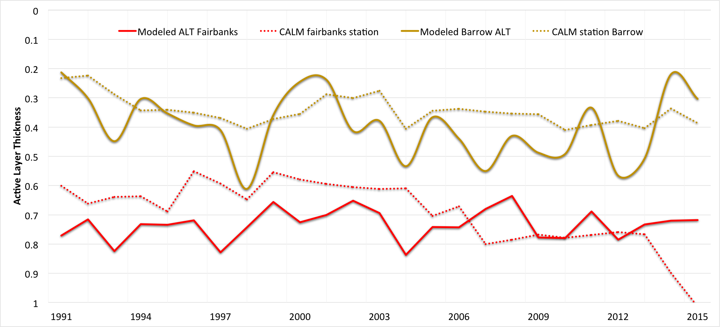
Data-Model Comparison

Slide 26
Data-Model Comparison

Slide 27
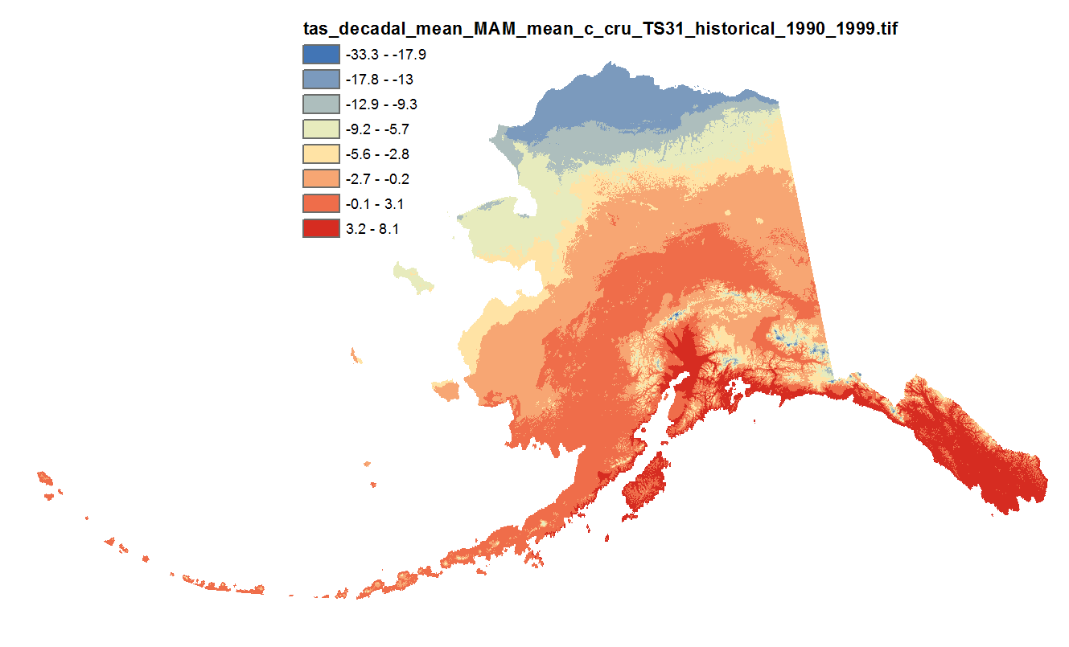
Climate Reanalysis Data
Original data source was CRU-TS3 monthly climate data at 771 * 771 m resolution.
It covers 1900-2009
http://ckan.snap.uaf.edu/dataset/historical-monthly-and-derived-temperature-products-771m-cru-ts

Slide 28
CRU_AKtemp
What is specific for this dataset within the permafrost modeling tool:
Data component, has an CSDM basic interface and can be coupled to models that need temperature data.
Python 2.7 package that provides access to NetCDF file constructed from the original GeoTiffs.
Geographical extent of this dataset reduced to Alaska.
Spatial resolution has been reduced by a factor of 13 in each direction, resulting in an effective pixel resolution of about 10km.
The data are monthly average temperatures for each month from January 1901 through December 2009.

Slide 29
Config File with CRU-AKtemp
#===============================================================================
# Config File for: cruAKtemp_method
#===============================================================================
# Input
filename | {filename} | string | name of this file
run_description | {run_description} | string | description of this configuration
run_region | {run_region} | string | general location of this domain
run_resolution | {run_resolution} | string | highres or lowres
# Dates are converted to datetime.date objects
reference_date | {reference_date} | string | model time is relative to this date
model_start_date | {model_start_date} | string | first day with valid model data
model_end_date | {model_start_date} | string | last day with valid model data
# Grid variables are processed separately after all config variables have been read in
# need to create np.float array of grids
grid_name | {grid_name} | string | name of the model grid
grid_type | {grid_type} | string | form of the model grid
grid_columns | {grid_columns} | int | number of columns in model grid
grid_rows | {grid_rows} | int | number of columns in model grid
# with temperature as np.zeros((grid_columns, grid_rows), dtype=np.float)
i_ul | {i_ul} | int | i-coord of upper left corner model domain
j_ul | {i_ul} | int | j-coord of upper left corner model domain
# timestep is converted to datetime.timedelta(days=timestep)
timestep | {timestep} | int | model timestep [days]
# Output
Note, input is specified in ‘grid rows’ and ‘grid columns’, for now we have no proper geo-referencing and remapping tools in CSDMS, so we just use the original projection and its grid.

Slide 30
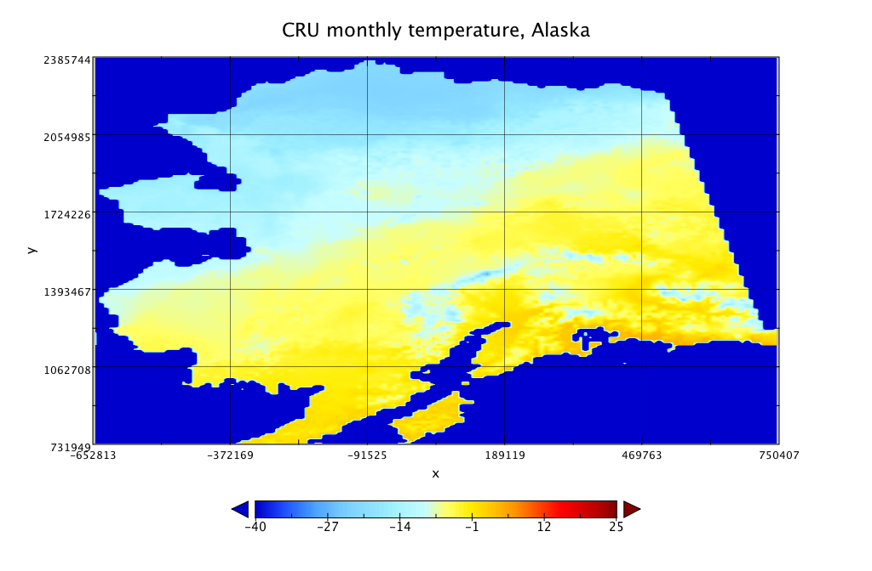
CRU_Aktemp example

Slide 31
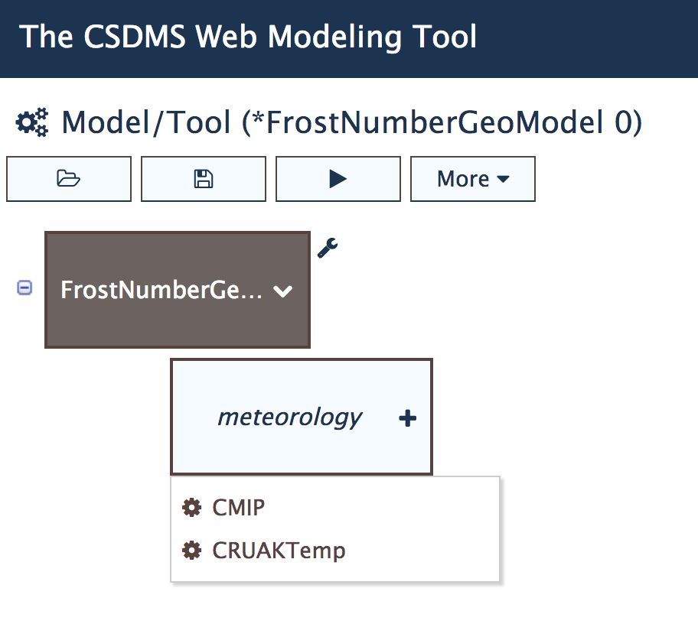
Predicting Permafrost?
Climate Model Intercomparison Project (CMIP) data set: output of the atmosphere ocean global climate models
Duration: 1902-2100
https://github.com/permamodel/cmip

Slide 32
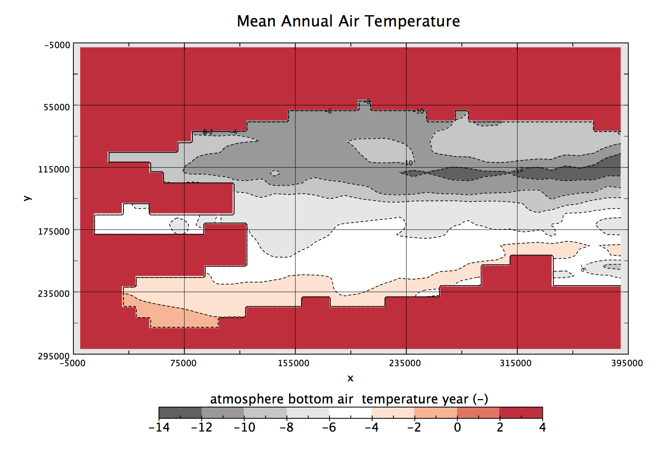
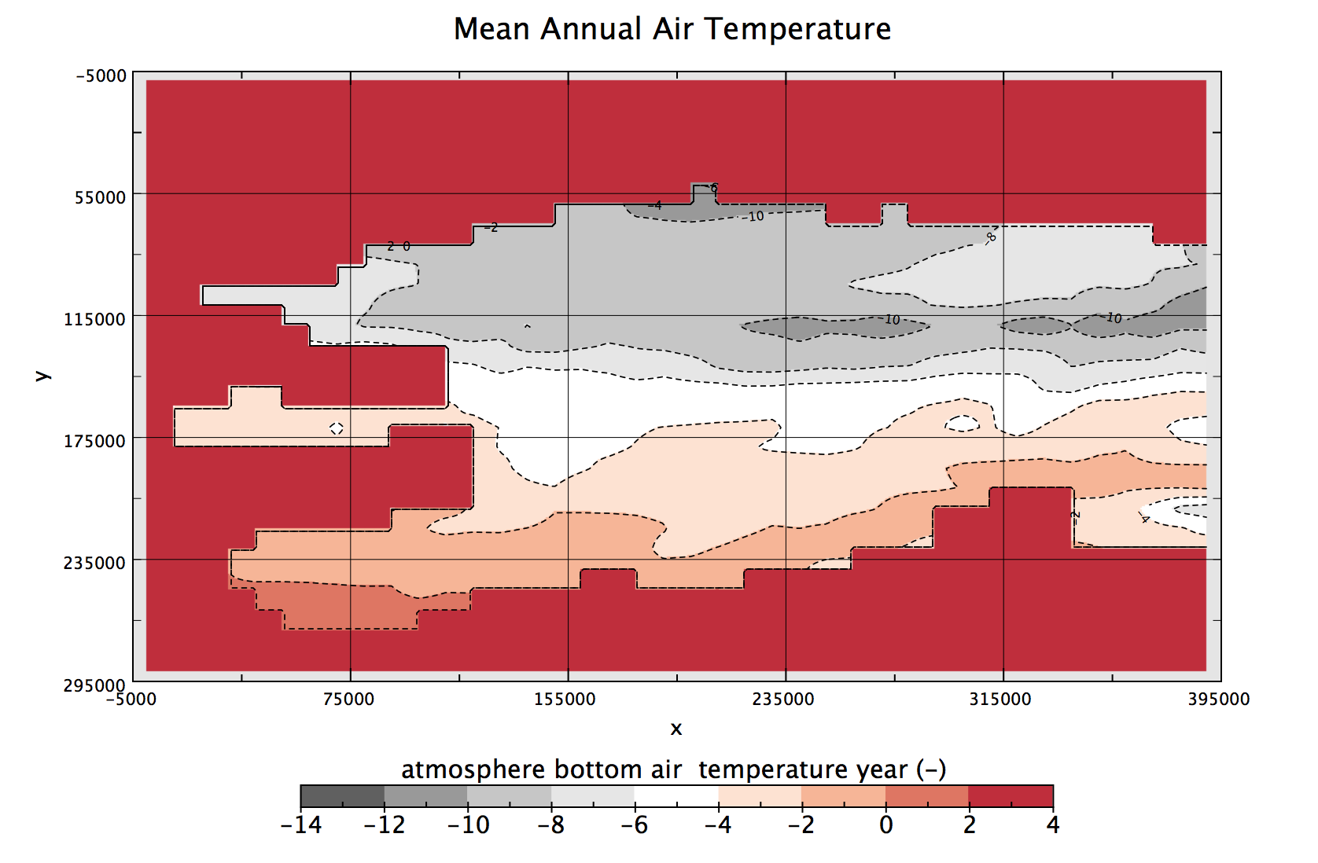
CMIP5 provides mean annual air temperature to Frost and Ku models
1955
2095

Slide 33
Demonstration
https://csdms.colorado.edu/wmt/

Slide 34
Demonstration
Retrieve Output
Set up parameters

Slide 35
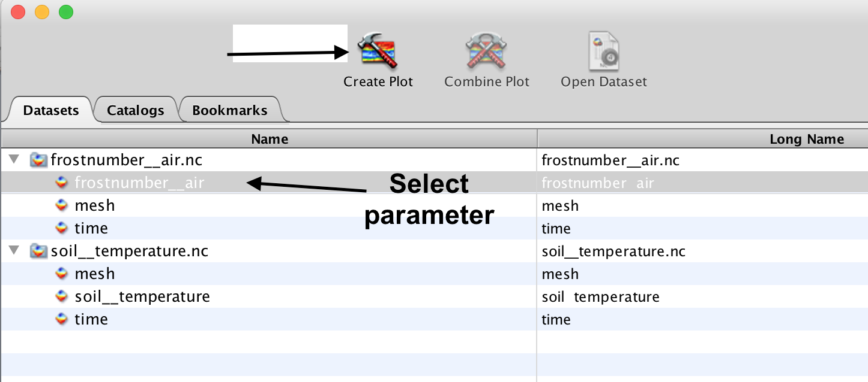
Visualize Output with Panoply
https://www.giss.nasa.gov/tools/panoply/

Slide 36
CMIP-5 grid geometry
Two sets of (x, y) values in the CMIP configuration file define your region of interest:
The coordinates of the upper-left grid cell:
upper-left x (longitude)
upper-left y (latitude)
The size of the grid:
xdim (width, in longitude)
ydim (height. in latitude)
Notes:
So, if you want to specify a 17 deg (wide) by 12 deg (high) subsection of the grid with upper-left coordinates at 165W and 70N, the upper left is:
(-165 - -180) * 2 = 30
(90 - 70) * 2 = 40
and the size of the grid is:
17 * 2 = 34
12 * 2 = 24

Slide 37
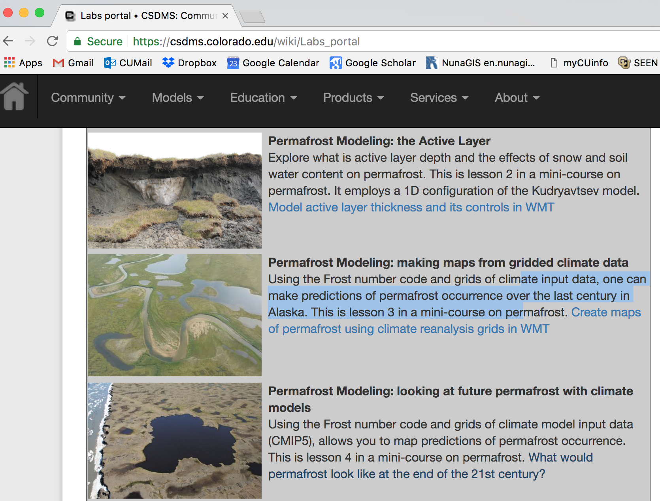
Hands-on
EXAMPLE
TODAY
http://csdms.colorado.edu/wiki/Labs_portal

Slide 38
CMIP5 provides mean annual air temperature to Frost and Ku models
1955
2095

Slide 39
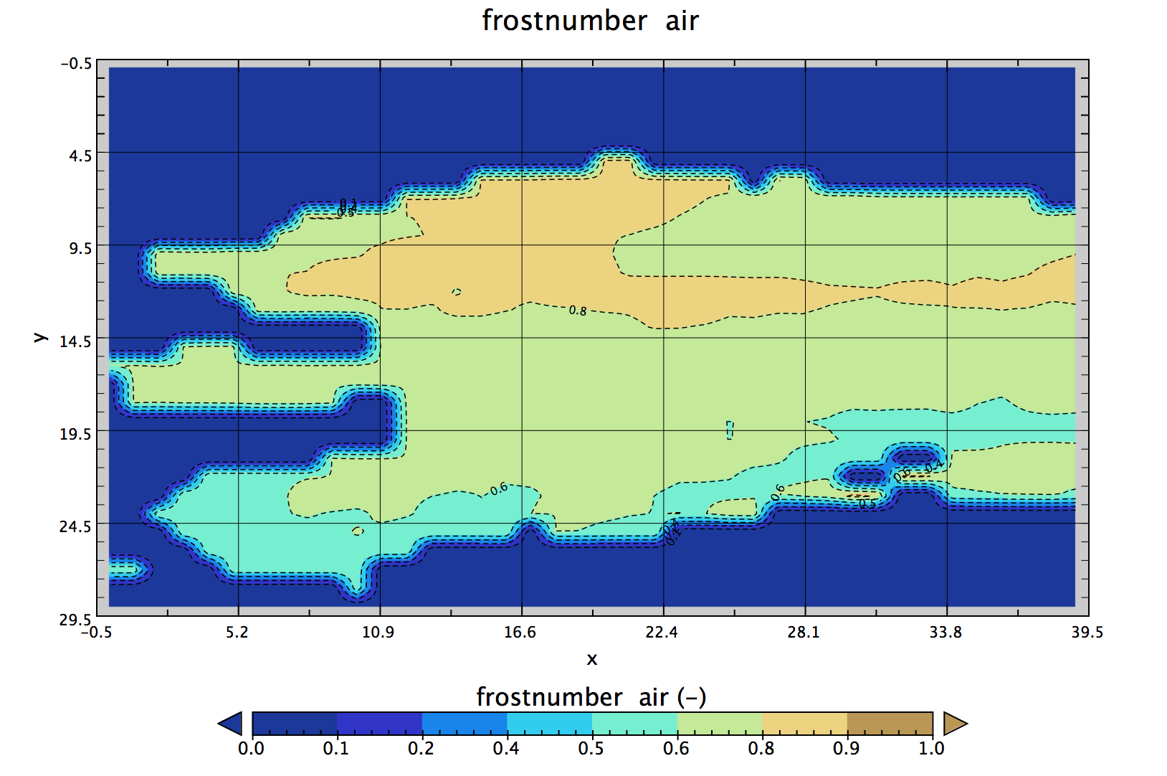
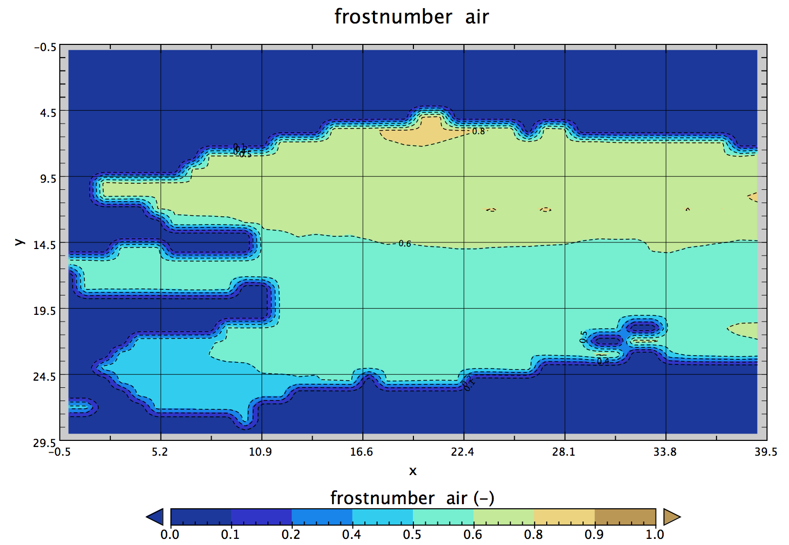
Predictions of Permafrost
1955
2095

Slide 40
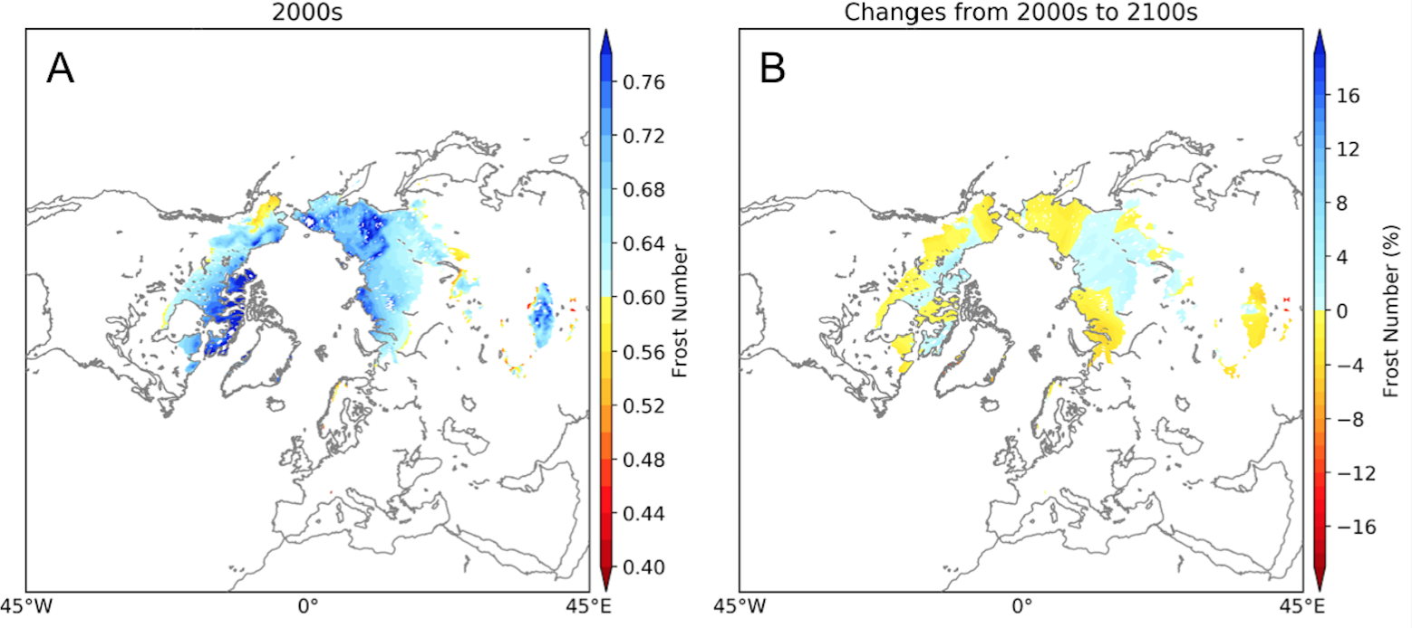
Implications for Permafrost Carbon Feedback
the loss of permafrost area is most pronounced at the southern edges of the permafrost region. In total, regions with Frost Number > 0.67, which we use here as a threshold for occurrence, declines about 6.68 million km² by the end of the twenty-first century.

Slide 41
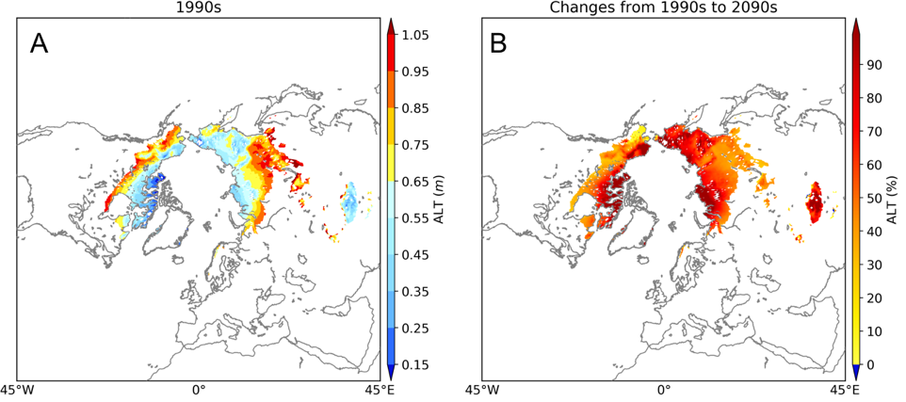
Implications for Permafrost Carbon Feedback? Ku model…
Active layer volume expands by 4911 km³. Total carbon storage is estimated to be 1035 Pg in the uppermost 3m of the permafrost zone, which means gross average carbon density is ~0.025 Pg per km³. Thus, the predicted increase of active layer thickness implies a reservoir of 123 Pg of newly exposed carbon over the 21st century.
Notes:
Figure 2A shows active layer thickness over 1990-2000 and contrasts it with the relative changes in active layer thickness at the end of the 21st century (2090-2100). Overall, the simulation predicts the active layer volume expands by 4911 km³. To put this in perspective, total carbon storage is estimated to be 1035 +/- 150 Pg in the uppermost 3m of the permafrost zone, which means gross average carbon density is ~0.025 +/- 0.004 Pg per km³. Thus, the predicted increase of active layer thickness implies a reservoir of 123 +/- 8 Pg of newly exposed carbon over the 21st century.

Slide 42
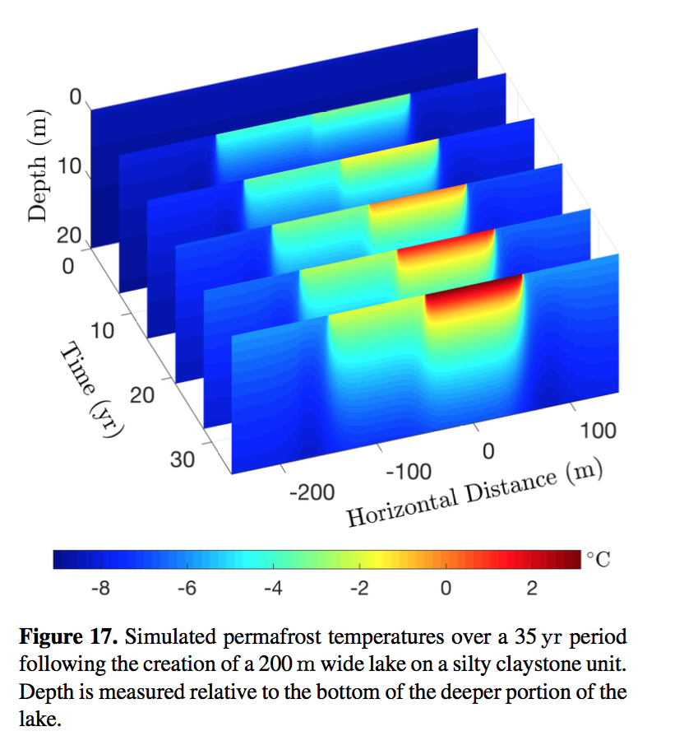
More advanced modeling: CVPM
Continuous Volume Permafrost Model
By Gary Clow
https://github.com/csdms-contrib/CVPM
Notes:
CVPM implements the nonlinear heat-transfer equations in 1-D, 2-D, and 3-D cartesian coordinates, as well as in 1-D radial and 2-D cylindrical coordinates. To accommodate a diversity of geologic settings, a variety of materials can be specified within the model domain, including: organic-rich materials, sedimentary rocks and soils, igneous and metamorphic rocks, ice bodies, borehole fluids, and other engineering materials. A complete description of the model physics and numerical implementation can be found in,
Clow, G.D., 2018. CVPM 1.1: a flexible heat-transfer modeling system for permafrost, Geoscientific Model Development, in review.

Slide 43
More advanced modeling (2)
Overview of GIPL developments
Scott Stewart main CSDMS component developer, original code from Elchin Jafarov
Discussion of development Basic Modeling Interface for GIPL

Slide 44
What’s next: Collaborate
https://github.com/permamodel
You can download codes
You can use codes and report issues
We need to fix issues that relate to switch to Blanca
You can become part of the team and contribute datasets or code
Coupled model challenge for summer 2018

Slide 45
What’s next: cyberinfrastructure development
What major questions could we tackle with this tool?
Collaboration 1, Los Alamos HighLat project
Permafrost Delta Modeling
Collaboration 2, Alfred Wegener Institute, Germany
Permafrost Evolution in Coastal Estuaries
Discussion
What other models can be brought in and would be useful?
What data could be brought in and useful?

Slide 46
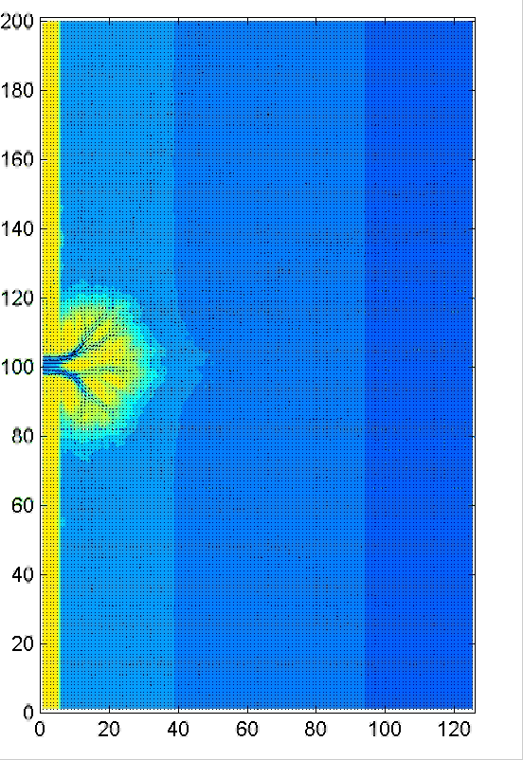
PyDeltaRCM with permafrost
Reduced Complexity Model for delta evolution, originally developed by Man Liang at Univ. of MN.
PyDelta RCM, python version of this model with Basic Model Interface by Mariela Perignon and Irina Overeem (CU)
Now linkage to permafrost dynamics: Ku model: soil water linked to drainage network, active layer depth linked to erodibility.

Slide 47
Acknowledgements
NSF Polar Programs Grant 1503559, ‘Towards a Tiered Permafrost Modeling Cyberinfrastructure’

Slide 48
References
Nelson, F.E., Outcalt, S.I., 1987. A computational method for prediction and prediction and regionalization of permafrost. Arct. Alp. Res. 19, 279–288.
Janke, J., Williams, M., Evans, A., 2012. A comparison of permafrost prediction models along a section of Trail Ridge Road, RMNP, CO. Geomorphology 138, 111-120.
Anisimov, O. A., Shiklomanov, N. I., & Nelson, F. E. (1997). Global warming and active-layer thickness: results from transient general circulation models. Global and Planetary Change, 15(3-4), 61-77. DOI:10.1016/S0921-8181(97)00009-X
Sazonova, T.S., Romanovsky, V.E., 2003. A model for regional-scale estimation of temporal and spatial variability of active layer thickness and mean nnaual ground emperatures. Permafrost and periglacial processes 14, 125-139. DOI: 10.1002/ppp.449

Slide 49
Papers in Review
Wang, K., Jafarov, E., Schaefer, K., Overeem, I., Romanovsky, V., Clow, G., Urban, F., Piper, M., Schwalm, C., Zhang, T., Kholodov, A., Sousanes, P., Loso, M., Swanson, D., Hill, K., (in review). A synthesis dataset of permafrost-affected soil thermal conditions for Alaska, USA, Earth System Science Data. https://www.earth-syst-sci-data-discuss.net/essd-2018-54/
Clow, G., (in review). CVPM 1.1: a flexible heat-transfer modeling system for permafrost, Geoscientific Model Development.
Overeem, I., Jafarov, E., Wang, K., Schaefer, K., Stewart, S., Clow, G., Piper, M., Elshorbany, Y., (in review). A modeling toolbox for permafrost landscapes. EOS.

