Slide 1

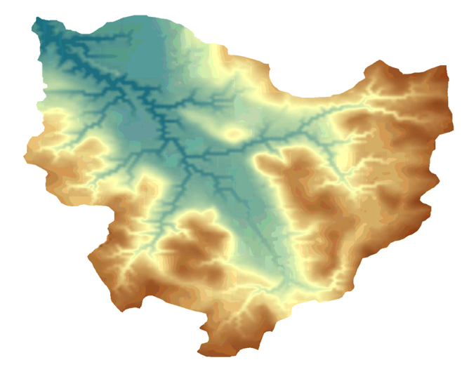
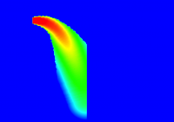
CSDMS Component Modeling Tool
Introduction
Run & Couple Surface Dynamics Models
By Irina Overeem, March 2013

Slide 2
Outline
  Introduction
  Vision behind CMT
  Update on Existing Components
  Basic CMT functionality
  Select Projects
  Workspace
  Set Up and Run Simulations
  Visualization with VisIt
  Demo 1
  Run a Stand-alone Model
  Demo 2
  Set-Up and Run Coupled Model
  15 Minutes – Questions, Sign-up for an Account, troubleshoot VPN or CMT

Slide 3
Grand Vision behind CMT
Develop a modeling framework of inter-connectable process modules able to predict the transport and deposition of water, sediment and nutrients over the Earth’s surfaces, and how surfaces evolve over a broad range of time and space scales.
Empowering users to model science questions...
Streamlining process of idea generation to actual simulation….
Be inclusive, modular, and user-friendly…..

Slide 4
What Framework Services?
Platform-independent GUI CMT (Linux, Mac OS X, Windows)
Language interoperability (C, C++, Java, Python, Fortran) with Babel;
Component preparation & project management using Bocca;
Low-level model coupling within a HPC environment using Ccaffeine;
Single-processor spatial regridding (OpenMI Regrid) or multi-processor spatial regridding (ESMF Regrid) – all grid types;
Component interface standards BMI & CMI;
Open-source standards (e.g. CCA, MPI, NetCDF I/O, OpenDAP).
Visualization of large datasets in a multiple processor environment (VisIt)
Platform for help / documentation associated with models to make them transparent

Slide 5
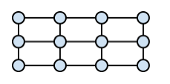

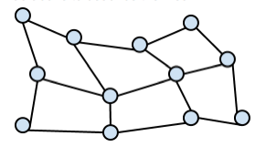
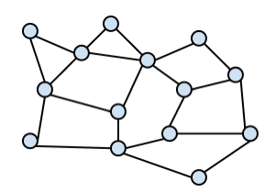
Protocols for CSDMS-component models
CCA Framework
Service
Components
CMI
CMI
BMI
BMI
Model 1
Model 2
BMI CSDMS "Basic Model Interface" is a set of public functions for developers
CMI CSDMS “Component Model Interface” provides BMI components with CMT services for coupling models written in different: 1) programming languages, 2) computational grids, 3) time-stepping, 4) variable names, 5) units; or 6) to run models on HPCC, or to 6) write output to NetCDF files (and future service functionality….)

Slide 6
Number of Components
A total of 54 components: first scientific papers are published
Another main use is in graduate classes & clinics (4 courses, 4 clinics 2009-2012)
Notes:
These numbers are valid as of March 2013.

Slide 7
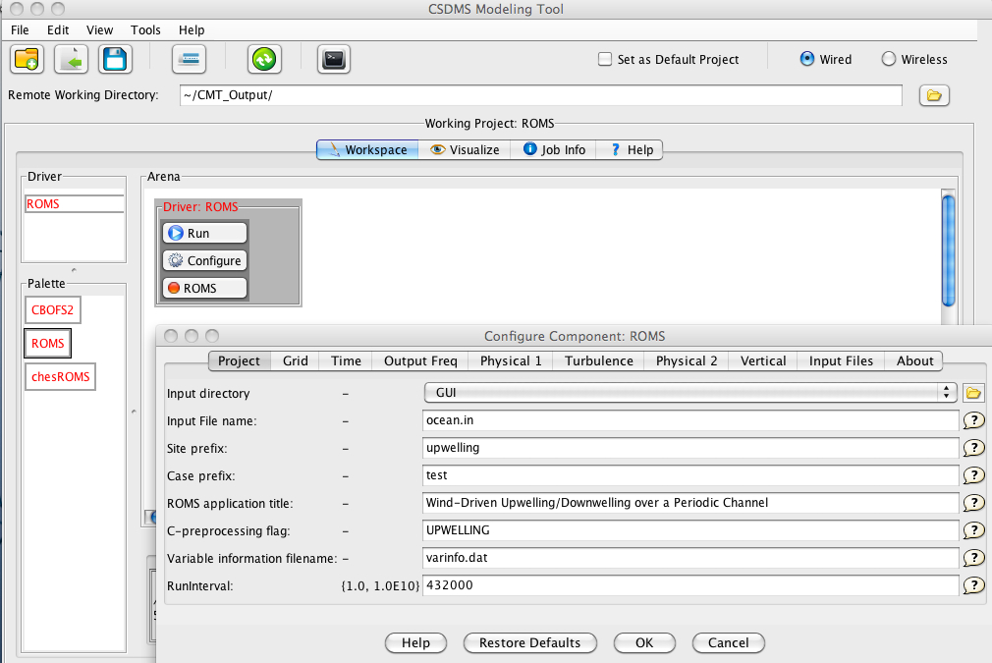
Available Projects in CMT (1)
ROMS - regional ocean modeling system
ROMS Builder – to compile specific instances of ROMS
CHESSROMS – ROMS for Chesapeake Bay
Sedflux2D and 3D – Stratigraphic process model
ERODE – Landscape Evolution Model
CHILD – Landscape Evolution Model
MARSSIM- Mars-scape Evolotion Model
FLEXURE
CHILD-Sedflux coupled
Some models have graphical interface
for the first time

Slide 8
Available Projects in CMT (2)
Educational
HYDROTREND – river basin runoff and sediment
PLUME – 2D river plumes into marine basin
COASTAL EVOLUTION MODEL (CEM) – wave dominated coasts
WAVES – wave climate generator
CEM-HYDROTREND-AVULSION-WAVES coupled
D8 FLOW - determine flowpaths on elevation grids
TOPOFLOW – hydrological toolbox (precipitation, infiltration, evapotranspiration, runoff, snow, channel dynamics)
Data – HIS service component
GC2D – glacier model
TOPOFLOW – GC2D coupled
Sediment Transport Models (e-book)
Tool
Data Ingestion

Slide 9
How to Get and Use CMT?

Slide 10
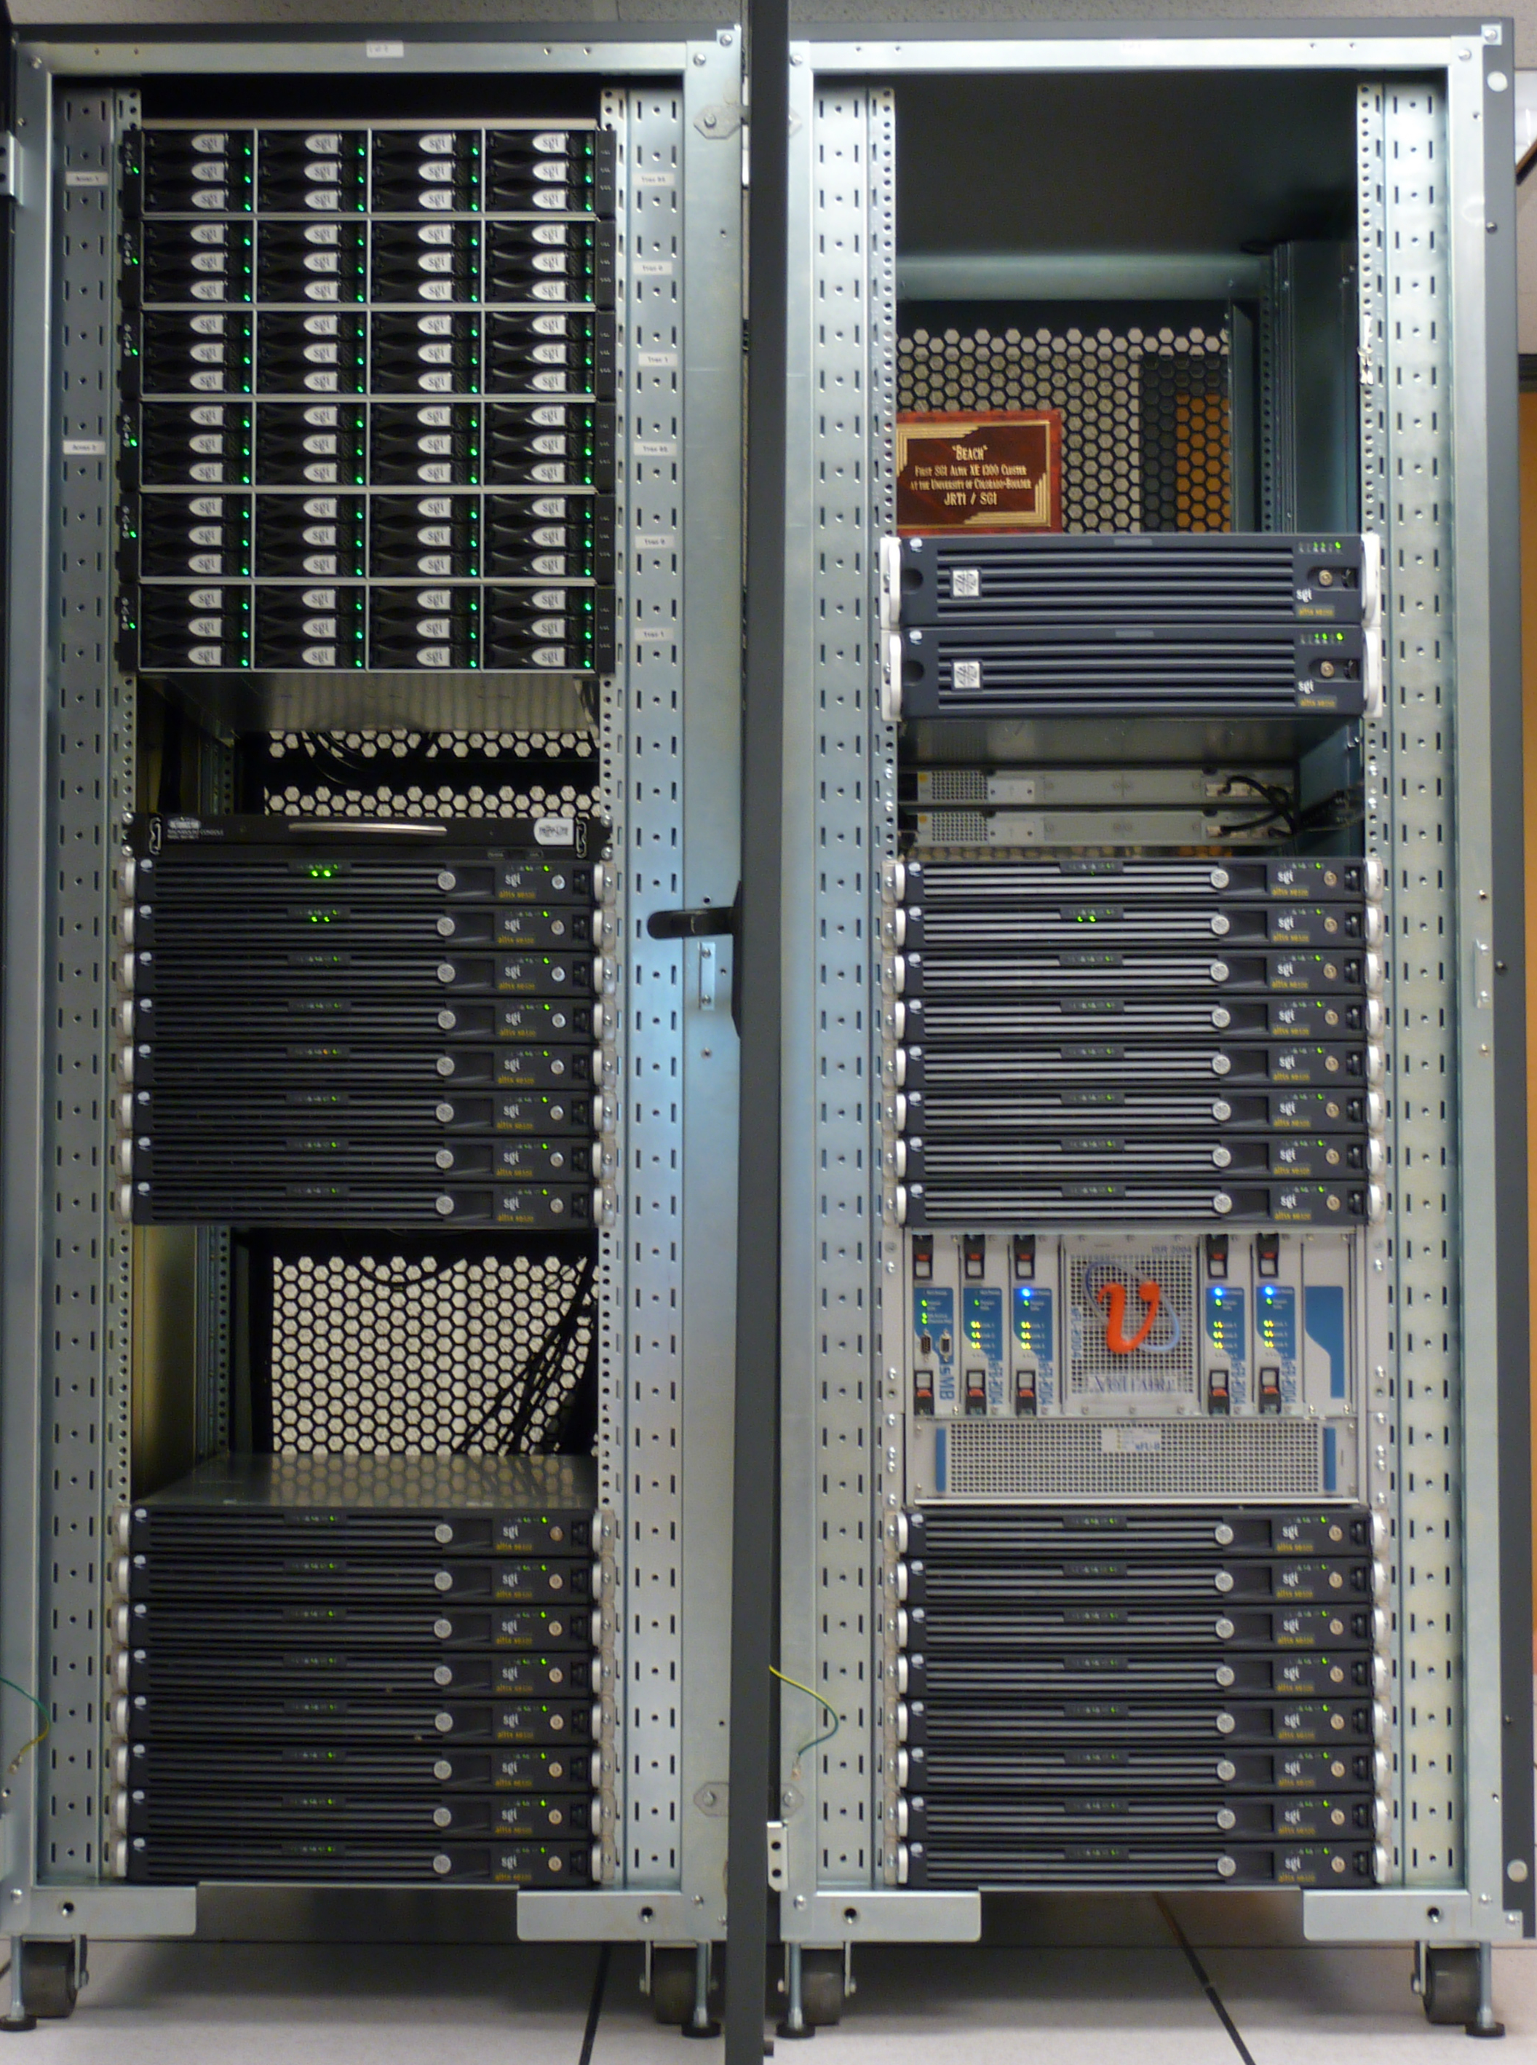
CMT runs on Beach
PRE-REQUISITES
Need to be a member
Need an account to use HPCC
Need a secure connection (with VPN)
Realize you are one of many users
Realize that 2-way traffic is ongoing
Download the CMT
to your computer
Beach in Colorado
512 nodes 4U
Beach will have a new head-node in Spring 2013;
will ease use, not competing with intensive model & data simulations

Slide 11
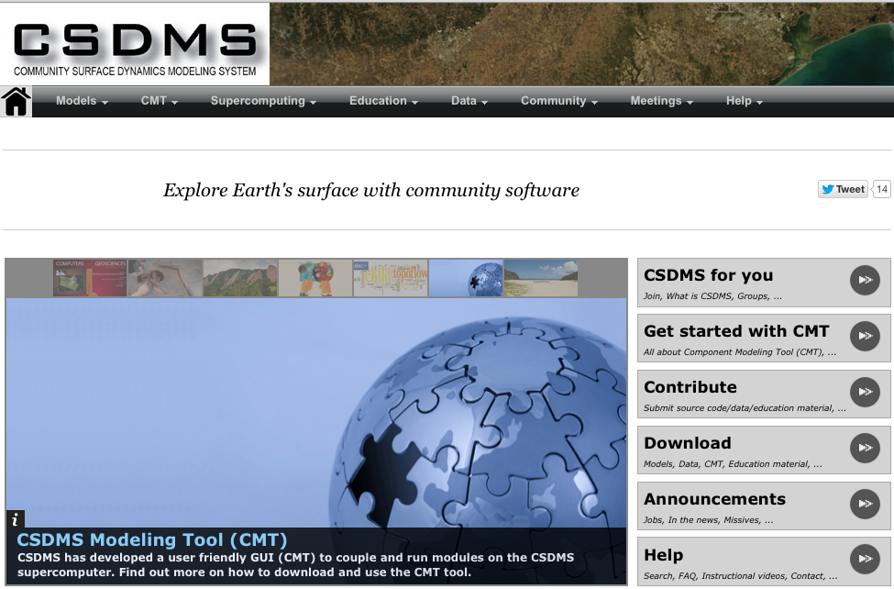
Download CMT
Get Help! information on the CMT
Info
Here
Download from CSDMS wiki: http://csdms.colorado.edu

Slide 12
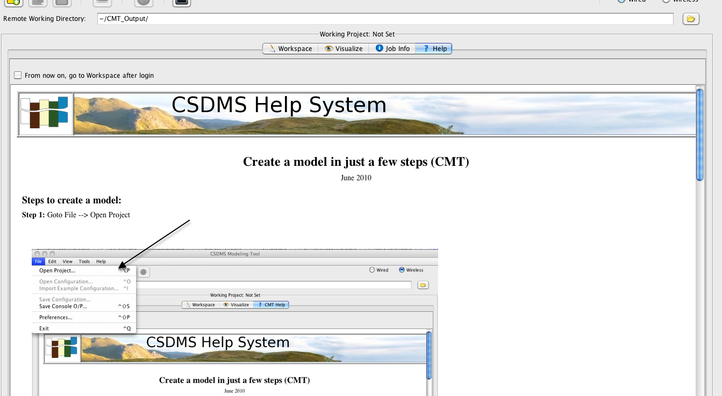
CMT Default Start-Up Screen
Workspace
Visualize
Job Info
Help

Slide 13
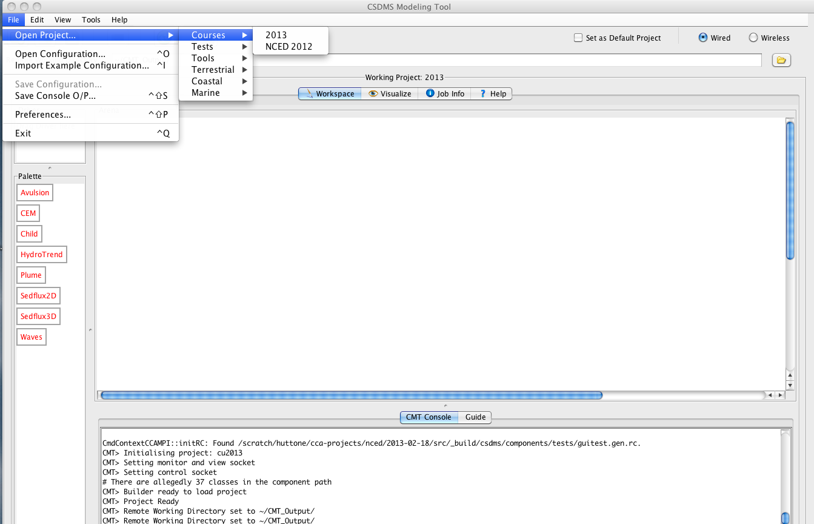
Open Projects
Workspace
Notes:
Talk about the different domains: tutorial, terrestrial, coastal, marine; behind the scenes…printer classes (netCDF, vtk=unstructured grids)

Slide 14
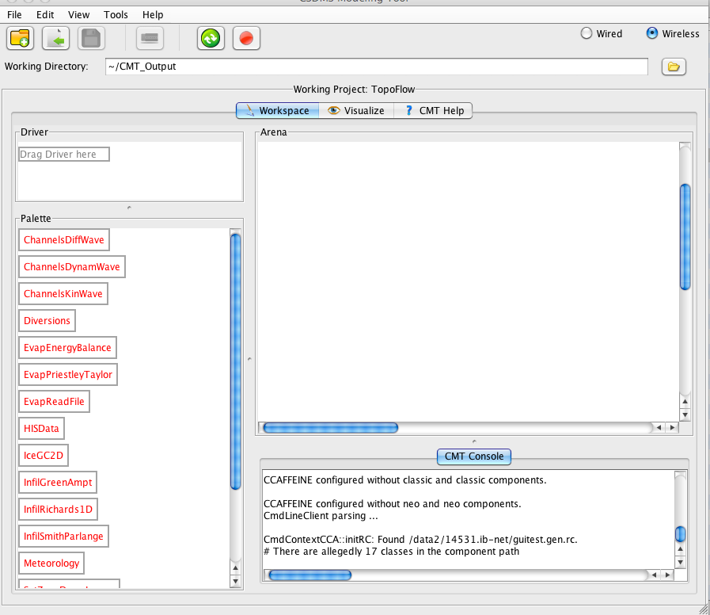
Workspace Features
Working Directory
Driver
Arena
Palette
Console
Notes:
Palette contains the suite of active model components, either to be used as simulation drivers or as ‘support’ components called by the driver.
The Driver Palette host the driver for a run.
If the driver gets dragged into the driver palette it will automatically show up in the CMT arena, there it can be coupled to other components
The working directory specifies the default location where input and output files are being opened and written. It is hosted on Beach.
When you have set up a simulation and press run, the Console window will report the messages during runtime.

Slide 15
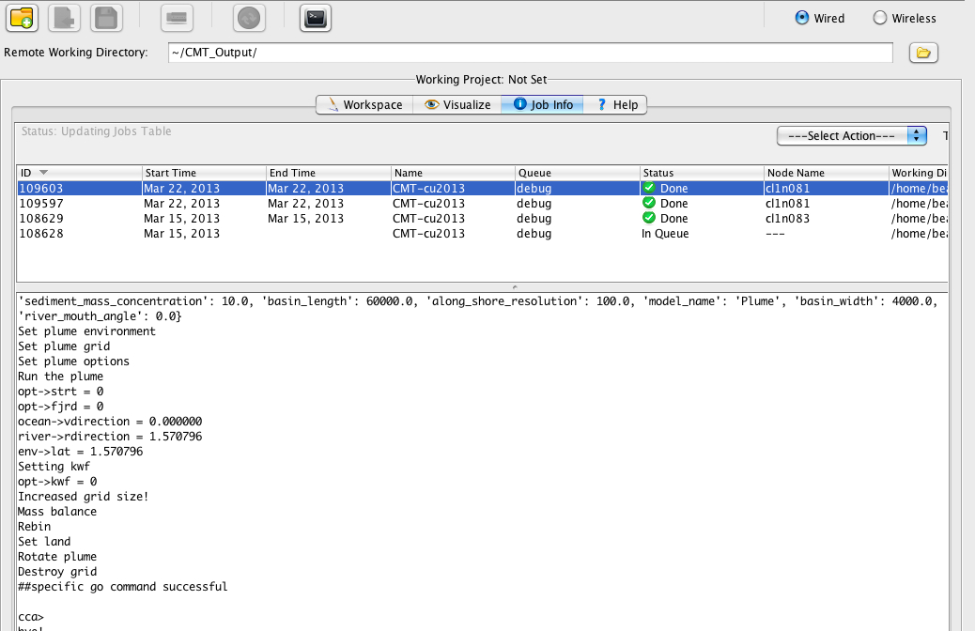
Job Info
Informs on simulation status on
Beach
Informs on specific model simulation;
possible errors. Really valuable feedback.

Slide 16
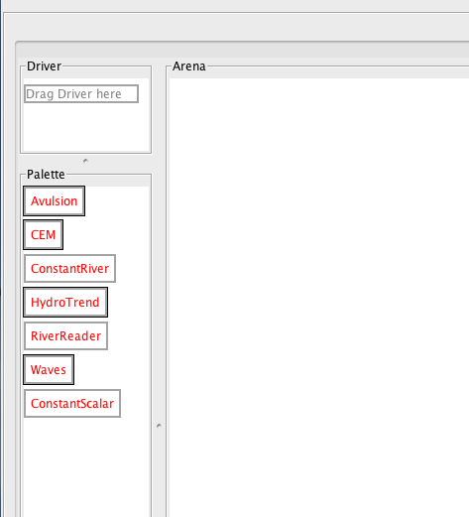
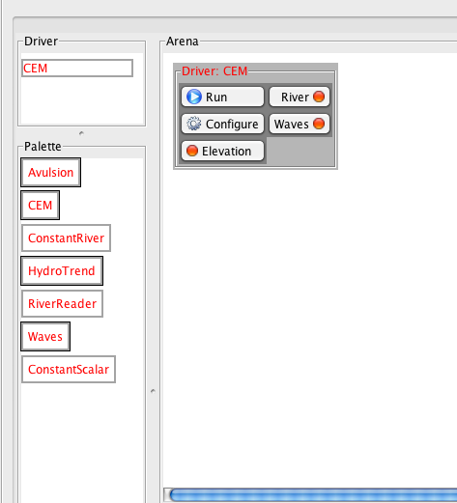
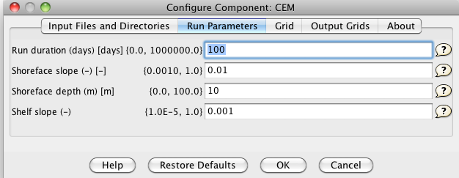
Setting up a Stand-Alone Model
Drag and Drop Here
Click on Configure
Notes:
Select a driver, it will show that it needs other components (potentially).
If you have this in the wireless mode, the connections will light up and be same color
Or if you think it is more clear; use the wired mode.
Now you can hit RUN

Slide 17
Demo 1: Run a Stand-Alone Model
Activate your VPN for secure connection
Launch the CMT tool (from the CSDMS website)
Log in to beach.colorado.edu
Open Group: Coastal
Open Project: Hydrotrend + Avulsion +CEM
Drag in HydroTrend Component to be the Driver
Change Settings in the HydroTrend Configure Menu
Run Simulations, Look at your results in the Console
Once Set-Up
<2 Minutes
10 Minutes

Slide 18
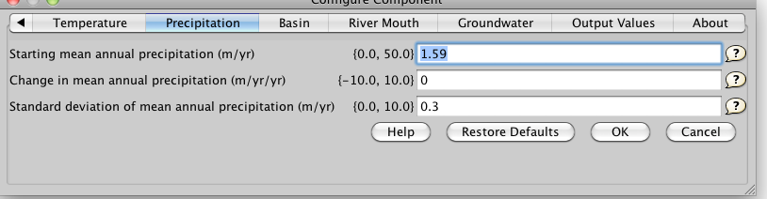
Topical Example: River response to climate change?
What is the effect of a 100% increase of precipitation over the next century?
HydroTrend Configure Menu: adapt precipitation

Slide 19
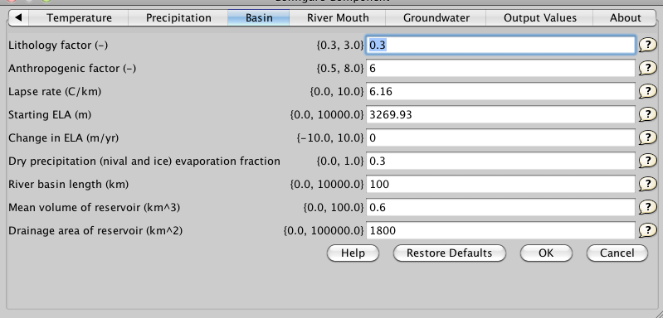
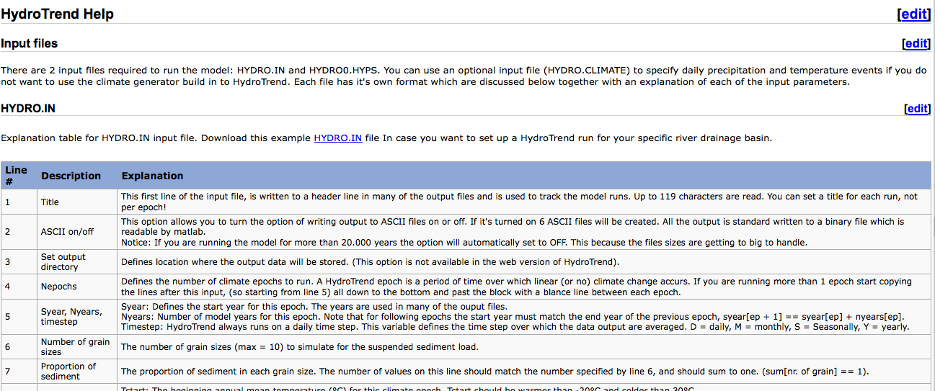
The ‘Help’ button in the Configure Menu links to online information on model parameters.
Model Help is a wiki-based resource, open and editable!

Slide 20
River system response to human impacts?
Model a planned drinking water supply reservoir in the basin. The reservoir would have 1800 km² of contributing drainage area, and be 1 km long and 100m wide, 5m deep.
HydroTrend Configure Menu: adapt reservoir settings

Slide 21
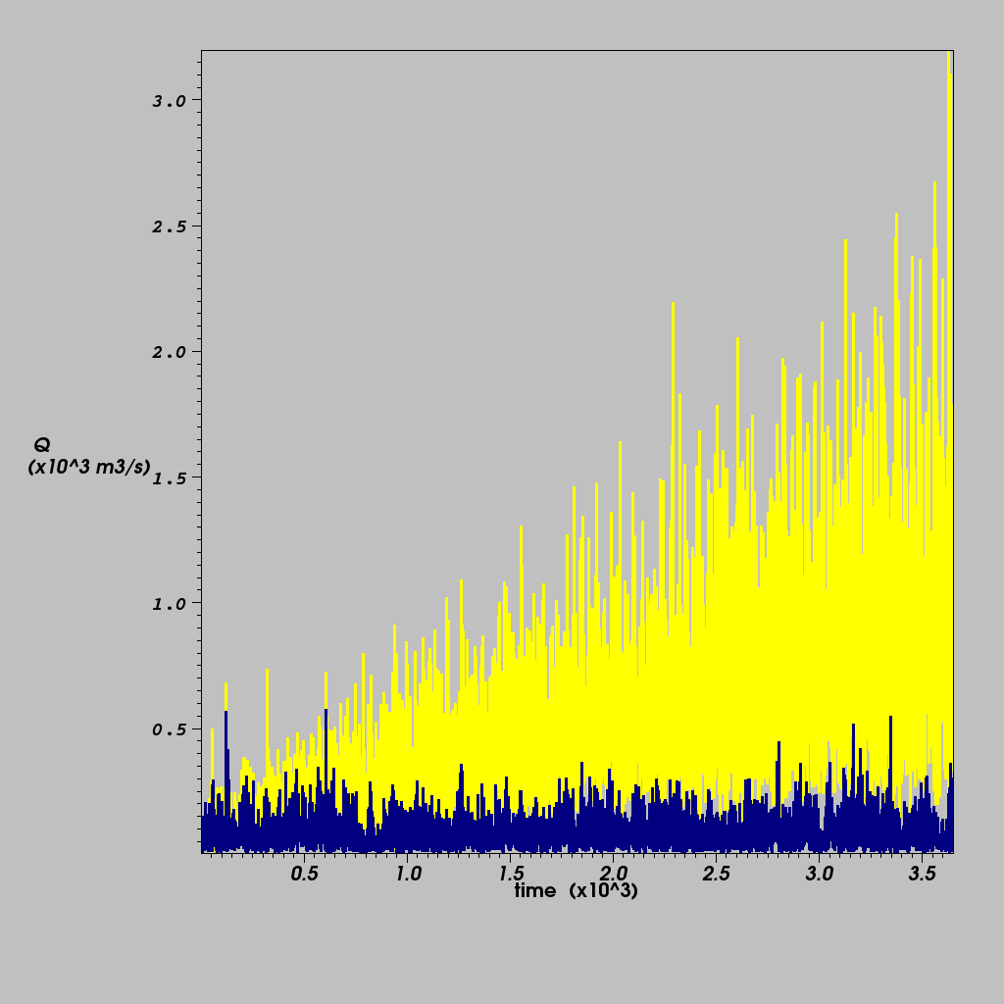
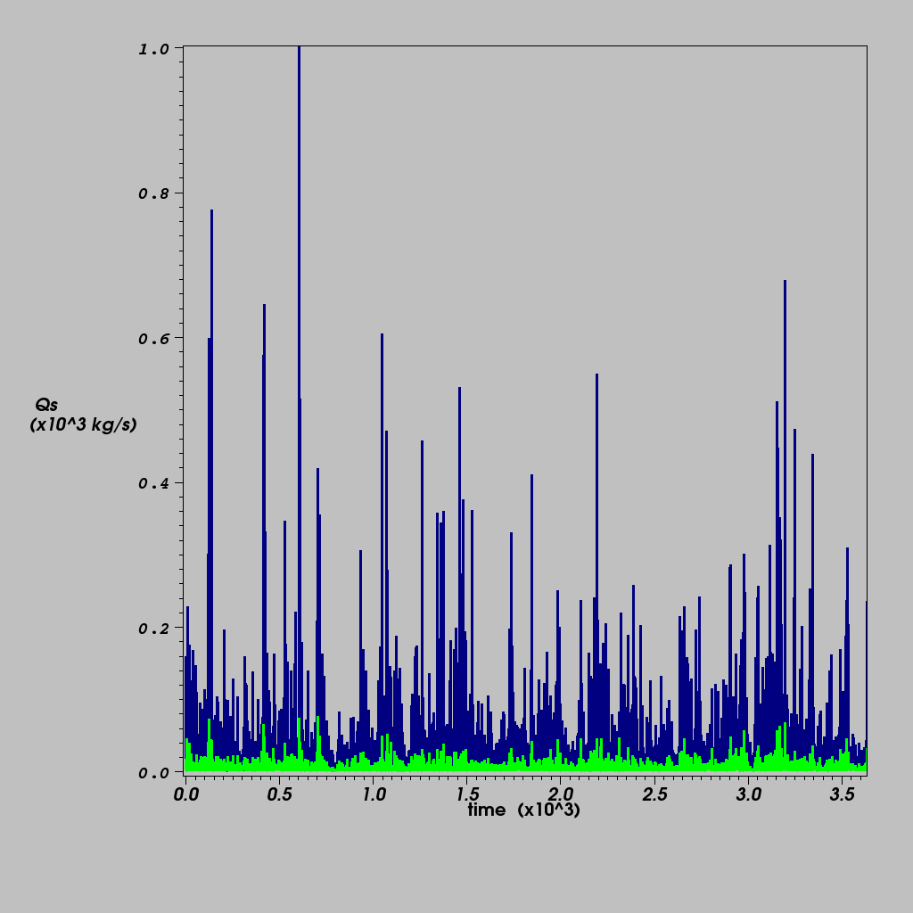
Output
VisIT: Daily Water Discharge Output
VisIT: Daily Sediment Load Output
base-case
base-case
reservoir
precipitation
Drastic changes in water flux result from increased precipitation regime,
Severe reduction in sediment flux results from damming.

Slide 22
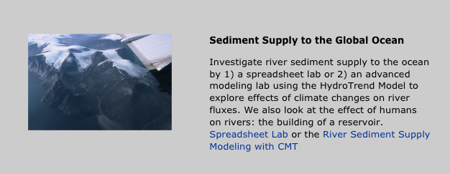
HydroTrend Example
Educational Material in CSDMS wiki
http://csdms.colorado.edu/wiki/Labs_portal

Slide 23
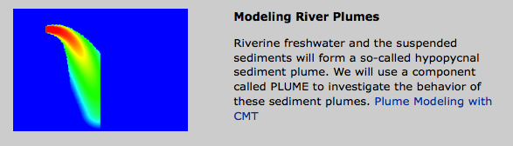
Plume Example
Educational Material in CSDMS wiki
http://csdms.colorado.edu/wiki/Labs_portal

Slide 24
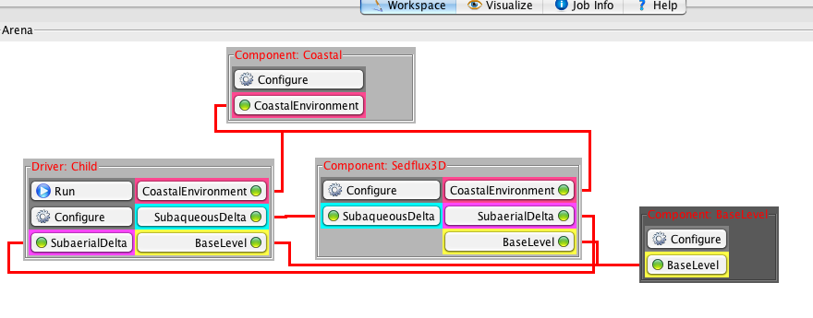
Demo 2: Setting up a Coupled Simulation
Now Configure
Notes:
Select a driver, it will show that it needs other components (potentially).
If you have this in the wireless mode, the connections will light up and be same color
Or if you think it is more clear; use the wired mode.
Now you can hit RUN

Slide 25
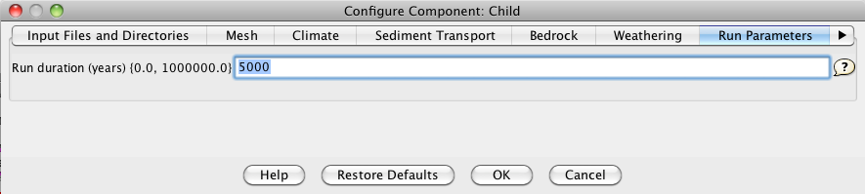
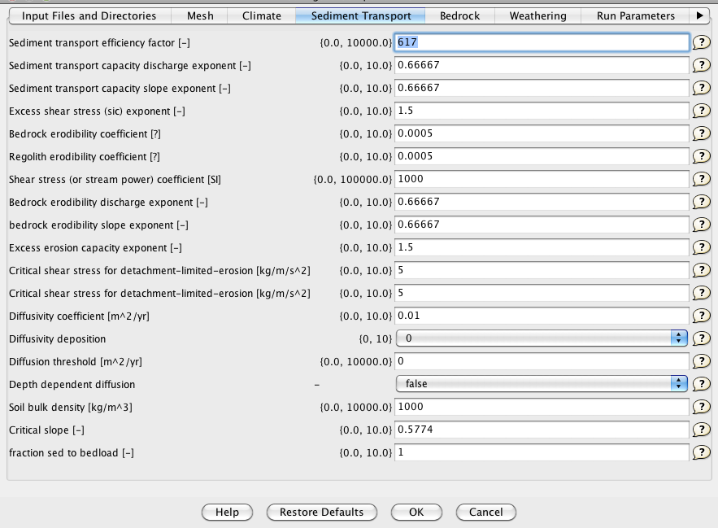
Demo 2: Configuration

Slide 26
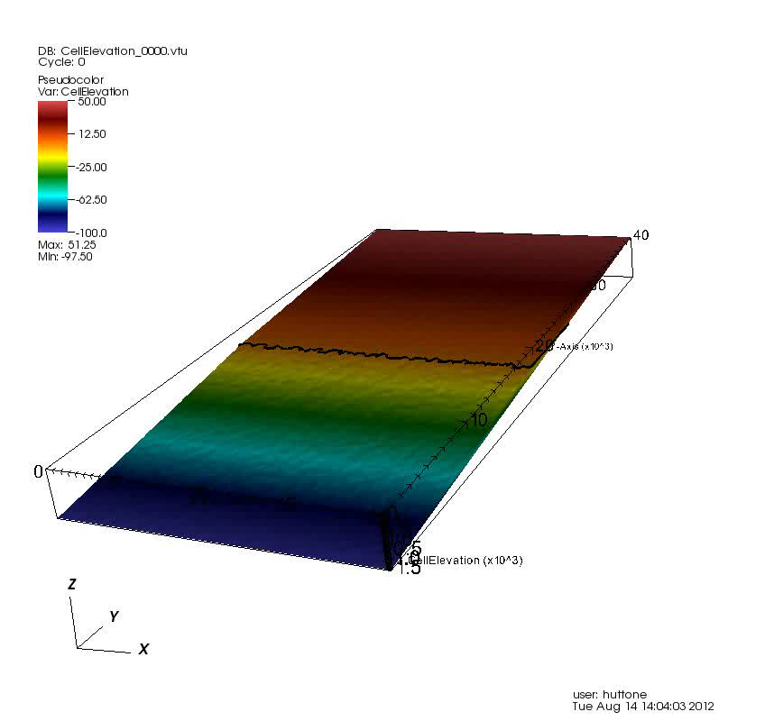

Slide 27
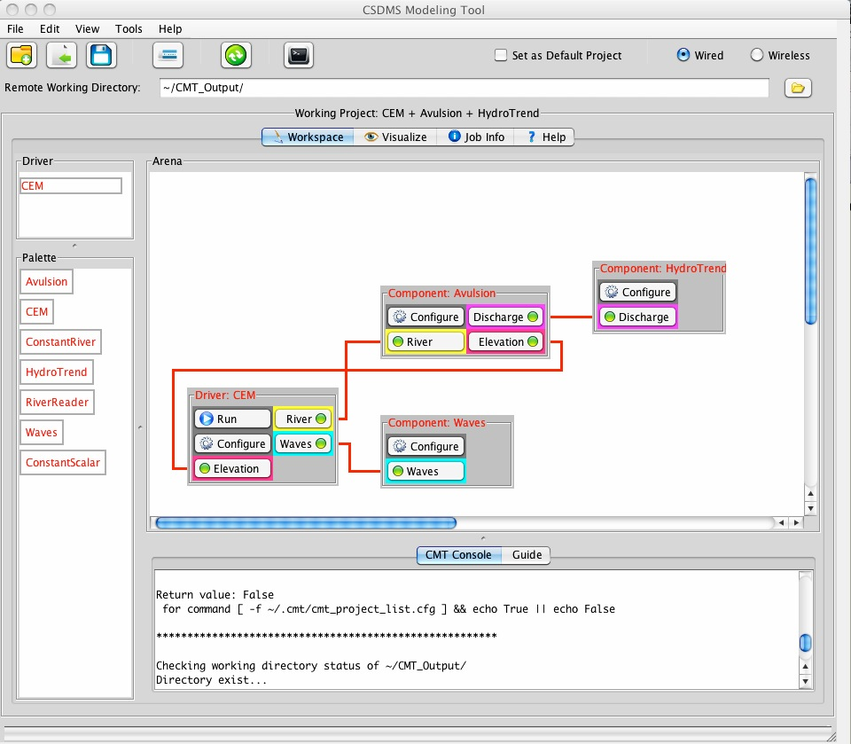
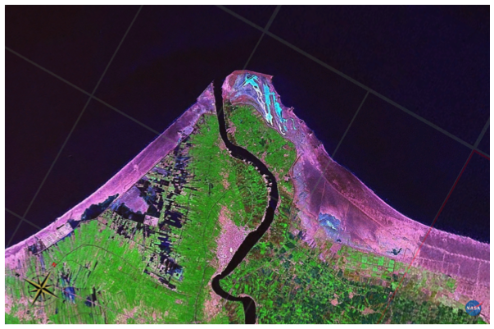
Model Coupling Example
Running CMT allows a user’s computer to become a client that connects remotely to a server on the CSDMS HPC cluster, where the model computation takes place
Delta Avulsion
HydroTrend
Coastal Evolution Model
Waves
Coupled code has 3 legacy models and 1 new model of > 7 developers linked.

Slide 28
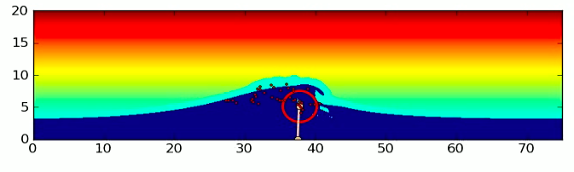
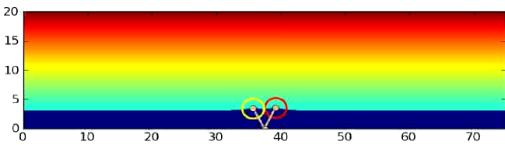
Model Coupling
Coupling a coastal evolution model (CEM) with a delta avulsion model (Avulse), a hydrological model (HydroTrend) and a wave generator (WAVE).
These codes were all in C, but originally had different dimensions (1D and 2D).
(Ashton et al., Computers & Geoscience, 2013)

Slide 29
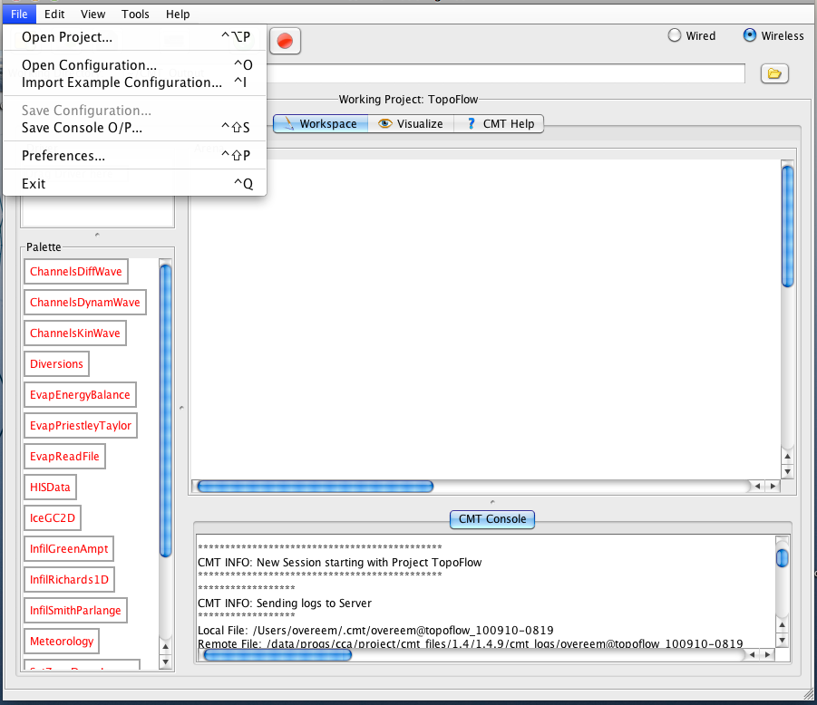
Example Configurations: ‘BLD-Files’
Notes:
Note Reed Maxwell’s experiment

Slide 30
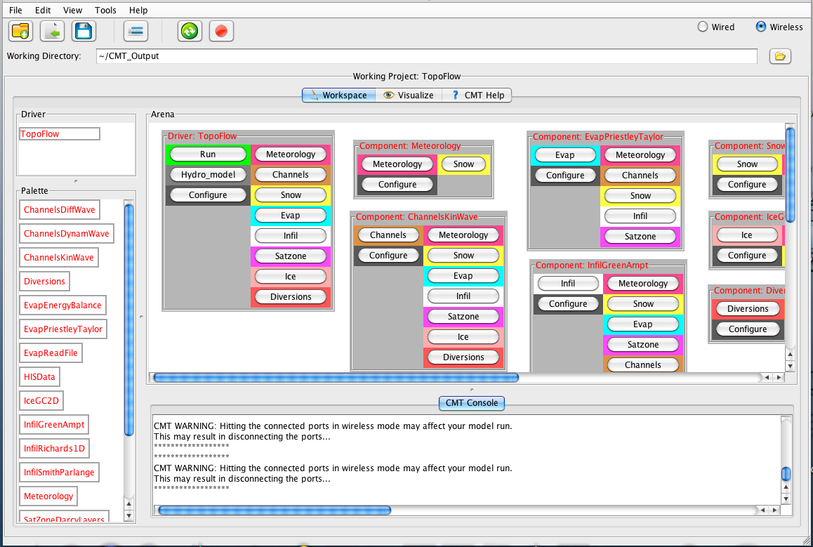
Example Configurations: ‘BLD-Files’
TopoFlow; infiltration modules. This is an example where you can first run more simple algorithms, Green-Ampt Infiltration, and then swap in more complex methods, f.e. Richards Infiltration.

Slide 31
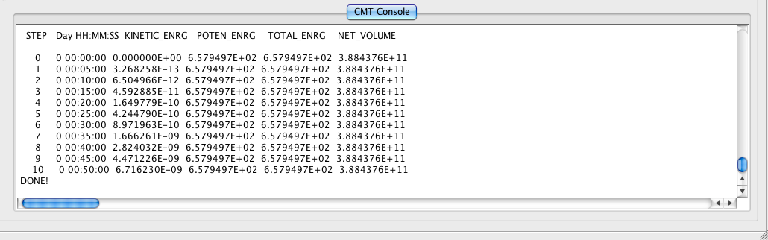
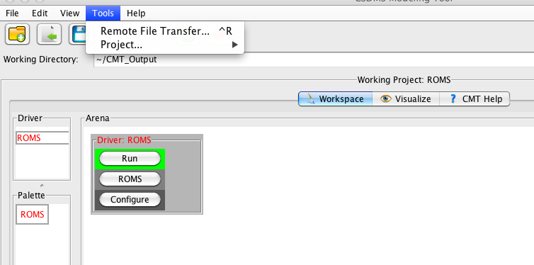
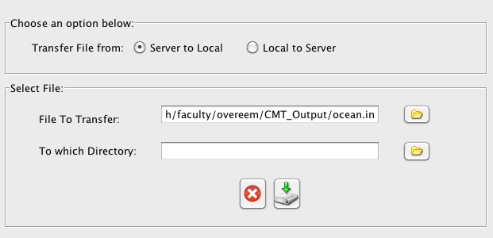
Getting Simulation Results
1. Console prints basic model results & statements on simulation
2. Output files have been written onto your Working directory on Beach. Go grab them!
Transfer the remote file to your local machine.

Slide 32
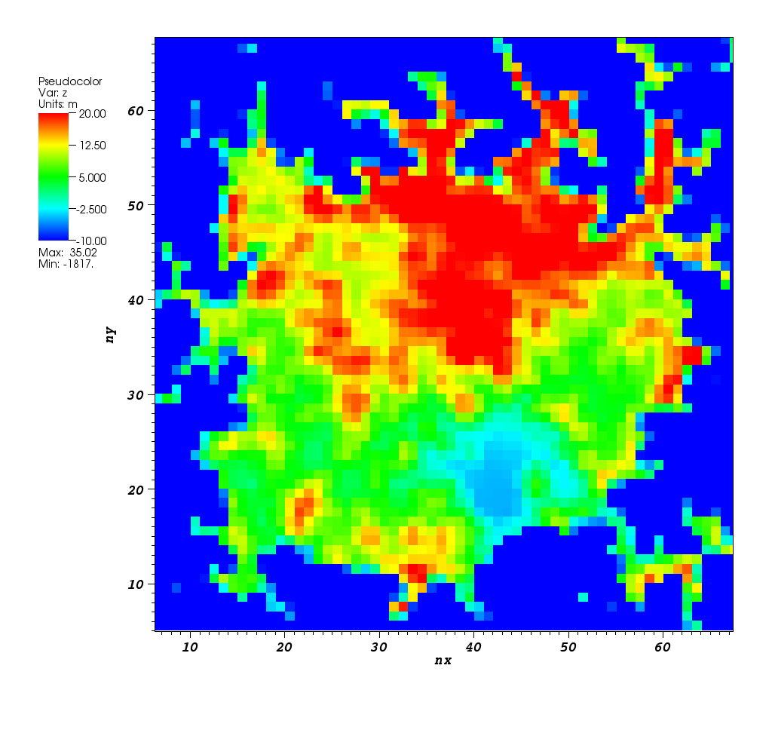
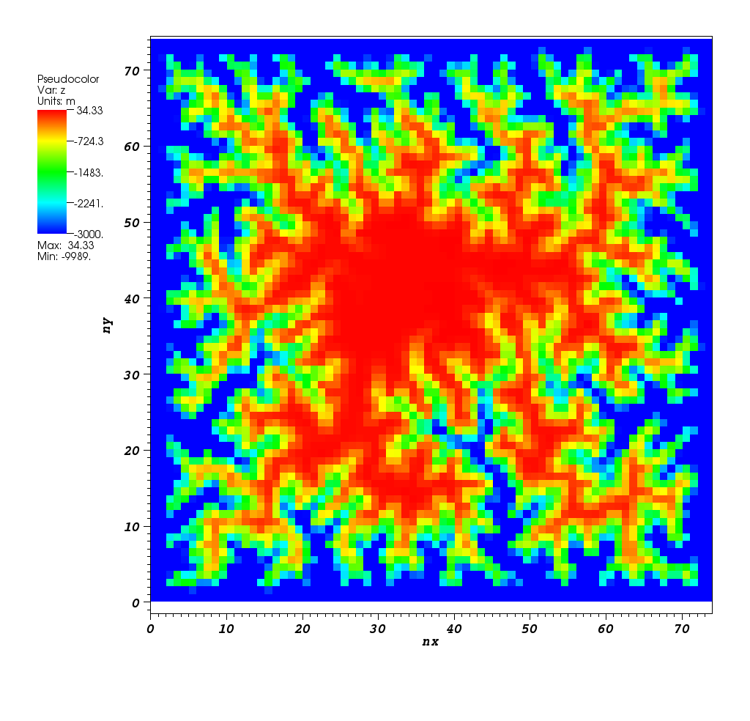
VisIt: Visualizing Grids
Example: Visualization of Landscape Evolution Experiments with ERODE-Global
Time-series, Grid-Stacks (0D,1D, 2D)
You can do this on HPCC and use multiple processors for large datasets

Slide 33
Questions on CMT?

Slide 34
Trouble Shooting for Users
VPN and Firewall issues (involve local IT staff)
Did jobs run & complete? (consult job info)
Empty Palette (bug we are working on; restart)
Directory for file I/O (set unique directories for individual simulations)
Model Errors (consult job Info)

Slide 35
Help on CSDMS wiki
1) Register for HPCC account and use Beach
http://csdms.colorado.edu/wiki/HPCC_Access
2) CSDMS Modeling Tool installation and use
http://csdms.colorado.edu/wiki/CMT_download
3) VisIt for parallel scientific visualization
http://csdms.colorado.edu/wiki/CMT_visualization
https://wci.llnl.gov/codes/visit/
4) NetCDF output files now standard within CSDMS framework
http://www.unidata.ucar.edu/software/netcdf/

Slide 36
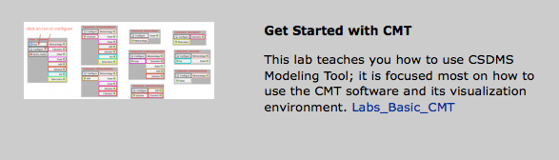
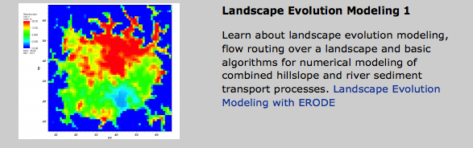
Get Started with Labs 2013

Slide 37
Future CMT-Related Development
A web-based Component Modeling Tool (CMTweb) that allows users to run CMT directly through a web browser
Automate ‘wrapping’ processes to allow legacy code in the repository to become plug-and-play components faster
Incorporate benchmark data into the CSDMS modeling framework, for model inter-comparisons
Development of an Educational Toolkit
Notes:
Alert; class will be working with software in development…..
Alert: class notes and exercises become an online course.

