Slide 1
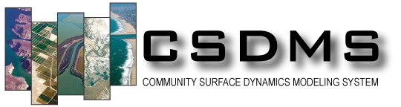
Energy Balance and the Hydrological Cycle
Hydrology Lab
Posted by Irina Overeem, May 2016

Slide 2
Importance of Energy Balance for Hydrological Cycle
Solar energy drives the global climate
Differential solar heating gives rise to an equator-to-pole temperature gradient, resulting in a gradient in the height of atmospheric pressure surfaces that drives the global atmospheric circulation.
Energy balance within a watershed varies dramatically with local slope and aspect

Slide 3
Key Physical Concepts
Planetary Energy Balance – Stefan-Boltzmann Law
Radiant incident to horizontal plane - Cosine / Geometry
Impacts of watershed slope and aspect on incoming radiation

Slide 4
Planetary Energy Balance
S= Solar energy Input
SHORT-WAVE
Reflected solar radiation = S (1-a_{p})
Stefan-Boltzmann Law
The total energy radiated per unit surface area of a black body per unit time is directly proportional to the fourth power of the black body's thermodynamic temperature T.
q= radiated heat from a black body
LONG-WAVE

Slide 5
Planetary Energy Balance
S= Solar energy Input
S= 1.74 * 10¹⁷ W
Planetary albedo ~0.3
a_{p} = 0.3
Stefan-Boltzmann Constant
σ = 5.67 *10⁻⁸ W m⁻² K⁻⁴
Earth’s surface area
5.1 * 10¹⁴ m²
Planetary Temperature without Atmosphere
254 K (or -19C or -2F)
Notes:
How would the mean temperature of the Earth change if its average albedo were changed to 0.1 or 0.5? (Courtesy Bob Anderson’s textbook, p 118).

Slide 6
Greenhouse Gasses
Gasses like a.o. H₂O, CO₂, CH₄,O₂ absorb energy, mostly from emitted infrared light.
Temperature shift due to absorption makes Earth’s temperature warmer, to an average of 15°C.

Slide 7
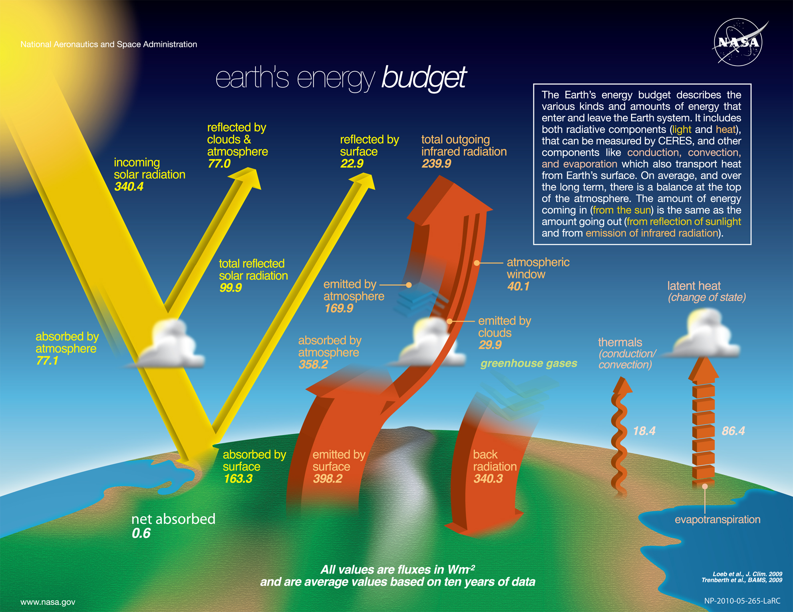
Earth’s Energy Balance and Greenhouse Gasses
Image Courtesy NASA (http://science-edu.larc.nasa.gov/energy_budget/)
Because of absorbtion and emission by greenhouse gases, most of the emission to space is from the atmosphere. Because of the counter-radiation back to the
surface from greenhouse gases (H20, CO2, CH4 and others) the earth’s average surface
temperature is a habitable 288 K, 33 K higher than the radiation emission temperature.

Slide 8
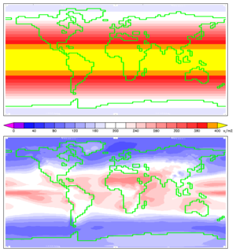
Insolation: incoming Solar integrated over time
Annual average insolation at the top of the Atmosphere (TOA), depends on latitude
Annual average insolation at the top of land surface, depends on latitude, and on athmospheric reflectance and absorption (a.o. cloudiness).
Image Courtesy Wikipedia

Slide 9
Radiation Incident on a Plane
η
equator
φ
S₀
Radiative Flux by latitude
Sij=cos(η+φ)
η = tilt of the Earth, varies -23.5° at summer soltice, to 23.5° at winter soltice.
φ = latitude

Slide 10
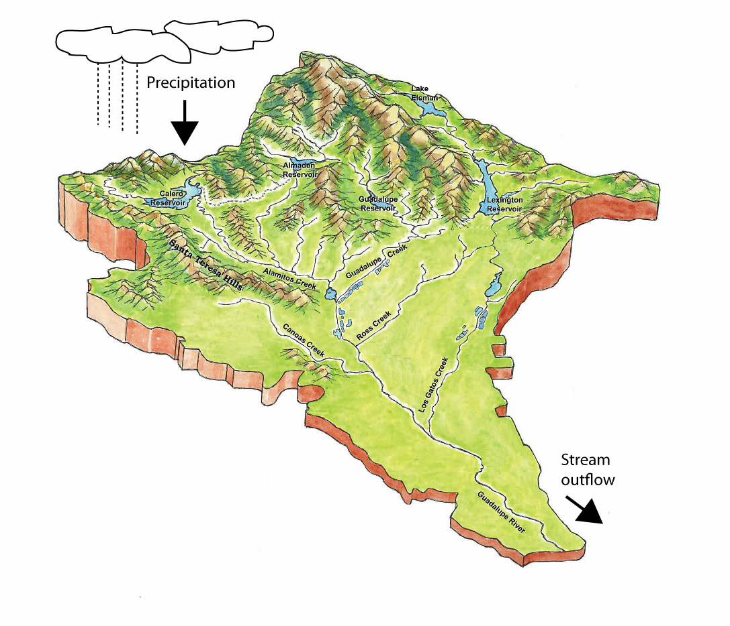
Hydrological Watershed
Watershed or drainage basin
Need to know its location: latitude and longitude.
Incoming radiation over the simulated events depends on the time of year.
Local morphometry of the watershed is important, because it further distributes the incoming energy.

Slide 11
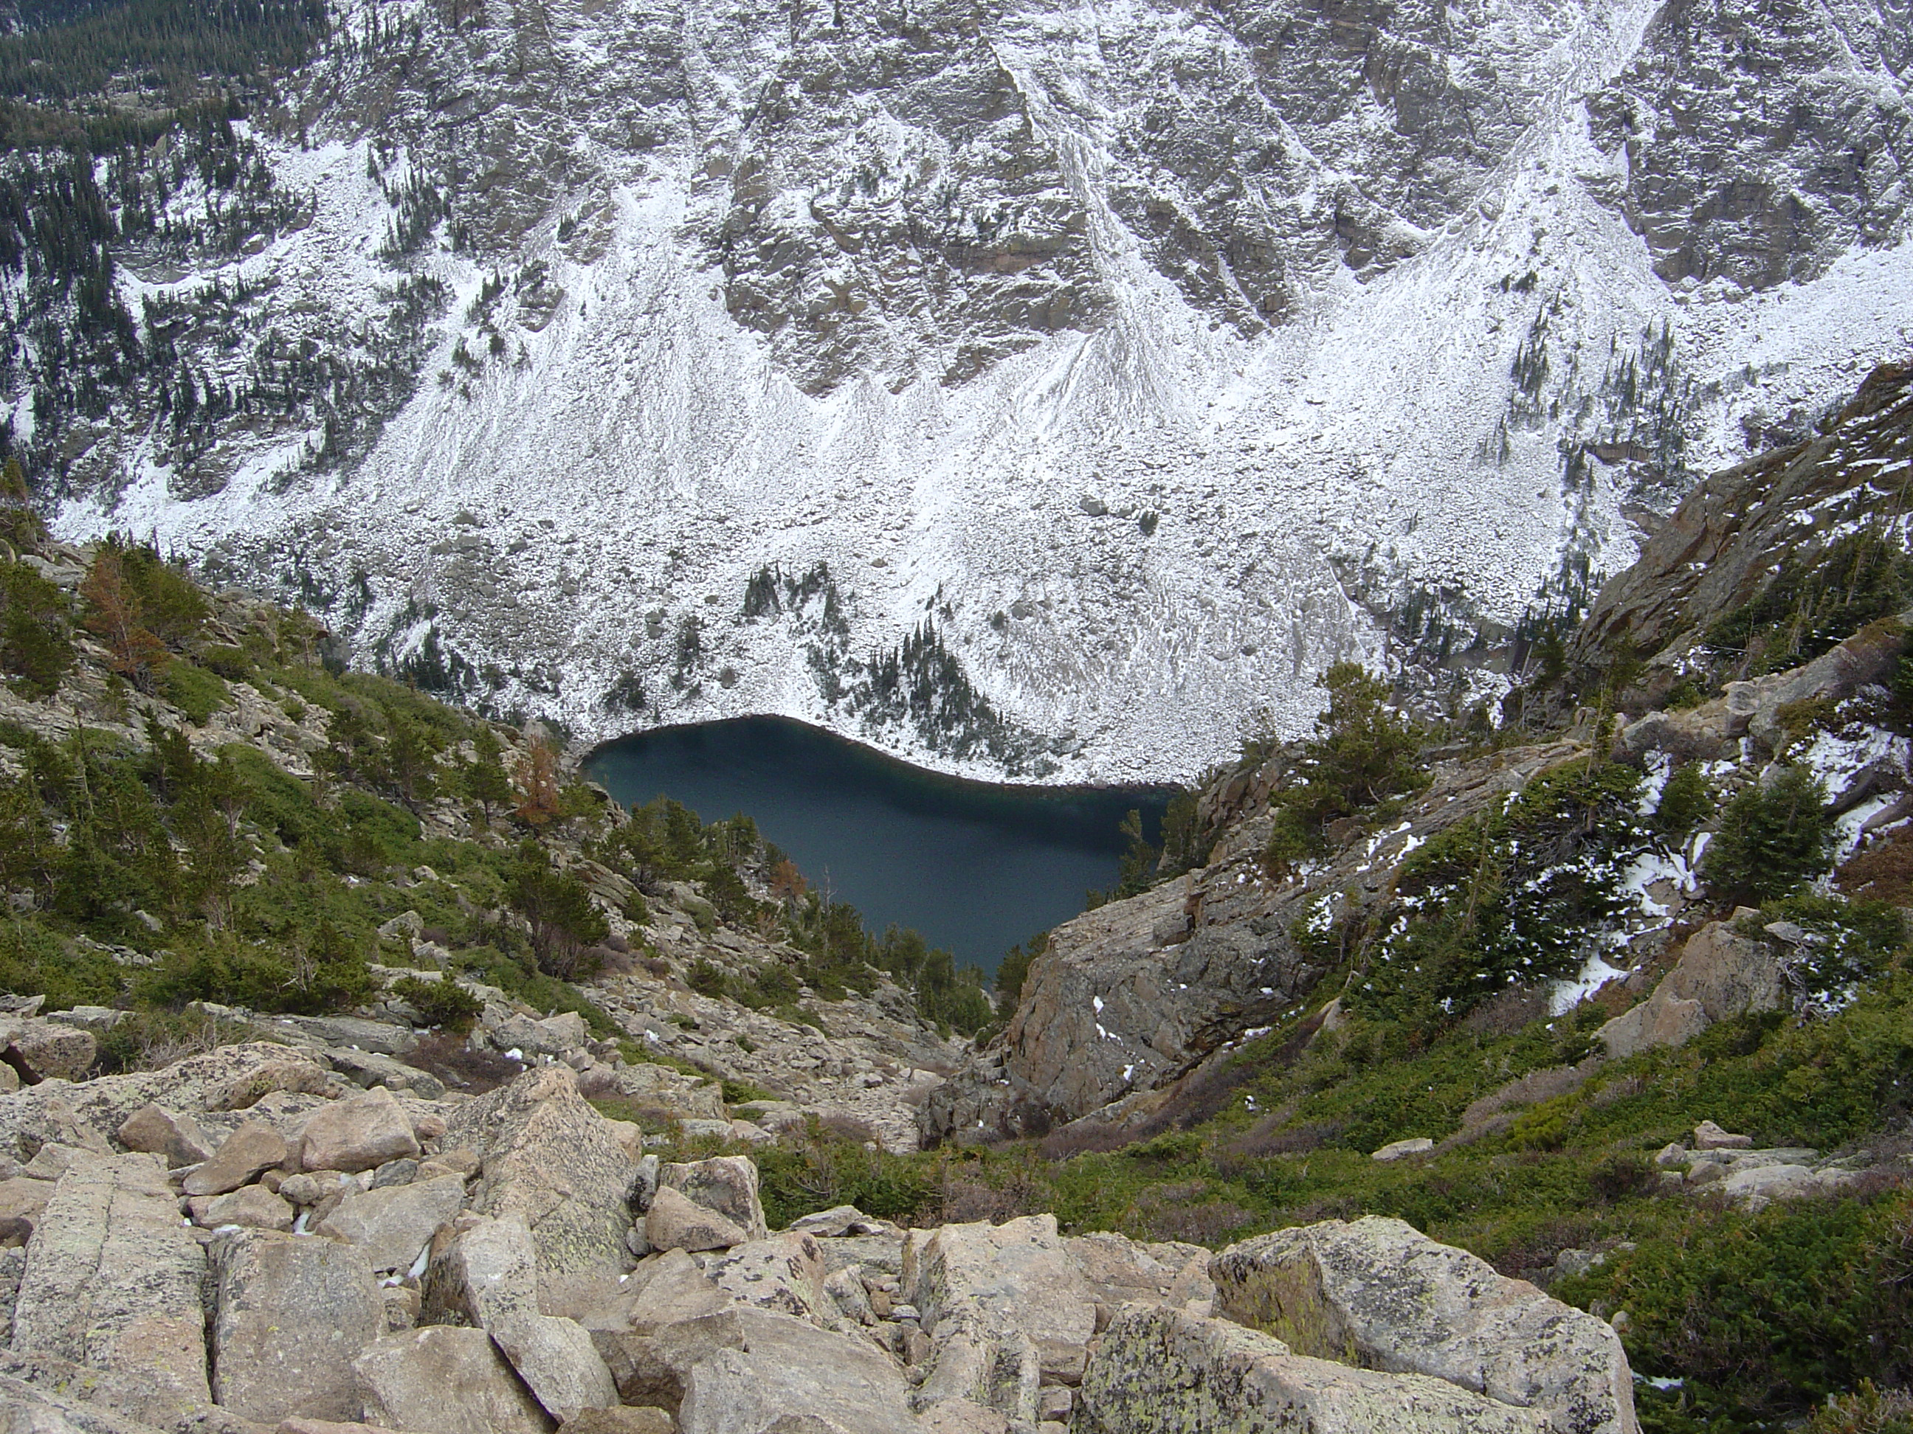
Morphometry of a Watershed
North-facing slopes
Aspect = direction that a topographical slope faces
Example in the alpine environment of the Rocky Mountains.
North-facing slopes hold snow and ice
for a longer period over the thaw cycle.
South-facing slopes
Image Courtesy; Irina Overeem

Slide 12
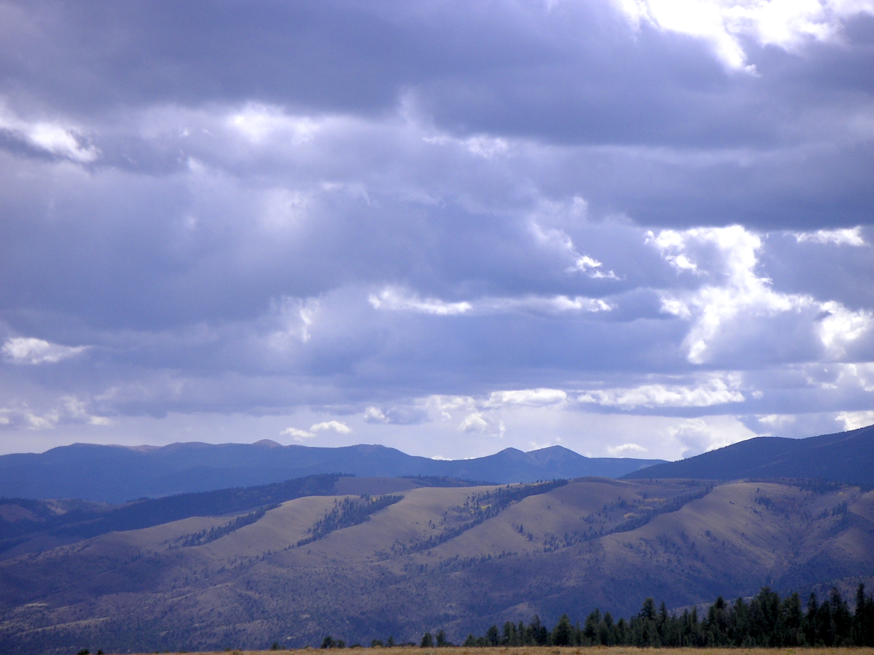
Morphometry of a Watershed
North-facing slopes
Aspect = direction that a topographical slope faces
Example in Rocky Mountain region, near Salida, Colorado.
North-facing slopes hold moisture and promote woody vegetation, whereas south-facing slopes are more dry and only grasses and small shrubs can sustain.
Image Courtesy; Irina Overeem
South-facing slopes

Slide 13
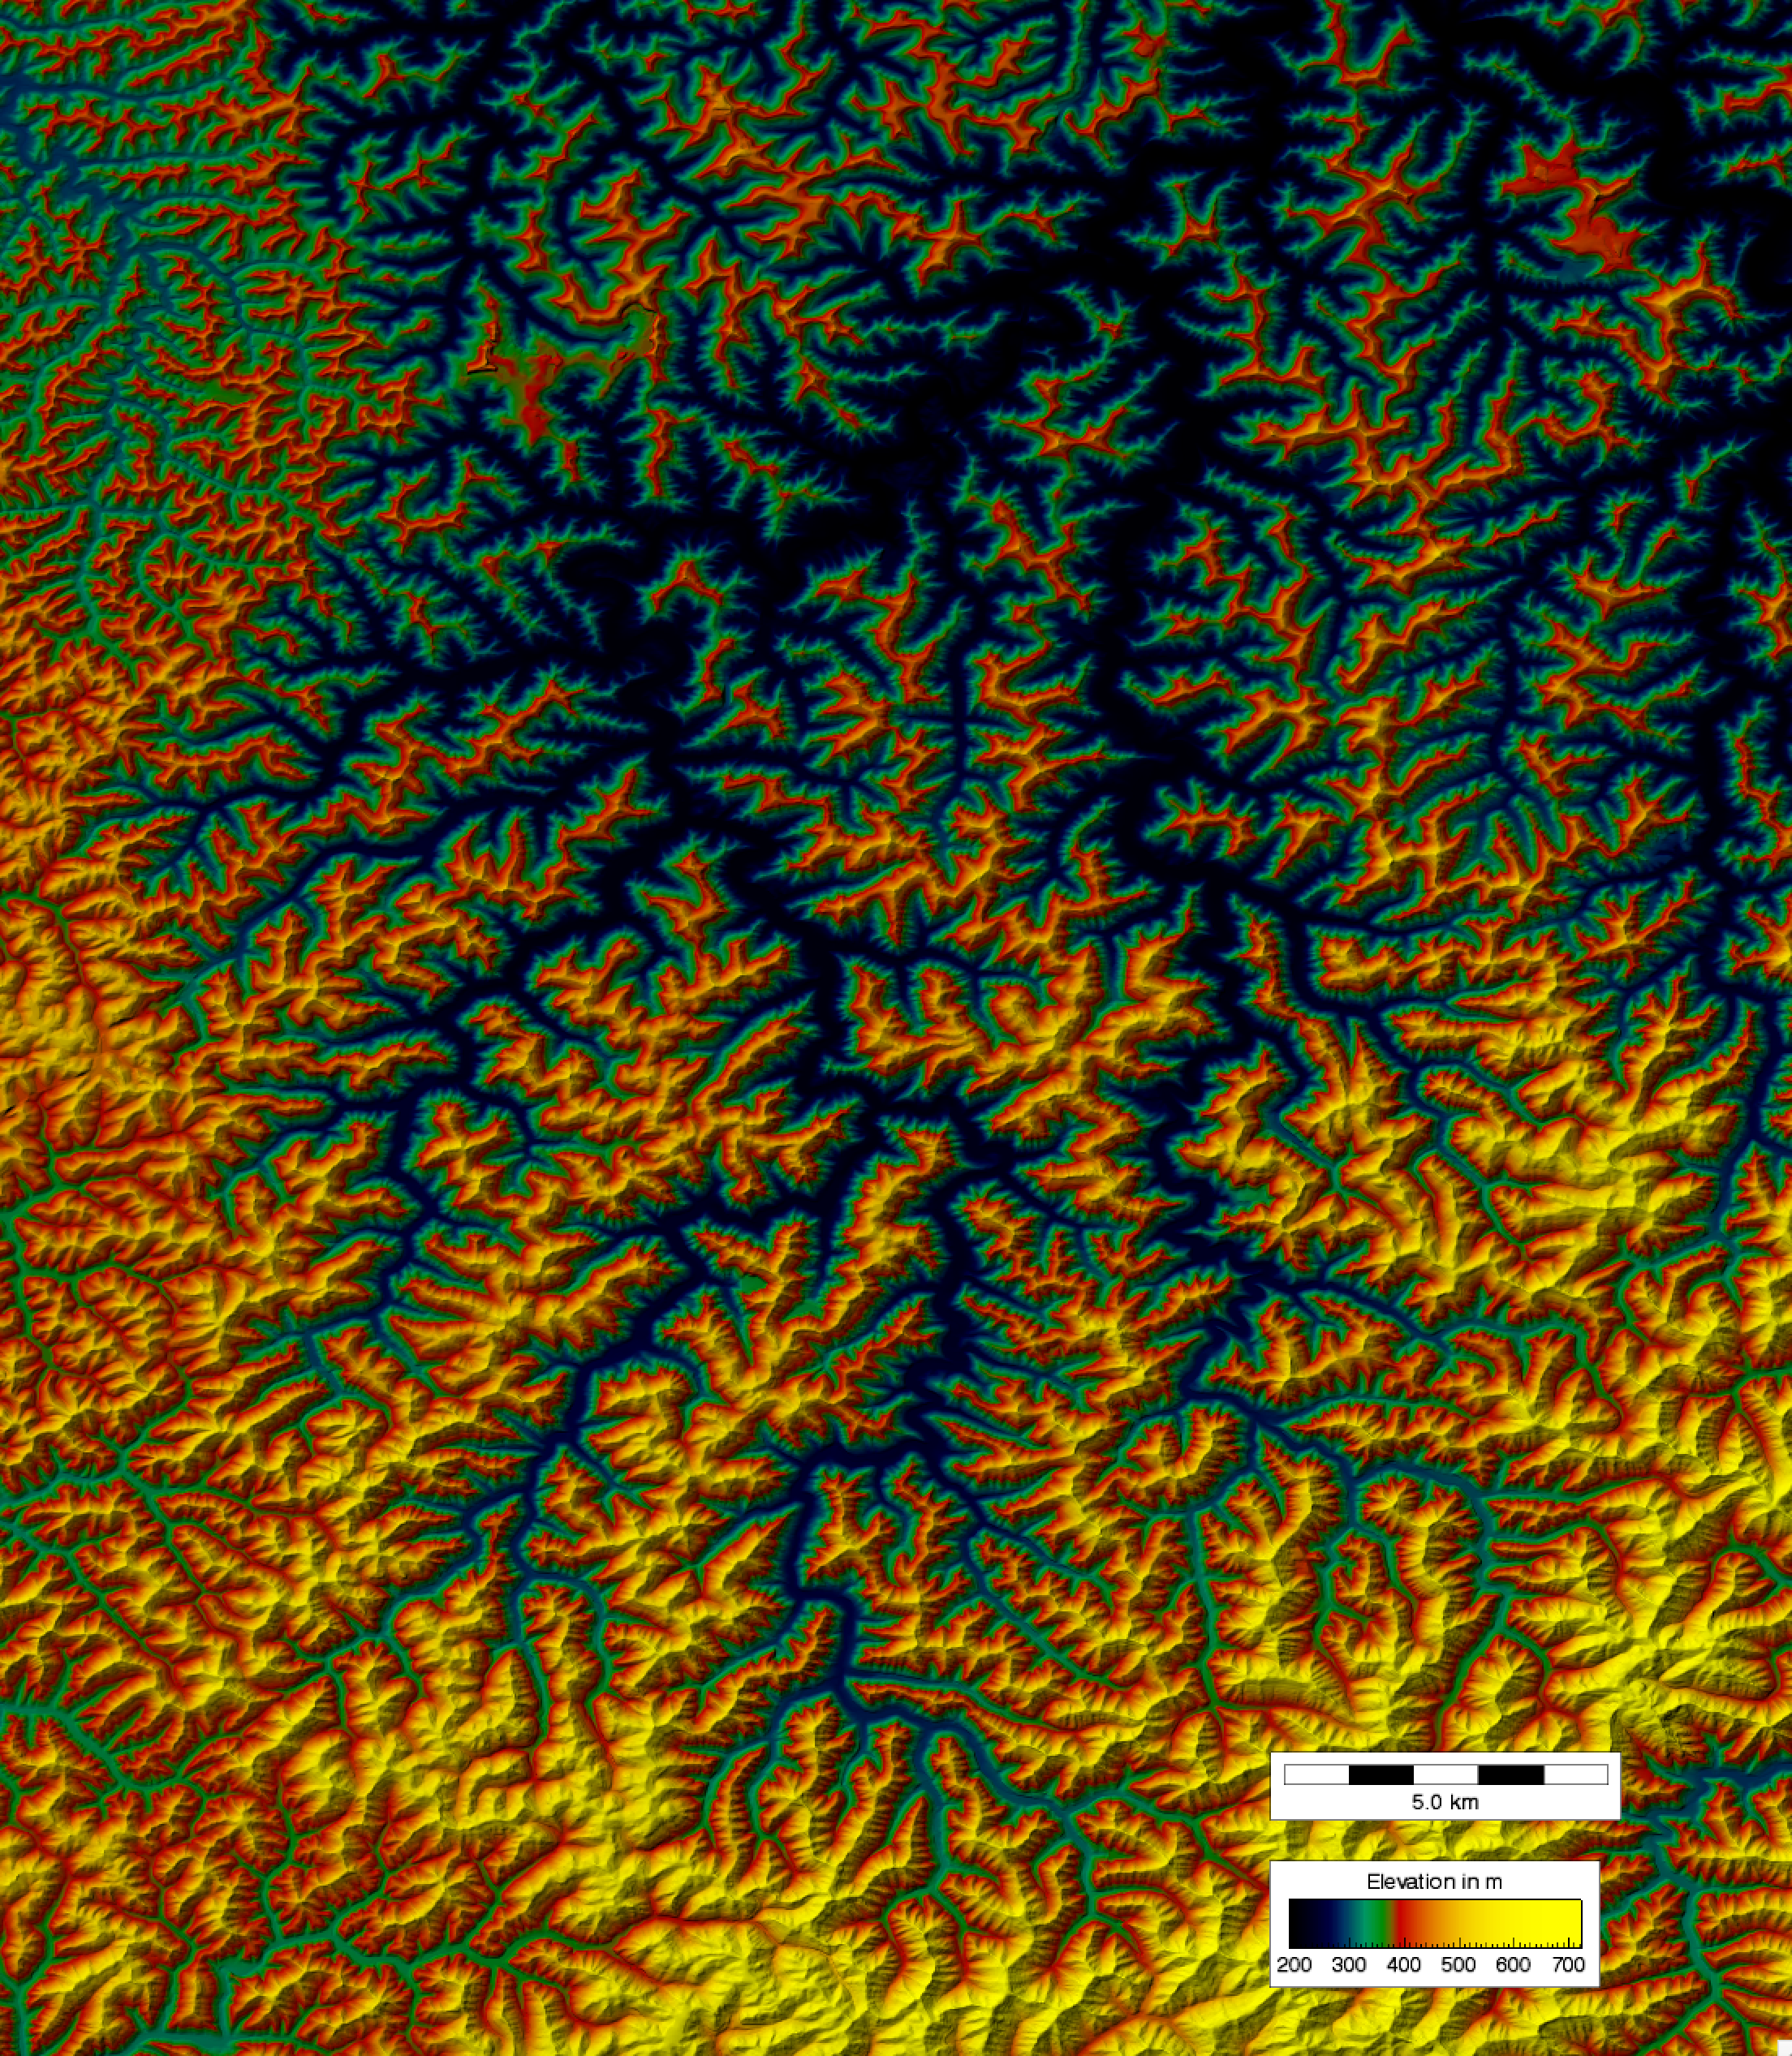
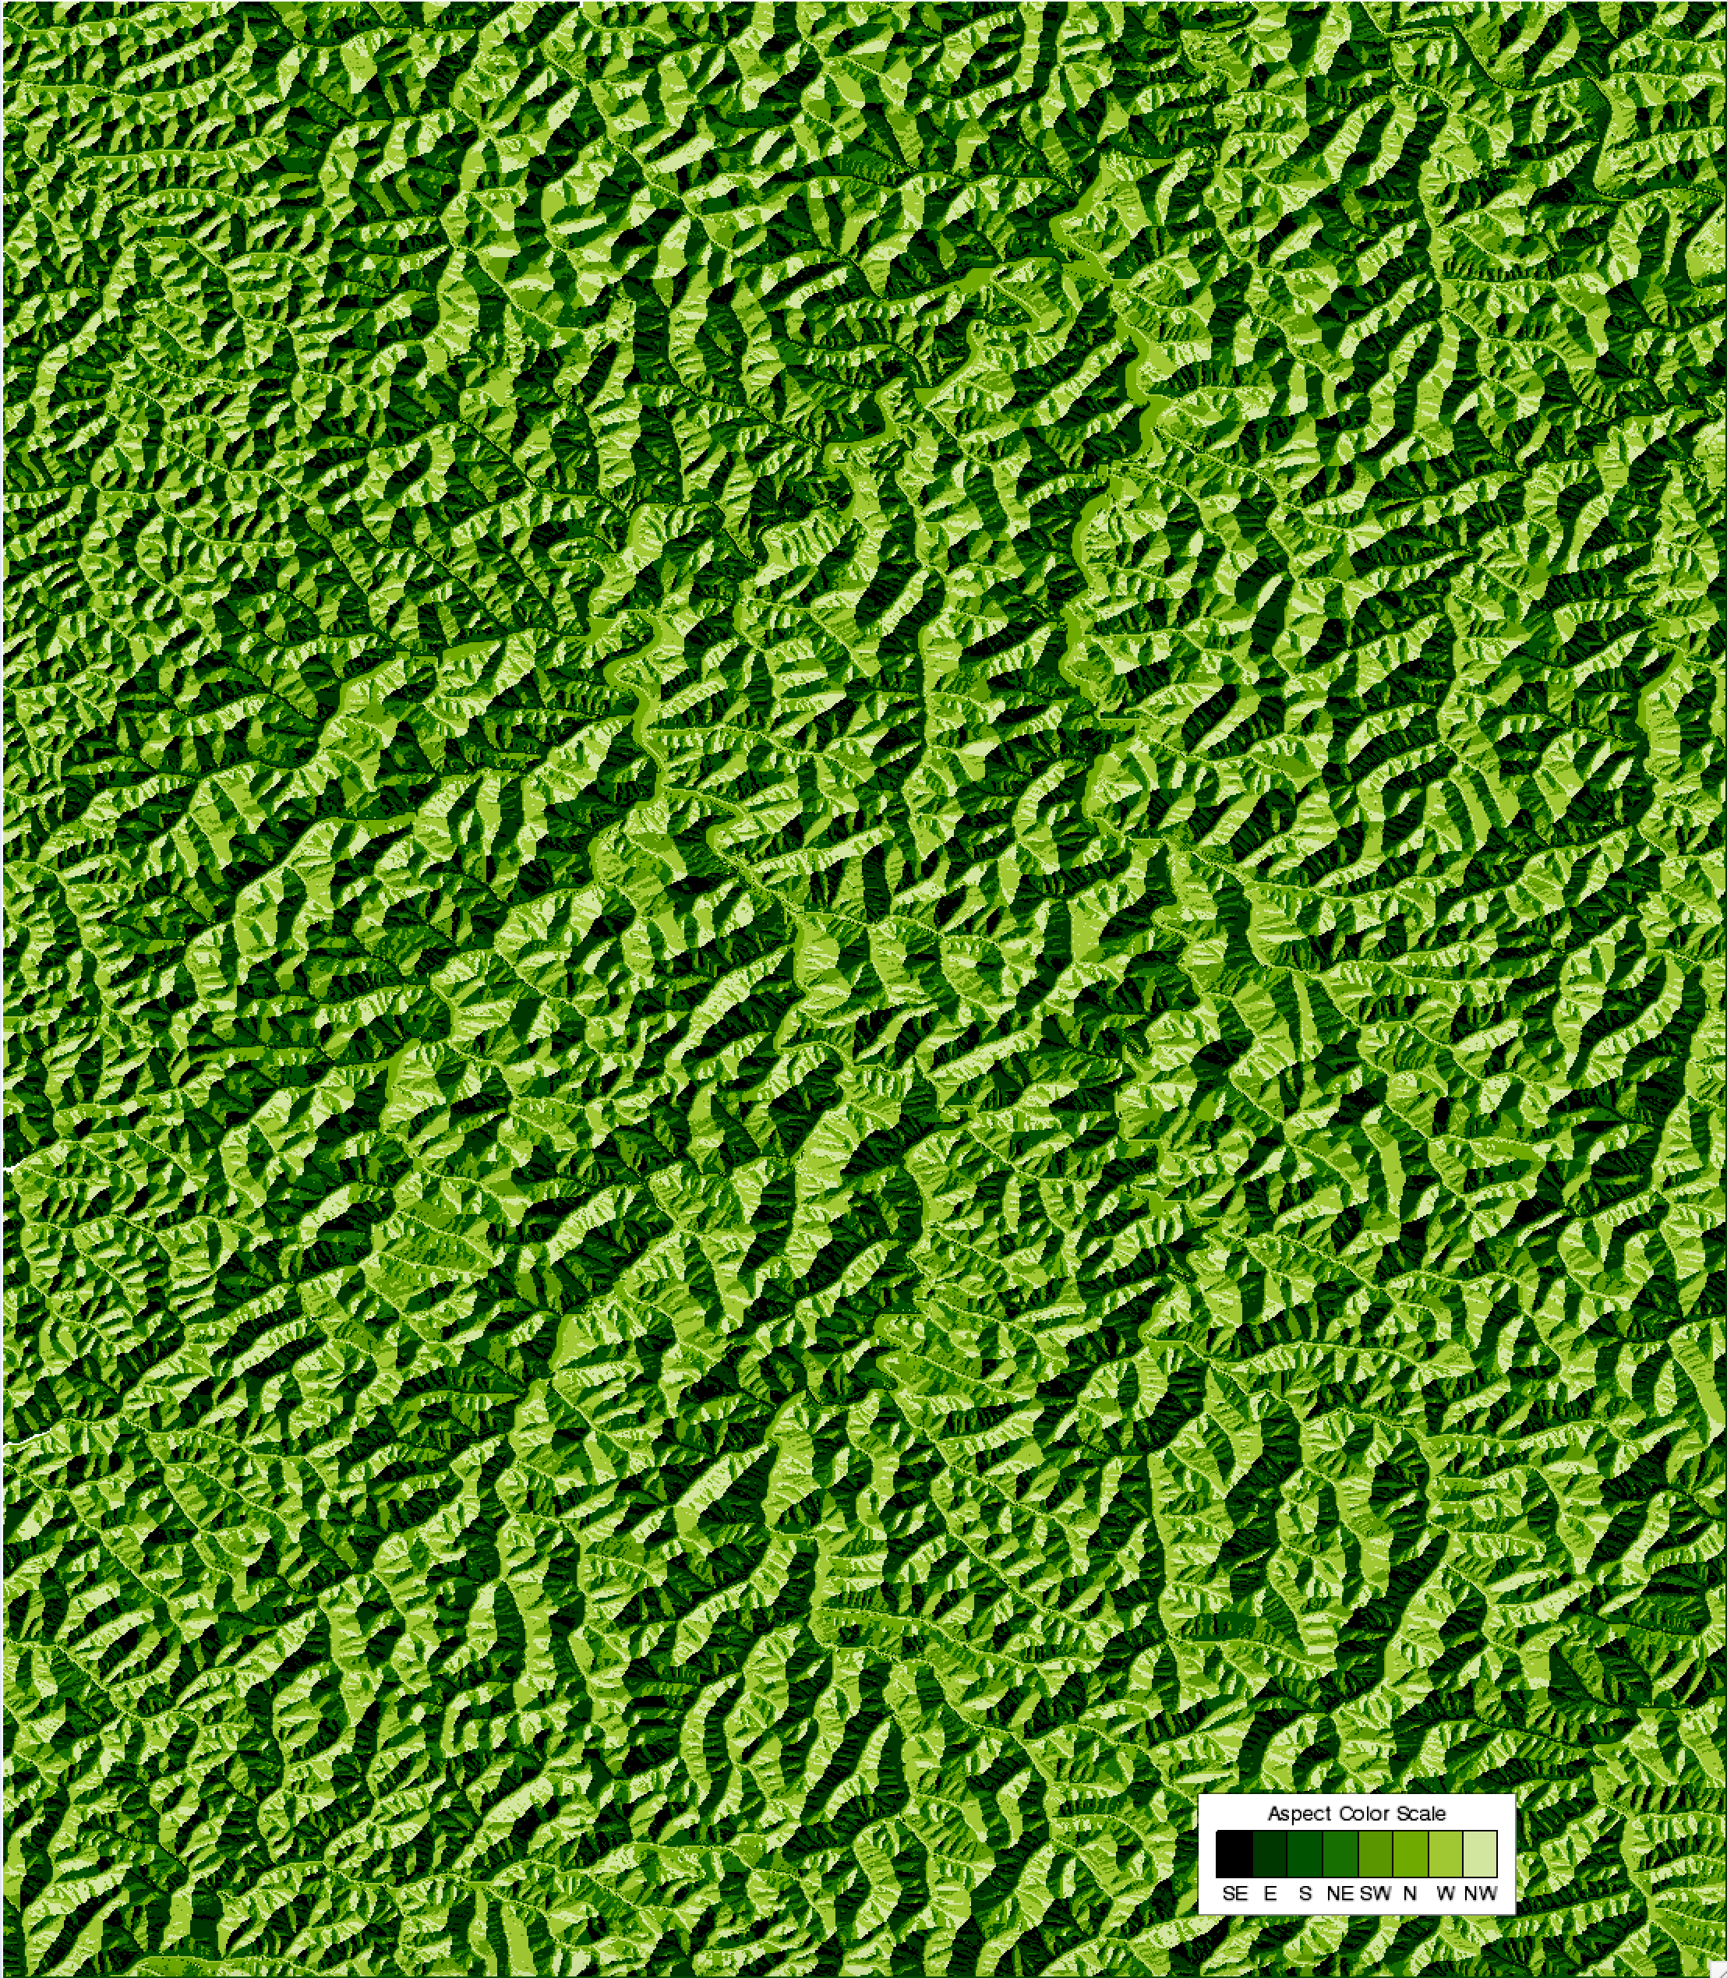
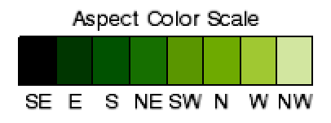
Beaver Creek Watershed, KY
Relief
Aspect
Beaver Creek is at 37° N
Classified into
45 degree bins

Slide 14
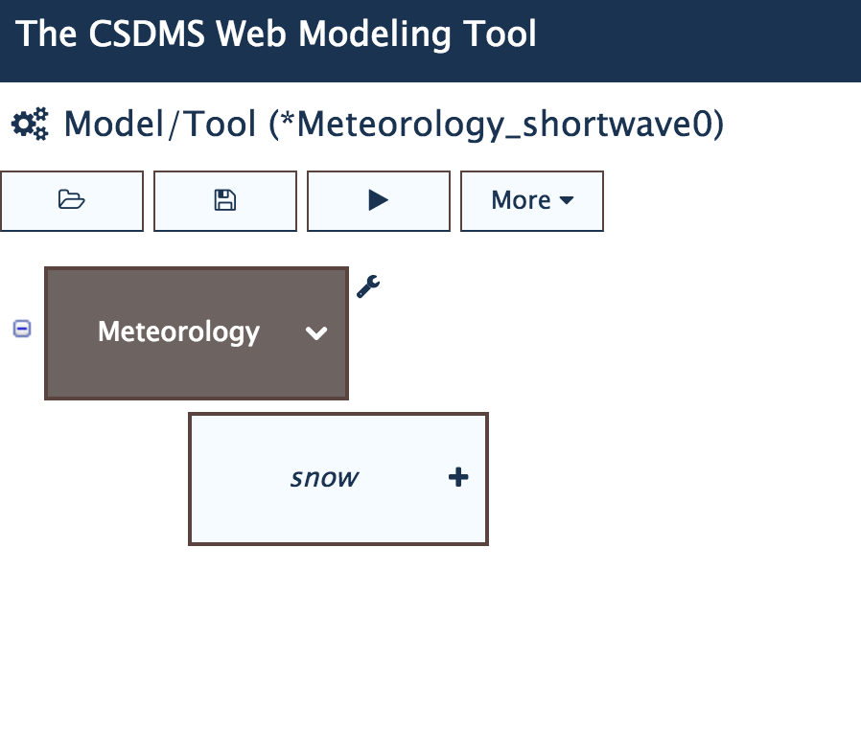
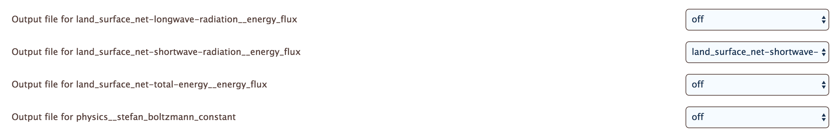
WMT-Hydrology
Energy Balance in Meteorology Component
Select Meteorology Component
Save output for:
‘land-surface-net-shortwave-radiation__energy flux

Slide 15
Setup in Meteorology
Use the example “Meteo_Shortwave_BeaverCreek”
Set up a run for a 6 hr simulation time (e.g. sunrise – noon) at an arbitrary date in the year.

Slide 16
WMT Energy Balance examples

Slide 17
WMT Energy Balance examples

Slide 18
Exercises
Change the data settings to include the summer equinox, summer solstice
Can you discuss how short-wave radiation would change the Beaver Creek catchment would be at 70° N?
Show the implications of solar radiation differences with aspect.

Slide 19
References
Dingman, S.L., 2008. Physical Hydrology, 2nd edition. ISBN 987-1-57766-561-8.
Anderson, R.S., Anderson, S., 2010. Geomorphology; the mechanics and chemistry of landscapes. ISBN 978-0-521-51978-6.

