Slide 1

Stream Response to Precipitation Event
Hydrology Lab
Posted by Irina Overeem, May 2016

Slide 2
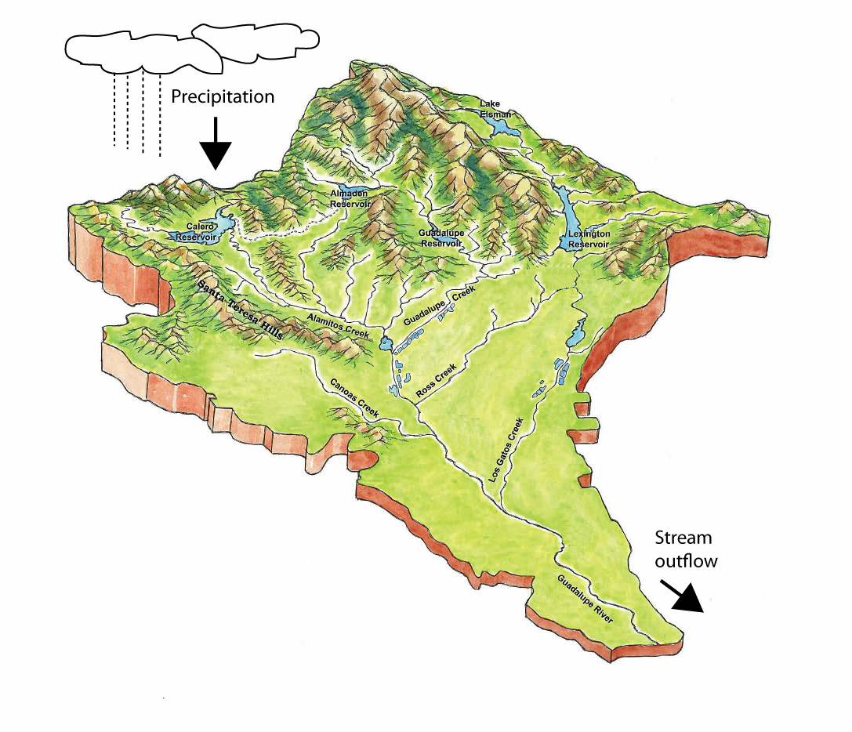
Hydrological Watershed
Watershed or drainage basin
Topographical area that contributes all the water that passes through a given cross-section of a stream or river
(after Dingman, 2008)

Slide 3
Conservation of Mass
Law of Conservation of Mass
Mass is neither created nor destroyed, for a given control volume and a defined time span.
Rainfall rate i
Amount In – Amount Out = Storage
I – Q = ΔS
or, rate of inflow minus rate of outflow equals the rate of change in storage:
I/Δt – Q/Δt = ΔS/Δt
Recall this can be written at instantaneous rate:
i-q=dS/dt
Qutflow rate q

Slide 4
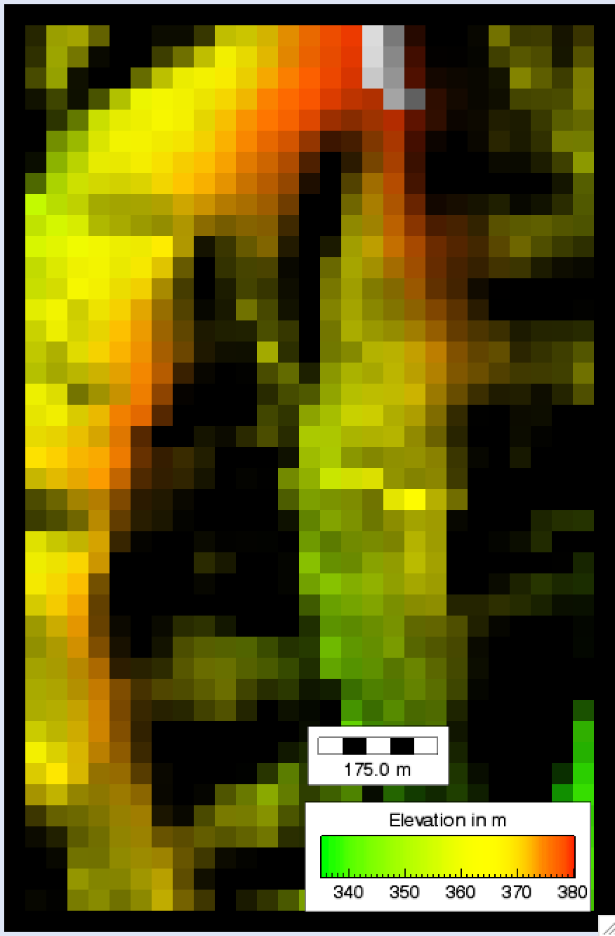
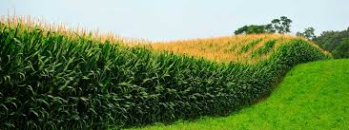
Experimental watershed in Iowa,
Treynor watershed
Treynor Watershed
Very small Agricultural Research Watershed in the Corn Belt in Iowa. Consist of deep loess soils, and is mostly single-cropped. Has been a study watershed for many decades for rain, runoff and erosion observations.
Digital Elevation Model in TOPOFLOW, 30m x,y resolution, 870m by 1320 m
site_DEM.rtg and site.rti (and the other input grids).

Slide 5
Theoretical Precipitation Input
Constant Rain Rate = 54 mm/hr for 3 hrs.
Stepwise Rain Rate = 156 mm/hr for 1 hr

Slide 6
Real-world Precipitation Input
A graph showing water input over time is called a “hyetograph”
Input file: 00_June_20_67_rain_rates.txt
The rain rates values are listed every minute for 180 minutes

Slide 7
Stream Response Concepts
A graph showing water discharge over time is called a “hydrograph”
1
2
WMT Output file: basin-outlet-water-xsection_volume flow rate
More upstream in a catchment the hydrograph shows a higher peak and
more rapid response to a rainfall event
2. Further downstream, the contributing are is larger and response is more dampened.

Slide 8
Hydrograph
Treynor, 3hr constant rain rate

Slide 9
Spatial distribution of Discharge
Treynor, 3hr constant rain rate

Slide 10
Hydrograph
Treynor, 3hr variable rain rate

Slide 11
Questions with Model Experiments
Calculate whether mass is conserved? Compare the rainfall influx and discharge outflux.
Why are these results unrealistic? Discuss missing processes, develop a hypothesis on how these processes impact water outflux.
What watershed parameters are set to be spatially uniform that are likely non-uniform?

Slide 12
References
Dingman, S.L., 2008. Physical Hydrology, 2nd edition. ISBN 987-1-57766-561-8.
Onstad, C.A., Piest, R.F., Saxton, K.E. 1976. Watershed Erosion Model Validation for Southwest Iowa. Proceedings of the Third Federal Interagency Sedimentation Conference, March 1976.

Slide 13
References
Dingman, S.L., 2008. Physical Hydrology, 2nd edition. ISBN 987-1-57766-561-8.
Onstad, C.A., Piest, R.F., Saxton, K.E. 1976. Watershed Erosion Model Validation for Southwest Iowa. Proceedings of the Third Federal Interagency Sedimentation Conference, March 1976.

