Slide 1



Evaluating luminescence as a sediment transport metric
Harrison Gray^{1,2}, Gregory Tucker¹, Shannon Mahan²

Slide 2


Photo credit: ImageStock
Photo credit: Fisher-Price Fun-2-Learn Computer Cool School

Slide 3
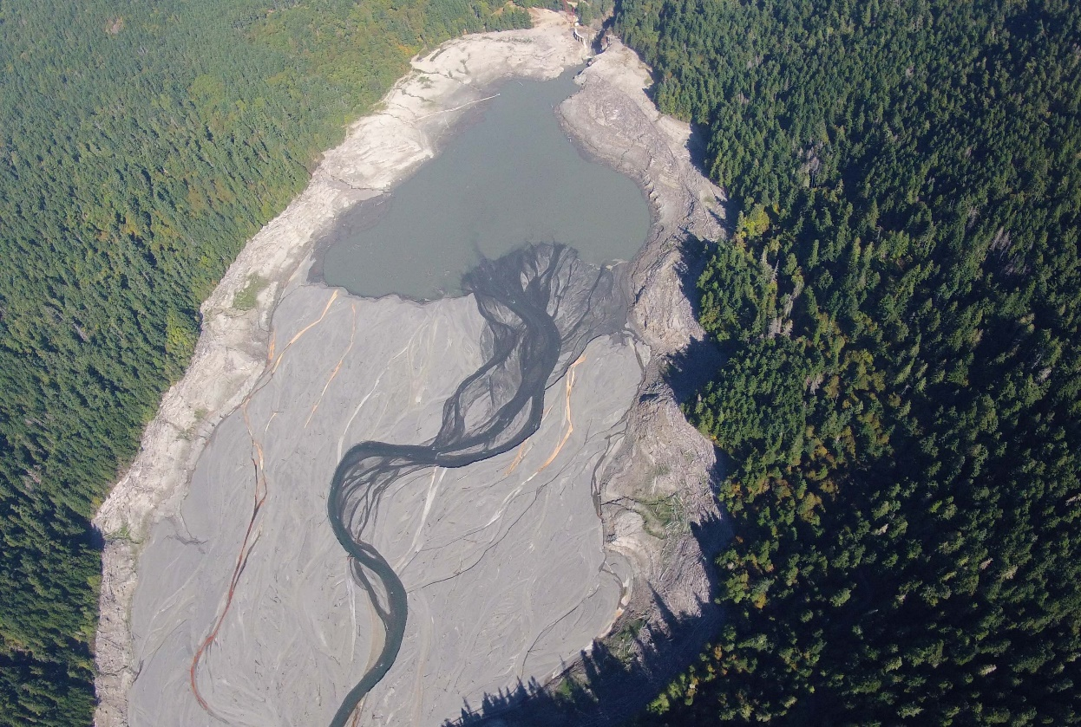
Fine sediment transport in rivers
The rates of fine sediment transport is an important variable in landscape evolution, river engineering, and restoration.
Obtaining long-term rates (~10⁴ year) are useful to place short-term (1-10² year) rates in context.
Obtaining this data is difficult!
http://www.nps.gov/
Lake Mills Reservoir, Elwa River, WA

Slide 4
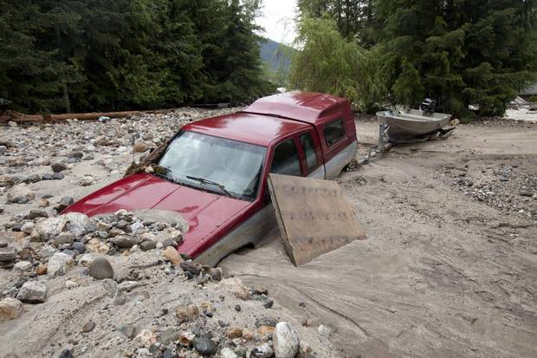
Also, rivers are bullies

Slide 5









Sediment transport information
$$ℓ_{s}$$
$$τ_{s}$$
= characteristic storage timescale
= characteristic transport lengthscale
River Channel
$$ℓ_{s}$$
$$ℓ_{s}$$
$$ℓ_{s}$$
$$τ_{s}$$
$$τ_{s}$$
$$τ_{s}$$
$$τ_{s}$$
Long-term storage center
Martin and Church, 2004; Lauer and Willenbring, 2010; Pizzuto et al., 2014

Slide 6
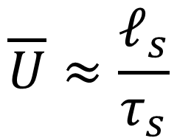
Sediment transport information
$$\overline{U}≈\frac{ℓ_{s}}{τ_{s}}$$
= ‘virtual velocity’ of sand grains
$$ℓ_{s}$$
$$ℓ_{s}$$
$$ℓ_{s}$$
$$τ_{s}$$
$$τ_{s}$$
$$τ_{s}$$
$$τ_{s}$$
Long-term storage center
Martin and Church, 2004; Lauer and Willenbring, 2010; Pizzuto et al., 2014

Slide 7
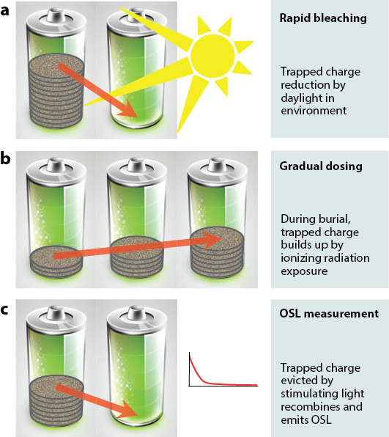
Luminescence in solids
Luminescence is a property of solids where light is produced from electrons “trapped” in crystal lattice defects.
These electrons become trapped with exposure to background radiation and escape these traps when given energy through sunlight.
Rhodes, 2011

Slide 8
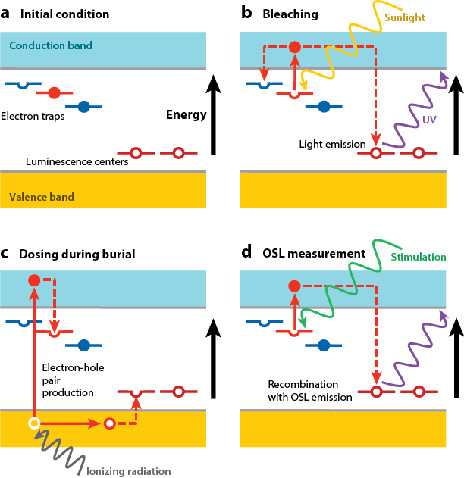
Luminescence in solids
Luminescence is a property of solids where light is produced from electrons “trapped” in crystal lattice defects.
These electrons become trapped with exposure to background radiation and escape these traps when given energy through sunlight.
Rhodes, 2011

Slide 9
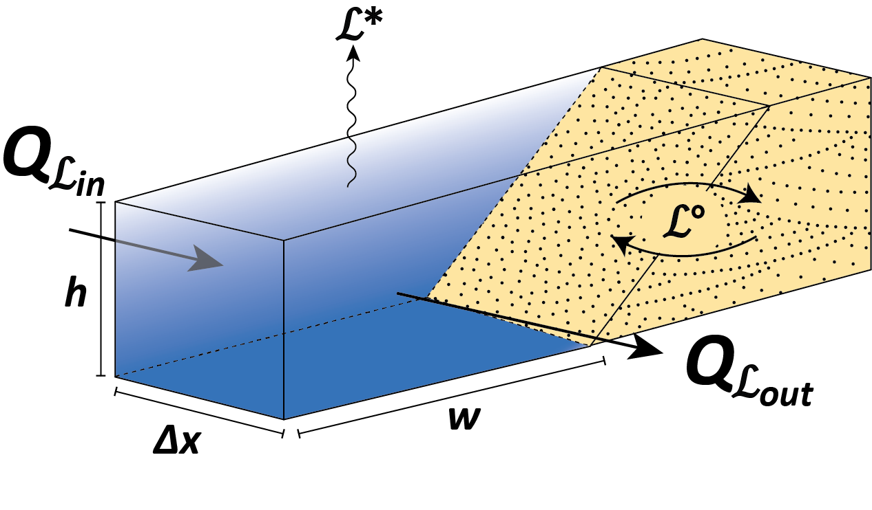
Modeling
Model built from “conservation of luminescence”
Essentially a simultaneous conservation of mass and energy
Flux of luminescence-bearing material is delivered from upstream and from interactions with floodplain storage
(Gray et al.,2017)

Slide 10
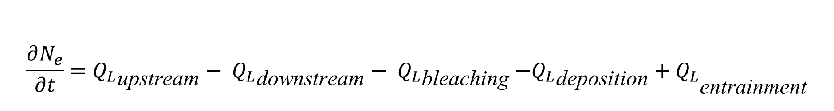
$$\frac{∂N_{e}}{∂t}={Q_{L}}_{\text{upstream}}− {Q_{L}}_{\text{downstream}}− {Q_{L}}_{\text{bleaching}}{ {−Q_{L}}_{\text{deposition}}+Q_{L}}_{\text{entrainment}}$$

Slide 11

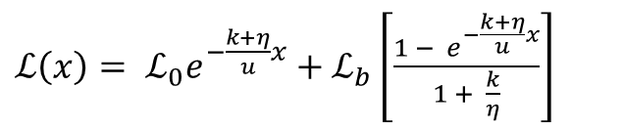

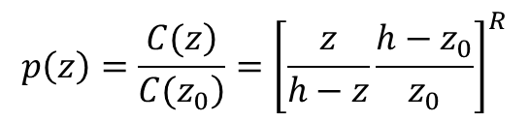





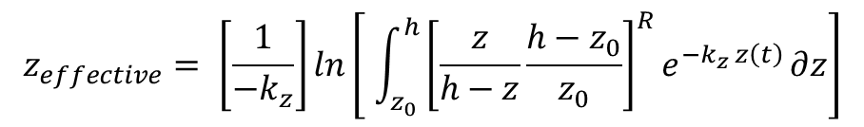



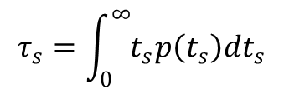
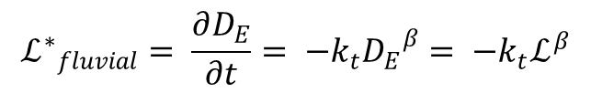
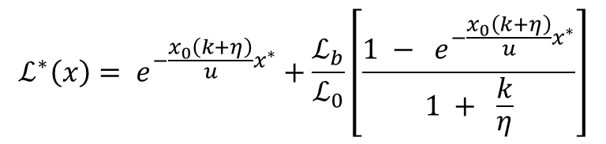

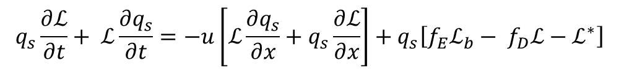

N_{e} =ΔxwhC$ℒρ$
$$Q_{\text{bleaching}}= {ΔxwhCℒ}^{∗}ρ$$
$$Q_{\text{upstream}}=whuCℒ\left(x\right)ρ$$
$${ Q}_{\text{deposition}}=Δxwhf_{D}Cℒρ$$
$${ Q}_{\text{entrainment}}= Δxwhf_{E}{Cℒ}_{b}ρ$$
$$Q_{\text{downstream}}=whuCℒ\left(x+∂x\right)ρ$$
OH GOD
$${φ\left(λ\right)=φ}_{o}(λ)e^{−\frac{z_{\text{eff}}}{\left.z_{∗}(λ\right)}}$$
$$\frac{∂(q_{s}ℒ)}{∂t}= u\frac{q_{s}\left(x\right)ℒ\left(x\right)}{Δx}− u\frac{q_{s}\left(x+∂x\right)ℒ\left(x+∂x\right)}{Δx}− { q_{s}ℒ}^{∗}− f_{D}q_{s}ℒ + f_{E}q_{s}ℒ_{b}$$
$D_{E}\left(t\right)=({\left(β−1\right)k_{t}t+D_{0}^{1−β})}^{\frac{1}{1−β}}$
$I(t)= ({\left(β−1\right)ft+I_{0}^{1−β})}^{\frac{1}{1−β}}$
$$q_{s}\frac{∂ℒ}{∂t}+ ℒ\frac{∂q_{s}}{∂t}=−u\left[ℒ\frac{∂q_{s}}{∂x}+q_{s}\frac{∂ℒ}{∂x}\right]+q_{s}\left[f_{E}ℒ_{b}− f_{D}ℒ−ℒ^{∗}\right]$$
$$z_{effective}= \left[\frac{1}{−k_{z}}\right]ln\left[ \int_{z_{0}}^{h}{{\left[\frac{z}{h−z}\frac{h−z_{0}}{z_{0}}\right]}^{R}e^{−k_{z} z\left(t\right)}}∂z\right]$$
PLEASE NO
$${ℒ^{∗}}_{fluvial}= \frac{∂D_{E}}{∂t}= −k_{t}{D_{E}}^{β}= −k_{t}ℒ^{β}$$
$\frac{∂D_{E}}{∂t}=\frac{∂I}{∂t}\left(\frac{D_{∗}}{I_{sat}−I}\right)$
$$p\left(z\right)=\frac{\left.C(z\right)}{\left.C(z_{0}\right)}={\left[\frac{z}{h−z}\frac{h−z_{0}}{z_{0}}\right]}^{R}$$
$$τ_{s}=\int_{0}^{∞}{t_{s}p\left(t_{s}\right)dt_{s}}$$
$$ℒ_{b}=D_{R}\left(x,t\right)∙τ_{s}$$
$\frac{∂ℒ_{b}(x)}{∂t}= D_{R}+ ηf_{V}\left(ℒ(x)−ℒ_{b}(x)\right)$
$$ℒ^{∗}\left(x\right)= e^{−\frac{x_{0}\left(k+η\right)}{u}x^{∗}}+\frac{ℒ_{b}}{ℒ_{0}}\left[\frac{1 − e^{−\frac{x_{0}\left(k+η\right)}{u}x^{∗}}}{1 + \frac{k}{η}}\right]$$
$ℒ\left(x\right)= ℒ_{0}e^{−\frac{k+η}{u}x}+ℒ_{b}\left[\frac{1 − e^{−\frac{k+η}{u}x}}{1 + \frac{k}{η}}\right]$

Slide 12
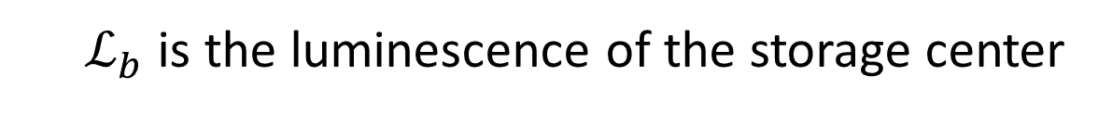
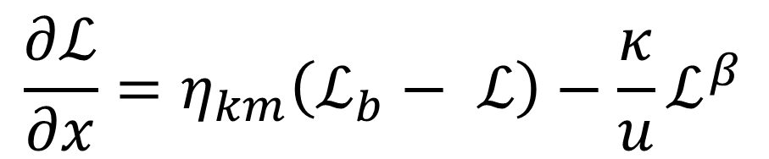

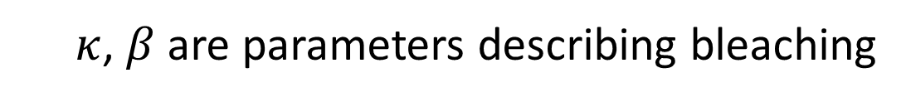
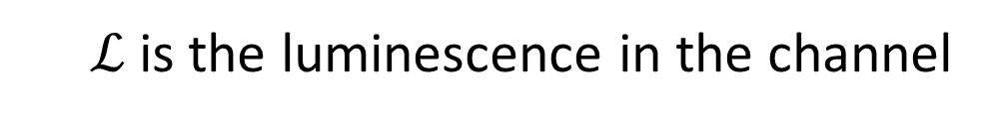
It simplifies!!!!
Two terms: first is a exchange term, second is a bleaching / advection term
$$\frac{∂ℒ}{∂x}=η_{km}\left(ℒ_{b}− ℒ\right)−\frac{κ}{u}ℒ^{β}$$
  η is the amount of sediment exchanged with a storage center per unit distance
  $ℒ_{b}$ is the luminescence of the storage center
  $u$ is the velocity of
  sediment in the channel
  $ℒ$is the luminescence in the channel
  $κ$, $β$ are parameters describing bleaching

Slide 13
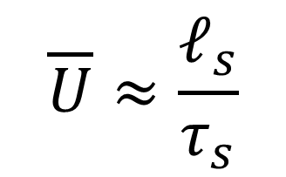
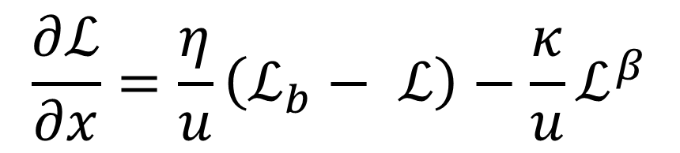
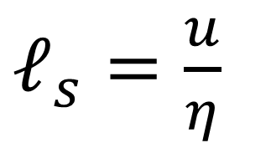
It simplifies!!!!
$$\frac{∂ℒ}{∂x}=\frac{η}{u}\left(ℒ_{b}− ℒ\right)−\frac{κ}{u}ℒ^{β}$$
By measuring the other parameters, we can solve for u and 𝜂
$ℓ_{s}=\frac{u}{η}$
$$\overline{U}≈\frac{ℓ_{s}}{τ_{s}}$$

Slide 14


Slide 15
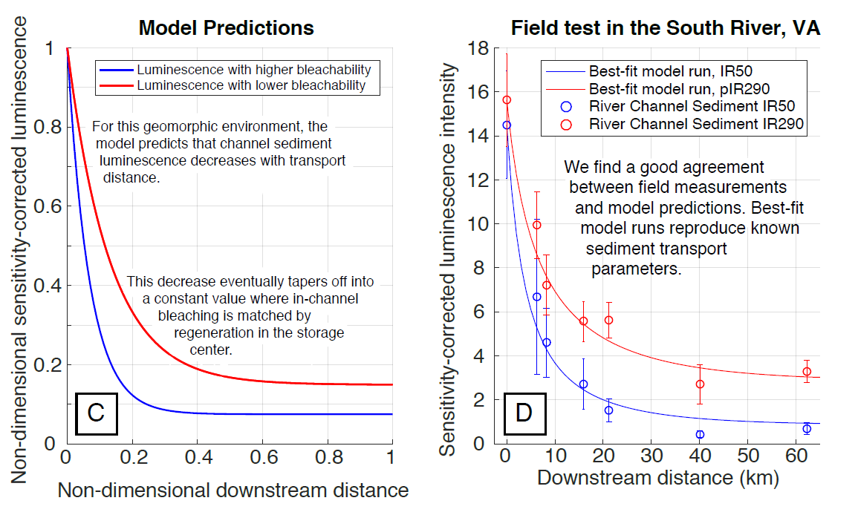

Slide 16


Slide 18
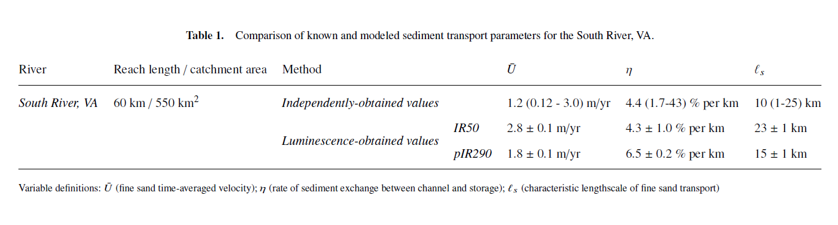

Slide 19
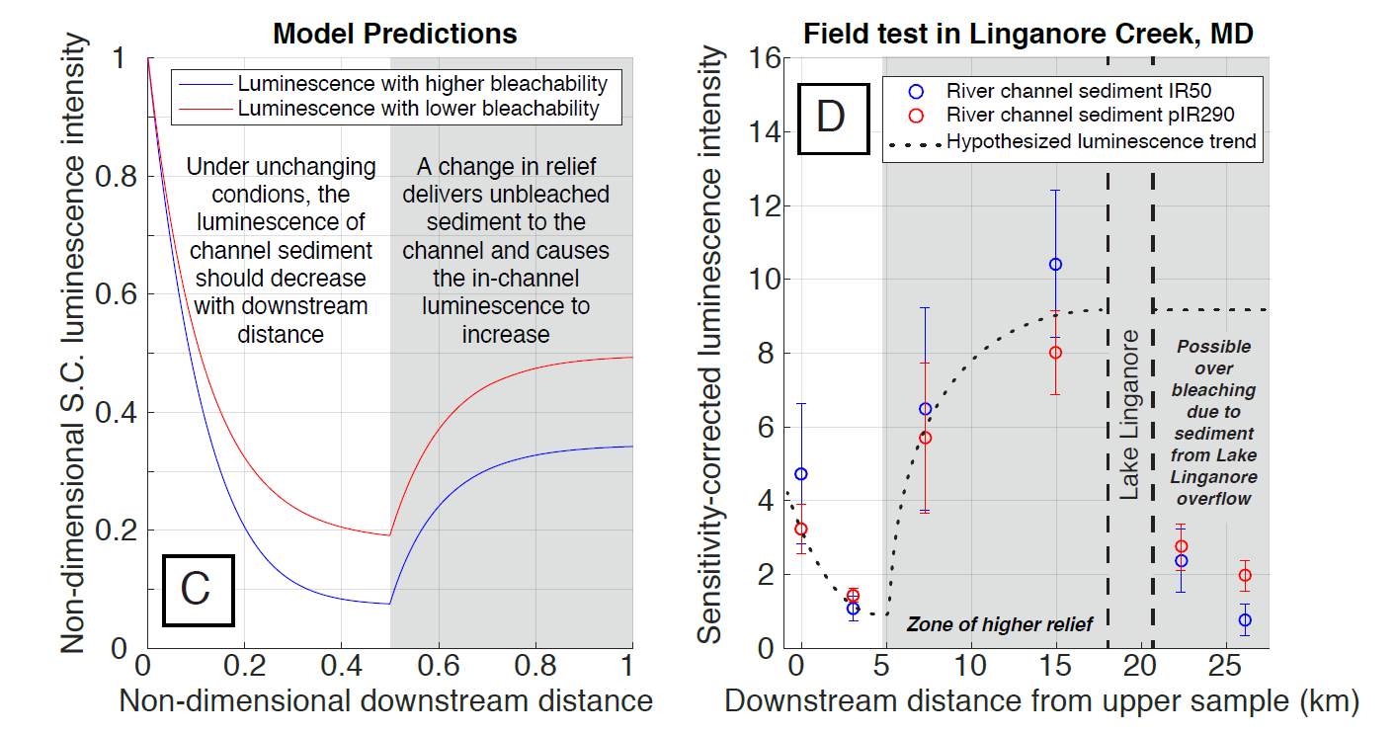

Slide 20
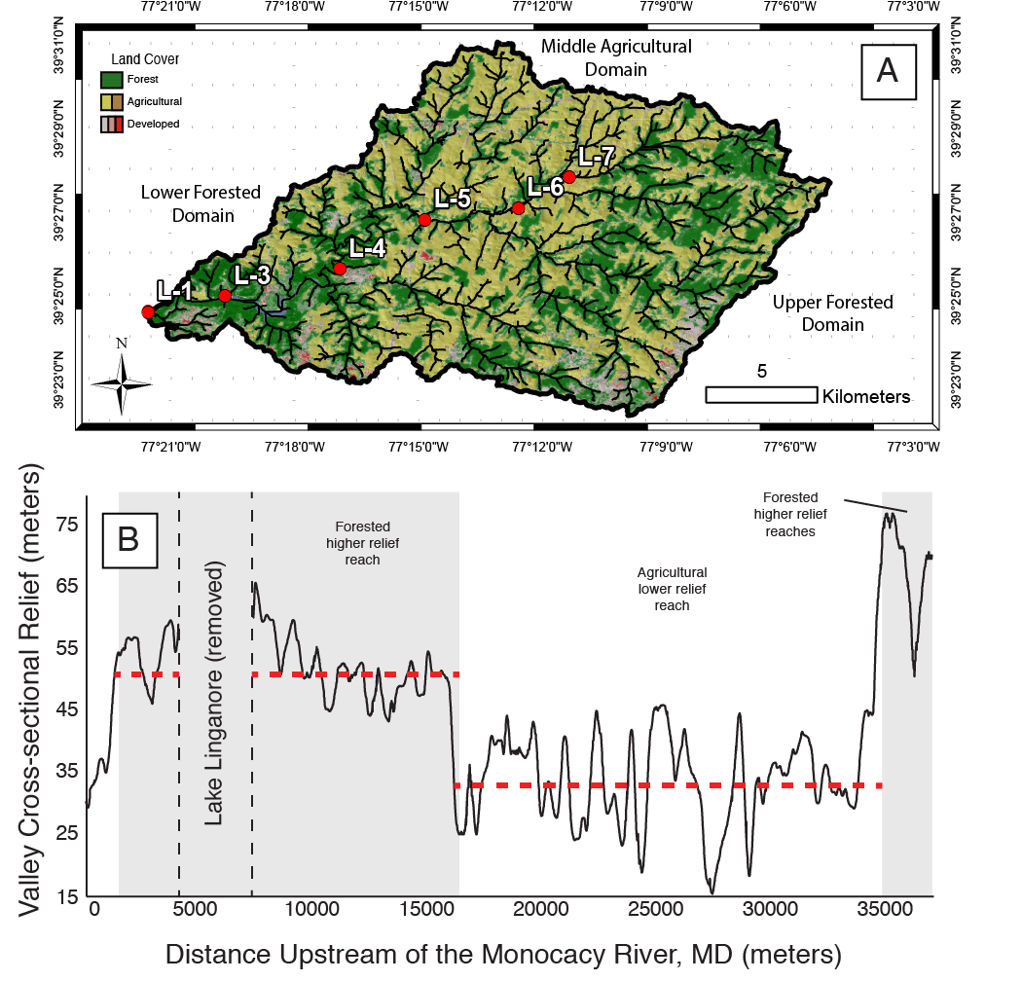

Slide 22
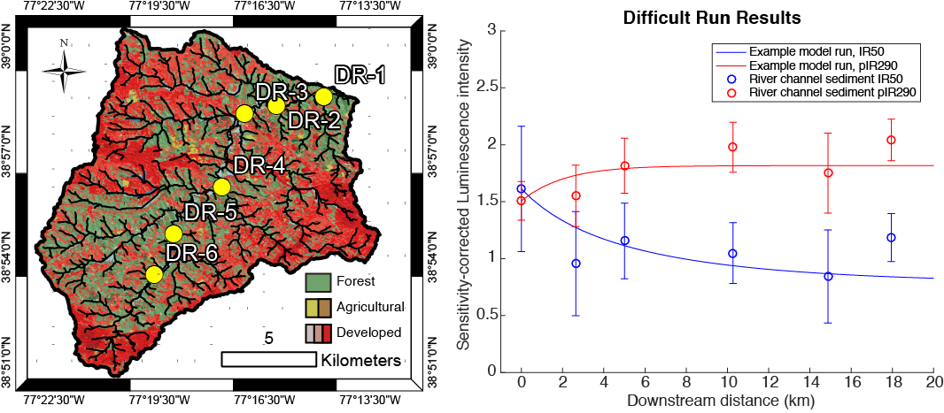

Slide 23
Conclusions
We find that luminescence appears to have potential to measure sediment transport rates.
In some places, the model cannot be applied due to the breakdown of model assumptions
Futher research and model application will help determine how applicable the model is.

Slide 24
Thank you!!!

