Slide 1
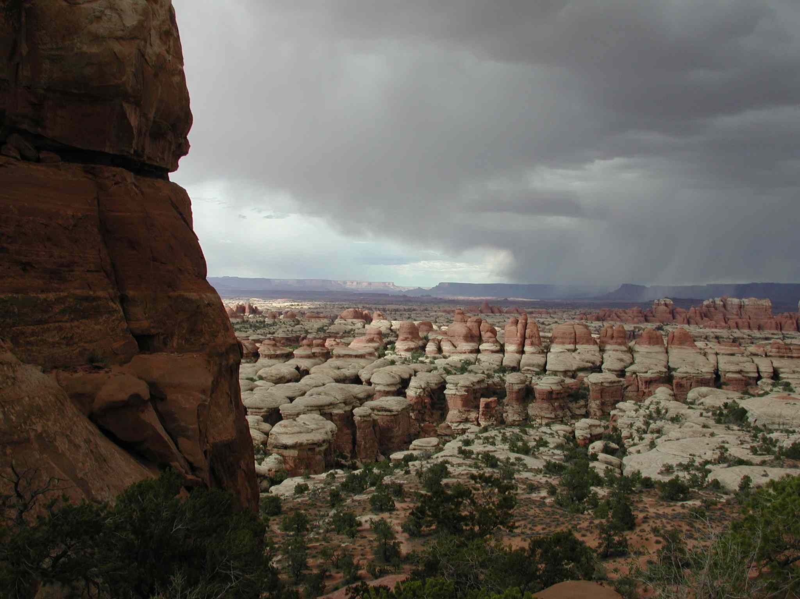

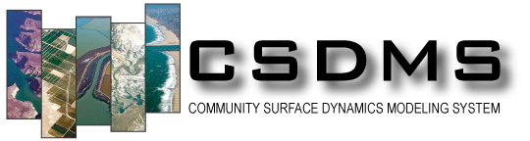
Introduction to the
Weather Research & Forecast (WRF) System,
a High-Resolution Atmospheric Model
Gary Clow
USGS / INSTAAR
clow@usgs.gov

Slide 2
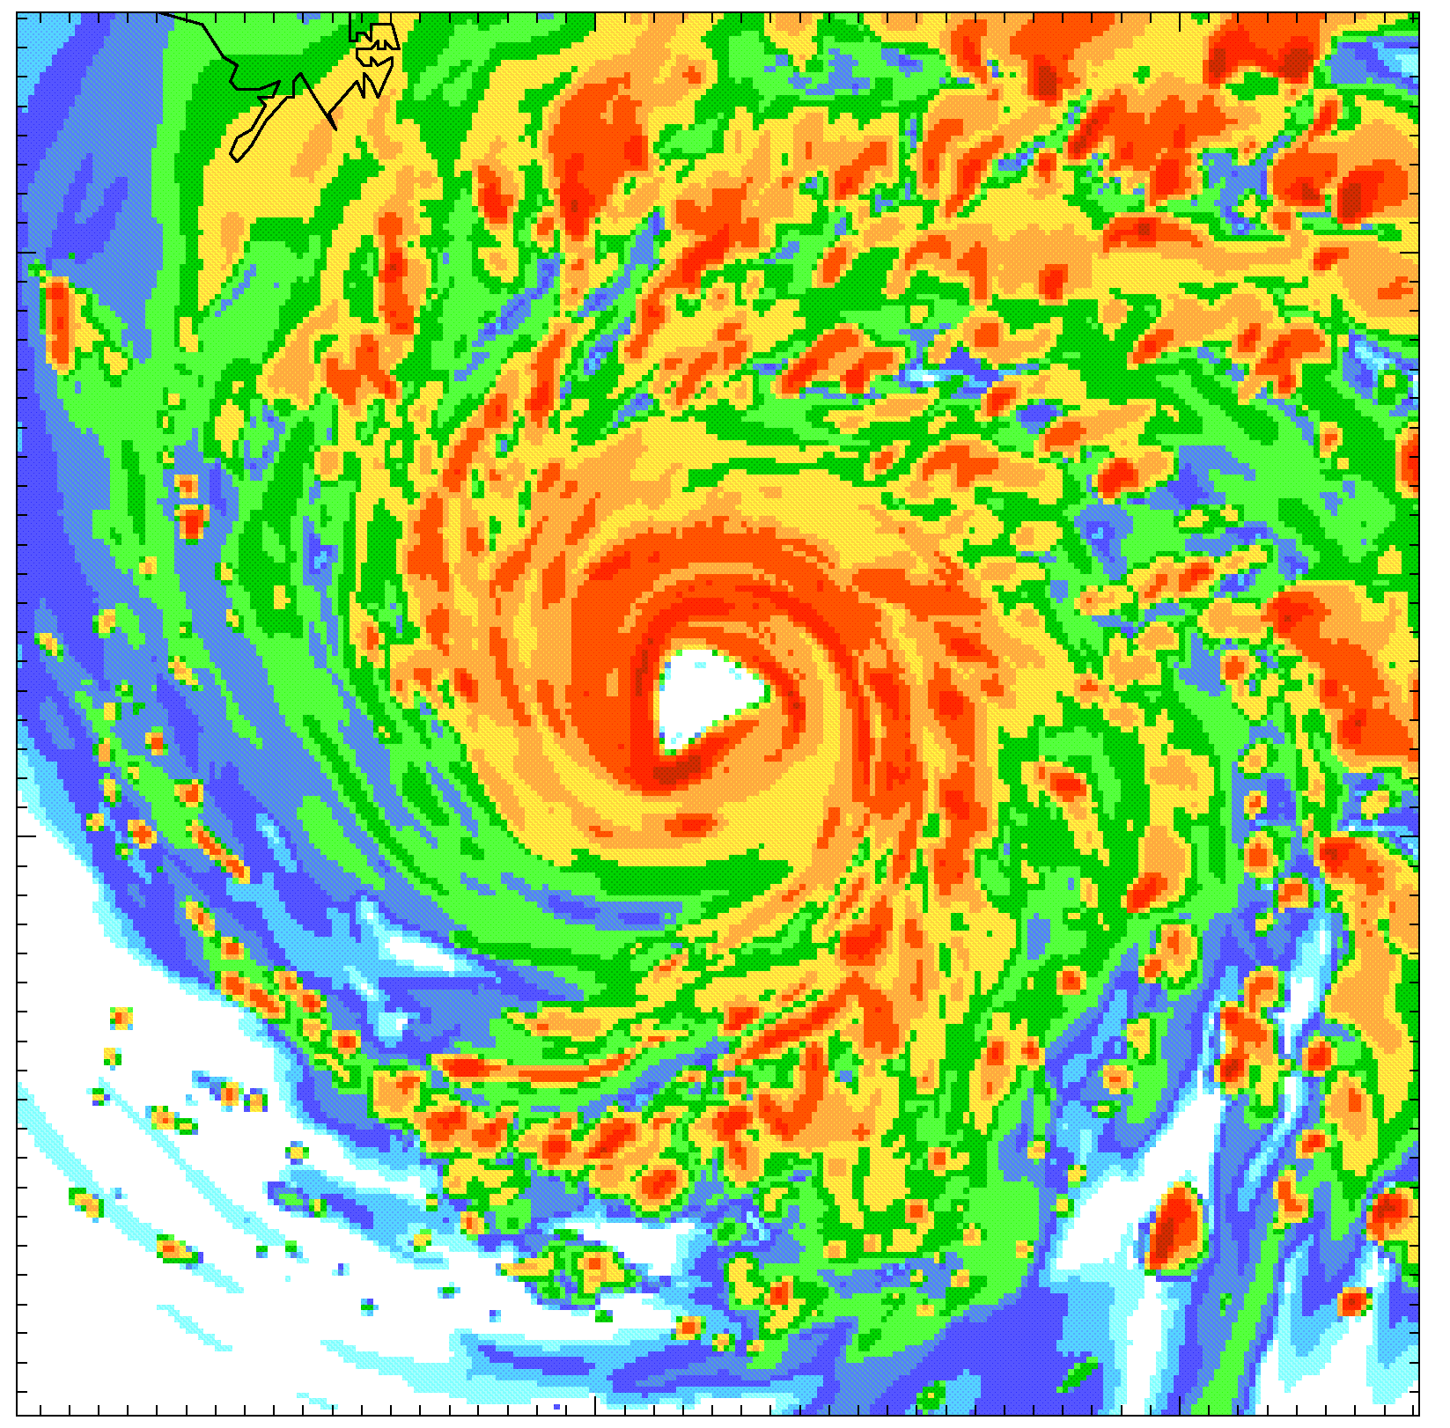
WRF Clinic Outline
1. Introduction and Welcome
2. Overview of WRF Modeling System
3. Resources
4. Steps for Running WRF
5. Examples
6. Q & A
Note: A Basic Model Interface (BMI) is currently
being developed for WRF so it can be readily
coupled with other models in the CSDMS system.

Slide 3

2. Overview of the WRF Modeling System
What is WRF?

Slide 4
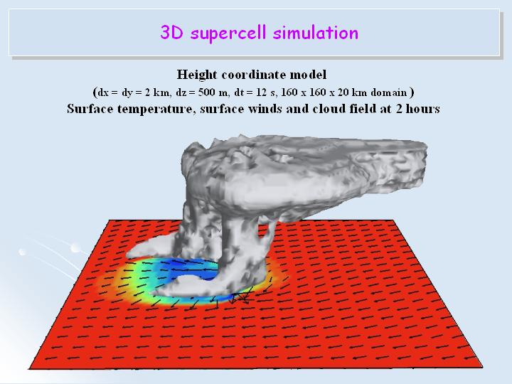
2. Overview of the WRF Modeling System
What is WRF?
State-of-the-art mesoscale atmospheric modeling system
  designed to serve both atmospheric research & NWP communities
  (flexible, modular, ...)
Solves fully compressible non-hydrostatic Euler equations
  (conservation of mass, momentum, energy)
  designed for use at scales ranging from meters to 1000s of kilometers
Community model
  distributed development, centralized support
3D supercell
Primary developers
NCAR, NOAA-ESRL, NOAA-NCEP
+ universities & govt agencies in U.S. and oversees

Slide 5
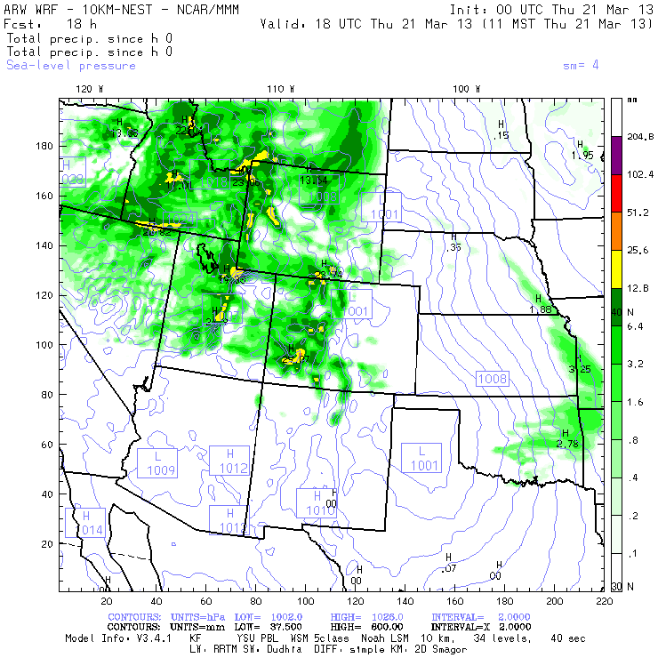
2. Overview of the WRF Modeling System
WRF Applications
Real-time numerical weather prediction (NWP)
  Daily weather and severe storm forecasts by NOAA, AFWA, ...
  Air-quality forecasts
  Forest fires
  Wind & solar forecasts for power utilities
Atmospheric Research
  Atmospheric physics / parameterization research
  Real-time NWP and forecasting research
  Regional climate and seasonal time-scale research
  Landsurface interactions
  Coupled-chemistry research
  Idealized simulations at many scales
  (e.g. mountain waves, convection, LES, ...)
  Planetary research (Mars, Titan, ...)

Slide 6
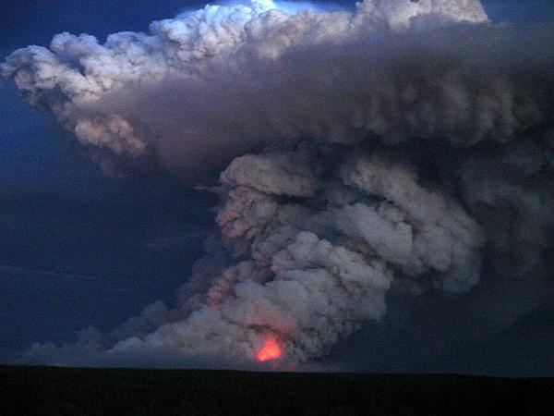
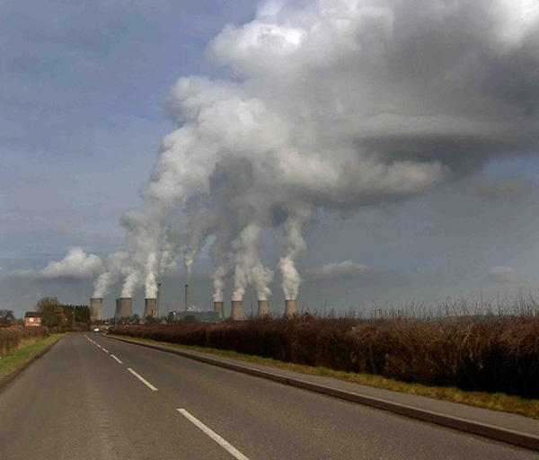
2. Overview of the WRF Modeling System
WRF now comes in multiple flavors!
2 Dynamical Cores (standard model)
  ARW: Advanced Research WRF core supported by NCAR
  NMM: Nonhydrostatic Mesoscale Model core supported by NOAA/NCEP
Specialized Versions of WRF
  HWRF forecasts the track and intensity of tropical cyclones (NOAA)
  WRF-AHW WRF-ARW for hurricane research (NCAR)
  WRF-Fire 2-way coupling of forest fire behavior with atmospheric dynamics
  WRF-Chem couples chemistry with WRF-ARW
  Polar WRF WRF-ARW modified for polar regions
  CWRF WRF-ARW modified for Regional Climate Modeling
  CLWRF WRF-ARW modified for Regional Climate Modeling
  planetWRF WRF-ARW modified for planetary research

Slide 7
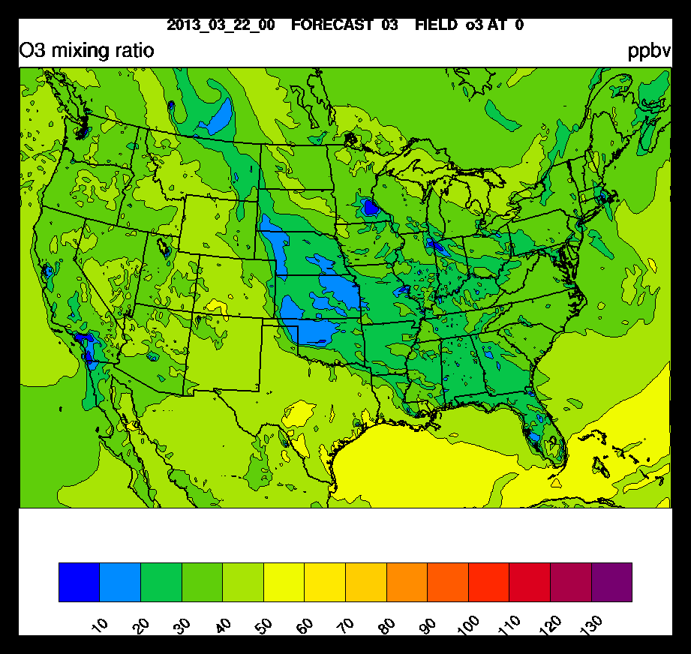
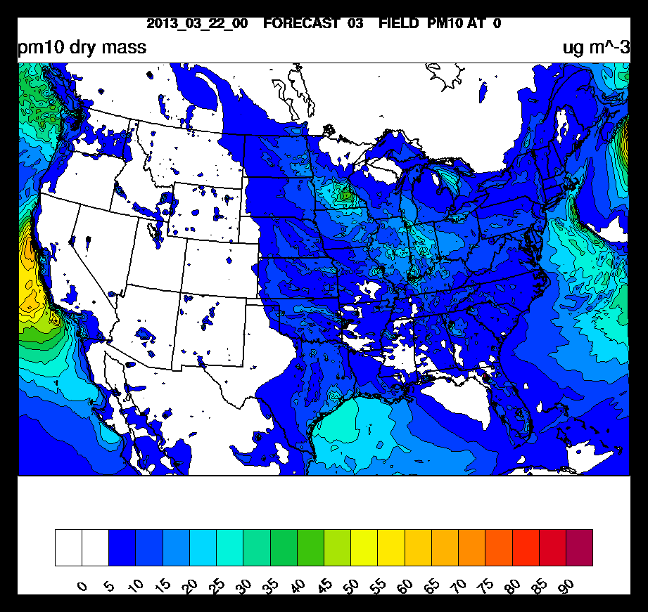
2. Overview of the WRF Modeling System
Who uses WRF?
Operational forecast centers
  In the U.S. and other countries
Academic research scientists
  Atmospheric dynamics, physics, weather, climate ...
Ozone forecast @ 8 m (NOAA)
Applications scientists
  Air quality, hydrology, utilities
There are currently over 20,000 users
of WRF from 130 countries.
pm10 forecast @ 8 m (NOAA)

Slide 8
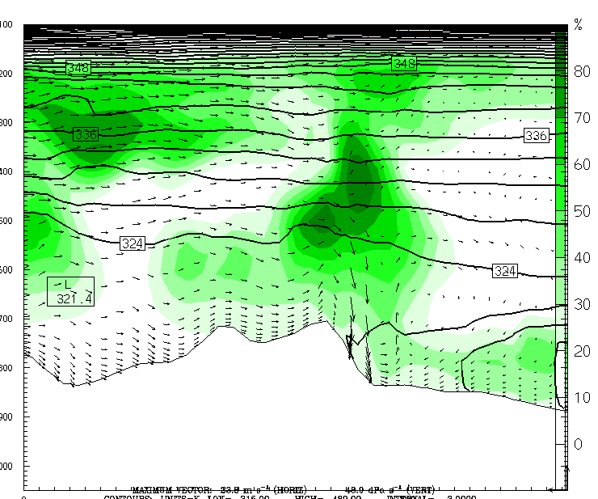
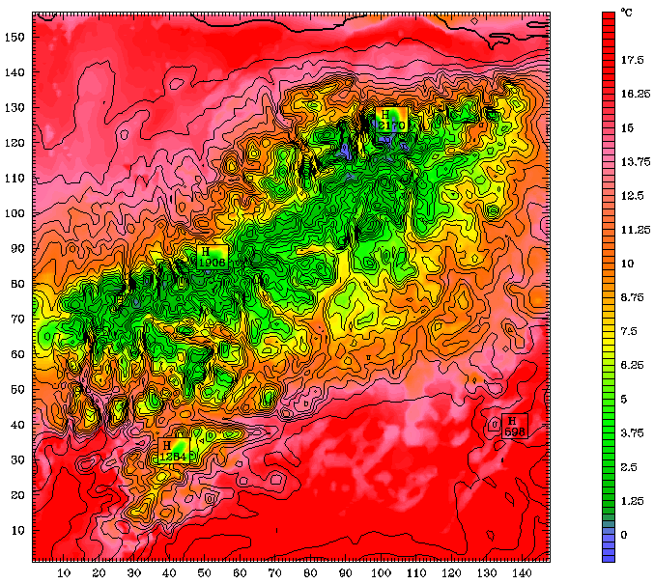
WRF Physics Modules & Coupling
Dynamics Solver – integrates the compressible
non-hydrostatic Euler equations (ARW, NMM)
Shortwave Radiation
Colorado
Front Range
D. Lawrence
Longwave Radiation
west
east
Cloud Microphysics
Cumulus Cloud Parameterization (dx > 10 km)
Planetary Boundary Layer (dz > 100 m)
Land Surface Model
cloud shadowing
Notes:
There is tight coupling within WRF

Slide 9
WRF Physics Modules & Coupling
Dynamics Solver – integrates the compressible
non-hydrostatic Euler equations (ARW, NMM)
Shortwave Radiation
Colorado
Front Range
Dudhia, Goddard, CAM, RRTMG, FLG, GFDL
D. Lawrence
Longwave Radiation
west
east
RRTM, CAM, RRTMG, Goddard, FLG, Held-Suarez, GFDL
Cloud Microphysics
Kessler; Lin; NCEP; WSM 3,5,6 class; Eta; Goddard; Thompson; Milbrandt;
Morrison; SBU-Ylin; WDM 5,6 class, NSSL 2-moment
Cumulus Cloud Parameterization
Kain-Fritsch, Betts-Miller-Janjic, Grell-Devenvi, Arakawa-Schubert,
Grell-3, Tiedtke, Zhang-McFarlane, new SAS
Planetary Boundary Layer
YSU, MYJ, GFS, QNSE, MYNNx, ACM2, BouLac, UW, TEMF, MRF
Land Surface Model
Noah LSM, RUC LSM, Pleim-Xiu LSM, NoahMP, SSiB, (CLM)
cloud shadowing
Notes:
There is tight coupling within WRF

Slide 10
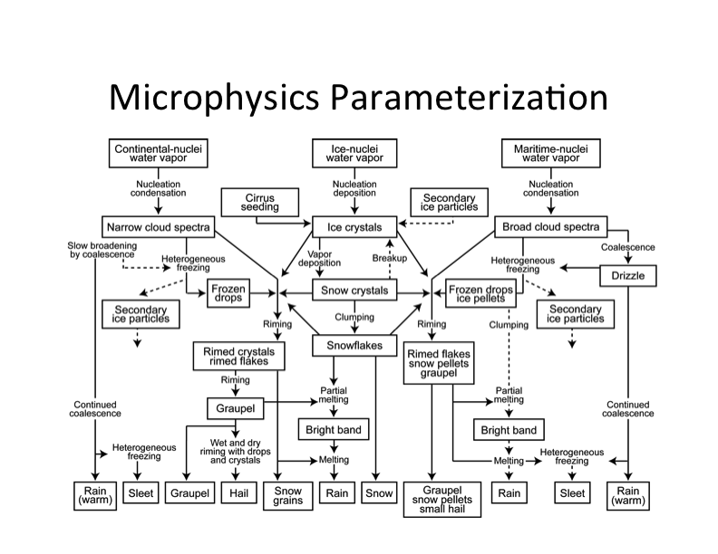
WRF Physics Modules & Coupling
Cloud Microphysics - parameterizations
D. Lawrence
from Dudhia, Overview of WRF Physics
Notes:
There is tight coupling within WRF

Slide 11
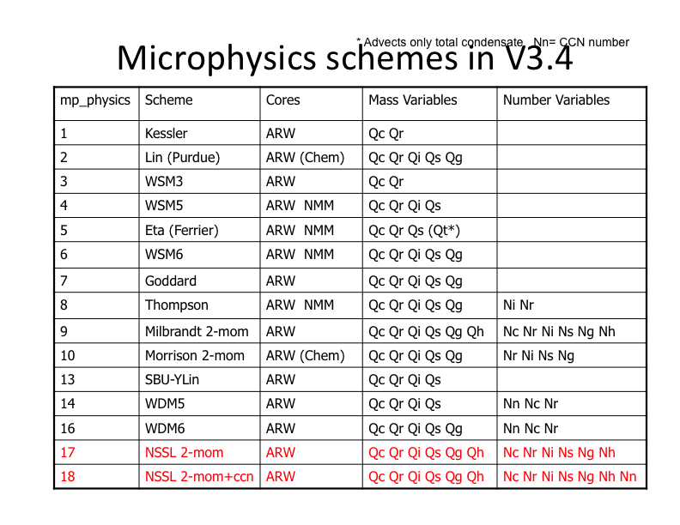
WRF Physics Modules & Coupling
Cloud Microphysics – schemes in v3.4
D. Lawrence
from Dudhia, Overview of WRF Physics
Notes:
There is tight coupling within WRF

Slide 12
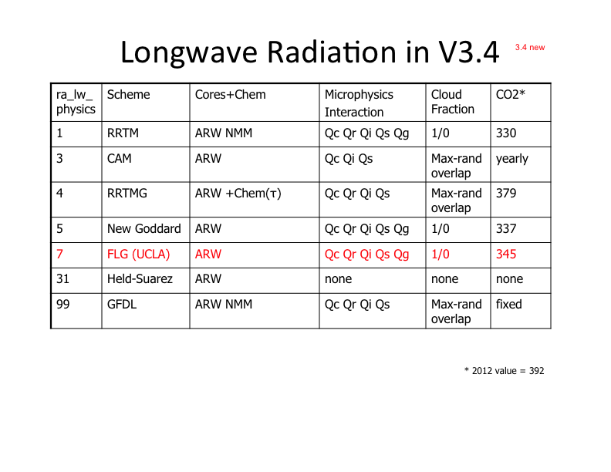
WRF Physics Modules & Coupling
Cloud Microphysics
– interaction with Longwave Radiation schemes
from Dudhia, Overview of WRF Physics
Notes:
There is tight coupling within WRF

Slide 13
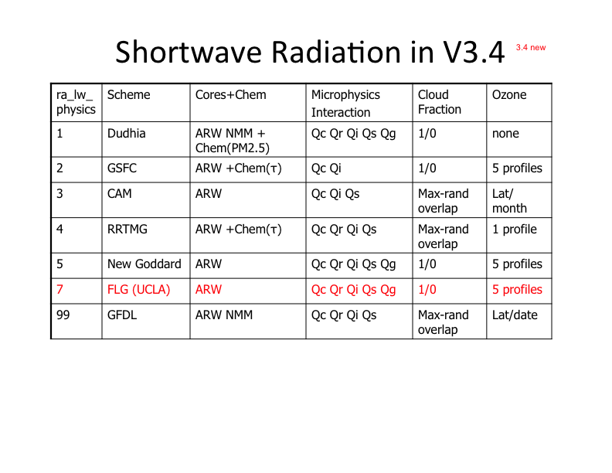
WRF Physics Modules & Coupling
Cloud Microphysics
– interaction with Shortwave Radiation schemes
from Dudhia, Overview of WRF Physics
Notes:
There is tight coupling within WRF

Slide 14
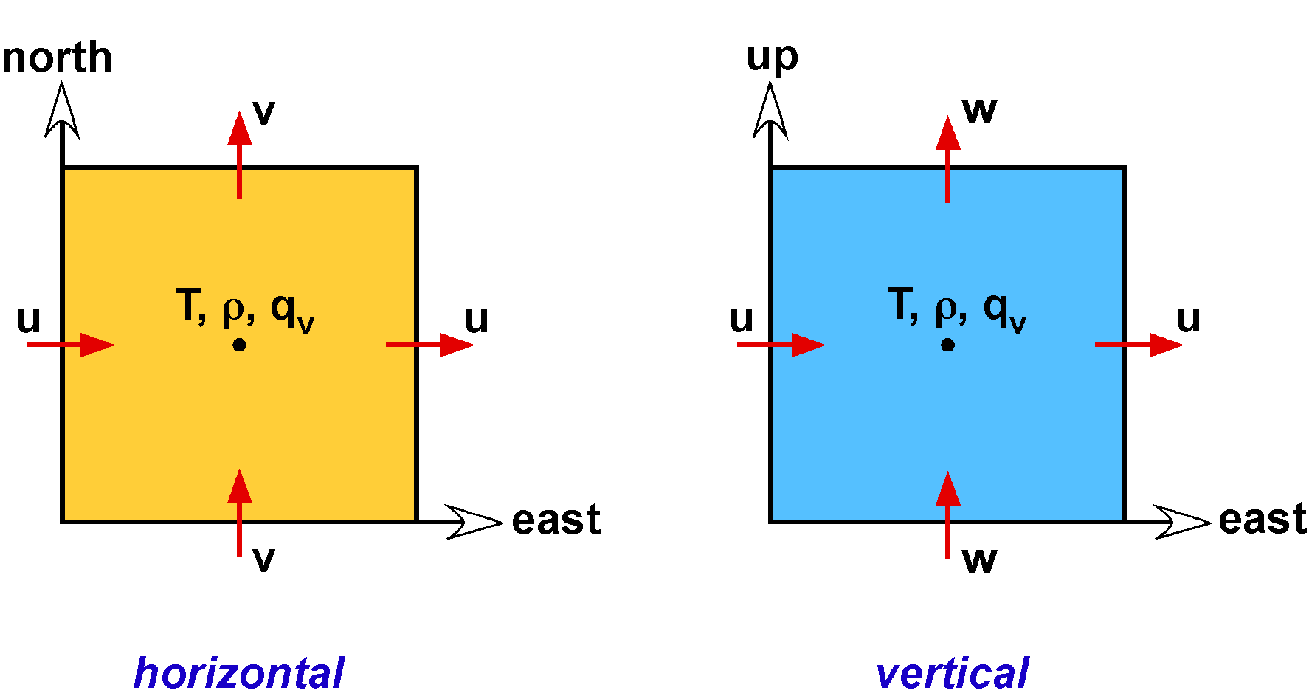
Spatial Discretization
Arakawa C-grid
WRF uses the flux-form of the Euler equations
(conserves mass, enthalpy, …)
Notes:
like Control Volume methods (if you’re familiar with them)
* velocities & fluxes are calculated on the grid cell boundaries
* conserves scalars

Slide 15
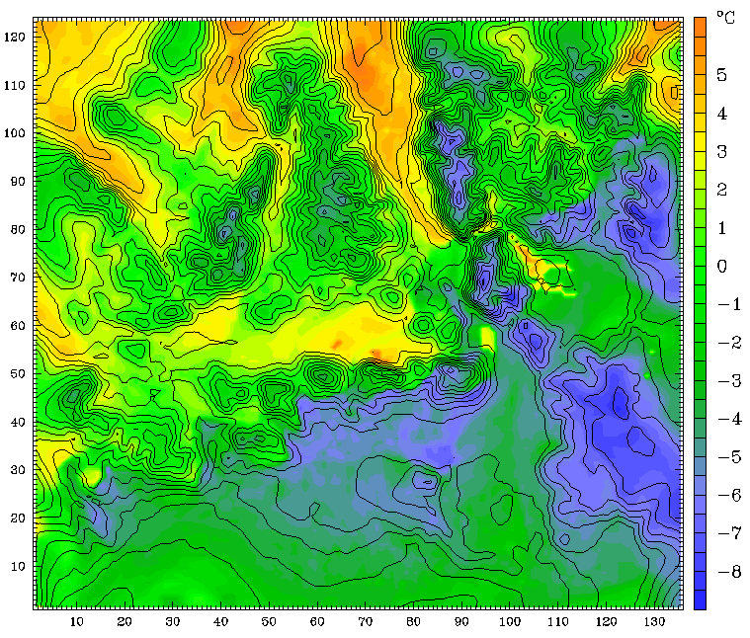
WRF Output & Diagnostic Fields
Atmosphere, Precipitation
Near Surface
air temperature
pressure
density
water vapor density
wind speed & direction
vorticity
convective instability
surface skin temperature
soil temperature
snow depth
snow water equivalent
soil moisture
soil liquid water
downward shortwave flux @ sfc
downward longwave flux @ sfc
upward sensible heat flux @ sfc
upward moisture flux @ sfc
upward latent heat flux @ sfc
ground heat flux
wind shear
surface friction velocity u*
surface runoff
underground runoff
precipitation (rain, sleet, graupel, hail, snow)
convective vs. non-convective precip.
column-integrated precipitable water
cloud cover
cloud ceiling
cloud-top temperature
Surface Air Temperature (RRL NWR)

Slide 16
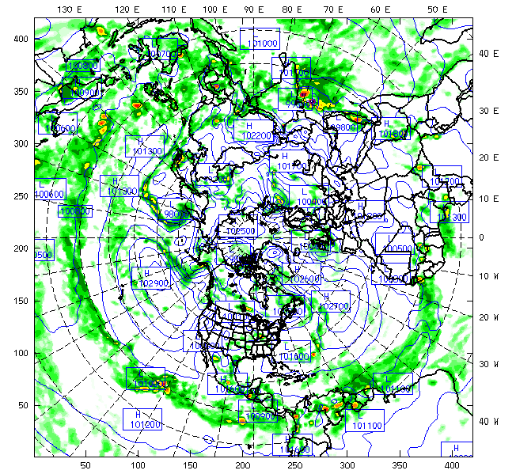
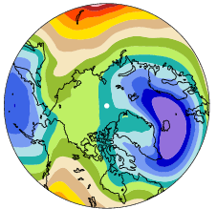
Boundary & Initial Conditions
1) Retrospective Analyses
2) Future (or Past) Projections
e.g. NCEP Global Analysis
(110-250 km)
e.g. an AOGCM
(180-250 km)
Nest WRF within large-scale circulation
projected by a global model.
Nest WRF within observed
large-scale circulation.
Notes:
There’s two ways to run WRF (assuming you’re not using a global version)

Slide 17
Initial Conditions
Lower Boundary
3D Fields
  elevation
  vegetation categories
  soil categories
  water categories (ocean, lake)
  albedo
  surface roughness
  surface pressure
  surface temperature (land & ocean)
  soil temperature
  soil moisture
  snow cover
  sea-ice coverage
  air temperature
  winds
  relative humidity
  geopotential height
vegetation
categories
elevation

Slide 18
Boundary Conditions
Lateral boundaries (every 6 hours)
sea-ice concentration
Beaufort Sea
2011-06-01
  air temperature
  winds
  relative humidity
  geopotential height
  surface pressure
Chukchi Sea
2011-06-14
Lower boundary*
  SSTs
  sea-ice coverage
2011-07-01
* for runs longer than 1 week

Slide 19
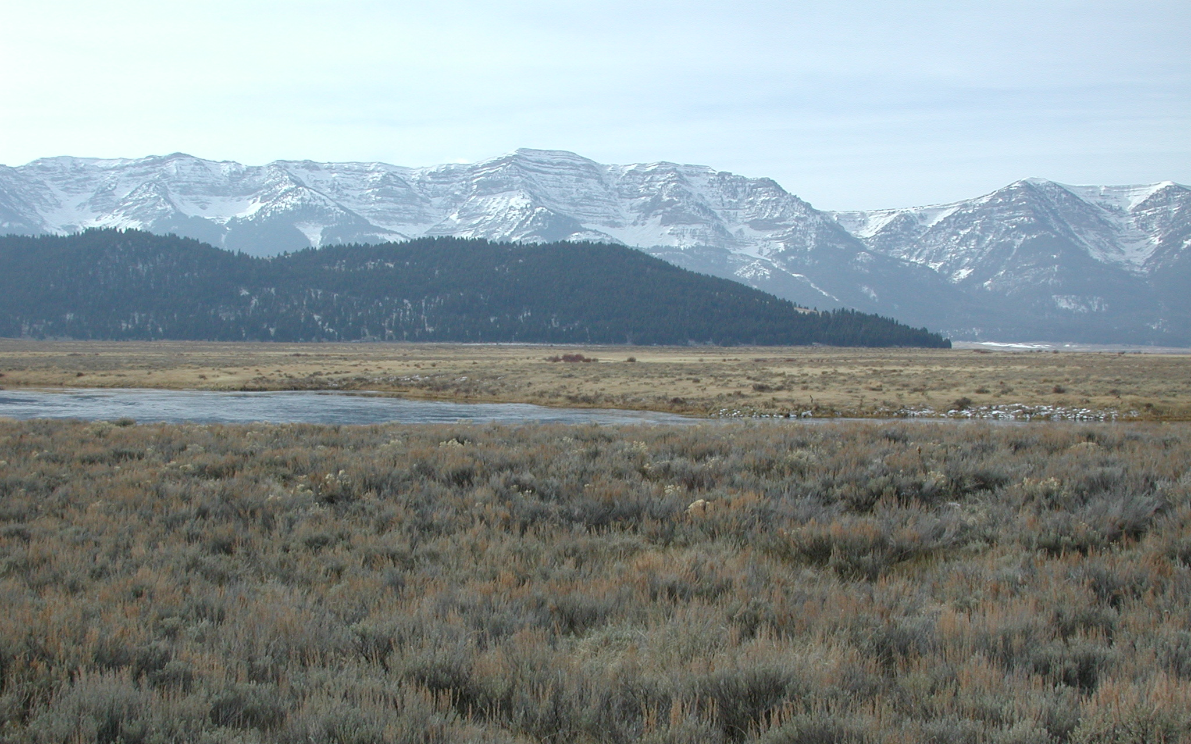
WRF Nesting Capability
Provides higher resolution in nested areas.
1-way
2-way interactive
moving nest
Example 2-way: Red Rock Lakes NWR, Montana
Notes:
* so I’m going to walk you through an example.
* suppose you’re interested in the wetlands found in the RRL NWR.

Slide 20
Sample 2-way WRF Nests
Parent Domain: 30-km resolution
D2: 10-km resolution
WRF outer boundary
large-scale
circulation
DEM
Notes:
Point out where our area of interest is (RRL NWR)
Explain 2-way interation.

Slide 21
Sample 2-way WRF Nests
Parent Domain: 30-km resolution
D2: 10-km resolution
WRF outer boundary
3.3 km domains
large-scale
circulation
DEM
Notes:
Point out where our area of interest is (RRL NWR)
Explain 2-way interation.

Slide 22
Sample 2-way WRF Nests
Parent Domain: 30-km resolution
D2: 10-km resolution
WRF outer boundary
3.3 km domains
1.1 km domain
large-scale
circulation
DEM
Notes:
Point out where our area of interest is (RRL NWR)
Explain 2-way interation.

Slide 23
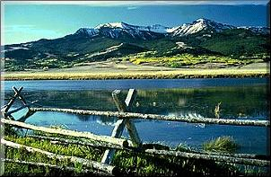
30 km
150 s
Red Rock Lakes NWR
Parent Domain:
200 km
DEM
Notes:
or looking at it another way …
For numerical stability, everything in this domain needs to calculated every 150 s.

Slide 24
30 km
150 s
Red Rock Lakes NWR
10 km
50 s
200 km
DEM
Notes:
and then a 3-km resolution nest …

Slide 25
30 km
150 s
Red Rock Lakes NWR
10 km
50 s
3.3 km
17 s
200 km
DEM
Notes:
this still isn’t fine enough to see the RRL NWR, so we declare a 1-km resolution nest

Slide 26
30 km
150 s
Red Rock Lakes NWR
10 km
50 s
3.3 km
17 s
200 km
1.1 km
6 s
DEM

Slide 27
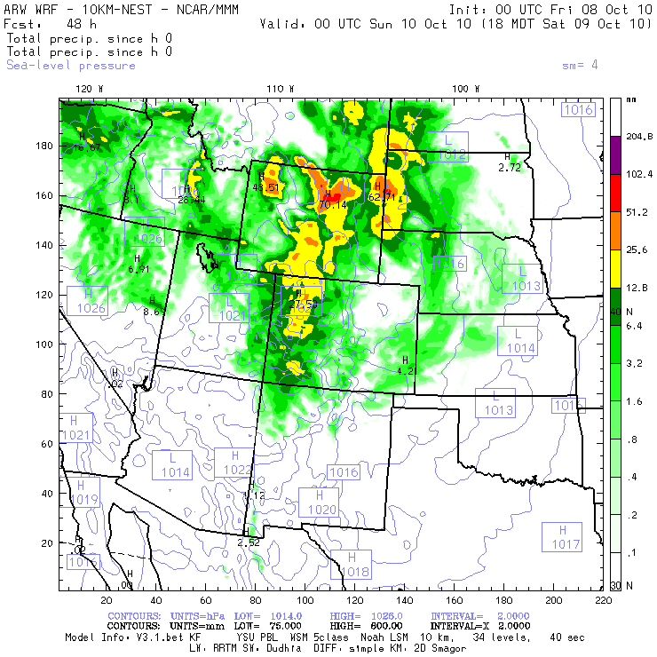
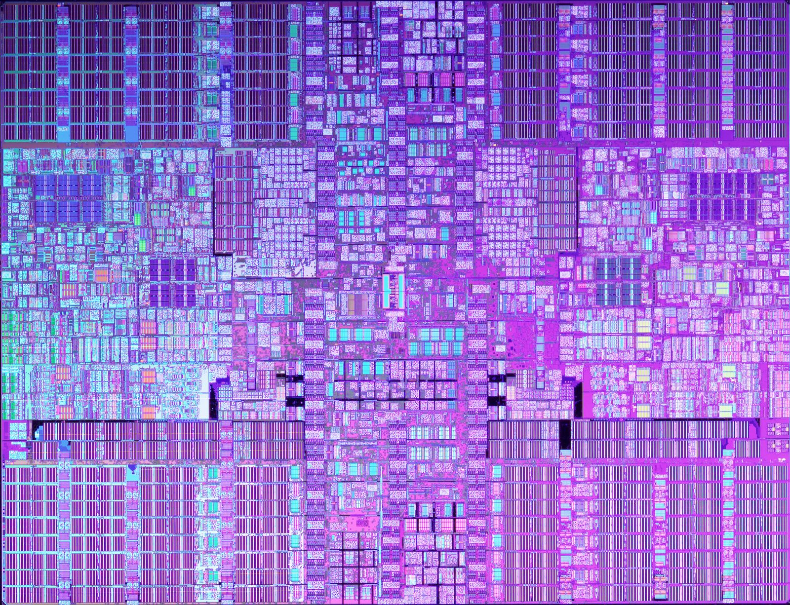
The Need for Parallel
A 48-hr WRF forecast for the continental U.S. would take 52 hours to calculate at 12-km resolution on a:
Dual core, 4.7 GHz chip
64-bit floating point precision
16 GB per processor
~ 6 Gflop/s (circa 2008)
Notes:
And for regional climate simulations, we want to run simulations for years and at higher resolutions.

Slide 28
2 Levels of WRF Parallelism
Model Domain
patch 1
node 1
2
3
Distributed Memory Parallel
Model domain is decomposed
into Patches, one for each
distributed memory Node.
mpi
Communication: MPI
Example: 9 available nodes,
9 patches
7
8
9
Notes:
So to be useful, WRF has to run in parallel.

Slide 29
2 Levels of WRF Parallelism
Model Domain
Shared Memory Parallel
Each patch is decomposed
into Tiles, one for each
shared memory processor.
patch 5
tile 1
processor 1
Communication: OpenMP
t8
p8
Example: 8 processors per node

Slide 30
2 Levels of WRF Parallelism
Model Domain
Shared + Distributed Memory
Parallel
Model domain is decomposed
into Patches & Tiles.
Communication:
  OpenMP & MPI
Example: 9 available nodes,
72 processors
Notes:
WRF is written so it can take advantage of both Shared Memory and Distributed Memory parallelism.

Slide 31
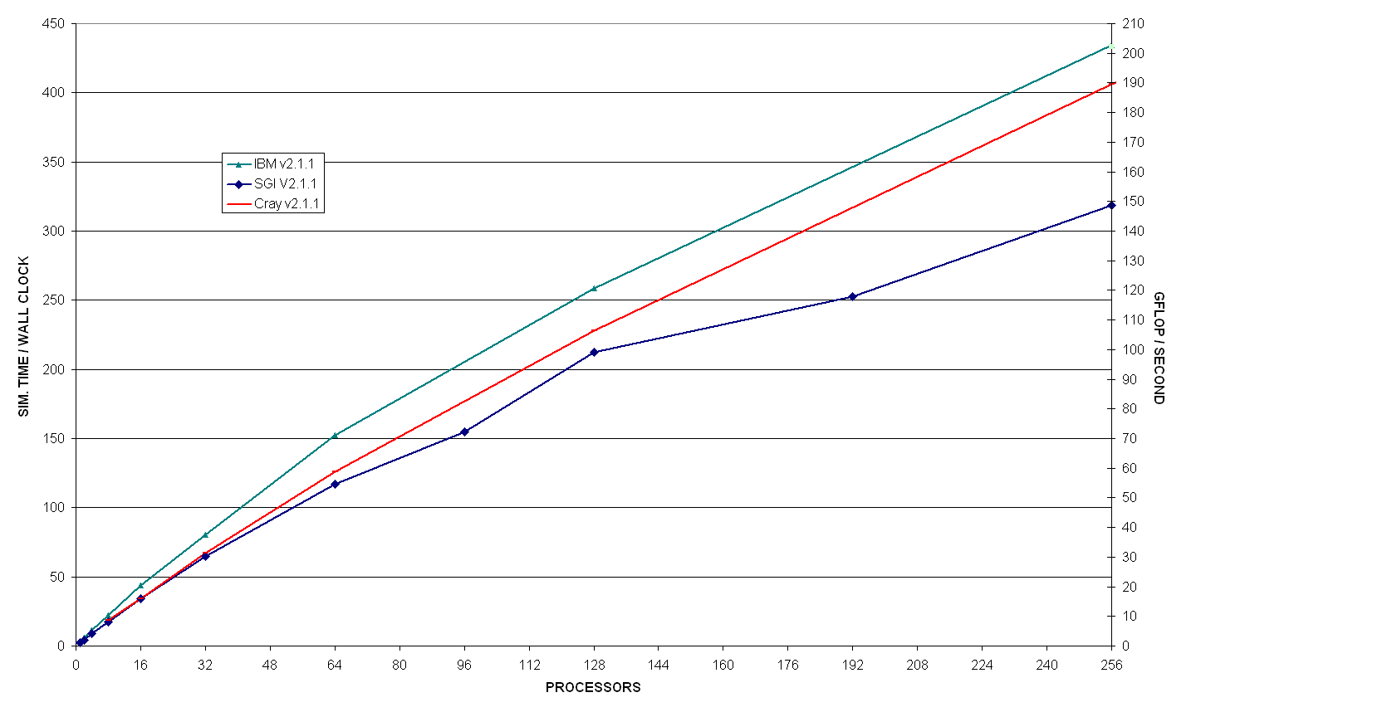
WRF Multiprocessor Performance
12km CONUS Benchmark
4.6 million grid cells
~7400 ops/cell-step
(adapted from John Michalakes, NCAR)
Notes:
32 processors sufficient for 48 hour fcst in 1 hour; 1024 processors gives fcst in under 4 mins
Scaling on 1024 processors is only about 34%, drops below 50% on about 500.

Slide 32
WRF Multiprocessor Performance
ideal
12km CONUS Benchmark
4.6 million grid cells
~7400 ops/cell-step
(adapted from John Michalakes, NCAR)

Slide 33

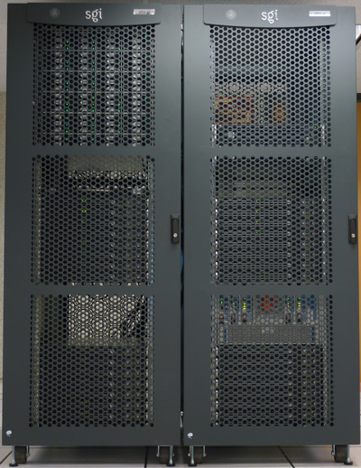
Software / Hardware Requirements
Platforms
Software
Vendor Hardware OS
Cray X1 UniCOS
Cray AMD Linux
IBM Power Series AIX
IBM Power Series Linux
SGI IA64/Opteron Linux
COTS* IA32 Linux
COTS* IA64/Opteron Linux
Mac Power Series Darwin
Mac Intel Darwin
NEC NEC Linux
Fortran 90/95 compiler
C compiler
Perl
netcdf library
Public domain mpich for MPI
NCAR Graphics is also handy
* commercial off the shelf
CSDMS HPCC
(beach)

Slide 34
3. Resources
WRF model description and documentation
WRF tutorials
Links to model download site
Links to site for downloading data needed to drive WRF
Links to specialized WRF versions
Real-time WRF forecasts

Slide 35
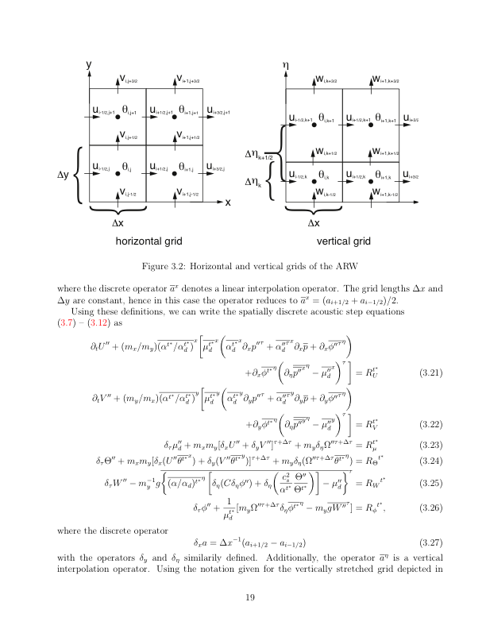
3. Resources
WRF home page
  http://www.wrf-model.org/index.php
WRF-ARW user's page
  http://www.mmm.ucar.edu/wrf/users/
WRF-NMM user's page
  http://www.dtcenter.org/wrf-nmm/users/
WRF tutorials
  http://www.mmm.ucar.edu/wrf/users/supports/tutorial.html
WRF source code
http://www.mmm.ucar.edu/wrf/users/download/get_source.html
Datasets for WRF
http://rda.ucar.edu/
Real-time WRF forecasts
  http://wrf-model.org/plots/realtime_main.php

Slide 36
4. Steps for Running WRF
Simplified WRF Flow Chart
External
data
WRF
pre-processing
system
WRF Model
Post-processing
& visualization
Vapor
WRF
terrestrial
data
NCL
WRF-ARW
WPS
real
RIP4
gridded
MET data
WRF-NMM
(large-scale circulation)
MET
.
.
.

Slide 37
4. Steps for Running WRF
WRF Pre-processing System (WPS)
WPS
ungrib
decode met data
from original sources
geogrid
metgrid
real
choose model domain(s)
horizontally interpolate terrestrial data
onto model grid for each domain
horizontally interpolate met data onto
model grid for each domain

Slide 38
4. Steps for Running WRF
WRF Model
WRF-ARW
WRF-NMM
Post-processing
& visualization
real
choose vertical model levels
vertically interpolate data onto model levels
create boundary condition file
run WRF model

Slide 39
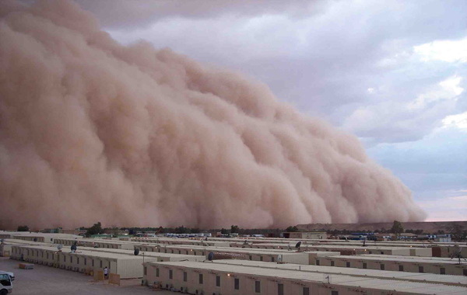
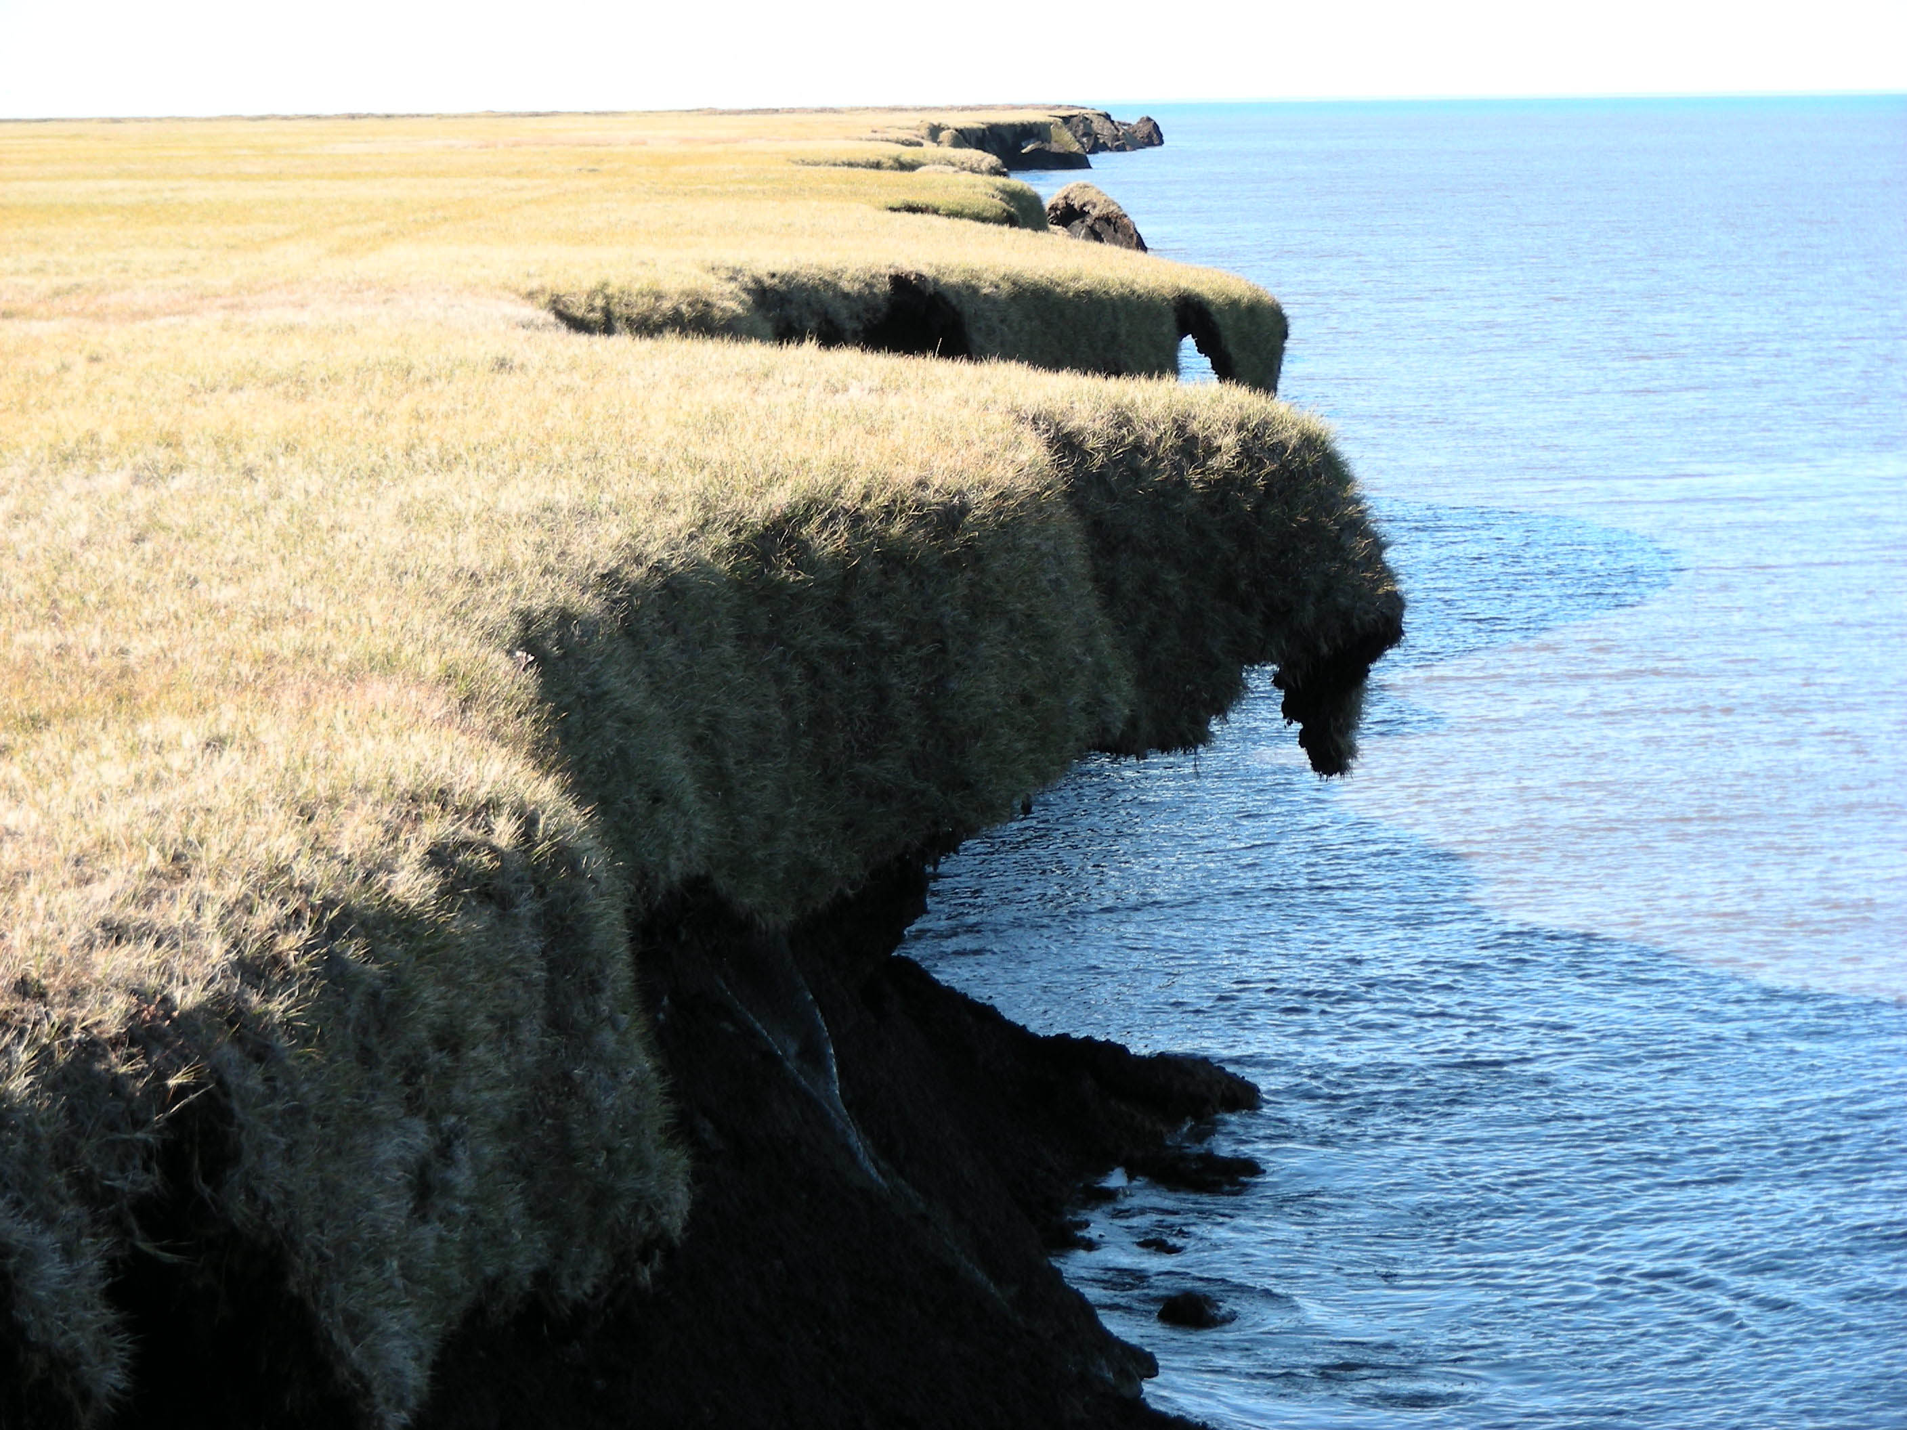
5. Examples
Afghanistan
(climate change?)
Mojave Desert
(dust storms,
wind erosion)
Arctic
(coastal erosion)
Rocky Mountains
(wetlands, glaciers)
Notes:
I’ve brought a few examples to illustrate the use of WRF.

Slide 40
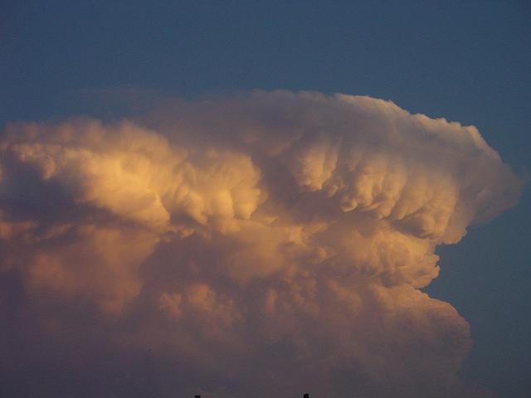
Thanks for coming to the WRF Clinic!
D. Lawrence

