Slide 1
Frost Number Model-GEO
Mapping Permafrost Occurrence using the CRU-NCEP reanalysis data
Lecture 3
Permafrost Modeling Short Course

Slide 2
Where do we find permafrost?
35% of the terrestrial surface experiences mean annual temperature < 0 °C
Permafrost = ground that remains at or below 0 °C for two or more consecutive years.
15 million km2 of the land surface
(Chadburn et al., 2017)

Slide 3
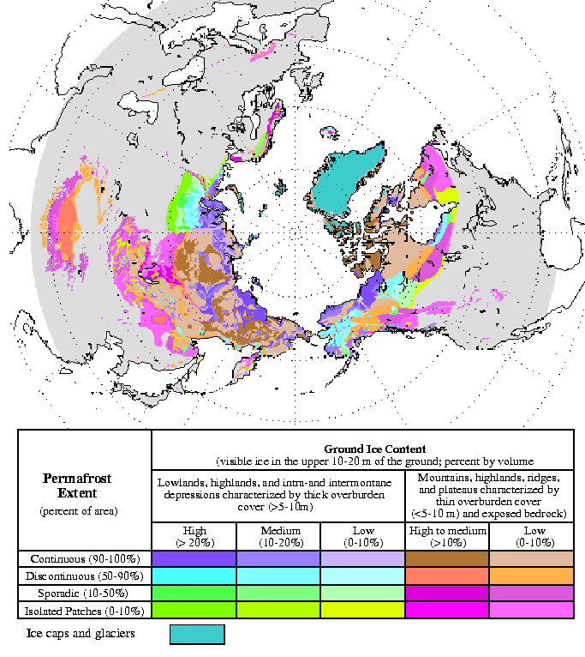
Where does Permafrost Occur?
24 % of the Northern Hemisphere
In mountainous areas permafrost occurs at high elevation and in isolated patches. e.g. RMNP (Janke et al.)
In High-Arctic permafrost is ‘continuous’ and deep. E.g. North Slope of Alaska

Slide 4
‘Air’ Frost Number
F = Frost Number (-)
DDF = freezing day index (°C days)
DDT = thawing day index (°C days)
(From: Nelson and Outcalt, 1987, AAAR.)

Slide 5
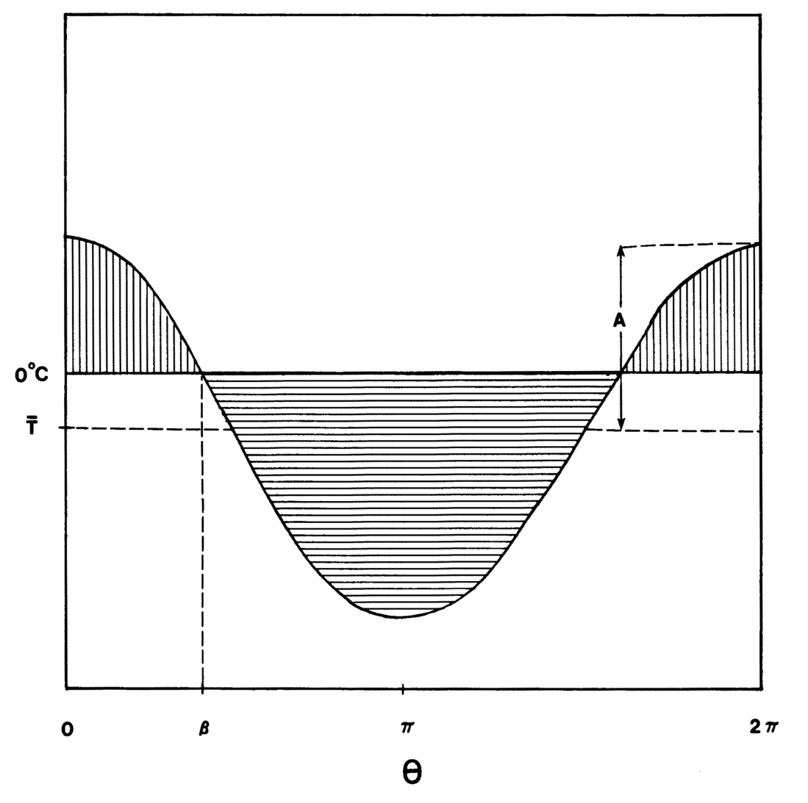
Cosine Approximation of Annual Temperature Distribution
A= amplitude in °C
Temperature
β
Time in days
(From: Nelson and Outcalt, 1987, AAAR)

Slide 6
Calculate DDT and DDF
Symbol | Parameter | unit
MAAT | Mean annual temperature | °C
A | Yearly temperature amplitude | °C
beta | Frost angle | -
Ts | Mean summer temperature | °C
Tw | Mean winter temperature | °C
Ls | Length of summer | days
Lw | Length of winter | days

Slide 7
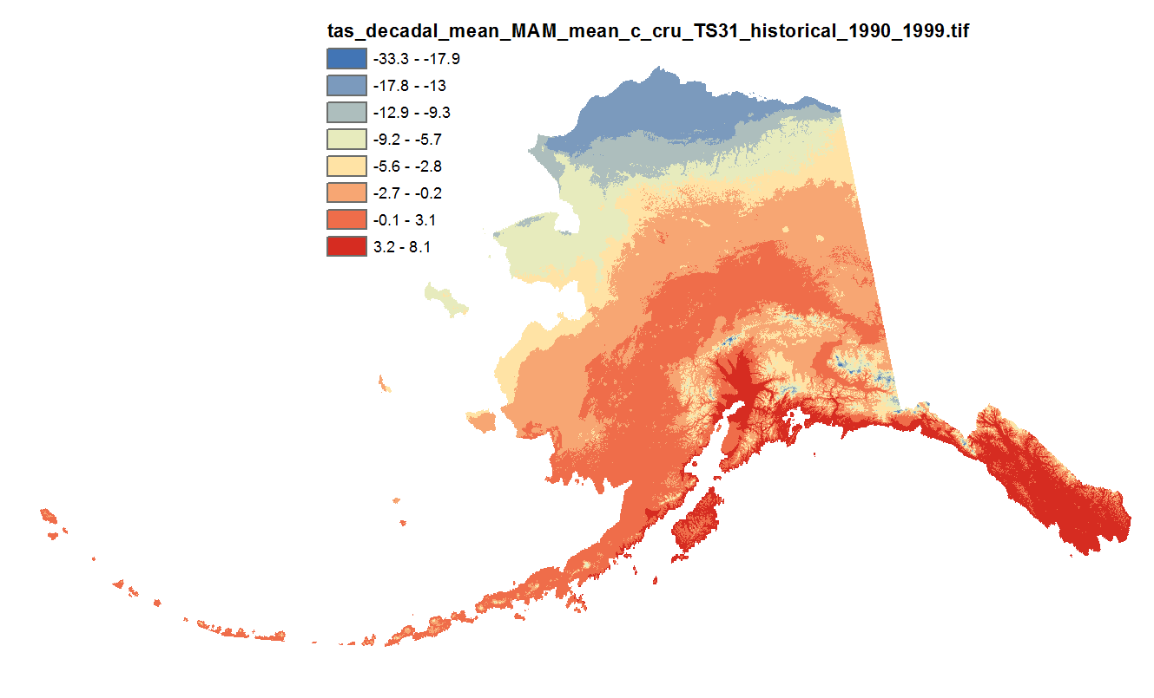
Climate Data for Frost Number Model
Original data source was CRU-TS3 monthly climate data at 771 * 771 m resolution.
It covers 1900-2009
http://ckan.snap.uaf.edu/dataset/historical-monthly-and-derived-temperature-products-771m-cru-ts

Slide 8
What is a Reanalysis Dataset?
A comprehensive record of how climate is changing over time, compiled from WMO and NOAA-NCDC station data.
A combination of observations and empirical/numerical models to generate a ‘synthesized estimate’ of the state of the system, with global coverage.
The original CRU-TS uses WMO meteorological stations, number of stations varies depending on timespan, e.g. ~2000 stations between 2002-2009.
Stations are only included if they have >75% data coverage.
When data is sparse, remote stations influence the reported value for a specific location without data (for temperature a ‘correlation decay distance’ of 1200km is used)
SNAP UAF CRU_TS also includes physiographic information to go to detailed resolution; this is dominated by climate-elevation regression (Daly et al., 2008).
(more details on data description and processing: Daly et al., 2008; Harris et al., 2014)

Slide 9
CRU_AKtemp
What is specific for this dataset within the permafrost modeling tool:
Data component, has an CSDM basic interface and can be coupled to models that need temperature data.
Python 2.7 package that provides access to NetCDF file constructed from the original GeoTiffs.
Geographical extent of this dataset reduced to Alaska.
Spatial resolution has been reduced by a factor of 13 in each direction, resulting in an effective pixel resolution of about 10km.
The data are monthly average temperatures for each month from January 1901 through December 2009.

Slide 10
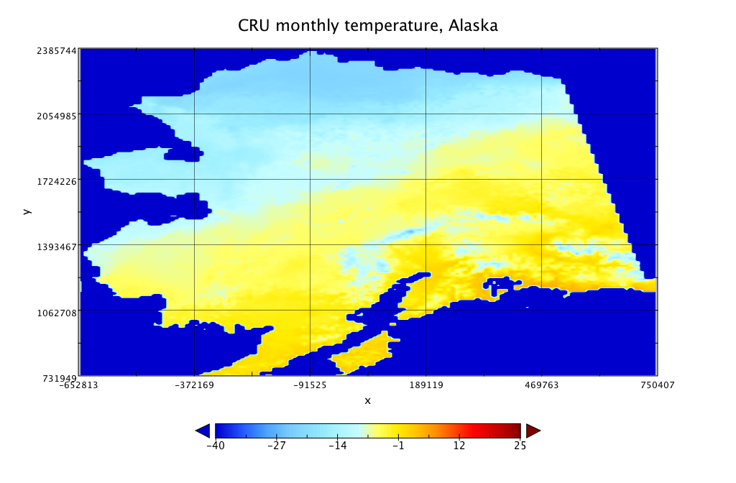
CRU_Aktemp example

Slide 11
Config File with CRU-AKtemp
#===============================================================================
# Config File for: cruAKtemp_method
#===============================================================================
# Input
filename | {filename} | string | name of this file
run_description | {run_description} | string | description of this configuration
run_region | {run_region} | string | general location of this domain
run_resolution | {run_resolution} | string | highres or lowres
# Dates are converted to datetime.date objects
reference_date | {reference_date} | string | model time is relative to this date
model_start_date | {model_start_date} | string | first day with valid model data
model_end_date | {model_start_date} | string | last day with valid model data
# Grid variables are processed separately after all config variables have been read in
# need to create np.float array of grids
grid_name | {grid_name} | string | name of the model grid
grid_type | {grid_type} | string | form of the model grid
grid_columns | {grid_columns} | int | number of columns in model grid
grid_rows | {grid_rows} | int | number of columns in model grid
# with temperature as np.zeros((grid_columns, grid_rows), dtype=np.float)
i_ul | {i_ul} | int | i-coord of upper left corner model domain
j_ul | {i_ul} | int | j-coord of upper left corner model domain
# timestep is converted to datetime.timedelta(days=timestep)
timestep | {timestep} | int | model timestep [days]
# Output
Note, input is specified in ‘grid rows’ and ‘grid columns’, for now we have no proper geo-referencing and remapping tools in CSDMS, so we just use the original projection and its grid.

Slide 12
Defining the Permafrost Limit
Permafrost is theoretically possible:
When the mean annual temperature is < 0°C
When the freezing and thawing indices are equal; thus when F > 0.5

Slide 13
References
Nelson, F.E., Outcalt, S.I., 1987. A computational method for prediction and prediction and regionalization of permafrost. Arct. Alp. Res. 19, 279–288.
Harris, I., Jones, P, Osborne, T, Lister, D., 2014. Updated high-resolution grids of monthly climaticobservations – the CRU TS3.10 Dataset. J. Climatol. 34: 623–642.
Chadburn, S.E., Burke, E.J., Cox, P.M., Friedlingstein, P., Hugelius, G., Westerman, S., 2017. An observation-based constraint on permafrost loss as a function of global warming. Nature Climate Change, 10 APRIL 2017 | DOI: 10.1038/NCLIMATE3262
Daly, C., et al., 2008. Physiographic sensitive mapping of climatological temperature and precipitation across the conterminous US. Int. J. Climatol. DOI: 10.1002/joc.1688
Model Code and Data Component
https://github.com/permamodel/cruAKtemp

Slide 14

Notes with Lab Exercises
The next few slides contain notes & answers with the lab questions.
Do the lab first, then check back here.

Slide 15
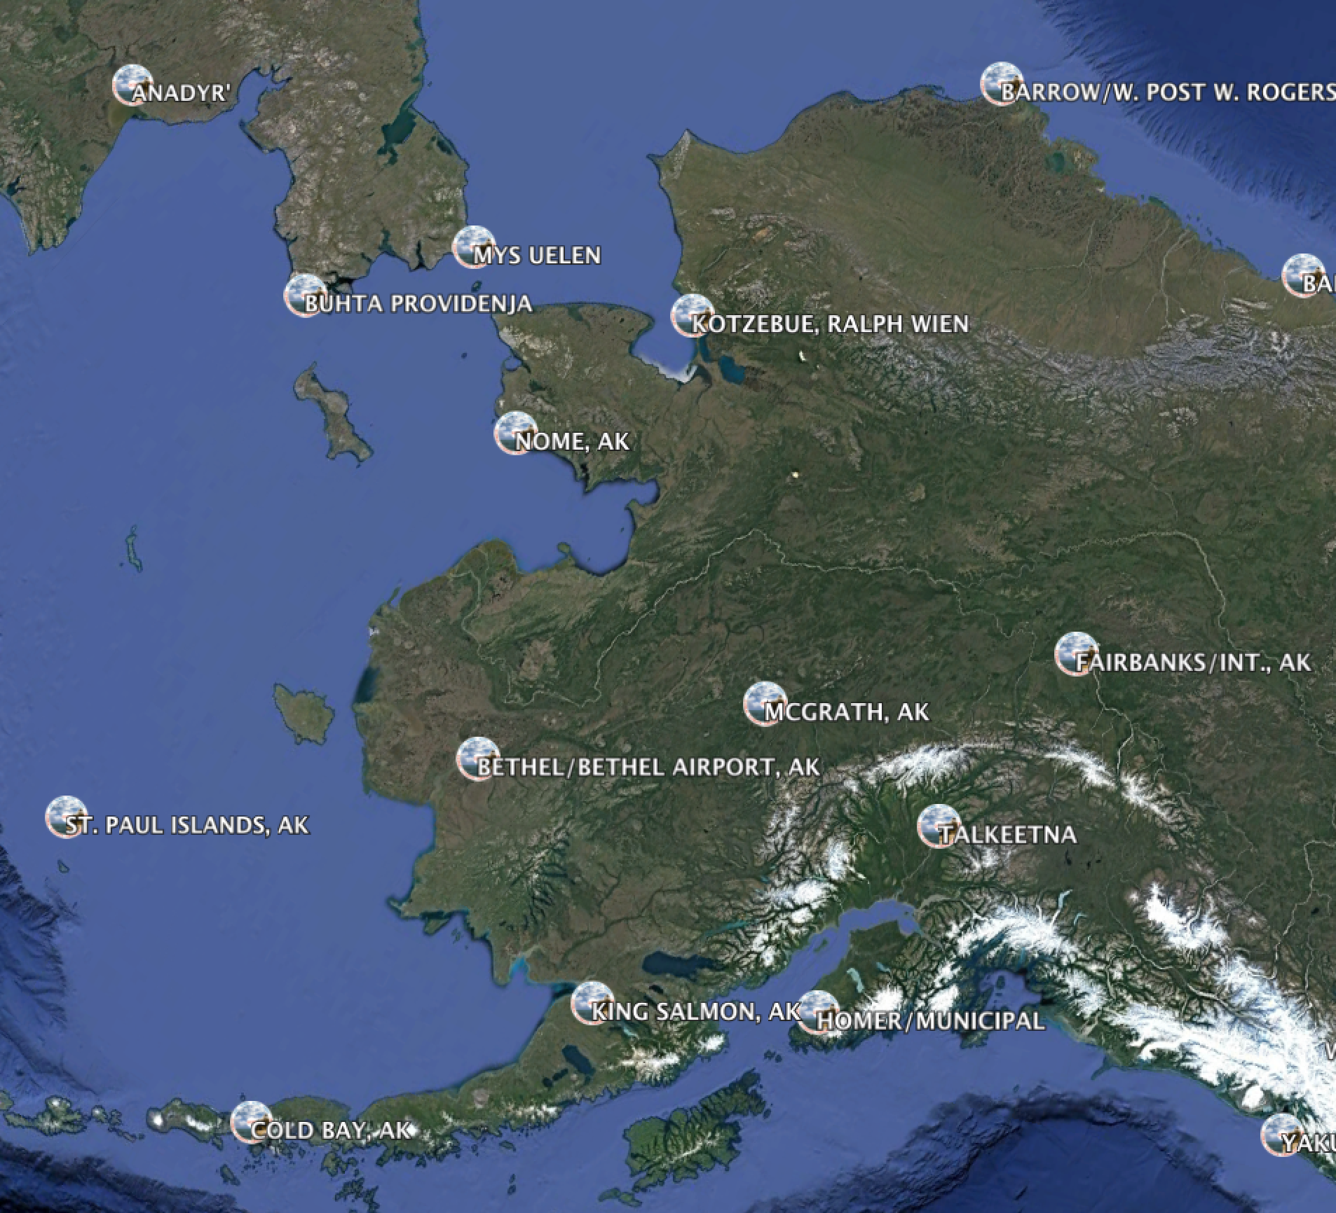
Notes with Lab 3 Exercises
Typically, the major reanalysis datasets have as few as 6 to 12 stations for Alaska (depending on the record length).
For example, the number of AK stations in the GCOS,
Global climate observing network.

Slide 16
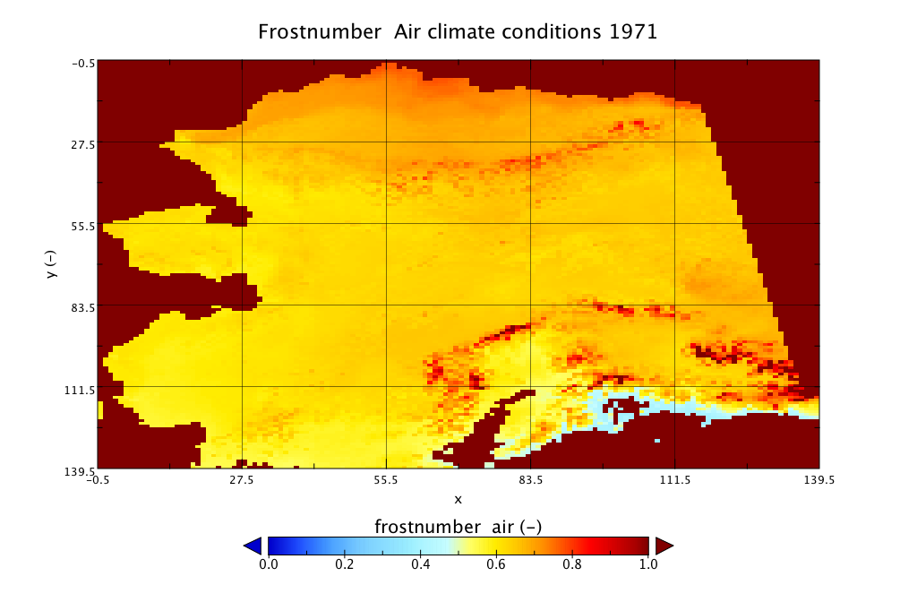
Notes with Lab 3 Exercises
1971 was a relatively cold year, and thus the Frost number predictions indicate possible permafrost in almost the entire state of Alaska.

Slide 17
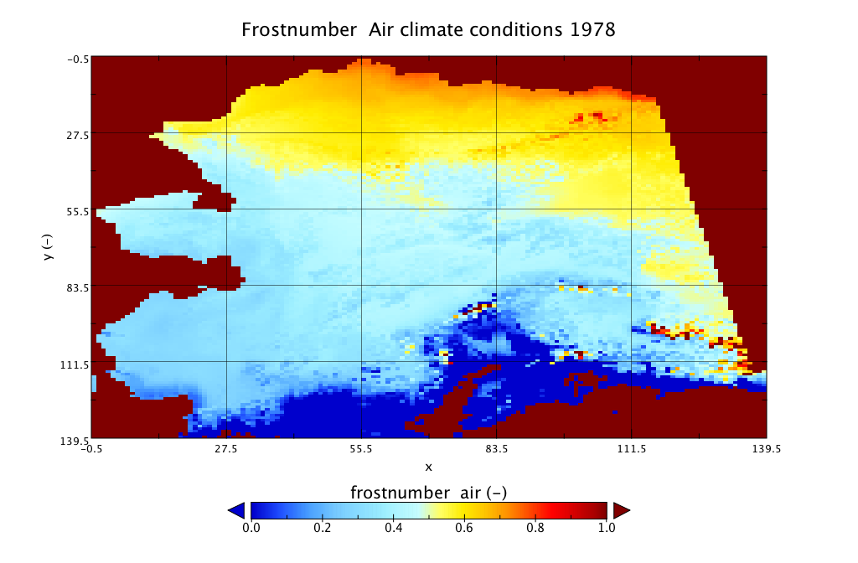
Notes with Lab 3 Exercises
Alaska Range
Notes:
Alaskan range runs over > 650 km length and is has the highest peaks beyond Asaia and the Himalays (including the Wrangell St Elias and Denali). Due to the high elevation air temps are much lower then nearby. This is occurrence of mountain permafrost.

