Slide 1
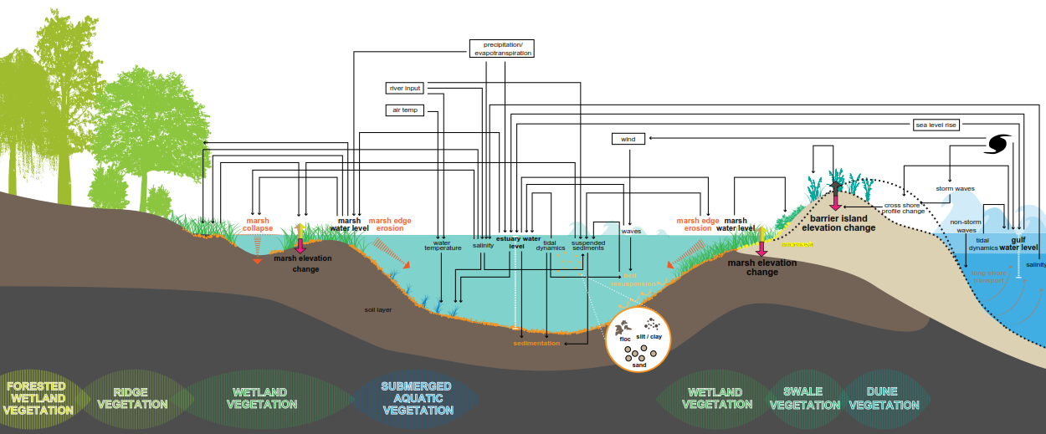
Coastal Ecosystem Integrated Compartment Model (ICM)
Ehab Meselhe, Water Institute of the Gulf | May 2015

Slide 2
Outline
Overall philosophy
Processes represented in the ICM
Model calibration and performance assessment
Uncertainty analysis
Closing Remarks

Slide 3
Overall Philosophy
Open Source
Coding language
Operating system
Reliance on proprietary software package
Replicating reality versus capturing relevant processes
Simplifying assumptions and computational efficiency
Uncertainty analysis
Future scenarios: climate change and environmental variability

Slide 4
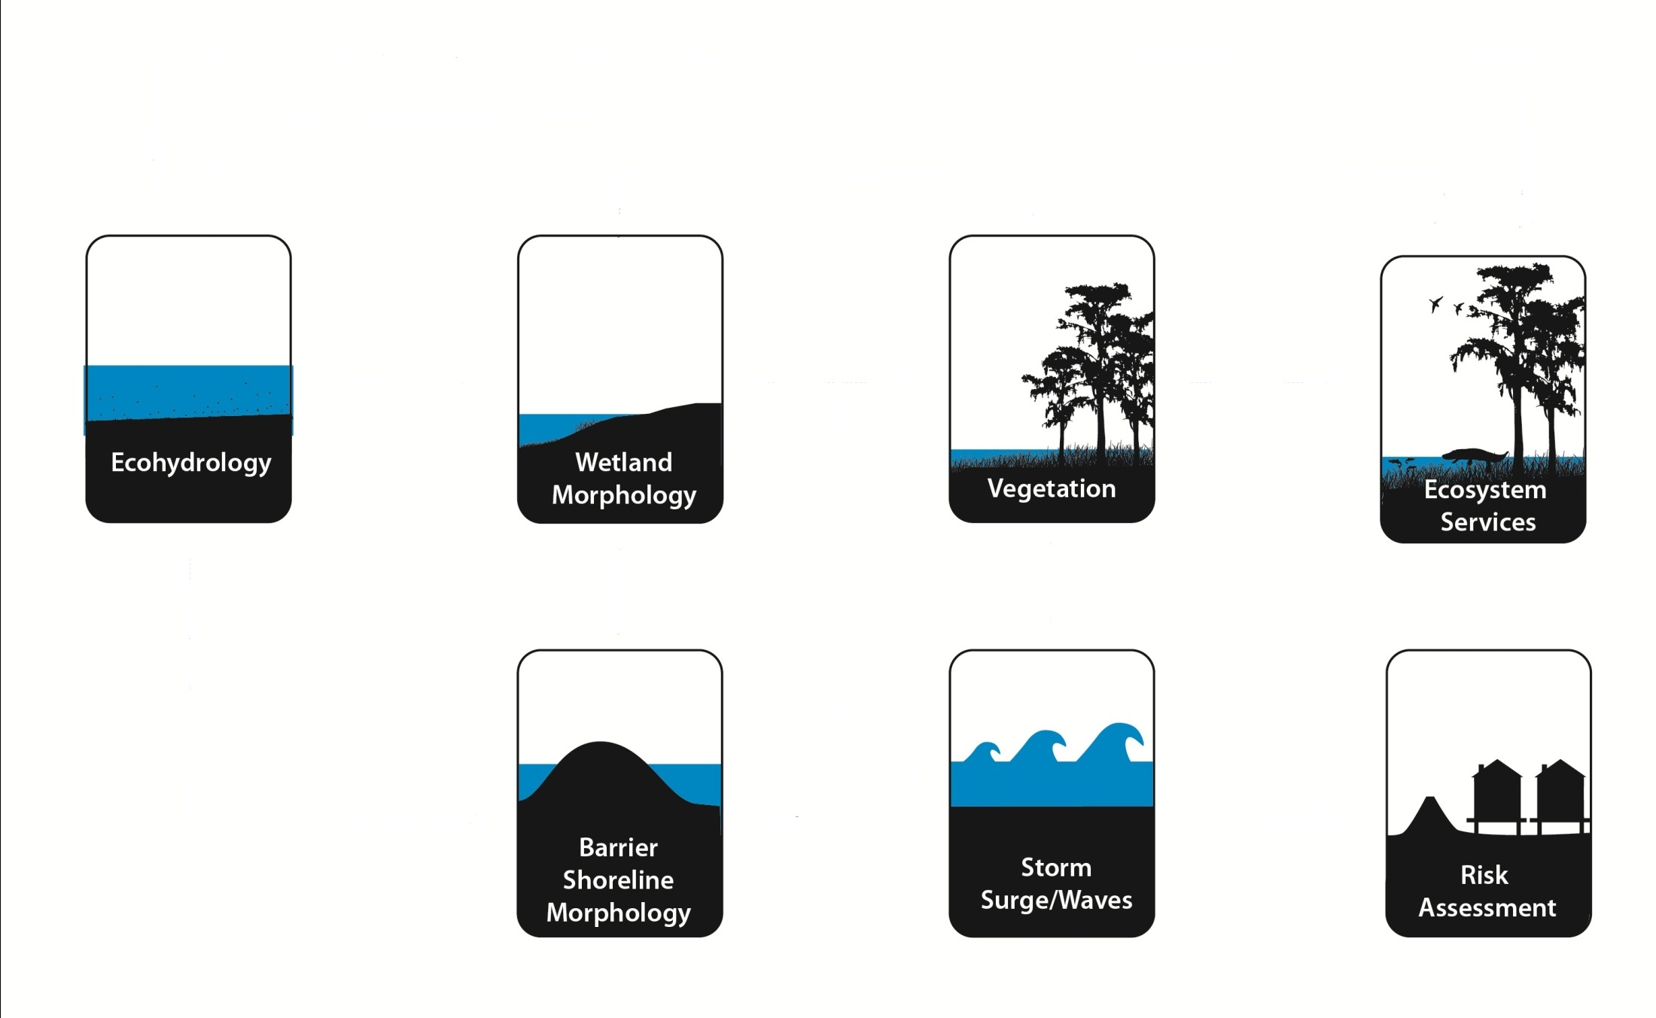
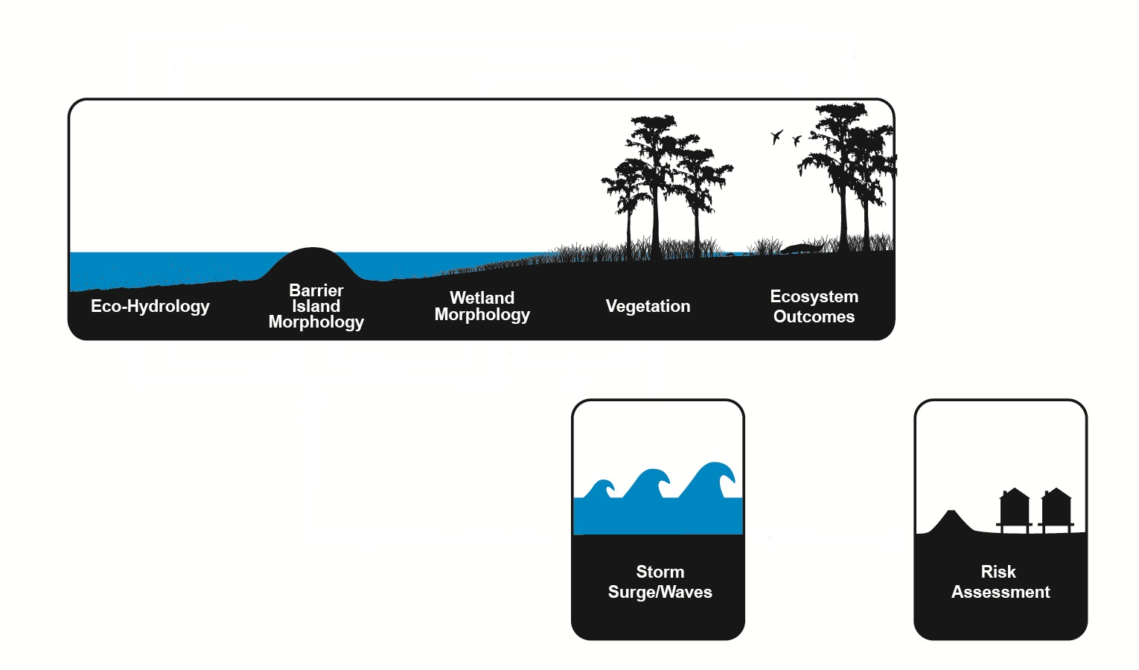
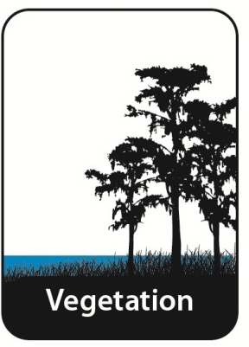
Integrated Compartment Model (ICM)
2012 Coastal Master Plan Analysis

Slide 5
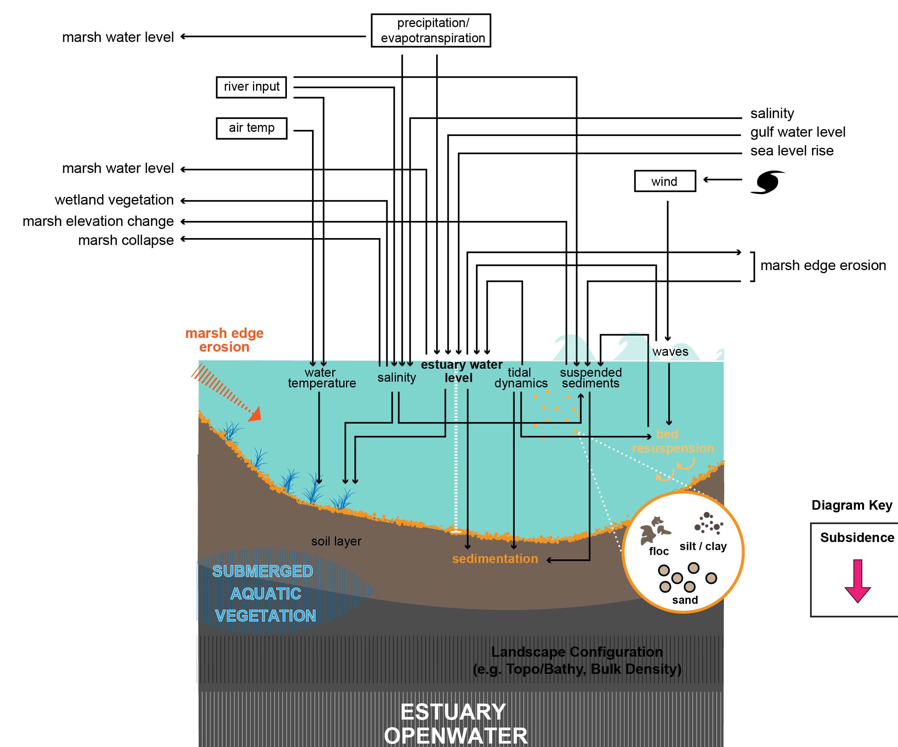
Estuary and Open Water Processes
Hydrodynamics
Water quality
Sedimentation
Bed resuspension
Sediment distribution

Slide 6
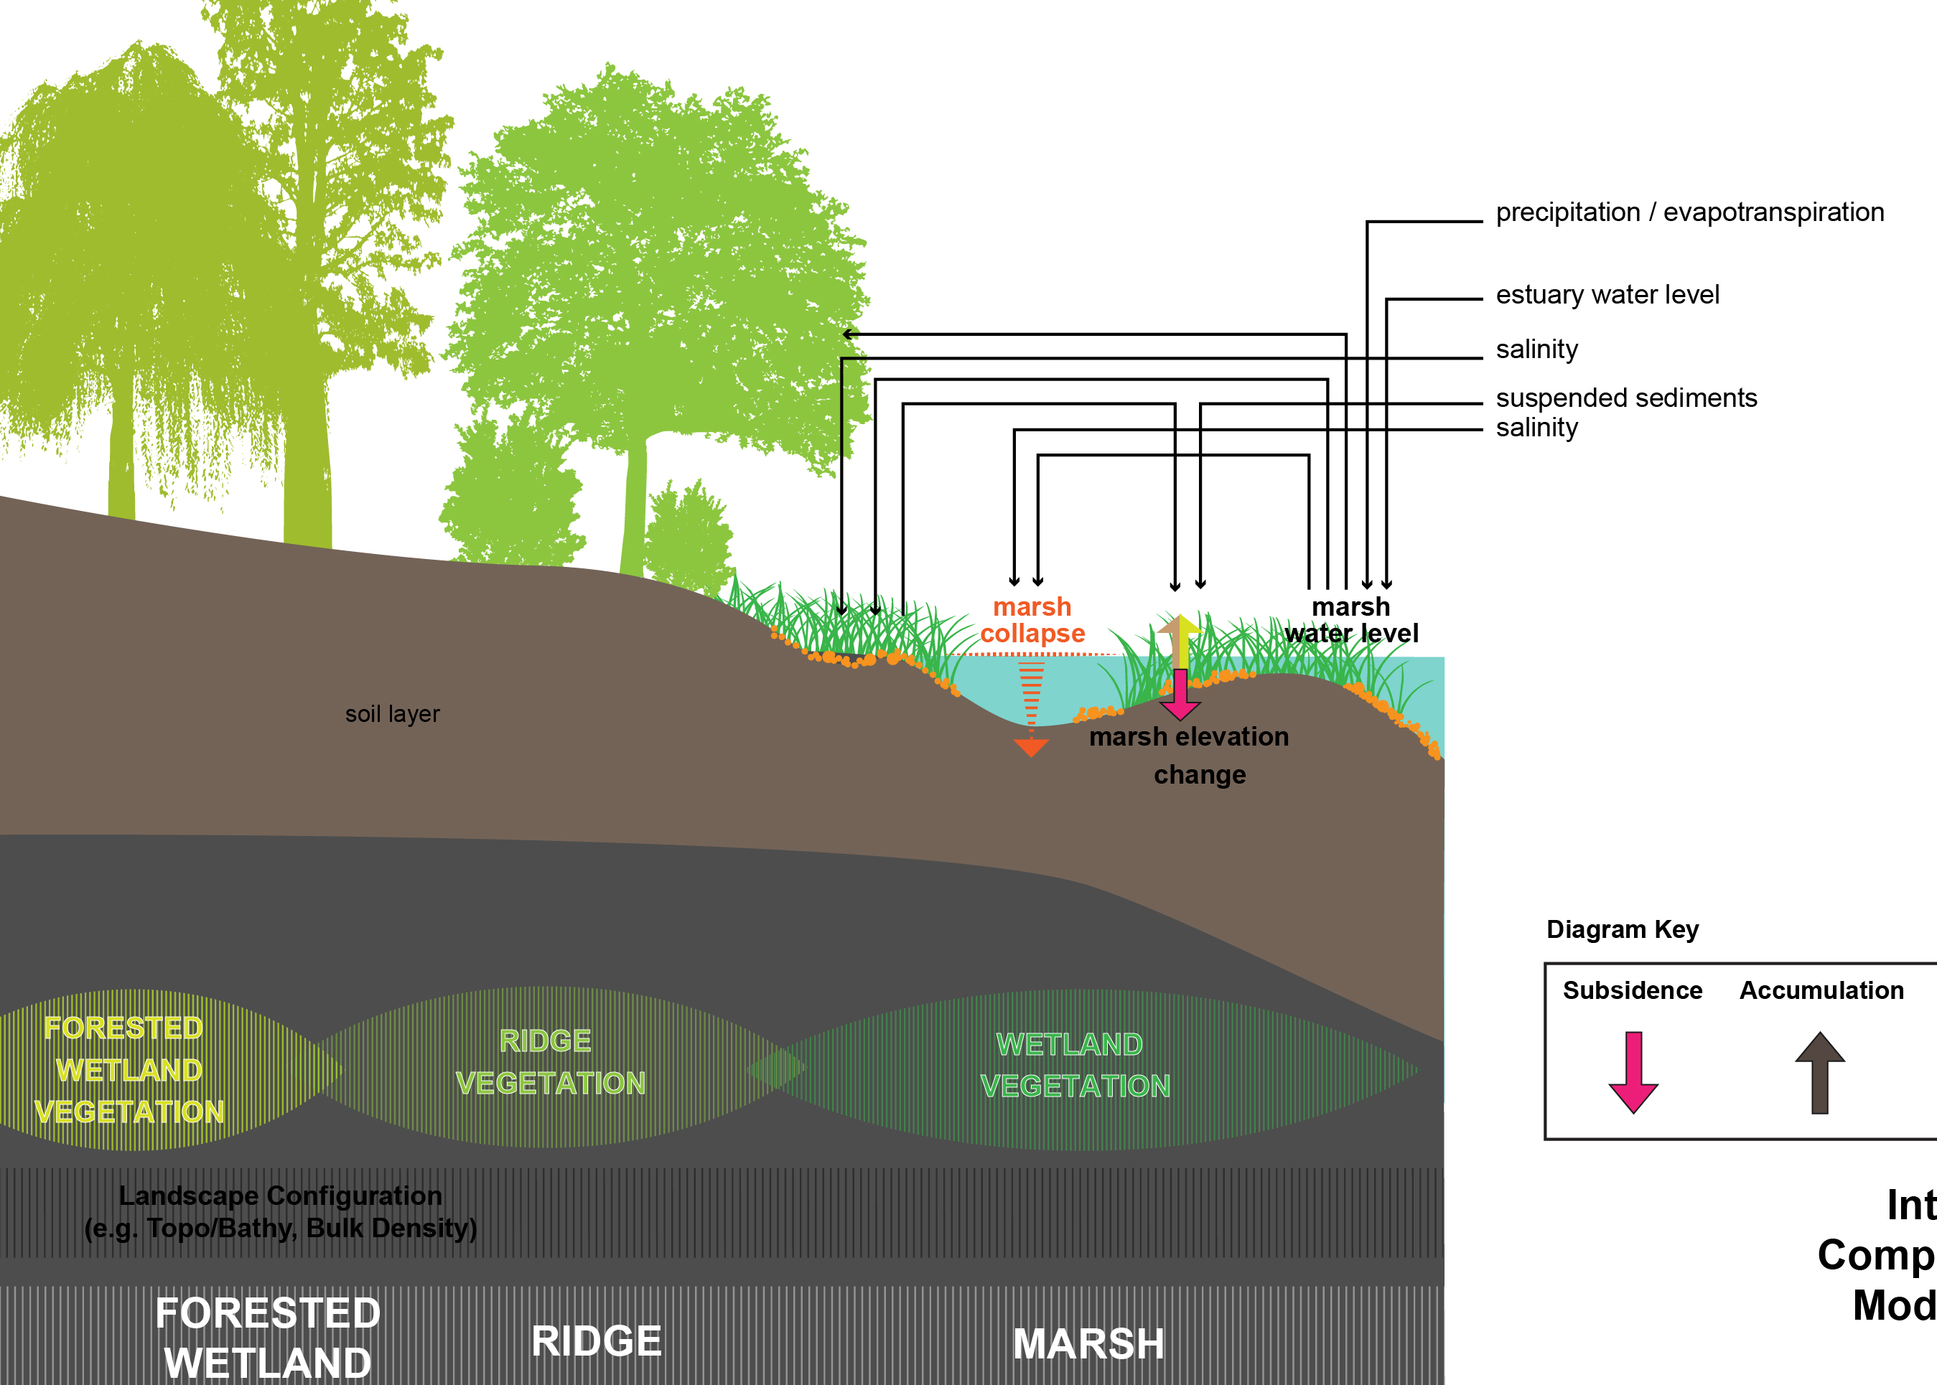
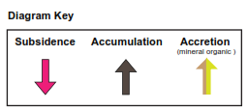
Wetland Processes and Vegetation
Wetland elevation change
Wetland area change
Marsh collapse
Marsh edge erosion
Storm effects
Coastal vegetation

Slide 7
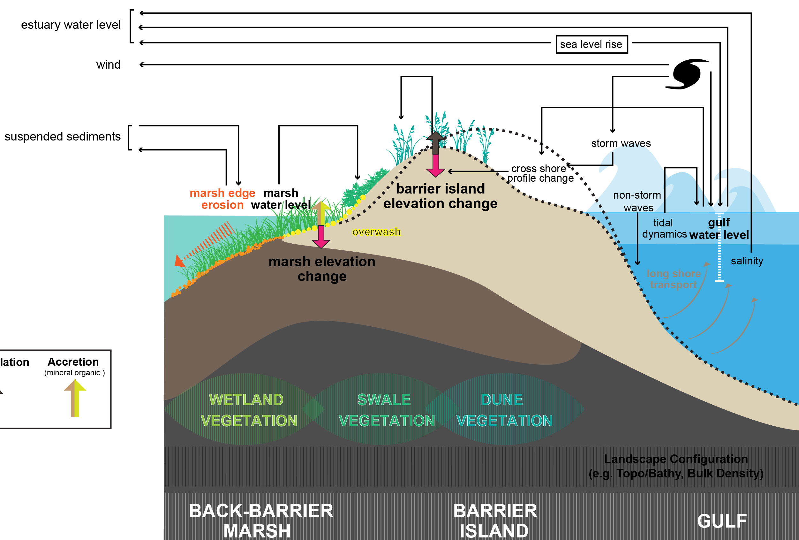
Barrier Island Processes
Island elevation change
Breaching
Overwash / cross shore profile change
Longshore transport
Wave transformation
Storm effects (SBEACH)
Back-barrier marsh, dune and swale vegetation

Slide 8
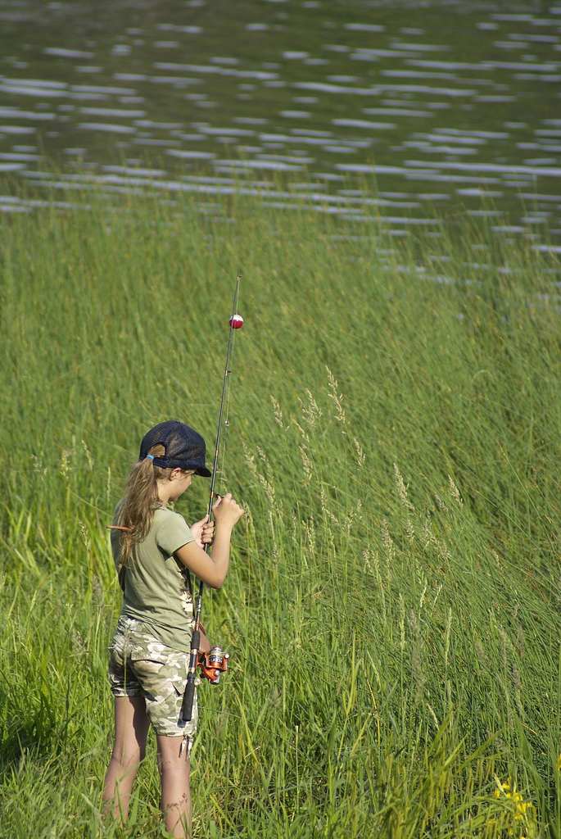
Ecosystem Outcomes
Fish, shellfish, and wildlife HSIs
Statistical analysis
Coded into the ICM
EwE (Ecopath with Ecosim)
Community fish and shellfish model
Dynamically coupled to the ICM
Additional ecosystem outcomes
Nitrogen uptake
Storm surge attenuation
Agriculture
Carbon
flickr

Slide 9
ICM Compartments

Slide 10
Hydraulic Link Network

Slide 11
Hydraulic Overland Flow (e.g. surge) Link Network

Slide 12
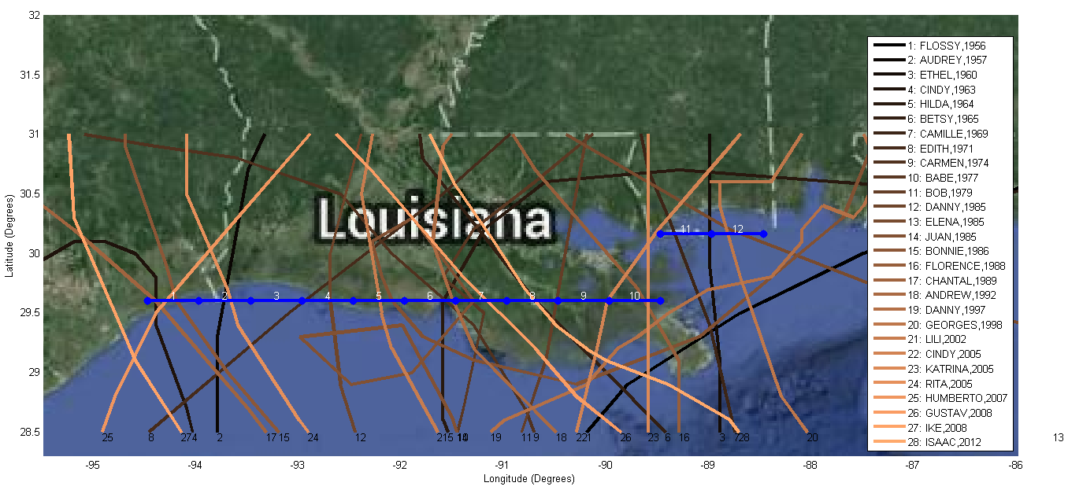
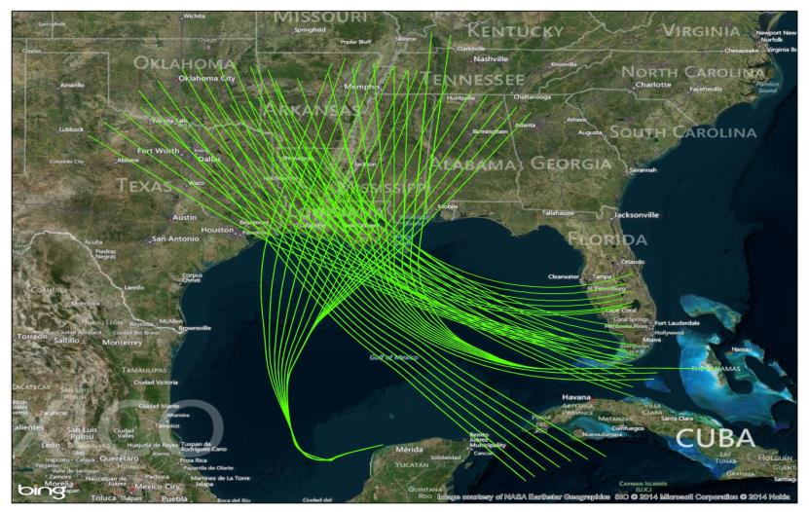
Storms in the Landscape
Identify historical hurricane strikes (1950-2013)
Locate ‘matching’ synthetic storms
Apply storms as forcings in the 50-year ICM model runs
Impacts to the landscape, including islands
(1)
(2)

Slide 13
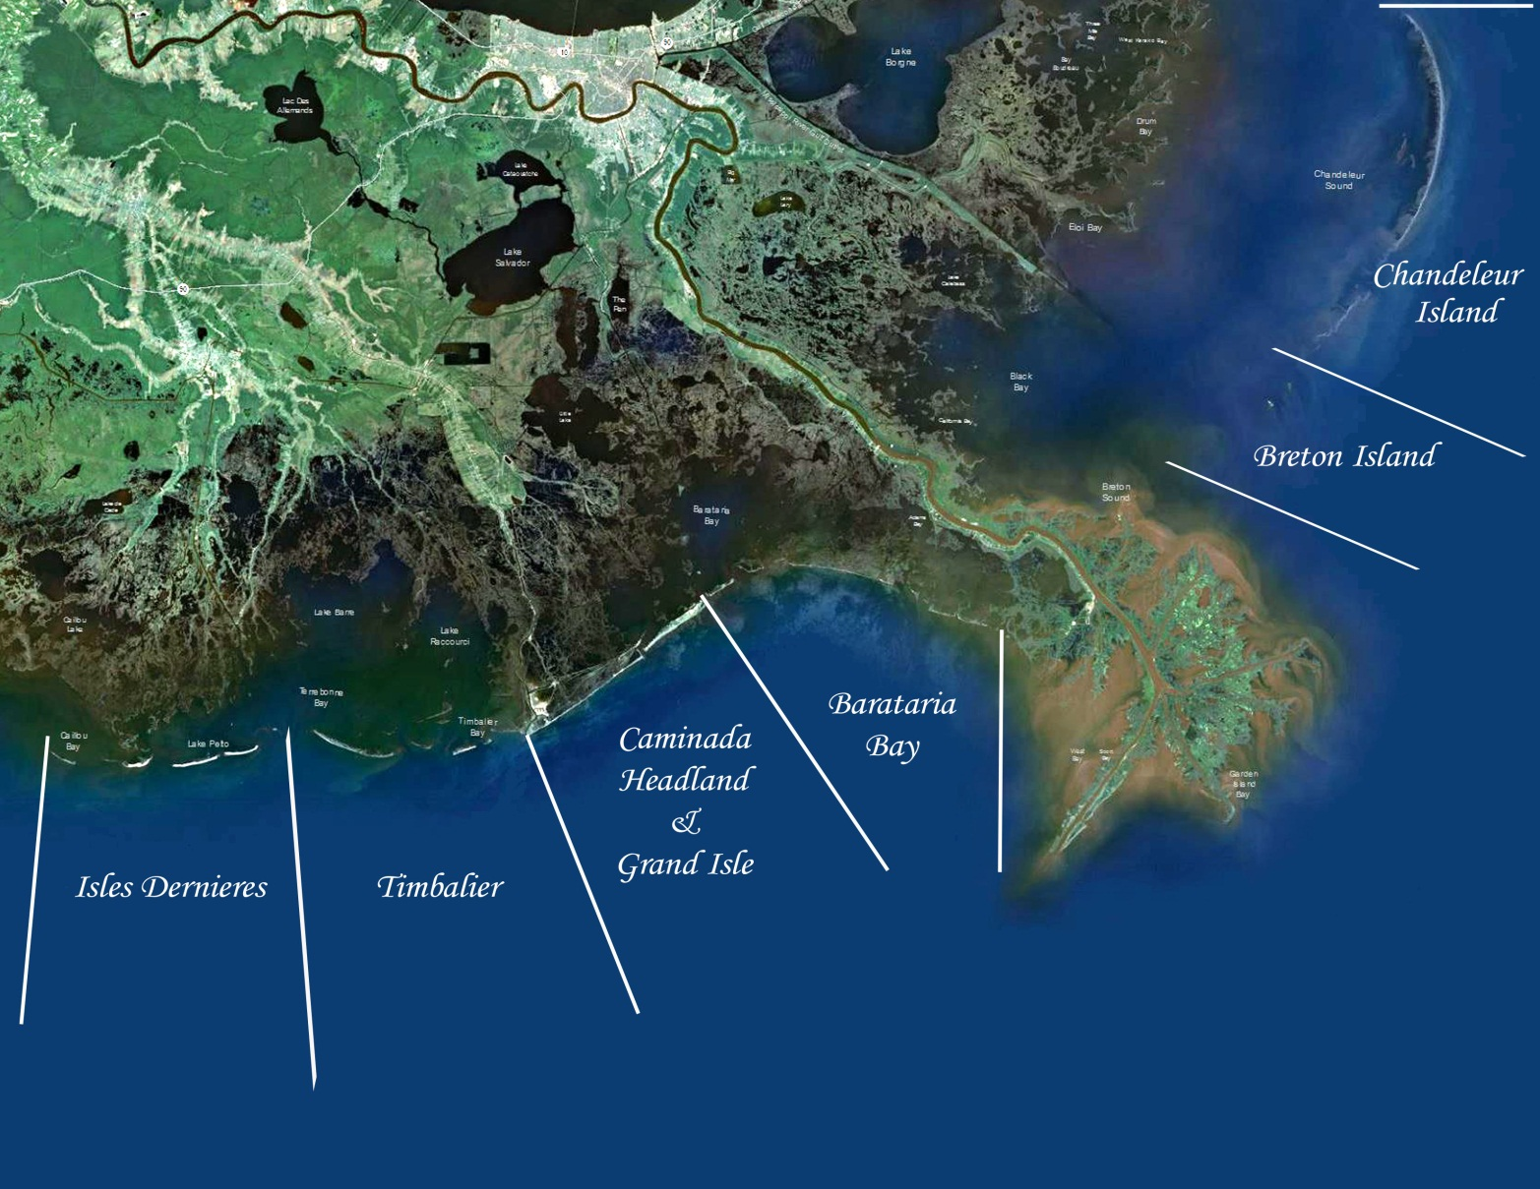
Barrier Islands
Wave transformation (SWAN)
Longshore sediment transport (2012 coding)
Cross-shore sediment transport (SBEACH)
Breaching - historical data (critical width & width/length ratios)
Inlets & bays (2012 coding)
Back-barrier marsh erosion
Explicit tropical event effects on the landscape

Slide 14
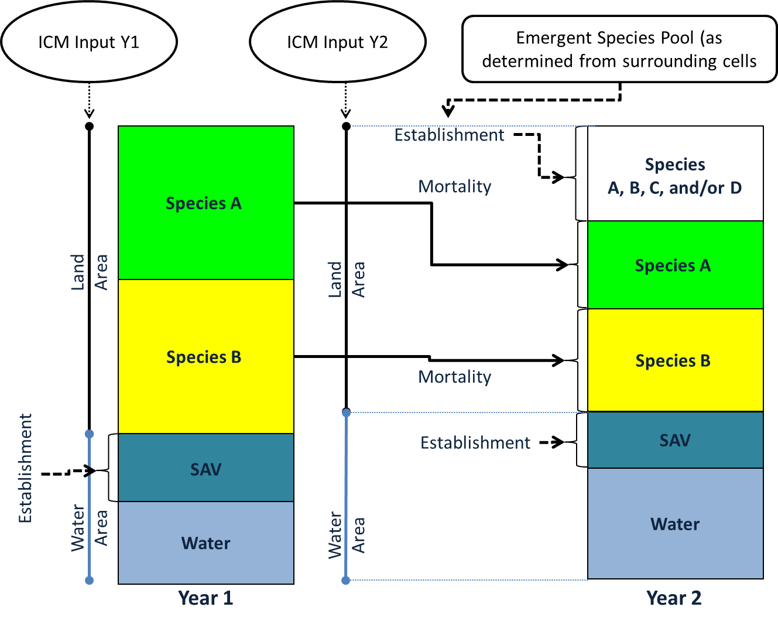
Vegetation Conceptual Model
Input 1
Input 2

Slide 15
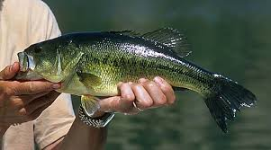
Habitat Suitability Indices
Literature reviews and life cycle descriptions
Subject-matter experts to develop/revise equations
Statistical analysis of existing fishery independent data
Coded directly into the ICM
Fish / shellfish
Bay anchovy (NEW)
Blue crab (NEW)
Gulf menhaden (NEW)
Largemouth bass
Spotted seatrout
Brown shrimp
White shrimp
Eastern oyster
Wildlife
Pelican (NEW)
Alligator
Crawfish
Gadwall
Green-winged teal
Mottled duck
Fish & Shellfish: Ann Hijuelos, Shaye Sable, Meg O’Connell, Jay Geaghan (statistical advisor)
Wildlife: Hardin Waddle, Robert Romaire, Paul Leberg

Slide 16
Ecopath with Ecosim (EwE)
Ecopath - virtual representation of the ecosystem
Ecosim - temporal dynamic simulations
Ecospace - spatial and temporal dynamic simulations (1 km² grid, monthly output, 20 and 50 year runs)
Species of interest
Oysters (adult and spat), juvenile and adult life stages for brown shrimp, white shrimp, blue crab, Gulf menhaden, Gulf sturgeon, red drum, speckled trout, black drum, Atlantic croaker, sheepshead, striped mullet, bay anchovy, southern flounder, largemouth bass, sunfishes, and blue catfish
Other important components of the foodweb
Phytoplankton, zooplankton, detritus, other forage species
Environmental factors
Salinity, temperature, turbidity, marsh cover or edge, total nitrogen
Fishing
Dynamic base maps with habitat characteristics (Ecospace)

Slide 17
Model calibration: Preliminary results
Hydro team:
Stokka Brown & Zhanxian Wang – Moffatt & Nicholl
Jenni Schindler & Mallory Rodrigue – Fenstermaker
Alex McCorquodale – University of New Orleans
Eric White, Yushi Wang & Ehab Meselhe – The Water Institute of the Gulf
Veg team:
Jenneke Visser & Scott Duke-Sylvester – University of Louisiana at Lafayette
Barrier Island team:
Gordon Thomson & Zhifei Dong – CB&I
Coastal Protection and Restoration Authority of Louisiana

Slide 18
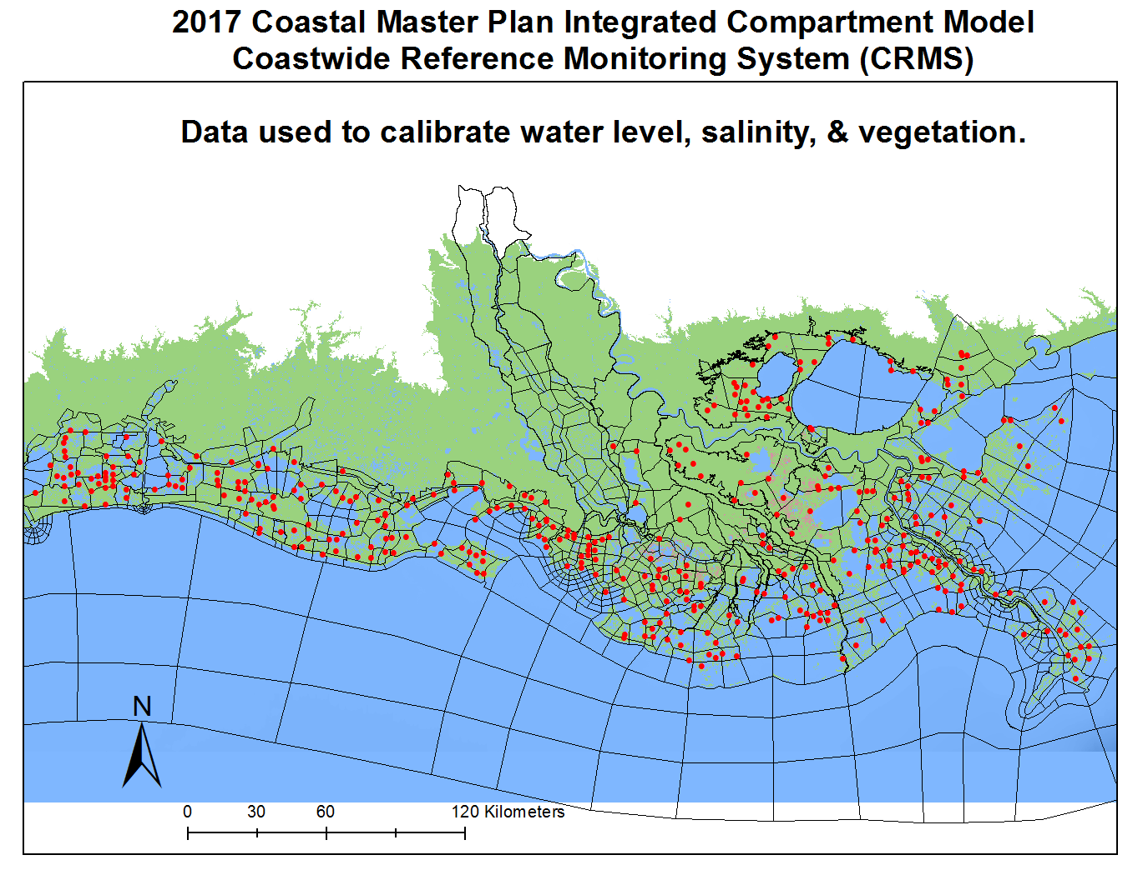

Slide 19
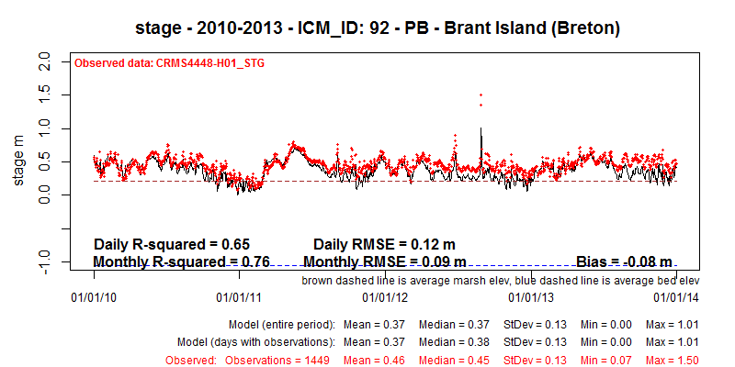
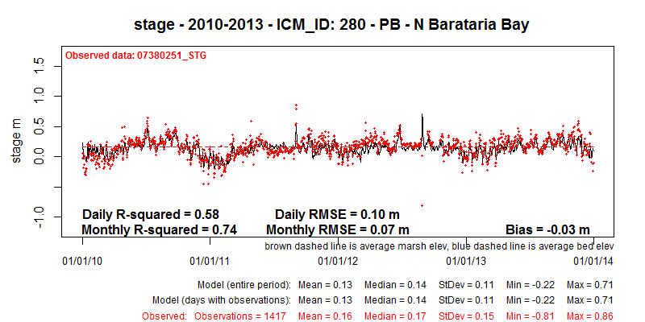
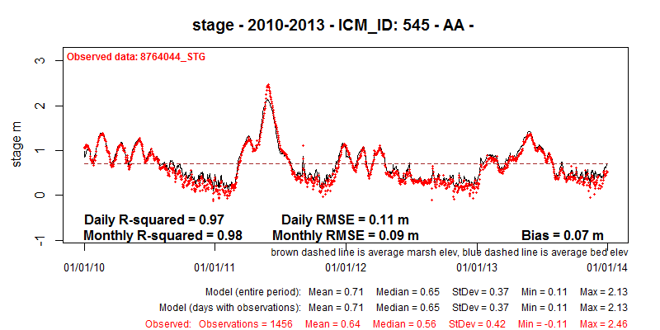
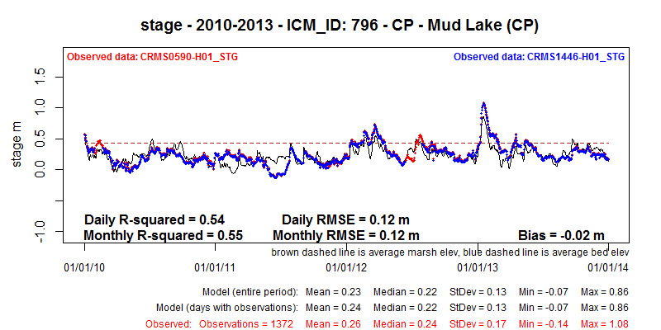
Stage Calibration – 201 sites
stage – 2010-2013 – ICM_ID: 545: AA - Atchafalaya River @ Morgan City

Slide 20
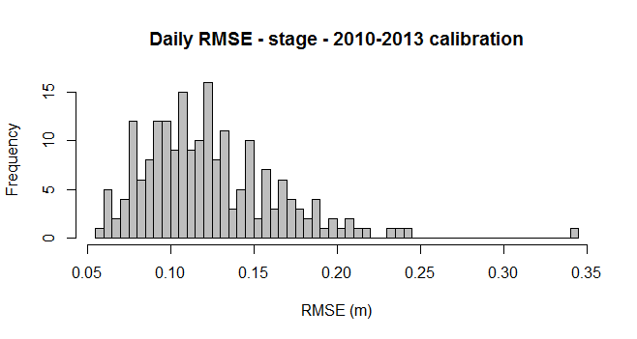
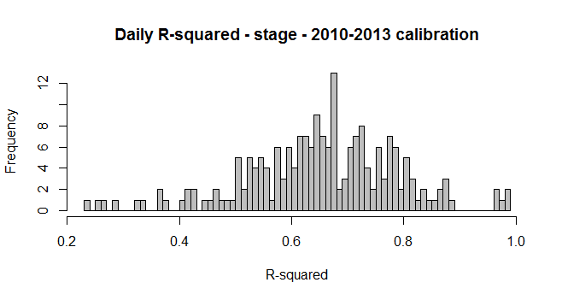
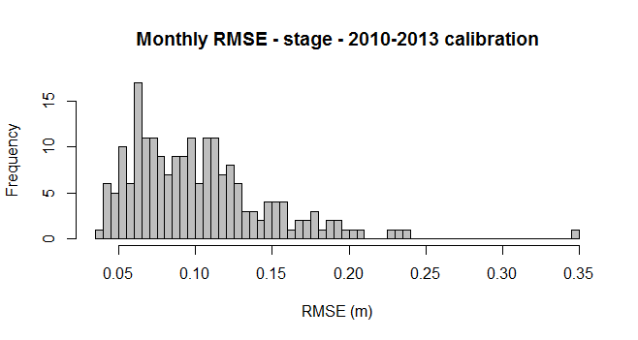
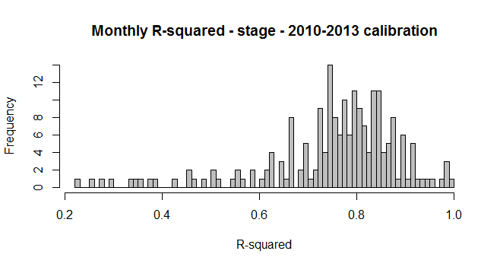
Stage Calibration – 201 sites
 | Bias (m) | Monthly RMSE (m) | Monthly R² | Daily RMSE (m) | Daily R²
mean | 0.00 | 0.10 | 0.75 | 0.12 | 0.65
stdev | 0.08 | 0.05 | 0.14 | 0.04 | 0.14
min | -0.31 | 0.04 | 0.23 | 0.06 | 0.24
max | 0.22 | 0.35 | 0.99 | 0.34 | 0.99

Slide 21
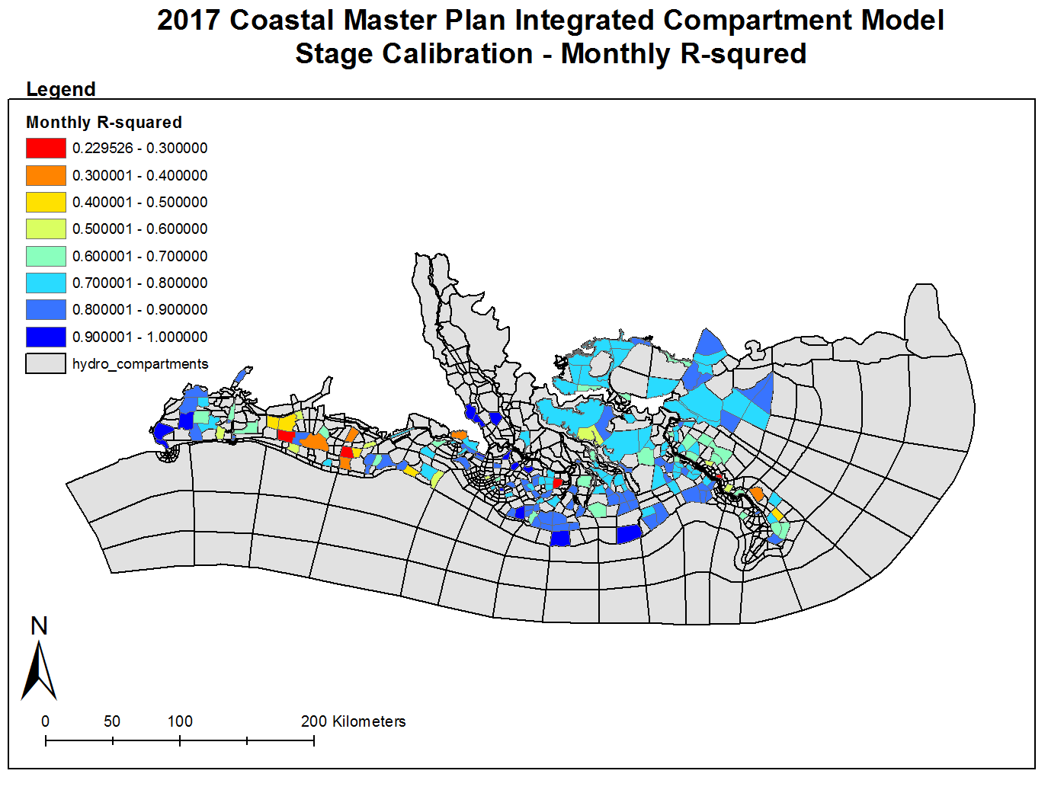

Slide 22
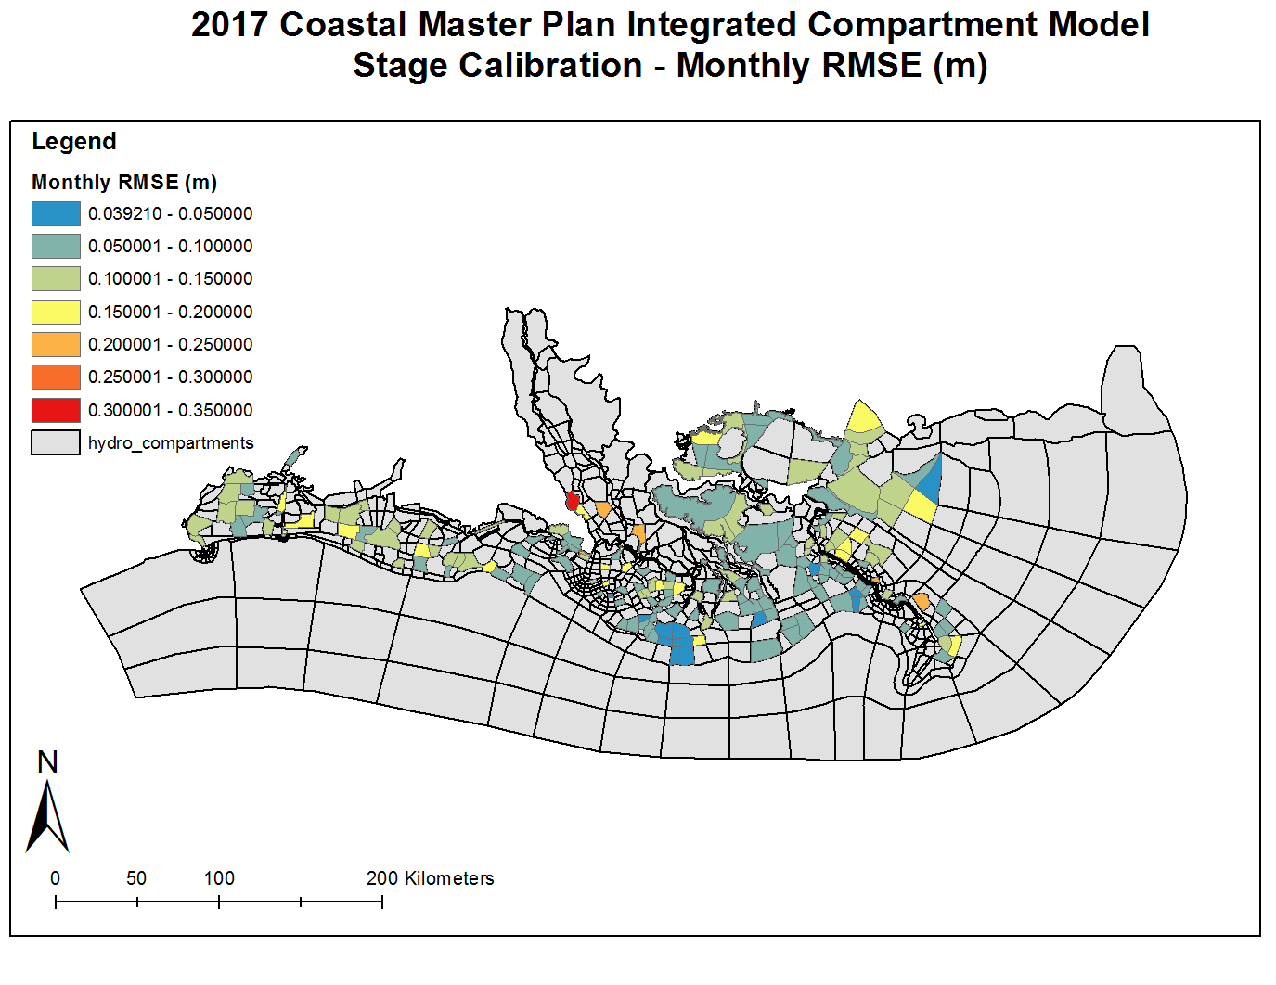

Slide 23
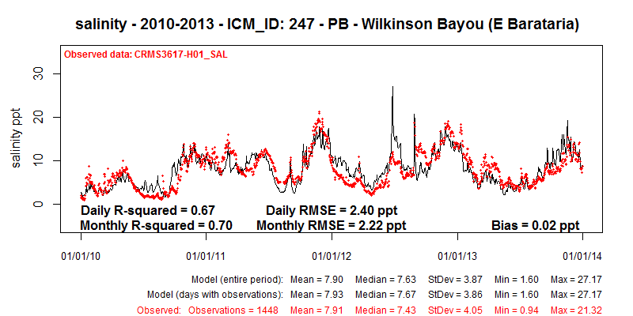
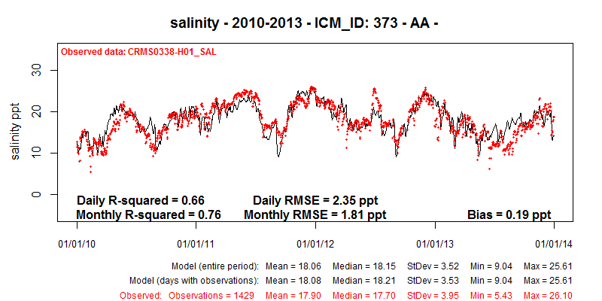
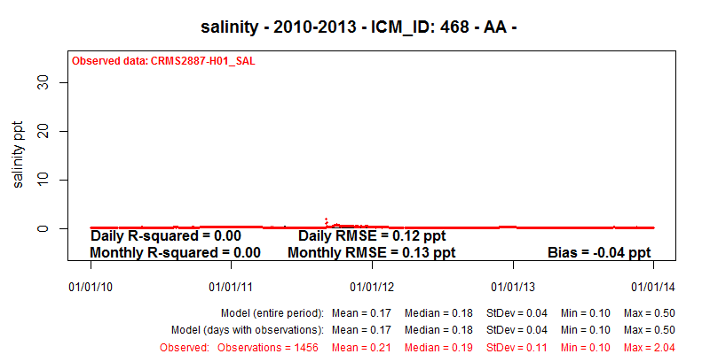
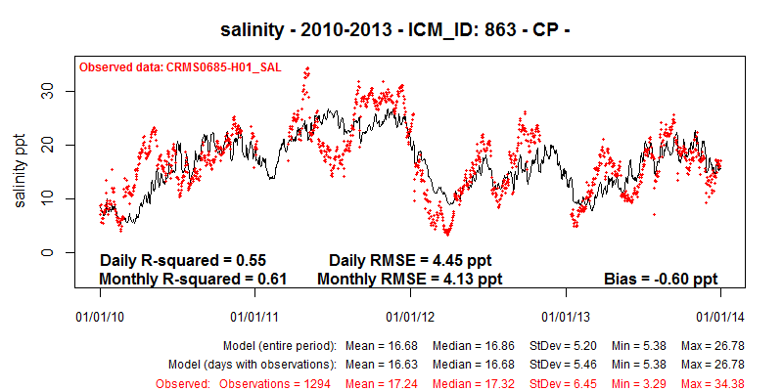
Salinity Calibration

Slide 24
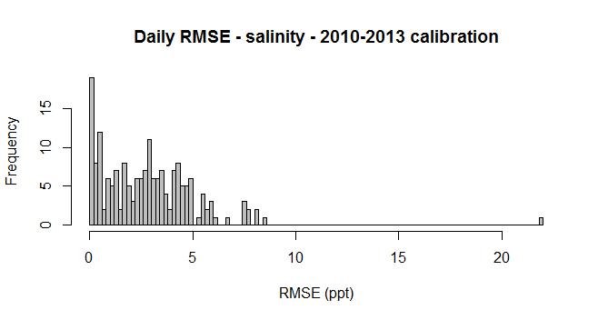
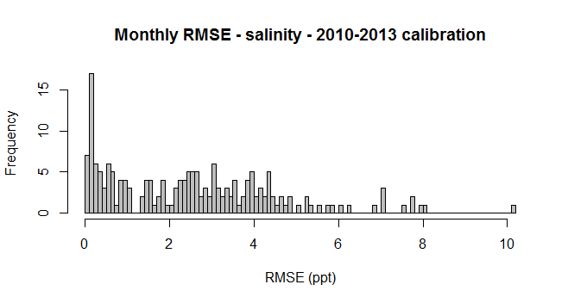
Salinity Calibration – 184 sites
106 sites with observed mean < 5ppt
 | Bias (ppt) | Monthly RMSE (ppt) | Monthly R² | Daily RMSE (ppt) | Daily R²
mean | 0.2 | 1.3 | 0.3 | 1.5 | 0.3
stdev | 0.9 | 1.3 | 0.3 | 1.3 | 0.2
min | -1.8 | 0.1 | 0.0 | 0.1 | 0.0
max | 5.3 | 5.7 | 0.9 | 6.0 | 0.8
74 sites with observed mean 5 – 20 ppt
 | Bias (ppt) | Monthly RMSE (ppt) | Monthly R² | Daily RMSE (ppt) | Daily R²
mean | -0.3 | 4.1 | 0.6 | 4.5 | 0.5
stdev | 2.4 | 1.6 | 0.2 | 2.5 | 0.2
min | -7.0 | 1.8 | 0.0 | 2.3 | 0.0
max | 5.7 | 10.1 | 0.9 | 21.9 | 0.9

Slide 25
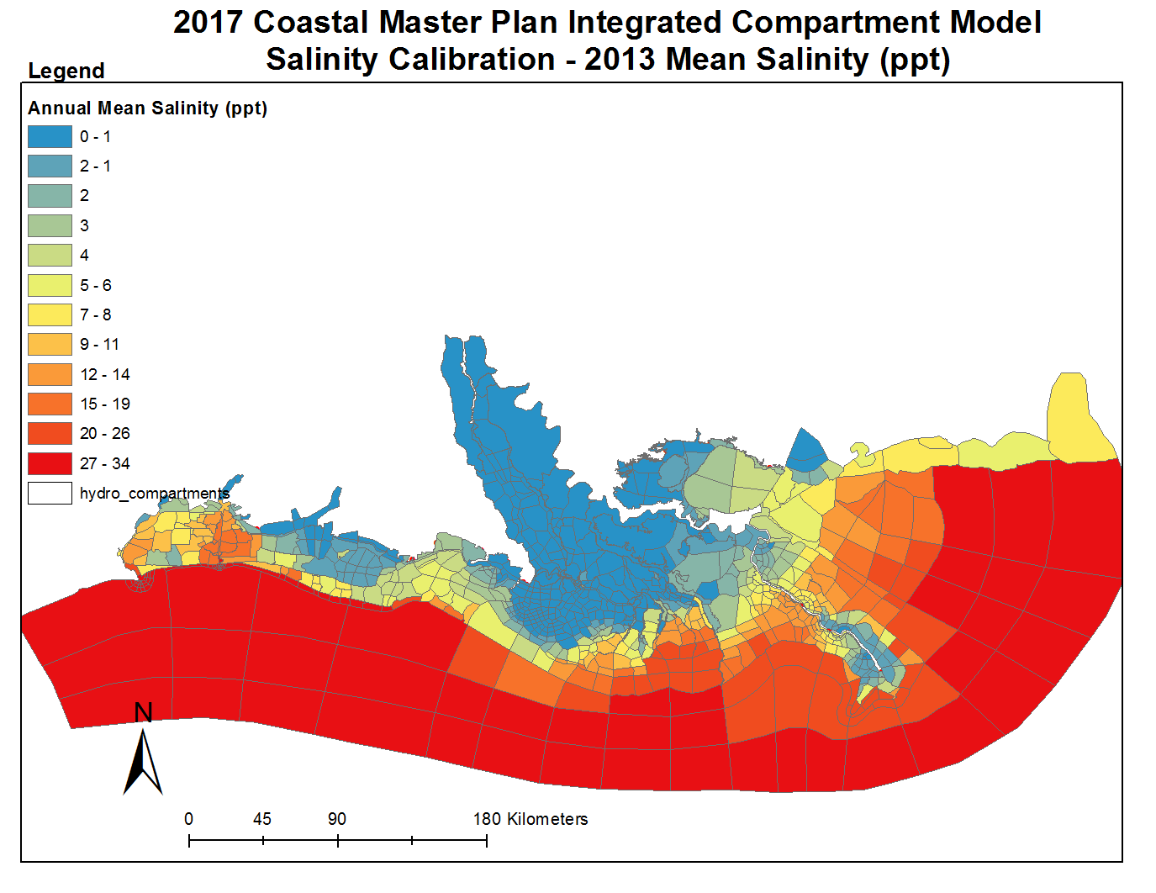

Slide 26
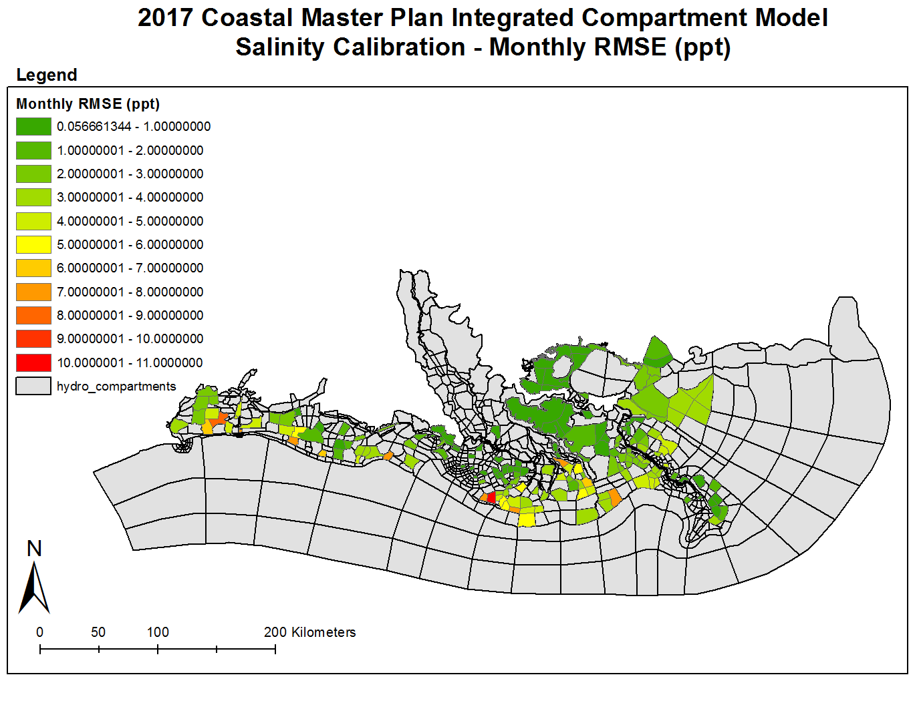

Slide 27
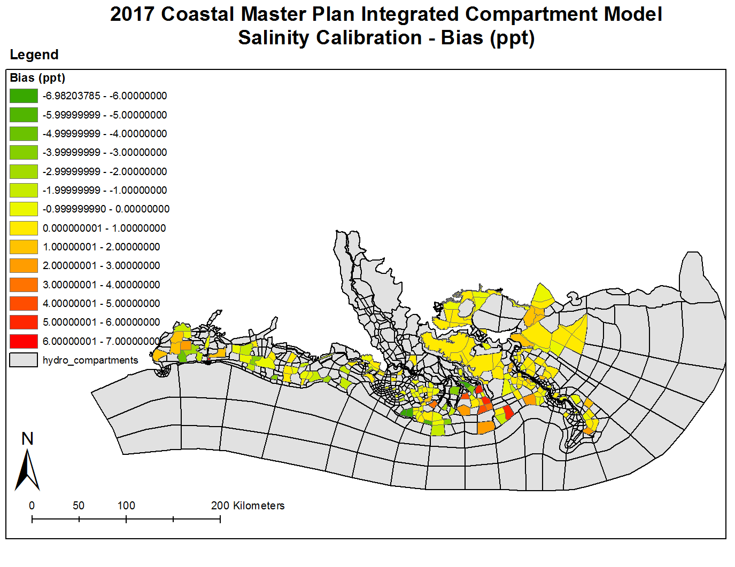

Slide 28
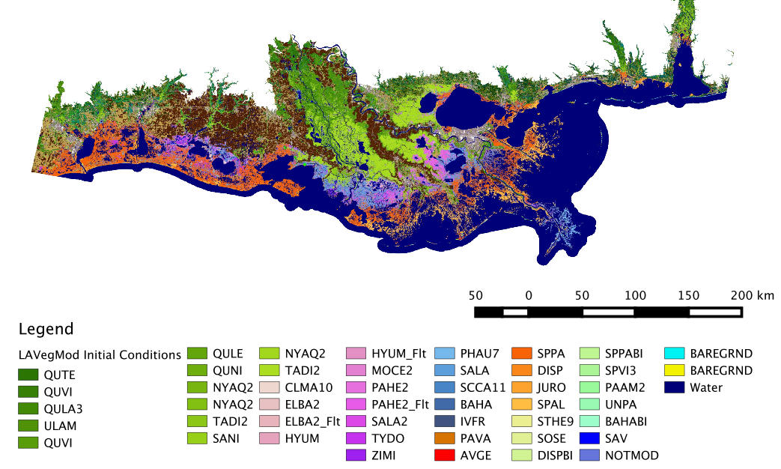
2010 Vegetation Initial Condition Map

Slide 29
Vegetation Calibration Overview
Swamp |  | Fresh Marsh |  | Intermediate Marsh |  | Brackish Marsh |  | Saline Marsh
Species | Fit | Species | Fit | Species | Fit | Species | Fit | Species | Fit
TADI2 | 70 | TYDO | 78 | SALA | 86 | SPPA | 71 | SPAL | 81
NYAQ2 | 90 | PAHE2 | 96 | PHAU7 | 87 | JURO | 88 | DISP | 74
SANI | 91 | HYUM | 98 | IVFR | 90 | PAVA | 87 | AVGE | 100
 |  | SALA2 | 98 | BAHA | 89
 |  | ZIMI | 97 | SCCA11 | 96
 |  | CLMA10 | 97
 |  | MOCE2 | 99
Average | 81 |  | 90 |  | 87 |  | 75 |  | 77
Fit is the percentage of correctly classified stations in 2014 (both presence and absence)
Average is the weighted average using species % of stations observed in 2012

Slide 30
BIMODE - Longshore Calibration Results
Location | Reported Transport (m³/yr) | Modeled Sediment Transport Potential (m³/yr)
Raccoon Island | 40,000 | 18,000 to 31,000
Whiskey Island | 40,000 | 37,000 to 39,000
Trinity & East Island | 46,000 | 24,100 to 37,000
Timbalier Island | 35,000 | 24,000 to 37,000
East Timbalier Island | 41,000 | 600 to 5,000
West Belle Pass Barrier Headland | 20,000 | 2,000 to 15,000
Caminada Headland | 63,000 | 1,700 to 80,000
Grand Isle | 63,000 | 2,000 to 48,000
West Grand Terre | 30,000 | 4,300 to 21,000
East Grand Terre | 40,000 | 21,000 to 39,000
Grand Pierre | - | 44,000 to 53000
Chenier Ronquille | 39,000 | 35,000 - 46,000
Chaland Headland | 58,900 | 22,000 to 46,000
Bay Joe Wise | 29,000 | 22,000 to 44,000
Shell Island West | 40,000 | 44,000 to 53,000
Shell Island East | 40,000 | 18,000 to 50,000
Pelican Island | 20,000 | 15,000 to 31,000
Scofield Island | - | 20,000 to 32,000
Breton Island | 310,000 | -
Chandeleur Island | 800,000 to 1,100,000 | 500,000 to 900,000

Slide 31
Uncertainty Analysis
Limited to parametric uncertainty
Key model parameters influencing model output
Apply perturbations to output of modules prior to usage in subsequent modules
Perturbations are guided by model performance during calibration & validation
Observe influence of perturbation on key model outcomes, e.g.:
Land building
Critical species
Etc.

Slide 32
Future Scenarios
Analyze influence of environmental parameters on model output
Sea level rise
Subsidence
Rainfall
Evapotranspiration
Riverine inflow
Sediment load
Storm frequency and intensity

Slide 33
Closing Remarks
Model calibration & validation is nearly complete
Development of future scenarios is underway
Uncertainty analysis is underway
Model application to restoration and protection projects this summer
Model distribution is expected in 2016

Slide 34
Ehab Meselhe / emeselhe@thewaterinstitute.org

Slide 35
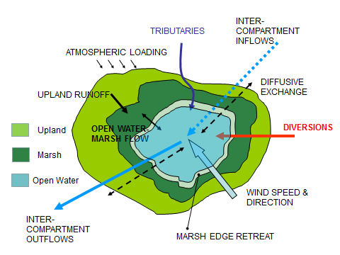
Sediment Distribution
Includes:
open water sediment processes
marsh sediment processes
flow & sediment exchange between open water & marsh
Mass balance based on: mass in, mass out, resuspension, & deposition
Feedback from marsh edge erosion provides sediment for distribution
Non-uniform deposition in marsh; particles with higher fall-velocities deposit in near-edge zone (30 m)
Procedure for sediment deposition and resuspension, also applied during storm events

Slide 36
Marsh Edge Erosion
Marsh edge retreat measurements compiled from aerial imagery from ~2,800 points across coastal LA
Retreat rates averaged by ICM compartment
Annual retreat rate is spatially variable, but does not vary in time

Slide 37
Additional Ecosystem Outcomes
Carbon
Nitrogen uptake
Surge and wave attenuation
Agriculture

