Slide 1
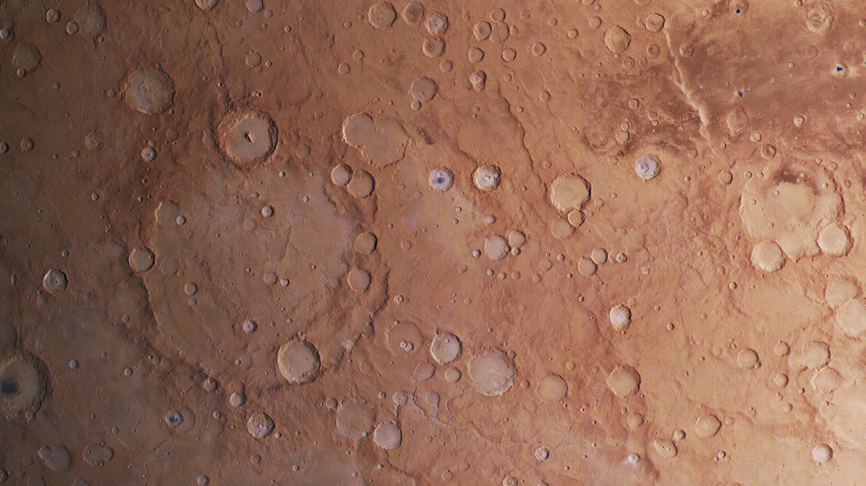
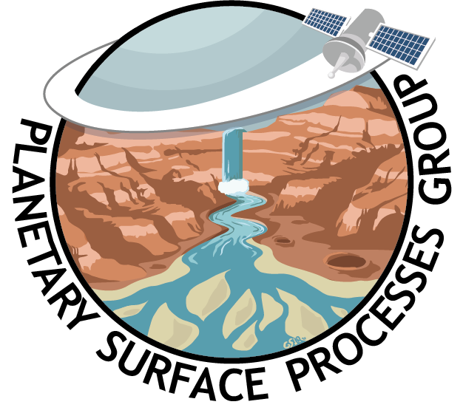

Cratering
Emily Bamber & Gaia Stucky de Quay
ESPIn 2021

Slide 2
Quick Intro
What is an impact crater?
Schrodinger Crater, the Moon
High Rim
Central depression

Slide 3
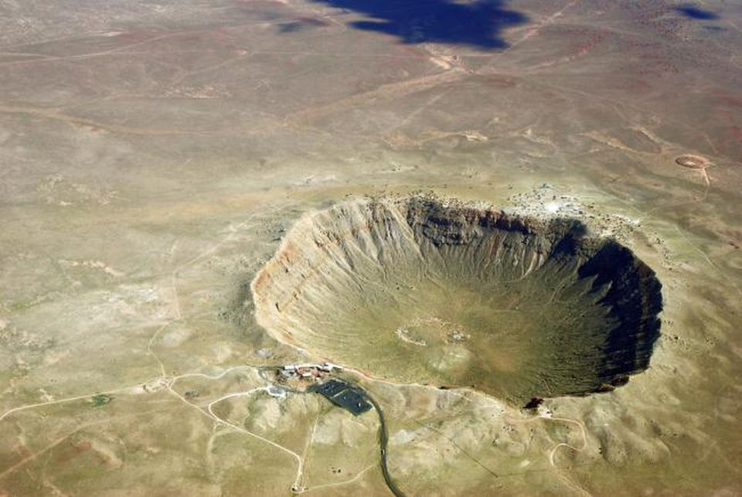
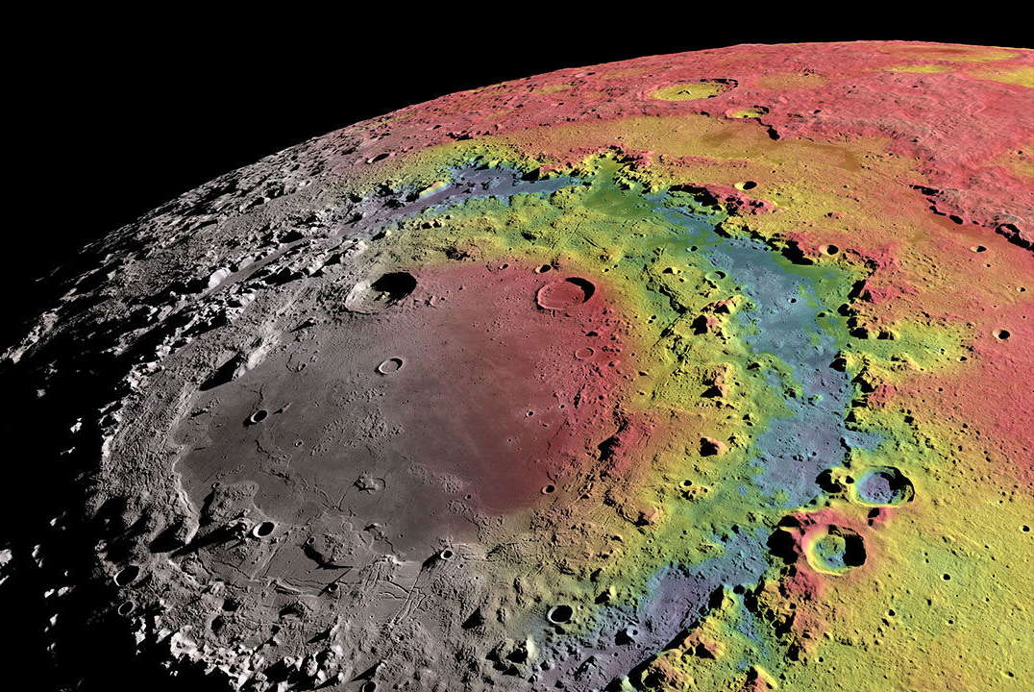
Quick Intro
What is an impact crater?
Schrodinger Crater, the Moon
High Rim
Central depression
Meteor Crater, USA

Slide 4

Motivation
Ok, very cool, but why do we care?

Slide 5
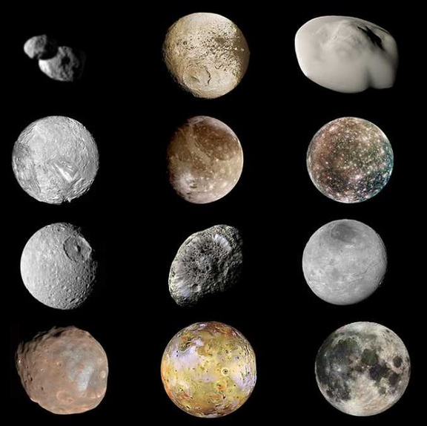
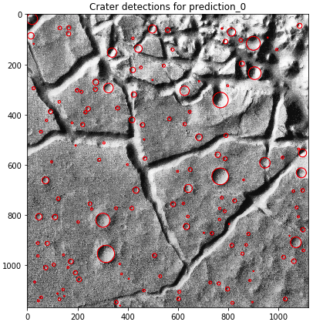
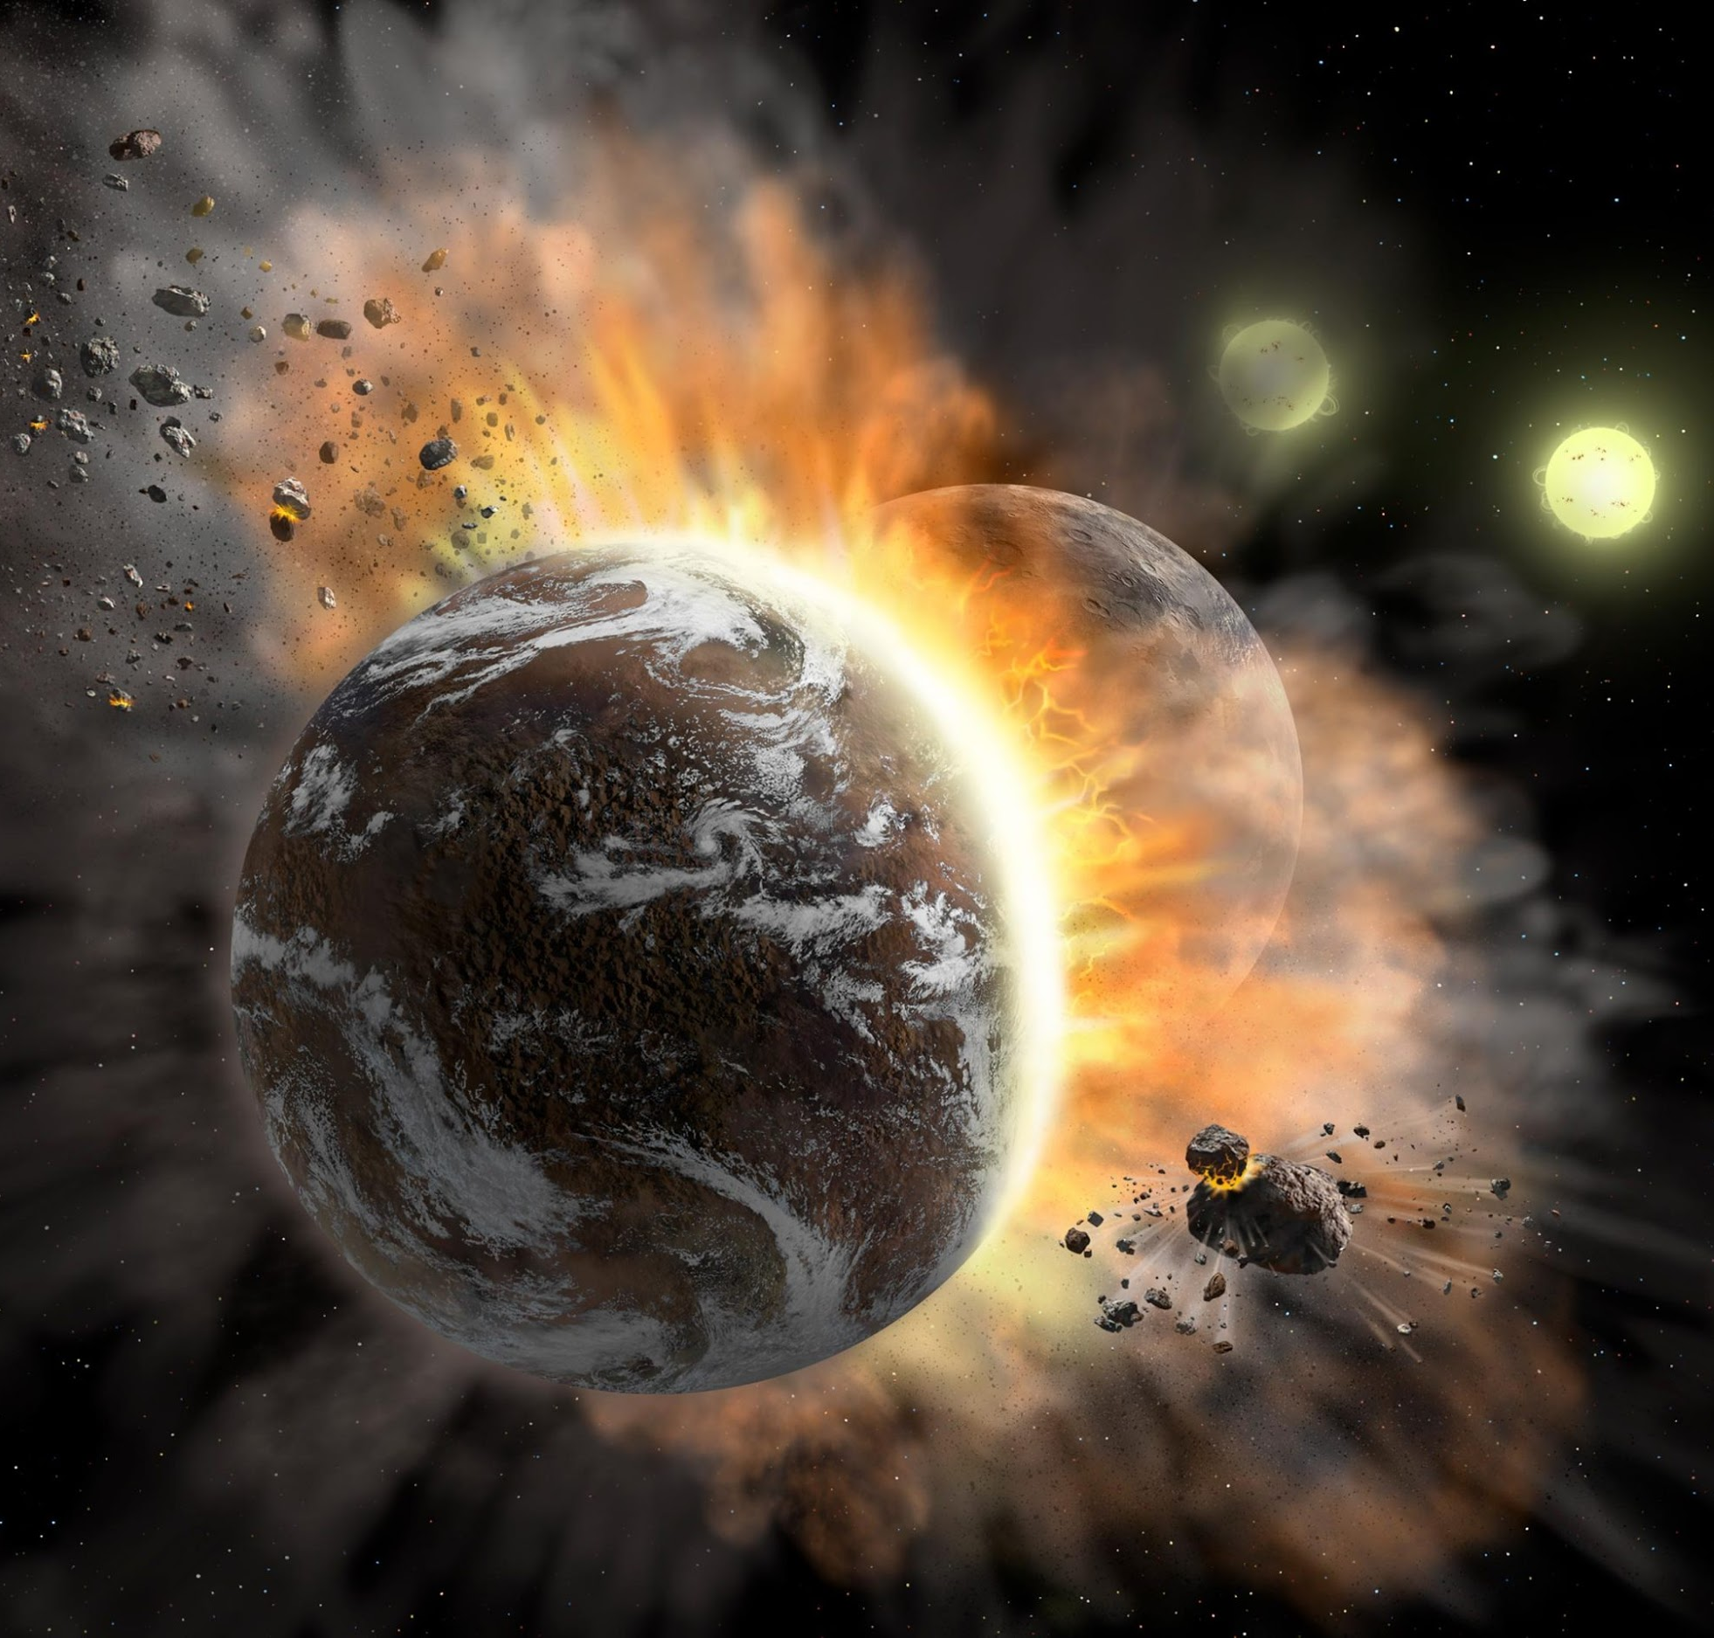
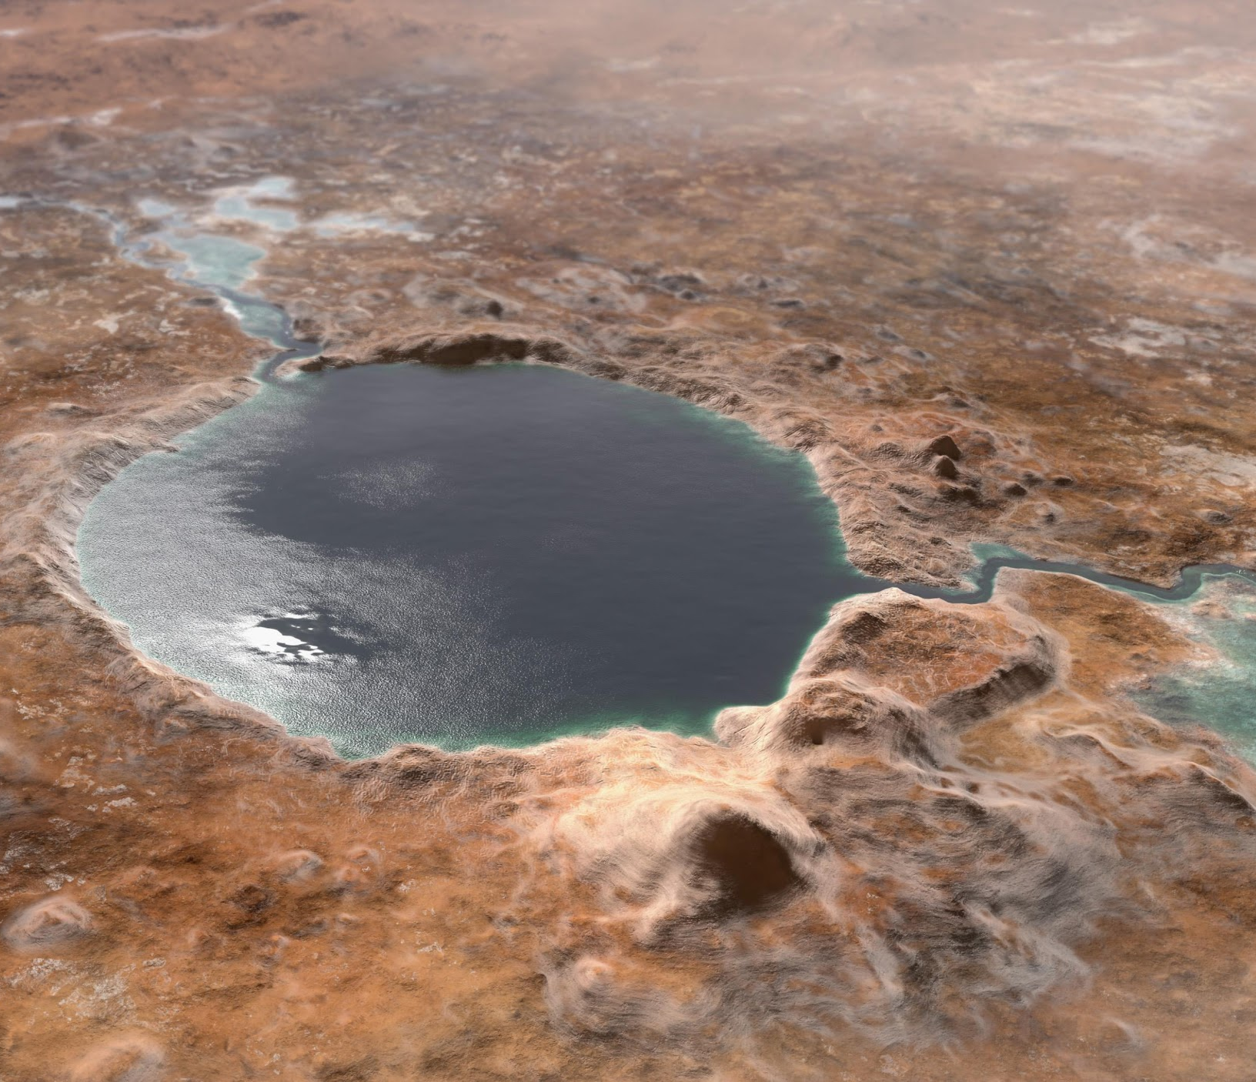
Motivation
Main geomorphic agent on every surface except Earth
Craters are key for dating surfaces (relative and absolute)
Record Solar System formation/evolution information
Relevant on m- to km-scales, for billions of years
Locations most likely to host alien life (e.g., Jezero, Mars)

Slide 6
Motivation
Main geomorphic agent on every surface except Earth
Craters are key for dating surfaces (relative and absolute)
Record Solar System formation/evolution information
Relevant on m- to km-scales, for billions of years
Locations most likely to host alien life (e.g., Jezero, Mars)

Slide 7
Motivation
Main geomorphic agent on every surface except Earth
Craters are key for dating surfaces (relative and absolute)
Record Solar System formation/evolution information
Relevant on m- to km-scales, for billions of years
Locations most likely to host alien life (e.g., Jezero, Mars)

Slide 8
Motivation
Main geomorphic agent on every surface except Earth
Craters are key for dating surfaces (relative and absolute)
Record Solar System formation/evolution information
Relevant on m- to km-scales, for billions of years
Locations most likely to host alien life (e.g., Jezero, Mars)

Slide 9
Motivation
Main geomorphic agent on every surface except Earth
Craters are key for dating surfaces (relative and absolute)
Record Solar System formation/evolution information
Relevant on m- to km-scales, for billions of years
Locations most likely to host alien life (e.g., Jezero, Mars)

Slide 10
Basic Idea
High Rim
Central depression
Meteor Crater, USA

Slide 11
Basic Idea
High Rim
Central depression
Initial surface
Meteor Crater, USA

Slide 12
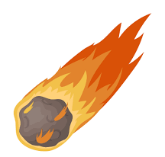
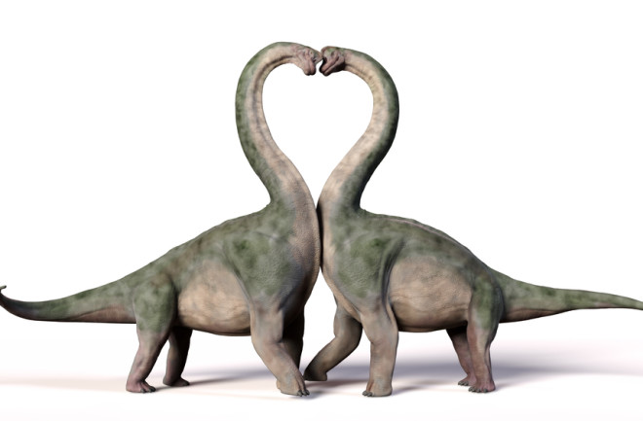
Basic Idea
High Rim
Central depression
Initial surface
Meteor Crater, USA

Slide 13
Basic Idea
High Rim
Crater basin
Central depression
Meteor Crater, USA

Slide 14
Basic Idea
High Rim
Rim
Crater basin
Central depression
Rim
Meteor Crater, USA

Slide 15
Basic Idea
Ejecta blanket
Ejecta blanket
High Rim
Rim
Crater basin
Central depression
Rim
Meteor Crater, USA

Slide 16
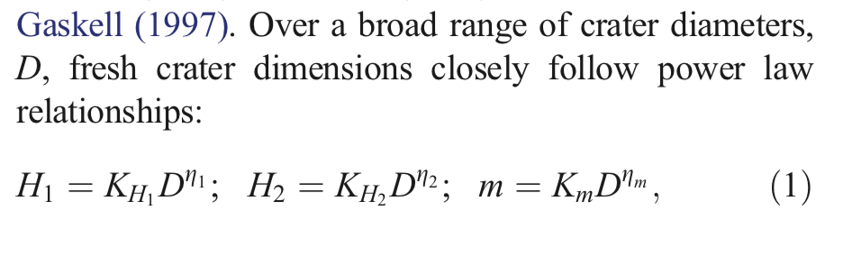
Basic Idea
Ejecta blanket
Ejecta blanket
High Rim
Rim
Crater basin
Central depression
Rim
Meteor Crater, USA
Howard (2007)

Slide 17
Basic Idea
Diameter, D
Ejecta blanket
Ejecta blanket
High Rim
Rim
Crater basin
Central depression
Rim
Meteor Crater, USA
Howard (2007)

Slide 18
Basic Idea
Diameter, D
High Rim
Central depression
OUT
INSIDE
OUT
crater_center
Meteor Crater, USA
Howard (2007)

Slide 19
Notebook: Objectives
Diameter, D

Slide 20
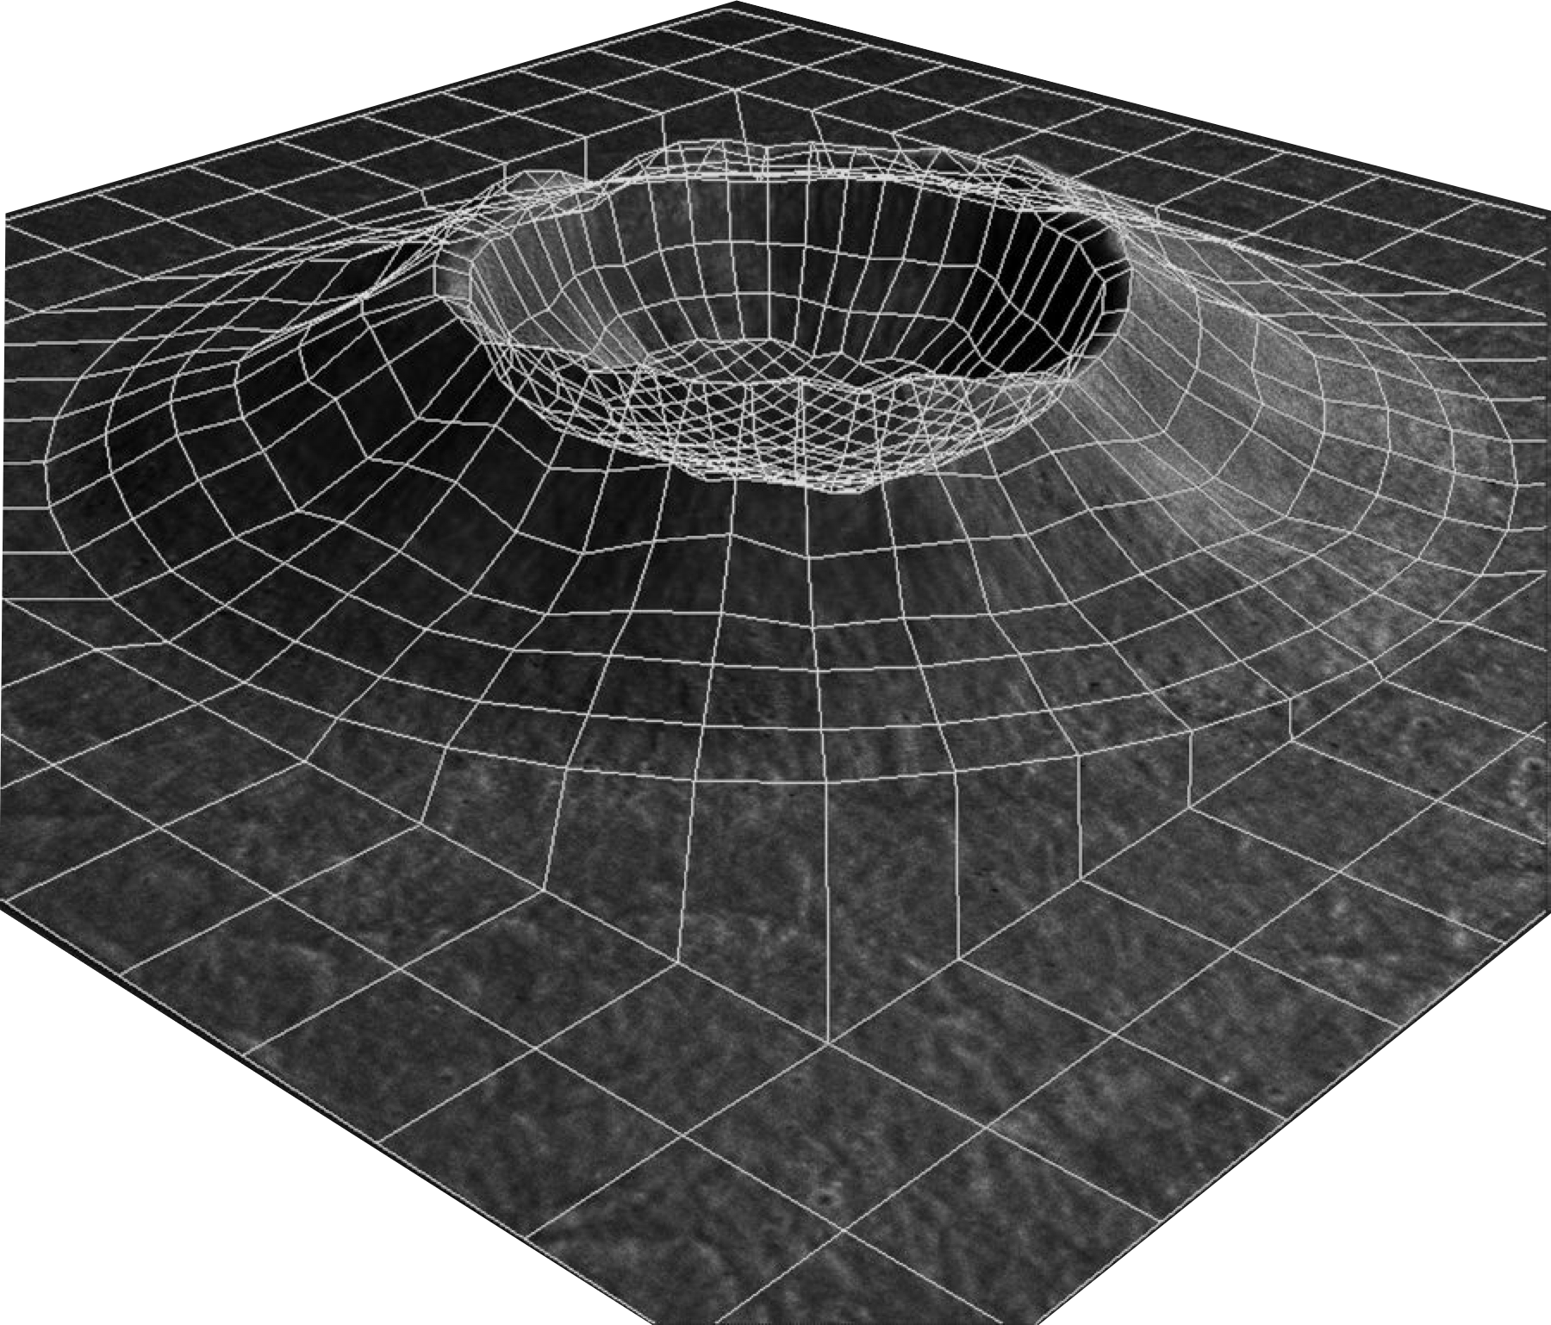
Notebook: Objectives
Diameter, D
(A)
2D → 3D

Slide 21
Notebook: Objectives
Diameter, D
(A)
(B)
2D → 3D
Population

Slide 22
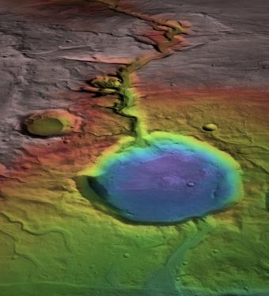
Notebook: Objectives
Diameter, D
(A)
(B)
2D → 3D
Population
(C)
Erosion

Slide 23

Notebook: Objectives
Diameter, D
(A)
(B)
2D → 3D
Population
(C)
Erosion
Cratered Landscapes

